Slide 1
Resonances in the ¹²C(α,γ)¹⁶O reaction
I have asked myself the question what is the consequences of the nuclear resonances in the proposed experiment in inverse kinematics of the α capture reaction?
So far, the reaction was discussed as it were an s-wave and that a measurement of the total astrophysical S factor (= sum of all partial waves) at a single kinematics would fully constrain it.
Can one find “the holy grail of astrophysics” [C. Rolfs] by a measurement with one spectrometer and α detector setting?

Slide 2
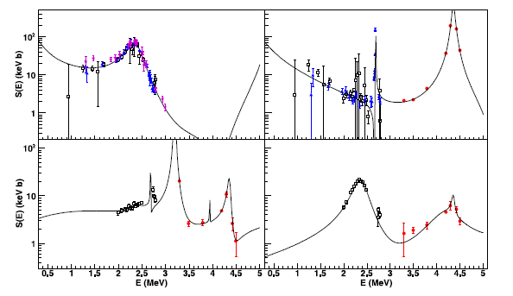
Existing S factor data
E1 ground state transition
E2 ground state transition
1⁻
2⁺
transition into 7.12 MeV state
transition into 6.92 MeV state
D. Schürmann, L. Gialanella, R. Kunz, F. Strieder: The astrophysical S factor of ¹²C(α,γ)¹⁶O at stellar energy, Phys. Lett. B 711, 35 (2012)

Slide 3
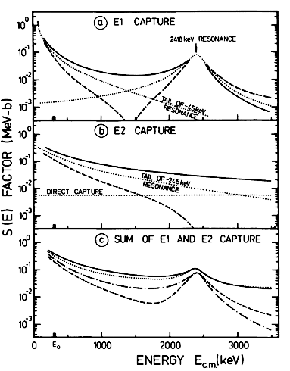
Schematic S factor curves
the cross section at stellar energies is, most likely, dominated by the tails of subthreshold resonances corresponding to the bound states at 7.12 MeV and 6.92 MeV, whereas in the experimentally accessible region it is dominated by the resonance corresponding to a 9.6 MeV state and by direct capture
constructive or destructive interference may occur.
the total cross section is incoherent sum of E1 and E2 leading to four possible curves depending on the sign of the interference effects.
C. E. Rolfs & W. S. Rodney: Cauldrons in the Cosmos, Chicago: Univ. Chicago Press (1988)

Slide 4
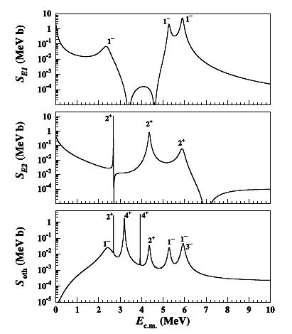
Extrapolated S factor curves
recent calculations for the different contributions to the S factor of the reaction and current precision.
→ ΔS/S ~ 12 %
D. Schürmann, L. Gialanella, R. Kunz, F. Strieder: The astrophysical S factor of ¹²C(α,γ)¹⁶O at stellar energy, Phys. Lett. B 711, 35 (2012)
R. Kunz et al.: Astrophysical Reaction Rate of ¹²C(α,γ)¹⁶O, Astrophys. J. 567, 643 (2002)

Slide 5
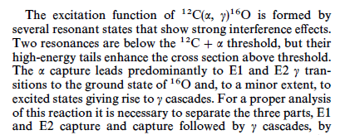
How to improve?
R. Kunz et al.: Astrophysical Reaction Rate of ¹²C(α,γ)¹⁶O, Astrophys. J. 567, 643 (2002)
D. Schürmann, L. Gialanella, R. Kunz, F. Strieder: The astrophysical S factor of ¹²C(α,γ)¹⁶O at stellar energy, Phys. Lett. B 711, 35 (2012)

Slide 6
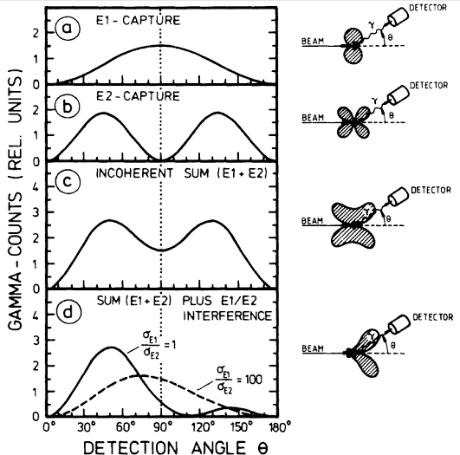
How to approach experimentally?
P. Prati et al.: Nuclear Astrophysics At LUNA: Status And Perspectives:
C. E. Rolfs & W. S. Rodney: Cauldrons in the Cosmos, Chicago: Univ. Chicago Press (1988)
“The measurement of the ¹²C(α,γ)¹⁶O reaction should be done in a nearly 4π geometry with an angle-segmented crystal ball detector. The measurement of angular distributions is necessary to separate the E1 and E2 components of both ground-state and cascade transitions.”
p-wave
d-wave

Slide 7
Consequences
It is important to get data of high relevance with respect to the (complex) properties of the S factor curve:
What’s the impact of a data point on total dσ/dΩ at a specific cosθ especially at E » E₀ where an extrapolation to E₀ is needed?
It is not possible to get σ_{total} (and therefore S _{total}) from dσ/dΩ.
It is not possible to separate multipoles.
The cascade γ-decay amplitude is not accessed by the inverse reaction
Is it crucial to get information on p- or d-waves?
Requirement to get a measurement with 10-20% accuracy.

Slide 8
Consequences
What is the ideal experimental setup?
A limited (or integrated) detection angle of the α particle leads to an unknown multipolarity of the measured cross section.
A detector ring or sphere with full angular coverage would have dramatically different background as a function of cosθ.
Is a gas detector a possible alternative to a detector?
A low pressure MWPC or multistep chamber can have a good timing resolution and high efficiency for nuclei while being extreme insensitive to gamma, electron, proton and neutron background
4π acceptance in a 1-3 Torr gas volume
see for example:
K. Assamagan et al: Time-zero fission-fragment detector based on low-pressure multiwire proportional chambers, Nucl. Instr. Meth. Phys. Res. A 426, 405 (1999)

Slide 9
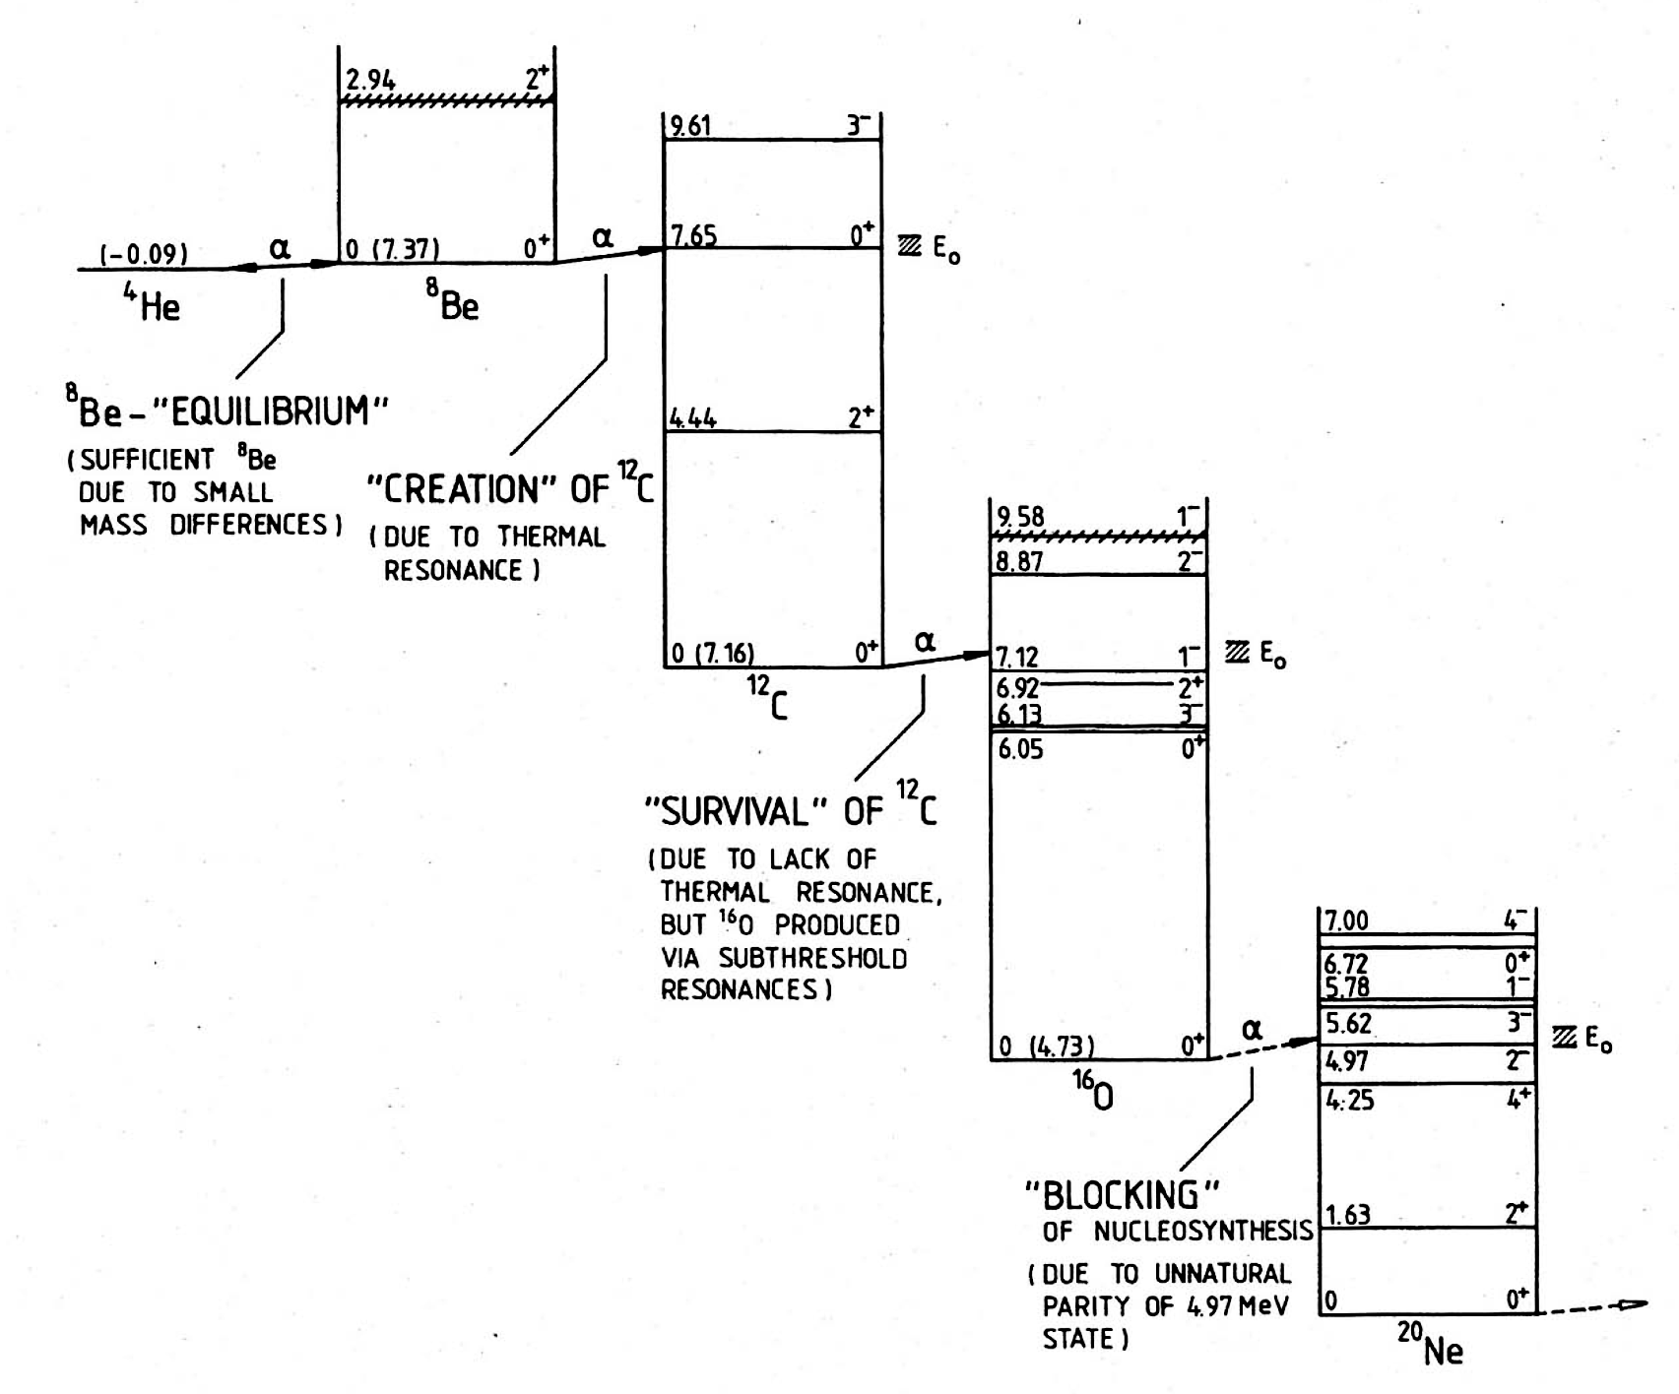
Helium burning reaction chain
C. E. Rolfs & W. S. Rodney: Cauldrons in the Cosmos, Chicago: Univ. Chicago Press (1988)

Slide 10
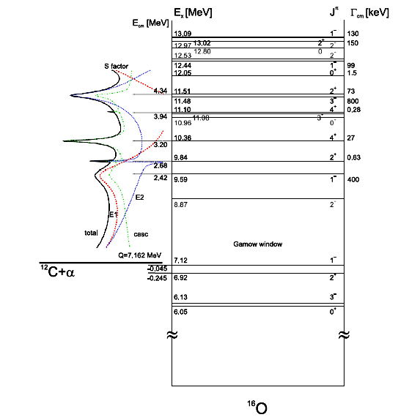
Level scheme of the ¹⁶O nucleus
α (J^{p}=0⁺) + ¹²C (J^{p}=0⁺) cross section, σ(E₀), is dominated by p-wave (E1) and d-wave (E2) radiative capture to ¹⁶O ground state (J^{p}=0⁺)
Two bound states, at 6.92 MeV (J^{p}=2⁺) and 7.12 MeV (J^{p}=1–), with sub-threshold resonances at E_{R}=-0.245 and -0.045 MeV, provide most σ(E₀) through their finite widths
Transition 1– → 0⁺ (E1) and transition 2⁺ → 0⁺ (E2) distinguished by γ-angular distributions
D. Schürmann, L. Gialanella, R. Kunz, F. Strieder: The astrophysical S factor of ¹²C(α,γ)¹⁶O at stellar energy, Phys. Lett. B 711, 35 (2012)

