Slide 1
Development of thin GEM readout structures
Yasemin Schelhaas
MAGIX Collaboration Meeting 2017-02-16

Slide 2
Topics
Layouts
Manufacturing plans
Testing plans
Open questions

Slide 3
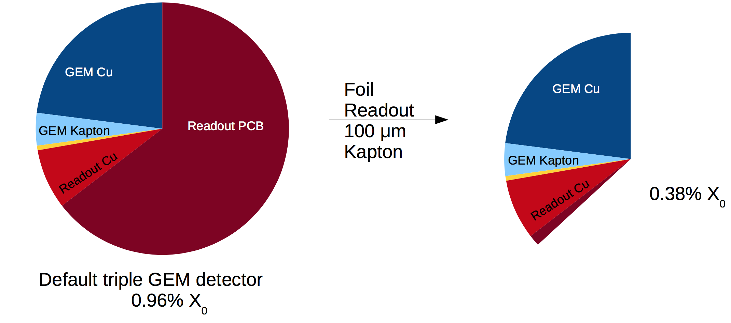
Motivation
Aim: Small radiation thickness
Make material thinner
Material budget:
→ Go to foil layout

Slide 4
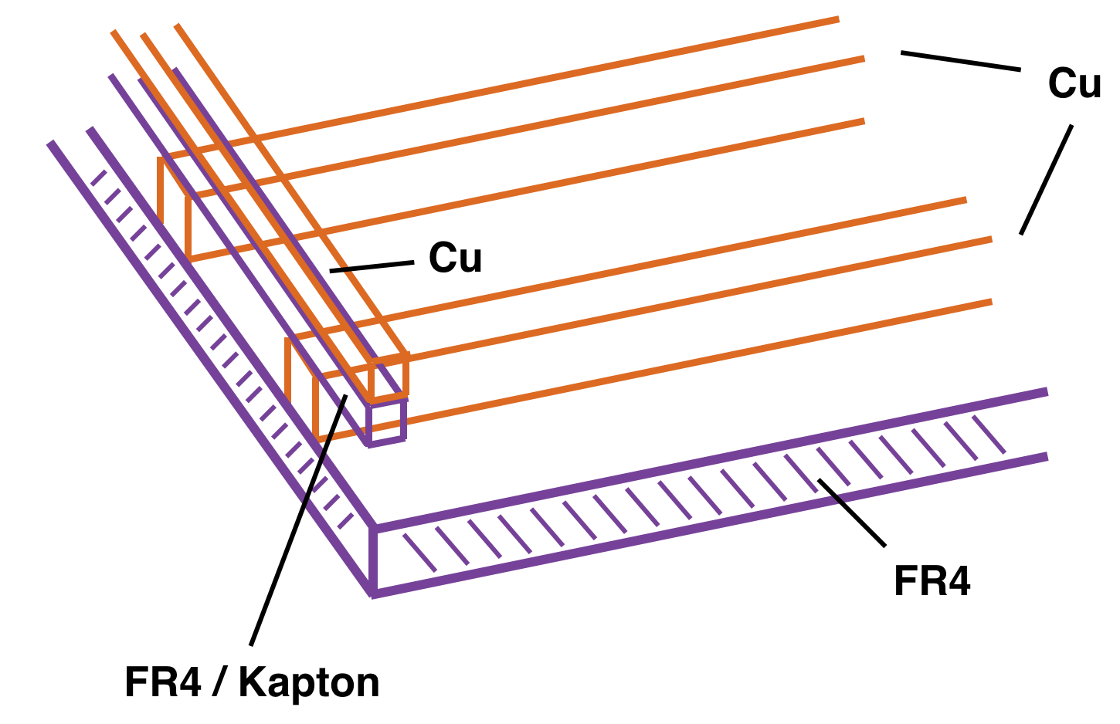
Traditional Layout
Problems:
Big and thick support structure
Crossed Cu strips
→ Twice as much material as needed
→ Go to one layer

Slide 5
Strips & Pads design

Slide 6
Strads design

Slide 7
Layouts
Two different layouts:
  Strips (vertical) & Pads (horizontal)
  Strips of pads (vertical & horizontal) → “Strads“
Same pitch for both layouts: 400 µm to achieve 50 µm resolution
Pads as oblongs or octagons → increase field homogeneity
Connections of pads with tracks on the backside of the board
Panasonic connectors (AXK6SA3677YG, 130 pins)
Guard-Rings as a field shield
Designed in Cadence Allegro → Support from PRISMA Detector Lab

Slide 8
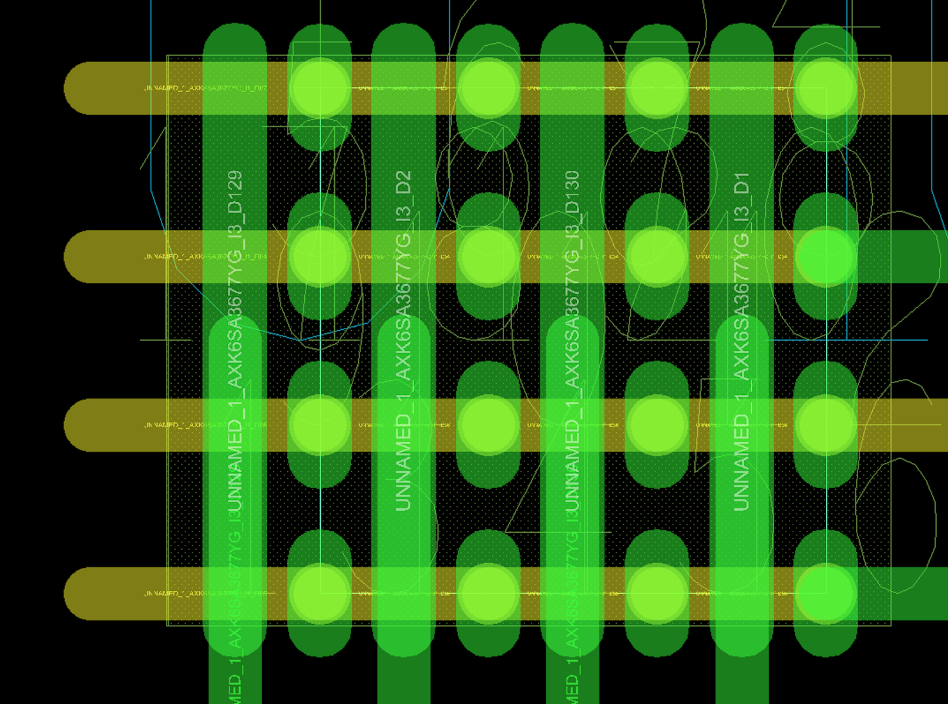
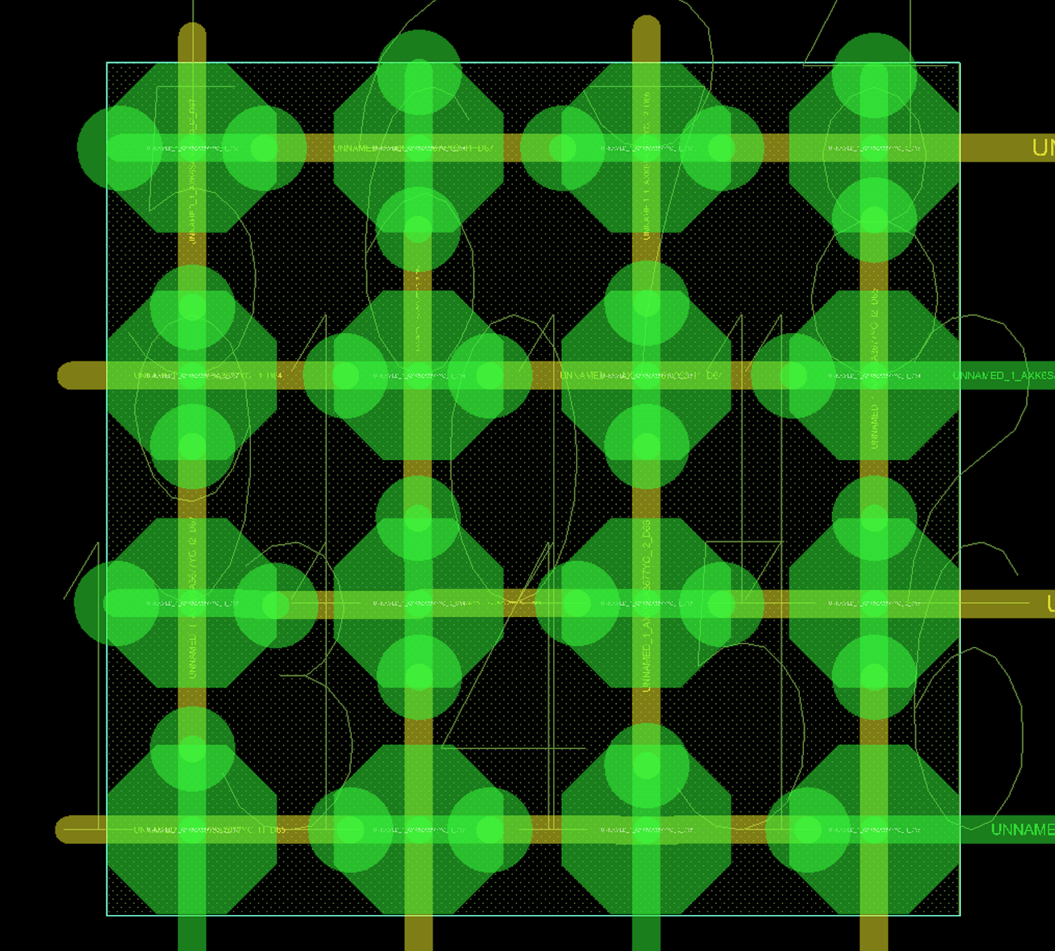
Cadence Allegro Sketches
Strips & Pads
Strads

Slide 9
Manufacturing plans
10 x 10 cm² PCB prototype
  Test layouts
  Measure energy resolution
10 x 10 cm² foil prototype
  Transfer layout to a thin foil
  Measure radiation thickness
30 x 30 cm² PCB
  Enlarge first layout
  Measure resolution
  Observe electronics coupling
30 x 30 cm² foil
  Final test of all parameters

Slide 10
Testing plans
Test with a ⁵⁵Fe source
  Measure energy resolution
  Stability
Test with cosmological radiation
  Homogeneity of detector and readout electronics
MAMI test-beam
  High rates
  Position resolution

Slide 11
Open questions
Can all tests be done with existent GEM detector?
Do we need a new prototype?
Prototype where PCB can be changed easier, e.g. build in cover?
Make familiar with existent GEM detector?
Start preparing tests?

Slide 12
Schedule & Outlook
Order PCB prototype boards until end of February
Test-beam: April 19-20
PRISMA support until October
End of master thesis: November 3, 2017

