Slide 1
Magix Common tools
Infrastucture and IT support for the MAGIX collaboration
Stefano Caiazza
Mainz, February 17 2017
Notes:
The main point of this session is to describe the different tools and software infrastructure we have or that we are preparing for MAGIX

Slide 2
Magix development
The group is quickly developing
Infrastructure developed as we grow
I started in 2013: we were 4
2014: 6/7 people
By the end of 2015 we were about 10 and needed a second office
Today we are about 30 from 5 institutes, 3 countries, 2 continents
We set up tools when we needed
We tested them by using them
We rationalized their usage through experience
Relevant constraints
Many tools require a KPH account
Many tools hosted in the KPH internal network
Is it there any contributor who cannot have a KPH account?
Notes:
The first thing to keep in mind in most of the following are:
We are developing tools when we realize we need them, in many case we are proceeding by trial and error by testing if a system is actual useful and if necessary we improve it, eliminate it or merge tools together for user simplicity. Most of them started for our internal use and the plan is to open them as much as technically possible to external users
The other important thing to know is that most of this tools require a KPH account for authentication and a KPH VPN to access the internal network where they are hosted. Whenever possible we will try to put them on public servers but that requires more maintenance work to make sure they are safe from external intrusions so we would like to limit the public available resources

Slide 3
KPH Authentication
LDAP Authentication
Allows to use the registered user name and passwords on a synchronized system
The simplest way to synchronize the authentication of many systems
Needs a KPH account to be included in the KPH LDAP database
Relevant constraints
Many tools use a KPH authentication
Many tools hosted in the KPH internal network, accessible via VPN
Notes:
This new project is called MESA and will be hosted in the space formerly used by the A4 experiment that was concluded. The possibility to use an existing build reduces the costs in a relevant matter but forces the accelerator to the adapt to existing space. Moreover, because MAMI will remain operation as the workhorse of our institute for the foreseeable future, our new project should not hinder the operation of MAMI
MAMI will continue to be used in the foreseeable future so any additional installation should not disturb the routine operation of MAMI.

Slide 4
ONLINE Resources
Notes:
What type of physics we aim to study at MESA

Slide 5
Mailing list
magix@lists.uni-mainz.de
Public subscription
Managed through the Uni-Mainz Sympa system
Can subscribe with external mail addresses
General news and communications
Newest tool in the bag
Created this week

Slide 6
MAGIX Website
http://magix.kph.uni-mainz.de
Temporarily hosted on the A1 webserver
General public information about the project
Needs a periodic update cycle
Notes:
You just heard from Harald of our existing facility which is MAMI.
This machine is a multi stage microtron that can reach about 1.5GeV with currents of 0.1 mA.
The complex includes 4 experimental areas: one in particular, that of A4 is not used anymore for the experiments with the MAMI beam and will now host the MESA machine
Let me start from the foundation of our work, that is MAMI.
As it happens in Mainz we have a long and out-standing expertize in running cutting edge experiments for nuclear and hadron physics. The current workhorse of our university is MAMI, a multi-stage microton capable of delivering an electron beam of 0.1 mA at energies up to 1.5 GeV. This device performed admirably and if you connect to our institute website you will find a list of the many accomplishment and publications of the experiments running with the beams provided by that machine.
And if you look carefully you will find out that for many of those experiments the limitations didn’t come from the available beam energy but rather from the statistics like in the case of searches for rare events like an hypotethical dark photon or that sometimes it is the minimum energy that limits the accuracy as when one tries to measure form factors at extremely low Q2 as for the extraction of the proton radius
Nonetheless I will start from the workhorse of our establishment, which is MAMI
Probably most of you know much better than me all the accomplishment of MAMI. Here you can see the layout of the current system with the main experimental hall. Because any further extension of the MAMI accelerator chain would be excessively expensive we decided to develop our tools in another direction.

Slide 7
MAGIX WIKI
https://wiki.magix.kph
Only accessible from the KPH network
Repository of internal information and documentation
Authentication with the KPH credentials
More people should actively contribute to the wiki
Notes:
You just heard from Harald of our existing facility which is MAMI.
This machine is a multi stage microtron that can reach about 1.5GeV with currents of 0.1 mA.
The complex includes 4 experimental areas: one in particular, that of A4 is not used anymore for the experiments with the MAMI beam and will now host the MESA machine
Let me start from the foundation of our work, that is MAMI.
As it happens in Mainz we have a long and out-standing expertize in running cutting edge experiments for nuclear and hadron physics. The current workhorse of our university is MAMI, a multi-stage microton capable of delivering an electron beam of 0.1 mA at energies up to 1.5 GeV. This device performed admirably and if you connect to our institute website you will find a list of the many accomplishment and publications of the experiments running with the beams provided by that machine.
And if you look carefully you will find out that for many of those experiments the limitations didn’t come from the available beam energy but rather from the statistics like in the case of searches for rare events like an hypotethical dark photon or that sometimes it is the minimum energy that limits the accuracy as when one tries to measure form factors at extremely low Q2 as for the extraction of the proton radius
Nonetheless I will start from the workhorse of our establishment, which is MAMI
Probably most of you know much better than me all the accomplishment of MAMI. Here you can see the layout of the current system with the main experimental hall. Because any further extension of the MAMI accelerator chain would be excessively expensive we decided to develop our tools in another direction.

Slide 8
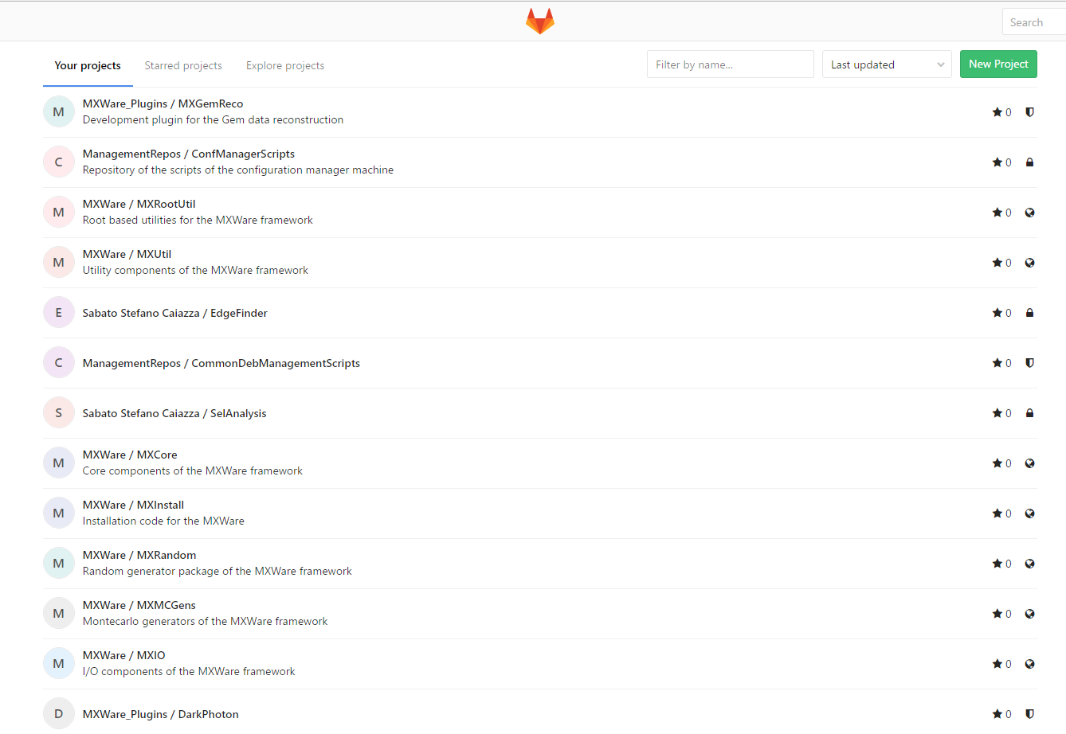
GIT repository
https://git.magix.kph
Only visible in the internal KPH network
Authentication through the KPH credentials
Based on gitlab
Open source
Similar interface as github
Easily installable in Debian
Most people use it productively
Notes:
This new project is called MESA and will be hosted in the space formerly used by the A4 experiment that was concluded. The possibility to use an existing build reduces the costs in a relevant matter but forces the accelerator to the adapt to existing space. Moreover, because MAMI will remain operation as the workhorse of our institute for the foreseeable future, our new project should not hinder the operation of MAMI
MAMI will continue to be used in the foreseeable future so any additional installation should not disturb the routine operation of MAMI.

Slide 9
Meeting management
https://indico.mitp.uni-mainz.de/
Until now only for special meetings
From this week approved for regular meetings
This conference, LEPP
Special section already opened
We will use it for regular short collaboration meetings

Slide 10
Document library
http://library.magix.kph/
Calibre database
Read-only web interface
Works perfectly with pdf
Some additional configuration needed
Data input a bit complex
Export files on the network drive
A script automatically loads the files in the library
System is in “Beta testing”

Slide 11
Debian repository
http://debrepos.magix.kph
Standard computer installation
Meta packages loading a predefined package set
Software distribution
Packaging our software in a Debian package for easy deployment
Raspberry repo
Not available yet, would be done soon

Slide 12
Computing resources

Slide 13
VM Host
VMWare host on a server workstation
Hosted machines
Hosted in the KPH counting room
128 MB RAM
1.5 TB SSD Drives
12 TB Raid5 HD Drives (8TB effective storage)
Service server
NAS
Comsol node
Cluster 0
All visible from the internal KPH network
10 Core, 3 GHz CPU

Slide 14
Service nodes
Online service server
Hosts most of the online services
Reserved access
NAS Server
FreeNAS VM
Provides 2 shared folders
MXData
MXCommon

Slide 15
Computing Nodes
Windows VM
COMSOL
Inventor
CST
Autocad
Cluster 0
First node of a computing cluster
Standard debian installation
64 GB memory available
Latest current software installation

Slide 16
Software
MXWare
Software framework for simulation, reconstruction, analysis and more
Slow Control
Based on MXWare Core and Epics
DAQ
Based on MXWare Core
To completely design
Design started

Slide 17
Conclusion

Slide 18
Final summary
Expanding collaboration
We are growing in number
Need usage and feedback
We need more user input
We are extending beyond KPH
The tools we established must grow accordingly
Actual input to expand the wiki as only a few people use it regularly
We need feedback to improve what we have, prune useless tools, provide more tools if necessary
Notes:
The collaboration is growing fast and expanding beyond the walls of KPH
The tools we established have to evolve accordingly
Many tools are already designed to scale with the collaboration
The most important thing is to use those tools and to provide feedback on what else is needed and what is superfluous

