Slide 1
Dark Magix
Dark photon searches at MAGIX
Notes:
I want to tell you about the first work we did and the prospect of the dark photon research for MAGIX.
As we have also students and people that may have not heard anything about the Dark Photon I will dare propose a couple of introductory slides.
The dark photon is an hypothetical U1 gauge boson, carrier of an unknown interaction between unknown particle, potentially heavy beyond detection or part of a completely decoupled dark sector. What makes the situation interesting is that this dark photon has the same quantum numbers of the QED photon but it’s massive. In this situation and if there is at any energy scale a particle charged under both fields the SM photon can oscillate to the dark photon through loop diagrams and the other way around. This means that the physical photon is actually a mixture of the SM photon and the dark photon in an unknown proportion parameterized through the epsilon parameter which represents the ratio between the photon coupling and the effective coupling of the dark photon.
What this means practically is that in any QED process containing a photon we can replace that with its darker counterpart with a reduced coupling. The simplest process we can do that is the bremsstrahlung, by replacing the outgoing photon with the dark counterpart. When we do so we replace a massless with a massive particle so that this process has a threshold and a different kinematics.
Now we can look on the other side which is that of the final states. How can we study a process like this? One option is to wait for the dark photon to interact through another QED process, like the electron positron pair production and measure the invariant mass of the produced pair. In case of the dark photon the intermediate particle has a well defined mass compared to the smooth background of the SM bethe heithler process. This is the type of experiment most collaboration focused on until know, trying to fill the gap in this plot. This is relevant whenever the dark photon is the lightest dark particle (LDP) so that its branching ratio is 100% in SM particles
The other option is to forget about the decays of the dark photon, forget about any assumption about the relationship between the dark photon and the rest of the dark sector and just try to detect the initial state particle after the interaction. This is the newest approach to the problem and this is reflected by the almost clean field in this plot. The challenge here is to be able to detect the recoil proton which has a very small momentum.
We started working on those models using our new software we are developing. Most of the work until now was done by a bachelor student who wrote the generator for the dark photon production in the case of the invisible decay. In the next few months we will extend this work adding all the necessary background processes and the generator for the visible decay.
Then the slides of Fabian

Slide 2
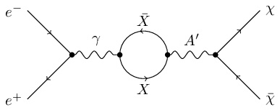
What is a dark photon
U(1) Gauge boson
Kinetic mixing
Massive (mass unknown)
Transitions mediated by loops at unknown scales
Mixing degree parameterized by $ε^{2}=\frac{α^{′}}{α}$
Mixing degree parameterized by 𝜀^2=𝛼^′/𝛼
Carrier of an unknown interaction between unknown particles
Same quantum numbers of the SM photon
No direct coupling with any SM field
Assuming a particle of any mass charged under both fields.
$α′$ is the effective SM coupling
𝛼′ is the effective SM coupling
Notes:
What is the dark photon.
Practically is a U1 gauge boson which mediates an unknown interaction between unknown particles and it’s supposed to be massive and not to have any direct coupling with any SM field.
What makes it special is that it can couple to the SM through a loop mediate process called kinetic mixing. The key characteristic is that this dark photon ,so defined, has the same quantum number of the ordinary photon so, assuming a particle at some mass scale charged under both fields, it is possible to have a loop mediated transition between the SM and dark photon. The transition probability is parameterized by the ratio between the dark photon and the SM photon coupling which is labelled epsilon^2

Slide 3
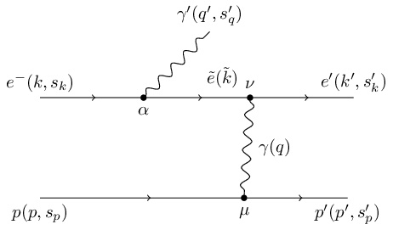
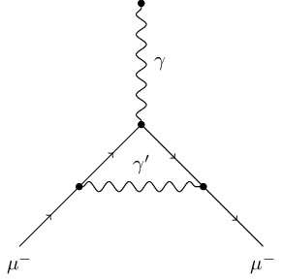
Dark photon production
Replace the SM photon in allowed processes
Bremsstrahlung
Schwinger term in muon magnetic moment
Electron pair production
Observable differences
Kinematic differences due to the particle mass
Cross section difference due to the additional diagrams
Notes:
How can we produce those dark photon. The basic recipe is to replace a SM model photon with a dark photon in normally allowed processes.
For example you can do this in the bremsstrahlung diagrams, in the magnetic moment diagrams or even in the pair production diagrams.
In the first case there are observable differences due to the mass of the particles involved, in the second the cross section would be different because of the additional diagrams

Slide 4
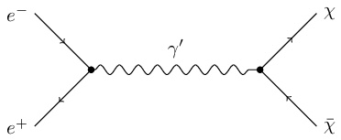
Dark photon detection
Visible decays
Invisible decays
Relevant branching ratio of $γ^{′}→SM$
Relevant branching ratio of 𝛾^′→𝑆𝑀
Possible if the dark photon is the LDP
Fixed decay product invariant mass
The dark photon decays in the dark sector
Likely if the dark photon is not the LDP
Reasonable to assume a complex dark sector (it should represents up to 85% of the universal mass)

Slide 5
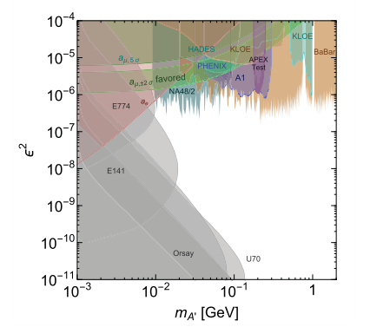
Visible decays
Bump hunting
The DP decay products have a well-defined invariant mass
Competing background are the similar SM photon processes
Needs to locate a narrow “bump” on the continuous spectrum
Fast ongoing developments
Many new running experiments quickly filling the holes
Will we still be competitive in 4/5 years?
Notes:
In the case of the visible decays the typical approach is to measure the invariant mass of the decay products. The typical background is that of the similar process involving normal photons so that one needs to isolate a bump in this invariant mass distribution

Slide 6
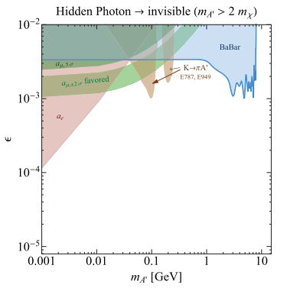
Invisible decays
Missing mass
Almost virgin territory
Measure all the final products
Measure the missing invariant mass
It’s challenging to tag the proton
Almost no constraint by current experiments
Several competing experiments in development
Important contributions to be made
Notes:
When it comes to the invisible decays the only accessible road is

Slide 7
MAGIX DP Simulation

Slide 8
General features
First benchmark of the MXWare software
Fast detector simulation
Extensible and configurable system
More on Friday
The detector are represented by their phase space acceptance
Detection efficiency parameterized in the acceptance
Event generator
Custom beam, target and detector representation
Pseudo- or quasi-random generator
Complete event generation for further analysis
Fast direct histogram generation
Bachelor thesis of F. Berressem

Slide 9
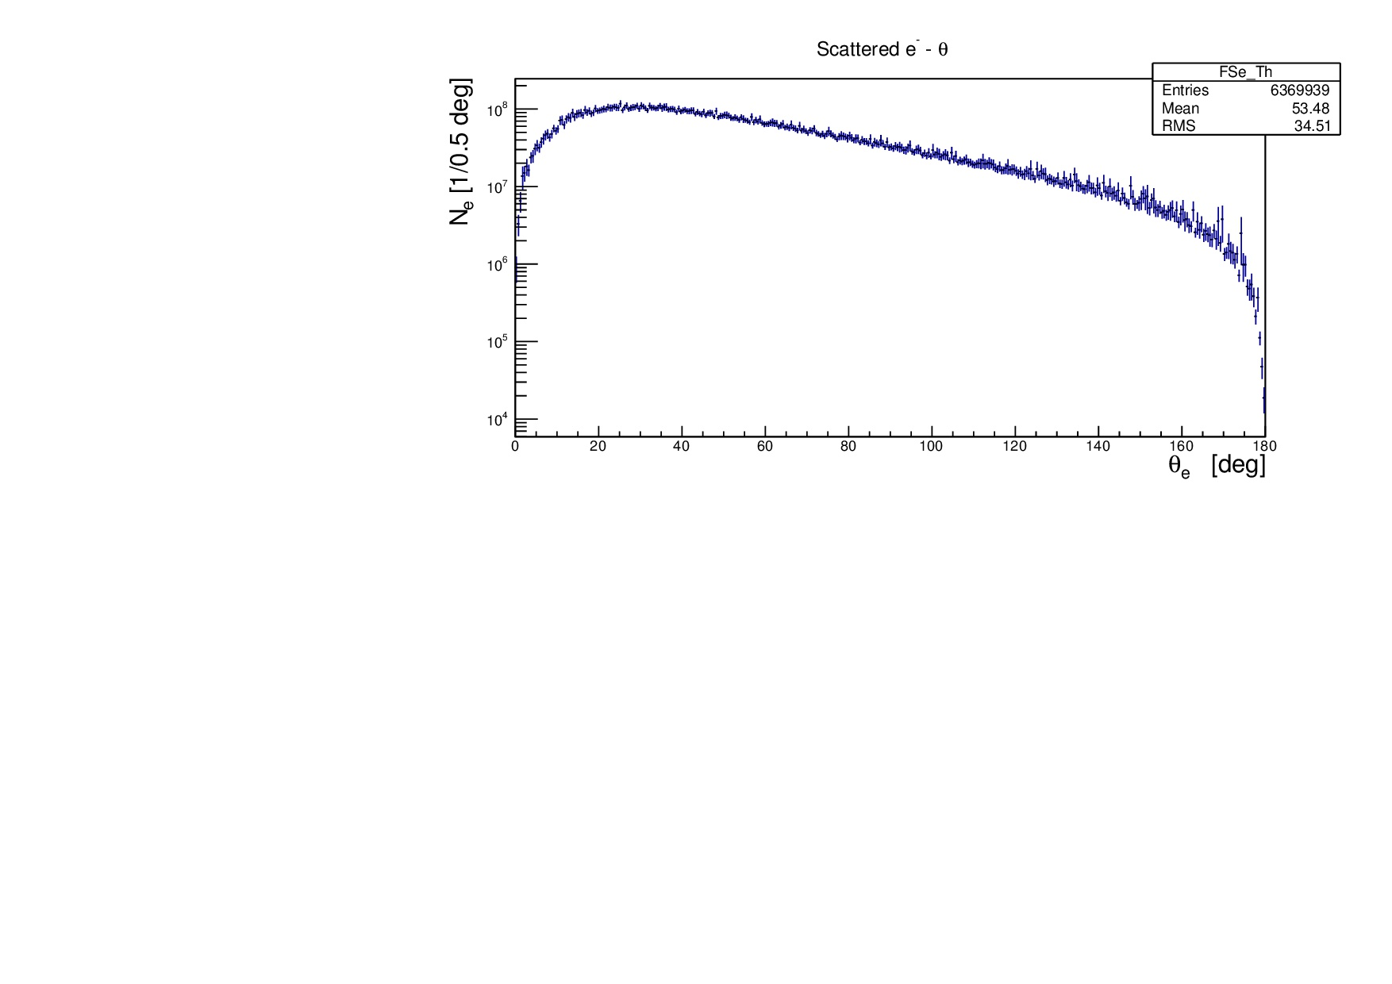
Cross section calculation
Customizable phase space constraints
Full phase space generator
Electron and proton angles and momenta
Dark photon mass
Restrictions to reduce run time
Experimental parameters
105 MeV electron beam
10 days run time
Luminosity $1.987 {10}^{34}cm^{−2}s^{−1}$
Luminosity 1.987 〖10〗^34 𝑐𝑚^(−2) 𝑠^(−1)

Slide 10
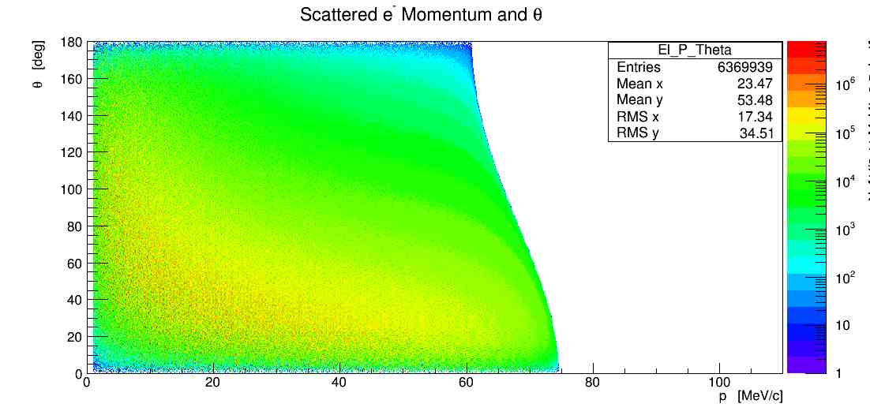
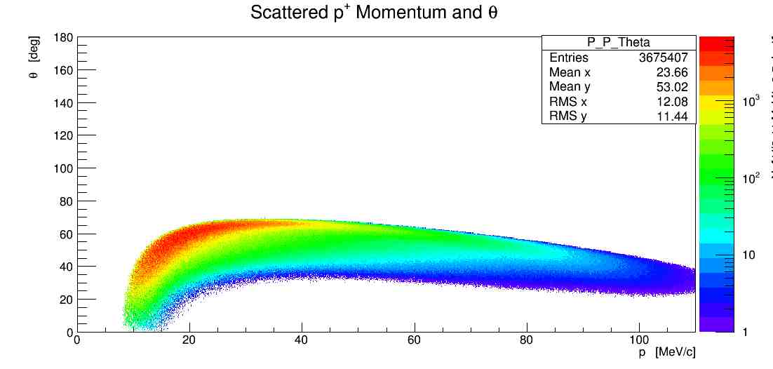
Setup optimization
Fix dark photon mass
Optimize electron spectrometer
Optimize proton spectrometer
Angle and momentum
Angle and momentum
m(γ') | Electron spectrometer |  | Proton spectrometer |  | 10-days event couns
 | Θ [°] | P [MeV] | Θ [°] | P [MeVI
15 | 14 | 40.87 | 71.03 | 10.02 | 4.68x10⁶
30 | 18 | 40.74 | 51.03 | 17.36 | 157722
45 | 16 | 30.5 | 49.05 | 29.74 | 28924

Slide 11
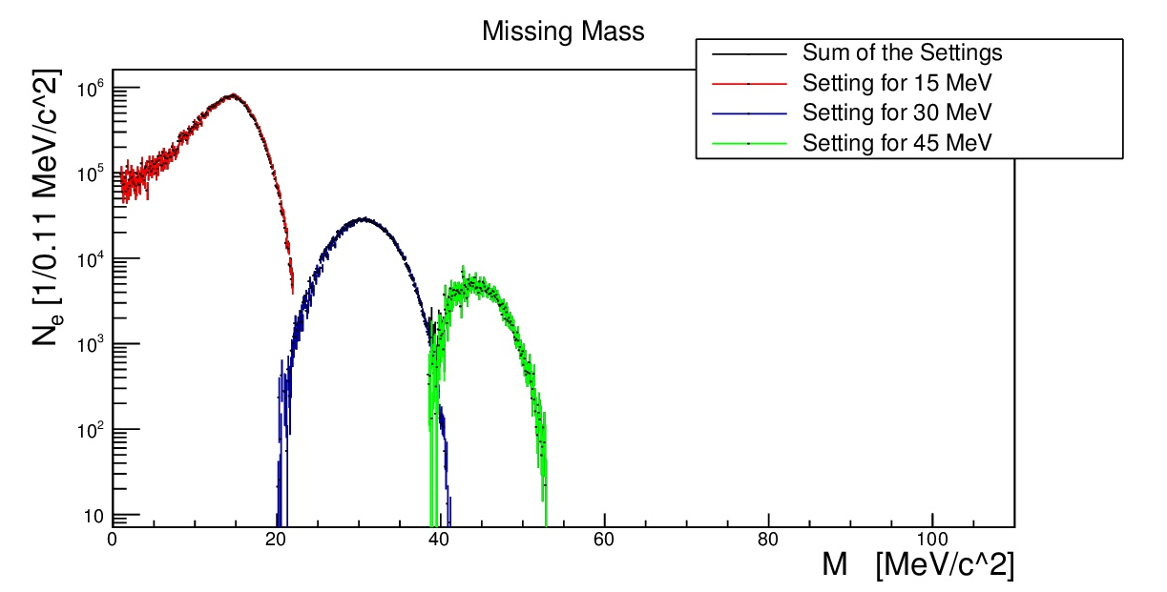
Rate simulation
For each defined setting
Run the simulation with random DP mass
Calculate the rate as a function of the missing mass
Next step
Implement the background generators (Bethe-Heitler)
Re-optimize
Calculate sensitivities

Slide 12
Conclusions

Slide 13
Next developments
Implement background process simulation
Putting all together
Bethe-Heitler
Student thesis project
Improved detector representation
Proton detector efficiency and momentum resolution
Needs a more complete detector simulation package
Adaptive Monte Carlo generator
To reduce the run time and simulation errors
One of the general improvements of the simulation package
Compute the MAGIX sensitivities for both processes
Implement the visible decay generator
And the bump hunting algorithm
Another possible student project

