Slide 1
Introduction to the MAGIX Target
General Design
Stephan Aulenbacher
MAGIX Collaboration Meeting 2017-02-16

Slide 2
Topics
The Tube Target
Concept
Summary
Design
Density profile simulation
The Jet-Target
Concept
Design
Technical implementation
Measurement of the density profile

Slide 3
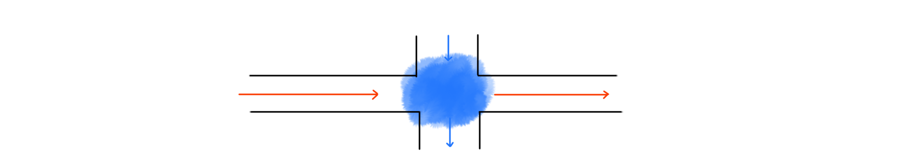
General Concept
Injection of the gas directly into the vacuum system
→ three options
Electon Beam
Focus at the position of the target in order to pass thin tubes
Differential Pumping
Gas must be pumped away quickly
Gas Injection
Injection
Beam
Energy recovering
Evacuation

Slide 4
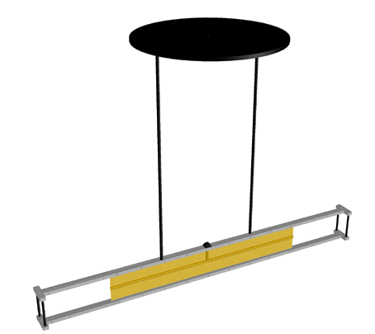
Target Designs
Molecular Flow inside of a tube
Jet Target
Gas Jet flows through the Chamber perpendicular to the beam
Cluster-Jet Target
Formation of clusters in the Jet
Tube Target

Slide 5
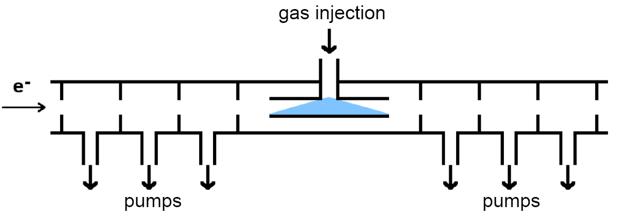
Approach 1: The Tube Target
~10³⁵ cm⁻²s⁻¹
Spin Polarization
Possibility to inject spin polarized Hydrogen
Windows
Beam scatteres on the gas without passing windows
Luminosity
Scattered particles has to pass the walls
~10³¹ cm⁻²s⁻¹ (pol.)

Slide 6
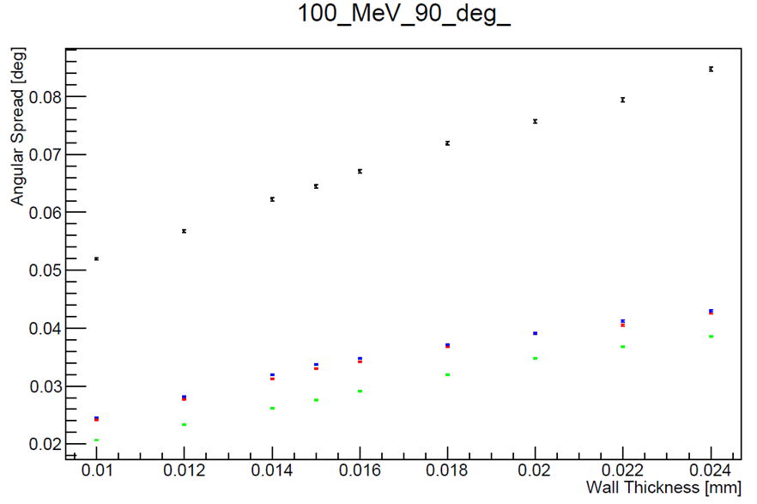
The Tube Target
Windowless design
Scattered particles have
to pass the wall
Beam should scatter directly on the gas.
Energy losses and multiple-scattering-angles are large at 100 MeV .
Accurate structure
Focused Beam has to pass thin structures
Aluminum
Mylar/Kapton
Beryllium
T-Shaped channel made out of
20 μm Mylar Film

Slide 7
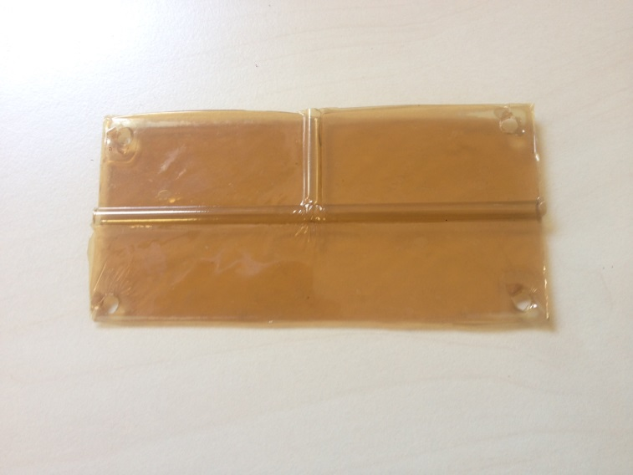
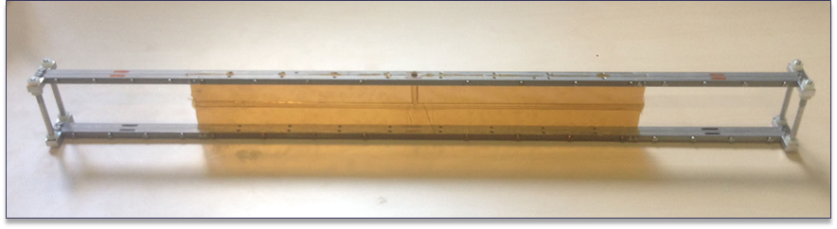
Technical Implementation

Slide 8
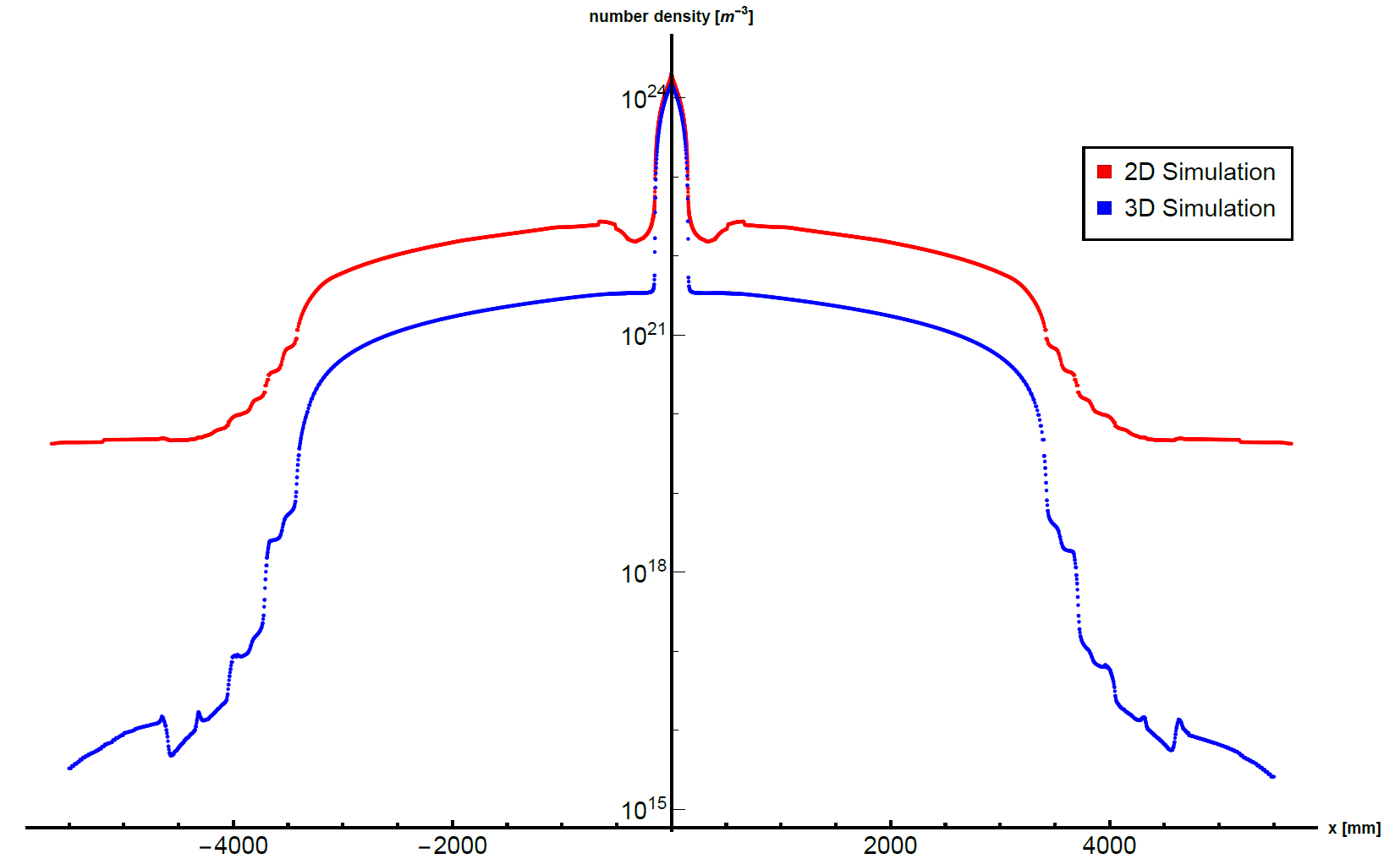
Simulation of the density profile

Slide 9
Simulation of the density profile

Slide 10
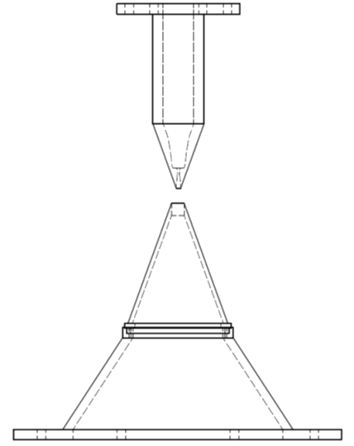
Approach 2: The Jet Target
No windows at all
Neither the beam nor the scattered particles have to pass a wall
Luminosity
Spinpolarization
Not possible due to high pressures
~10³⁵ cm⁻²s⁻¹
Laval-Nozzle
Beam
Catcher

Slide 11
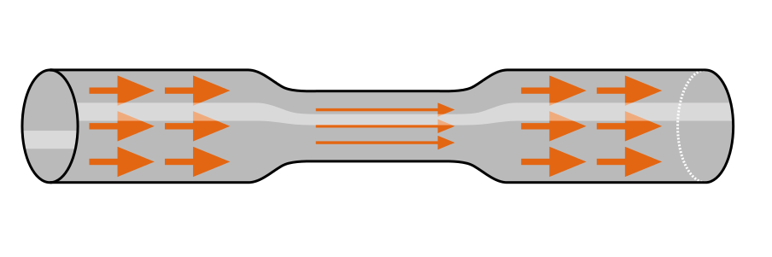
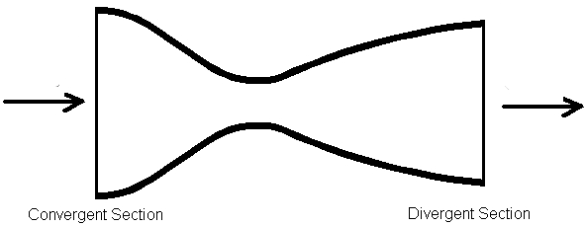
Nozzle Dynamics
Behavior from Bernoullis law
acceleration
deceleration

Slide 12



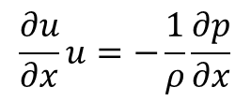

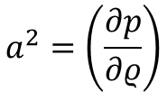
Nozzle Dynamics
Continuity equation for an isentropic process
$$ρuA=const.$$
$$\frac{1}{u}\frac{du}{dx}+\frac{1}{A}\frac{dA}{dx}+\frac{1}{ρ}\frac{dρ}{dx}=0$$
Derivate along the streamline
$$a^{2}=\left(\frac{∂p}{∂ρ}\right)$$
Speed of Sound
$$\frac{1}{u}\frac{du}{dx}+\frac{1}{A}\frac{dA}{dx}+\frac{1}{a^{2}ρ}\frac{dp}{dx}=0$$
$$\frac{∂u}{∂x}u=−\frac{1}{ρ}\frac{∂p}{∂x}$$
Component of the Euler equation along the streamline
$$\frac{1}{u}\frac{du}{dx}\left(1−M^{2}\right)=−\frac{1}{A}\frac{dA}{dx}$$
11

Slide 13
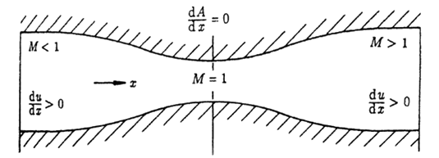
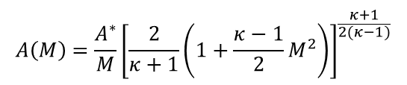

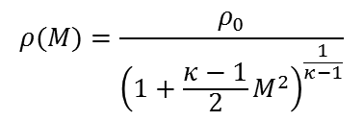
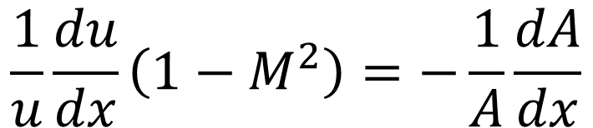
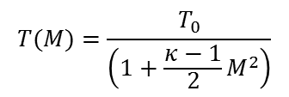
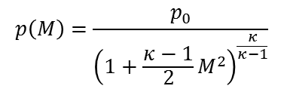

Nozzle Dynamics
$$\frac{1}{u}\frac{du}{dx}\left(1−M^{2}\right)=−\frac{1}{A}\frac{dA}{dx}$$
$$p\left(M\right)=\frac{p_{0}}{{\left(1+\frac{κ−1}{2}M^{2}\right)}^{\frac{κ}{κ−1}}}$$
}
$$T(M)=\frac{T_{0}}{\left(1+\frac{κ−1}{2}M^{2}\right)}$$
$$p=Sρ^{κ}$$
$$ρ(M)=\frac{ρ_{0}}{{\left(1+\frac{κ−1}{2}M^{2}\right)}^{\frac{1}{κ−1}}}$$
$$\dot{m}=ρuA=ρ^{∗}u^{∗}A^{∗}$$
$$A\left(M\right)={\frac{A^{∗}}{M}\left[\frac{2}{κ+1}\left(1+\frac{κ−1}{2}M^{2}\right)\right]}^{\frac{κ+1}{2(κ−1)}}$$

Slide 14
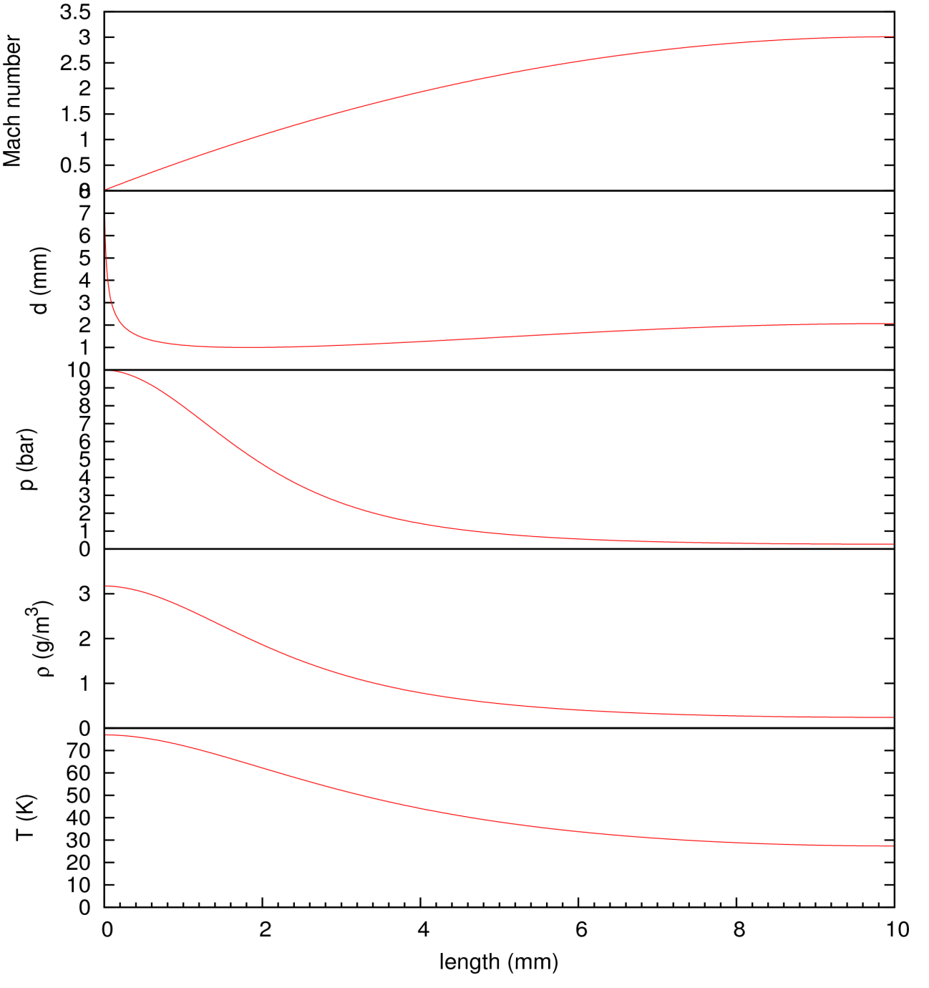
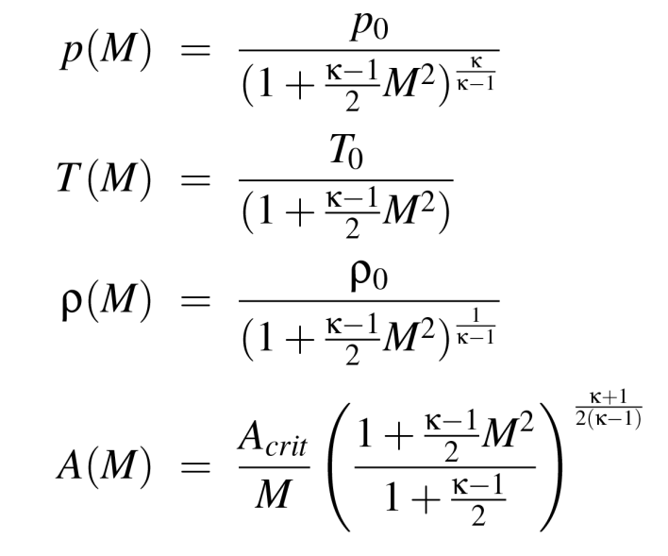
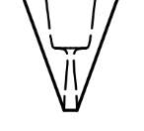
Nozzle Design
Leads to flux only in horizontal direction

Slide 15
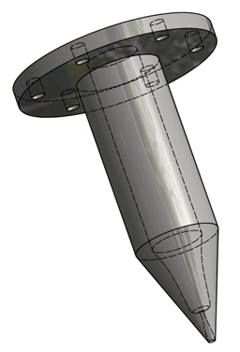
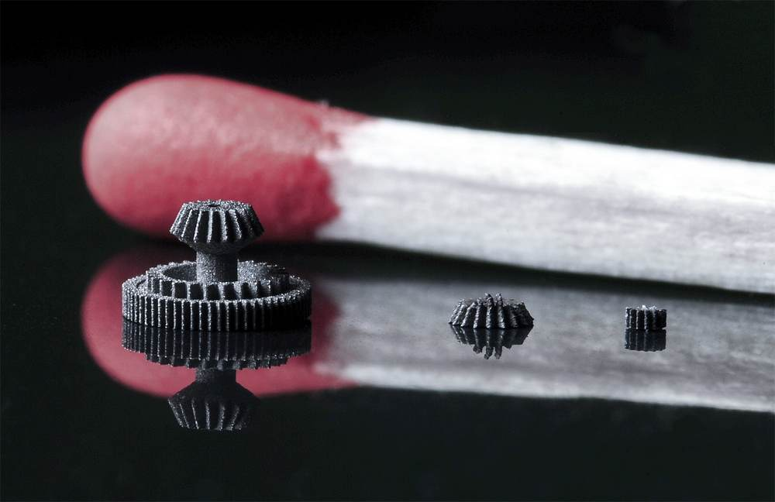
Technical implementation
Laser Sintering
Accuracy better than
100 µm
Not yet feasible!!!
Work in progress

Slide 16
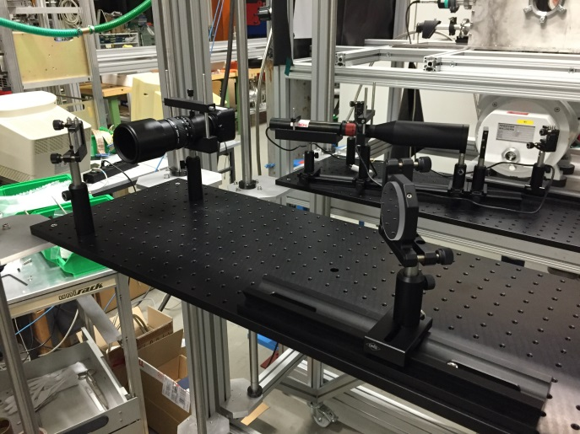
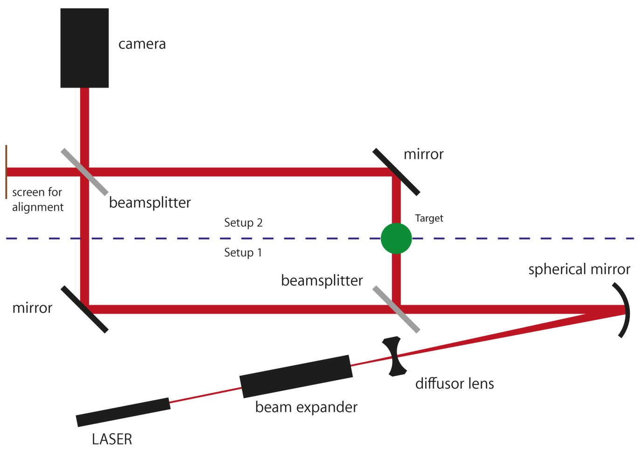
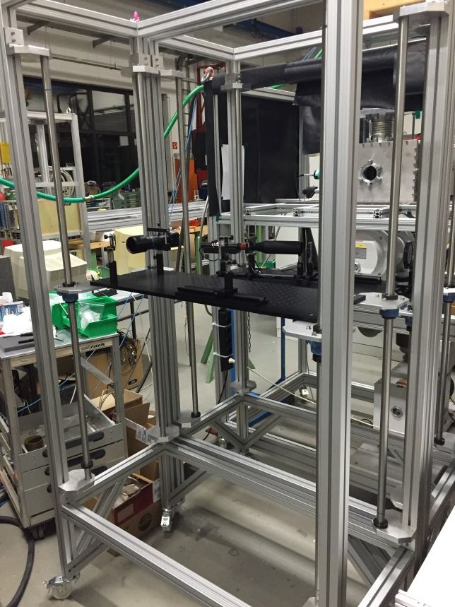
Measurement of the gas density
Density profile
Integral necessary to determine the luminosity
Profile necessary for vertex reconstruction
Mach-Zehnder Interferometry

Slide 17
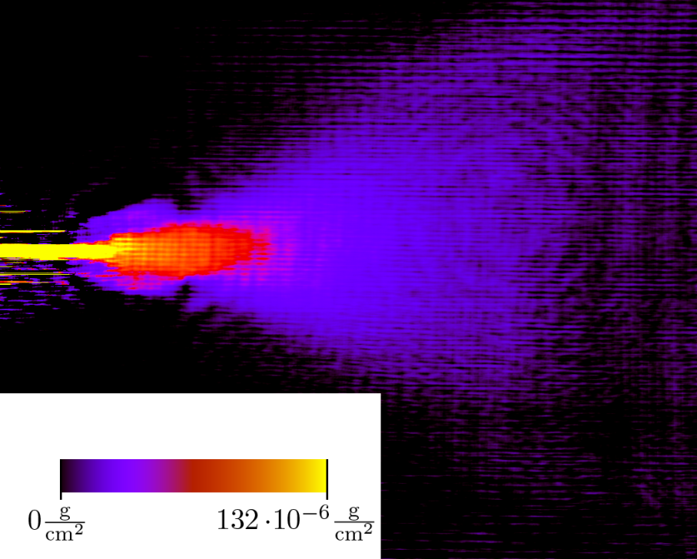
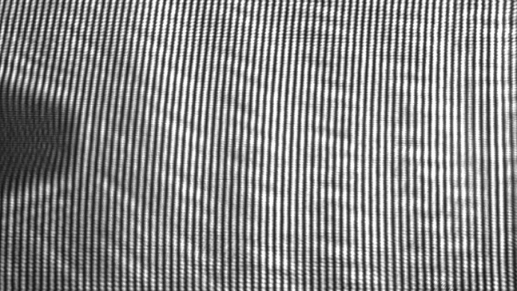
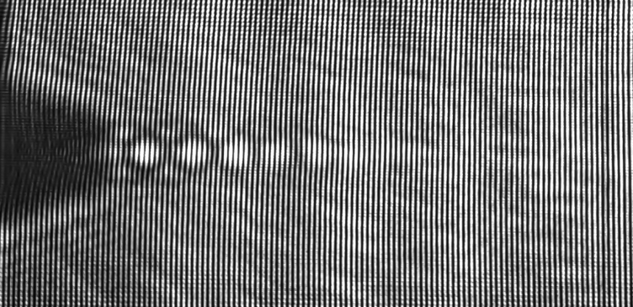
Measurement of the gas density

Slide 18
Summary
Luminosity:
~10³¹ cm⁻²s⁻¹
Jet Target
Luminosity:
~10³⁶ cm⁻²s⁻¹
Tube Target
Spin-polarization
Energy losses and multiple scattering
No windows
Next step: Using the jet Target for a measurement of the proton raduis @A1
(Talk at 15:40)

