Slide 1
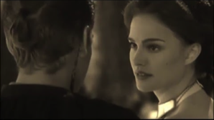
PADME Overview
© Lucasfilm Ltd.
Anakin Skywalker and Padmé Amidala
The PADME Collaboration is:
INFN Roma, INFN Frascati, INFN Lecce, MTA Atomki Debrecen, University of Sofia, Cornell University
– INFN Roma
Paolo Valente

Slide 2
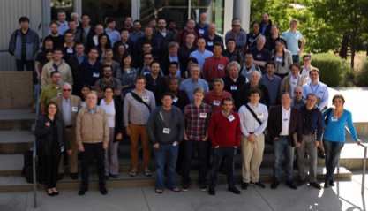
Introduction and outline
The motivations for searching a (light) mediator between the Standard Model and a new, dark sector has been very well discussed many times
arXiv:1608.08632 [hep-ph]
Dark Sectors Workshop, SLAC, 28-30 Apr. 2016
No physics preamble, but I will instead give an overview of:
The requirements for PADME experiment and the beam
The status of the PADME experiment construction
The program of physics runs
1

Slide 3
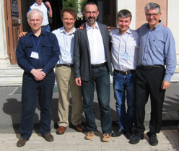
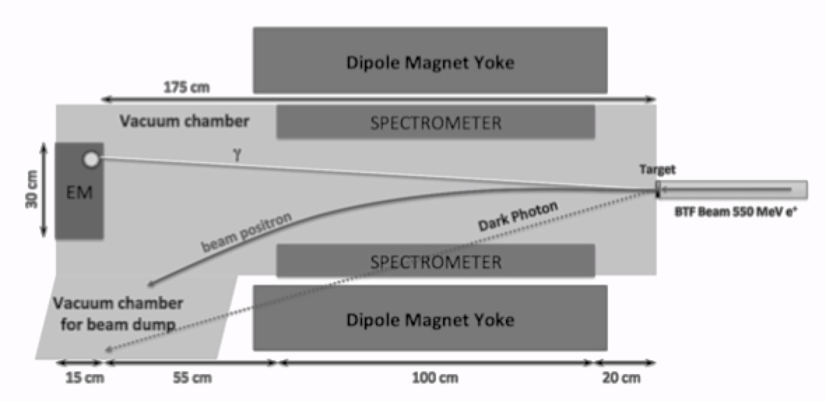
PADME proposal
B. Wojtsekhowski proposed to use e+ e− annihilations for searching the dark photon in the missing mass spectrum
The idea was to use the circulating e+ beam in a storage ring, striking an internal target and detecting the recoil photon
I. Rachek is leading the effort for realizing this at VEPP-3
Alternatively, use a positron beam onto an external target
M. Raggi, V. Kozhuharov and P. Valente:
Exploit the Frascati beam-test facility (BTF) extracted positrons
Use a thin, solid target
Preliminary design of the experiment and sensitivity estimate in 2014, experiment approval Sep. 2015, funding 2016-2018
Messina workshop, 34-27 Oct. 2016
2
Adv. High Energy Phys. 2014:959802

Slide 4
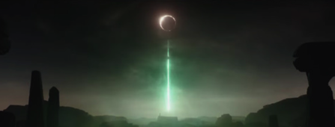
The PADME concept
The missing mass technique has two key elements:
The positron beam: we should know
The positron annihilation point
The positron momentum vector
The detector: we should measure
The photon momentum vector
(0 , p_{γ})
(m_{e} , p_{e+})
(m_{e} , 0)
A third basic element (relating beam and detector):
Which target material & thickness vs. beam intensity
3
DS-1 Orbital Battle Station

Slide 5
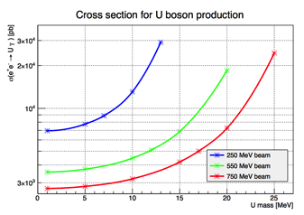
The PADME concept
Which target material & thickness vs. beam intensity
Material choice
Low Z: annihilation/Bremsstrahlung ratio gets worse with 1/Z
H₂ (or He) gas calls for a long target due to low density (impacting on the annihilation position resolution)
Pure Li, B thin targets not practical
Our choice is Carbon, in the form of polycrystalline detector
Thickness
Given the A’ production cross section, the compromise is luminosity vs. pile-up in the photon detector
Cross section also depends on the beam energy as well as A’ mass
4

Slide 6
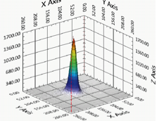
Positron beam intensity vs. quality
Beam requirements referring 100 μm Carbon target, 550 MeV e+
Highest possible repetition rate
49 Hz, with dedicated LINAC
From missing mass resolution:
Momentum spread <1%
Divergence <1 mrad
Spot <1 mm (σ)
From pile-up probability vs. luminosity:
5000 e+/40 ns (limited by LINAC gun pulsing system, see further)
A longer pulse duration allows increasing the number of positrons/pulse, and also requires dedicated LINAC (see further)
>10¹³ eot
Positron extracted in the BTF beam-line, can be produced either in the LINAC (positron converter) or striking primary electrons onto the BTF target
Good beam quality
(already extracting e+ beam in air)
5

Slide 7
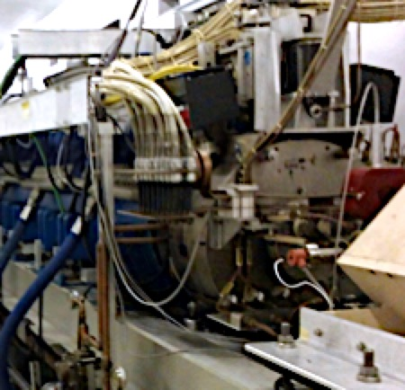
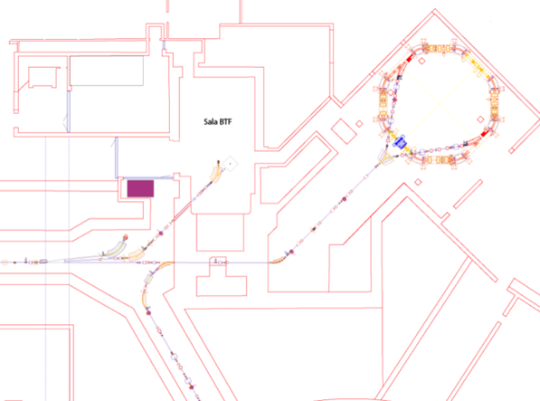
DAΦNE and BTF
Damping
Ring
BTF
Positron converter
transfer line
220 MeV e⁻
550 MeV e⁺
transfer line
LINAC
750 MeV e⁻
BTF target
transfer line
10 m
6
To the DAΦNE
main rings

Slide 8
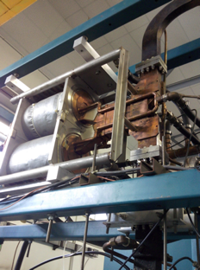
LINAC pulse width extension
Injection for DAΦNE operation requires short pulses (<10 ns)
Power supply generating pulses to the gun in the 1.5–40 ns range
New pulser for LINAC gun
Extends to the range 50-5000 ns
Installed and commissioned, operational since September 2016
But the electron current from the thermo-ionic gun has to be bunched and accelerated in the LINAC sections
The limiting factor in the accelerated beam pulse length comes from the falling off of the accelerating voltage due to the RF power compression (SLED device) used for reaching higher gradients
7

Slide 9
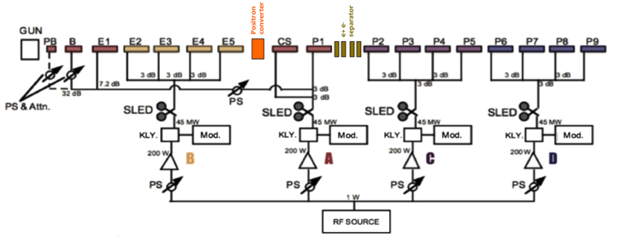
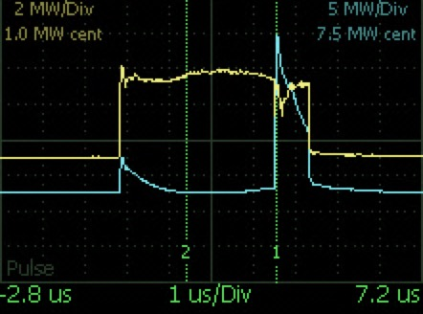
LINAC RF
Radio-frequency power is flat at the klystron output (over 4.5 μs)
SLED compresses the RF into a sharp (and approximately ×4 higher) peak
Optimize buncher, focussing, RF power & phases of the four stations, and timing, to compensate head-tail effects with longer pulses
8

Slide 10
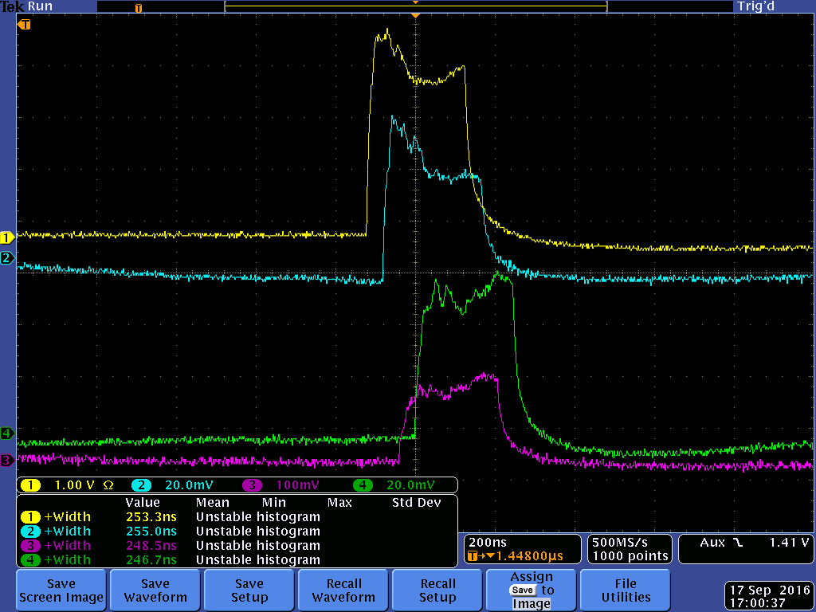
LINAC pulse width extension
BCM
BCM
BCM
BCM
250 ns
Still optimization work to be done
Expect to run at 160 ns (at least) in 2018
9

Slide 11
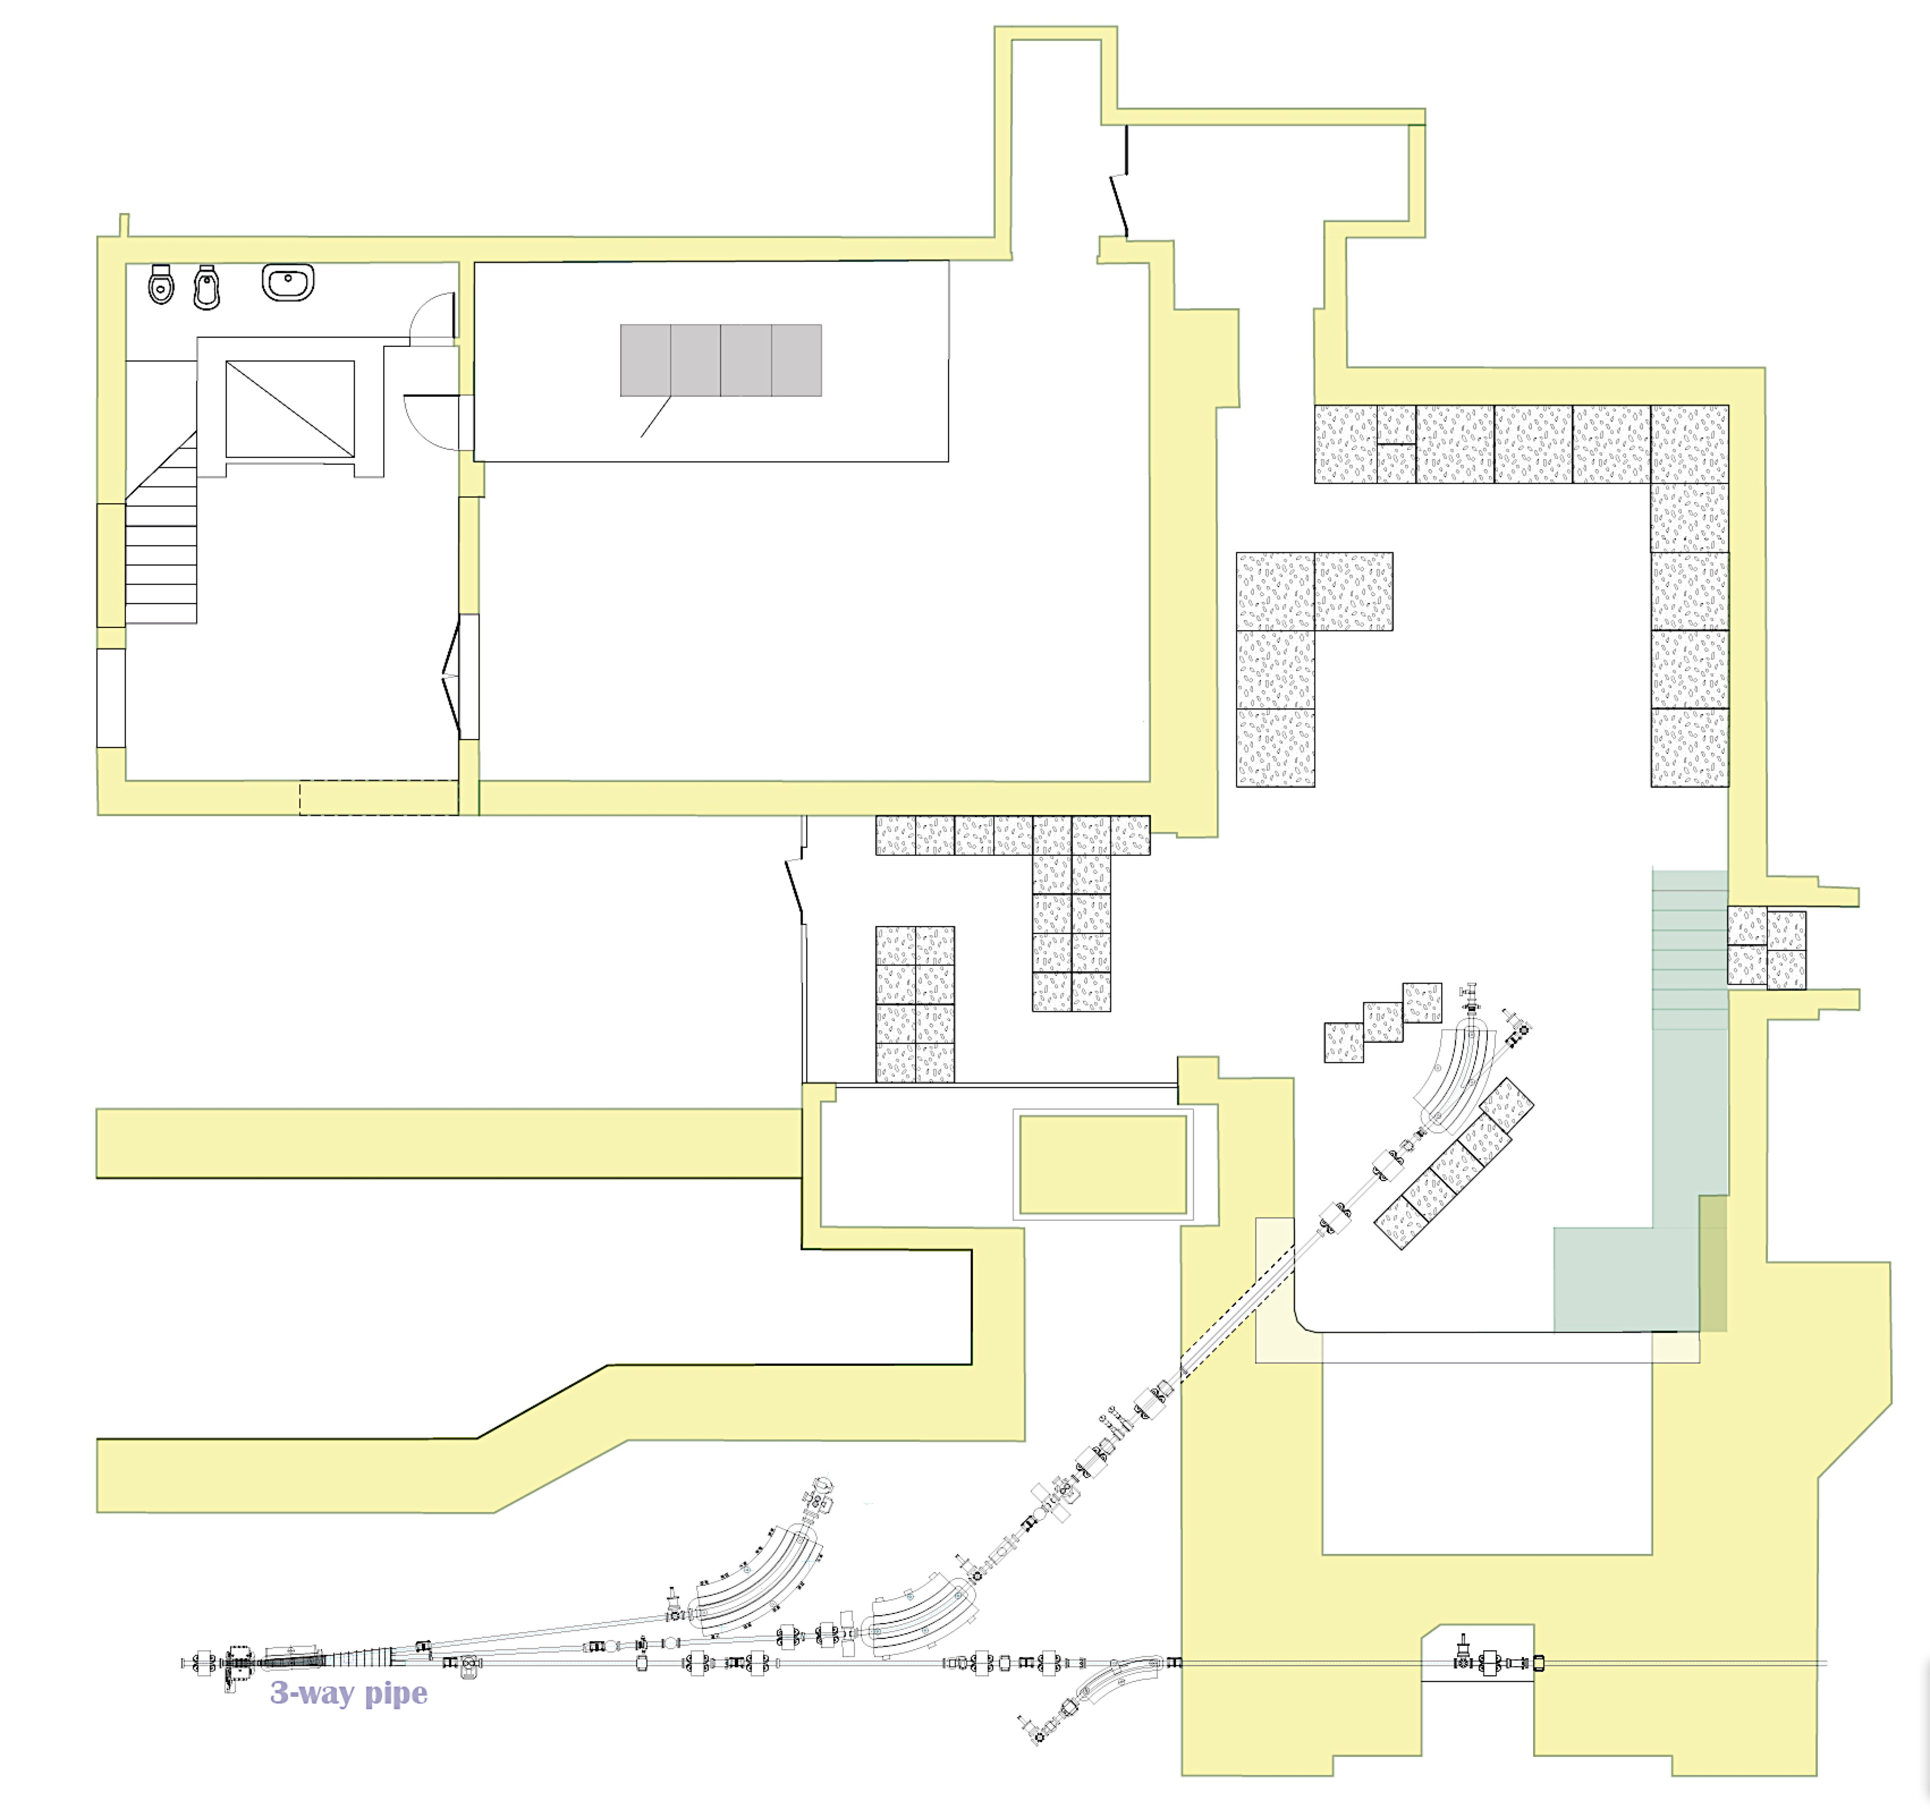
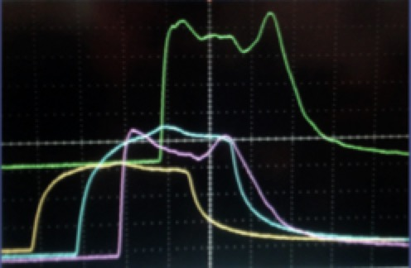
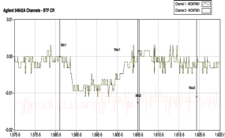
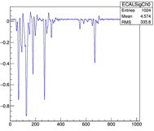
ΔE<1%
BCM4, end of LINAC
WCMTB01

Slide 12
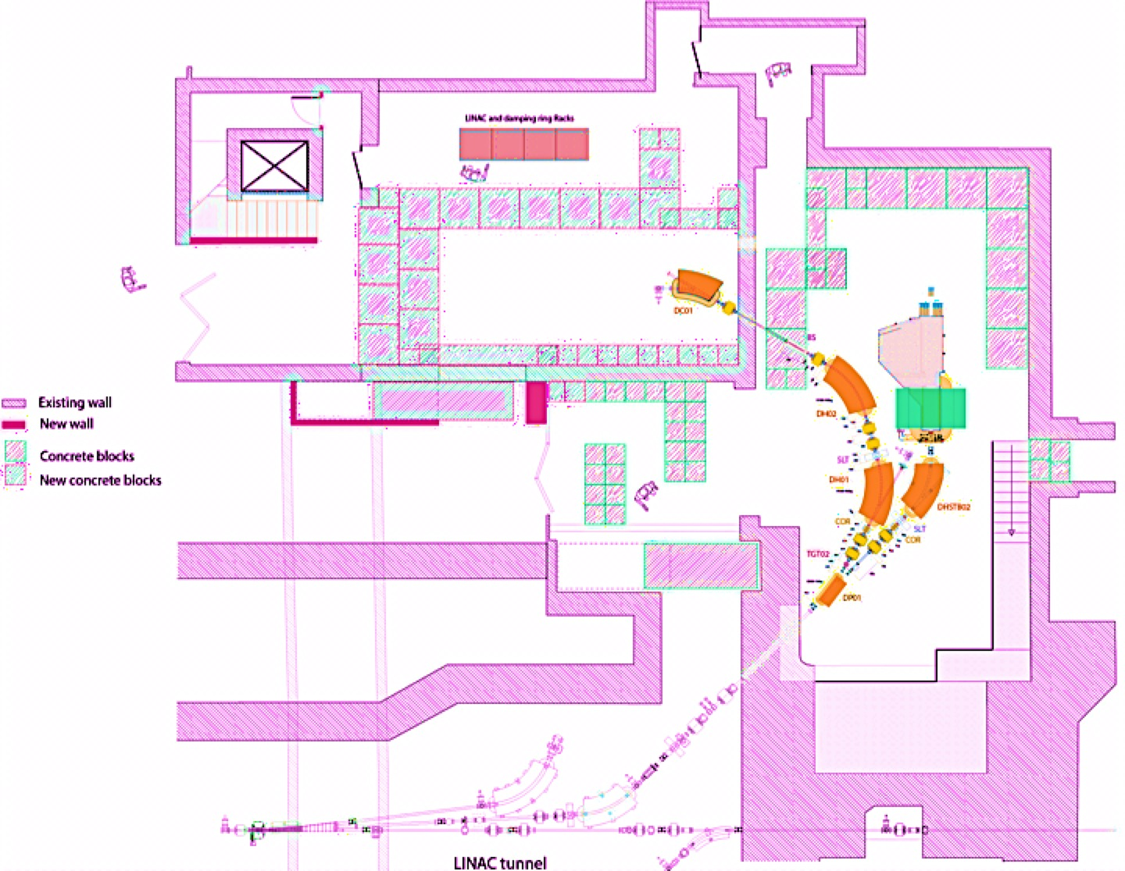
BTF upgrade & PADME: layout
PADME
BTF-2

Slide 13
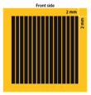
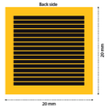
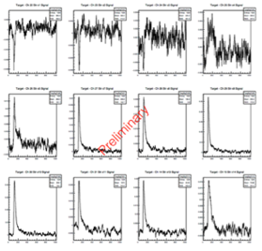
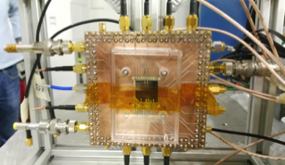
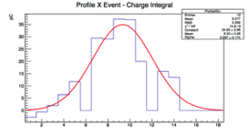
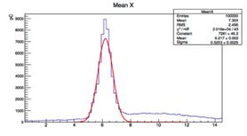
The diamond target
Given the number of positrons, 50-100 μm of Carbon
Given the beam spot size and shape, at least cm² area
20×20 mm², 50 μm detector tested on beam
16 strips per side, 1 mm pitch is the baseline design
Resolution adequate for monitoring beam spot
Digitized strips signals
10
Center of gravity
Average position
C-3PO Protocol droid

Slide 14
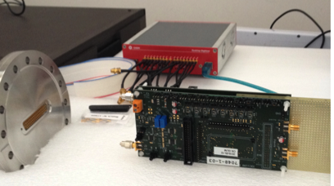
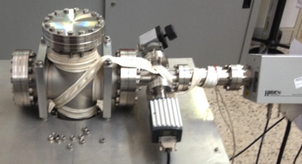
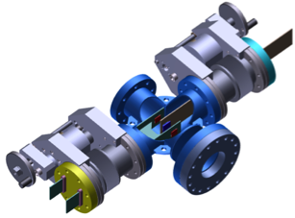
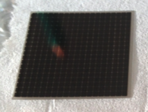
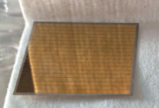
The diamond target
Readout board
Vacuum vessel test
Both graphite and metallic strips targets ready
Both 50 and 100 μm samples available
Readout electronics ready
Mechanics and motorized system ready (vacuum tests on-going)
11

Slide 15
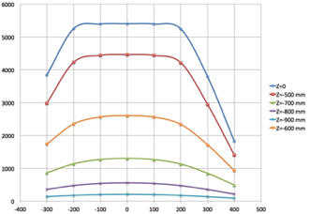
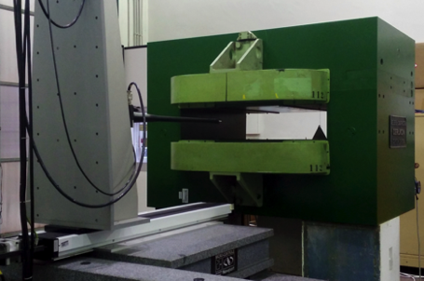
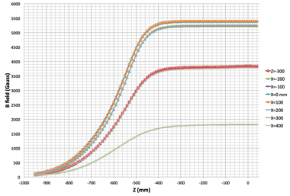
Magnet
MBP-S series, on loan from CERN
Adjustable gap by adding/removing iron insets
Many thanks to TE-MSC-MNC, R. Lopez, D. Tommasini
Shipped to Frascati in Dec. 2015
Magnetic field mapping completed
Pole
Coils
Pole
12

Slide 16
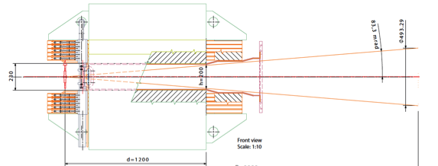
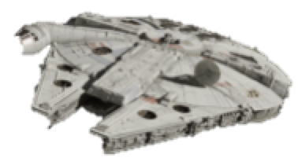
Angular coverage vs. missing mass resolution
d₁
d₂
YT-1300 freighter
The target position determines the angular acceptance, given the magnet gap (fixed to the maximum, h=230 mm)
Target not too inside the magnet poles, due to the fringe field in the coils region
Calorimeter lateral dimensions depend on the distance from the target:
distance ∝ diameter ∝ cost
BTF experimental hall size limits the maximum distance to 4-5 m
On the other side, given the granularity, the calorimeter distance cannot be too small in order not to spoil the missing mass resolution
13
Calorimeter material choice is crucial

Slide 17
Fighting the background
Backgrounds: one photon + something else (not a dark photon...) going undetected:
recoil γ
recoil γ
recoil γ
e⁺
e⁺
e⁺
e⁺
e⁻
γ
e⁻
γ
γ
Bremsstrahlung ≈Z²
γγ process, ≈Z
3γ process, ≈Z
Veto detectors (see further), for detecting the irradiating positron
Hole in the center of the calorimeter (very high rate at small angles)
Signature: >1 cluster in the calorimeter
Try to keep the fraction of lost photons as low as possible (below few per-mils)
Angular coverage of calorimeter at least of Δθ=100 mrad (taking into account edges for building at least a 3×3 cluster)
14
Stormtroopers Corps

Slide 18
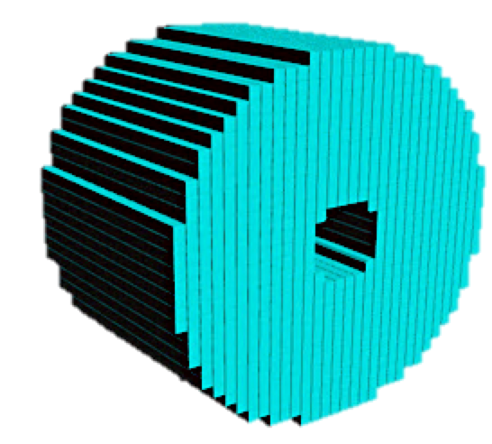
Calorimeter
The two basic requirements of the calorimeter:
1. Measure E_{γ} and θ_{γ}
Good energy resolution: 1-2%/√E[GeV])
High Photo-statistics
Containment
Good angular resolution: ≈1 mrad
2. Fight pile-up
Sub-ns timing resolution
γ
Moliére radius  granularity
Moliére radius  material
Material  radiation length  volume  cost
Material  light yield  energy and time resolution
(+ photo-sensor)
e⁺
Target
R2-D2 Droid
Light yield + compactness practically limit the choice to:
LYSO (R_{M}=2.07 cm)
BGO (R_{M}=2.23 cm)
15

Slide 19
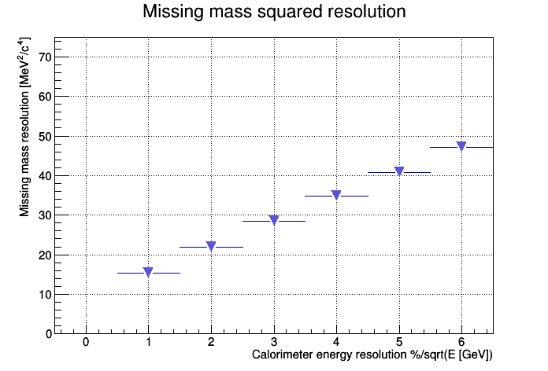
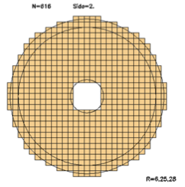
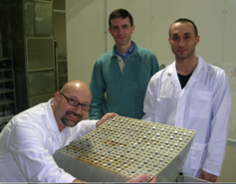
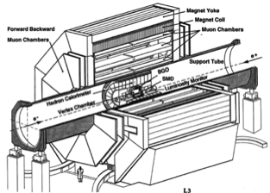
Calorimeter
Assume 20×20 mm² cells
At least 200 mm length
Our compromise:
Target to magnet iron = 200 mm
Maximum angle = 83 mrad
Target-calorimeter distance = 3 m
Calorimeter diameter
3000*0.083 + 1.5 cells = 560 mm
Inner hole = 5×5 cells
Total of 616 crystals (LYSO or BGO) = 50k cm³
BGO
LYSO
Not less than 1.5M, but…
Thanks to L3 collaboration, prof. S. Ting and INFN management we had access to L3 BGO crystals (one end-cap)
16
INFN Rome team during the construction of the L3 calorimeter

Slide 20
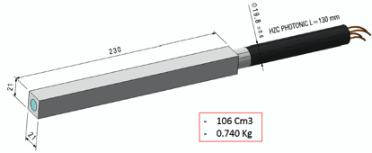
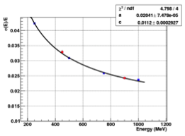
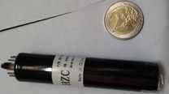
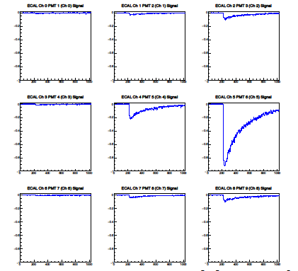
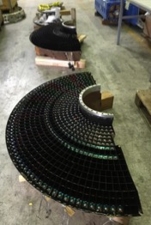
Calorimeter status
HZC XP1911 19 mm PMT
5×5 prototype: energy resolution 2.3% at 1 GeV
650×, tender assigned
HV supply: tender on-going
Crystals preparation completed
Extracted from L3 barrel
High-temperature annealing
Machining, gluing and painting: tender assigned
Mechanical structure and assembly procedure being finalized
17
Waveform digitizers: tender assigned
1 – 5 GS/s
896 channels
Calorimeter + Veto detectors + Target

Slide 21
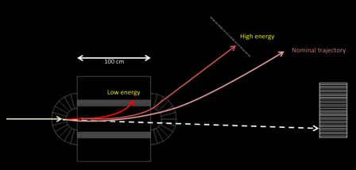
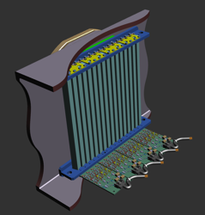
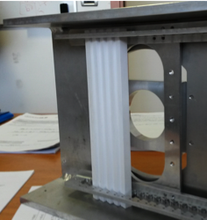
Veto detectors
Time resolution better than 500 ps
Momentum resolution of few % based on impact position
Efficiency better than 99.5% for MIPs
Low energy part inside the magnet gap
High energy part close to not interacting beam
10×10x180 mm³ scintillator
Design of the mechanics ready
Prototype of the assembly ready
Prototype electronics on-going
Test-beam in April
All scintillator bars delivered
Read-out by same digitizing system as calorimeter
18

Slide 22
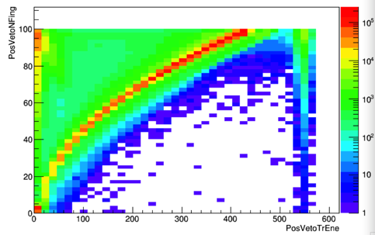
Veto detectors

Slide 23
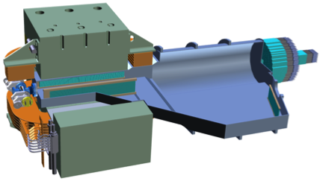
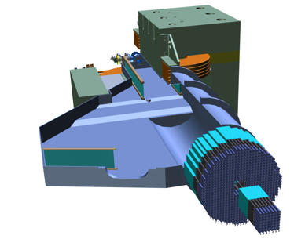
Vacuum vessel
Low energy
e+ veto
High energy e+ veto
Low energy
e+ veto
Not interacting e+ window
Secondary vacuum (not UHV)
Design dictated by:
Magnet constraints
Calorimeter distance
Veto detectors positioning
Target region also acting as interface to the beam-line
Target region
19

Slide 24
Background: Bremsstrahlung
The dominant background: tag with e+ veto
The scintillating bars e+ veto does not work for very soft Bremsstrahlung
Too close to the beam spot
Too high rate per single bunch
A high-resolution detector in the beam spot can improve the rejection of residual background with M²_{miss} ≈ E_{beam}
Spot enlarged by beam energy spread and divergence:
3×10 cm² active area (<10⁴ e+/cm²)
Silicon pixels with Timepix readout under evaluation
20

Slide 25
High energy positron/beam detector
Monte Carlo simulation:
2x7 array of TimePix (Silicon pixel sensors+readout) in vacuum
Directly placed in the beam (5000 particles in 40ns)
Single bunch in TimePix array simulation
Average 1 e⁺/bunch/fired pixel
Expect very precise measurement of N_{e+}

Slide 26
Background: 2 and 3 photons
The probability of losing 1 or 2 photons (given the first cluster) critically depends on the cluster definition and calorimeter angular acceptance
Recoil γ definition:
10 MeV < E < 400 MeV
30 mrad < θ < 65 mrad
ΥΥ events
1+2
2+3
Region 1: θ < 20 mrad
Region 2: 20 < θ < 75 mrad
Where is the cluster without and with recoil photon selection
Region 3: 75 < θ < 100 mrad
1+2+3
Lost
Lost: θ >100 mrad
3Υ events
1+2
2+3
Need for a veto detector covering the calorimeter hole:
Fast (pile-up translates in over-veto)
Moderate energy resolution
1+2+3
Lost
21

Slide 27
Small angle detector
Hamamatsu
R9880U-110
First tests:
SF-57 lead-glass bar, 20×20×200 mm³, n=1.8467
Wrapped in Teflon no optical coupling
Hamamatsu R9880U-110, operated at 950V (gain~1.5x10⁶)
Readout with CAEN V1742 digitizer set to 5 GS/s
Interesting alternative:
PbF₂: extended transparency at shorter wave-lenghts (higher Cherenkov yield)
150 ns long pulses
700 ps signal width
2.5 ns double peak separation
0.1 p.e./MeV
Final choice of PMT according to crystal size:
49 cells 2×2 cm² or 25 cells 3×3 cm²
22
Hamamatsu
R13478-10-UV

Slide 28
Beam pulse time structure
BCM4
SF-57

Slide 29
Background summary
e⁺e⁻→ γγ(γ)
e⁺N→e⁺Nγ
Pile up
Pile up contribution is important but can be efficiently rejected by cuts on maximum cluster energy and M²_{Miss}
Veto inefficiency at high missing mass when p_{e+}≃ p_{e+beam}
Additional positron veto detector can help rejecting residual background
Rejection of 2 and 3 photons backgrounds depend on the cluster definition and on the topology cuts
The main driver of the angular coverage choice
23

Slide 30
Sensitivity
Candidate Signal selection (simple and robust cuts)
Just one cluster in the calorimeter
30 mrad < θ_{Cl} < 65 mrad
E_{min}(M_{A’}) < E_{Cl} < E_{max}(M_{A’})
No track in the positron veto within ±2 ns
No cluster in small angle detector with E>50 MeV within ±2ns
Missing mass in the region: M_{A’} ± σ_{Mmiss}(M_{A’})
Monte Carlo simulation extrapolated to 1x10¹³ positrons on target
Using N(A’γ)=σ(N_{Bkg})
With very simple cuts, far from no-background sensitivity (improvements are possible)
Cross-section enhancement due to A’ mass
24

Slide 31
Missing mass resolution

Slide 32
BaBar 2017
arXiv:1702.03327v1 [hep-ex]

Slide 33
Running program
Jan | Feb | Mar | Apr | May | Jun | Jul | Aug | Sep | Oct | Nov | Dec
Procurement |  |  |  |  | Construction |  |  |  |  | Installation
2017
Jan | Feb | Mar | Apr | May | Jun | Jul | Aug | Sep | Oct | Nov | Dec
Commissioning |  |  | Physics Run 1 |  |  |  | DAΦNE collisions |  |  | Run 1
2018
Jan | Feb | Mar | Apr | May | Jun | Jul | Aug | Sep | Oct | Nov | Dec
Hand-shaking with DAΦNE collisions
2019
25
Galactic Standard Calendar

Slide 34
Axion-like particles
Primakoff
Limits on ALPs coupling to photons
PADME can search for long living ALPs by looking for 1 γ + M²_{miss} final states
In the visible final state a→γγ all production mechanisms can be exploited, extending the mass range in the region of ≈100MeV
The observables at PADME will be: eγγ or γγγ
Bremsstrahlung
Region of interest for PADME
ALP decay to photons
arXiv:1512.03069
Annihilation
+
26
Phys rev D 38 11 1998

Slide 35
Background to ALPs searches
Invariant γγ mass for all events collected by calorimeter (2×10¹⁰ e+ events) with two in-time clusters
Even without any selection cut PADME will be background free for masses >∼ 50MeV
Main background e⁺e⁻→γγ, e⁺e⁻→γγ(γ) has a kinematic limit at M_{γγ} =24 MeV
Background at higher masses is due to overlapping photons from different Bremsstrahlung interactions.
Can be suppressed by using the veto detector
27

Slide 36
Outlook
Almost all components available or ordered
Construction will be completed by the Fall 2017
Installation by the end of the year
Official start of physics run: April 2018
Aim at covering the (g-2)μ band in 6 months data taking
Estimating sensitivity for ALPs
More running in 2019 for adjusting beam energy, improving sensitivity, …
28
T-65B X-wing starfighter

