Slide 1
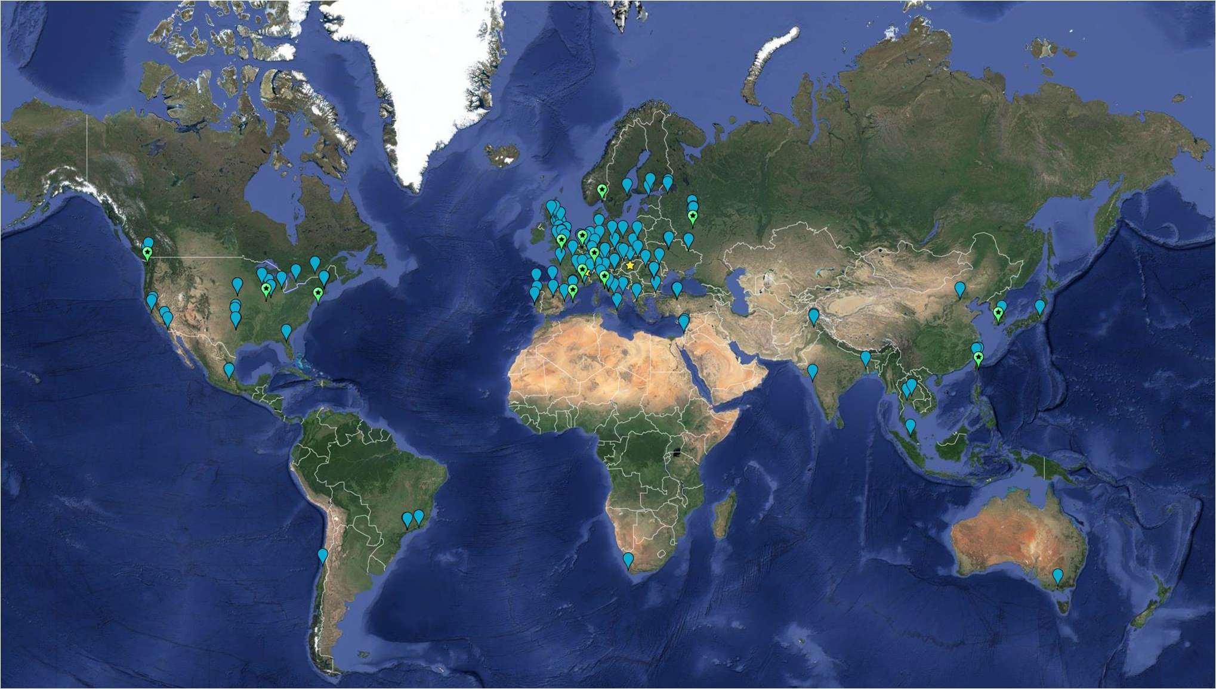
New strategies of the LHC experiments to meet
the computing requirements of the HL-LHC era
Dagmar Adamova (NPI AS CR Prague/Rez) and Maarten Litmaath (CERN)
Worldwide LHC Computing Grid (WLCG)
in October 2016:
- 63 MoU signatories
167 sites
42 countries
- Up to ~600k CPU cores, but equivalent to
~ 350k today’s fastest cores
- Disks: ~ 400 PB
- Tape storage: ~390 PB
LHC in 2016:
Reached luminosity 40% above the design value.
Integrated luminosity collected was 40 fb⁻¹ (the goal for 2016 was 25 fb⁻¹).
Run 2 has set new records in all areas of performance and capabilities.
The WLCG and experiments have managed the challenges successfully.
Continuous efforts in various areas like improvements of experiment software performance, changes of computing models, adoption of new data management strategies, upgrades of network capacity or utilization of external resources – high performance computing centers (HPC) and computational clouds make it possible to adapt the system to the constantly evolving demands on performance.

Slide 2
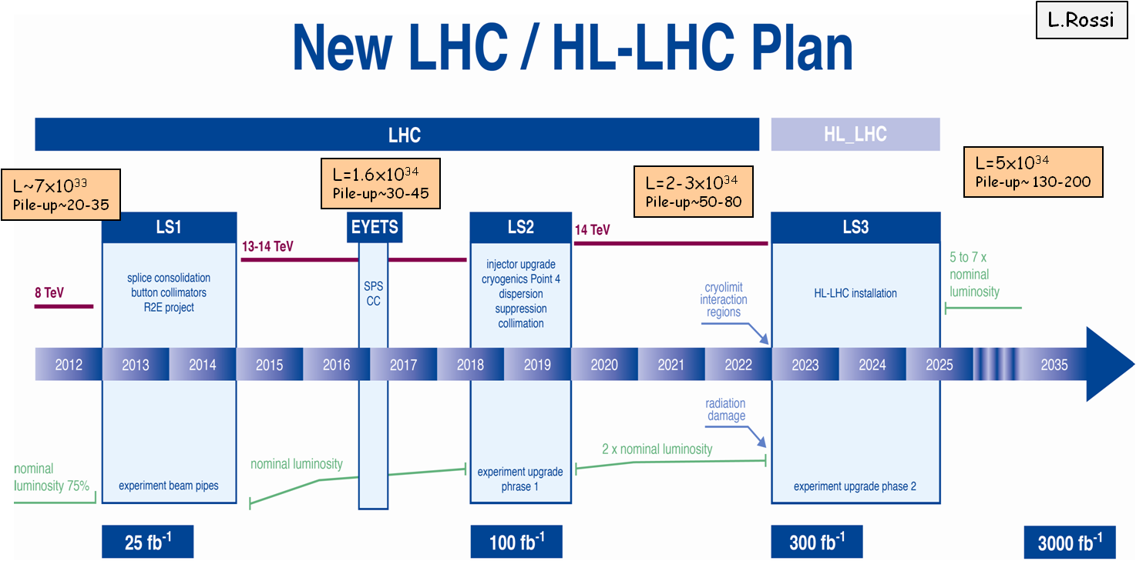
Outlook: HL-LHC might/will create a computational problem
6.5 to 7 TeV
Peak luminosity 1.6-1.7x10³⁴cm⁻²s⁻¹
7 TeV
Peak luminosity 2-3x10³⁴cm⁻²s⁻¹
Upgrade ALICE + LHCb for Run 3
→75 Gbyte/s for 6 weeks/year
Upgrade CMS + ATLAS for Run 4
→10-40 GByte/s data rates in p-p run
Luminosity upgrades → higher pile-up, new trigger strategies, higher event complexity.
Detector upgrades → more channels, more complex simulations.
→ More data
Estimates still vary a lot: 65 – 200 times larger needs than for LHC Run 2.

Slide 3
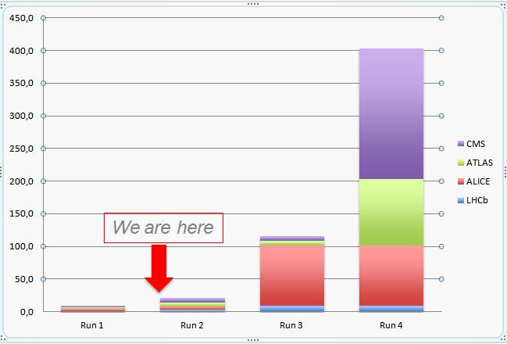
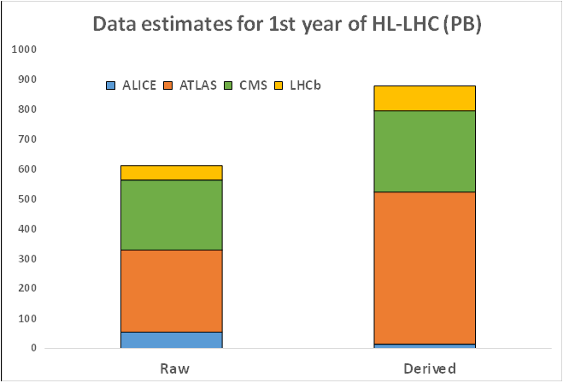
Estimates of data volumes and resource needs for HL-LHC
and the computing challenge
Data growth estimate:
Raw 2016: ~50 PB → 2027: 600 PB
Derived (1 copy): 2016: ~80 PB → 2027: 900 PB
Very rough estimate of RAW data produced per year of running using a simple
extrapolation of current data volume scaled by the output rates (in PB, follow-up of 2015).
To be added: derived data (ESD, AOD), simulation, user data…
The estimates are at least 10 times above what is realistic to expect from technology with reasonably constant cost. Without continuous efforts to optimize the system, computing could risk to become a bottleneck for LHC science.
Both CERN IT and experiments are increasingly held accountable for science throughput per investment by funding agencies
.
New Computing TDR is under preparation for 2020
It will be a checkpoint on a roadmap – the current working system will always continue to evolve.
In addition to technological challenges, there are also sociological aspects: without recognizing computing and software activities as being equally important as analysis in physics careers, the amount of effort available for computing matters might become a problem for LHC science.
CPU: 60 times upscale from 2016 needed
These estimates are based on today’s computing models, but with expected HL-LHC operating parameters. They are very preliminary and may change significantly over the coming years.

