Slide 1

THEIA in Finland
Pyhäsami mine as a possible site for WbLS detector
Wladyslaw Henryk Trzaska

Slide 2
Outline
Basic facts about the Pyhäsalmi mine:
  Where is the mine located?
  How does it look like?
  What is the infrastructure?
  What makes is special?
How much it would cost to build THEIA in the Pyhäsalmi mine?
How long the construction would last?
How easy it would be to maintain & operate THEIA in Pyhäsalmi?
Site comparison 2014 (Homestake vs. Pyhäsalmi)
  Material for discussion

Slide 3
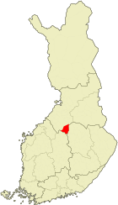
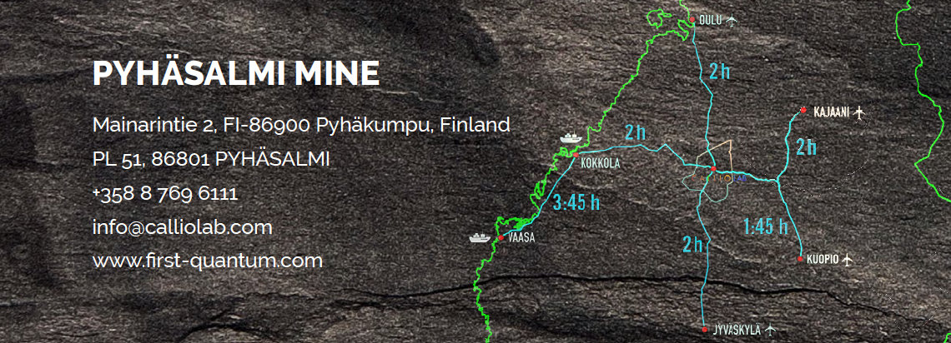
3 h
Helsinki

Slide 4
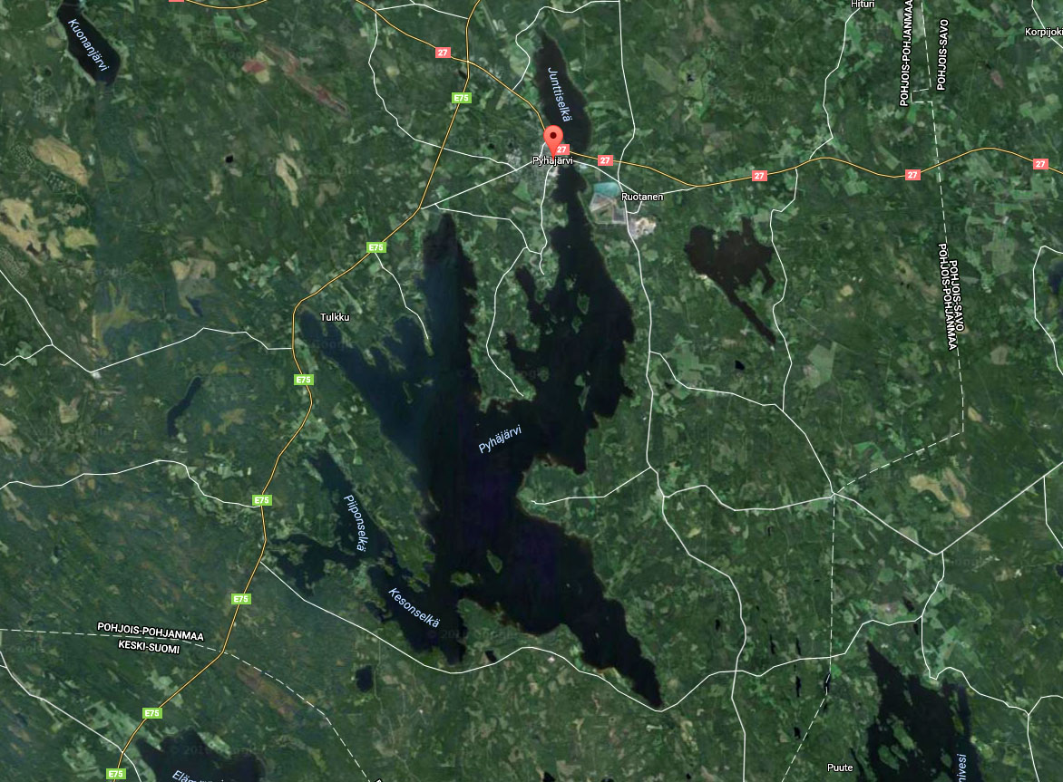
[Pyhä - järvi] → [Holy - lake]
[Pyhä - salmi] → [Holy - strait]

Slide 5
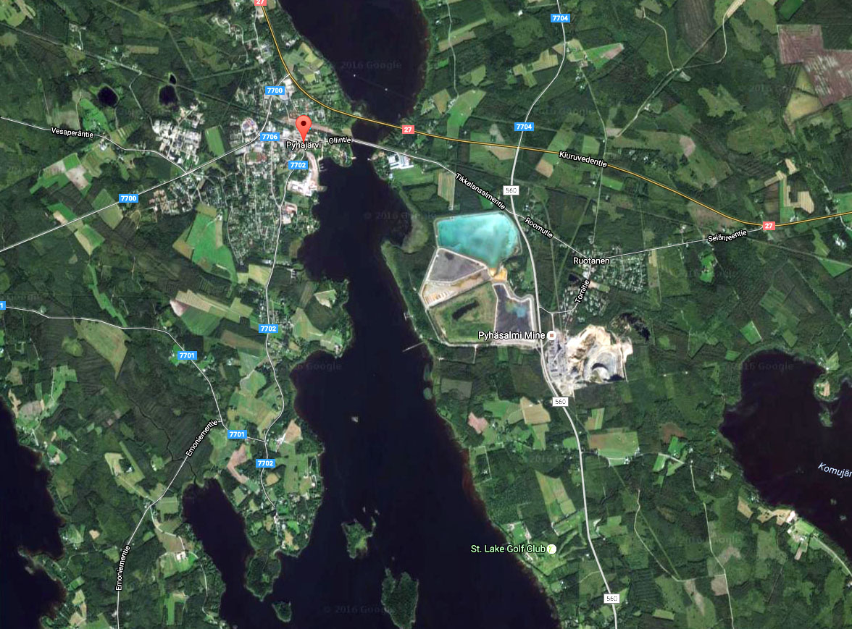

Slide 6
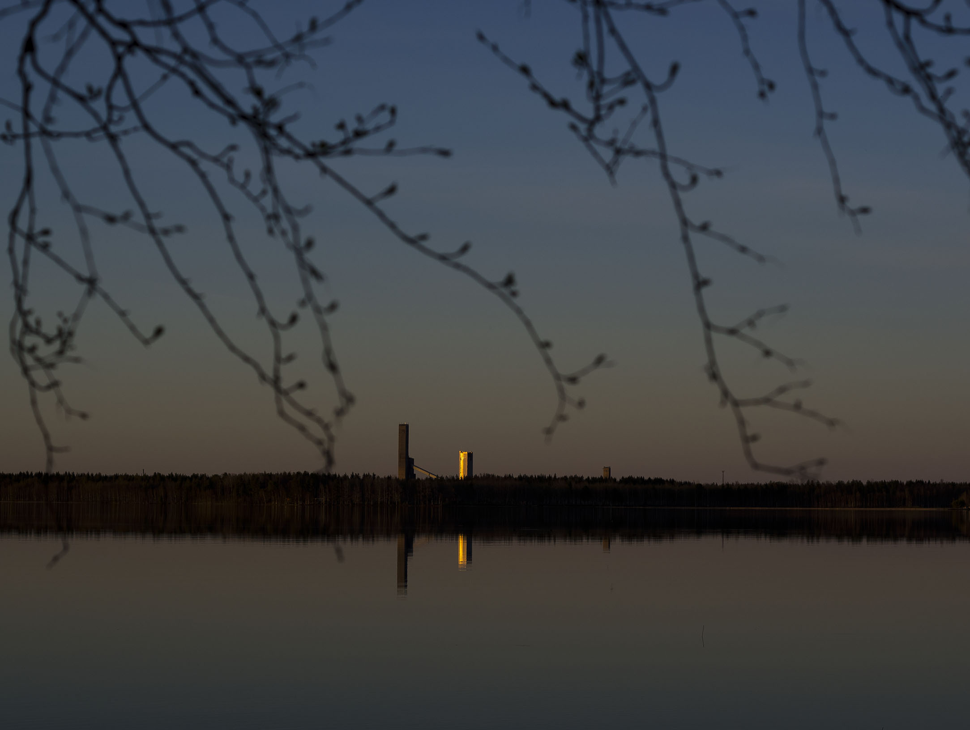
Pyhäsalmi is now a district within the Pyhäjärvi municipality

Slide 7
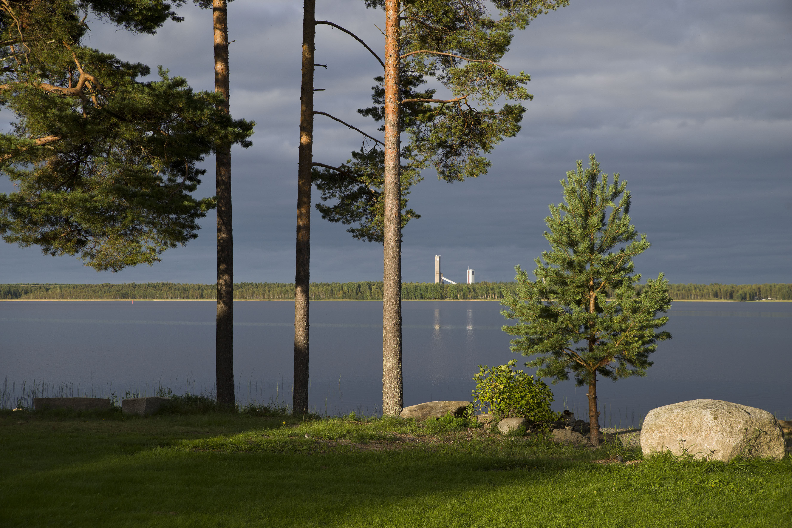

Pyhäjärvi

Slide 8
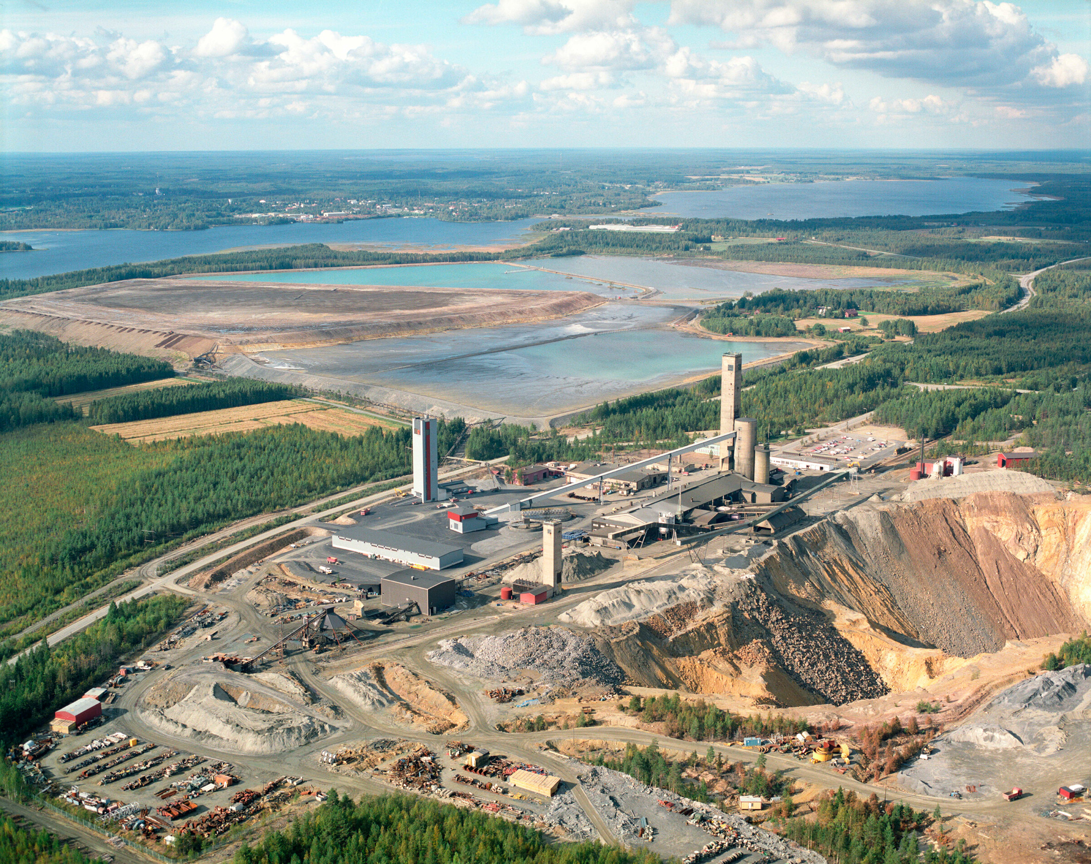

Slide 9

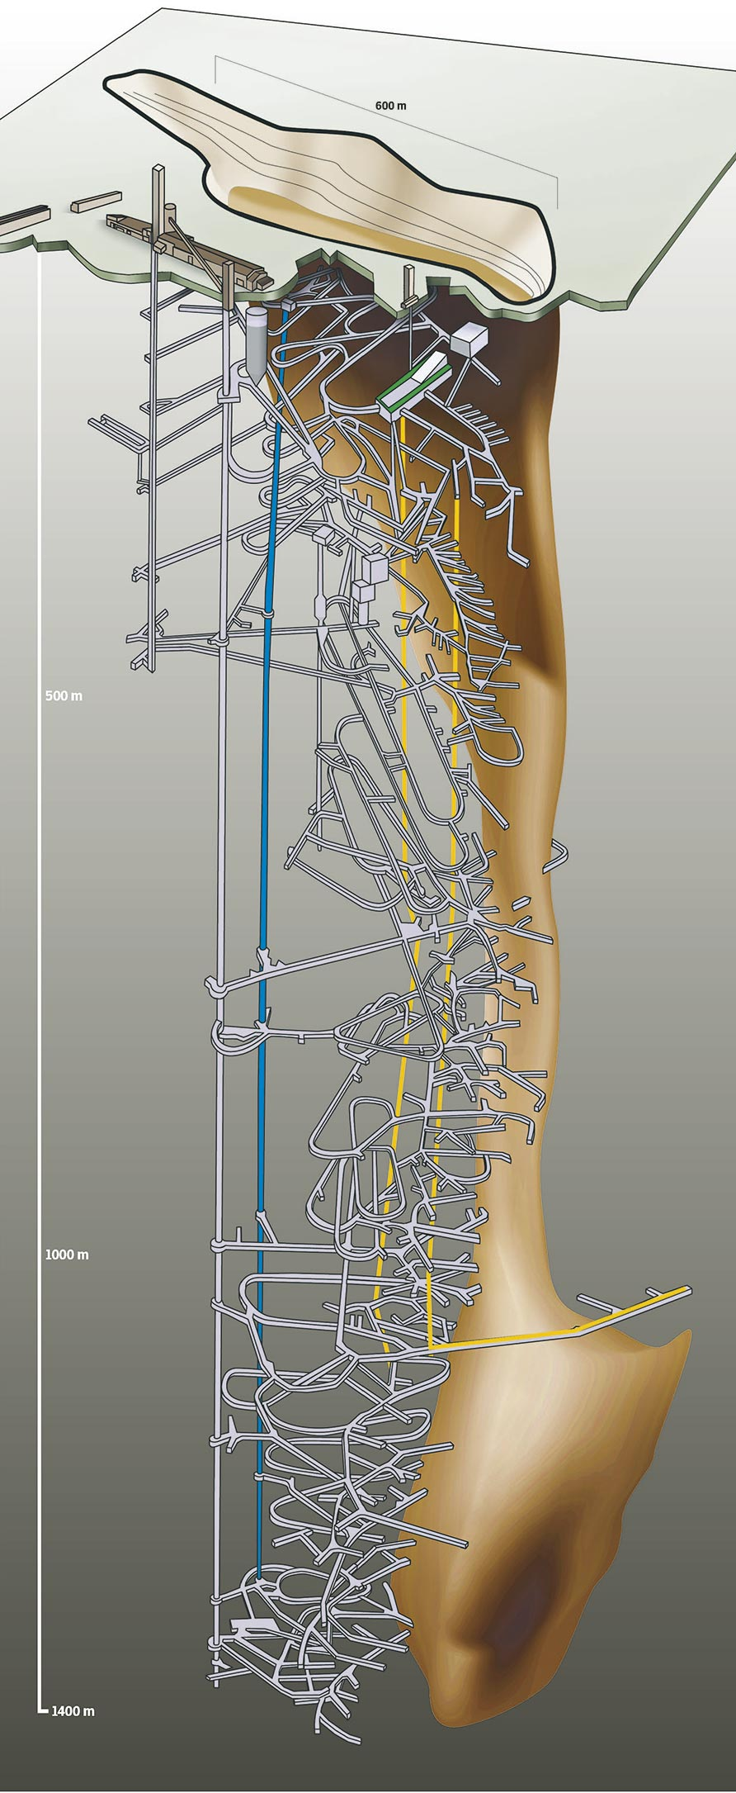
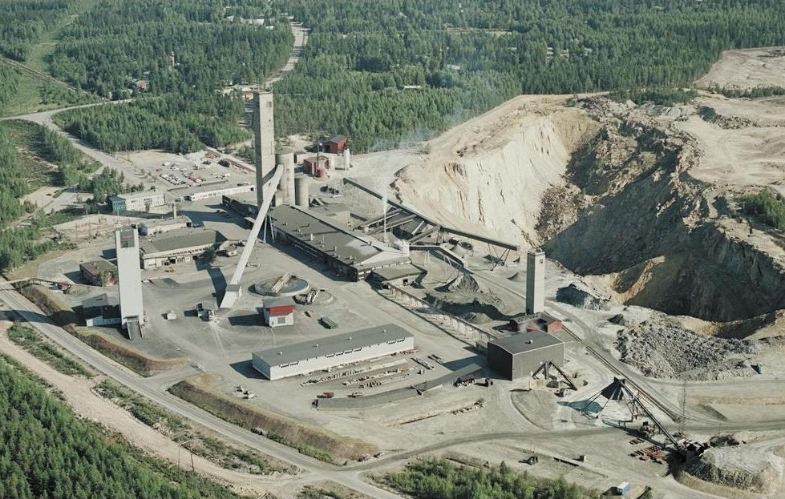
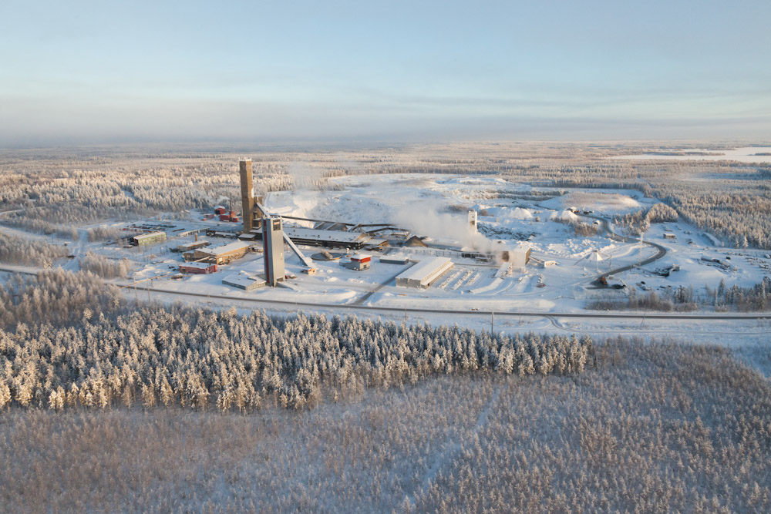
Pyhäsalmi mine

Slide 10
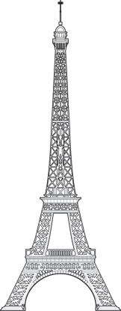
Pyhäsalmi mine
The deepest mine in Europe
Very small footprint
Double access mode:
    Shaft and decline
No water problem
Excellent rock quality
Cool environment
    22°C @ 1400 m
Modern infrastructure
    The most efficient mine of this type
Excellent safety record
Mining ends ~2018
Low seismic activity
Low reactor neutrino background

Slide 11
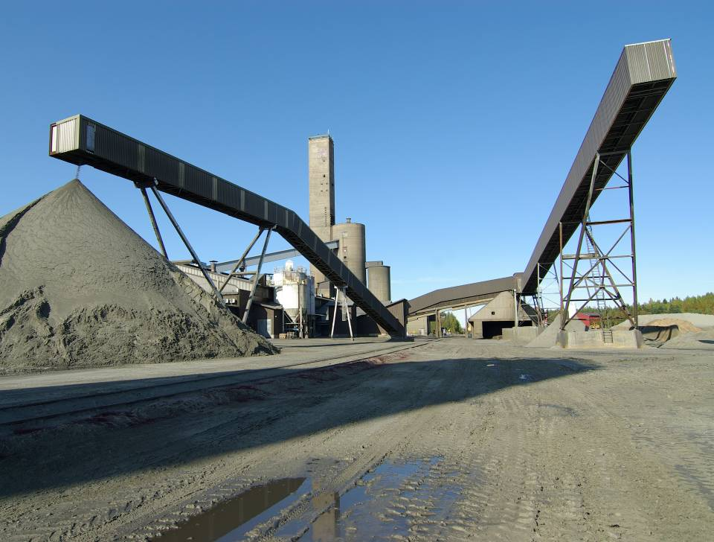
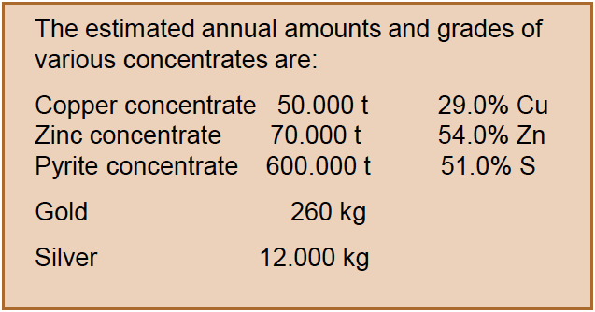
Annual yield and grade of concentrates

Slide 12
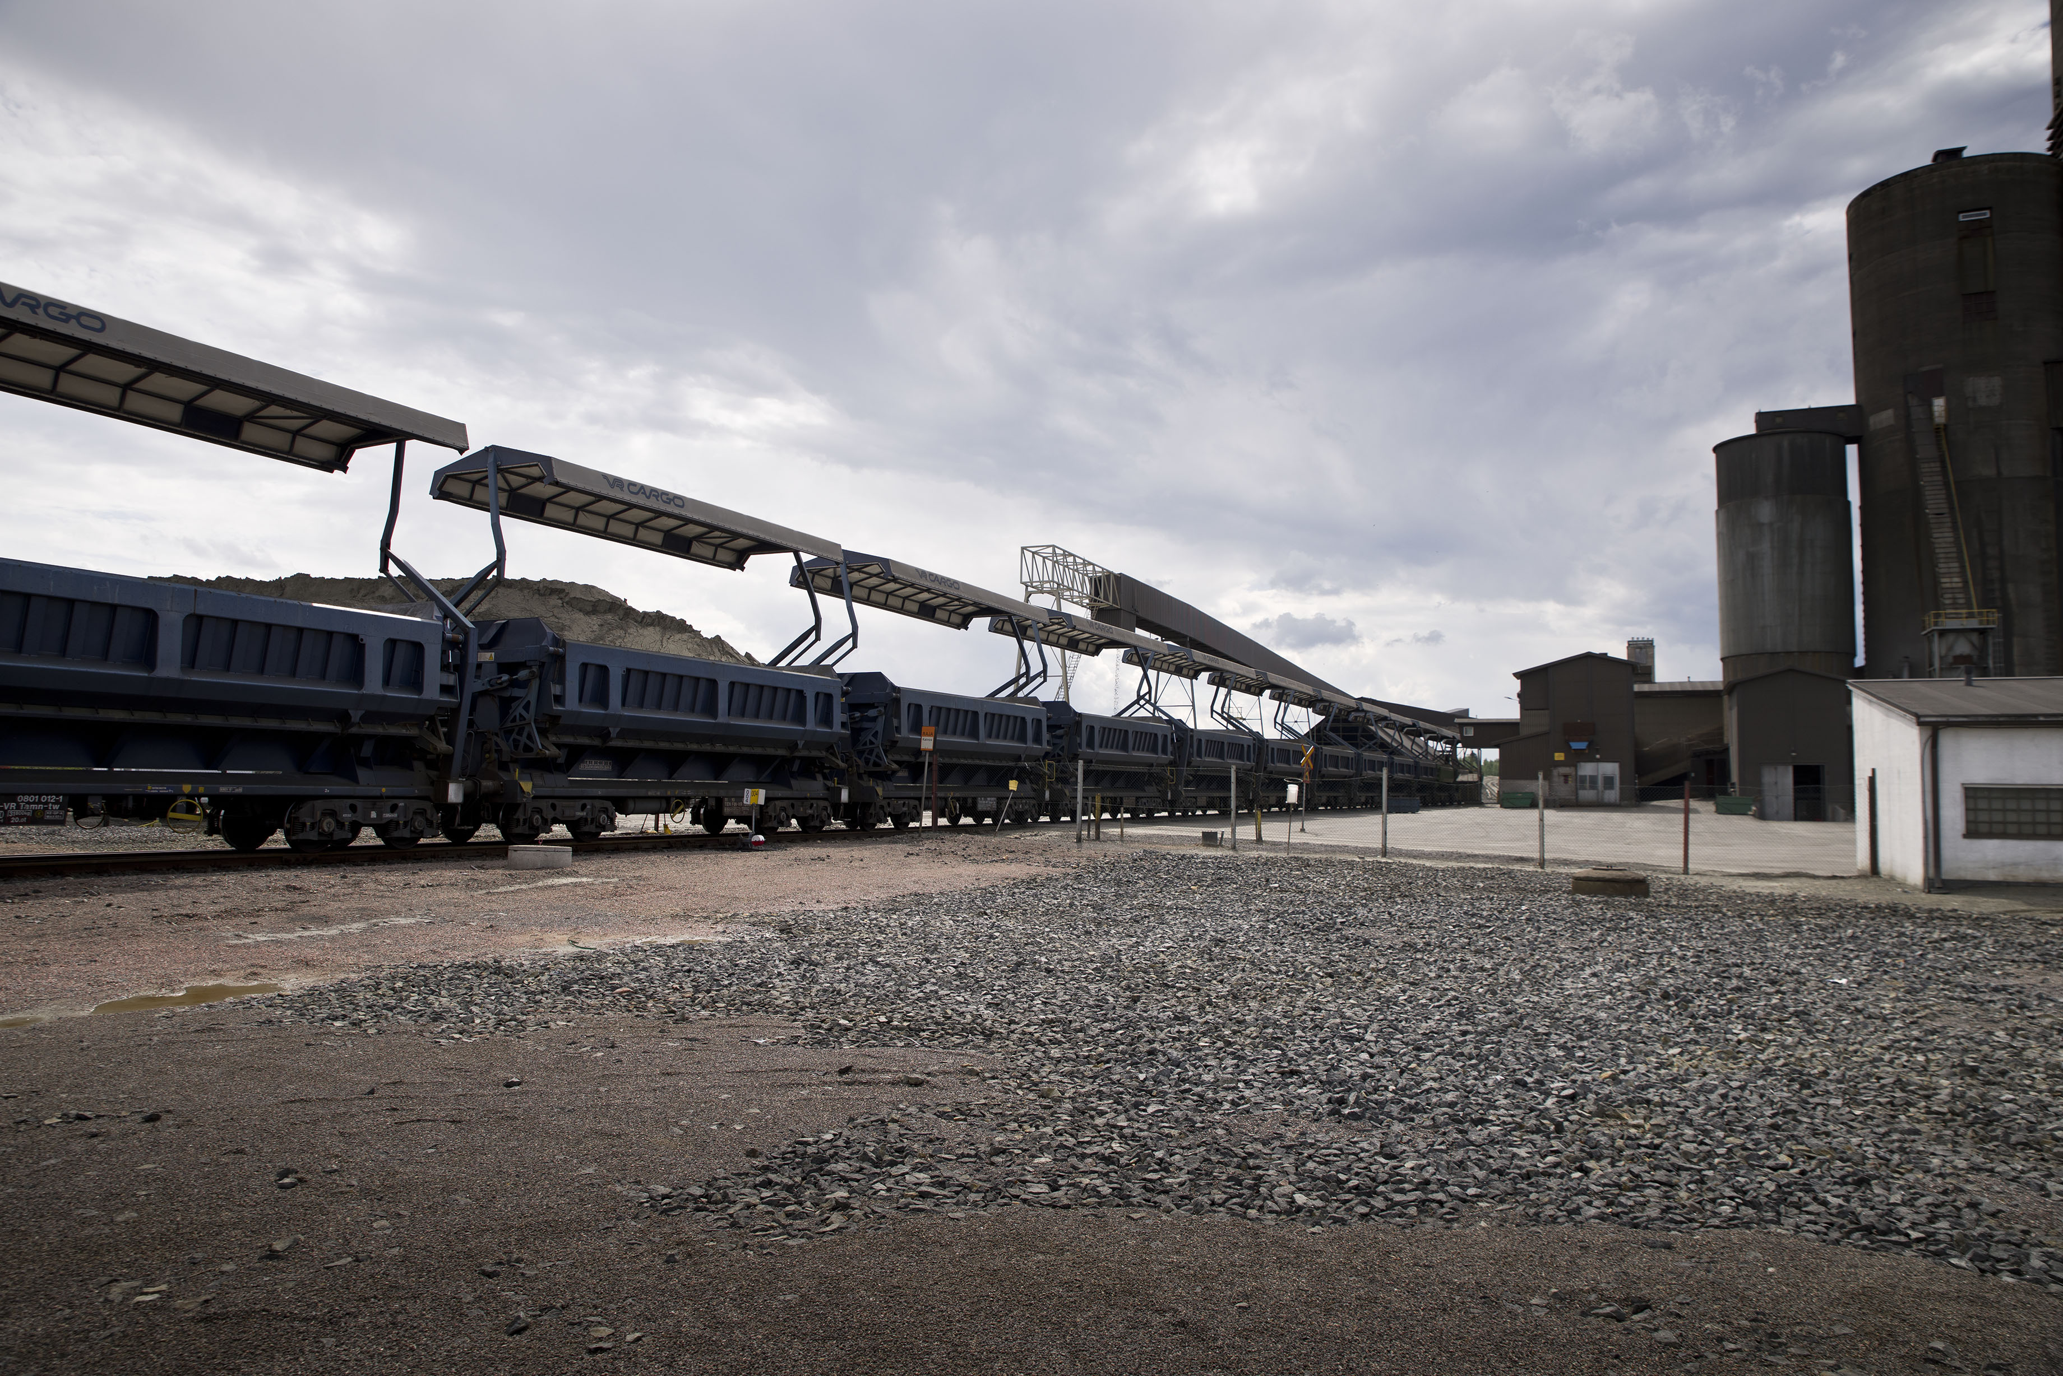
Transported by rail to Kokkola harbor and to domestic smelters

Slide 13
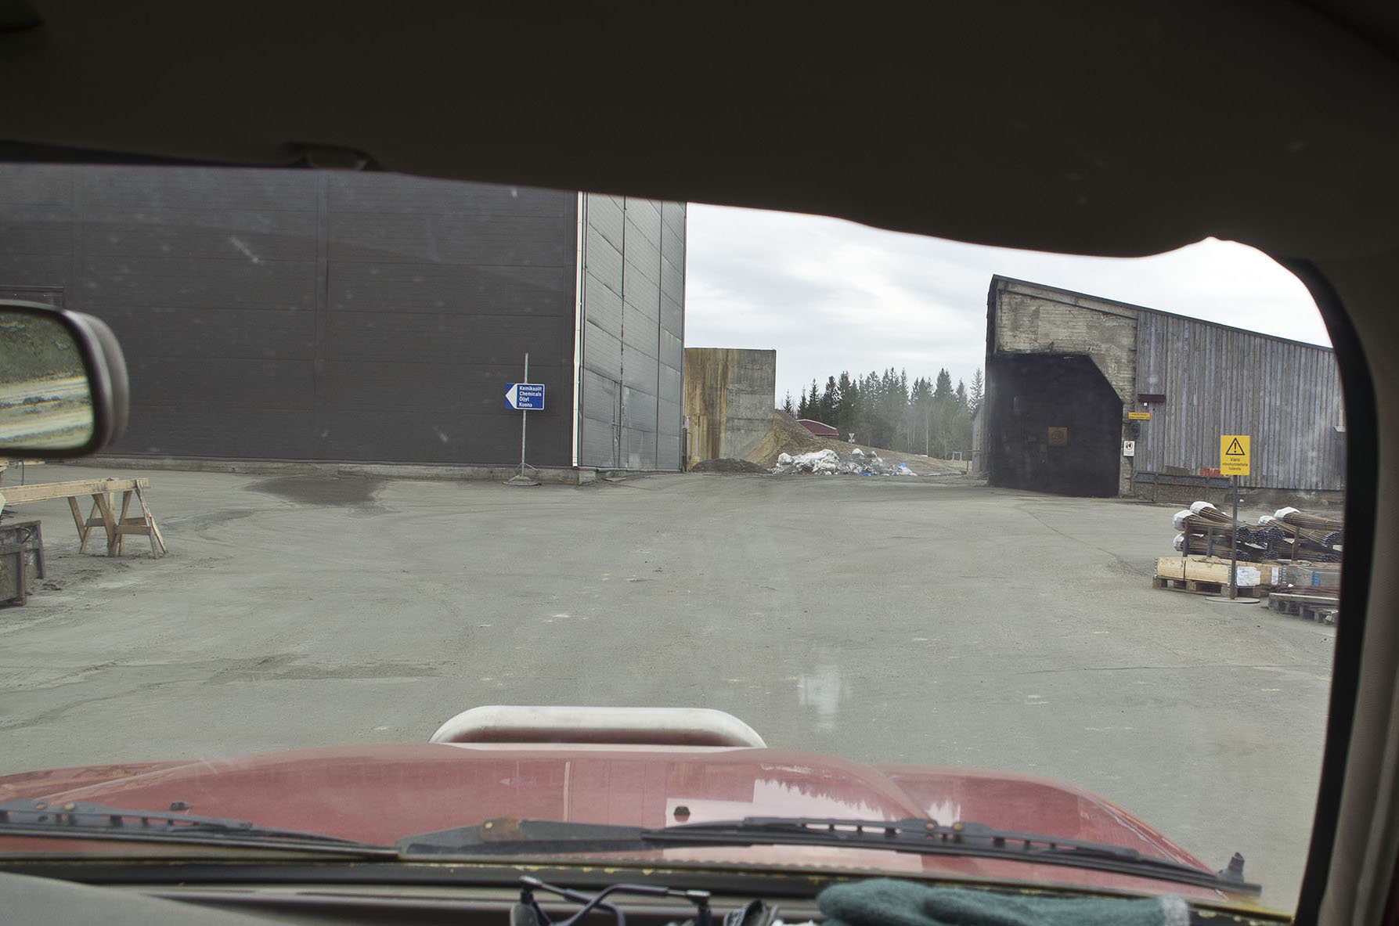
VT (ramp or decline) entrance at the surface

Slide 14
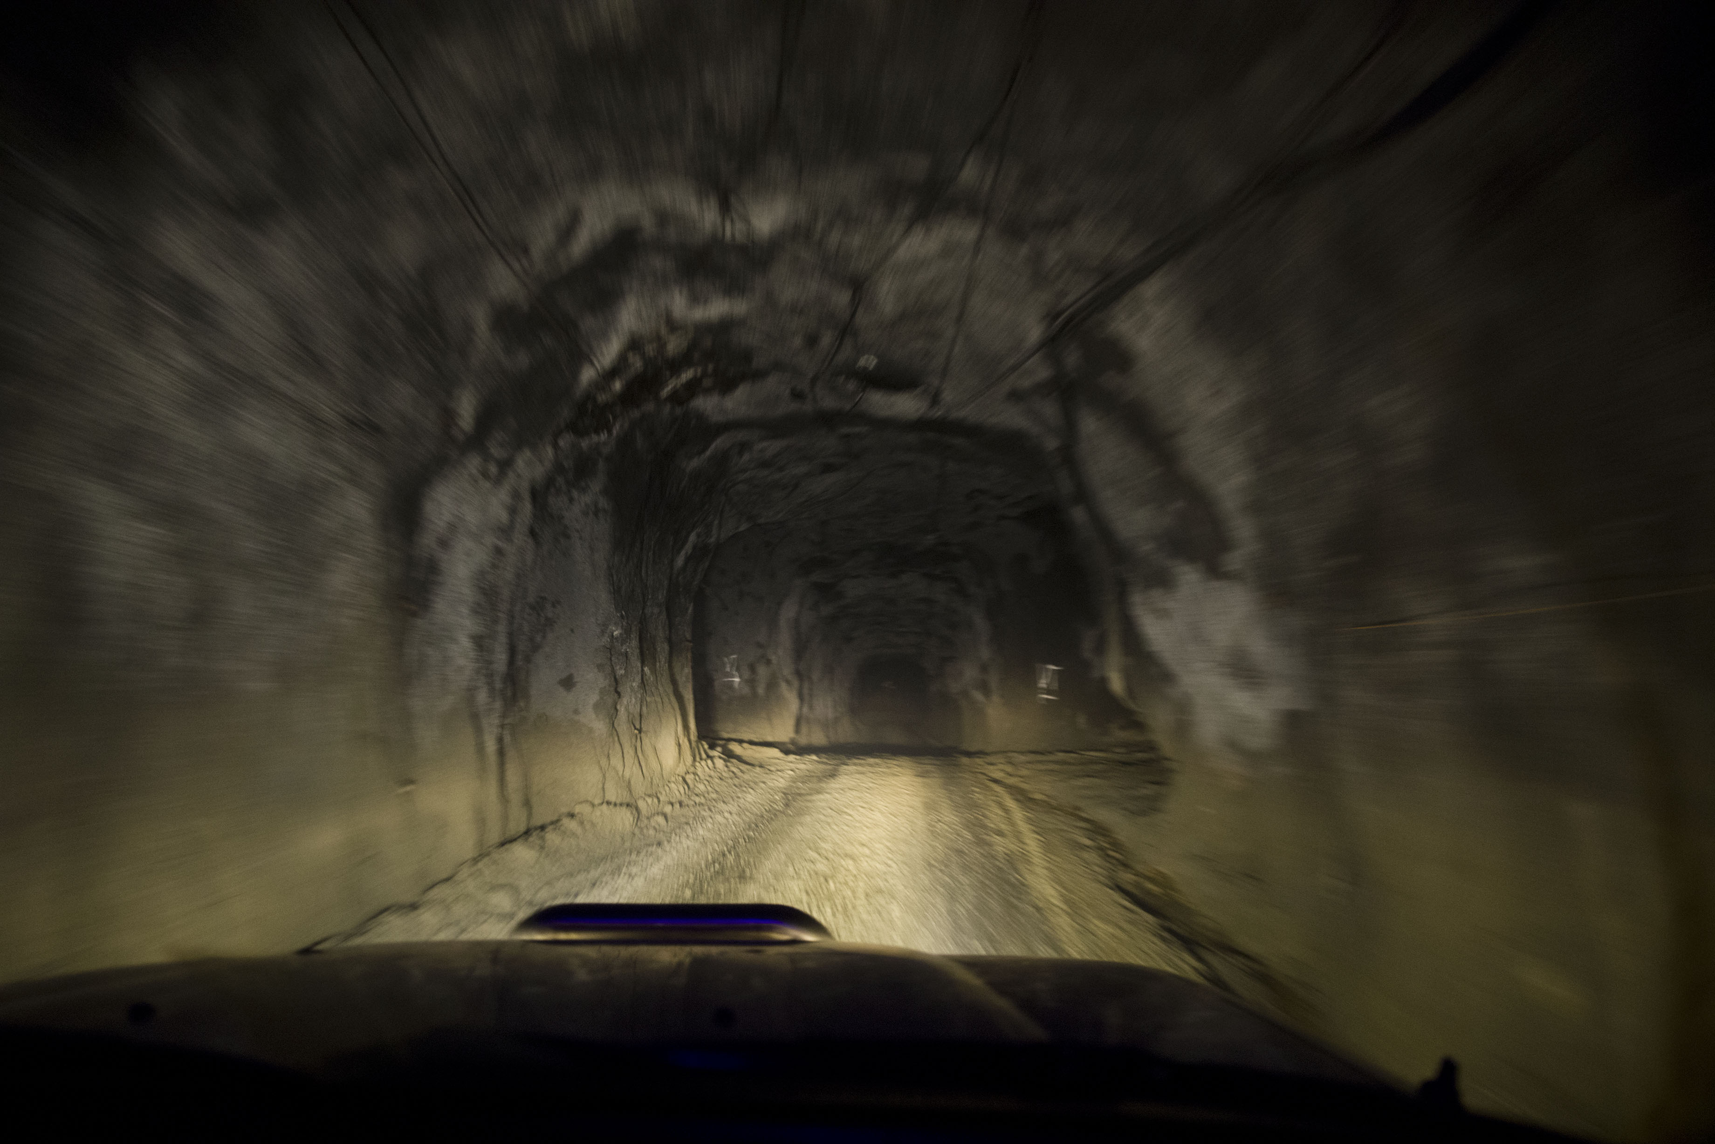
Max slope 1:7

Slide 15
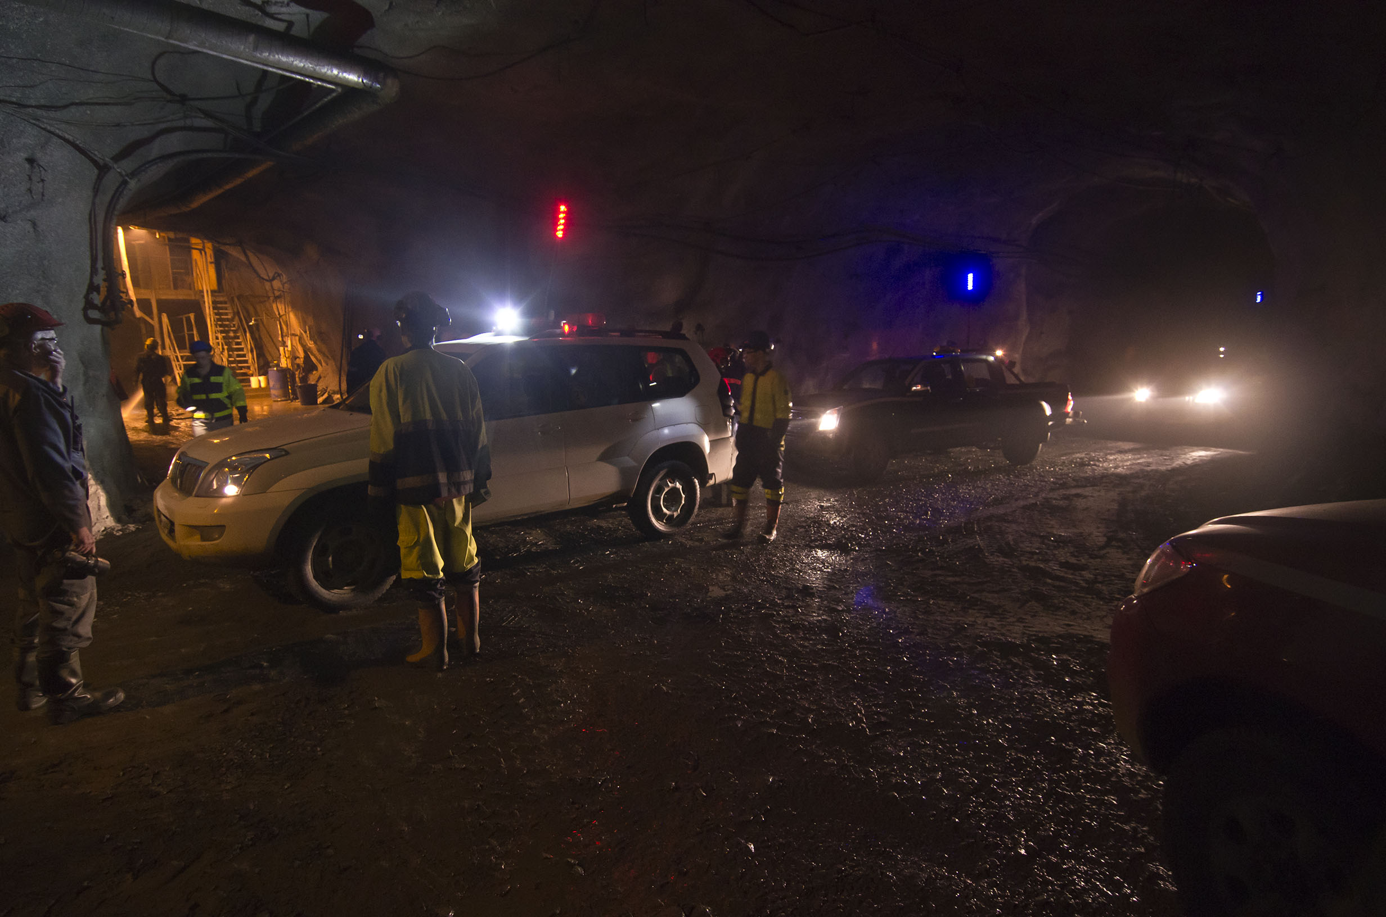
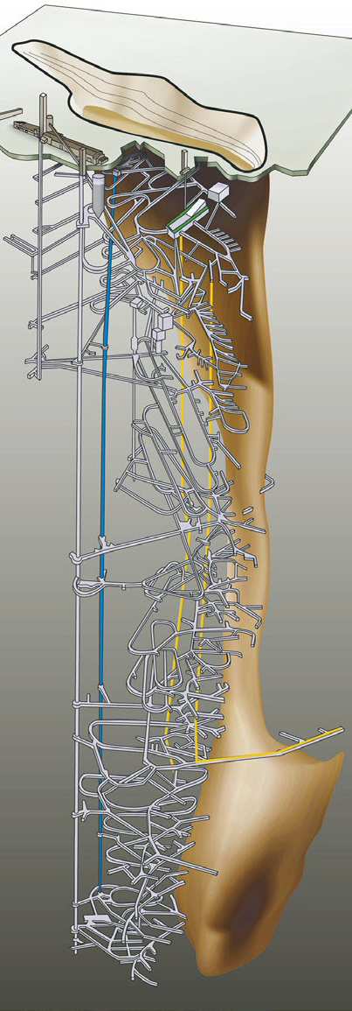

Slide 16
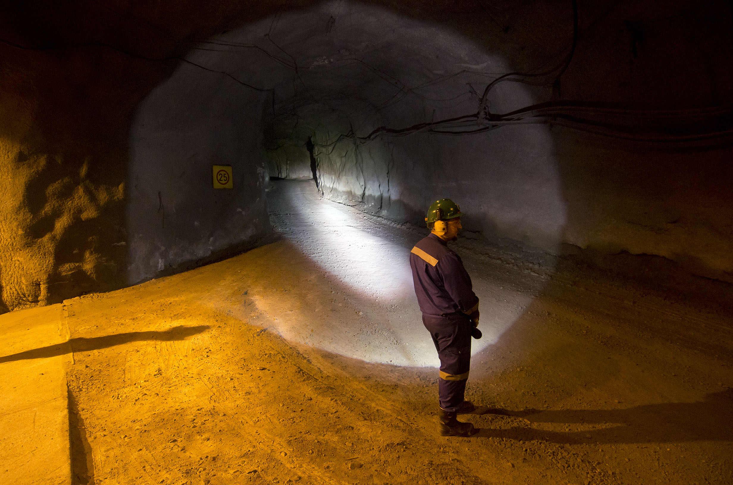
VT (ramp or decline) exit near the bottom level

Slide 17
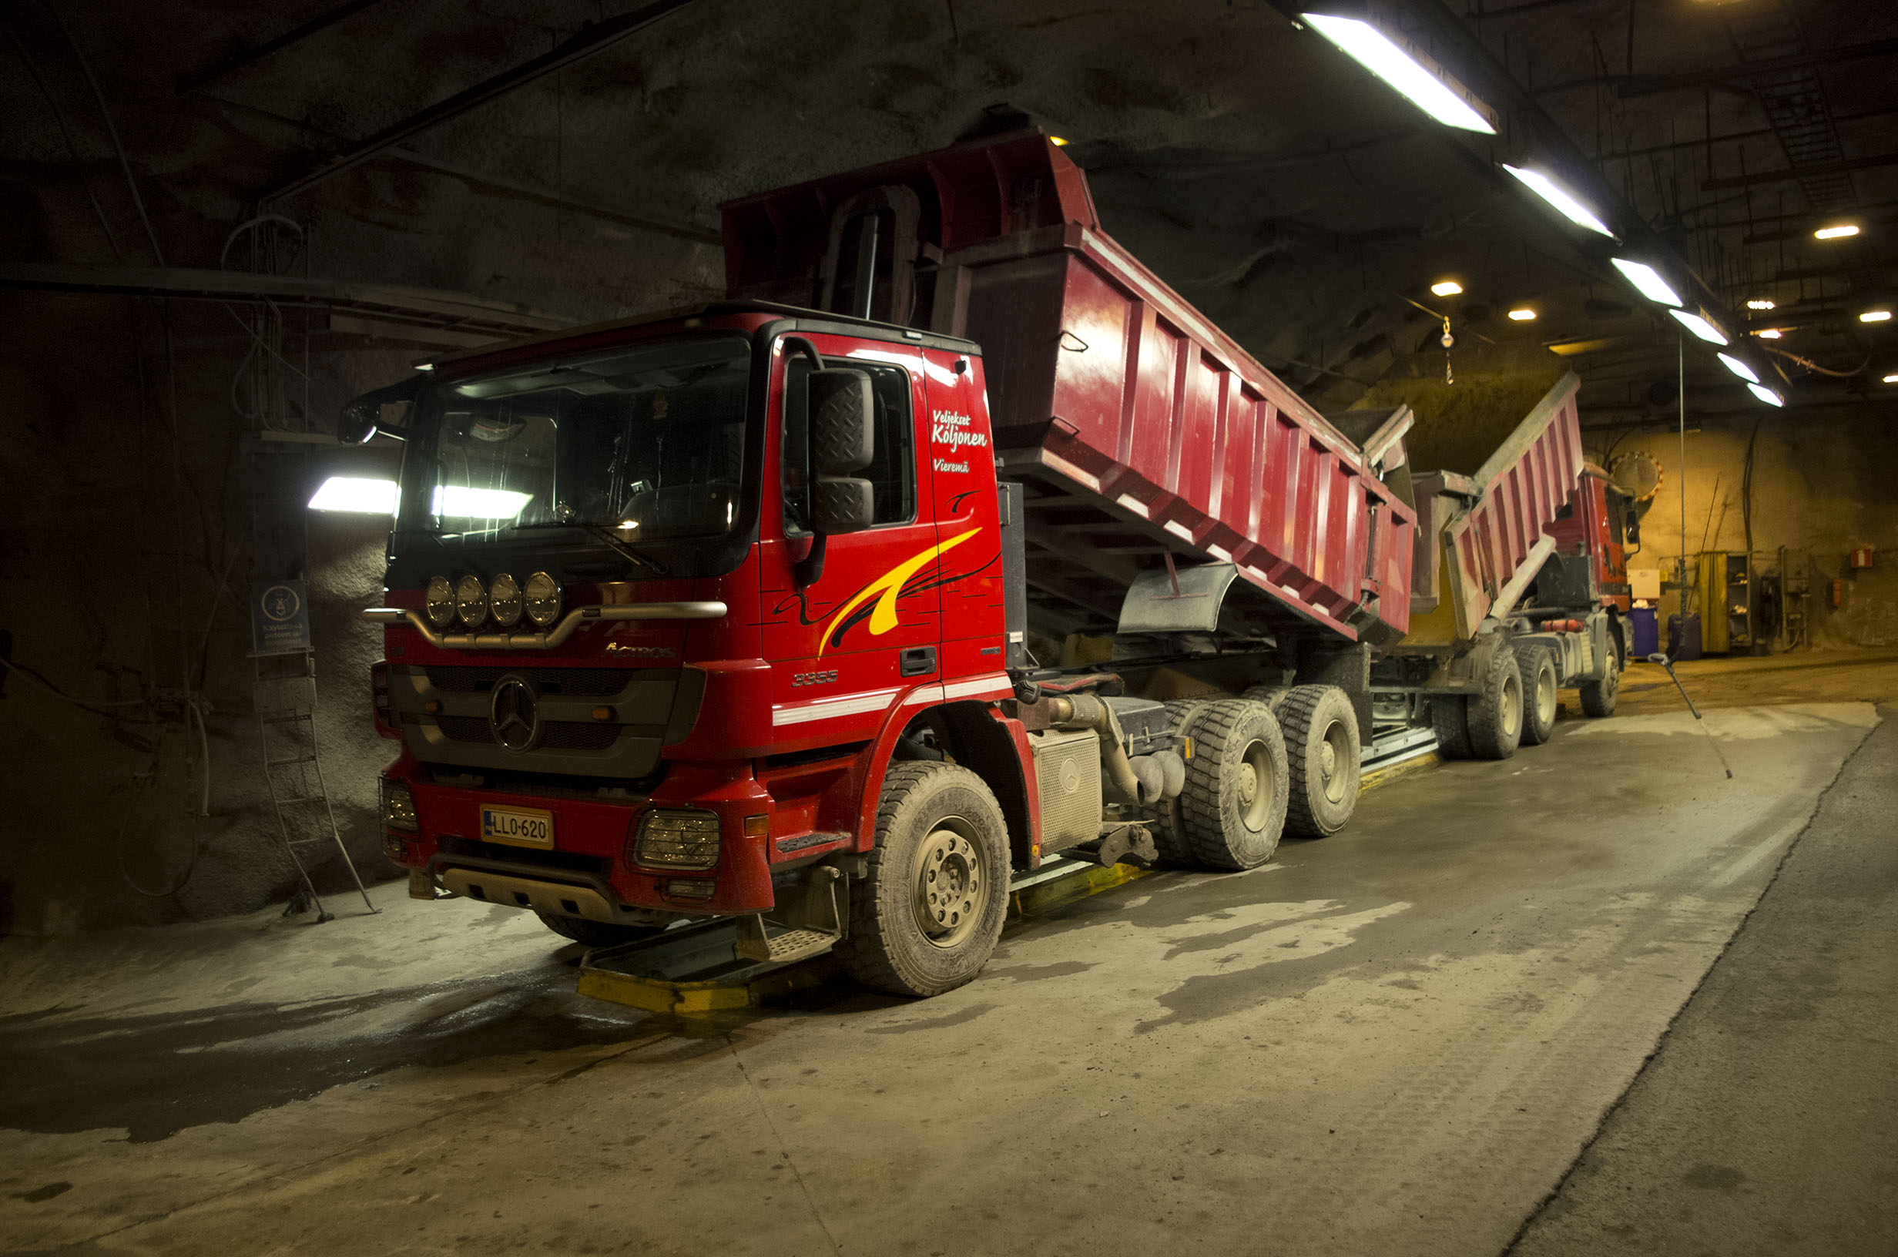

Slide 18
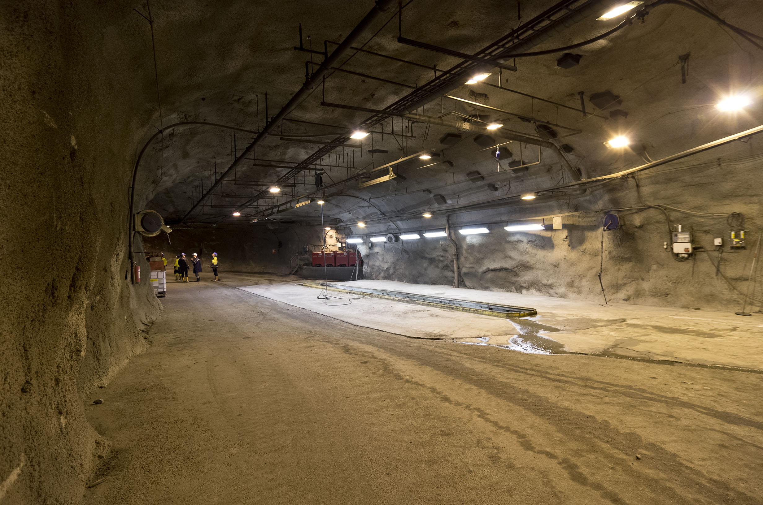

Slide 19
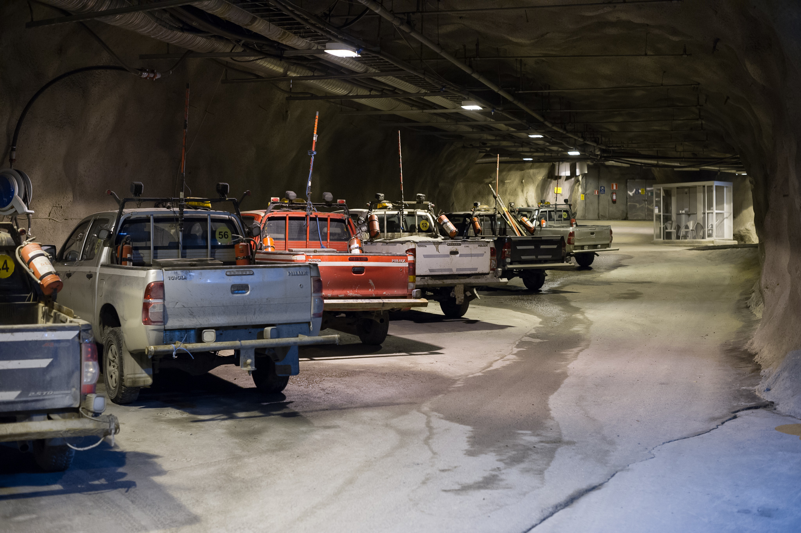

Slide 20
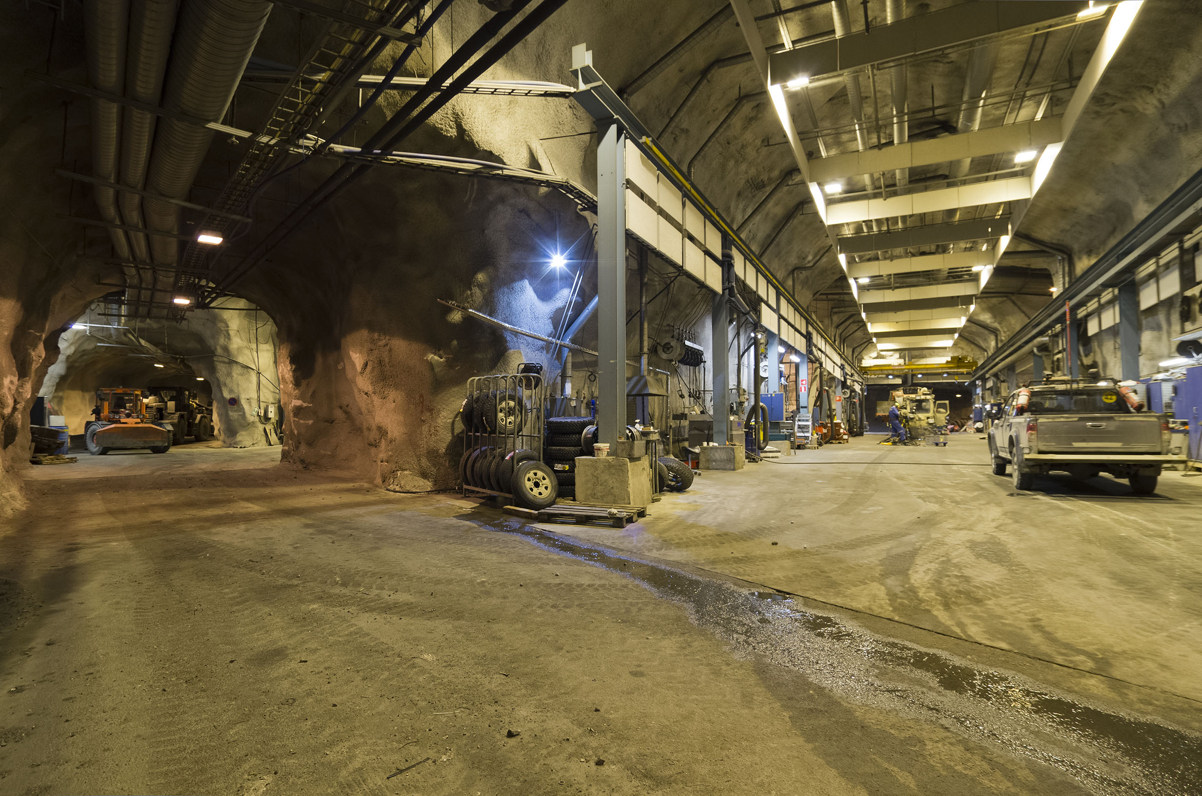

Slide 21
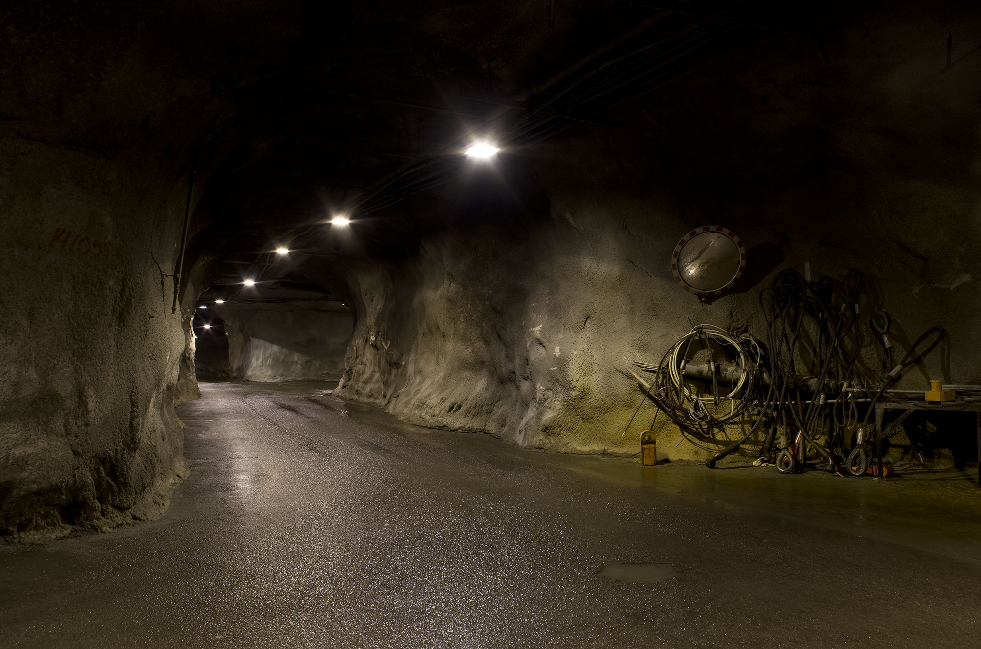

Slide 22
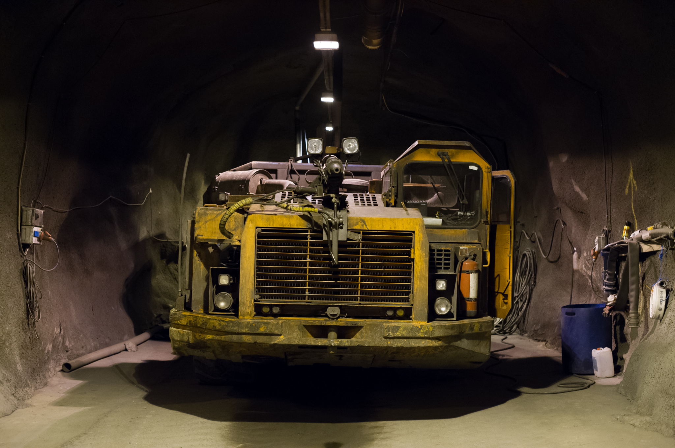

Slide 23
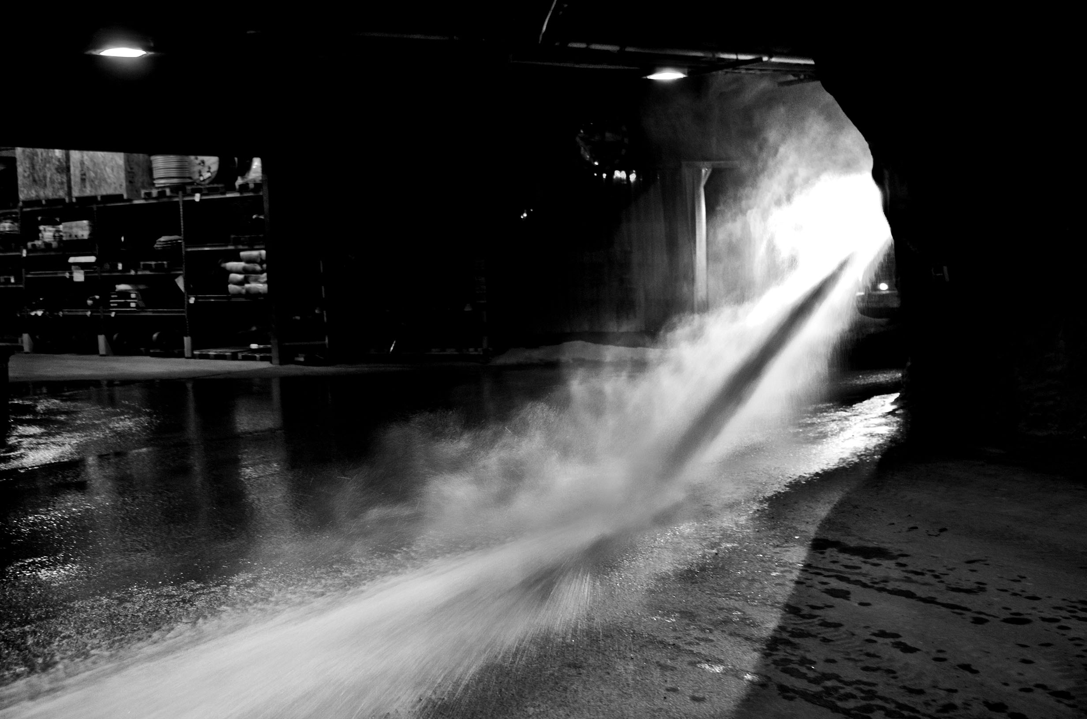

Slide 24
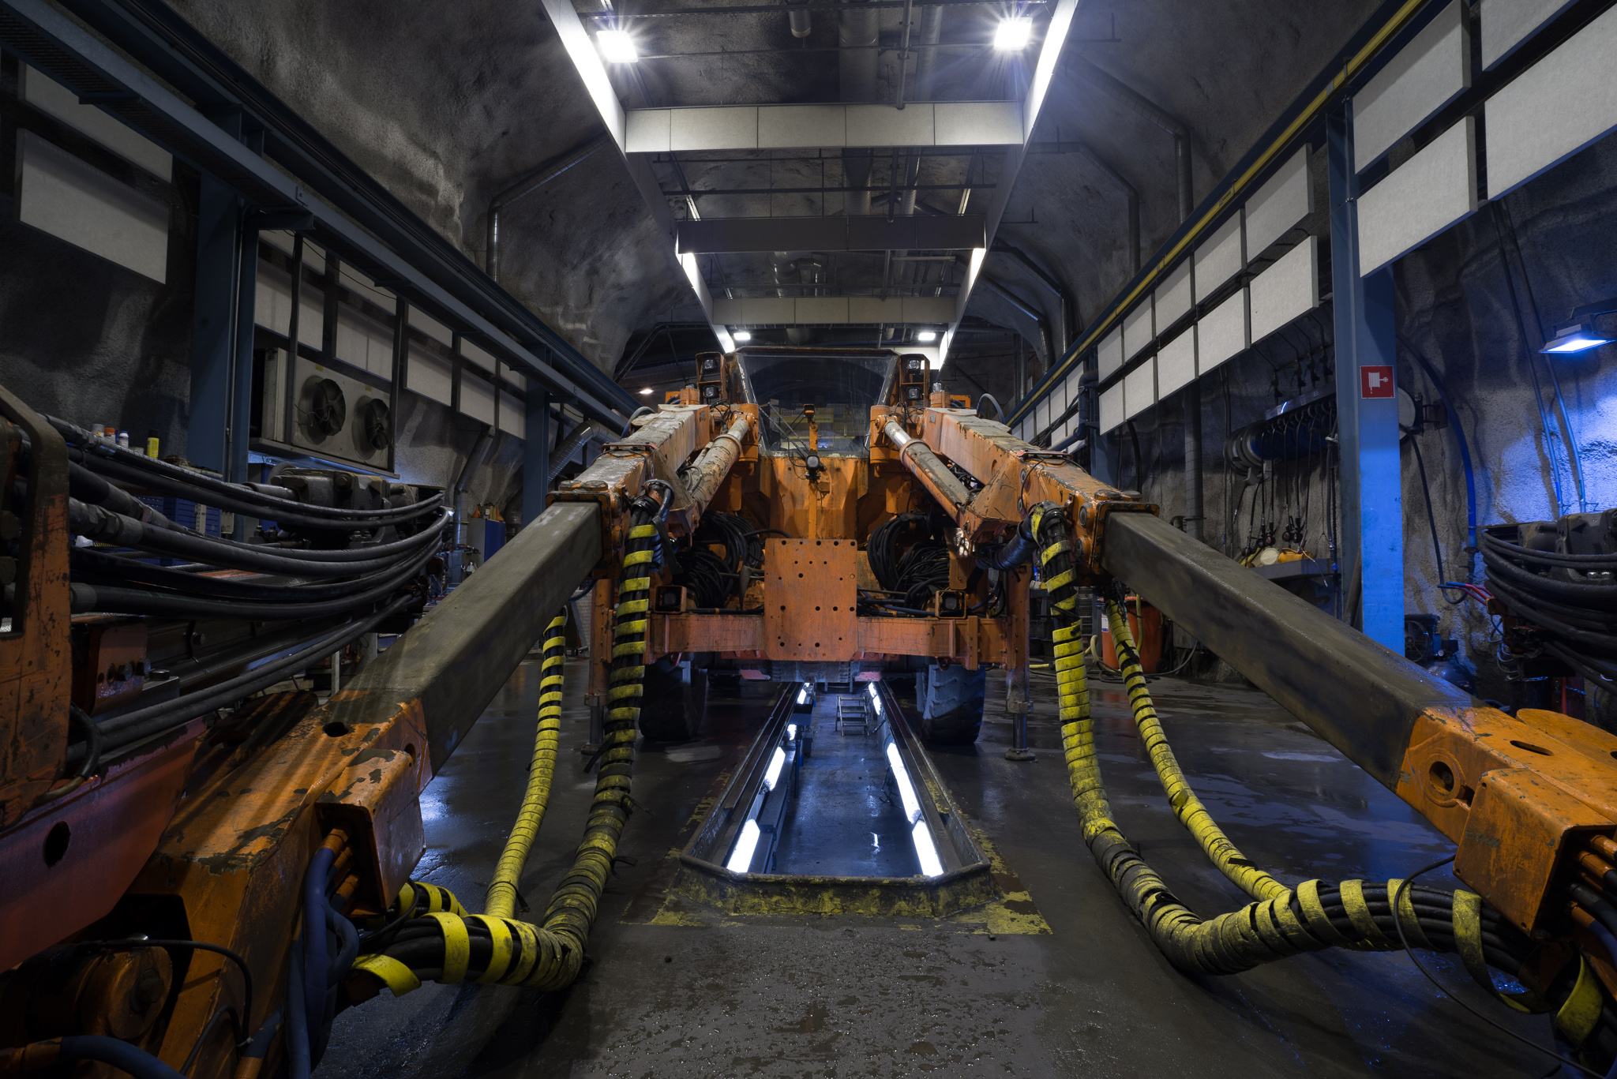

Slide 25
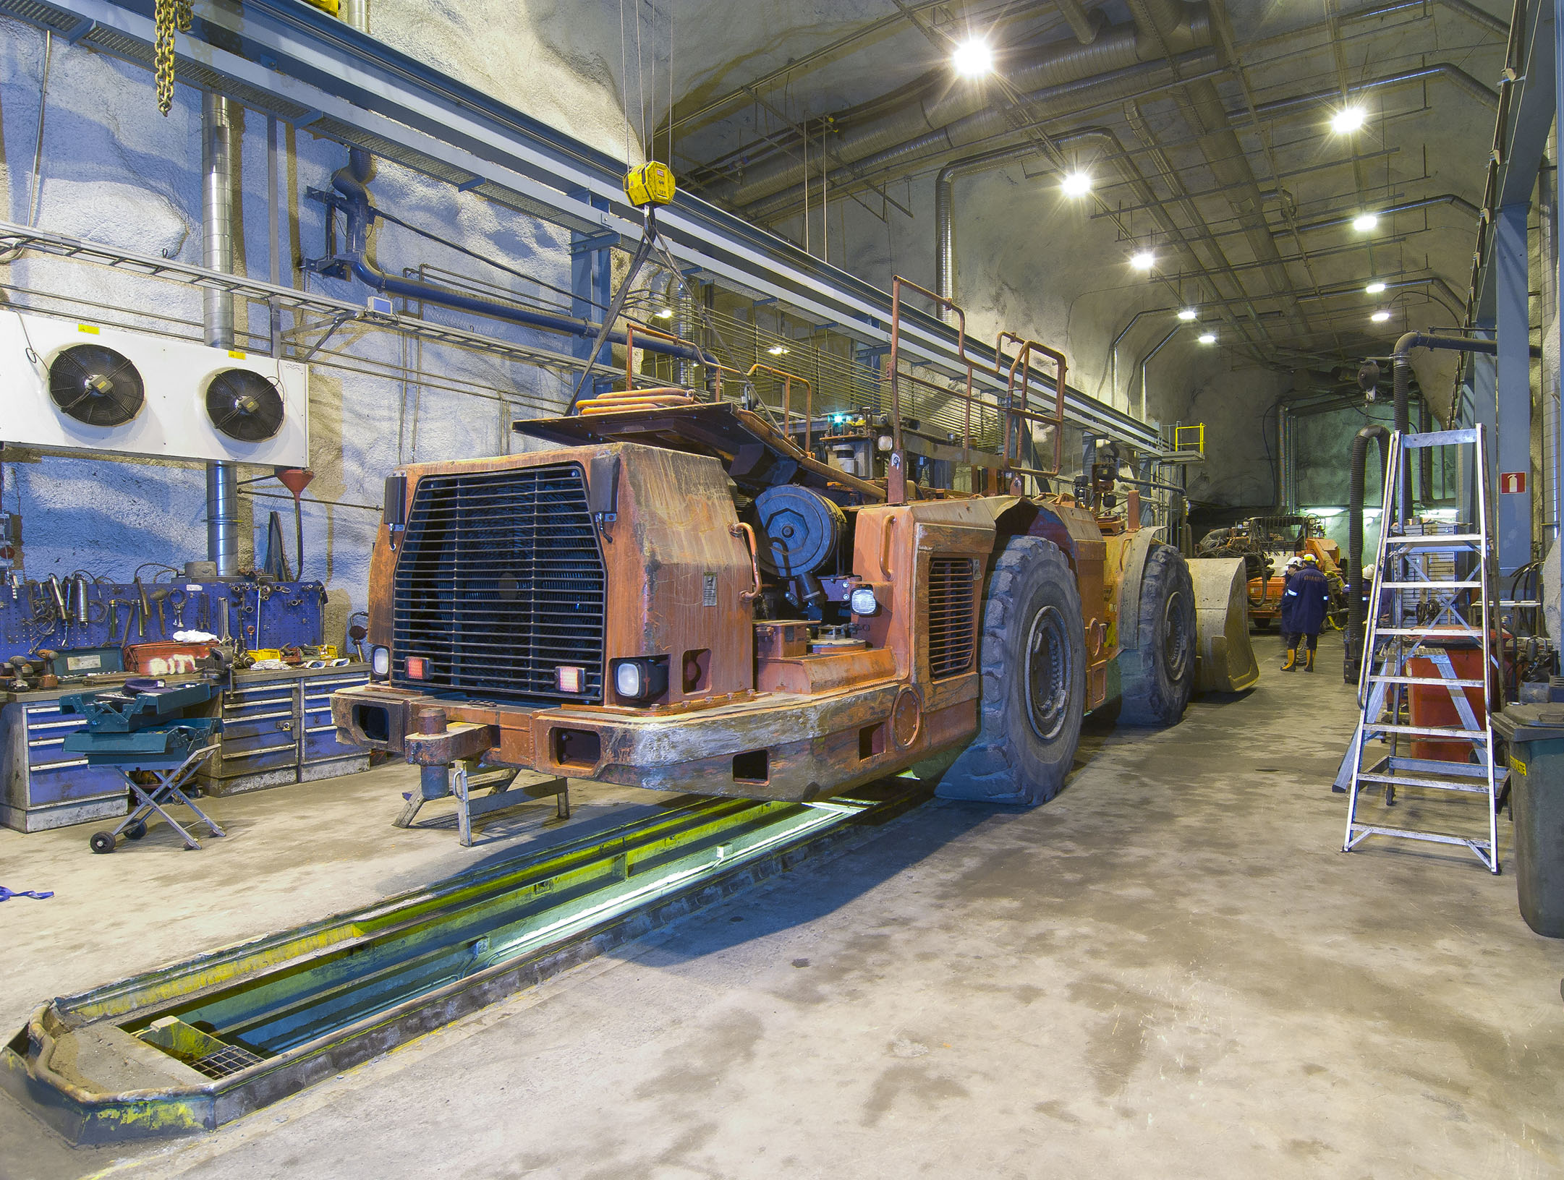

Slide 26
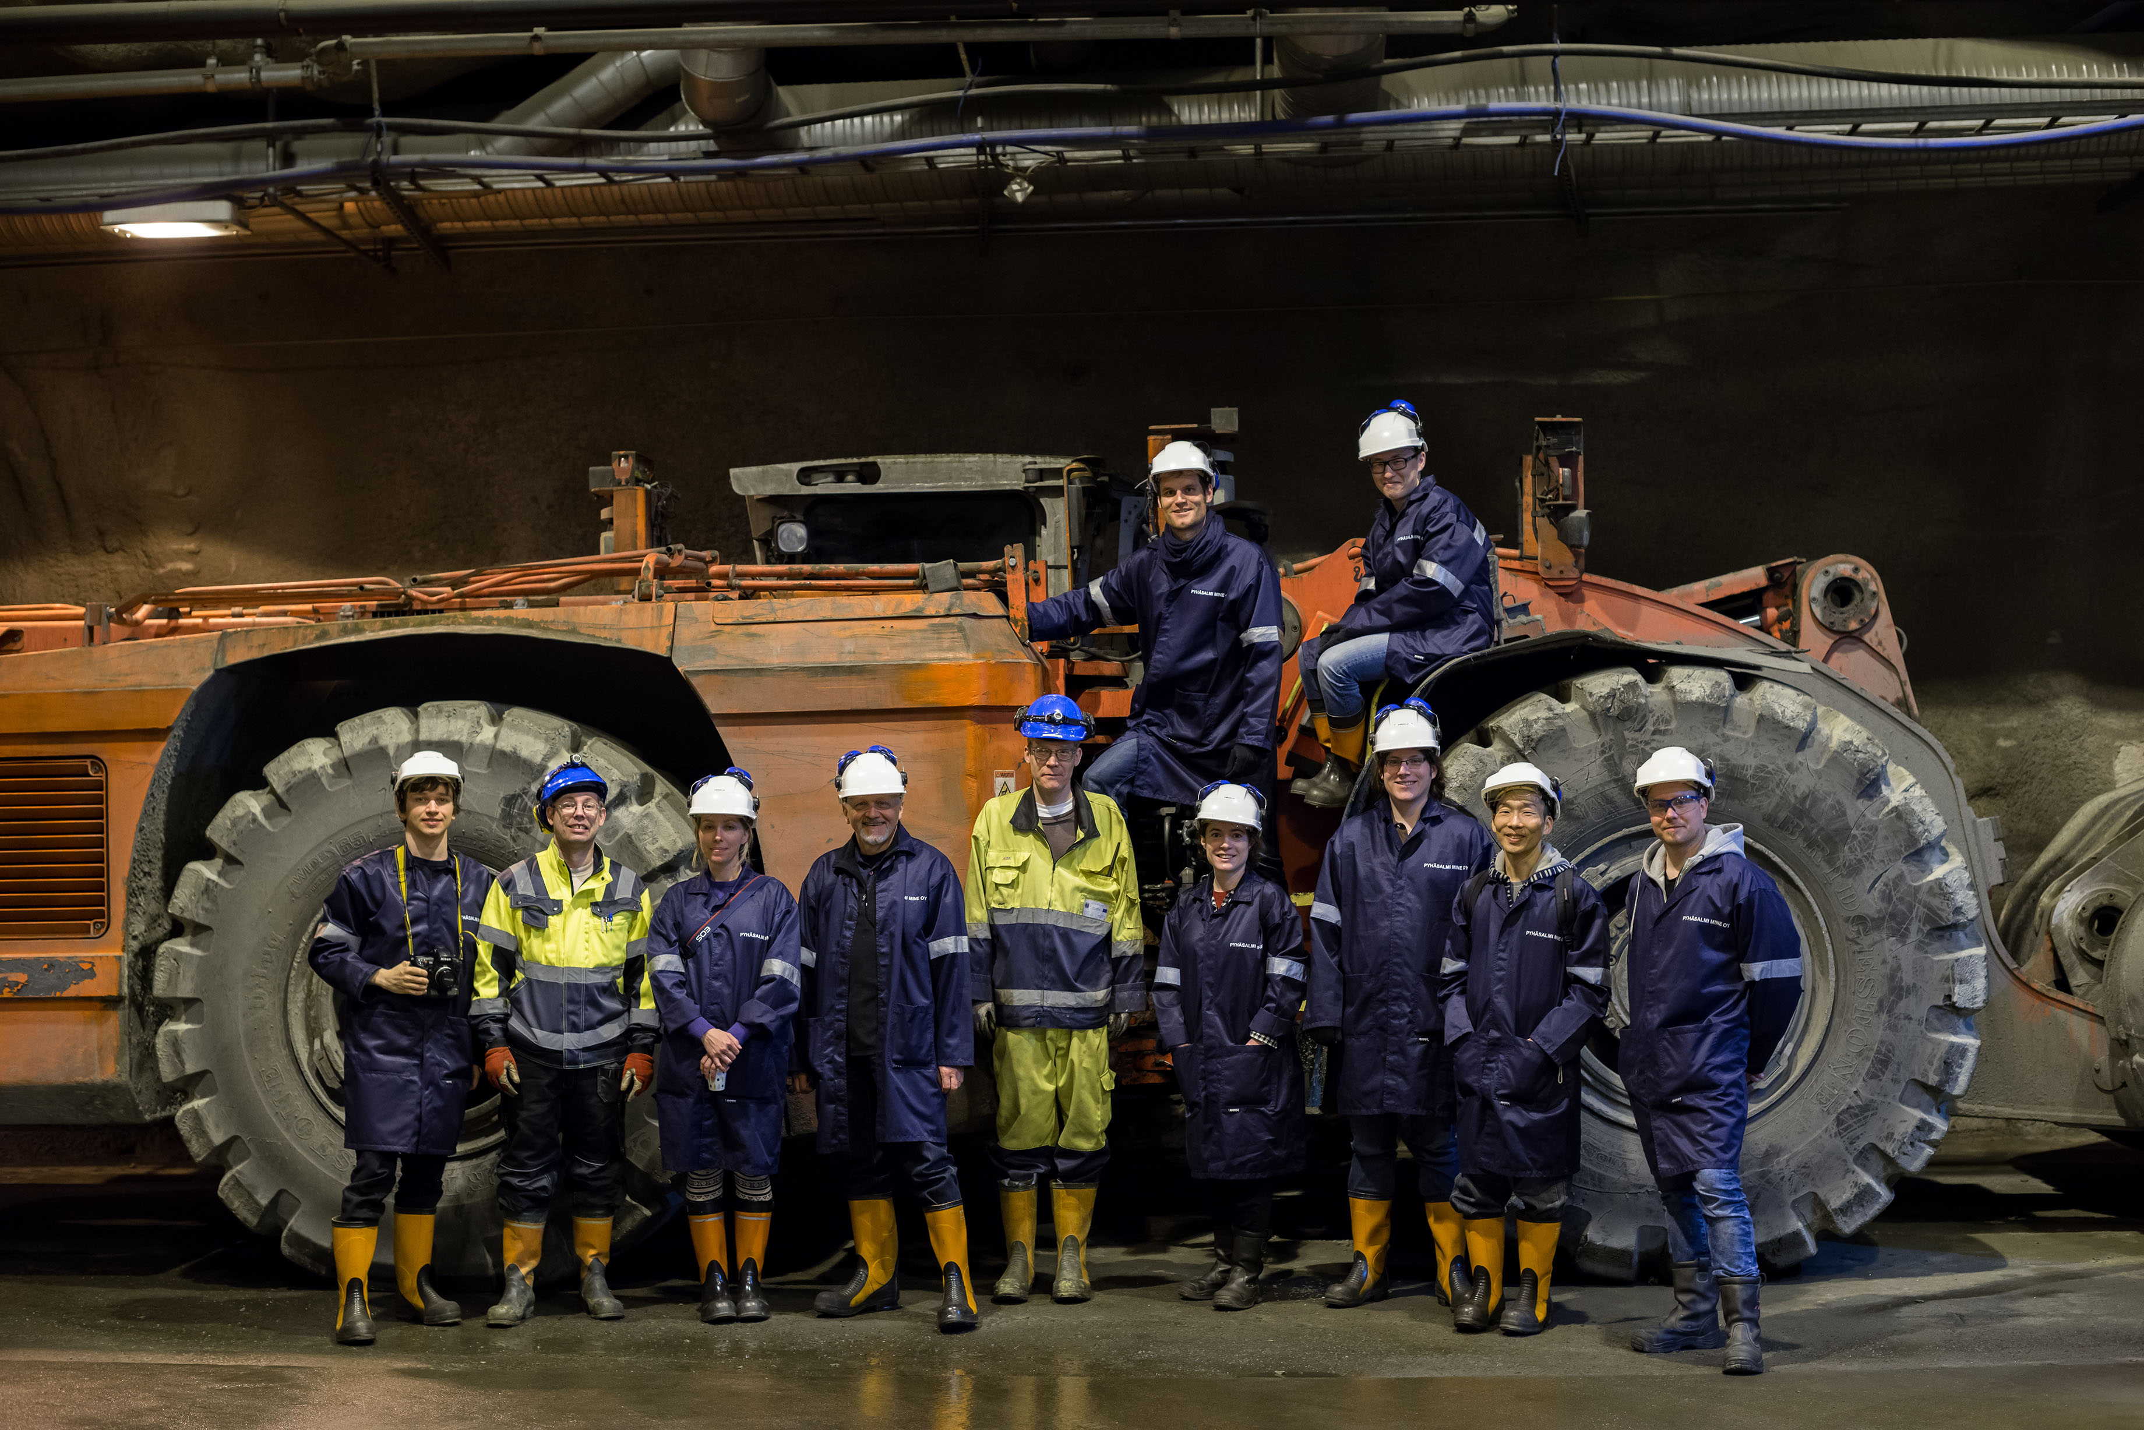


Slide 27
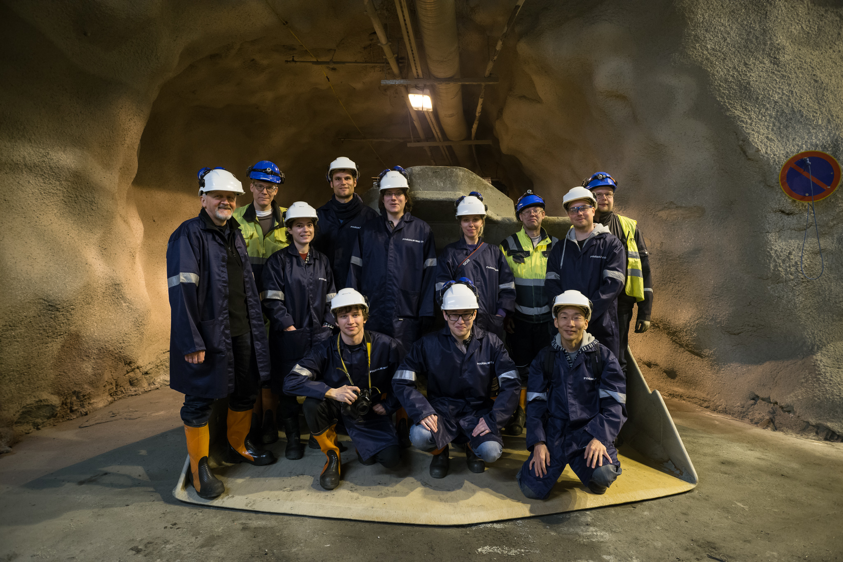

Slide 28
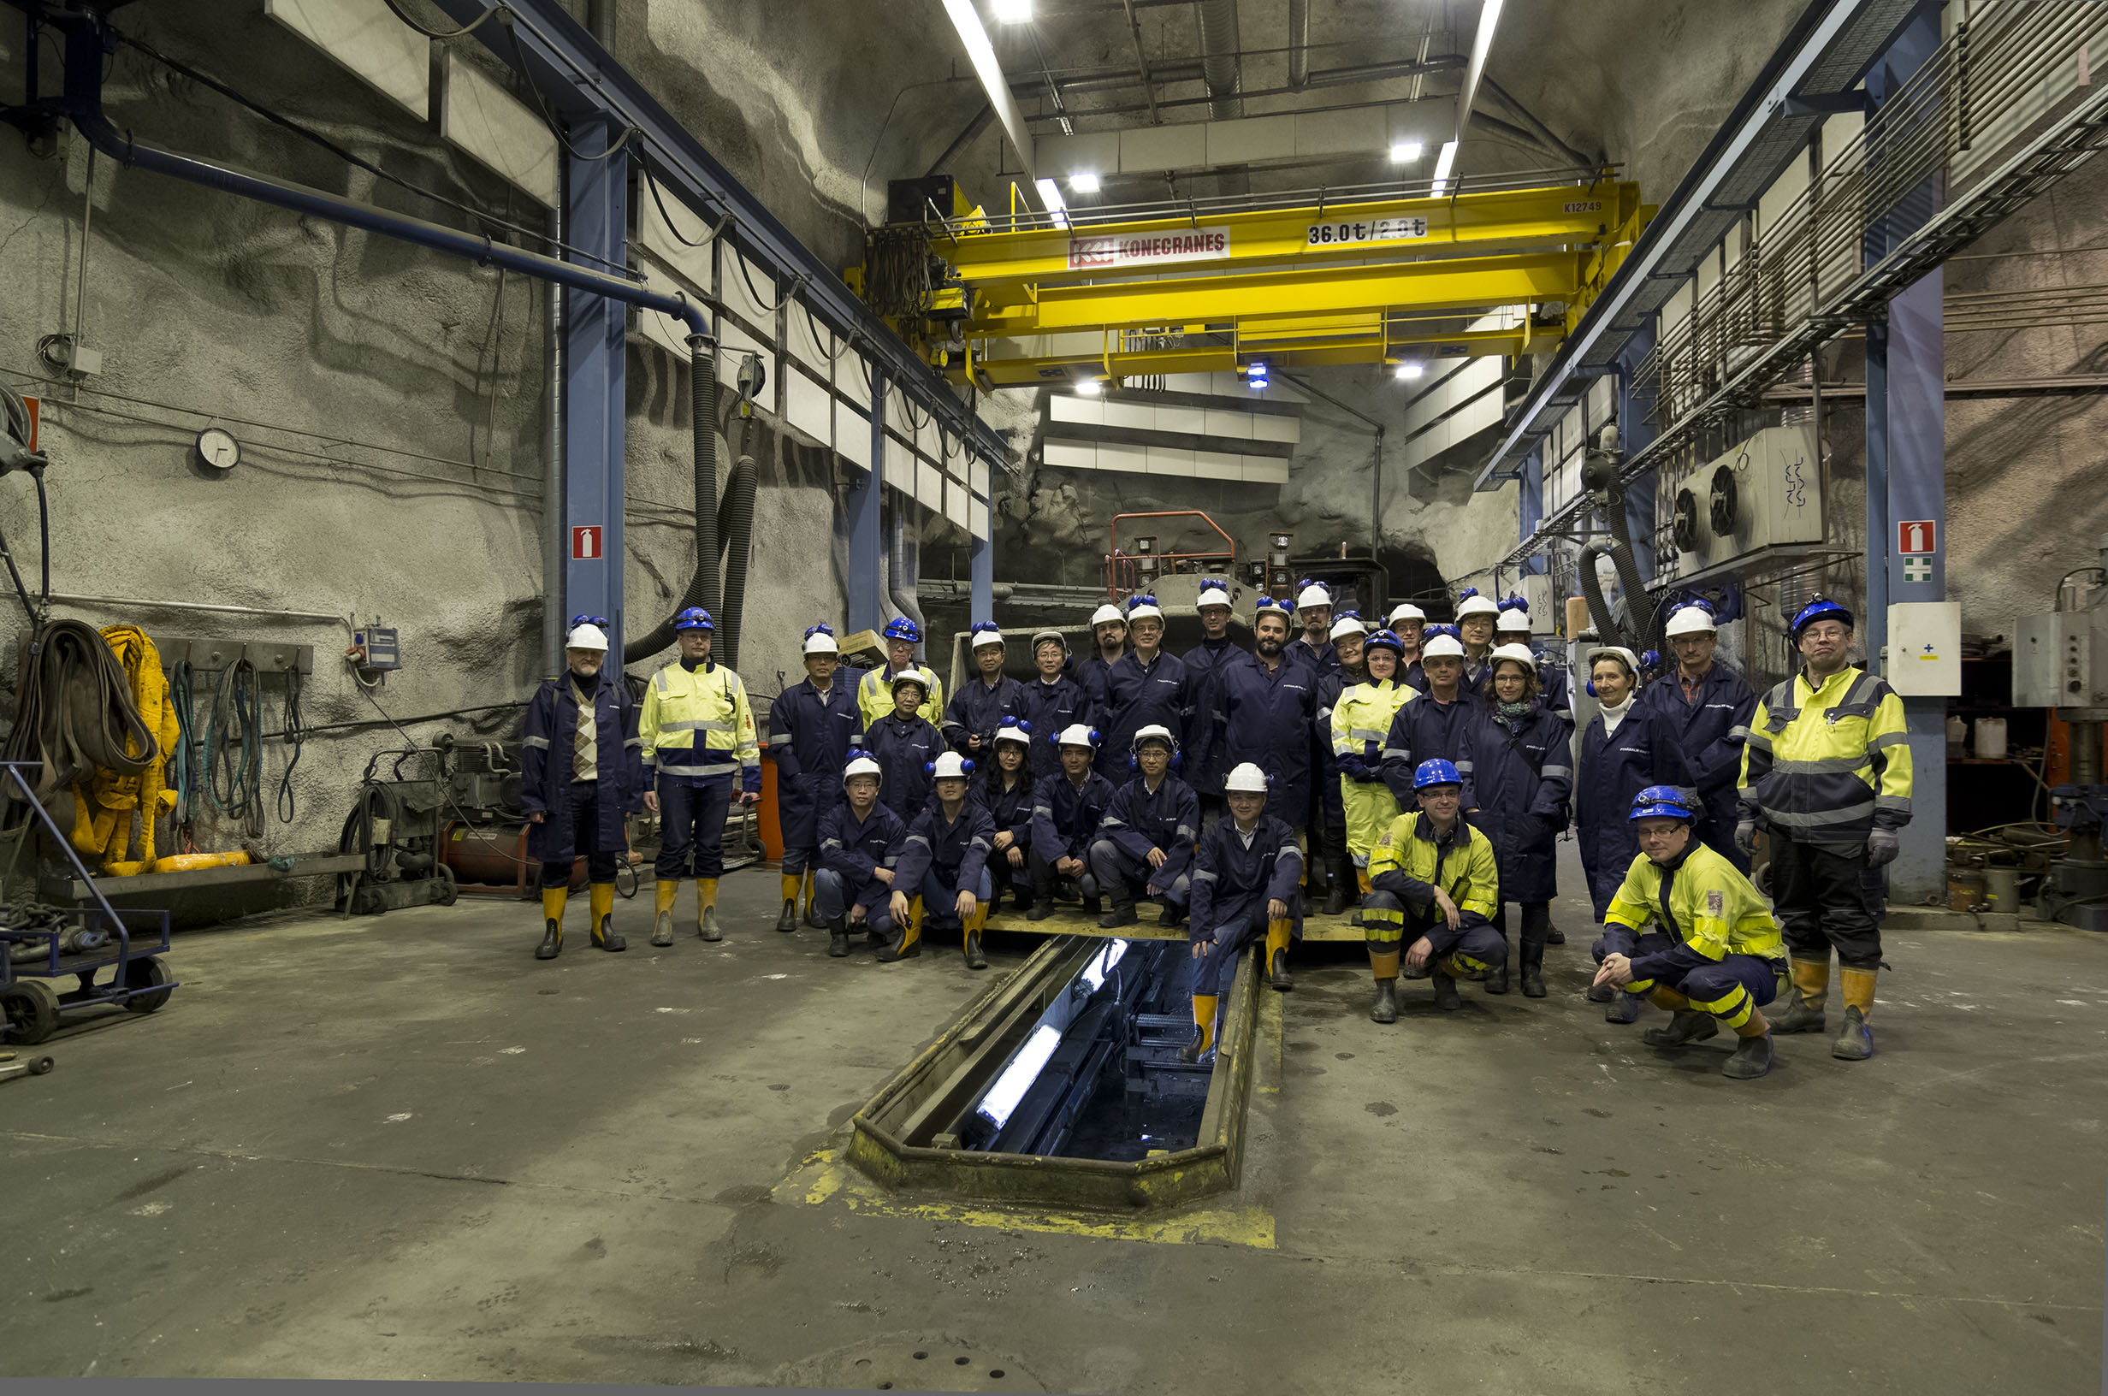

October 2015

Slide 29
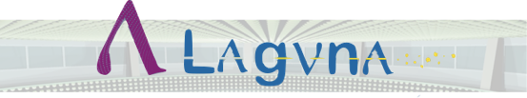
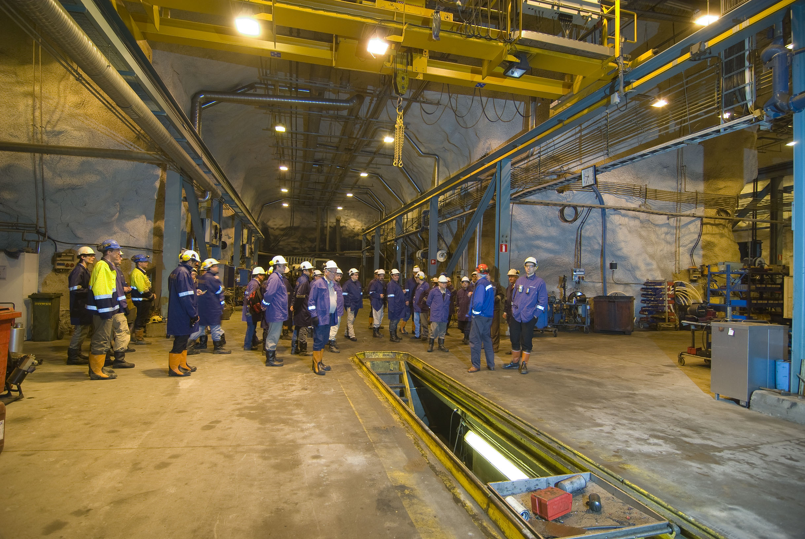

Slide 30
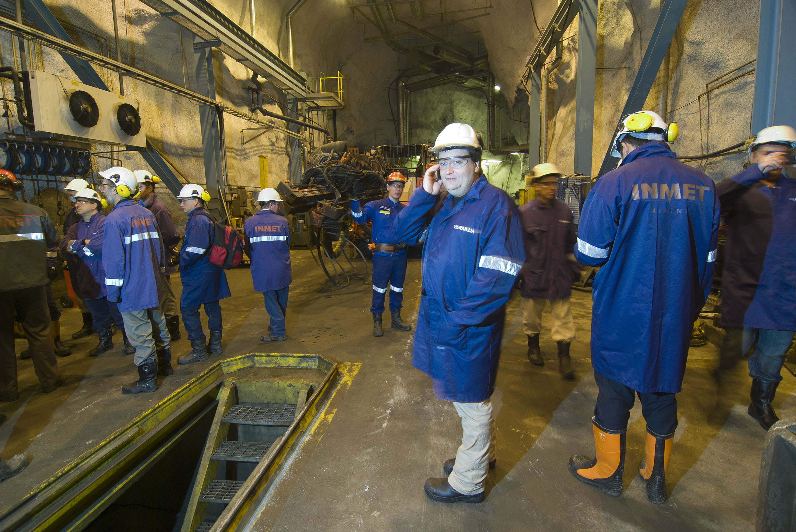

Slide 31
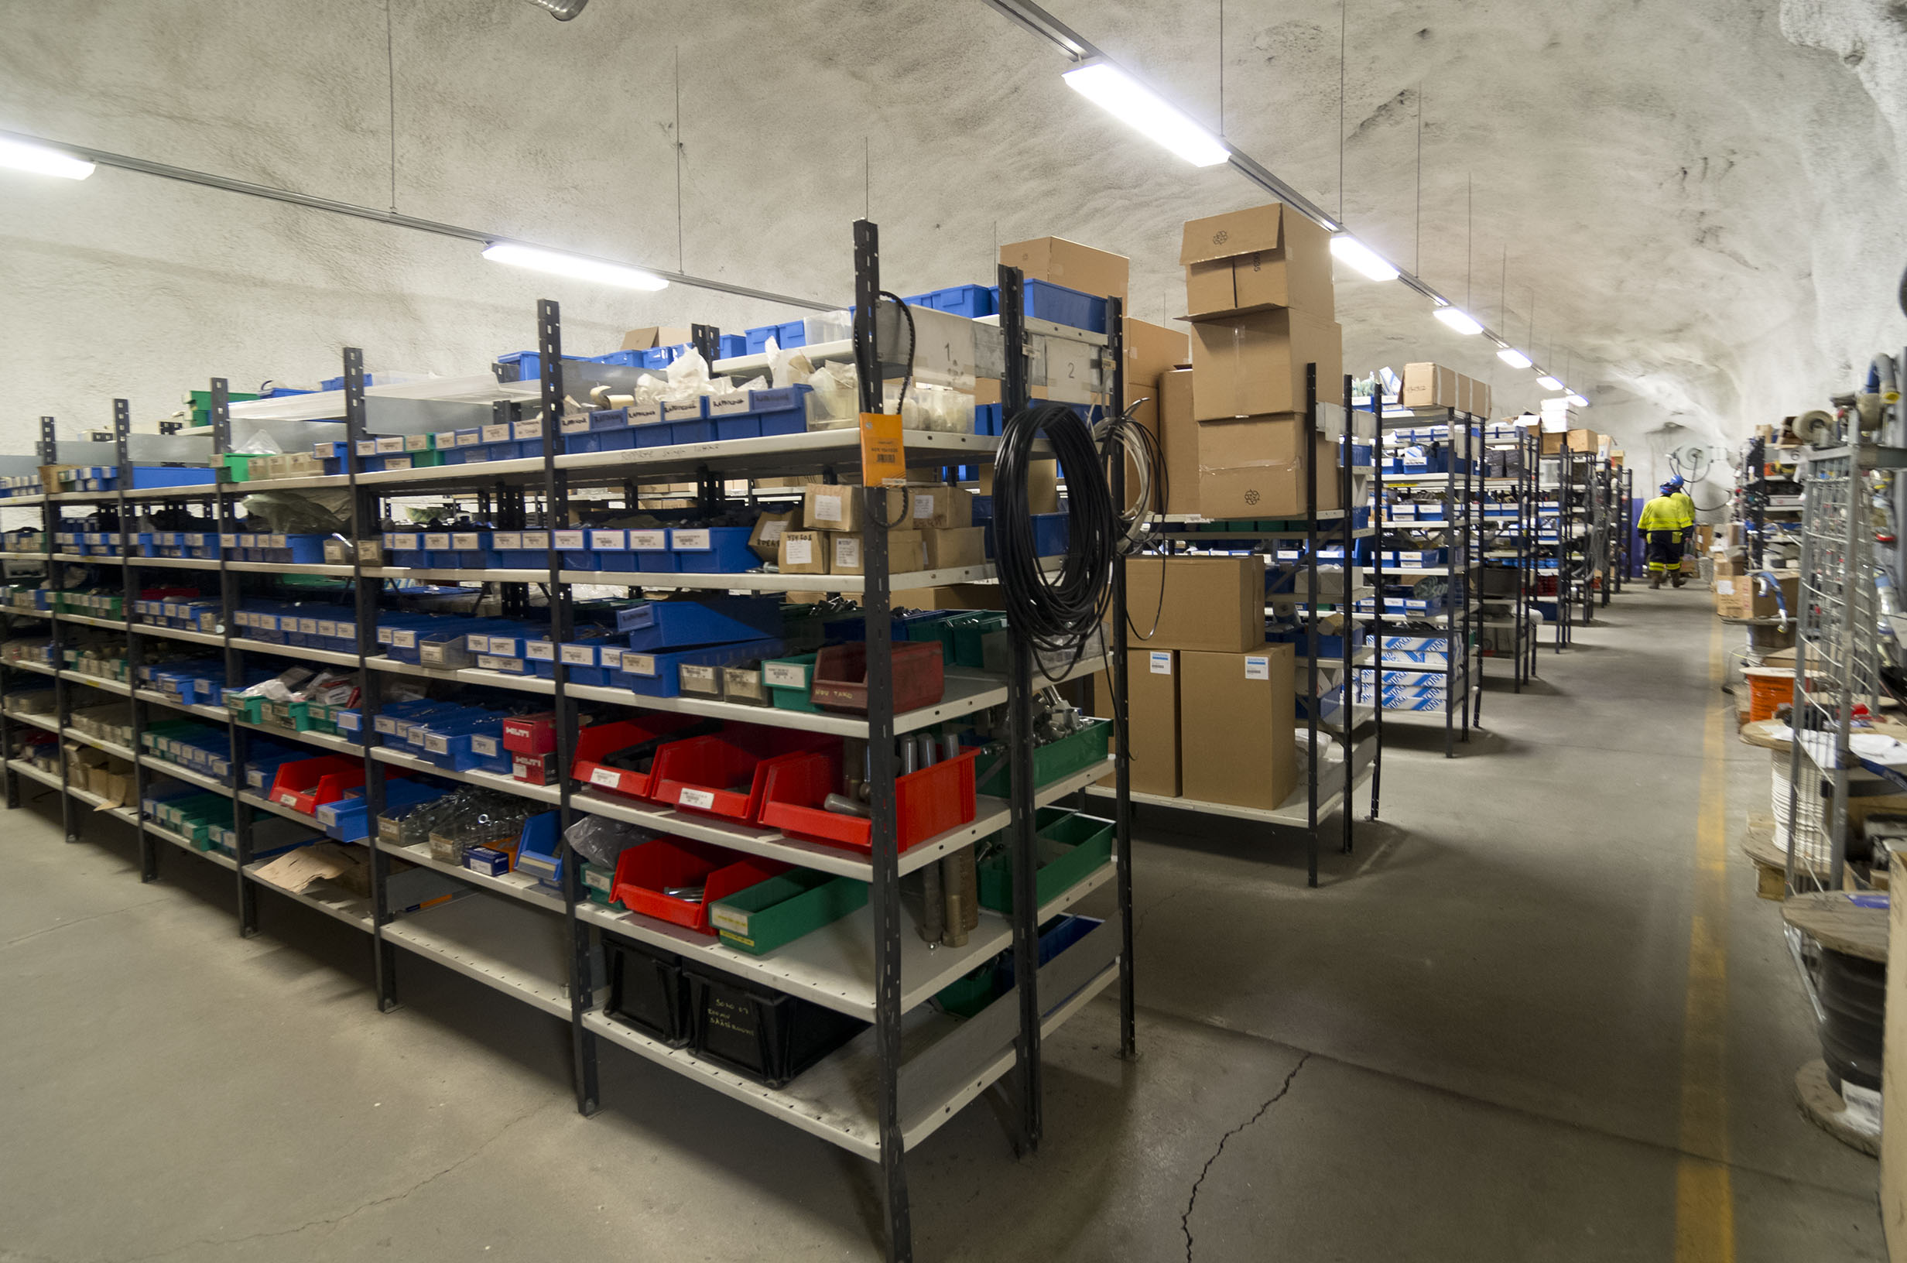

Slide 32
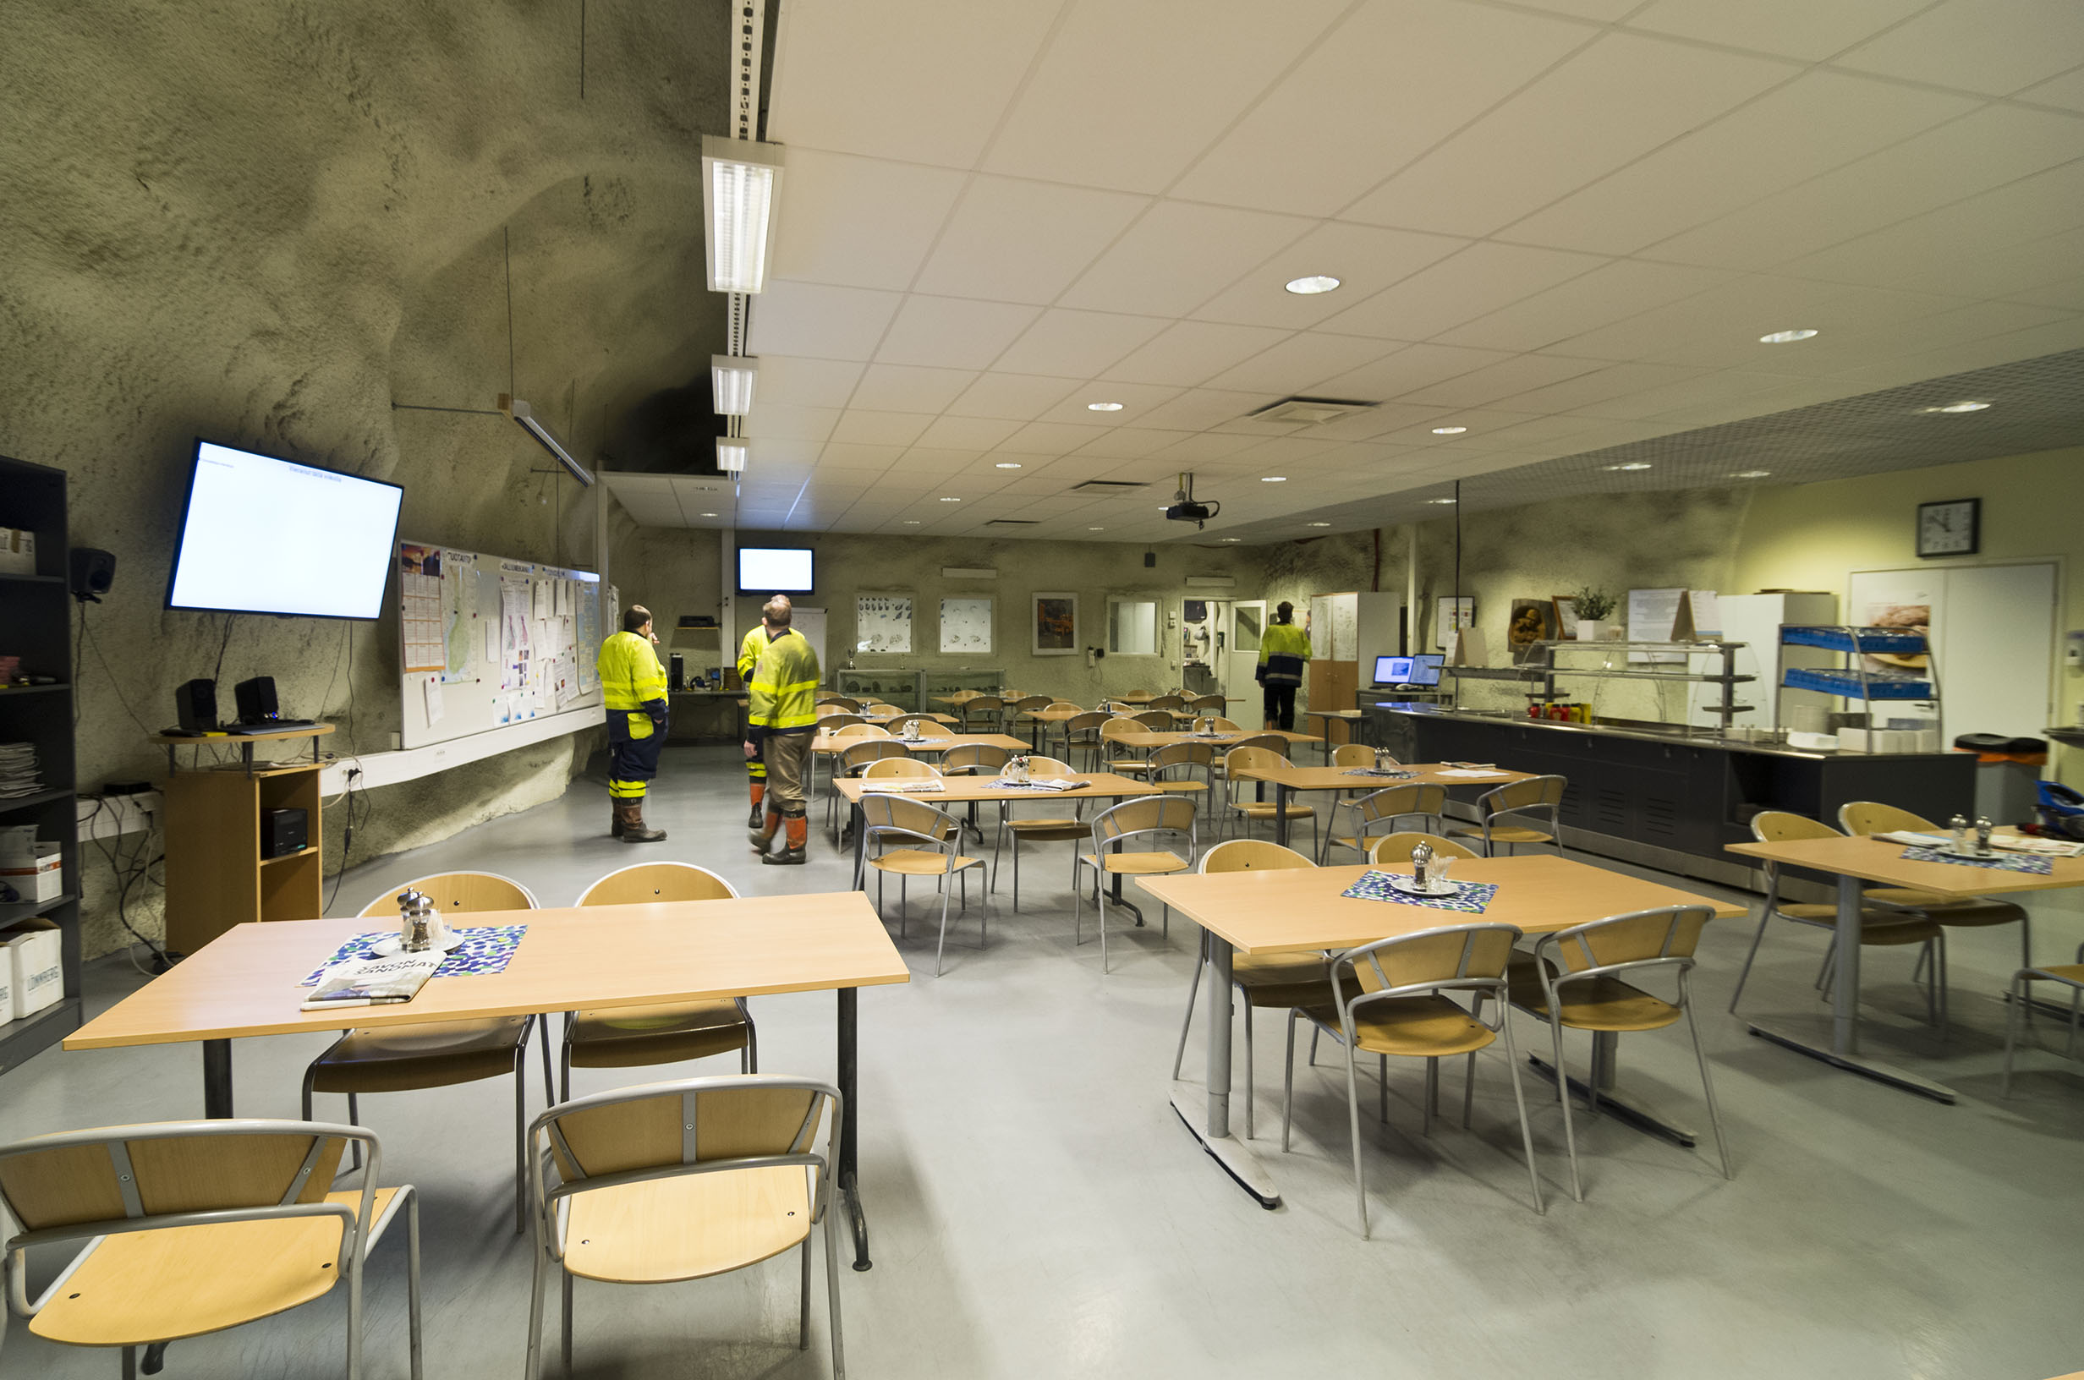

Slide 33
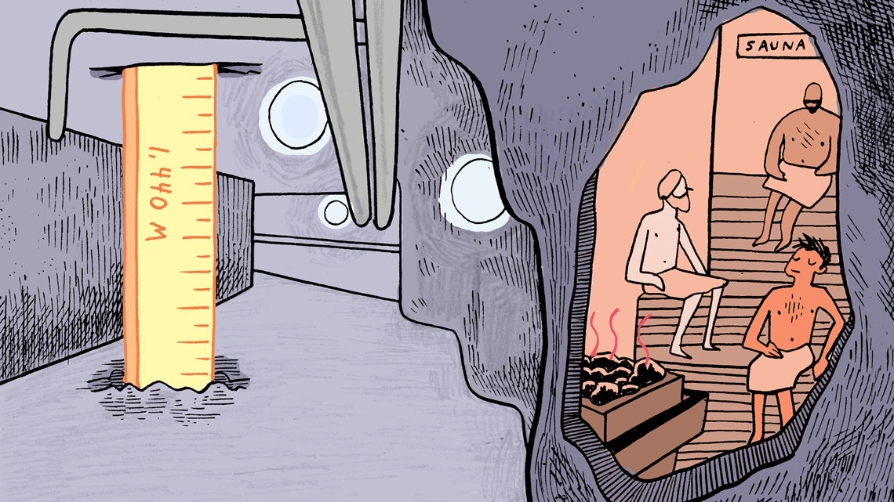

Illustration by Sandbox Studio, Chicago with Corinne Mucha

Slide 34
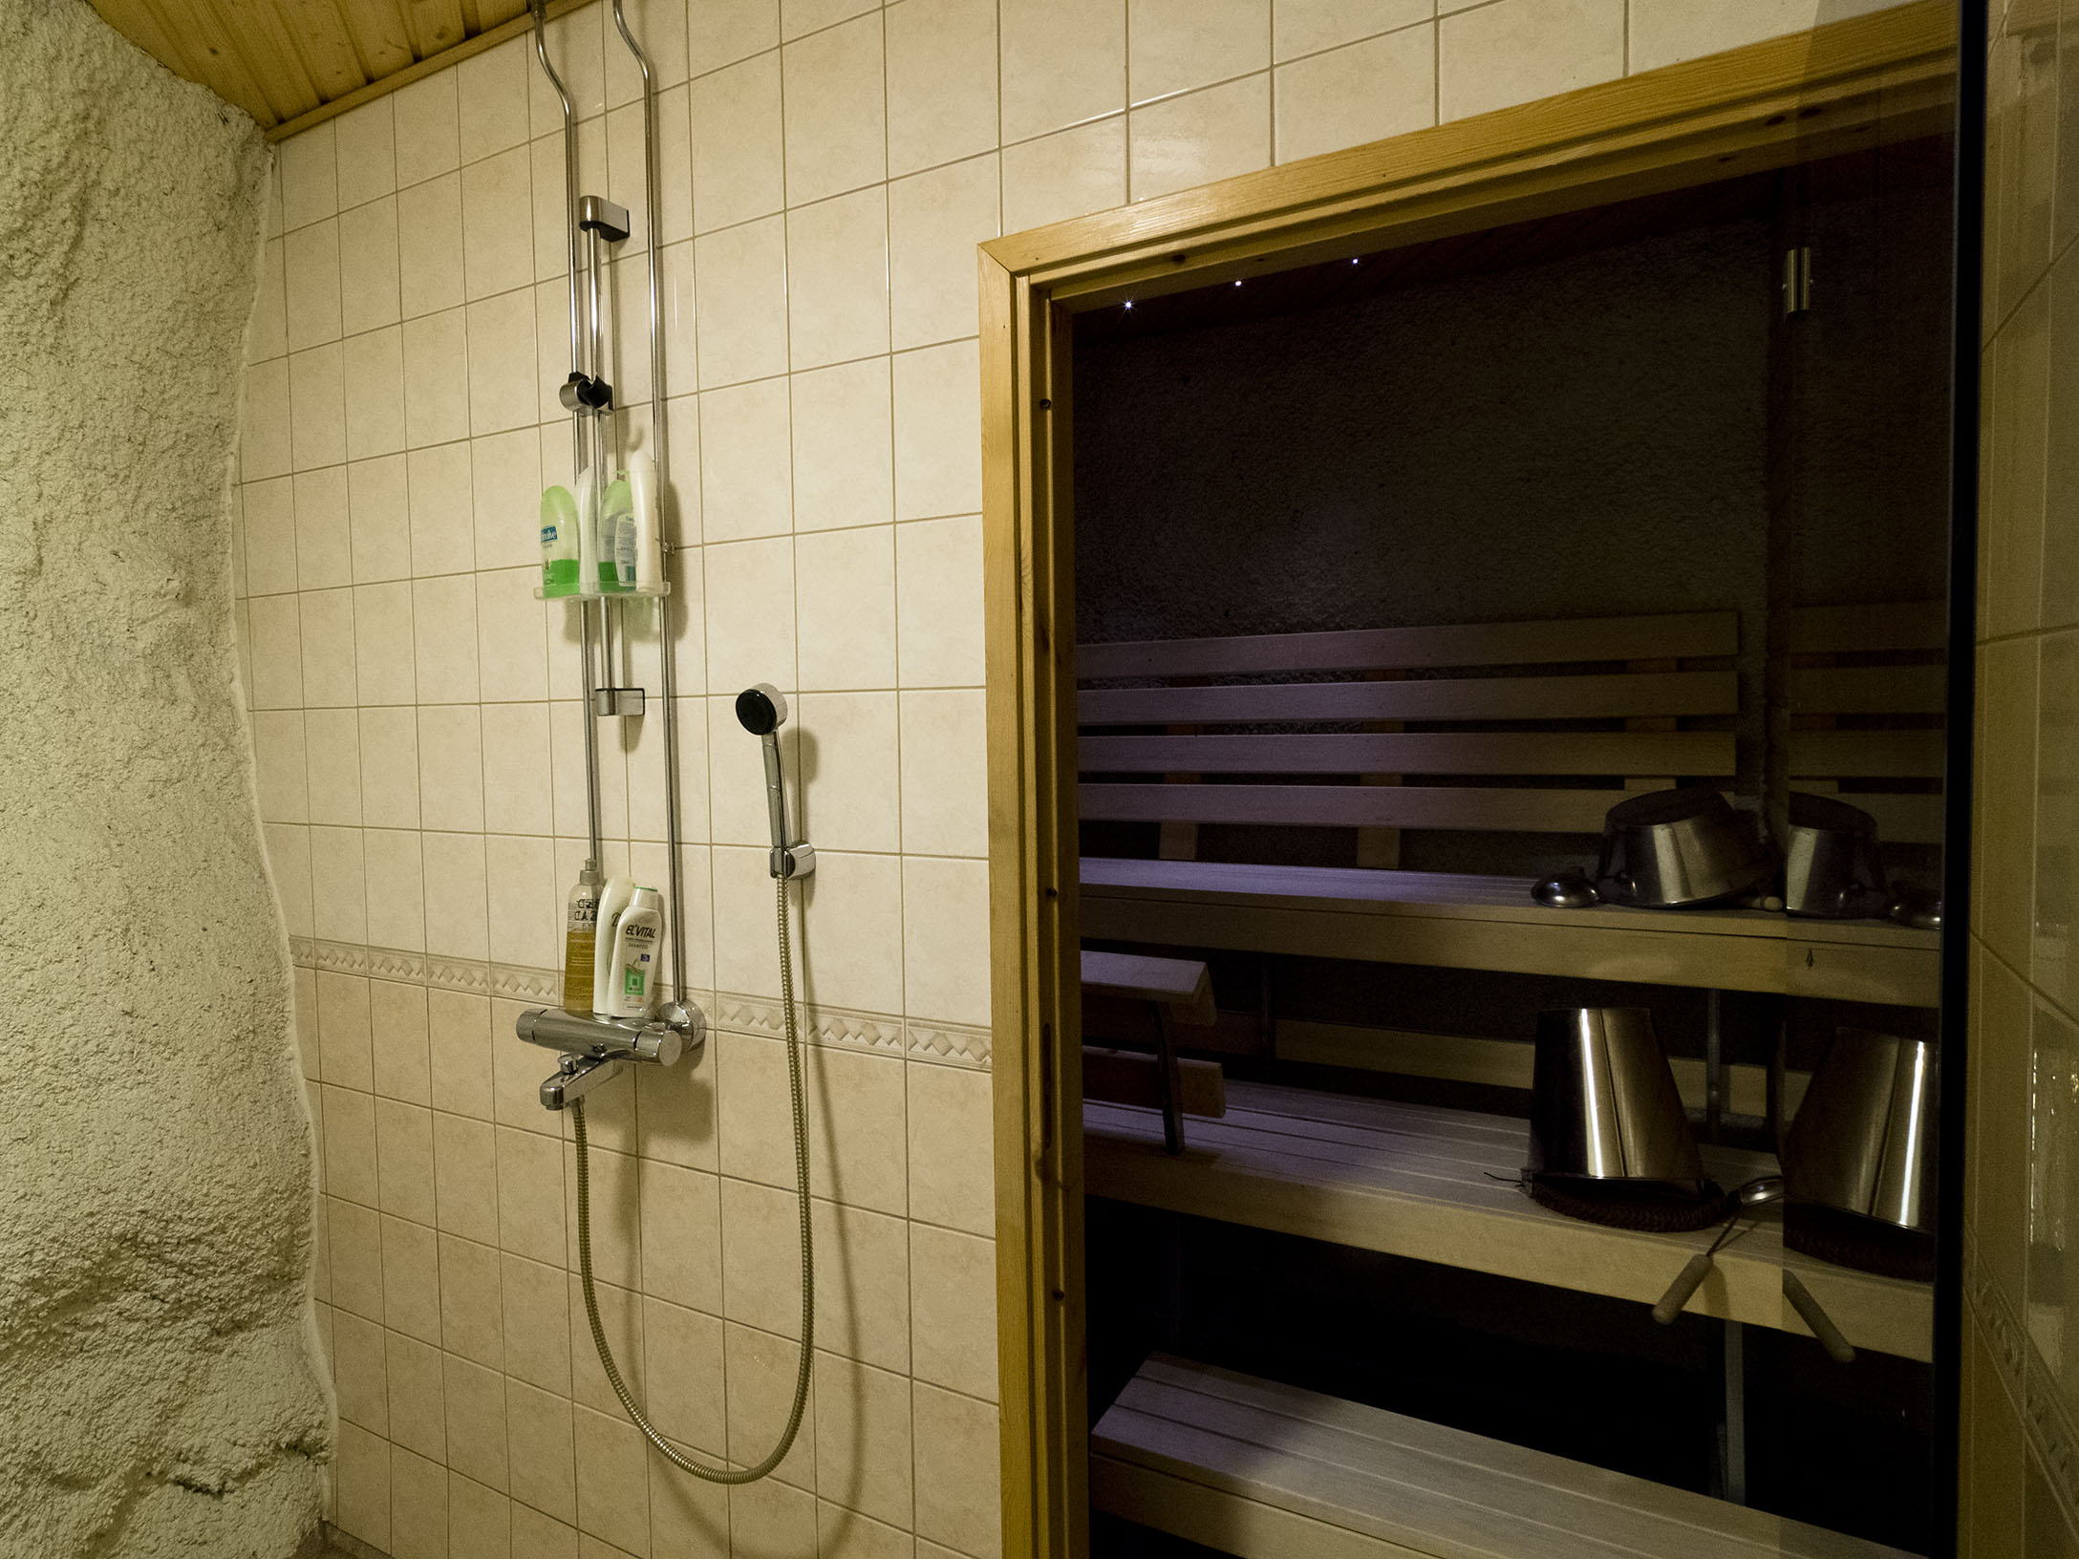

Slide 35
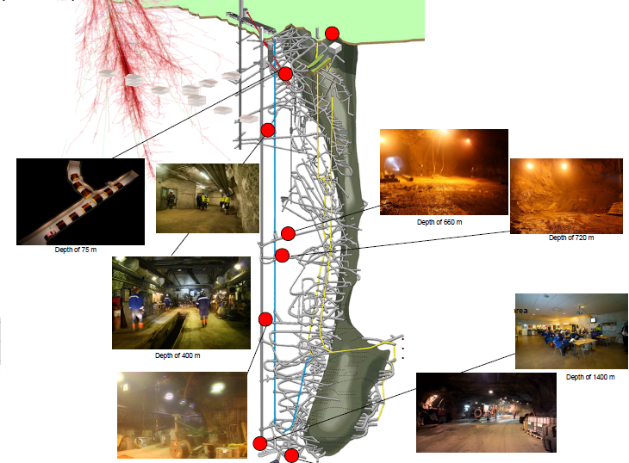
Ongoing scientific activity
in the mine
www.calliolab.com

Slide 36
Construction Time, Costing, and Operation
THEIA in Pyhäsalmi

Slide 37

Source of our know-how
LENA Pre-feasibility Study TUM (till 26/05/2008)
LENA Feasibility Study TUM (till 12/04/2010)
LAGUNA Design Study EU (2008 – 2011)
  1.7 M€; 10 countries; ~100 members
LAGUNA–LBNO Design Study EU (2011 – 2014)
  4.9 M€; 13 countries; ~300 members
EXTENDED SITE INVESTIGATIONS 2012-14
  1.6 M€ cost; extensive laboratory tests
  3.5 km new cores were drilled
  2.6 km of old cores re-logged
Notes:
Diameter = 4.2 cm; 2.7 g/cm3; 3.5 km → 13 t of rock

Slide 38
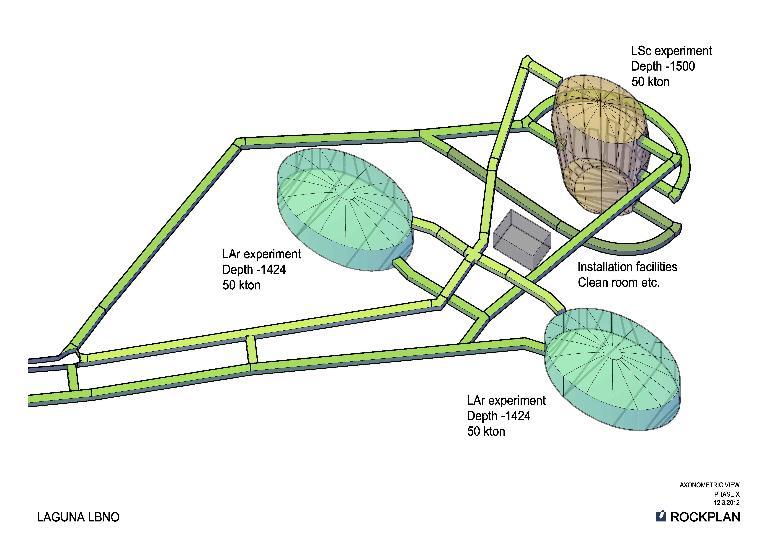
~71 m
~44 m
~120 m
102 m long
64 m wide
50 m high
~250 000 m³

Slide 39
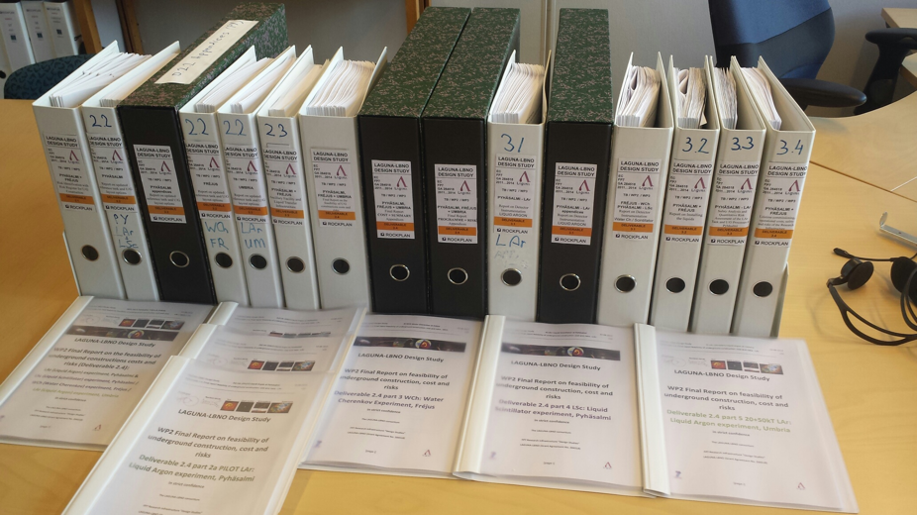
LAGUNA-LBNO (Grant Agreement No. 284518) - Deliverables
http://laguna.ethz.ch:8080/Plone/deliverables/laguna-lbno-284518-deliverables

Slide 40
A 50 kton LSc in Pyhäsalmi
0.5 k€ x 34 000 PMT
1.4 k€ x 34 000 PMT
(12” Hamamatsu)
1.8 k€/t x 69 000 t

Slide 41
Why excavation costs in Pyhäsalmi are so low
Most efficient mine of this type
  Modern, computerized equipment,
  Large, diesel-powered heavy machinery
  Crusher and automatic feeder to the hoist
  Fast and efficient hoist
  Ramp/decline access for equipment
Open pit takes all the excavated rock

Slide 43
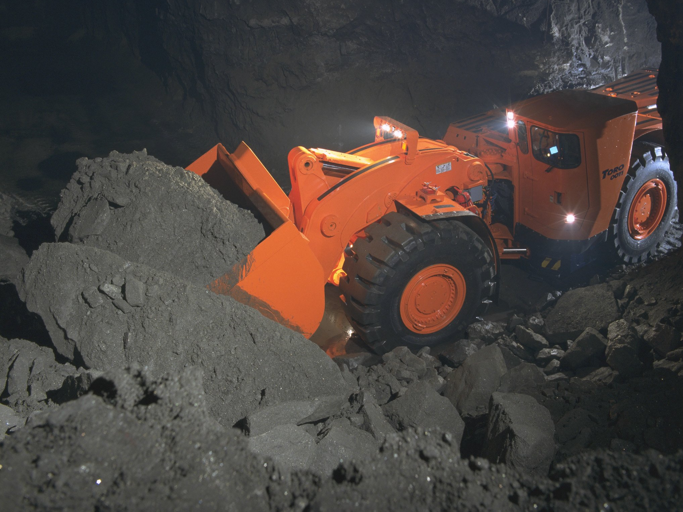

Slide 44
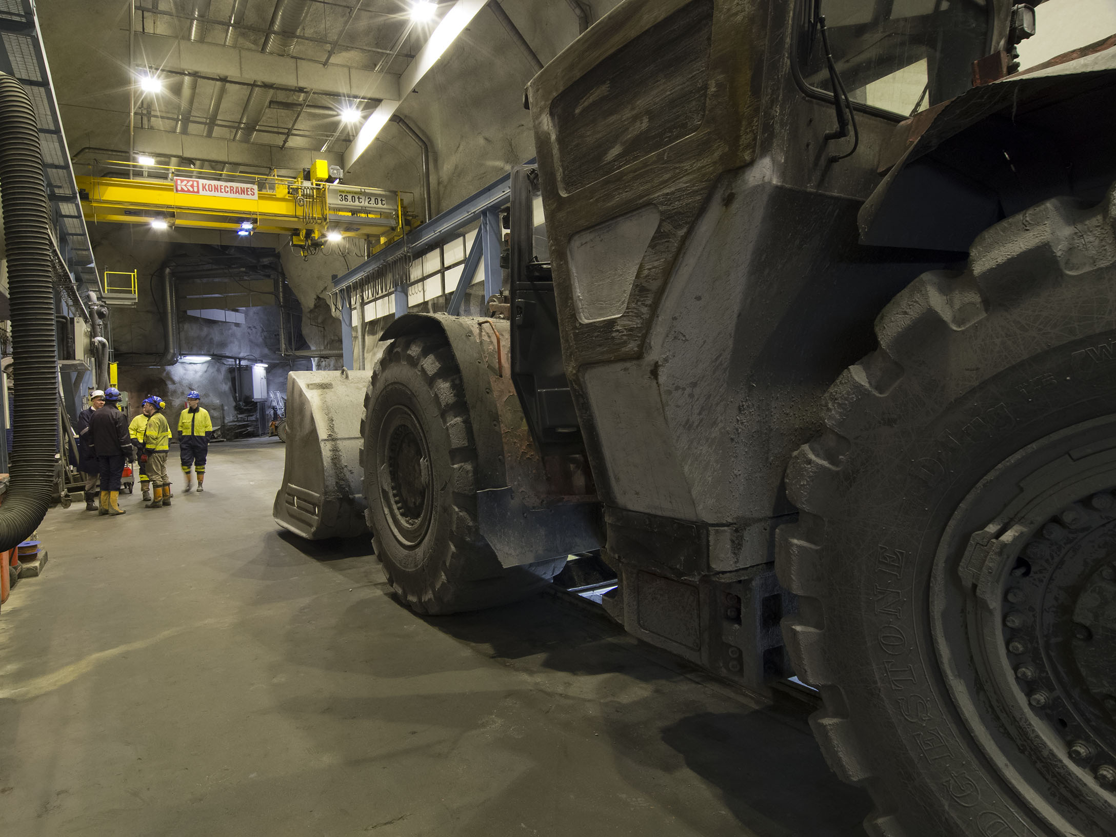

Slide 45
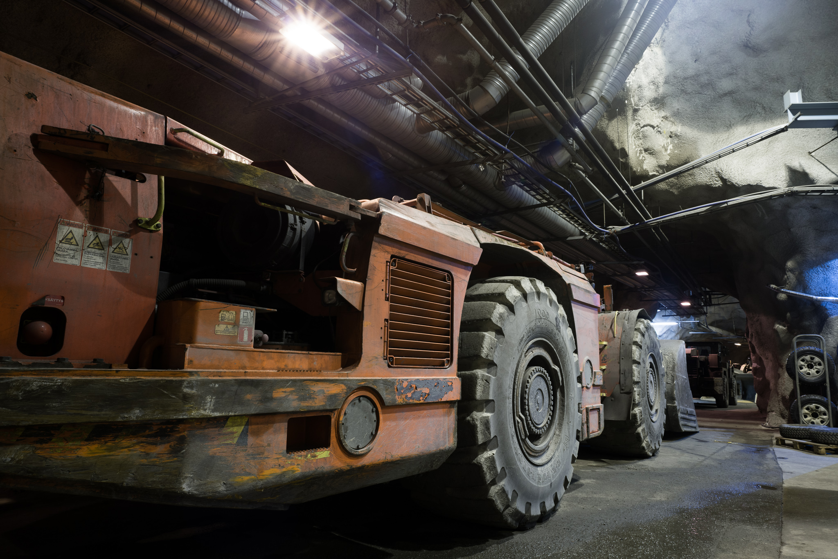

Slide 46
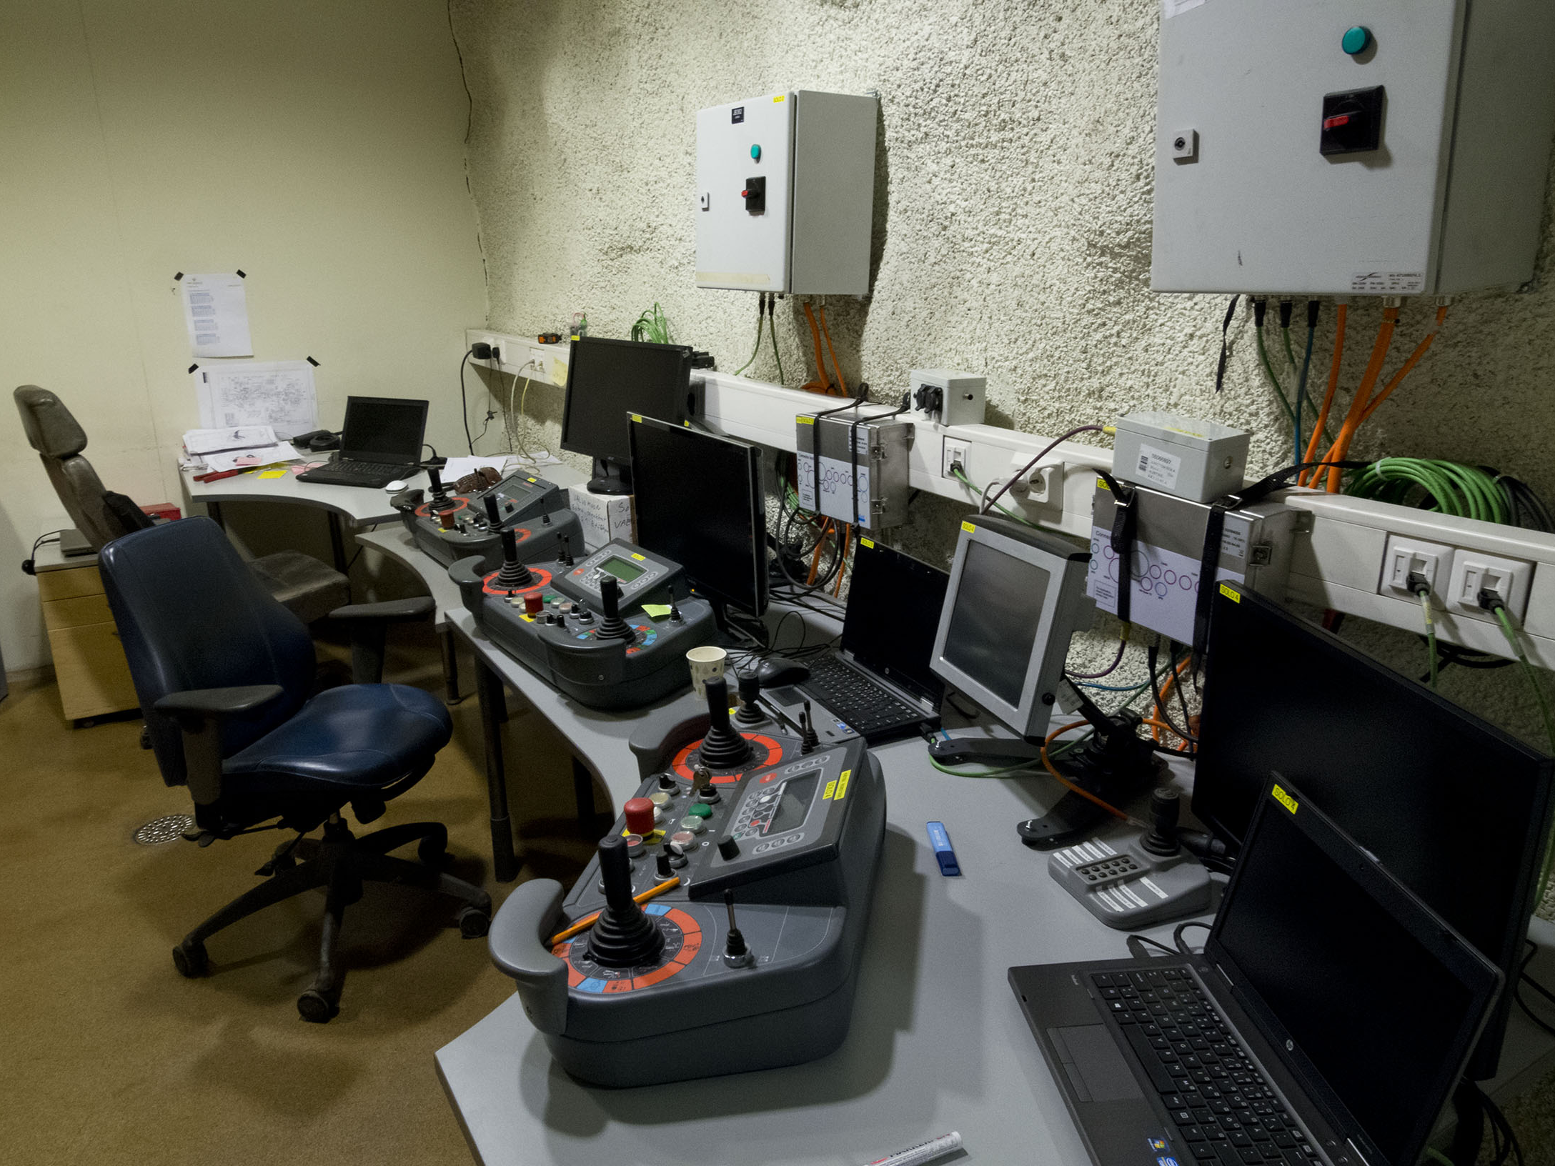

Slide 47
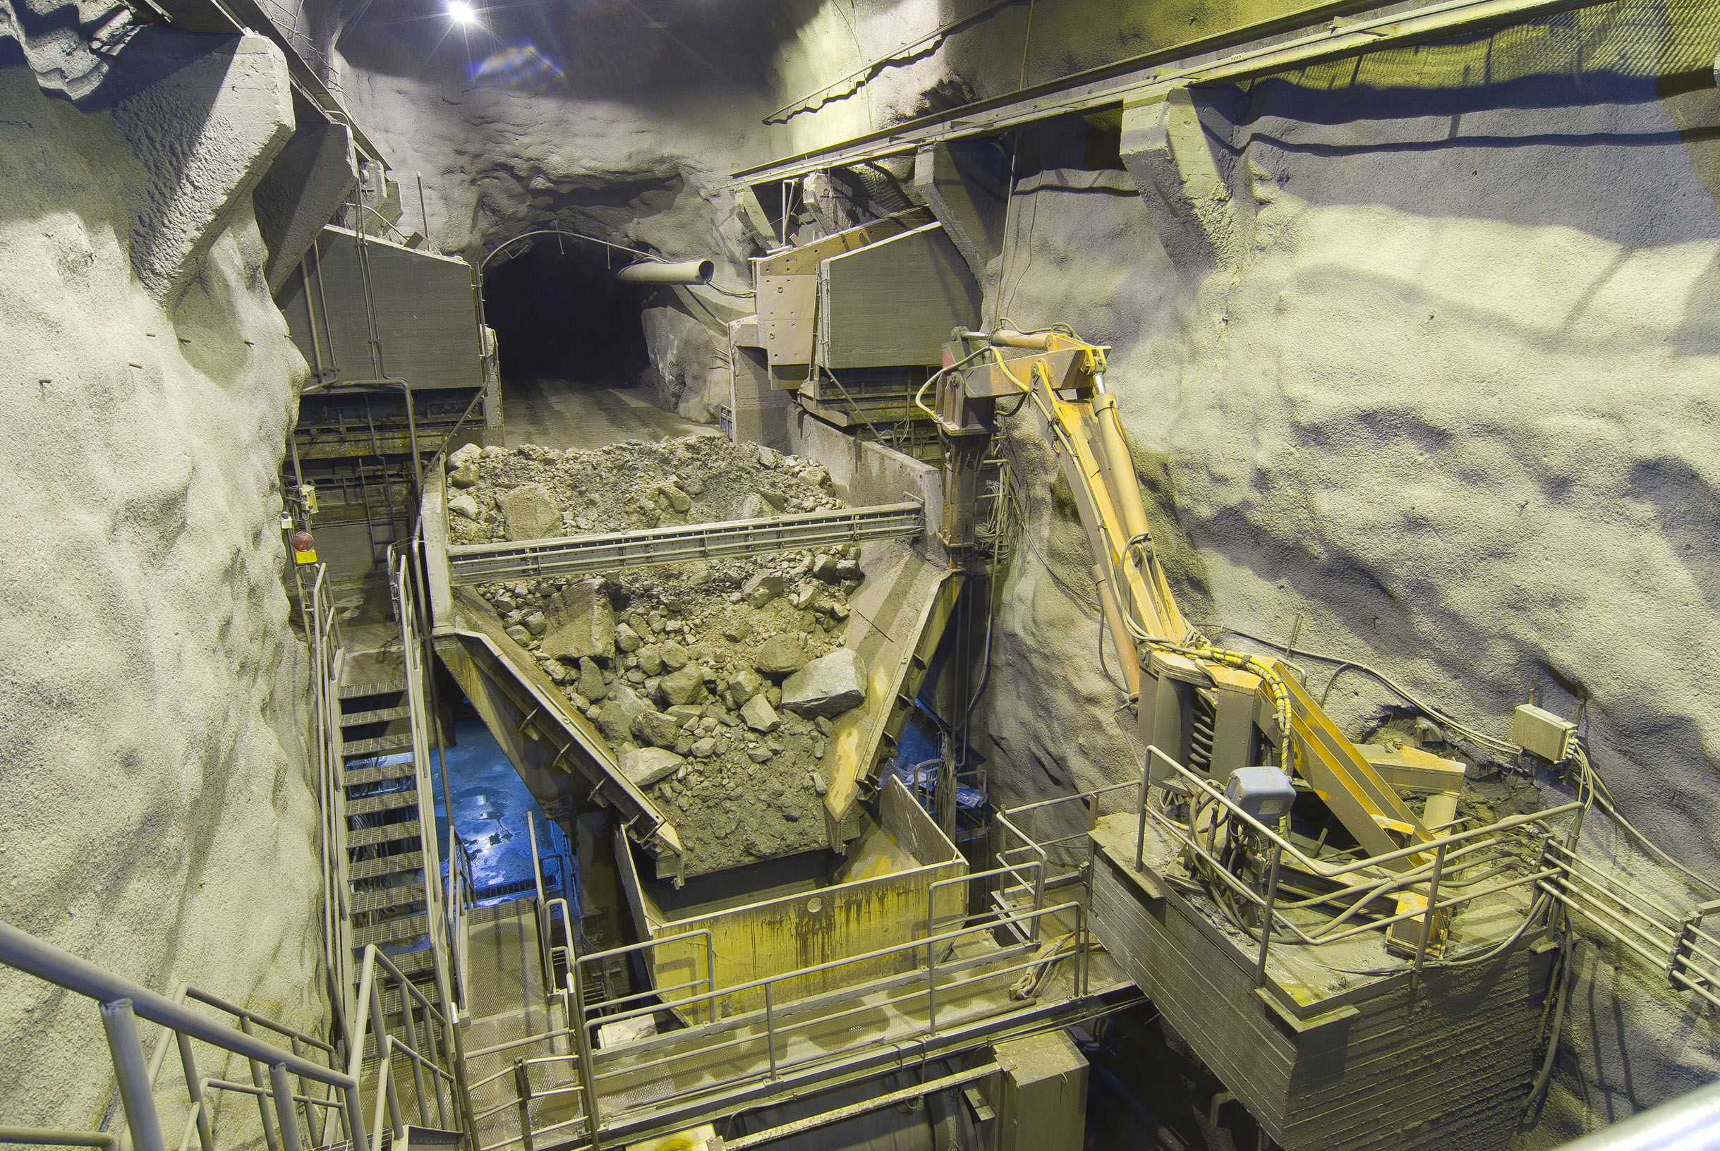

Slide 48
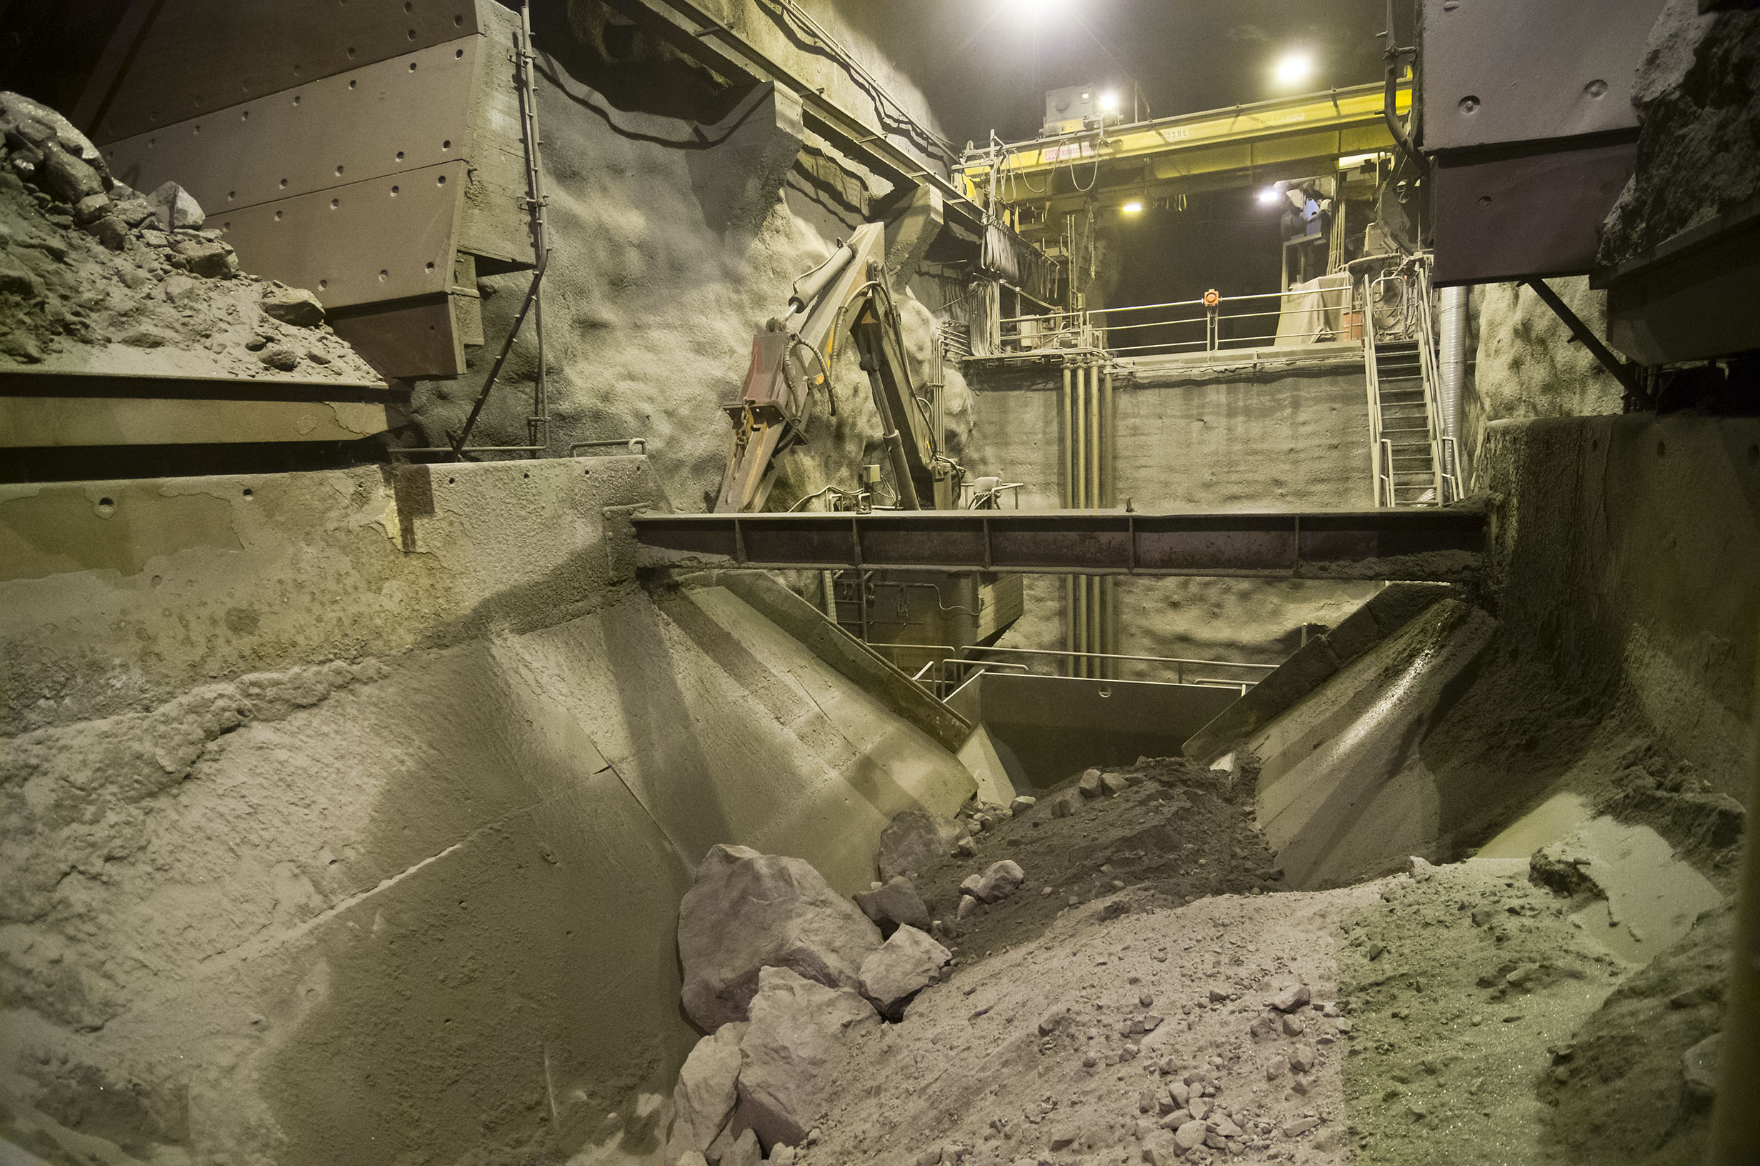

Slide 49
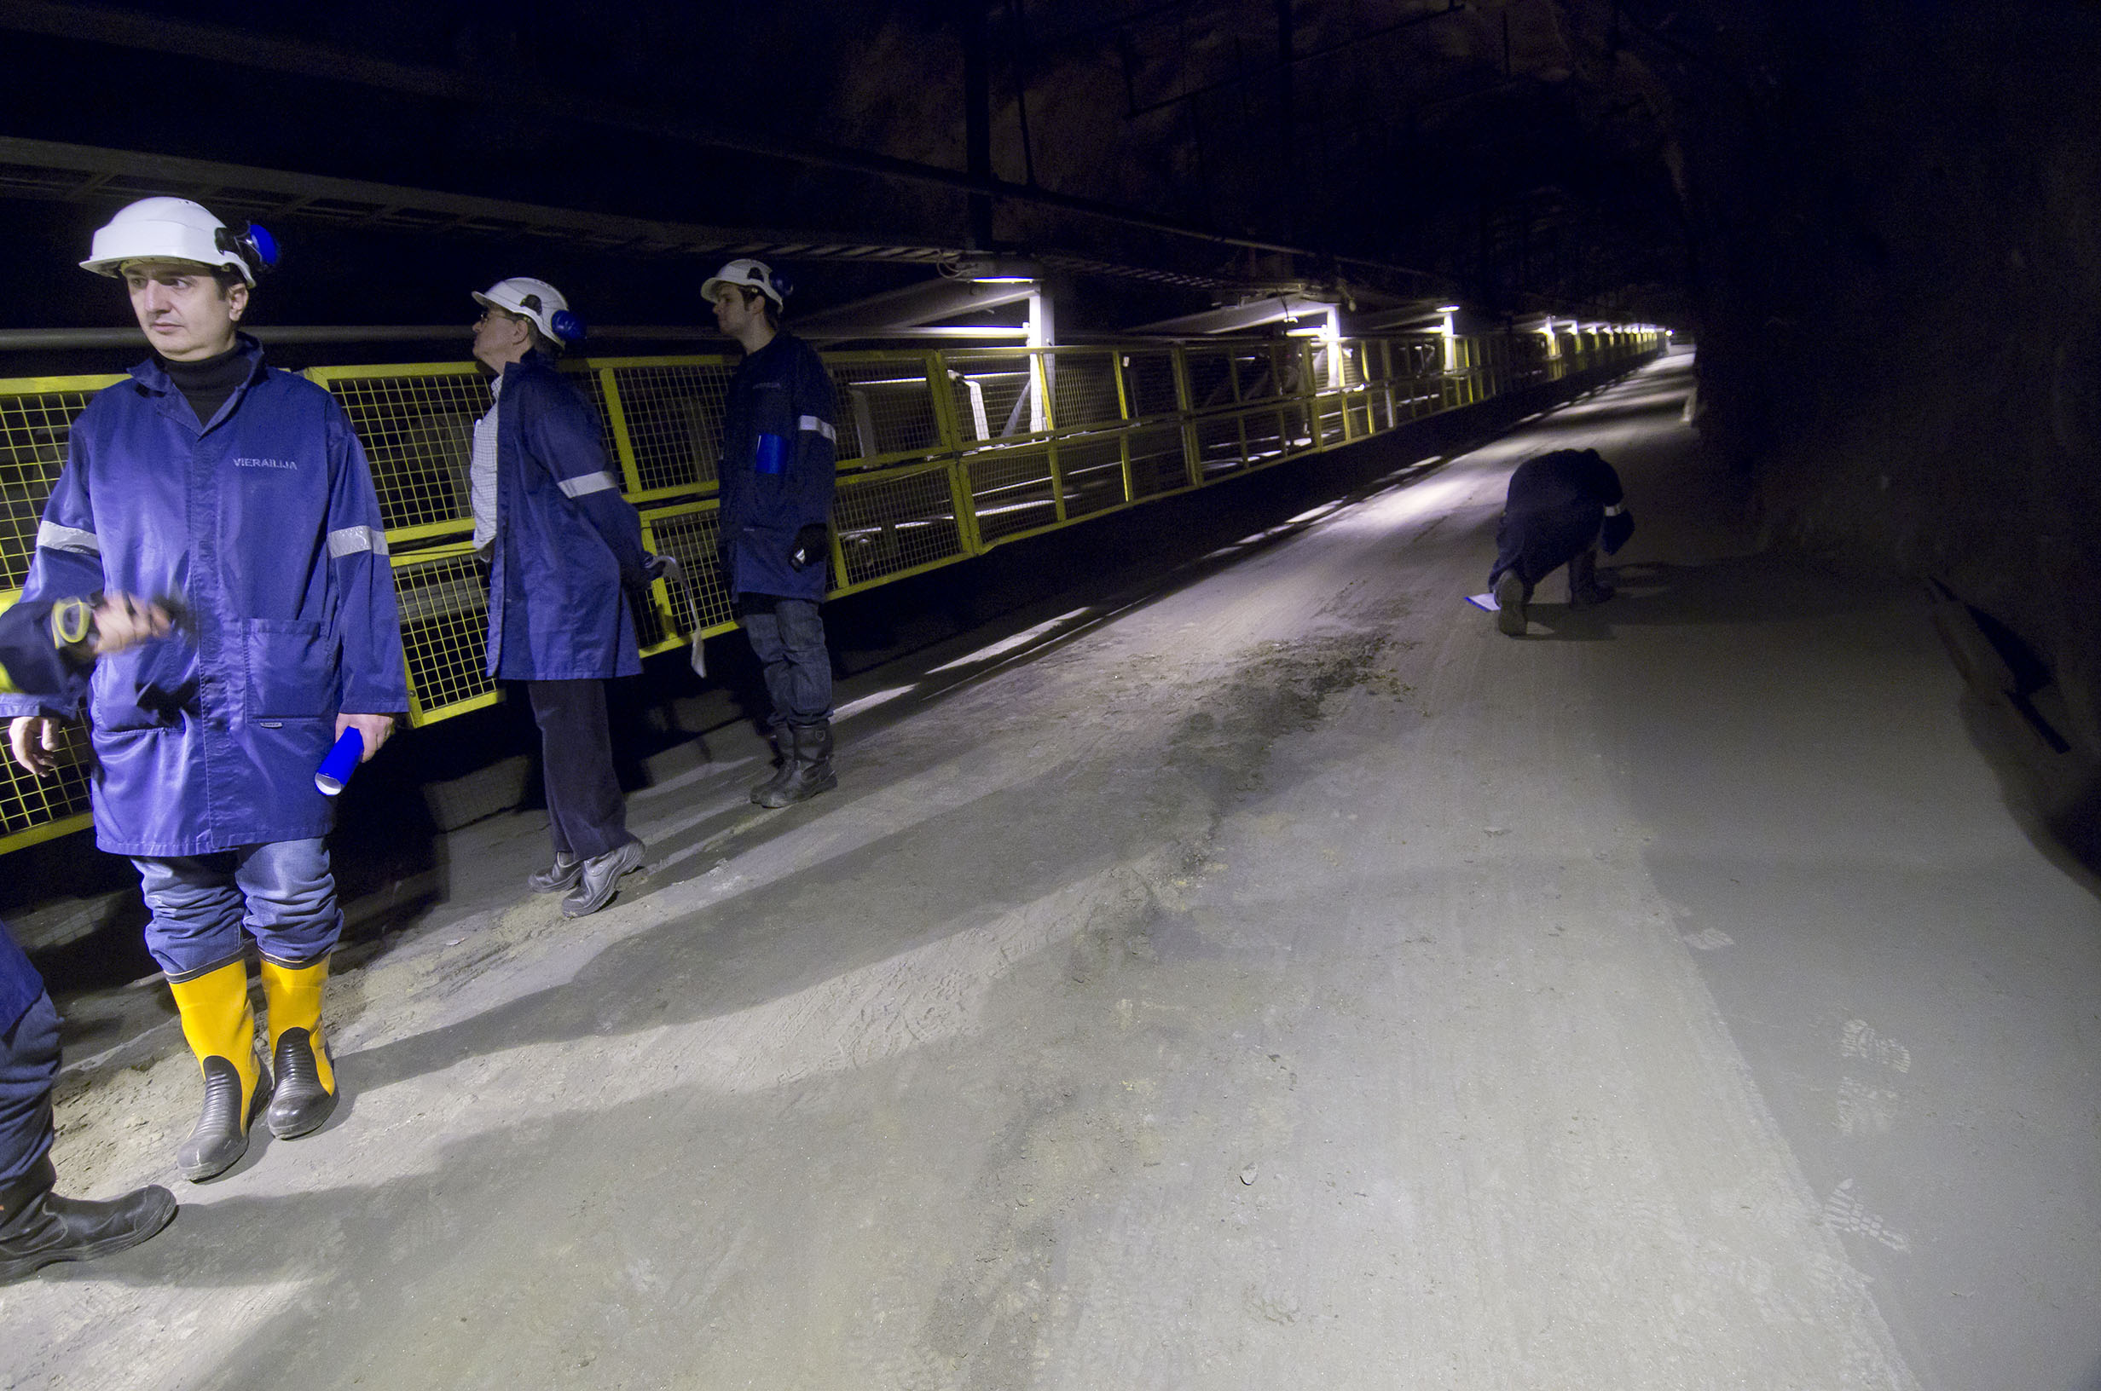

Slide 50
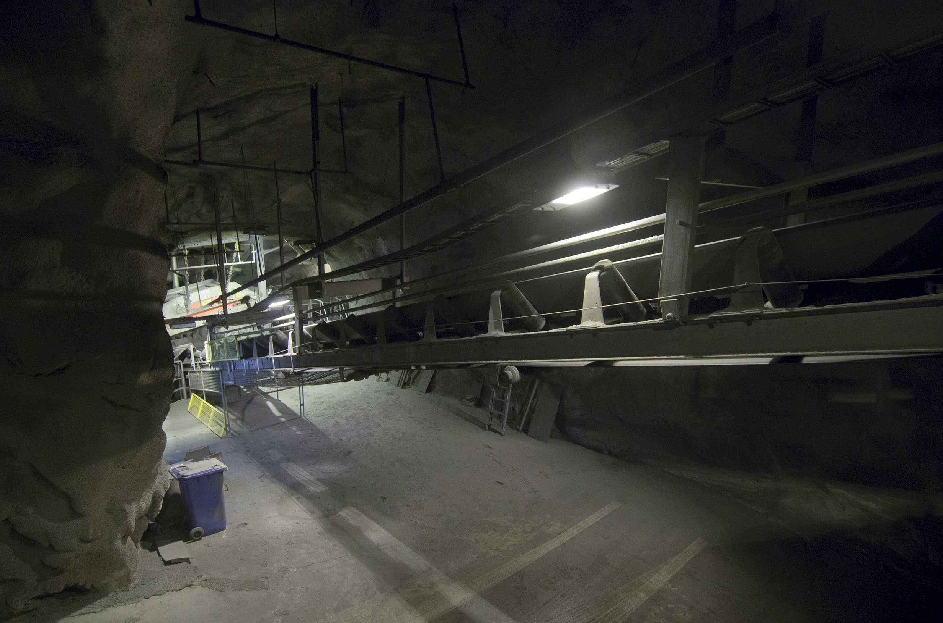

Slide 51
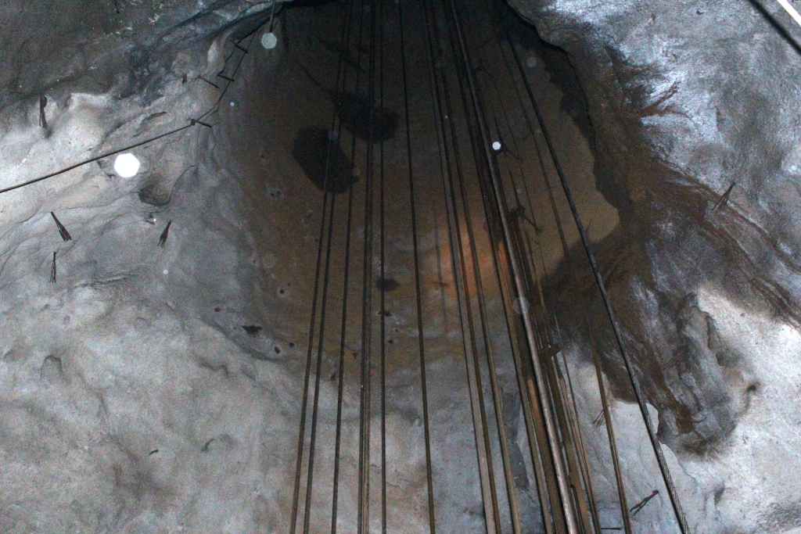


Hoist system
Shaft length 1440 m
Rope guided friction hoist
Capacity 275 t/h; 280 s cycle
Hoist velocity 15.5 m/s (ore)
12.0 m/s (people)
6 guide ropes, 4 head ropes,
3 balance ropes
Pulley diameter 4.5 m
Motor 2.5 MW
ABB, installed by the mine

Slide 53

This pump takes all the water
from 645 m to the surface
(water: 100 m³/h
ventilation: 100 m³/s))

Slide 54

The main transformer in the mine

Slide 55

Test excavation for
LAGUNA-LBNO
250 m x 5 m x 5 m

Slide 56


Slide 57


Slide 58


Slide 59


Slide 60

Homestake vs. Pyhäsalmi
Site comparison
A thorough comparison between sites was given by Guido Nuiten at NNN 2014
http://nnn2014.in2p3.fr

Slide 61


Slide 62


Slide 63


Slide 64


Slide 65

Any questions?
Thank you for your attention!

Slide 66

hydro-pumped-storage in Pyhäsalmi mine?

Slide 67


Slide 68


Slide 69


Slide 71


Slide 72



Slide 73


Slide 74


Slide 75

0.85 m³

