Slide 1
The Theia Detector Excavation – Input from the LBNE Water Cerenkov Detector Design Report
Kenneth Lande
University of Pennsylvania
FROST Workshop
Mainz, 23 October 2016

Slide 2
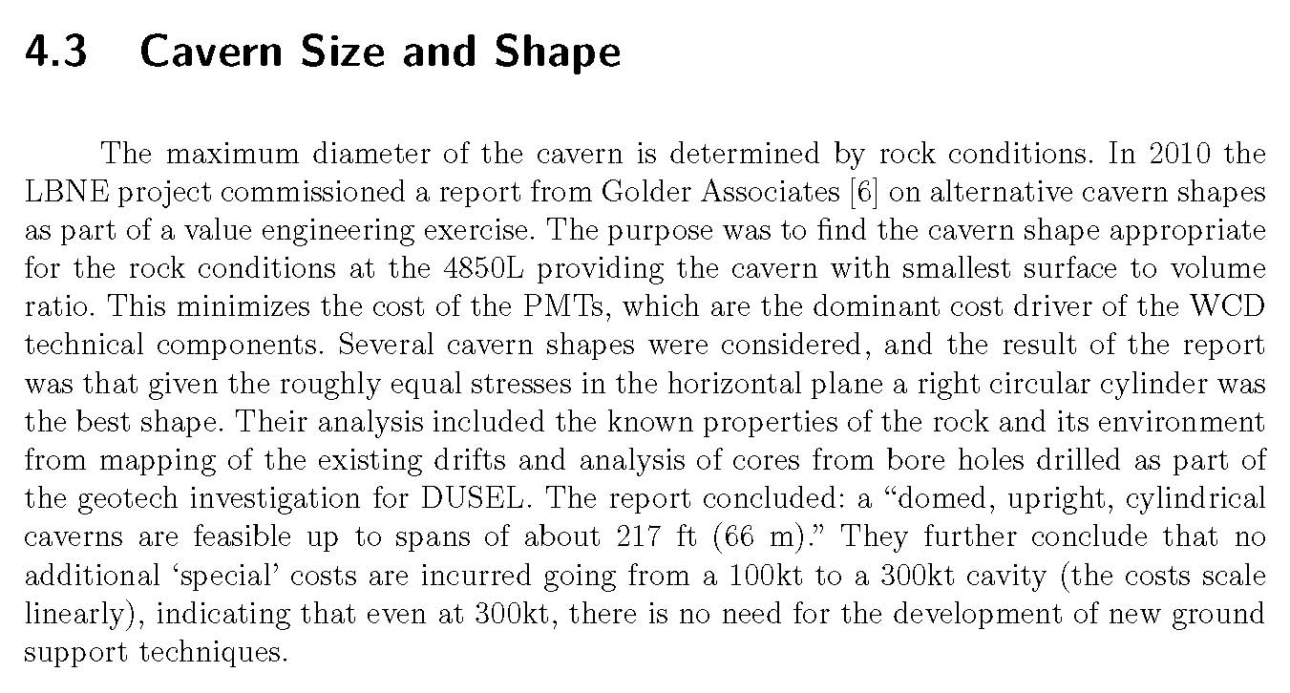
Between 2006 – 2011, we designed water Cerenkov Detectors with volumes from 100 ktonnes to 300 ktonnes for the LBNE at SURF2222.
Statement from the Conceptual Design Report, vol.4, of the LBNE WCD.

Slide 3
Cost Savings
The LBNE water Cerenkov Detector CDR (conceptual design report) provided a thoroughly studied and evaluated detector design that included chamber excavation, chamber liner and rock water seepage control, PMT installation, cabling, water cooling and purification, etc. The PMT installation plan permits adding PMTs to the full detector – consistent with Ed Blucher’s suggestion of a phased detector instrumentation and sensitivity.
Some of the construction and underground facility repair costs in this WCD report do not apply to Theia since they are already done or budgeted elsewhere. Also there may be other savings for Theia compared to the Water CD budget estimate.
One significant example are cost savings achieved by linking the Theia excavation to that of DUNE. That is, by beginning the Theia excavation before the DUNE excavation ends, we avoid an additional round of mobilization/demobilization, the costs of bringing equipment and personnel into the undergnd lab and then removing them at the end.
There may also be savings in sharing a common electrical substation and other similar facilities.

Slide 4
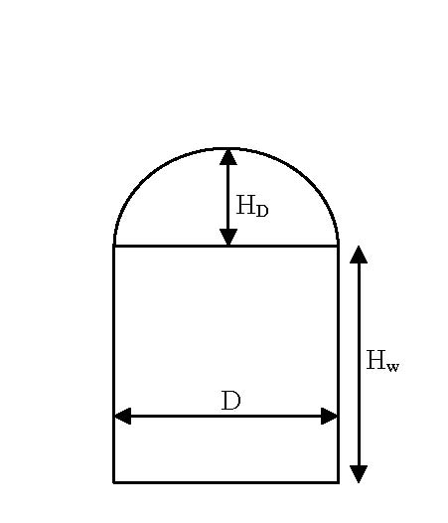
Setting Excavation Parameters
The maximum diameter, D, is determined by the
lesser of (a) the geological constraint, 66 m, and
(b) The light absorption length of the medium,
discussed on the next slide.
The maximum detector fill height, H_{w}, is determined
by the pressure tolerance of the PMTs. Milind Diwan
and associates have determined that to be 20 atm or
200 m. Other considerations limit this depth to ~ 70 m.
The dome height, H_{D}, is determined by geological
considerations and is typically D/4.

Slide 5
This plot & data provided by Minfang Yeh & Milind Diwan.
The WbLS attenuation length in the WbLS emssion region, 400 – 450 nm, is about 20 m. Part of this is due to absorption and the rest to scattering. In a Cerenkov detector the scattered light is lost to the signal and contributes to the background. Since scintillation light is emitted isotropically, the scattered light still contributes to the signal, albeit it with a brief time delay. Minfang’s estimate is that the absorption length is ≥ 50 m.

Slide 6
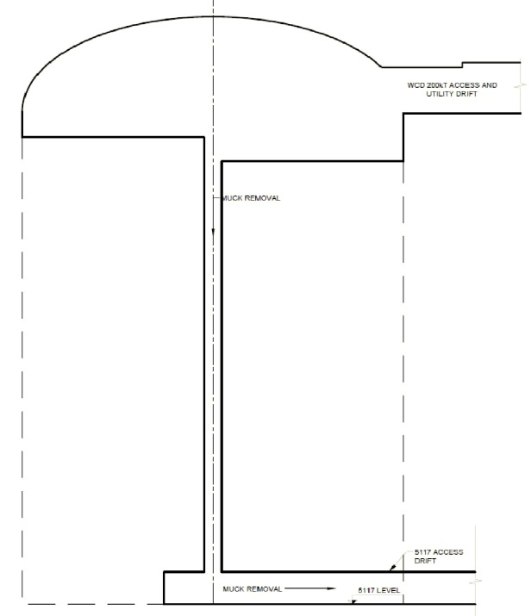
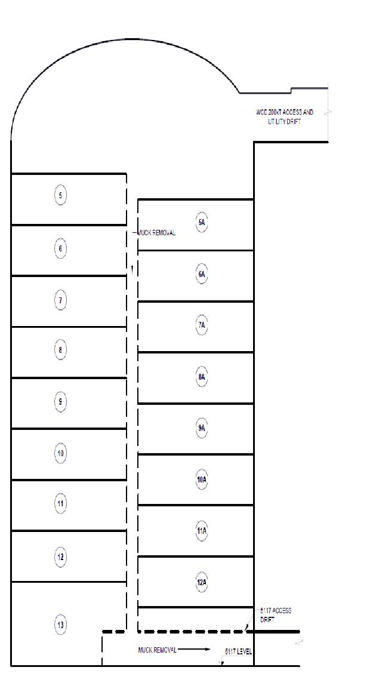
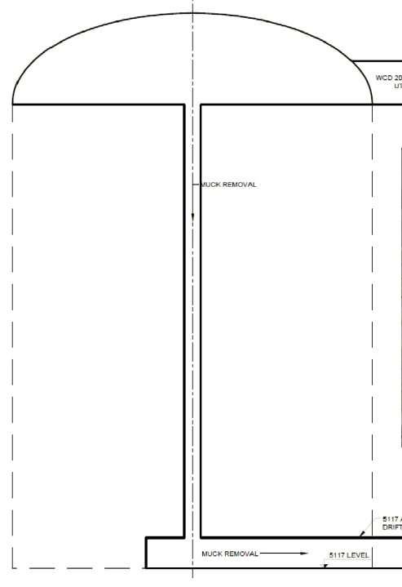
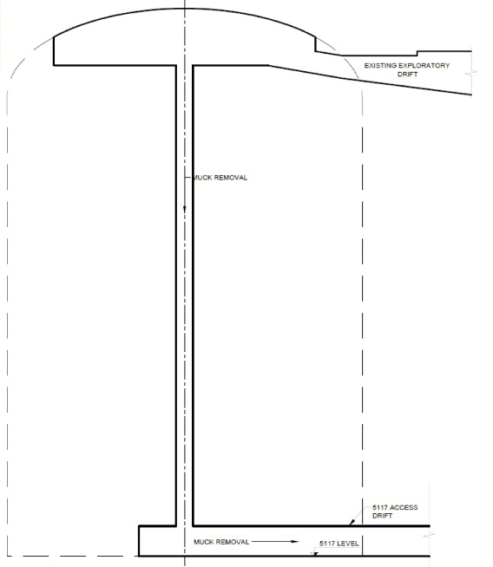
Excavation Sequence (David Vardiman)
1
2
3
4
The excavation begins (left) with tunnels at the top and bottom of the planned chamber. Next, a vertical hole is drilled from top to bottom and a reaming tool is used to enlarge the hole to about 3 m diameter. This is the chute through which the excavated rock is dropped to the bottom. Now there begins a sequence of (a) drilling holes for explosives, (b) blasting, (c) “mucking” – removing the loose rock, and (d) supporting the newly exposed rock walls with a variety of rock bolts, including long cable bolts. Figure 4 (right) shows a typical excavation series pattern, blasting 3 – 5 m high thicknesses of rock.
A recent development is to put the explosives into concentric rings and phase shift the blast time of these rings so that there is phase cancellation at the wall of the chamber. This prevents blast damage to the chamber walls.

Slide 7
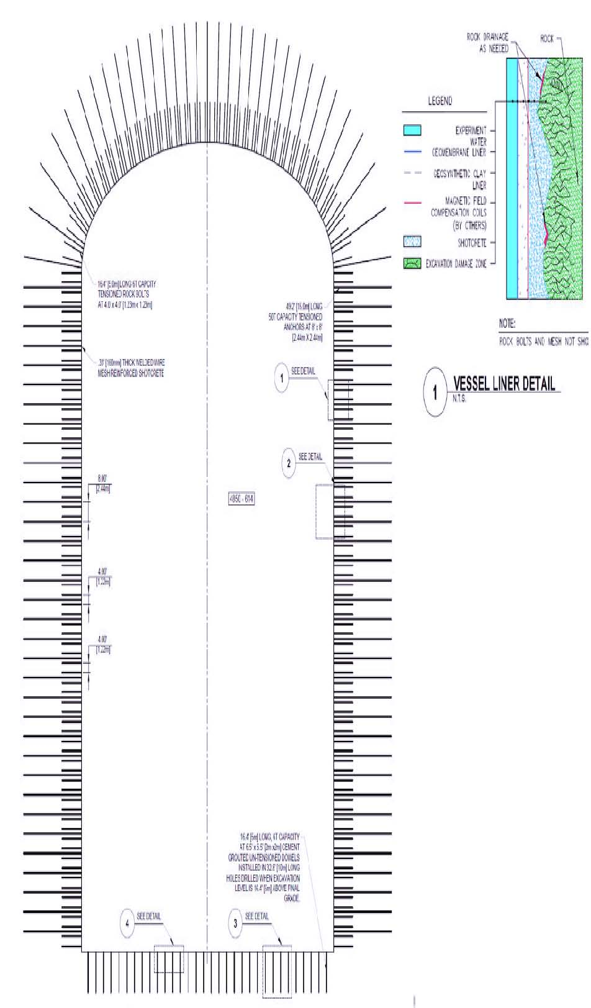
Final Excavation with Bolts & Liner Section
Cable bolts shown are ~16 m long and rock bolts ~5 m long.
The liner is designed to wick away water seepage from the rock, provide a smoothing filler to protect the inner sanitary liner from protruding rocks and provide space for magnetic field compensation coils.

Slide 8
Layout of the 4850 Level at SURF
DUNE
Detector
Cl Solar Detector
Rock Removal Tunnel

Slide 9
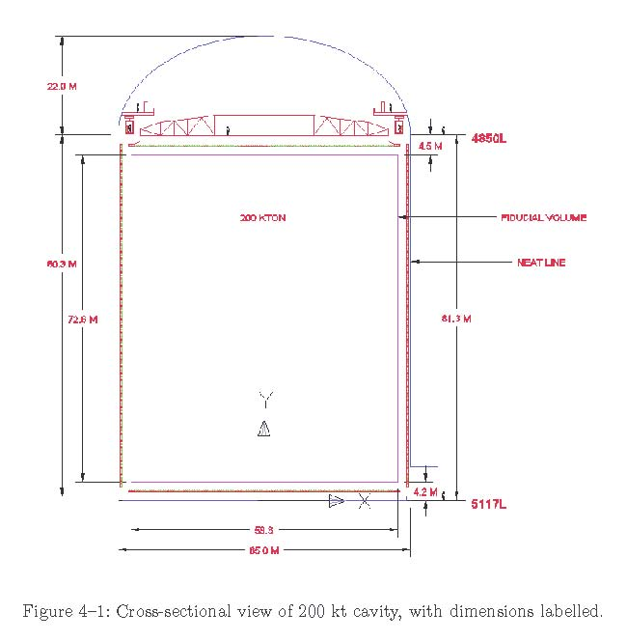
Detector Dimensions – 100 kt & 200 kt
Fiducial Mass | 200 kt | 100 kt
Excavated diameter | 65 m | 53 m
Fiducial diameter | 59 m | 47 m
Rock cylinder ht. | 80 m | 64 m
Fiducial cylinder ht. | 73 m | 58 m
Dome | 22 m | 15 m
The dimensions of the 100 kt fiducial mass detector are compatible with the light absorption length discussed earlier.

Slide 10
200 kt Underground Facilities & Comments for WbLS Plan
Temperatures – The rock is ~32ºC and the circulating air is ~20ºC. The WCD plan was to set the detector fill at 13ºC. This created a very large cooling power demand – see table. The dominant heat flow into the detector was from the top rather from the rock sides. If the WbLS is to be operated appreciably below 20ºC, then it might be prudent to install a thick insulating top cover.
Also, the total detector power requirements should be carefully evaluated. Excessive power capacity can be a steep driver of conventional facilities cost.
Similar comments apply to maximum people occupancy.

Slide 11
Summary
The Sanford (Homestake) rock has been extensively investigated and found capable of stable excavations of over 65 m diameter. These studies include a significant number of test bores and rock core studies as well as investigations by the Large Cavern Advisory Board. Finally, the proposed rock location is very close to and in the same rock formation as the Chlorine Solar Neutrino Detector, which was excavated in 1965 and remained in its original state with no rock failure until 2010 when it was converted into the LUX experiment.
Detailed rock excavation studies for a 100 – 300 kt chamber have been carried out by Golder Associates, a respected mine construction firm.
The chamber site is deep, ~1450 m of rock, and so well shielded from cosmic rays. It is also in the forthcoming intense long range neutrino beam from Fermilab. That permits neutrino beam studies during beam pulse on time and non-beam physics between pulses.
The Sanford Lab is a purely scientific endeavor involving multiple experimental groups in a comfortable and pleasant research setting.

