Slide 1

Sanford Underground Research Facility
FroST - THEIA Detector Workshop
                David Vardiman
                Project Engineer
October 22-24, 2016

Slide 2
Agenda
SURF Facilities
Existing Science
Future Science
4850L Geotechnical Site Investigations
THEIA Basis of Design
THEIA Basis of Estimate
2

Slide 3
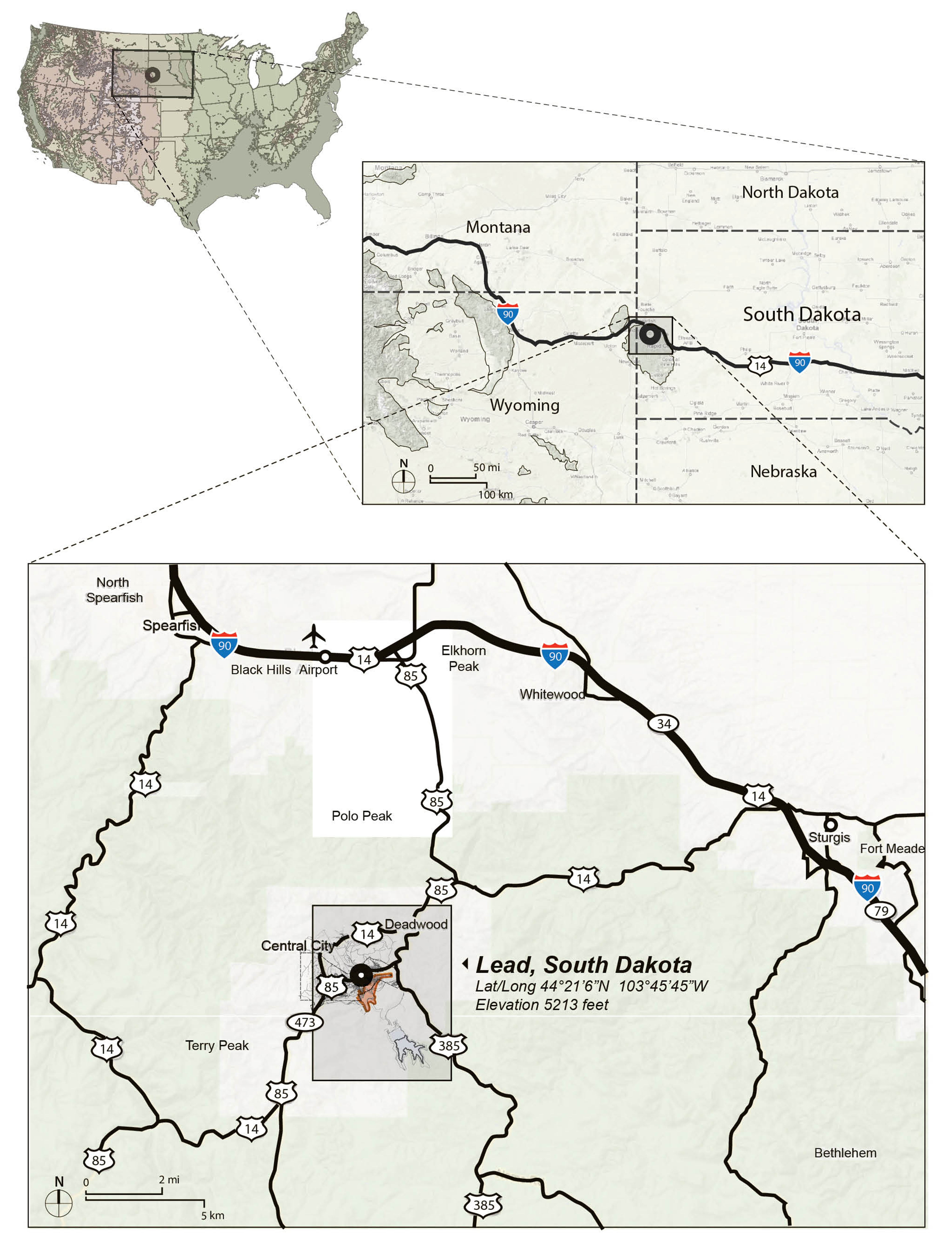
Sanford Underground Research Facility
Dedicated facility for underground scientific research
3

Slide 4
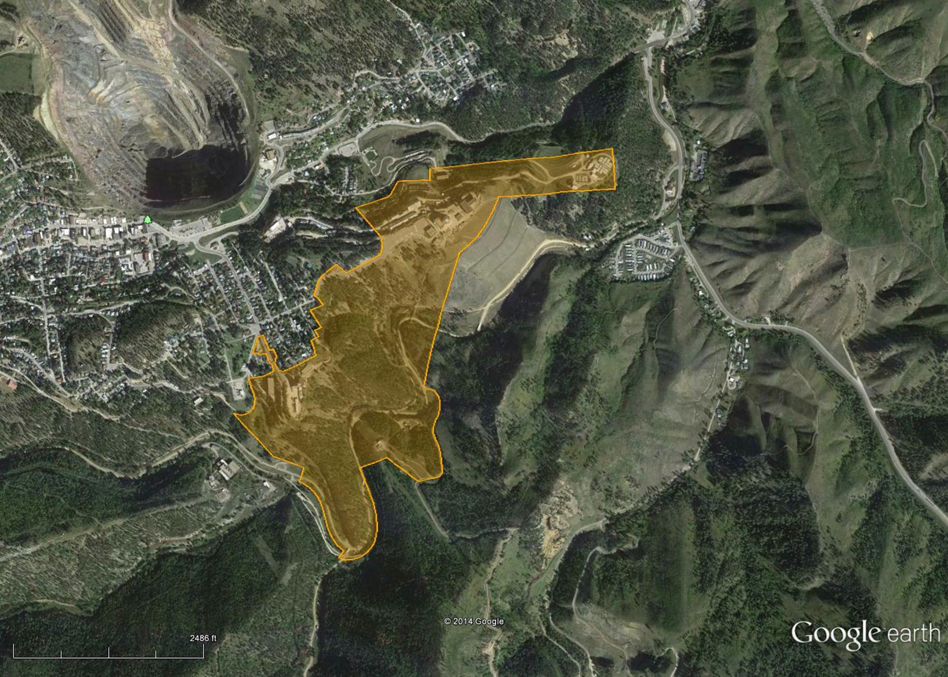
Sanford Underground Research Facility
Dedicated facility for underground scientific research
Open Cut
Yates Complex
Visitor Center
Created by the State of South Dakota with major philanthropic donations from T. Denny Sanford and Barrick Corporation
Continued support by the State of South Dakota ($52M through 2016)
Operated by the US Dept of Energy (HEP), through a subcontract between Fermi Lab and the SDSTA
Ross Complex
186 acres / 75 ha (surface)
7700 acres / 3116 ha (underground)
4

Slide 5
Global Underground Laboratories
Notes:
Updated March 30, 2016

Slide 6
SURF Science Institutions
Current Researchers From All Around the World (60 institutions)
United States
Bigelow Laboratory, East Boothbay, MA
Brown University, Providence, RI
Black Hills State University, Spearfish, SD
Caltech, Pasadena, CA
Case Western Reserve University, Cleveland, OH
Colorado School of Mines, Golden, CO
Dakota State University, Madison, SD
Desert Research Institute, Las Vegas, NV
Duke University/TUNL, Durham, NC
Fermi National Accelerator Lab, Batavia, IL
Idaho National Laboratory, Idaho Falls, ID
Indiana University, Bloomington, IN
Jet Propulsion Laboratory, Pasadena, CA
Lawrence Berkeley National Lab, Berkeley, CA
Lawrence Livermore National Lab, Livermore, CA
Los Alamos National Lab, Los Alamos, NM
National Energy Tech Lab, Albany, OR / Morgantown, WV
North Carolina State University, Raleigh, NC
Northwestern University, Evanston, IL
Oak Ridge National Lab, Oak Ridge, TN
Pacific Northwest National Lab, Richland, WA
Princeton University, Princeton, NJ
Rensselaer Polytechnic Institute, Troy, NY
Sandia National Laboratory, Albuquerque, NM
South Dakota School of Mines & Tech, Rapid City, SD
South Dakota State University, Brookings, SD
Spearfish School District, Spearfish, SD
SLAC National Accelerator Lab, Menlo Park, CA
Stanford University, Stanford, CA
State University of New York, Albany, NY
US – continued
Tennessee Tech University, Cookeville, TN
Texas A&M University, College Station, TX
US Geological Survey (AZ/SD), Tucson, AZ
University of California Berkeley, Berkeley, CA
University of California Davis, Davis, CA
UC Santa Barbara, Santa Barbara, CA
University at Albany/SUNY, Albany, NY
University of Maryland, College Park, MD
University of Minnesota, Minneapolis, MN
University of North Carolina, Chapel Hill, NC
University of Notre Dame, Notre Dame, IN
University of South Carolina, Columbia, SC
University of South Dakota, Vermillion, SD
University of Southern California, Los Angeles, CA
University of Rochester, Rochester, NY
University of Tennessee, Knoxville, TN
University of Wisconsin, Madison, WI
University of Washington, Seattle, WA
Yale University, New Haven, CT
World
Joint Institute for Nuclear Research, Dubna, Russia
Imperial College London, London, Britain
LIP– Coimbra, Coimbra, Portugal
NRC Institute for Theoretical and Experimental Physics, Moscow, Russia
Osaka University, Osaka, Japan
Queen’s University, Kingston, Canada
University College London, London, Britain
University of Edinburgh, Edinburgh, Scotland
University of Tasmania, Tasmania, Australia
Notes:
Updated Jun 7, 2016
51 US institutions (49 entries, 2x for USGS, 2 NETL sites -> 51, incl kISMET); don’t incl Xilinx, Golder (since companies) or LZ or DUNE (yet)
9 World
Total = 60

Slide 7
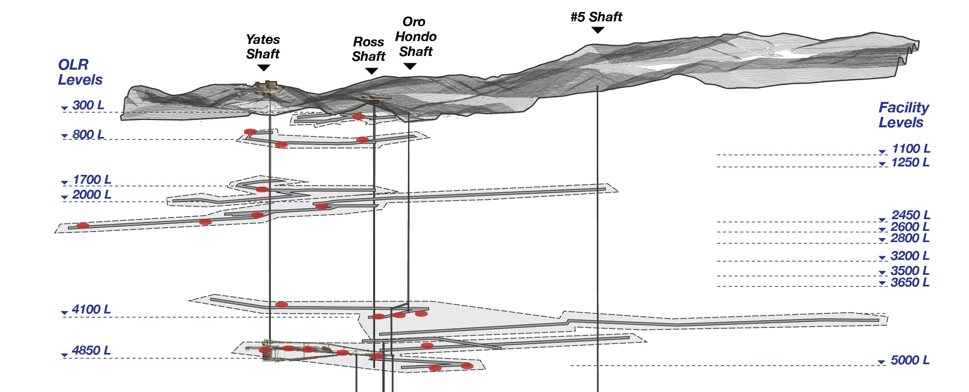
Sanford Lab Existing Science Facilities
• ~600 km of tunnels from Surface to 8000 feet deep
(63 total elevations, 29 currently accessible)
• ~20 km maintained for science and facility operations
Existing Facility-Wide Facilities
7

Slide 8
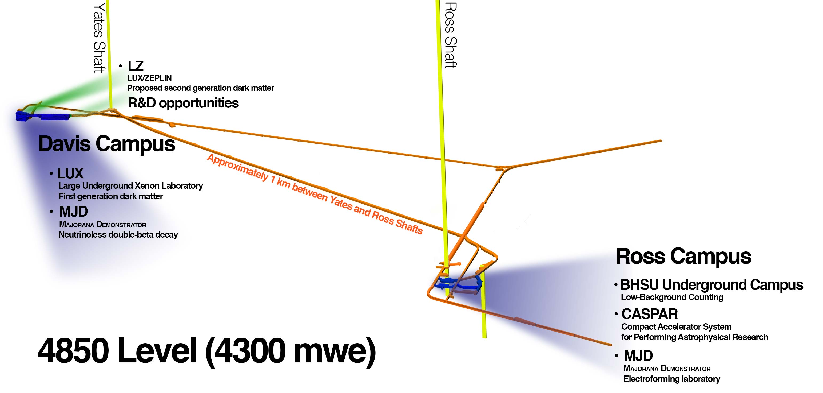
4850L Existing Science Facilities
Existing 4850L Facilities
8

Slide 9
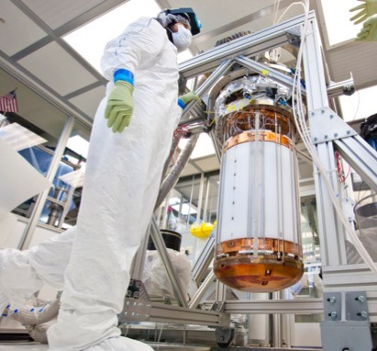
Existing 4850L Physics Program
Majorana Demonstrator (MJD):
Studying the neutrino’s mass and the
imbalance of matter/antimatter in the universe.
First module installed in the lead/copper shield. Module 2 detector strings assembled and in the shield. Physics data expected 2016.
Large Underground Xenon (LUX):
Direct detection of dark matter.
300-day data completed in May 2016.
4x improvement and still the most sensitive.
  Compact Accelerator System for Performing Astrophysical Research (CASPAR):
  Studying nuclear reactions in stars.
  Assembly in process. Operations planned for 2016.
  Black Hills State Univ. Underground Campus:
  Low Background Assay and Measurement
  Installed 4 Low Background Counters. More planned.
Notes:
- overview of the current Sanford Lab science program

Slide 10
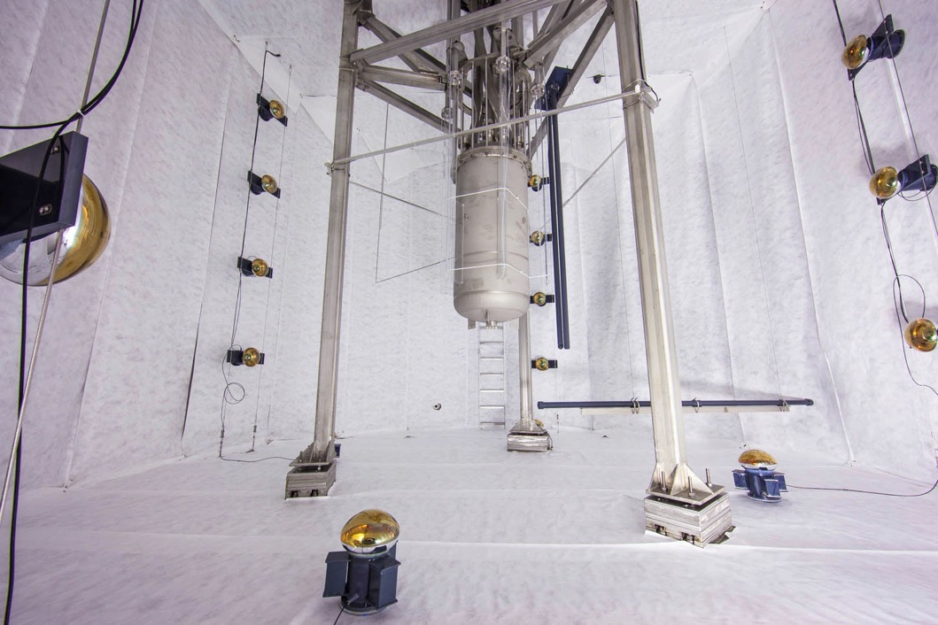
LUX Detector Deployed in Water Shield Tank
300 live day run concluded in May 2016. 4x improvement in sensitivity

Slide 11
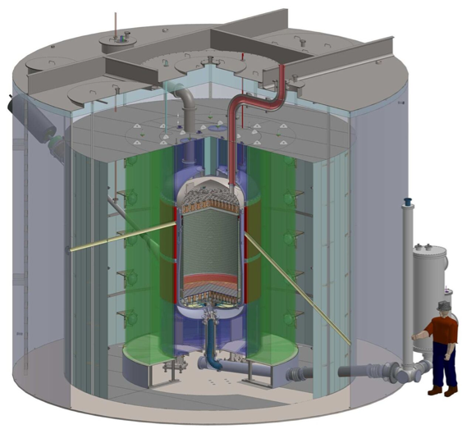
LUX-ZEPLIN (LZ) Dark Matter Experiment
LZ will be located in the Davis Cavern on the 4850 foot level
30x larger mass than the LUX experiment. 100x more sensitive.
LBNL leading experiment design and development
SDSTA to refurbish the existing Surface Laboratory and Davis Campus to host LZ
Experiment and facility design work currently underway
DOE recenlty received CD-2/3b
Facility modifications to occur in 2016 (surface) and 2017 (4850L)
Experiment installation underground planned for 2018-19
5 years of operations envisioned
LZ Detector and Shielding

Slide 12
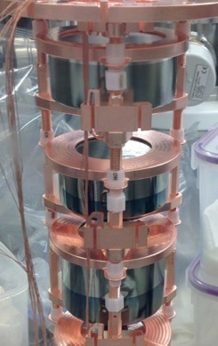
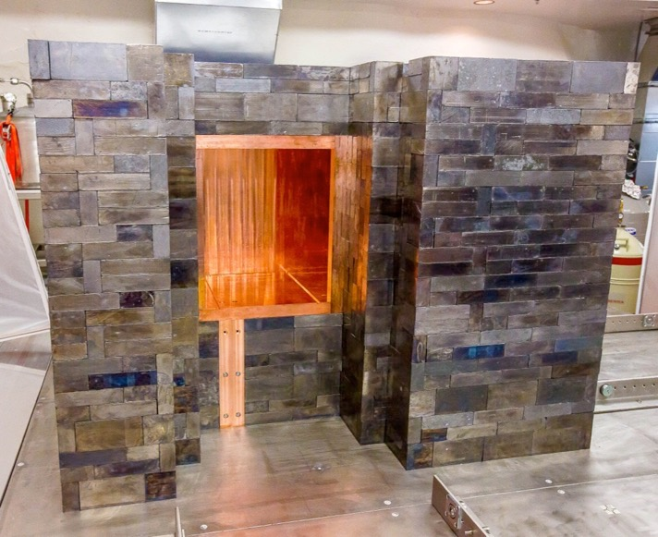
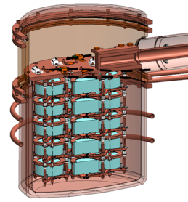
Majorana Shield and Detector Assembly
2 detector modules. 40kg total enriched Ge⁷⁶ . Scheduled start Dec. 2016
9

Slide 13
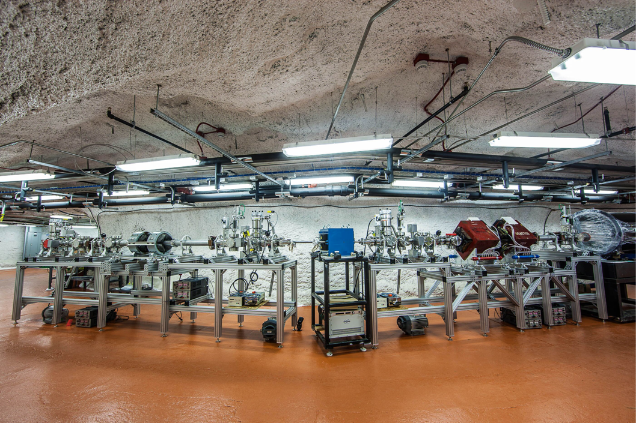
4850L Ross Campus: CASPAR
Compact Accelerator System for Performing Astrophysical Research

Slide 14
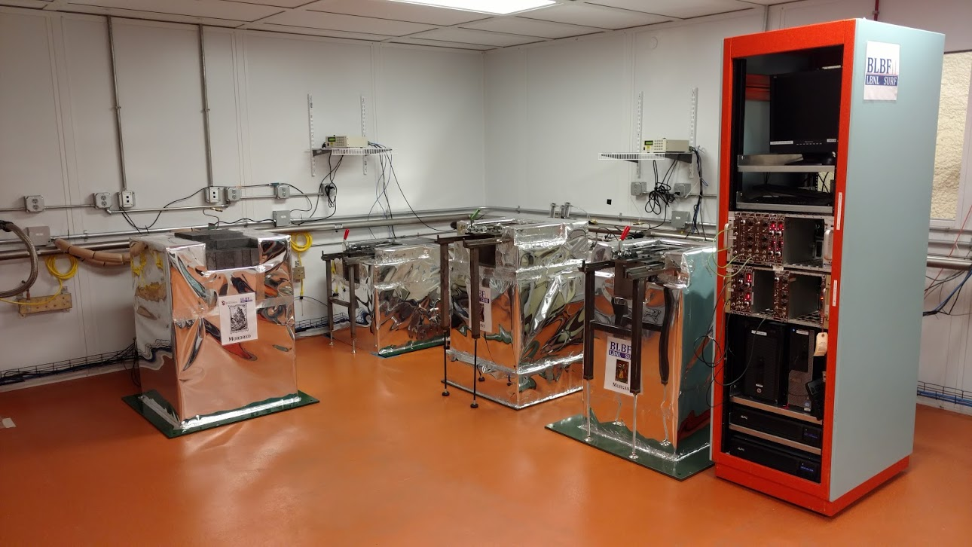
SURF Low-Background Counting
Establishing national-level capability in BHUC Cleanroom at SURF
Notes:
SDSTA investment ~$700k
Development approach: SDSTA to rehabilitate the space and contractor to outfit space. BHSU to provide cleanroom and support systems.

Slide 15
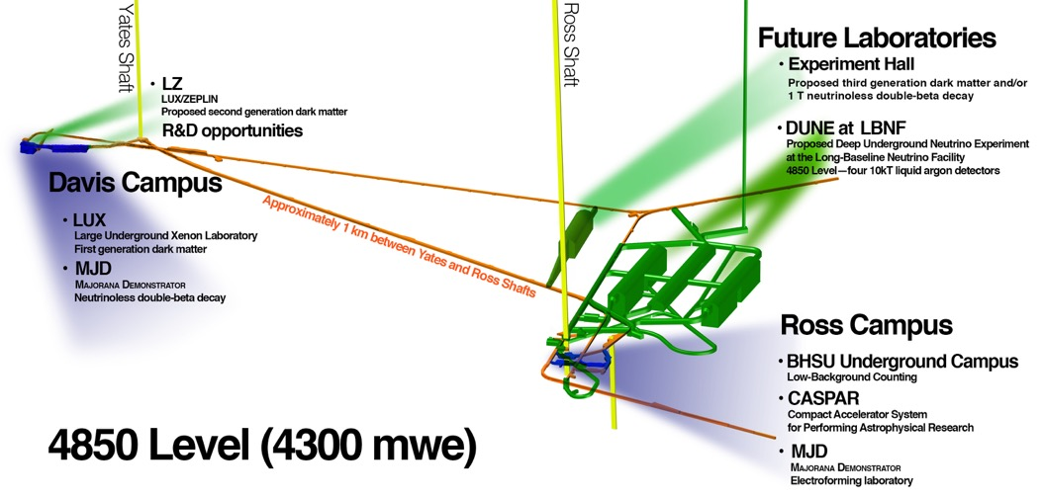
4850L Future Science Facilities
Existing Facilities
Future Facilities

Slide 16
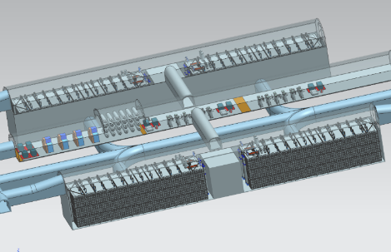
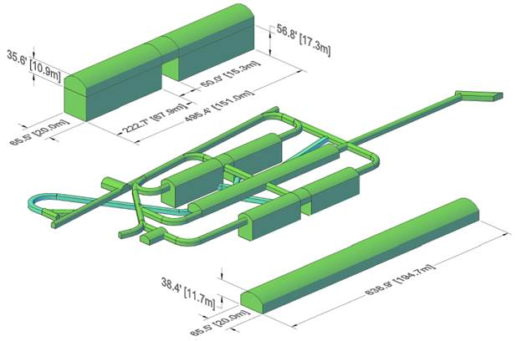
Underground Excavation

Slide 17
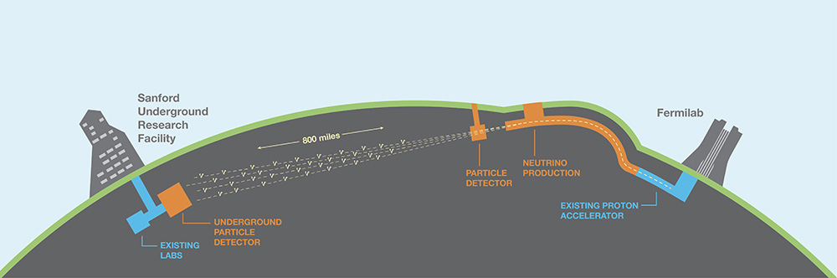
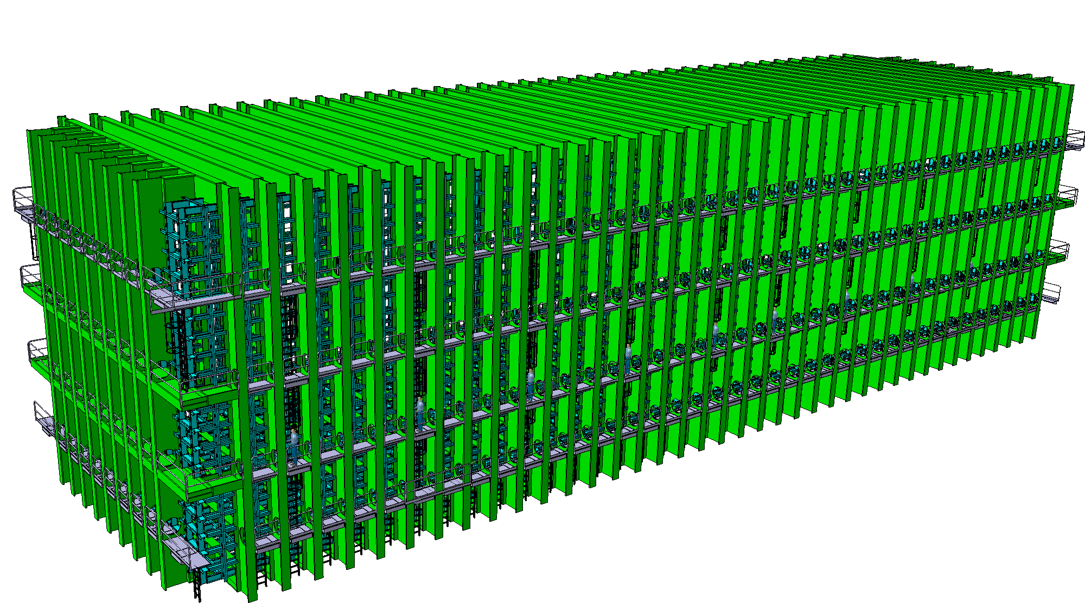
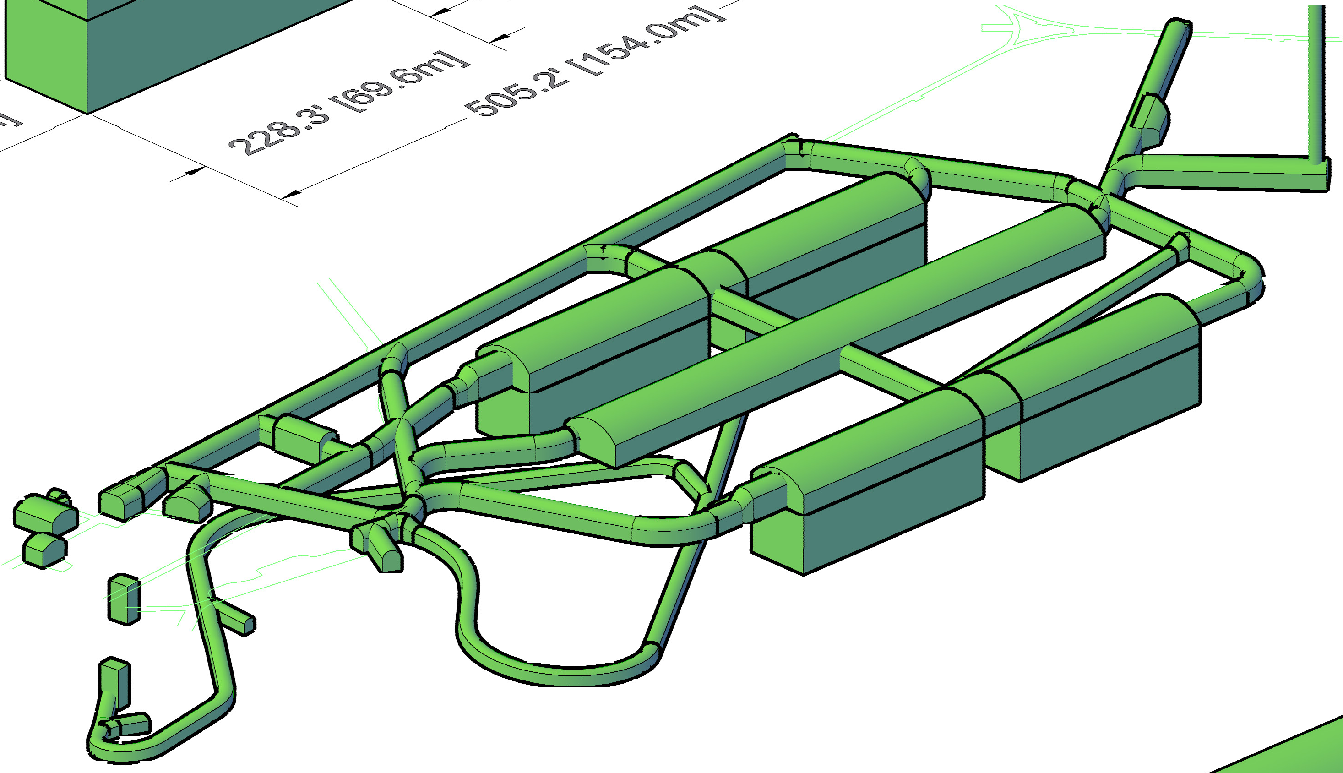
Long Baseline Neutrino Facility
LBNF will host Deep Underground Neutrino Experiment (DUNE)
LBNF is DOE project led by FNAL, SDSTA leading design for SD facilities
2 caverns on 4850L will accommodate 70 kT (total) / 40 kT (fiducial) LAr
Design optimized to allow parallel excavation/outfitting, geotechnical studies completed 2014, test blast program completed spring 2016
CD-3a held Dec 2015. Construction approval pending for 2017 start in SD
Excavation start 2019, ~3 year duration
4x10 kT, each chamber:
70m (L) x 20m (W) x 29m (H)
Free-standing steel cryostat
Notes:
Total cavern length = 154m
FY2017 budget $45M (pres.) + $10M (full senate) / $5M (house cmtte)
CD-3a (early construction) scope incl first detector cavern (2 detector chambers), the central utility cavern, associated drifts, utilities, cavern outfitting, and surface facilities
CD-3c/CD-2 timeframe is late 2019
Willhite schedule shown May DUNE collab meeting: excavation starts Jul 2018 completes by end of Feb 2021 -> 2.75 yrs total

Slide 18
4850L Geotechnical Site Investigations
Davis Campus
DUSEL
Yates Shaft
Poorman Formation amphibolite member
LBNF
Ross Shaft
Poorman Formation schist member
Ross Campus

Slide 19
Phase 1 – Geotechnical Site Investigation
Phase 1 Field Data Collection
Aug. 2013
Geotechnical site investigation goals and timeline
Mine drift mapping
Rock Mass Response and Performance
Modes of failure
Core drilling
In situ stress measurements
Hydrology
Lab analyses
Interpretation of Rock Mass Rated domains
Modeling
Timeline
Phase 2 Borehole Investigation
July 2014
Introduction

Slide 20
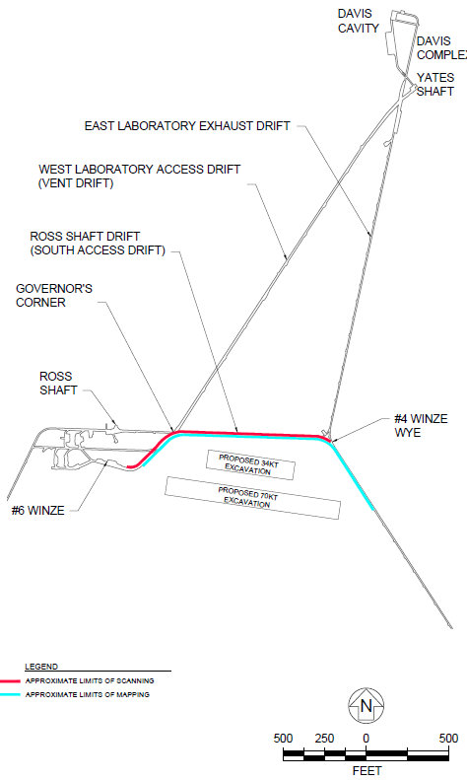
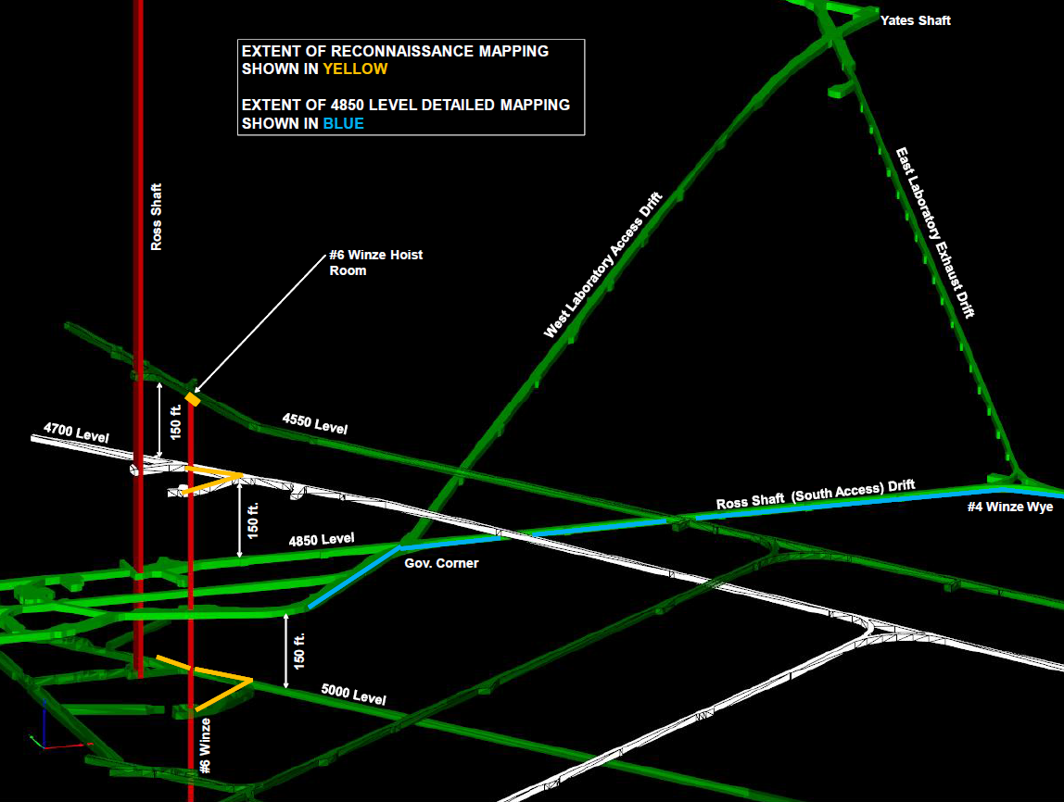
Phase 1 - Mapping Extents
1600 ft. (488m) mapped
1200 ft. (366m) laser scanned
Mapped limited areas above (4700 L) and below (5000 L)
4550 L hoist room
Proposed site

Slide 21
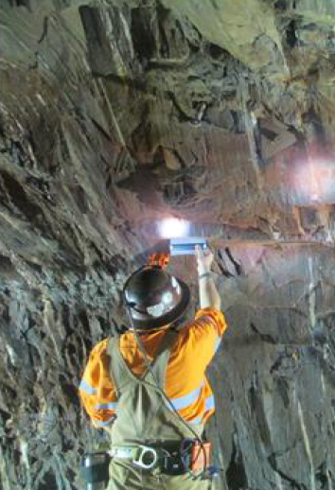
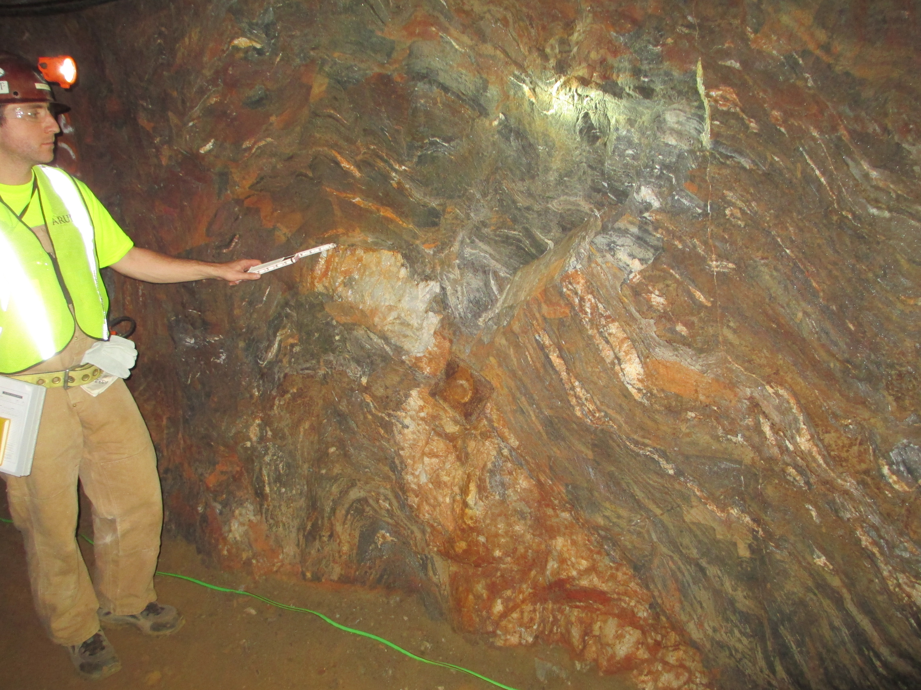
Phase 1 - Drift Mapping
Detailed geological mapping of existing mine drifts – both lateral and vertical extents considered
Laser scan drifts to collect as-constructed geometric info for uploading into SURF’s Vulcan 3D mine model
Characterize the rock mass and discontinuities for design purposes

Slide 22
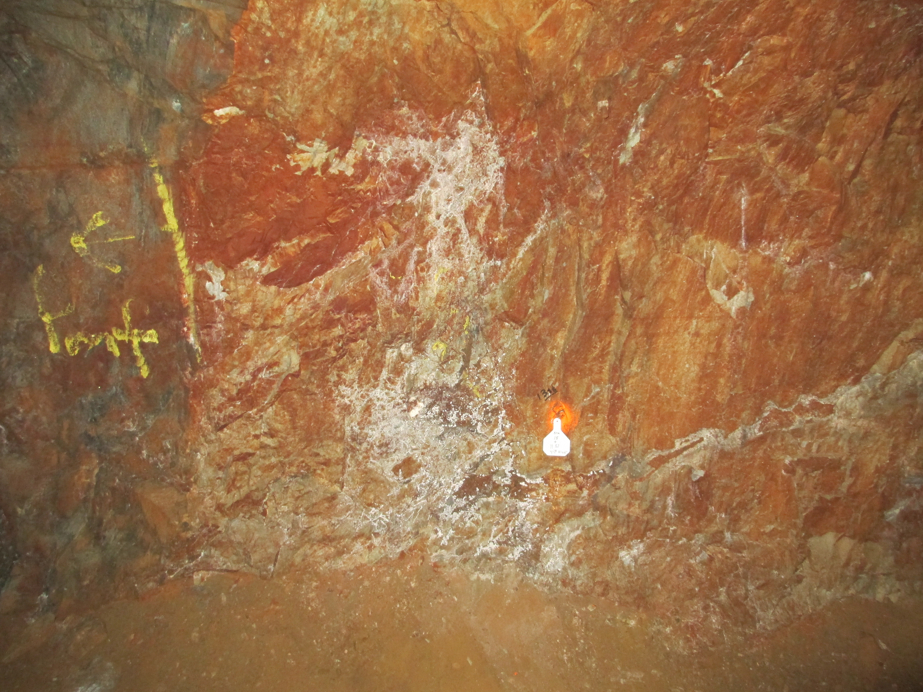
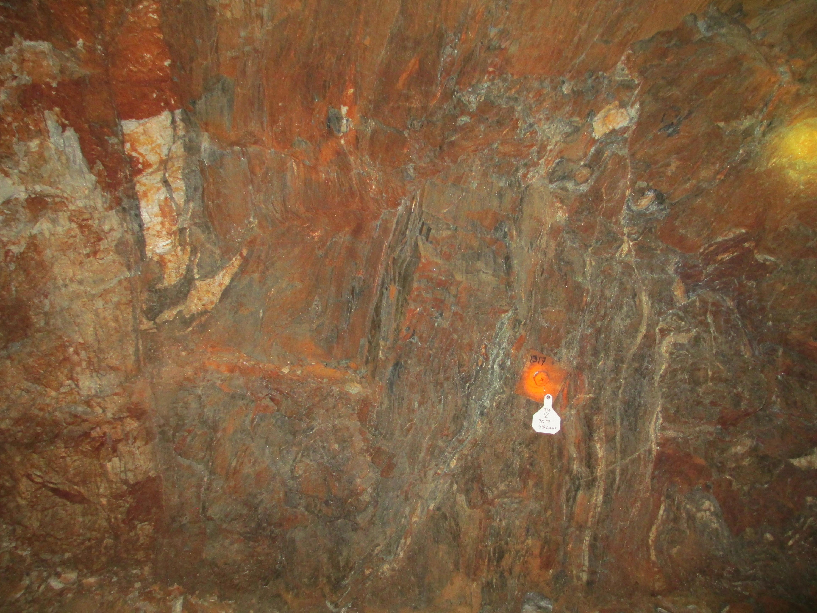
4850L Geological Mapping Observations
Tertiary rhyolite dikes
Not foliated
2 ft. (0.6m) to 40 ft. (12m) wide along drifts
Contact between the two is generally intact
Important to map / project as difference in engineering properties may (and has previously been observed) result in adverse behavior during excavation (e.g. spalling)

Slide 23
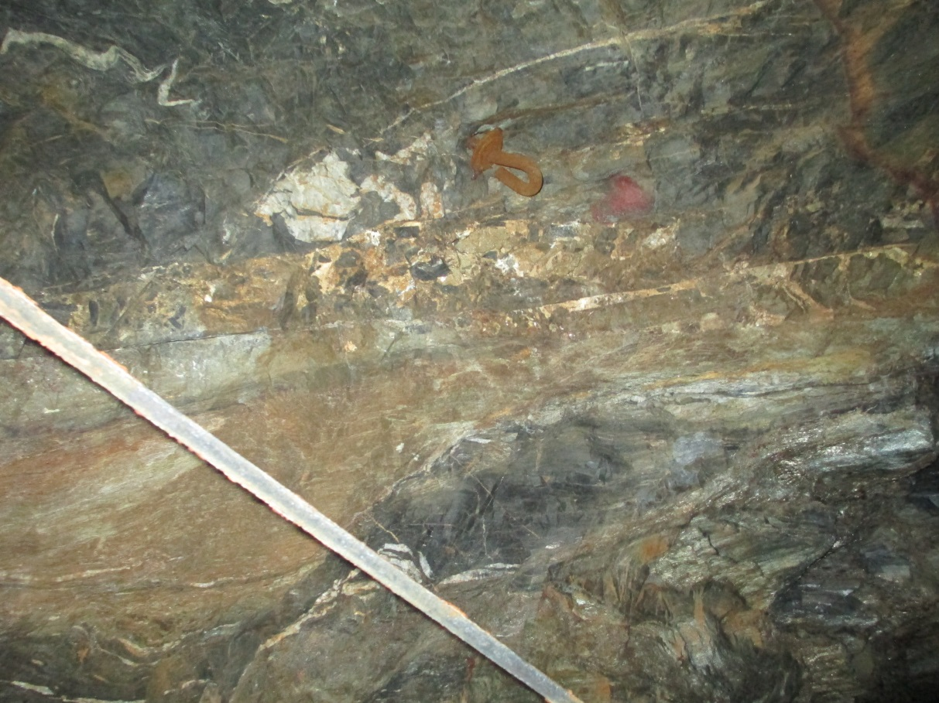
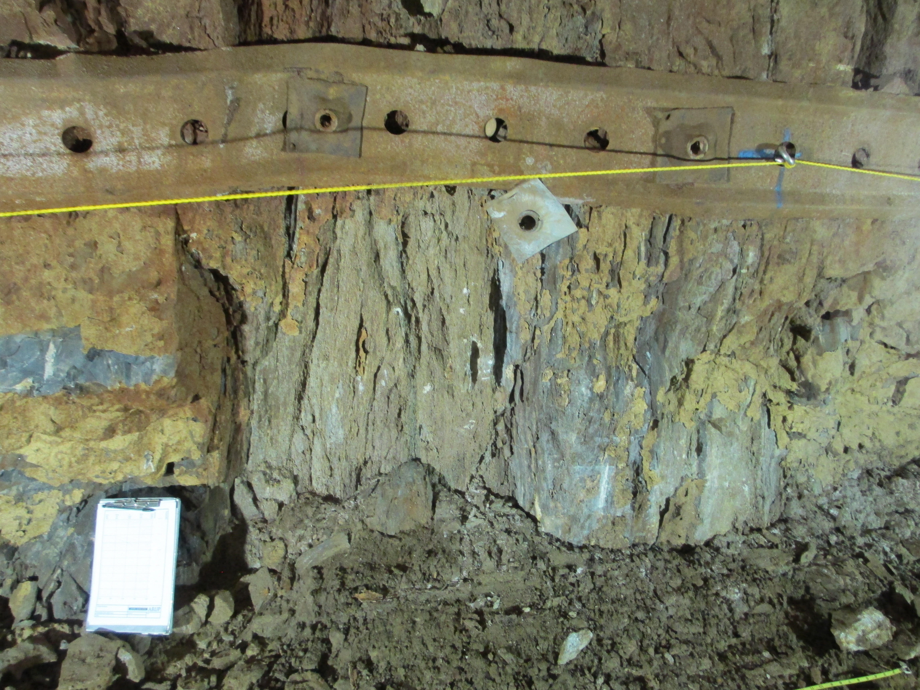
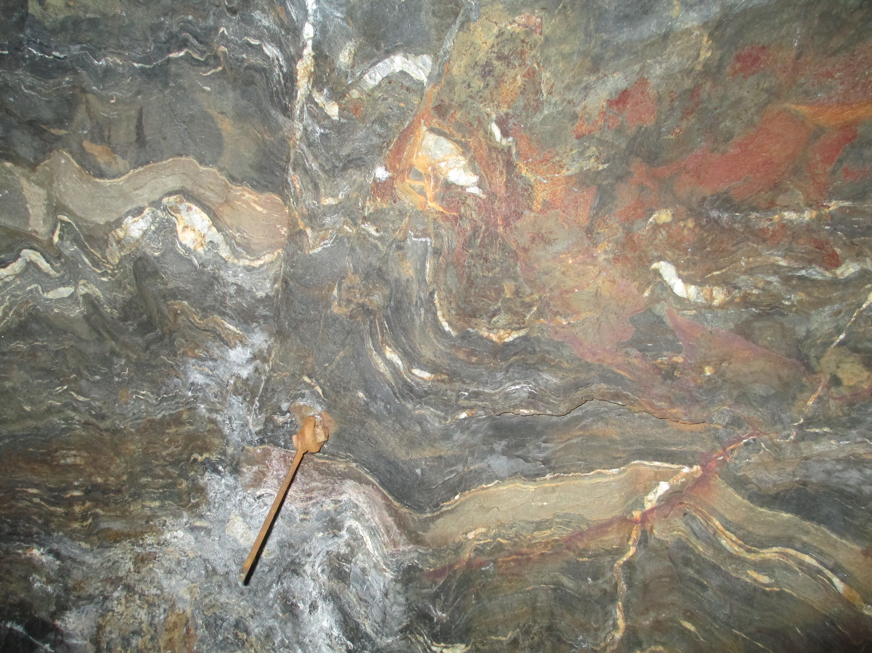
4850L Geological Mapping Observations
Faults and Shears
Limited structures
Majority well healed
Some apparent ductile shear zones, mica and quartz rich
Relatively continuous structure

Slide 24
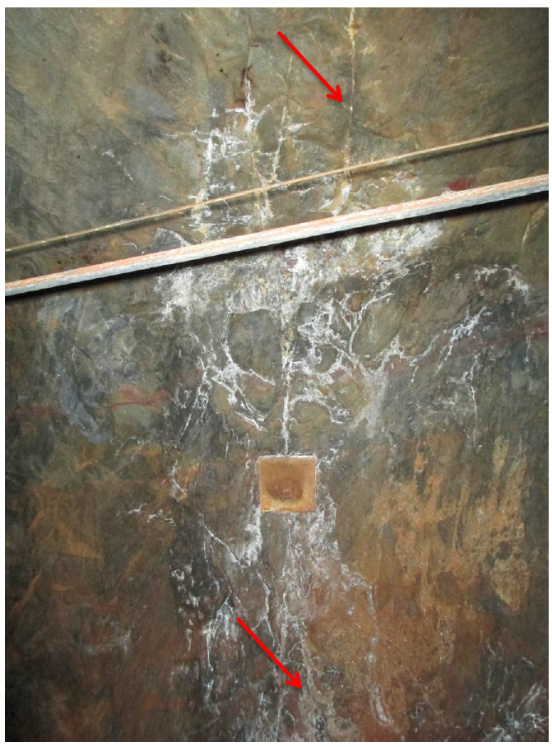
4850L Geological Mapping Observations
Joint Veins
Mineralized veins, through-going and high persistence, up to several inches thick
Occasionally acting as kinematic release plane for wedge fallout
J/Vs crosscut rhyolite dikes, suggesting they are manifestation of recent tectonic activity
Filled to partially filled with quartz and pyrite, often vuggy or voided
Often associated with white “effervescence” where groundwater seepage had/is occurring and dried out. (White residue is dissolved solids precipitated out)
Suggests these features are the main conduit for groundwater flow, where present

Slide 25
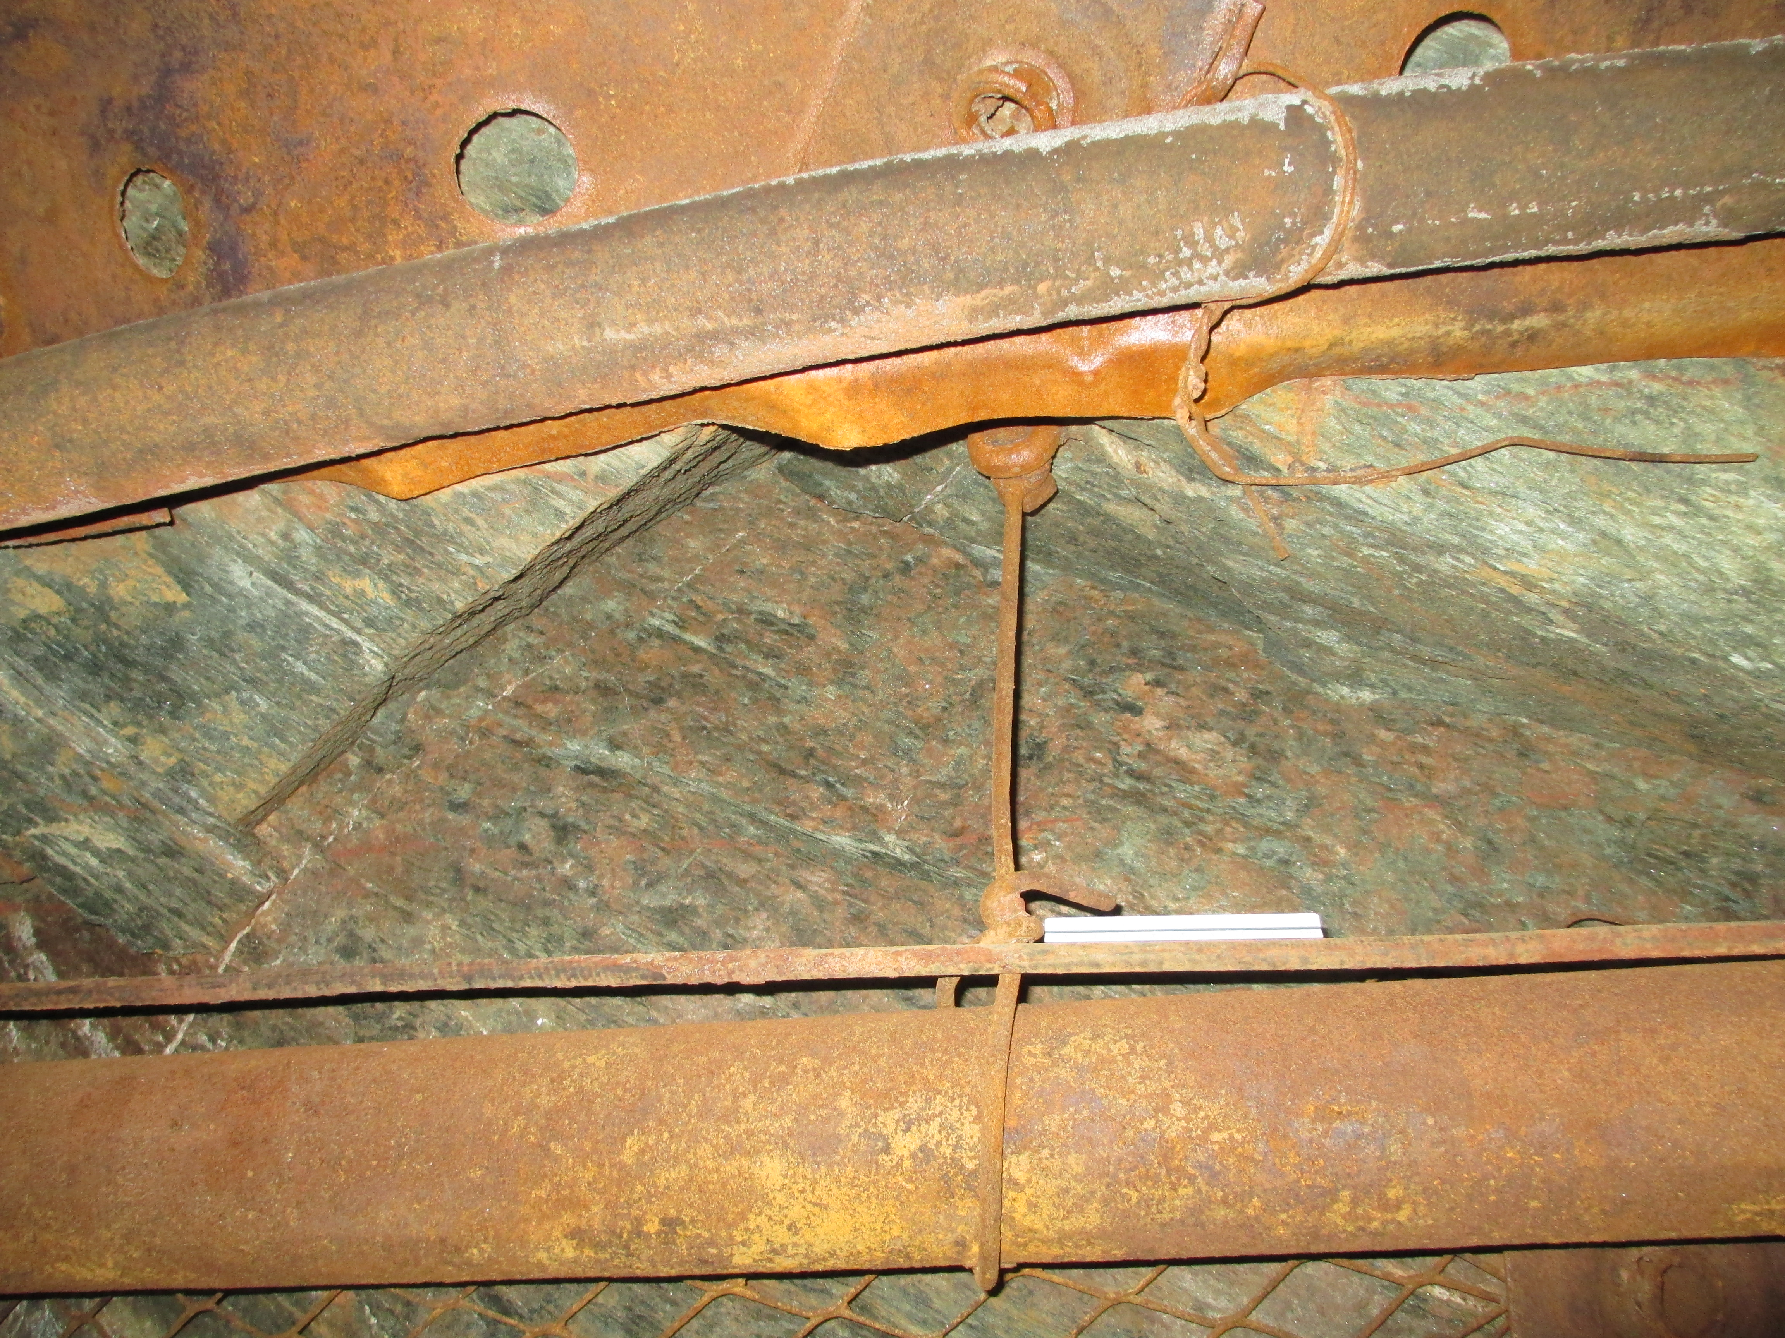
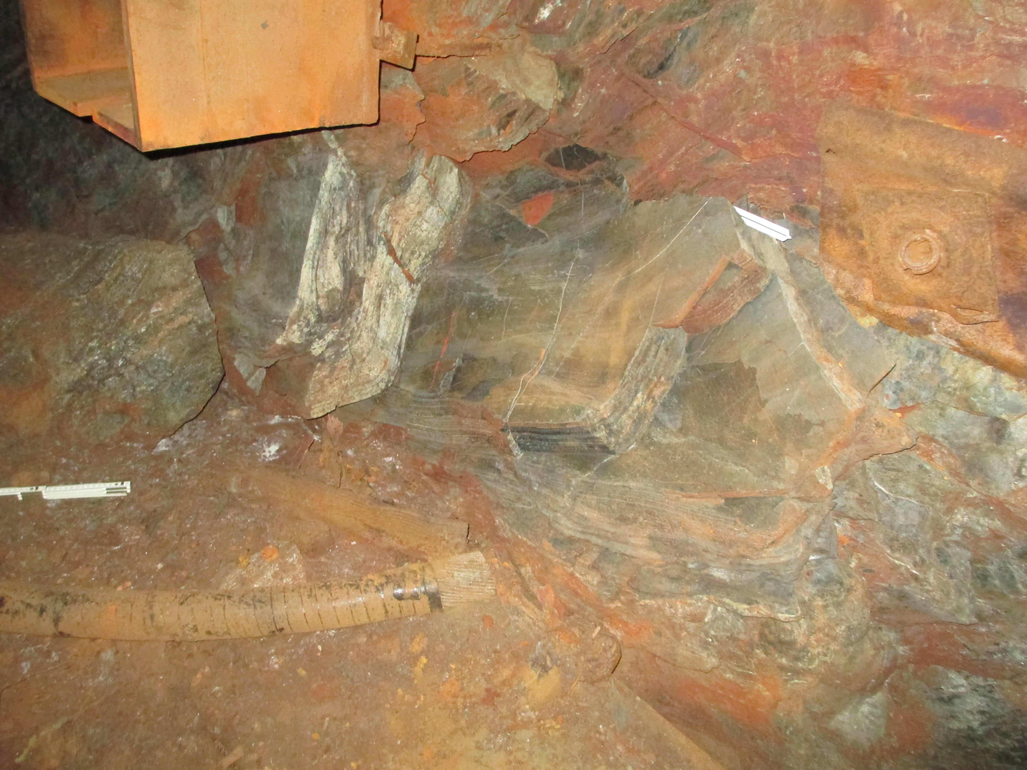
4850L Geological Mapping Observations
Other observations
Limited kinematic failures
Some slabbing past #4 Winze Wye where drift is subparallel to foliation
Modes of failure

Slide 26
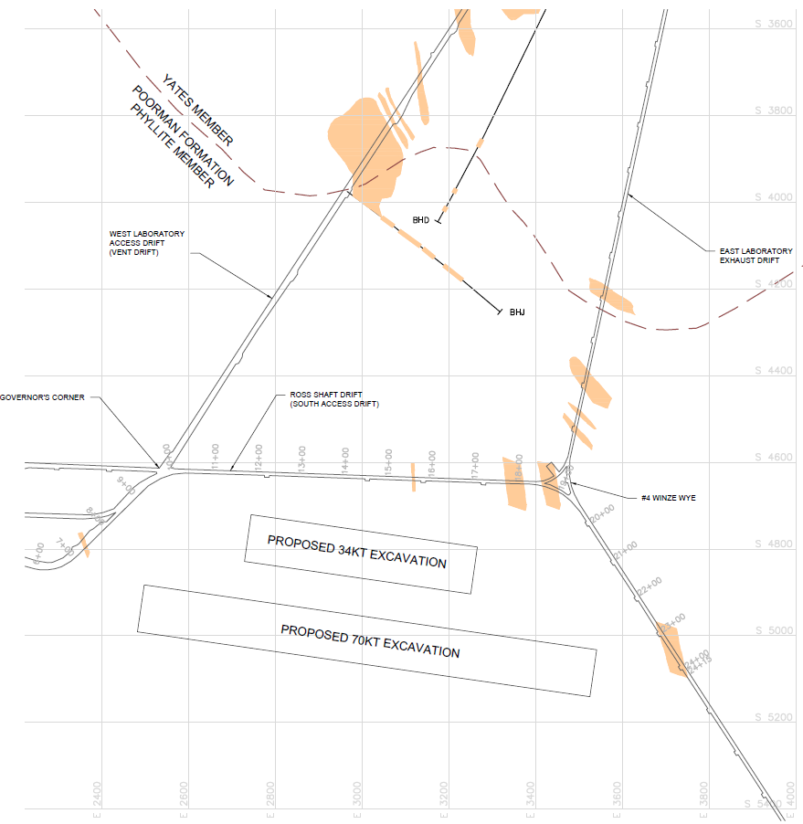
4850L LBNF Site Geologic Map
General Phase 1 Summary
Project area dominated by
Poorman Formation schist member.
Complexly foliated and folded
Rhyolite dikes and lower GSI rated
domain predominately on east side
of proposed site
Poorman Formation schist and amphibolite member contact to north
Proposed site

Slide 27
Phase 2 – Borehole Investigation
Phase 1 Field Data Collection
Aug. 2013
Geotechnical site investigation goals and timeline
Mine drift mapping
Rock Mass Response and Performance
Modes of failure
Core drilling
In situ stress measurements
Hydrology
Lab analyses of rock characteristics
Interpretation of Rock Mass Rated domains
Modeling
Timeline
Phase 2 Borehole Investigation
July 2014
Introduction

Slide 28
Phase 2 - Borehole Investigation
Primary goal was to evaluate different cavern configurations within the area of interest
Investigation Included:
771 meters of HQ-size (64 mm) core drilled in four drill holes
20.6 meters of PQ-size (152 mm) core drilled in two drill holes
Packer testing in two longest boreholes
Downhole imaging of HQ Boreholes
In-situ stress testing in PQ Boreholes

Slide 29
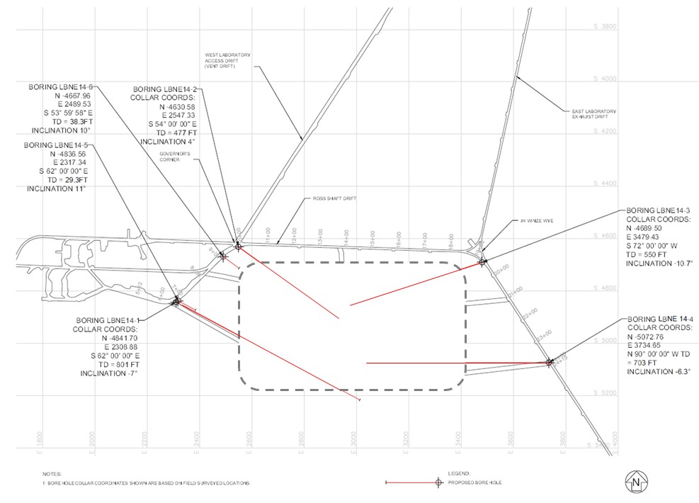
Phase 2 - Borehole Investigation
Potential for different cavern configurations covered by investigation
771 meters of
HQ-size (64 mm)
core drilled
20.6 meters of
PQ-size (152 mm)
core drilled for
CSIRO hollow
inclusion cell
(HI cell)

Slide 30
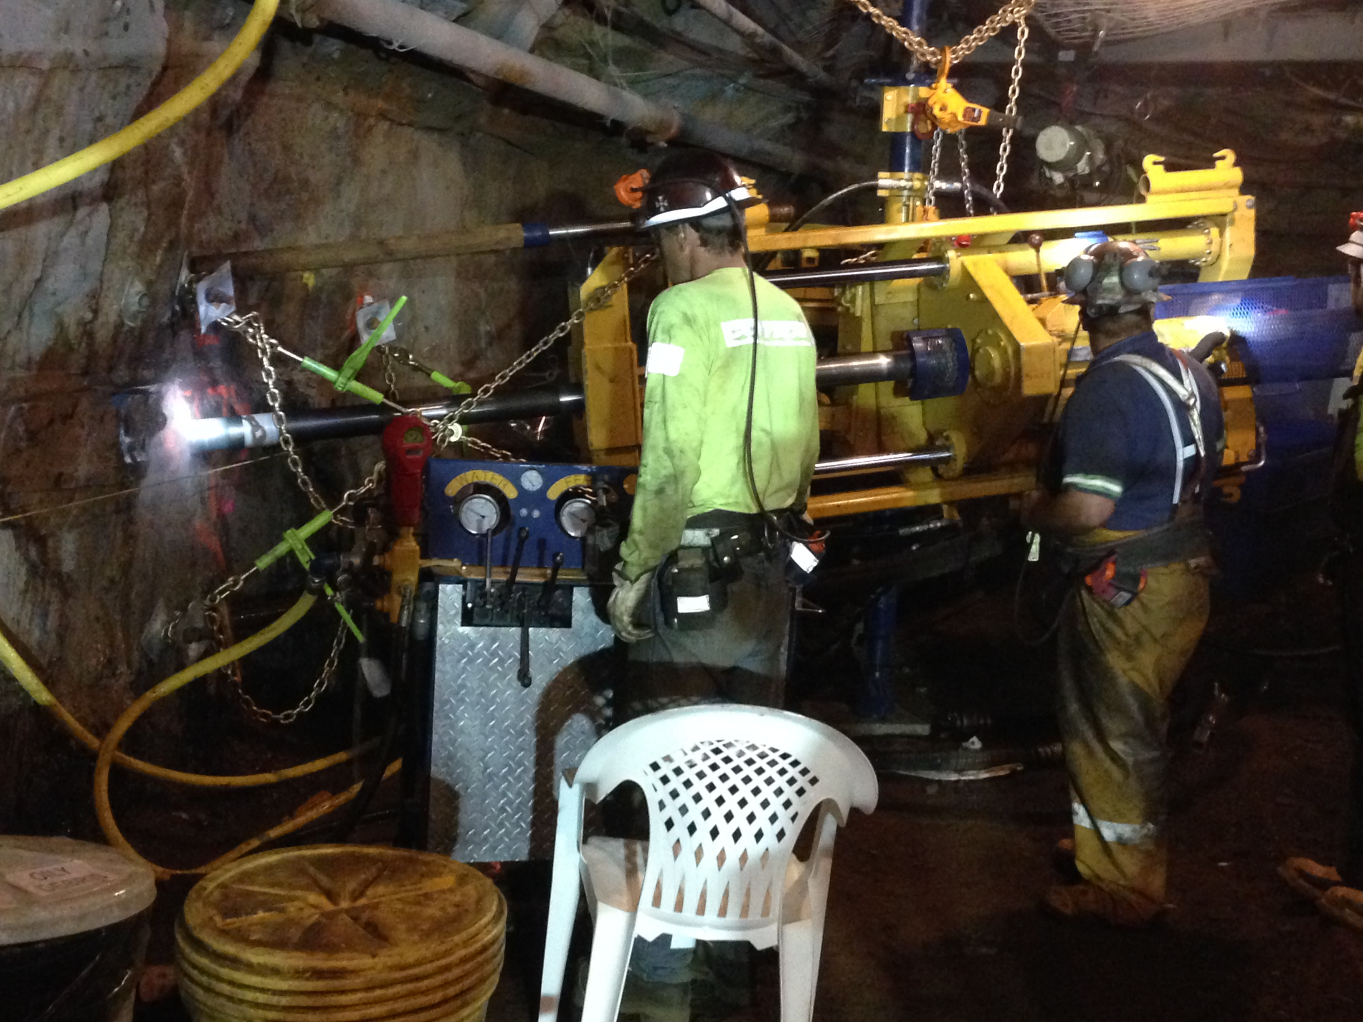
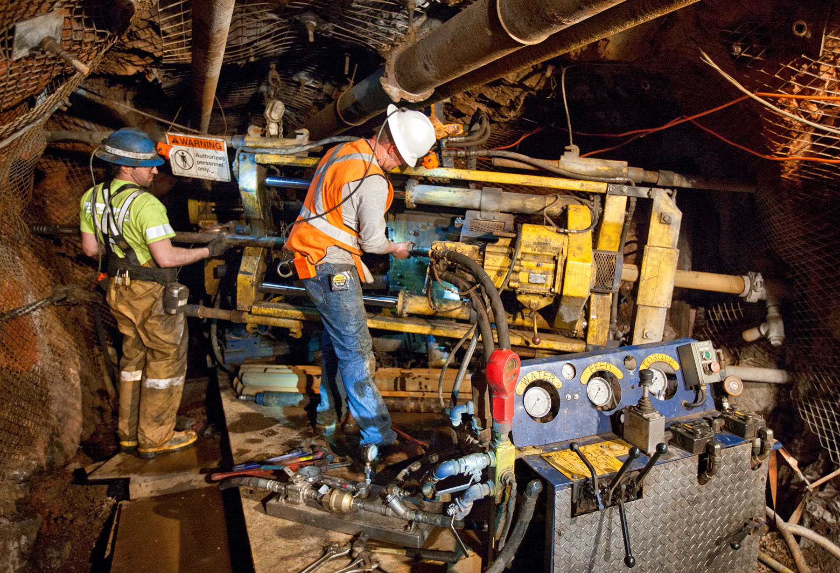
HQ (96/64 mm) Core Drilling Program
20HH Underground Electric / Hydraulic Core Drill
Large equipment for existing drifts
Significant setup efforts

Slide 31
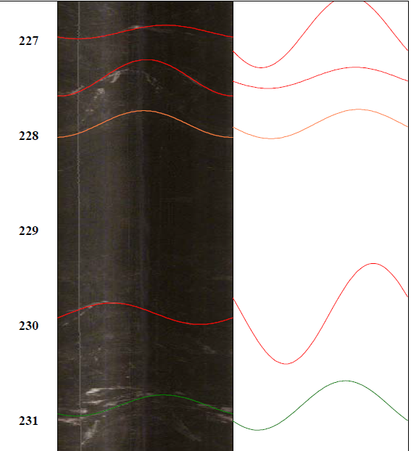
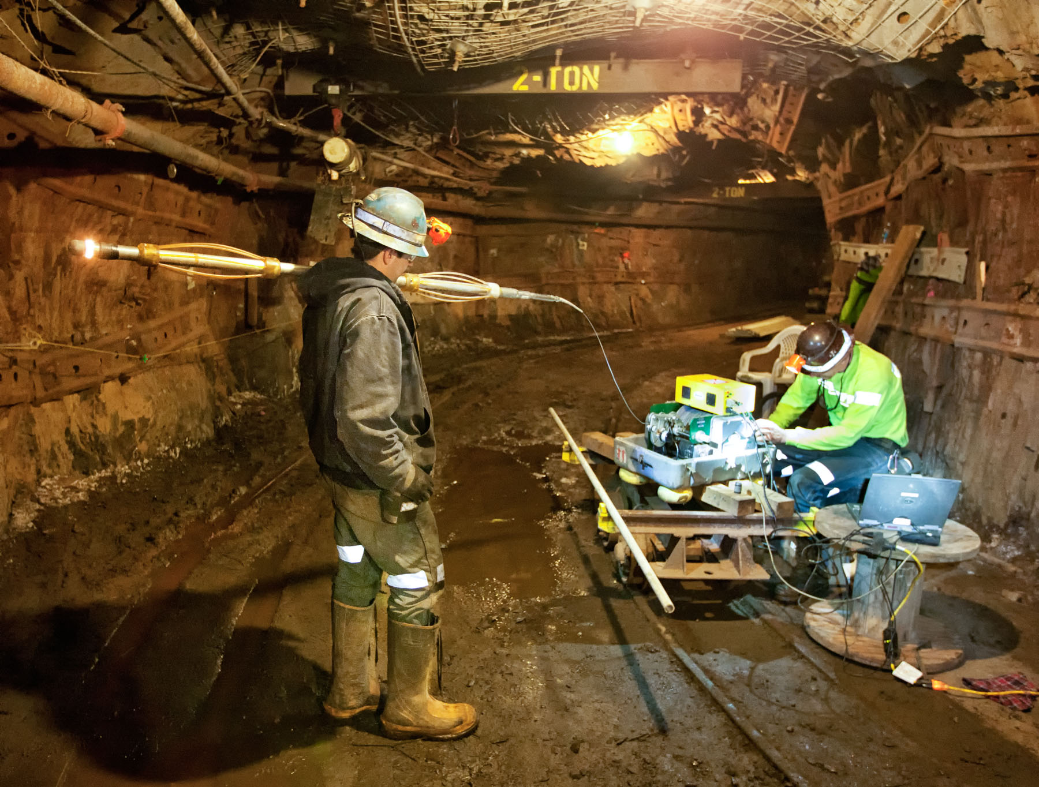
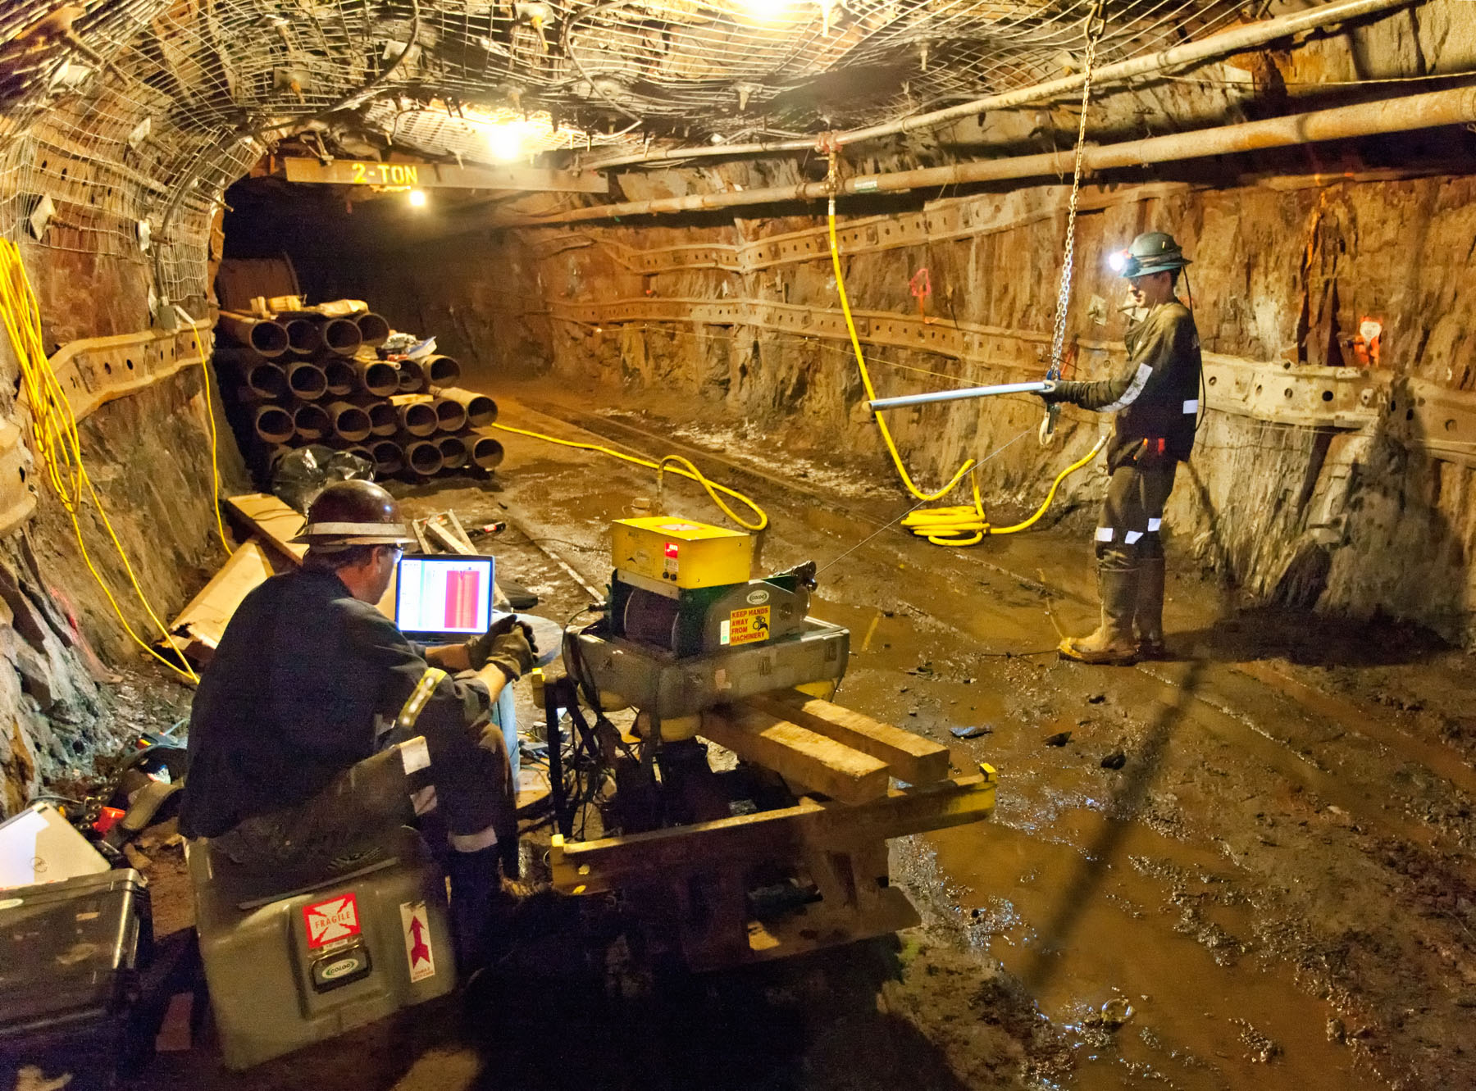
Downhole Imaging
Applied both acoustical and video
LBNE 14-3

Slide 32
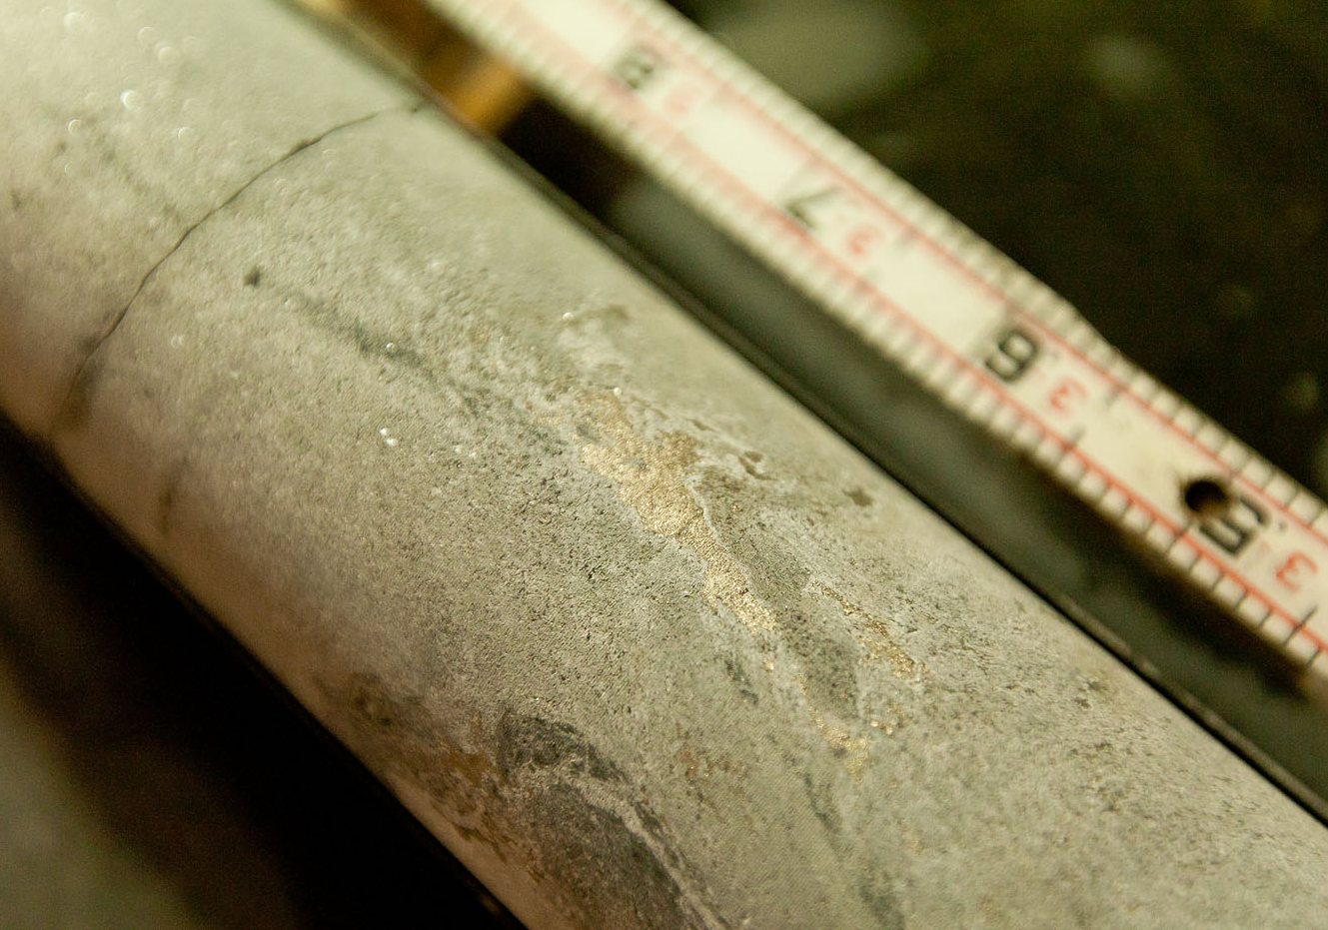
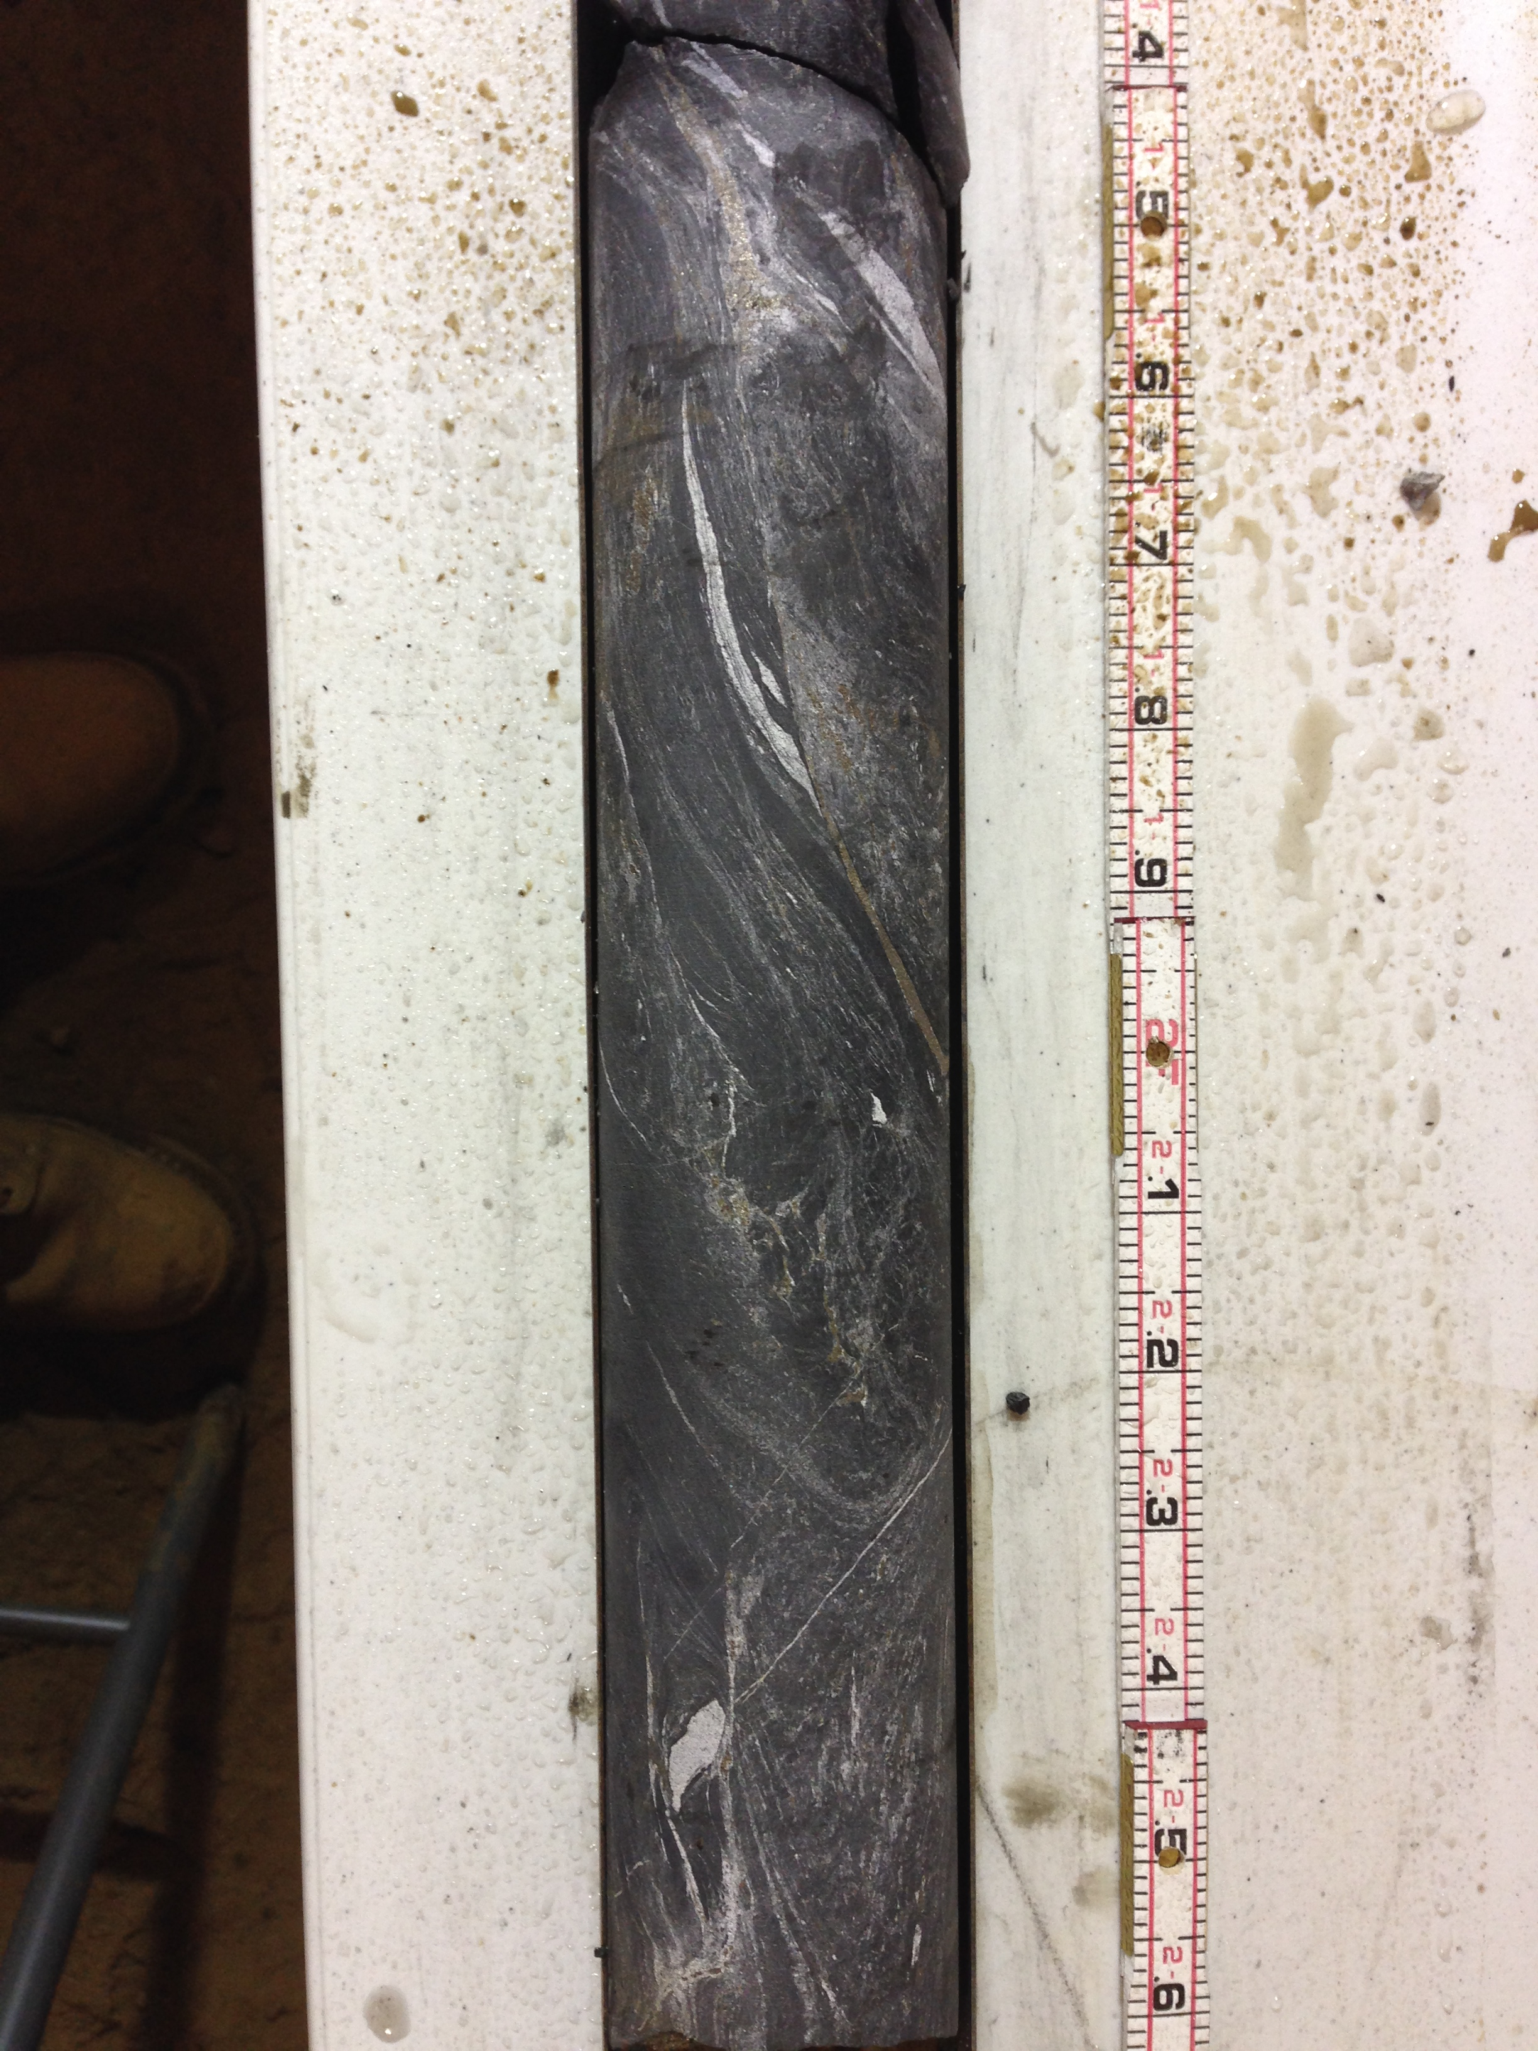
Phase 2 Investigation Results
Sulfides
Primarily in low carbonate, graphite-rich rock
Blebs and stringers
Locally magnetic

Slide 33
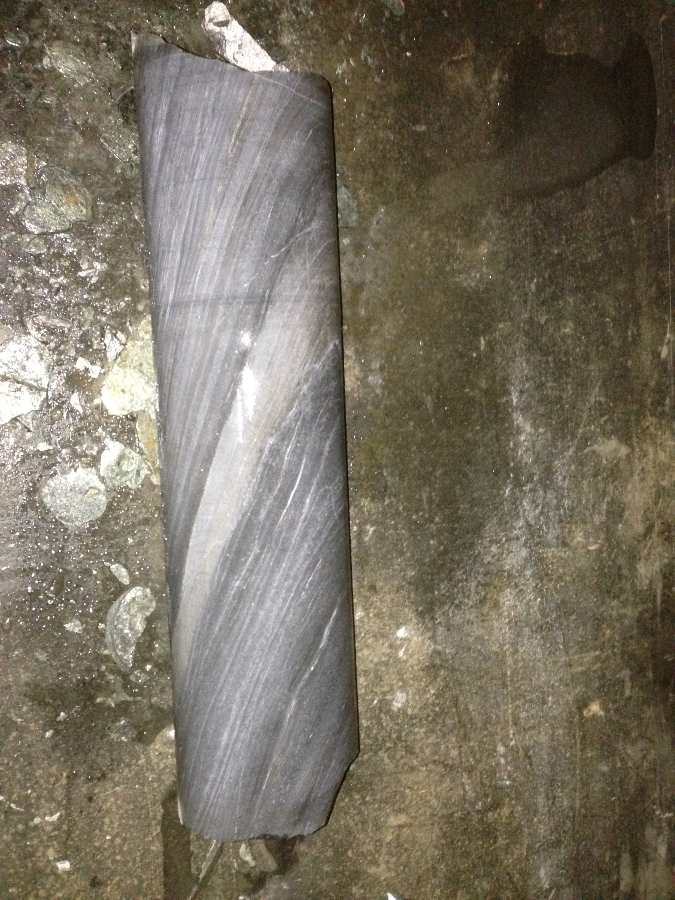
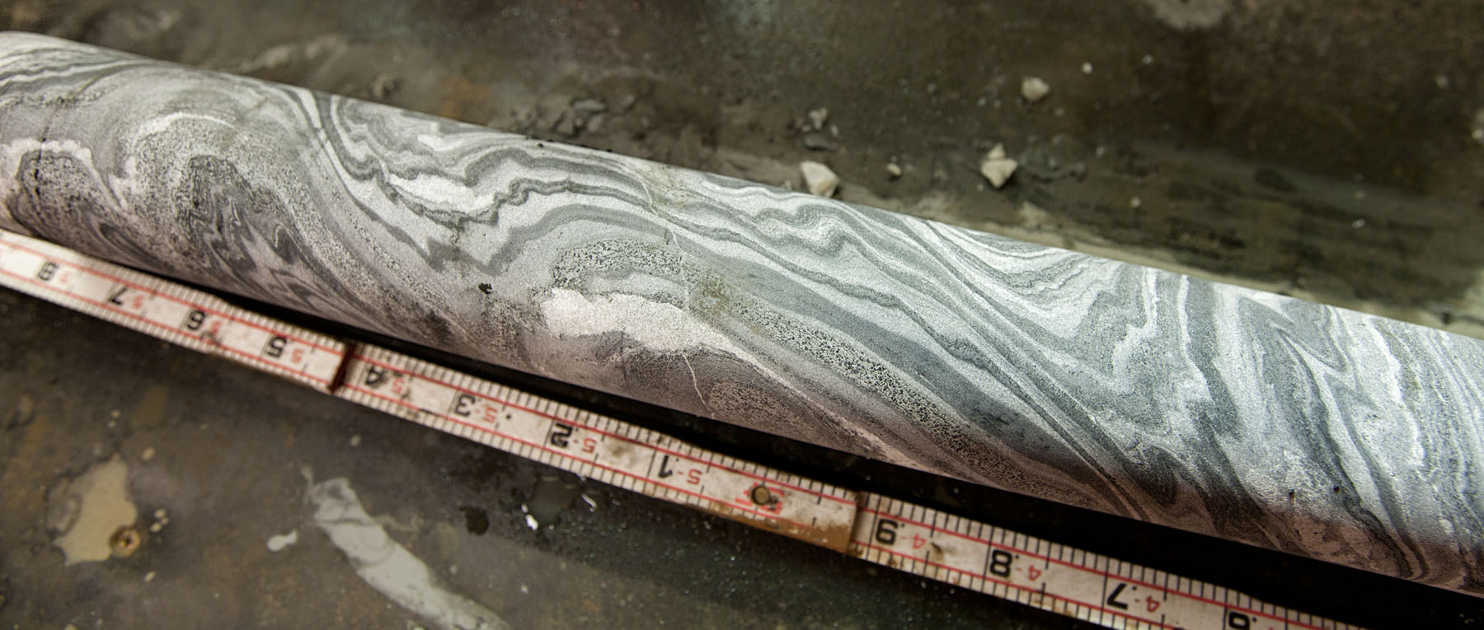
Phase 2 Investigation Results
Foliation
Contorted versus planar
Present at all scales

Slide 34
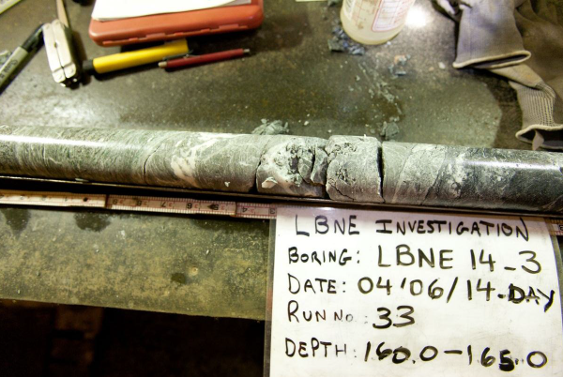
Phase 2 Investigation Results
Faults and Shears
1-2 zones encountered in each borehole, except LBNE 14-2 (none)
Typically 100mm wide or less, weakly cemented, brecciated shears, micaceous
Lower overall strength compared to surrounding rock mass (~50% lower)
Maximum thickness of 0.6m in LBNE 14-3. Altered, weak to very weak. Clay infilled and chlorite infilled, smooth joints.
Core demonstrates localized destressing (nickeling) weeks after drilling

Slide 35
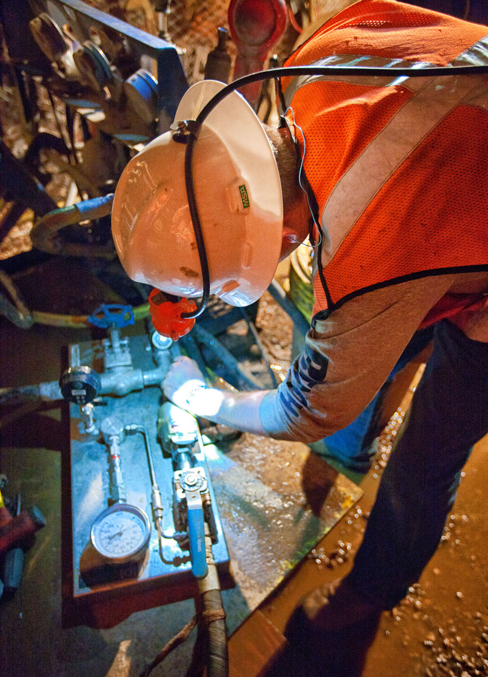
Phase 2 Investigation Results
Hydrologic Investigation
Pumped packer system down borehole
Packer injection testing
Borings LBNE 14-1 and LBNE 14-2 interval testing & full borehole testing
Rhyolite vs Poorman Formation Schist
Three holes encountered less then 0.1 liter per minute flows from fractures
Fourth hole encountered no flow and remains dry today

Slide 36
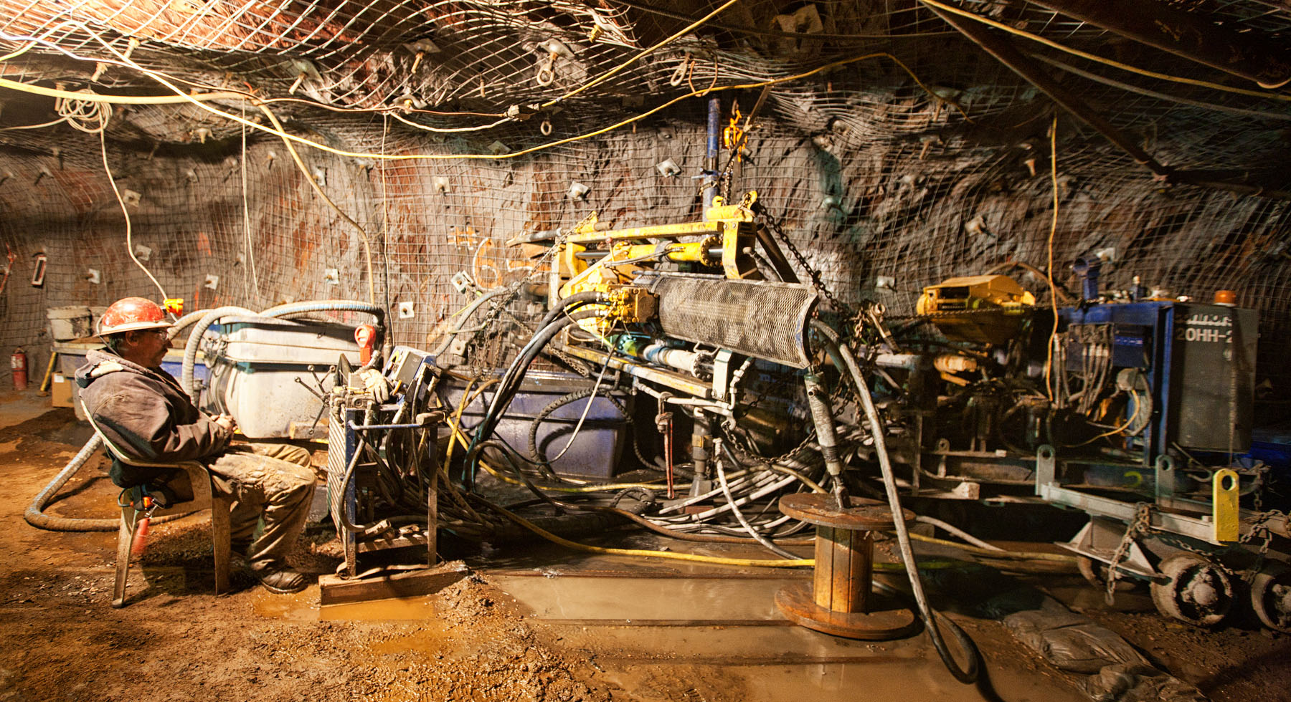
Phase 2 Summary Investigation Results
(3) lithologies of Poorman Formation Schist depending on mineralogy
  Sericite carbonate quartz schist (74.3 Percent)
  Graphitic quartz sericite schist (16.3 Percent)
  Biotite carbonate quartz schist (3.3 Percent)
Tertiary Rhyolite (6.1 Percent)
All lithologies contain graphite, just in varying percentages
Sulfides (pyrite, pyrrhotite) occur in blebs or stringers along foliation up to 20-30 percent in graphitic schist
Foliation varied from planar and intense to wavy and contorted

Slide 37
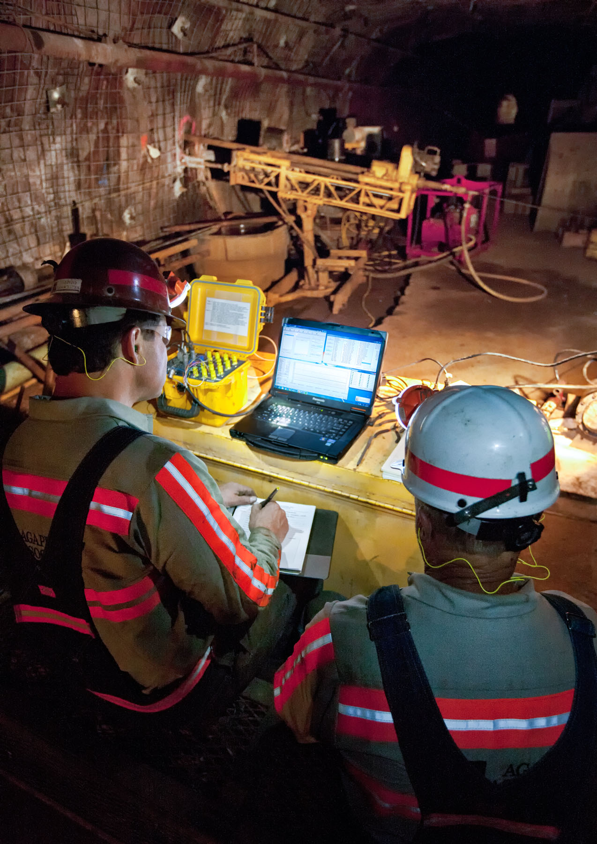
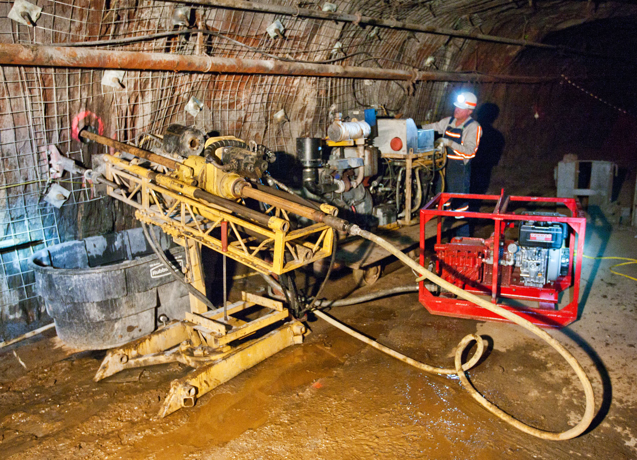
In-Situ Testing
Completed in LBNE 14-5 and LBNE 14-6
CSIRO hollow inclusion cell (HI cell)
Completed by Agapito Associates
6 tests scheduled, 5 successfully completed.

Slide 38
In-Situ Testing

Slide 39
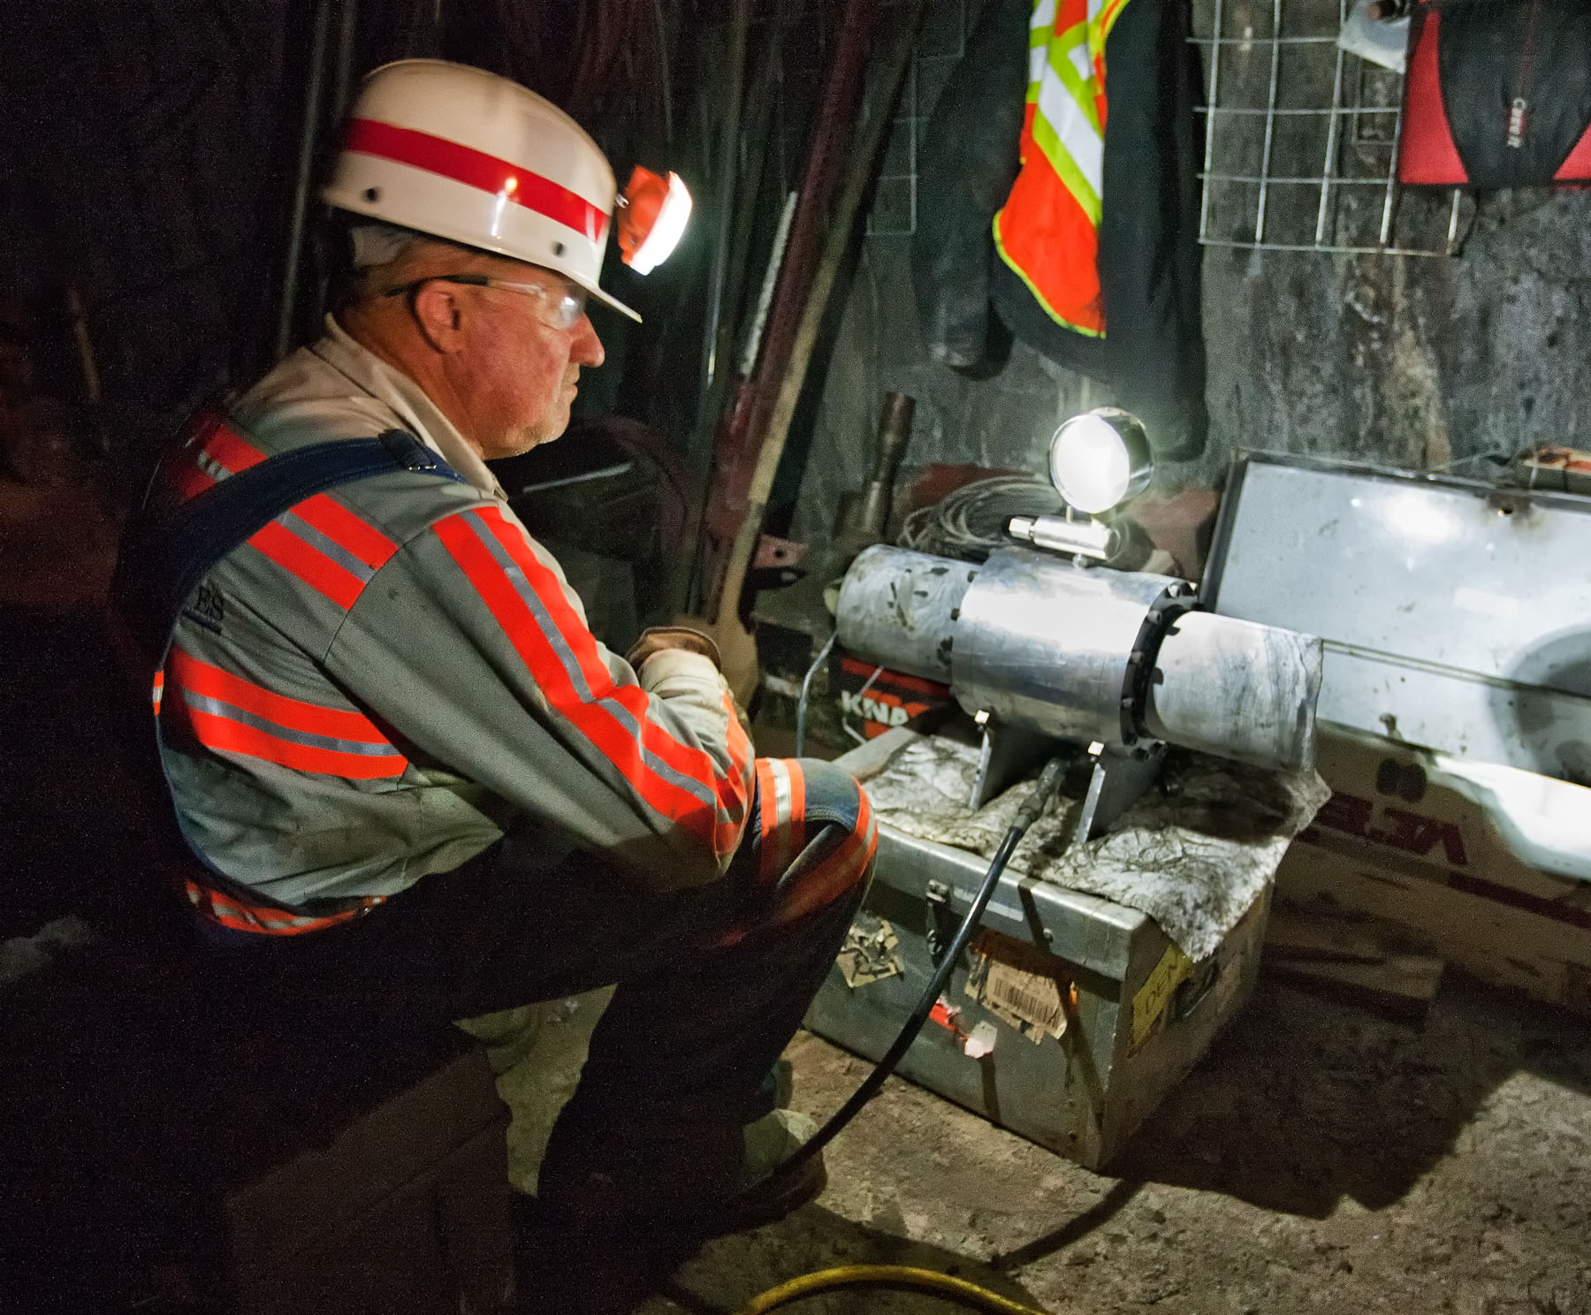
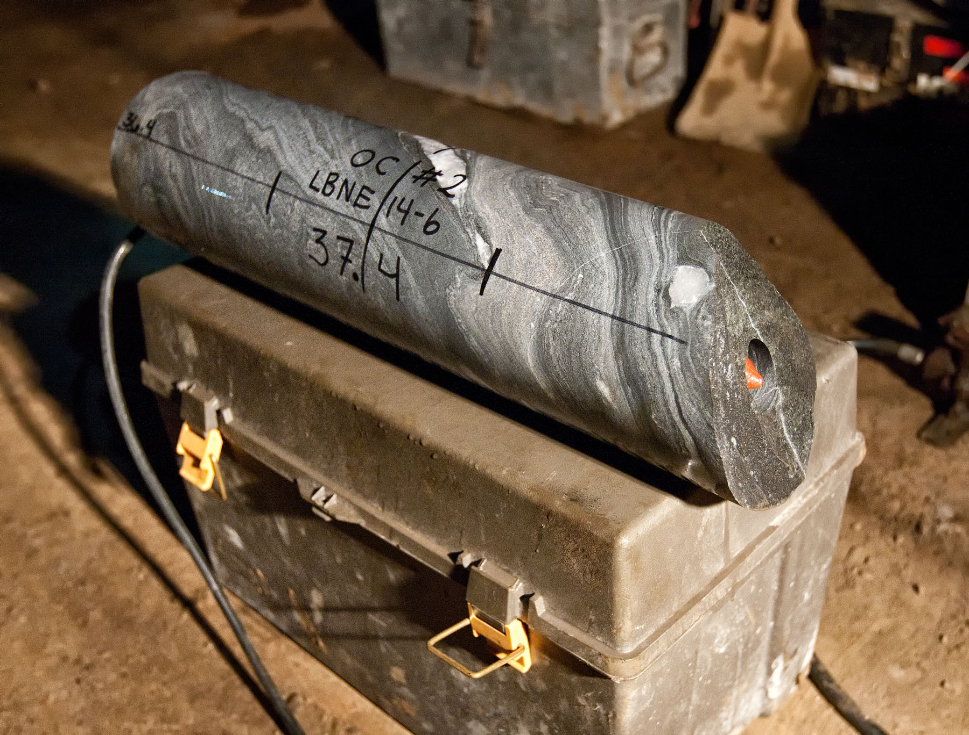
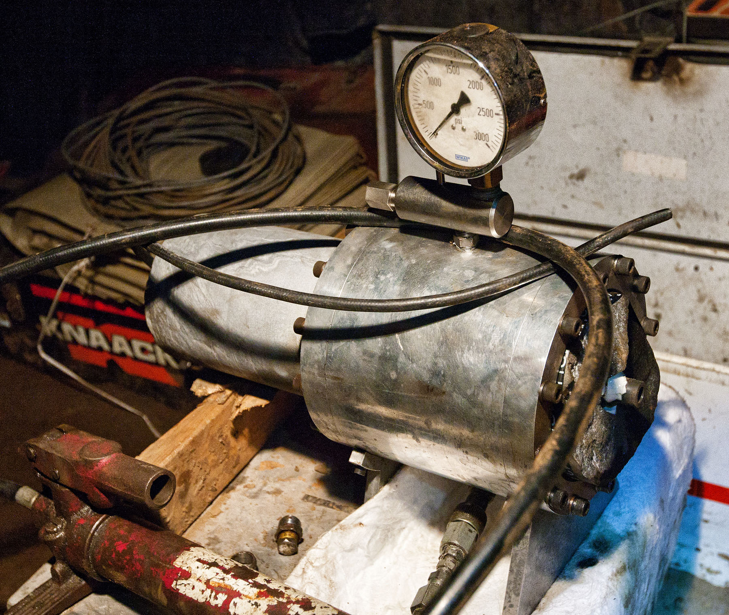
In-situ Testing
Biaxial Load Cell Tests
4 successful tests
Sample broke during overcore of 5th test

Slide 40
Laboratory Analysis
Laboratory testing of rock core including uniaxial compression strength tests, tensile strength tests, triaxial compression strength tests, uniaxial creep test, and direct shear tests on joints.
Laboratory chemistry testing of groundwater including pH and conductivity.
Observations of groundwater inflow and long term monitoring of groundwater (shut-in) pressure build-up in boreholes.
The density ranged from 169 pcf (26.5 kN/m3) to 191 pcf (30.0 kN/m3) with a mean of 176 pcf (27.6 kN/m3). For numerical modeling, a unit weight of 175 pcf (27.5 kN/m3) is recommended.
Twelve UCS tests were performed on the schist and test results ranged between 3.68 ksi (25.4 MPa) up to 17.16 ksi (118.3 MPa). Typically “non-structural” failures ranged between 10.22 ksi (70.5 MPa) and 17.16 ksi (118.3 MPa) while “structural” failures had lower strengths that ranged between 3.68 ksi (25.4 MPa) and 12.87 ksi (88.7 MPa).
It is anticipated that the rock strength of intact rock will typically range between 7 ksi (48.3 MPa) and 18 ksi (124.1 MPa) with the majority of the rock having strength around 13 ksi (89.6 MPa).
Two UCS tests were performed on the rhyolite and indicate a much higher strength when compared to the schist. Test results ranged between 20.26 ksi (139.7 MPa) and 26.46 ksi (182.4 MPa).

Slide 41
4850L Geotechnical Conclusions
Three distinct rock mass types;
  Poorman Formation schist member
  Poorman Formation amphibolite (Yates) member
  Tertiary-age rhyolite dikes
Poorman Formation rock masses highly deformed, foliated and variously jointed depending on rock type
Rock densities similar for Poorman Formation rocks, rhyolite lighter
Rock strength character varies by rock type, see previous slide
In-Situ Stresses: Sigma 1 sub-vertical and K ratios near parity
  Poorman Formation schist member amiable for upright cylinder cavern spans of 66 meter diameter and for mailbox caverns 34 meter spans. “Heroic” ground support measures are required beyond these limits of standard ground support 16 meter cable bolt lengths
  The Poorman Formation Schist is a “very good” to “extremely good” quality rock based on the rock mass characterization performed using the results of the geotechnical exploration program. The rhyolite tends to exhibit lower quality and ranges from “fair” to “very good” quality and is influenced by presence of fracture-born ground water, based on results presented by Golder Associates (2011).
  Tertiary-age rhyolite dikes occupy older sheared rock domains, these dikes crosscut all older rock types, and act as through going, joint-controlled water conduits. Recommend avoiding these domains if possible.

Slide 42
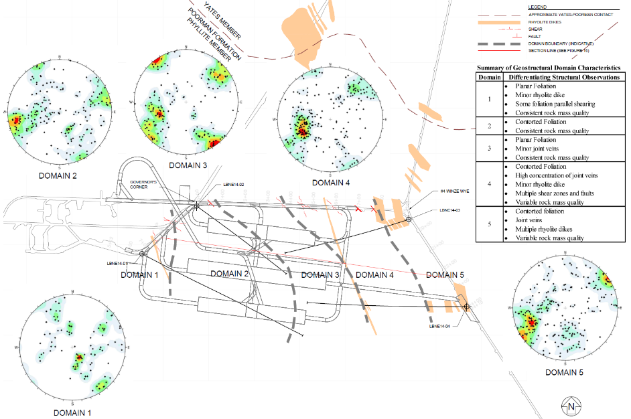

Cavern Locations

Slide 43

Upright Cylinder Trade Study Conclusions

Slide 44
Upright Cylinder Trade Study Conclusions

Slide 45

Upright Cylinder Trade Study Conclusions

Slide 46
THEIA BOE Assumptions
Disclaimer:
The following BOE is an initial, high-level design and cost
estimate premised upon SURF’s current level of understanding
of the THEIA Project requirements. It is known that further
maturation of project related requirements will significantly alter
cost and schedule estimates.

Slide 47

THEIA Project BOE Design
Proposed THEIA location constrained by ventilation and logistical issues, not geotechnical considerations

Slide 48
THEIA Project BOE Design
Dome plus
Access Drift
Height
17 meters
6 meters
40 meters
46 meters
48

Slide 49
THEIA Project BOE Schedule Estimate

Slide 50
THEIA Project BOE Cost Estimate

Slide 51

Sanford Underground Research Facility
Danke !

Slide 52

Long Baseline Neutrino Facility Schedule
Notes:
Total cavern length = 154m
FY2017 budget $45M (pres.) + $10M (full senate) / $5M (house cmtte)
CD-3a (early construction) scope incl first detector cavern (2 detector chambers), the central utility cavern, associated drifts, utilities, cavern outfitting, and surface facilities
CD-3c/CD-2 timeframe is late 2019
Willhite schedule shown May DUNE collab meeting: excavation starts Jul 2018 completes by end of Feb 2021 -> 2.75 yrs total

Slide 53
Sanford Underground Research Facility

