Slide 1
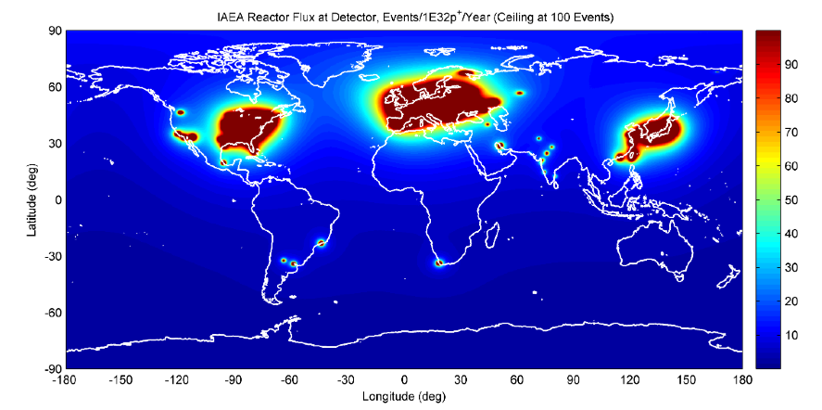
WATCHMAN, towards a Future of Water-based Neutrino Detectors
(Frost II 2016)
Steven Dazeley - LLNL
For the WATCHMAN Collaboration
Global reactor antineutrino fluxes
Simulation courtesy G. Jocher/J Learned, U Hawaii
This work was performed under the auspices of the U.S. Department of Energy by Lawrence Livermore National Laboratory under contract DE-AC52-07NA27344. Lawrence Livermore National Security, LLC. Release number LLNL-PRES-705911

Slide 2
WATCHMAN is the WATer Cherenkov Monitor for ANtineutrinos
Yes, the WATCHMAN project is alive and well….DOE-NNSA-Defense Nuclear Nonproliferation (DNN), remains a key supporter of this project
Our aim: Provide a working demonstration of long distance nuclear reactor monitoring in the 10-30 km range, with a scalable technology
Original Plan:
Joint non-proliferation/physics experiment funded by NNSA and DOE Office of Science
Current Plan:
Build proof of principle demonstrator of single reactor site remote monitoring
Raise awareness of physics and R&D potential of WATCHMAN - at FRosT and elsewhere
Become the primary R&D proving ground for future advanced water-based detectors (e.g. THEIA)
Get Office of Science involvement at a later date (Phase II)
Notes:
Main message I want to convey is that WATCHMAN is very much alive.
What happened was that originally WATCHMAN was conceived as a joint….

Slide 3
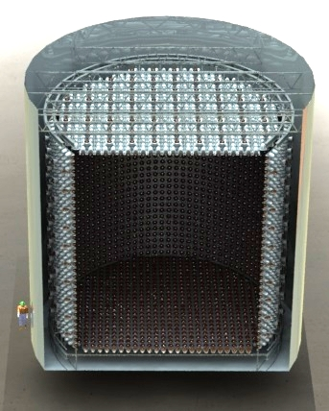
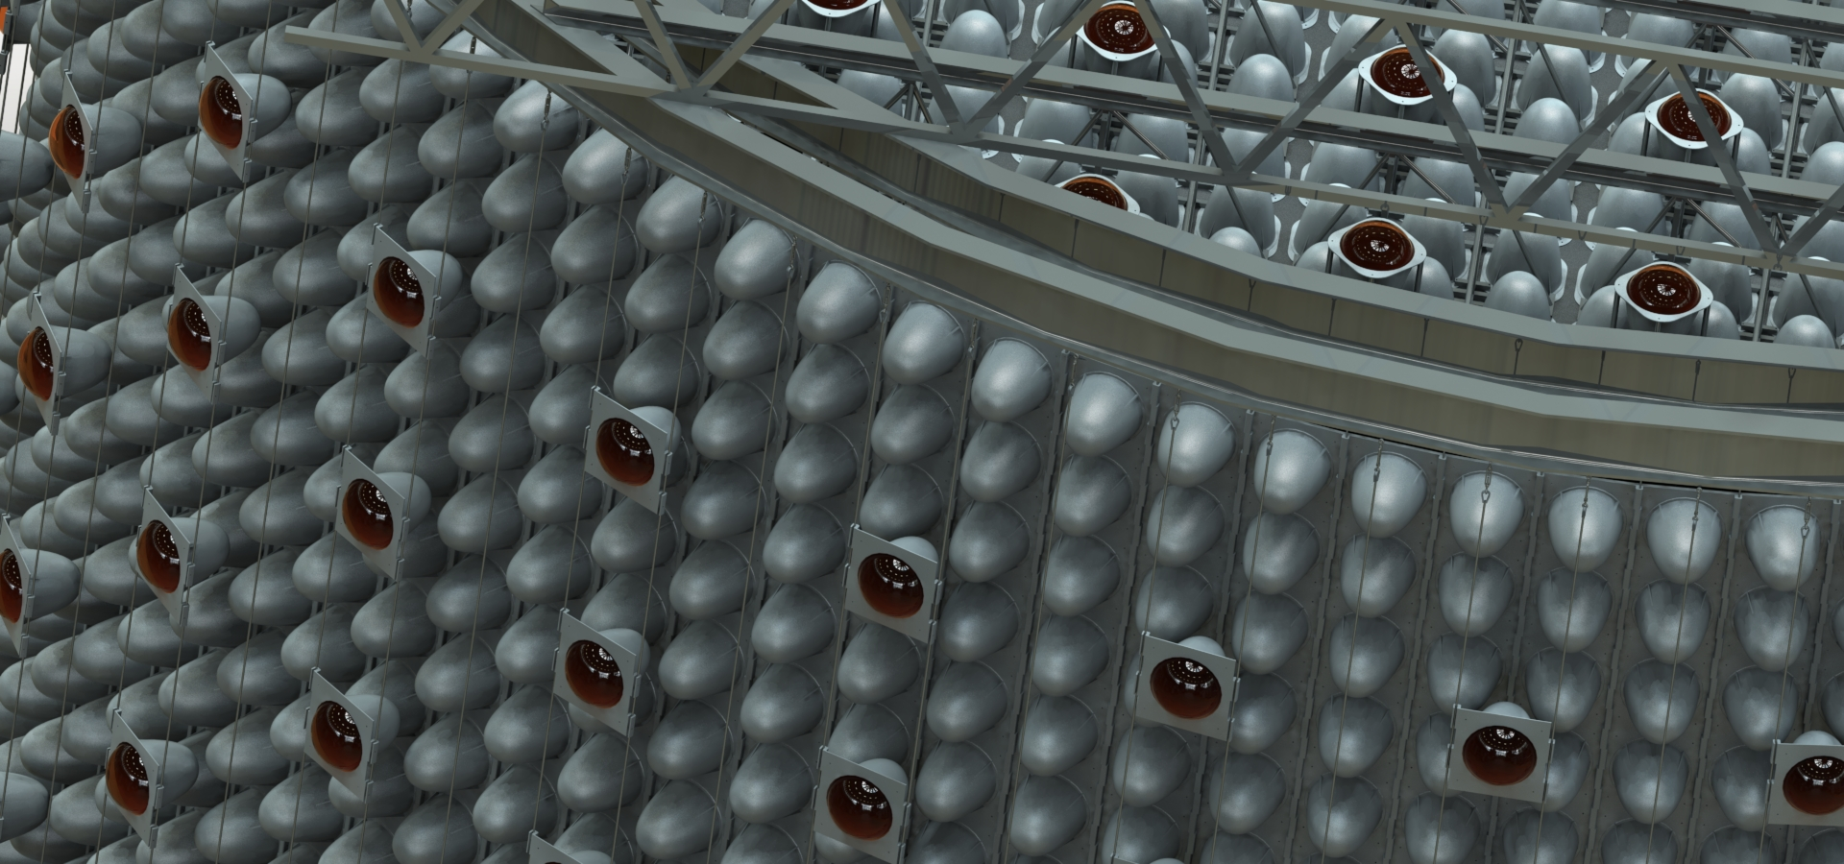
Design and Deployment Overview for WATCHMAN
Objective:
Remote fission reactor detection via antineutrino emission
Design Features:
Medium size (~1 kTon Fiducial volume) water-based gadolinium doped antineutrino detector.
Why water? We anticipate that water-based media are most likely to scale to the megaton mass scales needed for 100 km and beyond reactor standoff
~3 kTon total volume. 0→1 meter veto and 1 → 2 meter buffer (from PMT face to fiducial vol.)
PMTs mounted on a frame inside a stainless steel tank.
15% to 30% PMT coverage. Low radioactivity, HQE 10” Hamamatsu, 11” ETL PMTs studied so far
Deployment Options:
Two locations under consideration:
Fairport (Morton) Salt Mine – 13 km from Perry reactor
Boulby mine (UK) – 25 km from Hartlepool reactor
Physics and R&D potential:
Directional supernova detection
Sterile neutrinos (requires sources such as ISODAR)
R&D platform for water-based scintillator and Fast PMTs such as LAPPDs (after first phase demonstration)

Slide 4
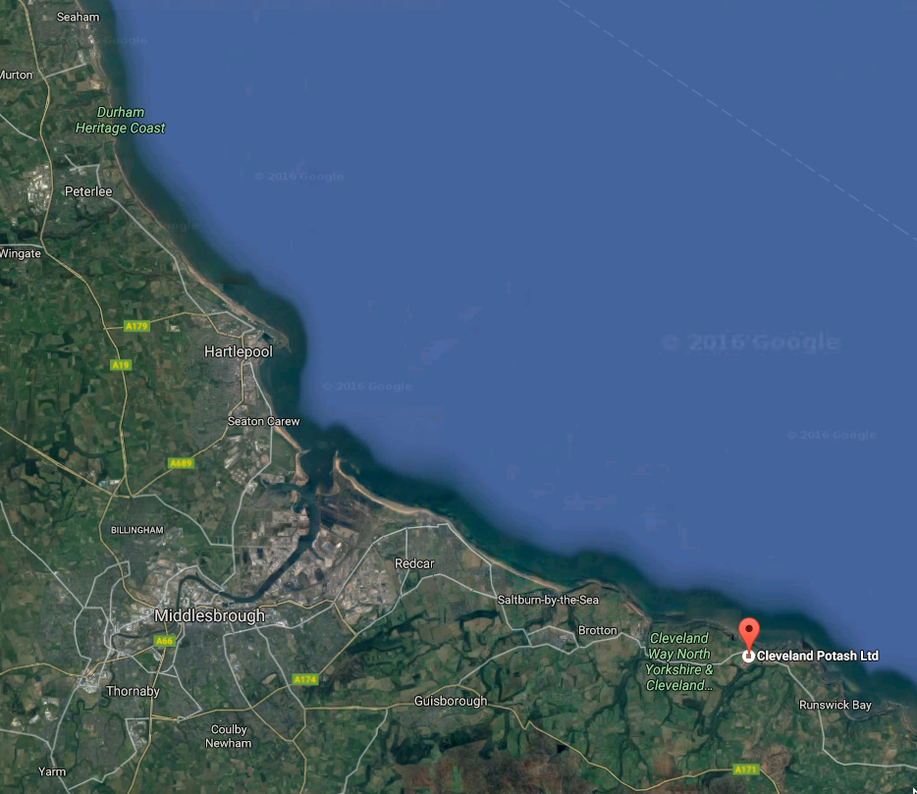
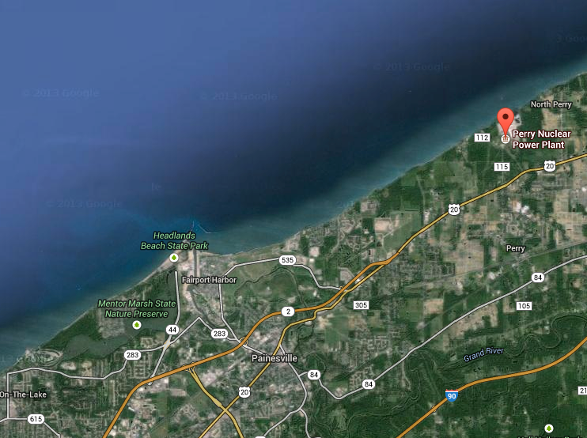
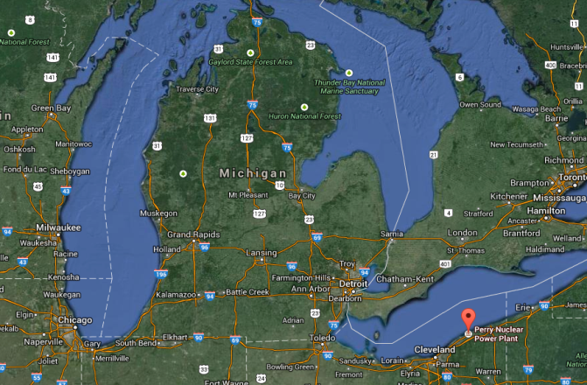
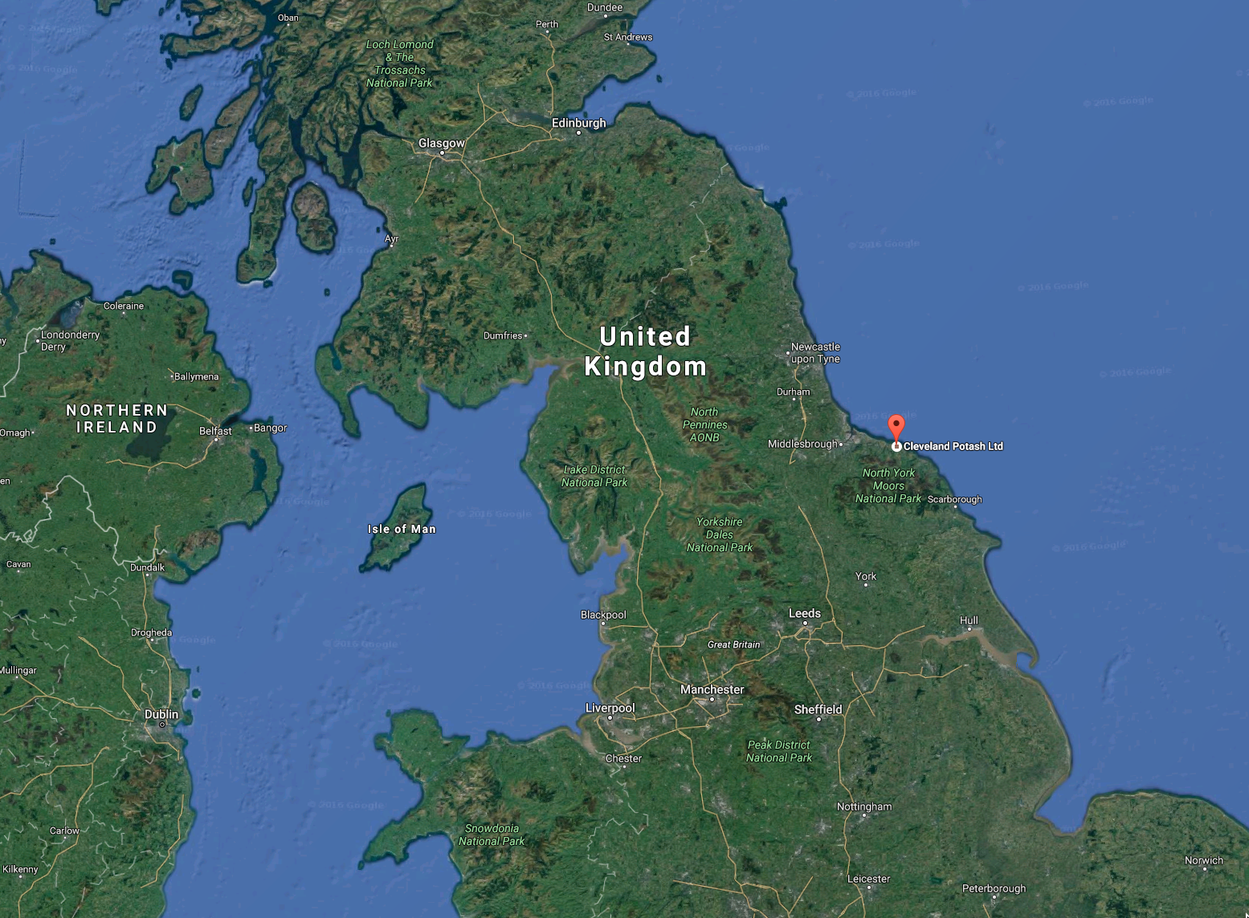
WATCHMAN Sites – Morton/Fairport Salt Mine Ohio Boulby Mine, England
Fairport Mine
No excavation required – former IMB cavern
Boulby Mine
Perry Reactor
Phase I Watchman:
Establish Feasibility of remote reactor antineutrino monitoring
Boulby Mine site:
2800 m.w.e ,
Operating salt mine
Currently houses a number
of physics experiments
Fairport mine site
1500 m.w.e
Operating salt mine
Former IMB site
no excavation required
13 km
Hartlepool
Reactor
Fairport mine
25 km
Boulby
mine
Great Lakes
England

Slide 5
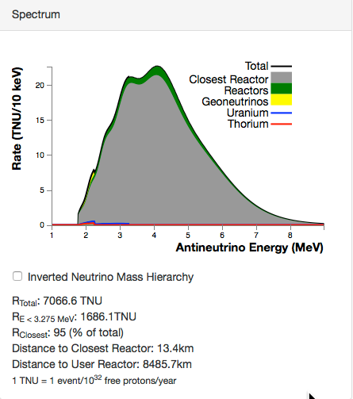
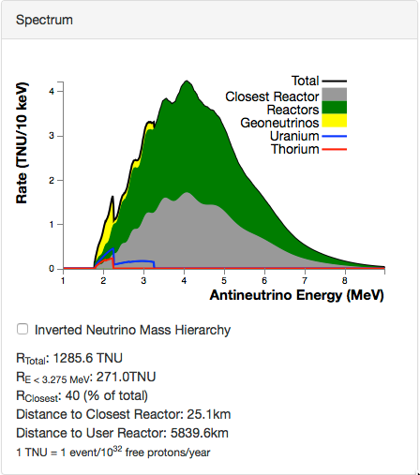
S. Dye Antineutrino Flux Model Comparison of the 2 Sites (go to geoneutrinos.org/reactors)
Fairport mine signal
Boulby signal
2 reactors
at single site
Single reactor

Slide 6
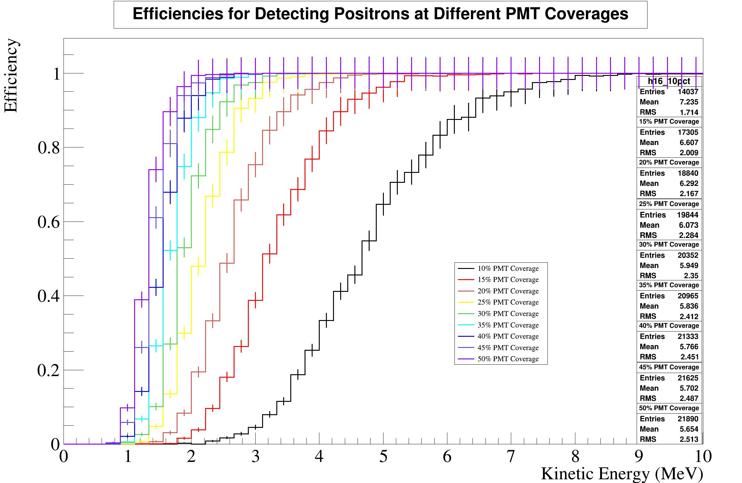
Current Design Work
Neutron captures
Elizabeth Macias (UC Davis)
Onaiza Kazi UC Davis
Focus:
Reactor ON/OFF difference
to 3σ within 30 days.
Q: PMT coverage is the biggest cost driver,
What is needed?
Considerations:
Position reconstruction dependence
signal/background and energy dependence of both
Investigating background levels now…..
Notes:
PMT coverage affects event location sensitivity, energy sensitivity, Both affect sensitivity to signal, background as function of PMT coverage.

Slide 7
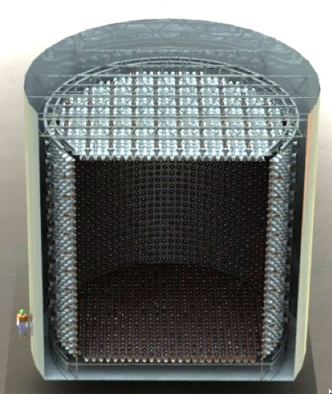
THEIA/WATCHMAN Relationship
60 m
15 m
WATCHMAN
EGADS (led by WATCHMAN co-spokperson M. Vagins) retired the technical risk of the Gd+H₂O technology for Super-K after a decade of R&D and over $10M in funding
Process involved small scale R&D experiments at UCI, LSU, LLNL, then ~$6m EGADS experiment.
A similar process can be envisioned for THEIA and WbLS + Gd
WATCHMAN can serve as a key test-bed to reduce technical risk of THEIA and other large detectors
WATCHMAN could also create opportunities for some physics studies, such as supernova detection, during the build-up to THEIA
Notes:
Think back to EGADS/Super-K relationship
So that is the rationale, WATCHMAN serves as a scale R&D experiment for THEIA, scale is somewhere between “tabletop” size and the 60kTon THEIA.

Slide 8
WATCHMAN Phases and Physics/R&D Goals
WATCHMAN
Post-WATCHMAN
Phase I
Phase II
THEIA – 50-100 kton
1 kTon Gd+H2O
PMT coverage limited
Gd+Water-based LS
40% PMT coverage
Very large scale water-based Liquid Scintillator, LAPPD coverage
Makes sense to try these things out on a medium-scale detector first.
Detector R&D
Single Reactor site detection
Limited fast PMT/LAPPD coverage
Reactor directionality – Radon reduction techniques
Supernova
detection
Supernova directionality and discrimination
Supernova burst
Physics
Long-baseline (mass hierarchy, CP violation)
Atmospheric neutrino interactions
With neutron in final state
Neutrinoless double beta decay
Sterile neutrino search with IsoDAR beam
Geo-antineutrinos
Nucleon decay
Source-based sterile searches
See “Advanced Scintillator Detector Concept (ASDC): A Concept Paper on the Physics Potential of Water-Based Liquid Scintillator”
(arxiv:1409.5864)
Solar neutrinos (solar metallicity, MSW transition)
Notes:
So if you look at WATCHMAN as a phased R&D lead up to THEIA it looks like this
Once WATCHMAN is built we can certainly make the case for an upgraded (phase II) WATCHMAN for physics.
While continuing the R&D needed for THEIA

Slide 9
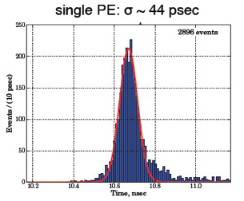
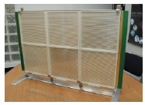
WATCHMAN Phase II Technology Development
Water-based Liquid Scintillator
(WbLS)
Large Area Picosecond PhotoDetectors (LAPPDs)
Under development at BNL
A water based scintillator cocktail with fast timing, good spectral response, tunable light yield
What light yield is best for THEIA?
How to clean/circulate at scale?
Materials compatibility
Leads to very large combined scintillator/Cherenkov detectors, ~50x KamLAND/SNO+
Chicago, ANL/LBL initiative
Large area (8” sq.) low cost MicroChannel plate-based PMTs with fast (~50psec) timing
Opens the possibility of very precise TOF in accelerator detectors - "Optical TPC”
Notes:
Add illustrations

Slide 10
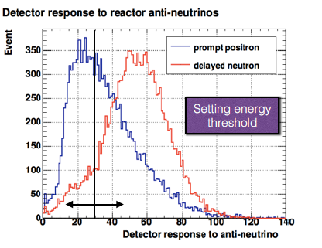
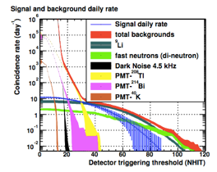
Full Signal and Background Monte Carlo
Full MC simulation codes
RAT-PAC (Reactor Analysis Tool
Plus Additional Codes).
(KamLAND/SNO pedigree)
RMSim (Based on WCSim from SK)
note: RAT-PAC is gradually taking over as fitters get better
Photoelectrons
Fairport mine: Predicted background and signal
Depth Dependent | events per day
Fast Punch-through Neutrons | 1
Radionuclides – ⁹Li, ⁸He | 2
Depth-Independent
PMT and Rock Gamma/Neutrons | <1
Other Reactors | <1
Geoantineutrinos | <<1
Total Background | 3-5
Perry Reactor Signal | 4-5
Notes:
WATCHMAN collaborators are contributing to the RAT-PAC GEANT4-based simulation code

Slide 11
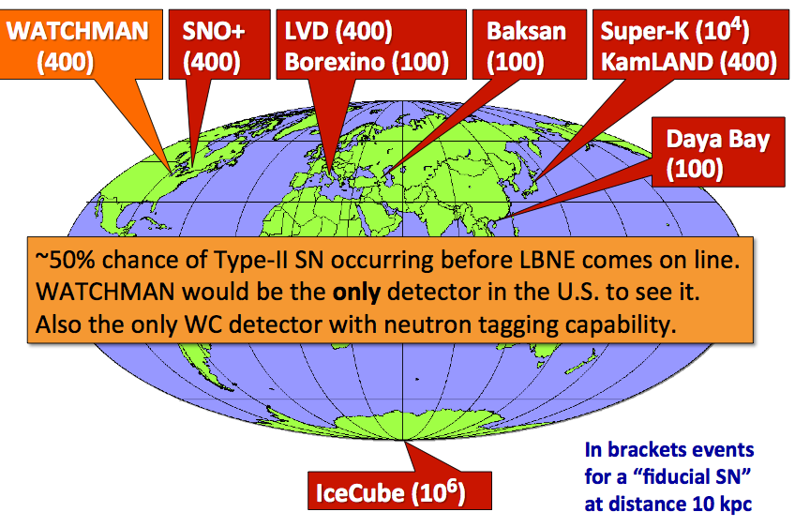
Supernova Detection ν / ν discrimination → WATCHMAN can be a directionally sensitive SN neutrino detector
_
SN 1987A estimate ~ 15 neutrinos @ WATCHMAN
Galactic center SN ~ 500 neutrinos @ WATCHMAN
Some estimates of galactic SN rate – 1 per ~15 to 20 years
WATCHMAN a pointing neutrino telescope?
IBD/ES discrimination via neutron tagging, reveals the directional ES component
SN neutrino/antineutrino flux
~few 10s MeV.

Slide 12
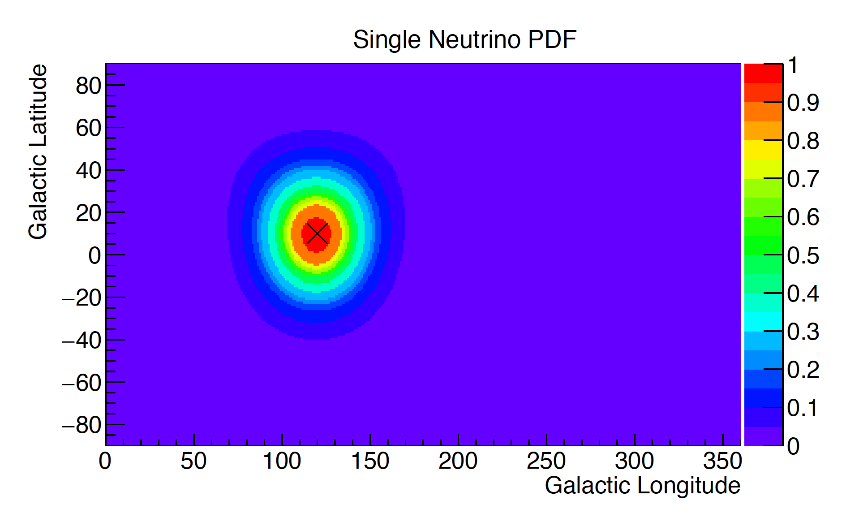
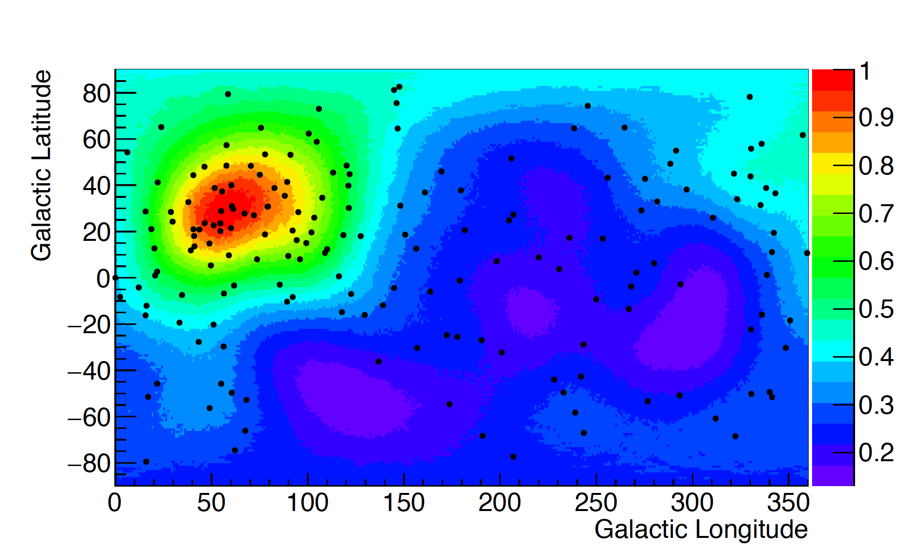
Supernova Pointing Capability at WATCHMAN
A full supernova generator is being added to RAT-PAC (Marc Bergevin). All interaction types included.
SN pointing with WATCHMAN can now be estimated directly from GEANT4 simulation
Detector background not included here
Reconstructed Galactic Supernova
@ 60º longitude, 30º latitude
After IBD event removal
A Single neutrino/antineutrino PDF
Example: PRELIMINARY
e.g.: ~85% of IBD are tagged and removed
from this sample

Slide 13
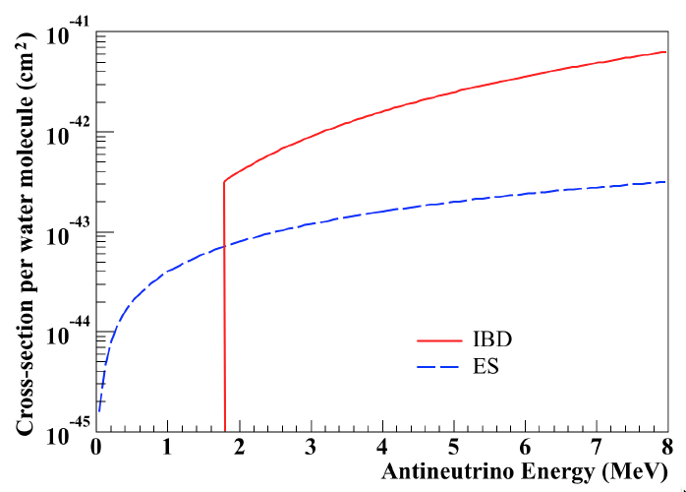
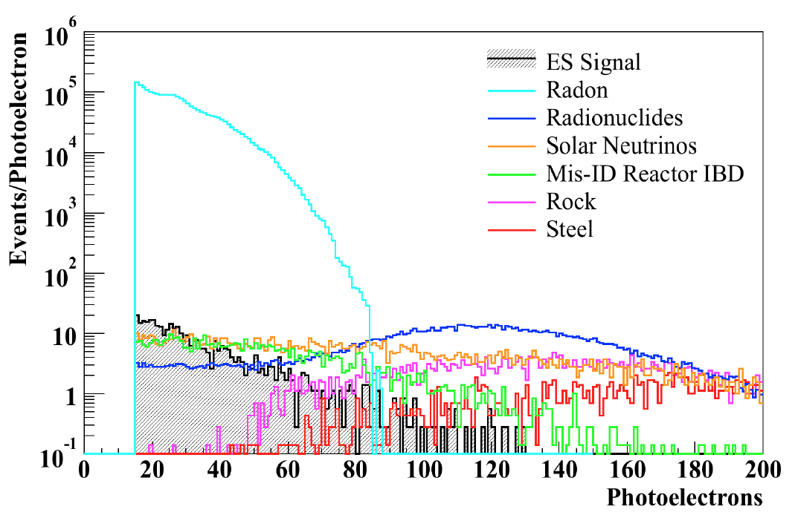
Reactor Directionality Cherenkov detectors have some directional capability (a la Super-K)
Antineutrino Elastic scattering cross-section
per electron cross-section is smaller than inverse beta decay (per proton)
However water has 5x more electrons than protons
Total cross-section difference is only a factor ~6x
Radon levels equal to SNO
Backgrounds @ Fairport site
Cosmogenic Radionuclides (scaled from Li and Beacom, 2014)
dominate at high energies → Deeper is better
Radon backgrounds (equivalent to SNO shown)
dominate at low energies.
Radon must be reduced by at least factor 10²

Slide 14
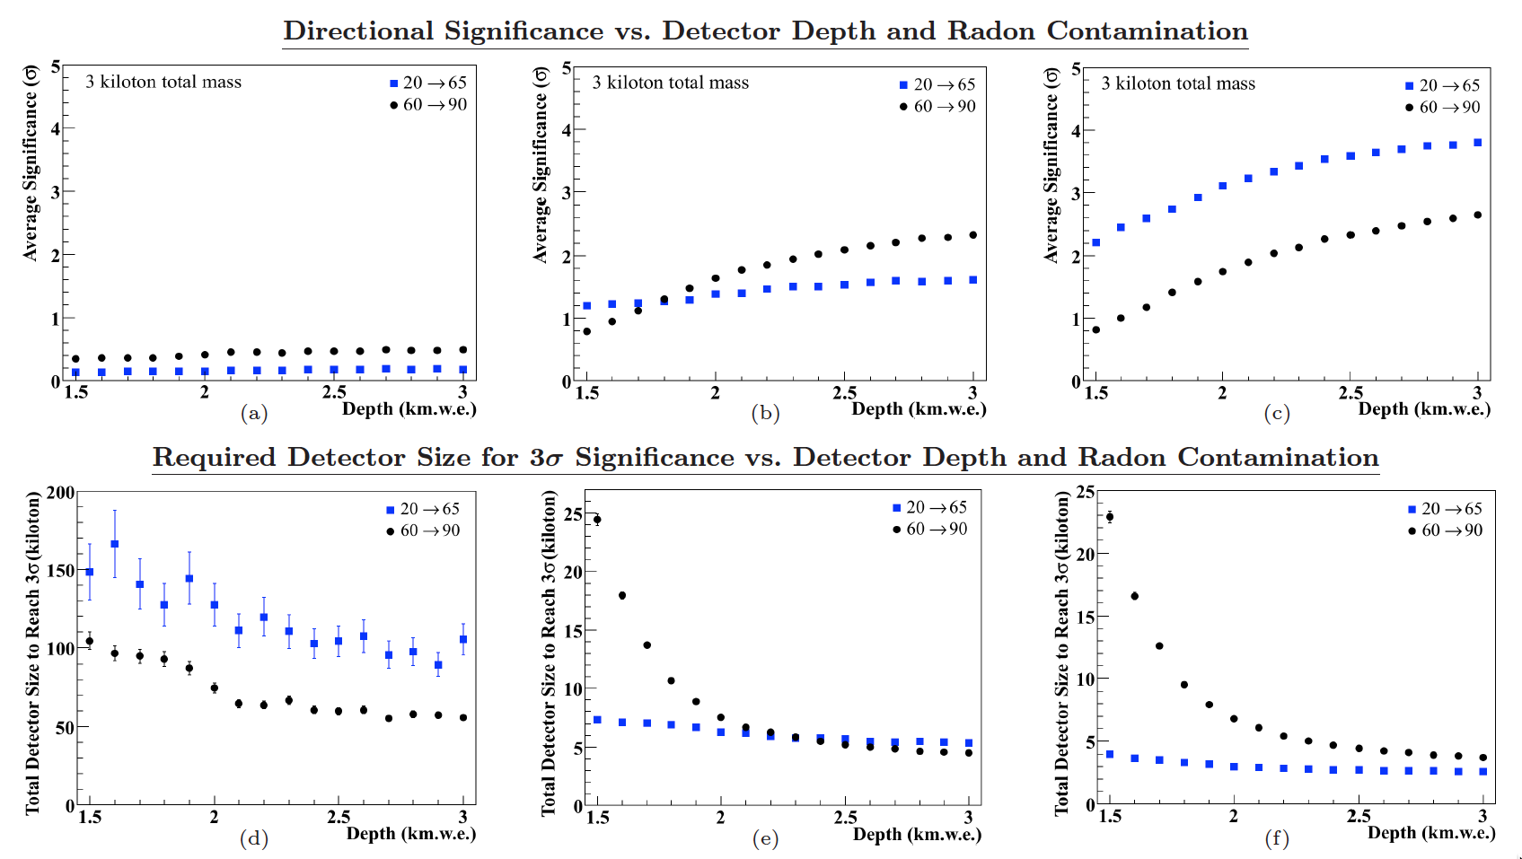
Reactor Directionality Concentrated R&D effort to control radon needed (requirement → factor 100x reduction relative to SNO) Possible with large/deep detectors.
Thought experiment: how sensitive would WATCHMAN be to reactor direction as a function of depth,
based on projected water-borne radon levels (radon in water as a fraction of SNO levels)
Some sensitivity, however WATCHMAN likely too small and too shallow OR requires new radon reduction techniques
Radon reduction R&D will be a significant effort @ WATCHMAN

Slide 15
Conclusions
The Watchman project is still on:
Aims to prove the feasibility of remote reactor monitoring with a scalable detector medium – water doped with gadolinium (Fairport mine, Perry reactor – 3.7 GWth @ 13 km, Boulby mine, Hartlepool reactor, 2 x 1.5 GWth @ 25 km)
Boulby mine depth 2800 m.w.e
Fairport mine depth 1500 m.w.e
Technical risk of the Gd+H2O technology was retired for Super-K after a decade and $10M of R&D
A similarly long process can be envisioned for THEIA, which is why WATCHMAN is important.
WATCHMAN is a natural bridge to very large water-based detectors for THEIA and further physics goals
Potential Physics Experiments @ WATCHMAN
Supernova detection
Sterile neutrino search (with IsoDAR)
Proton decay R&D (with water-based scintillator, Kaon mode)

Slide 16
The WATCHMAN collaboration
K. Van Bibber (Nucl. Eng.), G. Orebi Gann (Physics), B. Land, J. Caravaca, C. Roecker, D. Hellfeld
A. Bernstein, S. Dazeley, M. Bergevin
LLNL
UC Berkeley
C. Steer
M. Wetstein
D. Cowan
IAS
R. Svoboda, M. Askins, T. Pershing, D.Danielson, O. Kazi,
E. Macias
Penn. State
M. Yeh
UC Davis
J. Learned, S. Dye, J. Maricic
C. Mauger
U of Hawaii
U. Penn.
I. Jovanovic, F. Sutanto
S. Paling
U. Mich.
SFTC-Boulby
M. Vagins, M. Smy, W. Kropp
UC Irvine
M. Malek, L. Thompson,
N. Spooner, V. Kudryatsev,
F. Mouton
S.D. Rountree
Sheffield U.
Y. Kamyshkov, T. Handler, A.
Hatzikoutelis, B. Chance
Red = students
U. Tenn

Slide 17
Extra slides

Slide 18
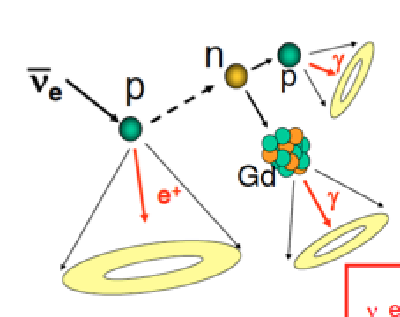
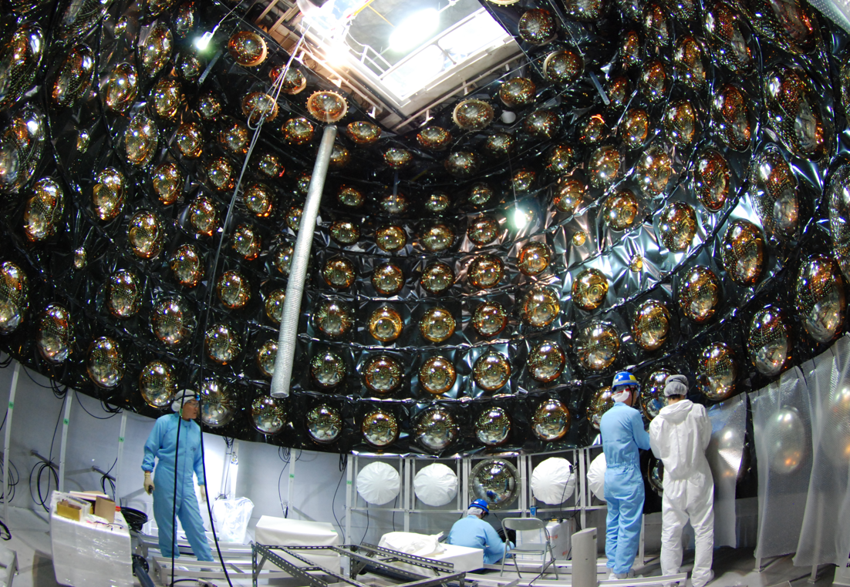
WATCHMAN Phase I – Gd Loading
Gadolinium doping in water
Gadolinium sulfate as a neutron capture agent - UC Irvine /University of Tokyo
Gd + H2O provides
efficient neutron detection in large water detectors
Antineutrino tagging

Slide 19
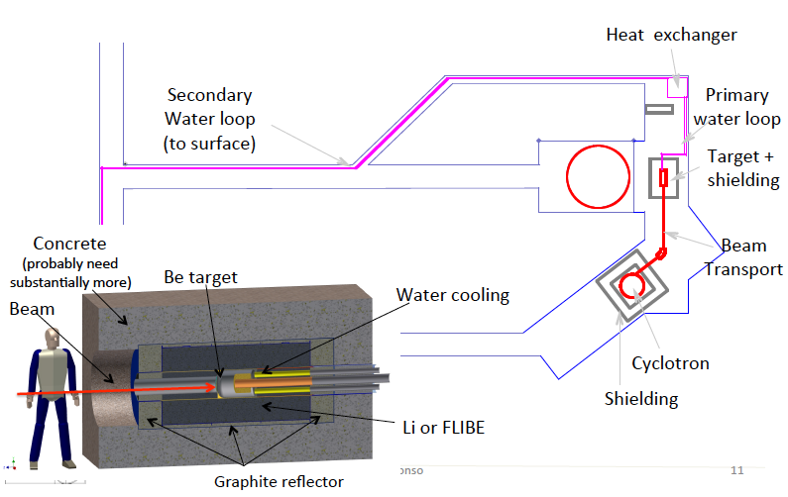
IsoDAR could be installed 16 m from the center of WATCHMAN
Drawing courtesy J. Alonso, IsoDAR collab.
WATCH MAN
Cyclotron, target, and shielding cost estimate 30 M$

Slide 20
Possible nonproliferation uses for large Gd-H2O detectors
Ensure no reactors are operating at several hundred km standoff
Ensure only declared reactors are operating at a known site – tens of km standoff
Simplest approach
Excludes new reactors in areas without existing reactors
Potential countermeasures are politically or financially costly
- Build another reactor
- Attack the detector
Range extension possible with directionality
More complex
Requires knowledge of signal from declared reactors
Adjusting power of declared reactors a potential countermeasure
Discrimination possible with directionality

Slide 21
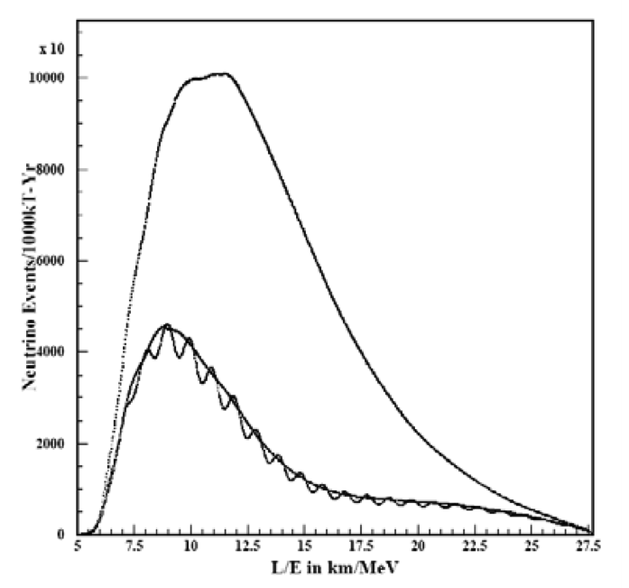
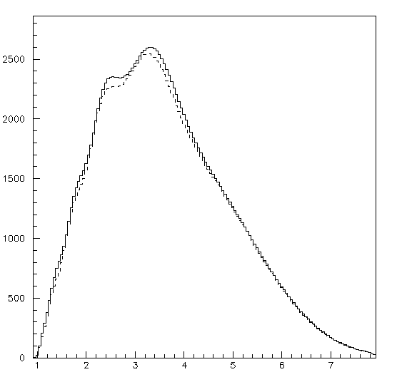
Mass Hierarchy (Phase II experiment)
Two approaches for reactor-based experiments.
~50km magic baseline. Highly sensitive to δm₁₃² – J. Learned, Stephen T. Dye, Sandip Pakvasa Robert C. Svoboda 2006
Requirements → Energy resolution 3.5%/√E
Optimal distance scale 56 ± 7 km
Experiments have been proposed → next-gen RENO (Korea), JUNO (China)
Watchman approach – 13 km
good ----- ~16 x more flux than 56 km
Fewer spectrum wiggles, E resolution requirements not as stringent (technology less risky)
bad ------- Fewer ν₁ - ν₃ oscillations→ so less sensitive to δm²₁₃
A larger antineutrino source would help
A full analysis of the sensitivity of Watchman to mass hierarchy is ongoing.
56km observable
Detector Energy Resolution
not included
Watchman observable
Normal
Assuming
No uncertainty
on Δ₃₁ or Δ₃₂
Inverted
Detector Energy Resolution
not included
MeV

Slide 22
Reactor antineutrino signal and background in WATCHMAN/Perry – preliminary estimates
Detector Fiducial Mass | 1000 | ton
Reactor Power | 3875 | MWt
Standoff | 13 | km
Overburden | 1670 | meters water equiv.
Efficiency (RMSIM, prelim.) | 50%
Perry reactor antineutrino rate | 12(#) | antineutrino or antineutrino-like events per day
Total background (RMSIM,prelim.) | ~2(*)
other reactors | 0.3
geoantineutrinos | 0 (for pure H2O)
PMT dark current | Negligible for 1 KHz d.c.
U/Th/K | 0.01
muogenic neutrons | 1.2
long-lived (~ 1 sec) radionuclide decays – | <1, not yet in MC
Days to 3 sigma detection of change in power (ON/OFF) | ~2 | Days (<30 days is our target)
(From Adam Bernstein: P5 presentation)
(*) Measurements underway. See talks by
Morgan Askins (UC Davis) – Radionuclide backgrounds. Caleb Roecker (UC Berkeley) – Fast neutron backgrounds
(#) Simulation studies. See talk by Marc Bergevin (UC Davis).

Slide 23
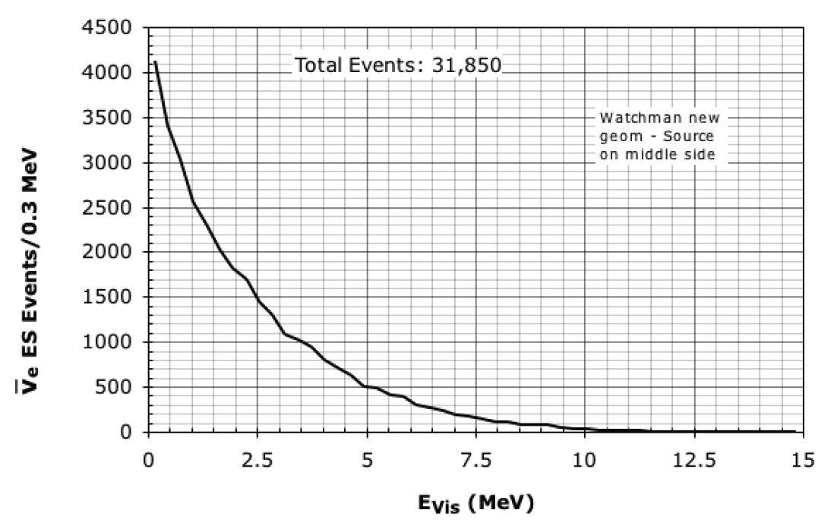
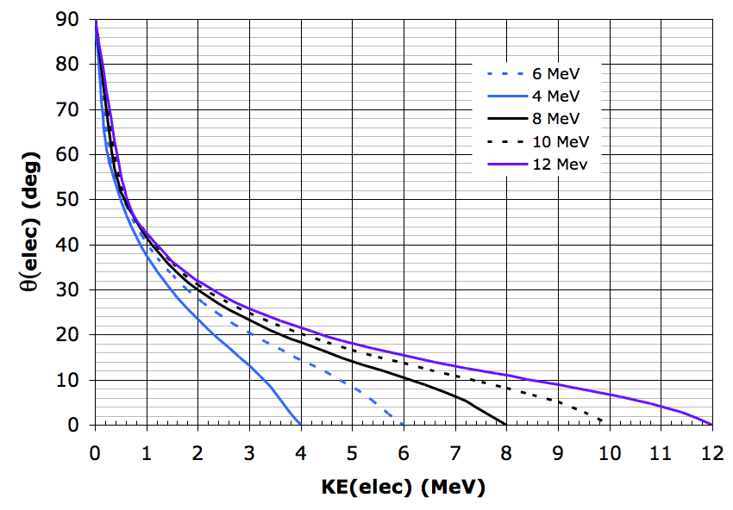
Non Standard interactions ( θ_{w}, g_{V}, g_{A} measurements)
With IsoDAR. Measurement of θ_{w} g_{V} and g_{A} via antineutrino-electron elastic scattering
Any deviations from SM?
Watchman (Phase I – water Cherenkov)
Advantages: electron scattering directionality → background reduction
Disadvantages: IBD events (where neutron capture is missed) will look like electron scattering, increasing background
Currently under investigation
5 years run time: IsoDAR at Watchman
_
Potential – ~ 5x larger than previous best ν_{e}-electron scattering dataset
MeV

Slide 24
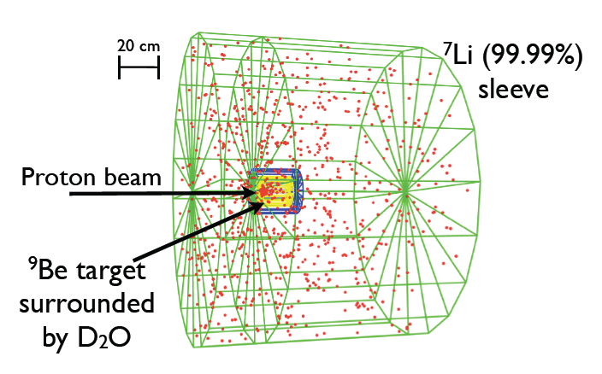
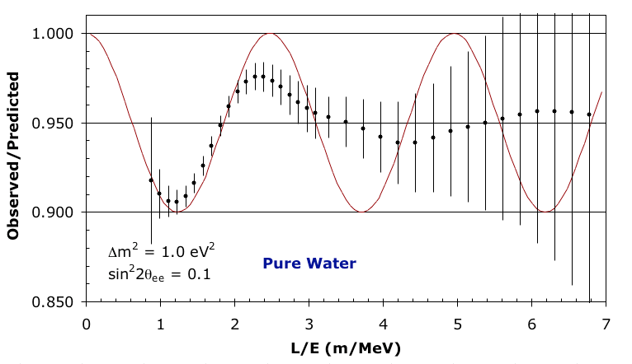
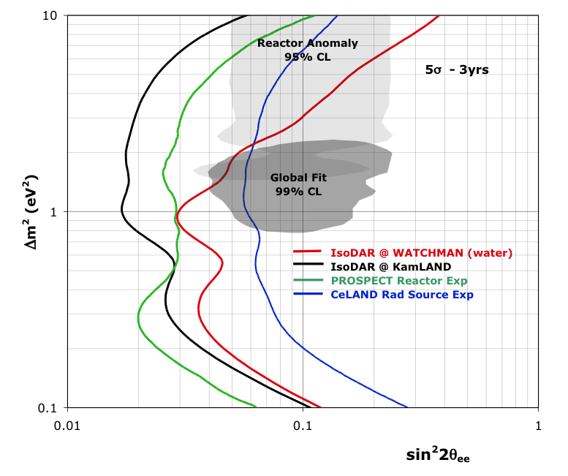
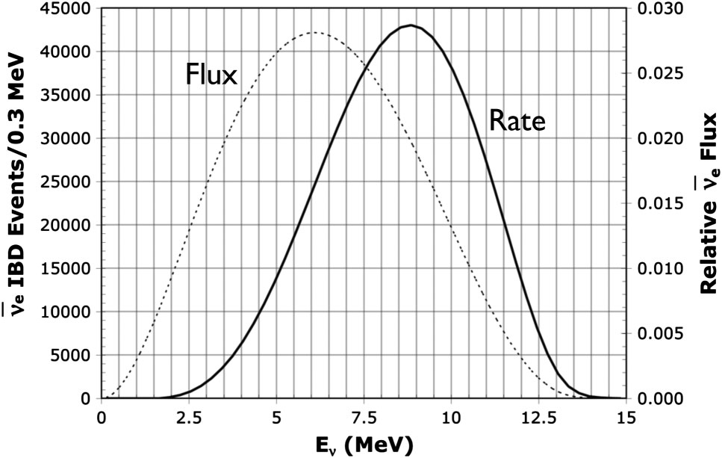
Sterile Neutrino Search Sterile neutrino existence can be tested at WATCHMAN note: at short baseline, detector size is less important
IsoDAR Beam (if installed at Watchman):
4π beam of antineutrinos from ⁸Li decay at rest
Baseline – 16 meters. Perfect for Sterile neutrino search, NSI search
+ Gd)
Gd + water
IsoDAR beam 16m from center of detector, 3 years runtime
Installation of accelerator at site required for this experiment

