Slide 1




Challenging the Standard Model with LHCb data
DESY
Physics Seminar
Johannes Albrecht
24. Mai 2017
Notes:
Test of fundamental forces with the LHCb experiment

Slide 2
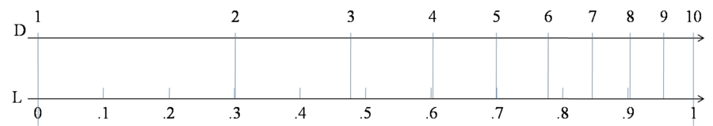
Searches for New Physics in Flavour
10GeV
100GeV
1TeV
10TeV
100TeV
Η⁰
b
W±, Z⁰
t
Particles produced at LHC

Slide 3
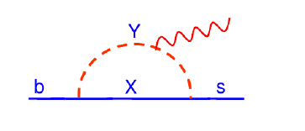
Searches for New Physics in Flavour
10GeV
100GeV
1TeV
10TeV
100TeV
Η⁰
b
W±, Z⁰
t
Particles produced at LHC
Flavour physics: Search for new heavy particles
in precision measurements of quantum effects
l⁺
l⁺
W±
Z⁰
l⁻
W±
Z⁰
l⁻
New
particles
t
t

Slide 4
Searches for New Physics in Flavour
10GeV
100GeV
1TeV
10TeV
100TeV
Η⁰
New particles ??
b
W±, Z⁰
t
Particles produced at LHC
Reach of Flavour Physics
Flavour physics: Search for new heavy particles
in precision measurements of quantum effects
l⁺
l⁺
W±
Z⁰
l⁻
W±
Z⁰
l⁻
New
particles
t
t
Precision data is sensitive to new particles of masses up to ~100TeV
[A. Buras et al, JHEP1411(2014)121]

Slide 5
Indirect discoveries
Most discoveries in HEP were done indirectly first
  The muon was a real surprise, however.
  The way to the Higgs Boson:
Pre-discovery (2011)
m_{H} = 94⁺²⁹ ₋₂₄ GeV
ATLAS & CMS (2016):
m_{H} = 125.09±0.24 GeV

Slide 7
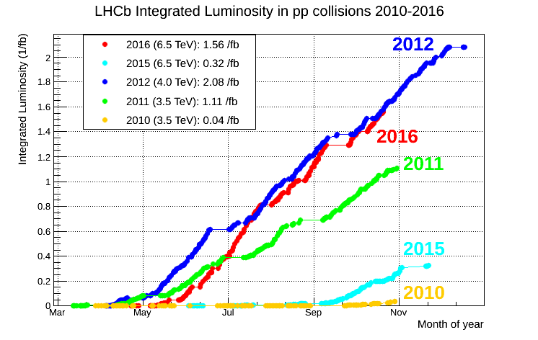
LHCb and beauty production
Proton collisions at 7-13TeV:
huge heavy flavour production cross sections
  In LHCb acceptance: 75kHz bb
  and 1.5MHz cc
  ~1/10 events contains b or c signal
>5 (so far)

Slide 8
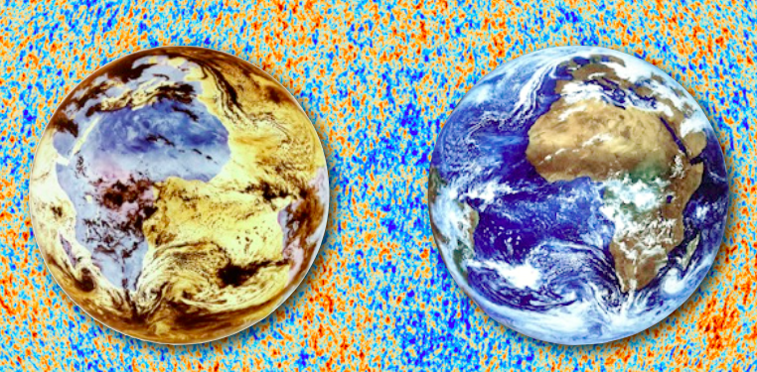

Test of fundamental interactions I
CP violation
B_{s} mixing and
CP violation

Slide 9
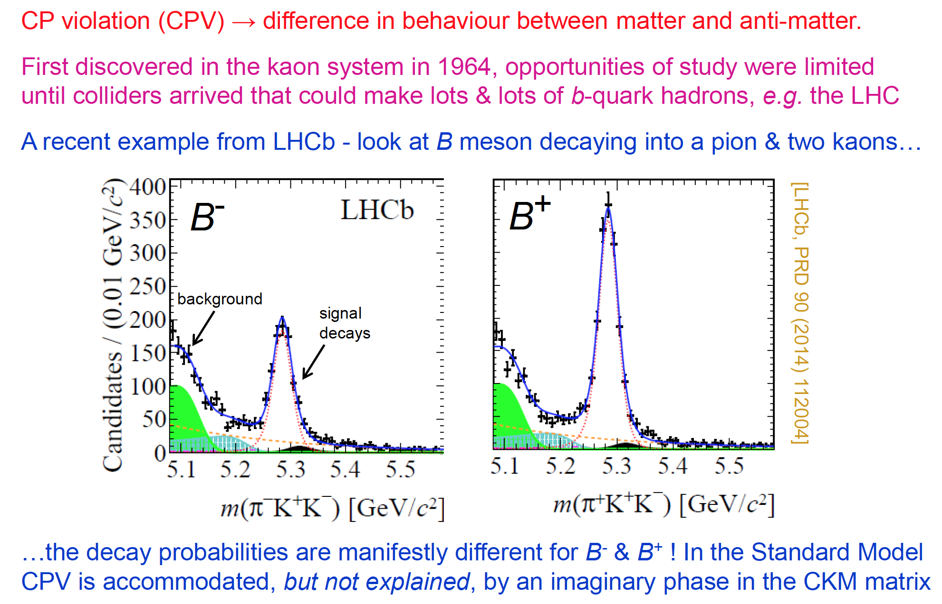
CP Violation

Slide 10
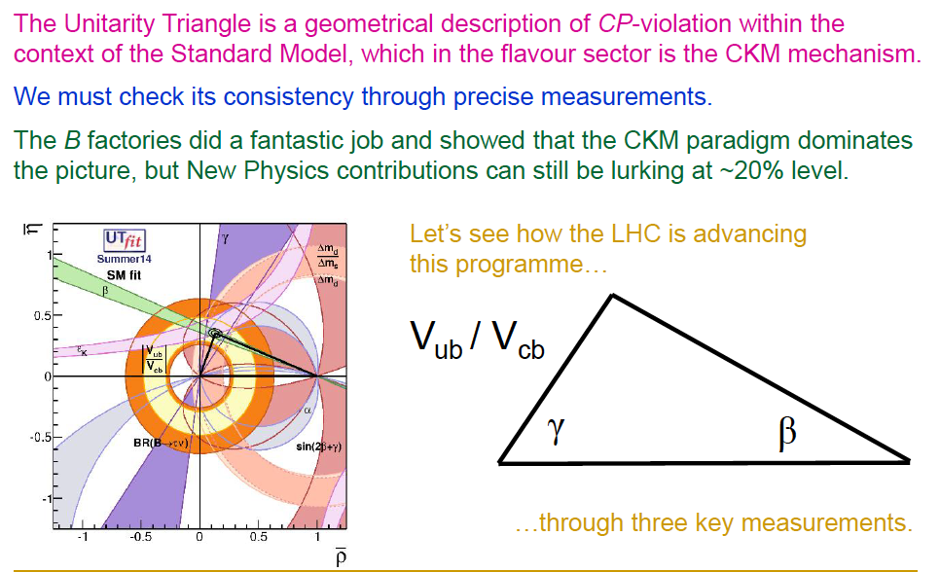
The unitarity triangle

Slide 11
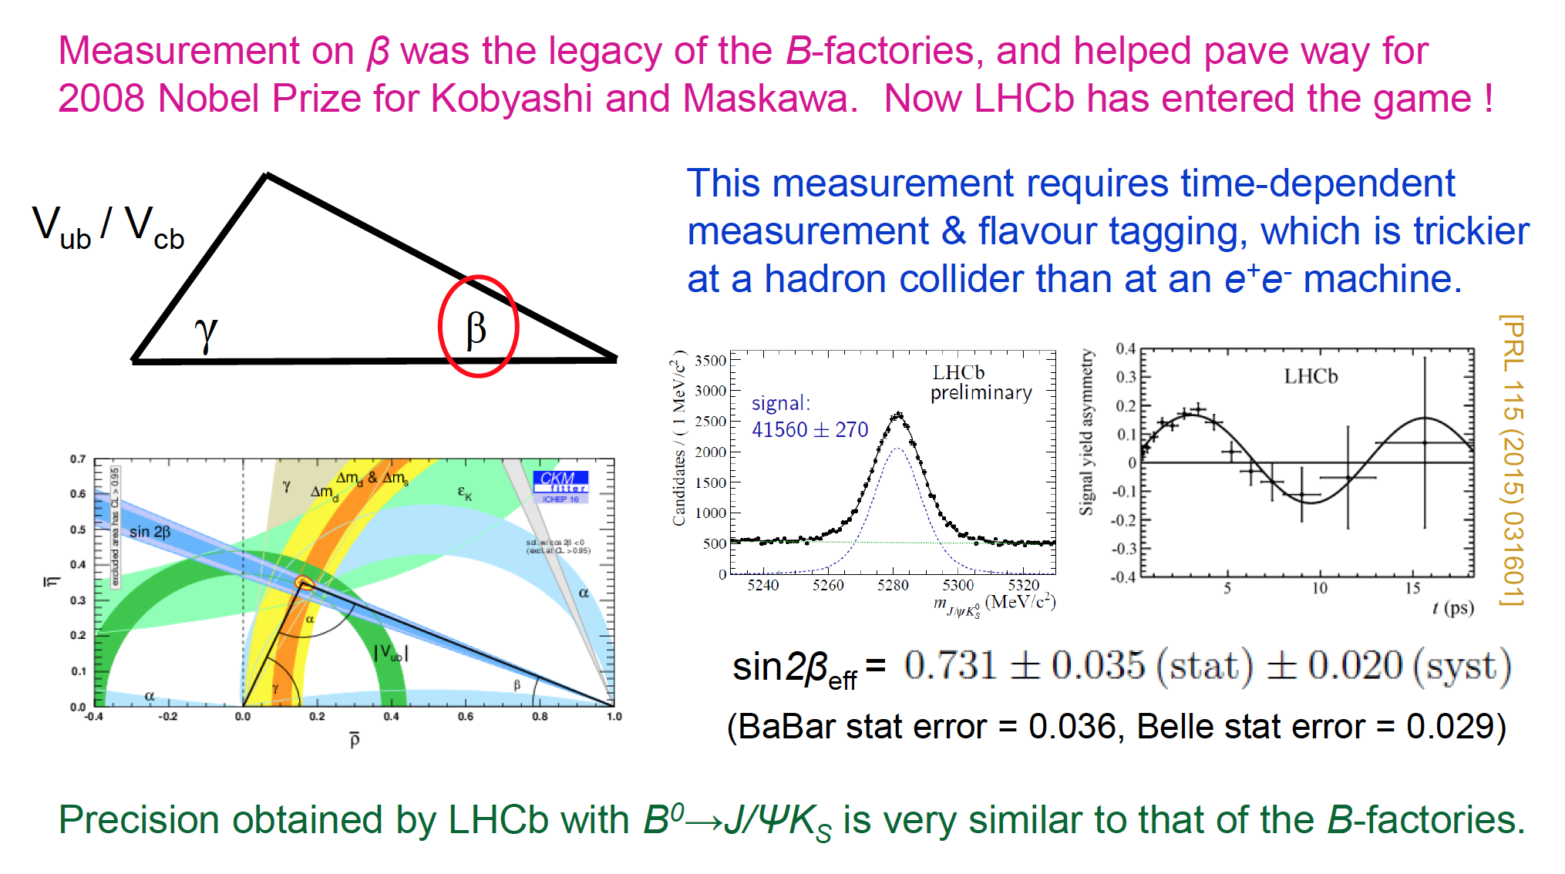
Unitarity triangle: sin2β

Slide 12
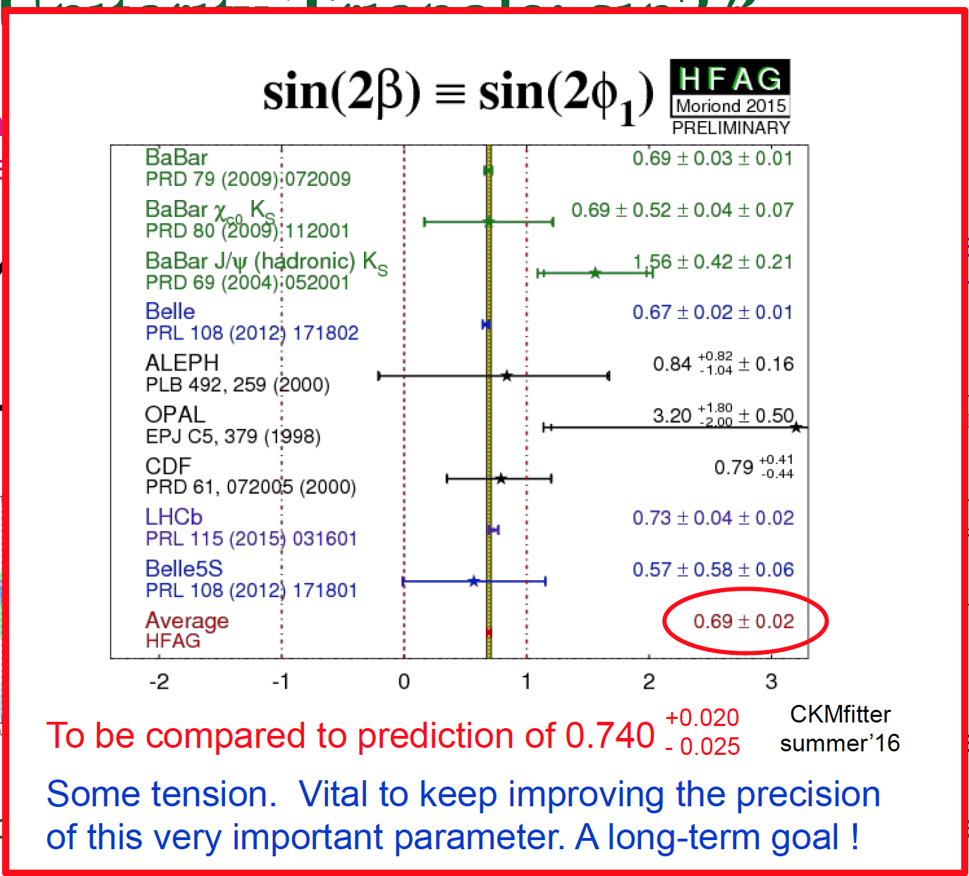
Unitarity Triangle: sin2β

Slide 13
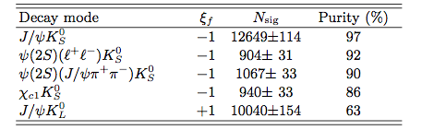
Unitarity Triangle: sin2β
Example: Belle decay modes

Slide 14
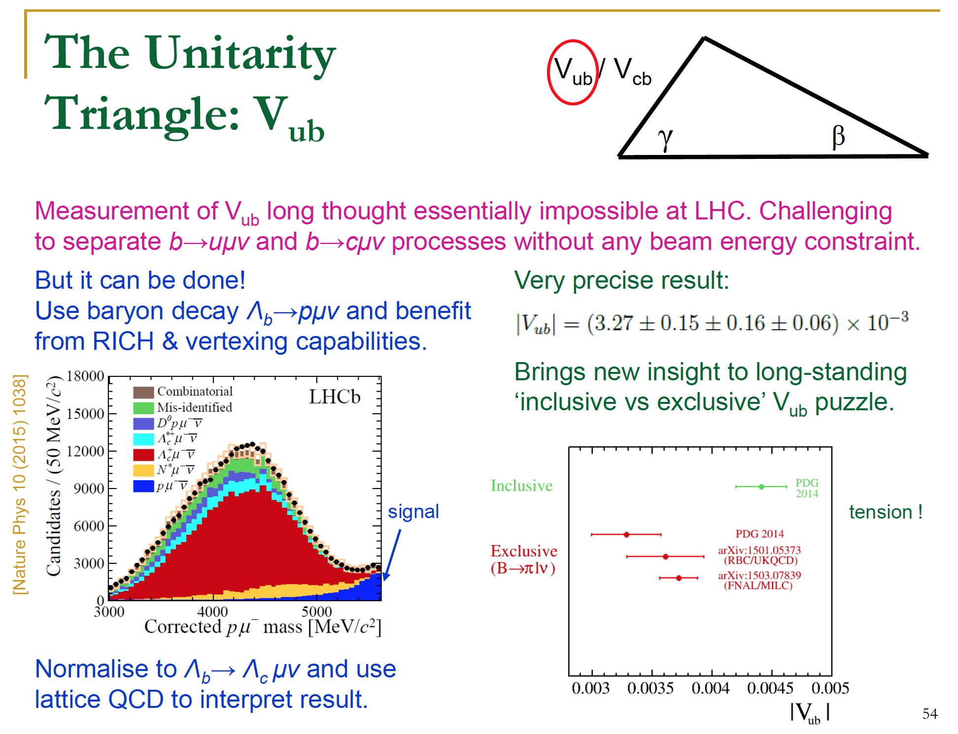
Unitarity Triangle: V_{ub}

Slide 15
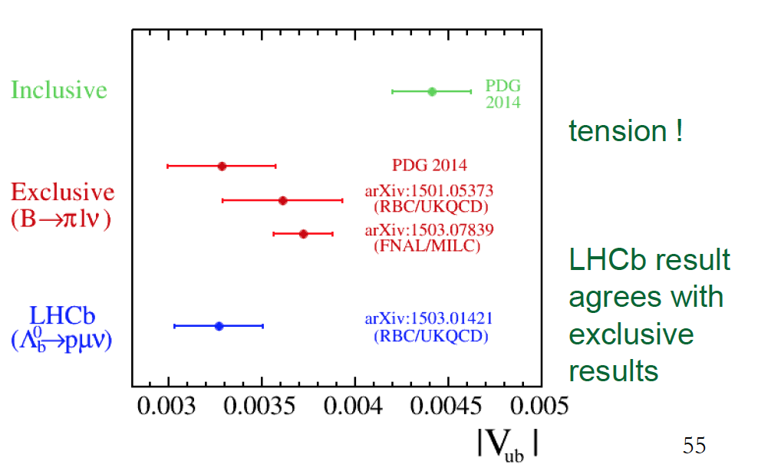
Unitarity Triangle: V_{ub}

Slide 16
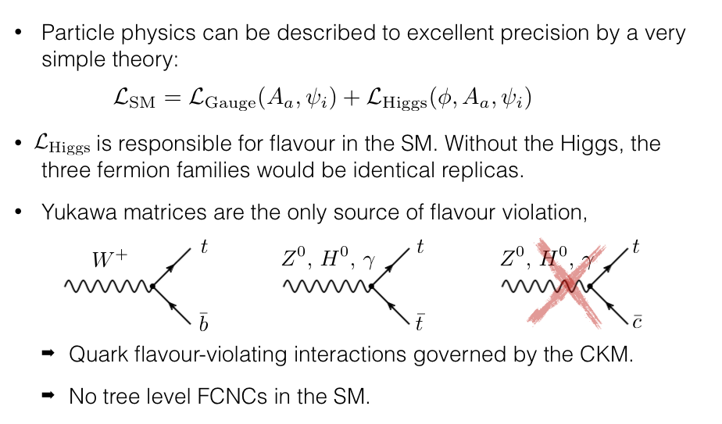
Test of fundamental interactions II
Rare decays
B_{s} mixing and
CP violation

Slide 17
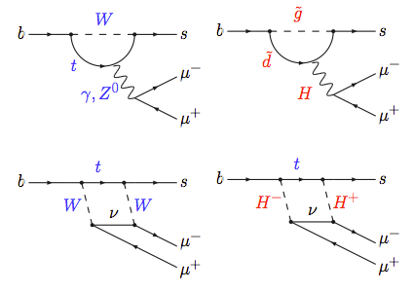
Rare menu
b → s μ⁺μ⁻ base diagram
Purely leptonic
  “add nothing”
Semileptonic
  add d quark as spectator
  → B⁰ → K^{*0} μ⁺μ⁻
  add s quark as spectator
  → B_{s} → φ μ⁺μ⁻
  add u quark as spectator
  → B⁺ → Κ⁺ μ⁺μ⁻
Ratios:
  Compare muons to electrons

Slide 18
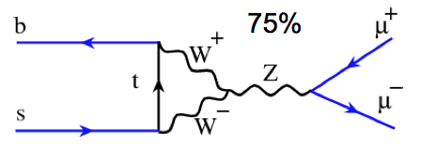
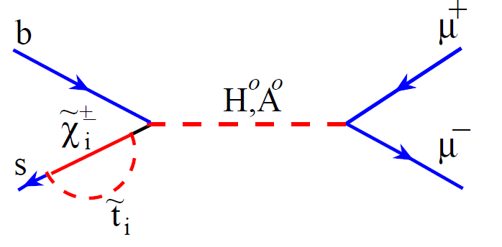
Golden channel: B_{s,d}→ μ⁺μ⁻
Theory prediction: Standard Model
Standard Model
decay | SM
B_{s}→ μ⁺μ⁻ | 3.5±0.3 x 10⁻⁹
B⁰→ μ⁺μ⁻ | 1.1±0.1 x 10⁻¹⁰
SM: Buras, Isidori et al: arXiv:1208.0934
Mixing effects: Fleischer et al, arXiv:1204.1737
Left handed couplings
→ helicity suppressed
Discovery channel for New Phenomena
Very sensitive to an extended
scalar sector
(e.g. extended Higgs sectors,
SUSY, etc.)
e.g. SUSY

Slide 19
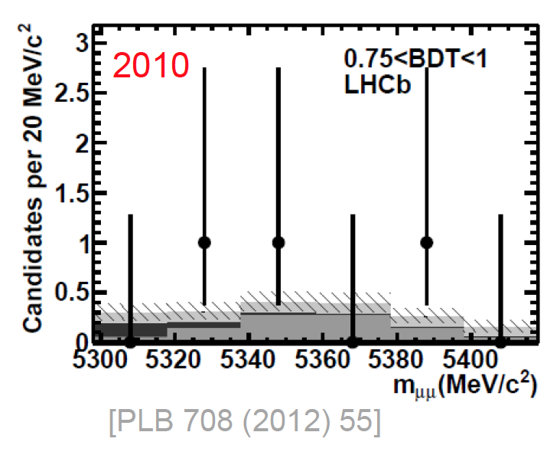
B→ μ⁺μ⁻ : Progress through run 1
Invariant mass in signal region (high BDT)
If there is a signal, we should see a peak
2010: nothing
Notes:
slide 43: I think it is a good place to say that LHCb had the first evidence in this channel with the previous analysis,
while I would remove the expected sensitivity (see next)
* slide 43: color convention confusing… sensitivity expectation in red as the result… I would honestly remove
the expected sensitivity, is not adding too much.

Slide 20
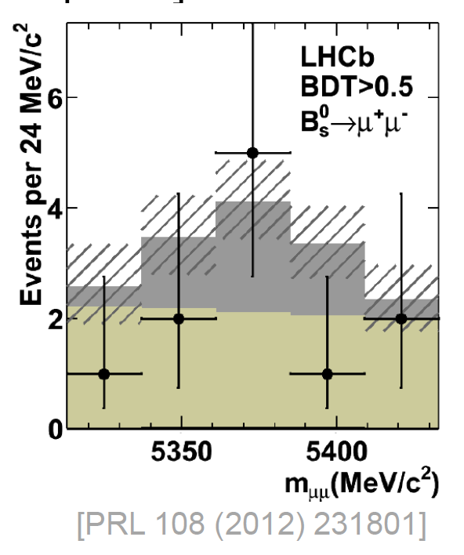
B→ μ⁺μ⁻ : Progress through run 1
Invariant mass in signal region (high BDT)
If there is a signal, we should see a peak
+2011: maybe??
But not significant enough for any claims
Notes:
slide 43: I think it is a good place to say that LHCb had the first evidence in this channel with the previous analysis,
while I would remove the expected sensitivity (see next)
* slide 43: color convention confusing… sensitivity expectation in red as the result… I would honestly remove
the expected sensitivity, is not adding too much.

Slide 21
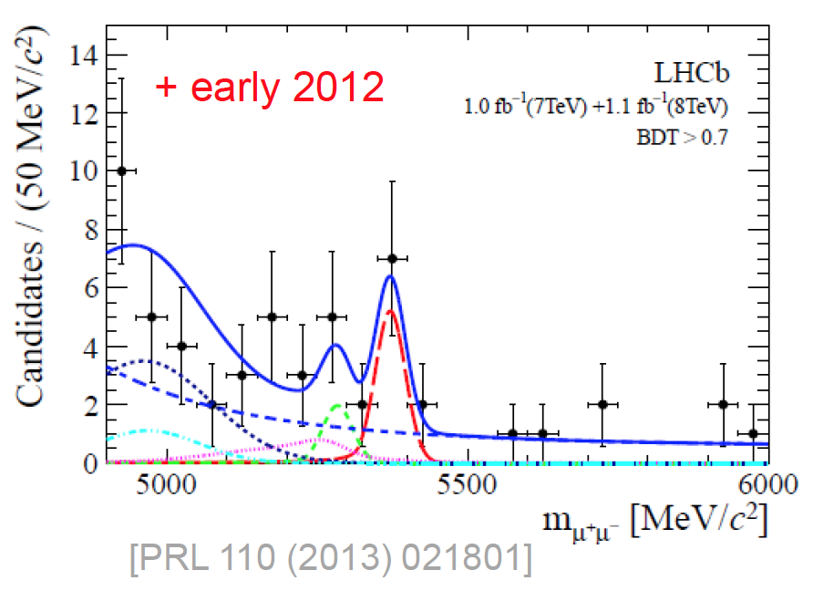
B→ μ⁺μ⁻ : Progress through run 1
Invariant mass in signal region (high BDT)
If there is a signal, we should see a peak
+ early 2012: First evidence of B_{s} → μ⁺μ⁻ !
Shown at HCP in Kyoto
Notes:
slide 43: I think it is a good place to say that LHCb had the first evidence in this channel with the previous analysis,
while I would remove the expected sensitivity (see next)
* slide 43: color convention confusing… sensitivity expectation in red as the result… I would honestly remove
the expected sensitivity, is not adding too much.

Slide 22
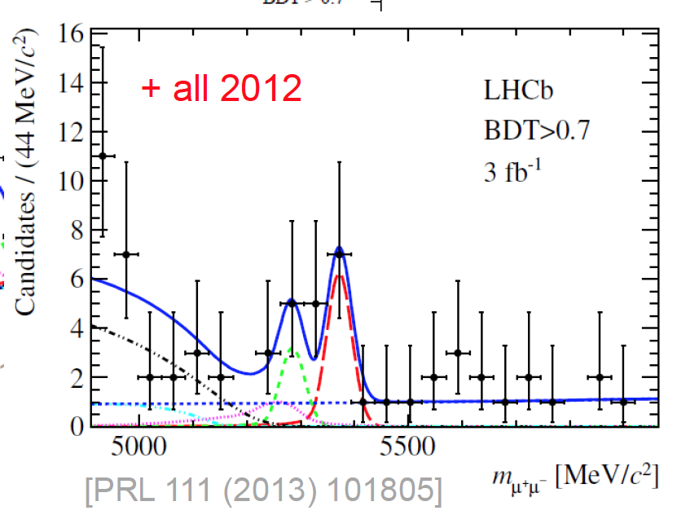
B→ μ⁺μ⁻ : Progress through run 1
Invariant mass in signal region (high BDT)
If there is a signal, we should see a peak
+ all 2012: The signal emerges
Anomaly in B⁰ → μ⁺μ⁻ or fluctuation ??
Notes:
slide 43: I think it is a good place to say that LHCb had the first evidence in this channel with the previous analysis,
while I would remove the expected sensitivity (see next)
* slide 43: color convention confusing… sensitivity expectation in red as the result… I would honestly remove
the expected sensitivity, is not adding too much.

Slide 23
First observation of B_{s}→ μ⁺μ⁻

Slide 24
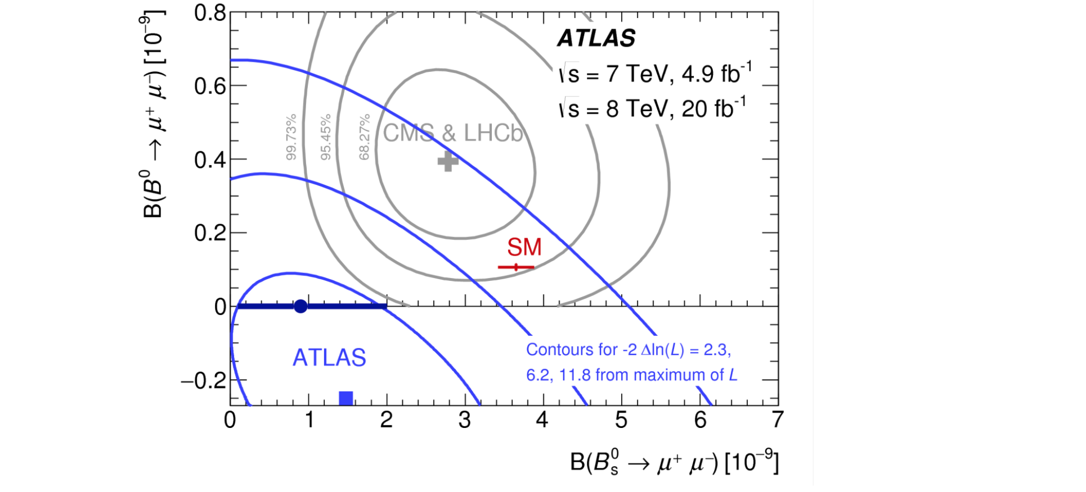
ATLAS joins the game
ATLAS has joined the game (arXiv:1604.04263)
No signal evidence in either mode ..
But lower intrinsic sensitivity than LHCb & CMS

Slide 25
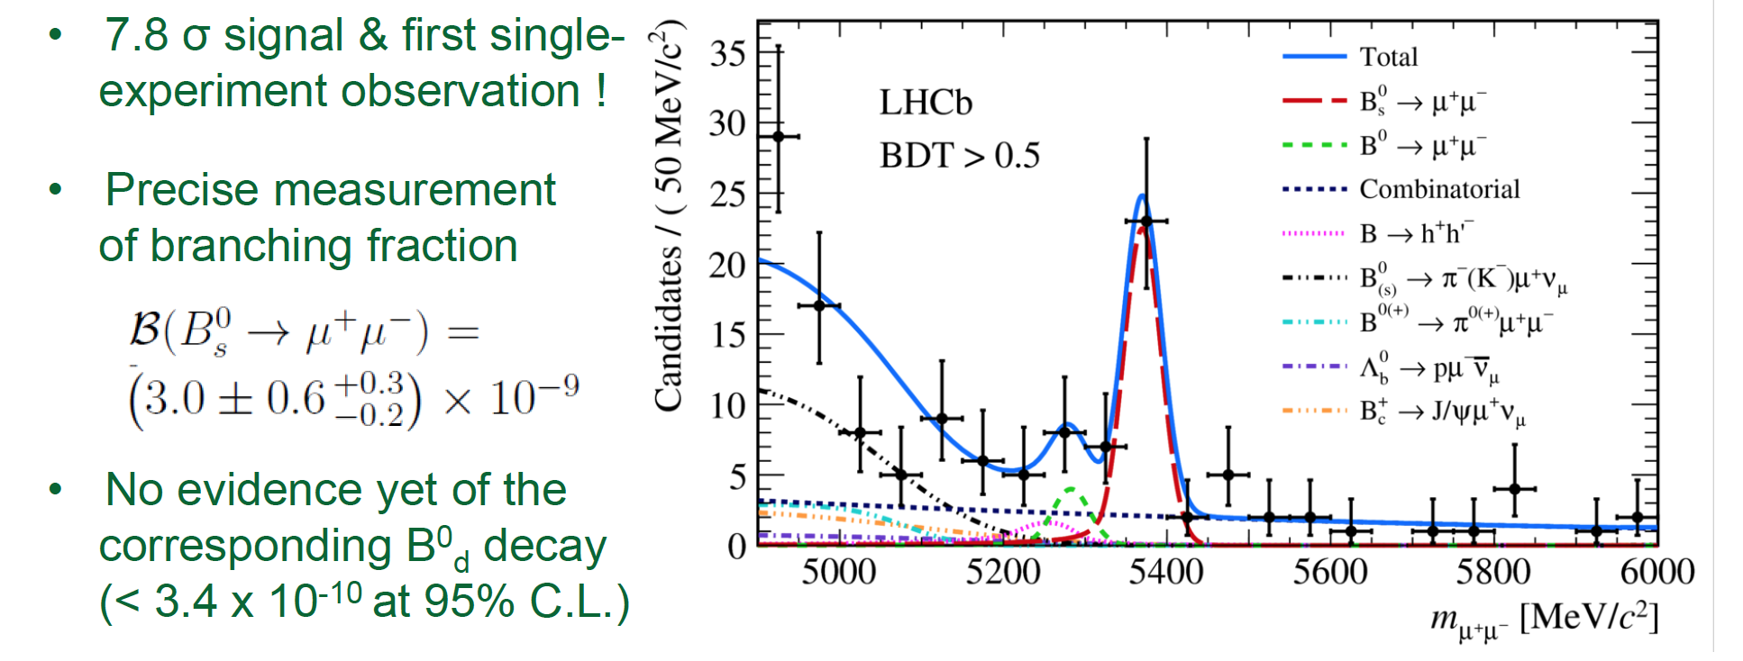
B→ μ⁺μ⁻ : First news from run 2
arxiv:1703.05747
LHCb has recently published a first run 1 + run 2 analysis (3+1.4fb⁻¹)
updated analysis with improved background suppression
No sign of 1st order New Physics effect!
B→ μ⁺μ⁻ becomes a precision test

Slide 26
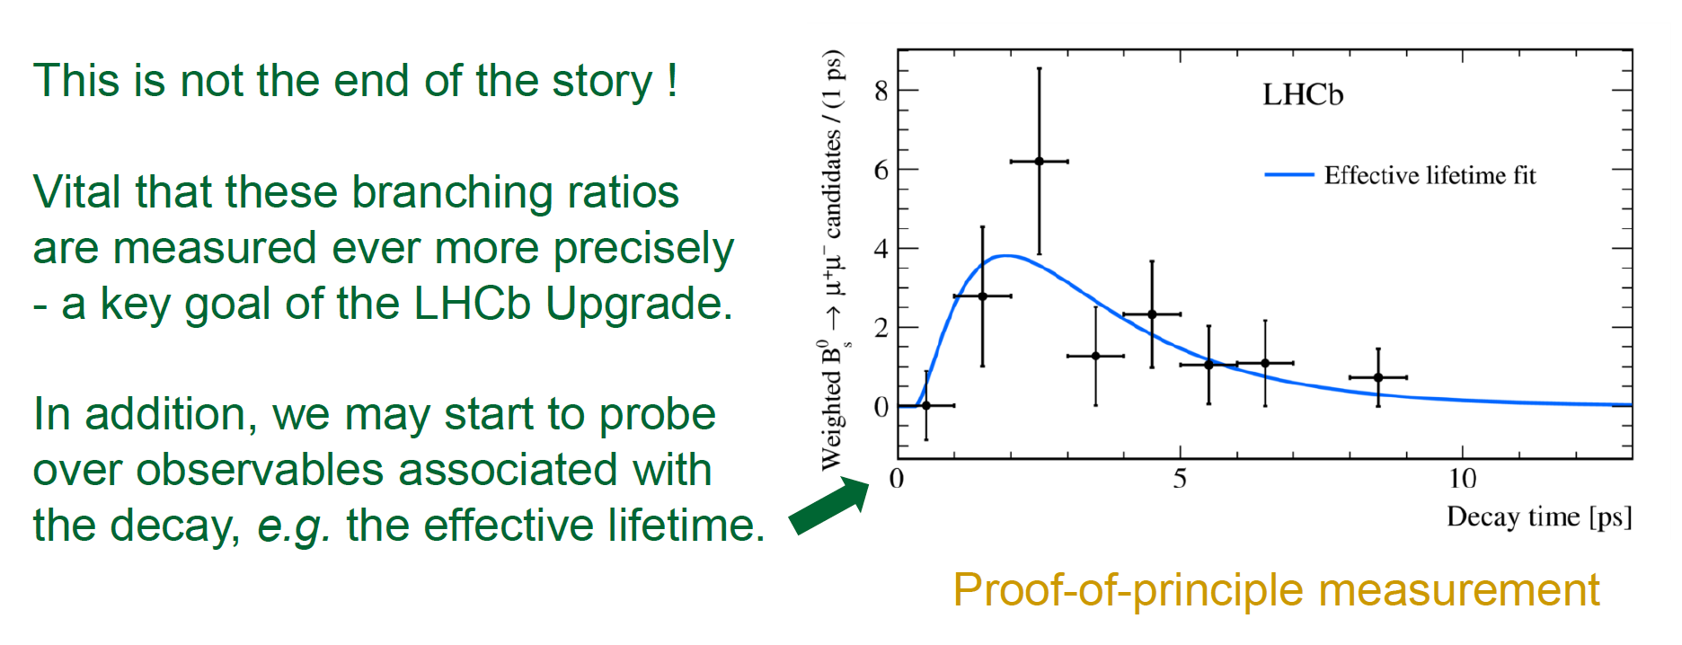
B→ μ⁺μ⁻ : First news from run 2
arxiv:1703.05747
LHCb has recently published a first run 1 + run 2 analysis (3+1.4fb⁻¹)
updated analysis with improved background suppression
No sign of 1st order New Physics effect!
B→ μ⁺μ⁻ becomes a precision test

Slide 27
Rare menu
b → s μ⁺μ⁻ base diagram
Purely leptonic
  “add nothing”
Semileptonic
  add d quark as spectator
  → B⁰ → K^{*0} μ⁺μ⁻
  add s quark as spectator
  → B_{s} → φ μ⁺μ⁻
  add u quark as spectator
  → B⁺ → Κ⁺ μ⁺μ⁻
Ratios:
  Compare muons to electrons

Slide 28
Angular analysis of B⁰ → K^{*0} μ⁺μ⁻
d
d
d
d
b
s
b
s
Observables depend on B→K* form factors and on short distance physics

Slide 29
Angular analysis of B⁰ → K^{*0} μ⁺μ⁻
LHCb published the first full angular analysis of the decay
  Unbinned maximum likelihood fit to Kπμμ mass and three decay angles
  Simultaneously fit Kπ mass to constrain s-wave configuration
  Efficiency modelled in four dimensions
  Binned in
  q² = m_{μμ}²
JHEP02(2016)104
Example fit projections in low q² bin

Slide 30
Results
References:
LHCb [JHEP 02 (2016) 104] ,
CMS [PLB 753 (2016) 424]
BaBar [arXiv:1508.07960]
CDF [PRL 108 (2012) 081807]
Belle [PRL 103 (2009) 171801].

Slide 31
Puzzling deviations: B⁰ → K^{*0} μ⁺μ⁻
2013, LHCb has observed a deviation in angular observables in B⁰ → K^{*0} μ⁺μ⁻ decays

Slide 32
Puzzling deviations: B⁰ → K^{*0} μ⁺μ⁻
2013, LHCb has observed a deviation in angular observables in B⁰ → K^{*0} μ⁺μ⁻ decays
Full Run 1 analysis confirms effect

Slide 33
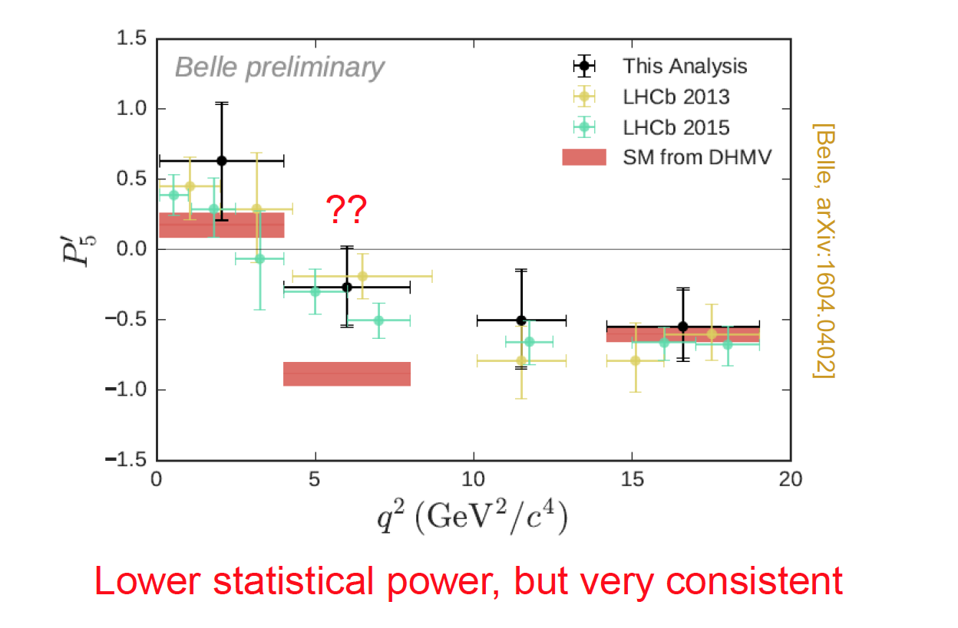
Puzzling deviations: B⁰ → K^{*0} μ⁺μ⁻
2013, LHCb has observed a deviation in angular observables in B⁰ → K^{*0} μ⁺μ⁻ decays
Full Run 1 analysis confirms effect
Belle still has a word to say
1

Slide 34
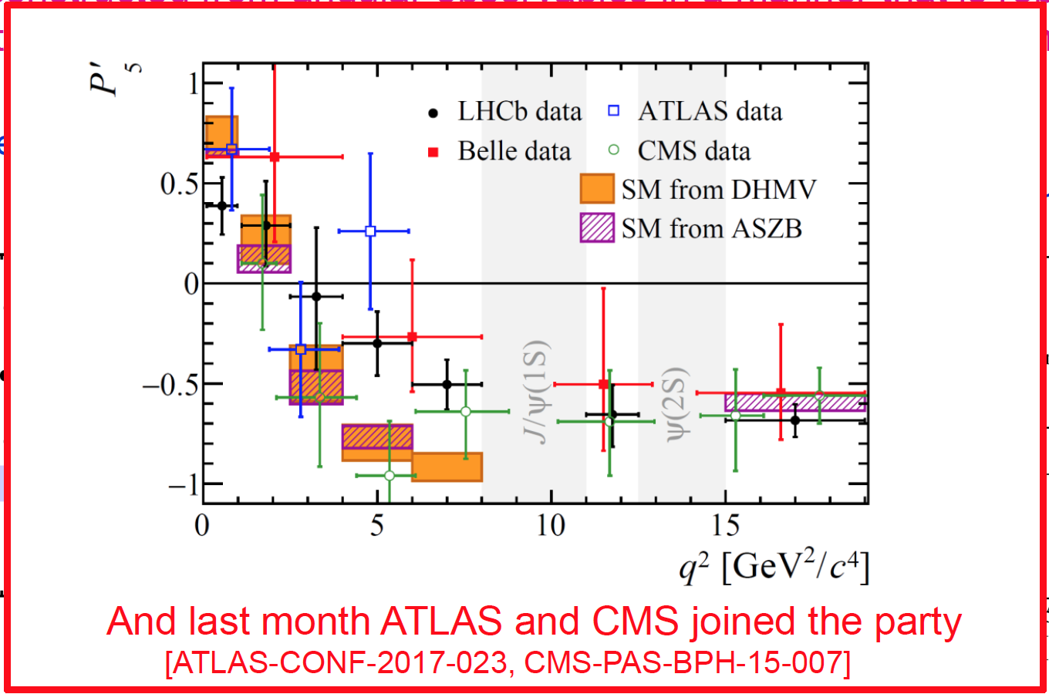
Puzzling deviations: B⁰ → K^{*0} μ⁺μ⁻
2013, LHCb has observed a deviation in angular observables in B⁰ → K^{*0} μ⁺μ⁻ decays
Full Run 1 analysis confirms effect
Situation unclear…. If real, expect discrepancies in other b → s decays ..
… very recently ATLAS and CMS joined
1

Slide 35
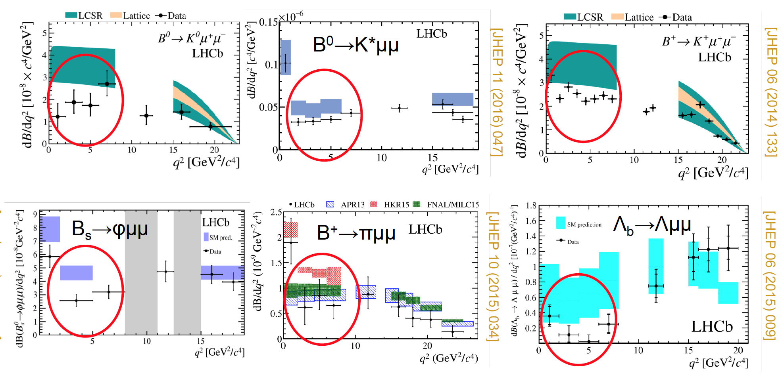
Branching fractions of b → s μ⁺μ⁻
Analysis of large class of b → s,d μ⁺μ⁻ decays
  Several tensions seen, but individual significance is moderate
  Tendency to undershoot prediction of differential x-sections
  → intriguing hint or TH issue in prediction?
→ We need cleaner tests …

Slide 36
Lepton universality
In the SM, leptons couple universal to W± and Z⁰
→ test this in ratios of semileptonic decays
Ratios differ from unity only by phase space
→ hadronic uncertainties cancel in the ratio
electrons / muons
tau / muons
u,d
u,d
b
s

Slide 37
LFU: electron vs. muon (R_{k})
LHCb measures with 3fb⁻¹
(SM: R_{k}=1.0, consistent at 2.6σ)

Slide 38
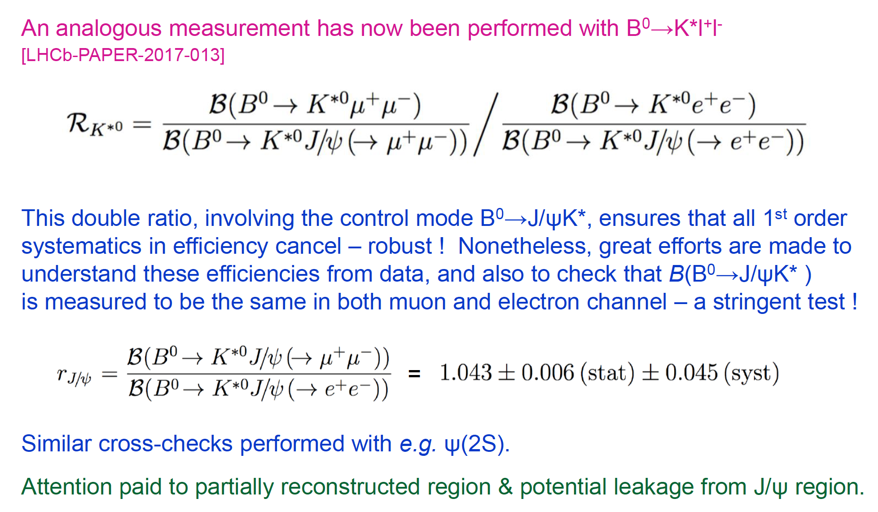
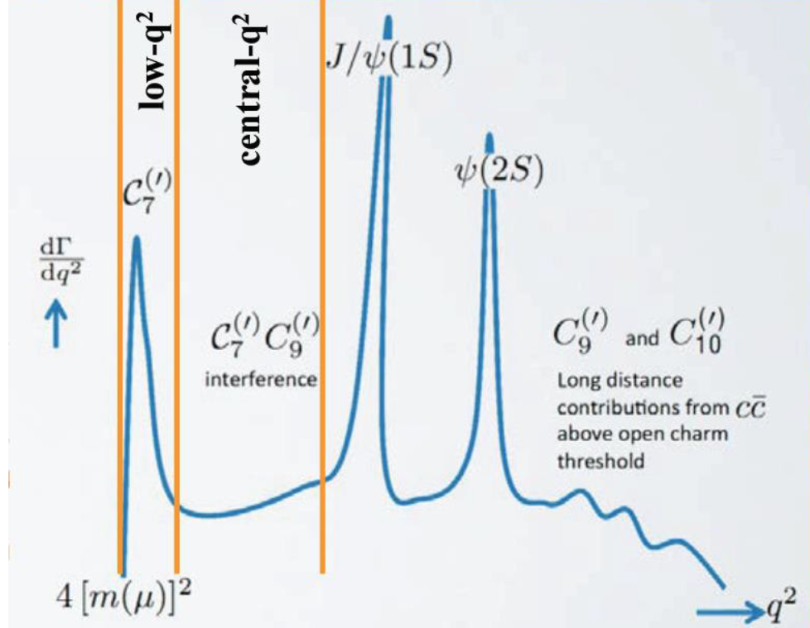
LFU: new Result with B⁰ → K^{*0} l⁺l⁻
arXiv:1705.05802
Analogous measurement with B⁰ → K^{*0} l⁺l⁻
  Double ratio: to first order systematics cancel
Measurement in regions
  Low-q²: 0.045 < q²< 1.1 GeV²
  Mid-q² : 1.1 < q²< 6 GeV²
  High q² region above resonances of
  interest, but different experimental
  challenges → separate analysis
Comic of di-lepton spectrum

Slide 39
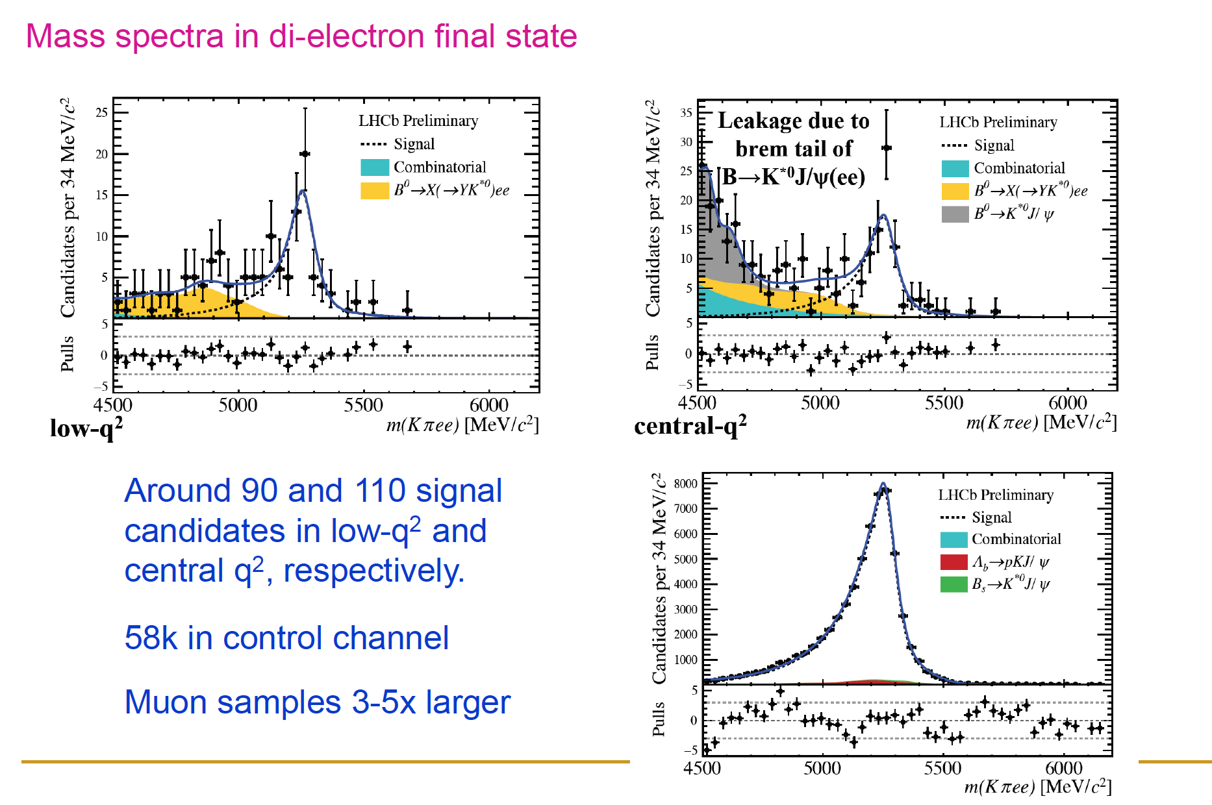
Mass distributions
Great efforts to check efficiencies from data with B⁰ → J/ψ K^{*0}
Similar cross check with ψ(2S)
Attention paid to partially reconstructed region & potential J/ψ leakage
90

Slide 40
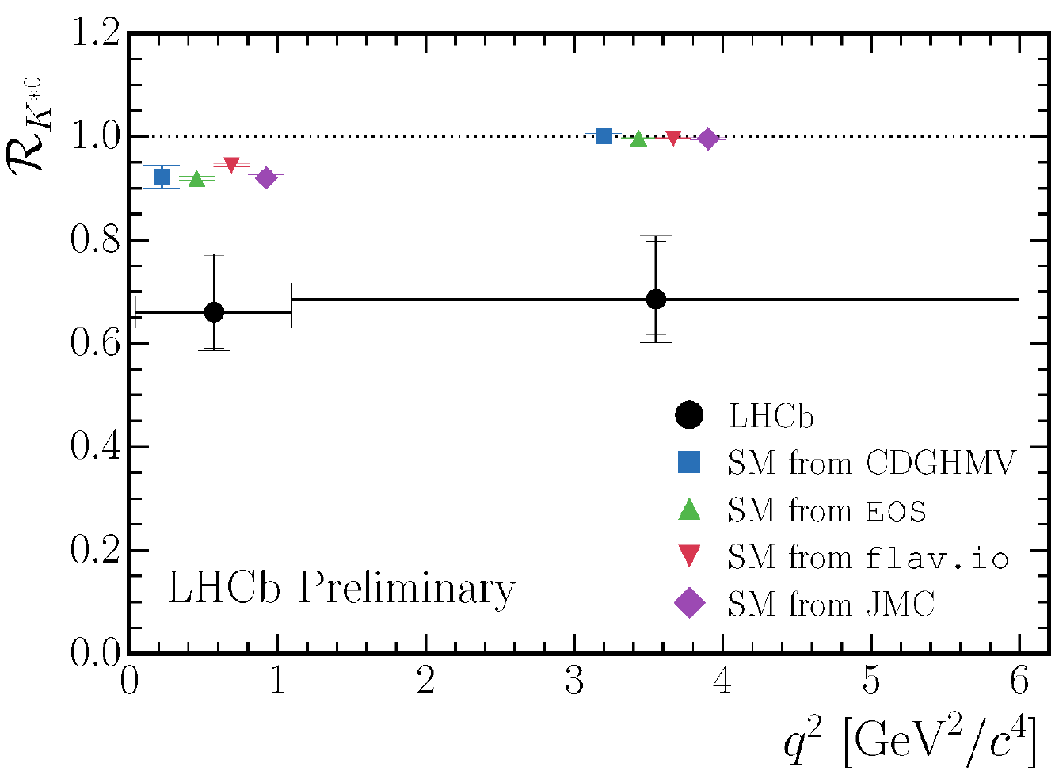
Lepton Flavour Universality Measurement
Measurement:
tension with SM
  Low-q²: 2.2-2.4σ
  mid-q²: 2.2-2.4σ
Interpretation?
  Typical approach: global analysis of all observables and fit to
  Wilson coefficients
  Intriguing: a coherent picture seems to emerge
  some analyses: large significances (e.g. arXiv:1704.05340, > 5σ) which has lead to excited discussions of Z’s, leptoquarks etc
  Experimentalists view: Hypotheses non fingo
  Excitement premature: we need significant individual measuremnts

Slide 41
Summary
The Standard Model is tested in a variety of channels
→ many measurements consistent with predictions
→ significant deviations in of b → s l⁺l⁻ channels,
lepton flavour universality is currently a hot topic
  → need for data to conclude
Interesting flavour data coming soon
  LHCb Run 2 → tripling the dataset (~factor 2 already!)
  LHCb Upgrade – record data with „Trigger-less Readout“
  Belle2 in the starting blocks

Slide 42

Backup

Slide 43
Expected future sensitivities
Global fit to b → s data
Many such fits around → essentially consistent results
Central value moved for illustration
Wilson scan: S. Reichert, D. Straub, F. Bernlochner, J.A.

Slide 44
Expected future sensitivities
Global fit to b → s data
Many such fits around → essentially consistent results
Project sensitivity to final Belle2 & LHCb dataset
Central value moved for illustration
Wilson scan: S. Reichert, D. Straub, F. Bernlochner, J.A.

Slide 45


Complementarity LHCb – Belle 2
Time dependent B_{s} physics
  CPV in B_{s} → J/ψ φ, B_{s} → φφ
B_{s} →μ⁺μ⁻
CKM angle γ
CPV in B_{d}
B → X_{s} l⁺l⁻ (exklusive) → LFU
B → X_{s} γ (exklusive)
Charm physics
Semileptonic B decays
B → D τ⁻ ν, B → D* τ⁻ ν
Dark matter
τ – physics: LFV
B → τ⁻ ν, B → μ⁻ ν
B → K* νν, B → νν
B → X_{s} l⁺l⁻ (inclusive)
B → X_{s} γ (inclusive)
“B_{s} &
charged tracks”
Important overlap:
sporty competition!
“inclusive & neutrals ”

Slide 46
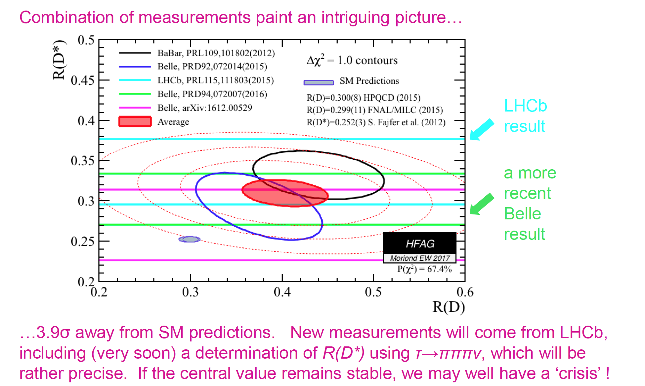
R(D) and R(D*)

Slide 47
LHCb upgrade in a nutshell

Slide 48
LHCb upgrade scheme

Slide 49
LHCb upgrade DAQ
Detector readout and trigger at 40 MHz + higher rate to storage will be the drivers to handle 5x luminosity and collect larger samples
Based on new front-end electronics, large PC-based event-builder network, and large expansion of online CPU farm
Real-time data calibration and reconstruction

Slide 50
Status of current flavour data
Observed tensions
Summary talks of Z. Ligeti and C. Bobeth, Moriond QCD 2016

Slide 51
Status of current flavour data
Observed tensions
Large effort to perform global fit
global fit
Summary talks of Z. Ligeti and C. Bobeth, Moriond QCD 2016
Results consistent (significance of 4-5σ):
Reduce strength of left handed EW penguin processes by ~25%

Slide 52
Current Flavour data hints at new particles
Z’ boson
Leptoquarks
Composite models
b
μ⁻
μ⁻
s
μ⁺
μ⁺
Additional U(1) vector boson, mass 1-10 TeV
couples to quarks and leptons, mass ~TeV
Some particles might
not be fundamental
e.g.Altmannshofer1308.1501,1411.3161,
1403.1269,Buras:1309.2466,1311.6729,
1409.4557, Celis:1505.03079,Crivellin:1501.00993,1503.03477,1505.02026, Gauld:1308.1959,1310.1082,Glashow:1411.0565,
Niehoff:1503.03865
e.g. Alonso:1505.05164, Bauer:1512.
06828,1511.01900, Becirevic:1503.09024, Biswas:1409.0882, Buras:1409.4557, Hiller:1408.1627,1411.4773, Sahoo:1501.05193
e.g. Carmona:1510.07658, Gripaios:1412.1791, Isidori:1604.03940, Niehoff:1503.03865,1508.00569
[I stopped collecting references in summer, apologies if I missed yours]
The coming years of LHCb running, together with inputs from the Belle2 experiment, will illuminate if we see fluctuations or exciting hints of something new
Notes:
The most recent ATLAS/CMS analyses exclude a leptoquark lighter than 850 GeV/760 GeV at 95% CL,

Slide 53
LHC(b) long term plan

Slide 54
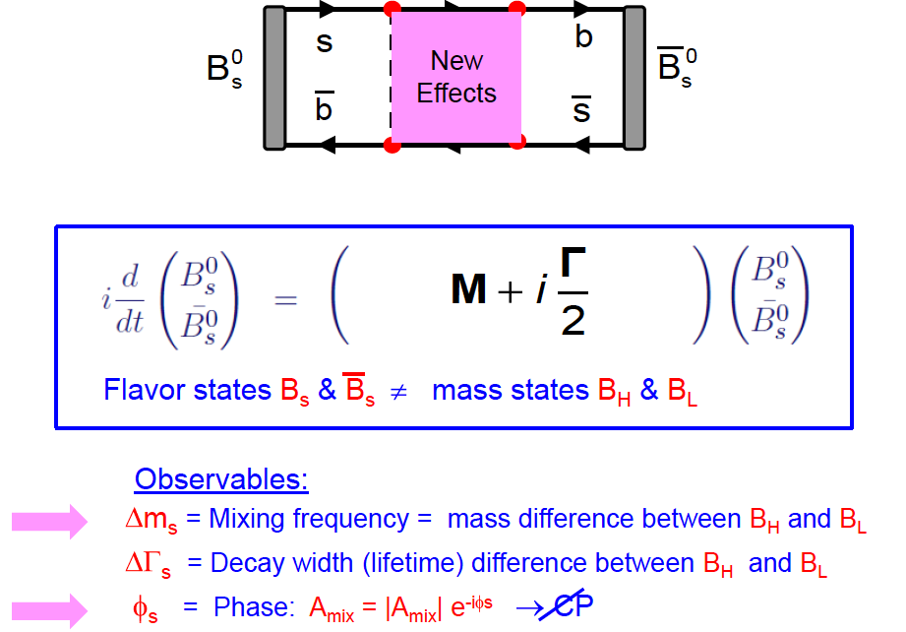
B_{s} mixing and CP violation

Slide 55
Measurement of B_{s} mixing
Δm_{s} = 17.768 ± 0.023^{stat} ± 0.006^{syst} ps⁻¹
Standard Model: Δm_{s} = 17.3±1.5
(U. Nierste, 2012)

Slide 56
CP-violating phase φ_{s}
Measure CP violating phase in B_{s} → J/ψ φ decays
Standard Model prediction:
→ basically a NULL test
φ_{s}
J/ψ φ

Slide 57
CP-violating phase φ_{s}
φ_{s} = 0.010±0.039

Slide 58
LHCb Upgrade Projections

Slide 59
b → s l⁺l⁻ as test bench for high scales
b → s l⁺l⁻ decays allow precise tests of Lorentz structure
  Sensitive to new phenomena via non-standard couplings
  Best described with effective field theory, allows to extract potential New Physics amplitudes
Menu for this talk:
  Purely leptonic decays: B_{s}→ μ⁺μ⁻
  → sensitive to C_{S,P} and C₁₀
  Recent measurements of b → s l⁺l⁻, dominantly B⁰ → K* μ⁺μ⁻
  → sensitive to C_{7,9} and C₁₀
  Lepton flavour universality
  → sensitive to Ce vs C^{μ}
Notes:
Mention PID

Slide 60
Combine all b → s data in global fit
Effective Hamiltonian:
Branching fractions
Angular variables
Global fit to all b → s data prefers a deviation from the Standard Model in a vector-like interaction
Interpretation:
  “clearly New Physics”, or ..
  Not well understood QCD contribution
→ Understanding needs more data and theoretical work

Slide 61
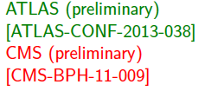
Experimental overview of b → s (d) l⁺l⁻
FCNC decays b → s (d) l⁺l⁻ : large variety of final states
  Allows detailed test of the structure of the underlying interaction
  Effects in one decay can be cross checked in others
# of events | BaBar 433fb⁻¹ | Belle 605fb⁻¹ | CDF 9.6fb⁻¹ | LHCb 1 / 3 fb⁻¹ | ATLAS 5fb⁻¹ | CMS 5fb⁻¹
B⁰ → K^{*0} l⁺l⁻ | 137±44* | 247±54* | 288±20 | 2361±56 | 466±34 | 415±29
B⁺ → K^{*+} l⁺l⁻ |  |  | 24±6 | 162±16
B⁺ → K⁺ l⁺l⁻ | 153±41* | 162±38* | 319±23 | 4746±81
B⁰ → K⁰_{s} l⁺l⁻ |  |  | 32±8 | 176±17
B_{s} → φ l⁺l⁻ |  |  | 62±9 | 174±15
Λ_{b}→ Λ l⁺l⁻ |  |  | 51±7 | 78±12
B⁺ → π⁺ l⁺l⁻ |  | limit |  | 25±7
LHCb
arxiv:1403.8044
+1305.2168
+1306.2577
+JHEP12(2012)125
*mixture of B⁰ and B± and l = e,μ
other experiments: l = μ only
Notes:
Comment K*mm 900 (1fb) vs 2.3k?

