Slide 1
What’s the (Quantum) Matter with Black Holes?
The Non-Singular Endpoint of Gravitational Collapse
(1916-2015)
E. Mottola, LANL
Review:
w. R. Vaulin, Phys. Rev. D 74, 064004 (2006)
w. P. Anderson, Phys. Rev. D 80. 084005 (2009)
Review Article: w. I. Antoniadis & Mazur, N. Jour. Phys. 9, 11 (2007)
w. P. O. Mazur
arXiv:1606.09220
Acta Phys. Pol. B 41, 2031 (2010)
Proc. Natl. Acad. Sci., 101, 9545 (2004)
Class.Quant.Grav. 32 (2015) no.21, 215024

Slide 2
Outline
Classical Black Holes in General Relativity
The Problems reconciling Black Holes with Quantum Mechanics
  Entropy & the Second Law of Thermodynamics
  Temperature & the ‘Trans-Planckian Problem’
  Negative Heat Capacity & the ‘Information Paradox’
  Update on Recent ‘Firewall’ Controversies
Effective Theory of Low Energy Gravity
  New Scalar Degrees of Freedom
  Conformal Phase Transition
  Near Horizon Boundary Layer
Gravitational Vacuum Condensate Stars
Astrophysical Observations and Tests
Possible Model for Cosmological Dark Energy, CMB

Slide 3
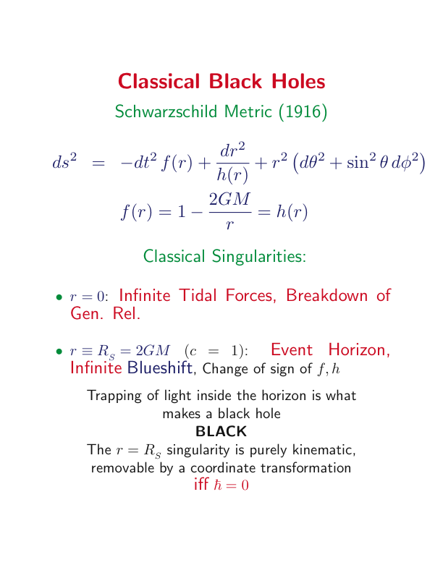
And iff T_{μν} = 0 on the horizon

Slide 4
Mathematical Black Holes
Classical Matter reaches the Horizon in Finite Proper Time
The Local Riemann Tensor Field Strength
& its Contractions remain Finite at r=2GM/c²
Kruskal-Szekeres Coordinates (1960) (G/c² = 1)
ds² = (32M³/r) e^{-r/2M} (-dT² + dX²) + r² dΩ²
Same geometry in different coordinates outside Horizon
Future/Past Horizon at r = 2GM/c² is T = ± X Regular
It is possible to use Kruskal coordinates to analytically continue inside r < 2GM/c² all the way to r = 0 singularity
Necessarily involves complex continuation of coordinates

Slide 5
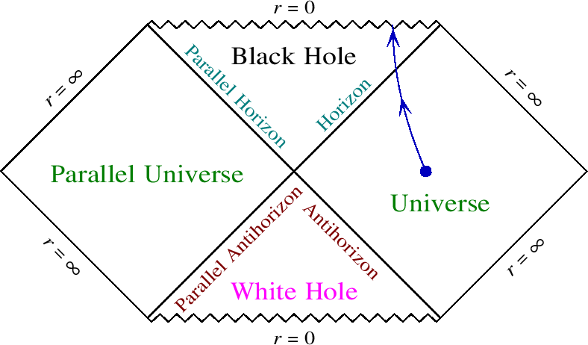
Schwarzschild Maximal Analytic Extension
Carter-Penrose Conformal Diagram
Interior
T=X
World Line of typical infalling particle
Exterior
T= -X

Slide 6
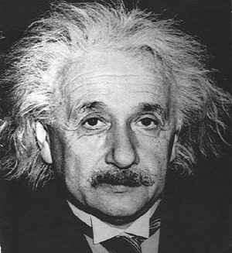
Mathematical Black Hole Interiors
What really happens when one reaches the Event Horizon and inside it?
“There arises the question whether it is possible
to build up a field containing such singularities
with the help of actual gravitating masses, or
whether such regions with vanishing g₄₄ do not
exist in cases which have physical reality.”
--- A. Einstein (1939)
(Same year as Oppenheimer-Snyder)
Schwarzschild soln. also has a true spacetime singularity at r=0
A Single Spacetime Point with the mass of a million suns?
Notes:
6

Slide 7
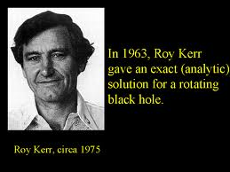
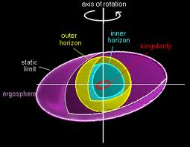
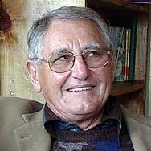
Rotating Black Holes

Slide 8
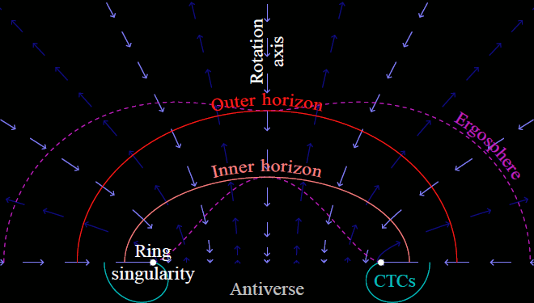
Mathematical Kerr Black Hole Interiors
More singularities
More universes!
Closed Timelike Curves:
(say hello to your greatgrandparents)
More unphysical

Slide 9
Irreducible Mass and First Law
All Gen. Rel. Black Holes specified by their mass, angular
momentum and electric charge: M, J, Q
Rotating Kerr Black Holes have all higher multipoles
determined completely by M, J (no “hair”)
Irreducible Mass M_{irr} increases monotonically classically
(Christodoulou, 1972) M² = (M_{irr} + Q/4M_{irr})² + J²/4M_{irr}²
M_{irr}² = (Area)/16πG
Δ M_{irr}² ≥ 0
First Law of BH Mechanics (Smarr, 1972)
dM = κ dA/8πG + Ω dJ + Φ dQ

Slide 10
Black Holes, Quantum Mechanics & Entropy
A fixed classical solution usually has no entropy :
(What is the ‘entropy’ of the Coulomb potential Φ = Q/r ?)
… But if matter/radiation disappears into the black ‘hole,’
what happens to its entropy? (Only M, J, Q remain)
Is the horizon area A--which always increases when matter
is thrown in–a kind of ‘entropy’?
To get units of entropy need to divide Area, A by (length)²
… But there is no fixed length scale in classical Gen. Rel.
Planck length involves
Bekenstein suggested with γ ~ O(1)
Hawking (1974) argued black holes emit thermal radiation at
Apparently then the first law,
dE = T_{H} dS_{BH} fixes γ = ¼
But …

Slide 11
What’s the (Quantum) Matter with Black Holes?
T_{H} requires trans-Planckian frequencies at the horizon
ħ cancels out of dE = T_{H} dS_{BH} : Quantum or Classical?
In the classical limit T_{H} → 0 (cold) but S_{BH} → ∞ (?)
S_{BH} ∝ A is non-extensive and HUGE
E ∝ T⁻¹ implies negative heat capacity: ⟨(H-E)²⟩ < 0 (?)
⇒ highly unstable
Equilibrium Thermodynamics cannot be applied (?)
Information Paradox: Where does the information go?
(Pure states → Mixed States? Unitarity ? )
What is the statistical interpretation of S_{BH} ?
Boltzmann asks: What about S = k_{B} ln W ?

Slide 12
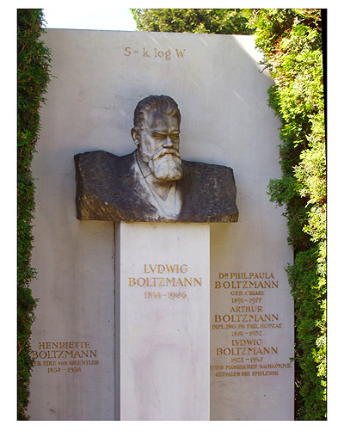

Slide 13
Statistical Entropy of a Relativistic Star
S = k_{B} ln W(E) (microcanonical) is equivalent to
S = - k_{B} Tr (ρ ln ρ)
Maximized by canonical thermal distribution
Eg. Blackbody Radiation E ~ V T⁴ , S ~ V T³
S ~ V^{1/4} E^{3/4} ~ R^{3/4} E^{3/4}
For a fully collapsed relativistic star E = M , R ~ 2GM ,
so S ~ k_{B} (M/M_{Pl})^{3/2 ← note 3/2 power}
S_{BH} ~ M² is a factor (M/M_{Pl})^{1/2} larger or 10¹⁹ for M = M
There is no way to get S_{BH} ~ M² by any standard
statistical thermodynamic counting of states

Slide 14
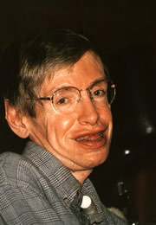
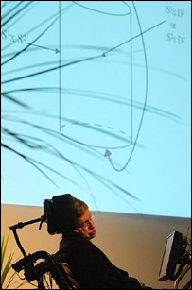
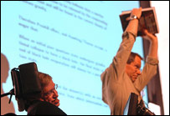
Thursday, 15 July, 2004, 17:08 GMT 18:08 UK
Hawking backs down on black holes
Stephen Hawking says he was wrong about a key argument he put forward 30 years ago on the behaviour of black holes.
The world-famous physicist addresses an international conference on Wednesday to revise his claim that black holes destroy everything that falls into them.

Slide 15
Late Report from the Front of ‘Black Hole Wars’
~60 ‘Firewall’ papers in last few years arguing about mutual inconsistency of:
Hawking radiation is in a pure state (QM: unitarity)
information carried by radiation in low-energy EFT
Nothing happens at the horizon to infalling observer
“Proof” by contradiction, many assumptions but still doesn’t tell you what actually happens

Slide 16
Crisis in Foundations of Physics ?!
Desperate conditions
demand desperate
measures ?!
Faster than Light Propagation ?

Slide 17
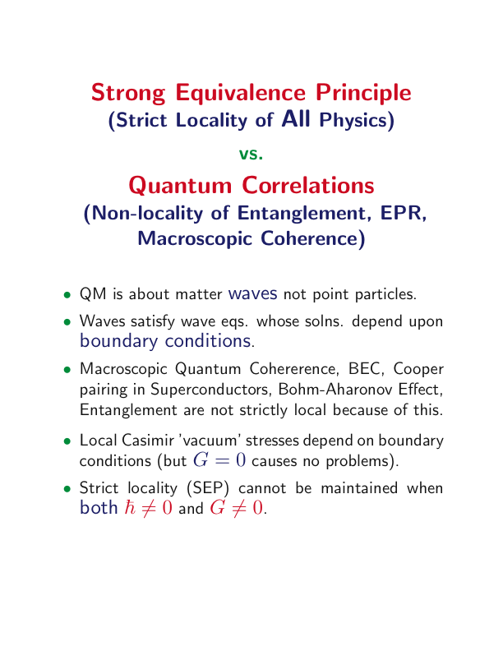
The ‘crisis’ is caused by assuming ‘nothing happens’
at the black hole horizon - tacitly assuming SEP.
The quantum ‘vacuum’ is not featureless ‘nothing.’

Slide 18
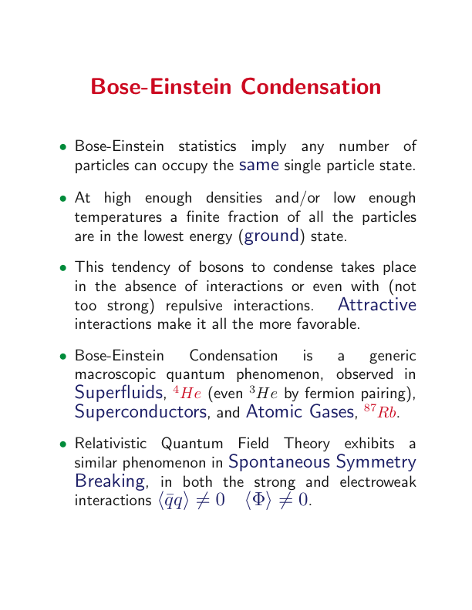
A Macroscopic Quantum Effect

Slide 19
Black ‘Holes’… or Not
Black Holes believed ‘inevitable’ in General Relativity but
Difficulties reconciling Black Holes with Quantum Mechanics
  Hawking Temperature & the ‘Trans-Planckian Problem’
  Entropy & the Second Law of Thermodynamics
  Negative Heat Capacity & the ‘Information Paradox’
Singularity Theorems assume Trapped Surface and
Energy Conditions: Strong Energy Condition
Violated by Quantum Fields, e.g. by Casimir Effect &
Hadron ‘Bag’, Cosmological Dark Energy, Inflation V(φ):
Negative Pressure Effective Repulsion

Slide 20
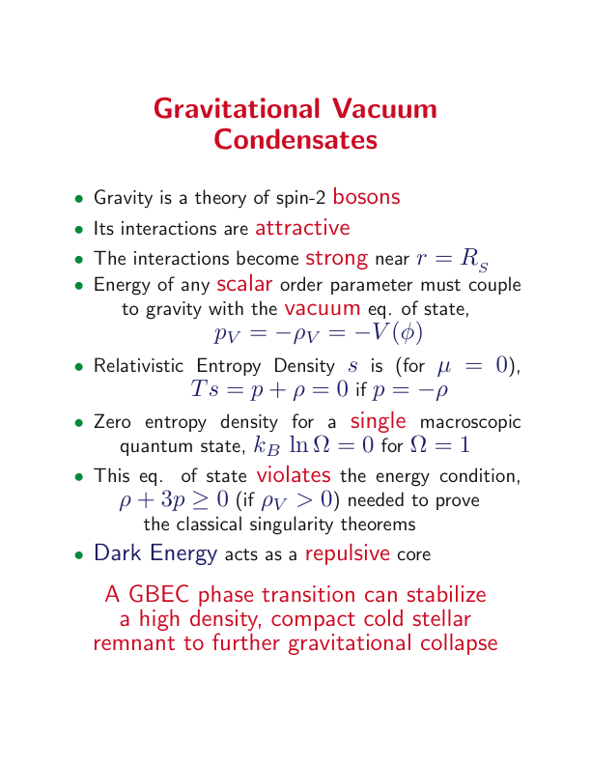
Realized in Schwarzschild’s Interior Soln.!

Slide 21
Static, Spherical Symmetry
2 Metric Fns.
⬅Misner-Sharp Mass
3 Stress Tensor Fns.
2 Einstein Eqs.
1 Conservation Eq.

Slide 22
Schwarzschild Interior Solution (1916)
Constant Density
Pressure
Diverges at iff
≥ 0
Vanishes only at same R₀

Slide 23
Buchdahl Bound (1959)
Assuming classical Einstein eqs. &
Static Killing time:
Spherical Symmetry:
Isotropic Pressure:
Positive Monotonically Decreasing Density:
Metric Continuity at Surface of Star r=R
Then
or the pressure must diverge in the Interior Note this R is outside horizon

Slide 24
Interior Pressure
R= 1.25 R_{s}

R = Total Radius
R_{s} = 2 GM/c²
(Schwarzschild Radius)
R= 1.126 R_{s}

As R ➔ 9/8 R_{s} from above central pressure diverges

Slide 25
Interior Pressure
R₀ = Radius where f(r)=0
Pressure becomes
negative
for 0 < r < R₀
R₀
⬅R=1.124R_{s}
As from above from below and negative pressure region
fills entire interior with
p= - ρ
R=1.001R_{s}⬇

Slide 26
Interior Redshift
Non-negative (no trapped surface)
vanishes at same radius
where p diverges
Redshift
has cusp-like behavior

Slide 27
R=R_{s} Limit is Grav. Condensate Star (2001-4)
No divergence in p
Pressure becomes
w=-1
⬇
but non-analytic cusp
Discontinuity
Interior is p= - ρ
de Sitter vacuum
Redshift cusp at R=R_{s}
⬇

Slide 28
Komar Mass-Energy Flux (1959-62)
Surface Gravity
Total Mass: ‘Gauss’ Law’ for Static Gravity

Slide 29
Transverse Pressure
Cusp in Redshift produces Transverse Pressure
Localized at r =R₀
Integrable Surface Energy

Slide 30
Surface Tension of the Vacuum ‘Bubble’
Discontinuity in Surface Gravities
is surface tension/tranverse pressure
Interior is not analytic continuation of exterior

Slide 31
First Law
Classical Mechanical Conservation of Energy
Gibbs Relation
Schw. Interior Soln. in Limit describes
a Zero Entropy/Zero Temperature Condensate
Discontinuity in κ implies non-analytic behavior
No Trapped Surface, Truly Static, t is a Global Time
Surface Area is Surface Area not Entropy
Surface Gravity is Surface Tension not Temperature

Slide 32
Remarks
Non-Analyticity Characteristic of a Phase Boundary
Freezing of Time ➔ Critical Slowing Down
is everywhere timelike: Hamiltonian exists & is Hermitian w. proper b.c. at 0 and ∞
Quantum State of Test Field ~ Boulware State (No Flux)
Energy Density
Violates Both Weak & Strong Energy Conditions
Significant Backreaction when
Occurs at Physical Length
Also Time Delay ~ ln (ε)
All Regulated by finite ε

Slide 33
Surface Oscillations
Energy Minimized by minimizing A for fixed Volume
Surface Tension acts as a restoring force
Surface Oscillations are Stable
Surface Normal Modes are Discrete
Characteristic Frequency
Discrete Gravitational Wave Spectrum
Striking Signature for LIGO/VIRGO for
Slowly Rotating Soln. now exists also (Aguirre-Posada)

Slide 34
Refraction of Null Rays at Surface
Solve
Geodesic Eq.
Snell’s Law
n < 1
Surface at
Impact
Parameter
b

Slide 35
Defocusing of Null Rays
No Horizon ➔ Light Rays Penetrate Interior
Time
Delay
~ ln (ε)
Different Imaging from a Black Hole, EHT

Slide 36
Gravitational Wave Echoes
Different b. c. on surface from BH Horizon
Transmission (with time delay) through surface
Use Regge-Wheeler radial coordinate
Scalar Wave or Grav. Wave Eq. gives
Reflection from de Sitter interior barrier: ‘Echo’

Slide 37
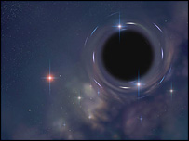
Gravitational Vacuum Condensate Stars
Gravastars as Astrophysical Objects
Cold, Dark, Compact, Arbitrary M, J
Accrete Matter just like a black hole
But matter does not disappear down a ‘hole’
Relativistic Surface Layer can re-emit radiation
Supports Electric Currents, Large Magnetic Fields
Possibly more efficient central engine for Gamma Ray Bursters, Jets, UHE Cosmic Rays
Formation should be a violent phase transition converting gravitational energy and baryons into HE leptons and entropy
Gravitational Wave Signatures
Dark Energy as Condensate Core -- Finite Size Effect
of boundary conditions at the horizon
Possible Model for Cosmological Dark Energy ?
Notes:
37

Slide 38
Summary
Buchdahl Bound ➔ Under Adiabatic Compression
Interior Pressure Divergence Develops before Event
Horizon Forms for
Constant Density Interior Schwarzschild Solution Saturates Bound & shows the generic behavior:
Infinite Redshift at the Central Pressure Divergence
But gives Integrable Komar Energy
Implies Formation of a δ-fn. Surface & Surface Tension
A Non-Singular (de Sitter ) ‘BH’ Interior

Slide 39
Summary
Area term is Classical Mechanical Surface Energy not Entropy
QM, Unitarity ✓ No ‘Information Paradox’
Condensate Star negative pressure already realized/ inherent in Classical General Relativity
in Schwarzschild Interior Solution (1916)
Cold Quantum Final State of Gravitational Collapse
Full Non-Singular Soln. Requires Quantum
Effective Theory of the Conformal Anomaly
Dynamical Vacuum Condensate Energy
Testable Predictions for Imaging, GW’s, Echoes

Slide 40
Quantum Effects at Horizons
Infinite Blueshift Surface
ω_{local} = ω∞ (1 - 2GM/r)^{-1/2}
No problem classically, but in quantum theory,
ħ → 0 and r → 2GM limits do not commute (⇒ non-analyticity)
Singular coordinate transformations → new physics (e.g. vortices)
Energies becoming trans-Planckian should call into doubt
the semi-classical fixed metric approximation
Large local energies must be felt by the gravitational field
Large local energy densities/stresses are generic near the horizon
⟨ T_{a}^{b} ⟩ ~ ħω_{local}⁴ ~ ħM⁻⁴ (1 - 2GM/r)⁻²
The geometry does not remain unchanged down to r = 2GM
Quantum Vacuum Polarization Effects are important on horizon
E_{local} = ħω_{local} = ħω∞ (1 - 2GM/r)^{-1/2} → ∞

Slide 41
Quantum Effective Theory
Needs to have 3 elements
Consistent with Quantum Theory & General Covariance
Important Effects Near Macroscopic (Apparent) Horizons
Allows Vacuum Energy to Change (Quantum Phase Transition)
Note: QCD also provides Vacuum Energy in Bag Constant (Gluon Condensate)
Relevant in NS’s near Mass Limit esp. if Density Dependent
QCD Conformal Anomaly ➔ General Conformal Anomaly

Slide 42
New Horizons in Gravity
Einstein’s classical theory receives Quantum Corrections relevant at macroscopic Distances & near Event Horizons
These arise from new scalar degree of freedom in the EFT of Low Energy Gravity required by the Conformal/Trace Anomaly
EFT of Gravity predicts the existence of scalar gravitational waves
EFT enables efficient computation of vacuum effects in BH and cosmological spacetimes
Conformalon Fluctuations can induce a Quantum Phase Transition at the horizon of a ‘black hole’ and on cosmological de Sitter horizon
Quantum Mechanism in EFT for realizing the gravastar soln.
Possible Model for Cosmological Dark Energy ~ 1, Testable in CMB Non-Gaussianity
Notes:
42

Slide 43
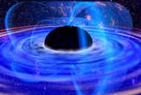
Λ_{eff} is a dynamical condensate which can change in the phase transition & remove ‘black hole’ interior singularity
Gravitational Condensate Stars resolve all ‘black hole’
paradoxes ⇒ Astrophysics of gravastars testable
The cosmological dark energy of our Universe may be a macroscopic finite size effect whose value depends not
on microphysics but on the cosmological horizon scale
This should also be testable in CMB. LSS

