Slide 1
Low-Energy Precision Measurements at the S-DALINAC
Norbert Pietralla
IKP, TU Darmstadt
Outline
Status of the S-DALINAC
  3rd recirculation, ERL mode, beam quality
Overview
  coherence of program, exploiting the strengths of the S-DALINAC
Plans for Low-Energy Precision Measurements
  scientific needs, experimental opportunities
Summary

Slide 2
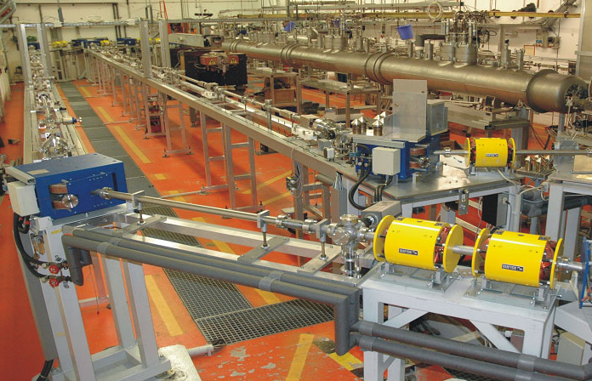
S-DALINAC at TU Darmstadt
Recirculating
superconducting LINAC
Niobium cavities,
LHe cooled @ 2 K,
3 GHz cw e-beams,
< 130 MeV, ≤ 60 μA

Slide 3
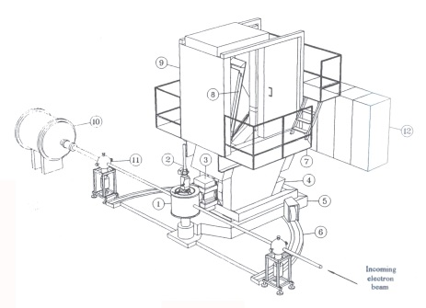
S-DALINAC at TU Darmstadt
Thanks to
State of Hesse
TU Darmstadt
DFG
i
2
1
Source
Thermionic
Photogun
Photon Experiments
e - Scattering
1
10 MeV Injector: Photon Scattering / Photofission
High – acceptance, 180º
2
30 MeV Tagger: Photodesintegration / Photon Scattering
High resolution

Slide 4
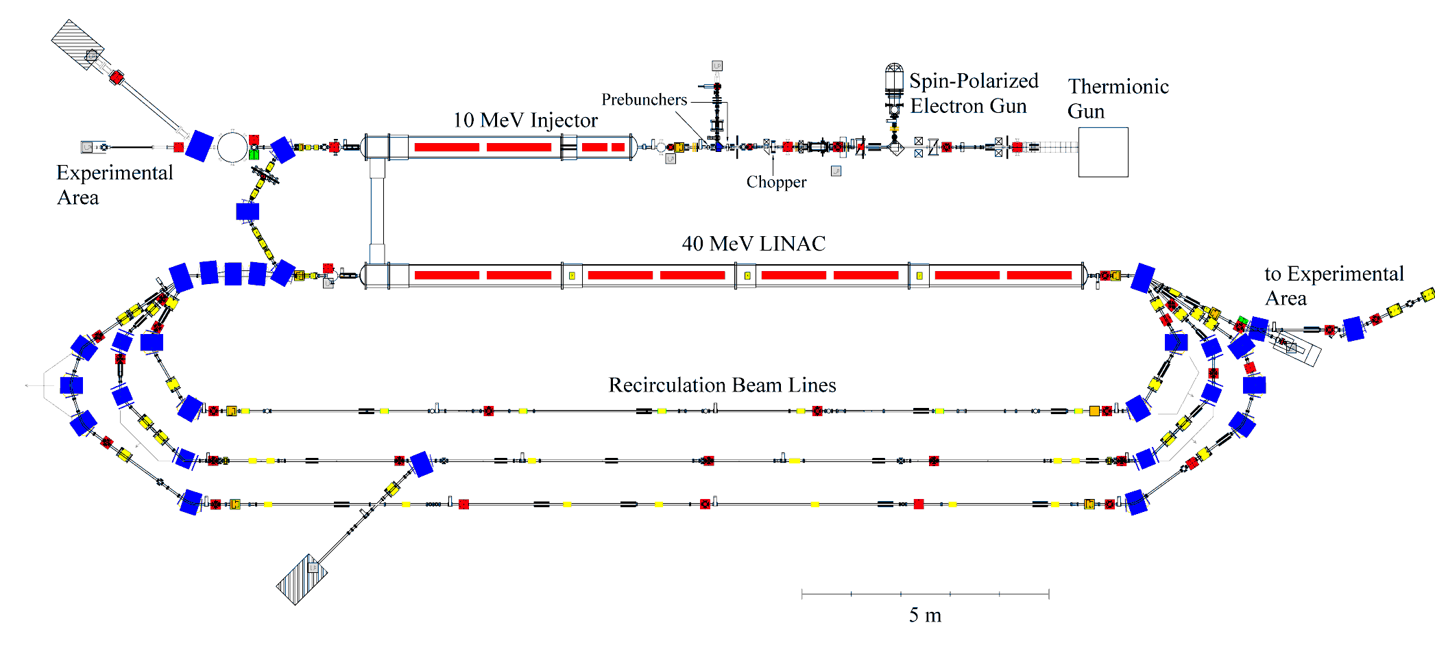
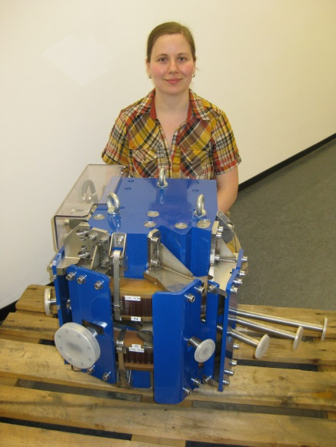
3rd Recirculation at S-DALINAC
7.65
38.25 MeV
68.85 MeV
99.45 MeV
130.05 MeV
30.6
Single pass, one or three recirculations
Installation to be completed by June 2016
layout, design, realization (Ph.D. thesis of M. Arnold)
option for ERL mode for one or two recirculations
6/11/2015 10 am

Slide 5
S-DALINAC at TU Darmstadt on shut-down, Nov. 2015

Slide 6
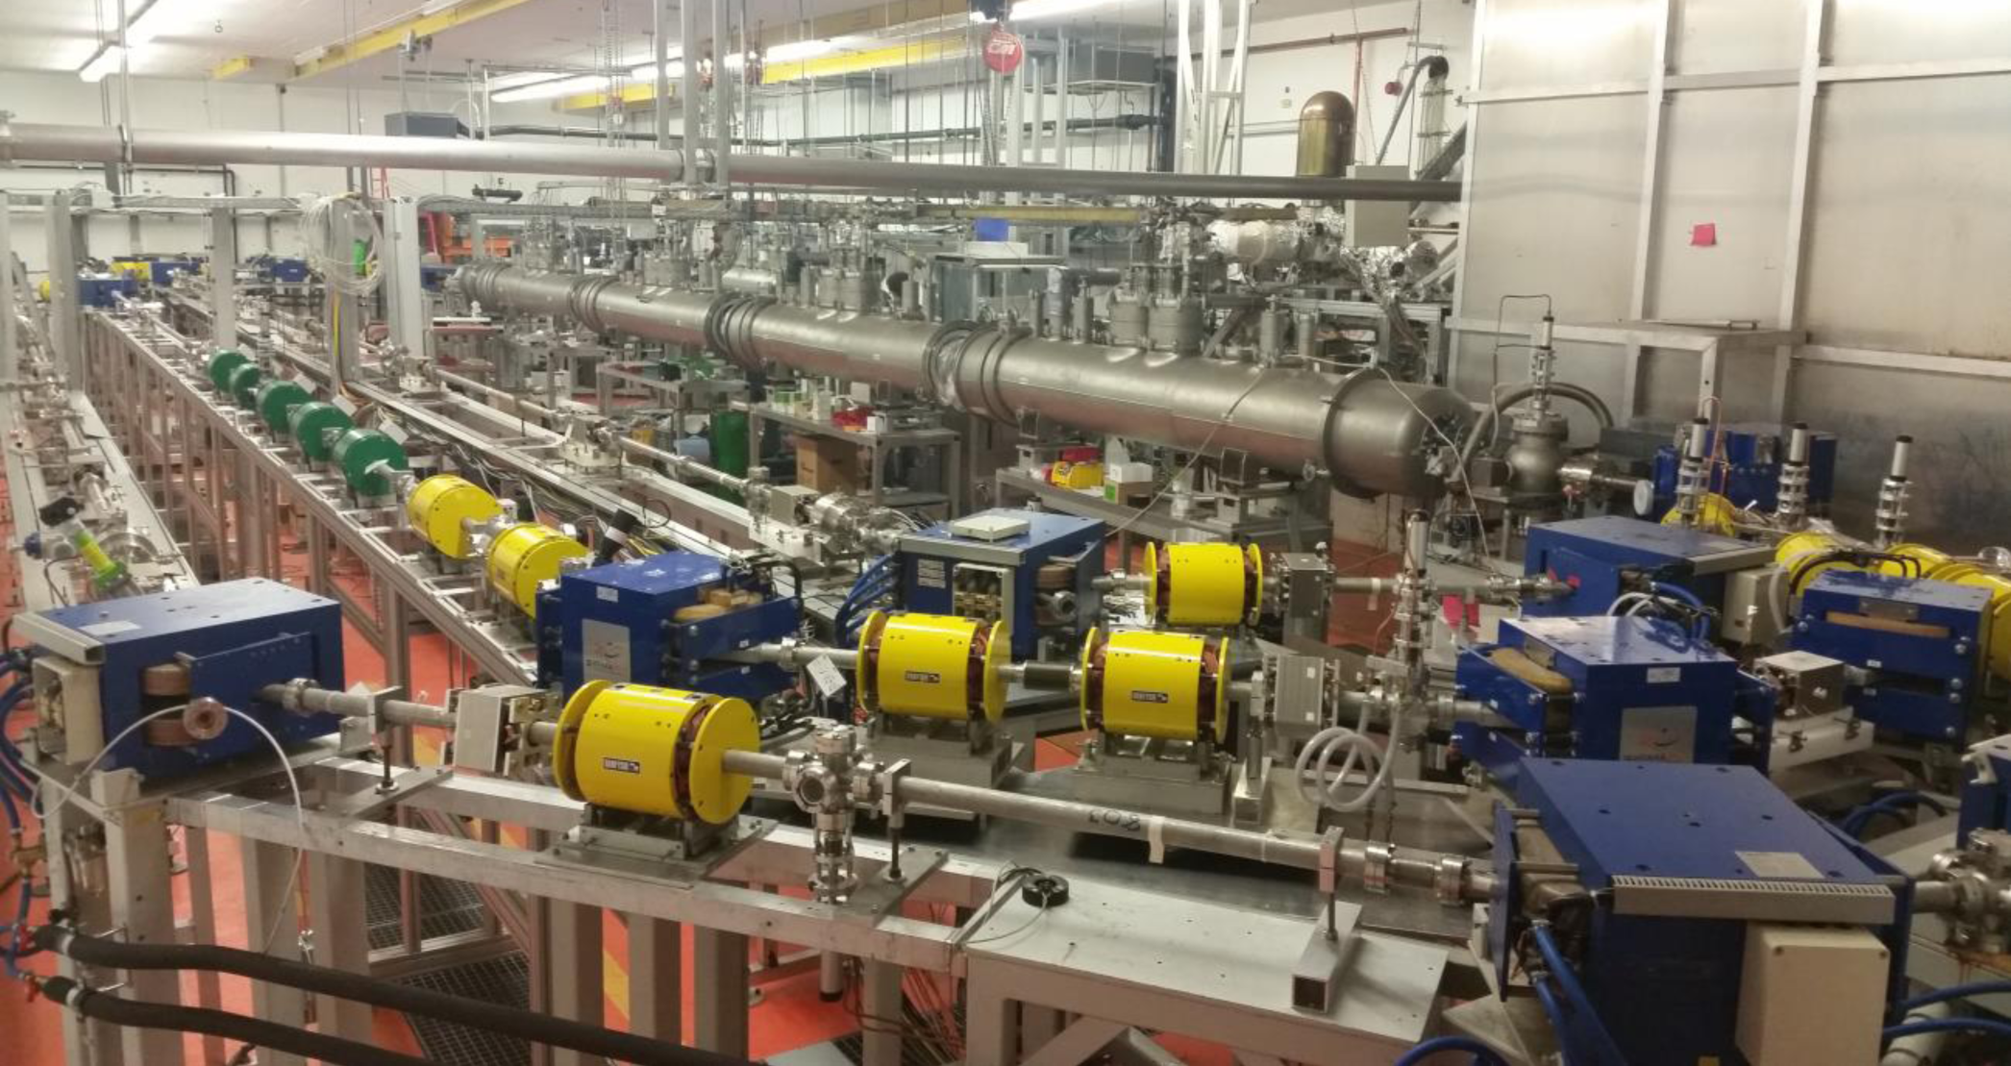
S-DALINAC at TU Darmstadt
March 2016
first beam in June 2016
first ERL in Germany in fall 2016

Slide 7
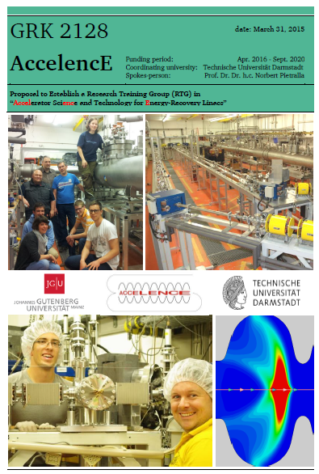
GRK 2128 „AccelencE“
Research Training Group in Accelerator Physics
Adressing Physics of Energy Recovery LINACs
Electron sources – injectors – diagnostics – beam dynamics – beam-target relations
23 Positions for PhD Students (100% / 75% / 50% E13)
More information http://www.ikp.tu-darmstadt.de/dasinstitut/accelence/

Slide 8
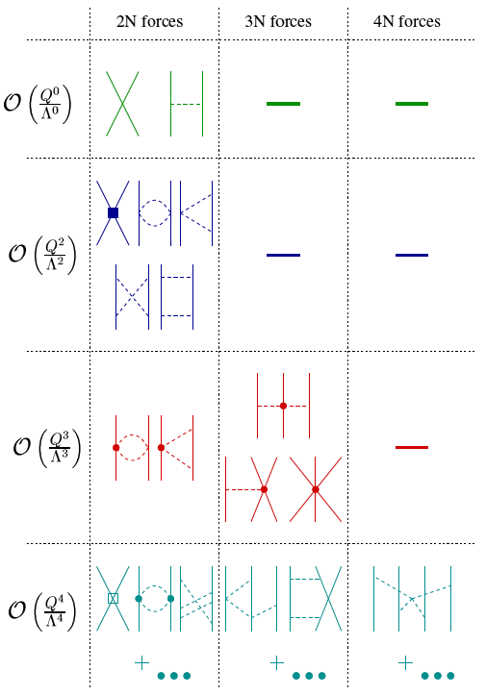
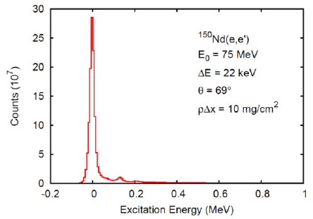

Low-Energy Precision Physics making contact with QCD through χEFT
S-DALINAC is the machine for the χEFT-energy regime
Highest energy resolution demonstrated
    ΔE = 22 keV @ 75 MeV; goal: < 10 keV

Slide 9

Some Plans for
Low-Energy Precision Measurements

Slide 10
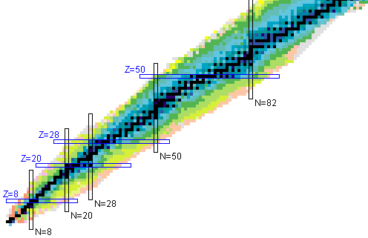
Overview
Nuclear Polarizability: Fine Structure of GDR
Nuclear Structure for DM Searches
Nuclear Structure for 0νββ
Fundamental Mechanisms of
Nuclear Structure Formation:
cluster structure,
Type II Shell Evolution,
effective pn-Interaction
Q(¹²C)
0⁺₁(⁶Li)
0⁺₂(⁴He)
R_{p}

Slide 11
Proton Radius
(not part of SFB 1245)

Slide 12
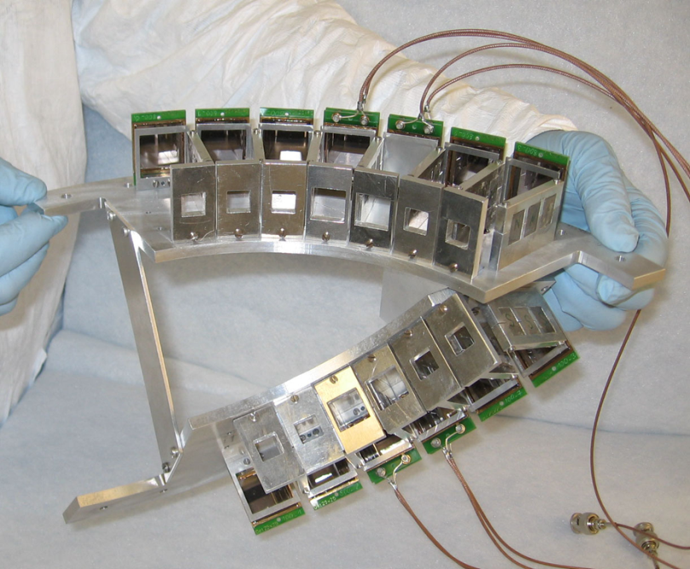
Proposed Set-up
control of beam position
control of target evaporation
early prototype

Slide 13
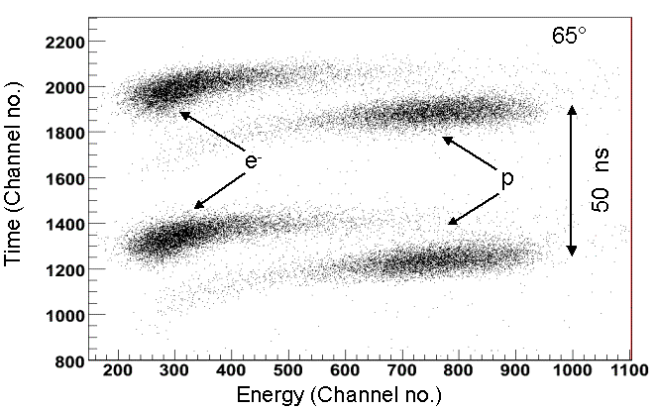
Proton Radius at Low-Q current data: Q² > ~0.004 (GeV/c)²
CH₂(e,ep) @ 30, 50, 80 MeV
Simultaneous measurement of electrons in spectrometer and recoil protons in Si-detector goniometer
electron-spectrometer as monitor
simultaneous measurement of up to 10 proton angles Q² = [.1-.001](GeV/c)²
Precise energy calibration by separation of elastic lines
Discrimination from background with time-of-flight in pulsed mode
S-DALINAC test experiment
with prototype
20 MHz pulsed beam, E = 65 MeV,
polyethylene foil
discrimination of recoil protons vs.
scattered electrons by t.o.f.

Slide 14
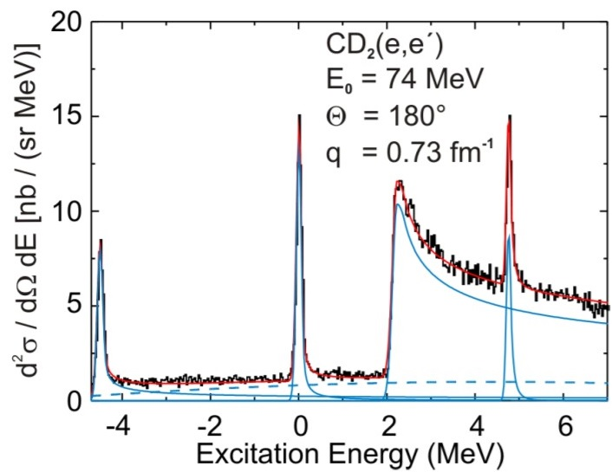
Example for Resolution:
Inclusive Deuteron Breakup at 180º
S-DALINAC data, polyethelene foil
¹²C
D
H
N. Ryezayeva et al., Phys. Rev. Lett. 100 (2008) 172501

Slide 15
Effective 4-Body Forces
⁴He

Slide 16
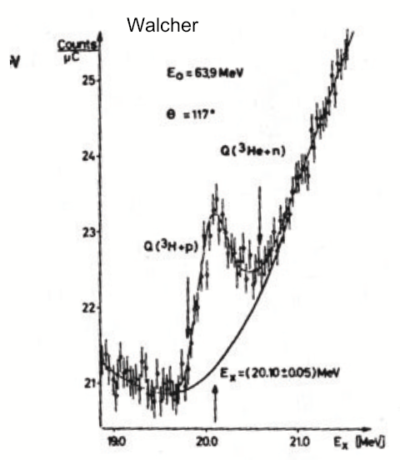
E0 transition form factor in ⁴He –
Benchmark for chiral EFT
20210
0⁺,T=0
⁴He
0⁺,T=0
DALINAC
data
Th. Walcher, Phys. Lett. B 31, 442 (1970)

Slide 17
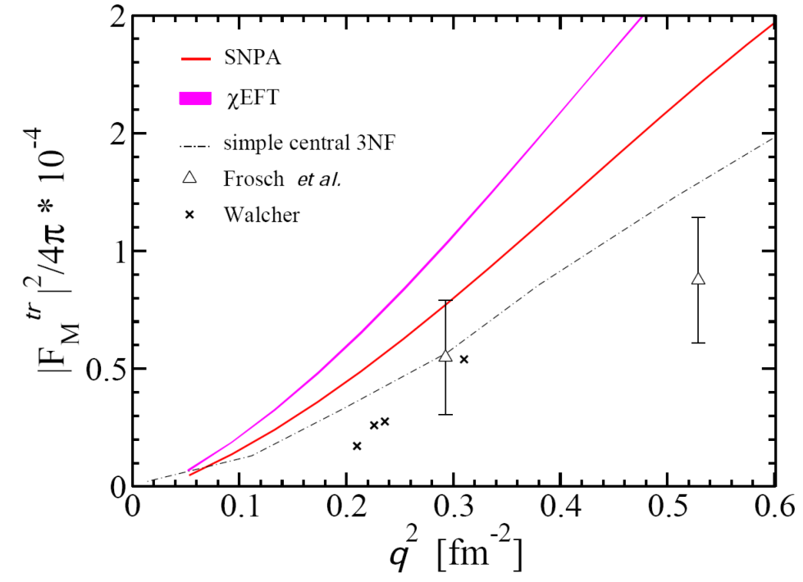
E0 transition form factor in ⁴He –
Benchmark for chiral EFT
20210
0⁺,T=0
Theory:
Unexpected discrepancies between different modern theories
Negligible contribution of 2-body currents
Discrepancy to experimental data
⁴He
0⁺,T=0
Experiment:
Inelastic electron scattering at QCLAM spectrometer
Statistical uncertainty of about 5%
Check luminosity relative to ground state
Cryostat for ⁴He_{lq} target in preparation
S. Bacca et al, PRL (2013)
accessible at S-DALINAC

Slide 18
Effective 2-Body Currents
⁶Li

Slide 19
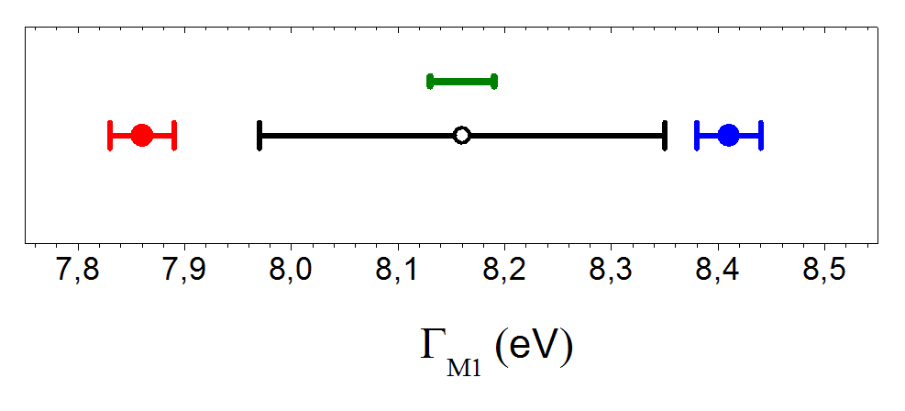
B(M1) in ⁶Li – Probe of 2-body currents
3562
0⁺,T=1
3508
⁶Li (0⁺ → 1⁺)
0⁺,T=1
⁶He + e⁺
M1
2185
NCSM
Exp.: 8.16(19) eV (e,e‘)
GFMC
B(GT)=4.6851(47)
Knecht et al.,
PRL 108, 122502 (2012).
± 0.1%
3⁺,T=0
⁶Li
1⁺,T=0
NCSM: NN+3N in N_{max}=10, no 2-body currents
GFMC: S. Pastore et al., PRC (2013)
χEFT provides consistent description of eff. forces and currents
Expect effective 2-body currents contribution of a few %
Uncertainty of M1 transition rate = 2.5 %
Aim at 0.5%
Halflife T_{1/2} = 55.9(13) as, aim at ± 300 zs. Need new method
Relative nuclear Self Absorption (RSA)
C. Romig, Dissertation TU Darmstadt (2014)

Slide 20
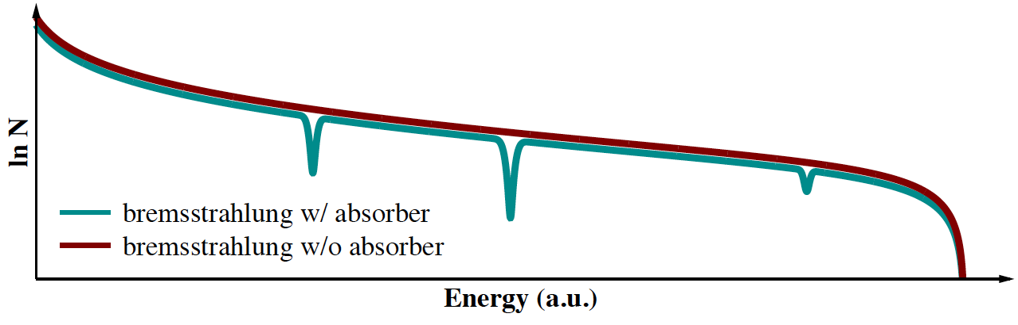







Absorption Processes
Absorption lines only a few eV wide!
atomic attenuation
  several processes
  contributes at each energy
  independent of
resonant absorption
  only at resonance energies
  depends on

Slide 21
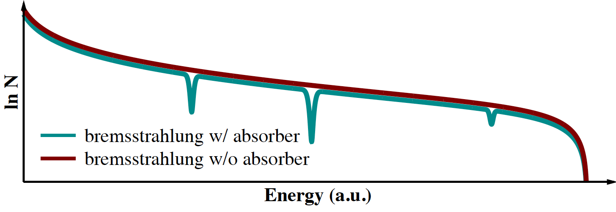
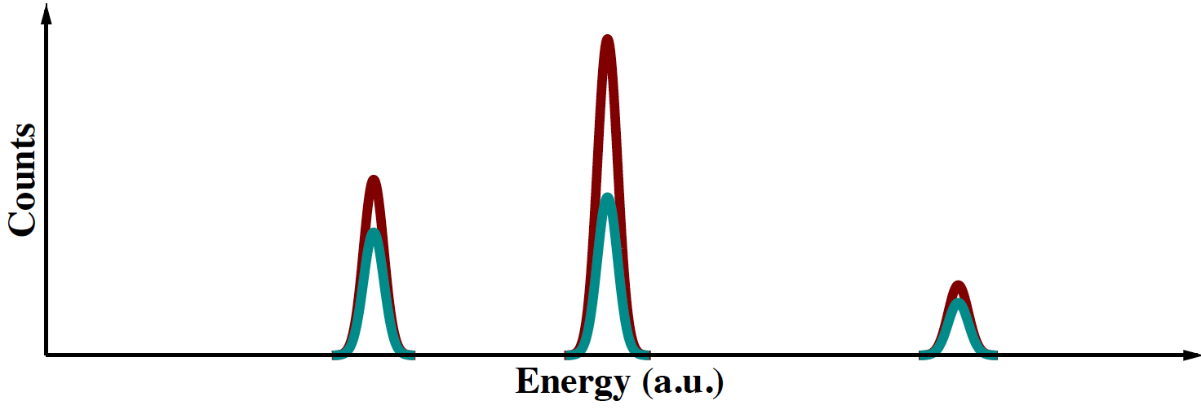
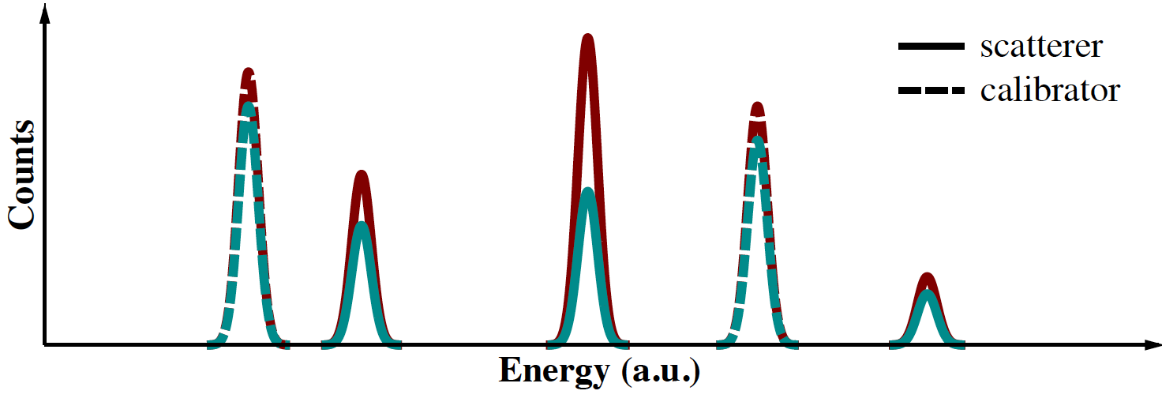
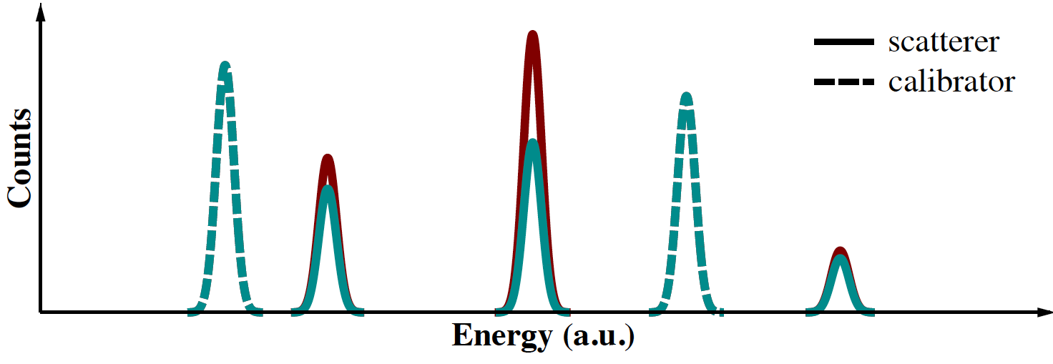
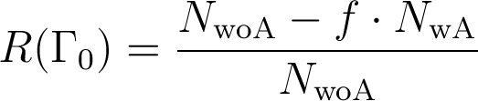
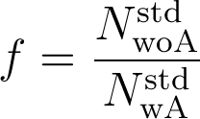
Principle of Measurement and Self Absorption¹
1 F. R. Metzger, Prog. in Nucl. Phys. 7 (1959) 53
Use scatterer made of absorber material as „high-resolution detector“.
scatterer
scatterer
calibration
target
calibration
target
Self Absorption:
Decrease of Scattered Photons because of Resonant Absorption

Slide 22
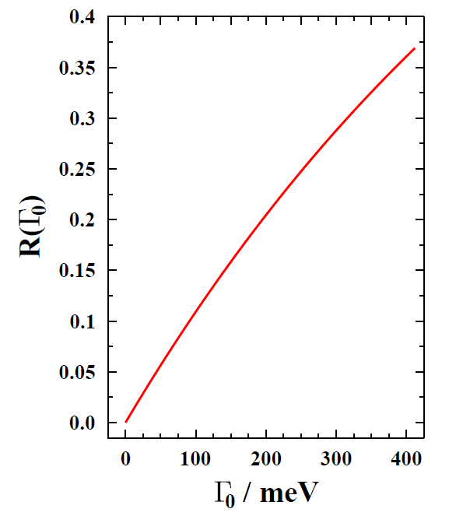
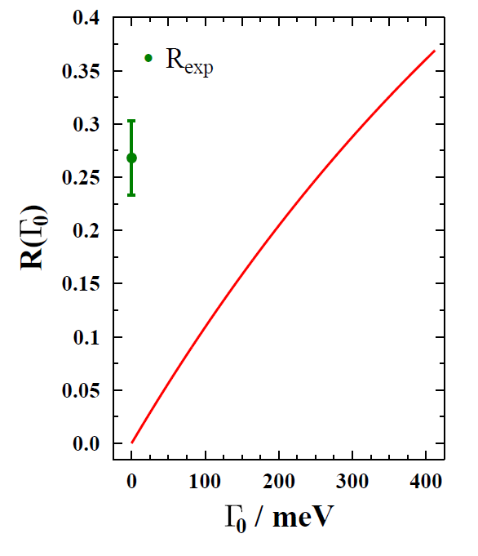
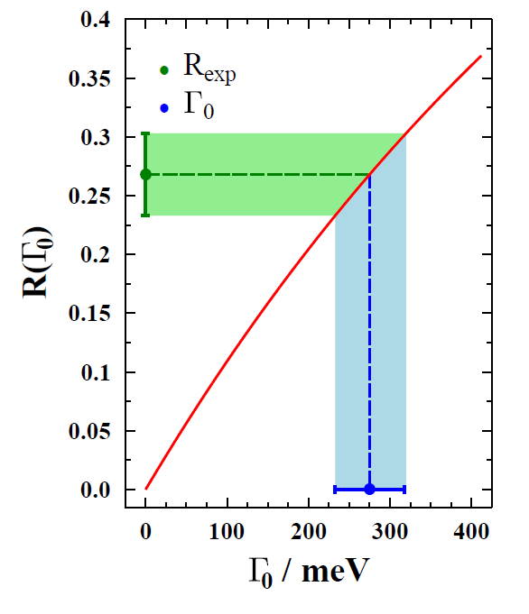
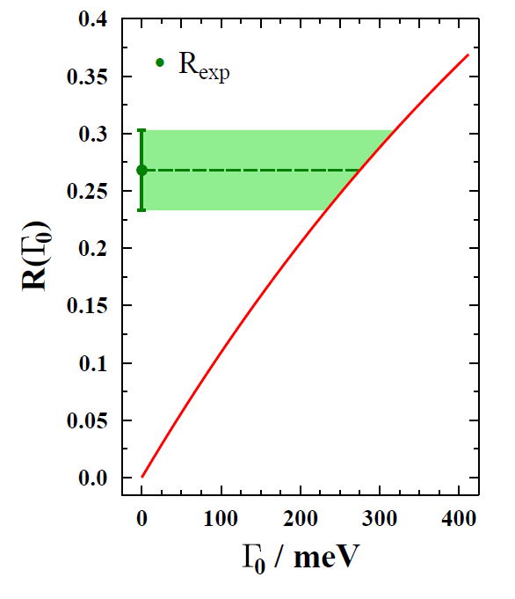
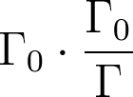

Determination of Ground-State Transition Width and Branching Ratio to the Ground State
calculate R as function of (may require some effort!)
self absorption R_{exp} determined experimentally
comparison of experiment and calculation gives ground-state transition width
NRF measurement gives
thus total transition width and branching
ratio to ground state can be determined

Slide 23
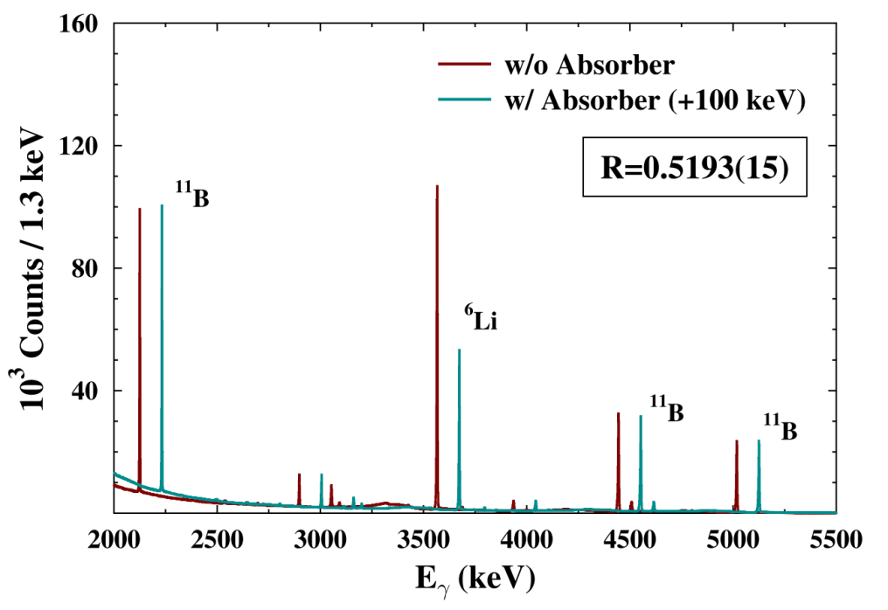
B(M1) in ⁶Li – Probe of 2-body currents
3562
0⁺,T=1
3508
⁶Li (0⁺ → 1⁺)
RSA, exp. accuracy
0⁺,T=1
⁶He + e⁺
M1
2185
NCSM
Exp.: 8.16(19) eV (e,e‘)
GFMC
3⁺,T=0
⁶Li
1⁺,T=0
NCSM: NN+3N in N_{max}=10, no extrapol., no 2-body currents
GFMC: S. Pastore et al.,, PRC (2013)
Newly developed:
Relative nuclear Self Absorption (RSA)
C. Romig, Dissertation TU Darmstadt (2014)
Achievable accuracy: 0.3 %
currently waiting for
DFT molecular dynamics calculations…
target / absorber
⁶Li₂CO₃
Notes:
Hallo Wilfried, hier die NCSM-Zahl mit chiralen NN+3N im größten Modellraum (N_max=10) ohne chirale Ströme: B(M1, 0+ -> 1+) = (15.05 +- 0.06) mu_N^{^2} Mit wachsendem N_max wird diese Zahl dem Trend nach auf jeden Fall noch kleiner werden. Die angegebene Unsicherheit kommt jetzt allein aus der Variation der chiralen NN+3N Wechselwirkung, die verwendet wurde. Gruss, Robert

Slide 24
Nuclear Cluster-Structure
¹²C

Slide 25
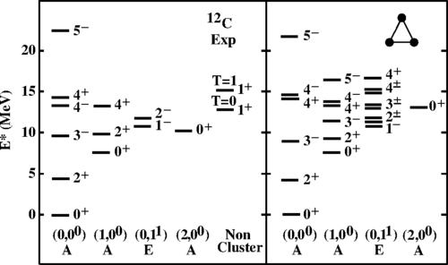
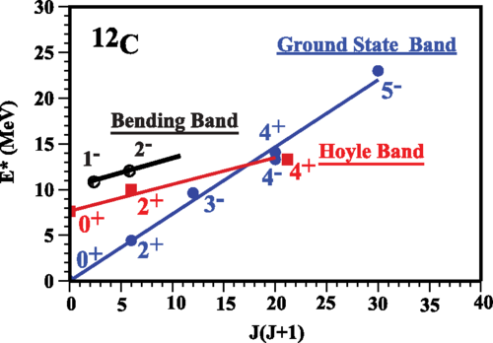
Cluster Structure of ¹²C
D. J. Marín-Lámbarri et al., Phys. Rev. Lett. 113, 012502 (2014).
Evidence for D_{3h} – Cluster-Symmetry
Decisive measurement of quadrupole moment
Literature: Q(2⁺₁) = 6(3) e fm²

Slide 26
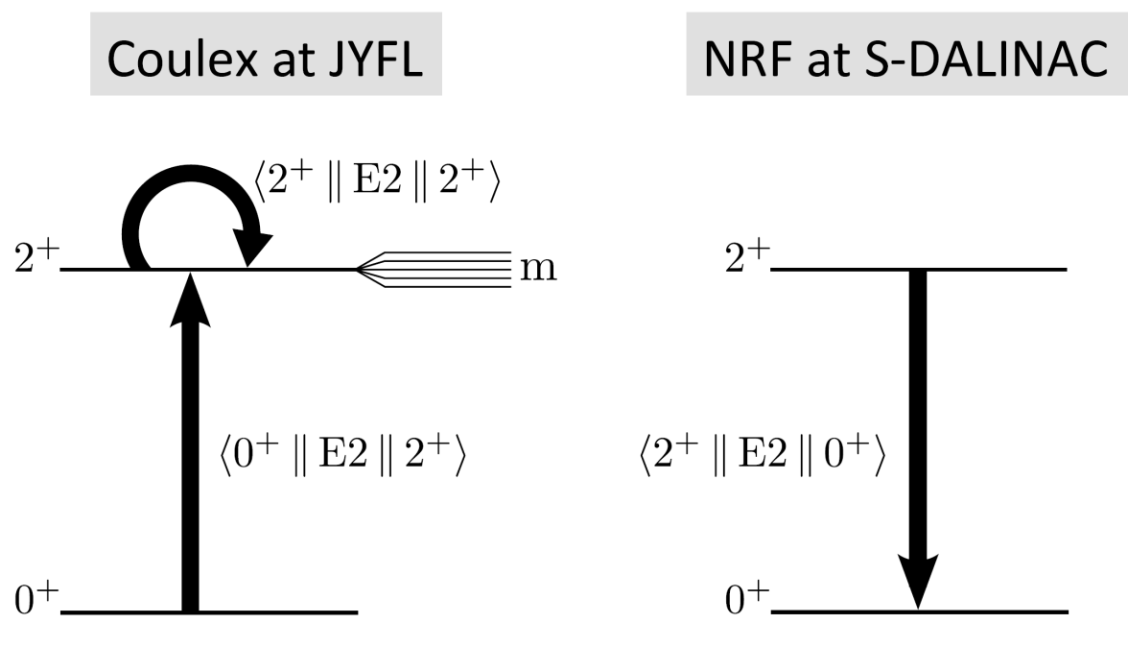
Cluster Structure of ¹²C
For Q(2⁺₁) to 20%, need B(E2) to 2% ⇒ need improvement of B(E2) by 3
RSA to ⁶Li, ¹¹B to < 1%
NRF of ¹²C vs. ⁶Li/¹¹B/²⁷Al to < 2 %

Slide 27
Nuclear Structure for Physics Beyond the Standard Model

Slide 28
Nuclear Structure for 0νββ-Decay
¹⁵⁰Nd

Slide 29
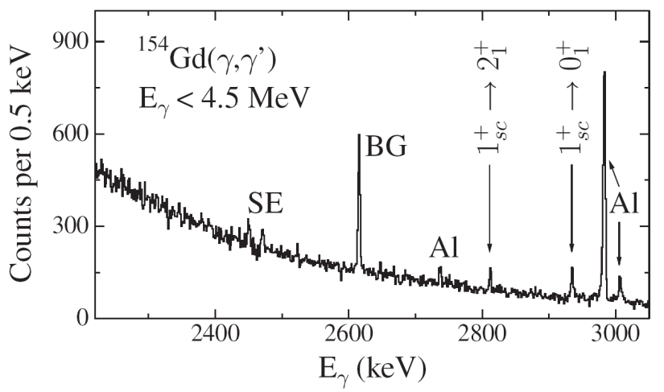
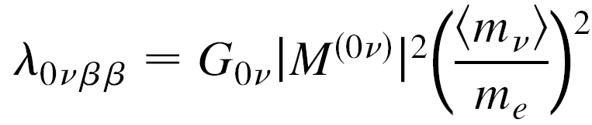
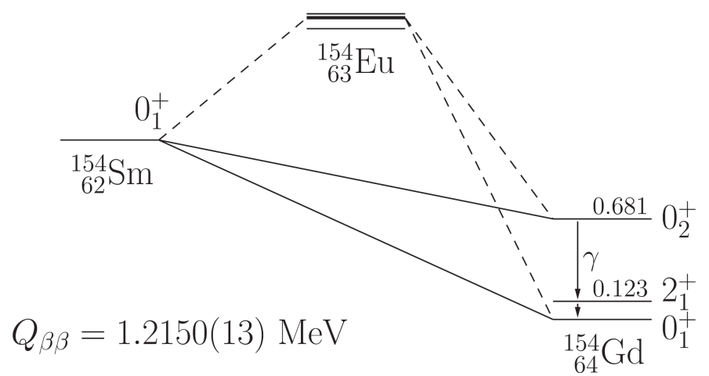
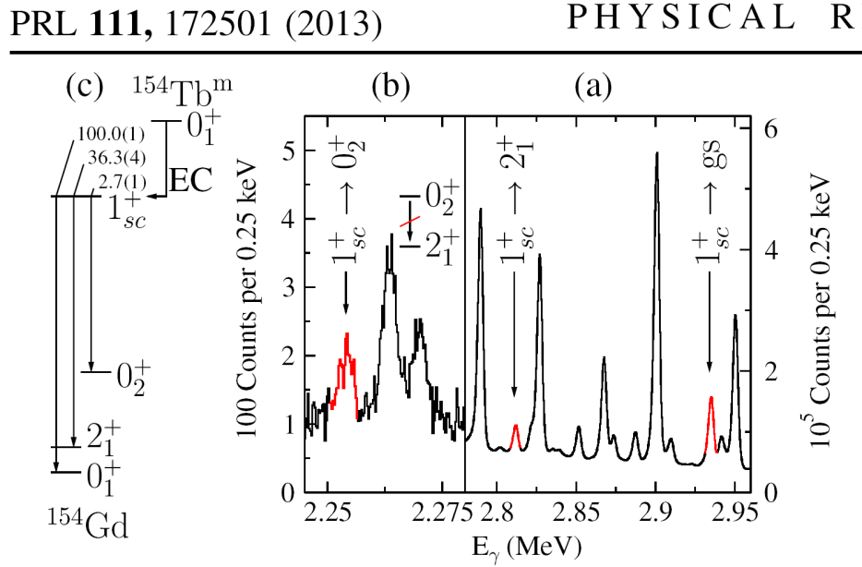
Expect 0νββ-Branching due to Nuclear Shape Transition
S-DALINAC
deformed
J.Beller et al.
transitional

Slide 30
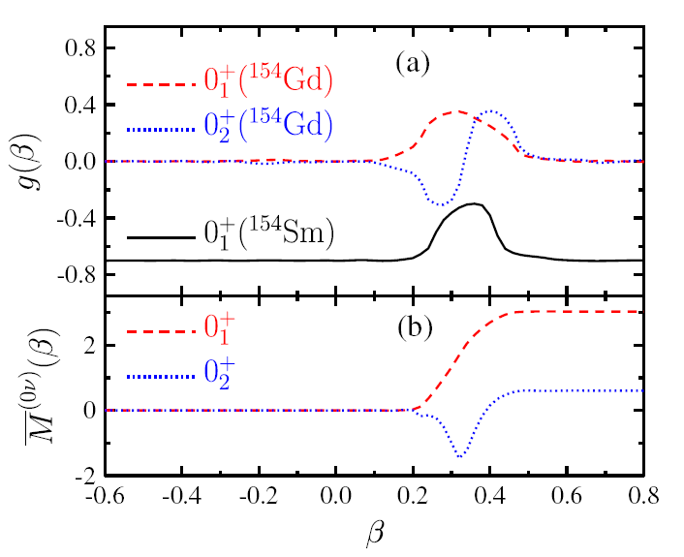
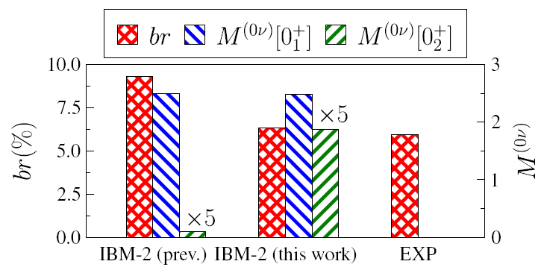
Expect 0νββ-Branching due to Nuclear Shape Transition
J.Beller et al., PRL 111, 172501 (2013).
Expected 0νββ branching larger by O.o.M.
In ¹⁵⁴Sm → ¹⁵⁴Gd gs-branch still „larger by 5“.
Theory now predicts larger 0νββ branch to excited 0⁺₂ rather gs 0⁺₁ in ¹⁵⁰Nd

Slide 31
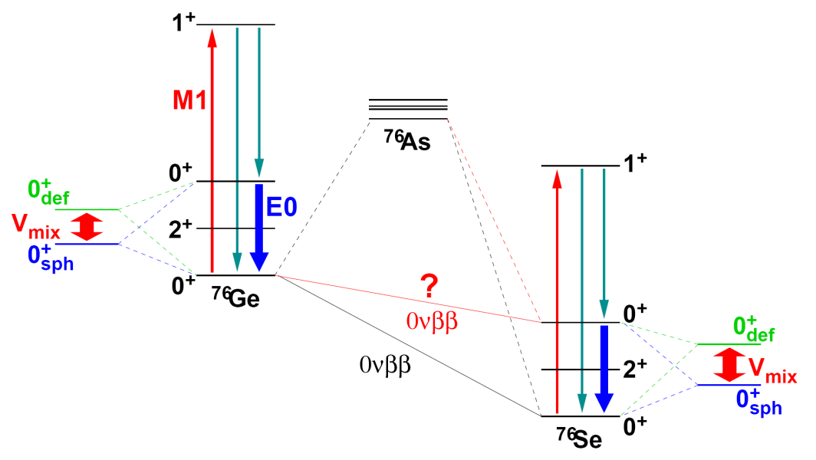
Expect 0νββ-Branching due to Nuclear Shape Transition
J.Beller et al., PRL 111, 172501 (2013).
Expected 0νββ branching larger by O.o.M.
In ¹⁵⁴Sm → ¹⁵⁴Gd gs-branch still „larger by 5“.
Theory now predicts larger 0νββ branch to excited 0⁺₂ rather gs 0⁺₁ in ¹⁵⁰Nd
Measure M1 strengths of 1⁺→0⁺ in ¹⁵⁰Nd/Sm, ⁷⁶Ge/Se in NRF + ρ(E0) in (e,e‘)

Slide 32
Nuclear Structure for Dark Matter Searches
^{129,131}Xe

Slide 33

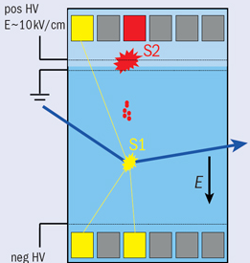
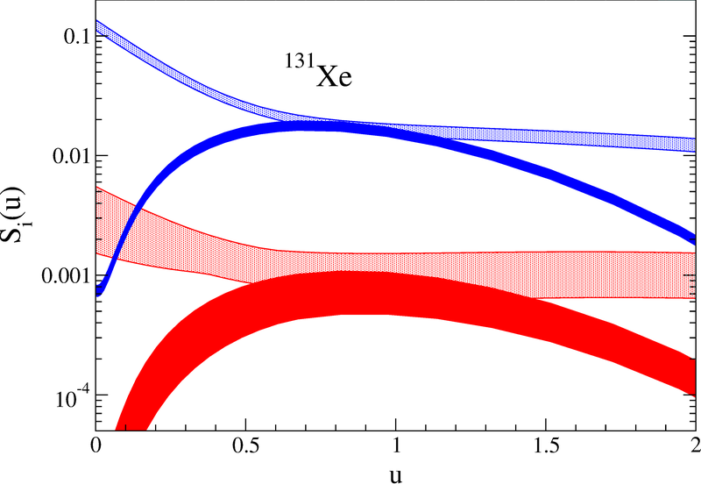
B03: Motivation
WIMP – Nucleus scattering
Dark matter direct detection requires
WIMP-nucleus scattering cross sections
at low momentum transfers
Particularly sensitive to nuclear structure
for spin-dependent WIMP interactions:
¹²⁹Xe, ¹³¹Xe
Klos et al., PRD (2013)
Interesting inelastic channels
Baudis et al., PRD (2013)
Test and constrain nuclear structure calculations with electron scattering
WIMP
¹³¹Xe
elastic, n only
inelastic, n only
elastic, p only
inelastic, p only
S-DALINAC

Slide 34
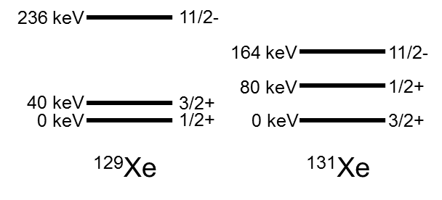
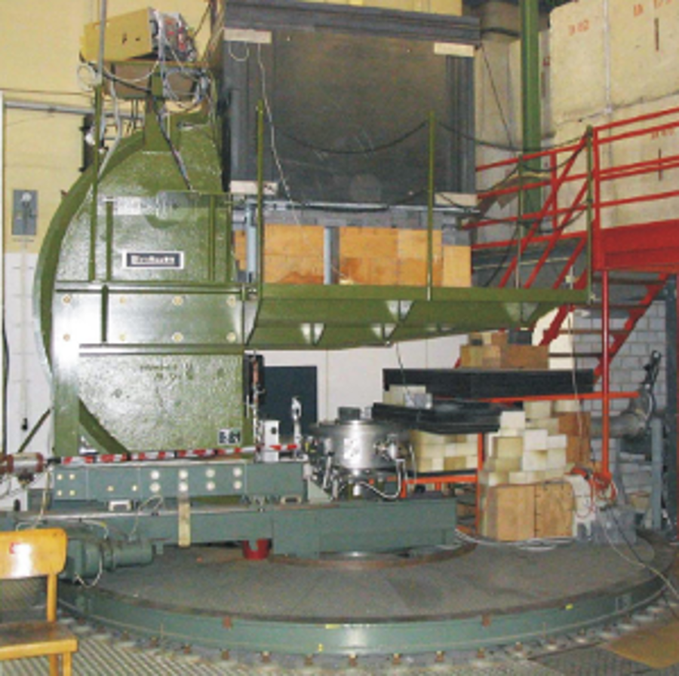
B03: Research plan
WIMP – nucleus scattering
Measure elastic and inelastic electron scattering
form factors
Low excitation energies
high resolution needed
Comparison of form factors
experiment large-scale nuclear structure calcs.
    Test and improve nuclear structure factors
    Use for WIMP-nucleus scattering
Lintott spectrometer

Slide 35
Nuclear Structure for Astrophysics

Slide 36
Nuclear Equation of State (EoS), Neutron Skins, and Polarizabilities

Slide 37
Polarizability
Key observable to constrain the symmetry energy near
Polarizability:
Complete dipole response or
GDR
PDR(?)
QD region
~5
Energy (MeV)
~25-35

Slide 38
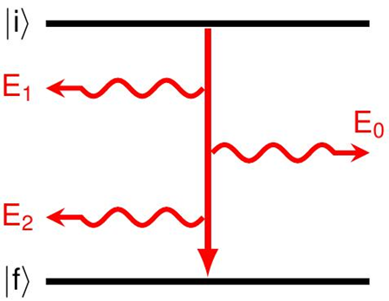
Static and dynamical properties of heavy nuclei
Correlation of EOS to polarizability
Static electromagnetic properties
    Dipole polarizability
    Generalized transition polarizabilities
    determine rate of double-γ decay
  Explore relation of α_{fi} with α_{D} and 0νββ for the first time
²⁰⁸Pb
Roca-Maza et al., PRC (2013)
M. Göppert-Mayer, Über Elementarakte mit zwei Quantensprüngen (Diss., 1930)

Slide 39
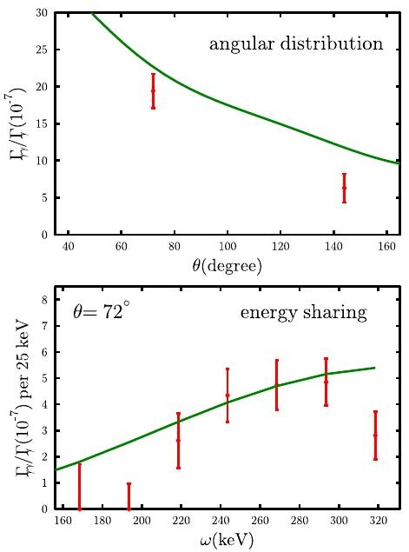
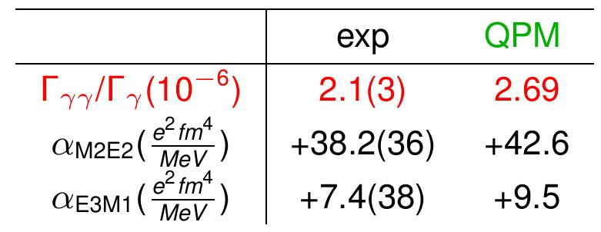

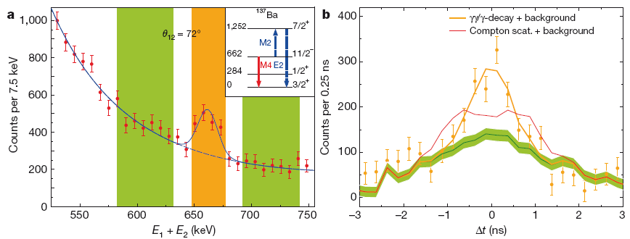
First Observation of the Competitive Double-Gamma (γγ/γ) Nuclear Decay
C.Walz et al.,

Slide 40

Summary
Physics and Technology of Energy Recovery LINACs
Nuclear Polarizability: Fine Structure of GDR
Nuclear Structure for DM Searches
Thank you for attention !
Nuclear Structure for 0νββ
Fundamental Mechanisms of
Nuclear Structure Formation:
cluster structure,
Type II Shell Evolution,
effective pn-Interaction
Q(¹²C)
0⁺₁(⁶Li)
0⁺₂(⁴He)
R_{p}

Slide 41
Back-up Slides

Slide 42
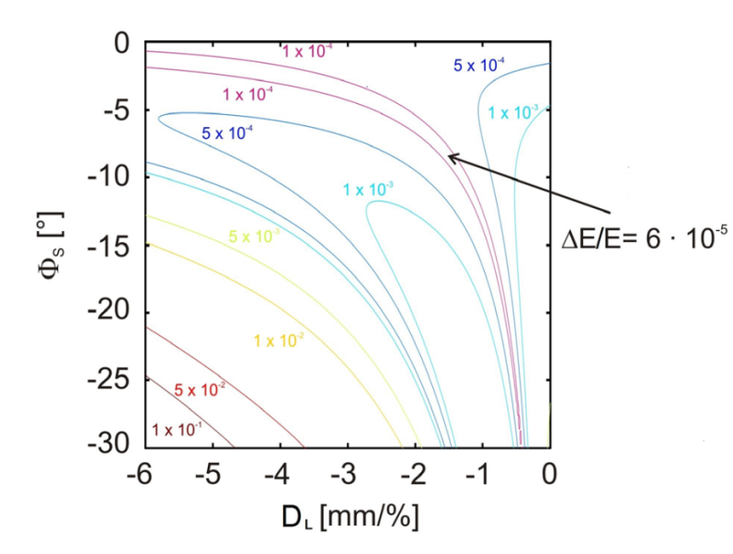
Non-isochronuous Recirculation
Implementation of fractional-integer synchrotron tune for obtaining low ΔE/E (also in ERL-mode !?)
Main issue for small, multi-turn ERL‘s/recirculators is obtaining good beam parameters and high BBU-threshold.
Modest HOM-Damping and 1/N² scaling of threshold current in our SRF modules allows investigations of conventional or (proof of principle) unconventional beam dynamical countermeasures
F. Hug et al. Proceedings LINAC 2012

Slide 43
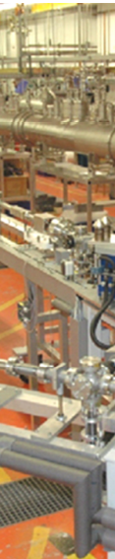
Summary
RTG „Accelence“ will be first ERL-training initiative at German University
It covers ERL-science from source to target
AccelencE builds on unique situation in Rhine-Main area:
ERL S-DA(R)LINAC operational with MESA under construction
5 project areas including aspects of ERLs from source to target
      14 PhD projects, 1 postdoc project + 9 matching projects
Enhanced qualification and supervising concepts for efficient and transparent career progress (junior and established researchers)
Apply for PhD position while obtaining Master‘s degree! For info, visit http://www.ikp.tu-darmstadt.de/dasinstitut/accelence/
Thank you for attention !

