Slide 1
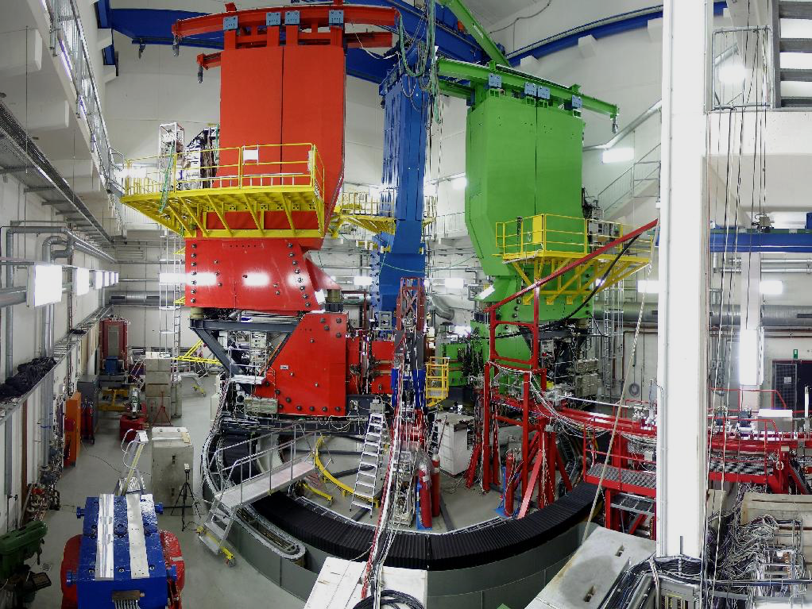
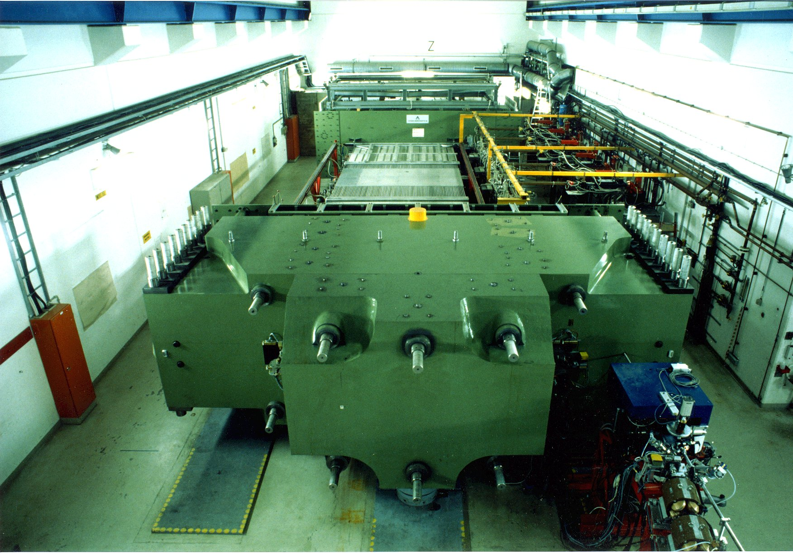
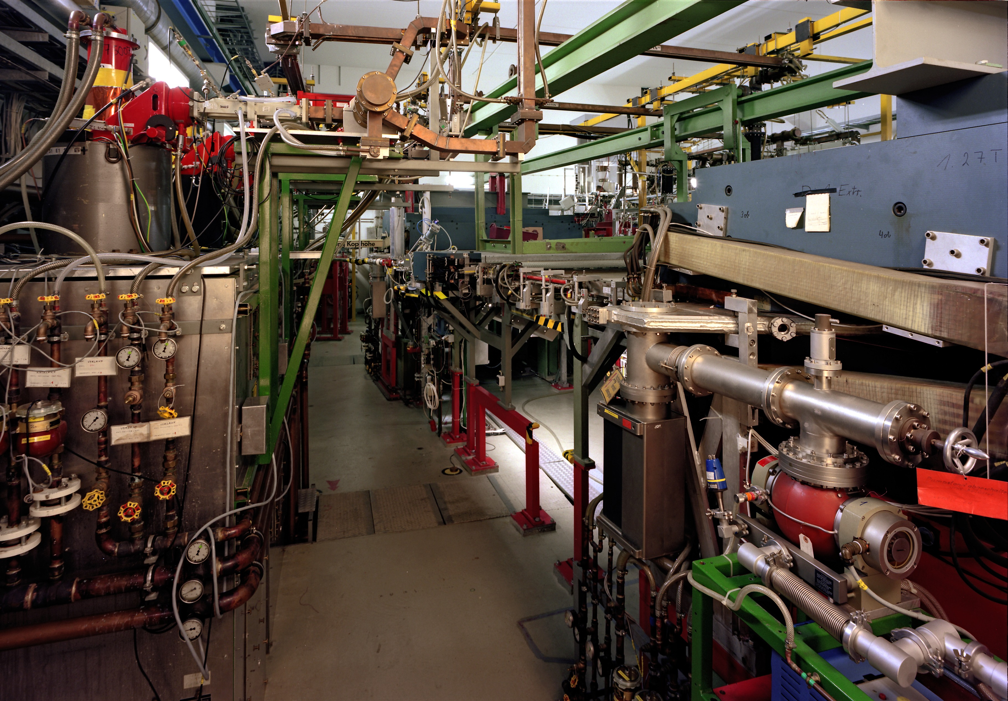



ISR Experiment at MAMI
Miha Mihovilovic
JGU Mainz and JSI
LEPP Workshop, Mainz 2016

Slide 2

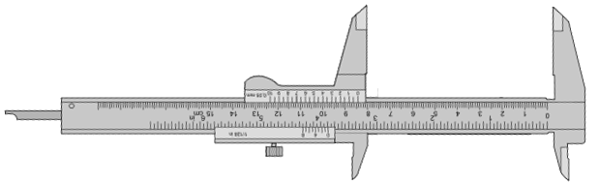
The proton radius problem
The 8σ discrepancy in the r_{p} measurements questions QED.
Nuclear results questionable due to the lack of data at very low Q².
ISR aims to provide new insight into the matter!

Slide 3
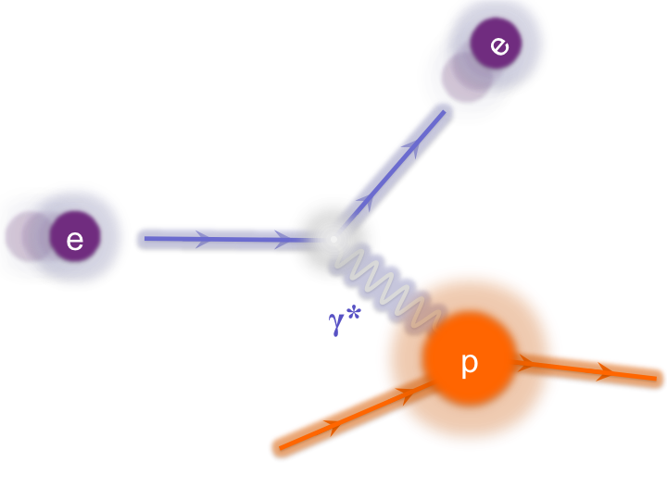
Radius via Cross-section measurement
Extraction of FF via Rosenbluth Separation.
Best estimate for radius:

Slide 4
Proton’s charge form-factor
Data available only for Q² > 0.004 (GeV/c)².
Extrapolations to zero are needed!
Instabilities related to extrapolation are sources of systematic offsets.

Slide 5
New electron scattering experiment
Determination of proton radius depends on the slope of FF (Q²->0).
No data at lowest Q².
- Region of Q² < 0.004 (GeV)²
is extremely hard to reach.
Kinematic range is limited
by available experimental
apparatus.
Novel techniques are
needed to explore
extremely low Q² regime.
?
Here no data exist!
For precise radius determination new measurements at even lower Q² are needed.

Slide 6
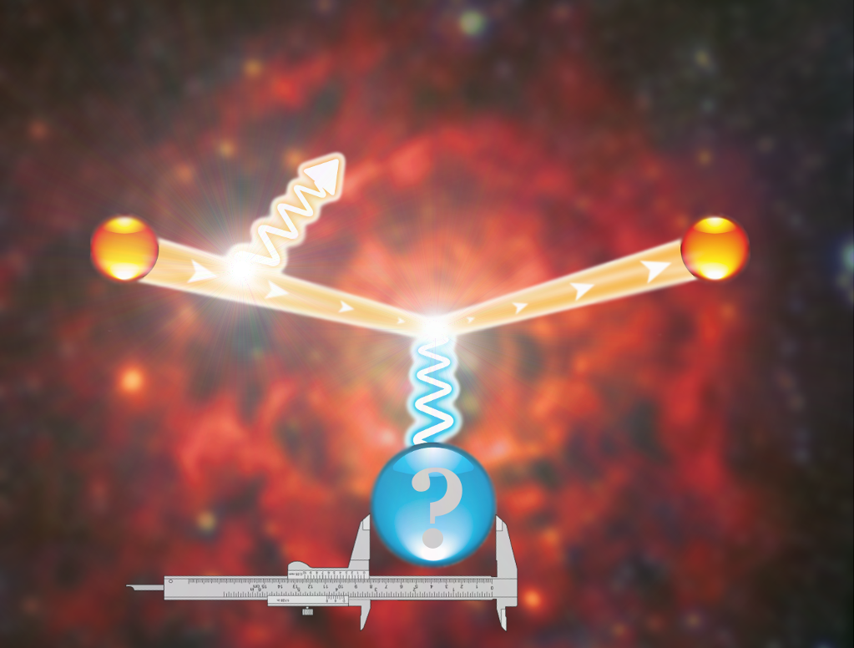
ISR Experiment at MAMI
Elastic
peak
#
Radiative
tail
p

Slide 7
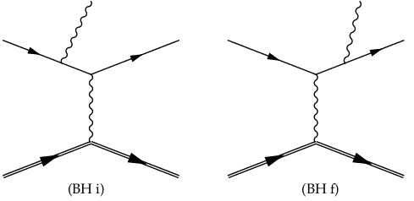
Radiative tail
Dominated by coherent sum of two Bethe-Heitler diagrams.
FSR
2
+
=
ISR
G_{E}
In data ISR can not be distinguished from FSR.
Combining data with the simulation, ISR information can be reached.
Redundancy measurements at higher Q² for testing this approach in a region, where FFs are well known.

Slide 8
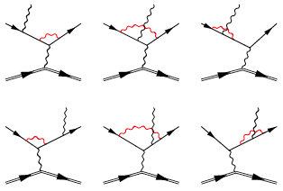
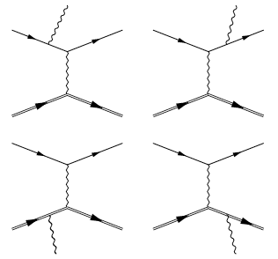
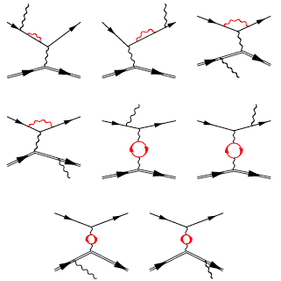
Simul++
Based on standard A1 framework.
Detailed description of apparatus.
Exact calculation of the leading order diagrams:
The NL-order virtual and real corrections included via effective corrections to the cross-section.
ISR
…

Slide 9
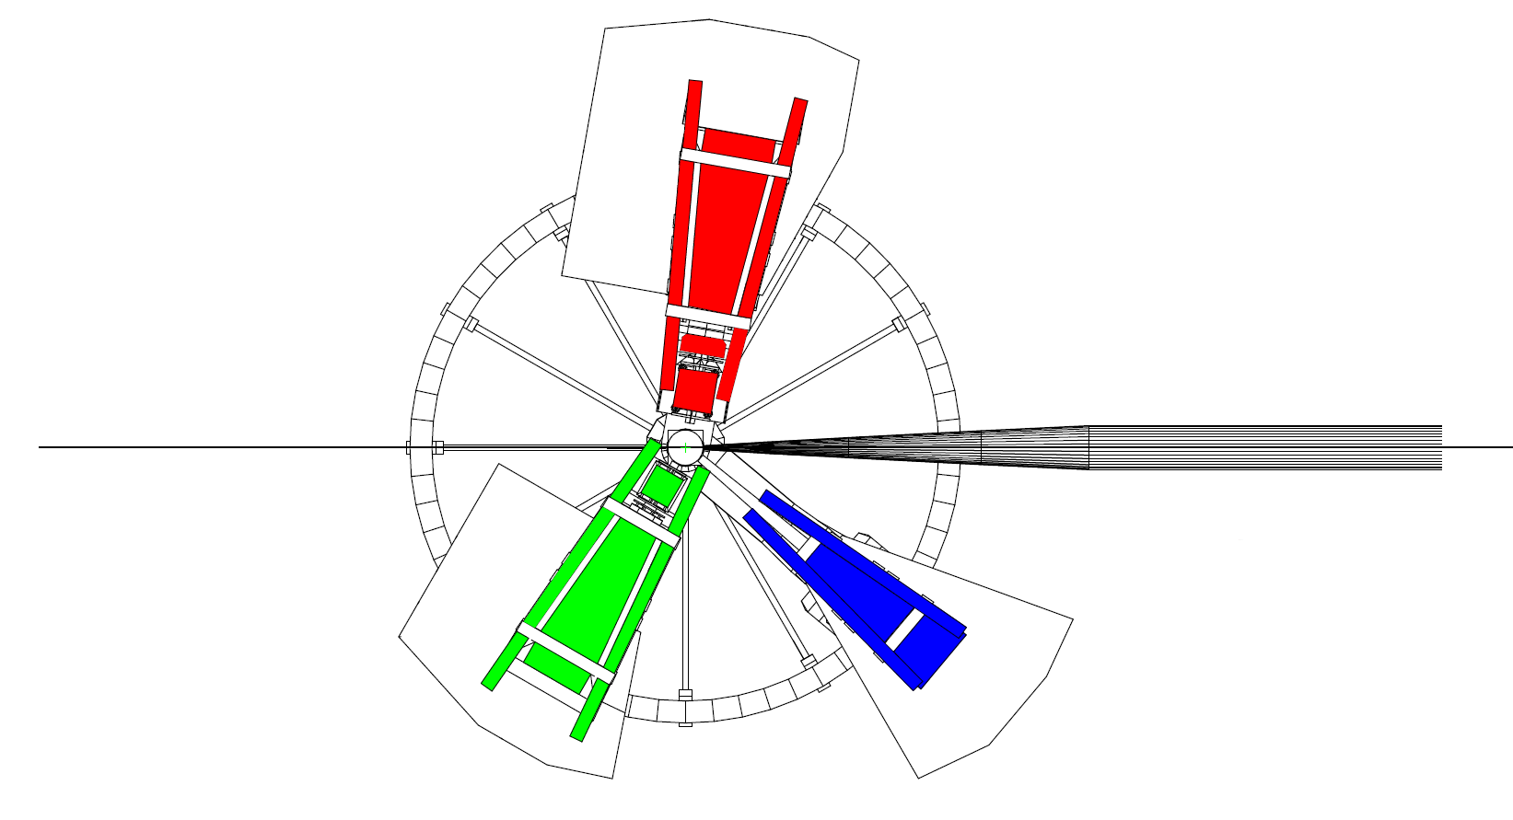
The ISR experiment
Full experiment done in August 2013. Four weeks of data taking.
Spectrometer A:
- Luminosity monitor (const. setting)
- Momentum: 180, 305, 386 MeV/c
- Angles: 50°, 60°
Electron Beam:
- Energy: 195, 330, 495 MeV
- Current: 10nA – 1μA
- Rastered beam
BPM
SEM
Förster probe
Spectrometer B:
- Data taking
- Angle: 15.3°
- Momentum:
48 - 194 MeV/c (35 setups)
156 - 326 MeV/c (12 setups)
289 - 486 MeV/c (9 setups)
pA
Luminosity monitors:
- pA-meter
- Förster probe
- SEM
Spectrometer C:
- Not used
Beam control module:
Communicates with MAMI and ensures very stable beam.
BPM and pA-meter measurements performed automatically every 3min.

Slide 10
Entrance flange contributions
Target
Good track
Collimator
Spectr. B
Bad track
Target
Nominal
acceptance
Spec. B encompasses a long entrance flange.
Events rescattered from the snout cover the whole vertex acceptance.

Slide 11
Preliminary Results
Existing apparatus limits reach and resolution of present ISR experiment to Q² ~ 10⁻³ GeV².
Pion production processes contribute ~10% at smallest momenta.
Simulation performed with Bernauer parameterization of form-factos.
A sub-percent agreement between the data and simulation validates the ISR technique.

Slide 12
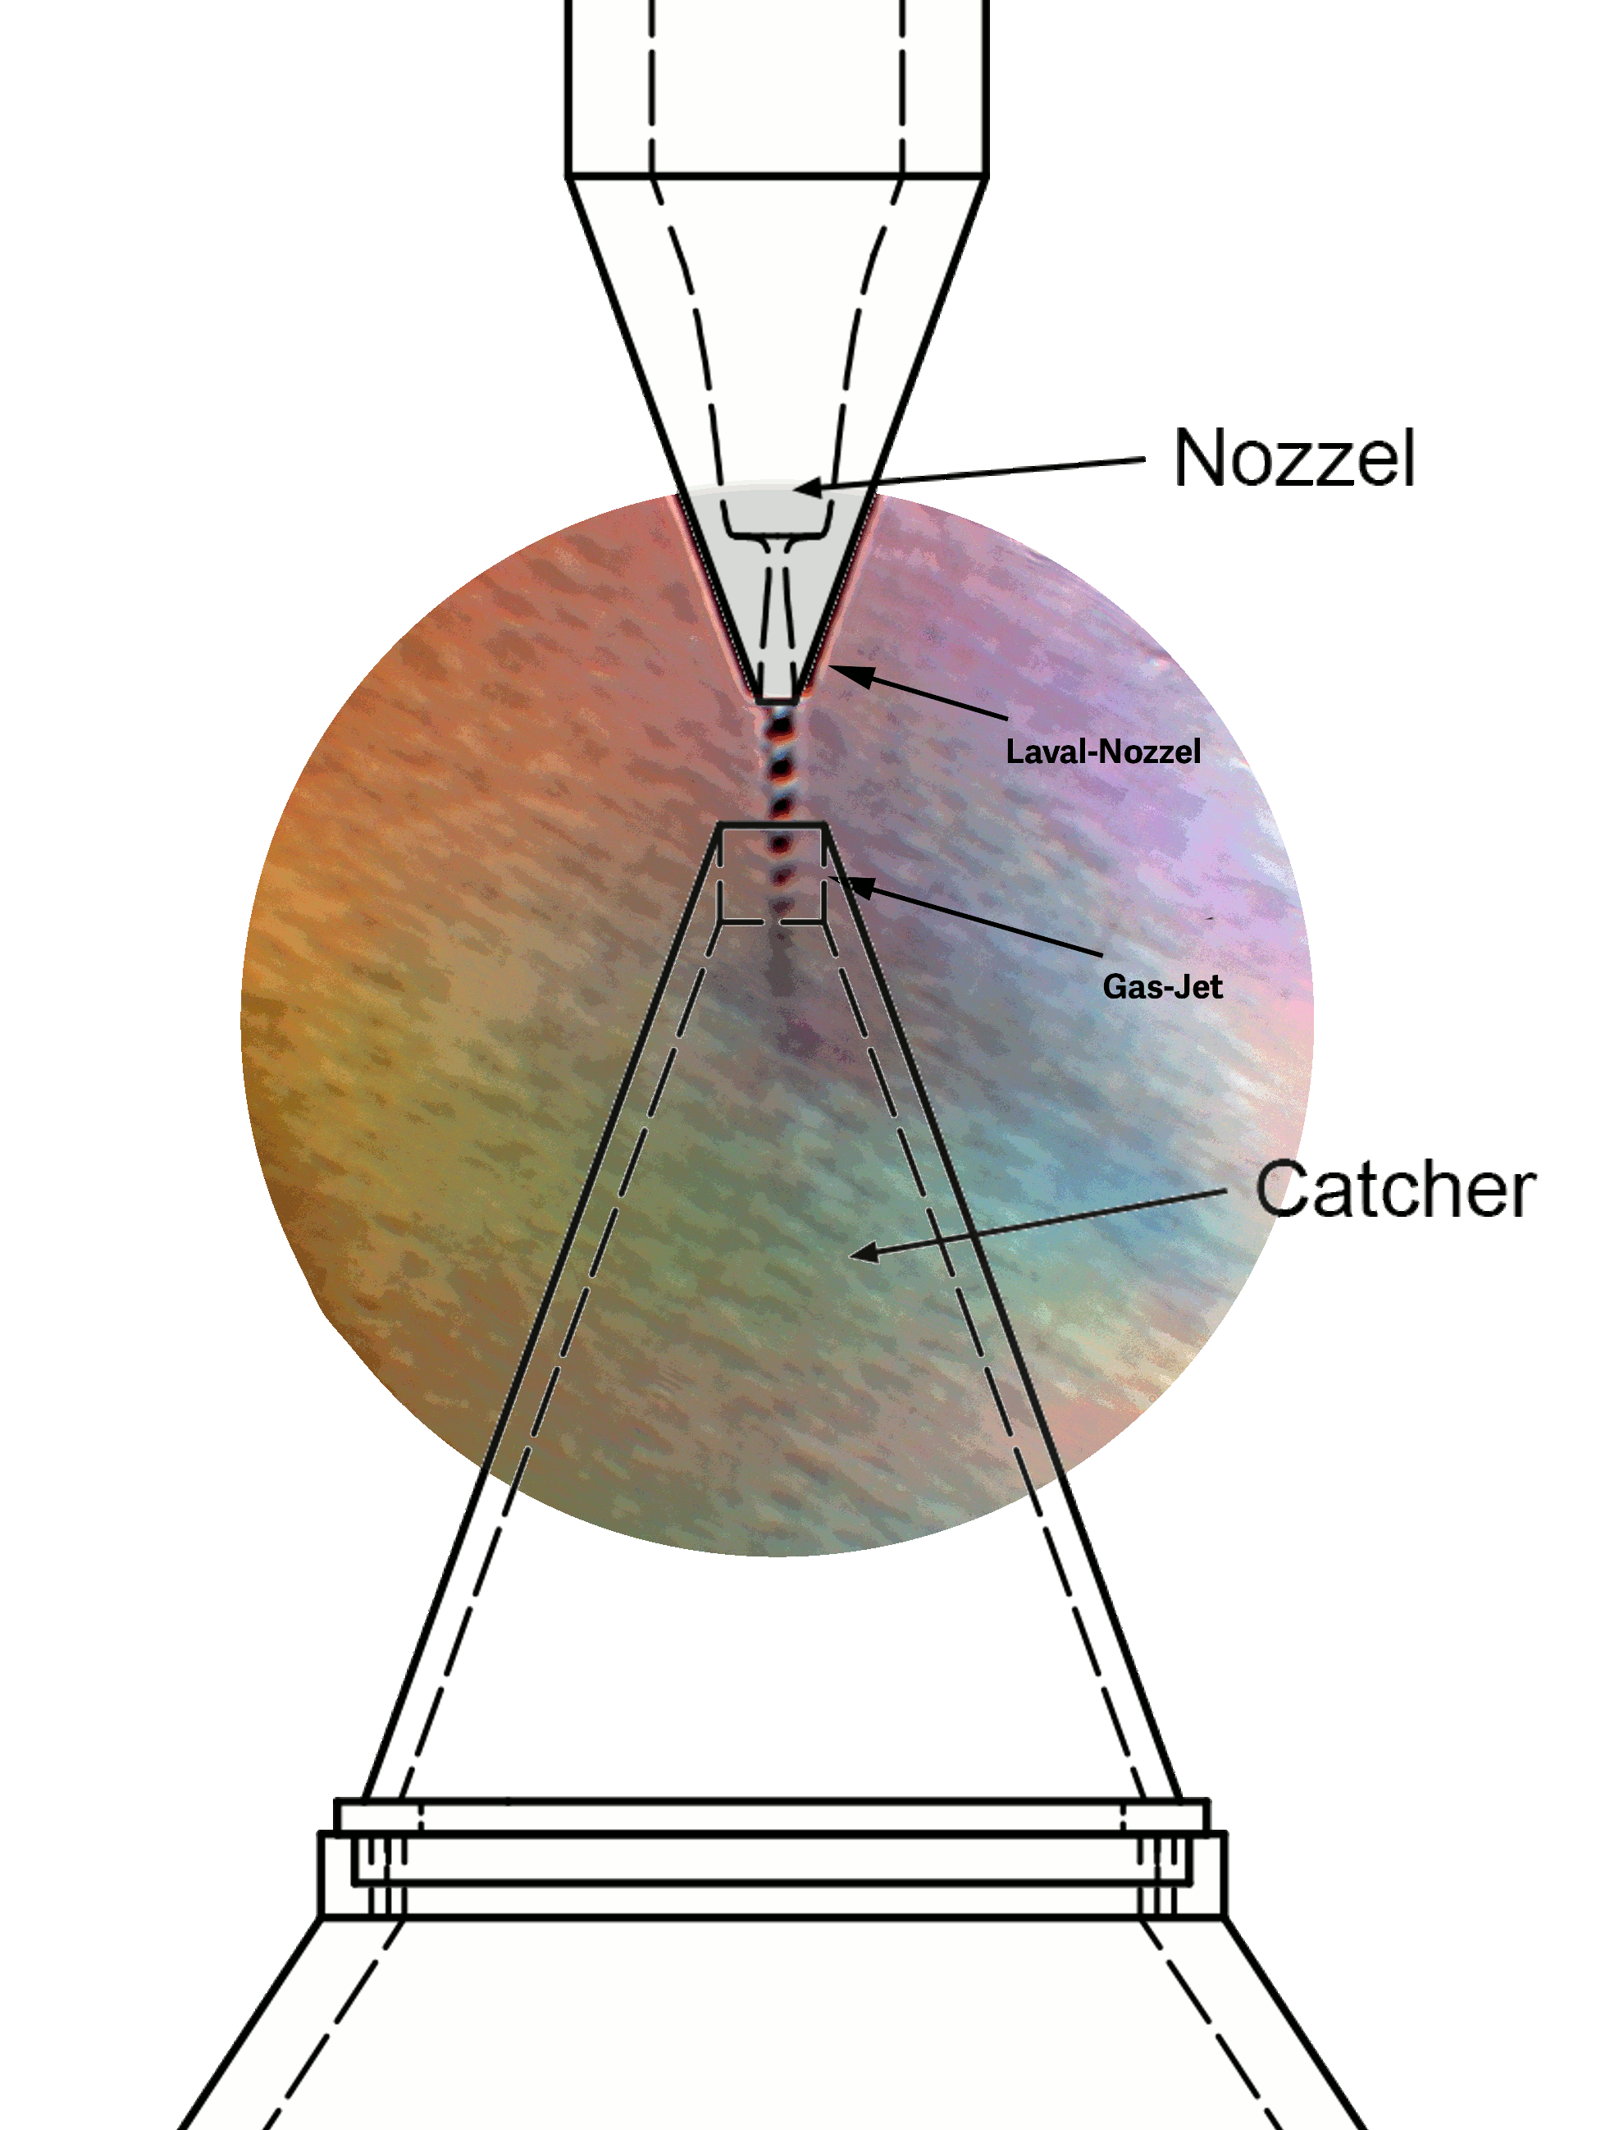


Future measurements
Next generation of experiments foreseen at:
ISR valuable technique for future experiments.
Modifications to the spectrometer setup required.
A point-like target without extensive frame needed.
(Solid-state plastic target not an option).
Hypersonic gas jet target for measurements with minimal background contributions.

Slide 13
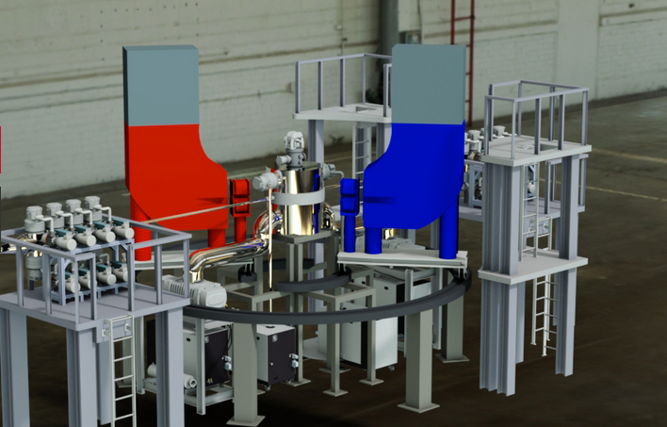
Summary
A pilot experiment has been performed at MAMI to measure G_{E}^{p} at very low Q².
A new technique for FF determination based on ISR has been successfully validated.
Reach of the first ISR experiment limited by unforeseen backgrounds.
Next generation experiments are scheduled/foreseen at the A1 and at the new accelerator MESA.

Slide 14
Thank you!

Slide 15
Kinematic settings
Neighboring setrings overlap for ½ of the acceptance.
Three kinematic regions overlap to verify ISR approach.
Test of ISR
Overlap for ½ of
the acceptance

Slide 16
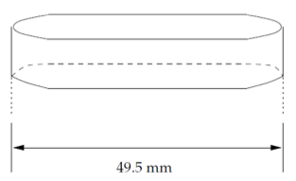
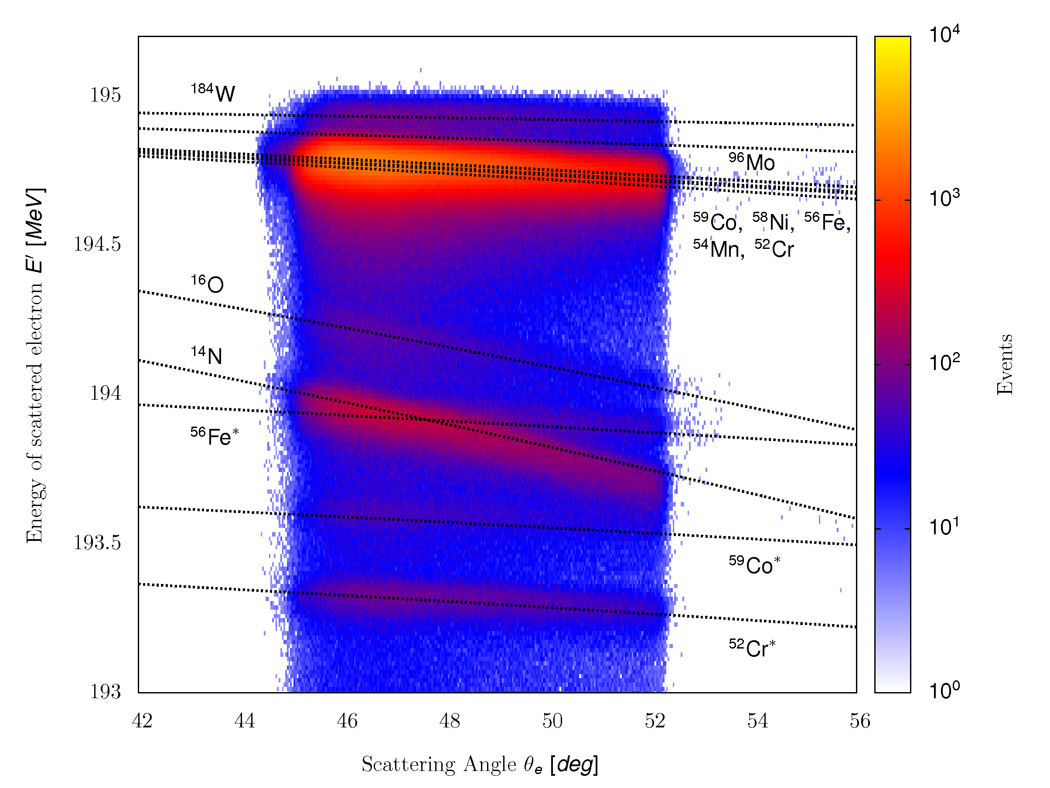
Cryogenic depositions
Disturbs Luminosity determination.
Good vacuum in target chamber (10⁻⁶ mbar)
Fixing Spectrometer A to elastic settings to see effects of snow gathering more clearly.
Spectrometer A has enough
resolving power for clear
identification of Nitrogen and
Oxygen.

Slide 17
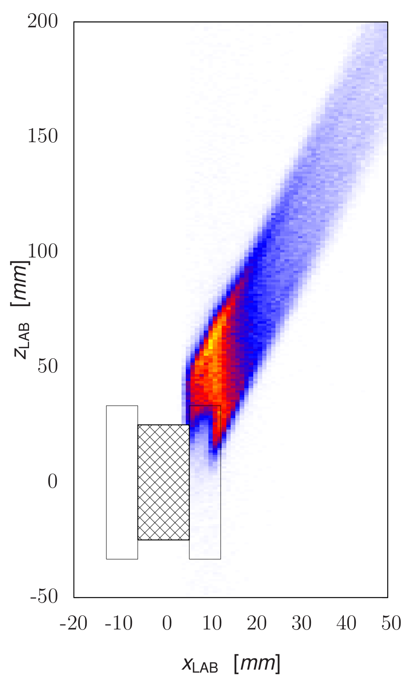
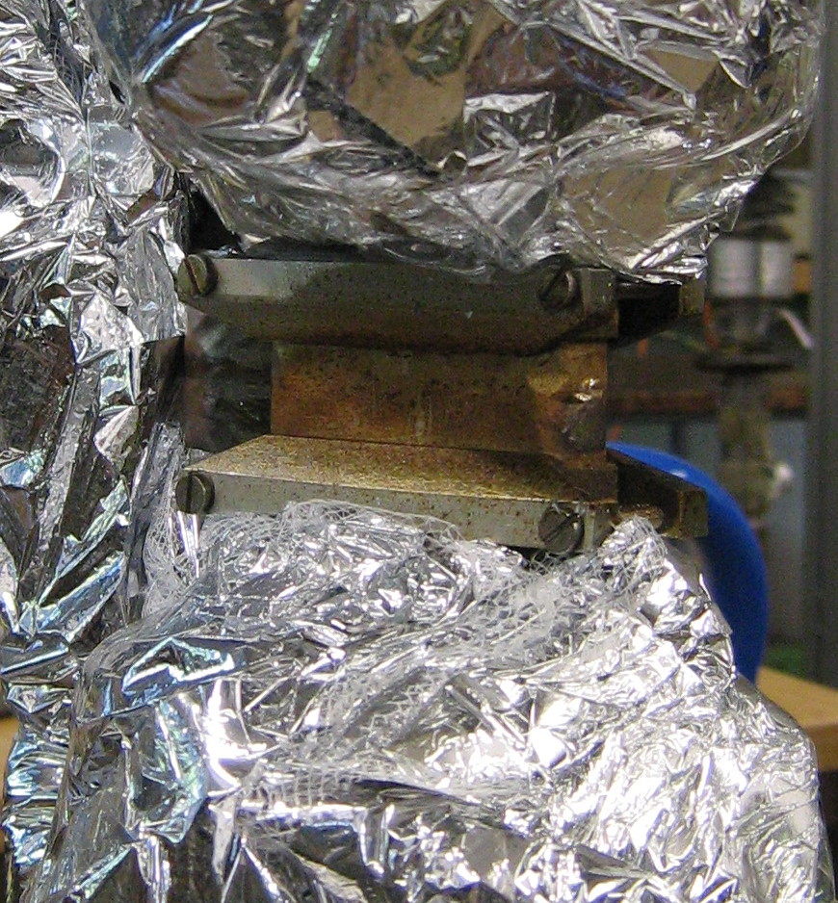
Target Frame contributions #1
Presence of target frame results in the deficiency of the elastic events .
Elastically
scattered
electron
Incoming
electron
Scattered electron
annihilated in
the frame
Projection
plane

Slide 18
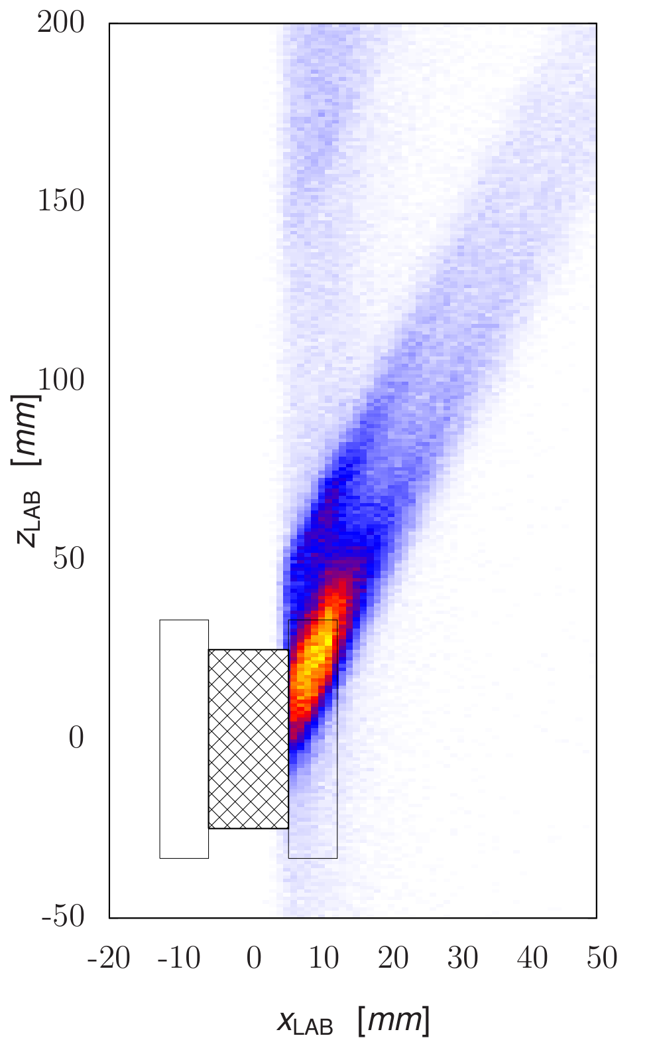
Target Frame contributions #2
… and in the abundance of bogus events in radiative tail of the elastic peak.
ISR+FSR
electrons
Incoming
electron
Projection
plane
Reemerging elastically
Scattered electrons

Slide 19
Extracting G_{E}^{p} from data
Scattering angle of emitted photon offers clear separation of ISR and FSR and gives insight into the G_{e}^{p} depedence of measured cross-section.
A lookup table used to transform data to the G_{e}^{p} .
ISR
FSR

