Slide 1



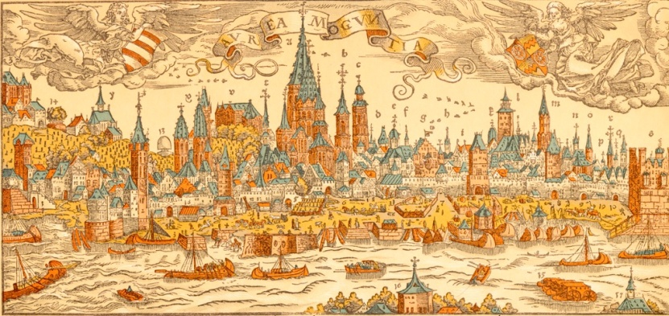
Search for dark forces with KLOE
E. Graziani
INFN – Roma 3
on behalf of the KLOE-2 Collaboration
NEW VISTAS IN LOW ENERGY PRECISION PHYSICS (LEPP)
4-7 April 2016 - Mainz

Slide 2
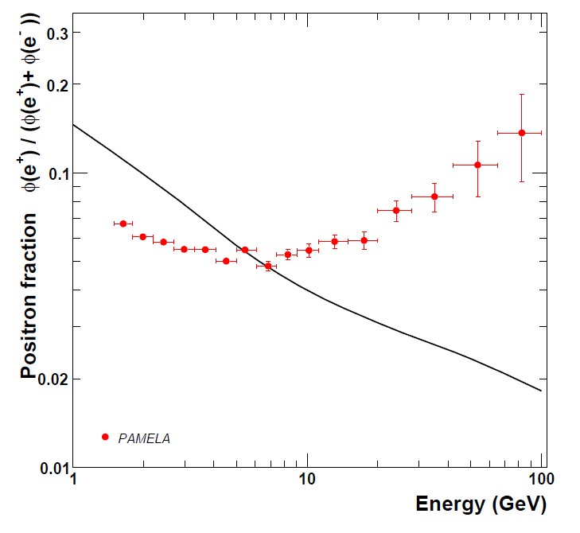
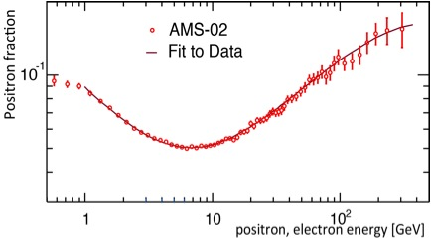
Motivations for dark forces search
Several recent astrophysical observations
(Pamela, AMS, Fermi, Atic, Integral, DAMA/LIBRA, etc …) may suggest the existence of a light Gev-ish dark sector: a new low energy gauge interaction U(1)_{S} mediated by a neutral light mass vector particle, usually named the U boson (but also A’, V, …), with a small kinetic mixing ε (<10⁻³) with SM
A low mass U boson could explain the well known ∼ 3.6 σ a_{μ} discrepancy with SM
A natural hypothesis is that the new symmetry is spontaneously broken by an Higgs-like mechanism, thus introuducing the existence of an additional scalar particle, with interesting phenomenological consequences
PAMELA
You know already
See M. Pospelov’s talk
There are several different experimental ways (on earth) to take a look at the dark world:
  fixed target experiments
  e⁺e⁻ machines
  rare meson decays

Slide 3
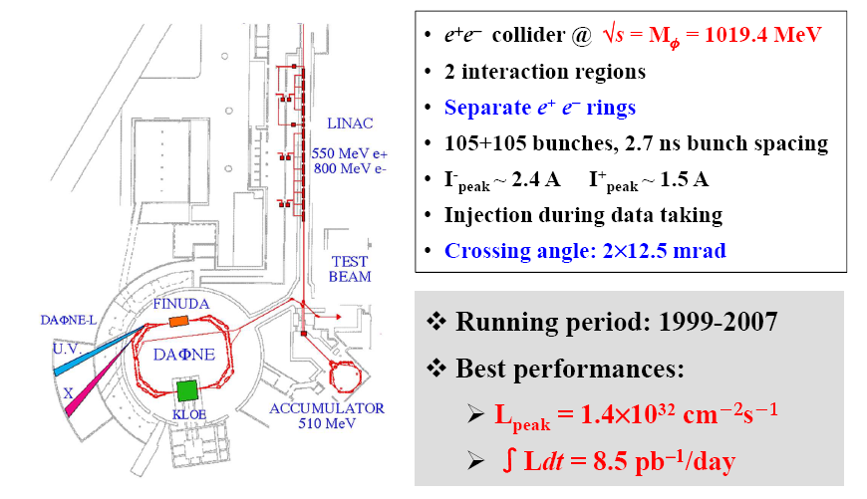
DAφNE: the Frascati φ factory

Slide 4
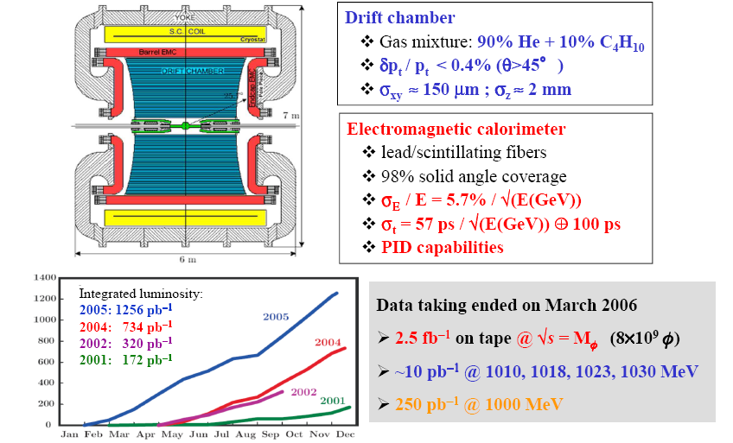
The KLOE experiment at DAΦNE

Slide 5
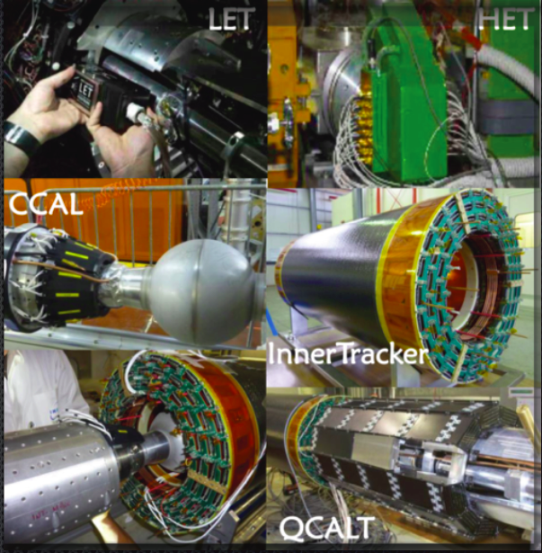
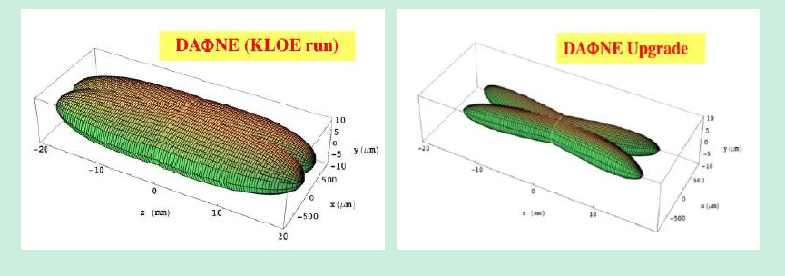
From DAφNE to DAφNE-2, from KLOE to KLOE-2
New interaction region: large beam crossing angle + sextupoles for crabbed waist optics.
Increase ₤ by a factor ~1.5÷2
Run started in November 2014
milestone: 1 fb⁻¹ of good data by mid 2015
next milestone: 2.5 fb⁻¹ by July 2016 (on track)
→ IT: four layers of cylindrical triple GEM near IP
We aim at L_{int} ≈ 5 fb⁻¹ on the φ meson peak within the next 2 years

Slide 6
Dark forces at KLOE
KLOE/KLOE-2 is an a very good position to probe a light dark sector at the GeV scale:
It operates on DAφNE exactly at that scale: E_{cm}∼ 1 GeV
Most of the interesting dark process cross sections at e⁺e⁻ colliders scale with 1/s: a factor ∼100
wrt to B factories, which almost compensates the integrated luminosity
It’s a unique place to study some rare meson decays (it’s a φ factory, folks!)
Outline of the talk
Decay of the φ meson into a U boson + pseudoscalar η:
φ→ηU, U→e⁺e⁻, η→πππ → Phys.Lett. B706 (2012) 251
Phys.Lett. B720 (2013) 111
Associated Uγ production: e⁺e⁻→Uγ→μ⁺μ⁻γ → Phys.Lett. B736 (2014) 459
e⁺e⁻→Uγ→e⁺e⁻γ → Phys.Lett. B750 (2015) 633
e⁺e⁻→Uγ→π⁺π⁻γ → arXiv:1603.06086, subm. to PLB
Higgsstrahlung process, in the m_{h′}<m_{U} scenario, with an invisible Higgs:
e⁺e⁻→ Uh′→μ⁺μ⁻ + missing energy → Phys.Lett. B747 (2015) 365

Slide 7
φ meson decay into a U boson + pseudoscalar η: φ→ηU, U→e⁺e⁻,η→πππ
Associated Uγ process: e⁺e⁻→Uγ→μ⁺μ⁻γ
e⁺e⁻→Uγ→e⁺e⁻γ
e⁺e⁻→Uγ→π⁺π⁻γ
Higgsstrahlung process, in the m_{h′}<m_{U} scenario, with an invisible Higgs:
e⁺e⁻→ Uh′→μ⁺μ⁻ + missing energy
KLOE data

Slide 8
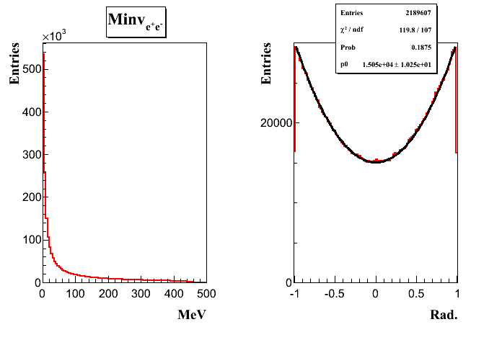
U boson search in φ→ηe⁺e⁻ decays
Mesons undergoing radiative decays to photons could also decay to a U boson with branching fraction BR (X→YU) ∼ε² × |FF_{XYγ}|² × BR (X→Yγ)
σ (φ→ηU )≈ 40 fb for FF_{φη}≈1 and ε ≈10⁻³
form factor
σ(φ→ηe⁺e⁻) = 0.7 nb
Selected decay chains:
U→e⁺e⁻ and η → π⁺ π⁻ π⁰ (BR = 22.7%)
Phys.Lett. B706 (2012) 251-255
η → π⁰ π⁰ π⁰ (BR = 32.6%)
Combined result Phys.Lett. B720 (2013) 111
Irreducible background: φ → η e⁺e⁻, η → πππ
Simulated with a Vector Meson Dominance parameterization
Signal → narrow peak above the continuum background
M_{ee} (MeV)
Notes:
The φ, with a mass of 1019.3 MeV, decays to ηγ 1.3% of the time; the η (mass 547.9 MeV) decays to γγ 39% of the time.
Thus we can search for φ→ηU at KLOE, or φ→ηγ followed by γ →ηU.
Momenta of charged tracks at KLOE are measured to about 0.4% accuracy [6].

Slide 9
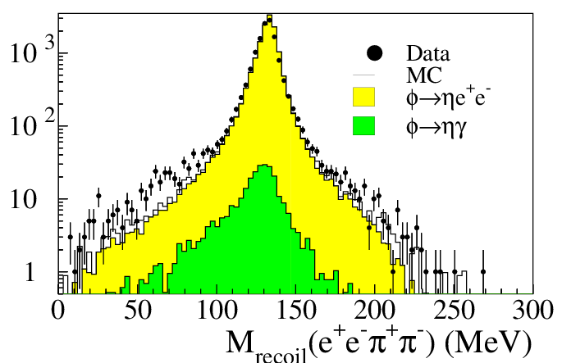
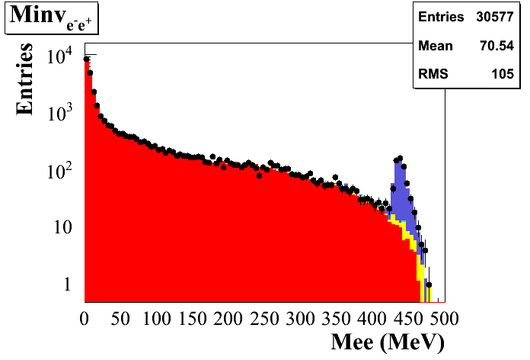
U boson search in φ→ηe⁺e⁻ decays: selections
4 tracks + 2 photon candidates
Best π⁺π⁻γγ match to the η mass
495 < M_{ππγγ} < 600 MeV
70 < M_{γγ} < 200 MeV
535 < M_{recoil}(ee) < 560 MeV
γ conversion + K_{L}K_{S} rejection (ToF)
100 < M_{recoil}(eeππ) < 160 MeV
L= 1.5 fb⁻¹
η→π⁺π⁻π⁰
Entries
30577
2 tracks + 6 photon candidates
Six prompt photon candidates:
|T_{γ} − R_{γ}/c| < min(3σ_{T}, 2 ns)
400 < M_{6γ} < 700 MeV
γ conversion + K_{L}K_{S} rejection (ToF)
536.5 < M_{recoil}(ee) < 554.5 (3σ cut)
L= 1.7 fb⁻¹
L= 1.7 fb⁻¹
Data
φ→ηe⁺e⁻
e⁺e⁻→ ωπ⁰
φ→K⁺K⁻
φ→K_{S}K_{L}
φ→ρπ
φ→ηγ
η→π⁰π⁰π⁰
Notes:
9
Signal simulation with dG(f→he+e-)/dmee weighted according to…

Slide 10
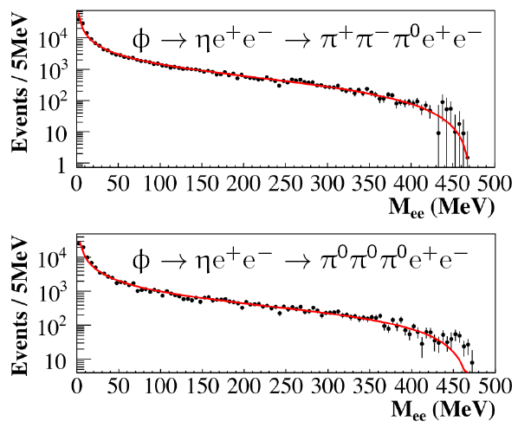
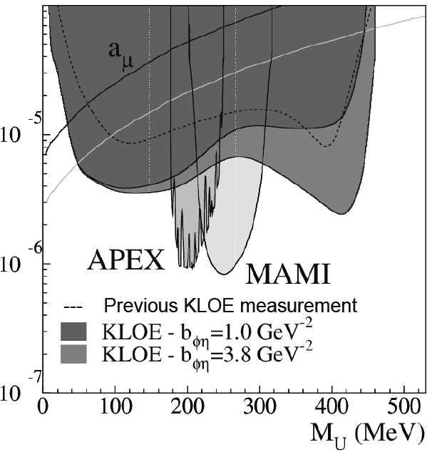
U boson search in φ→ηe⁺e⁻ decays: 90% CL upper limits
Di-electron mass spectrum
No clear signal above background → UL evaluation
background → fit of the M_{ee} distribution excluding the region around M_{U} → CL_{S} method
ε² ≤ 1.7×10⁻⁵ @ 90% C.L. for 30<M_{U}<400 MeV
ε² ≤ 8.0×10⁻⁶ @ 90% C.L. for 50<M_{U}<210 MeV
Phys.Lett. B720 (2013) 111
Notes:
10

Slide 11
φ meson decay into a U boson + pseudoscalar η: φ→ηU, U→e⁺e⁻,η→πππ
Associated Uγ process: e⁺e⁻→Uγ→μ⁺μ⁻γ
e⁺e⁻→Uγ→e⁺e⁻γ
e⁺e⁻→Uγ→π⁺π⁻γ
Higgsstrahlung process, in the m_{h′}<m_{U} scenario, with an invisible Higgs:
e⁺e⁻→ Uh′→μ⁺μ⁻ + missing energy
KLOE data

Slide 12
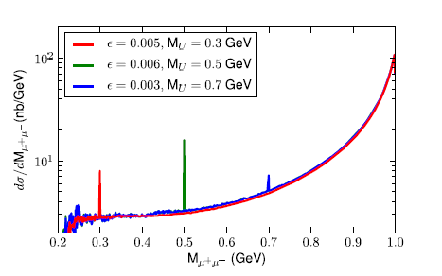
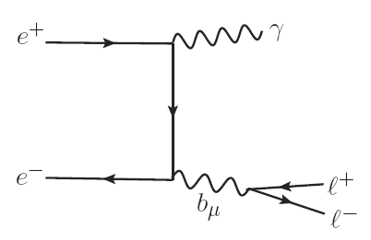
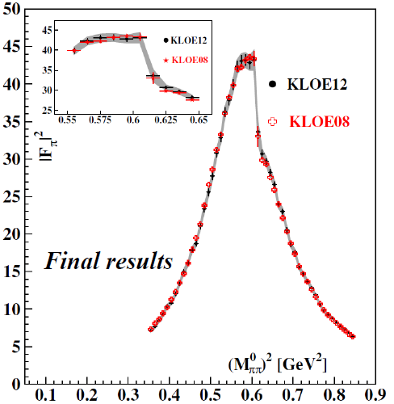
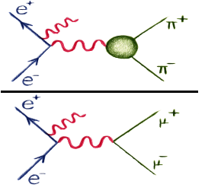
U boson search in e⁺e⁻→μ⁺μ⁻γ
Expect a narrow Breit-Wigner peak above the continuum
U
Directly derived from our measurement of |F_{π}|²
√s=1.02GeV
L= 240 pb⁻¹

Slide 13
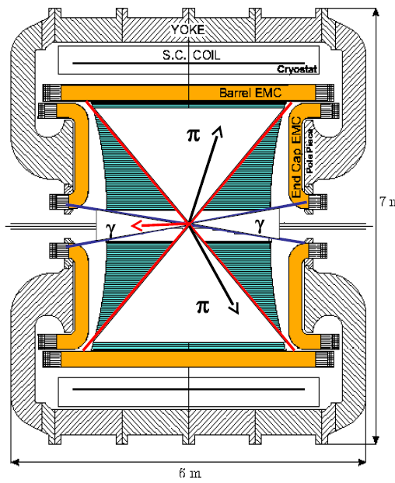
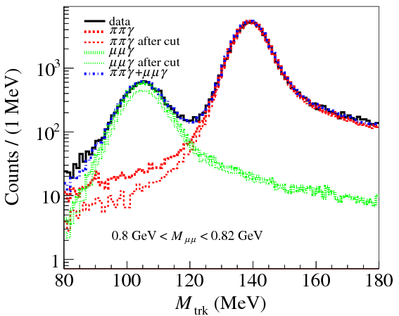
U boson search in e⁺e⁻→μ⁺μ⁻γ
undetected small angle photon θ_{γ}<15°, θ_{γ}>165°
two opposite sign charged tracks 50°<θ_{μ}<130°
μ
high statistics ISR
low FSR contribution
significant suppression of Φ → π⁺ π⁻ π⁰
μ
π/μ separation
Three main sources of background:
e⁺ e⁻ → π⁺ π⁻ γ(γ)
e⁺ e⁻ → e⁺ e⁻ γ(γ)
φ → π⁺ π⁻ π⁰
M_{trk} → mass computed by assuming two equal mass charged particles and 1 γ in the final state

Slide 14
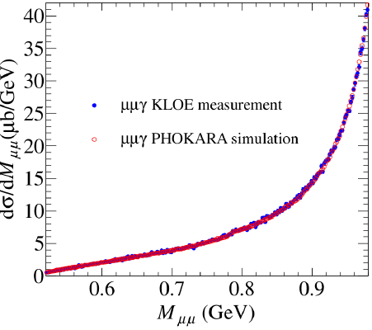
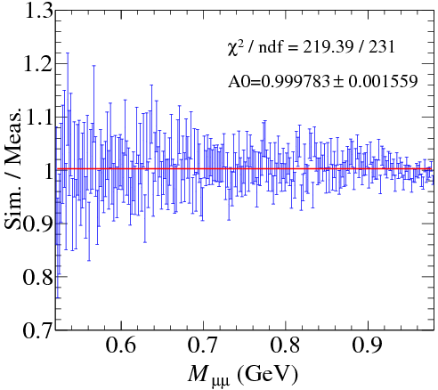
e⁺e⁻→μ⁺μ⁻γ: 90% CL UL
μμ mass spectrum
NLO QED PHOKHARA
excellent Data/MC agreement
CL_{S} technique
Results based on only 240 pb⁻¹
Using the 2.5 fb⁻¹ full KLOE data set improves the sensitivity by a factor ∼ 3
A further factor 2 in sensitivity expected from KLOE-2 experiment
Phys.Lett. B736 (2014) 459

Slide 15
φ meson decay into a U boson + pseudoscalar η: φ→ηU, U→e⁺e⁻,η→πππ
Associated Uγ process: e⁺e⁻→Uγ→μ⁺μ⁻γ
e⁺e⁻→Uγ→e⁺e⁻γ
e⁺e⁻→Uγ→π⁺π⁻γ
Higgsstrahlung process, in the m_{h′}<m_{U} scenario, with an invisible Higgs:
e⁺e⁻→ Uh′→μ⁺μ⁻ + missing energy
KLOE data

Slide 16
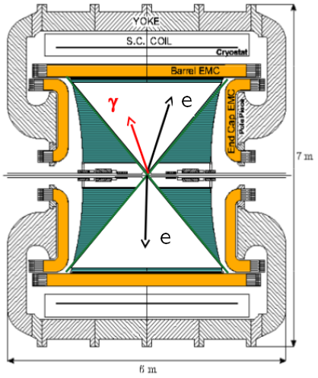
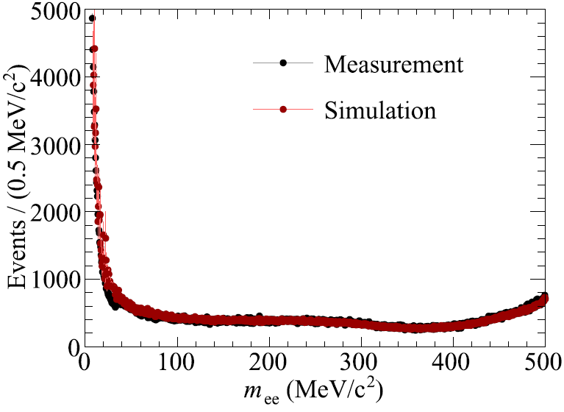
U boson search in e⁺e⁻→e⁺e⁻γ
detected large angle photon θ_{γ}<50°, θ_{γ}>130°
two opposite sign charged tracks 50°<θ_{e}<130°
M_{TRK} to separate from μμγ, ππγ
allows to explore the 2m_{e} threshold region
great suppression of t-channel Bhabha
background contamination ≈1.5%
e⁺e⁻ mass spectrum
Babayaga-NLO simulation (with weighted events)
L=1.54 fb⁻¹
Background estimated from data
No peak observed → UL CL_{S} technique

Slide 17
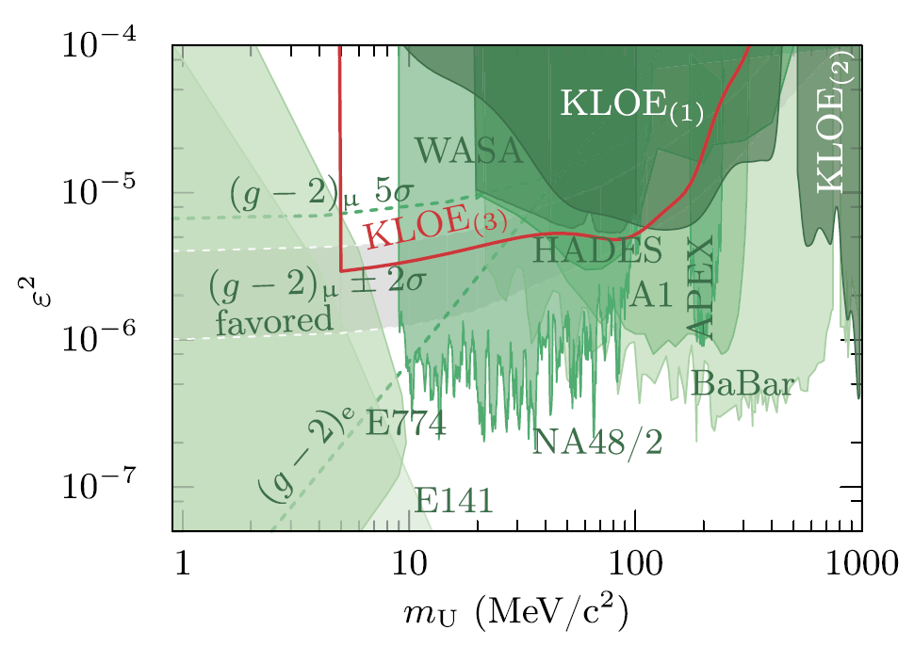
U boson search in e⁺e⁻→e⁺e⁻γ: 90% CL upper limits
Phys.Lett. B750 (2015) 633

Slide 18
φ meson decay into a U boson + pseudoscalar η: φ→ηU, U→e⁺e⁻,η→πππ
Associated Uγ process: e⁺e⁻→Uγ→μ⁺μ⁻γ
e⁺e⁻→Uγ→e⁺e⁻γ
e⁺e⁻→Uγ→π⁺π⁻γ
Higgsstrahlung process, in the m_{h′}<m_{U} scenario, with an invisible Higgs:
e⁺e⁻→ Uh′→μ⁺μ⁻ + missing energy
KLOE data

Slide 19
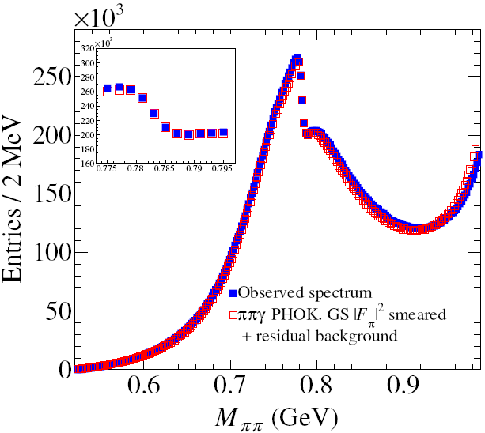
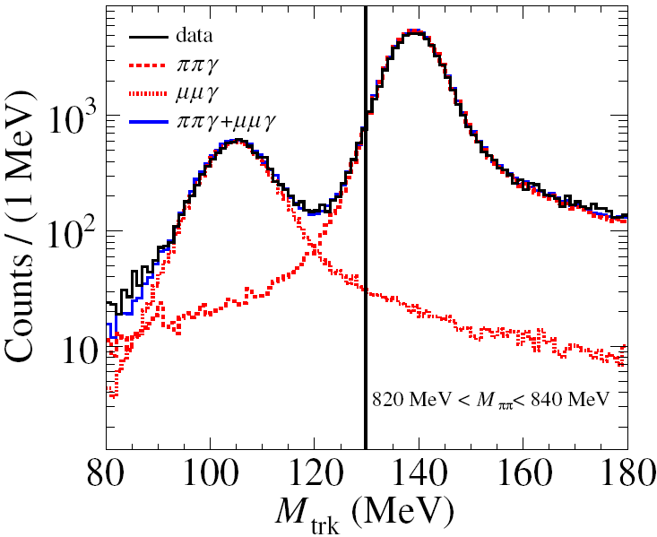
U boson search in e⁺e⁻→π⁺π⁻γ
BR (u → µµ,ππ)
ππ
π
µµ
undetected small angle photon θ_{γ}<15°, θ_{γ}>165°
two opposite sign charged tracks 50°<θ_{π}<130°
π
m_{U}
π⁺ π⁻ mass spectrum
π/μ separation
L=1.93 fb⁻¹

Slide 20
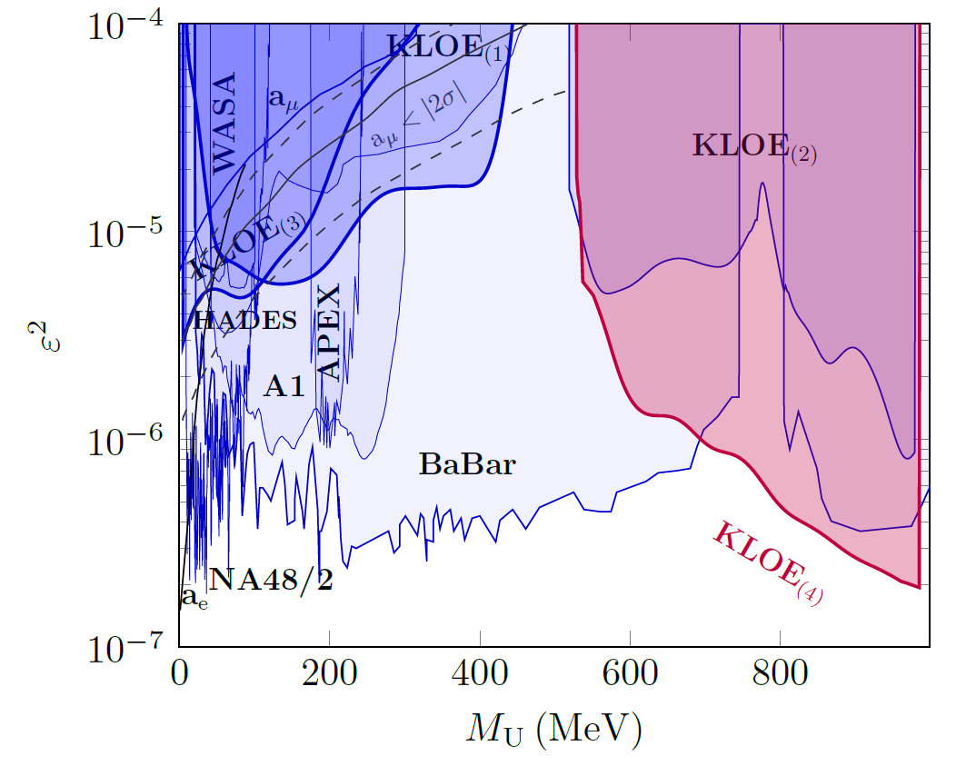
U boson search in e⁺e⁻→π⁺π⁻γ: 90% CL upper limits
L=1.93 fb⁻¹
KLOE₍₁₎ → Dalitz φ→ηe⁺e⁻
KLOE₍₂₎ → e⁺e⁻→μ⁺μ⁻γ
KLOE₍₃₎ → e⁺e⁻→e⁺e⁻γ
KLOE₍₄₎ → e⁺e⁻→π⁺π⁻γ
arXiv:1603.06086, subm. to PLB

Slide 21
φ meson decay into a U boson + pseudoscalar η: φ→ηU, U→e⁺e⁻, η→πππ)
Associated Uγ process: e⁺e⁻→Uγ→μ⁺μ⁻γ
e⁺e⁻→Uγ→e⁺e⁻γ
e⁺e⁻→Uγ→π⁺π⁻γ
Higgsstrahlung process, in the m_{h′}<m_{U} scenario, with an invisible Higgs:
e⁺e⁻→ Uh′→μ⁺μ⁻ + missing energy
KLOE data

Slide 22
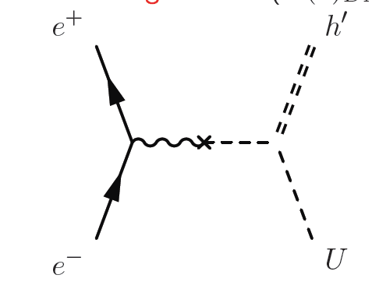
The e⁺e⁻→h′U higgsstrahlung process
h′
Very different scenarios depending on
m_{h′}<m_{U} ⇒ “invisible”
m_{h′}>m_{U}⇒ h→ uu → 4l,π+2l,π
γ
∼ α_{D}ε²
ε = 10⁻³
α_{D}= α_{em}
m_{U,h′}∼100 MeV
U
τ_{h′}>5 µs → βγcτ > 100 m
invisible up to ε ≈ 10⁻²÷10⁻¹ depending on m_{h′}
U
rapidly increasing with decreasing ε
We studied only the muon case m_{h′}<m_{U}: e+e⁻ → µ+µ⁻ + missing energy
σ(e⁺e⁻→h′U) α_{D}= α, ε = 10⁻³, s=1 GeV²
fb
BR (u → µµ,ππ)
m_{h′}
Batell, Pospelov, Ritz ,
Phys. Rev. D 79,
115008 (2009)
ππ
µµ
≈0.5
m_{U}
m_{U}

Slide 23
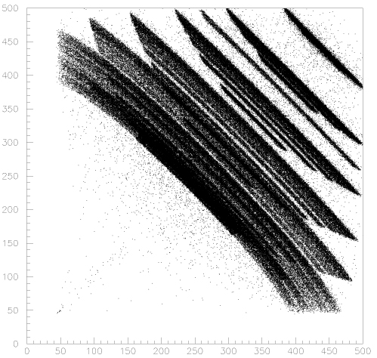
e⁺e⁻→h′U: selections
two charged tracks, q₁+q₂=0
vertex in a cylinder around IP
p_{1,2}< 460 MeV
cosθ < 0.75 , cosθ_{1,2} < 0.8
p₁ + p₂ > 450 MeV
E_{miss}: calorimeter veto
PID: two muons
vtx-IP cut (anti K⁺K⁻)
p₁
K⁺K⁻→μ⁺μ⁻νν decaying in the IP region
h′U, U→μμ
IP
K⁻
μ⁻
K⁺
m_{u}
μ⁺
m_{U},m_{h’} → bands
p₂
1-ε_{veto}
e ─
µ ─
eeγ(γ) data
cosθ_{miss} < 0.75
NN output
P_{miss} (MeV)

Slide 24
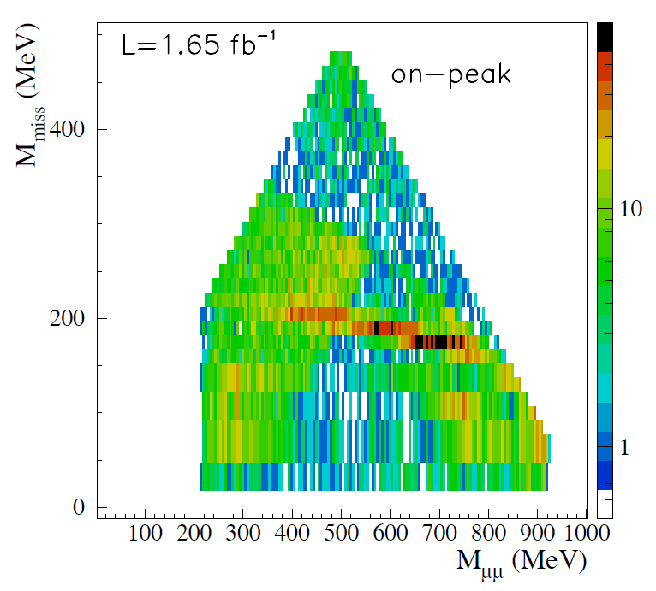
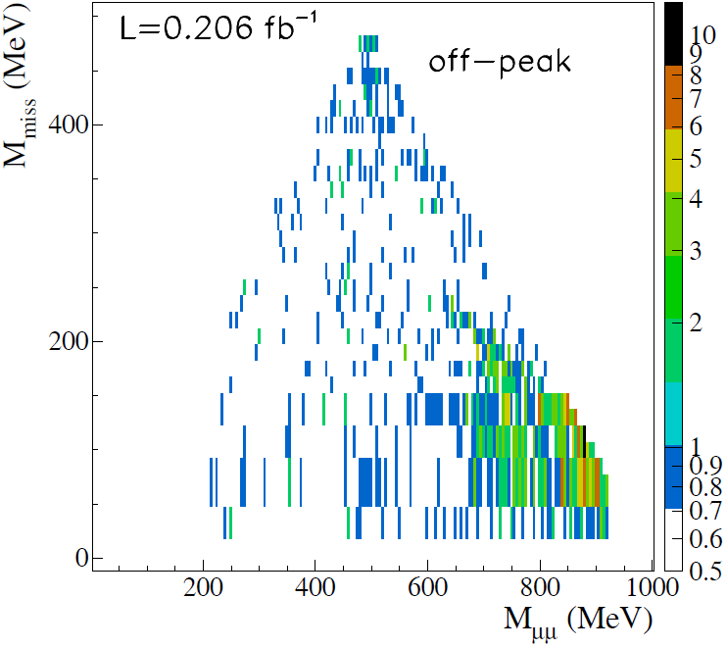
e⁺e⁻→h′U: results
K⁺K⁻→μ⁺μ⁻νν
ee→eeμ⁺μ⁻
ee→eeπ⁺π⁻
ee→eeμ⁺μ⁻
ee→eeπ⁺π⁻
π⁺π–π⁰
μ⁺μ⁻γ
μ⁺μ⁻γ
π⁺π⁻γ
π⁺π⁻γ
Backgrounds
φ → K⁺ K⁻ , K±→μ±ν
φ → π⁺π–π⁰
e⁺e⁻→ μ⁺μ⁻ γ
e⁺e⁻→ π⁺π⁻ γ
e⁺e⁻→e⁺e⁻μ⁺μ⁻
e⁺e⁻→e⁺e⁻π⁺π⁻
φ decays
continuum

Slide 25
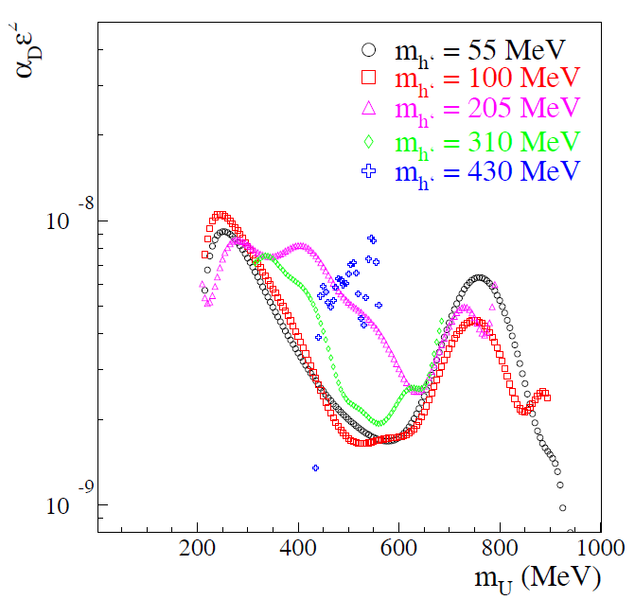
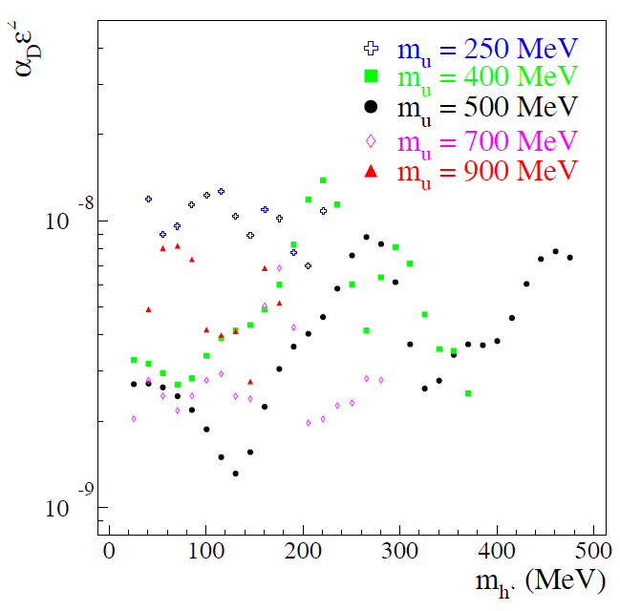
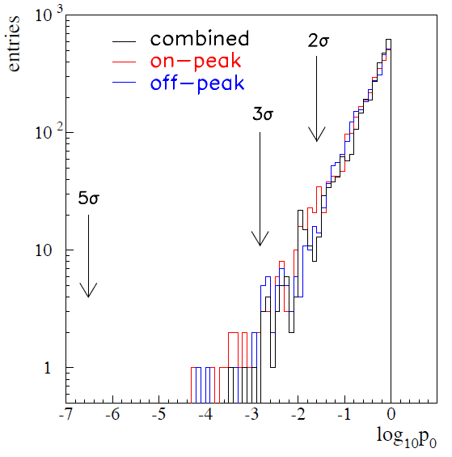
e⁺e⁻→h′U: p₀ values and 90% CL upper limits
smoothed results
smoothed results
p₀
Phys.Lett. B747 (2015) 365
Limits ∼ 10⁻⁸÷10⁻⁹ in α_{D}ε² (translate in 10⁻³÷ some 10⁻⁴ in ε if α_{D}= α_{em})
Search complementary with BaBar/Belle
Expect a ≈ 2.5 improvement in KLOE2 (luminosity + suppression of K⁺K⁻ background due to IT) → full study of the ε ≈ 10⁻⁴ region
No significative excess

Slide 26
Dark forces at KLOE: summary and conclusions
KLOE searched for a dark gauge U boson in six different processes:
  φ meson decay: Φ→ηU with U→e⁺e⁻, η→πππ Phys.Lett. B720 (2013) 111
  Uγ associate production: e⁺e⁻→Uγ→μ⁺μ⁻γ Phys.Lett. B736 (2014) 459
  Uγ associate production: e⁺e⁻→Uγ→e⁺e⁻γ Phys.Lett. B750 (2015) 633
  Uγ associate production: e⁺e⁻→Uγ→π⁺π⁻γ arXiv:1603.06086, subm. to PLB
  Higgsstrahlung: e⁺e⁻→ Uh′→μ⁺μ⁻ + missing energy Phys.Lett. B747 (2015) 365
We found no evidence and set upper limits on the mixing parameter ε² (α_{D}ε²), as a function of the U (and h′) mass, in the range 10⁻⁵÷10⁻⁷, depending on the process.
All these measurements, performed with the KLOE data set, are statistically dominated, so…
… the increased DAφNE-2 delivered luminosity and the presence of the new detectors in KLOE-2 are expected to improve these limits by a factor ∼2 or better .
New KLOE-2 run is well in progress. Stay tuned!

Slide 27
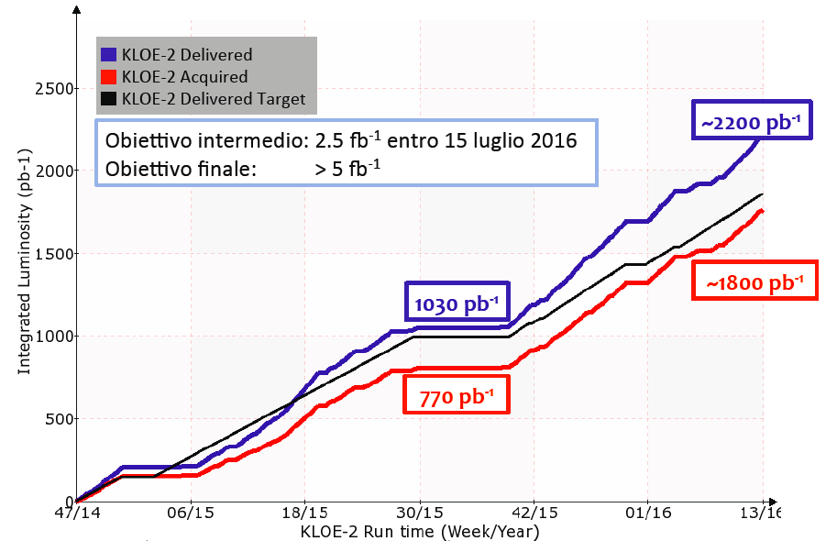
Dark forces at KLOE-2: present and future
Increased luminosity
Increase of machine background
Detailed studies show the good quality of the collected data
Background largely reduced by exploiting the excellent timing performance of the calorimeter
No dark force analysis yet
Expected improvement on mass resolution (better S/N ratio) and vertex reconstruction (better K± rejection)
Next milestone: 2.5 fb⁻¹ by July 2016
Final goal: 5 fb⁻¹ within the next 2 years
On track to 5 fb⁻¹ goal
New ideas
B boson search (leptophobic): φ→ηB, B→π⁰γ (in progress)
Invisible U decays to light dark matter (smart ideas or single γ trigger)

Slide 28
SPARE SLIDES

Slide 29
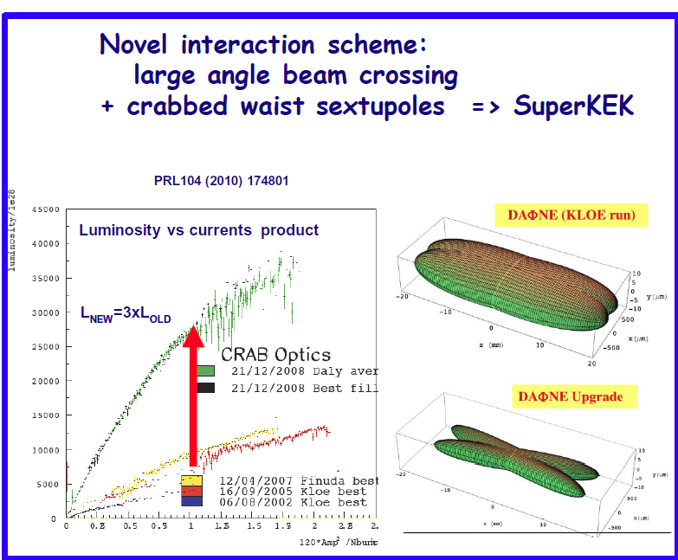
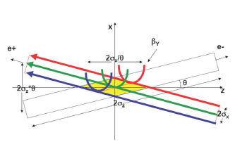

Slide 30
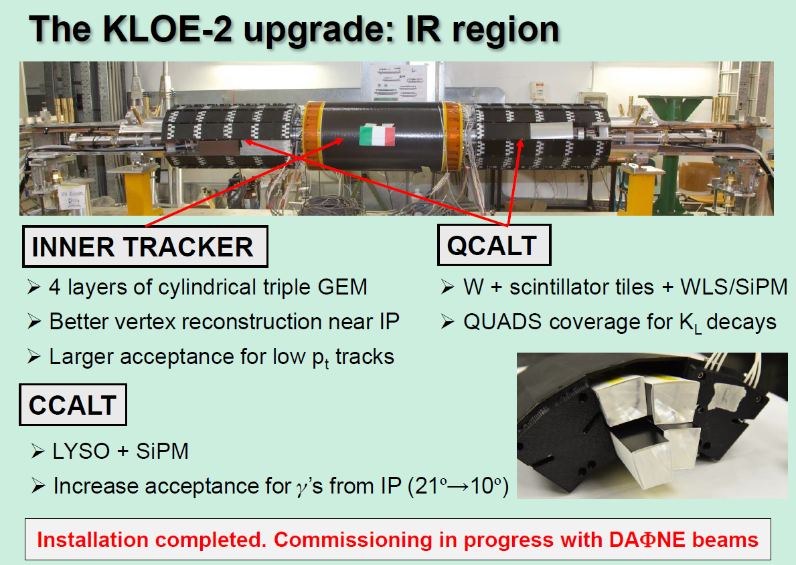

Slide 31




To express limits in terms of ε² we need a form factor
FF slope:
… but SND: b_{fh}= (3.8±1.8) GeV⁻²

Slide 32
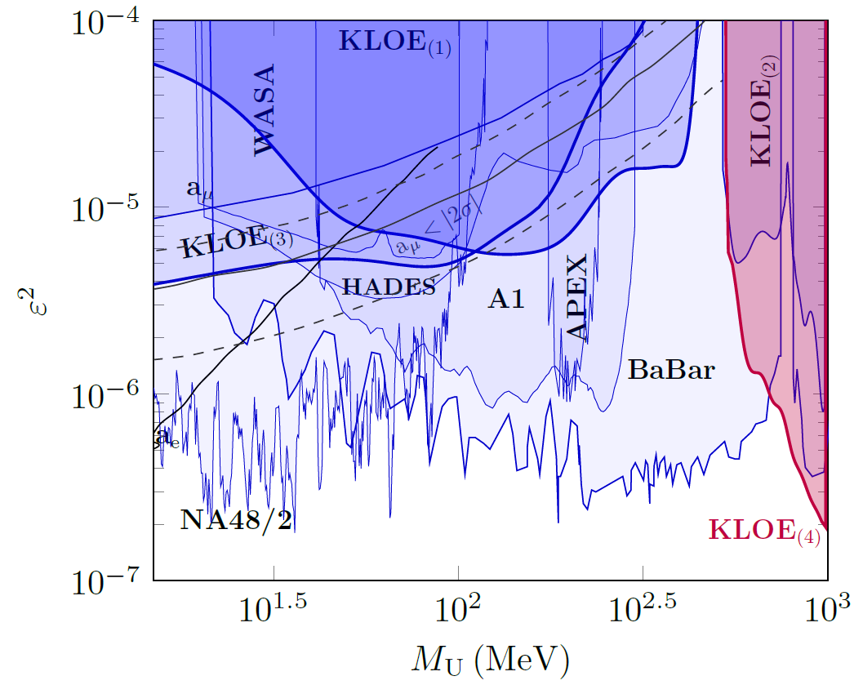
e⁺e⁻→e⁺e⁻γ: 90% CL upper limits

Slide 33
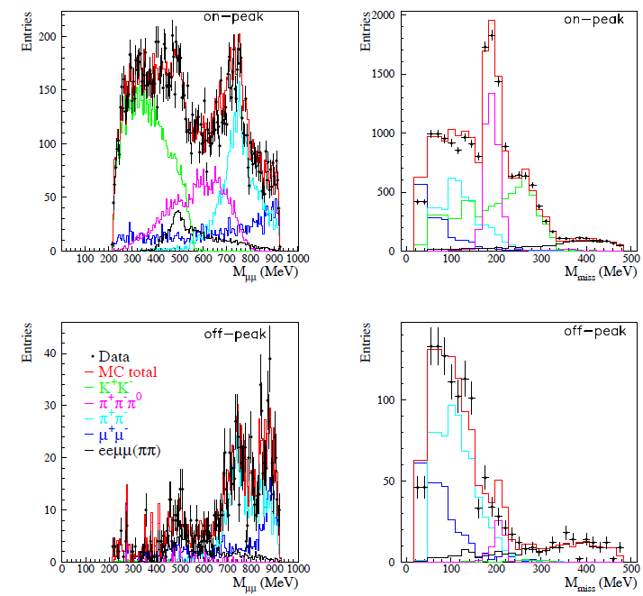
e⁺e⁻→h′U: M_{μμ} and M_{miss} spectra

