Slide 1
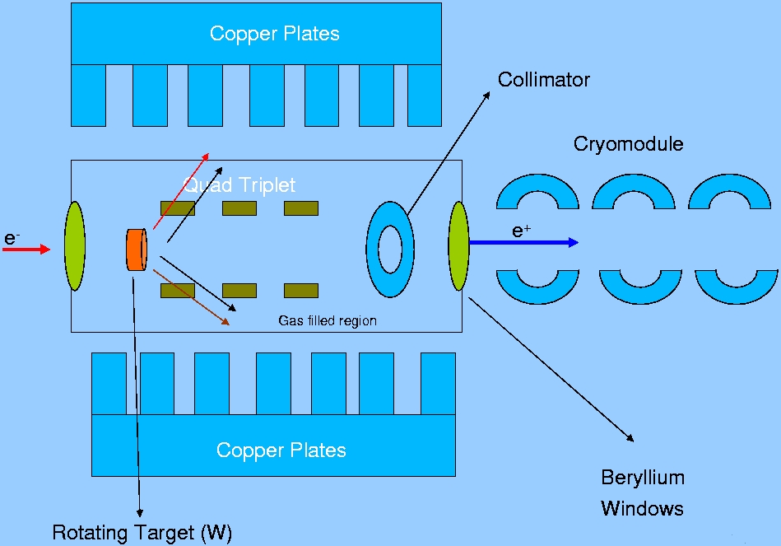
Low-Energy Polarized Positrons
for Physics
e⁺ @ MESA
Eric Voutier
Institut de Physique Nucléaire
Orsay, France
Low-energy positron physics
Slow positron physics
Polarized positron production
Conclusions
Work in progress….
LEPP16, New Vistas in Low-Energy Precision Physics
Mainz, April 4th-7th, 2016

Slide 2
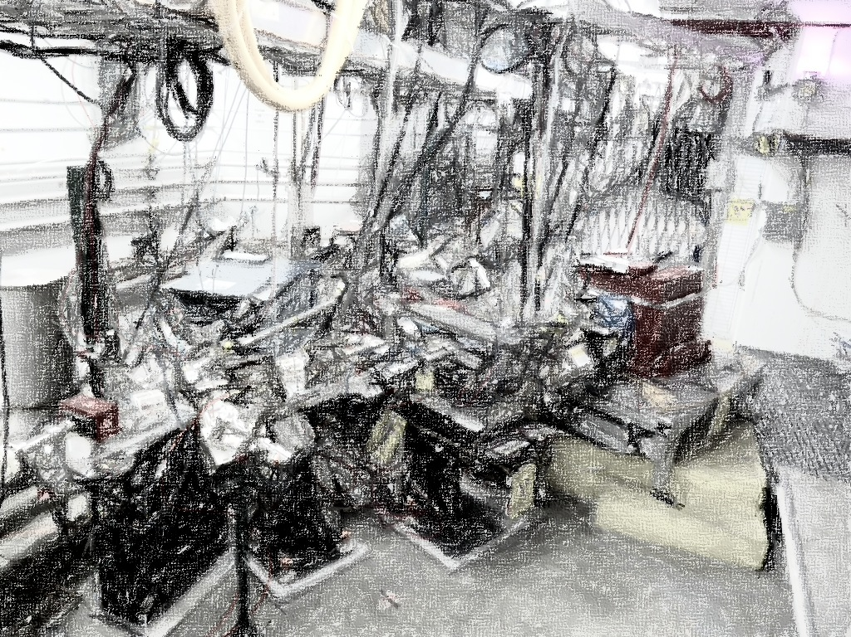
Low-Energy Positron Physics
(E > 10 MeV)
Two-photon physics (U,P)
Standard Model test (U,P)
Mainz, April 4th-7th, 2016

Slide 3

Two-photon physics
Electromagnetic Form Factors
P.A.M. Guichon, M. Vanderhaeghen, PRL 91 (2003) 142303
Following the very first measurements of polarization transfer observables in electron elastic scattering, the validity of the 1γ exchange approximation of the electromagnetic interaction has been questioned.
Within the 2γ exchange hypothesis, the electromagnetic structure of the nucleon may be parameterized by 3 generalized form factors, corresponding to 8 unknown quantities.
Mainz, April 4th-7th, 2016
3/20

Slide 4
Two-photon physics
Experimental Observables
M.P. Rekalo, E. Tomasi Gustafsson, NPA 742 (2004) 322 C. Carlson, M. Vanderhaeghen, ARNPS 57 (2007) 171
Unpolarized e± elastic scattering and polarization transfert observables off the nucleon involve up to 5 unknown quantities.
Cross Section
Polarization
Transfert
5 unknown contributions for 6 independent observables
Combining polarized electrons and positrons allows a model independent separation of the electromagnetic form factors of the nucleon.
Mainz, April 4th-7th, 2016
4/20

Slide 5
Standard Model test
Dark Photon Search
➔ P. Valente, PADME experiment @ Frascati
Low energy: on a proton target, the energy range below the pion production threshold is unique because free of hadronic background contribution. This feature is of particular interest when searching for rare processes as evidence of a new light dark boson.
Y. Liu, G. Miller, PRC 92 (2015) 035209
Beam polarization: constitutes the finest scalpel of physics, and may also be significant for the dark photon search.
Mainz, April 4th-7th, 2016
5/20

Slide 6
Slow Positron Physics
(E < 1 MeV)
Positron annihilation spectroscopy
Slow positron production
Mainz, April 4th-7th, 2016

Slide 7
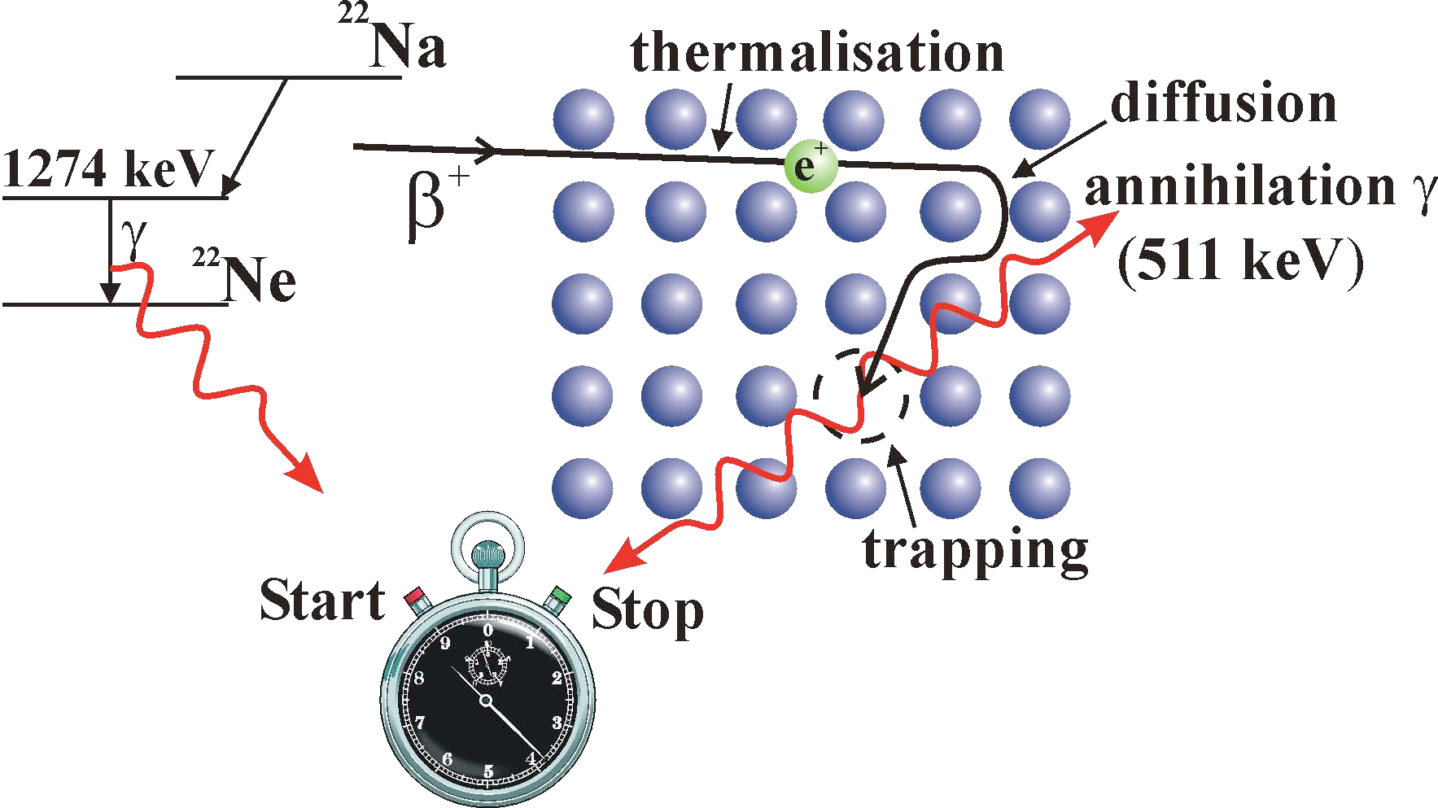
Positron annihilation spectroscopy
Principle of Operation
Positron annihilation spectroscopy (PAS) is a well-known technique for characterizing properties of electron densities at the surface, interface, and in the bulk of a material.
Dopler broadening
PAS is sensitive to small changes in electron density, difficult to observe otherwise.
Positron annihilation
Mainz, April 4th-7th, 2016
7/20

Slide 8
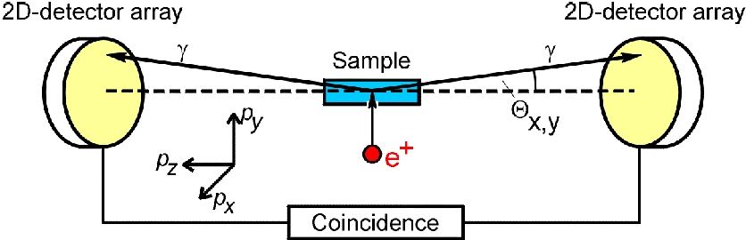
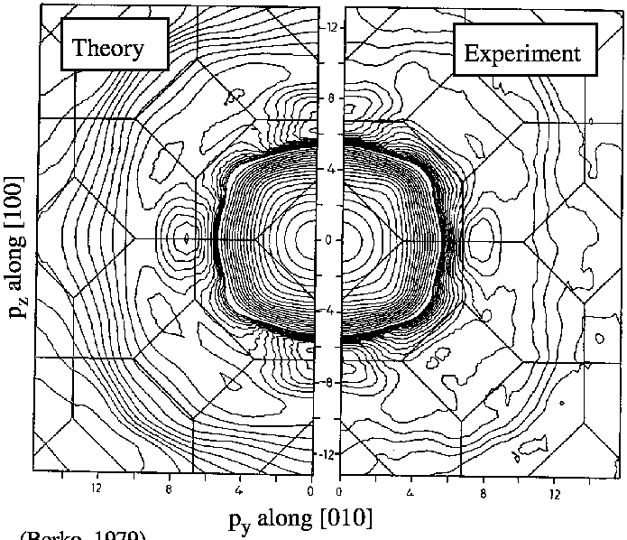
Positron annihilation spectroscopy
2D/3D ACAR
Angular Correlation of Annihilation Radiation
Fermi surface of copper
Together with Dopler broadening, the motion of atomic electrons results in an angular deviation breaking γ’s colinearity.
Fermi surface of Materials
Technological (production and thermalisation of e⁺) and instrumental
(δΘ = 1 mrd, δk ≤ 1 keV) challenges.
Mainz, April 4th-7th, 2016
8/20

Slide 9
Positron annihilation spectroscopy
Spin Polarized - PAS
A. Rich, RMP 53 (1981) 127 A. Kawasuso et al., JMMM 342 (2013) 139 M. Maekawa et al., JJAP 2 (2014) 011305
Dopler broadening for the study of ferromagnetic band structure.
Study of current induced spin polarization effects (spintronics) through positronium formation.
Mainz, April 4th-7th, 2016
9/20

Slide 10
Slow positron production
Current Status
Slow positrons are usually obtained from radioactive sources or pair production inside a reactor. Thermalisation occurs via multiple scattering inside a moderator, reducing drastically the positron yield.
-> Reactor/radioactive source based facilities
POSH @ Delft (4×10⁸ e⁺/s)
NEPOMUC @ München (10⁹ e⁺/s)
JAEA @ Takasaki (10⁵ e⁺/s, 27%)
-> Linac based facilities
SPF @ Tsukuba (5×10⁷ e⁺/s)
EPOS @ Rossendorf (projected 10⁹ e⁺/s)
ELI-NP @ Magurele (projected 2×10⁶ e⁺/s, 33%)
A linac based moderator free polarized positron source can potentially deliver 100 times higher beam current, and bring efficient polarization capabilities to PAS.
Mainz, April 4th-7th, 2016
10/20

Slide 11
Polarized Positron Production
Polarization transfer physics
PEPPo experiment
Optimized positron production
Mainz, April 4th-7th, 2016

Slide 12
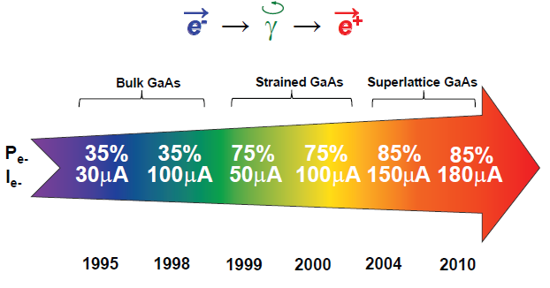
Polarization transfer physics
Polarized Bremsstrahlung
E.G. Bessonov, A.A. Mikhailichenko, EPAC (1996) A.P. Potylitsin, NIM A 398 (1997) 395
e⁻ → γ → e⁺
Sustainable polarized electron intensities up to 4 mA have been demonstrated
from a superlattice photocathode.
R. Suleiman et al., PAC’11, New York (NJ, USA), March 28 – April 1, 2011
Mainz, April 4th-7th, 2016
12/20

Slide 13
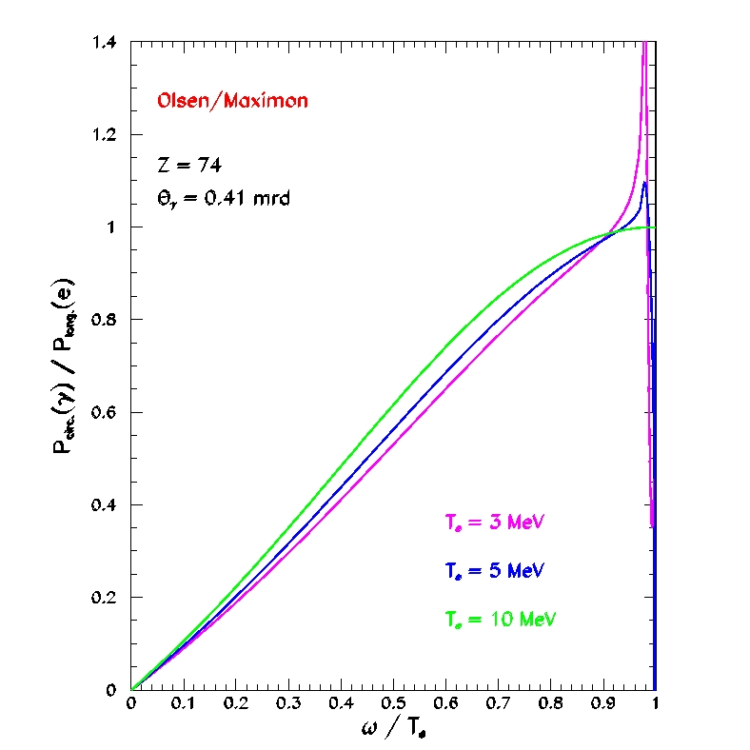
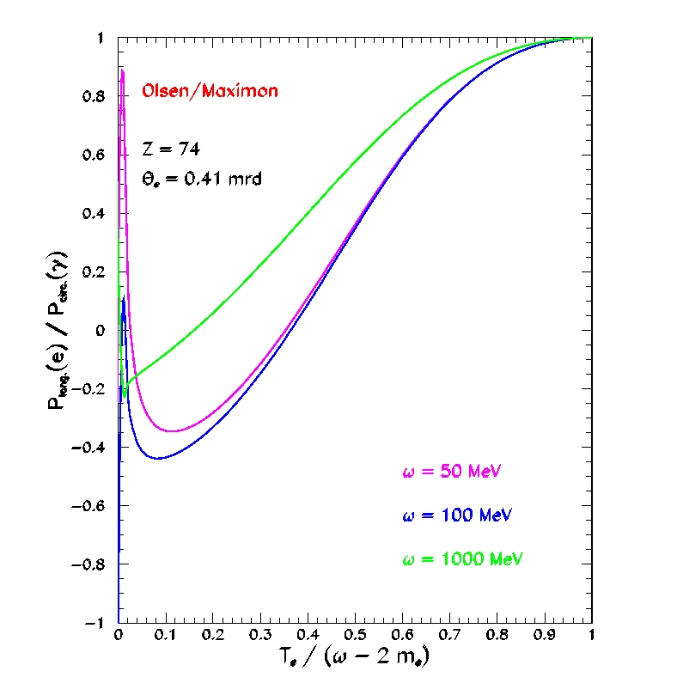
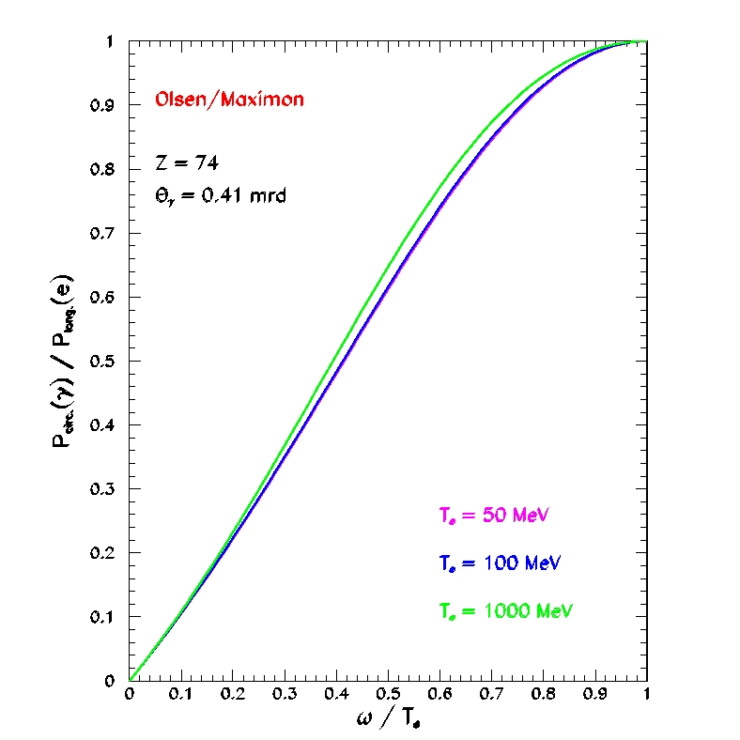
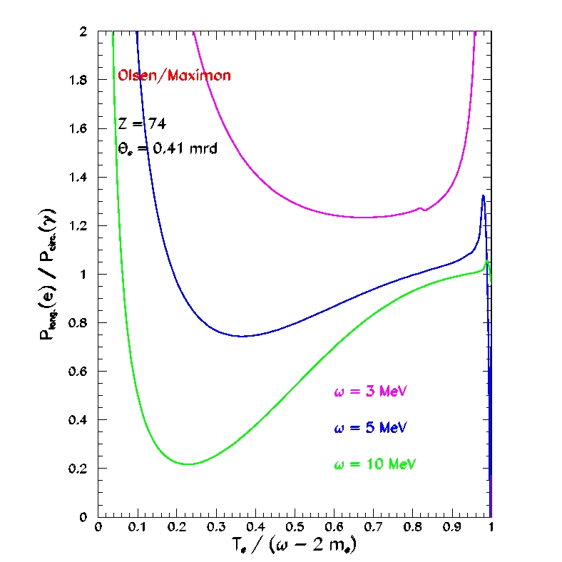
Polarization transfer physics
Bremsstrahlung and Pair Creation
H. Olsen, L. Maximon, PR114 (1959) 887
The most currently used framework to evaluate polarization transfer for polarized bremsstrahlung and pair creation processes is the O&M work developped in the Born approximation for relativistic particles and small scattering angles.
BREMSSTRAHLUNG
PAIR CREATION
Mainz, April 4th-7th, 2016
13/20

Slide 14

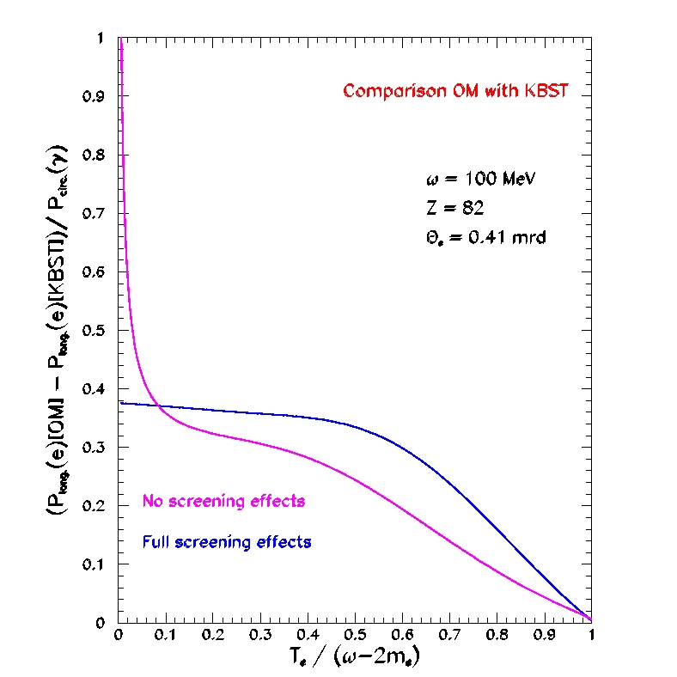

Polarization transfer physics
Bremsstrahlung and Pair Creation
E.A. Kuraev, Y.M. Bystritskiy, M. Shatnev, E. Tomasi-Gustafsson, PRC 81 (2010) 055208
These reference processes have been revisited considering the finite mass of the leptons, generating additionnal terms to the leptonic tensor.
BREMSSTRAHLUNG
PAIR CREATION
Mainz, April 4th-7th, 2016
14/20

Slide 15

PEPPo experiment
Polarized Bremsstrahlung
(PEPPo Collaboration) J. Grames, E. Voutier et al., JLab Experiment E12-11-105, 2011
The purpose of the PEPPo (Polarized Electrons for Polarized Positrons) was to evaluate feasibility of using bremsstrahlung radiation of polarized electrons for the production of polarized positrons.
Mainz, April 4th-7th, 2016
15/20

Slide 16
PEPPo experiment
Proof-of-Principle
(PEPPo Collaboration) J. Grames, E. Voutier et al. , JLab Experiment E12-11-105, 2011
The PEPPo experiment at the CEBAF injector demonstrated efficient polarization transfer from 8.2 MeV/c electrons to positrons produced in the 3.1-6.3 MeV/c, expanding polarized positron capabilities from GeV to MeV accelerators.
e⁻ beam polarization
85.2 ± 0.6 ± 0.7 %
Whenever producing positrons from electrons,
polarization is coming for free if initial electrons are polarized.
Mainz, April 4th-7th, 2016
16/20

Slide 17



Optimized positron production
Figure-of-Merit
R. Dollan, K. Laihem, A. Schälicke, NIM A 559 (2006) 185 J. Dumas, J. Grames, E. Voutier, AIP 1160 (2009) 120 J. Dumas, Doctorate Thesis (2011)
The polarization distribution of generated positrons is typical of bremsstrahlung induced pair creation with a production rate dominated by low-energy particles.
Optimum
FoM
Optimum energy
The positron energy at optimum FoM is about half of the electron beam energy.
Mainz, April 4th-7th, 2016
17/20

Slide 18
Optimized positron production
Expected Performances
J. Dumas, Doctorate Thesis (2011)
The optimized FoM at each electron beam energy defined the « operational conditions »; simplistic cuts mimic a capture system and/or an accelerator acceptance, and define the quantitative source performances.
Δp/p = 10% ΔΘ = 10°
In the energy range accessible at MESA, one can reasonably expect to optimaly achieve
75% electron polarization transfer and 10⁻⁴-10⁻³ e⁺/e⁻.
Mainz, April 4th-7th, 2016
18/20

Slide 19
Conclusions
Summary
Polarized positrons could be an important addition to MESA capabilities, either they would be directly used after production, or injected into MAMI, or decelerated to very low energies.
Dark matter search, 2γ physics, Material Science @ very low energy…
PEPPo demonstrated that
polarized positrons can be efficiently obtained from the bremsstrahlung radiation of a polarized electron beam.
Available e⁺ beam current remains to be optimized for each possible use.
Mainz, April 4th-7th, 2016
19/20

Slide 20


Conclusions
PRAE
Platform for Research and Applications with Electrons
S. Barsuk, A. Faus-Golfe, B. Genolini, Y. Prezado, E. Voutier et al.
Multidisciplinary facility for R&D&A in Physics, Instrumentation, Radiotherapy.
High precision
measurement of G_{E}(p) in
the 10⁻⁵-10⁻⁴ (GeV/c²)² range
v
v
ISR @ MAMI
High energy
instrumentation platform
down to mono-electron beam
Prad @ JLab
v
High-gradient traveling wave cavities
S-band, 3 GHz, 65 MV/m
eHGRT
High energy
electron grid therapy
10 ps bunch, 50 Hz
Q ≤ 2 nC/bunch (polarized)
E ≤ 140 (300) MeV
P2iO emblematic project (www.labex-p2io.fr)
20/20
Mainz, April 4th-7th, 2016

