Slide 1
Simulation study of beam polarization for CEPC
DUAN, Zhe (IHEP)
Apr 16th, 2016
Acknowledgements:
M. Bai, D. P. Barber, and E. Forest.
EuCARD-II XPOL workshop, April 16, Rome.

Slide 2
Outline
Simulation Tool
Preliminary simulation results for 45 & 80GeV
Simulation study for ultra-high beam energies & comparison with theories^{[1]}
Conclusion
[1] Z. Duan, M. Bai, D. P. Barber and Q. Qin, NIM A793 (2015) 81.

Slide 3

Polarization Simulation with PTC
  Polymorphic Tracking Code(PTC) ^{[1]} is capable of orbital & spin tracking, as well as normal form analysis of one turn map.
Lattice imperfection & correction can be implemented with MADX or BMAD and exported to PTC format. Fortran scripts are developed calling PTC as a library.
Equilibrium polarization calculation including first order spin resonances:
  First order normal form to obtain and , then apply DK formula.^{[2]}
Equilibrium polarization calculation including higher order spin resonances.
  Monte-Carlo simulation of depolarization rate, similar to SITROS & SLICKTRACK.
  This is essential for higher beam energy as in CEPC and FCC-ee.
[1] F. Schmit, E. Forest and E. McIntosh, CERN-SL-2002-044, 2002.
[2] E. Forest, KEK Report KEK-2010-39, 2010.

Slide 4
Comparison of Monte-Carlo simulation code
Code\features | orbit map | Photon emission | Speed
SITROS | 2nd order matrix | “Big photon” localized at several points
SLICKTRACK | 1st order matrix | “Big photon” localized at several points
PTC | nonlinear symplectic integrator | at each integration step of each dipole. | much slower compared to the others.
It is not clear now if the more precise treatment in PTC have large effects on the simulation results.
The lumped treatment in SITROS & SLICKTRACK can also be implemented within PTC with some effort.

Slide 5
Model Ring
Arc FODO cells of phase advances 60/60 degrees, connected by straight FODO cells; Periodicity: 4. Circumference: 50294.4m. No polarization wigglers yet.
Same lattice for Z & W.
Parameters \ Energy Range | Z | W
energy(GeV) / aγ | 45.6 / 103.5 | 80.4/182.5
working point Q_{x}/Q_{y}/Q_{z} | 236.08/236.22/0.0286 | 236.08/236.22/0.05
natual emittance(nm) | 0.58 | 1.81
damping time (turn) τ_{x}/τ_{y}/τ_{z} | 1511/1511/756 | 276/276/139
rms energy spread σ_{ε} (10⁻⁴) | 5.3 | 9.4
rms energy spread σ_{ε} (MeV) | 24.2 | 75.6
polarization build-up time(hour) | 41.4 | 2.43
spread of spin precessing rate σ_{ν}=aγ σ_{ε} | 0.055 | 0.172
modulation index σ=σ_{ν} /Q_{z} | 1.9 | 3.43

Slide 6
Lattice imperfection introduction & correction
In MADX, vertical misalignment errors are introduced for each quadrupole(2736 quads in total), with a rms ymis = 50μm, correction is also done in MADX.
Near each quad, there is a zero-length BPM & and a H/V corrector of 0.05m. BPM error is not introduced yet.
MICADO algorithm is used to correct vertical orbit only, different number of correctors used in MICADO correspond to different final rms vertical closed orbit & rms tilt of n0-axis.
Harmonic closed orbit spin matching is not implemented yet.
Increase in the rms tilt of n0-axis generally leads to increase of and therefore a reduction in equilibrium beam polarization.

Slide 7

45.5GeV
Uncorrected
ycorms = 1.388 mm
Corrected with 50 correctors in MICADO
ycorms = 0.161564 mm
The closed orbit spin tune shifts a lot in this particular case of 45.5GeV.

Slide 8
45.5&80GeV, n0-axis tilt
vertical dispersion
number of correctors in MICADO | ycorms (mm) | dyrms (mm) | emittance ratio
uncorrected | 1.388 | 91.8 | 0.248
50 | 0.162 | 13.8 | 0.0079
200 | 0.078 | 1.79 | 0.0003
500 | 0.048 | 1.77 | 0.0002

Slide 9
45.5&80GeV, first order calculation of polarization
vertical dispersion
number of correctors in MICADO | ycorms (mm) | dyrms (mm) | emittance ratio
uncorrected | 1.388 | 91.8 | 0.248
50 | 0.162 | 13.8 | 0.0079
200 | 0.078 | 1.79 | 0.0003
500 | 0.048 | 1.77 | 0.0002
The closed orbit spin tune shifts a lot in this particular case of 45.5GeV.

Slide 10


80GeV
Corrected with 200 correctors in MICADO
ycorms = 0.069 mm
Corrected with 500 correctors in MICADO
ycorms = 0.03 mm

Slide 11
Discussion
As shown above, one particular case of misaligned ring & orbit correction was passed to polarization simulation. For a specified misalignment error setting in quads, a lot of different random seeds are needed to feed the polarization simulation, to get a statistical understanding. Note that the step size is too large to exhibit synchrotron sideband resonances in the simulation, which also needs improvement.
For the same lattice, the same vertical orbit distortion, tilt of n0-axis scales with beam energy, enhancement factor due to synchrotron sidebands increase with beam energy as well.
The upper limit of beam energy with useful polarization is set by the machine alignment precision and orbital correction capability.
On the other hand, polarization can be regarded as one criterion on lattice error tolerance studies.
Lattice processed by practical modeling of different error sources and the state of art error corrections should be passed to polarization simulation to get a reliable understanding.

Slide 12
Theoretical overview for ultra-high beam energies
Derbenev, Kondratenko and Skrinsky’s work dates back to 1970s.^{[1]}
  Higher order resonances (primarily synchrotron sidebands) become dominant at ultra-high beam energies. First order theory no longer suffices.
  Different regimes of spin diffusion:
    Correlated resonance crossing: the width of synchrotron sideband is smaller than the synchrotron resonance spacing. (consistent with observations in LEP)
    Uncorrelated resonance crossing: the width of synchrotron sideband is larger than the synchrotron resonance spacing, different behaviors when the spread of spin precessing rate is much smaller or much larger than 1. (CEPC & FCC-ee might enter this regime.)
[1] Y. Derbenev, A. Kondratenko, A. Skrinsky, Particle Accelerators 9 (1979) 247.

Slide 13
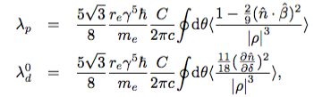
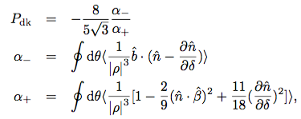
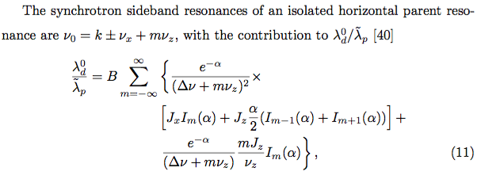
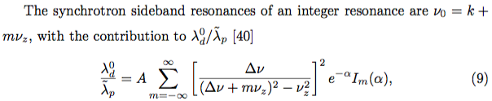
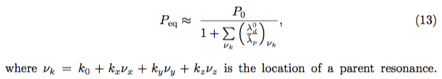
DK theory (correlated regime)
Away from spin resonances[1]
Synchrotron sideband resonances[2]
:
The equilibrium beam polarization can be estimated with
[1] Y. Derbenev, A. Kondratenko, Sov. Phys. JETP 37 (1973) 968.
[2] S. Mane, Nucl. Instrum. Meth. A292 (1990) 52.

Slide 14


DK theory (uncorrelated regime)^{[1,2]}
Near a spin resonance, stochastic photon emissions should contribute to the depolarization rate^{[2]}, which is generally small if the spread of spin precessing rate is small, and we don’t run a machine near major spin resonances.
If the rms spread in spin phase advance in a synchrotron oscillation period is large ( correlation index > 1), and the rms spread of the spin precession frequency is larger than synchrotron tune:
  The spin resonances completely overlap and are unavoidable.
  The crossings of resonances during synchrotron motion are completely uncorrelated.
  The depolarization rate is described by
Not clear if the first term in α+ still holds, and can be added to the latter term.

Slide 15
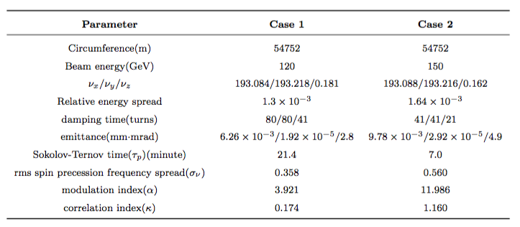
Simulation study of a model ring
A ring of arc FODO cells connected by FODO straight sections, Periodicity = 4.
Four skew quads are symmetrically inserted to drive horizontal & vertical spin resonances. No lattice imperfections.

Slide 16
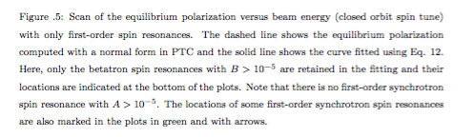
First order calculations

Slide 17

Calculation of spin resonance strengths

Slide 18
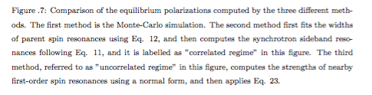
Monte-carlo simulation against theories

Slide 19
Discussion
The simulation results support the theory of uncorrelated regime at ultra-high beam energies. LEP2 @ 104GeV and FCC-ee 175GeV operation is expected to be within this regime.
LEP2 didn’t observe useful polarization at such a high beam energy.
This study shows there are still some open questions to be answered theoretically, which is now under investigation by D. P. Barber, J. A. Ellison, and K. Heinemann.
Siberian snakes are not taken into account in this study, which would change the picture totally.

Slide 20
Conclusion
Monte-Carlo simulation of beam equilibrium polarization is set up with error & corrections at Z&W. More work is needed to implement more practical error settings and correction schemes.
Monte-Carlo simulations of a model ring at ultra-high beam energies support DKS’s theory of correlated & uncorrelated regimes, qualitatively. Better understanding of the theories is needed.

