Slide 1
Polarization wigglers for FCC-ee (TLEP) and lessons from LEP
Mike Koratzinos
EuCARD-2 XPOL workshop on Polarization Issues in Future High Energy Circular Colliders
16 April 2016
Rome

Slide 2
Bibliography
[1] | R. Assmann et al., “Calibration of centre-of-mass energies at LEP1,” Eur. Phys. J. C 6, 187-223 (1999).
[2] | L. Arnaudon et al., “Accurate Determination of the LEP Beam Energy by resonant depolarization,” Z. Phys. C 66, 45-62 (1995).
[3] | A.A. Sokolov, I.M.Ternov, “On Polarization and spin effects in the theory of synchrotron radiation,” Sov. Phys. Dokl. 8, 1203 (1964).
[4] | A. Blondel and J.M. Jowett, “Dedicated Wiglers for Polarization,” LEP note 606, CERN, 1988.
[5] | R. Assmann et al., “Spin dynamics in LEP with 40–100 GeV beams,” in AIP Conf. Proc. 570 , 169 , 2001.
[6] | G. Wilson, “Prospects for Center-of-Mass Energy Measurements at Future e⁺e⁻ Colliders” talk in TLEP7, 19 June 2014.
[7] | M. Koratzinos, “Transverse polarization for energy calibration at Z-peak”, arXiv:1501.06856 [physics.acc-ph]
[8] | M. Koratzinos, “Beam energy calibration: systematic uncertainties”, talk in TLEP8, 28 October 2014
[9] | M. Koratzinos, “FCC-ee: Energy Calibration Options”, FCC week 2015, Washington.
[10] | M. Koratzinos et al., “FCC-ee: Energy Calibration”, IPAC ‘15
But better ask Alain Blondel, the real expert in this field

Slide 3
Outline
Energy calibration at the Z and W energies is a vital part of the physics programme of FCC-ee
Best known method is the resonant depolarization method. We are lucky that (unlike LEP), this method is available for both the Z and W running
We are aiming at an error of ~100keV. Therefore we need to improve by a factor 20 on the Z and a factor of 200 for the W.
Only snag: polarization times are ~200h at the Z. Only way out is to use wigglers

Slide 4
Opportunities in EW precision physics
Observable | Measurement | Current precision | TLEP stat. | Possible syst. | Challenge
m_{Z} (MeV) | Lineshape | 91187.5 ± 2.1 | 0.005 | < 0.1 | QED corr.
Γ_{Z} (MeV) | Lineshape | 2495.2 ± 2.3 | 0.008 | < 0.1 | QED corr.
R_{l} | Peak | 20.767 ± 0.025 | 0.0001 | < 0.001 | Statistics
R_{b} | Peak | 0.21629 ± 0.00066 | 0.000003 | < 0.00006 | g → bb
N_{ν} | Peak | 2.984 ± 0.008 | 0.00004 | < 0.004 | Lumi meas.
α_{s}(m_{Z}) | R_{l} | 0.1190 ± 0.0025 | 0.00001 | 0.0001 | New Physics
m_{w} (MeV) | Threshold scan | 80385 ± 15 | 0.3 | < 0.5 | QED Corr.
N_{ν} | Radiative returns e⁺e⁻→γZ, Z→νν, ll | 2.92 ± 0.05 2.984 ± 0.008 | 0.001 | < 0.001 | ?
α_{s}(m_{W}) | B_{had} = (Γ_{had}/Γ_{tot})_{W} | B_{had} = 67.41 ± 0.27 | 0.00018 | < 0.0001 | CKM Matrix
m_{top} (MeV) | Threshold scan | 173200 ± 900 | 10 | 10 | QCD (~40 MeV)
Γ_{top} (MeV) | Threshold scan | ? | 12 | ? | α_{s}(m_{Z})
λ_{top} | Threshold scan | μ = 2.5 ± 1.05 | 13% | ? | α_{s}(m_{Z})

Slide 5
Z peak
At the Z we will use the resonant depolarization method that gives excellent instantaneous accuracy. This technique is unique to circular colliders.
Since the statistical precision achievable at the Z is O(10²) better than what was achieved a LEP, an effort should be made to also improve the accuracy of the collision energy.
The expected statistical accuracy is fantastic due to the very high statistics: 5keV for the Z mass, 8keV for the Z width (baseline scheme)

Slide 6
Differences from LEP
During the LEP era the prevailing error was due to the extrapolation from the (few) resonant depolarization calibrations.
This error will become negligible at the FCC-ee (from 60 measurements → 10,000 measurements)
A dedicated polarimeter will measure the energy of positrons (we have two beam pipes!!) – no error from extrapolating to positrons from electrons
Polarization times at the FCC-ee are extremely long and beam lifetimes short → use non-colliding bunches (different tune shift!) and use polarization wigglers

Slide 7
wigglers
Alain proposed to solve the problem of long polarization time by introducing wigglers
However, wigglers not only decrease the polarization time, they also increase the energy spread that leads to depolarization
Alain considered that we can afford to increase the energy spread up to 52MeV
Alain used the design and number of wigglers built for LEP: 12 wigglers with a ratio between B+ and B- of 6.25

Slide 8
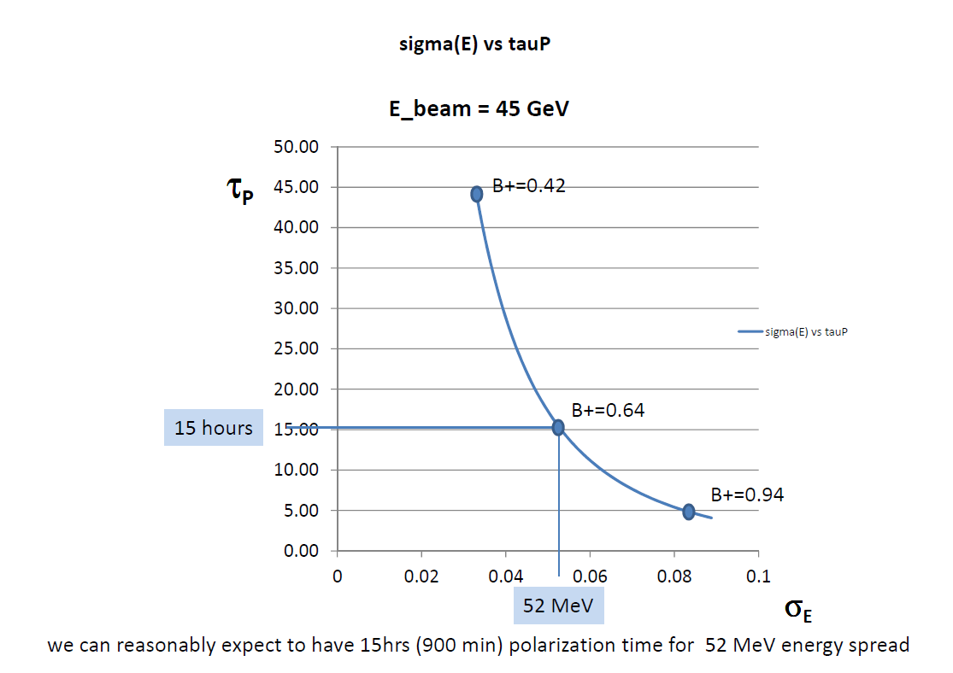
Using 12 LEP-type wigglers
A.Blondel TLEP6 polrization 17/10/2013

Slide 9
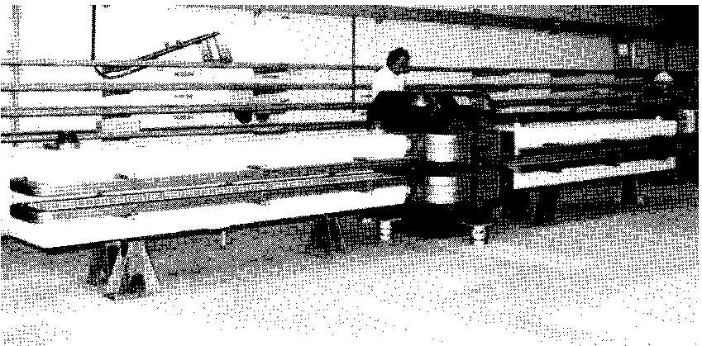
LEP wigglers
Quick and dirty design, troublesome from operational point of view
For TLEP some optimization would be needed
Alain says that changing the wiggler parameters “makes little difference”
← I agree

Slide 10
Wigglers – how much time and power?
Wigglers are essential since natural polarization time is long.
Unfortunately, they also increase the energy spread and contribute to the SR power budget of your machine
Strategy is to use them is such a way that The energy spread is less than some manageable number (so that no resonances are encountered) – defined by Alain to be 52MeV and to switch them on only where necessary
Machine | Energy | No. of wigglers | B+ | Polarization time to 10% | Energy spread | Wiggler SR power | Critical energy
TLEP | 45 | 0 | 0 | 25 hours | 17MeV | 0
TLEP | 45 | 12 | 0.62T | 2.1 hours | 52MeV | 20MW | 0.8MeV
TLEP | 45 | 8 | 0.70T | 2.2 hours | 52MeV | 18MW | 0.9MeV
TLEP | 45 | 4 | 0.87T | 2.3 hours | 52MeV | 14MW | 1.2MeV
TLEP | 45 | 2 | 1.08T | 2.3 hours | 52MeV | 11MW | 1.4MeV
TLEP | 45 | 1 | 1.35T | 2.4 hours | 52MeV | 9MW | 1.8MeV
What about emittance?
Lose ~2h at the beginning of (hopefully) very long fills – can reduce this if lower polarization levels could be distinguished by the polarimeter

Slide 11
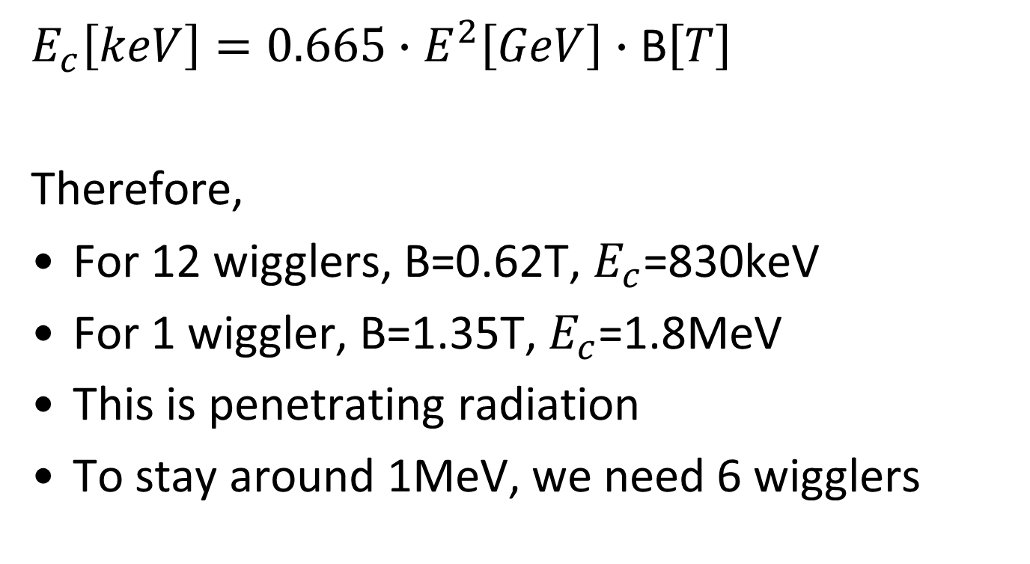
Critical energy of SR photons
$E_{c}\left[keV\right]=0.665∙E^{2}\left[GeV\right]$ $∙$ B$\left[T\right]$
Therefore,
For 12 wigglers, B=0.62T, $E_{c}$=830keV
For 1 wiggler, B=1.35T, $E_{c}$=1.8MeV
This is penetrating radiation
To stay around 1MeV, we need 6 wigglers

Slide 12
Polarization wigglers
5~10% polarization is needed for energy calibration. ~ 1/10 polarization build-up time is needed. Polarization wigglers can further boost the process.
LEP type polarization wiggler is assumed,
B+ / B- = 6.25.
~ 40min to reach 10% polarization.
In partial double ring scheme, a scheme similar to FCC-ee can be adopted. A small fraction of non-colliding bunches, after 45min, every 10min one bunch is depolarized to continuously monitor beam energy.
1 wiggler costs 8% SR power;
2 wigglers cost 10% SR power;
12 wigglers cost 20% SR power.
DUAN, Zhe (IHEP)
Apr 14th, 2016, this conference
Our CEPC colleagues facing the same problem have come up with similar conclusions

Slide 13
The strategy at FCC-ee
Fill with 250 non-colliding bunches (both e+ and e- rings)
Switch wiggler(s) ON. Emittance is increased, orbit length is increased, trim the RF to match.
Wait for 100 minutes as polarization builds up. Power loss due to wigglers negligible
Fill the machine while the wiggler is on (30 mins). Progressively, more power is lost due to SR next to the wiggler, eventually reaching ~10MW.
Now, enough time has passed and the non-colliding bunches have polarized to 5-10%.
Switch wiggler(s) OFF. Emittance returns to normal, orbit returns to normal
Start physics running: measure energy with the RDM every ~6 mins. One non-colliding bunch is lost per successful measurement. Replace it with fresh non-polarized bunch
By the time the 250th bunch has been used up, the earliest new bunch has been polarized to adequate levels.

Slide 14
Conclusions
A clear strategy has emerged.
From power and polarization considerations, one wiggler is better than 12 wigglers (15% more polarization time, but 55% less power consumption) but of SR local irradiation worse
Risks:
  the different tunes of the non-colliding bunches, which need to be kept in the machine together with the high tune shift colliding bunches
  We need to deal with ~1MeV critical energy SR photons

Slide 15
Error analysis

Slide 16
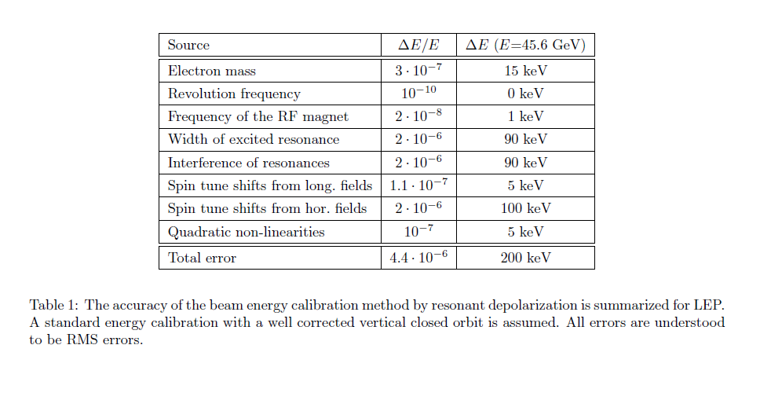
Resonant depolarization accuracy at LEP
Nature of the error
systematic
systematic
statistical
Stat/syst
systematic
systematic
systematic
Total error was given as 200keV per beam
Some of these numbers are upper bounds
Some of these numbers are theoretical estimations which could not be verified experimentally

Slide 17
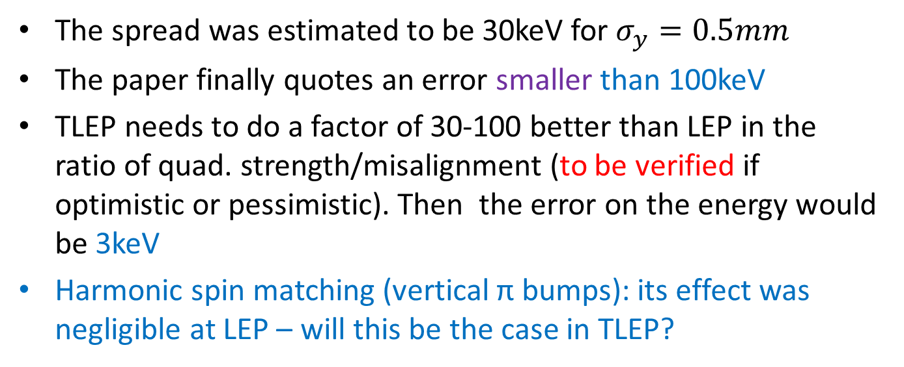
Resonant depolarization accuracy – spin tune shifts
The systematic error of resonant depolarization at LEP was dominated by spin tune shifts due to radial magnetic fields (due to quad misalignement).
nq: number of quads
KL: quad strength
σy : RMS orbit distortion
The spread was estimated to be 30keV for $σ_{y}=0.5mm$
The paper finally quotes an error smaller than 100keV
TLEP needs to do a factor of 30-100 better than LEP in the ratio of quad. strength/misalignment (to be verified if optimistic or pessimistic). Then the error on the energy would be 3keV
Harmonic spin matching (vertical π bumps): its effect was negligible at LEP – will this be the case in TLEP?

Slide 18
Interference between depolarizing resonances
The resonance interference error is the shift of an (artificially excited) spin resonance due to a nearby natural spin resonance
It is actually stated in the text (but not the table) of the paper that the effect is smaller than 90keV.
it has a statistical and systematic component depending on if the excited spin resonance on the right or on the left of the natural resonance.
I will have to assume that most of this error contribution would become statistical (why should we always approach a resonance from the same side?) (to be worked on!)
My assumption: 9keV systematic, 90keV statistical

Slide 19
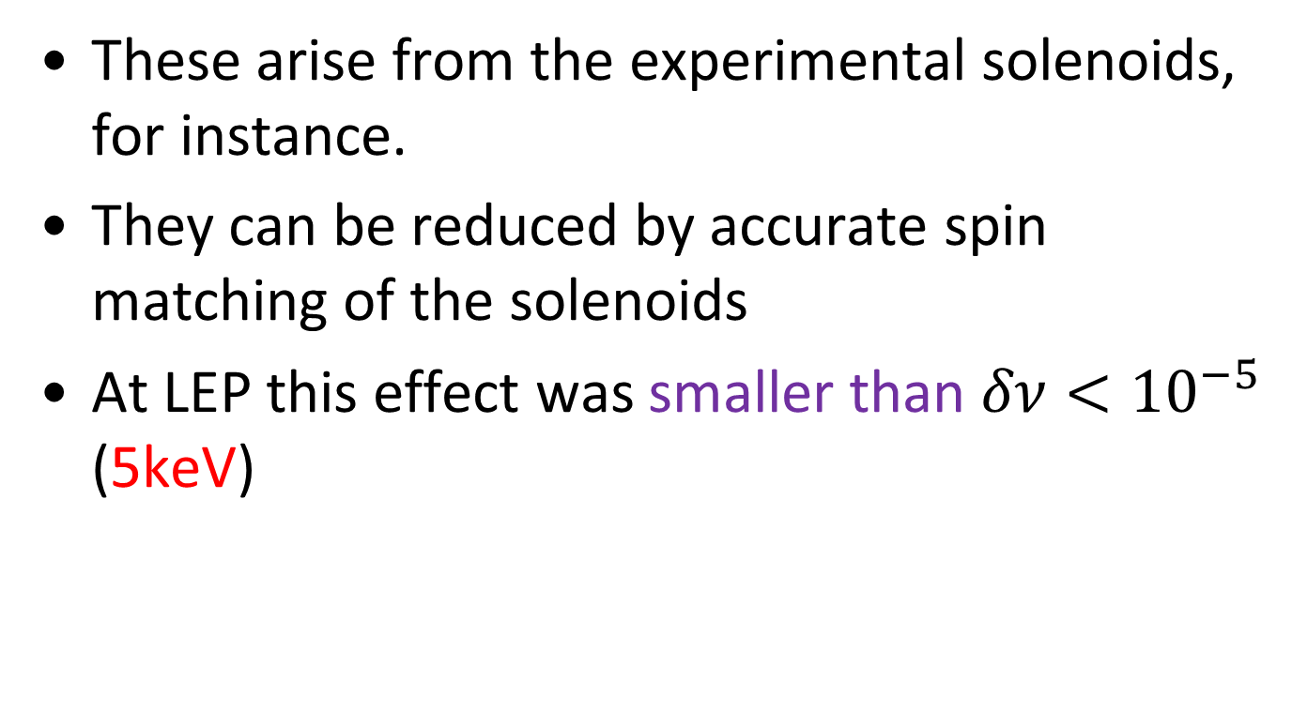
Spin tune shifts due to longitudinal fields
These arise from the experimental solenoids, for instance.
They can be reduced by accurate spin matching of the solenoids
At LEP this effect was smaller than $δν<{10}^{−5}$ (5keV)

Slide 20
Quadratic non-linearities
Small systematic spin tune shifts can occur due to the spin tune spread related to synchrotron oscillations of the individual particles.
For LEP this shift produces a relative error of ΔE/E < 1·10⁻⁷ (~5keV). This was not measured/estimated at LEP, but chromaticity was increased by a factor 10 with no effect in energy.
A study for FCC-ee should be done. In absence of a study, I will use the LEP number

Slide 21
IP-specific corrections plus ECM corrections
Resonant depolarization gives the average energy of the beam through the ring
What we need is the ECM energy per experiment
There are IP specific corrections (due to RF)
There are also corrections when computing ECM from the beam energy (in some specific dispersion scheme)

Slide 22
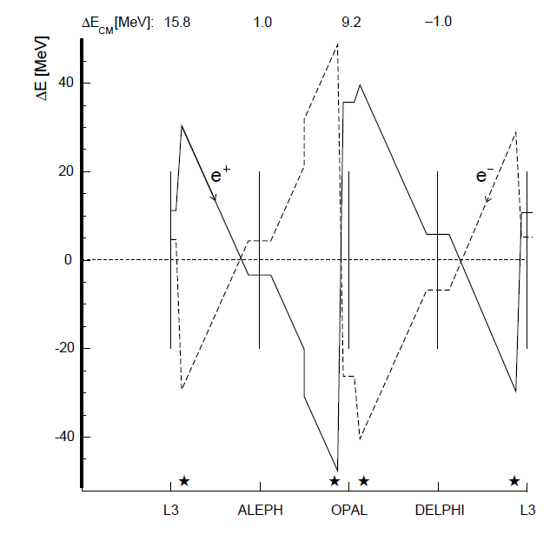
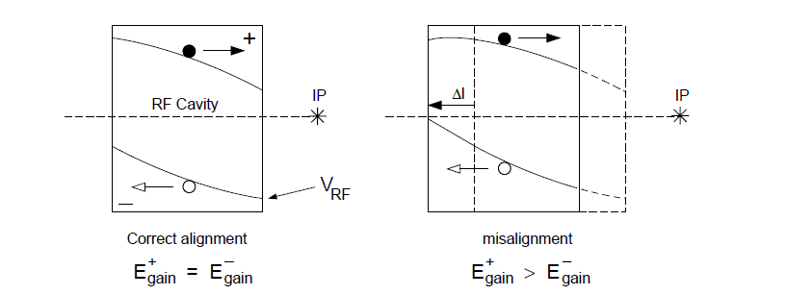
RF corrections
Errors arise due to cavity misalignments primarily:
At LEP cavity misalignment was assumed to be 1.4mm in 1995
Work is needed to reduce this error. For LEP the error was of the order of 500keV (leading to an error of 400/200keV for the mass/width of the Z. Need to reduce this error by (more than) a factor of 10!
This might be the dominant error at FCC-ee

Slide 23

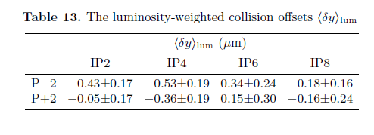
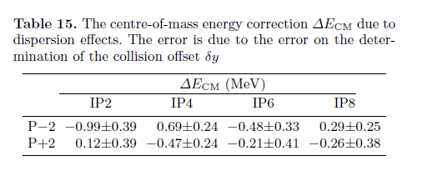
Opposite side vertical dispersion
OSVD introduced a correlation between ECM energy and bunch collision offset
Dispersion difference at the IP was ~2mm
Collision offsets were sub-micron!
To avoid the problem, we should run with zero OSVD!
LEP error (ECM) ~400keV

Slide 24
Resonant depolarization accuracy at TLEP/FCCee – wild extrapolation
Per beam, not ECM
Correlated/Z mass | Uncorrelated/ Z width
15keV | 0keV
0keV | 0keV
1keV | 0keV
1keV | 1keV
9keV | 9keV
5keV | 5keV
3keV | 1keV
5keV | 5keV
~20keV | ~12keV
~40keV | ~20keV
~45keV | ~23keV
IP specific errors
total
Statistical errors are divided by sqrt(10,000) - negligible
This is a zeroth order working hypothesis
The table should eventually also include effects that were negligible at the time of LEP

Slide 25
Energy spread
Total error at LEP was 1000keV translating to 200keV for the Z width
The method used at LEP (which was measuring the bunch length at the IP) cannot be used at the FCC-ee if the crab waist scheme is used
another method should be used: for instance an SR camera at a place of large known dispersion (in the arcs)
Energy spread at the Z is 17MeV. We need a system that can measure this to 0.1% (not the accuracy of individual measurements, but the accuracy of the method) → 20keV per beam translating to 7keV for the Z width

Slide 26
Other effects
If we are planning to reduce the error of resonant depolarization measurements by a large amount compared to LEP, new effects that were negligible back then will make their appearance.
A careful study is called for.
  For example: what is the energy difference between colliding and non-colliding bunches?

Slide 27

W physics
$$σ_{E}∝\frac{E^{2}}{\sqrt{ρ}}$$
In contrast to LEP, adequate polarization levels are expected to exist at the FCC-ee since the energy spread decreases in a larger ring (to be verified)
Analysis will be similar to the Z, and resulting error much smaller than what was achieved at LEP (that had to rely on large extrapolation)
The statistical error is expected to be 0.3MeV (which is a factor of ~100 larger than what can be achieved at the Z- 0.005MeV), so we can be fairly confident that the systematic error due to the energy uncertainty will not be a limiting factor
Polarization time is only ~1.5h for 10% polarization, so wigglers will not be needed

Slide 28
Summary: What accuracies could we aim at?
 | LEP |  | TLEP
measurement | Contribution energy error | Contribution energy spread | Contribution energy error | Contribution energy spread
Z mass | 2MeV |  | ~0.09MeV
Z width | 2MeV | 0.2MeV | ~0.05MeV | ~0.007MeV
W measurements | 25MeV |  | ~0.09MeV
120GeV running | - | - | ~2MeV
Top physics 175GeV | - | - | ~4MeV
All errors at the Z and W are below the 0.1MeV level (but keep in mind that these numbers are not verified by solid measurements/simulations – more like “back of the envelope” calculations

Slide 29
Conclusions
A first attempt to quantify the possible errors due the uncertainty of the energy and energy spread of the machine.
In these “back of the envelope” calculations, errors due to energy on the mass and width of the Z and the mass of the W are below the 0.1MeV level.
This needs to be substantiated by solid work in the field, to be done over the next couple of years.
I hope that we will be able to improve on some of these errors!

Slide 30
End
Thank you

Slide 31
backup slides

Slide 32
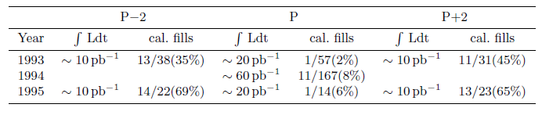
LEP 1993-1995: calibrated fills
Some proportion of fills was calibrated at the end of a fill (64/352)
6 fills had measurements at the beginning and at the end of the fill

Slide 33
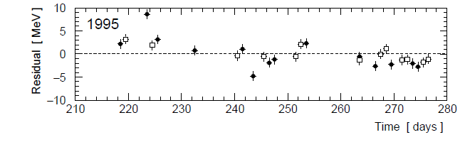
How good was the energy model?
Plot the model prediction versus the real resonant depolarization values. RMS was ~few MeV

Slide 34
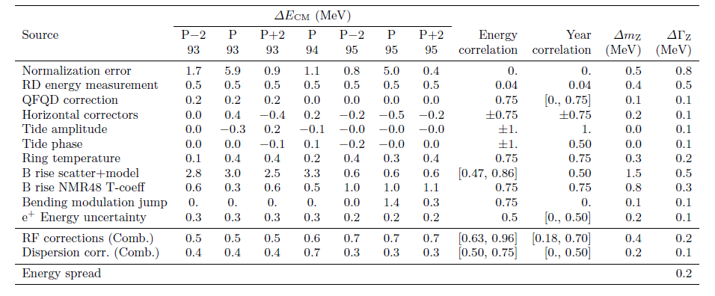
LEP error table (simplified)
Can be reduced by measuring the energy continuously during physics
Can be reduced by measuring the energy of positrons as well

Slide 35
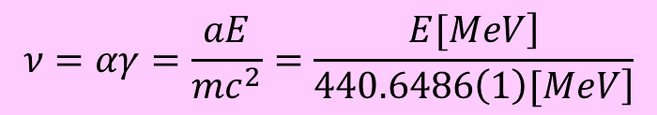
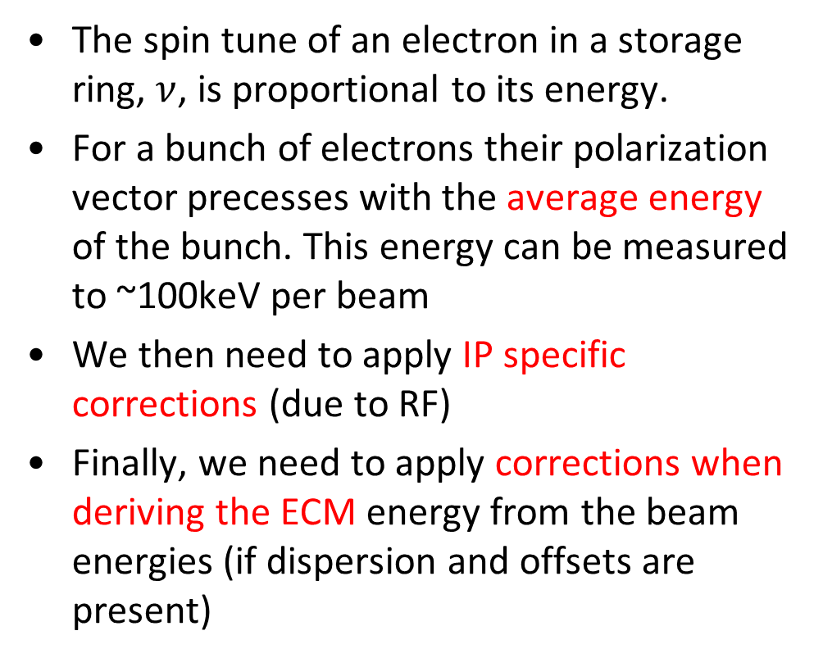
The resonant depolarization method
$$ν=αγ=\frac{aE}{mc^{2}}=\frac{\left.E[MeV\right]}{\left.440.6486\left(1\right)[MeV\right]}$$
The spin tune of an electron in a storage ring, $ν$, is proportional to its energy.
For a bunch of electrons their polarization vector precesses with the average energy of the bunch. This energy can be measured to ~100keV per beam
We then need to apply IP specific corrections (due to RF)
Finally, we need to apply corrections when deriving the ECM energy from the beam energies (if dispersion and offsets are present)

Slide 36
Resonant depolarization measurement
The measurement consists of measuring the spin precession frequency by introducing a resonance in a ‘random walk’ fashion.
  Failure: nothing observed, the frequency used not the correct one
  Success: the bunch depolarizes, the frequency corresponds to the exact energy at that moment
For the measurement one needs levels of polarization of 5-10% (the better the polarimeter, the smaller the value) – I hope we will have a good polarimeter!
One bunch is targeted at a time and one bunch depolarizes per success

