Slide 1


Overview of polarized electron and positron sources
Louis Rinolfi
16th April 2016
X-POL workshop Rome

Slide 2
Contents
General concepts to produce polarized e⁻ and e⁺ beams
Overview of polarized electron and positron sources
Polarized sources challenges for future high energy colliders
Summary
The unpolarized electron and positron sources, with all related challenges are not discussed here.

Slide 3
Method to produce polarized e⁻
Laser
Photocathode GaAS
with superlattice
e- beam
E = 5 - 10 MeV
Electric field
DC
or RF
Cesiated GaAs is the only material for polarized electrons with GaAs/GaAsP superlattice crystal => 95 % polarization possible

Slide 4
Some key parameters for polarized e⁻ source
Photocathode
  High quantum efficiency
  Long life time
Drive laser
  Reliable
  Synchronization with the machine
  Sufficient power
  Wavelength tunable
Vacuum
  Good dynamic vacuum (with beam on)
Electric field
  Avoid break down and field emission

Slide 5
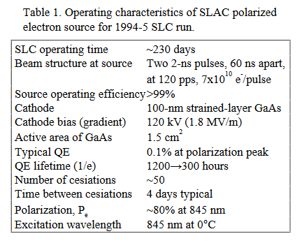
SLC photogun for polarized e⁻
J. Clendenin / SLAC

Slide 6
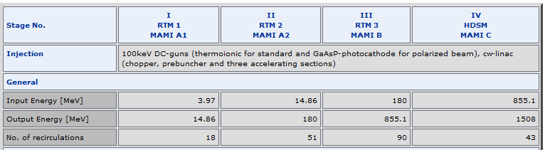
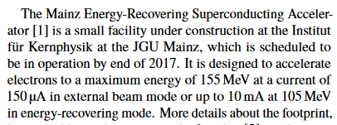
MAMI photogun for polarized e⁻
K. Aulenbacher / Mainz
IPAC 2014 Dresden

Slide 7
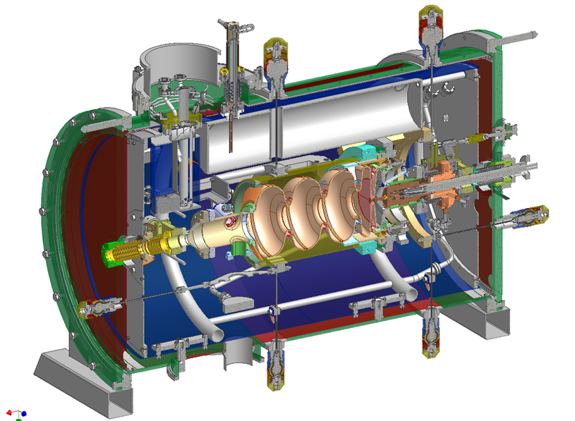
ELBE photogun for polarized e⁻
J. Teichert / HZDR
Superconducting RF gun at Rossendorf
Parameter | ELBE |  | High Charge
final electron energy | ≤ 9.5 MeV
RF frequency | 1.3 GHz
operation mode | CW
Photo cathode | Cs₂Te
bunch charge | 77 pC | 1 nC
repetition rate | 13 MHz | 500 kHz
laser pulse (FWHM) | 4 ps | 15 ps
transverse rms emittance | 1 mm mrad | 2.5 mm mrad
average current | 1 mA | 0.5 mA

Slide 8
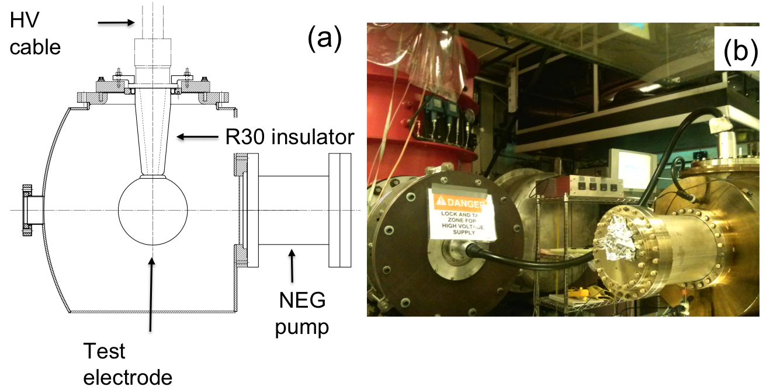
Building 350 kV DC gun at JLAB
500 kV DC gun in Japan
Collaboration KEK / JAEA / Nagoya
Stable operation at 500kV has been confirmed.
10mA beam generation has been demonstrated.
The gun in cERL commissioning shows good performances.

Slide 9
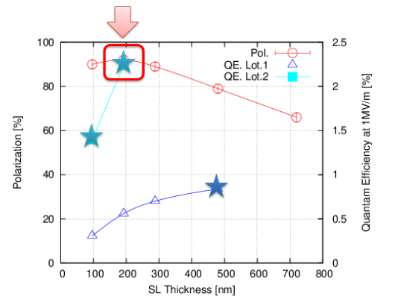
New Strain-Compensated Super-Lattice
N. Yamamoto / Nagoya U.
POSIPOL 2014
500 kV DC gun @ KEK
=> 6.9 MV/m
Achieved results:
Max Pol. 92 %
Max QE 2.2 %

Slide 10
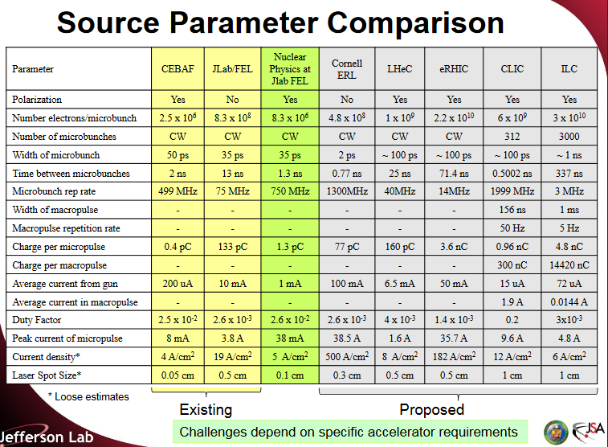
Source parameter comparison
Polarized e⁻ beams
M. Poelker / JLAB

Slide 11
High current beam at Cornell
G. Hoffstaetter /
FCC week 2016 - Rome
Peak current of 75mA (world record)
NaKSb photocathode
High rep-rate laser
DC-Voltage source
Source achievements:
2.6 day 1/e lifetime at 65mA
8h at 65mA
With only 5W laser power (20W are available)
now pushing to 100mA
Simulations accurately reproduce photocathode performance with no free parameters, and suggest strategies for further improvement.
Source current can meet ERL needs

Slide 12

Methods to produce polarized e⁺
Creation of pair production by circularly polarized photons with $ℏω>2mc2$
Radiation from helical undulator
Compton backscattering of circularly polarized laser photons by relativistic electrons
Synchrotron radiation from a dipole magnet
Bremsstrahlung from longitudinally polarized electrons (PEPPo collaboration at JLAB)
We will mention mainly the two first methods

Slide 13
For future high energy colliders
1) Helical undulator
e⁻
e- beam
E > 100 GeV
rays
E = 10 -20 MeV
e⁺
L > 100 m
2) Compton backscattering with laser
Laser
e⁻ @10 Mev => γ @ 10 keV
e⁻ @ 1 Gev => γ @ 10 MeV
e- beam
E = 1 - 6 GeV
e⁻
rays
E = 10 -60 MeV
e⁺

Slide 14
Some key parameters for a polarized e⁺ source
independent of γ rays production (where many challenges exist not discussed here)
Photons impinging on the target
  Energy
  Collimation
Target
  Appropriate Z material
  Thermal stress
  Shock stress
Matching device
  Adiabatic
Radiation issues
  Shielding

Slide 15
Two large colliders ran with polarized e⁺
 | SLC |  | LEP 2
Collider | Linear |  | Circular
Shut-down | 1998 |  | 2000
Max c.m. energy (GeV) | 91 |  | 104
Leptons | e⁻ | e⁺ | e⁻ | e⁺
Polarization at source | Yes ^{DC gun} | No | No | No
Polarization at IP | Yes | No | Yes Self-polarized | Yes Sokolov-Ternov
Number of bunches | 1 | 1 | 4 | 4
Polarization measured (%) | ~ 85 | 0 | ~ 50 | ~ 50
Future lepton colliders (ILC, CLIC, LHeC, CepC, FCC-ee, ….) require polarized e⁺ beams

Slide 16
ILC Positron Source (TDR)
Positron source is located at end of main linac and uses e⁻ beam
Superconducting helical undulator
  K=0.92, λ=1.15cm, (B=0.86T on the axis), aperture 5.85mm
  Max 231m active length
e+ Production Target
  400m downstream the undulator
  0.4 X₀ Ti alloy
Positron Capture: Pulsed flux concentrator + capture RF
    Alternative: quarter wave transformer + capture RF
e+ polarization
  By default: ~30%
  Polarization upgrade possible up to ~ 60% with a photon collimator

Slide 17
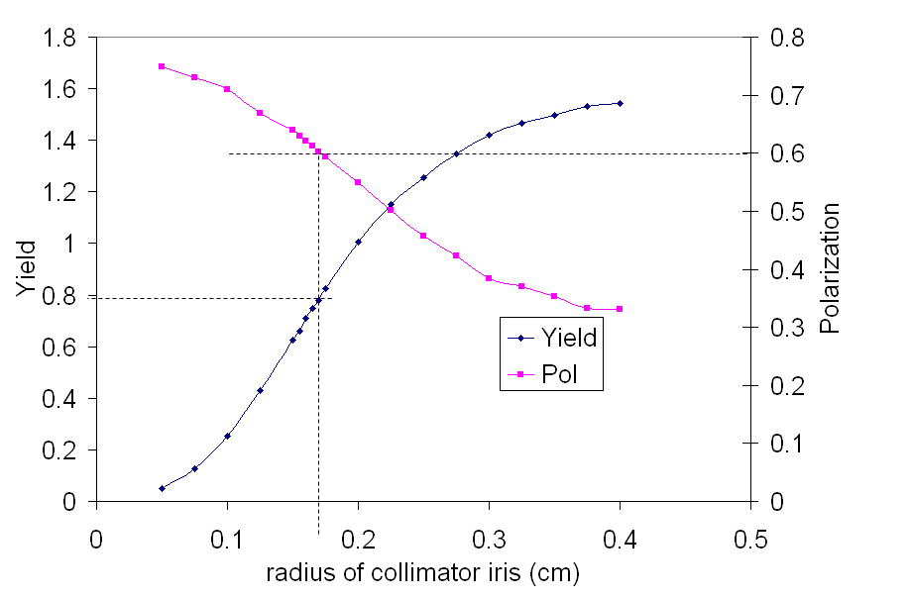
ILC Polarization upgrade
W. Gai / ANL
231m RDR undulator, 150GeV drive beam, ¼ wave transformer
With QWT, with a photon collimator to upgrade the polarization to 60%, the positron yield will drop to ~0.8

Slide 18
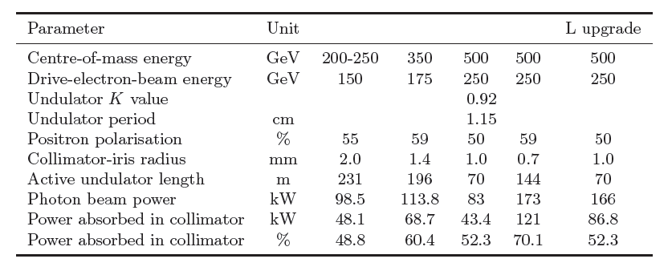

ILC positron polarization
S. Riemann / DESY
Demonstration with E-166 experiment at SLAC
R. Pitthan & J. Sheppard / SLAC
Polarization of 80% was measured
for e⁺ (and e⁻) in the range 4 – 8 MeV

Slide 19
CLIC Positron Source
Compton configuration for polarized e⁺
2.424 GeV
e⁺ DR
20 turns makes 312 bunches with 4.4x10⁹ e⁺/bunch
2.424 GeV
e⁺ PDR and Accumulator ring
C = 47 m, 156 ns/turn, 312 bunches with 6.2x10¹⁰ e⁻/bunch
Injector Linac
2.2 GeV
RF gun
2 GHz
Drive Linac
1.06 GeV
Compton ring
2 GHz
2 GHz
50 Hz
Pre-injector
Linac for e⁺
200 MeV
γ
Stacking cavity
γ (10-20 MeV) 2.1x10⁹ /turn/bunch
e+ 2.6x10⁸ pol. /turn/bunch
1 YAG Laser pulse
e⁺ target
600 mJ

Slide 20
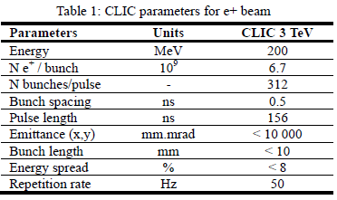
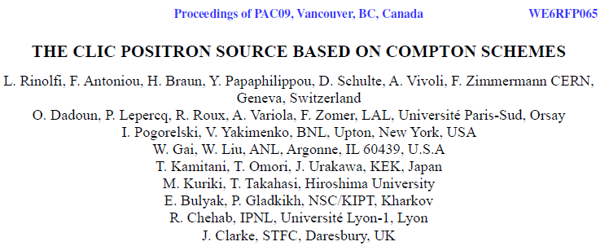
CLIC positron source data
CERN-ATS-2009-086
CLIC Note 788

Slide 21
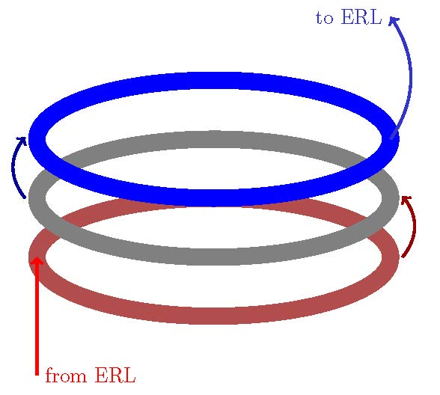
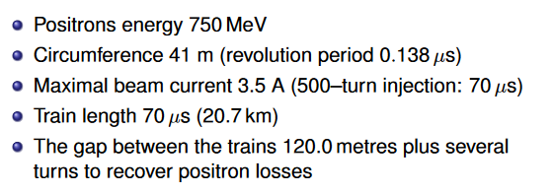
LHeC Positron Source (CDR)
Three rings transformer for polarized e⁺ option
extraction ring (N turns)
fast cooling ring (N turns)
accumulator ring (N turns)
E. Bulyak et al.“Performance of Compton Sources of Polarised Positrons”
Positron for LHeC - Brainstorming workshop - May 2011

Slide 22
Leptons flux comparison for future colliders
 | SLC | CLIC (3 TeV) | ILC (RDR) | LHeC p-140 | LHeC ERL
Energy (@ DR) [GeV] | 1.19 | 2.86 | 5 | 140 | 60
e⁺/ bunch at IP [10⁹] | 40 | 3.72 | 20 | 1.6 | 2
e⁺/ bunch after capture [10⁹] | 50 | 7.6 | 30 | 1.8 | 2.2
Bunches / macropulse | 1 | 312 | 2625 | 10⁵ | NA
Macropulse repet. rate [Hz] | 120 | 50 | 5 | 10 | CW
Bunches / second | 120 | 15600 | 13125 | 10⁶ | 20x10⁶
e⁺ / second (x 10¹⁴) | 0.06 | 1.1 | 3.9 | 18 | 440
x 20
x 65
x 300
x 7000

Slide 23
FCC-ee parameters
Accelerator | FCCee-Z |  | FCCee-W |  | FCCee-H |  | FCCee-tt
Energy [GeV] | 45.6 |  | 80 |  | 120 |  | 175
Type of filling | Full | Top-up | Full | Top-up | Full | Top-up | Full | Top-up
LINAC # bunches | 915 |  | 530 |  | 195 |  | 81
LINAC repetition rate [Hz] | 50
LINAC RF freq [MHz] | 2000
LINAC bunch population [10⁹] | 3.3 | 0.38 | 3.3 | 0.38 | 3.3 | 0.38 | 3.3 | 0.38
# of LINAC injections | 5 |  | 5 |  | 4 |  | 5
SPS/BR bunch spacing [MHz] | 400
SPS bunches/injection | 183 |  | 106 |  | 39 |  | 16
SPS bunch population [10¹⁰] | 1.7 | 0.19 | 1.7 | 0.19 | 1.7 | 0.19 | 1.7 | 0.19
SPS duty factor | 0.5 |  |  |  |  |  | 0.17
SPS / BR # of bunches | 915/4575 |  | 530/2650 |  | 156/780 |  | 81/81
SPS / BR cycle time [s] | 1.2 / 12 |  |  |  |  |  | 1.2 / 7.2
Number of BR cycles | 50 | 9 | 10 | 2 | 7 | 2 | 3 | 1
Transfer efficiency | 0.8
Total number of bunches | 91500 |  | 5260 |  | 780 |  | 81
Filling time (both species) [sec] | 1200 | 216 | 240 | 48 | 168 | 48 | 43.2 | 14.4
Injected bunch population [10¹⁰] | 1.7 | 0.19 | 1.7 | 0.19 | 1.7 | 0.19 | 1.7 | 0.19

Slide 24
Flux for FCC-ee
 | SLC | LEP 2 | FCC Z | FCC W | FCC H | FCC tt
Energy (GeV) | 1.19 | 104.5 | 45.5 | 80 | 120 | 175
e / bunch after capture (10⁹) | 45 | 155 | 3.3 | 3.3 | 3.3 | 3.3
Bunches / macropulse | 1 | 4 | 915 | 530 | 195 | 81
Repetition rate (Hz) | 120 | 0.004 | 50 | 50 | 50 | 50
e / second (x 10¹⁴) | 0.06 | 0.0023 | 1.5 | 0.9 | 0.3 | 0.1
x 25
Max requested flux is between CLIC and ILC => would be OK

Slide 25
Summary
Polarized electron sources for future high energy colliders:
1) The proposed electron source will depend on the accelerator requirements.
2) Polarized electron source implies photoemission. The choice is between DC versus RF.
3) Today the electron source technology is mature, nevertheless many stimulating problems still need be solved.
4) For FCC-ee, the requested flux and polarization level would be reachable.
Polarized positron sources for future high energy colliders:
Today the requested flux and polarization present several challenges with the present technology but it would be doable.
For FCC-ee, test facilities and experimental measurements are strongly recommended to check the performance of polarized electron and positron sources.

