Slide 1
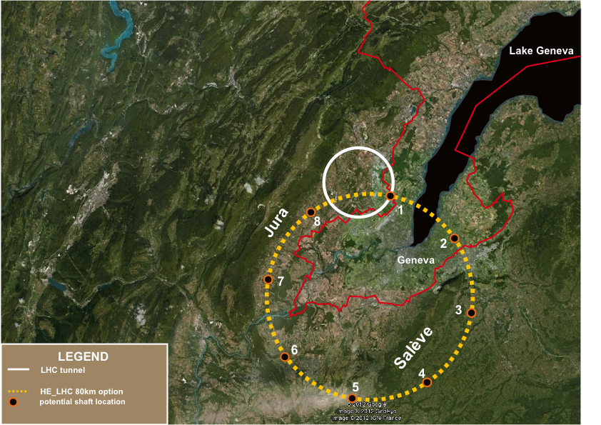
LEP and FCC-ee
Beam Polarization and Energy Calibration
Keil
Jowett
Wenninger
Buon
Hofmann
Placidi
Assmann
Koutchouk
and many others!

Slide 2
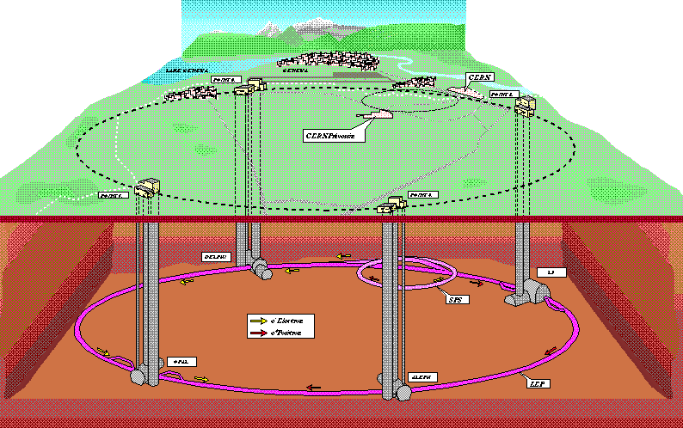
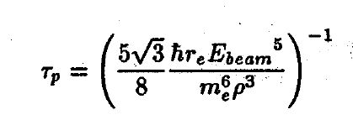
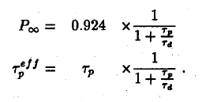
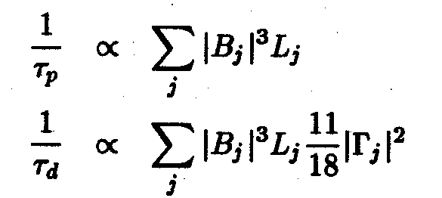
LEP (1989-2000) first observation of P⊥ in 1990
first resonant depolarization in 1991
=310 minutes
at 46 GeV
Spin tune at the Z peak : 103.5
The scan points 101.5 / 103.5 / 105.5 are perfect optimum for Z width meast
Spin tune for W threshold 183.5

Slide 3
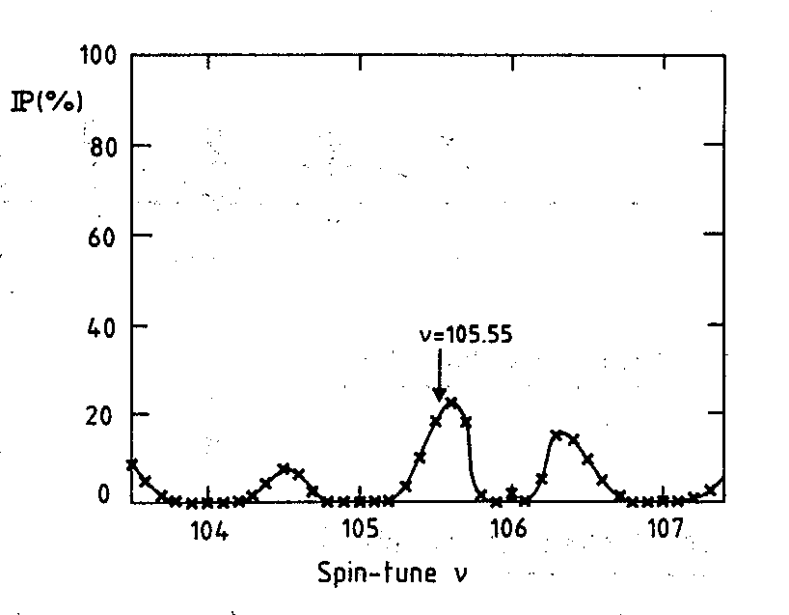
Self polarization:
a priori expectations were O(5-20%)
depending on imperfections (Koutchouk)
At beginning of LEP a layer of nickel in beam pipe
caused a strong xy coupling – taken out in 1990
Polarization measurement with a back scattered
frequency doubled Nd-Yag laser (528 nm)

Slide 4
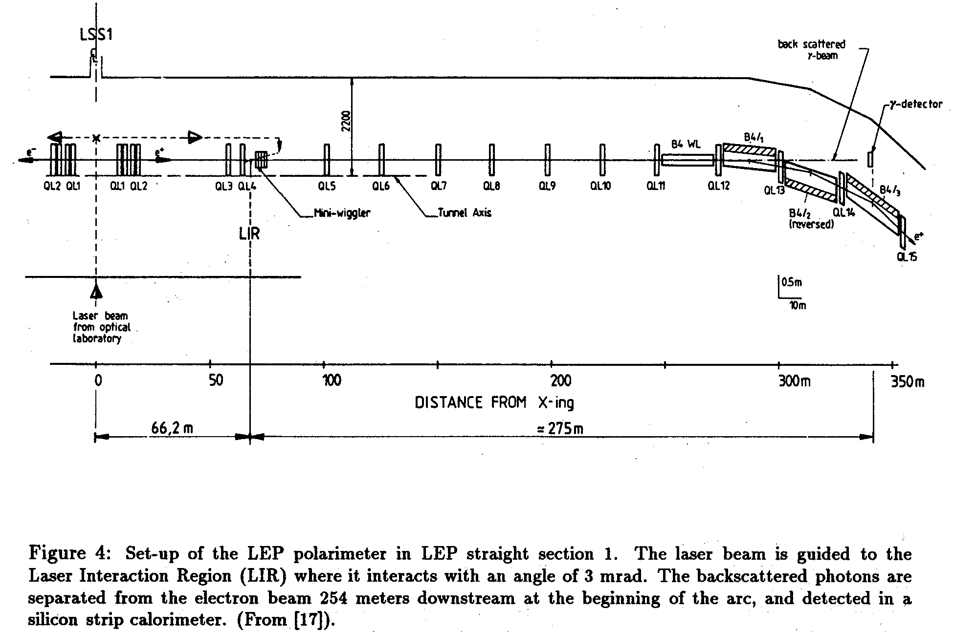

Slide 5
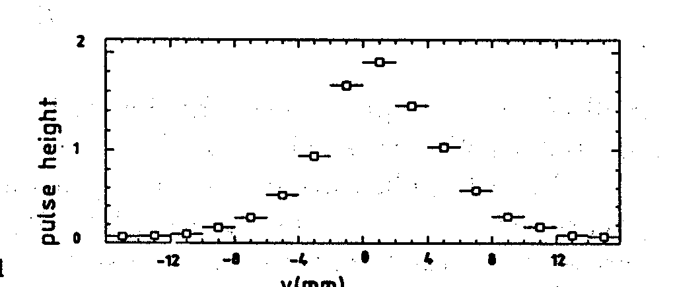
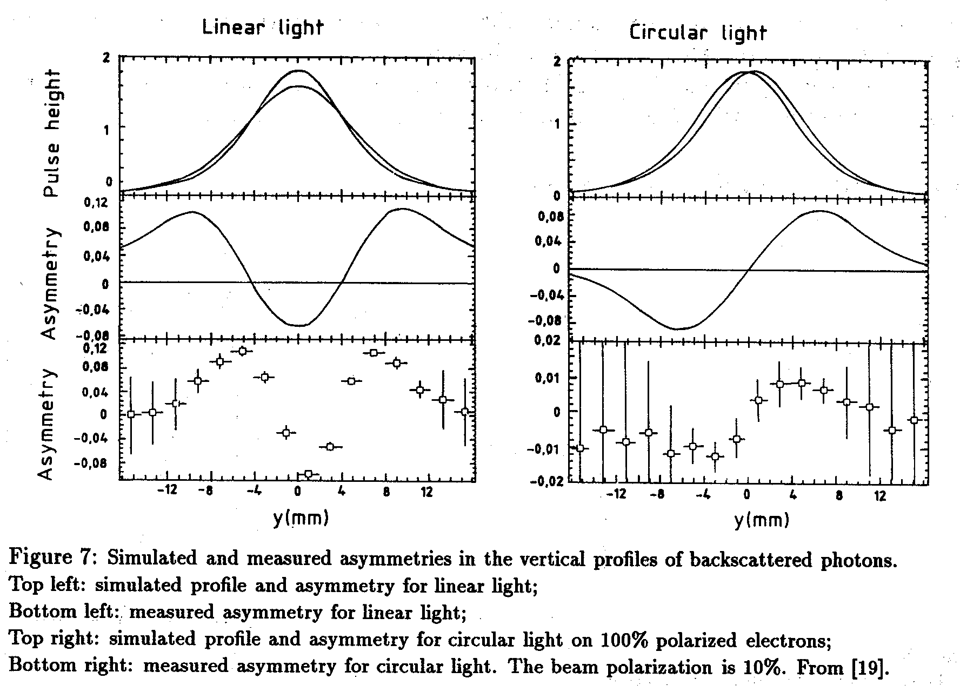
in FCC-ee emittances are much smaller and
profile should be narrower.
displacement upon inversion
of circular light is a measure of
the vertical polarization

Slide 6
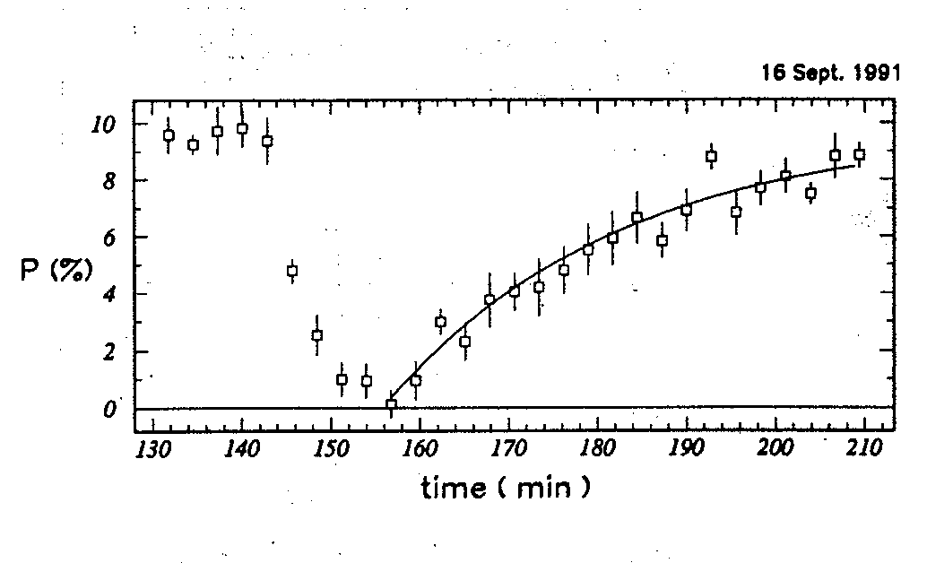
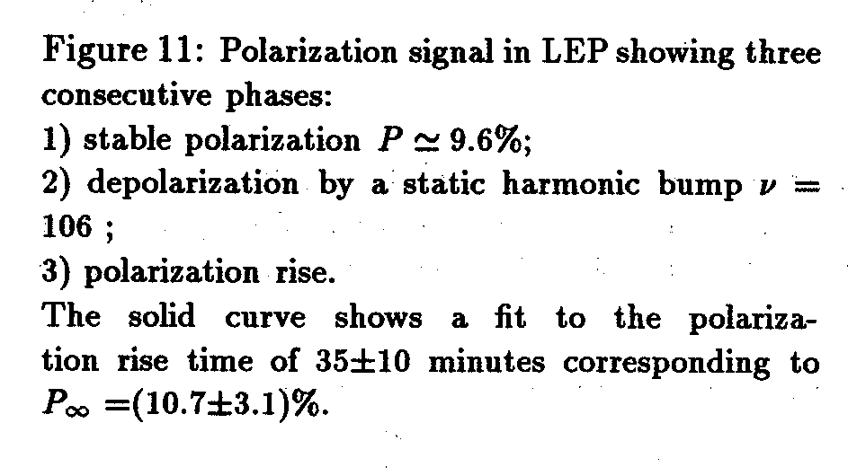
depolarization by a static harmonic bump
and polarization rise.

Slide 7
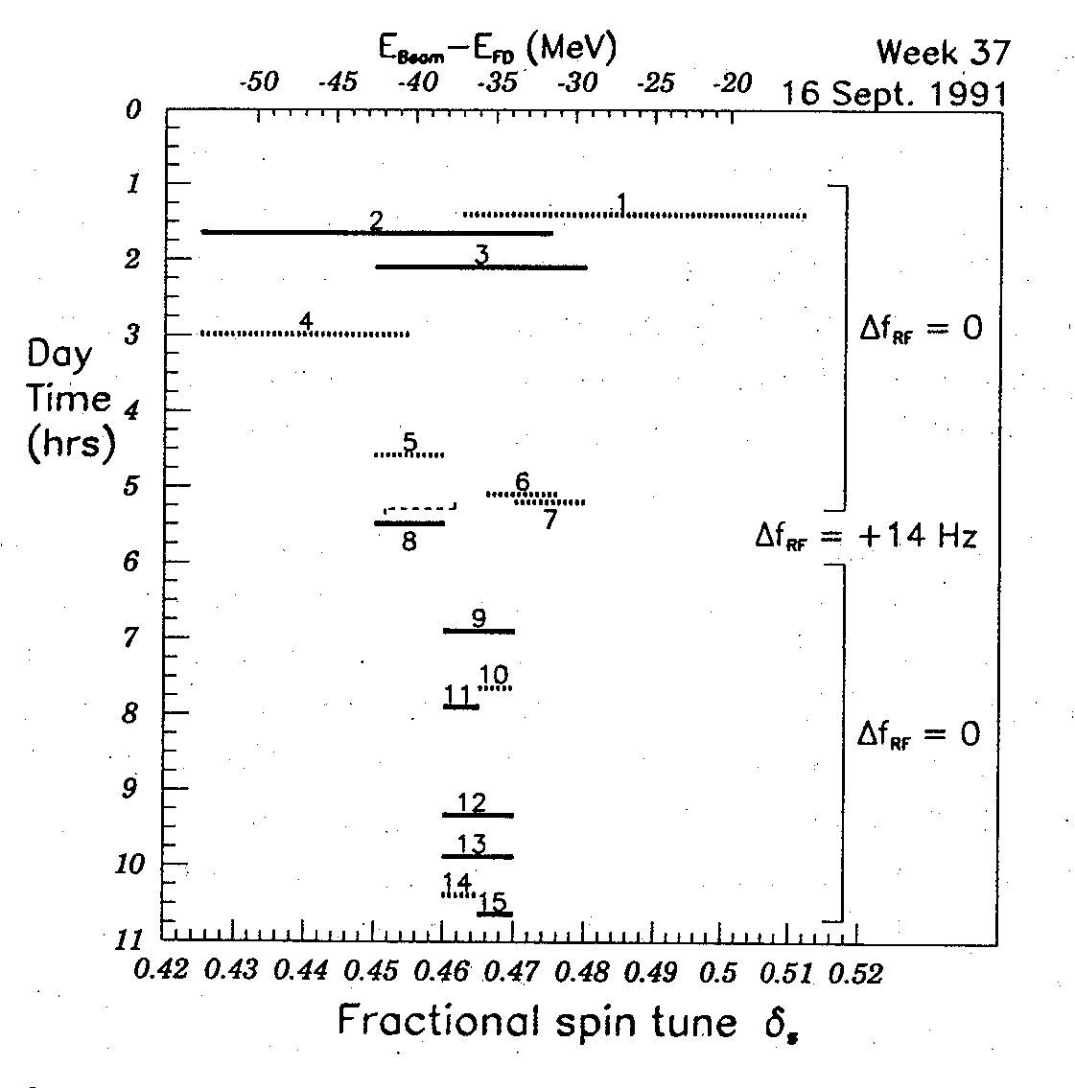
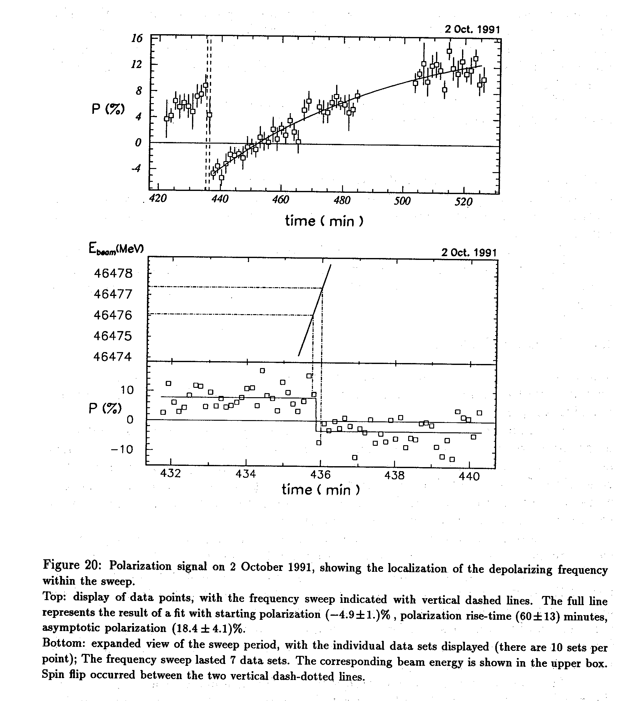
Resonant depolarization, 1991
variation of Rf frequency
to eliminate half integer
ambiguity

Slide 8
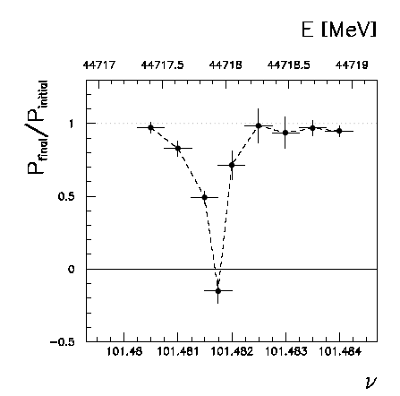
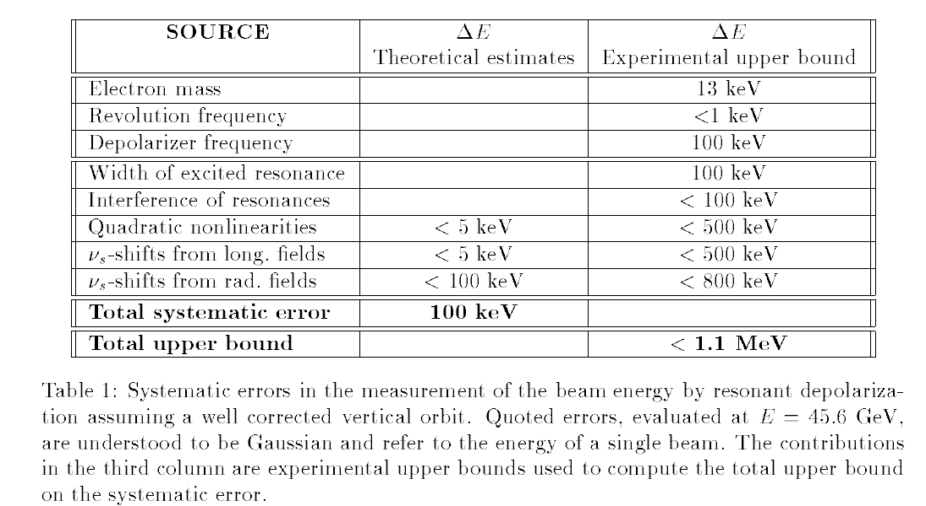
in 1995 we pushed the measurement
to «high precision» (100 keV)
spin tune

Slide 9
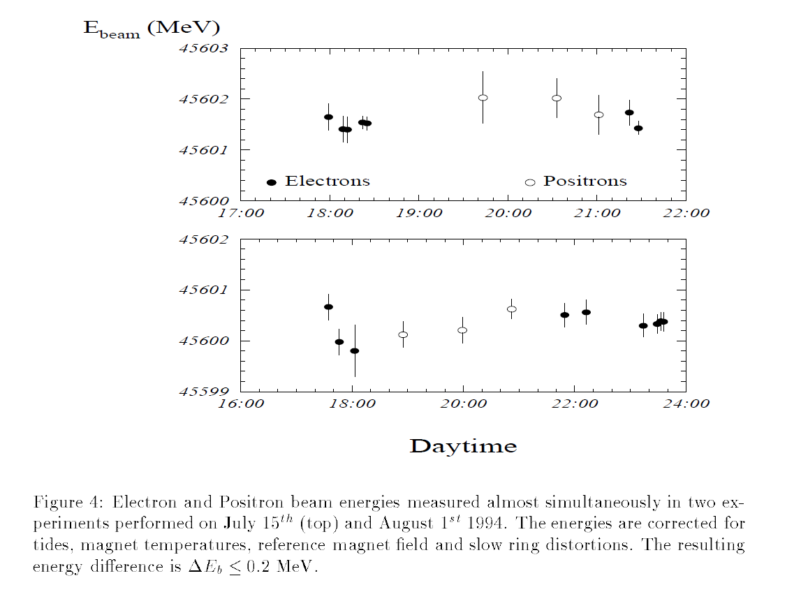

Slide 10
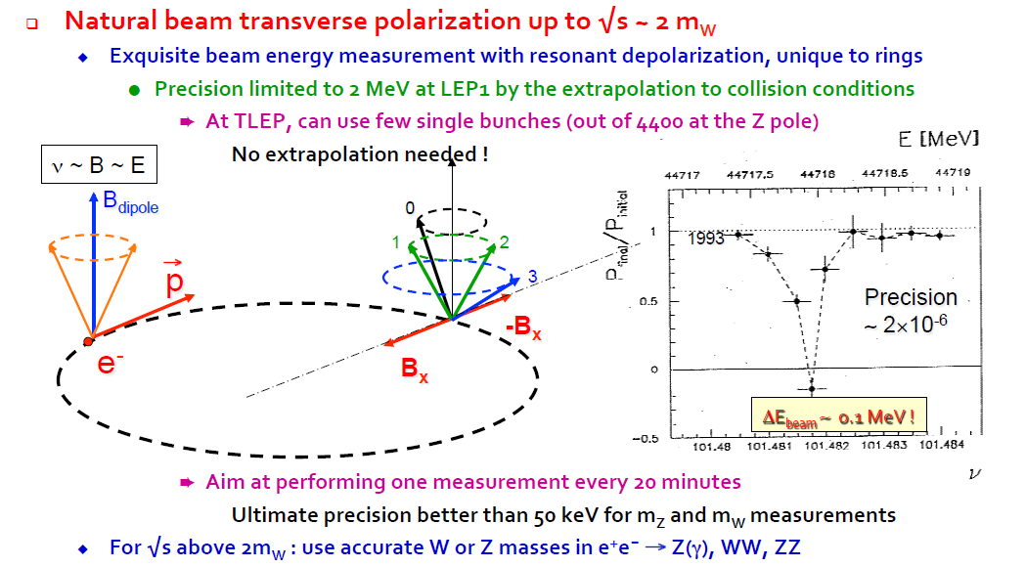
... and no e+
polarimeter!
should revisit the uncertainty and the method to understand how much better
we can do.
Also how practical is it to co-exist
‘polarized single bunches’ with ‘top-off injection’

Slide 11
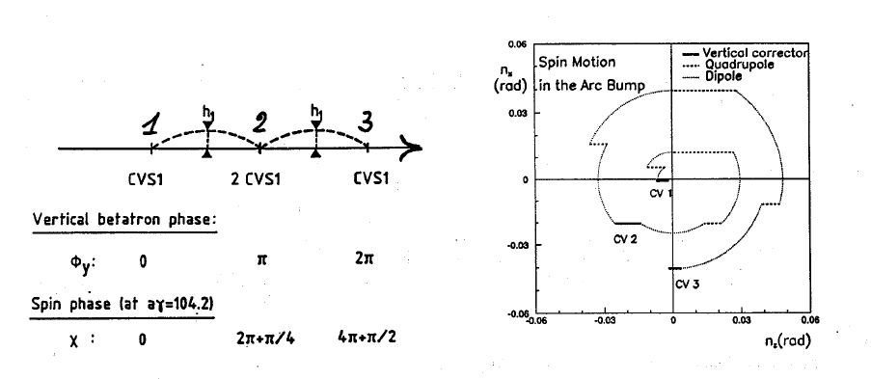
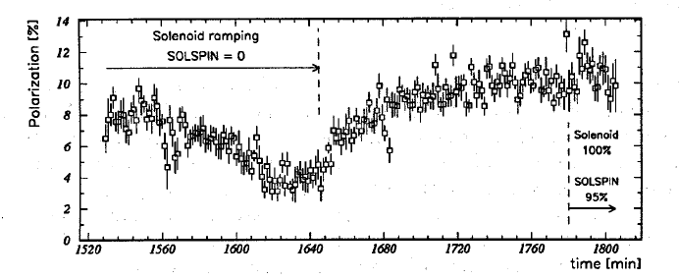
Spin corrections
In order to disturb the experiments as little as possible we compensated the solenoids
BL=10Tm
$\hat{n}$ vertical
experimental
verification

Slide 12
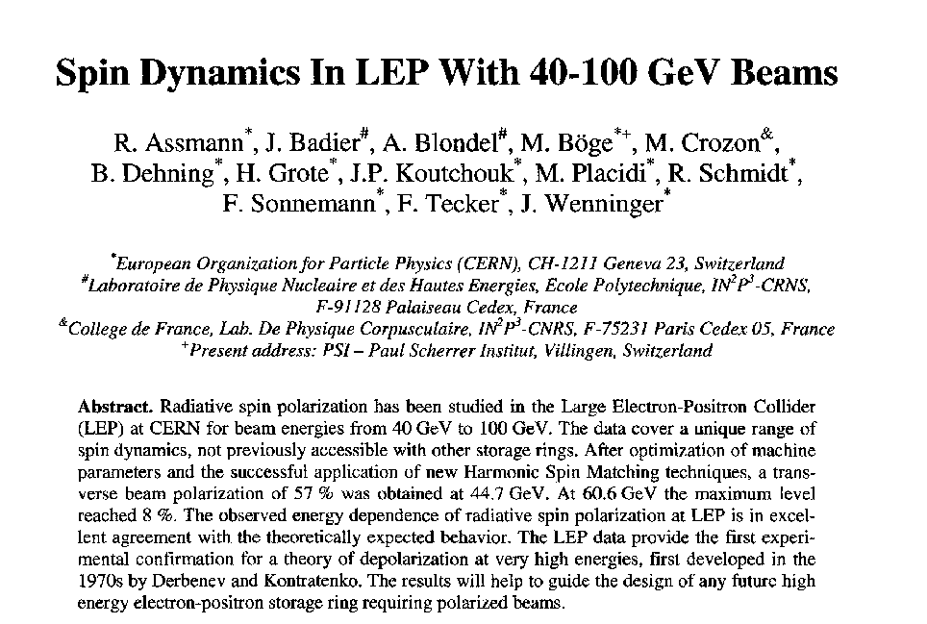
What we know from LEP on depolarizing effects
http://dx.doi.org/10.1063/1.1384062
AIP Conf. Proc. 570, 169 (2001) Spin 2000 conf, Osaka

Slide 13
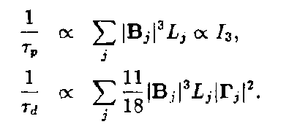
can be improved by increasing
the sum of |B|³ (Wigglers)
can be improved by ‘spin matching’
the sources of depolarization can be separated into harmonics
(the integer resonances) and/or into the components of motion:
receipes:
-- reduce the emittances and vertical dispersion δη
→ this will be done at TLEP to reduce beam size!
-- reduce the vertical spin motion δn →harmonic spin matching
-- do not increase the energy spread

Slide 14
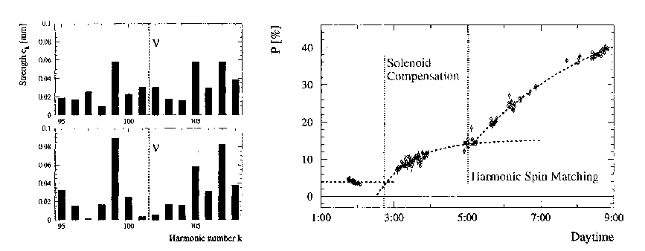
examples of harmonic spin matching (I)
Deterministic Harmonic spin matching :
measure orbit, decompose in harmonics, cancel components near to spin tune. ☺ NO FIDDLING AROUND.
This worked very well at LEP-Z
and should work even better at TLEP-Z if orbit is measured better.

Slide 15
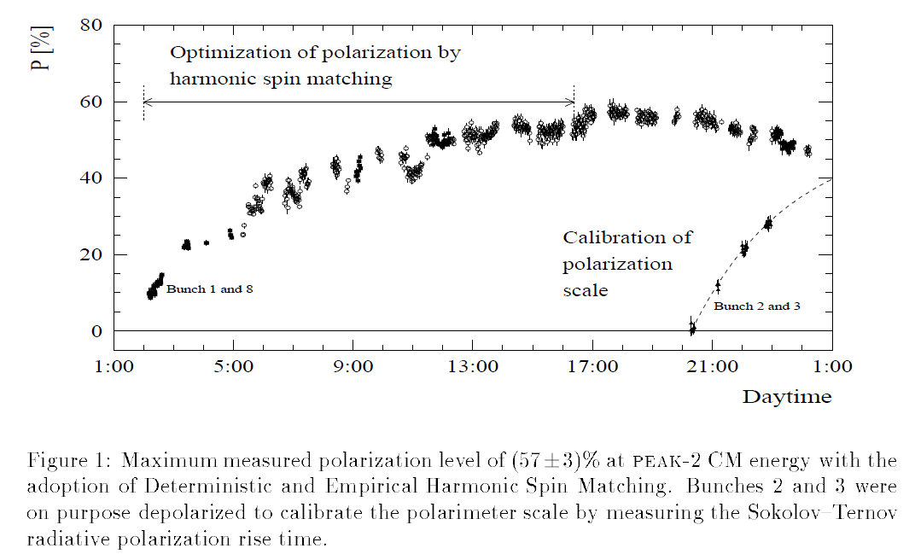
NB high level of polarization requires constant adjustments to remain.

Slide 16
examples of harmonic spin matching (II)
When all else fails, empirical spin matching: excite harmonics one by one to measure directly their effect on polarization and fit for pole in 4-D space.
Here 8% polarization at 61 GeV.

Slide 17
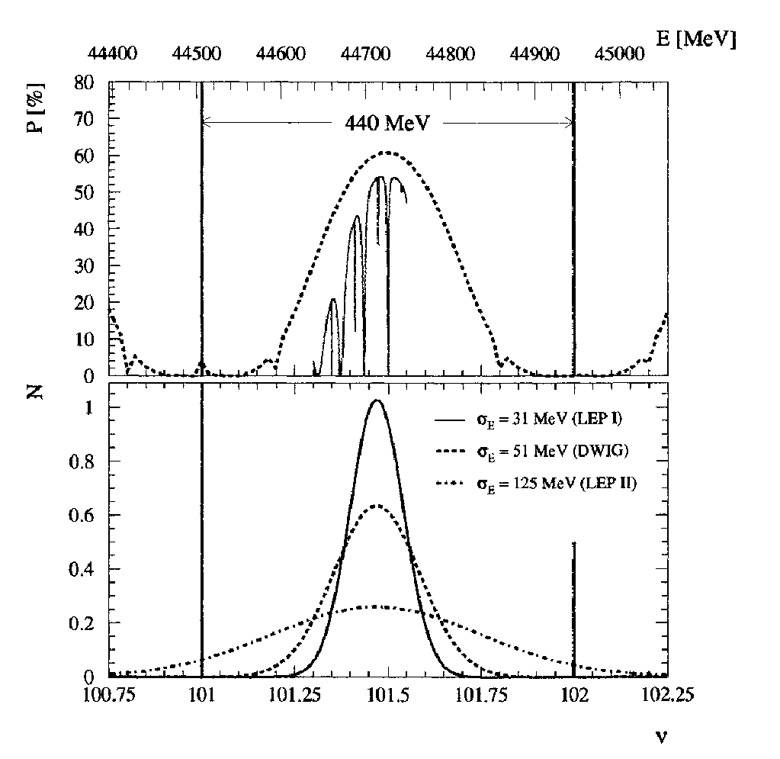
The energy spread really enhances depolarization

Slide 18
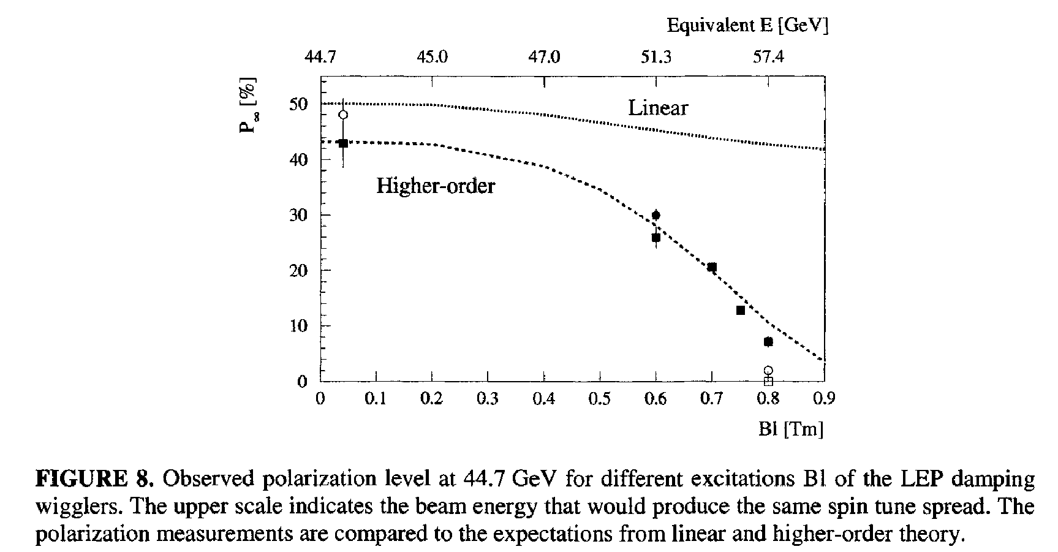
effect of energy spread on Polarization in a given machine was studied using the damping wigglers

Slide 19
These observations were consistent with the hypothesis that
energy spread drives the synchrotron resonances.
We were able to keep the polarization as long as σ_{E} < 56 MeV.
In a larger ring the energy spread is smaller ☺
But the polarization time is much longer.

Slide 20
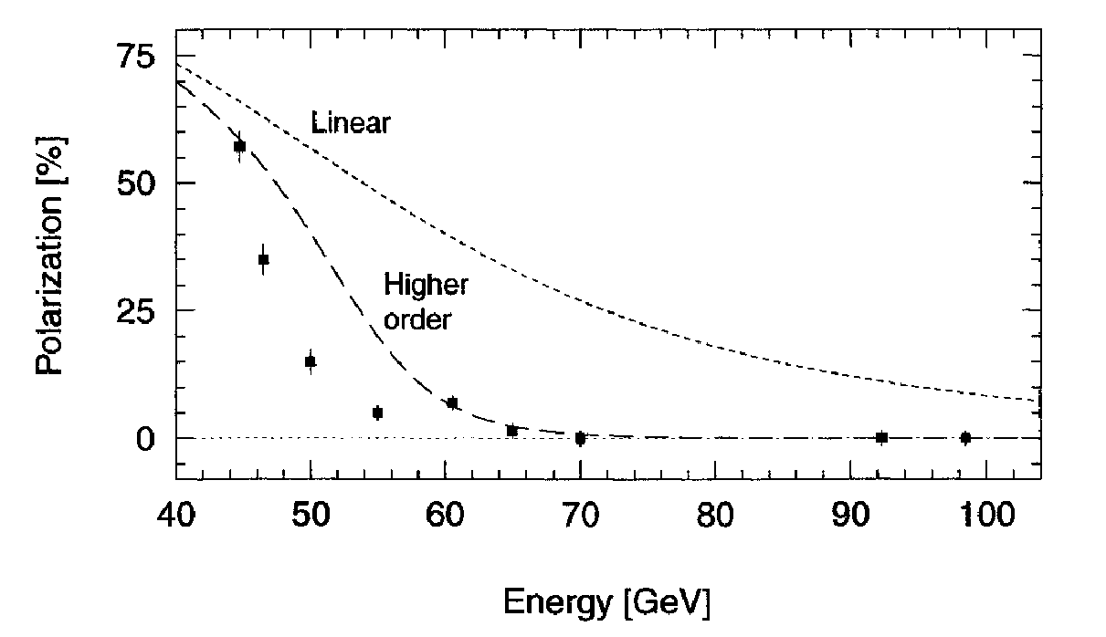
σ_{E} ∝ E_{b}² / √ρ
The good news is that polarization in LEP at 61 GeV corresponds to
polarization in TLEP at 81 GeV
➔ Good news for M_{W} measurement (see E. Gianfelice’s presentation)

Slide 21
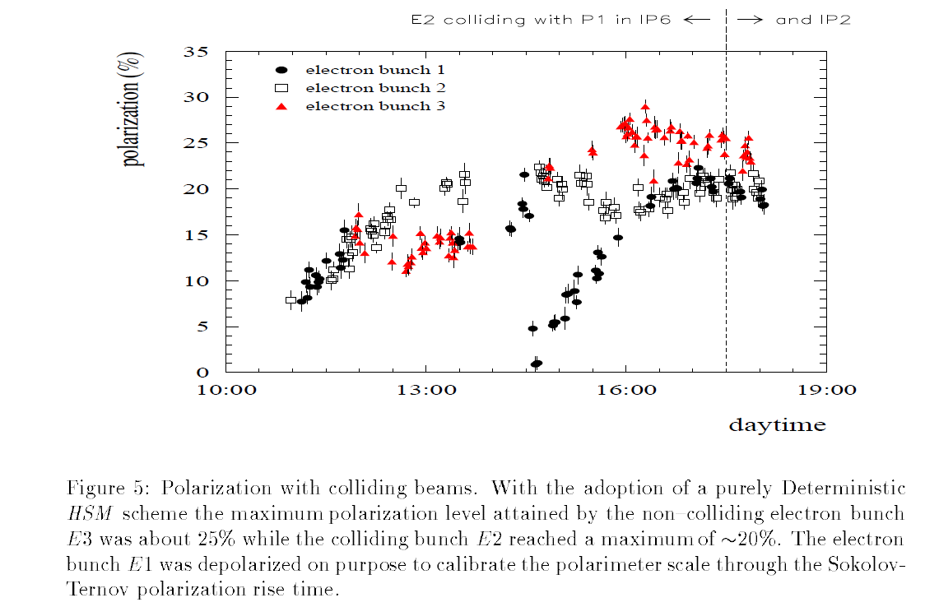
Polarization in collisions
CERN-SL-26-021
v = 101.5
11-1994
ξ_{y} = 0.04

Slide 22
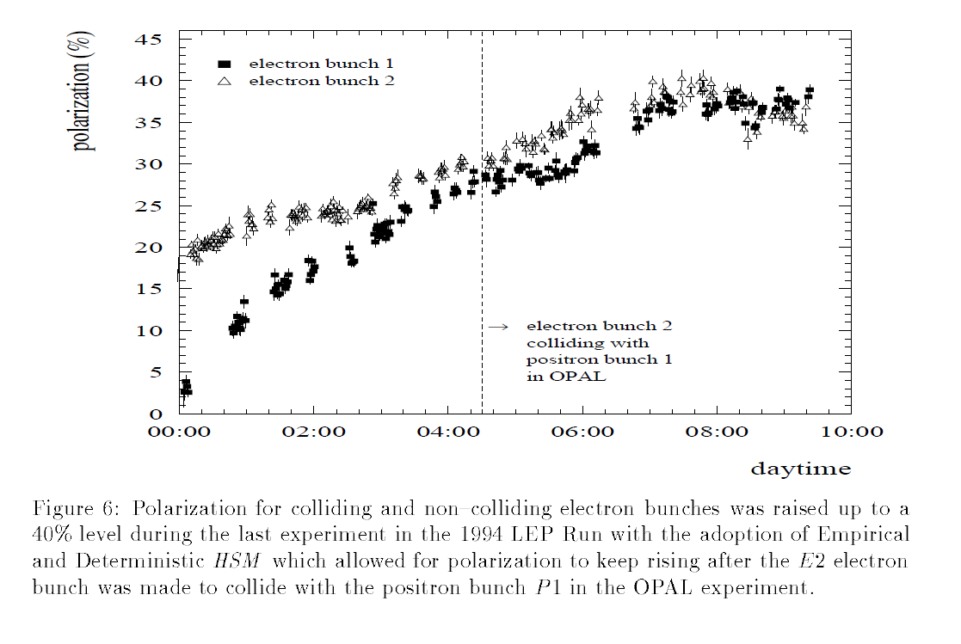

Slide 23
Beam beam depolarization is not very large. < 0.65
Alone, and for one exp. it would have limited the polarization to ~55%
Predictability is low.

Slide 24
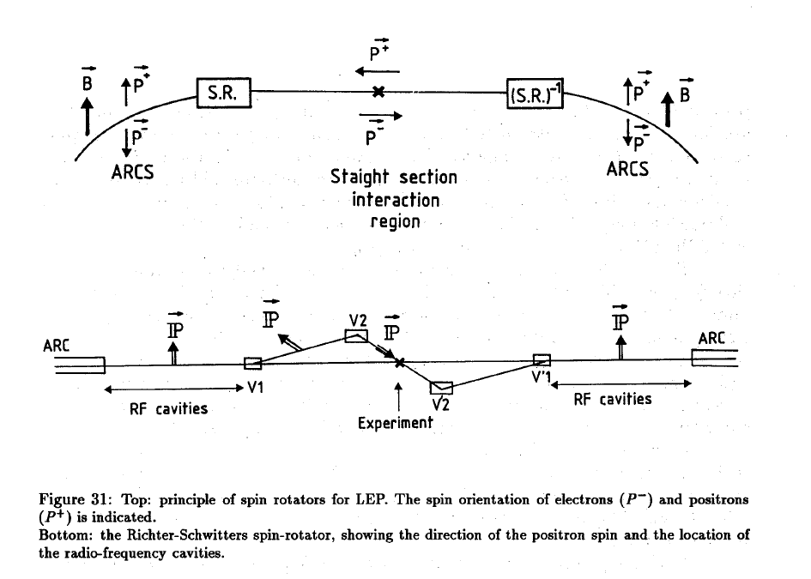
Longitudinal polarization at LEP?
scheme developed in 1988 see A.B. CERN-PPE-93-125

Slide 25
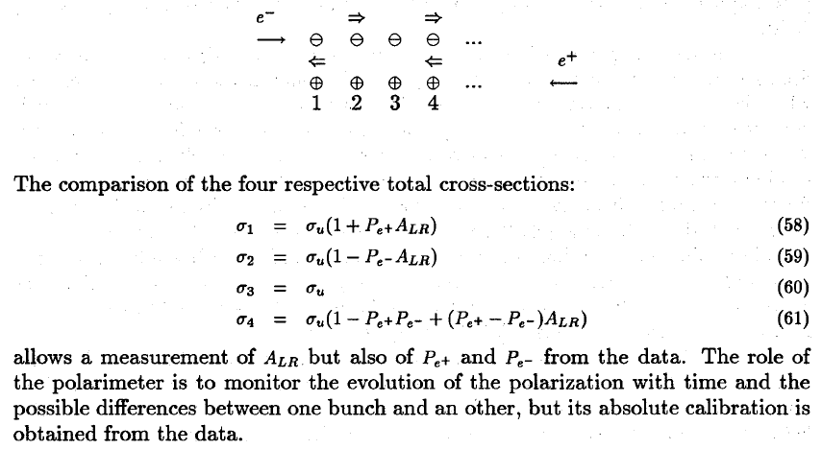
measuring the polarization asymmerty:
requires (continuous) depolarization of selected bunches
e+ and e- polarimeter
bb tune shift not too large. → probably at least factor 4 loss in Luminosity.
Did not happen under pressure from LEP2, then LHC

Slide 26
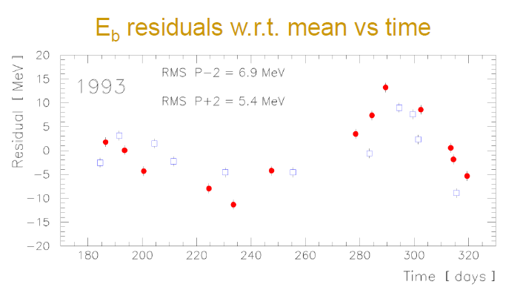
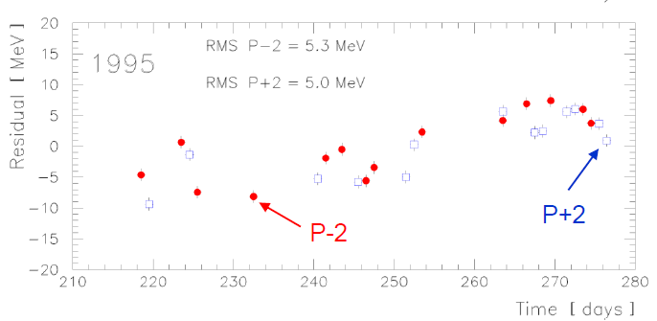
Energy calibration for physics
The main goal was to measure the Z mass and width. in 1993 and 1995 data were
taken at three energy points with spin tune 101.5/103.5/105.5
where resonant depolarization could be applied.
(To my great frustration the solenoid compensation was not applied
and we could not measure the polarization during data taking. )
The energy measurements were taken at the end of the physics fills,
which were very long: LEPI was beam-beam limited and the luminosity
would remain constant -- or event improving – for up to 10 hours.
The energy calibrations showed important residuals.

Slide 27
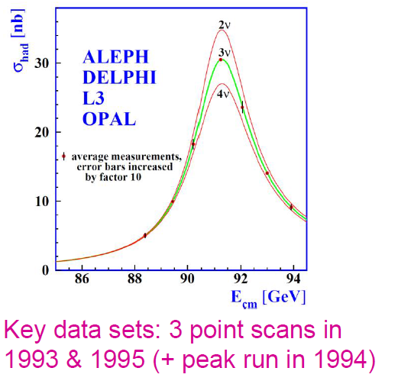

Slide 28
Energy calibrations at LEP
Intrinsic calibration was established to be better than 100 keV per beam
at the time of the measurement.
Long term stability was found to not be better than 5 MeV
It was found and demonstrated that it was affected by gound motion
and electric effects
Ground motion:
-- tides
-- level of the lake
-- rain on the Jura
Electric effects:
-- trains

Slide 29
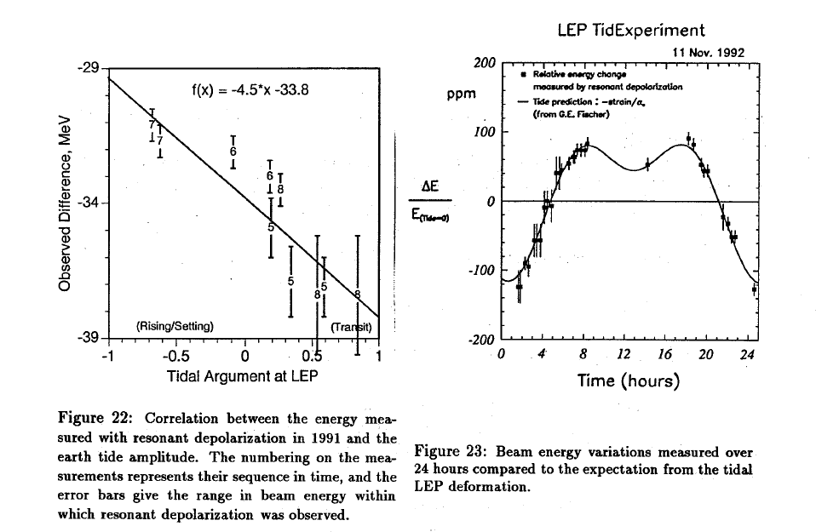

Slide 30
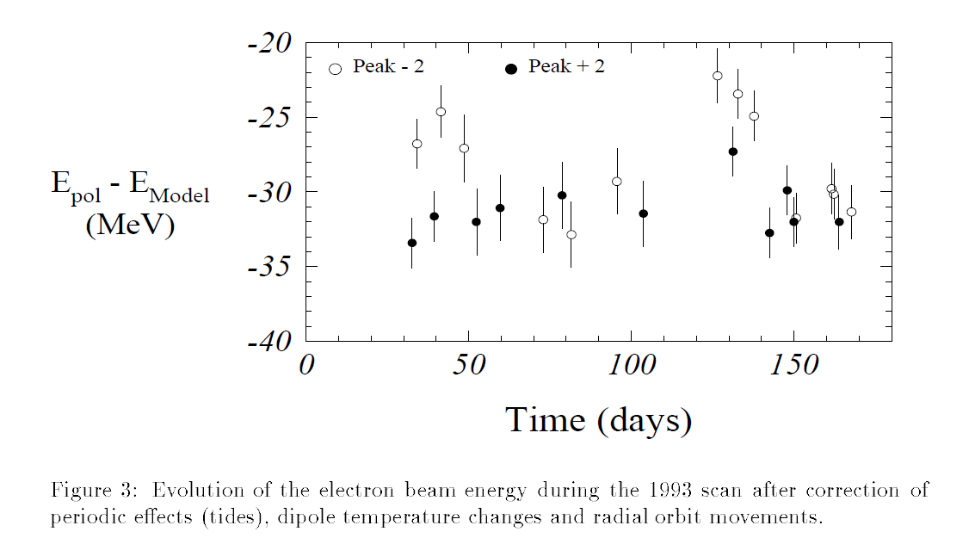
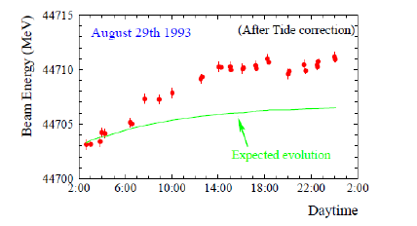
still after corrections for tides there were large fluctuations.
a drift during a long MD fill
-- beyond tides –
was cause of concern
for 2 years….

Slide 31
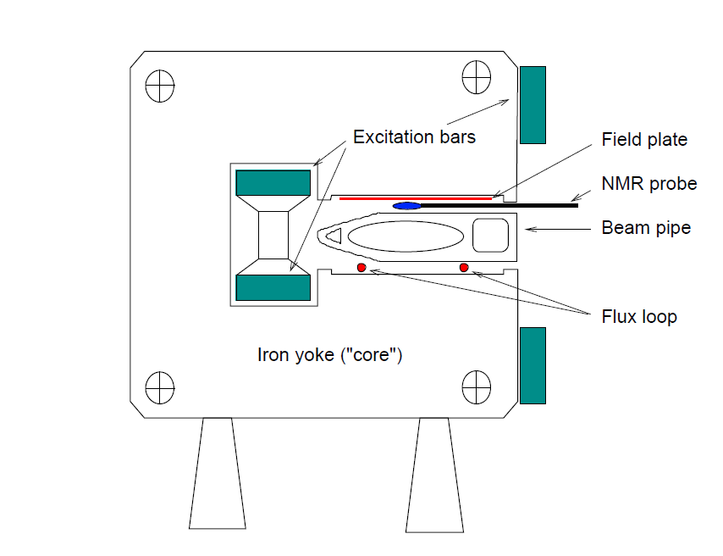
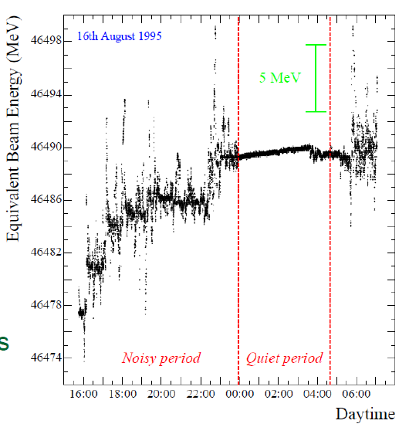
in 1995 NMR probes were installed
inside two magnets on the ring
and the observations were striking:
the field rises during the fills!
in 1996 14 more NMRs were installed
→ two per octant

Slide 32
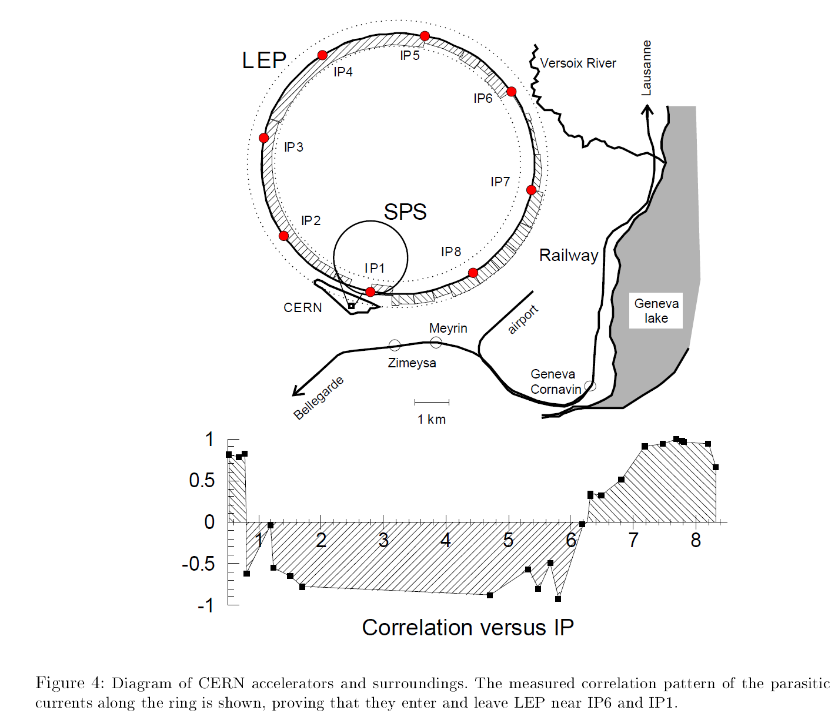
Measurements
of the current flowing
on the LEP beam pipe
showed a strange
correlation pattern
as if current
flowed from point 1
to point 6 in the two
arcs at the same time
The culprit was found
to be the TGVs

Slide 33
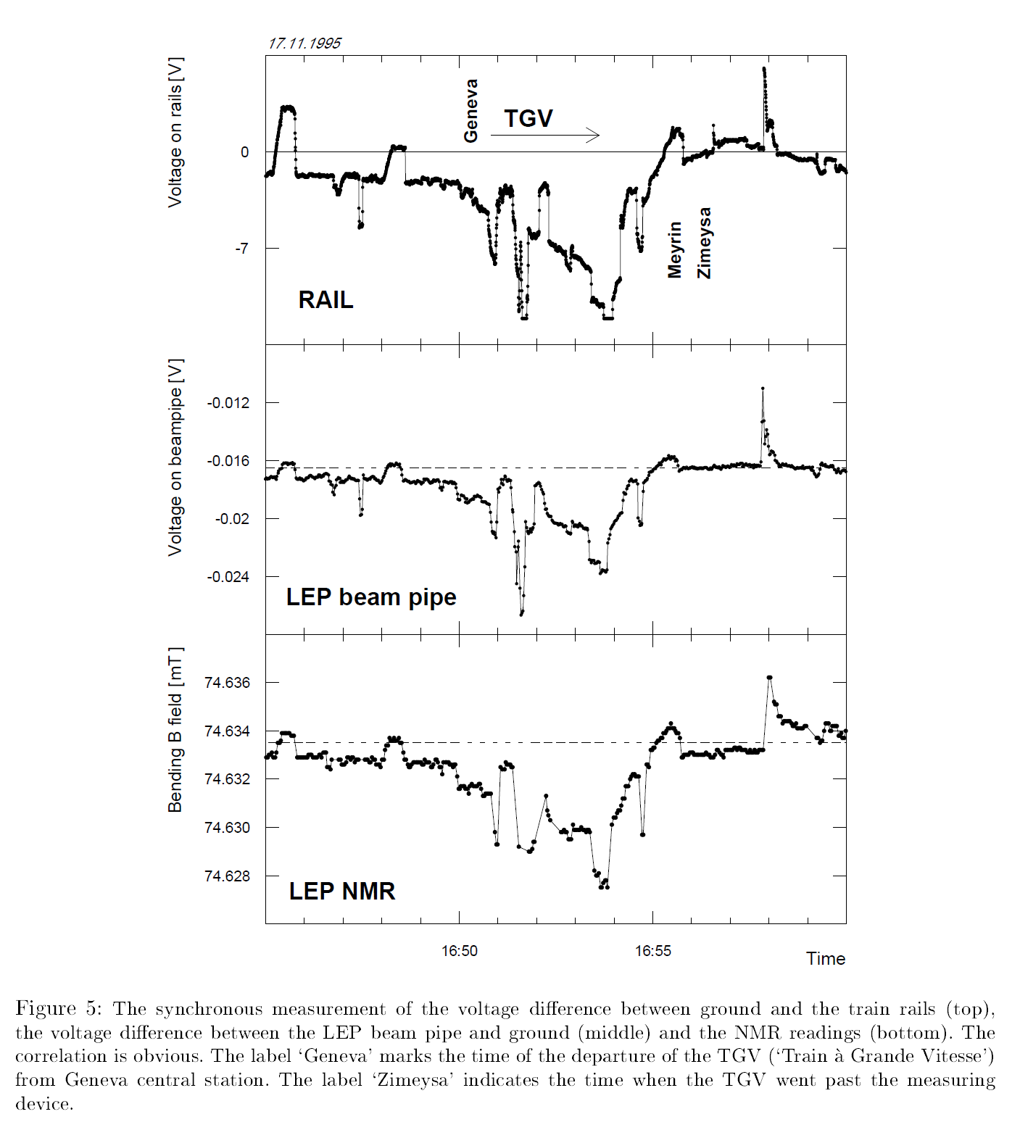

Slide 34
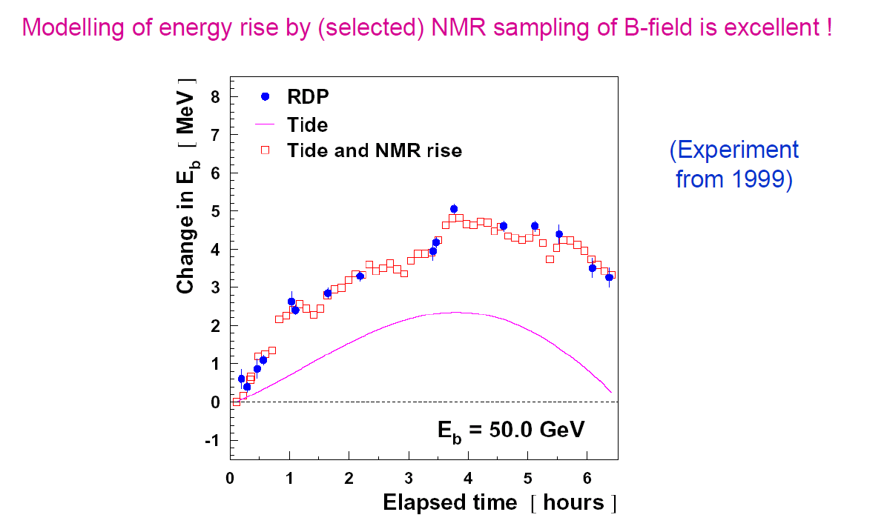
by 1999 we had an excellent model of the energy variations…
but we were not measuring the Z mass and width anymore
– we were hunting for the Higgs boson!

Slide 35
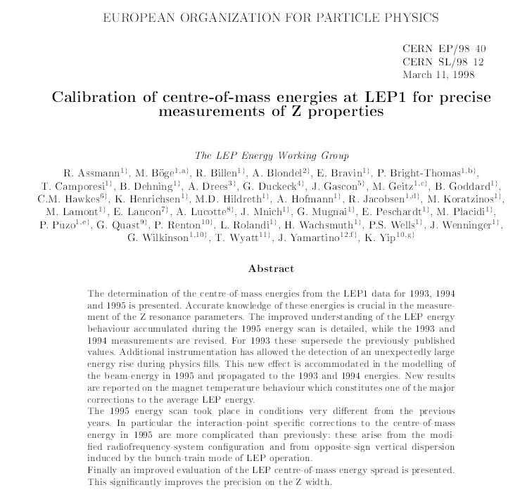

Slide 36
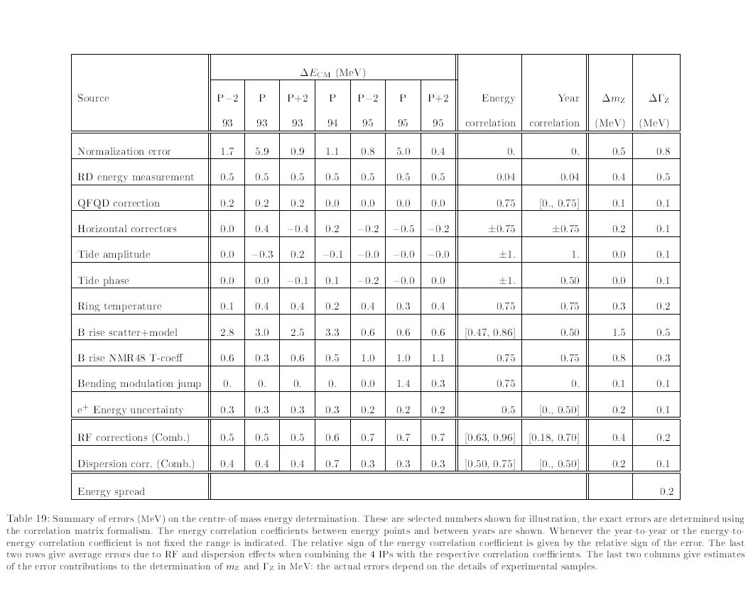
Final table of errors on the LEP center of mass energies
see M. Koratzinos for analysis

Slide 37
Conclusions and outlook for FCC-ee
Polarization was ‘easy’ to achieve at LEPI and could be improved to ~55%
by means of harmonic spin matching.
Deterministic (based on orbit measurements)
or Empirical (based on polarization itself)
Spin bumps were π+π bumps and worked well (do not generate much dispersion)
Polarization was possible as long as beam energy spread < ~55 MeV
2. resonant depolarization (RD) calibration could be achieved
with precision of < 100keV on beam energy
3. for physics use, many problems arose because RD was not done during physics
-- tides, ground motions, trains etc… had to be discovered and corrected
a posteriori. Time consuming and loss of information.
-- in my personal opinion this is a result of excessive separation
between accelerator and particle physics worlds
-- but also because procedure was delicate and not automatized.

Slide 38
G. Wilkinson

Slide 39
For FCC-ee
the energy calibration with resonant depolarization is given naturally
an essential ingredient for the energy calibration
needs to keep a few 100 bunches polarized and not interacting
-- since top-up with unpoarized beams would destroy polarization
4. needs polarimeters for both e+ and e-
5. life should be made easier by smaller beams and modern beam diagnostics
6. continuous monitoring of B field and polarization needed
7. probably complementary compensation of solenoids needed
8. Given the high statistics longitudinal polarization is not required
-- the same information can be obtained otherwise
9. list o required equipemnt to bbe established.
10 possible issue with RD at the Higgs if v is integer.
11. a complementary measurement at similar level of precision could be useful
if simple enough

Slide 40
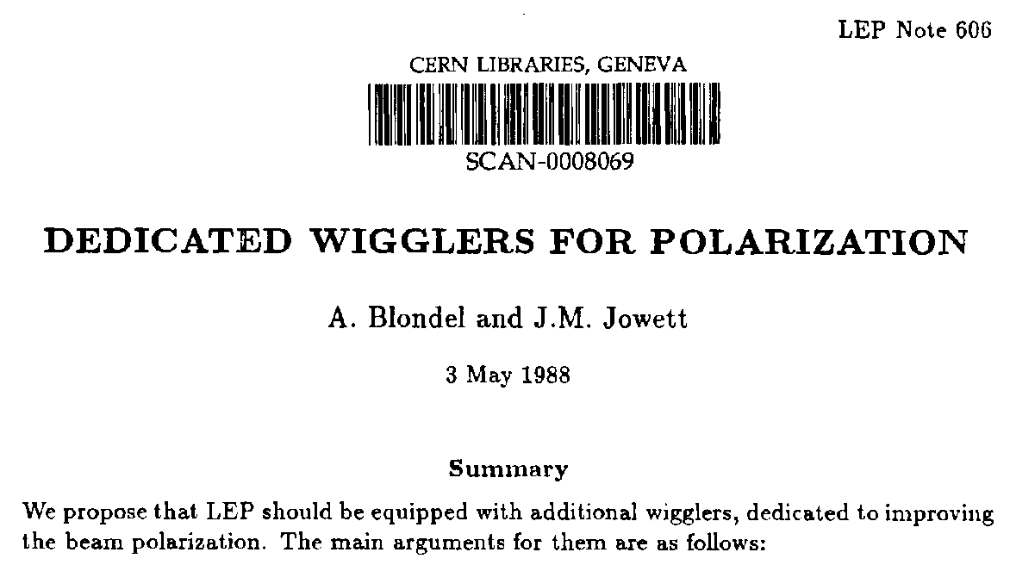
Use of polarization wigglers at TLEP

Slide 41
FOREWORD How the sausage was made...
In order to evaluate the effect of wigglers and top-up injection on TLEP polarization performance, I have generated two spread sheets
1. the first one calculates the energy pread and polarization time in TLEP assuming a bending radius of 10km for a circumference of 80km, and the presence of the 12 polarization wigglers that were built for LEP as calculated in LEP note 606 (Blondel/Jowett)
2. the second one folds the achived polarization performance with top up injection, given the luminosity life time and the regular injection of unpolarized particles.
The variable parameters are
-- B+ : field in the positive pole of the wigglers
-- beam energy
-- luminosity lifetime
-- and of course Jx but I have refrained to play with it. (one would want it as small as possible)

Slide 42
Energy spread (Jx=1) LEP TLEP
beam energy sigma(E) tau_P sigma(E) tau_P
45 GeV no wiggs 32 MeV 5.5 hrs 18 MeV 167 hrs
45 GeV wigglers 46 MeV 2.4 hrs 58 MeV 12 hrs
55 GeV no wiggs 48 MeV 1.96 hrs 26 MeV 61 hrs
61 GeV no wiggs 59 MeV 1.1 hrs 33 MeV 36 hrs
81 GeV 58 MeV 8.9 hr
➔ ☹ annoyingly: with wigglers at TLEP, the energy spread is larger than at LEP,
for a given polarization time.
consider somewhere between 48 and 58 MeV as maximum acceptable for
energy spread*). Take 52 MeV for the sake of discussion.
Note that wigglers make energy spread worse faster at TLEP (damping is less)
☺ There is no need for wigglers at 81 GeV.
*) The absolute value of energy spread corresponds to an absolute value of spin-tune spread
$$\text{=}\frac{E_{beam}}{0.44065}$$

Slide 43
Hypothetical scenario
Insert in TLEP the 12 Polarization wigglers that had been built for LEP (B-=B+/6.25)
Use formulae given in TLEP note 606 to determine as a function of B+ excitation
1. the energy pread σ_{E}
2. the polarization time τ_{P}
then set an uppper limit on energy spread ...
and see what polarization time we get
for 10% polarization the time is τ_{P} ^{eff} = 0.1 τ_{P}
for 52 MeV energy spread at TLEP Z we get τ_{P} = 15hrs or τ_{P} ^{eff} = 90 minutes
-- lose 90 minutes of running , then can depolarize one bunch every 10 minutes
if we have 9 ‘single bunches’ per beam. (will keep a few more to be sure)
Changing the wigglers (e.g. more, weaker) makes little difference
B-
B+
B-

Slide 44
Jowett: were not easy to use (orbit distortions)
and should probably be better designed

Slide 45
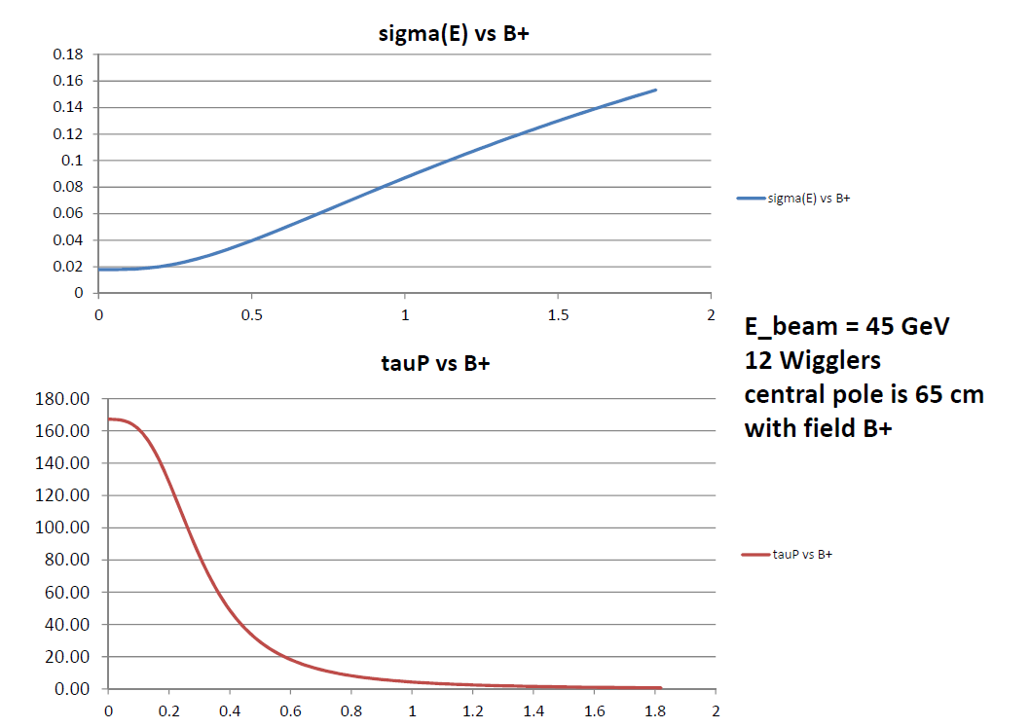
σ_{E}(GeV)
hrs
B_{Wiggler}(T)

Slide 46
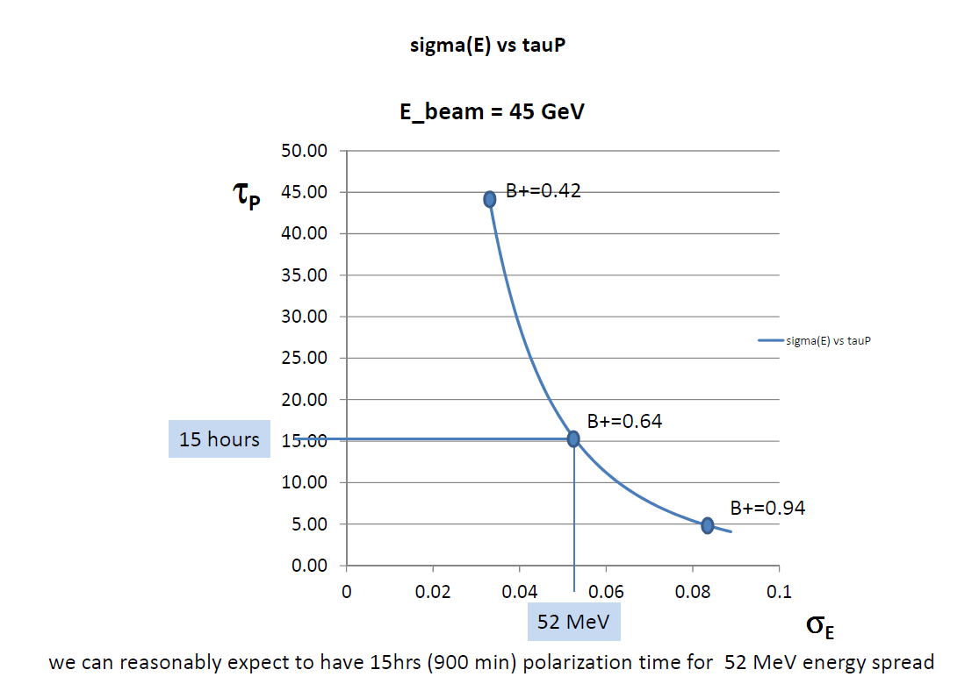

Slide 47
Synchroton radiation power in the wigglers
Synchrotron radiation power by particles of a given energy in a magnet of a given length
scales as the square of the magnetic field.
The energy loss per passage through a polarization wiggler was calculated in LEP note 606
(see next page). It is 3.22 MeV per wiggler or 38.6 MeV for the 12 wigglers.
At LEP the energy loss per particle per turn is 117 MeV/turn in the machine with no wiglers
and becomes 156 MeV per turn with the 12 wigglers at full field. From this it follows that
in the machine running at 45 GeV and wigglers at full field the radiation power
in the wigglers would have been 25% of the total power dissipated around LEP.
In TLEP now, the energy loss per turn in the ring is 36.3 MeV while, in the wigglers at 0.64T,
the energy loss in the wigglers is approx. a quarter of the above or 9.4 MeV.
The fraction of energy lost in the wigglers is then 9.4/(36.3+9.4) or 21%.
For a total SR power of 100MW,
21 MW will go in the wigglers.

Slide 48
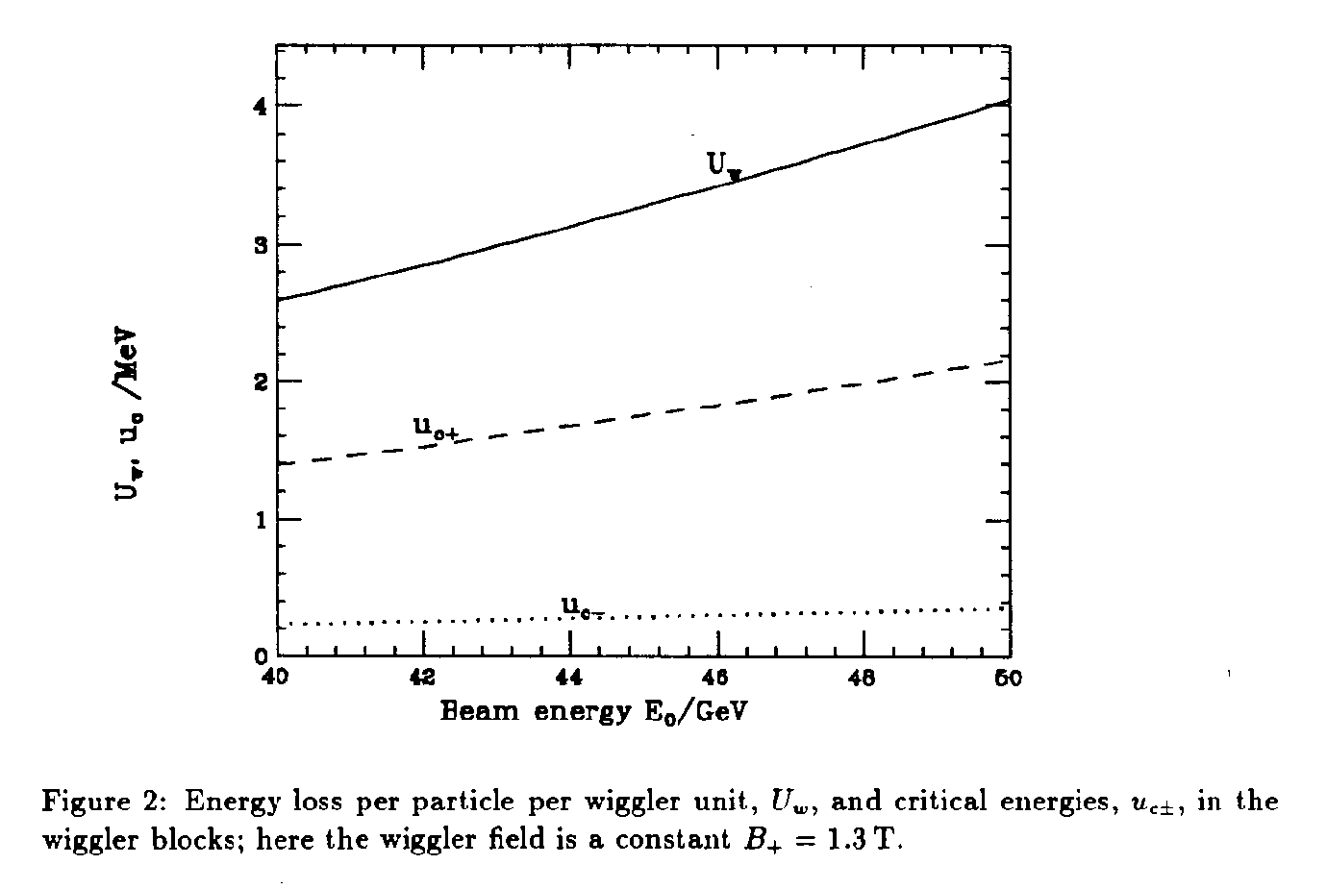
ENERGY LOSS PER PARTICLE PER WIGGLER
3.22MeV at 45 GeV

Slide 49
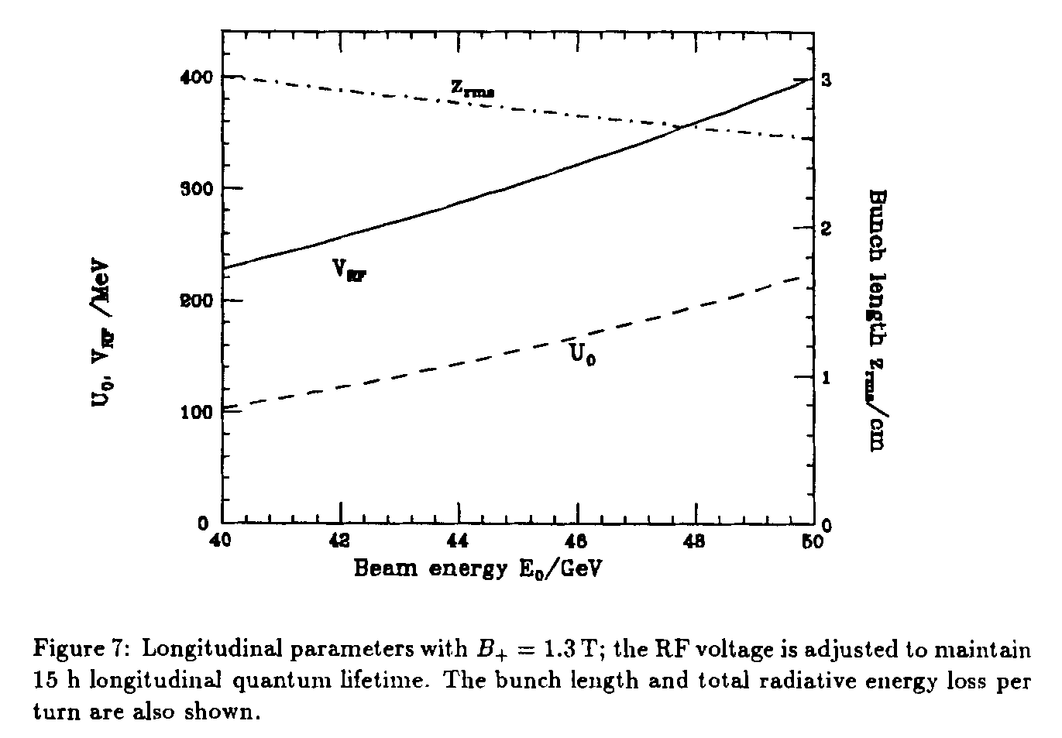
TOTAL ENERGY LOSS PER TURN PER PARTICLE WITH 12 WIGGLERS

Slide 50
Preliminary conclusions:
1. ☹ the wigglers increase energy spread in TLEP faster than in LEP
2. ☺ a workable point can be found for the ‘energy calibration mode’
at the Z pole or W threshold, assuming no better performance than in LEP for
depolarizing effects.
3. ☺ things should get better with lower emittance and lower vertical dispersion.
4. !!! A very careful design of the SR absorbers is required, as the SR power
in the wigglers is very large (20% of the total in the ring) !!!
5. reducing the luminosity for polarization runs can be envisaged,
since the statistical precision on m_{Z} and Γ_{Z} is very small (<10 keV) and probably
smaller than systematics.

Slide 51
A Sample of Essential Quantities:
X | Physics | Present precision |  | TLEP stat Syst Precision | TLEP key | Challenge
M_{Z} MeV/c2 | Input | 91187.5 ±2.1 | Z Line shape scan | 0.005 MeV <±0.1 MeV | E_cal | QED corrections
Γ_{Z} MeV/c2 | Δρ (T) (no Δα!) | 2495.2 ±2.3 | Z Line shape scan | 0.008 MeV <±0.1 MeV | E_cal | QED corrections
R_{l} | α_{s ,} δ_{b} | 20.767 ± 0.025 | Z Peak | 0.0001 ± 0.002 - 0.0002 | Statistics | QED corrections
N_{ν} | Unitarity of PMNS, sterile ν’s | 2.984 ±0.008 | Z Peak Z+γ(161 GeV) | 0.00008 ±0.004 0.001 | ->lumi meast Statistics | QED corrections to Bhabha scat.
R_{b} | δ_{b} | 0.21629 ±0.00066 | Z Peak | 0.000003 ±0.000020 - 60 | Statistics, small IP | Hemisphere correlations
A_{LR} | Δρ, ε_{3 ,}Δα (T, S ) | 0.1514 ±0.0022 | Z peak, polarized | ±0.000015 | 4 bunch scheme | Design experiment
M_{W} MeV/c2 | Δρ, ε_{3 ,} ε_{2,} Δα (T, S, U) | 80385 ± 15 | Threshold (161 GeV) | 0.3 MeV <1 MeV | E_cal & Statistics | QED corections
m_{top} MeV/c2 | Input | 173200 ± 900 | Threshold scan | 10 MeV | E_cal & Statistics | Theory limit at 100 MeV?

Slide 52
Longitudinal polarization operation:
Can we operate routinely with longitudinal polarization in collisions?
Polarization in collisions was observed in LEP
the following must be satisfied (in addition to spin rotators):
0. we have to take into account the top-off injection of non-polarized particles
1. random depolarization must be reduced wrt LEP by a factor 10 to go from 10% to 55% P
with life time of 15hrs=900 minutes (i.e with wigglers ON as before)
This is beyond what was achieved at LEP but there is hope that it can be done with
improved optics at TLEP, given better dispersion corrections (➔ simulation job to do)
2. luminosity lifetime must be reduced to 900 minutes as well. This means reducing
luminosity by a factor 10 down to 6 10^34/cm2/s/IP , or increase the number of bunches
(NB luminosity lifetime is sensitive to the momentum acceptance of the machine ➔ check!)
3. then the top up will reduce polarization further, to reach an equilibrium value of 44%
4. the effective polarization over a 12 hours stable run is then 39%

Slide 53
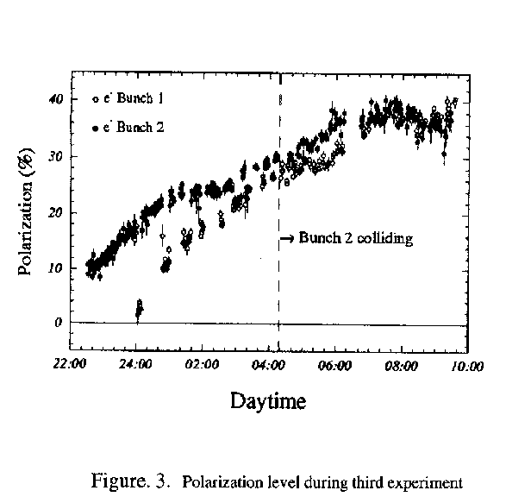
PAC 1995
LEP:
This was only tried 3 times!
Best result: P = 40% , ξ*_{y}= 0.04 , one IP
TLEP
Assuming 4 IP and ξ*_{y}= 0.01 ➔
reduce luminositiy somewhat, 10¹¹ Z @ P=40%

Slide 54
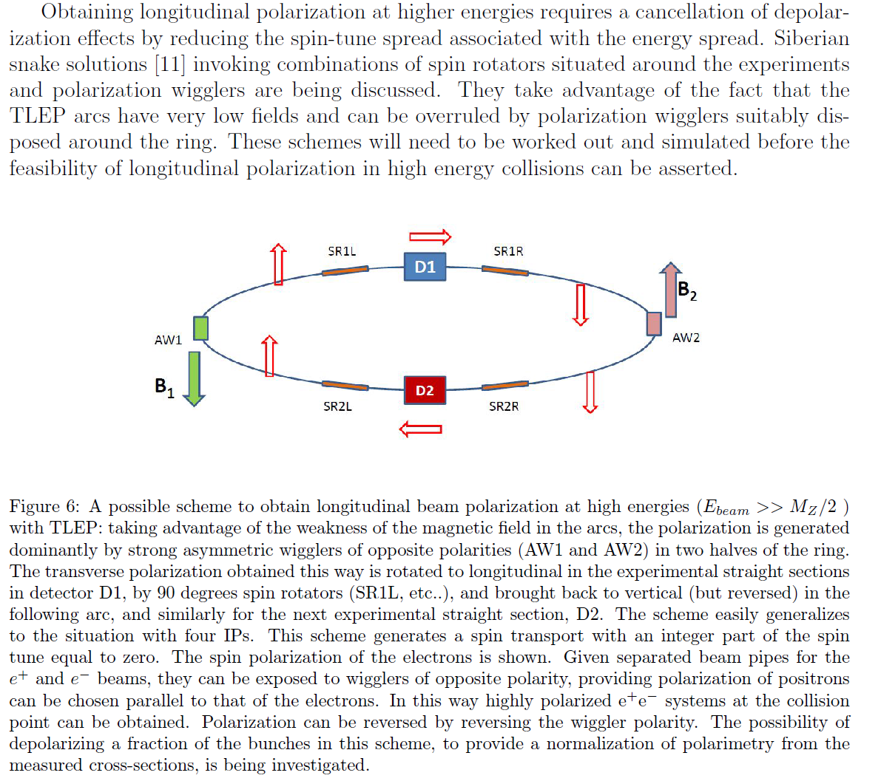
AB, U. Wienands)

