Slide 1
Performance of a HERMES-type
Internal Gas Target in the LHC (and FCC)
P. Lenisa – University of Ferrara and INFN
E. Steffens – University of Erlangen-Nürnberg
Polarization issues in High-energy circular colliders
Rome, 16.04.16

Slide 2
Motivation
AFTER@LHC initiative for A Fixed-Target Experiment at LHC.
Fixed-Target experiments led to the discovery of many new phenomena.
Valuable additions to colliders (e.g. HERA, RHIC) due to high luminosity and different kinematical range.
Accepted paper C. Barschel (LHCb), P. Lenisa (Ferrara), A. Nass (FZJ) and E.St. (Erlangen): A Gas Target Internal to the LHC for the Study of pp Single-Spin Asymmetries and Heavy Ion Collisions

Slide 3
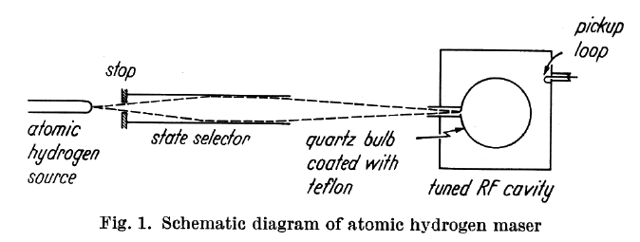
History
Storage Cell part of the hydrogen MASER (Ramsey 1965):
  dissociator;
  state selector (6-pole magnet);
  storage cell (‘bulb’) Teflon coated;
  homogenous B-field;
  Inside rf-cavity used as sensitive microwave amplifier.
Teflon-coated storage cell filled with polarized H from an ABS as target for Scattering Experiments first proposed by W. Haeberly in 1965
First experimental test of in Madison, Wisconsin (1980)

Slide 4
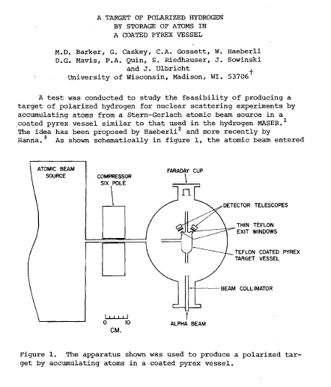
First storage cell in a nuclear scattering experiment (1980)
Teflon-coated cell with polarized H from Atomic Beam Source
12 MeV beam passing the cell through entrance and exit tube
Scattered α detected left and right
Results:
No depolarization after 900 wall collisions!
Areal density: 1.1∙10¹²/cm²
Similar results for deuterium
H
α

Slide 5
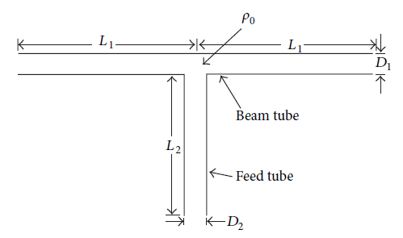
The HERMES (at DESY) target (1995-2005)
Low-β section @ 30 GeV HERA e⁺/e⁻
Polarized ³He, ¹H, ²D and unpolarized gas H₂ to Xe [NIM A540 (2005) 68].
T-shaped Al-storage cell (75 μm thick)
  400 mm long
  Elliptical cross section r_{x,y} ≈ 15 σ_{x,y} + 1 mm
  Feed tube: 100 mm long, 10 mm (plus capillary for gas feed system).
  Cell temperature T_{c} = 100 – 300 K.
Density ρ₀ at cell center: ρ₀ = I / C_{tot}
Narrow tube gives high density, but space for the beam needed!
Additional requirements:
  wall properties for low recombination and depolarization;
  strong guide field.

Slide 6
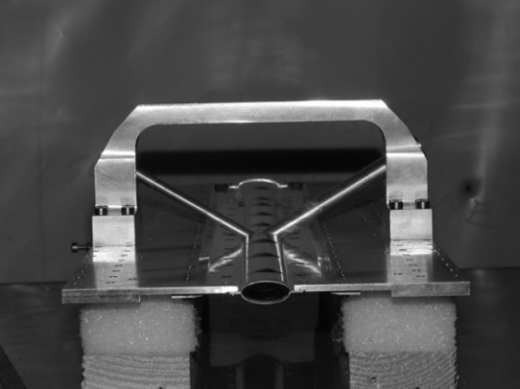
The storage cell
Material: 75 μm Al with Drifilm coating
Size: length: 400mm, elliptical cross section (21 mm x 8.9 mm)
Temperature: 100 K ( variable 35 K – 300 K)

Slide 7
HERMES target schematics (top view)
Polarized atomic beam injected from left
Sample beam:
  QMS (α = molecular fraction).
  Polarimeter (P = atomic polarization).
Sampling corrections to compute polarization seen by beam.
Atomic Beam Source
Target B
Target Gas Analyzer
Sample Beam Polarimeter

Slide 8
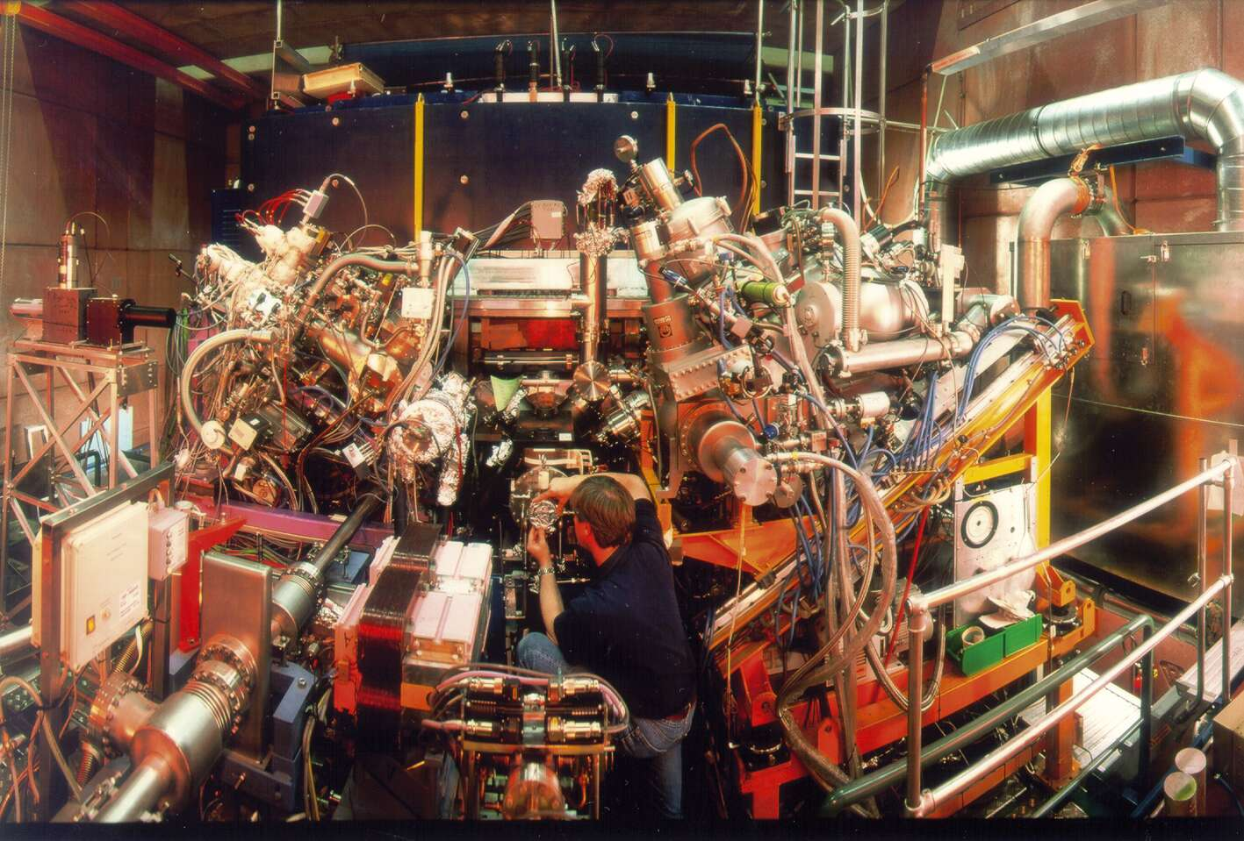
HERMES H&D target
p 920 GeV
e 27.6 GeV

Slide 9
Performance for H (2002/03)
HERMES 2002/03 data taking with transverse proton polarization
Top: Degree of dissociation measured by the TGA (α = 1: no molecules);
Bottom: Vector polarization P_{z} measured by Breit-Rabi-Polarimeter.

Slide 10
HERMES H&D target: operation
Operated 1996 – 2005 in the HERA e-ring (E = 27.6 GeV, I_{e} ≤ 40 mA).
Maintenance:
  One access per month, plus emergency.
  Vacuum system with total pumping speed of 10,000 l/s.
Tungsten collimators shield from synchrotron radiation:
  At HERA: X-ray beam on axis with 200 Watts power traversing the cell.
  At LHC X-ray power for 7 TeV p-beam <1 W
  At FCC X-ray power for 50 TeV p-beam possibly comparable with HERA (calc. needed).
High P and low α required T = 100 K
  √3 higher areal density respect 300 K.
B ≈ 0.3 T decouples electron and nucleon spins, enabling high polarization
These effects (and more!) have to be studied for LHC conditions!

Slide 11
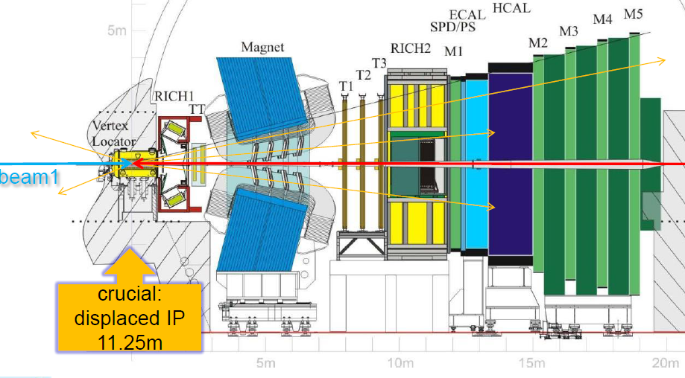
The SMOG gas target @ LHCb
for diagnostic purposes (vertex locator)
from talk by M. Ferro-Luzzi (CERN) workshop AFTER@LHC on 17-Nov-2014
≈12°

Slide 12
The SMOG internal gas target @ LHC
AFTER@LHC M. Ferro-Luzzi (CERN):
Originally: pure residual gas (10⁻⁹ mbar).
  Switching off the pumps, pressure up to 5∙10⁻⁹ mbar used as target.
Since 2012: Ne injected up to p ≈ 1.5∙10⁻⁷ mbar
  At T=293K corresponds to ρ = 4∙10¹² /cm³.
  Pressure bump 10 m long areal density θ is 4∙10¹⁵/cm².
  Beam losses negligible (t >>10⁸ s).
Si-strip detector (VELO): two halves positioned near beam axis.
  Closed position: detectors-distance to beam: 8 mm, Al housing: 5 mm.
  Opened position: free space of ≈ 50 mm.
Conclusions:
“LHCb has pioneered the use of gaseous “fixed target” in the LHC for beam-gas imaging, luminosity calibration, ghost and bunch charge measurements …”
“Extensions involving target polarization would require much bigger investments and long studies (!) ….”

Slide 13
LHC (FCC) beams
p and Pb beams intensities @ LHC
  Protons: I_{p} = 3.63∙10¹⁸ p/s @ 7 TeV (similar @ FCC)
  Lead: I_{Pb} = 4.64∙10¹⁴ Pb/s @ 2.76 TeV/u (19 TeV/u @FCC).
1σ-radius at IP (full energy): < 0.02 mm
  Negligible compared with the cell radius (> 5 mm)
Safety radius at injection (450 GeV for p): > 25 mm
  “Openable” cell required.
Beam half-life: ≈ 10 h
  Parallel/parasitic operation requires small reduction of half-life (< 10%)

Slide 14
Geometry for a LHC (FCC) storage cell
LHC Requirements:
Beam tube
  Length: 1000 mm
  Closed: D₁ = 14 mm (> D_{VELO} = 10 mm).
  Opened: D₁ = 50 mm L₁ = 500 mm
Feed tube:
  D₂ = 10 mm and L₂ = 100 mm
Cell temperature: T = 300 K.
Conductance: C_{i} [l/s] = 3.81 √(T/M)∙ D_{i}³ / (L_{i} + 1.33 D_{i}) (M = molecular weight)
Density: ρ₀ = I / C_{tot} with C_{tot} = C₁ + C₂ +... (I [part/s] gas flow-rate)
Example H, C_{tot} = 2 C₁ + C₂ = 12.81 l/s, I = 6.5∙10¹⁶/s (HERMES):
ρ₀ = 5.07∙10¹²/cm³
areal density θ = L₁∙ ρ₀ = 2.54∙10¹⁴/cm²

Slide 15
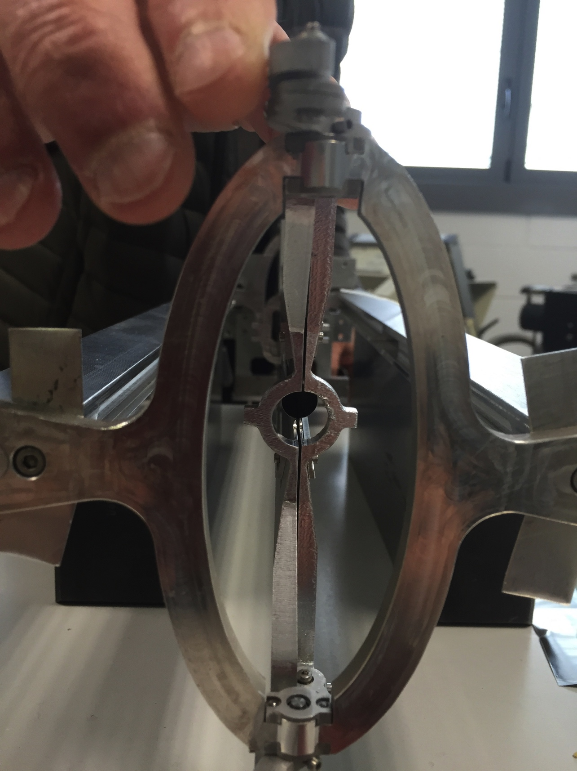
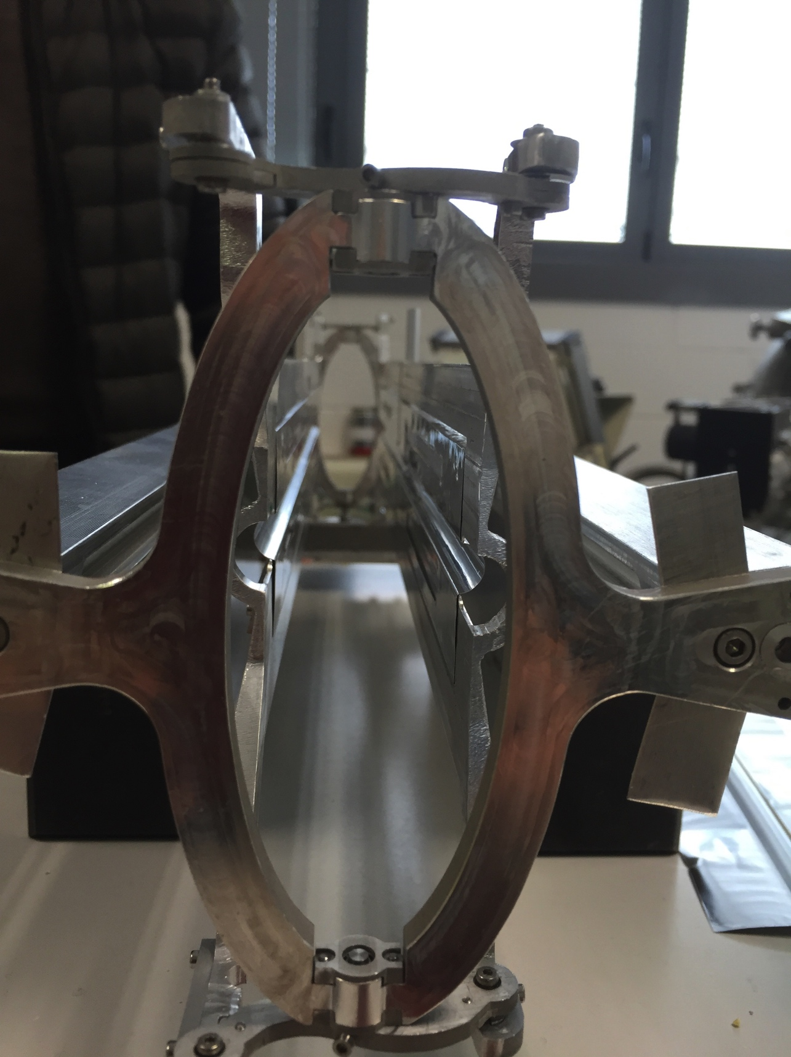
Openable storage cell development in Ferrara
(Storage cell for 2 GeV p/d beam at COSY (FZ-Juelich)

Slide 16
Polarized ¹H gas target performance
Polarized H injected into storage cell
  Areal density: θ = 2.54∙10¹⁴ H/ cm²
  Proton current I_{p} = 3.63∙10¹⁸/s (similar @ TeV)
Total luminosity: L_{pp} = 0.92∙10³³/ cm² s
  (About 10% of the collider luminosity)
σ_{pp} @ √s = √2M_{n}E_{p} ≈ 100 GeV = 50 mb = 5∙10⁻²⁶ cm²
  Loss rate dN/dt: 4.5∙10⁷/ s
  Stored protons: N = 3.2∙10¹⁴
Max. relative loss rate: (dN/dt)/N = 1.4∙10⁻⁷/ s.
The H target does not affect the life time of the 7 TeV proton beam.
(For FCC the situation even more favorable -> more p stored)

Slide 17
Polarized ²D and ³He gas targets
Polarized ²D target produced with densities comparable ¹H.
HERMES H&D target run at 100 K:
  Density increase by a factor √(300/100) = √3 = 1.73 .
  Maximum luminosity: L_{pp} (100 K) = 1.59∙10³³/ cm² s
  (16% of the pp collider design luminosity).
HERMES: ³He target operated at HERA in 1995.
  ³He gas polarized by Metastability Exchange Optical Pumping (1083 nm laser).
  Modern lasers mak3 a ³He source (much) more intense than an ABS
Choice of the best target has to be made in an early phase of the project!

Slide 18
Requirements for a polarized gas target
High gas flow (10¹⁷ atoms/s or Q∙(H₂) = 1.9∙10⁻³ mbar l s) into the target section requires powerful differential pumping system and some space.

Slide 19
HERMES H&D target (running 1996 – 2005)
p 920 GeV
e 27.6 GeV

Slide 20
Requirements for a polarized gas target
High gas flow (10¹⁷ atoms/s or Q∙(H₂) = 1.9∙10⁻³ mbar l s) into the target section requires powerful differential pumping system and some space.
54% of gas exits through beam tube: beam directed along beam axis.
Example: to pump the section to 10⁻⁷ mbar S = 2∙10⁴ l/s needed!
  Possible use of modern adsorption pumps (Cryo, NEG) (0.2 bar∙l of H₂ /day)

Slide 21
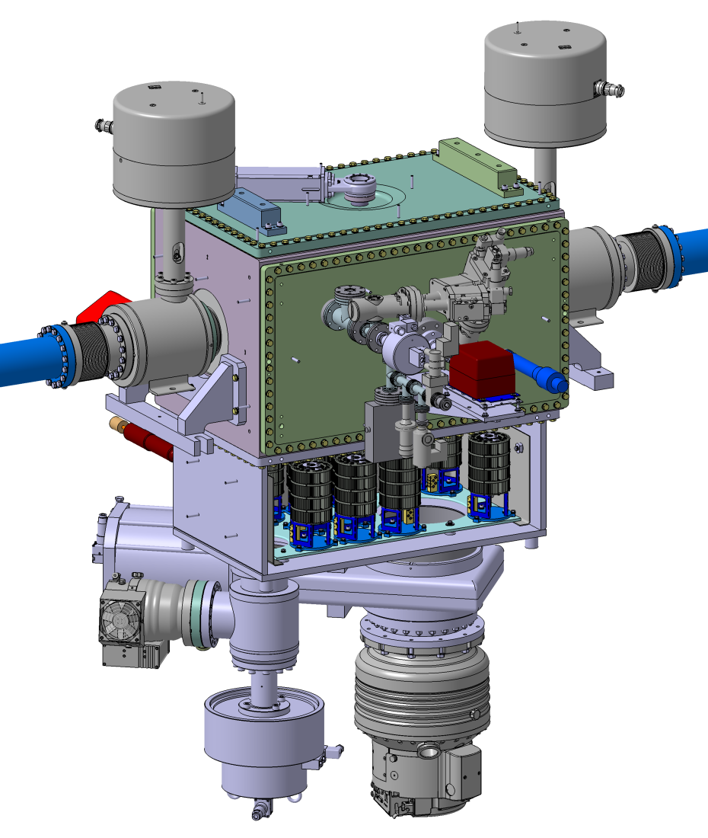
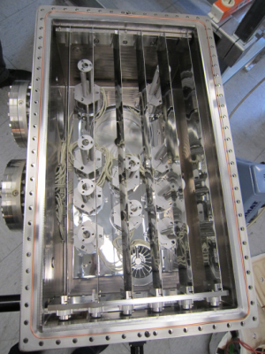
NEG pump system (12000 l/s)
for the PAX target at COSY (FZ-Jülich)

Slide 22
Requirements for a polarized gas target
High gas flow (10¹⁷ atoms/s or Q∙(H₂) = 1.9∙10⁻³ mbar l s) into the target section requires powerful differential pumping system and some space.
54% of gas exits through beam tube: beam directed along beam axis.
Example: to pump the section to 10⁻⁷ mbar S = 2∙10⁴ l/s needed!
  Possible use of modern adsorption pumps (Cryo, NEG) (0.2 bar∙l of H₂ /day)
Failure of the target source: valves to target section closed by Interlock.
  Option of feeding the cell with unpolarized gas.
  Access to the target area for fixing the polarized target enabled.
Experimental to be designed for parallel running with Collider experiments.
  Cell close to a beam-waist.
  Counter-rotating beam guided through the experiment: (i) on-axis of the storage cell, or (ii) with a Chicane of moderate deflection angle sideways by the cell.

Slide 23
Unpolarized gas targets (¹H₂,²⁰Ne,⁸⁴Kr,¹³¹Xe,...)
LHC: two-in-one main dipoles enable collisions of beams of same rigidity
  i.e. p-p collisions @ E_{max}= 2x7 TeV and Pb-Pb @ E_{max} = 2x2.76 TeV/nucleon.
  Different beams of equal rigidity |B∙ρ| = c∙p /q ≈ E /q can be collided as well: p (3.50 TeV) on Pb (1.38 TeV/A) provided in 2013 for ALICE).
  Other ions than p or Pb not used for experiments so far.
Heavy-Ion Fixed-Target program in parallel to the operation of the collider at moderate costs (compared with a new machine).
  Storage cell target fed with unpolarized gas:
    Different combinations of masses could be studied (e.g. Pb on Xe or on Ne).
    Different kinematical range, together with flexibility in the choice of the target gas. E.g.: nucleon-nucleon CM energy √s = 71.9 GeV (> CERN SPS Heavy Ion program = 20 GeV) and FAIR CBM program (4 – 9 GeV).

Slide 24
Pb on Xe target
(with Pb-beam loss rate limited to 10%)
Pb lifetime in Pb-Pb collider: τ_{c} = 10 h/ 0.693 = 14.4 h
  Induced target life time: τ_{t} = 10∙14.4 h = 144 h
  Loss rate dN/dt = N∙ (N = number Pb ions = 4∙10¹⁰):
  N∙/N = 1/144 h -> N∙ = N/5.18∙10⁵ s = 7.72∙10⁴/s = L_{Pb-Xe} ∙ σ_{tot} (Pb-Xe)
  σ_{hadronic}: 7.65 barn -> scaling with nuclear radii: σ_{tot} (Pb-Xe) = 6.6 barn
Max. Pb-Xe lumi: L_{Pb-Xe} = 1.17∙10²⁸/ cm²s
  Xe density θ: 2.52∙10¹³/cm².
  Xe flow rate at 300 K: 2.1∙10⁻⁵ mbar l/s.
  10 x Pb-Pb collider design luminosity (10⁻²⁷/ cm² s.)

Slide 25
Conclusions
Storage cell target provides highest areal density at minimum gas input.
Performance tested at the HERA - 27.6 GeV e⁺/e⁻ at I = 40 mA
Polarized H gas target:
  Cell with L=1 m and φ = 14 mm assumed (same aperture as SMOG/VELO @ LHCb)
  10³³/cm² s accessible in :
    10% of the collider lumi;
    > 600 x higher than Bent-Crystal beam and UVa-type target used at JLab;
  no background i.e. better systematics;
  sign of P switchable at 1/min or faster.
Unpolarized target:
  p-A and Pb-A collisions with H₂, He, Ne, Ar, Kr and Xe
  Max. Pb-Xe lumi: L_{Pb-Xe} = 1.17∙10²⁸/ cm²s (10 x higher than collider lumi)
Locations at LHC to be identified for realistic planning and design!
Thank you !

Slide 26
“Topical meeting on opportunities with internal gas target in the LHC.”
July 4 – Building 61 - CERN

Slide 28
Extracted beam by bent-crystal
AFTER@LHC (Phys. Part. and Nucl.(2014) p. 336):
LHC beam halo (p)extraction by bent-crystal onto polarized proton target.
  Exp beam intensity: i_{p} = 5∙10⁸/s.
COMPASS type frozen spin target too large for LHC tunnel.
UVa-type NH₃ DNP target with smaller target set-up considered:
  n_{t} = 1.5 10²³/cm², P_{p} = 0.85, dilution f = 0.17.
  FoM = n_{t} P ² f ² = 3.1∙10²¹/cm².
  Beam intensity i_{p} also enters the measurement quality:
    FoM* = i_{p} ∙ FoM = P² ∙ f ² ∙ i_{p} ∙ n_{t} = P² ∙ f ² ∙ L
Comparison:
UVa-target and bent-crystal extr. beam: FoM* = 1.57∙10³⁰/cm² s
‘COMPASS-target “ “ “ FoM* = 1.87∙10³²/cm² s
‘HERMES’ target and full LHC beam: FoM* = 0.60/1.04∙10³³/cm² s
(T = 300/100 K, P = 0.85, α = 0.95)

