Slide 1

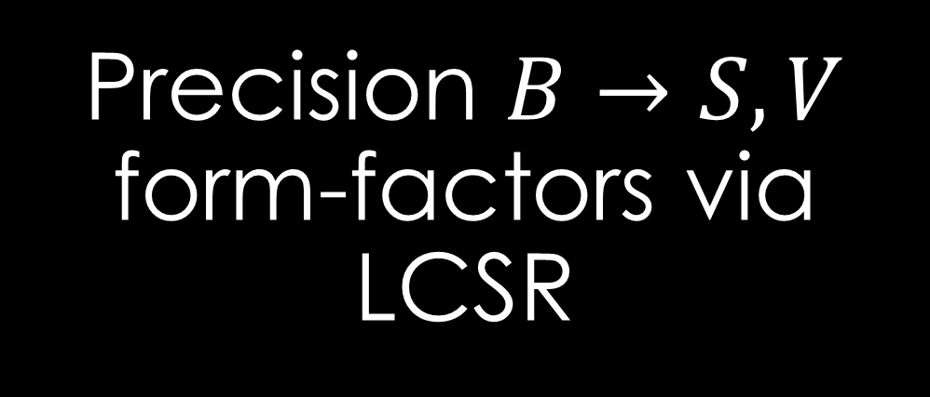
Precision $B→S,V$ form-factors via LCSR
Flavourful Opportunities in Semileptonic B Decays: Connecting Theory and Experiment– mitp, Mainz, 2026
Arslan Sikandar

Slide 2
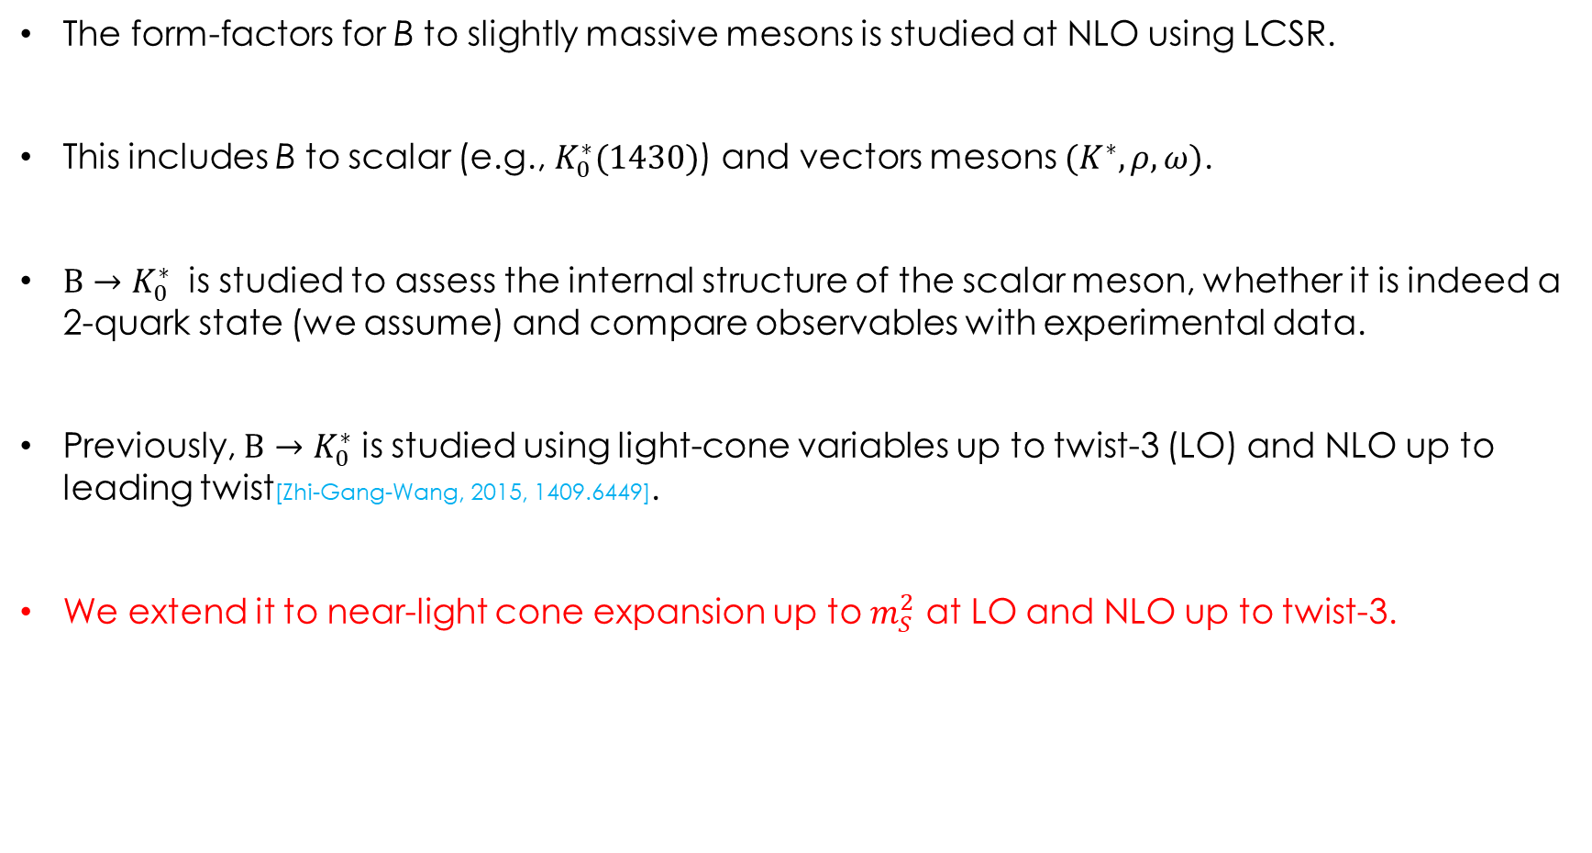
Motivation
The form-factors for B to slightly massive mesons is studied at NLO using LCSR.
This includes B to scalar (e.g., $K_{0}^{∗}(1430)$) and vectors mesons $(K^{∗},ρ,ω)$.
$B→K_{0}^{∗}$ is studied to assess the internal structure of the scalar meson, whether it is indeed a 2-quark state (we assume) and compare observables with experimental data.
Previously, $B→K_{0}^{∗}$ is studied using light-cone variables up to twist-3 (LO) and NLO up to leading twist[Zhi-Gang-Wang, 2015, 1409.6449].
We extend it to near-light cone expansion up to $m_{S}^{2}$ at LO and NLO up to twist-3.

Slide 3
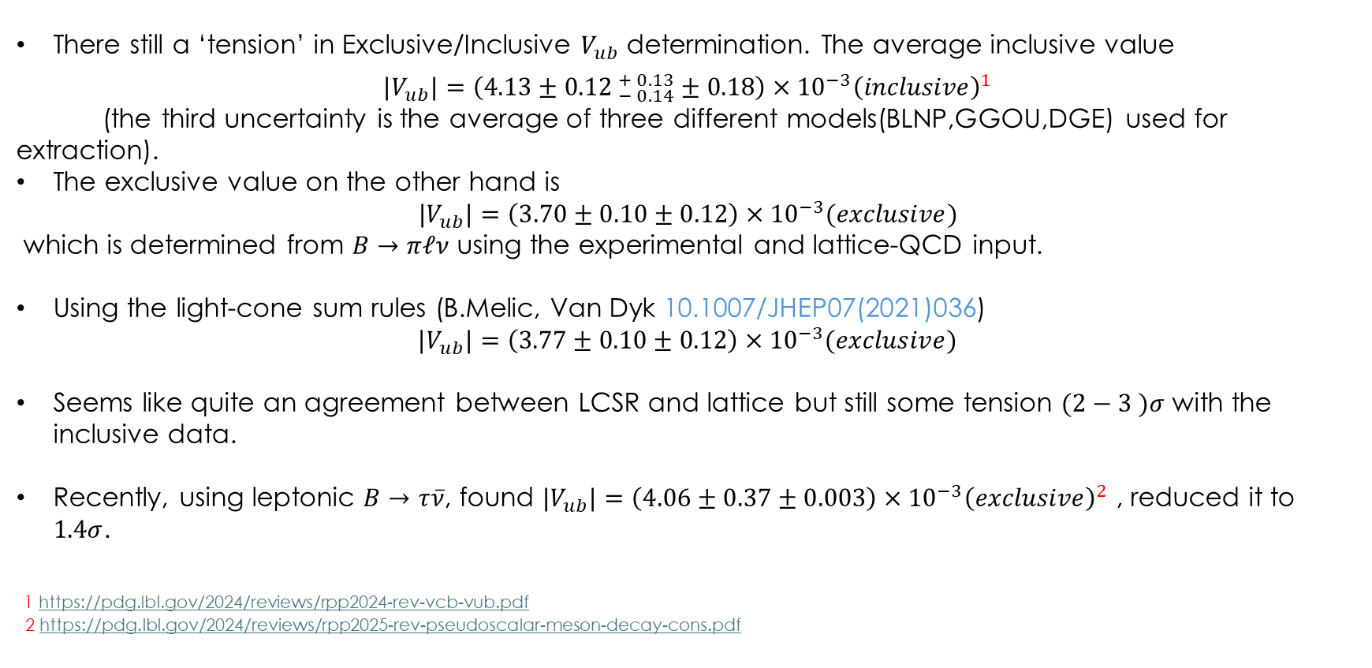
Motivation
There still a ‘tension’ in Exclusive/Inclusive $V_{ub}$ determination. The average inclusive value
$${|V}_{ub}|=\left(4.13±{0.12 }_{− 0.14}^{+ 0.13}±0.18\right)×{10}^{−3}{\left(inclusive\right)}^{1}$$
(the third uncertainty is the average of three different models(BLNP,GGOU,DGE) used for extraction).
The exclusive value on the other hand is
$${|V}_{ub}|=\left(3.70±0.10±0.12\right)×{10}^{−3}(exclusive)$$
which is determined from $B→πℓν$ using the experimental and lattice-QCD input.
Using the light-cone sum rules (B.Melic, Van Dyk 10.1007/JHEP07(2021)036)
${|V}_{ub}|=\left(3.77±0.10±0.12\right)×{10}^{−3}(exclusive)$
Seems like quite an agreement between LCSR and lattice but still some tension $(2−3 )σ$ with the inclusive data.
Recently, using leptonic $B→τ\overline{ν}$, found ${|V}_{ub}|=\left(4.06±0.37±0.003\right)×{10}^{−3}{\left(exclusive\right)}^{2}$ , reduced it to $1.4σ$.
1 https://pdg.lbl.gov/2024/reviews/rpp2024-rev-vcb-vub.pdf
2 https://pdg.lbl.gov/2024/reviews/rpp2025-rev-pseudoscalar-meson-decay-cons.pdf

Slide 4
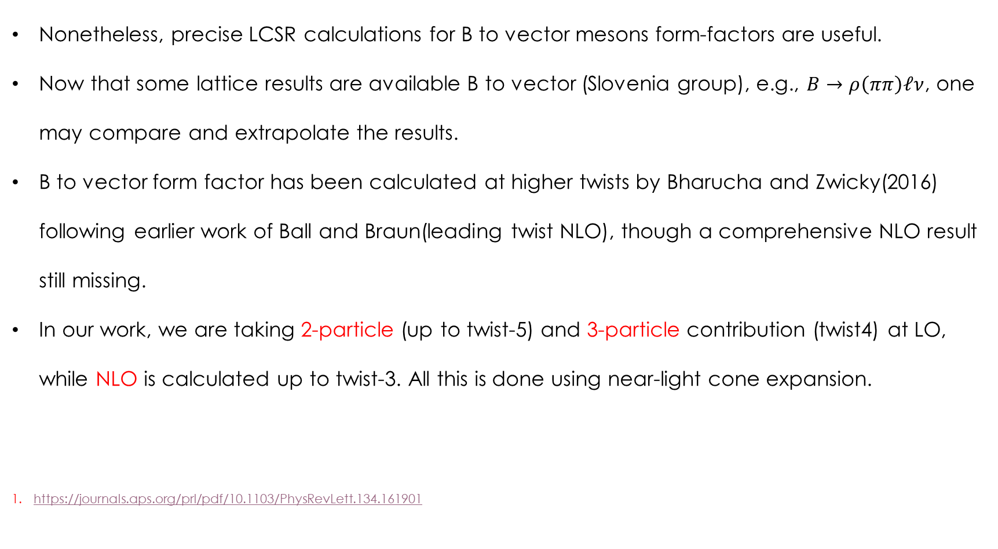
Motivation
Nonetheless, precise LCSR calculations for B to vector mesons form-factors are useful.
Now that some lattice results are available B to vector (Slovenia group), e.g., $B→ρ\left(ππ\right)ℓν$, one may compare and extrapolate the results.
B to vector form factor has been calculated at higher twists by Bharucha and Zwicky(2016) following earlier work of Ball and Braun(leading twist NLO), though a comprehensive NLO result still missing.
In our work, we are taking 2-particle (up to twist-5) and 3-particle contribution (twist4) at LO, while NLO is calculated up to twist-3. All this is done using near-light cone expansion.
https://journals.aps.org/prl/pdf/10.1103/PhysRevLett.134.161901

Slide 5

Light Cone Sum Rules
Define a correlation function in space-like region with two heavy-to-light currents and a b-quark interpolating current
$Π_{Γ}\left(p_{B}^{2},q^{2}\right)=∫d^{4}z e^{i q⋅z}⟨(V\left(p,ε^{∗}\right),S\left(p\right))|T\left\{\overline{q}\left(z\right)Γb\left(z\right),m_{b}\overline{b}\left(0\right)i γ_{5}q\left(0\right)\right\}|0⟩$
Using dispersion relation and quark hadron duality

Slide 6
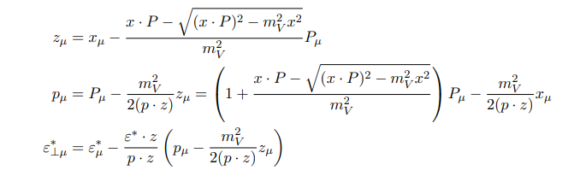
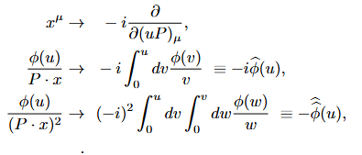
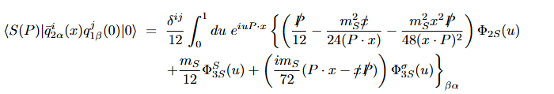

LCDA’s near the light cone
The scalar meson LCDA in light-cone variables (z,p) is:
Expanding near the light-cone we transform the coordinates to $\left(x^{μ},P^{μ}\right)$ such that $x^{2}≠0$ and $P^{2}=m_{V}^{2}$:
scalar meson LCDA in light-cone variables (x,P)

Slide 7
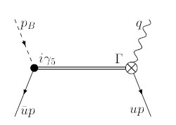
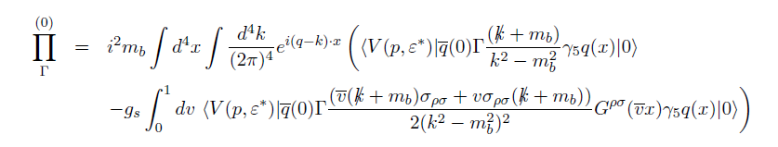
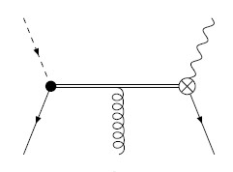


Leading Order
$$V\left(P,ε^{∗}\right), S(P)$$
$$V\left(P,ε^{∗}\right)$$

Slide 8
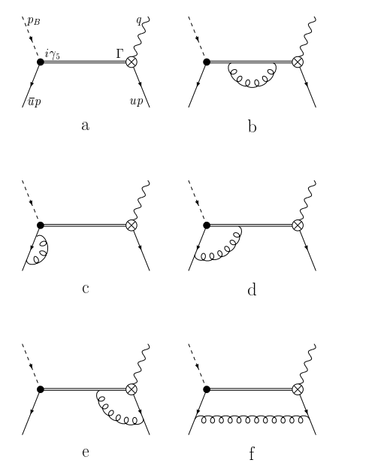
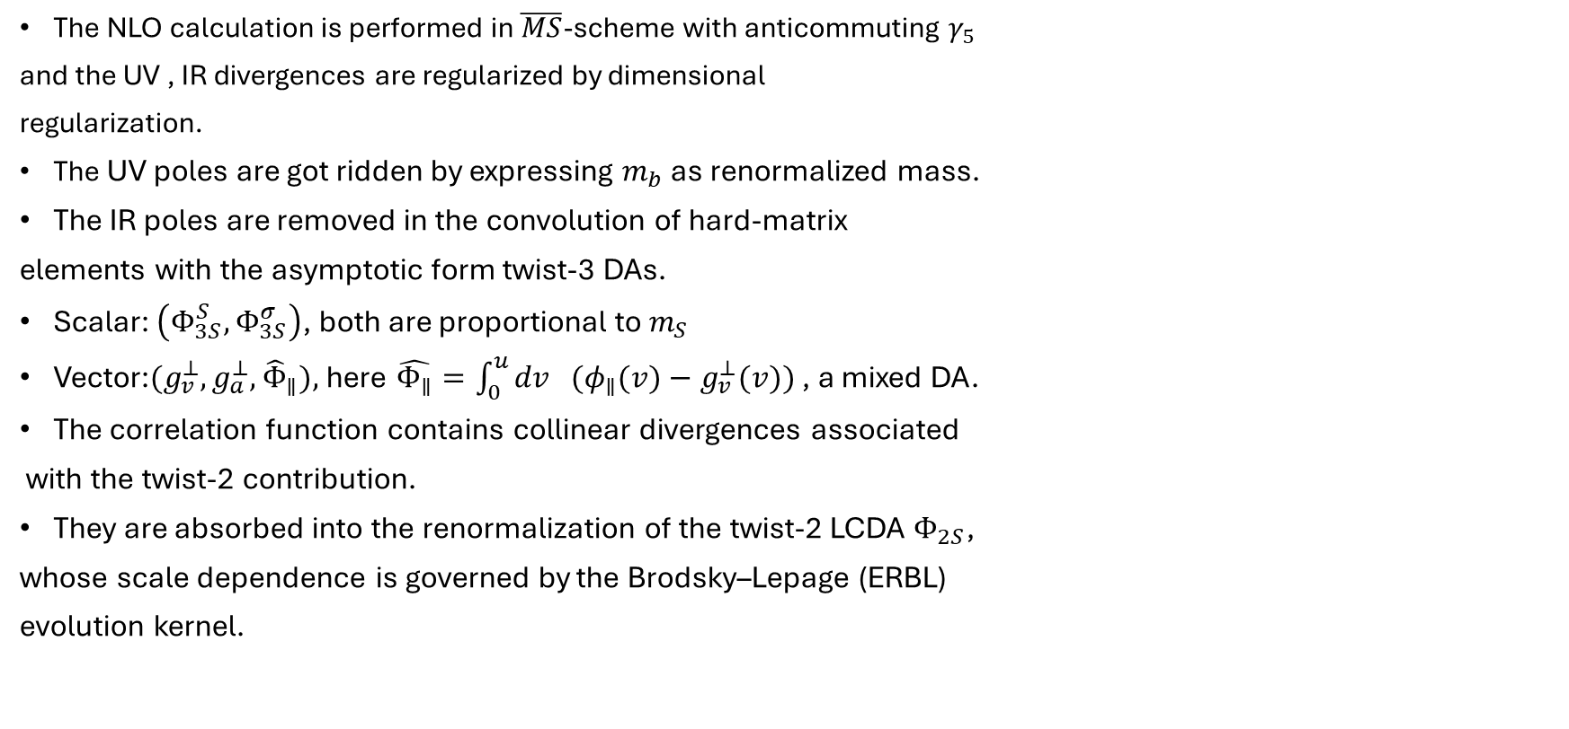
NLO corrections
The NLO calculation is performed in $\overline{MS}$-scheme with anticommuting $γ_{5}$
and the UV , IR divergences are regularized by dimensional
regularization.
The UV poles are got ridden by expressing $m_{b}$ as renormalized mass.
The IR poles are removed in the convolution of hard-matrix
elements with the asymptotic form twist-3 DAs.
Scalar: $\left(Φ_{3S}^{S},Φ_{3S}^{σ}\right)$, both are proportional to $m_{S}$
Vector:${(g}_{v}^{⊥},g_{a}^{⊥}, {\hat{Φ}}_{∥}),$here $\hat{Φ_{∥}}=\int_{0}^{u}{dv } {(φ}_{∥}(v)−g_{v}^{⊥}(v))$ , a mixed DA.
The correlation function contains collinear divergences associated
with the twist-2 contribution.
They are absorbed into the renormalization of the twist-2 LCDA $Φ_{2S}$,
whose scale dependence is governed by the Brodsky–Lepage (ERBL)
evolution kernel.

Slide 9

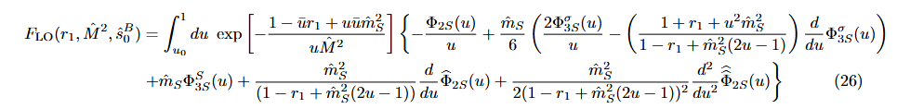

Scalar Form-Factors
The form factor is given as
The LO result for this case is
The NLO is of the form

Slide 10
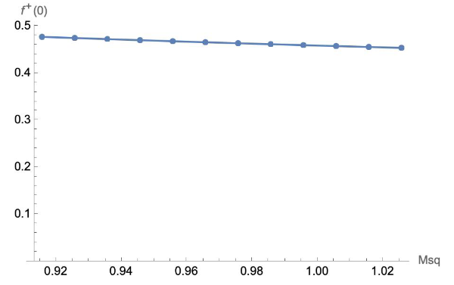
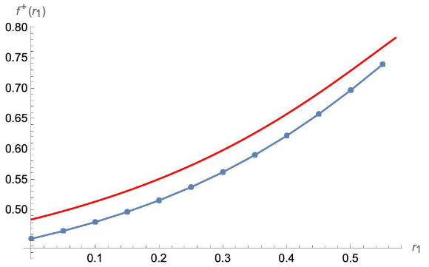

Scalar Form-Factors
The internal parameters, i.e., Borel mass $M$, scale $μ$and threshold parameter are adjusted.
For $B→K_{0}^{∗}(1430)$, we have the Borel window in the range $M^{2}=16−18GeV^{2}$for the sum rule.
A 5% suppression in the form-factor from the twist-2 $m_{S}^{2}$-terms. Recall, twist-2 contribution here is $∝$ to suppressed decay constant and vanishes in the SU(3) limit $m_{u}=m_{s}$.

Slide 11
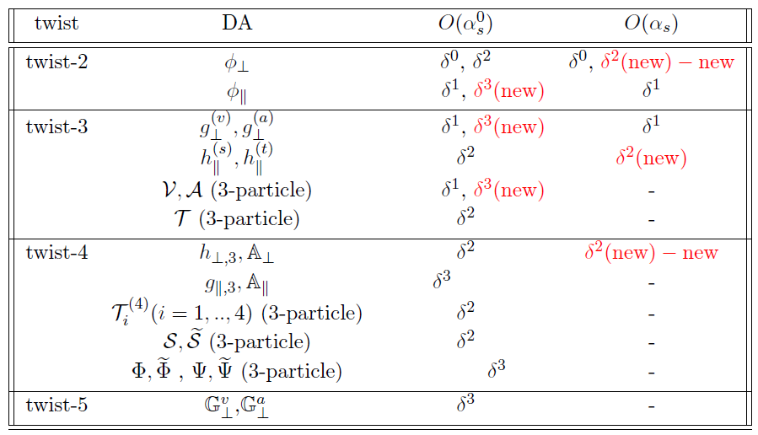

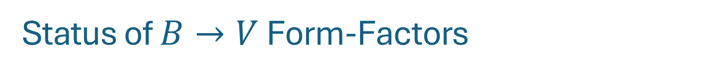
Status of $B→V$ Form-Factors
Up to twist-5 at LO correction for
2-particle Distribution amplitudes.
Up to twist-4 three particle DAs.
At NLO, twist 2 and some twist-3 DA
Up to $m_{V}^{2}$ order. $δ=m_{V}/m_{b}$.

Slide 12
Conclusion
Near light-cone expanded results are obtained for B to Scalar and vector mesons.
Fintie NLO corrections in the limit of asymptotic DAs are obtained.
Form-factors for Scalar mesons are obtained. Further phenomenology is being persued.
Form-factors for B to vectors are being found in collobaration with Chinese group (Yu-Ming) for independent checks.

Slide 13
Thank you
Arslan Sikandar
Quaid-i-Azam University, Pakistan.
Ruder Boskovic Institute, Zagreb, Croatia.

