Slide 1

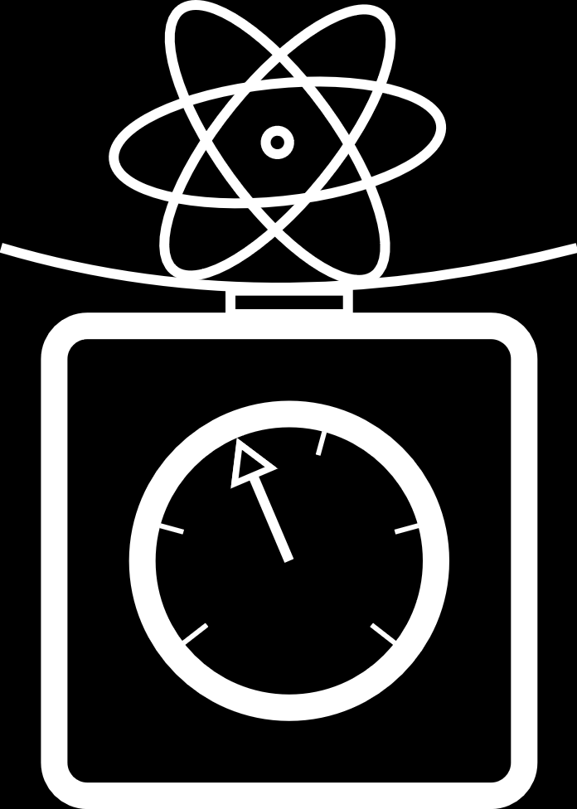
Recoil measurement with single-photon transitions
Jesse Schelfhout
University of Oxford
YOUNGST@RS – Quantum Sensing for Fundamental Physics
MITP, 21st November 2024

Slide 2
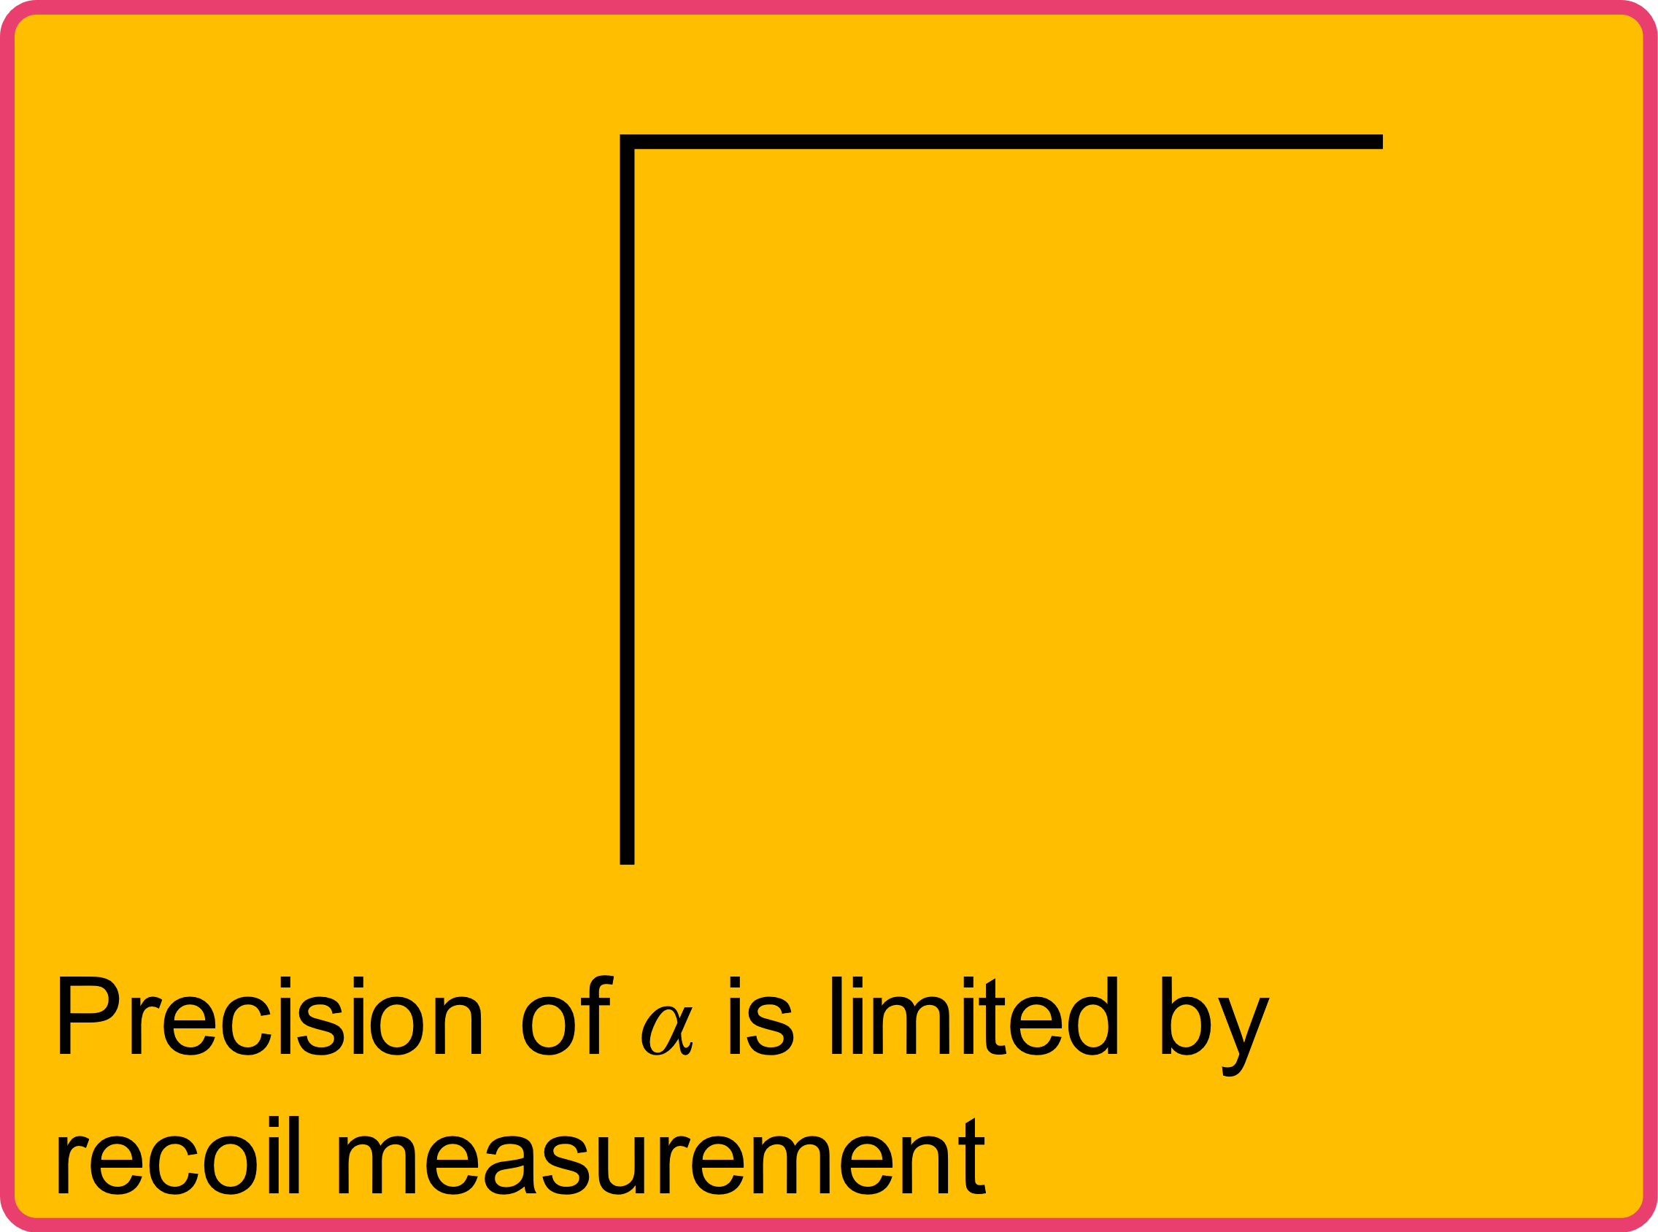
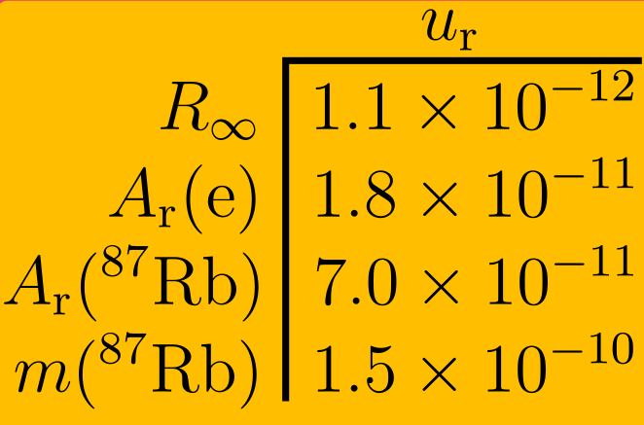
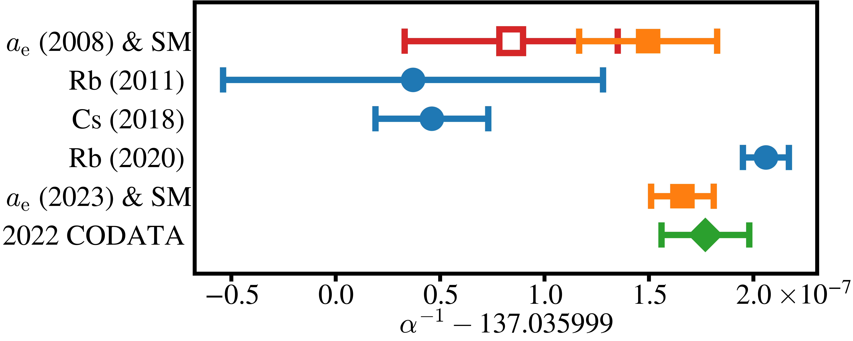


Fine-structure constant ($α$)
$$α^{2}=\frac{2hR_{∞}}{m_{e}c}$$
Coupling strength for electromagnetic interaction
An empirical parameter of Standard Model
>5σ discrepancy between best recoil experiments
2022 CODATA
2022 CODATA
2020 AME
Rb (2020)
Without 10th-order Feynman diagrams
With 10th-order Feynman diagrams
D. Hanneke et al., PRL 100, 120801 (2008)
T. Aoyama et al. Atoms 7, 28 (2019)
R. Bouchendira et al., PRL 106, 080801 (2011)
R. Parker et al., Science 360, 191 (2018)
L. Morel et al., Nature 588, 61 (2020)
X. Fan et al., PRL 130, 071801 (2023)
E. Tiesinga et al. (2024) physics.nist.gov/constants
>5σ

Slide 3
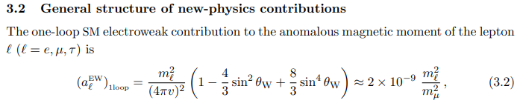
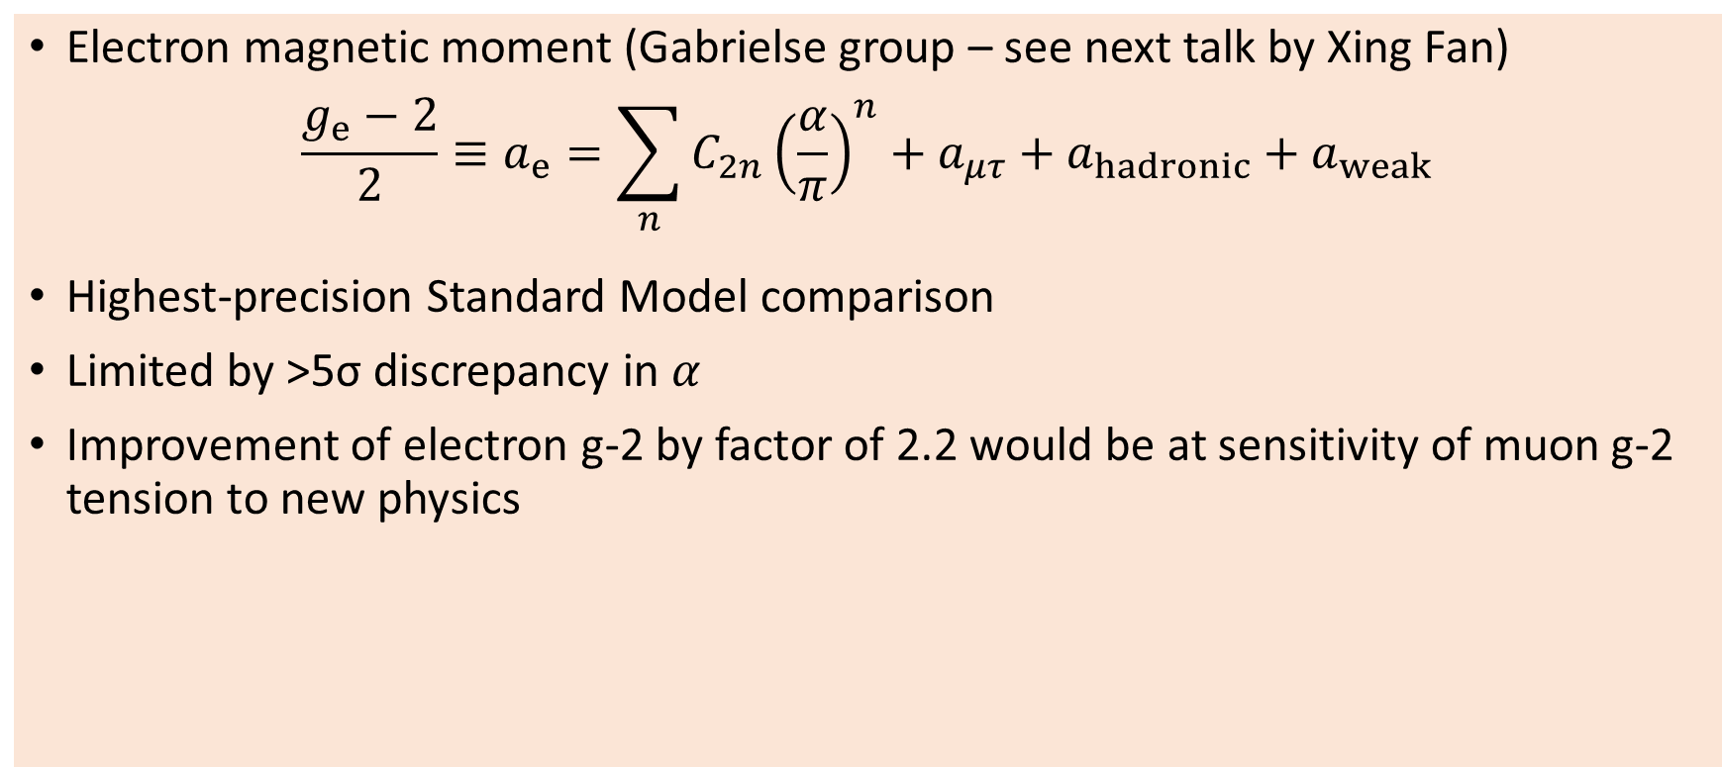

Testing the Standard Model
Electron magnetic moment (Gabrielse group – see next talk by Xing Fan)
$$\frac{g_{e}−2}{2}≡a_{e}=\sum_{n}{C_{2n}{\left(\frac{α}{π}\right)}^{n}}+a_{μτ}+a_{hadronic}+a_{weak}$$
Highest-precision Standard Model comparison
Limited by >5σ discrepancy in $α$
Improvement of electron g-2 by factor of 2.2 would be at sensitivity of muon g-2 tension to new physics
$${\left(\frac{m_{e}}{m_{μ}}\right)}^{2}∼2.4×{10}^{−5}$$
X. Fan et al., PRL 130, 071801 (2023); G. Giudice et al., JHEP 2012, 113 (2012)

Slide 4


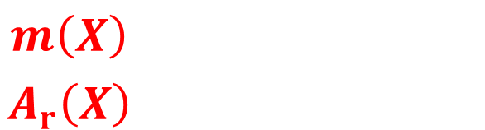



Atomic mass constant ($m_{u}$)
$α\left(Rb\right) \& α\left(Cs\right)$ both use same $A_{r}\left(e\right) \& R_{∞}$
$⇒$ Discrepancy is in $m_{u}=m\left(X\right)/A_{r}\left(X\right)$
$⇒$ Test of Standard Model is limited by (not) pinning down $m\left({}_{}^{12}C\right)$
$$a_{e}=\sum_{n}{C_{2n}{\left(\frac{α}{π}\right)}^{n}}+a_{μτ}+a_{hadronic}+a_{weak}$$
$$\frac{e^{2}}{2ε_{0}hc}=α=\sqrt{\frac{2hR_{∞}}{m_{e}c}}$$
Is running of coupling constants involved somewhere here?
$$m_{e}=A_{r}\left(e\right)m_{u}$$
$$\frac{m\left(X\right)}{A_{r}\left(X\right)}=m_{u}=\frac{m\left({}_{}^{12}C\right)}{12}$$

Slide 5







Ramsey-Bordé interferometer(s)
Four $π/2$ pulses form two conjugate Ramsey interferometers
Originally used to cancel dephasing by (first-order) Doppler effect for optical Ramsey fringes with thermal beams of atoms
Bordé realised its use as a recoil-sensitive atom interferometer
Two interferometers close for
$$t_{2}−t_{1}=T=t_{4}−t_{3}$$
Differential phase:
$ΔΦ=\frac{2ℏk^{2}T}{m(X)}=4ω_{rec}T$
$$\frac{π}{2}$$
$$\frac{π}{2}$$
$$x$$
t₁
t₂
t₃
t₄
$$t$$
$$\frac{π}{2}$$
$$\frac{π}{2}$$
C. Bordé et al., PRA 30, 1836 (1984); C. Bordé, Phys. Lett. A 140, 10 (1989); J. Bergquist et al., PRL 38, 159 (1977).

Slide 6
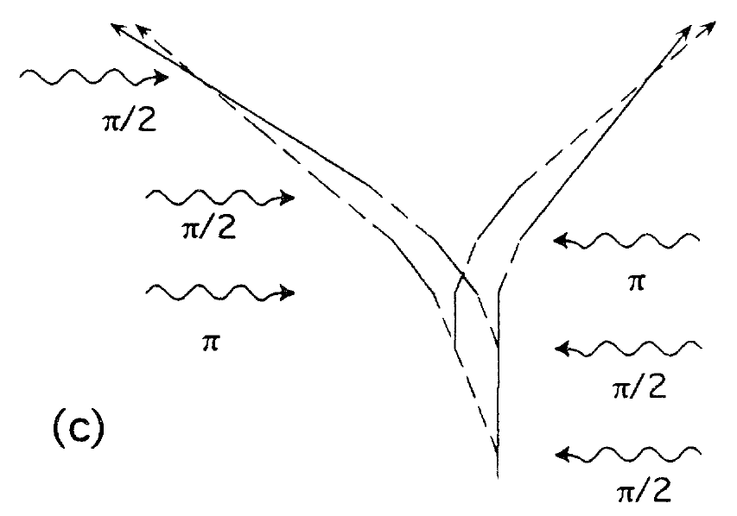
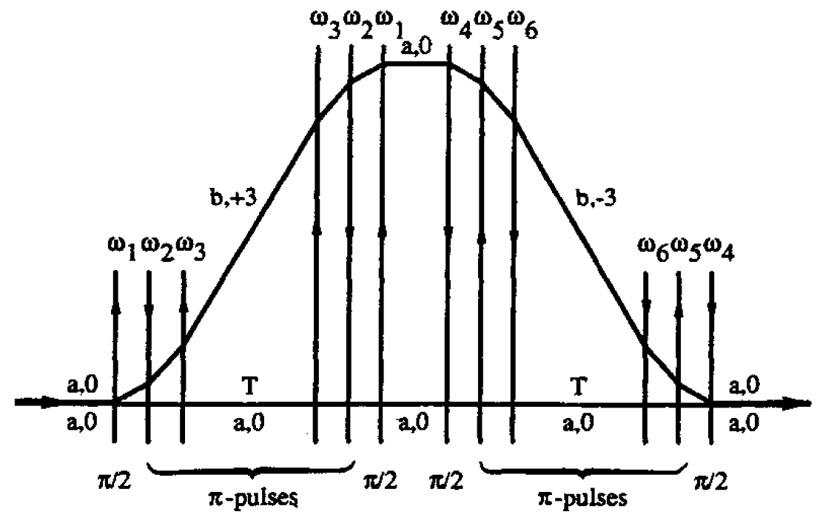
Enhanced Ramsey-Bordé interferometry
Large momentum transfer (LMT) can increase sensitivity
Phase scales as difference in recoil energy between interferometer arms
LINEAR
SCALING
QUADRATIC
SCALING
D. Weiss et al., PRL 70, 2706 (1993). C. Bordé et al., AIP Conf. Proc. 290, 76 (1993).

Slide 7
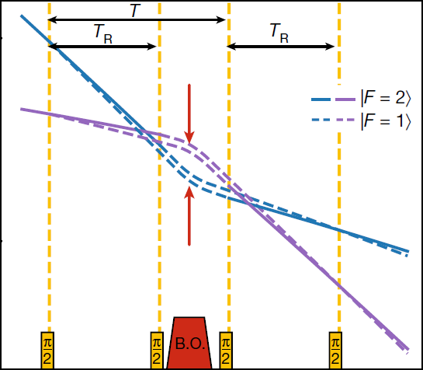
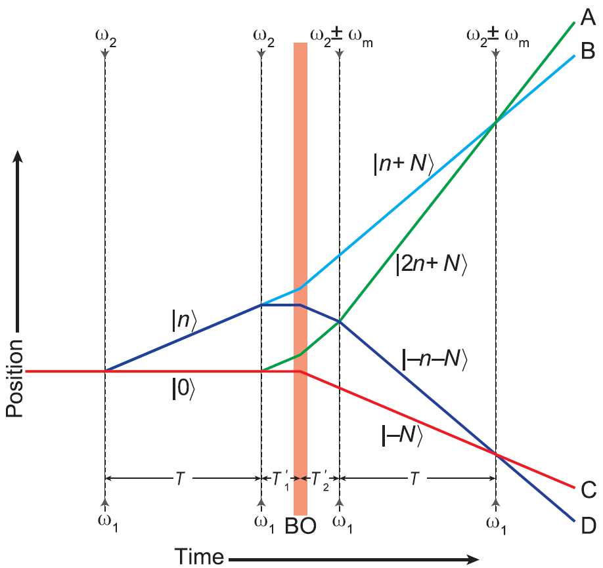

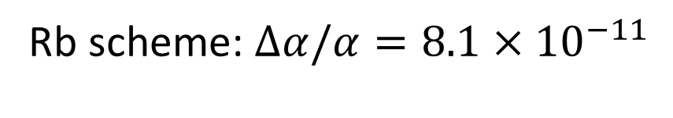

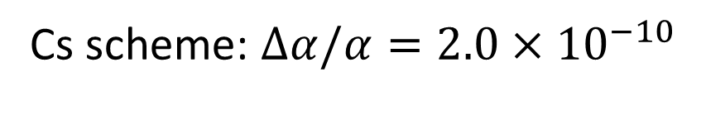
State of the art (Rb & Cs)
Rb scheme: $Δα/α=8.1×{10}^{−11}$
Cs scheme: $Δα/α=2.0×{10}^{−10}$
Bragg beam-splitter
n=10ħk
N=400ħk
n=2ħk
Raman beam-splitter
1000ħk
Bloch oscillations
$$T_{R}∼20 ms$$
$$T∼80 ms$$
L. Morel et al., Nature 588, 61 (2020); R. Parker et al., Science 360, 191 (2018)

Slide 8
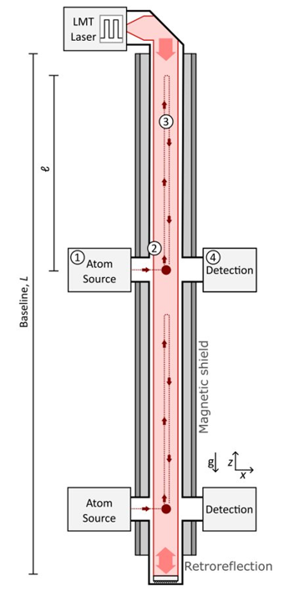
Intermediate-scale clock-atom interferometers
Long coherence times afforded by single-photon optical clock transitions
Favourable scaling compared to counter-propagating pulses (Raman transitions/Bragg pulses)
Large scale (km) gravitational wave detectors planned
  AION, MAGIS, MIGA, ELGAR, ZAIGA
  Also proposed to investigate ultralight dark matter – see other talks by, e.g. John Carlton, Chris Overstreet, Leonardo Badurina
Intermediate scale (~10 m) prototypes under development with clock atoms
  AION-10, Stanford Sr tower, VLBAI-Teststand, ZAIGA 10m tower
10m
S. Abend et al., AVS Quantum Sci. 6, 024701 (2024)

Slide 9
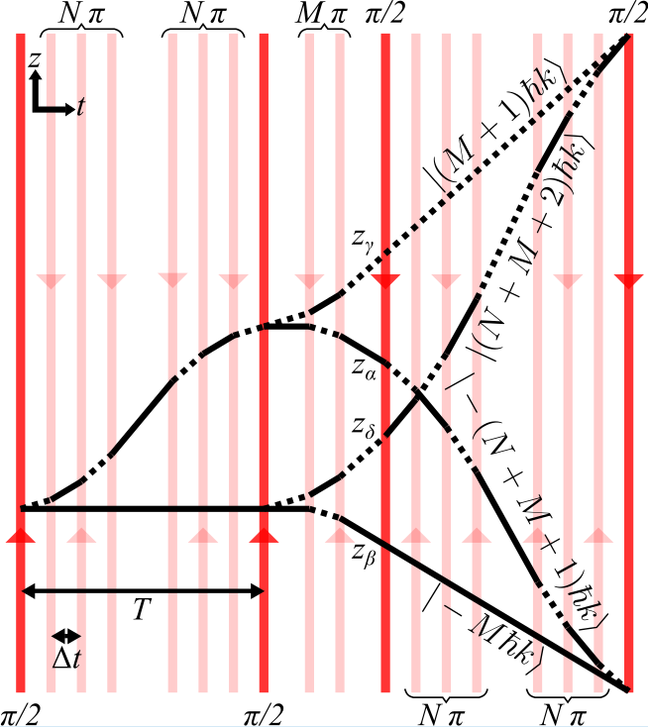


Recoil measurement scheme
LMT by π-pulses in alternating directions, separated by Δt
Differential phase:
$$ΔΦ=\frac{\left(N+1\right)\left(N+2M+2\right)ℏk^{2}(T−NΔt)}{m(X)}$$
$$−\frac{N\left(N+1\right)\left(N+2\right)ℏk^{2}Δt}{3 m(X)}$$
$$≥\left(N+1\right)\left(2M\left(N+1\right)+\frac{\left(N+2\right)\left(2N+3\right)}{3}\right)\frac{ℏk^{2}Δt}{m(X)}$$
$(2N+1)Δt≤T$ due to pulse timing constraints
JS et al., PRA 110, 053309 (2024)

Slide 10
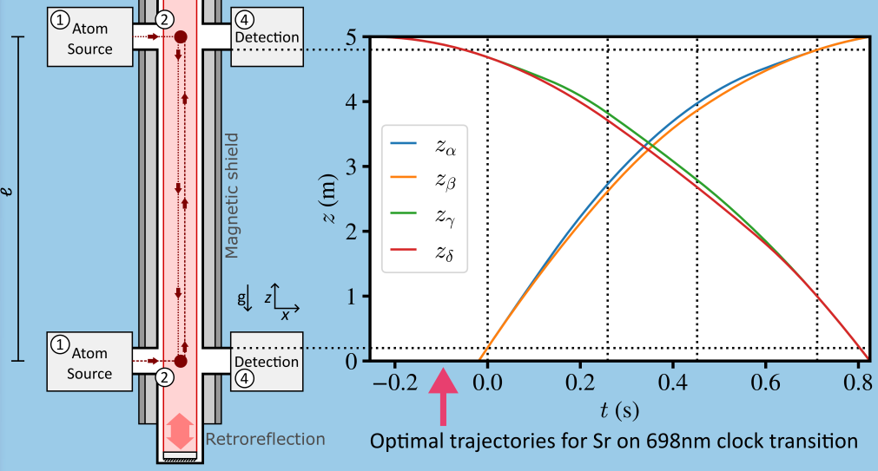

Prospects for intermediate-scale atom interferometers
`X’ configuration
Constraints:
$ΔΦ_{GG}=0$
Interferometry in magnetically shielded region
Atoms able to be imaged at same time
Optimise:
LMT (N & M)
Launch/drop
10

Slide 11
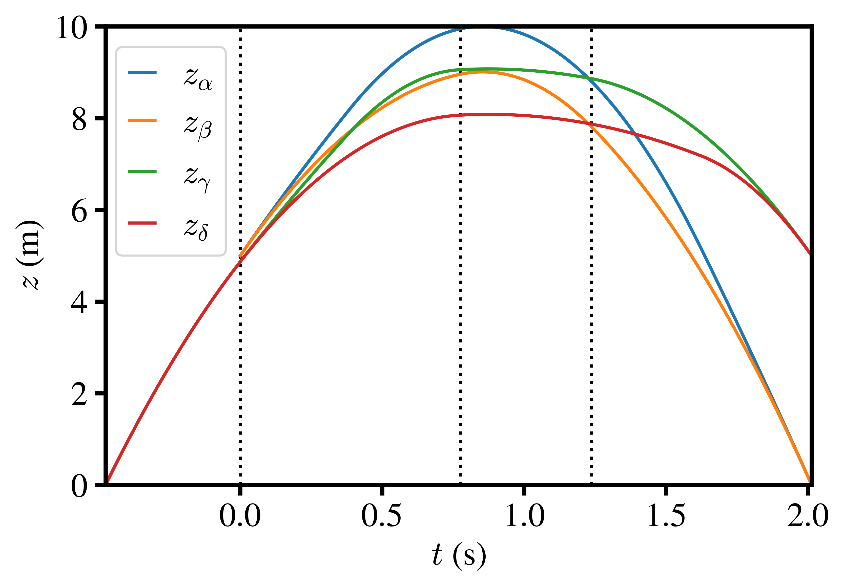

Prospects for intermediate-scale atom interferometers
Fountain configuration
Crossing the source region
  Questionable magnetic shielding?
Allows longer interrogation times
For Sr, L=10m, Δt=1ms:
  N=387
  M=461
  $ΔΦ=1.1×{10}^{10} rad$
11

Slide 12



Prospects for intermediate-scale atom interferometers
For L=5m (4.6m shielded region), Δt=1ms, optimal values are
  Sr: N=129, M=192, $ΔΦ=4.7×{10}^{8} rad$
  Yb: N=123, M=203, $ΔΦ=3.3×{10}^{8} rad$
At 1mrad resolution*
  Sr: $u_{r}\left(m\left(87Sr\right)\right)=2.2×{10}^{−12}$
  Yb: $u_{r}\left(m\left(171Yb\right)\right)=3.1×{10}^{−12}$
$$\frac{Δα}{α} ≈\frac{1}{2}\sqrt{{\left(\frac{ΔR_{∞}}{R_{∞}}\right)}^{2}+{\left(\frac{ΔA_{r}\left(e\right)}{A_{r}\left(e\right)}\right)}^{2}+{\left(\frac{ΔA_{r}\left(Sr\right)}{A_{r}\left(Sr\right)}\right)}^{2}+{\left(\frac{Δm\left(Sr\right)}{m\left(Sr\right)}\right)}^{2}}$$
Limited to 2× improvement in Δα without better relative masses
$$\left(Δt=1 ms\right)$$
2022 CODATA
2022 CODATA
2020 AME &
Rana et al. PRA 86, 050502(R) (2012)
⁸⁷Sr
A_{r}(¹⁷¹Yb)
$$8.2×{10}^{−11}$$
Precision of α would be limited by relative masses
*AION-10 target resolution per shot

Slide 13
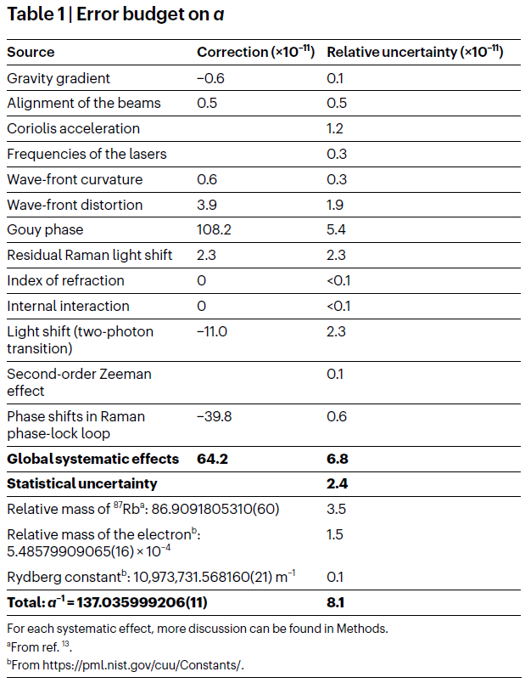
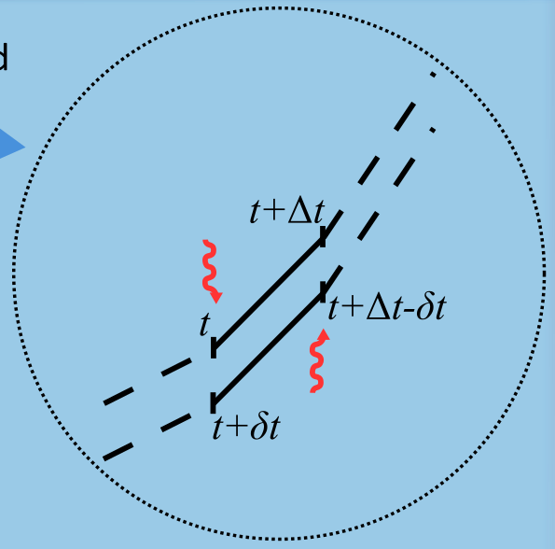

Systematics
Light propagation delay investigated & found to contribute above 1mrad level
Long list of other effects to consider…
(Rb experiment, LKB)
L. Morel et al., Nature 588, 61 (2020).

Slide 14
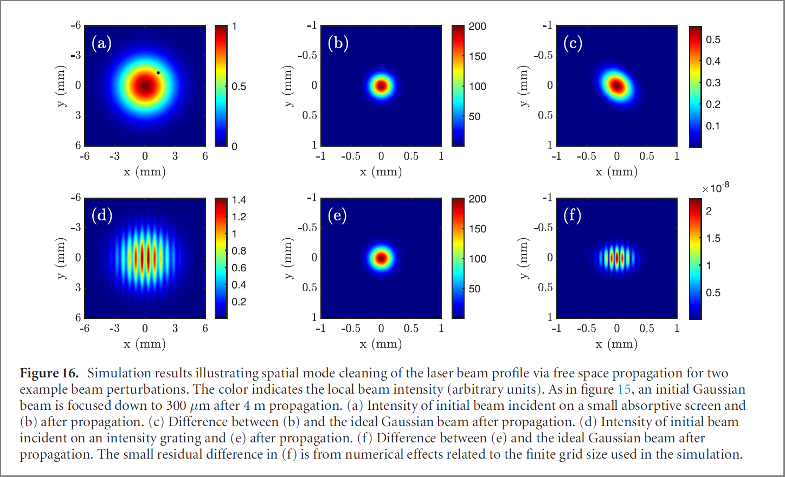

Laser beam quality
Focused after 4m propagation
$$\vec{k}=∇φ_{laser}(\vec{r})$$
Largest systematics in Rb and Cs measurements arise from the laser beam
Gravitational wave detector prototypes being designed with:
Large laser beams (~1cm diameter)
  Factor of ~2 larger than existing Rb and Cs recoil measurements
  Less divergence/curvature in laser wavefronts
In-vacuum free-space laser propagation and expanding telescope
  Spatial mode cleaning of imperfections in the beam
Imperfect initial beam
Scale of final imperfections
M. Abe et al., Quantum Sci. Technol. 6, 044003 (2021).

Slide 15
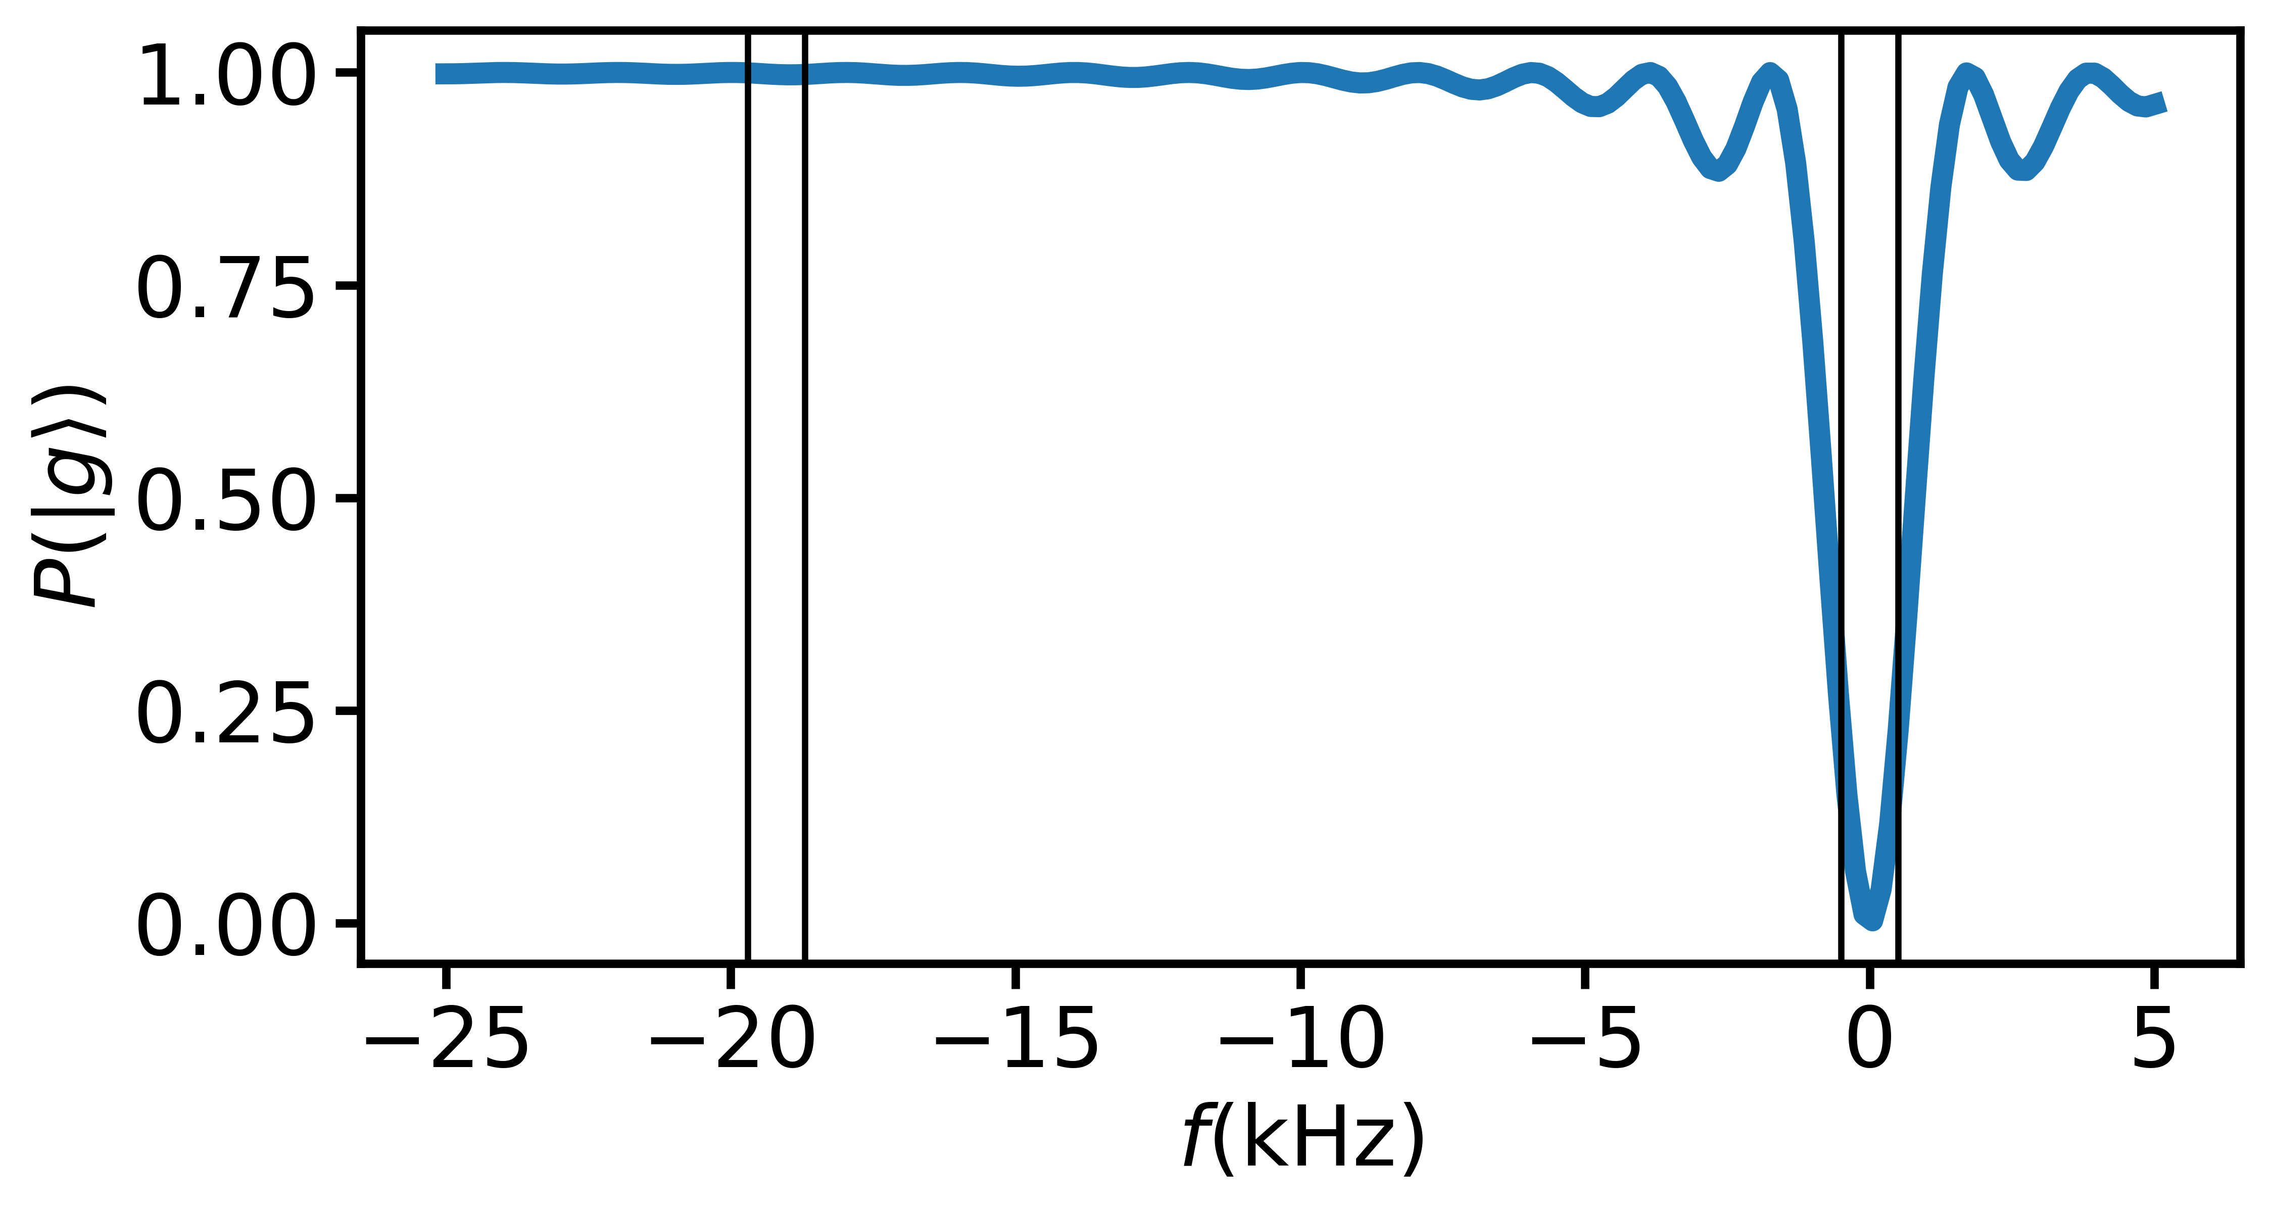



ac Stark shift
Rectangular pulses resonant at one velocity are near-resonant at others, including in the other interferometer arm of velocity-selective pulses
Leads to parasitic interferometers, loss of contrast
Doppler shift of $2×$ recoil velocity
Fidelity ~91.6%
$$Ω=2π×1 kHz$$
$$0.916100∼{10}^{−4}$$
$⇒$ not suitable for LMT
1kHz wide

Slide 16
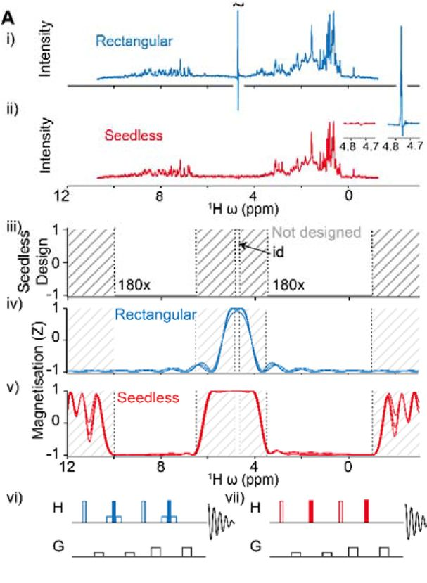
Quantum optimal control
NMR experts at Oxford have developed a program called Seedless
  Highly-optimised implementation of GRAPE in C++ allowing “on-the-fly” calculations
Pulse shaping via phase-only control
Functionality includes:
  Specifying desired behaviour of different frequency bands
  Robustness to Rabi frequency variations
NMR notation differs from that in atom interferometry, e.g. frequency in ppm
  Work-around: set the carrier frequency to 1MHz
C. Buchanan et al., bioRxiv:2024.01.31.578133.

Slide 17
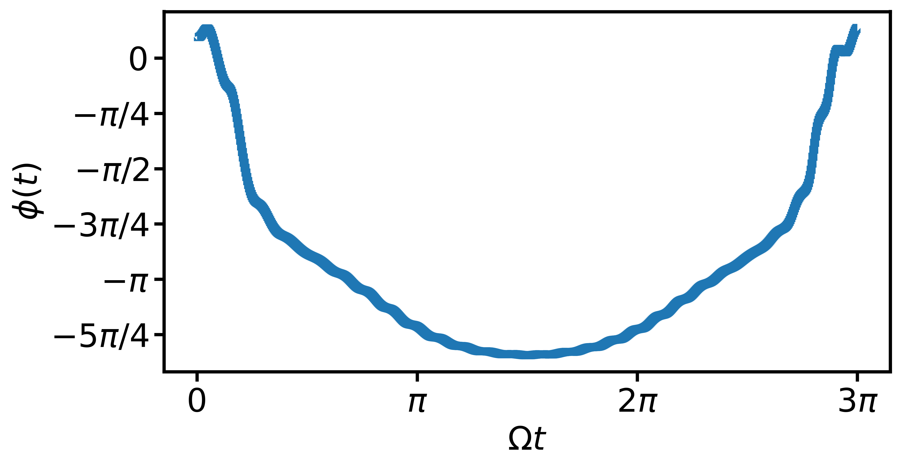
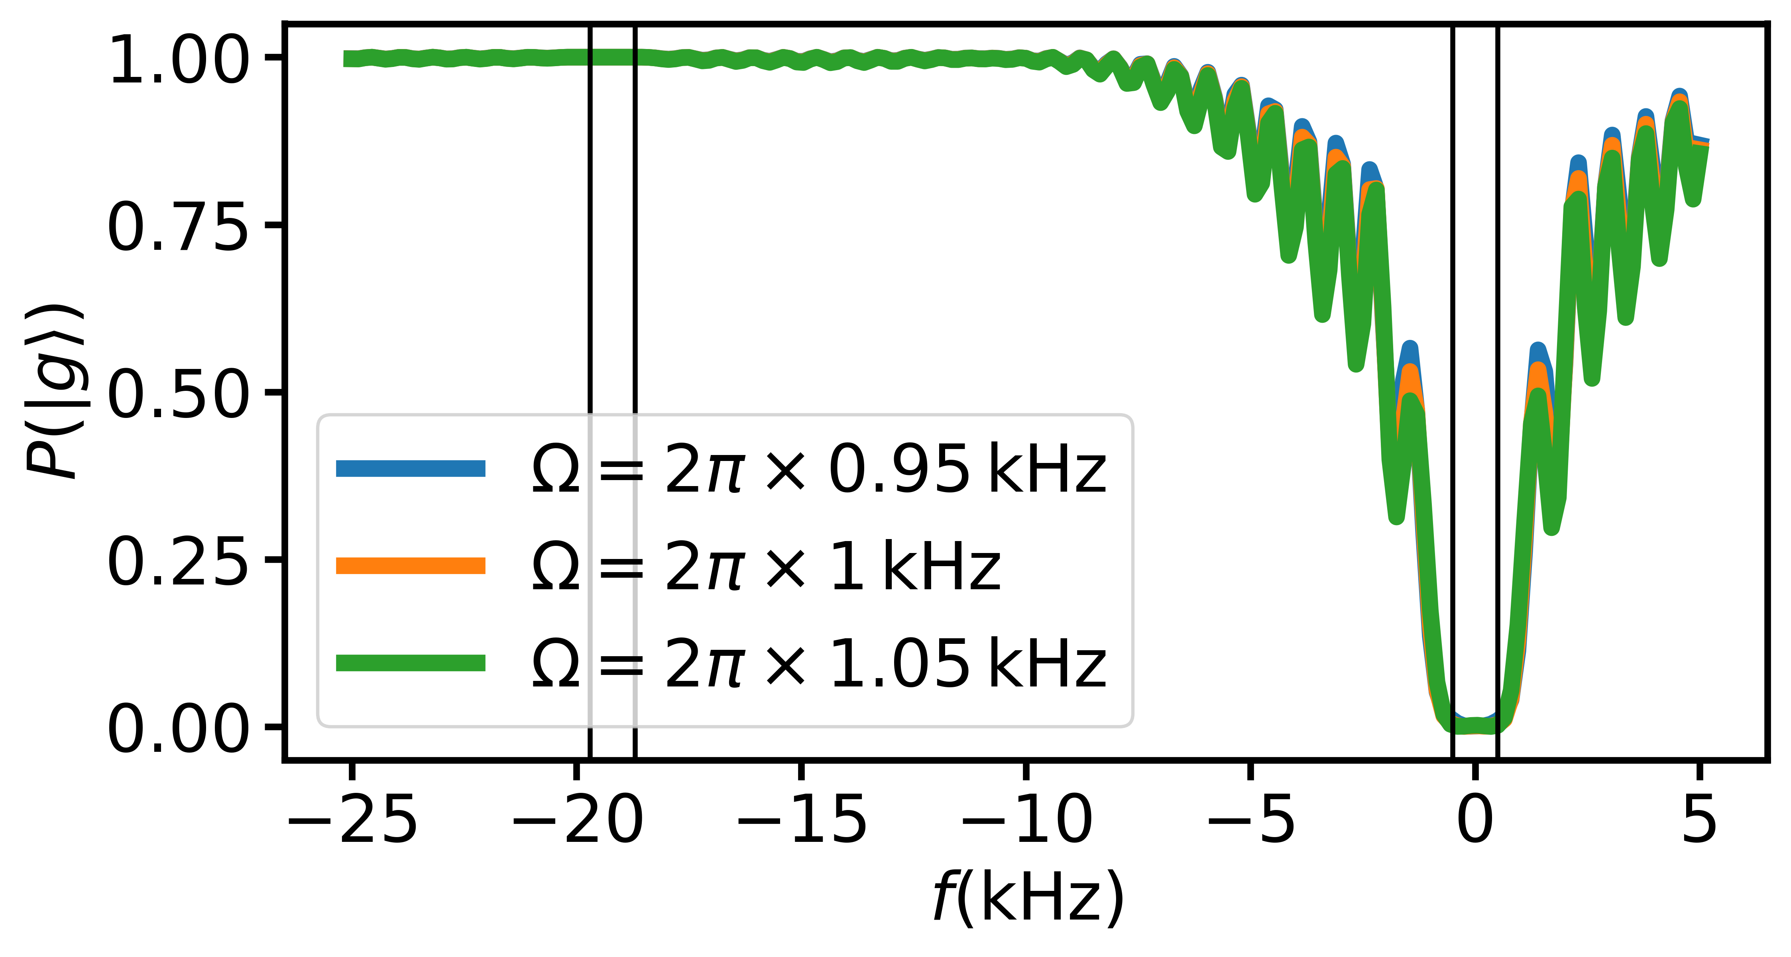
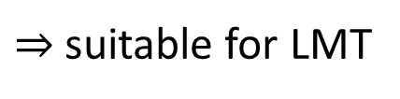


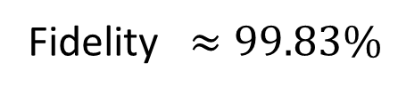
Preliminary calculations with Seedless (JS & JJ)
Assuming velocity spread $≲1 nK$ (obtainable with delta-kick collimation)
$⇒$ Doppler distribution width $∼k\sqrt{\frac{k_{B}T}{m}}≈2π×500 Hz$
Fidelity $≈99.83\%$
$$0.9983100∼0.84$$
$⇒$ suitable for LMT
Trade-off between fidelity, pulse duration, and width of Doppler distribution

Slide 18
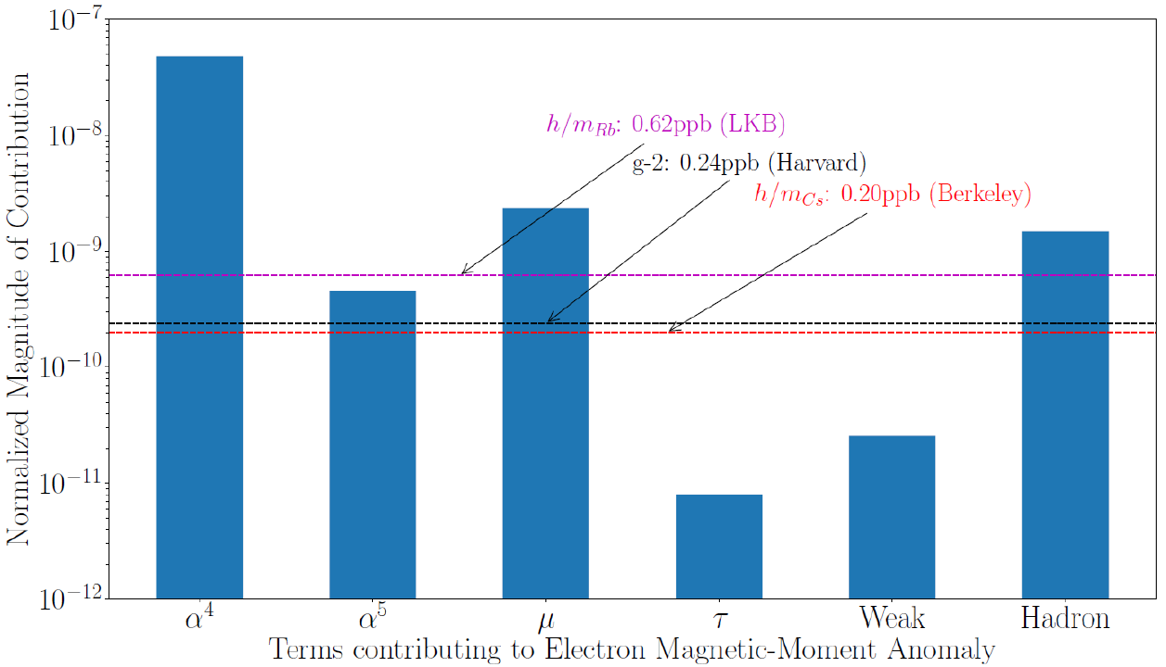


Conclusions & outlook
Recoil experiments contribute to best empirical determinations of $α$
Future experiments with Sr, Yb could aid in resolving discrepancy between Rb, Cs
Experiments over longer baselines offer opportunities for:
  Better laser beam preparation (reduced systematics)
  Longer interrogation times, higher momentum transfer (increased sensitivity)
Much still to investigate for implementation with single-photon transitions
$$\frac{m\left(Sr 5s5p{}_{}^{3}{P_{0}}\right)}{m\left(Sr 5s^{2}{}_{}^{1}{S_{0}}\right)}−1=2.2×{10}^{−11}$$
81ppt (LKB)
👀
Limit due to current relative masses just short of seeing weak interaction contribution to g_{e}-2
Factor of 10 improvement sees weak interaction contribution and on the verge of tau contribution
R. Parker et al., Science 360, 191 (2018).

Slide 19

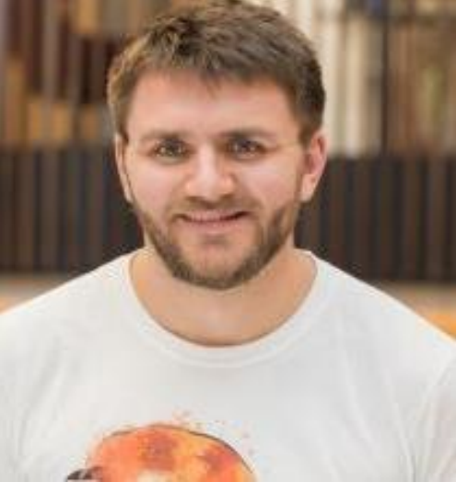
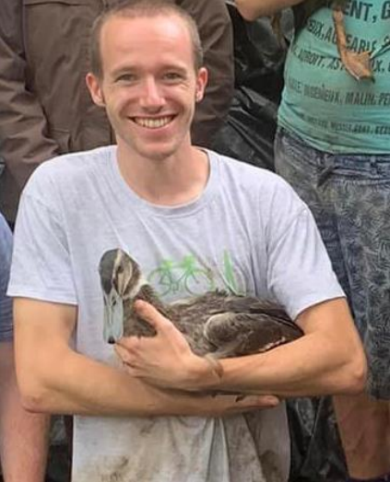
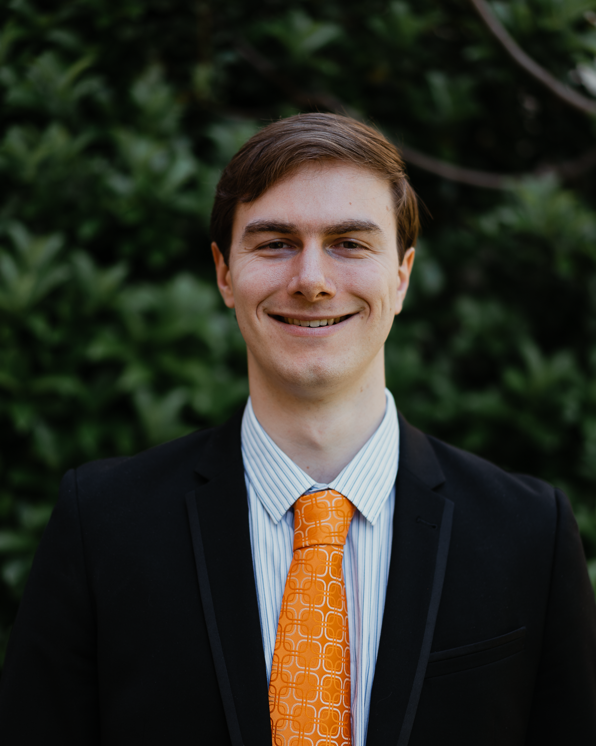

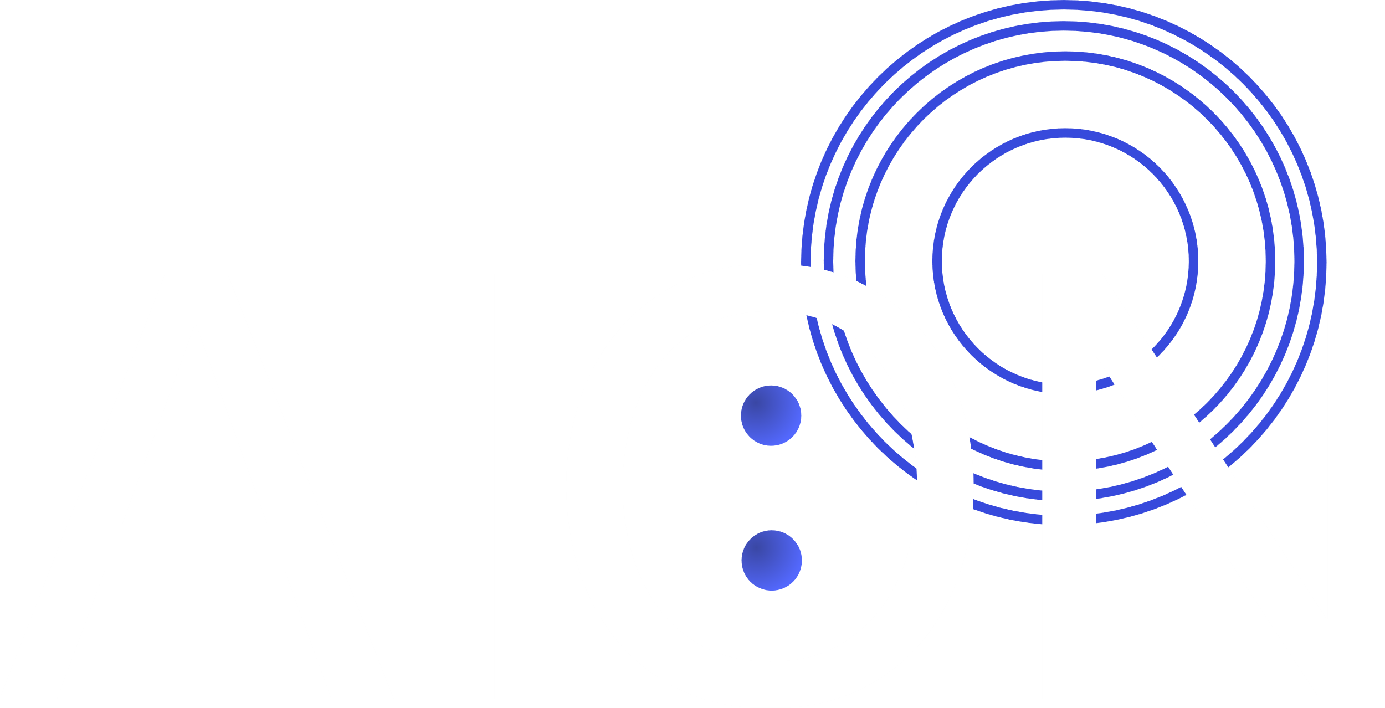



Acknowledgements
NMR expert:
Prof Christopher Foot Dr Thomas Hird Dr Kenneth Hughes Jesse Schelfhout Prof Jonathan Jones
Seedless code for NMR pulses from Prof. Andrew Baldwin et al. (Oxford Chemistry Department) & JJ
Thanks to many members of the atom interferometry community with whom we have had discussions

Slide 20
Thank you!
Questions?

Slide 21
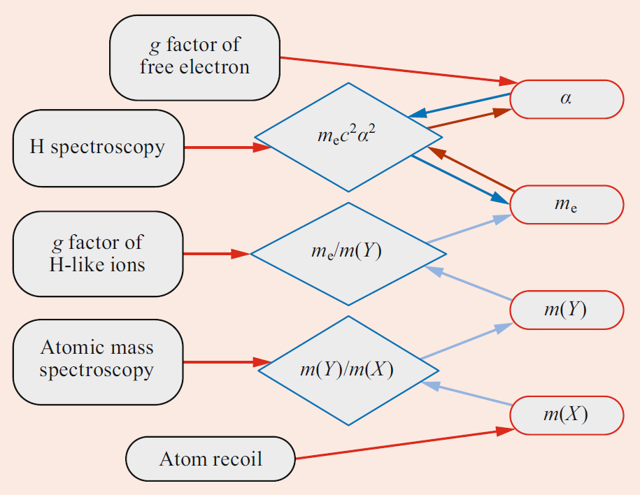




Atomic mass & fundamental constants
Kilogram redefined in 2019 by fixing $h=6.62607015×{10}^{−34} J s$
Measurement of $h/m\left(X\right)$ gives $m\left(X\right)$ in kg
Many constants follow:
$m_{u}=m\left(X\right)/A_{r}\left(X\right)$
$m\left({}_{ }^{12}C\right)=12m_{u}$
$m_{e}=A_{r}\left(e\right)m_{u}$
$α=\sqrt{2hR_{∞}/(cm_{e})}$
$μ_{0}=4παℏ/(e^{2}c)$ – hence also $ε_{0}=1/(μ_{0}c^{2})$
$μ_{B}=eℏ/(2m_{e})$
$a_{0}=ℏ/(αm_{e}c)$
$$R_{∞}$$
$$A_{r}\left(e\right)$$
$$A_{r}\left(X\right)$$
E. Tiesinga and P. Mohr, “Tests of fundamental physics”, in Drake (Ed.) Springer handbook of atomic, molecular, and optical physics, 2nd edition, Springer, 2023.

Slide 22
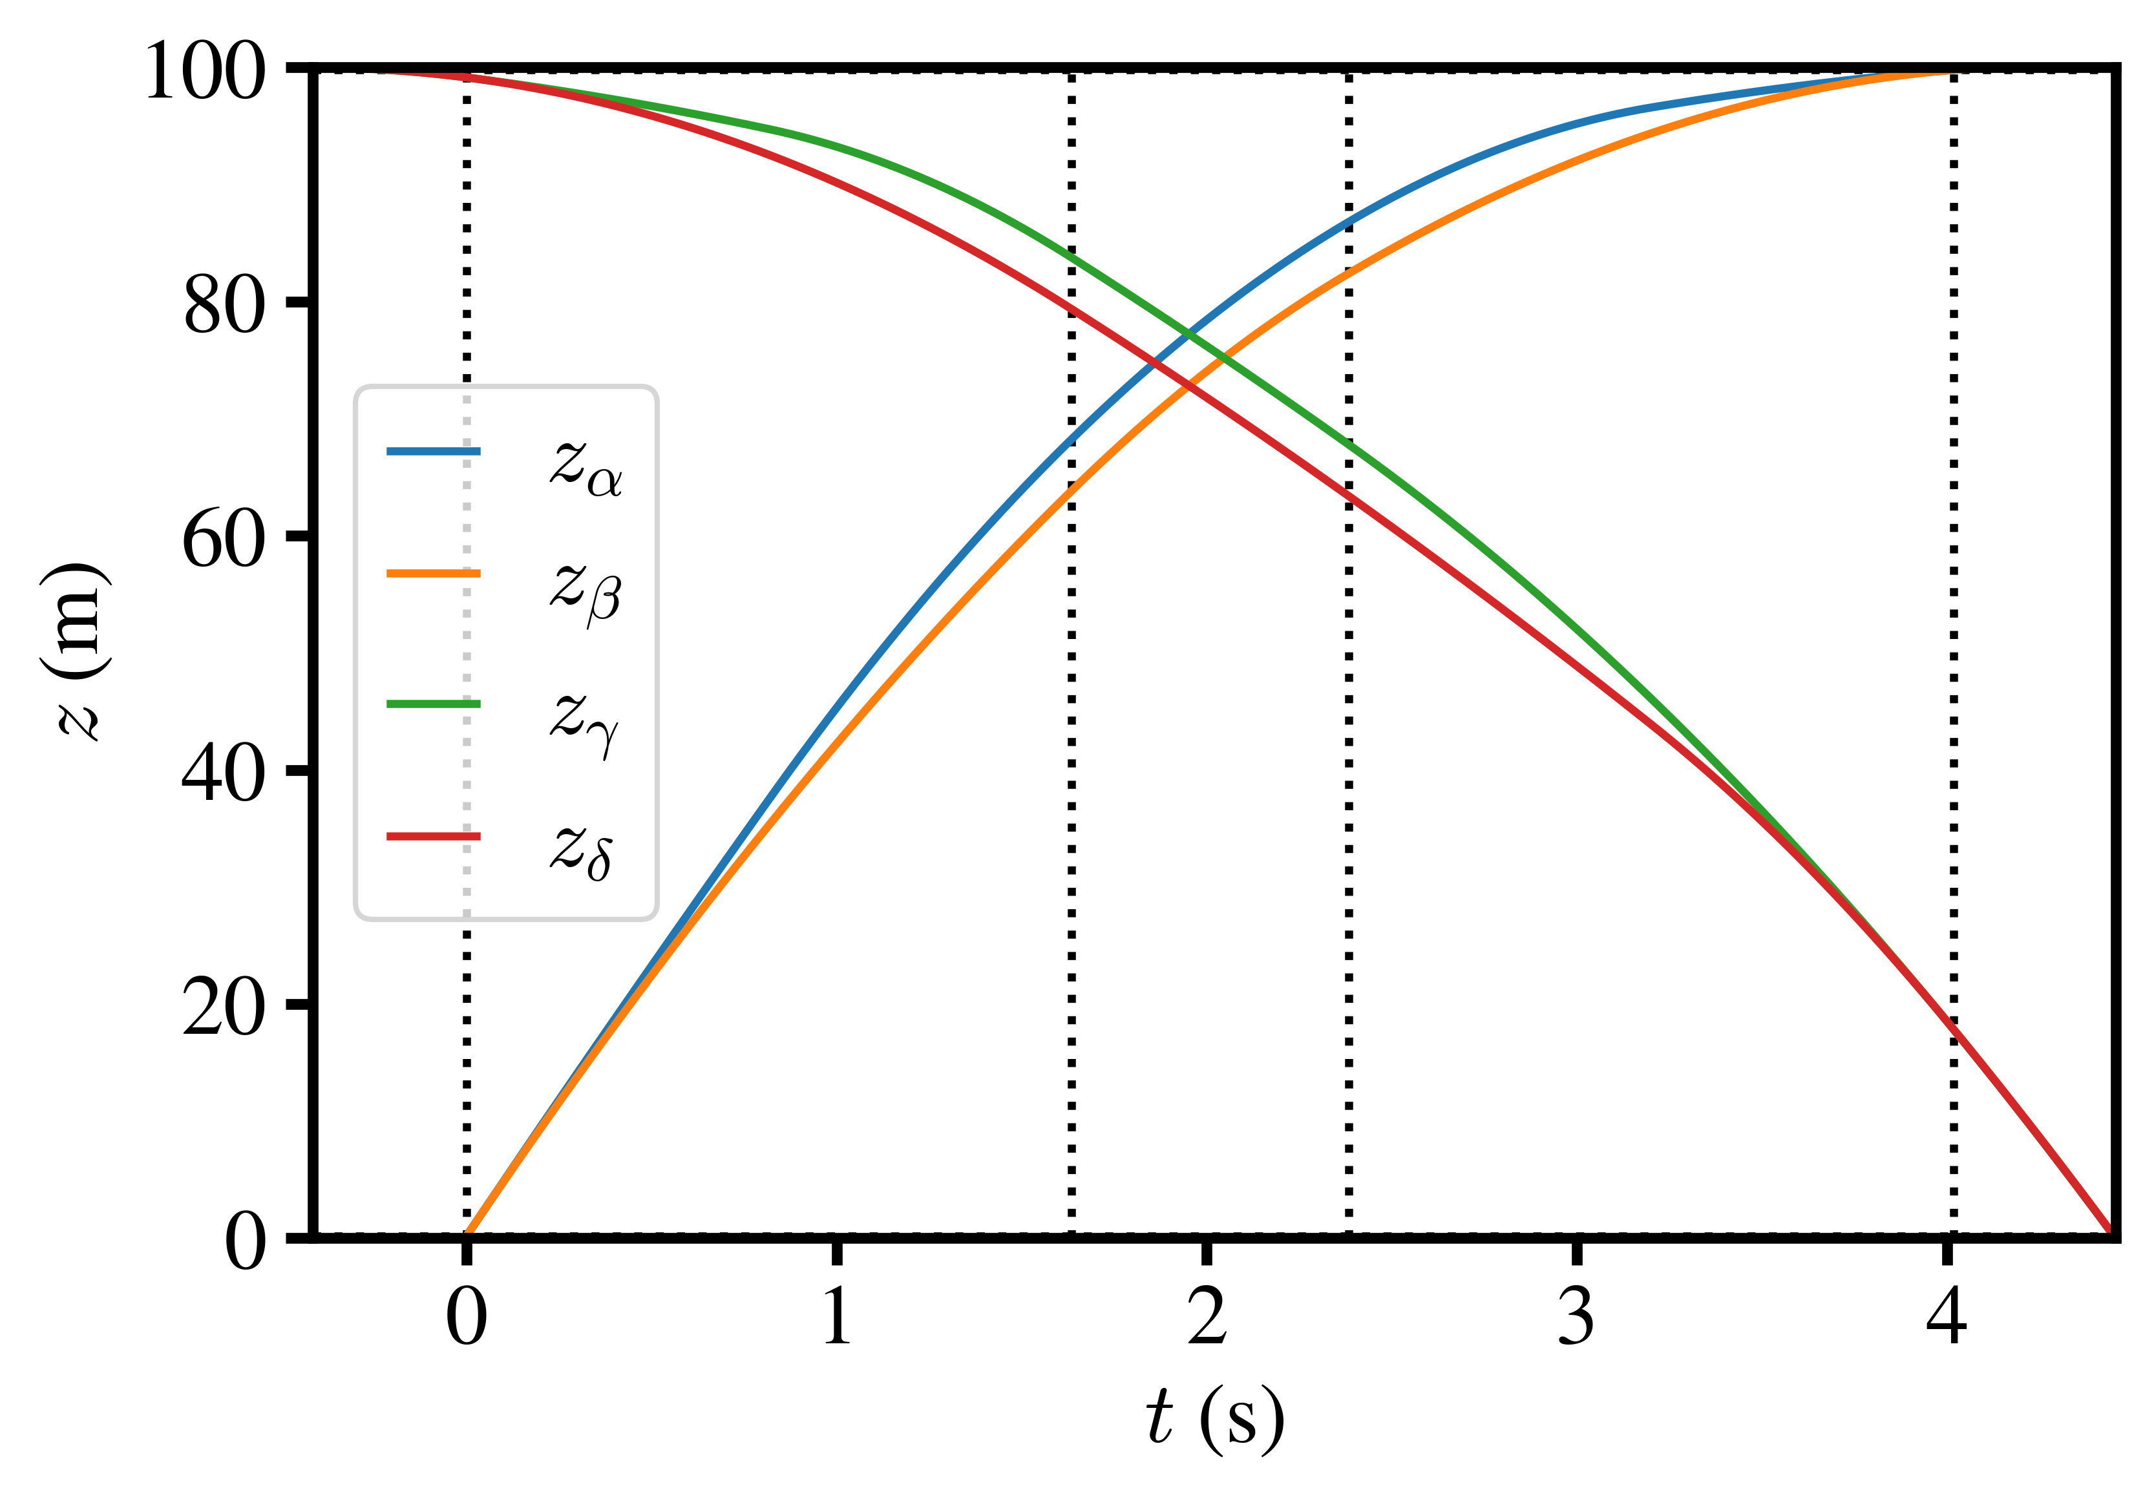
Bonus slide: 100m `X’ configuration

