Slide 1

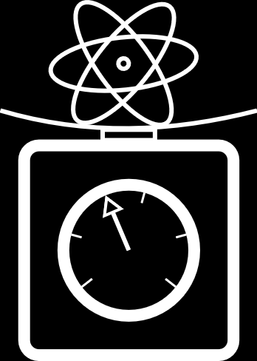
Clock atom interferometry for determining α
Jesse Schelfhout
University of Oxford
“Precision Determinations of the Fine-structure Constant” Workshop
Mainz Institute for Theoretical Physics
27th October 2025

Slide 2
Outline
A fresh perspective on the current state of play
Schemes for clock atom interferometers
Opportunities with intermediate-scale instruments (gravitational wave detector prototypes)
Coherent control of the atom-light interactions

Slide 3
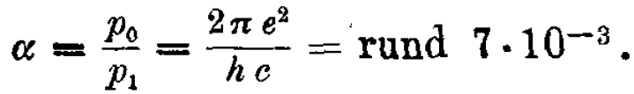
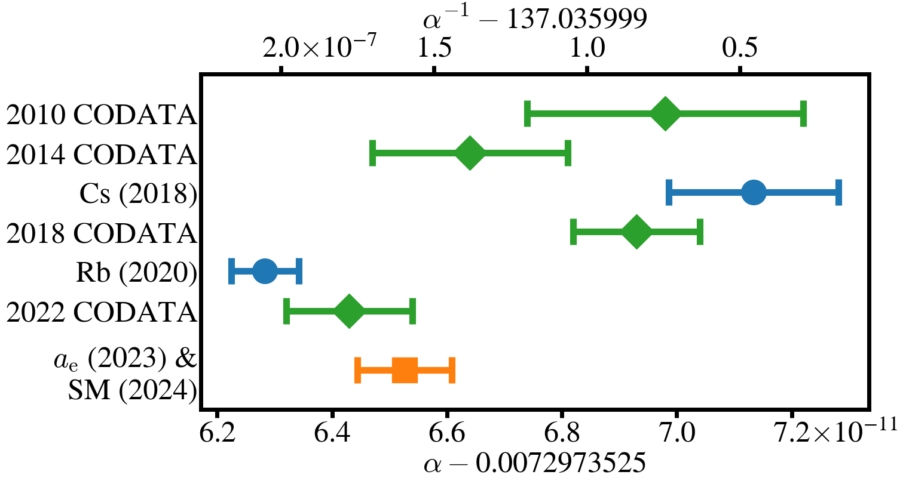


Fine-structure constant ($α$)
$$α^{2}=\frac{2hR_{∞}}{m_{e}c}$$
Coupling strength for electromagnetic interaction
An empirical parameter of the Standard Model
>5σ discrepancy between best recoil experiments (Rb & Cs)
A. Sommerfeld, Ann. Phys. 356, 1 (1916).
P. Mohr et al., RMP 84, 1527 (2012).
P. Mohr et al., RMP 88, 035009 (2016).
R. Parker et al., Science 360, 191 (2018).
E. Tiesinga et al., RMP 93, 025010 (2021).
L. Morel et al., Nature 588, 61 (2020).
P. Mohr et al., RMP 97, 025002 (2025).
X. Fan et al., PRL 130, 071801 (2023).
S. Volkov, PRD 110, 036001 (2024).
>5σ

Slide 4
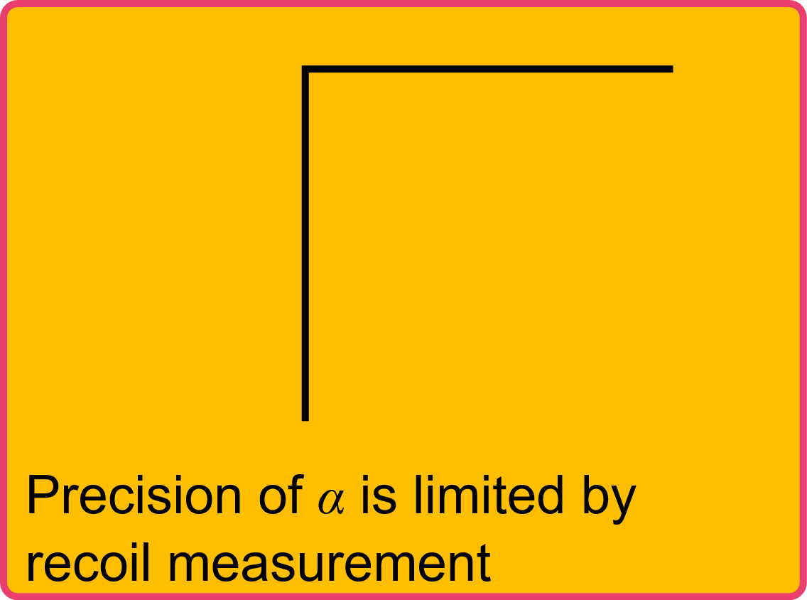
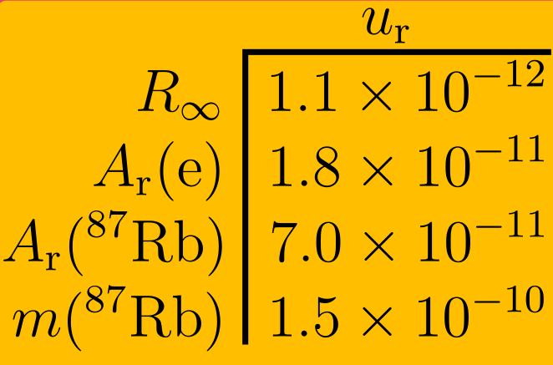


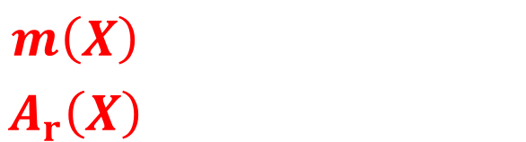


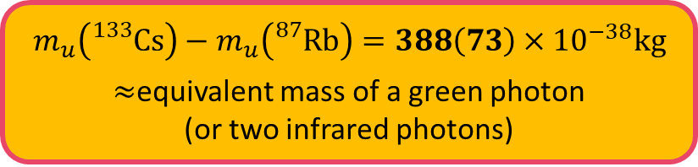

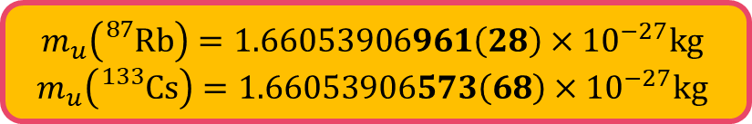
Atomic mass constant ($m_{u}$)
$α\left(Rb\right) \& α\left(Cs\right)$ both use same $A_{r}\left(e\right) \& R_{∞}$
$⇒$ Discrepancy is in $m_{u}=m\left(X\right)/A_{r}\left(X\right)$
$⇒$ Best test of SM is limited by knowledge of $m\left({}_{}^{12}C\right)$
2022 CODATA
2022 CODATA
2020 AME
Rb (2020)
$$\frac{g_{e}−2}{2}=\sum_{n}{C_{2n}{\left(\frac{α}{π}\right)}^{n}}+a_{μτ}+a_{hadronic}+a_{weak}$$
$$\frac{e^{2}}{4πε_{0}ℏc}=α=\sqrt{\frac{2hR_{∞}}{m_{e}c}}$$
$$m_{u}\left({}_{}^{87}{Rb}\right)=1.66053906961\left(28\right)×{10}^{−27}kg$$
$$m_{u}\left({}_{}^{133}{Cs}\right)=1.66053906573\left(68\right)×{10}^{−27}kg$$
$$m_{u}\left({}_{}^{133}{Cs}\right)−m_{u}\left({}_{}^{87}{Rb}\right)=388\left(73\right)×{10}^{−38}kg$$
$≈$equivalent mass of a green photon
(or two infrared photons)
$$m_{e}=A_{r}\left(e\right)m_{u}$$
$$\frac{m\left(X\right)}{A_{r}\left(X\right)}=m_{u}≡\frac{m\left({}_{}^{12}C\right)}{12}$$

Slide 5
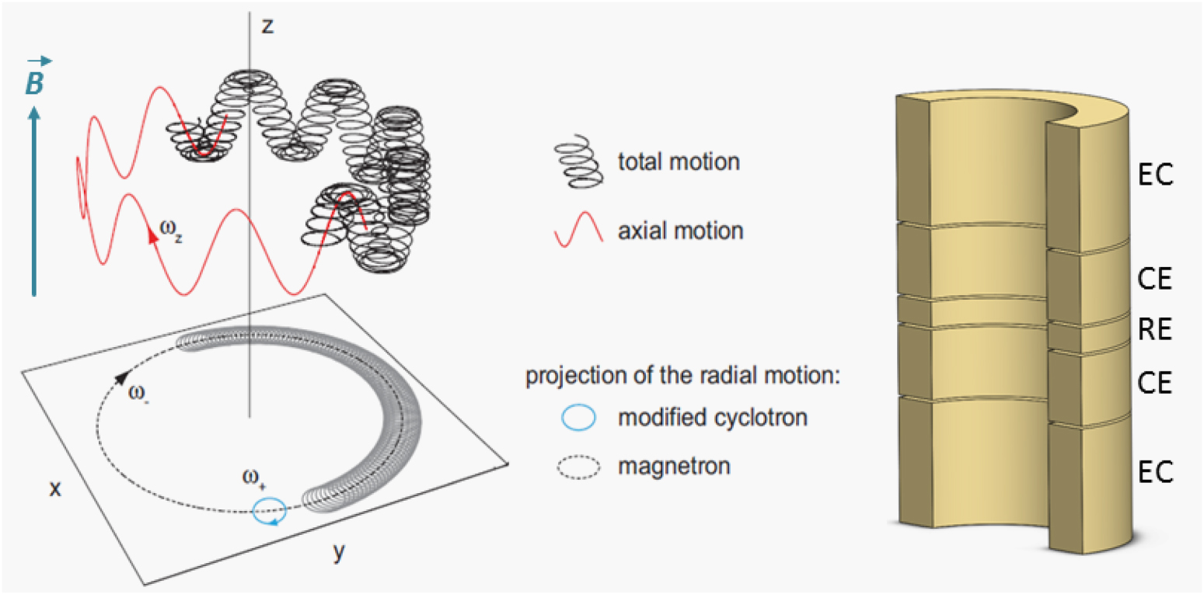


$A_{r}\left(X\right)$: Penning traps
Charged ion in uniform magnetic
field and quadrupolar electric field
Cyclotron frequency determined
using Brown-Gabrielse invariance
theorem:
$\frac{qB}{m}=ω_{c}=\sqrt{ω_{+}^{2}+ω_{z}^{2}+ω_{−}^{2}}$
Mass ratios from co-trapped ions
used to link back to ¹²C
Precisions of better than 10⁻¹⁰ can be achieved, e.g. PENTATRAP
L. Brown & G. Gabrielse, PRA 25, 2423 (1982); E. Myers, IJMS 349-350, 107 (2013); K. Blaum et al., QST 6, 014002 (2020).

Slide 6
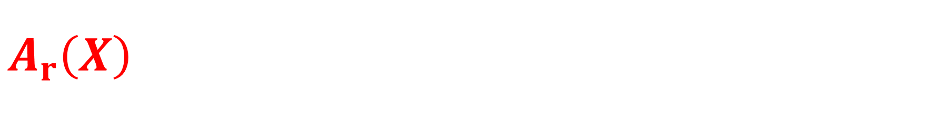
$A_{r}\left(X\right)$: Getting to ¹²C (according to AME2020)
⁸⁷Rb
⁸⁷Sr
¹³³Cs
¹⁷¹Yb
⁸⁴Kr
¹²⁹Xe
⁸⁶Kr
¹³²Xe
¹³¹Xe
C₆H₁₄
N₆
C₂O₄
C₃O₆
C₁₀H₁₀
¹⁴N₁₀
Molecular data from NIST Atomic Spectra Database*
¹²C
W. Huang et al., CPC 45, 030002 (2021).
*No longer being updated?

Slide 7








$m\left(X\right)$: Ramsey-Bordé interferometers
Four $π/2$ pulses form two conjugate Ramsey interferometers
Bordé realised its use as a recoil-sensitive atom interferometer
Two interferometers close for
$$t_{2}−t_{1}=T=t_{4}−t_{3}$$
Differential phase:
$ΔΦ=\frac{2ℏk^{2}T}{m(X)}=4ω_{rec}T$
$$\frac{π}{2}$$
$$\frac{π}{2}$$
$$x$$
t₁
t₂
t₃
t₄
$$t$$
$$\frac{π}{2}$$
$$\frac{π}{2}$$
C. Bordé et al., PRA 30, 1836 (1984); C. Bordé, Phys. Lett. A 140, 10 (1989); J. Bergquist et al., PRL 38, 159 (1977).

Slide 8
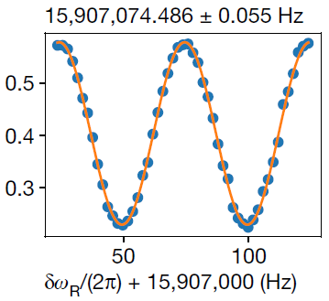
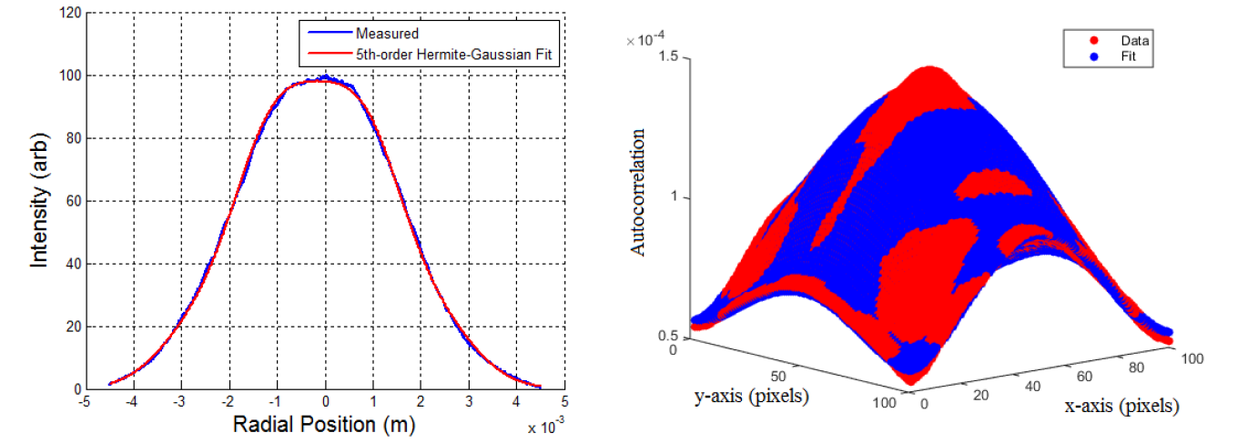

Measurement principles
Ramsey sequence provides reference to atomic frequency
Velocity (from recoil) shifts resonance frequency for second Ramsey sequence
$$ΔΦ=C\left(\frac{ℏk^{2}}{m}−δω_{R}\right)T+corrections$$
Measure required frequency shift, $δω_{R}$
(find $ΔΦ=0$ independent of $T$)
Measure laser wavevector, $k$
(depends on wavefront curvature)
Calculate mass of atom
L. Morel et al., Nature 588, 61 (2018); R. Parker et al., Science 360, 191 (2018).

Slide 9
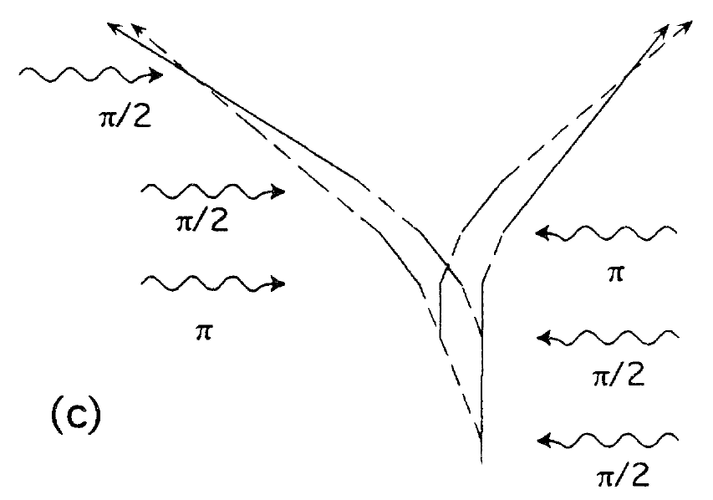
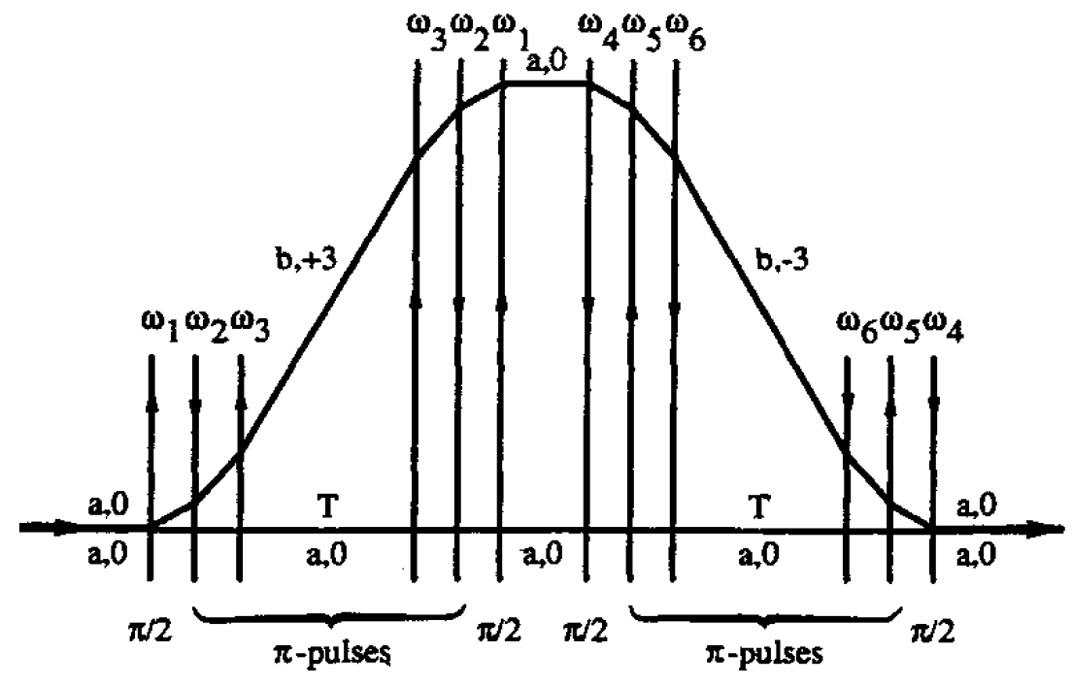
Enhanced Ramsey-Bordé interferometry
Large momentum transfer (LMT) can increase sensitivity
Sensitivity scales as difference in recoil energy between interferometer arms
LINEAR
SCALING
QUADRATIC
SCALING
D. Weiss et al., PRL 70, 2706 (1993). C. Bordé et al., AIP Conf. Proc. 290, 76 (1993).

Slide 10
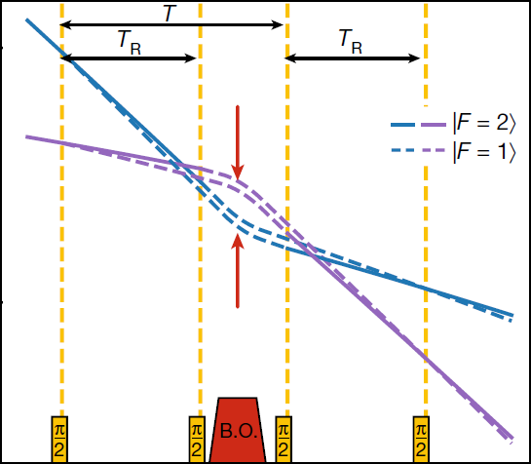
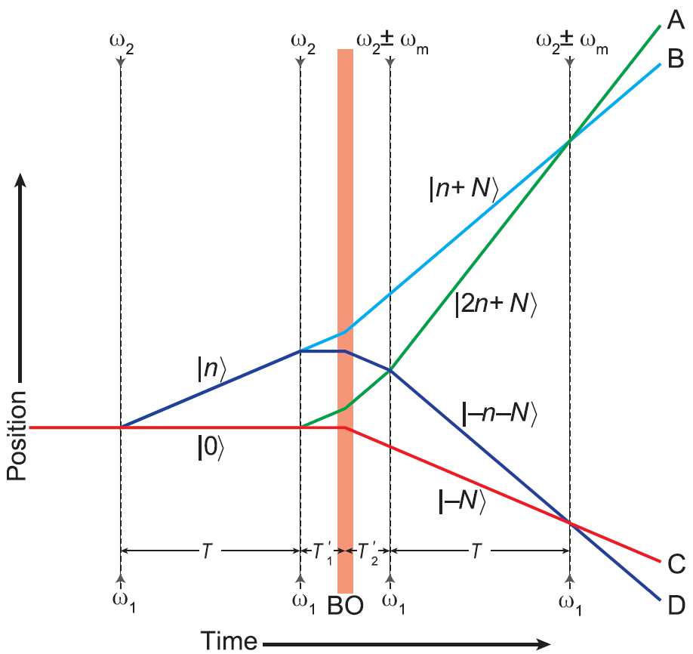

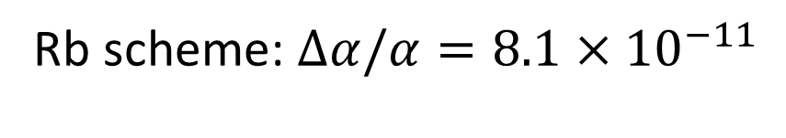

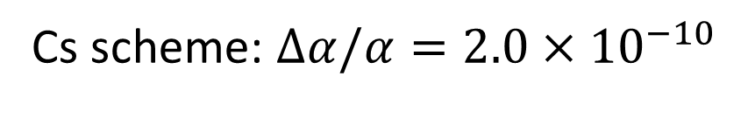
State of the art (Rb & Cs)
Rb scheme: $Δα/α=8.1×{10}^{−11}$
Cs scheme: $Δα/α=2.0×{10}^{−10}$
Bragg beam-splitter
n=10ħk
N=400ħk
n=2ħk
Raman beam-splitter
N=1000ħk
Bloch oscillations
$$T_{R}∼20 ms$$
$$T∼80 ms$$
L. Morel et al., Nature 588, 61 (2020); R. Parker et al., Science 360, 191 (2018)

Slide 11
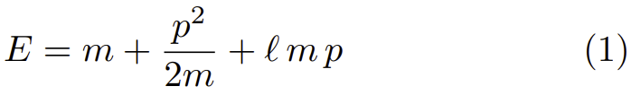

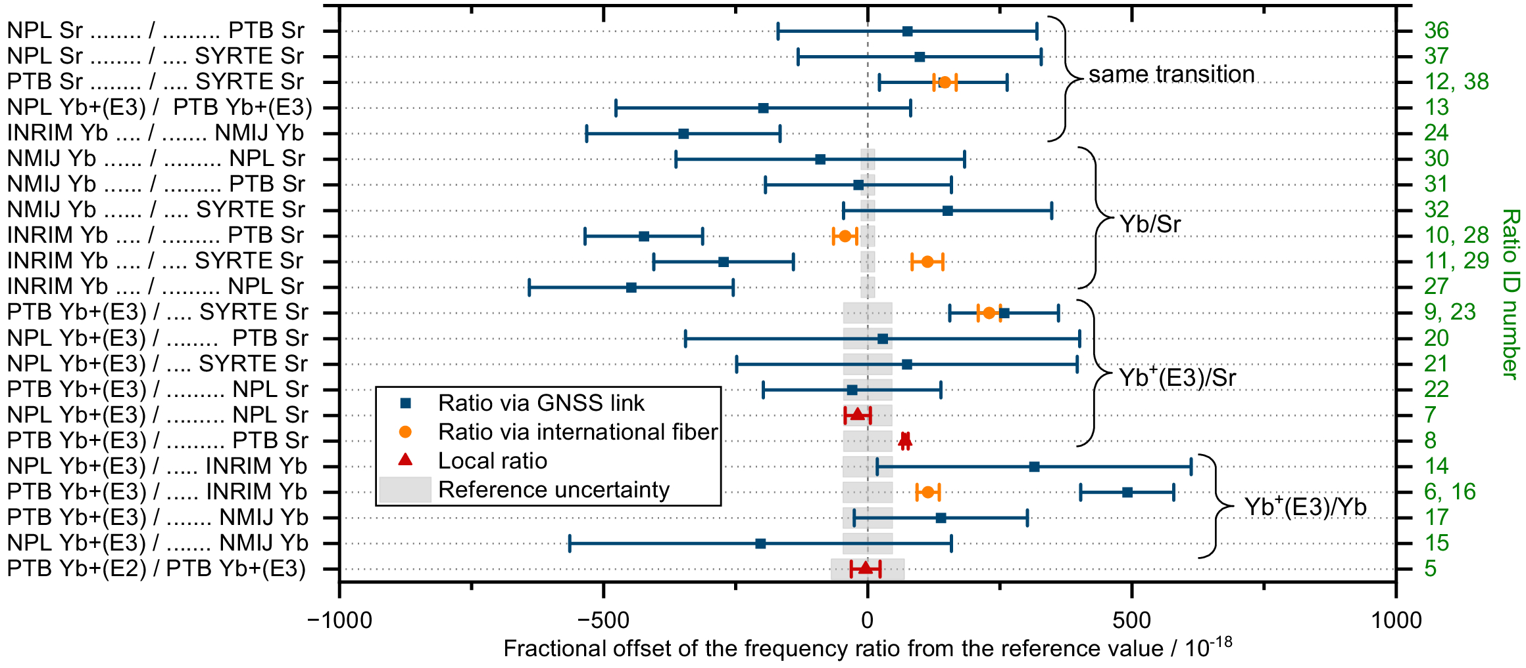
What’s different? (Cause(s) of discrepancy?)
Atom-light interactions used for beam-splitter (Raman vs Bragg)
Future research direction for Paris and/or Berkeley
Interferometry sequence
Speculation that modified energy-momentum
dispersion relation is responsible for shifting α(Cs)
Atomic species (Rb vs Cs)
Equivalence principle tests produce
consistent results between species
Location (Paris vs Berkeley)
g-2 experiments produce consistent results
before and after moving locations
Implementation
Clock comparisons suggest a single
measurement should not be trusted
n=10ħk
N=400ħk
n=2ħk
N=1000ħk
G. Amelino-Camelia et al., arXiv:2508.06171 [gr-qc]; T. Lindvall et al., Optica 12, 843 (2025).

Slide 12
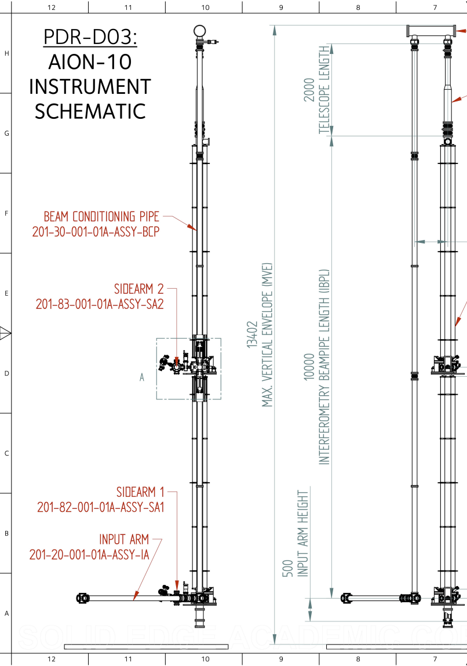
Intermediate-scale clock-atom interferometers
Different atomic species and atom-light interactions
Long coherence times afforded by single-photon optical clock transitions
Sr (5s²) ¹S₀ – (5s5p) ³P₀ ~ 150s
Yb (6s²) ¹S₀ – (6s6p) ³P₀ ~ 20s
Intermediate scale (~10 m) gravitational wave detector prototypes under development with clock atoms
Hannover VLBAI-Teststand (Yb upgrade)
Stanford Sr tower
AION-10 (Oxford Sr tower)
ZAIGA 10m tower (plans for Sr or Yb?)
Different systematics and controllability
Internal energy much more important than for Raman
Dedicated beam-cleaning optics for high quality wavefronts
K. Bongs et al. (AION Collaboration), arXiv:2508.03491 [physics.atom-ph]

Slide 13
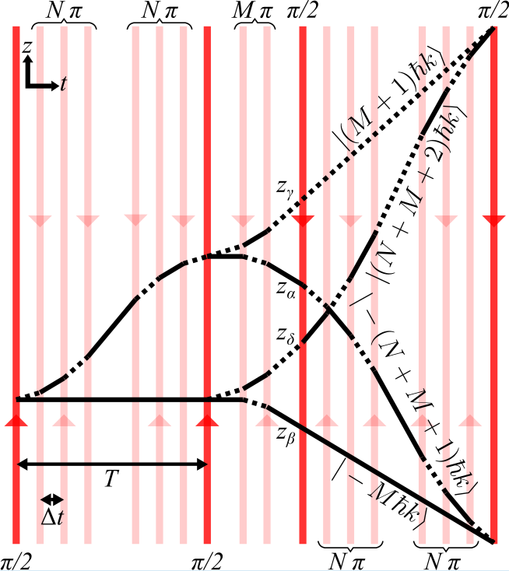

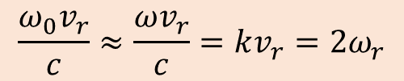
Clock recoil measurement scheme
Contributions to differential phase calculation from
Internal evolution during light propagation delay, $ω_{0}Δz/c$
Wavepacket separation, $kΔz$
Differential phase:
$$ΔΦ=2\left(N+1\right)\left(ω_{0}\frac{v_{r}}{c}−ω_{r}\right)\left[\left(N+2M+2\right)\left(T−NΔt\right)−\frac{N\left(N+2\right)}{3}Δt\right]+O\left(\frac{1}{c}\right)$$
$$\frac{ω_{0}v_{r}}{c}≈\frac{ωv_{r}}{c}=kv_{r}=2ω_{r}$$
JS et al., PRA 110, 053309 (2024)

Slide 14
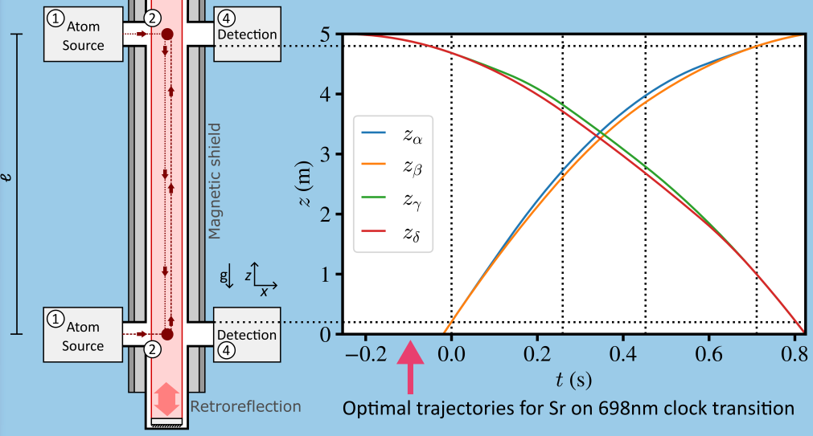

Prospects for intermediate-scale atom interferometers
`X’ configuration
Constraints:
$ΔΦ_{GG}=0$
Interferometry in magnetically shielded region
Atoms able to be imaged at same time
Optimise by varying:
LMT (N & M)
Launch/drop
14

Slide 15
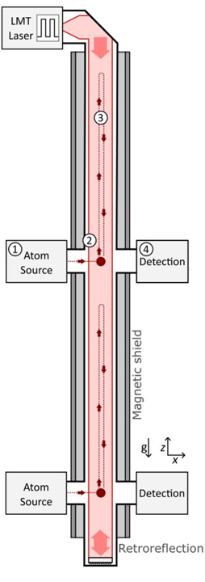
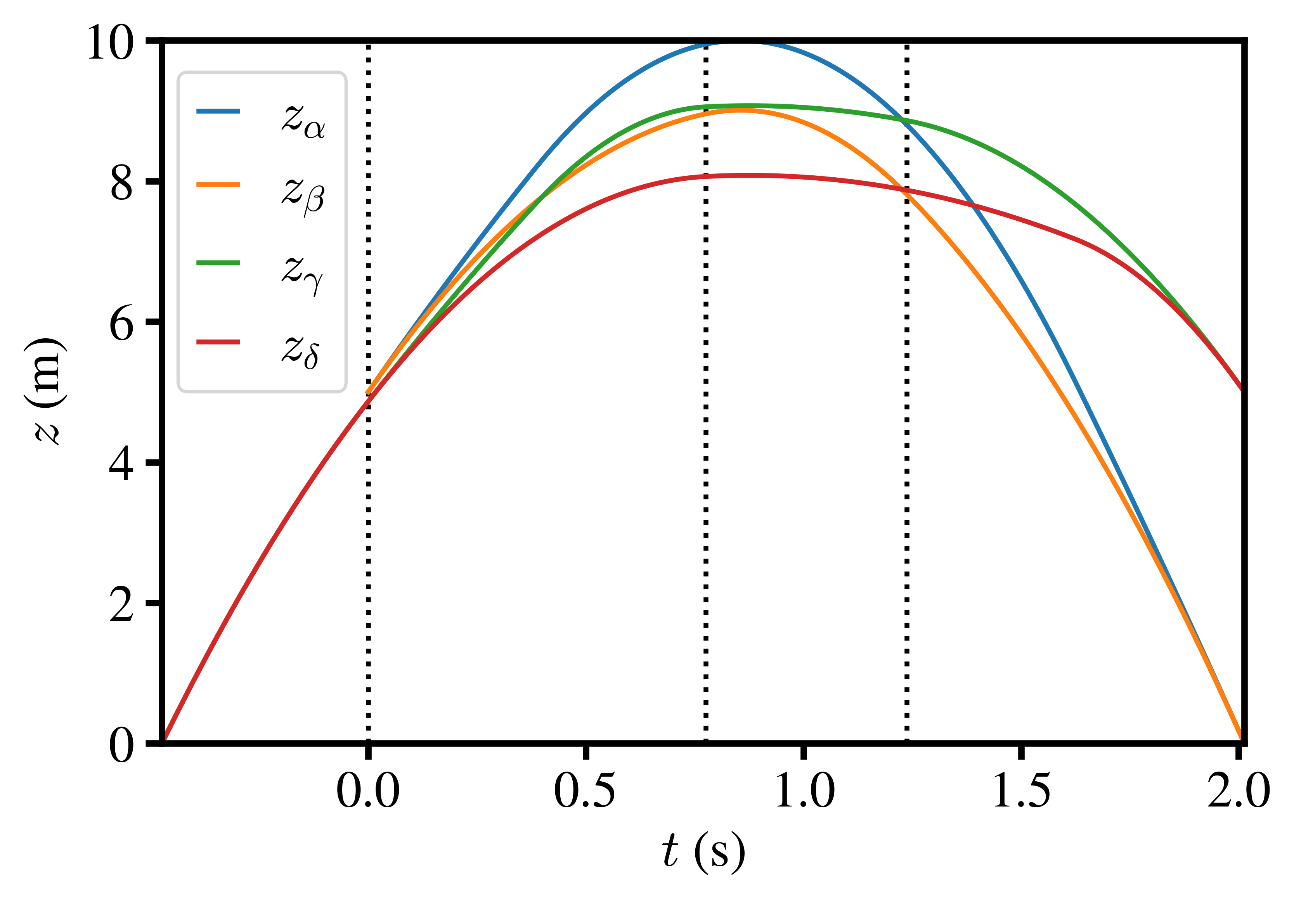

Prospects for intermediate-scale atom interferometers
Fountain configuration
Crossing the source region
Questionable magnetic shielding
Allows longer interrogation times
For Sr, L=10m, Δt=1ms:
N=387
M=461
$ΔΦ=1.1×{10}^{10} rad$
15

Slide 16



Prospects for intermediate-scale atom interferometers
For 4.6m interferometry region using feasible parameters with 1mrad phase resolution*
$u_{r}\left(m\left(87Sr\right)\right)=2.2×{10}^{−12}$
$u_{r}\left(m\left(171Yb\right)\right)=3.1×{10}^{−12}$
Limited to 2× improvement in Δα
without better relative masses
$$\frac{Δα}{α} ≈\frac{1}{2}\sqrt{{\left(\frac{ΔR_{∞}}{R_{∞}}\right)}^{2}+{\left(\frac{ΔA_{r}\left(e\right)}{A_{r}\left(e\right)}\right)}^{2}+{\left(\frac{ΔA_{r}\left(Sr\right)}{A_{r}\left(Sr\right)}\right)}^{2}+{\left(\frac{Δm\left(Sr\right)}{m\left(Sr\right)}\right)}^{2}}$$
$u_{r}\left(m\left(87Sr\right)\right)$ likely dominated by systematics rather than statistics
$$\left(Δt=1 ms\right)$$
2022 CODATA
2022 CODATA
2020 AME &
Rana et al. PRA 86, 050502(R) (2012)
⁸⁷Sr
A_{r}(¹⁷¹Yb)
$$8.2×{10}^{−11}$$
Precision of α would be limited by relative masses
*AION-10 target resolution per shot

Slide 17
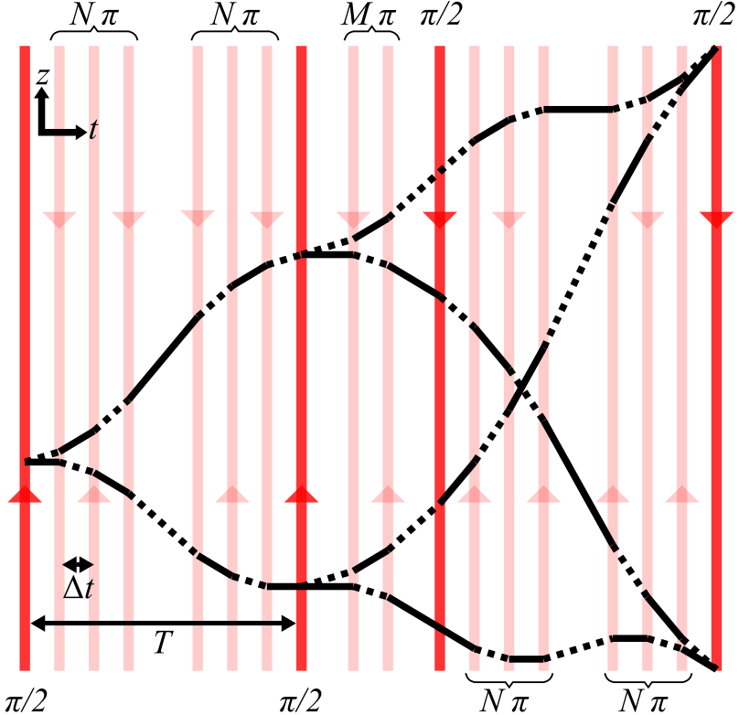

Intercombination recoil measurement scheme
Ω ~1000 times larger than clock transition
Ω >> ω_{r} => LMT pulses not velocity selective
Differential phase:
$$ΔΦ=4\left(M+1\right)\left(ω_{0}\frac{v_{r}}{c}−ω_{r}\right)\left[\left(2N+1\right)T−2N(N+1)Δt\right]+O\left(\frac{1}{c}\right)$$
Likely limited by finite excited state lifetime
Still 2nd order in LMT, but no $N2T$ term (as expected)

Slide 18
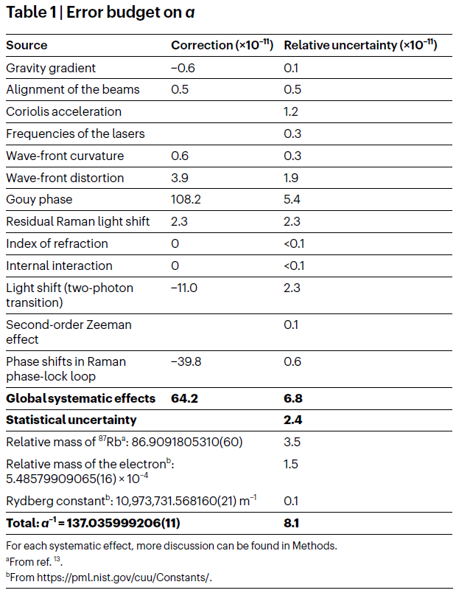
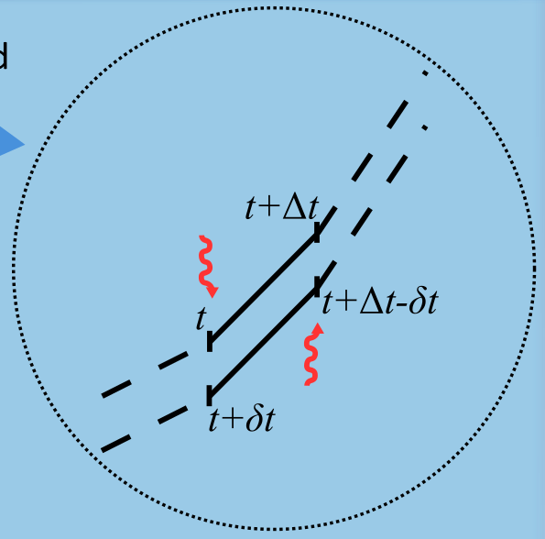

Systematics
Light propagation delay investigated & found to contribute above 1mrad level
Long list of other effects to consider…
(Rb experiment, LKB)
L. Morel et al., Nature 588, 61 (2020).

Slide 19
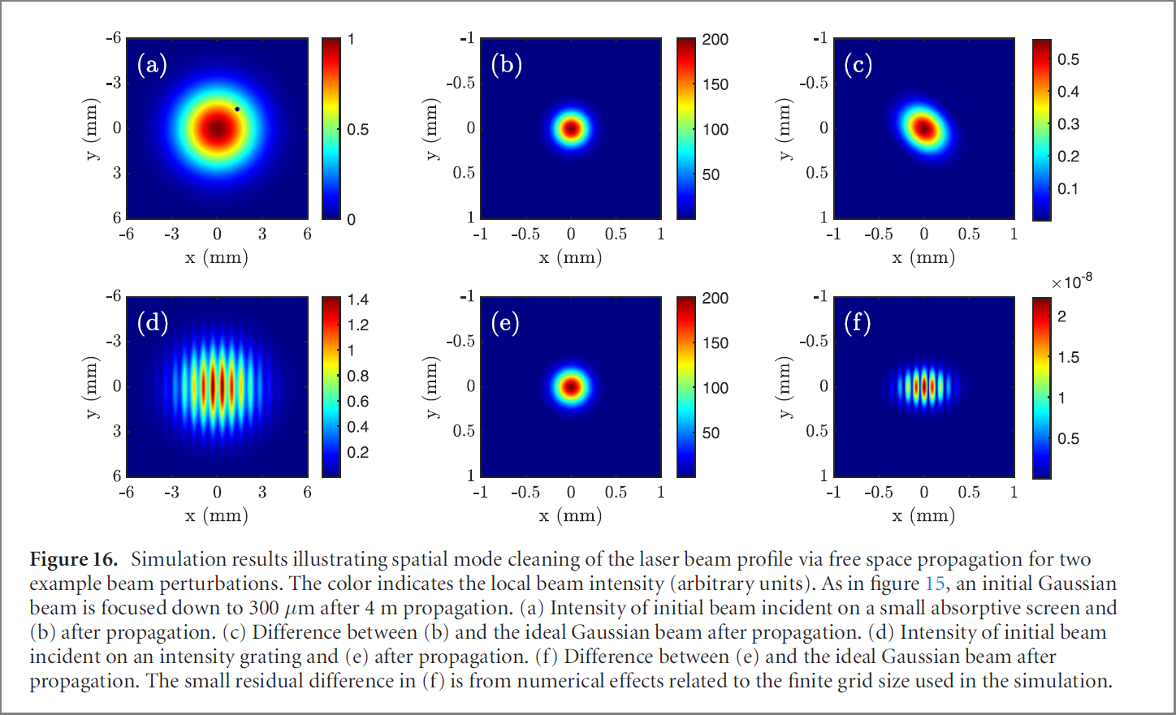

Laser beam quality
Focused after 4m propagation
$$\vec{k}=\vec{∇}φ_{laser}(\vec{r})$$
Largest systematics in Rb and Cs measurements arise from the laser beam
Gravitational wave detector prototypes being designed with:
Large laser beams (~1cm diameter)
Factor of ~2 larger than existing Rb and Cs recoil measurements
Less divergence/curvature in laser wavefronts
In-vacuum free-space laser propagation and expanding telescope
Spatial mode cleaning of imperfections in the beam
Imperfect initial beam
Scale of final imperfections
M. Abe et al., Quantum Sci. Technol. 6, 044003 (2021).

Slide 20
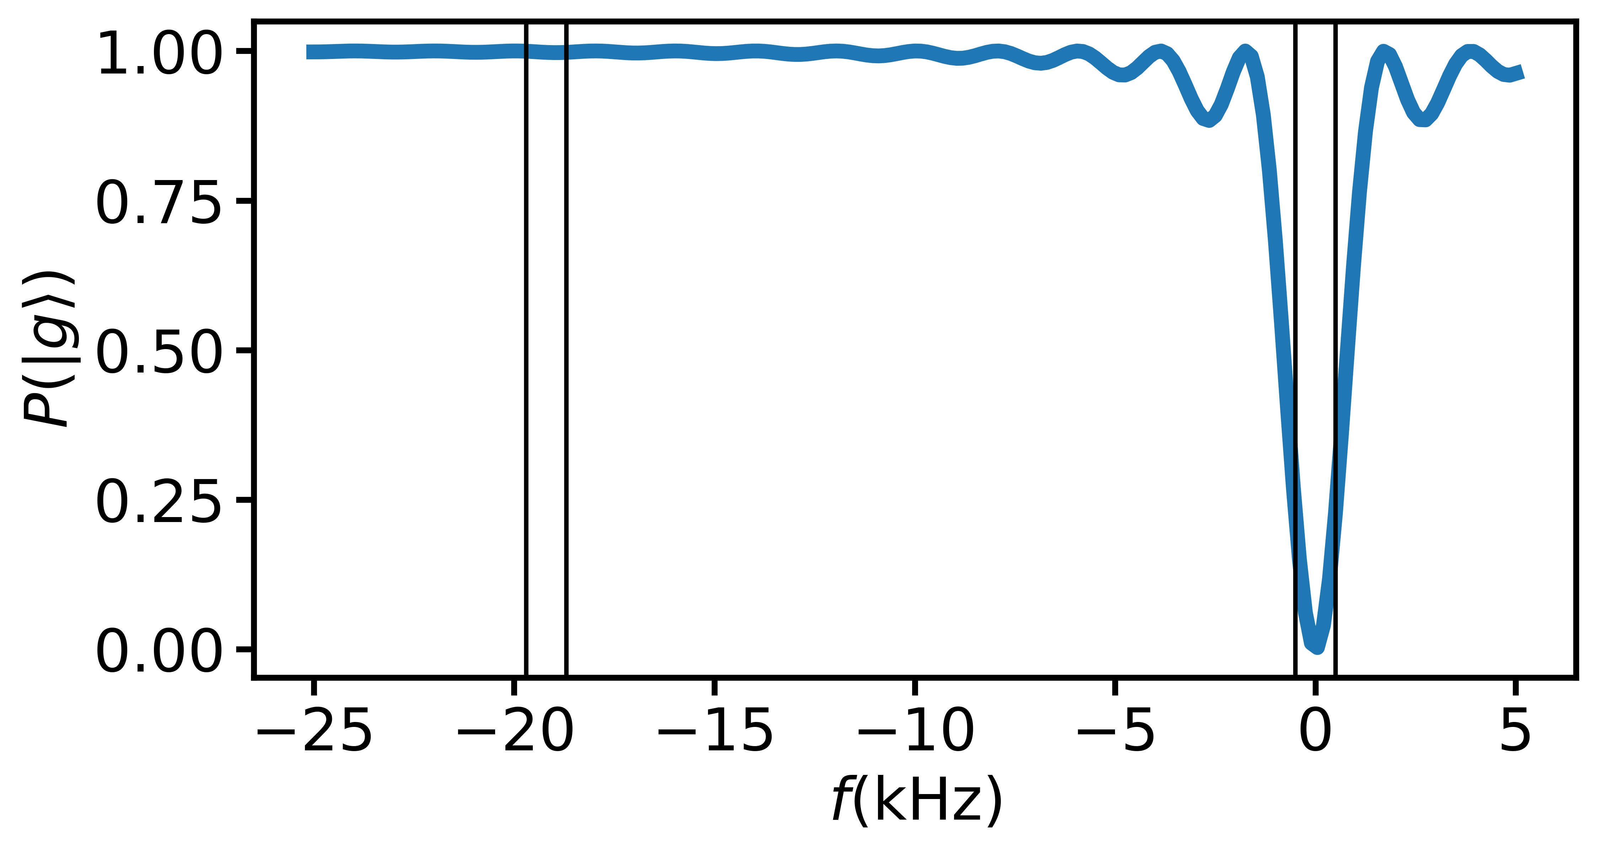



Atom-light interaction
Rectangular pulses resonant at one velocity are near-resonant at others, including in the other interferometer arm of velocity-selective pulses
Leads to parasitic interferometers, loss of contrast
Doppler shift of $2×$ recoil velocity
Fidelity ~91.6%
$$Ω=2π×1 kHz$$
$$0.916100∼{10}^{−4}$$
$⇒$ not suitable for LMT
1kHz wide

Slide 21
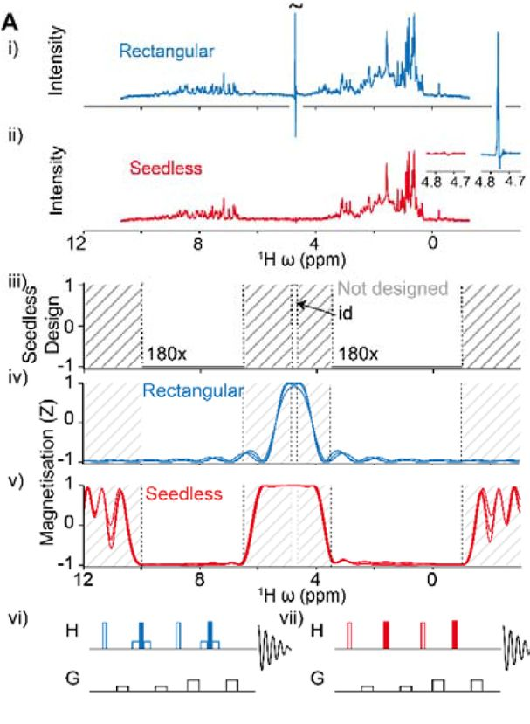
Quantum optimal control
NMR experts at Oxford have developed a program called Seedless
Highly-optimised implementation of GRAPE in C++ allowing “on-the-fly” calculations
Pulse shaping via phase-only control
Amplitude shaping functionality is present, but not really needed
Features include:
Specifying desired behaviour of different frequency bands
Robustness to Rabi frequency variations
C. Buchanan et al., Nat. Commun. 16, 7276 (2025).

Slide 22
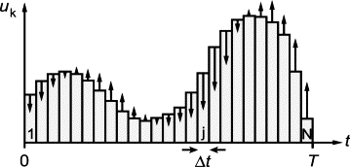

GRadient Ascent Pulse Engineering (GRAPE)
Piecewise-constant pulses have analytic propagators for two-level systems
$${\hat{U}}_{n}=\exp\left(−i{\hat{ℋ}}_{n}t\right)=\left(\begin{matrix}\cos\left(\frac{\tilde{Ω}t}{2}\right)−i\frac{Δ}{\tilde{Ω}}\sin\left(\frac{\tilde{Ω}t}{2}\right) & −i\frac{Ω}{\tilde{Ω}}sin\left(\frac{\tilde{Ω}t}{2}\right)exp⁡(−iφ_{n}) \\ −i\frac{Ω}{\tilde{Ω}}\sin\left(\frac{\tilde{Ω}t}{2}\right)exp⁡(iφ_{n}) & \cos\left(\frac{\tilde{Ω}t}{2}\right)+i\frac{Δ}{\tilde{Ω}}\sin\left(\frac{\tilde{Ω}t}{2}\right)\end{matrix}\right), \tilde{Ω}=\sqrt{Ω^{2}+Δ^{2}}$$
Fidelity and its gradient w.r.t. $\vec{φ}$ can be computed efficiently by propagating initial state forwards and target state backwards in time
$$ℱ\left(\vec{φ}\right)={\left|\left\langle ψ_{target}\left|\prod_{n}{{\hat{U}}_{n}}\right|ψ_{initial}\right\rangle \right|}^{2}$$
Optimisation for ensembles by summation
$$ℱ\left(\vec{φ}\right)=\sum_{p}{ℱ_{p}\left(\vec{φ}\right)}$$
N. Khaneja et al., JMR 172, 296 (2005).

Slide 23
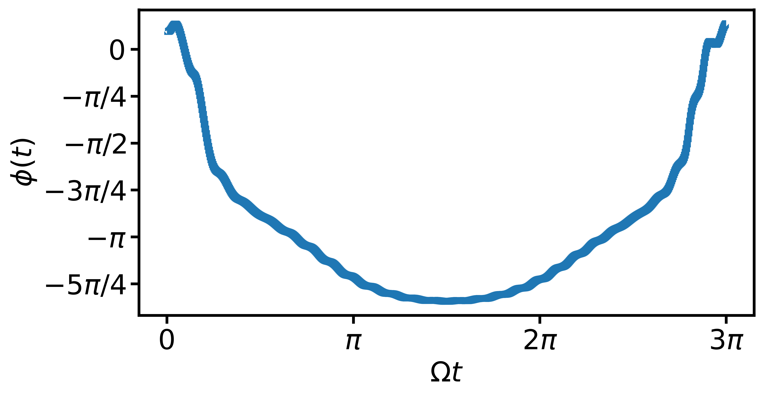
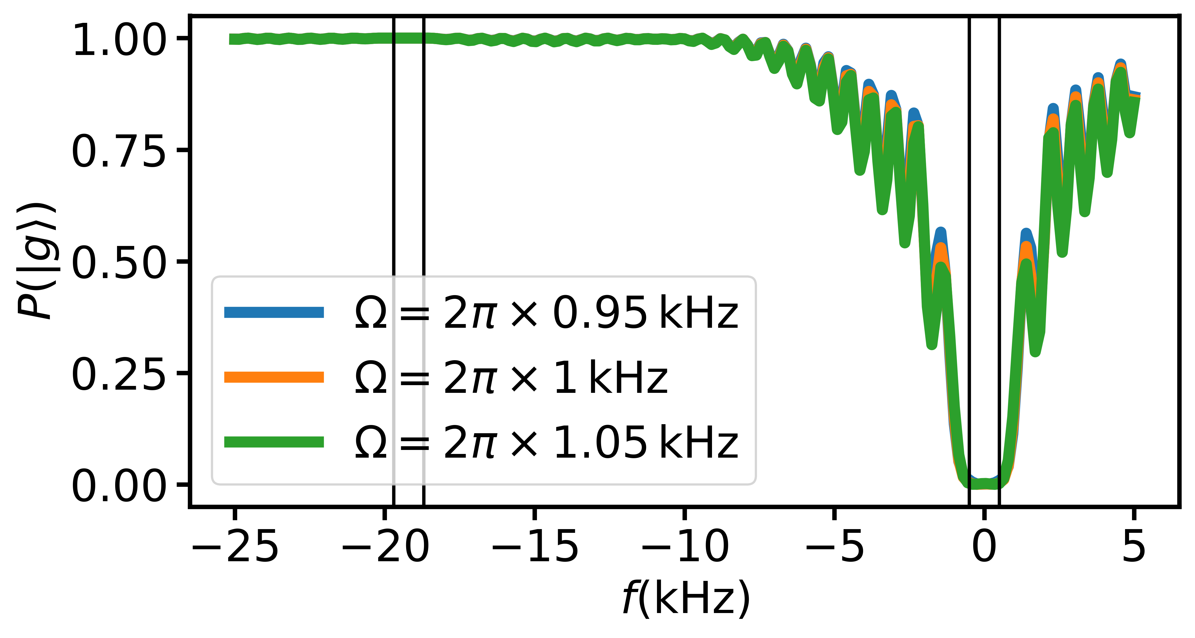
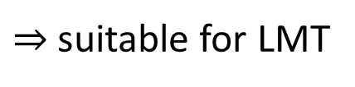


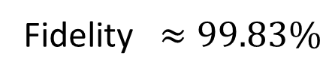
Preliminary calculations for clock transition
Using 1D temperature $≲1 nK$ (delta-kick collimation/velocity selection)
$⇒$ Doppler distribution width $∼k\sqrt{\frac{k_{B}T}{m}}≈2π×500 Hz$
Fidelity $≈99.83\%$
$$0.9983100∼0.84$$
$⇒$ suitable for LMT
Trade-off between fidelity, pulse duration, and width of Doppler distribution

Slide 24
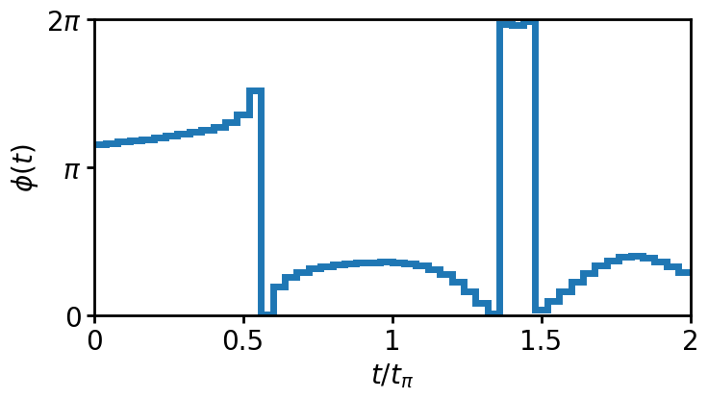
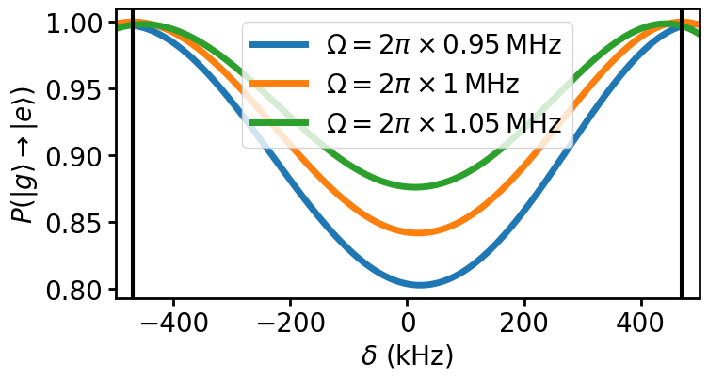

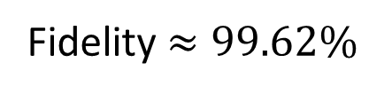
Preliminary calculations for intercombination line
Generalisation of Floquet technique (used by Stanford for 400ħ­k result)
$Ω=2π×1 MHz \left(±5\%\right)$
$Δ≈±50ℏk (4 kHz wide)$
Fidelity$≈99.62\%$
Trade-off between fidelity, pulse duration, and excited state lifetime

Slide 25
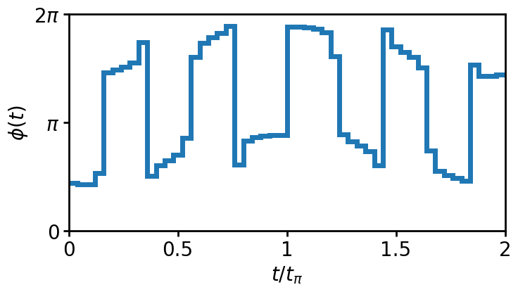
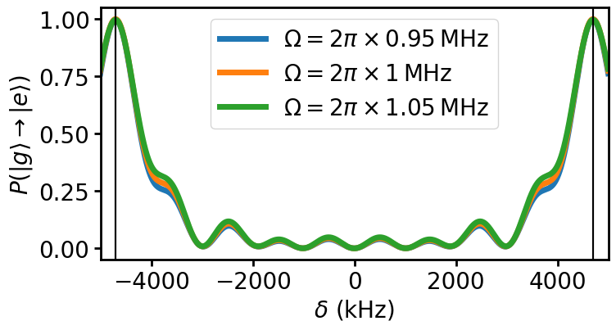

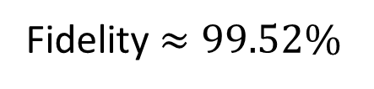
Preliminary calculations for intercombination line
Generalisation of Floquet technique (used by Stanford for 400ħ­k result)
$Ω=2π×1 MHz \left(±5\%\right)$
$Δ≈±500ℏk (4 kHz wide)$
Fidelity$≈99.52\%$
Trade-off between fidelity, pulse duration, and excited state lifetime

Slide 26
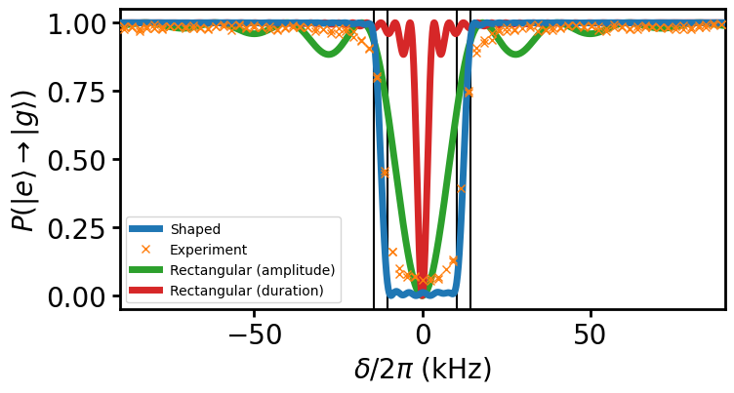
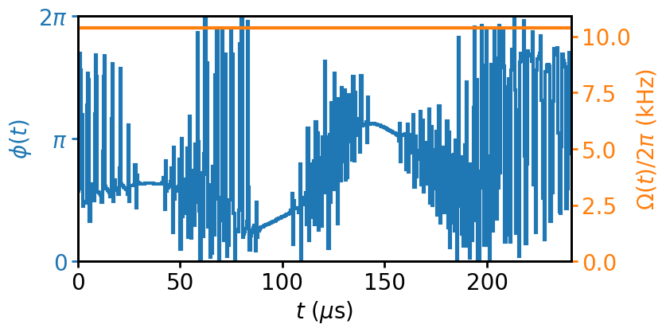
Preliminary clock interferometry experiments
C. Baynham et al. (AION Collaboration), arXiv:2504.09158 [hep-ex]
AION lab at Imperial College are doing clock interferometry with ⁸⁷Sr
First pulse shaping test: velocity selection
Implemented via DDS signal sent to AOM
Resulting excitation profile probed using narrow standard π-pulse

Slide 27
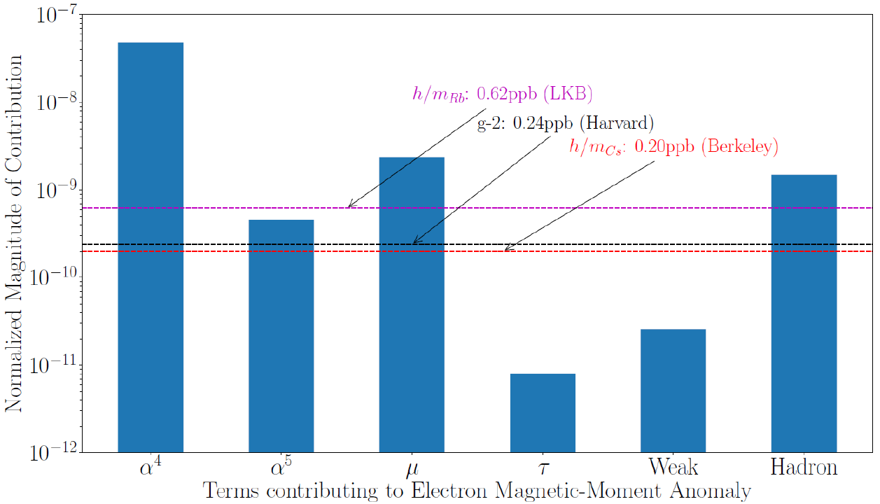


Conclusions & outlook
Recoil experiments contribute to best empirical determinations of $α$
Future experiments with Sr, Yb will be useful cross-checks against Rb, Cs
Experiments over longer baselines offer opportunities for:
Higher-quality laser wavefronts (reduced systematics)
Longer interrogation times, larger momentum transfer (increased sensitivity)
Detailed estimates for systematics of single-photon implementation ongoing
$$\frac{m\left(Sr 5s5p{}_{}^{3}{P_{0}}\right)}{m\left(Sr 5s^{2}{}_{}^{1}{S_{0}}\right)}−1=2.2×{10}^{−11}$$
81ppt (LKB)
👀
Limit due to current relative masses just short of seeing weak interaction contribution to g_{e}-2
Factor of 10 improvement sees weak interaction contribution and on the verge of tau contribution
R. Parker et al., Science 360, 191 (2018).

Slide 28










Acknowledgements
Now @ Birmingham: NMR expert: Imperial College:
Prof Chris Foot Dr Kenneth Hughes Dr Thomas Hird Jesse Schelfhout Prof Jonathan Jones Alice Josset
Seedless code for NMR pulses from Prof. Andrew Baldwin et al. (Oxford Chemistry Department) & JJ
Thanks to many members of the atom interferometry community with whom we have had discussions

Slide 29
Thank you!
Questions?

Slide 30





Atomic mass & fundamental constants
Kilogram redefined in 2019 by fixing $h=6.62607015×{10}^{−34} J s$
Measurement of $h/m\left(X\right)$ gives $m\left(X\right)$ in kg
Many constants follow:
$m_{u}=m\left(X\right)/A_{r}\left(X\right)$
$m\left({}_{ }^{12}C\right)=12m_{u}$
$m_{e}=A_{r}\left(e\right)m_{u}$
$α=\sqrt{2hR_{∞}/(cm_{e})}$
$μ_{0}=4παℏ/(e^{2}c)$ – hence also $ε_{0}=1/(μ_{0}c^{2})$
$μ_{B}=eℏ/(2m_{e})$
$a_{0}=ℏ/(αm_{e}c)$
$$R_{∞}$$
$$A_{r}\left(e\right)$$
$$A_{r}\left(X\right)$$
E. Tiesinga and P. Mohr, “Tests of fundamental physics”, in Drake (Ed.) Springer handbook of atomic, molecular, and optical physics, 2nd edition, Springer, 2023.

Slide 31



Testing the Standard Model
Electron magnetic moment (Gabrielse group)
$$\frac{g_{e}−2}{2}≡a_{e}=\sum_{n}{C_{2n}{\left(\frac{α}{π}\right)}^{n}}+a_{μτ}+a_{hadronic}+a_{weak}$$
Highest-precision Standard Model comparison
Limited by >5σ discrepancy in $α$
Improvement of electron g-2 by factor of 2.2 would be at sensitivity of muon g-2 tension to new physics
$${\left(\frac{m_{e}}{m_{μ}}\right)}^{2}∼2.4×{10}^{−5}$$
X. Fan et al., PRL 130, 071801 (2023); G. Giudice et al., JHEP 2012, 113 (2012)

Slide 32

Bonus slide: 100m `X’ configuration

