Slide 1

Modeling frequency instability in
high-quality resonant experiments
Saarik Kalia
w/ Hao-Ran Cui and Zhen Liu
MITP QSGW Workshop
July 2, 2025

Slide 2
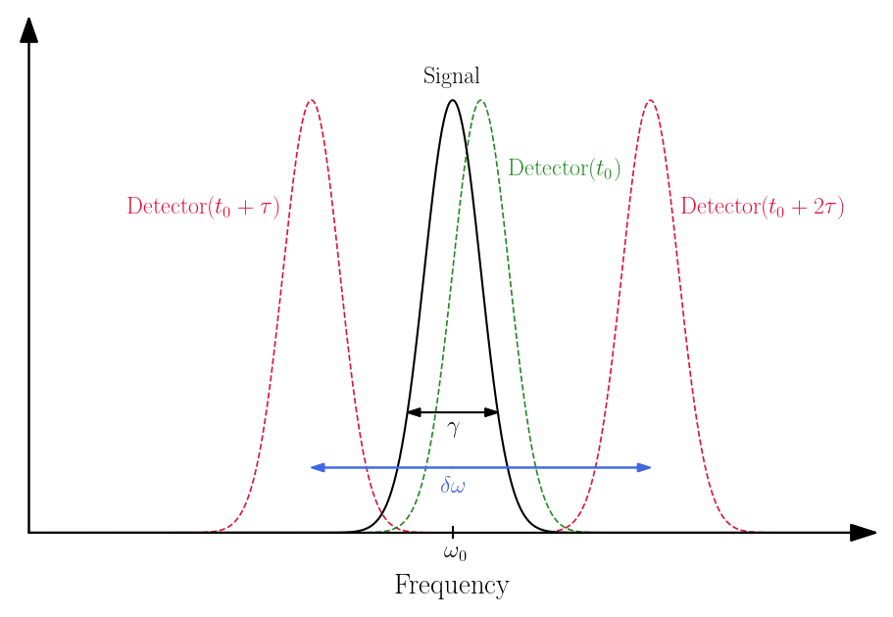
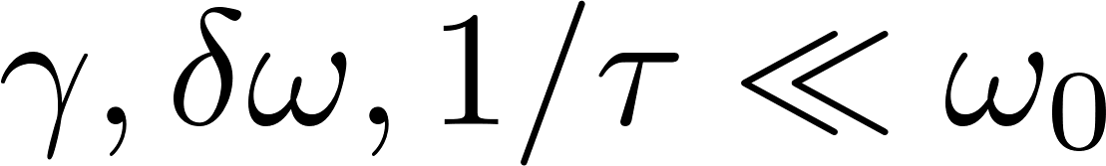
Introduction

Slide 3
Outline
Jittering Resonator
System Characteristics
Spectral Features and Sensitivity

Slide 4
Jittering Resonator

Slide 5
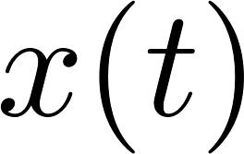

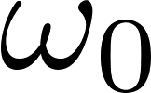
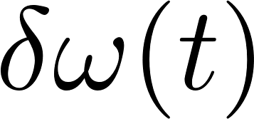
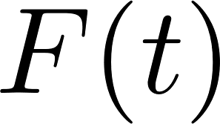
Jittering resonator model
: response or “position”
  e.g., electric field in resonant cavity, etc.
: linewidth of resonator
: central resonant frequency
: stochastic frequency modulation or “jittering”
  e.g., deformations of resonant cavity, etc.
: driving “force”
  e.g., currents in resonant cavity, etc.

Slide 6
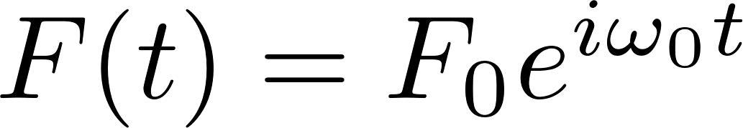
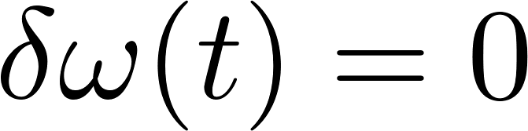
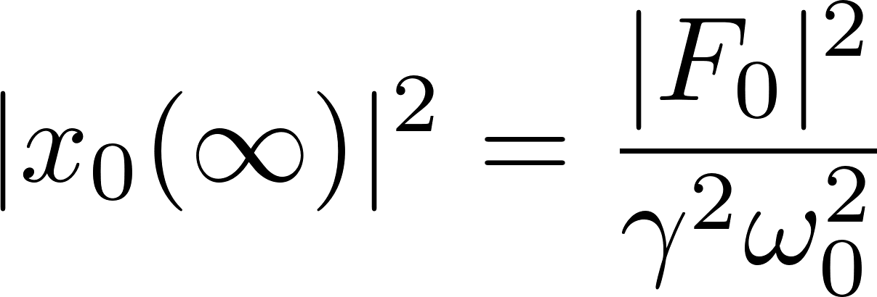
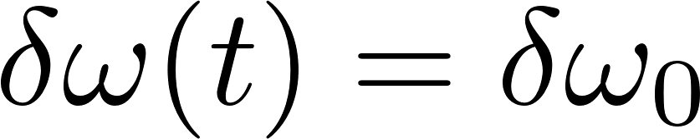
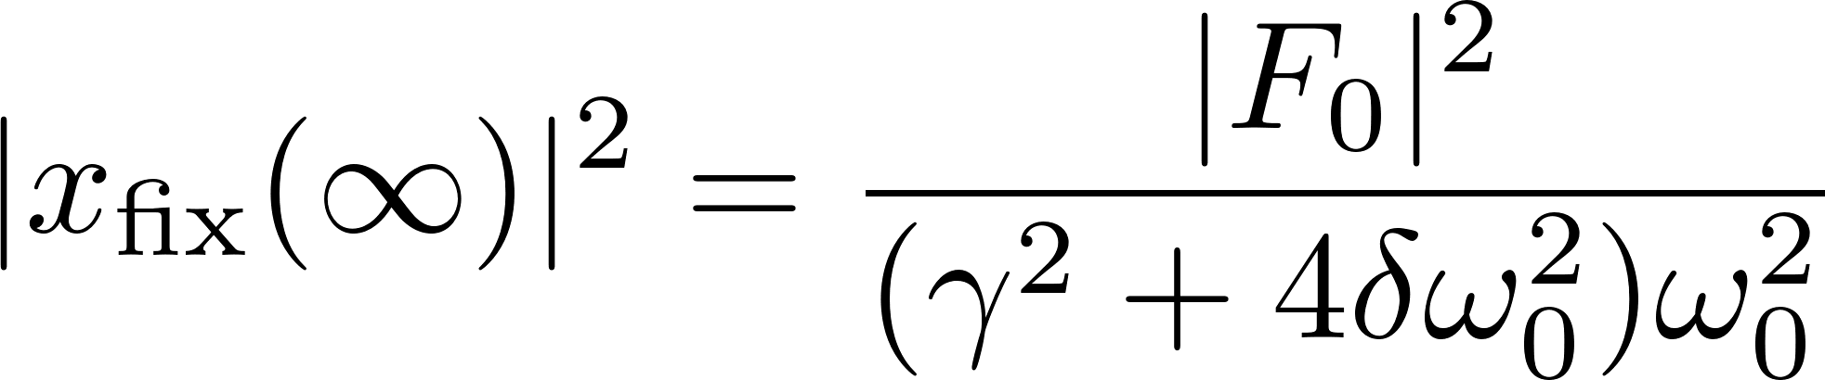
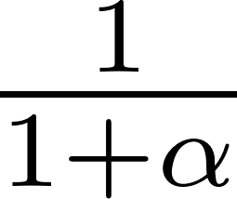
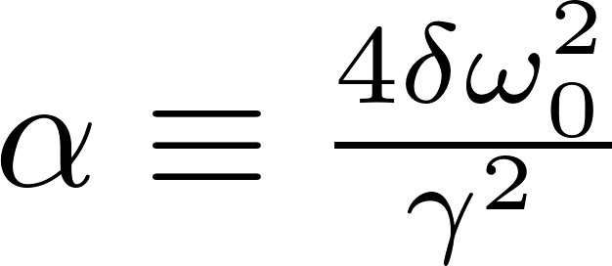
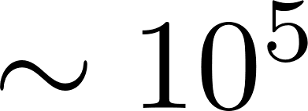
Power suppression
On-resonance monochromatic force
(Asymptotic) power for no jittering ( ):
Power for fixed offset ( ):
Worst-case suppression , where ( for Dark SRF)

Slide 7
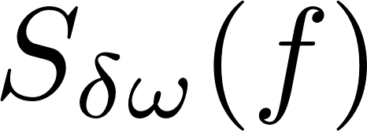
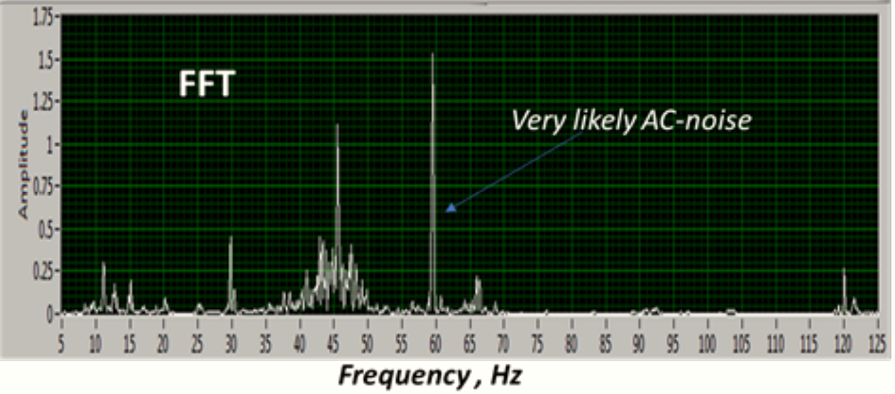
Modeling
Power spectrum of jittering
[Pischalnikov et al.(2019)]

Slide 8
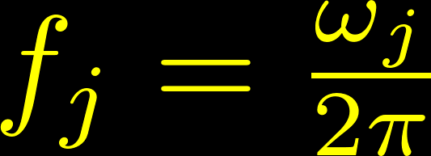
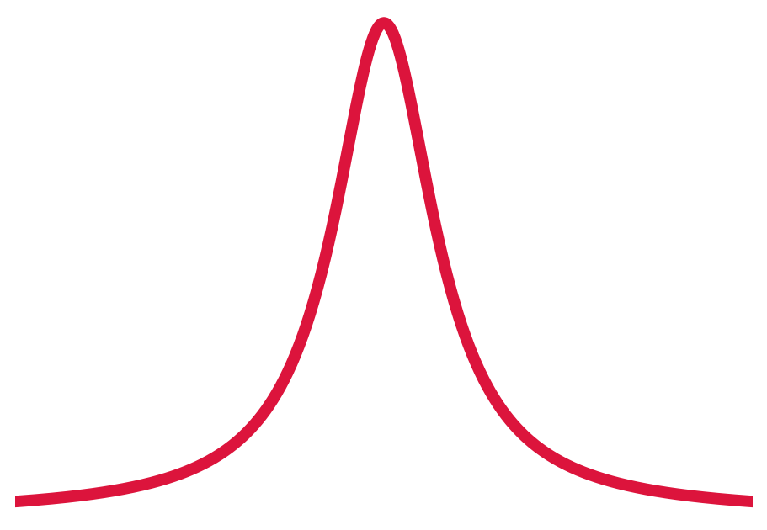
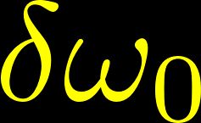
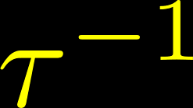
Modeling
Power spectrum of jittering → approximate by single Lorentzian
Higher-point statistics → Gaussian or dichotomic Markov process (DMP)
[Pischalnikov et al.(2019)]

Slide 9
System Characteristics

Slide 10
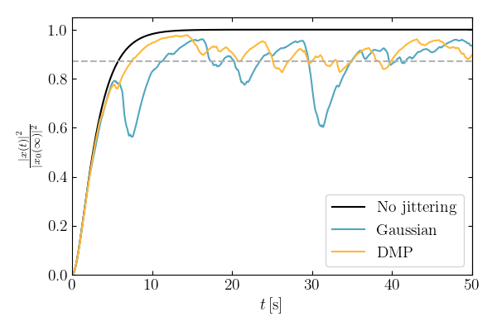
Sample evolution

Slide 11
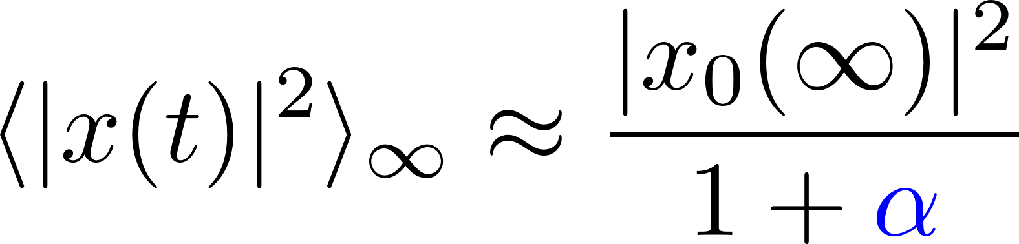
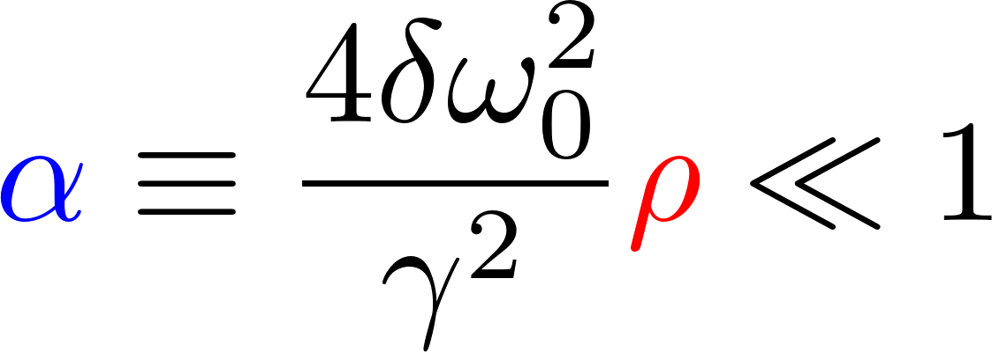
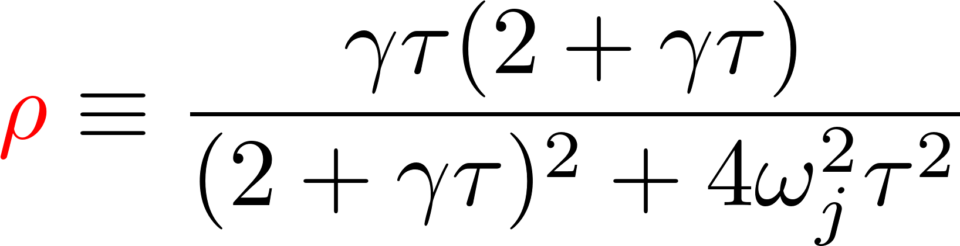
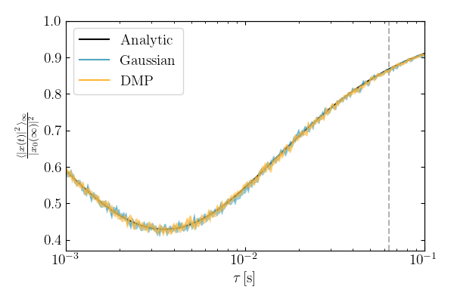
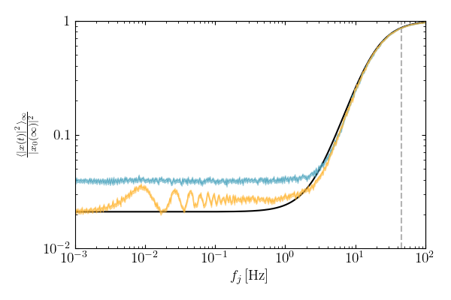
Perturbative result
Fast jittering reduces
suppression!

Slide 12
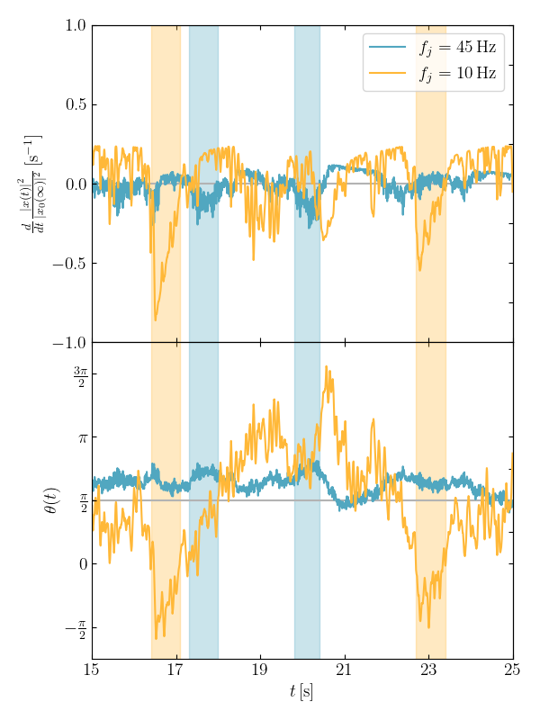
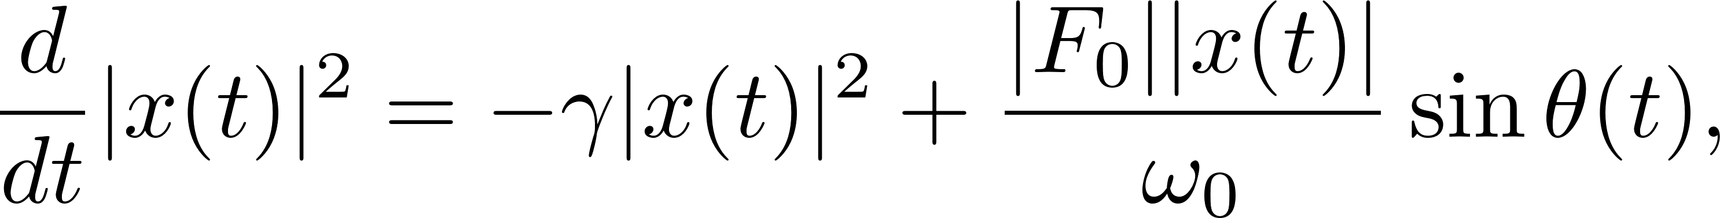
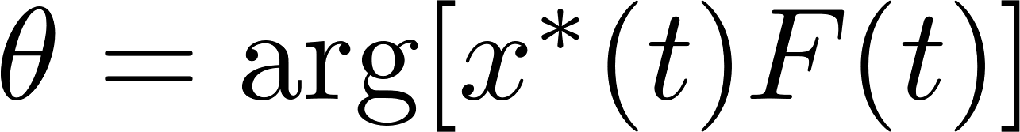
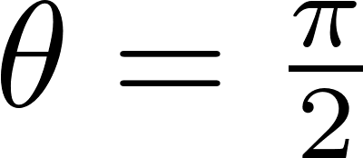
Relative phase
Power accumulation depends on relative phase
where
Stable resonator driven on-resonance has
Fixed offset or slow jittering causes dephasing
Fast jittering washes out phase!

Slide 13
Spectral Features and Sensitivity

Slide 14
Sensitivity
In time domain, sensitivity depends on
  Signal power Barely affected by jittering
  Coherence time Complicated temporal correlations
In frequency domain, depends on
  Signal power
  Linewidth Straightforward from spectrum

Slide 15
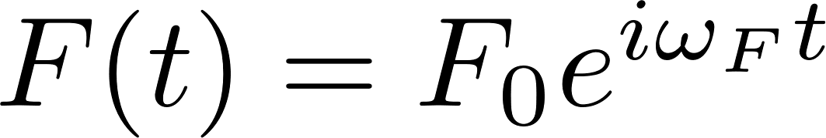
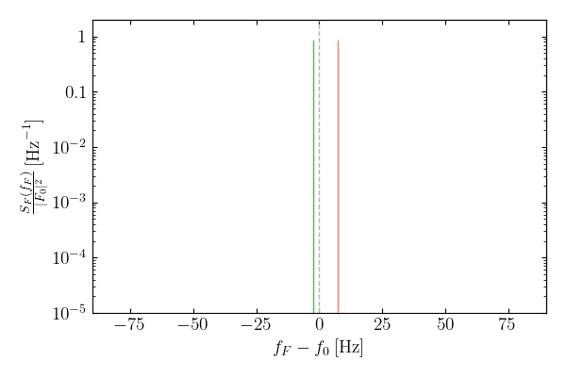
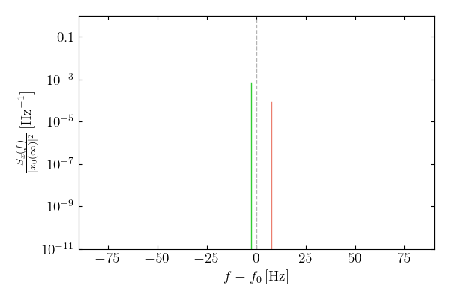
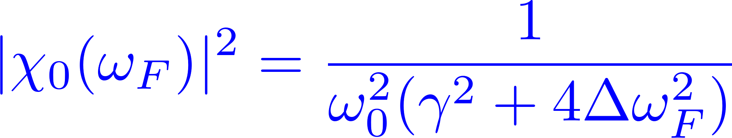
Driving force vs. response (stable)

Slide 16
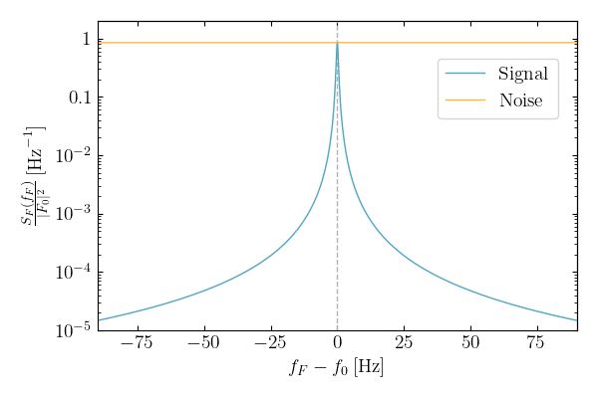
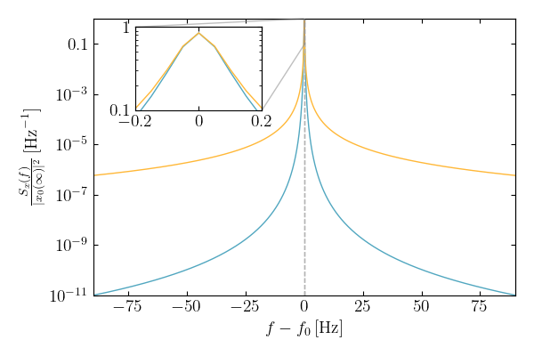
Driving force vs. response (stable)

Slide 17
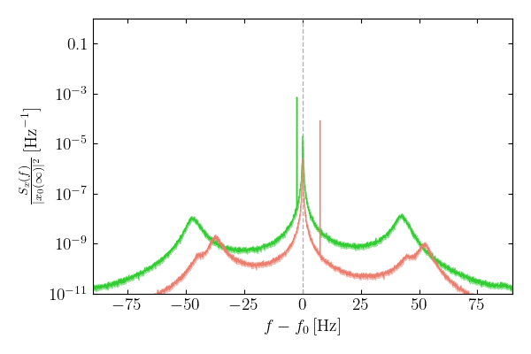
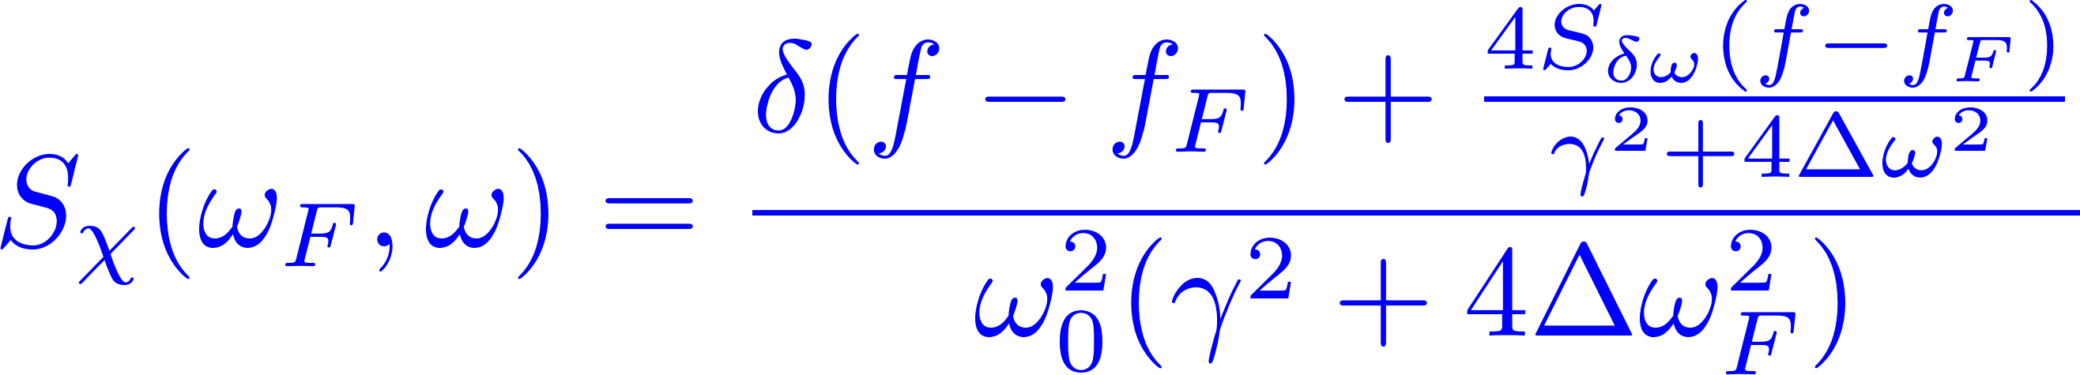
Driving force vs. response (jittering)

Slide 18
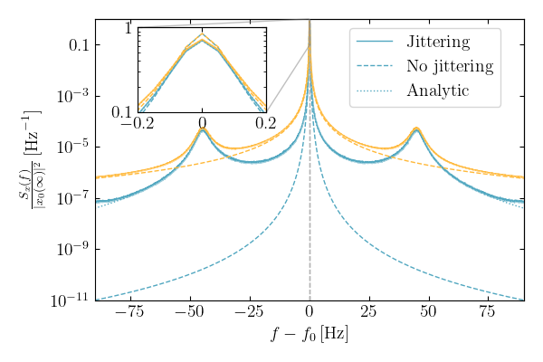
Driving force vs. response (jittering)

Slide 19
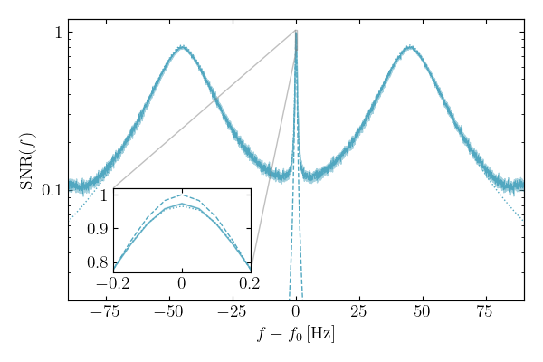
Signal-to-noise ratio

Slide 20
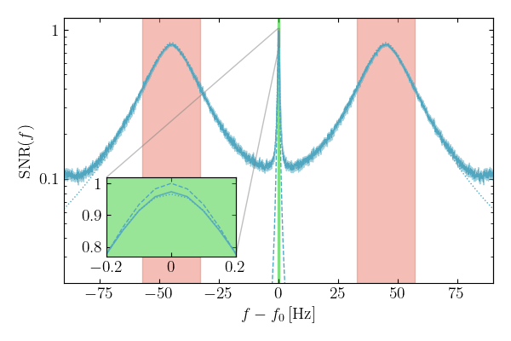
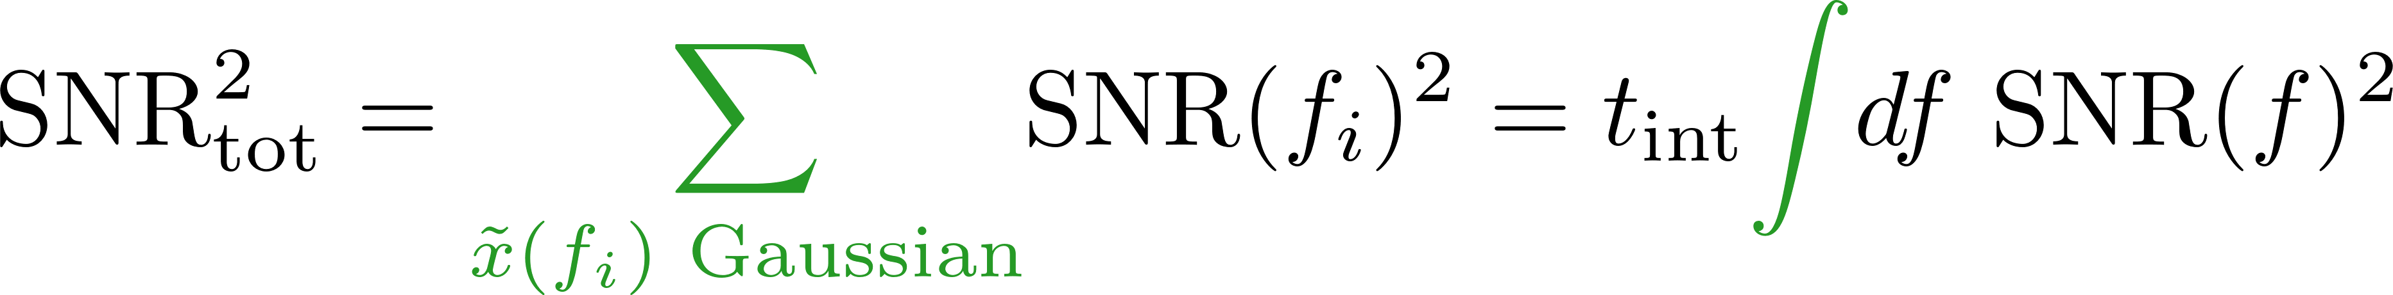
Signal-to-noise ratio
Jittering doesn’t
affect SNR!

Slide 21
Conclusion
High-Q experiments may have to worry about frequency instability
  Naive suppression for Dark SRF
Timescale of jittering is important → fast jittering = no power suppression
  Power accumulation depends on relative phase
  Fast jittering washes out phase
Jittering introduces distinct spectral features, but does not affect sensitivity
Allows us to improve Dark SRF’s quoted constraint by order of magnitude!

Slide 22
Backup Slides

Slide 23
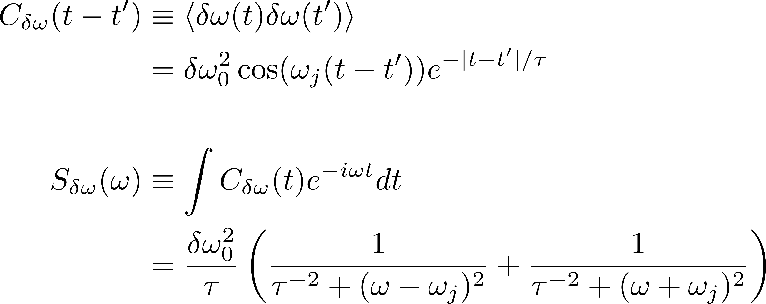
Lorentzian jittering spectrum

Slide 24
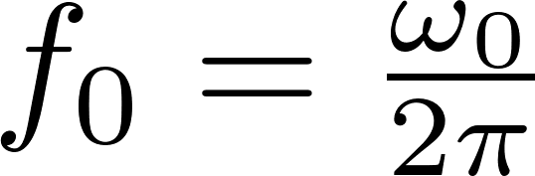
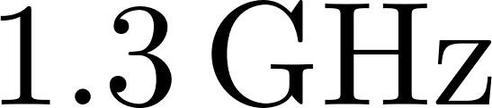
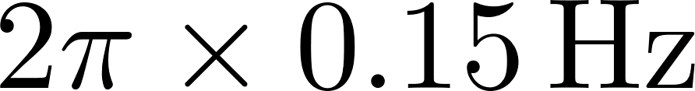
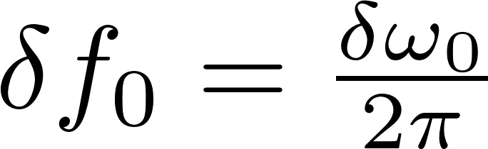
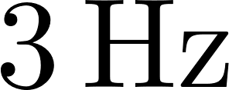
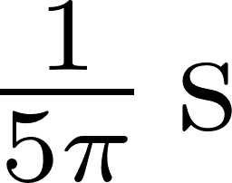

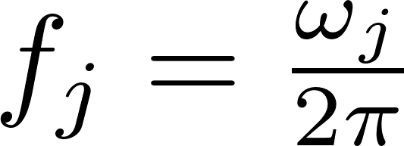

Benchmark parameters
Parameter | Symbol | Value
Central natural frequency
Resonator linewidth
Jittering amplitude
Jittering correlation time
Peak jittering frequency

Slide 25




Jittering decomposition
Can decompose into two independent time series
with correlation functions
Gaussian: For , variables are multivariate Gaussian
DMP: alternates between with expected time

Slide 26



Jittering realizations

Slide 27



Numerical evolution
Split into intervals of duration
Within each interval, constant → analytic solution:

Slide 28





Observables
Evolve runs, each for time
For observable , compute asymptotic ensembled-averaged
Total standard deviation (statistical + systematic) given by

Slide 29

Power distribution

Slide 30











Temporal correlations
Parameter | Perturbative | Fit

Slide 31


Mechanical susceptibility PSD
For monochromatic force and fixed jittering, let response be
Can define PSD of mechanical susceptibility (averaged over jittering)
Mechanical susceptibility PSD converts force PSD to response PSD

