Slide 1

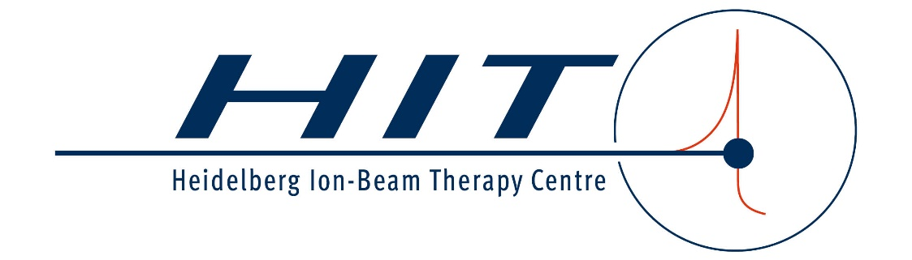
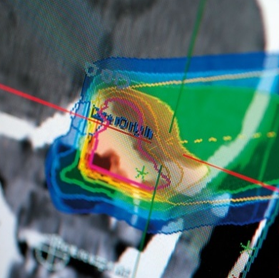
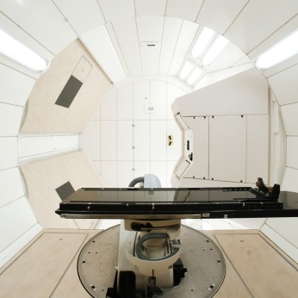
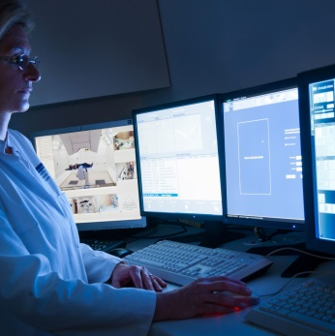

Accelerators for ion beam therapy
MPA Retreat 2024
30.09.2024
Christian Schömers

Slide 2
Outline
Introduction
  Overview of therapy accelerators in the world
  Rationales for particle therapy (PT): biological / physical / technical aspects
  Clinical examples
The accelerator
  Cyclotron and examples
  Synchrotron, example facility in Heidelberg: HIT
  Comparison to other accelerators for PT in the world
Recent developments in PT (very limited and personal choice)

Slide 3
Outline
Introduction
  Overview of therapy accelerators in the world
  Rationales for particle therapy (PT): biological / physical / technical aspects
  Clinical examples
The accelerator
  Cyclotron and examples
  Synchrotron, example facility in Heidelberg: HIT
  Comparison to other accelerators for PT in the world
Recent developments in PT (very limited and personal choice)

Slide 4

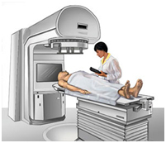
What are medical facilities?
In the accelerator context
Particle Therapy Centers
doing patient treatment
with protons or heavier ions
109 Protons
15 Carbon (+ p)
ptcog.ch/ (Sept. 2024)
Facilities in operation only.
48
30
2
28

Slide 5
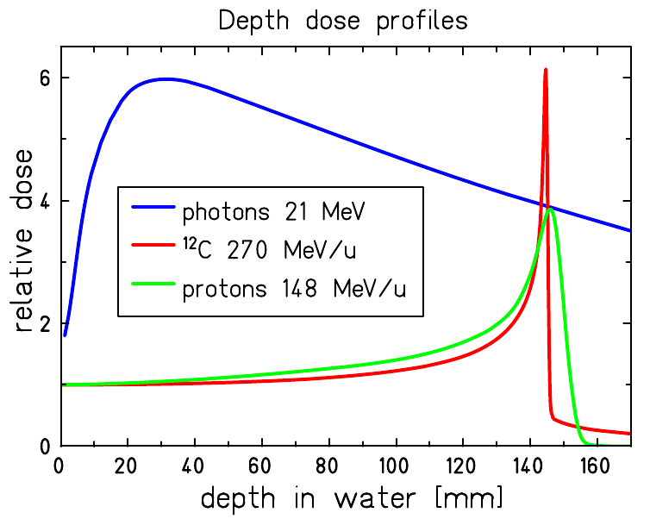
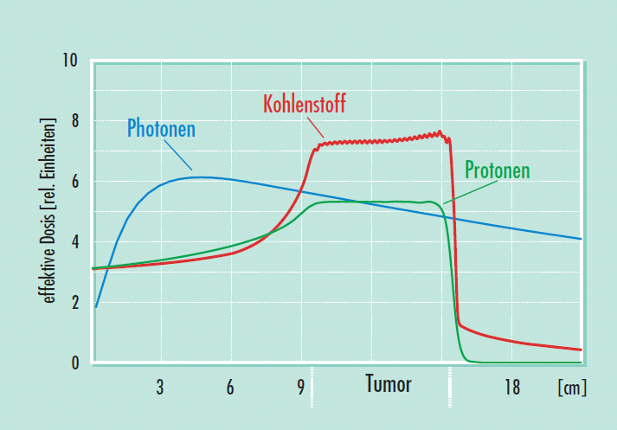
Rationales for proton and ion beam therapy
Depth-dose profile:
Bethe-Bloch
Range defined by starting energy (Bragg peak)
Higher biological effectiveness
Less lateral scattering
Possibility of lateral
guidance (scanning)
Krämer & Durante, Eur. Phys. J. D 60 (2010)

Slide 6
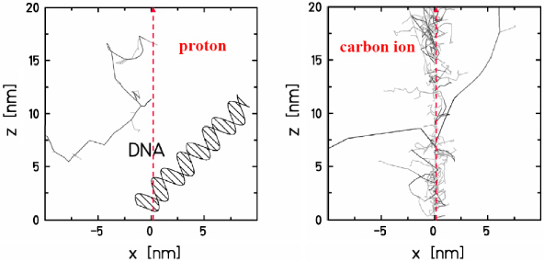
Rationales for proton and ion beam therapy
Depth-dose profile:
Bethe-Bloch
Range defined by starting energy (Bragg peak)
Higher biological effectiveness
Less lateral scattering
Possibility of lateral
guidance (scanning)
Amaldi & Kraft, Rep. Prog. Phys. 68 (2005)

Slide 7
Rationales for proton and ion beam therapy
Depth-dose profile:
Bethe-Bloch
Range defined by starting energy (Bragg peak)
Higher biological effectiveness
Less lateral scattering
Possibility of lateral
guidance (scanning)
ca. 30 cm
ca. 30 cm
Protons
Carbon ions

Slide 8
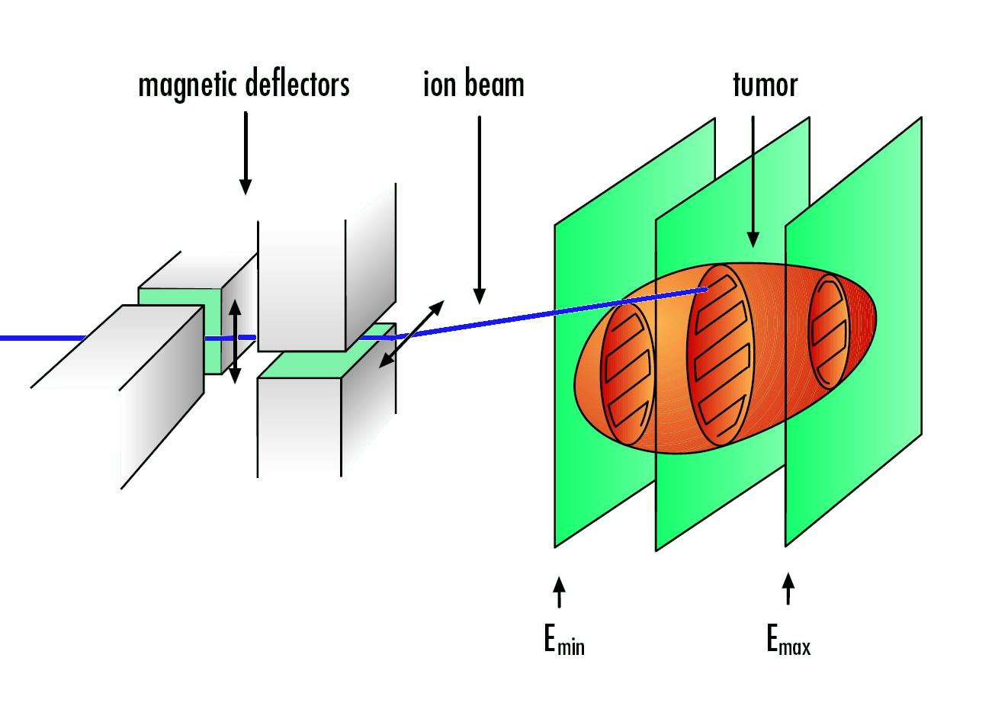
Rationales for proton and ion beam therapy
Depth-dose profile:
Bethe-Bloch
Range defined by starting energy (Bragg peak)
Higher biological effectiveness
Less lateral scattering
Possibility of lateral
guidance (scanning)
Dose-delivery system
Haberer et al., NIM A 330 (1993)

Slide 9
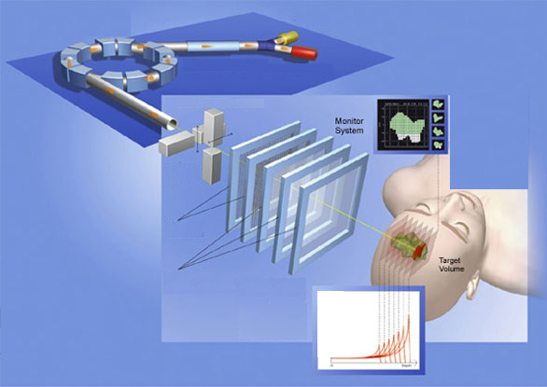
How we do therapy
State of the art: raster-scanning
Accelerator
delivers a spectrum
of ion energies
Pencil beam is
guided by
  scanning magnets
monitored by
  multi-wire chambers
  ionization chambers
Spread out
Bragg Peak
courtesy of Siemens Health Care

Slide 10
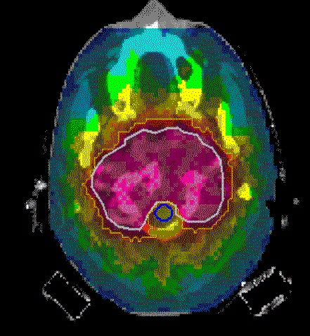
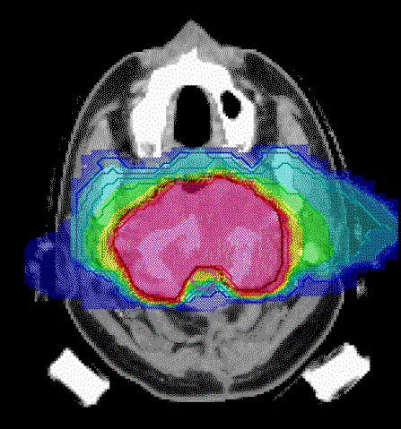
Clinical examples
Photons vs. ions I
Conventional (photons, 9 fields)
Charged particles (2 fields)
Kraemer M and Scholz M, Treatment planning for heavy ion
therapy, Phys. Med. Biol. 45 3319–30

Slide 11
Further examples of tumours treated with ions
Skull
Chordoma and chondro-sarcoma at the base of the skull,
Adenoid cystic carcinoma in the head and neck region (salivary glands)
Characteristics:
  Deep located
  Radio-resistant
  Close vicinity to organs at risk
  (optical nerves, brain stem)

Slide 12
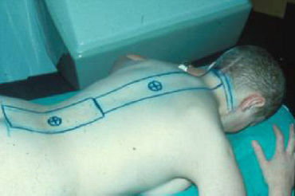
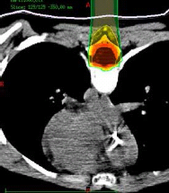
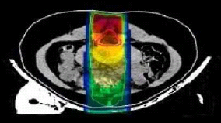
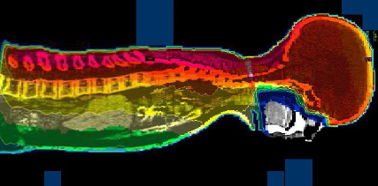
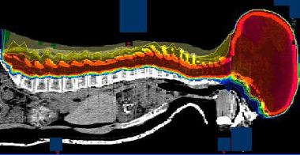
Clinical examples
Photons vs. ions II
Conventional (photons)
Charged particles
Courtesy of K. Herfarth

Slide 13
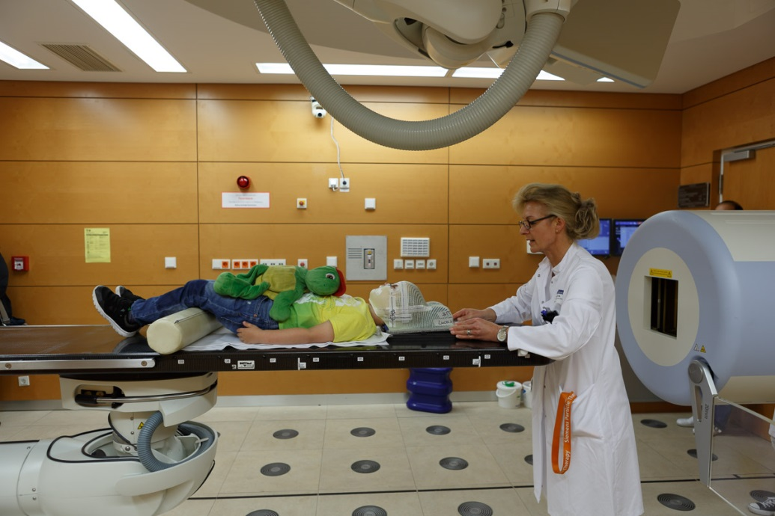
What makes a medical facility special?
“Beam target” is a patient!
Mission: provide particle beams in therapy
quality 335 days / year
Avoid any interruptions to guarantee
therapy success
The dose delivery must be safe and precise
Fast: reduction of irradiation time only
without affecting safety and precision
Large variety of beam parameters (ion types,
energy steps, spot sizes, intensity range, gantry angles)

Slide 14
Introduction
  Overview of therapy accelerators in the world
  Rationales for particle therapy (PT): biological / physical / technical aspects
  Clinical examples
The accelerator
  Cyclotron and examples
  Synchrotron, example facility in Heidelberg: HIT
  Comparison to other accelerators for PT in the world
Recent developments in PT (very limited and personal choice)

Slide 15
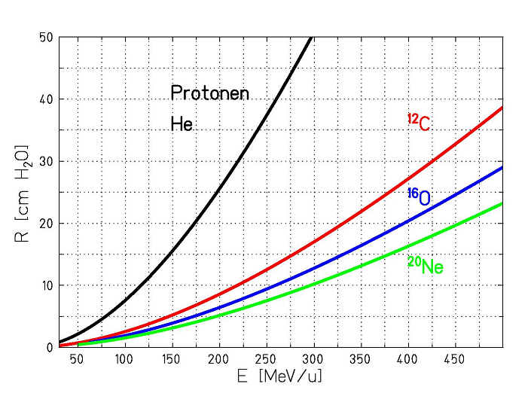
Beam requirements
Energy defined by required
penetration depth:
For 30 cm:
  220 MeV for p
  430 MeV/u for ¹²C⁶⁺
Intensity:
  few ~ 10⁹ protons/s
  few ~ 10⁷ ¹²C⁶⁺/s

Slide 16
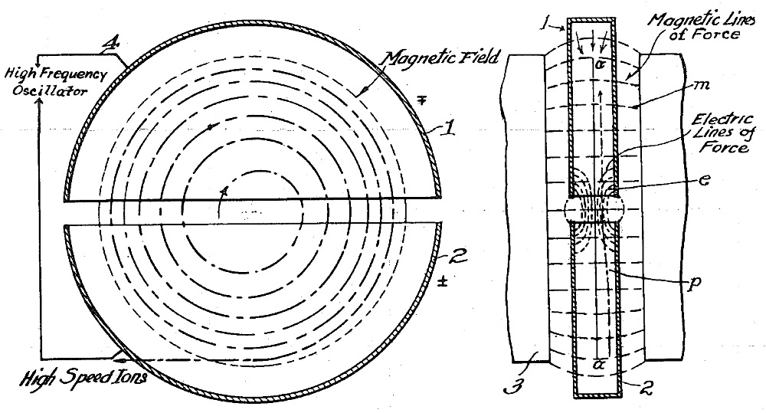
Cyclotrons
Remark: Besides Proton-beam therapy, cyclotrons are also used as Radioisotope factories for nuclear medicine.
→ The cyclotron is the most used ion-accelerator for medical purposes.
E. Lawrence's original concept of the cyclotron (1934 patent)
D-shaped RF electrodes (“Dees”) placed in a disk-like vacuum chamber and embedded in a large (near-homogeneous) static magnetic field.
Radius of particle trajectory increases at each passage through the gap.
But the cyclotron-frequency is constant (non relativistic case)!

Slide 17
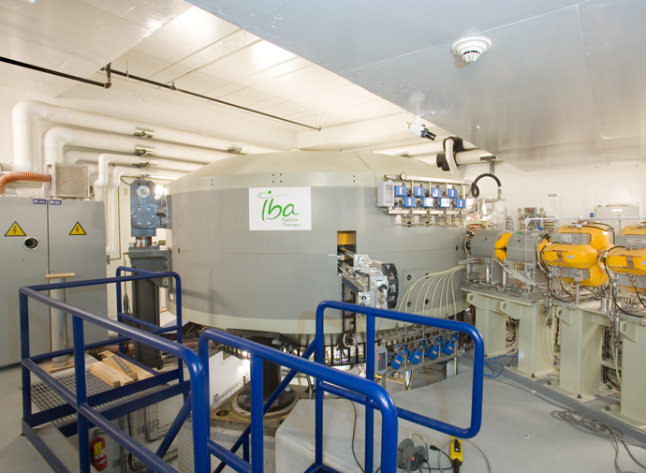
Cyclotrons for ion-beam therapy
C230 by IBA
Designed for proton therapy
Installed at 16 facilities.
Mass: 220 t
B = 2.2 T
A. Peters, CERN Academic Training Lecture (2013)

Slide 18
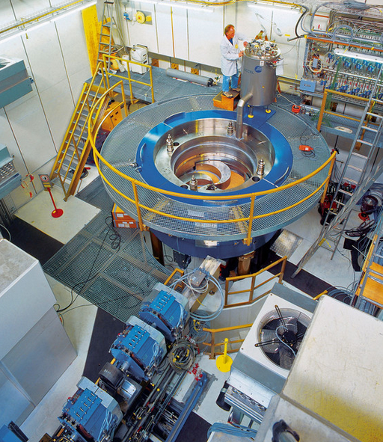
Cyclotrons for ion-beam therapy
COMET superconducting cyclotron
Developed by ACCEL / PSI (later
Varian Medical) for proton therapy
Mass: 80 t
B_{max} = 3.8 T
www.psi.ch

Slide 19
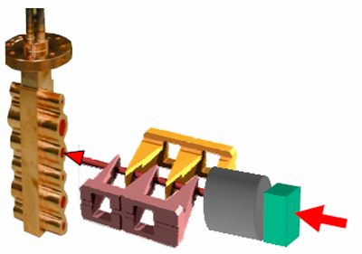

Cyclotrons for ion-beam therapy: Energy selection
Accelerator: 250 MeV
250
A cyclotron is a fixed energy machine
→ Degrader + momentum-selection
Energy-selecting
slits
Multi-wedge degrader (PSI): 238 … 70 MeV
collimator
degrader
A. Peters, CERN Academic Training Lecture (2013)
beam diag.
At low final E >99% of all p are lost!
→ Strong activation of beamline components.

Slide 20
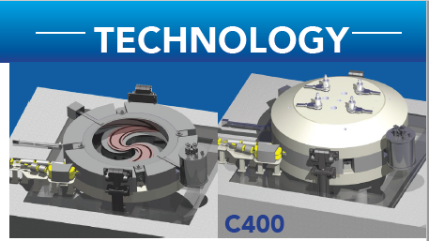
Cyclotrons for ion-beam therapy: ¹²C⁶⁺ ?
“magnetic rigidity”: Relates particle momentum and
charge to magnetic field and bending radius
Protons (220 MeV): Bρ = 2.3 Tm
¹²C⁶⁺ (430 MeV/u): Bρ = 6.6 Tm
To go from protons to carbon ions, one needs to increase either the
magnetic field or the size of the machine by a factor ~3.
Although they are very successful in proton therapy, there is no cyclotron
for carbon-ion therapy yet.
But: Project ARCHADE to install a carbon-treatment facility in Caen (France).
Based on a superconducting cyclotron (“C400”) developed by IBA.
The C400: the ARCHADE
multi-ions cyclotron, Jacques BALOSSO, Workshop on Ion Beam Therapy,
Archamps, 2018

Slide 21
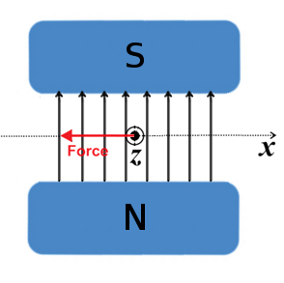
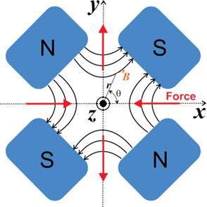
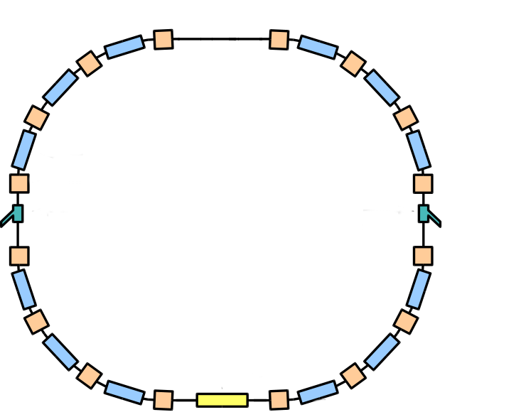
Synchrotrons
Advantage:
Individual elements
(magnets, vacuum
chambers) can be
small …
… but the size of the
machine is almost
unlimited.
Typical size of p/C
therapy synchrotron:
20 m diameter
Deflection
magnets
(dipoles)
Focusing
magnets
(quadrupoles)
Medium
energy
ions
Beam
extraction
Beam
injection
Extraction
beam line
Accelerating
cavity (f_{RF}, U_{RF})
circulating
ions
High
energy
ions
Linac

Slide 22
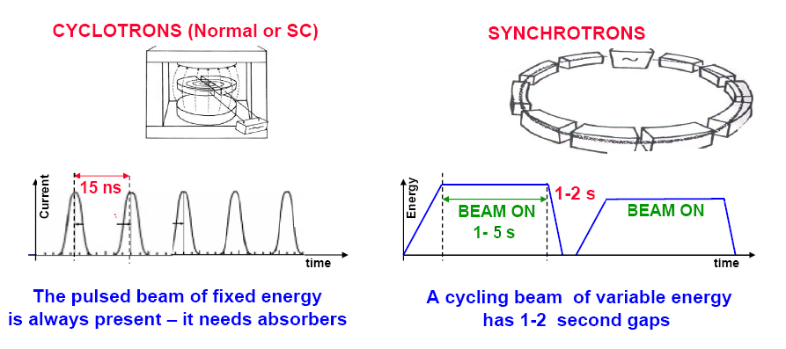
Cyclotron beam vs. Synchrotron beam
Pros
Continuous train of short particle bunches.
High intensity
Cons
Fixed energy: needs degraders
(particle loss, radiation safety issues).
Heavy ions (12C6+) would require very
large magnet and chamber.
Pros
Scalable, can deliver heavy ions.
Variable energy, (almost) no particle losses.
Easy to operate different ion species
Cons
Pulsed operation, breaks between cycles
Very high dose rates hard to achieve

Slide 23
Introduction
  Overview of therapy accelerators in the world
  Rationales for particle therapy (PT): biological / physical / technical aspects
  Clinical examples
The accelerator
  Cyclotron and examples
  Synchrotron, example facility in Heidelberg: HIT
  Comparison to other accelerators for PT in the world
Recent developments in PT (very limited and personal choice)

Slide 24
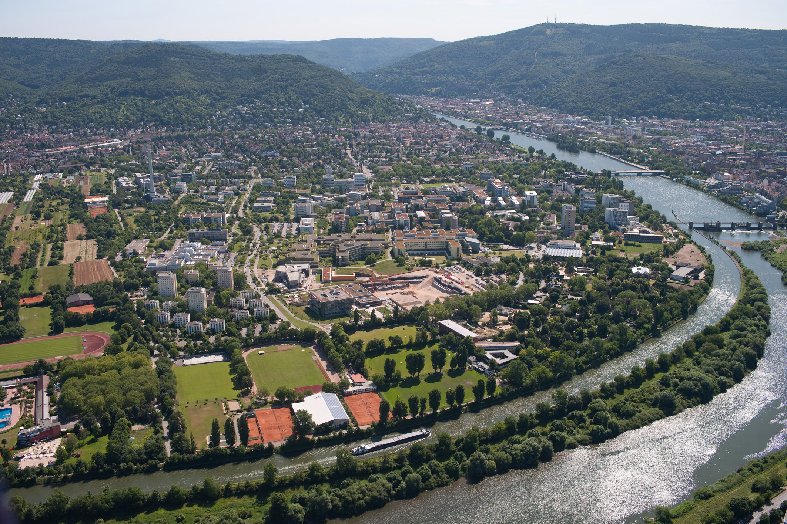

Slide 25
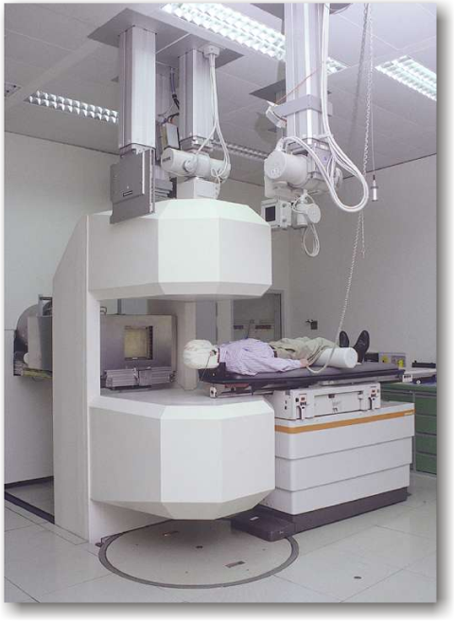
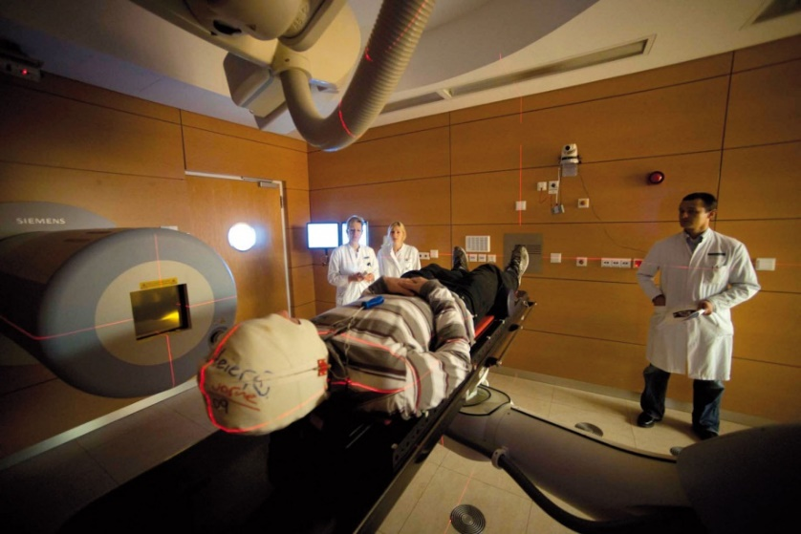
HIT
History – beam parameters – patients
fair-center.eu
Successor of GSI pilot project (440 patients treated)
1st hospital based particle therapy facility in Europe
≈ 700 patients/year since 2009
Total No. of patients treated > 9000
Treatment with:
  Carbon ions
  Protons
  Helium ions: Regular treatments since July 2024
  Oxygen ions: only for experiments
255 energy steps each (penetration depth: 2cm…30cm)
Different spot sizes
Different intensity levels

Slide 26
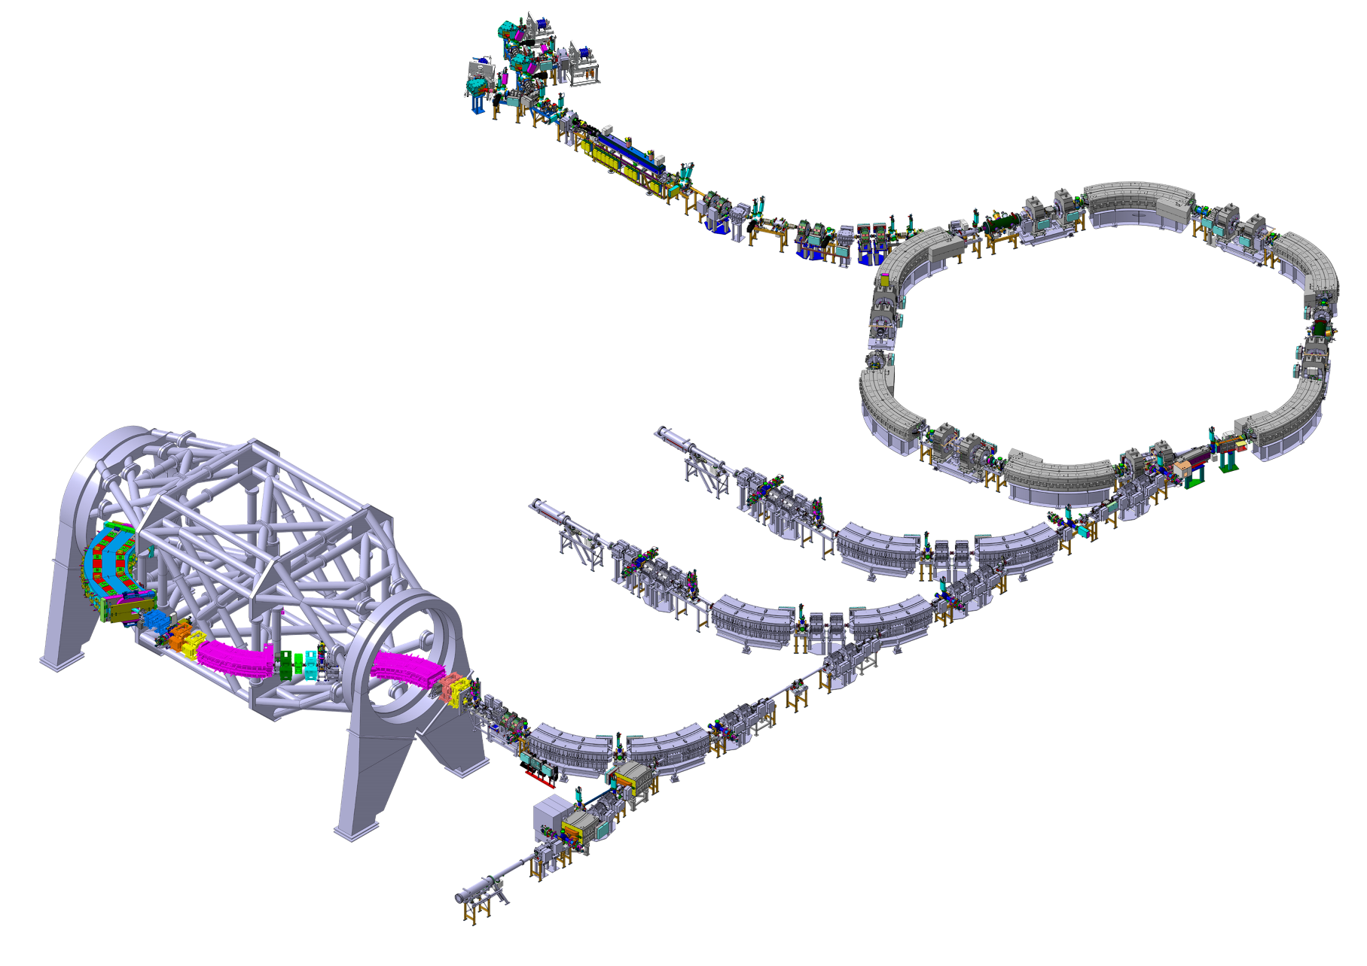
Facility design
Accelerator layout
Sources
Injector LINAC
Treatment rooms
Synchrotron,
(48 - 430 MeV/u)
Beam transport Beam shaping
Abort systems
Experimental room

Slide 27

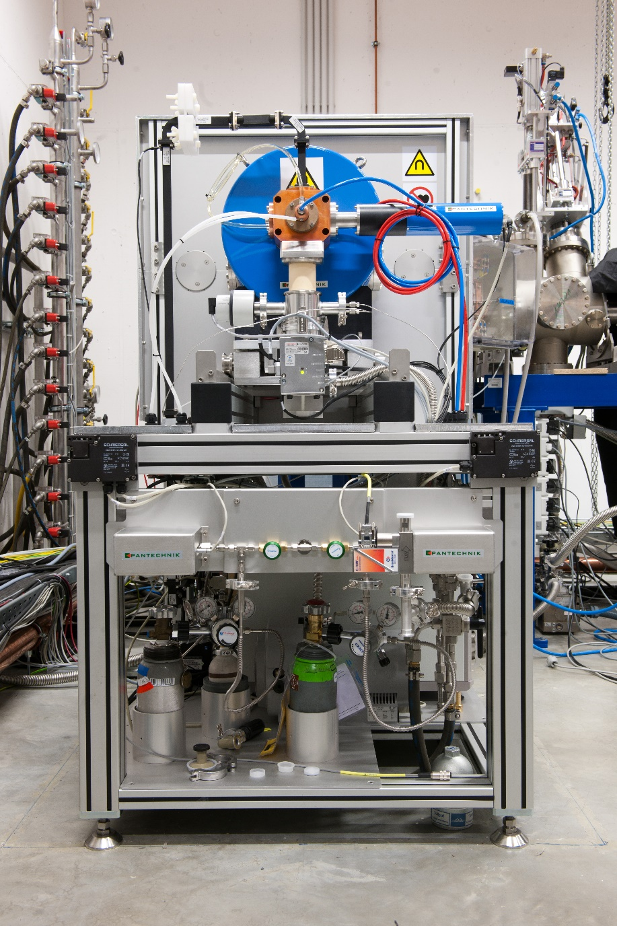
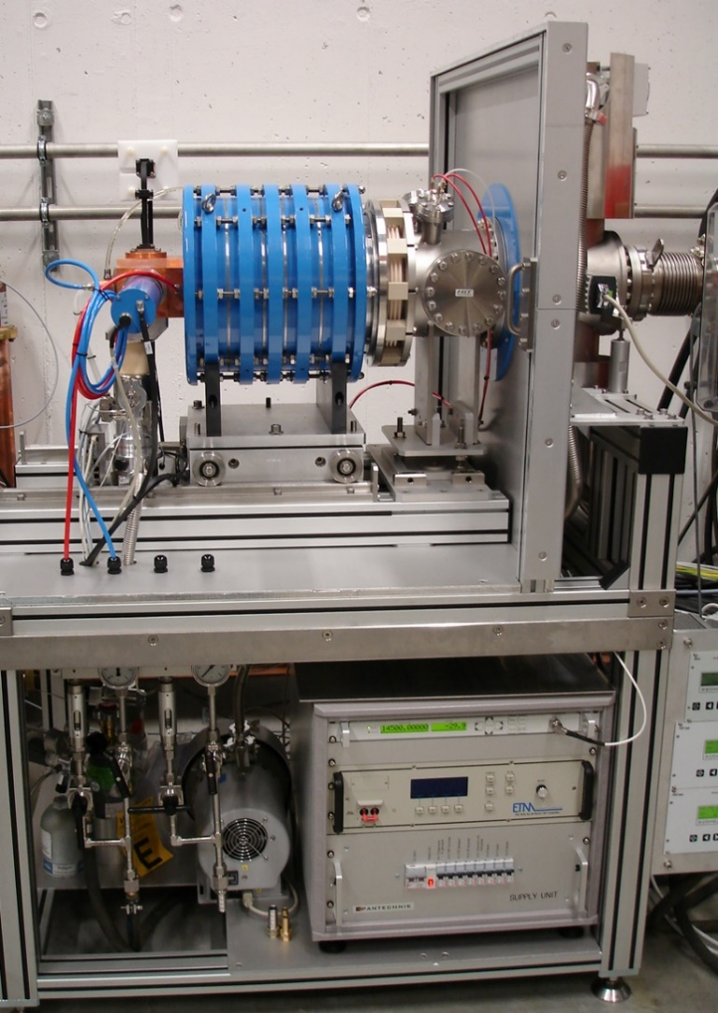
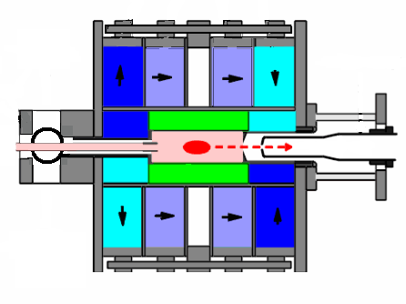
Ion Sources
ECR ion source (Electron Cyclotron Resonance)
Generation of ion plasma through microwave heating
RF
Gas
Permanent
magnets

Slide 28
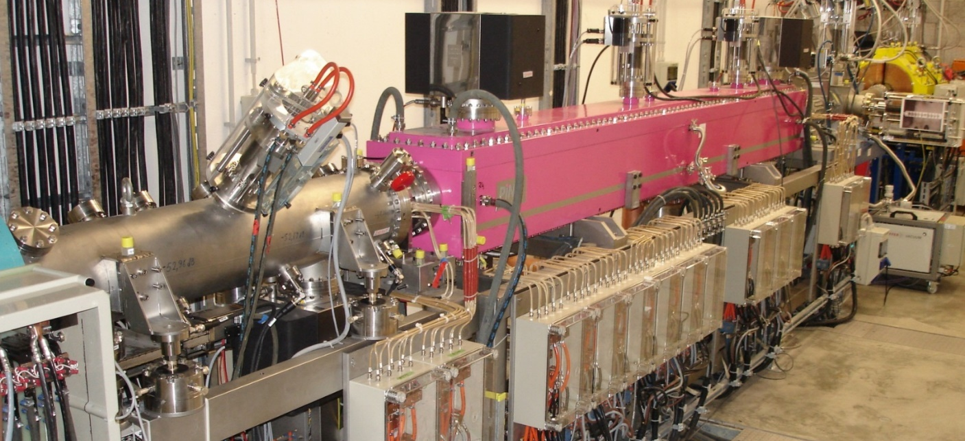
Injector-LINAC (LINear ACcelerator)
Why we need a LINAC:
  Small beam energy of the ECR ion source implies
  extremely low B-field in the synchrotron
  Intensity of C⁶⁺ from ECR not sufficient
  → must extract C⁴⁺ and strip ions later

Slide 29
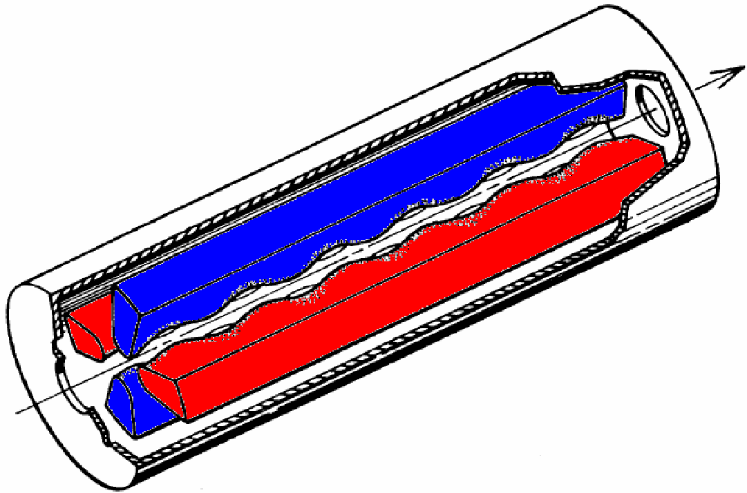
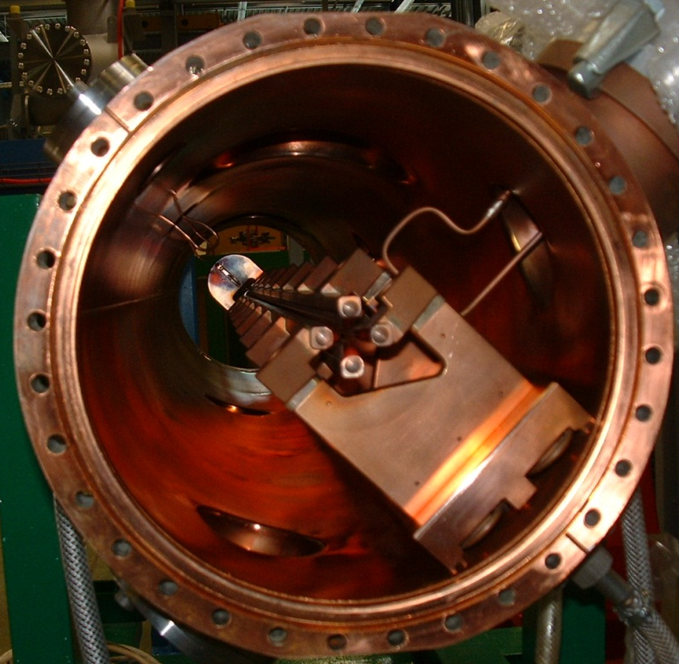
What is part of the LINAC?
RFQ (Radio-Frequency-Quadrupole)
0,25 m
Sinusoidal structure of 4 electrodes
8keV/u → 400keV/u
An RFQ can do 3 things in parallel:
Transverse focusing
Bunching
Acceleration

Slide 30
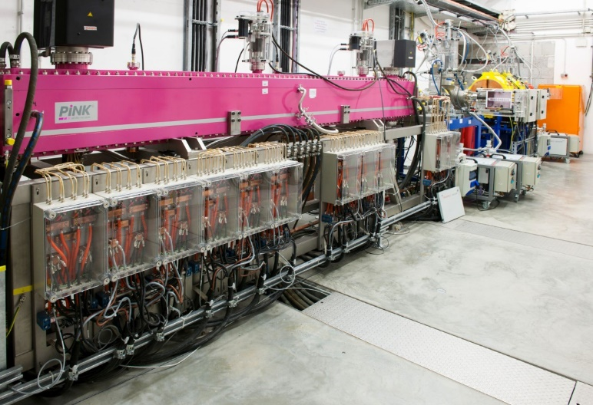
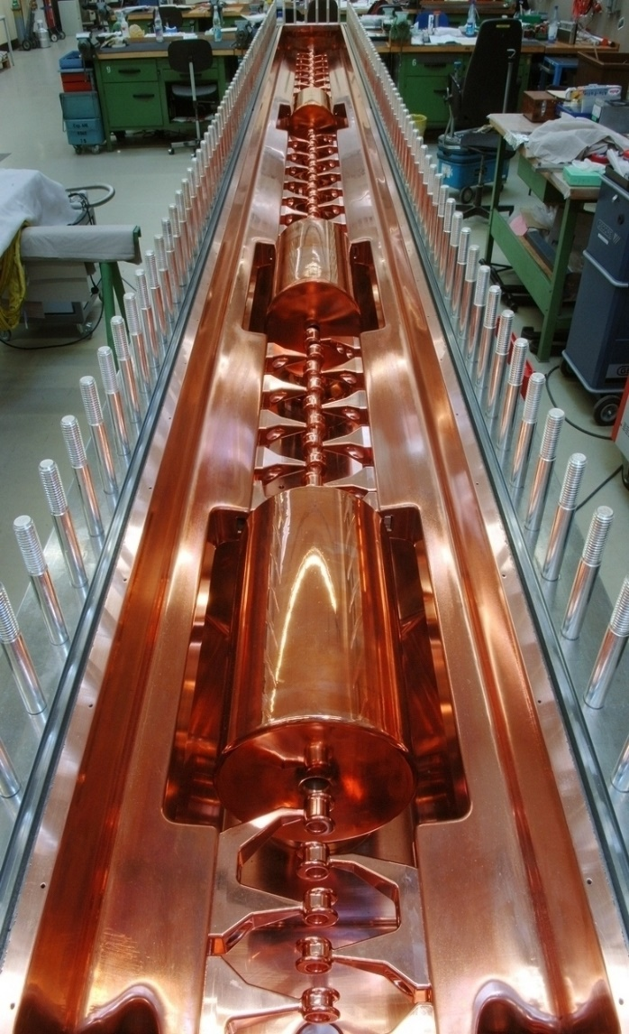
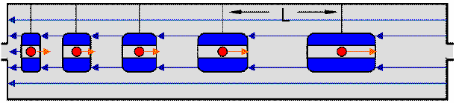
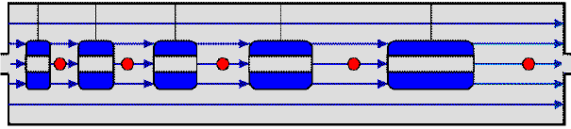
What is part of the LINAC?
IH Drift Tube Linac
Drift tubes
Drift of the beam particles during field reversal
Acceleration of the beam particles
Additional focusing elements
400keV/u → 7MeV/u

Slide 31
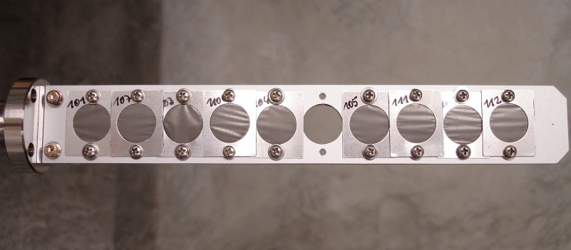
Medium Energy Beam Transport (MEBT)
Function
Transport the beam to the synchrotron
Strip ions and charge separation of stripped ions
Optimisation for good injection conditions (longitudinal and transversal)
Foil stripper: 100 µg/cm² Carbon
H₃⁺
⁴He²⁺
¹²C⁴⁺
¹⁶O⁶⁺
P
⁴He²⁺
¹²C⁶⁺
¹⁶O⁸⁺

Slide 32
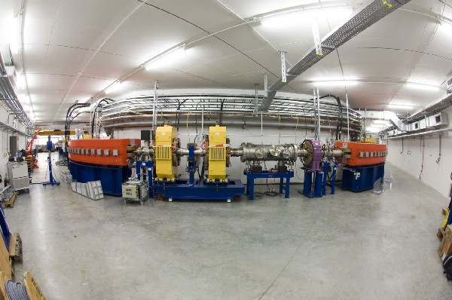
Synchrotron
Beam injection and accumulation
Acceleration to the final energy
Slow extraction allowing for beam spills
of several seconds with interruptions
Setup:
6 dipoles 60°
12 Quadrupoles
4 Sextupoles
2 RF cavities
RF-knockout exciter
…

Slide 33
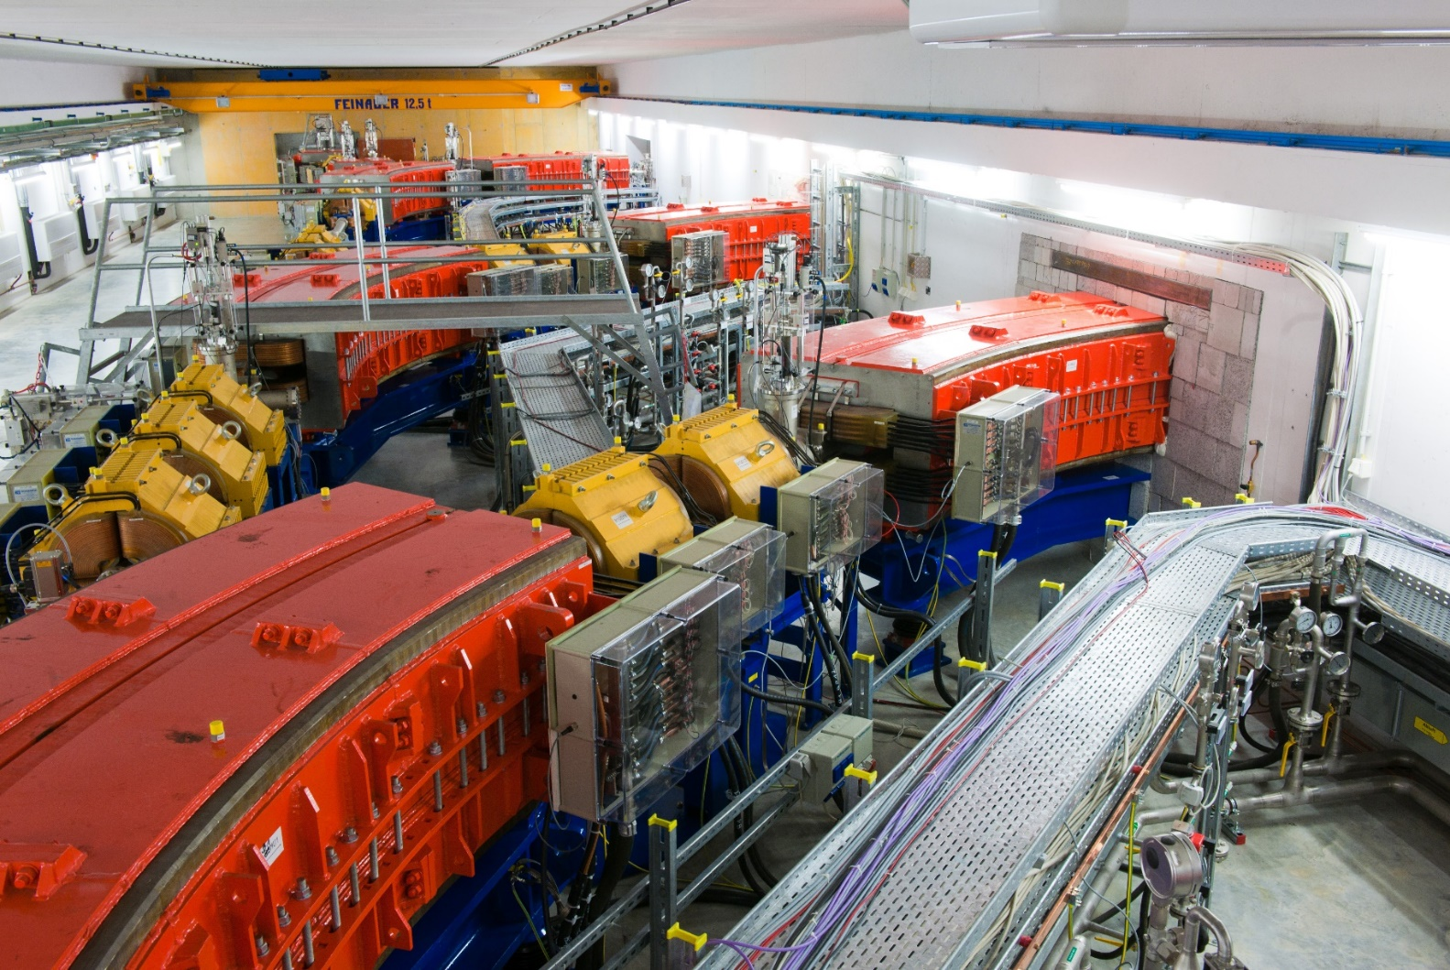
High Energy Beam Transport (HEBT)
Beam transport to treatment rooms
Spill abort systems
Quadrupoles for final focusing
Dipoles and Steerer for
position correction
Scanning magnets

Slide 34
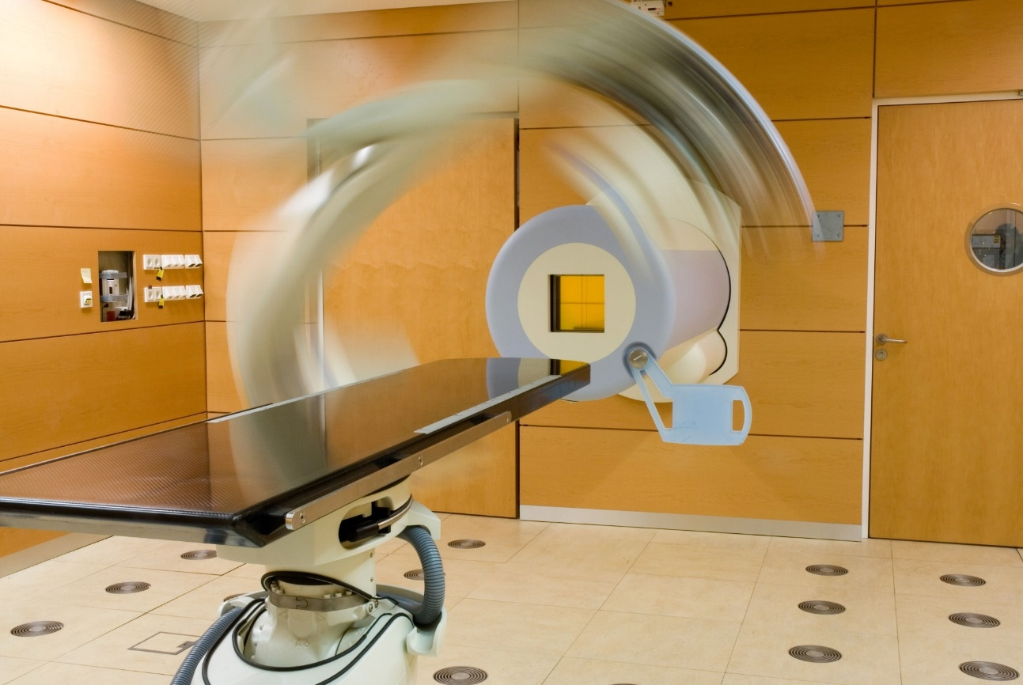
Horizontal Treatment Rooms
Beam application and monitoring system
Imaging system
Patient table
Laser positioning system
Patient treatment requires
preparation and post-processing time
(Patient positioning, imaging, …)
→ To optimally use the accelerator,
we need more than one treatment room

Slide 35
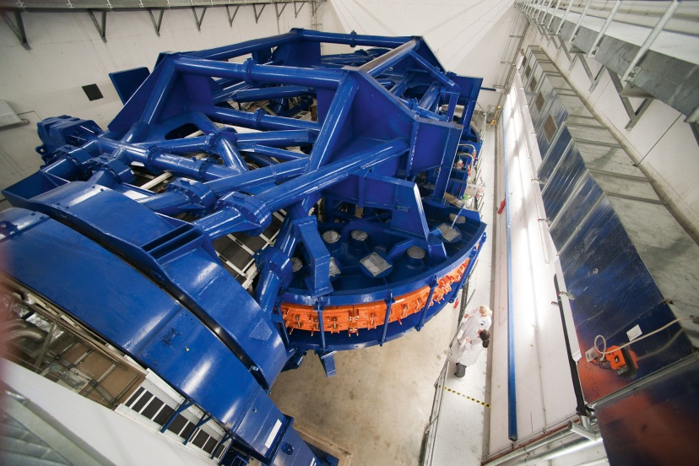
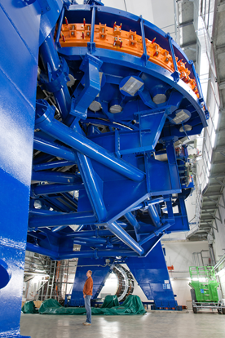
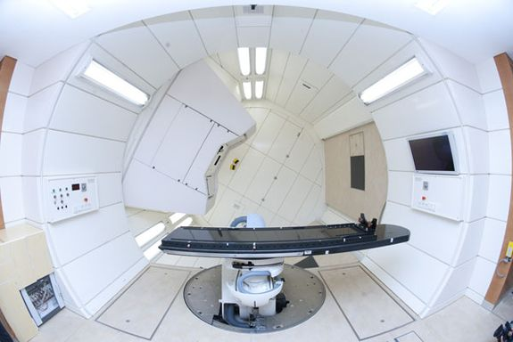
Heavy-ion Gantry
First heavy ion gantry worldwide
Arbitrary entrance angle
Full 360° rotation
Overall weight > 600 tons
Diameter: 13m
Length: 25m
In operation (for treatments)
since 2012.
Accuracy of beam position in
isocenter: ± 0.5 mm
beam

Slide 36
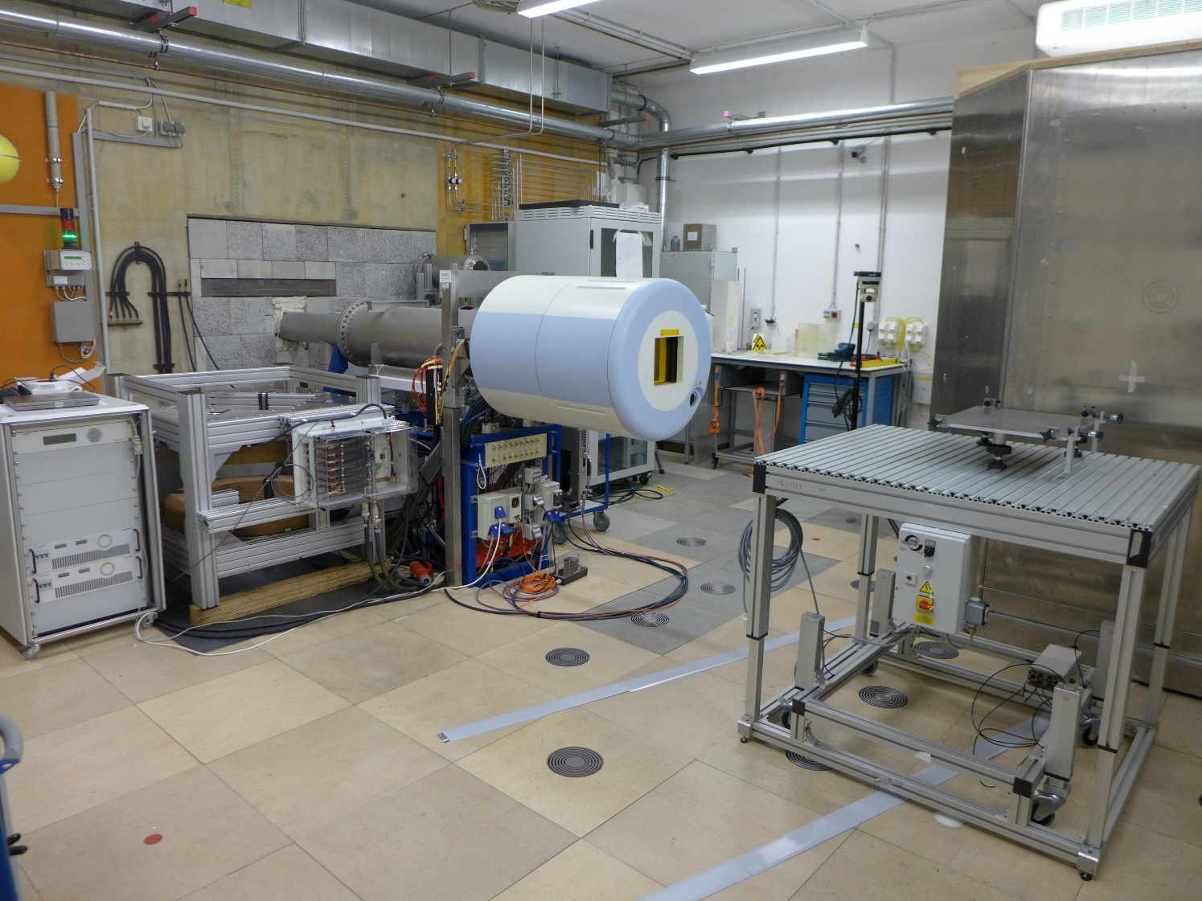
Experimental Room
Dedicated to R & D
Equipment similar to treatment rooms
Even higher flexibility of beam parameters

Slide 37

Typical therapy day @HIT
Acc
QA
Med. Phys.QA
Patient treatment
QA,
Plan Verific.
R & D
or
Beam adjustment
4h 6h 8h 10h 12h 14h 16h 18h 20h 22h 24h 2h 4h
Accelerator QA (1h):
  Measurements along the accelerator
  Beam size and position
  Particle rates and spill structure
  Beam currents in LEBT-LINAC-Section
  Output energy of LINAC

Slide 38


Typical therapy day @HIT
Acc
QA
Med. Phys.QA
Patient treatment
QA,
Plan Verific.
R & D
or
Beam adjustment
4h 6h 8h 10h 12h 14h 16h 18h 20h 22h 24h 2h 4h
Medical Physics QA (2h):
  Room certification
  Position and width check
  Beam abort systems
  Patient table movement
  Treatment plan verification

Slide 39


Typical therapy day @HIT
Acc
QA
Med. Phys.QA
Patient treatment
QA,
Plan Verific.
R & D
or
Beam adjustment
4h 6h 8h 10h 12h 14h 16h 18h 20h 22h 24h 2h 4h
H1
H2
Gantry
Room activity
(15th Nov. 2018)
71 patients

Slide 40

Typical therapy day @HIT
Acc
QA
Med. Phys.QA
Patient treatment
QA,
Plan Verific.
R & D
or
Beam adjustment
4h 6h 8h 10h 12h 14h 16h 18h 20h 22h 24h 2h 4h
R & D
  Bio-physics experiments
  Detector development
  Accelerator R & D
Accelerator beam adjustment

Slide 41
Other particle therapy facilities
Introduction
  Overview of therapy accelerators in the world
  Rationales for particle therapy (PT): biological / physical / technical aspects
  Clinical examples
The accelerator
  Cyclotron and examples
  Synchrotron, example facility in Heidelberg: HIT
  Comparison to other accelerators for PT in the world
Recent developments in PT (very limited and personal choice)

Slide 42


Synchrotron ion-beam therapy facilities around the world
Example Chiba, Japan:
HIMAC (Heavy-Ion Medical
Accelerator in Chiba, NIRS, 1994)
Two 800 MeV/u synchrotrons, for ions up to ⁴⁰Ar¹⁸⁺, mostly ¹²C⁶⁺.
cortesy of K. Noda
HIMAC
Linac
Ion Source
Synchrotron
Room
C
Room
A
Example: CNAO, Pavia, Italy, cortesy of M. Pullia
National Center for Oncological Hadrontherapy
New Facility
Room
B
Room E
Room F
S.C.
Gantry
Room
G
(under construction)

Slide 43

Synchrotron ion-beam therapy facilities around the world
MIT (Marburg) Layout,
cortesy of C. Krantz
MedAustron (Wiener Neustadt, Austria)
Layout, courtesy of M. Kronberger

Slide 44


Synchrotron proton-beam therapy facilities
Loma Linda, USA
Endo, M. Radiol Phys Technol (2018) 11: 1
1st hospital-based proton therapy centre (since 1990)
Proton synchrotron designed by Fermilab
> 20000 patients treated

Slide 45
Introduction
  Overview of therapy accelerators in the world
  Rationales for particle therapy (PT): biological / physical / technical aspects
  Clinical examples
The accelerator
  Cyclotron and examples
  Synchrotron, example facility in Heidelberg: HIT
  Comparison to other accelerators for PT in the world
Recent developments in PT (very limited and personal choice)

Slide 46



Reduce size and costs
Cyclotrons - Single-room solutions
iba-worldwide.com
S250 system by Mevion
Gantry-mounted superconducting cyclotron.
Installed at 15 sites.
Proteus ONE single-room solution by IBA:
40 installations world-wide
mevion.com

Slide 47



Reduce size and costs
Synchrotrons - single-room solutions
Umezava et al., Hitachi Rev. 64 (2015) 508
ca. 5 m
hitachi.com
Hitachi ProBeat V System
Compact p-synchrotron (250 MeV)
with single-room solution

Slide 48


Reduce size and costs
Synchrotrons – State of the art
Toshiba Heavy Ion (¹²C⁶⁺) Therapy System
Installed at multiple sites in
Japan and South Korea.
global.toshiba
www.toshiba.com/heavy-ion/

Slide 49




“Plan of Miniaturizing”, the Japanese way
1st Generation Quantum Scalpel
3rd generation
4th generation
2nd generation Quantum Scalpel
Ion Therapy in Japan
Koji Noda
National Institute of
Radiological Sciences QST
Workshop on Ion Beam Therapy,
Archamps, 2018
10 m
10 m
10 m
23 m

Slide 50


HIT – current projects
B
IES #3
IES #2
Control system upgrade to allow for multi energy operation
New RFQ
IES #1
t
B
Phases without beam availability at target (Injection, acceleration, reset, …)
IES #3
IES #2
IES #1
t
C. Schoemers et al.
"Reacceleration of ion beams for particle therapy."
Proc. of IPAC2014, Dresden.
H. Höltermann, H. Hähnel, B. Koubek, H. Podlech, U. Ratzinger TUNING AND RF MEASUREMENTS OF THE LILAC RFQ Proc. of 15th Int. Conf. on Heavy Ion Acc. Technology HIAT2022, Darmstadt, Germany

Slide 51

“FLASH-effect” – Ultra High Dose Rate (UHDR) Irradiations
What is uHDR: dose rates > 40Gy/s (while standard dose rates (SDR) are << 1Gy/s)
Under investigation: are there biologic benefits when applying uHDR?
“FLASH effect”: normal tissue sparing without sacrificing tumour control?
Example helium: 3.5e10 particles in 90ms →
3.9e10 part./s. > 50 times higher than therapy
T. Tessonnier, S. Mein, D.W.M. Walsh, N. Schuhmacher, H. Liew, U. Weber, R. Cee, M. Galonska, C. Schömers, S. Scheloske, S. Brons, J. Debus, T. Haberer, A. Abdollahi, A. Mairani, and I. Dokic. FLASH dose-rate helium ion beams in vitro. International Journal of Radiation Oncology, Biology, Physics, 2021.
C. Schömers, S. Brons, R. Cee, A. Peters, S. Scheloske, T. Haberer, “BEAM PROPERTIES BEYOND THE THERAPEUTIC RANGE AT HIT”, in Proc. IPAC’23, Venice, Italy, May 2023, paper THPM064, http://doi/jacow-ipac2023-thpm064/index.html

Slide 52

iRAD – Ion Beam Radiography
Detector
Object /
Patient
Idea of ion beam radiography: use particle beams also for imaging
Good for treatment planning – same radiation for image and treatment
Possibility of in situ monitoring
T. Gehrke et al., “Theoretical and experimental comparison of proton and helium-beam radiography using silicon pixel detectors”, Phys. Med. Biol., vol. 63, no. 3, p. 035037, Feb. 2018. https://doi:10.1088/1361-6560/aaa60f
A. Burker et al., “Imaging with Ion Beams at MedAustron”, Nuclear Inst. and Methods in Physics Research, A 958 (2020) 162246, https://doi.org/10.1016/j.nima.2019.05.087

Slide 53
iRAD – Ion Beam Radiography
Carbon – Helium mixed beam
Treatment and online monitoring
at the same time
Accelerate 2 ions with same a/q
to same energy
Carbon ions stop in the patient
Helium ions stop in detector
Simultaneous extraction!
L. Volz, L. Kelleter, S. Brons, L. Burigo, C. Graeff, N. I. Niebuhr, R. Radogna, S. Scheloske, C. Schömers, S. Jolly, and J. Seco. Experimental exploration of a mixed helium/carbon beam for online treatment monitoring in carbon ion beam therapy. Physics in Medicine & Biology, 65(5):055002, feb 2020.
C. Knobloch, M. Metzner, F. Kehrein, C. Schömers, S. Scheloske, S. Brons, R. Hermann, A. Peters, O. Jäkel, M. Martisikova and T. Gehrke. Establishment and evaluation of a water-equivalent thickness calibration for helium-beam radiography with high-energy beams and thin silicon pixel detectors. Medical Physics, to be published 2022

Slide 54
Multi ion treatment
What is multi ion treatment: treating the patient with more than one ion type.
Why? Maximize the therapeutic effects;
make use of different LETs (=linear energy transfer, “severeness” of damage)
Two ions → twice the number of slices → double irradiation time
To be comparably fast as now: increase the speed of dose application e.g. higher intensity.
Taku Inaniwa et al, Adaptation of stochastic microdosimetric kinetic model to hypoxia for hypo-fractionated multi-ion therapy treatment planning, 2021 Phys. Med. Biol. 66 205007

Slide 55
Particle ARC therapy
What is ARC-therapy: delivery
technique with dosimetric
advantages (dose conformity,
treatment time)
Live/dynamic gantry rotation
during irradiation instead of
2-3 fields “step and shoot”.
Already used in standard photon therapy → What about particle-therapy: spot-scanning hadron arc (SHArc)?
beam
Stewart Mein, Thomas Tessonnier, Benedikt Kopp, Christian Schömers, Semi Harrabi, Amir Abdollahi, Jürgen Debus, Thomas Haberer, Andrea Mairani, Biological Dose Optimization for Particle Arc Therapy Using Helium and Carbon Ions International Journal of Radiation Oncology*Biology*Physics, Volume 114, Issue 2, 2022, Pages 334-348, https://doi.org/10.1016/j.ijrobp.2022.04.025

Slide 56
Take-home messages
Introduction
  Overview of therapy accelerators in the world
  Rationales for particle therapy (PT): biological / physical / technical aspects
  Clinical examples
The accelerator
  Cyclotron and examples
  Synchrotron, example facility in Heidelberg: HIT
  Comparison to other accelerators for PT in the world
Recent developments in PT (very limited and personal choice)

Slide 57


…and all people for the discussions, that gave input and contributed to this talk, especially:
HIT: Thomas Tessonnier, Malte Ellerbrock, Rainer Cee, Andreas Peters, Thomas Haberer and the entire accelerator team
Siemens Health Systems: Abel Robin
GSI: Claude Krantz, Michael Galonska
MIT: Alexander Schottelius
CNAO: Marco Pullia
MedAustron: Matthias Kronberger-Mayerhofer
HIMAC: Koji Noda
Thank you!

Slide 58
Backup-Slides

Slide 59


Spillpause – mechanism to spare healthy tissue
Spill pause is a fast beam-off mechanism
Pause and resume the beam extraction
several times on flattop
RF-KO allows spill pause
Used for:
  Scanning without dose deposition
  Respiratory gating
Scan path
Gating
Target
movement
Irradiation window
Tumour
Time
Courtesy of S. Nill & U. Oelfke, DKFZ, C. Bert et al

Slide 60

HIT – Operating concept
Accelerator team: ~20 people
  Physicists, engineers, technicians
  2 accelerator operators on-site, 24/7
  On-call duty for each maintenance group
Availability of accelerator:
  > 330 days of operation per year
  1 shutdown Christmas – 1st week in January
  5 maintenance blocks 2 days each
  12 single maintenance days

Slide 61

Requirements from dose distribution techniques
State of the art:
Pencil-beam scanning
”Paint” iso-energetic slice of the
target volume.
Requires beam size, energy, and intensity to be stable over several seconds!
Durante and Paganetti,
Rep. Prog. Phys. 79 (2016)

Slide 62
Topic 1: Intensity control system of a slowly extracted ion beam
B
Extraction
Acceleration
Reset
Injection
t
Notes:
The first topic now is the intensity control system that has been fully implemented in the therapy operation yet
Let's have a look on the standard synchrotron cycle that somehow looks like this
When you try to shorten the overall cycle you can
either try to reduce the time, while the patient receives dose
or try to reduce the acceleration and preparation phases
We have examples for both in this talk
This development deals only with the extraction phase

Slide 63
Intensity control system
Use intensity signal
Add feedback loop
Position and intensity is measured, the scanning velocity and the intensity are adapted
Therapy- Control- System
RF-KO
exciter
Intensity feedback loop

Slide 64

Topic 1: Intensity control system
Setup "Dynamic Intensity Control"
Intensity is monitored →
  Scanning velocity is adapted
  AND
  Beam intensity is adapted
Fast response due to RF-KO extraction (~ms)!
Intensity feedback
"DIC"
Therapy control system
RF-knockout
exciter
Notes:
This is again visualized here:
The beam is measured in front of the patient with ICs and MWPCs
The therapy control system adapts the scanning magnets
What we did is we closed another feedback loop
We take the signal of the ionisation chambers, that monitor the beam intensity anyway
Instead of just adapting the scanning speed, we now directly also influence the Amplitude of the transverse KO-Exciter and thus delivered beam intensity
This is possible, as the knockout exciter can adapt the intensity on a ms timescale.
So we here coupled the industrial product, the accelerator and the medical product, the scanning system

Slide 65



Extraction system: RF knock-out
More Details about the particular excitation, frequencies, hardware and
recent improvements achieved in the spill structure in the talks of Eike Feldmeier and Cristopher Cortés this afternoon.
RF-Knockout-Exciter parameters
Horizontal resonance tune: 1.67
RF-KO electrode length: 0.7 m
RF-KO electrode distance: 0.15 m
Maximum exciter power: 400 W
Intensity feedback system implemented (dose delivery system ↔ RF-KO exciter)
Ideal - flat
Typical RF-KO
Intensity controlled

Slide 66

Topic 1: Intensity control system
Spill with intensity control
Intensity is monitored →
  Scanning velocity AND
  Beam intensity is adapted
Typical spill shape at HIT after April 2013
  With feedback
  Reference value
  Without feedback
Higher average intensity
Less treatment time
Notes:
This is the spill shape after we closed the feedback loop, compared to the spill you have seen before
We can keep the intensity close to the desired value
The average is higher due to several reasons
As there are less fluctuations, we can go closer to the upper limit, without having the risk of irradiating to fast
Fast rise time, which is significant, as many spills do not last 5s but maybe just one or two, in case the slice is already completed
We still had, however, one fixed intensity for the whole cycle;
rasterpoints that require only a low dose, are irradiated with the same intensity as very "large", high-dose rasterpoints, which than take much longer to be completed

Slide 67


Why a raster-point-individual intensity makes sense
…if you have an intensity control
Dose in each voxel ≠ dose per raster-point
Example of dose distribution of one slice
Fixed intensity: irradiation time per raster point can vary by a factor of 2000!
ions
C. Schoemers et al, Nuclear Instruments and Methods in Physics Research Section A: Accelerators, Spectrometers, Detectors and Associated Equipment, Volume 795, 21 September 2015, Pages 92-99, ISSN 0168-9002, http://dx.doi.org/10.1016/j.nima.2015.05.054

Slide 68
Topic 3: Multi-energy operation of a synchrotron
B
Reset
Extraction
Acceleration
Injection
t
Notes:
The third and last topic of cycle time reduction is what we call multi-energy operation
It focuses mostly on the acceleration and reset phase

Slide 69


Topic 3: Multi-energy operation
Present situation
HIMAC approach: Y. Iwata et al.
"MULTIPLE-ENERGY OPERATION WITH QUASI-DC EXTENSION OF
FLATTOPS AT HIMAC."
Proc. of IPAC10, Kyoto.
B
Energy #2
Energy #1
∆E < 4 MeV/u
$\overset{̿}{T}$_{Extr} = 1.5 s
(5 s possible)
C. Schoemers et al.
"Reacceleration of ion beams for particle therapy."
Proc. of IPAC2014, Dresden.
t
Notes:
Today, each iso-energy-slice (IES) requires new synchrotron cycle.
Remaining particles at the end of extraction are dumped
and usually there are still particles left after completing one iso energy slice:
At HIT the average extraction time in therapy is 1.5 seconds, usually we have enough particles for 5s.
In the typical therapy case, the next cycle has just a slightly different energy of some MeV/u
We put a lot of effort of ramping down, ramping up again to end up with an energy that is almost the same.
Our Japanese colleagues realized the potential and started a very interesting work already some years ago and they published several papers on that
they have chosen the approach of having a pattern of the whole available energy range and stop this pattern, to have an extraction flattop whenever needed

Slide 70
Topic 3: Multi-energy operation
Concept
Accelerate (or decelerate) n times according to the patient-specific treatment plan
Iso energy slices irradiated with short interruptions
HIT test system with 2 extraction flattops available now
B
E #n
E #n-1
E #2
//
E #n-2
E #1
M. Galonska et al. "Multi-Energy Trial Operation of the HIT Medical Synchrotron: Accelerator Model and Data Supply."
Proc. of IPAC2017, Copenhagen.
t
Notes:
Our approach is similar but different
Fill synchrotron to maximum
Accelerate or decelerate remaining particles to the next energy level
but we want to do this again in a patient specific way, depending on the demands of the actual treatment plan
this means at any time in the cycle, if possible to any required energy
Several iso energy slices can be irradiated with short interruptions only
as long, as there are still some particles left in the synchrotron
in average we will be able to have about 6 extraction levels per cycle
in some cases one cycle will even be enough to cover the whole tumour
We changed our data supply model in a way, to be able to have 2 extraction levels within one cycle, as this was possible with only moderate changes of the existing control system hardware

Slide 71

Topic 3: Multi-energy
Test-system results: Spill
Interspilltime < 300ms (TCS dominated)
Energy verified ü
(PTW Peakfinder
water column)
Next step: control system upgrade!
1st Extraction @
E₁ = 352 MeV/u
2nd Extraction @
E₂ = 358 MeV/u
Notes:
You clearly see 2 spills on the ionization chamber of the HEBT-line
With a very short interruption in the order of some 100ms, which is btw. not dominated by the accelerator, but some internal communication of the therapy control system
We verified the energy in the treatment room with the standard device for range measurements at HIT
The next big step will be to think about a larger control system update and a new data supply model, that allows energy jumps according to the individual treatment plan

Slide 72
Particle ARC therapy
What the accelerator has to provide
Intensity range comparable to today
But: Stability of intensity!
Apart from SX: Multi-energy mode → fast energy switching mandatory, more degrees of freedom, robust optimization, better coverage, faster irradiation time!
Multi-energy mode requires beam off / on spill pause mechanism

