Slide 1
Neutron excess
In nuclei
60th International Winter Meeting on Nuclear Physics
22 – 26 January 2024
Alexandre Obertelli, TU Darmstadt

Slide 2
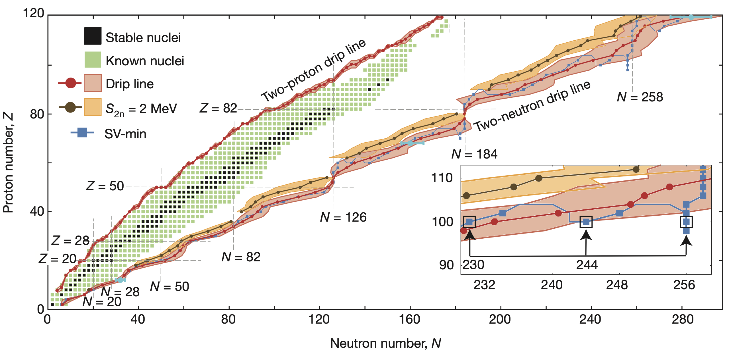
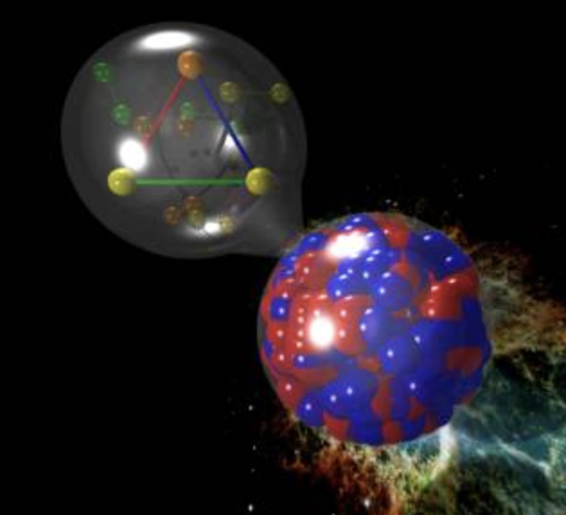
nuclear forces, Nuclei & STARS
$\sim$4000 nuclei unknown
A $\sim$ 10⁵⁷ baryons
Erler et al., Nature (2012)
From Watts et al., RMP (2016)

Slide 3
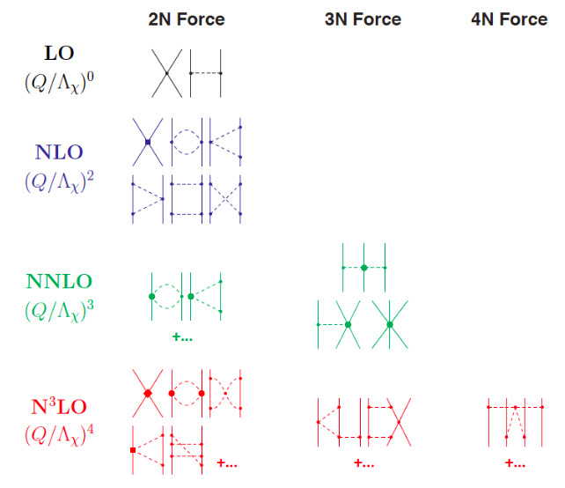
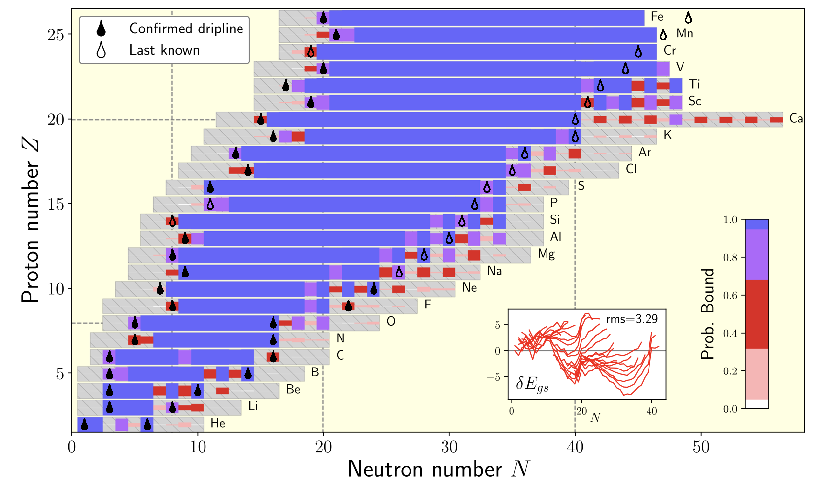
nuclear forces, Nuclei & STARS
Modern theory : effective field theory (EFT) from QCD and many-body ab initio methods
Stroberg, Holt, Schwenk, Simonis, PRL (2021)

Slide 4
Most neutron-rich systems: the tetraneutron and the unbound ²⁸O
Duer et al., Nature (2022); Kondo et al., Nature (2023)
Neutron skins in rare isotopes
PUMA collaboration, EPJA (2022)

Slide 5
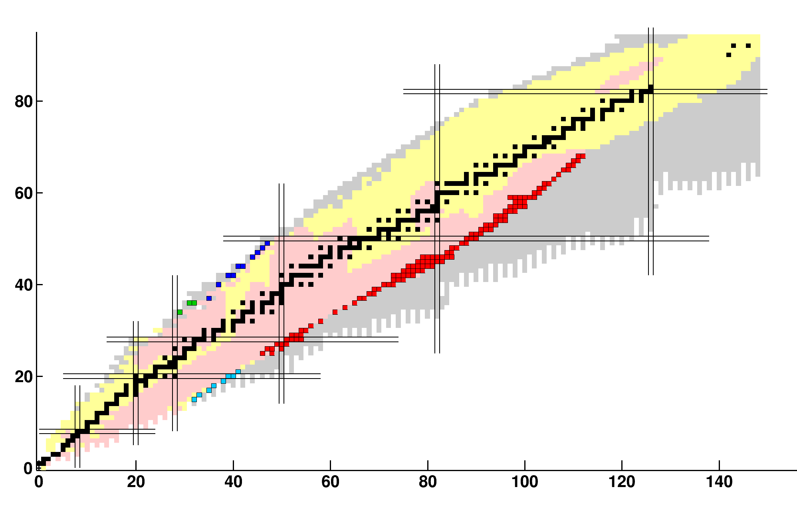
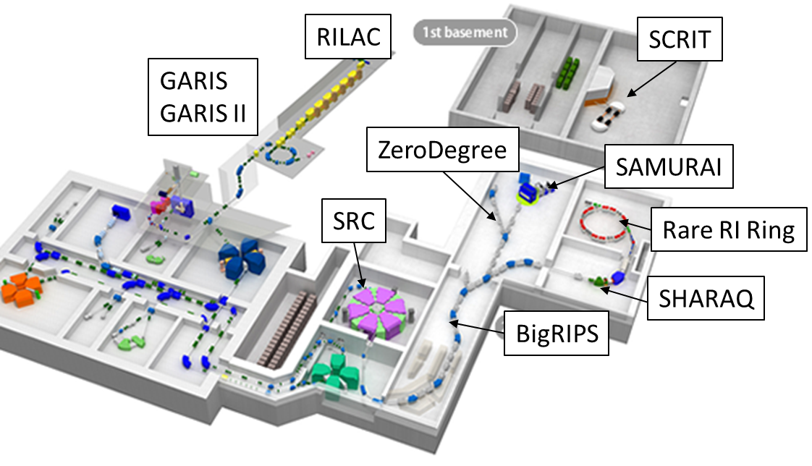
Structure of neutron-rich systems
RIBF, RIKEN
^{238U}
© Thomas Ott
© Thomas Ott
Proton number
Isotopes produced (1460)
New isotopes (2007–2019)
²³⁸U in-flight fission (119)
¹²⁴Xe P.F. (10)
⁷⁸Kr P.F. (4)
⁷⁰Zn P.F. (8)
⁴⁸Ca P.F. (1)
Primary stable beams up to 345 MeV/nucleon
1 p𝜇A for light beams, 100 pnA for ²³⁸U
Neutron number

Slide 6
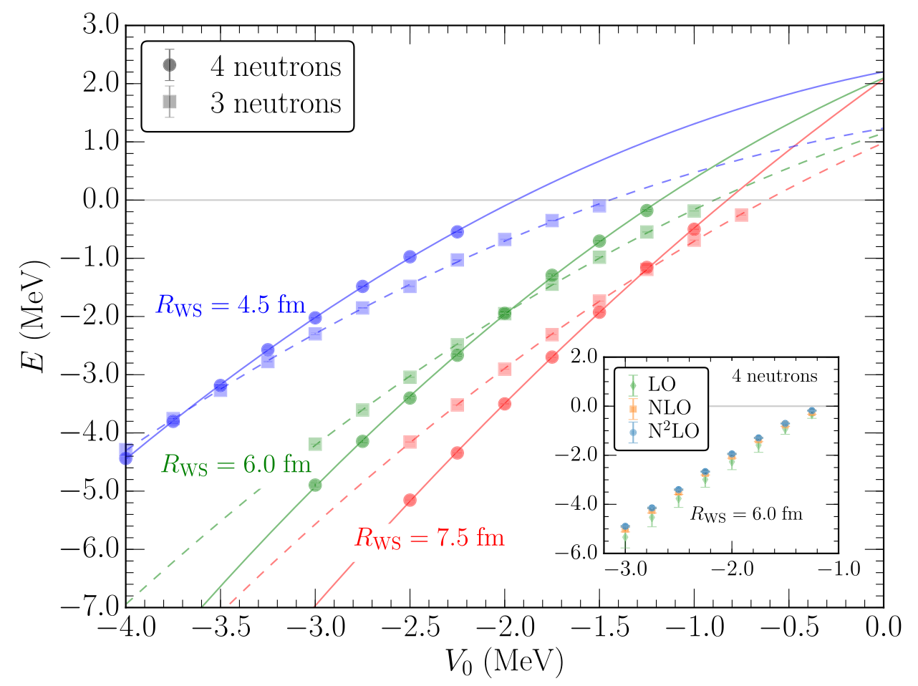
Structure of neutron-rich systems | The tetraneutron
tetraneutron: a 60-year quest
Modified from Marques, EPJPlus (2021)
Quantum Monte Carlo + N2LO chiral EFT
Gandolfi et al., PRL (2017)
Deltuva, Lazauskas, PRL Comment (2019)
Gandolfi et al., PRL Reply (2019)
No bound tetraneutron compatible with theory
Debate if a low-energy resonance exists

Slide 7
Structure of neutron-rich systems | The tetraneutron
⁸He(p,p𝛼)4n
1.25 T
⁸He beam at 156 MeV / nucleon ($β$=0.5), 10⁵ pps
Selected kinematic region of largest momentum transfer to minimize final state interactions (FSI)
Missing mass measurement from detection of alpha and proton, i.e, no neutron detection

Slide 8
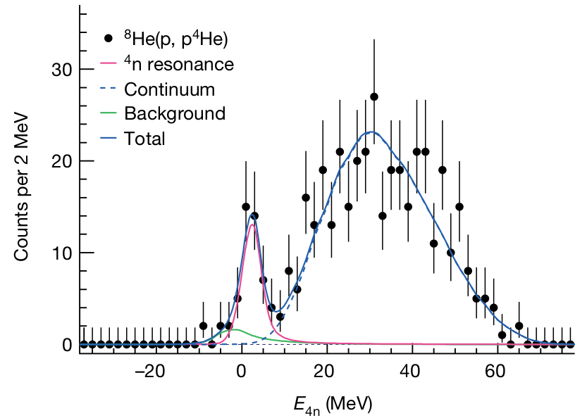
Structure of neutron-rich systems | The tetraneutron
Evidence of correlated
free 4 neutrons
Er = 2.37±0.38(stat.)±0.44(sys.) MeV
Γ = 1.75±0.22(stat.)±0.30(sys.) MeV
Duer et al., Nature (2022)

Slide 9
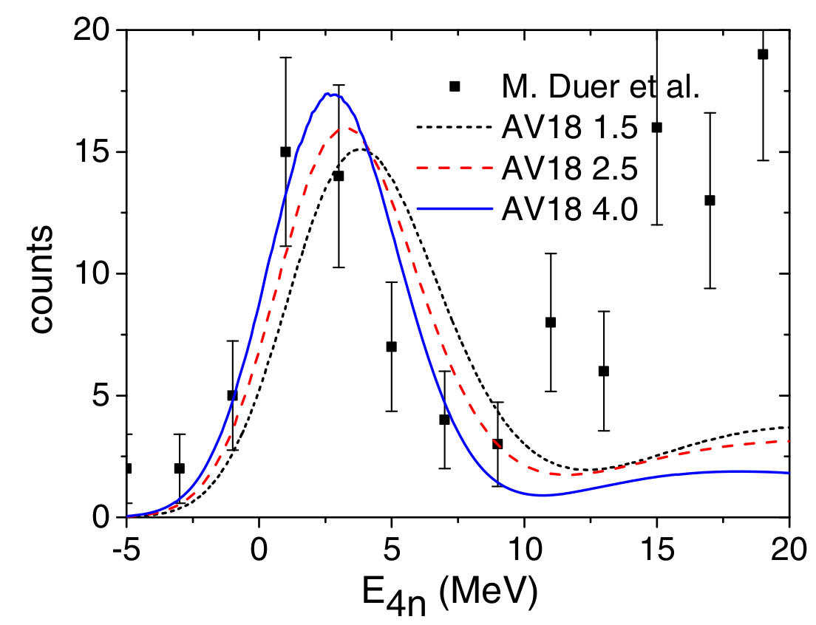
Structure of neutron-rich systems | The tetraneutron
Evidence of correlated
free 4 neutrons
Resonance or non-resonant FSI among the neutrons and reaction mechanism?
New experiments and predictions in preparation
Er = 2.37±0.38(stat.)±0.44(sys.) MeV
Γ = 1.75±0.22(stat.)±0.30(sys.) MeV
Duer et al., Nature (2022)
Laszauskas, Hiyama, Carbonell, PRL (2023)

Slide 10
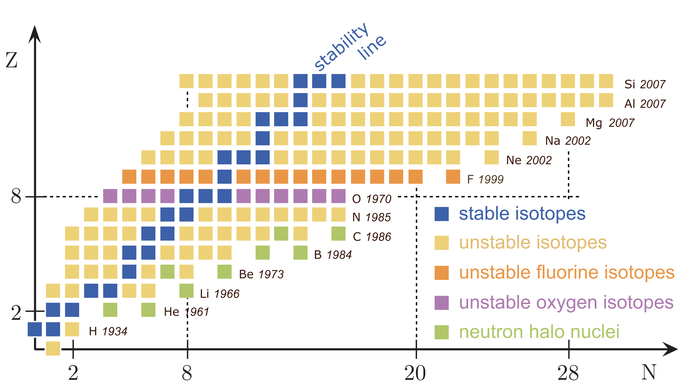
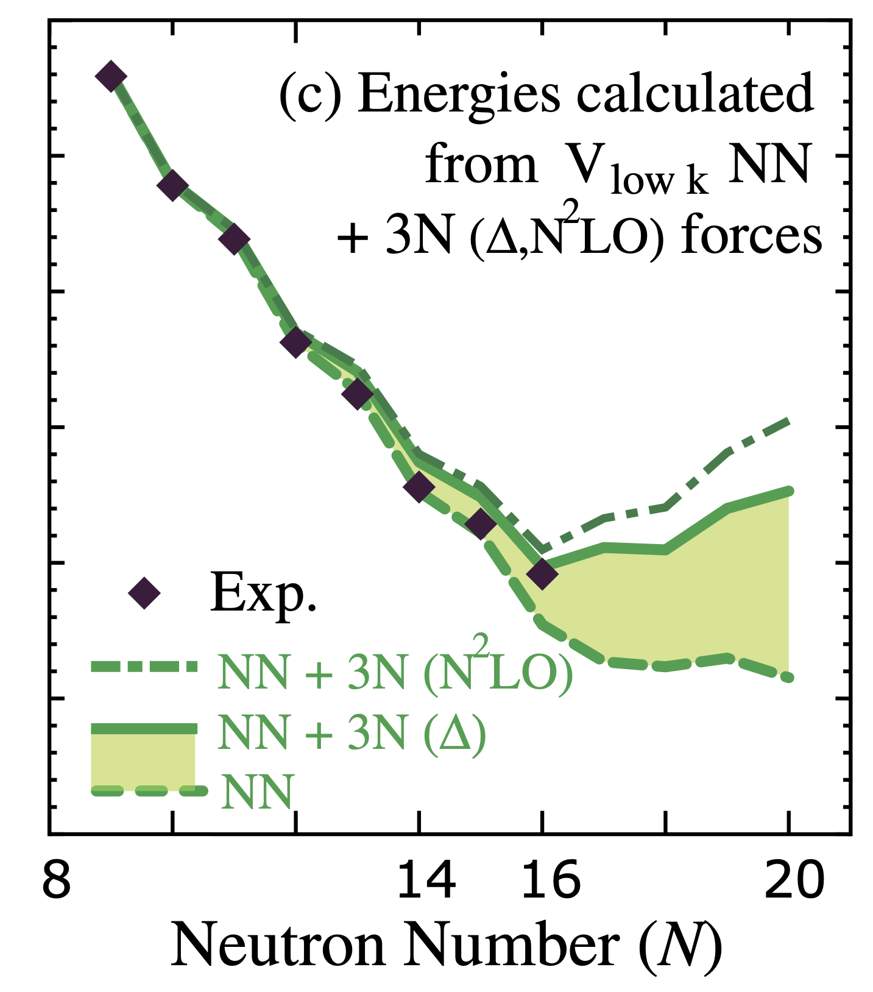
Structure of neutron-rich systems | ²⁸O
The oxygen dripline
Oxygen anomaly: dripline at ²⁴O (N=16)
Dripline not reproduced without 3N forces
Benchmark for modern theories
Otsuka et al., PRL (2010)
+6 neutrons

Slide 11
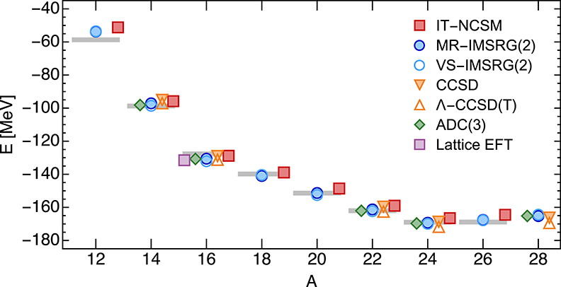
Structure of neutron-rich systems | ²⁸O
The oxygen dripline
Oxygen anomaly: dripline at ²⁴O (N=16)
Dripline not reproduced without 3N forces
Benchmark for modern theories
Hergert, Front. Phys. (2020)
+6 neutrons

Slide 12
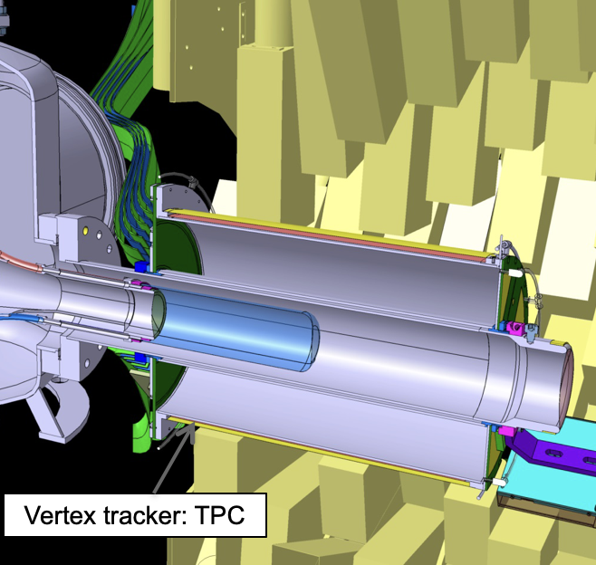
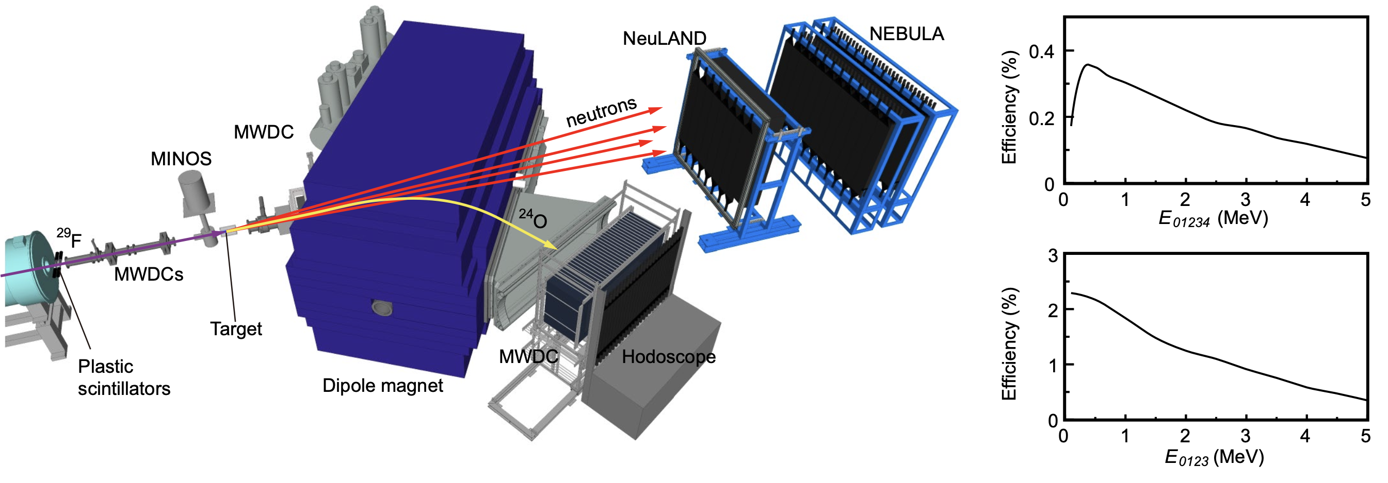
Structure of neutron-rich systems | ²⁸O
The experiment
proton
²⁹F
²⁴O+4n
MINOS target & tracker
AO et al., EPJA (2014)
Quasifree scattering ²⁹F(p,2p)²⁸O$→$²⁴O+4n, ²⁹F beam at 235 MeV / nucleon ($β$=0.6), 90 pps
First detection of 4 neutrons ($ε4n$=0.3%) in inverse kinematics in coincidence for invariant mass
Key role of MINOS hydrogen target (1 g.cm⁻²) and tracker & NeuLAND demonstrator (FAIR-0)

Slide 13
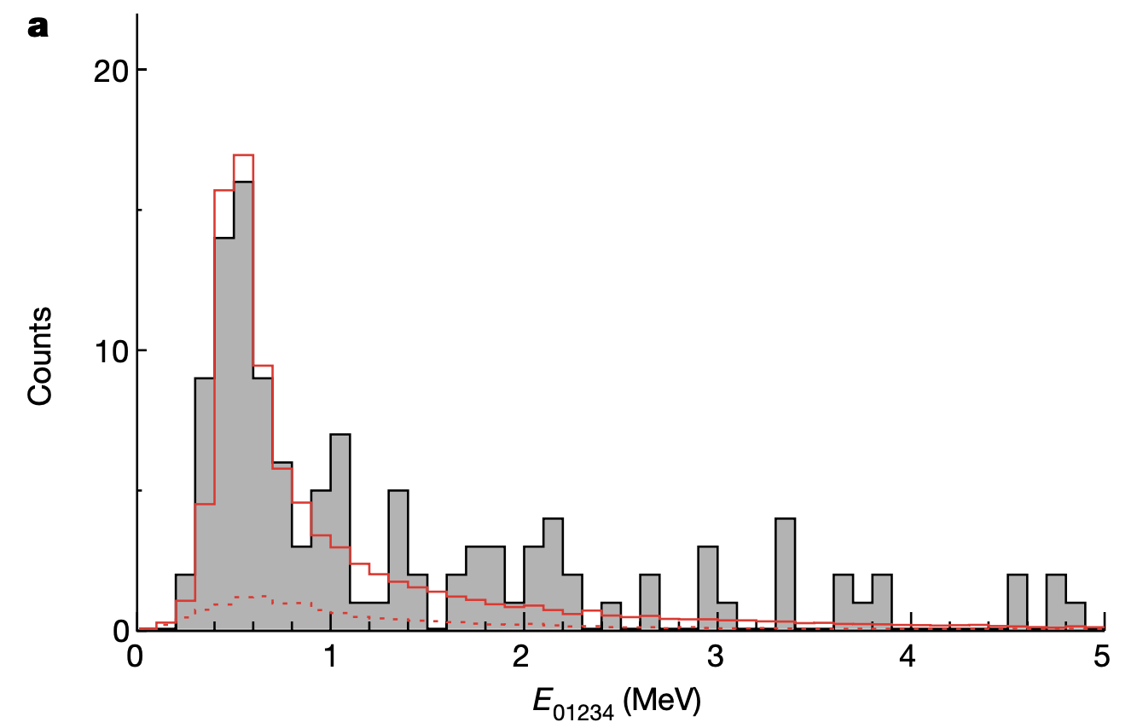
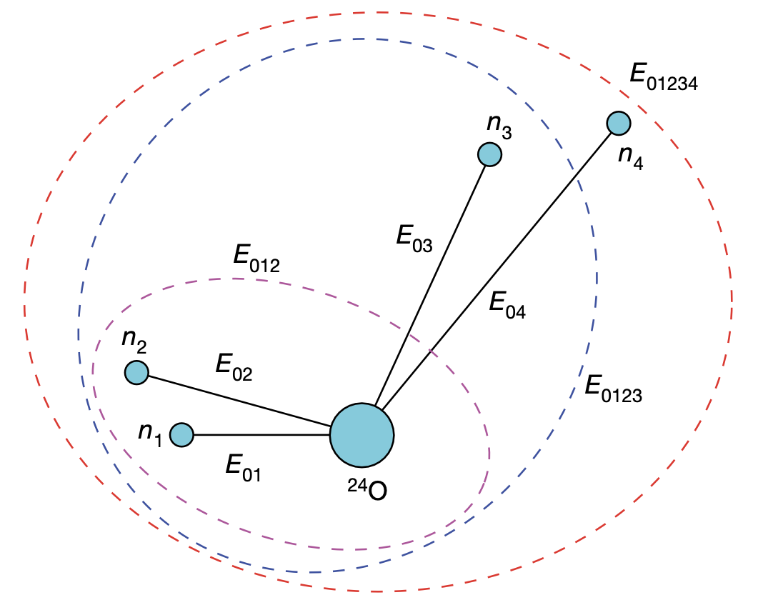
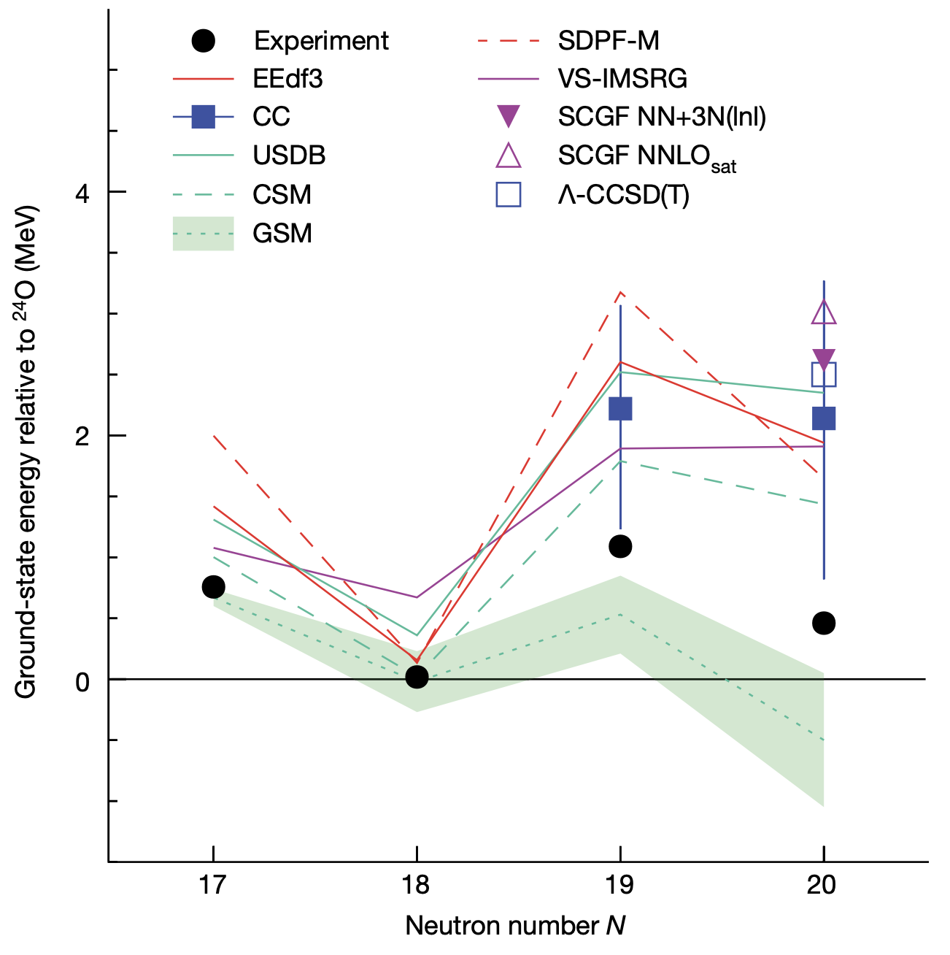
Structure of neutron-rich systems | ²⁸O
Ground-state energy of ²⁸O
$$E_{01234}=M\left({}_{}^{28}{\text{O}}\right)−M\left({}_{}^{24}{\text{O}}\right)−4M_{n}$$
$$M({}_{}^{28}{\text{O}\text{)}=\sqrt{{(\sum_{i=0}^{4}{E_{i}})}^{2}−{(\sum_{i=0}^{4}{p_{i}})}^{2}}}$$
²⁸O unbound by 0.46(6) MeV, overestimated by 1 MeV by theory
²⁹F(p,2p)²⁸O cross section consistent with deformed ²⁸O
Role of interactions, deformation and continuum still to be investigated
Kondo et al., Nature (2023)

Slide 14
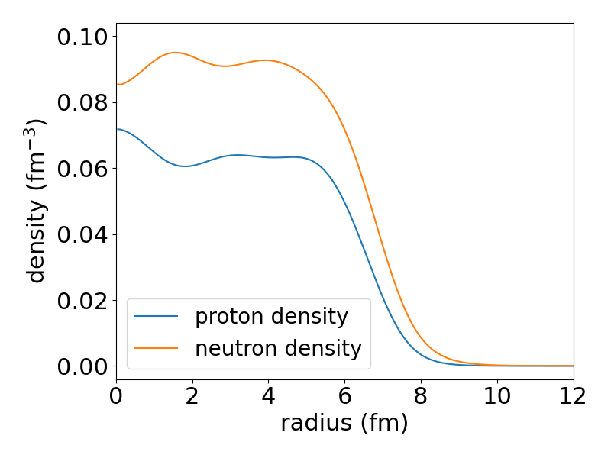
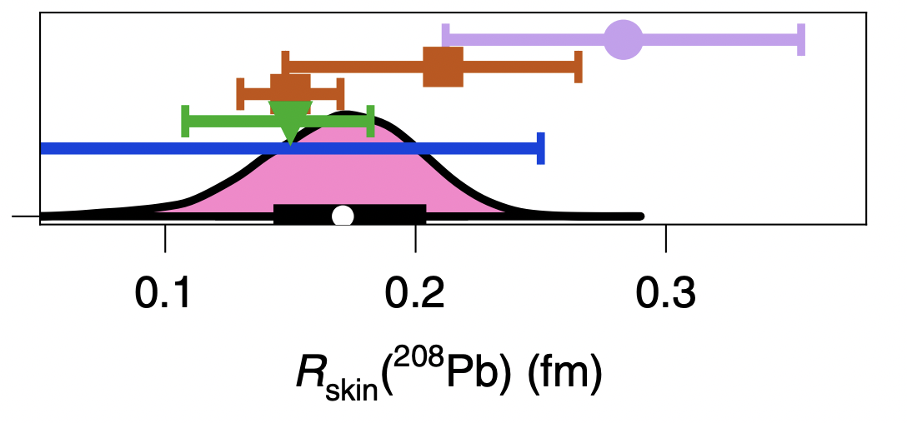
Neutron skins in rare isotopes
Neutron skin of ²⁰⁸Pb
From Hu et al., Nature Phys. (2022)
𝜋⁰ photoproduction
Proton elastic scattering
Electroweak
Gravitational Waves
Antiprotonic atoms
© Thomas Ott
${Δr}_{np}=\sqrt{\left\langle {r_{n}}^{2}\right\rangle }−\sqrt{\left\langle {r_{n}}^{2}\right\rangle }$ (fm)
$$p$$
Charge radius from electron elastic scattering (Coulomb)
Matter or neutron radius experimentally challenging to access
Neutron skin thickness linked to nuclear equation of state (EOS) around saturation

Slide 15
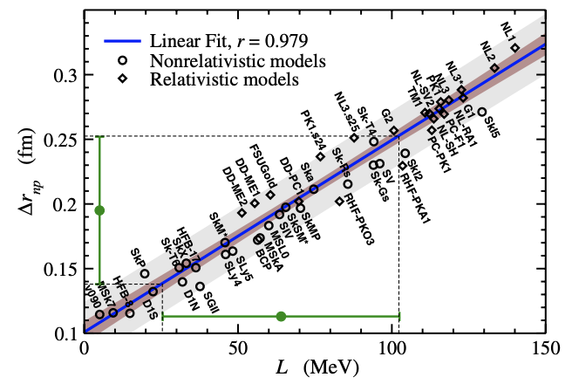
Neutron skins in rare isotopes
Neutron skin of ²⁰⁸Pb
From Hu et al., Nature Phys. (2022)
𝜋⁰ photoproduction
Proton elastic scattering
Electroweak
Gravitational Waves
Antiprotonic atoms
© Thomas Ott
${Δr}_{np}=\sqrt{\left\langle {r_{n}}^{2}\right\rangle }−\sqrt{\left\langle {r_{n}}^{2}\right\rangle }$ (fm)
$$p$$
Charge radius from electron elastic scattering (Coulomb)
Matter or neutron radius experimentally challenging to access
Neutron skin thickness linked to nuclear equation of state (EOS) around saturation
Roca-Maza et al., PRL (2021)

Slide 16
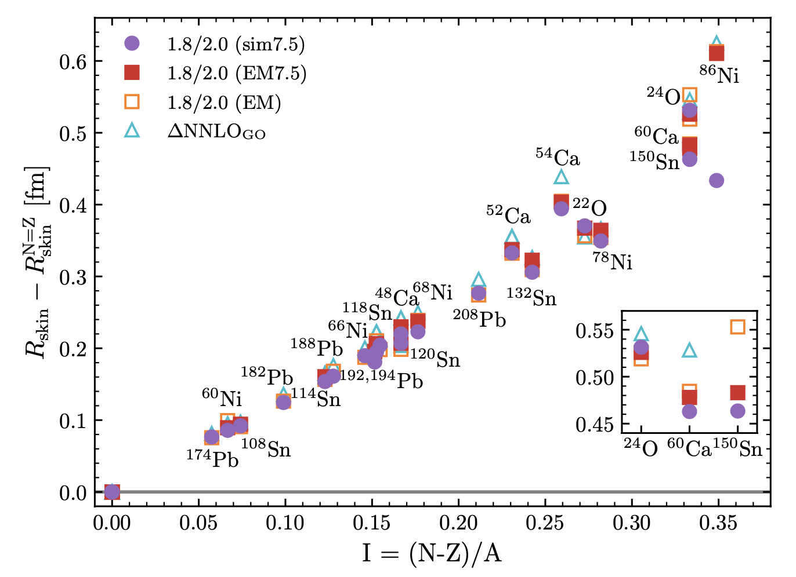
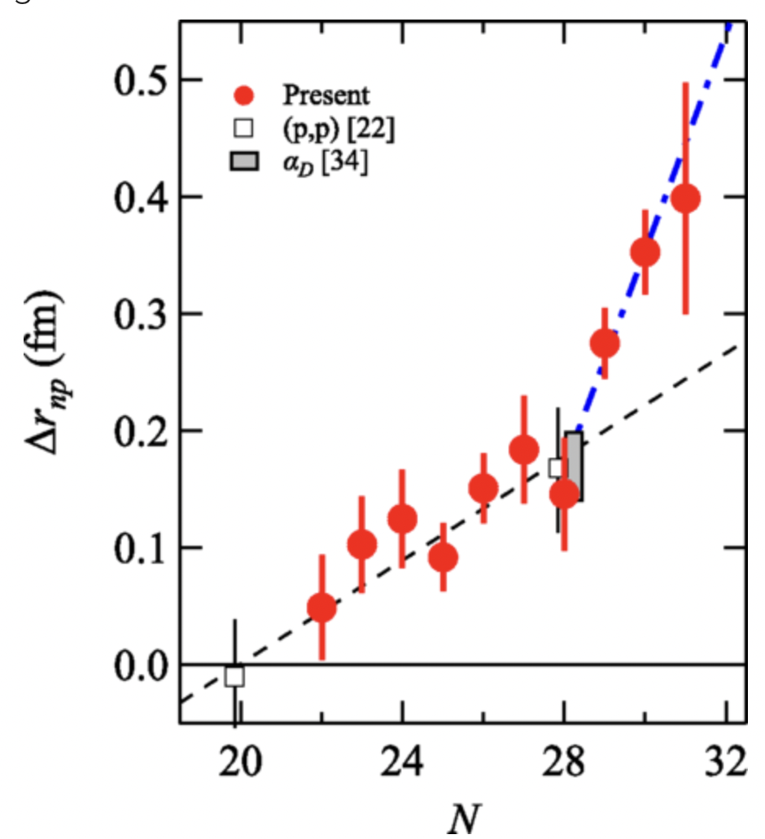
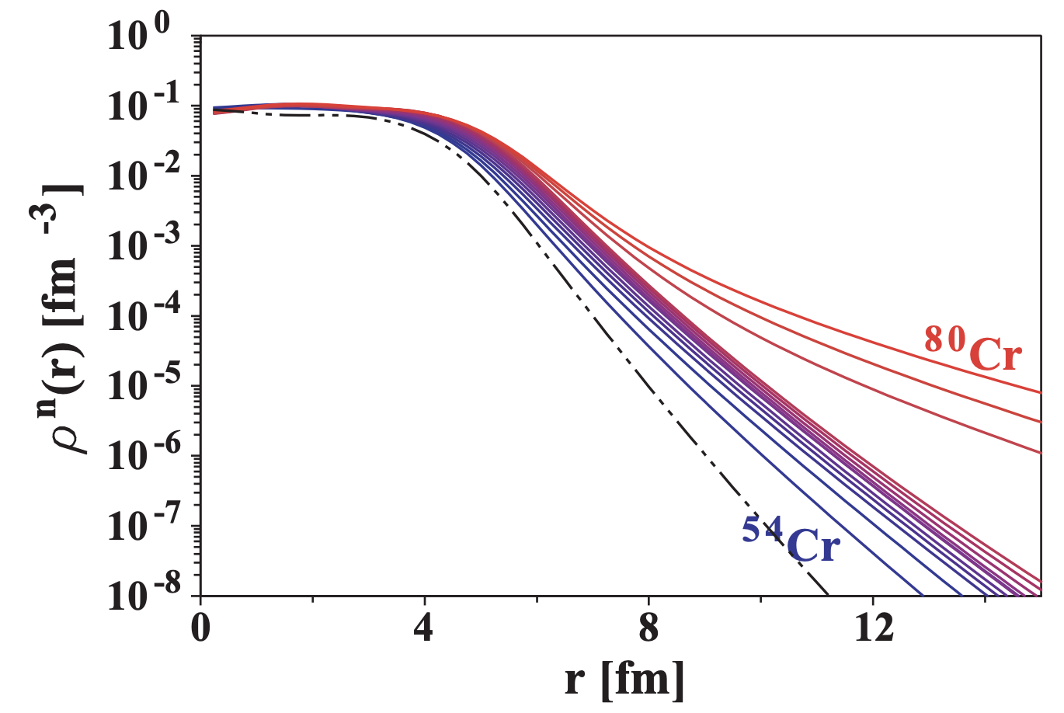
Neutron skins in rare isotopes
Neutron skins in rare isotopes
Interaction cross sections
© Thomas Ott
Ca
Rotival, Duguet, PRC (2009)
Arthuis, Hebeler, Schwenk, arXiv (2024)
Tanaka et al., PRL (2020)

Slide 17
Neutron skins in rare isotopes
Neutron skins in rare isotopes
Interaction cross sections
© Thomas Ott
Ca
Rotival, Duguet, PRC (2009)
Arthuis, Hebeler, Schwenk, arXiv (2024)
Tanaka et al., PRL (2020)

Slide 18
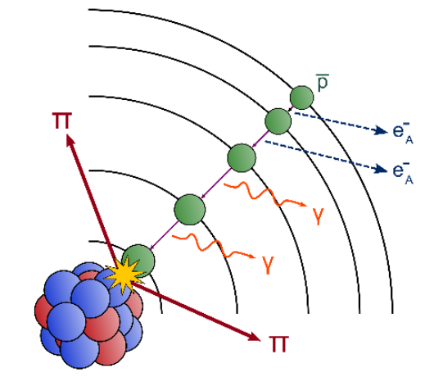
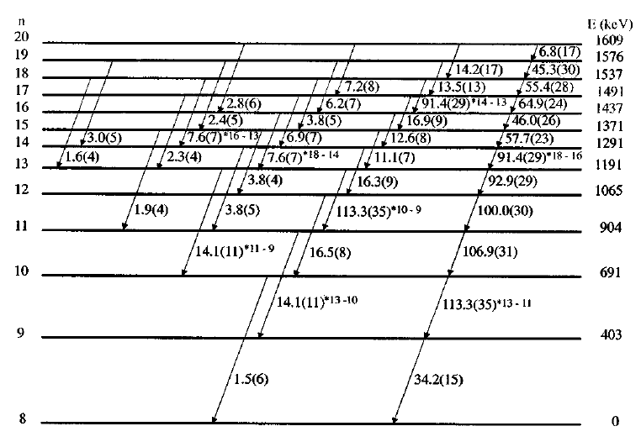
Neutron skins in rare isotopes
Low energy antiprotons as probe
¹⁷²Yb @ LEAR, CERN
$\overline{p}$ captured in antiprotonic orbital ($\sim$QED)
then annihilate in tail $ρ_{n/p}\left(r\right)$ (QCD)
Conservation of total charge
$0$ for $\overline{p}p$
Schmidt et al., PRC (1998)
$$\sum_{π}{qπ}=$$
$−1$ for $\overline{p}n$

Slide 19
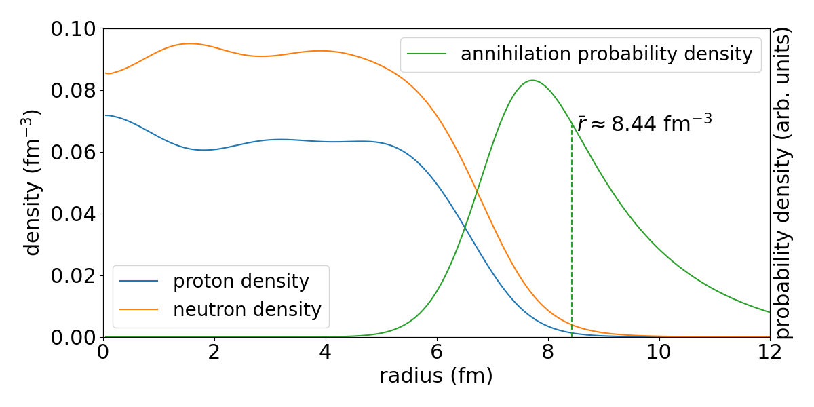
Neutron skins in rare isotopes
Low energy antiprotons as probe
$\overline{p}$ captured in antiprotonic orbital ($\sim$QED)
then annihilate in tail $ρ_{n/p}\left(r\right)$ (QCD)
Conservation of total charge
First application of method: Bugg et al., PRL (1973)
Application to rare isotopes first proposed by:
Wada and Yamazaki, NIM B (2004)
Expected sensitivity: 10%, dominated by FSI
$$\sum_{π}{qπ}=$$
$0$ for $\overline{p}p$
$−1$ for $\overline{p}n$

Slide 20
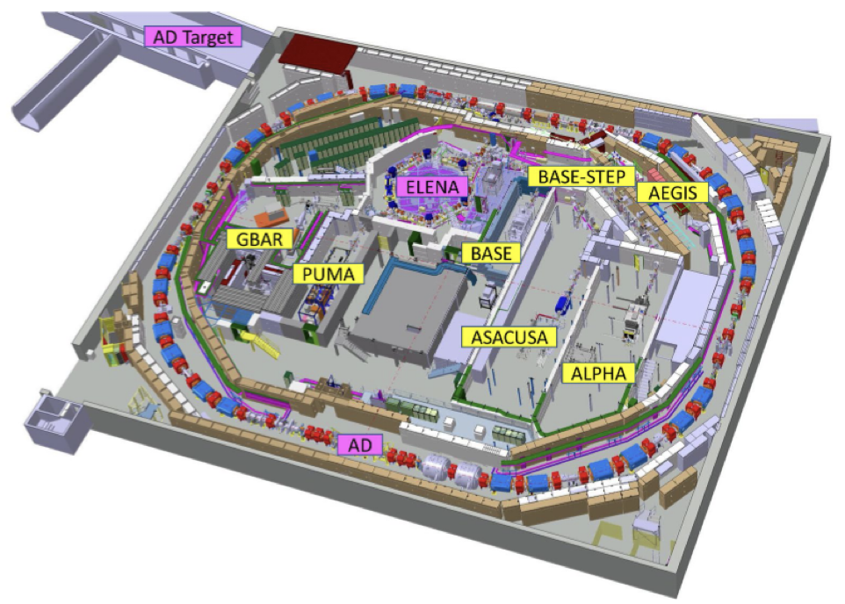
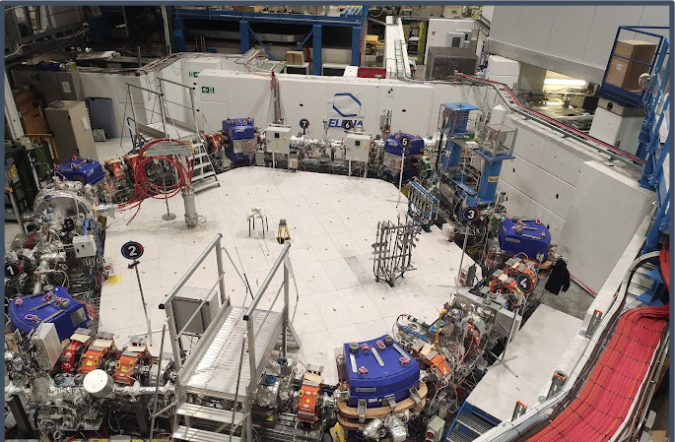
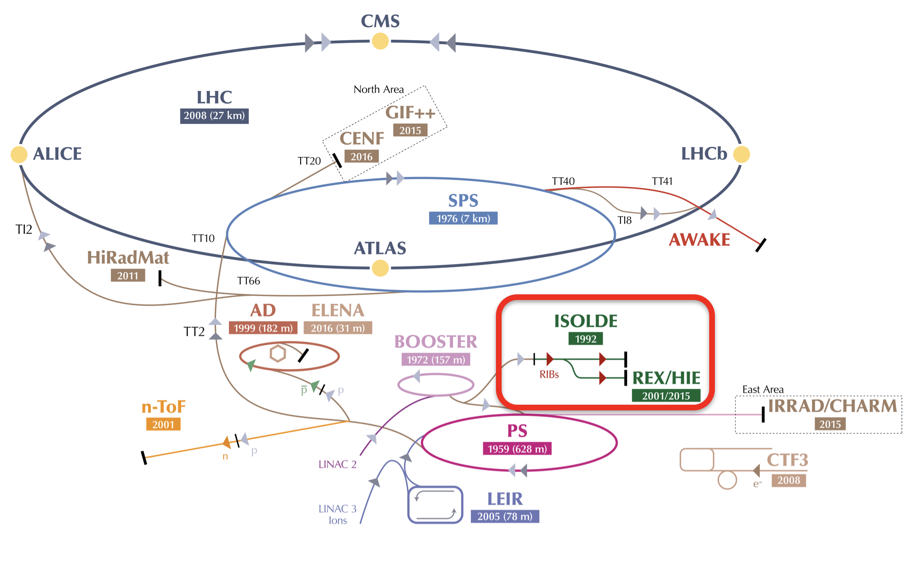
Neutron skins in rare isotopes
The Antimatter factory at CERN
1.5 10¹³ protons at 26 GeV/c from PS
3. 10⁷ antiprotons at AD
Deceleration: 5.3 MeV (AD), 100 keV (ELENA)
Experiments: 4. 10⁶ antiprotons every 110 s
Low energy radioactive beams produced at ISOLDE

Slide 21
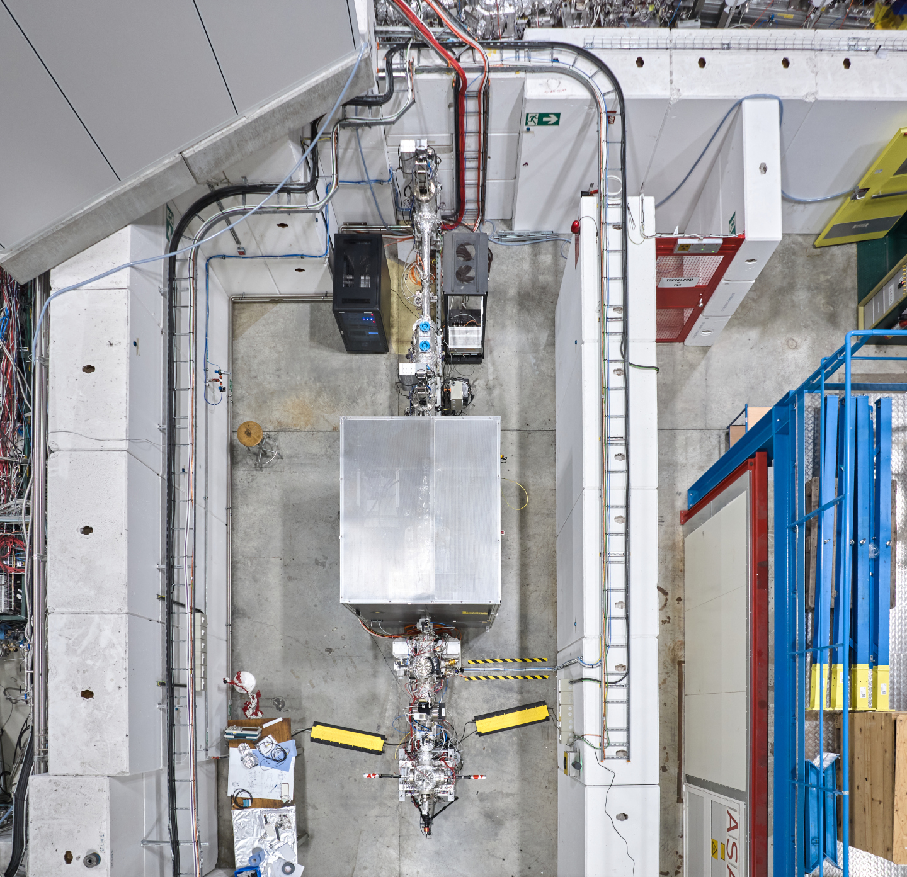
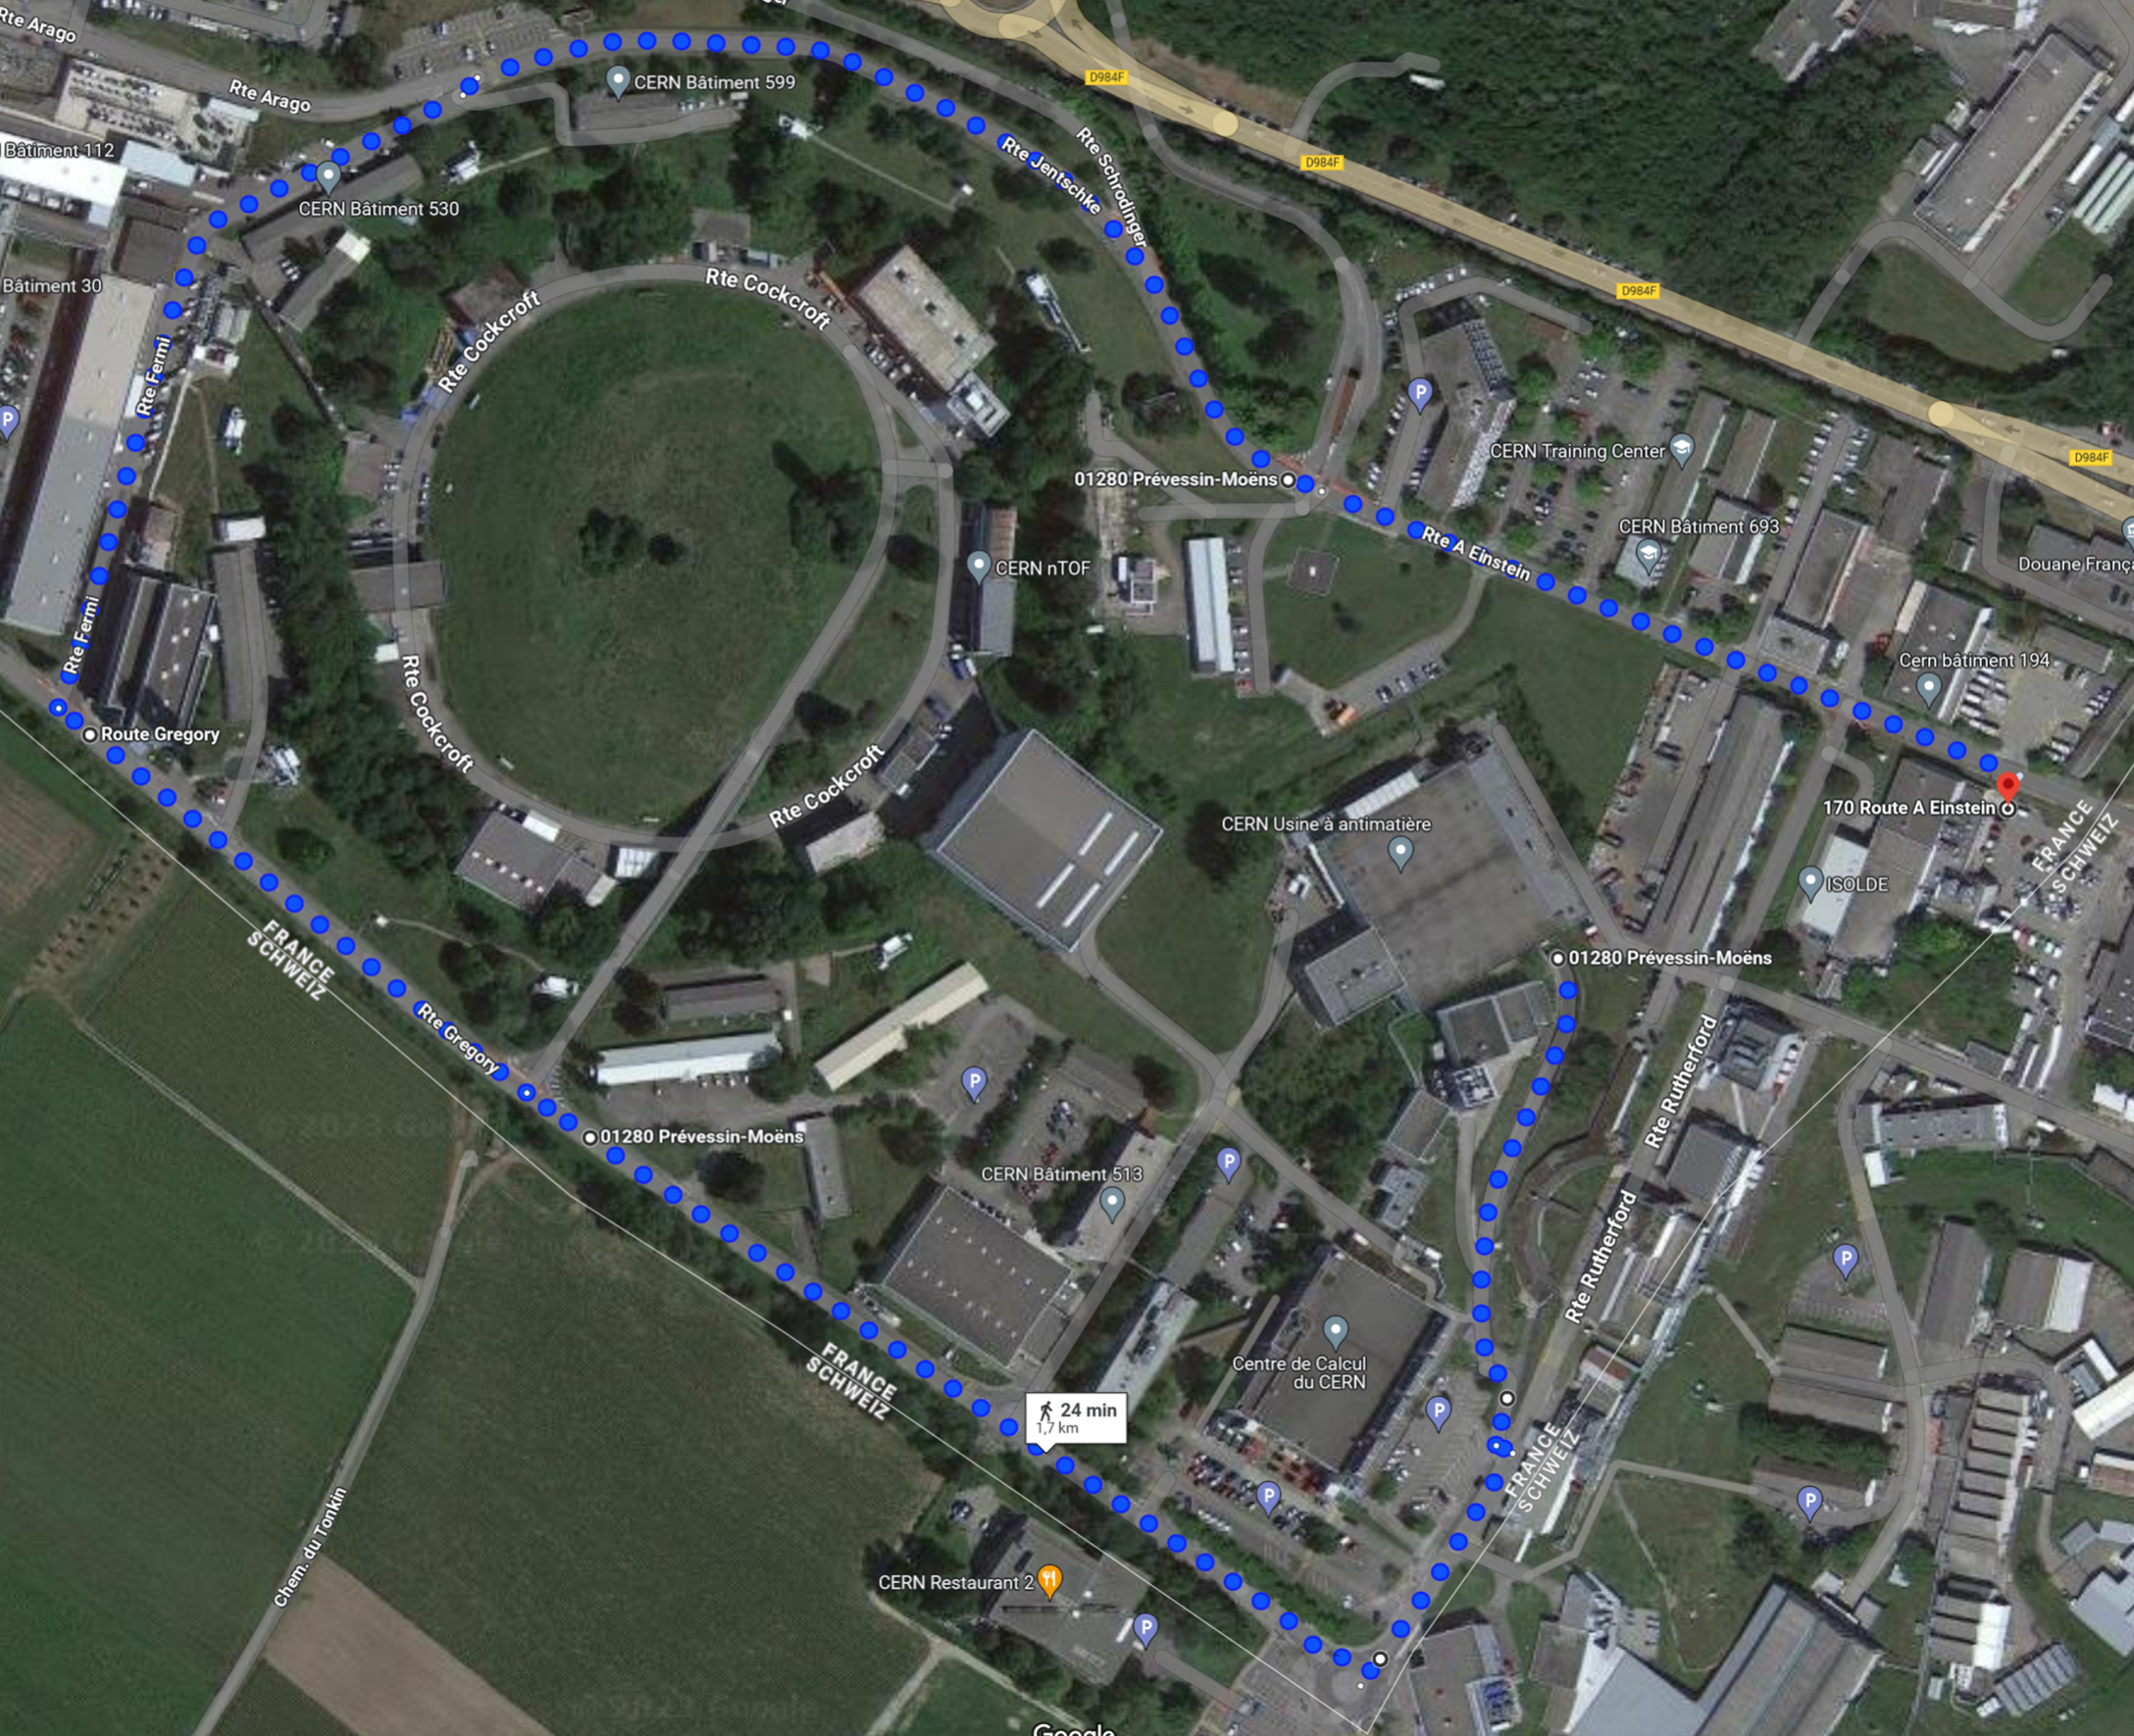
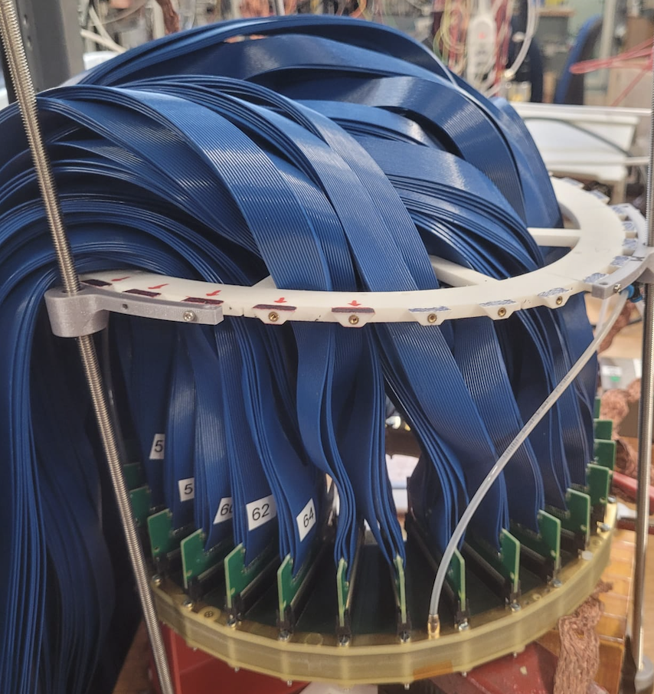
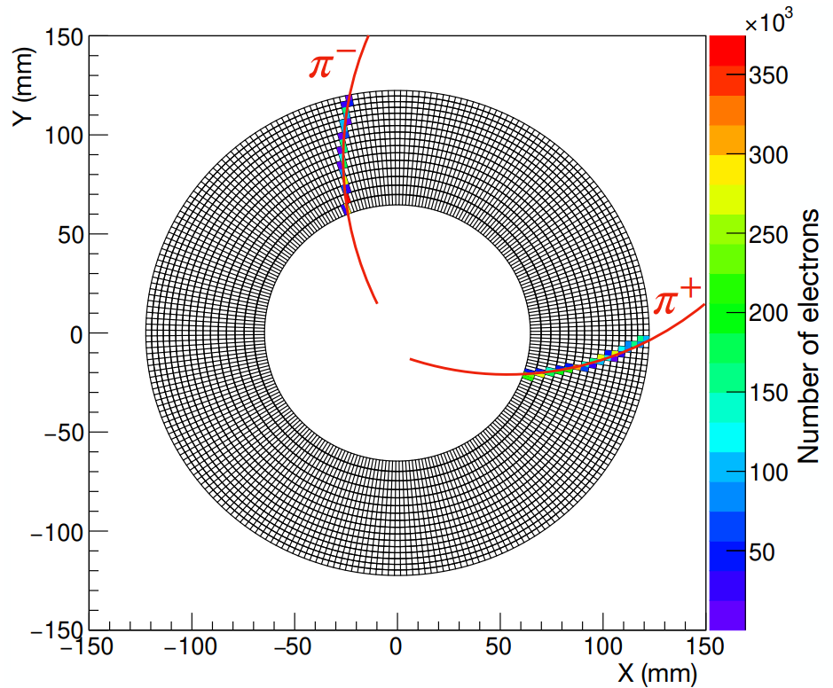
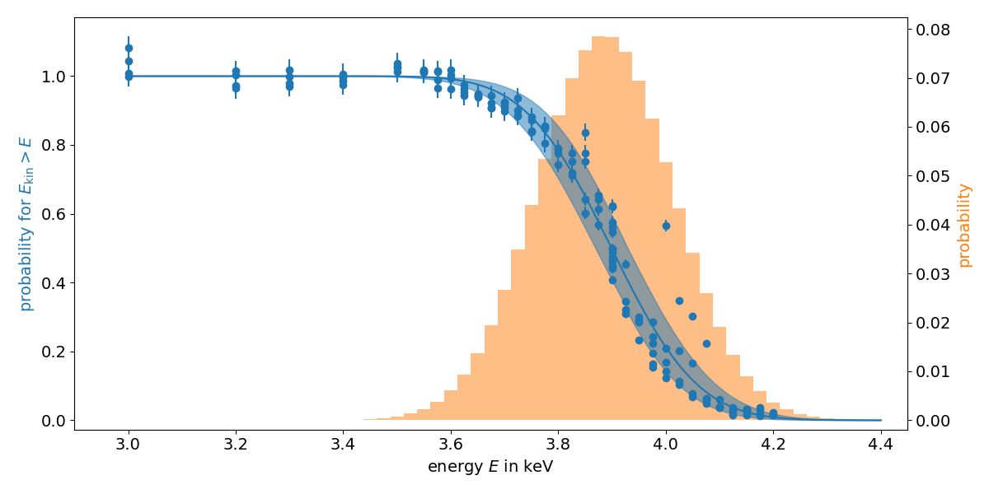
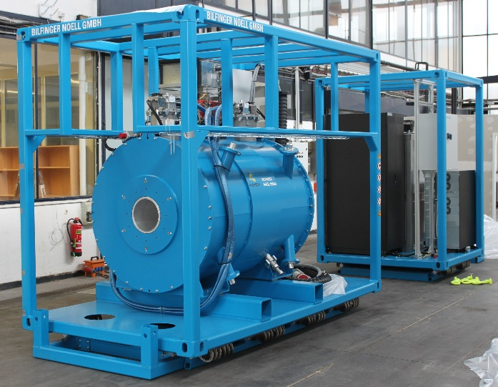
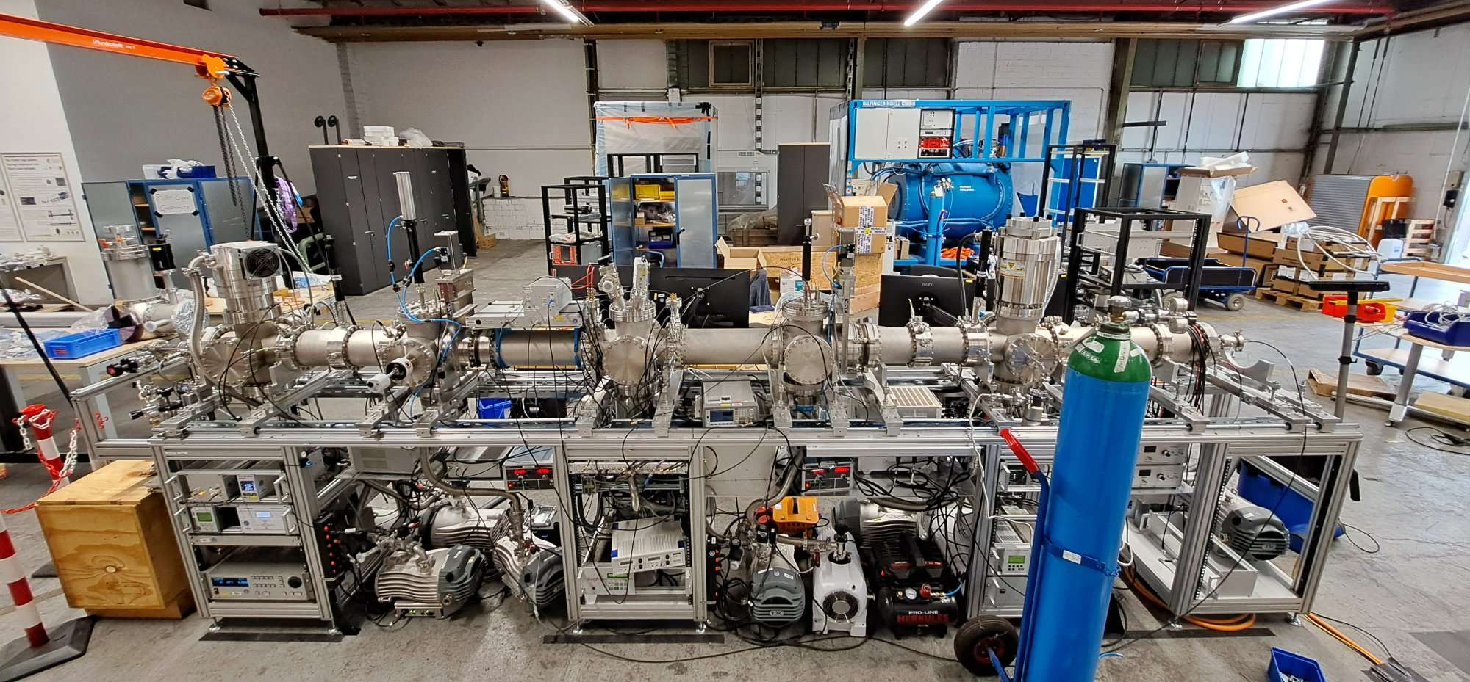
Neutron skins in rare isotopes
The puma experiment
Slow antiprotons
ISOLDE
Tracker
AD
Ion and antiproton trap
Slowed down antiprotons at ELENA
Transportation: AD → ISOLDE
Transportable magnet
Offline ion source
First measurements with stable ion at AD/ELENA from 2024, rare isotopes at ISOLDE from 2025
Long antiproton trapping time already achieved. Record: BASE: > 50 years
Transportation of antiprotons is also a core component of BASE-STEP (PI: C. Smorra)

Slide 22
collaborations
SAMURAI
PUMA T. Aumann, N. Azaryan, W. Bartmann, A. Bouvard, O. Boine-Frankenheim, A. Broche, F. Butin, D. Calvet, J. Carbonell, P. Chiggiato, H. De Gersem, R. De Oliveira, T. Dobers, F. Ehm, J. Ferreira Somoza, J. Fischer, M. Fraser, E. Friedrich, M. Gomez-Ramos, J.-L. Grenard, G. Hupin, K. Johnston, C. Klink, M. Kowalska, Y. Kubota, P. Indelicato, R. Lazauskas, S. Malbrunot-Ettenauer, N. Marsic, W. Müller, S. Naimi, N. Nakatsuka, R. Necca, D. Neidherr, A. Obertelli, Y. Ono, S. Pasinelli, N. Paul, E. C. Pollacco, L. Riik, D. Rossi, H. Scheit, M. Schlaich, A. Schmidt, L. Schweikhard, S. Sels, E. Siesling, T. Uesaka, M. Wada, F. Wienholtz, S. Wycech, C. Xanthopoulou, S. Zacarias, with contribution from B. Loeher, GSI

Slide 23
Structure of neutron-rich systems
Perspectives
Most neutron-rich light systems: 4n, ²⁸O
Duer et al., Nature (2022); Kondo et al., Nature (2023)
Is the « tetraneutron » a resonance of a final state interaction effect?
Role of deformation and / or continuum in the binding of ²⁸O
Going more neutron rich with new machines and upgrades: FRIB (US), FAIR
Shell evolution and deformation at the driplines; Ex. spectroscopy of ⁶⁰Ca
Neutron skins and densities towards the dripline
PUMA collab., EPJA (2022)
First measurements with antiprotons at ELENA from 2024, ISOLDE from 2025
Dedicated programs of reaction studies at R3B, FAIR
Beyond nuclei: hypernuclei towards $Λn$ interactions

Slide 25
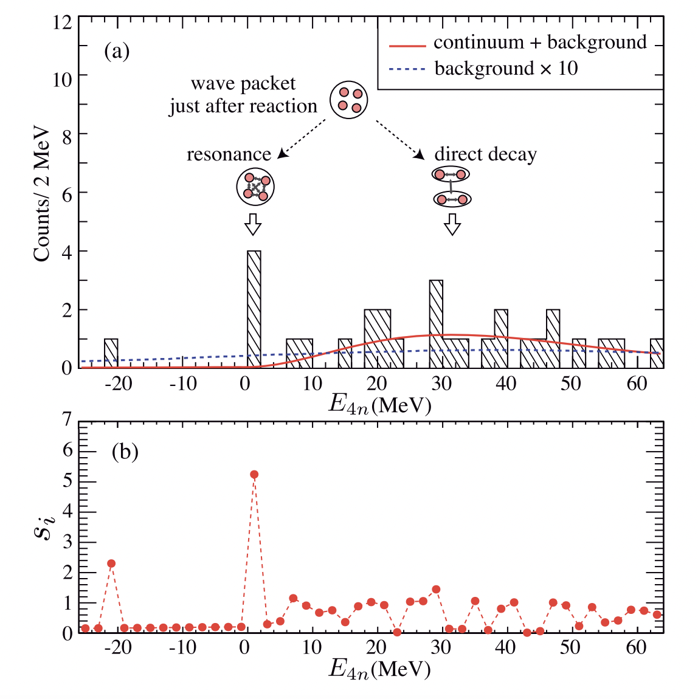
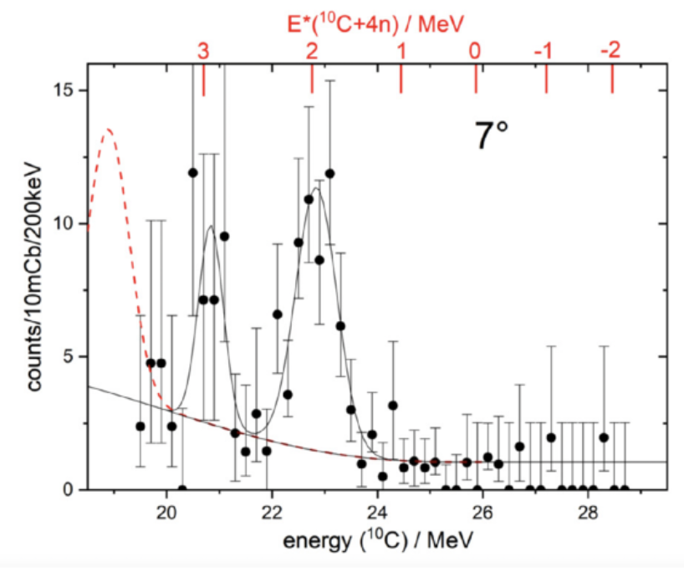
Structure of neutron-rich systems | neutron-rich Calcium isotopes
Tetraneutron experiments
${}_{}^{7}{\text{Li}}({}_{}^{7}{\text{Li}},{}_{}^{10}{\text{C}})$at 46 MeV
Kisamori et al., PRL (2016)
Faestermann et al., PLB (2022)

Slide 26
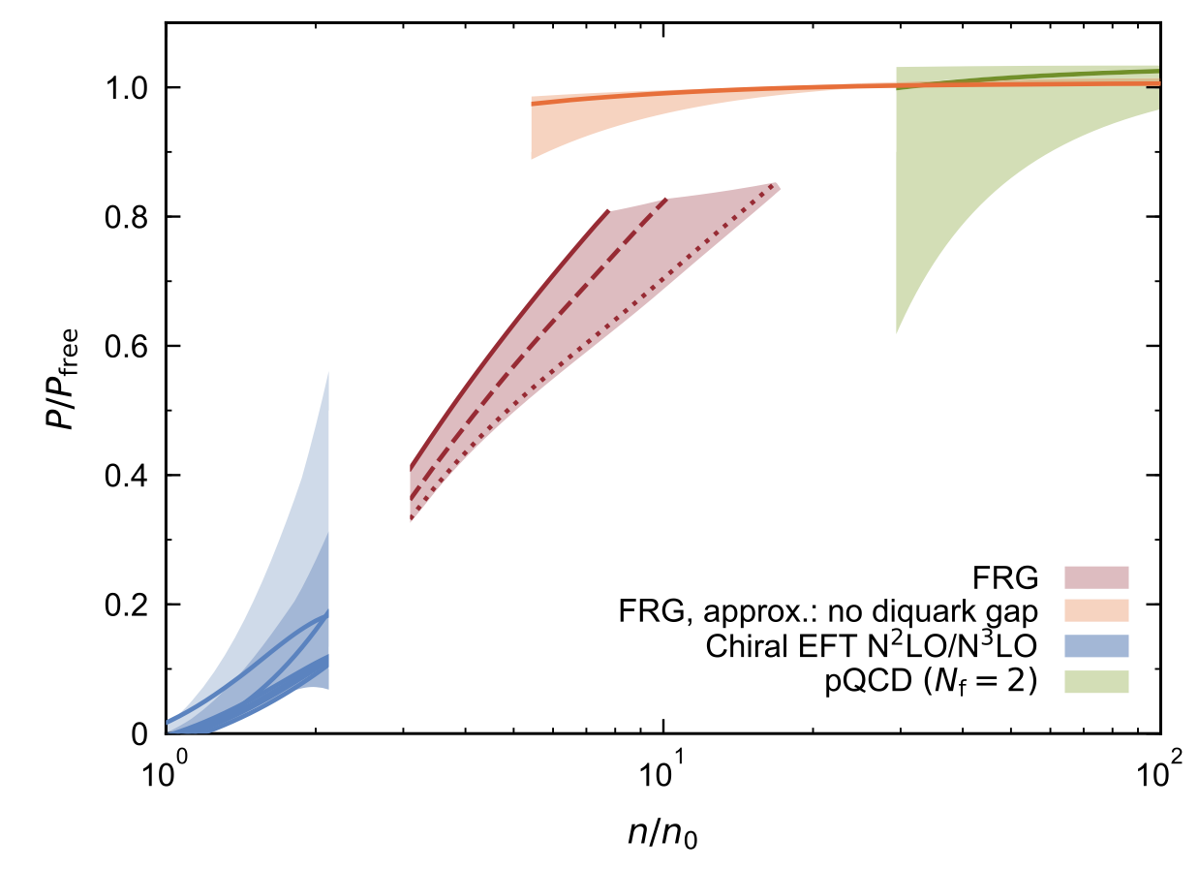
nuclear forces, Nuclei & STARS
EFT interactions used from few-body systems to infinite nuclear matter EOS up to 1.5-2 n₀
Leonhardt et al., PRL (2020)

