Slide 1
Kaon-nucleon/nuclei strong interaction studies at the DAɸNE Collider: a strangeness journey
Mihail Antoniu Iliescu
60th International Winter Meeting on Nuclear Physics Bormio, Italy, January 2024

Slide 2
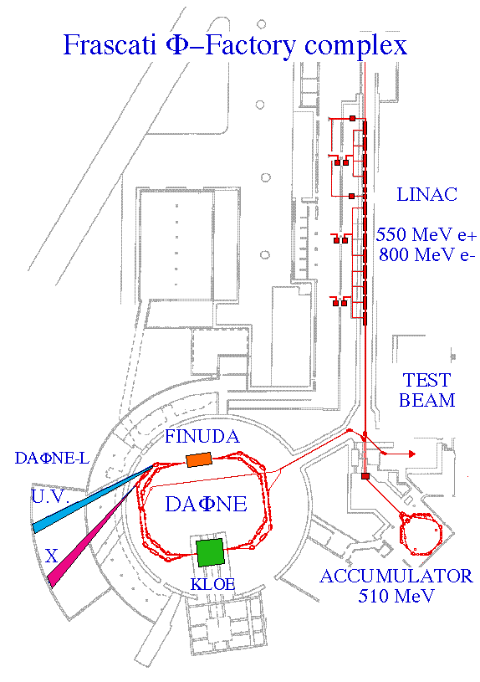
DAΦNE collider
Electron-positron collider, tuned at Φ resonance, which is produced nearly at rest (Φ Factory)
-boost: 55 mrad crossing angle → 28 MeV/c
-Φ production cross section ~ 3000 nb (loss-corrected)‏
-Integral luminosity ~ 7 pb⁻¹ per day ¹⁾ (~ 10⁷ K± )‏, crab waist optics
Peak luminosity ~ 4 × 10³² cm⁻² s⁻¹ ⁼ 550 Hz K±
Lifetime ~ 20 min, high background during injections.
Φ Decays in k+k− (48.9%±0.5%), k_{0S}k_{0L} (34.2%±0.4%),
ρ + π / π⁺ + π⁰ + π⁻ (15%)
Studies completed or ongoing:
Neutral channel - CP Violation, rare decays (KLOE)
Charged -light kaonic atoms (DEAR, SIDDHARTA, SIDDHARTA-2)
-Hypernuclei (FINUDA)
-k (multi)nucleon absorption, Λ1405
nature (AMADEUS)
Proposed studies:
-extensive light kaonic atoms (EXCALIBUR)
-charged kaon mass measurement
-low energy k+ N scattering
SIDDHARTA is set up here
2

Slide 3
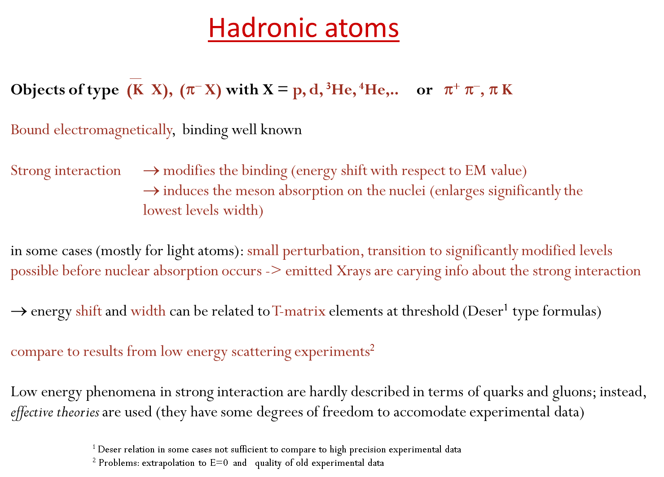

Slide 4
Kaonic atom processes
0) Moderated, then stopped in a target medium
e⁻
highly-excited state
1) Capture
Auger Electron
n ~ sqrt(M*/me) n’ ~ 25 (for K-p)
(M* : K-p reduced mass)
K⁻
Auger
5) Nuclear absorption
2) Cascade
Collision induced
de-excitation
e.g.
1s for K-p, K-d
2p for K-He
On the lowest levels
X-ray
3) Strong interaction
If survives to Stark mixing effect →
4) Radiative transition
The strong interaction width >> E.M. radiative transition width
The level shift is of the same order of magnitude ->
direct information about the scattering amplitude at threshold

Slide 5
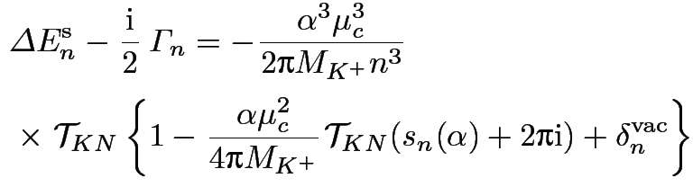
Kaonic Hydrogen – Deser formula
__
With a₀, a₁ standing for the I=0,1 S-wave KN complex scattering lengths in the isospin limit (m_{d} = m_{u}), μ being the reduced mass of the K⁻p system, and neglecting isospin-breaking corrections, the relation reads:
… a linear combination of the isospin
scattering lengths a₀ and a₁;
to disentangle them, the kaonic deuterium
scattering length is needed, as well
‘‘By using the non-relativistic effective Lagrangian approach a complete
expression for the isospin-breaking corrections can be obtained;
in leading order parameter-free modified Deser-type relations exist and
can be used to extract scattering lenghts from kaonic atom data“¹
¹Meißner,Raha,Rusetsky, 2004

Slide 6
Kaonic Hydrogen X-ray measurements summary
Repulsive type
SIDDHARTA
DEAR
Attractive

Slide 7
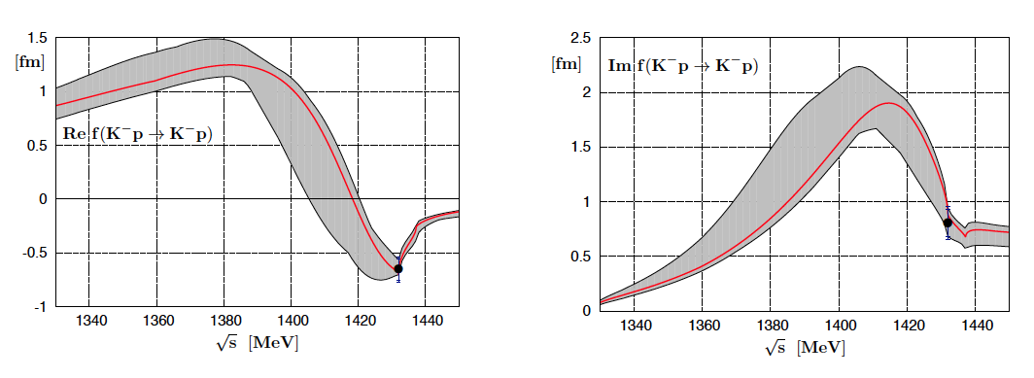
Improved constraints on chiral SU(3) dynamics from kaonic hydrogen
Y. Ikeda, T. Hyodo and W. Weise, PLB 706 (2011) 63

Slide 8
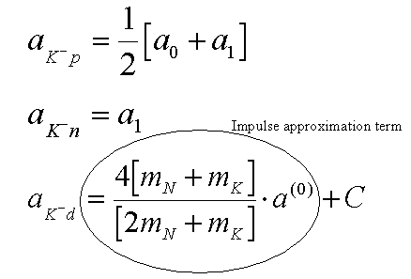
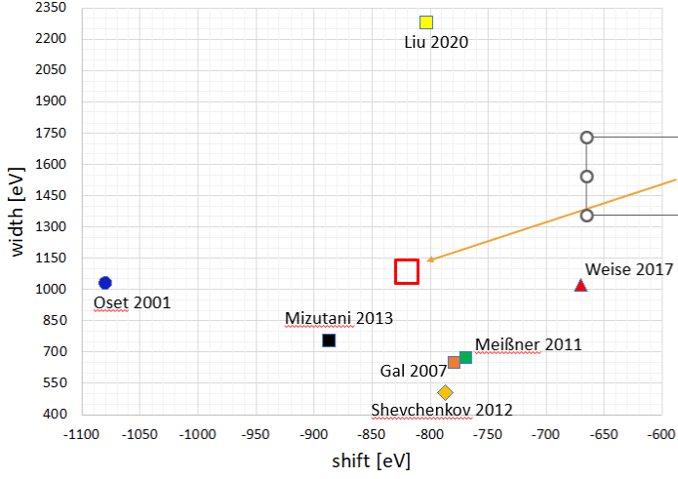

Kaonic deuterium
For the determination of the isospin dependent scattering lengths a₀ and a₁ the hadronic shift and width of kaonic hydrogen and kaonic deuterium are necessary !
Elaborate procedures needed to connect the observables with the underlaying physics parameters.
Kaonic deuterium predictions
larger
than
leading
term
SIDDHARTA-2
Achievable
precision

Slide 9
Why at DAΦNE?
- Almost monochomatic Kaon beam from Φ decay => facilitates stopping the kaons in a small volume of gas at specific density => allows to produce the exotic atoms before kaon decay and enhace the detection efficiency for rare events. However, the boost induced by the beams crossing angle requires a compensating step degrader.
-Minimum beam-related hadronic background (Φ decays in 49% back-to-back charged and 31% neutral kaons)‏
-High luminosity (4 × 10³² cm⁻² s⁻¹ )
-Φ is polarized, so the kaon flux emitted mostly on transverse plane to machine beam pipe (sin² distribution)=> easier to capture a high fraction on a reduced solid angle

Slide 10
Experimental problems
-Asynchronous background: the transitions of interest are in the keV range; the final component of electromagnetic cascades produced in the accelerator pipe (and other setup materials) invested by e-/e+ lost from the beam overlaps the signal; each lost particle cascades down 5 orders of magnitude, while the loss rate in the interaction region reaches few MHz. This sums up to a total rate of ~10¹⁰ X-ray photons/s. The main contribution comes from Touschek effect.
-Synchronous background, associated to K absorption on materials nuclei, or to other Φ decay channels. It can be considered a hadronic background.
-Spectra contamination by Xray fluorescence or by X-rays produced in higher transitions of other kaonic atoms, formed in the setup materials; this imposes a very restrictive choice of the materials to be used and high purities.
-Low energy kaons decay rate; the target geometry, related to the optimal gas density, shielding and trigger, results in a moderation kaon path of ~20-30 cm, through kapton and high density gas. Consequently, a fraction of kaons will decay before being captured.
-Survival of the exotic atom down to the last cascade step (to the 1s level): in the case of kaonic Hydrogen, only 1.2% of the atoms perform the 2p->1s transition, while for the kaonic Deuterium the theoretical estimates indicate only ~10⁻³ of them will reach the lowest state. The main reason is the Stark mixing effect.

Slide 11
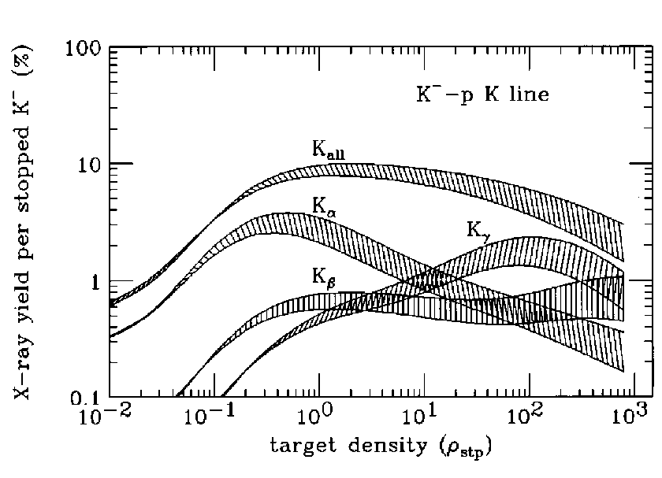
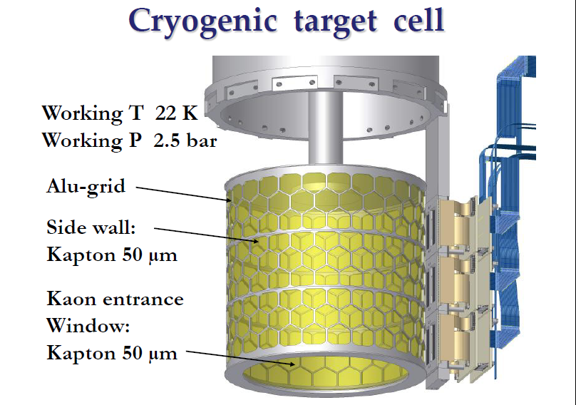
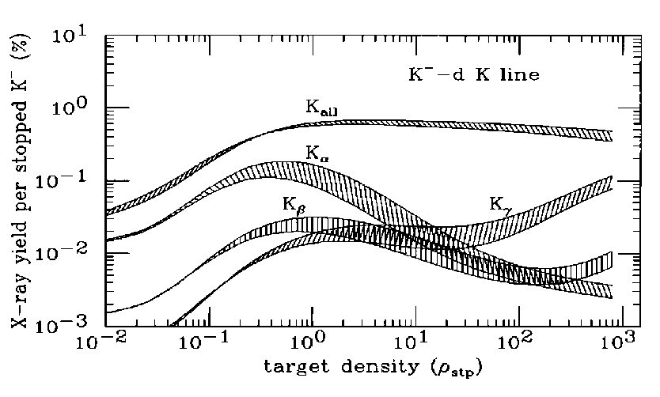
SIDDHARTA cryo target
The optimization of the target density took into account the balance between the Stark effect and kaon
stopping power. The chosen density was ~30x STP, which would require thick windows to stand
the high corresponding pressure. Since thick windows would not allow X-rays to reach the SDD
detectors, a cryogenic target was designed and build, operating near the H₂ L.P. A 2-stage He expansion
cryostat grants the necessary cooling. In order to minimize the detector noise, the SDDs were also
operated under cryogenic conditions (~150K). The setup is under high vacuum insulation.
1 bar
SDD sockets
Yield estimates for kH and kD.Koike, Harada, and Akaishi, 1996

Slide 12
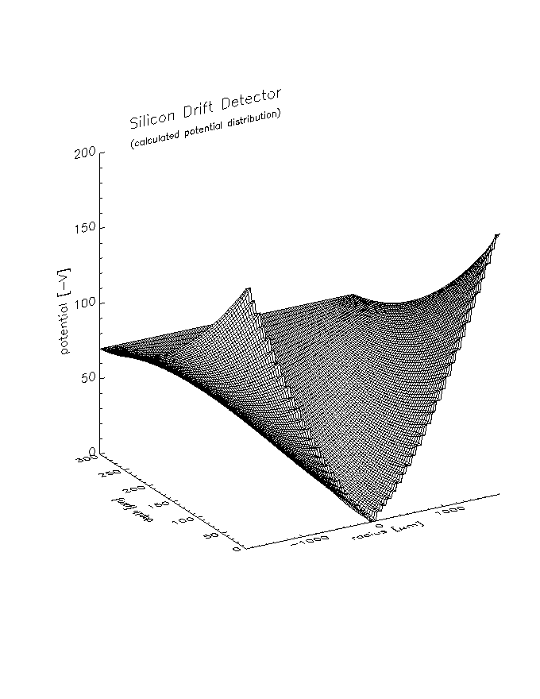
Fast X-ray detectors
The Semiconductor Drift Detector
Entrance window
ANODE
Anode
The electrons are collected by the small anode,
characterized by a low output capacitance.
Advantages: very high energy resolution
at fast shaping times, due to the small anode
capacitance, independent of the active area of
the detector

Slide 13
Fast X-ray detectors
Spectroscopic resolution: detector comparison
SDD PIN Si(Li) 150 K 5.9 keV line
800
700
600
PIN Tsh=20us
500
FWHM (eV)
400
300
200
Si(Li) Tsh=20us
SDD Tsh=1us
100
0
0.1
0.2
0.3
0.4
0.5
0.6
0.7
0.8
0.9
1
A (cm⁻²)

Slide 14
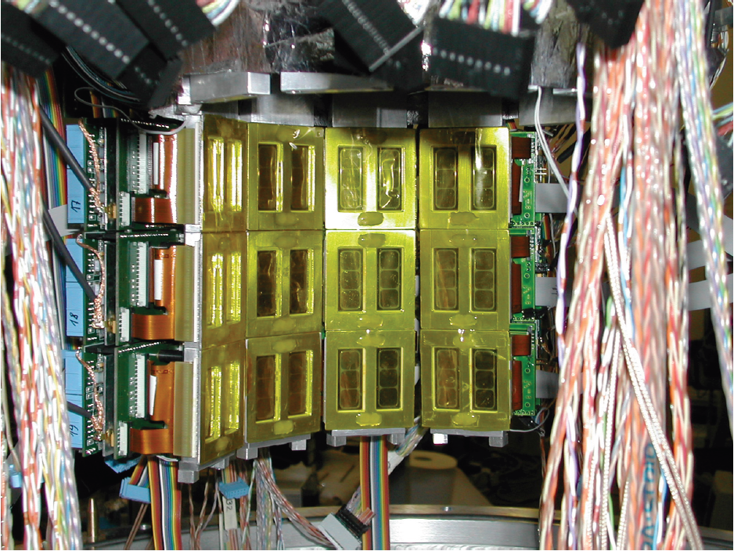
144 SDD’s 1cm x 1cm

Slide 15
SIDDHARTA DAQ flow chart
Control signals &
threshold prog.
Scintillator
arrays
SDD
array
2 x 3
DAΦNE
injection
control
Hit Edep.
SDD
front
end
Event timing
(R.T.)
SDD
DAQ
Inhibit (R.T.)
K trigg.
electronics
Hit addr.&HT
Coincidence (R.T.)
SDD
front
end
Event Index (R.T.)
K trigg.
DAQ
Edep.,Δt k-X, Addr., Index
T.O.F.,Edep., Addr., Index
Offline selection
(TOF1, TOF2,
Edep.K, H.T.,
topology, drift time)
Full event info
SDD
front
end
“Clean” Kaonic X-ray event

Slide 16
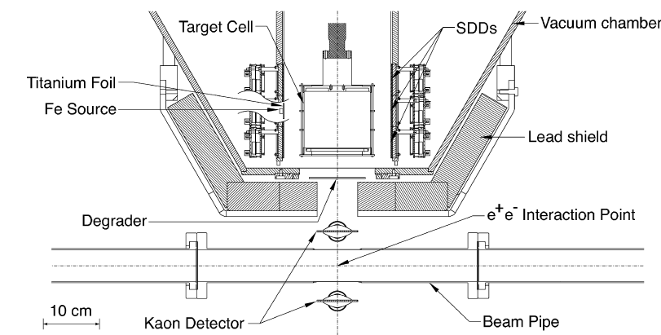
Dealing with the asynchronous (EM) background
Shielding and fast X-ray detectors, synchronized with the kaon trigger
(two scintillator arrays, timed by the DAFNE RF)‏
SIDDHARTA SETUP

Slide 17
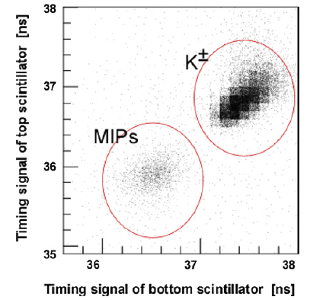
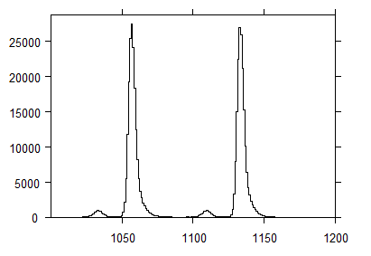
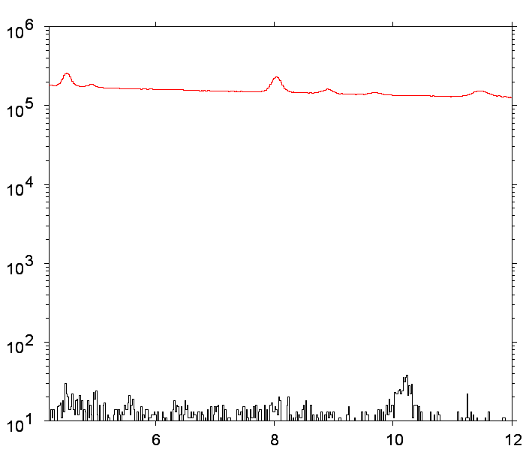
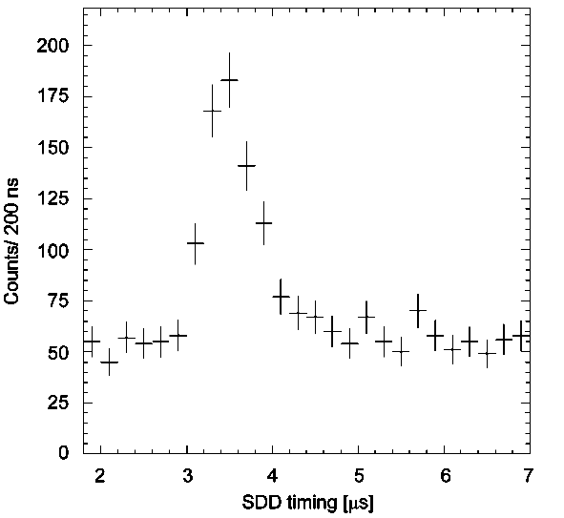
SIDDHARTA trigger
The trigger is generated by the coincidence of 2 back-to-back scintillators.
Further kaon ID is given by the specifc TOF, measured from the collision time, marked by RF.
1 ns
Kaons
2.8 ns
MIP’s
MIP’s
SDD Self trigger
Drift time
SDD and kaon trigger
Rejection factor >10⁴

Slide 18
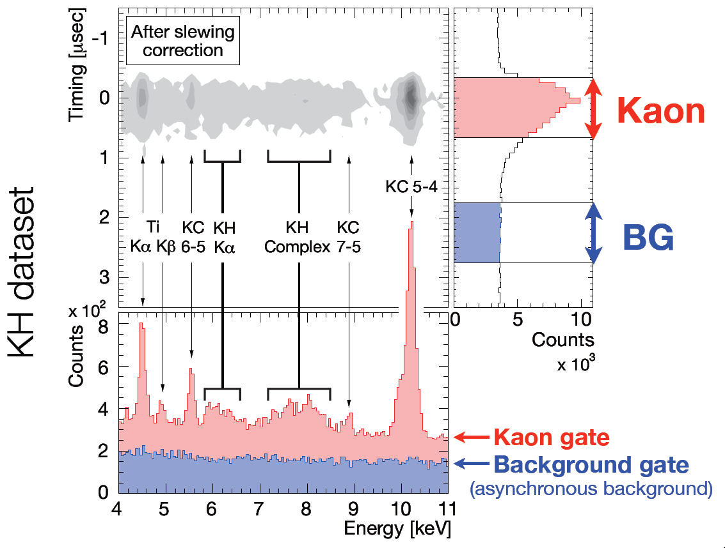
SIDDHARTA results
Kaonic hydrogen

Slide 19
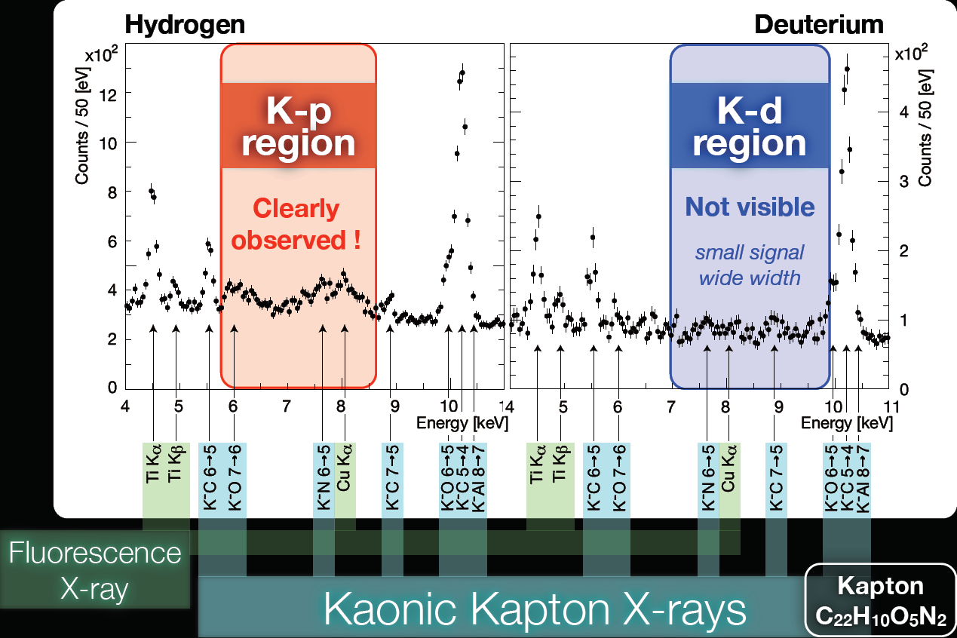
Kaonic hydrogen and kaonic deuterium

Slide 20
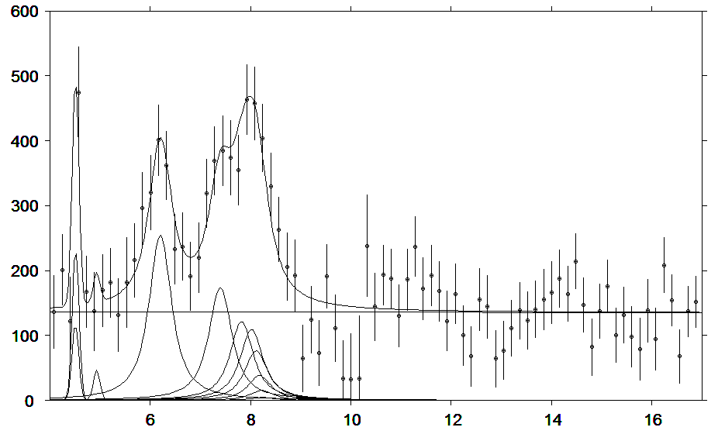
Kaonic hydrogen background subtracted spectrum
A simultaneous fit of KH and Kd spectrum was done, to get rid of the kaonic background lines (KO, KN). The overall integrated luminosity for the KH run was 290 pb⁻¹.
For the signal component 8 voigtians with given gauss resolution
and free identical lorentz width were used for (2-1),.. (9-1)‏
transitions.
The relative positions follow a pattern fixed by the QED values.
The main intensities of (2-1),(3-1) and (4-1)‏ lines were left free,
while the higher transitions were coupled according to theoretical
expectations (cascade calculation, Koike‘s values)‏.
KH
(4-1),..
(9-1)‏
KH
(2-1)‏
KH
(3-1)‏
ε1s = -283 ± 36(stat) ± 6(syst) eV
Γ1s = 541 ± 89(stat) ± 22(syst) eV
Note: K_{high}
yield pattern
Energy (keV)‏
Nuclear Physics A 881 (2012) 88–97
The backgound shape is determined by fitting the KD data and including the pattern function in the KH fit.

Slide 21
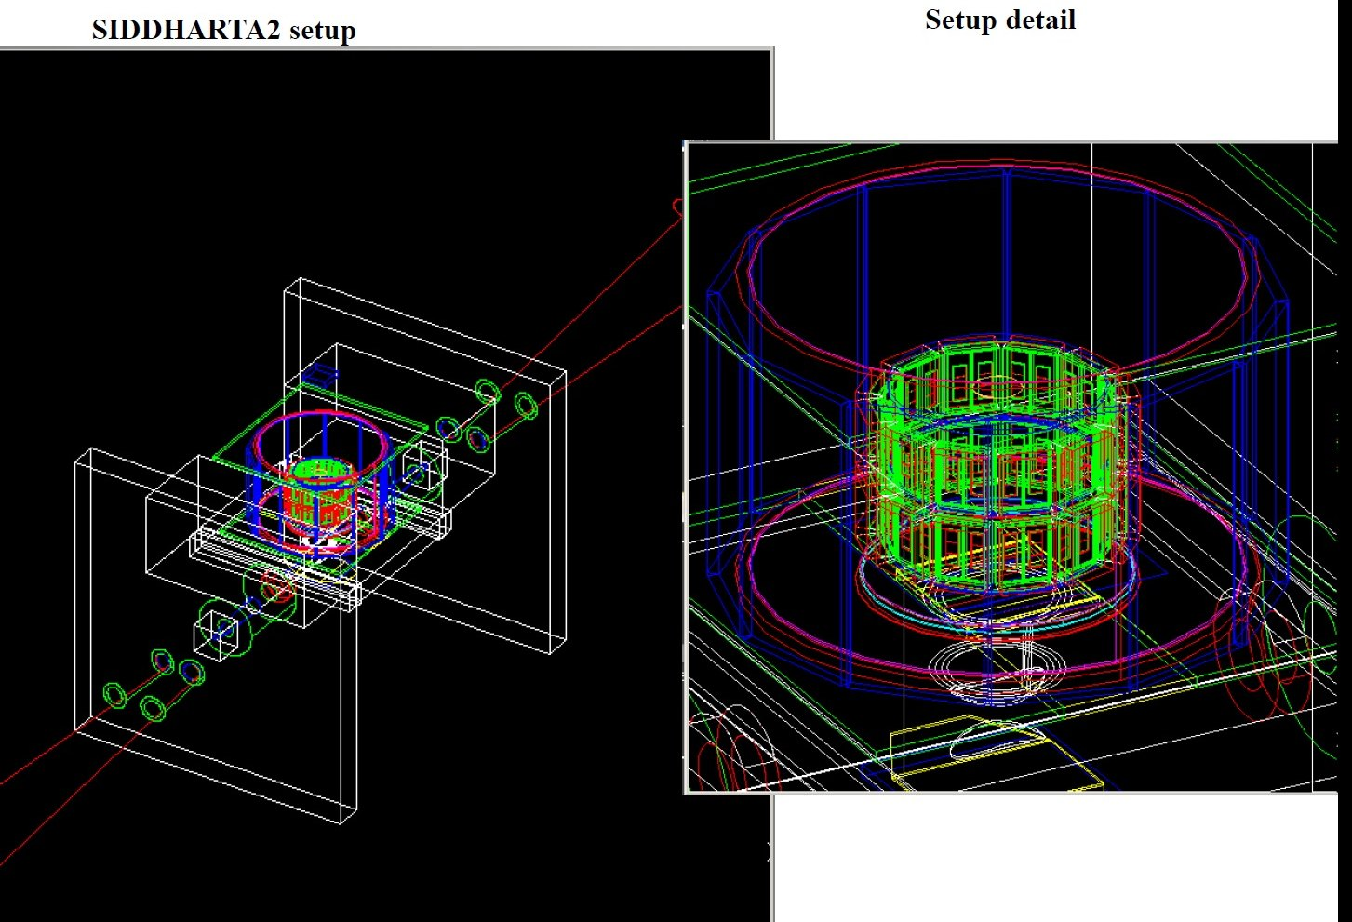
SIDDHARTA-2 Monte Carlo
To compensate for the very low yield of kaonic Deuterium, a GEANT 4 MC optimization has been performed and three new detectors were added to the setup.
To account for exotic atoms production, for spin-to-spinless decay (Φ and ρ) and for machine background normalized input three new GEANT4 core classes were written.
The full DAFNE interaction region was included, to evaluate the effect of particle losses.

Slide 22
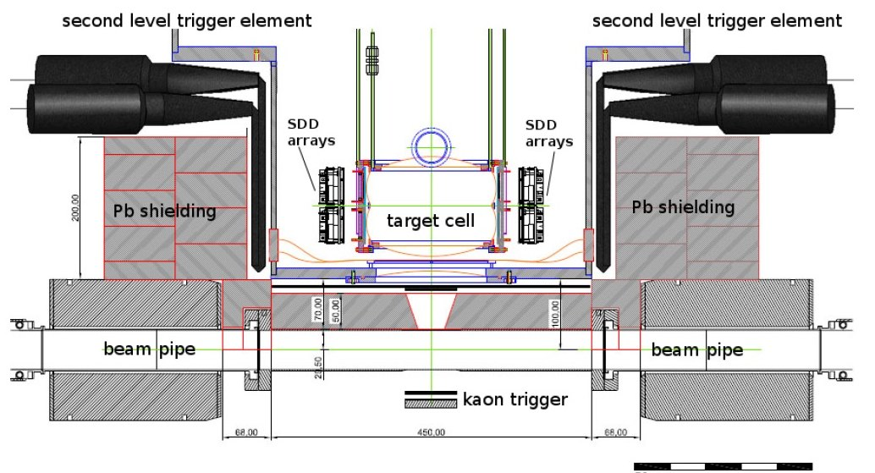
SIDDHARTA-2 setup
Veto-1
Veto-2
k- detector

Slide 23
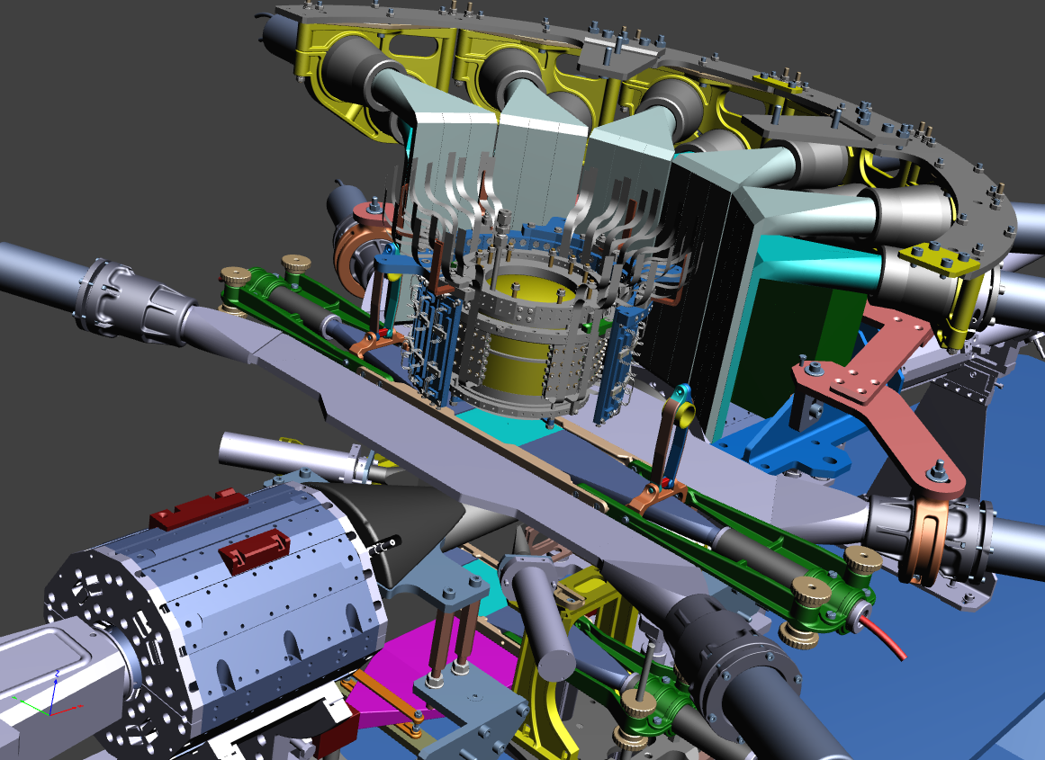
SIDDHARTA-2 setup
Veto-1
Kaon Trigger
Target
Veto-2
384 SDDs
k- ID

Slide 24
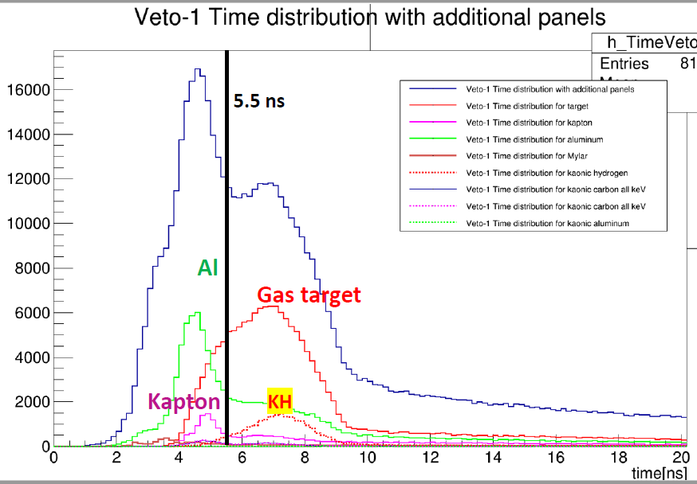
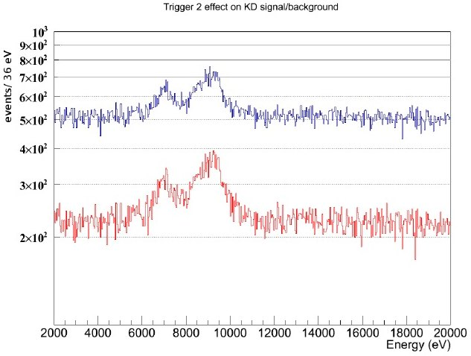
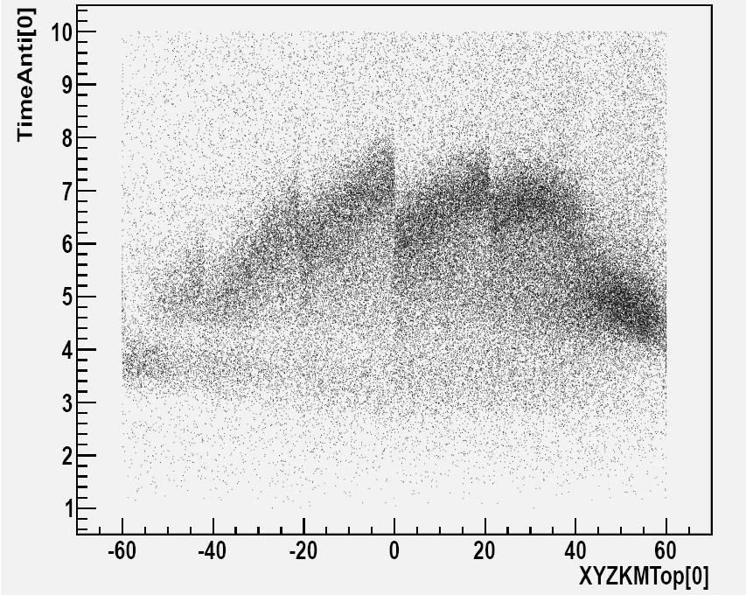
SIDDHARTA-2 Veto-1for kaon gas moderation
Improves S/B (and reduces the
contamination component)
In conjunction with the top
scintillator of Ktrigger allows
fast degrader tuning

Slide 25
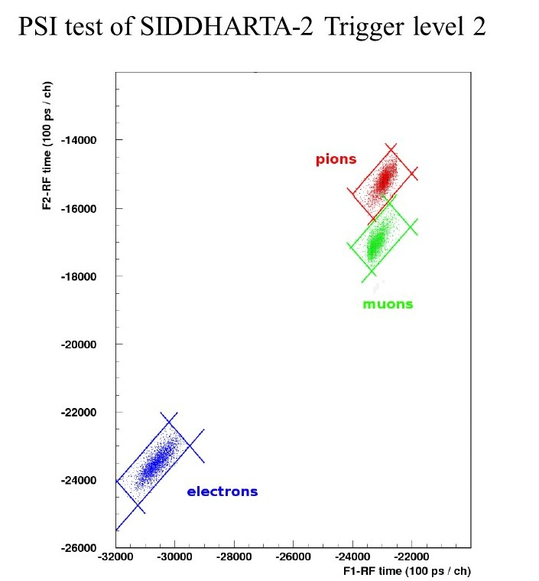
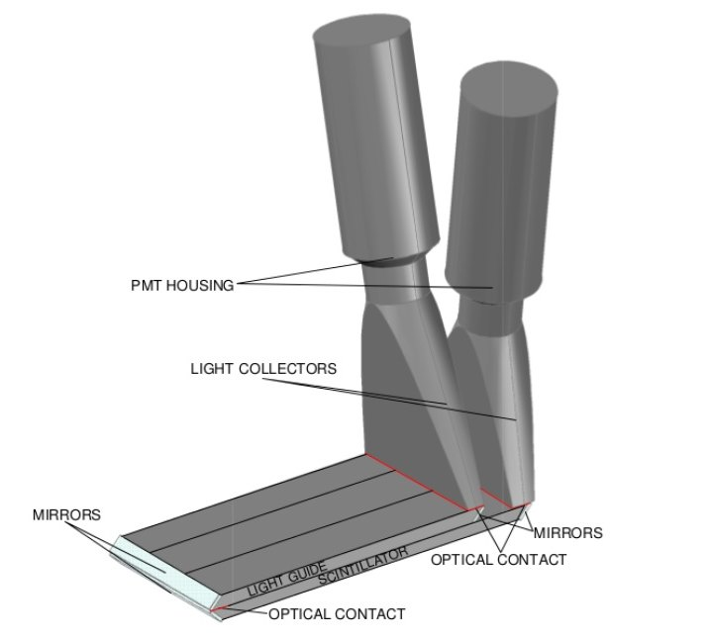
SIDDHARTA-2 Veto-1
Optics, contacts and segmentation
optimized by MC.

Slide 26
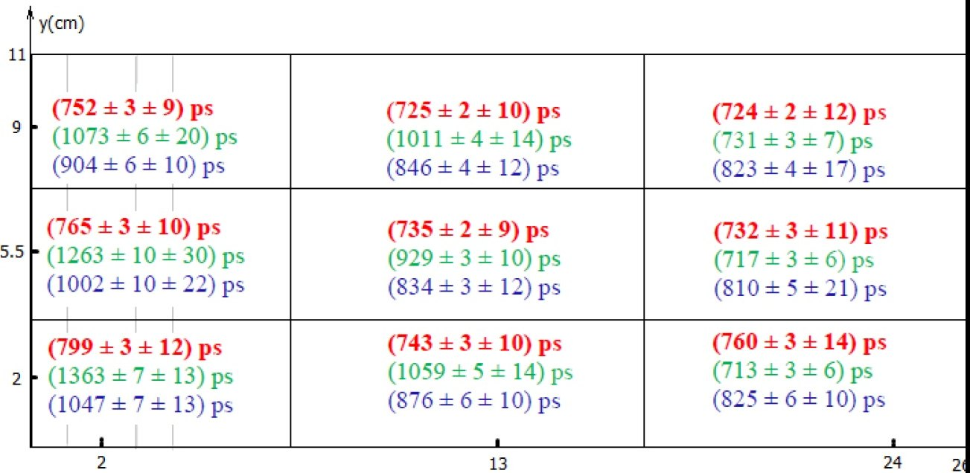
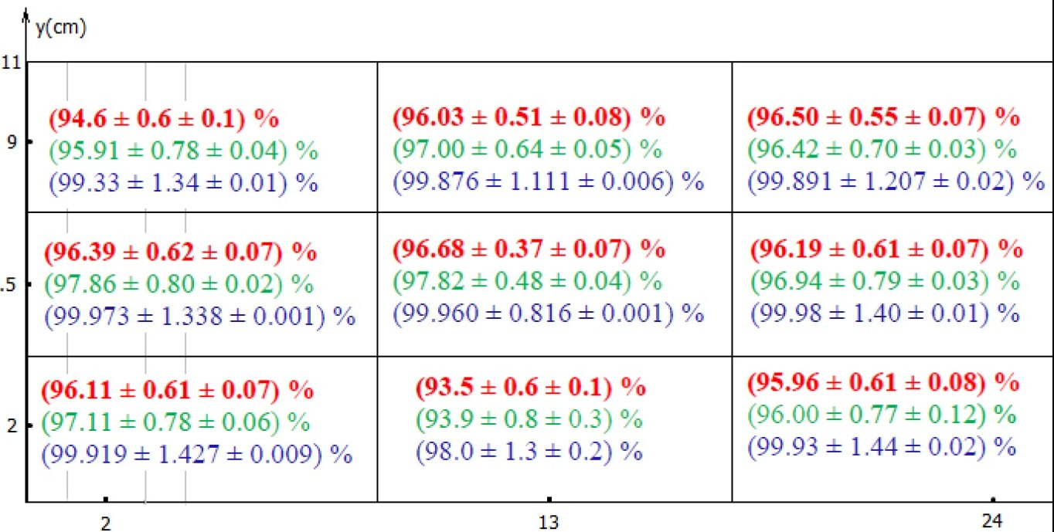
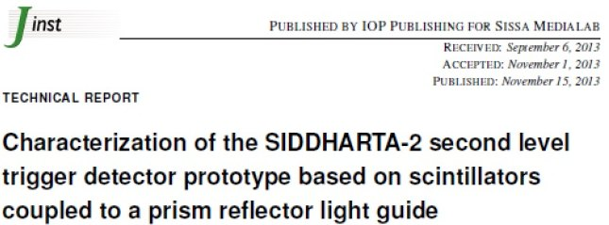
SIDDHARTA-2 Veto-1

Slide 27
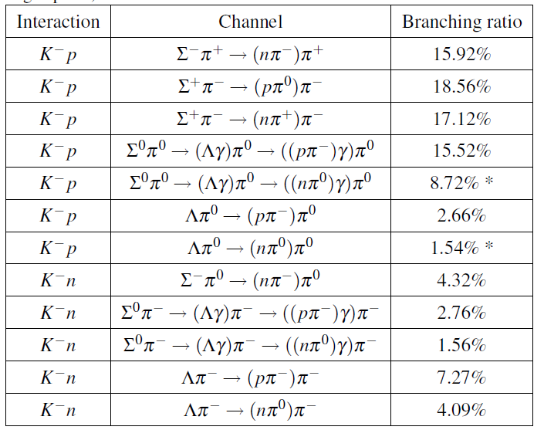
SIDDHARTA-2 kaon charge identification
-Stopping both k+ and k- in a passive layer (teflon) and detect secondaries in a second one, thus avoiding the pileup on the tail of a high k pulse (tested with laser, low ID efficiency)
p
k-
k+
μ+
k+
2 mm teflon
5 mm scintillator
Fast prompt
83% crossing probability
π-
Delayed prompt
53% crossing probability
μ+
The k- ID on the bottom will enhance also the Veto1 k+ rejection, compensating inefficiencies, so granting >50%.
Estimated k+ bkg rejection efficiency:
(0.83 * 0.5) + 0.5 ≈ 0.9
Geant4 cited sources:
C. Vander Velde-Wilquet, et al.,
- Determination of the Branching Fractions for K- Meson
Absorption at Rest in Carbon Nuclei, Nuovo Cim.
A 39 (1977) 538.
- K- -Meson Absorptions at Rest in Carbon Nuclei Leading
to Final States Containing a Lambda Hyperon, Nuovo Cim.
A 38 (1977) 178.
- The Conversion Probability and Emission Ratio of Charged
Sigma Hyperons Following K􀀀-Meson Capture at Rest in
Carbon, Nucl. Phys. A 241 (1975) 511.

Slide 28
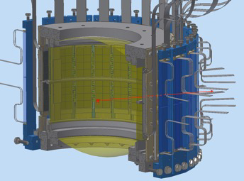
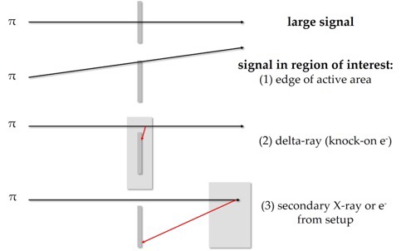
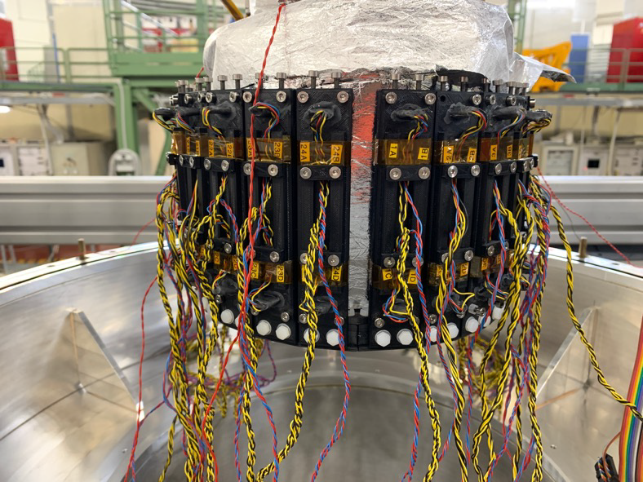
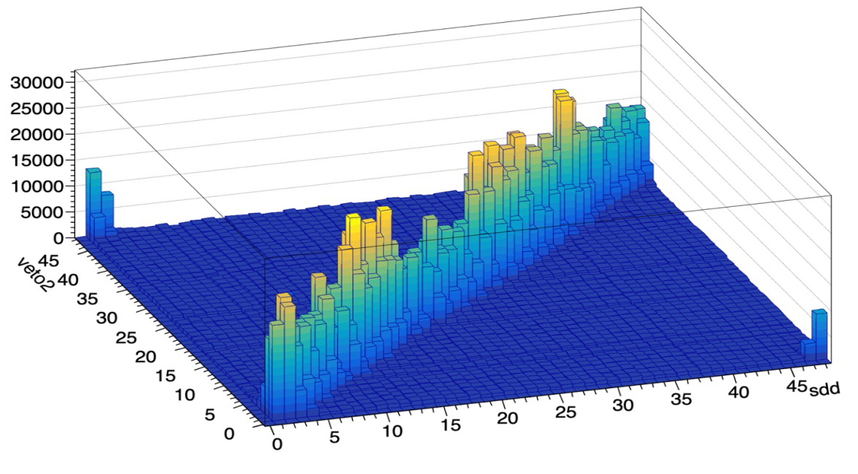
SIDDHARTA-2 Veto-2 system
It consists in a set of scintillators read by SiPM,
placed under vacuum, behind each SDD array.
Identifies grazing
MIPS from k-
absorption,
releasing an amount
of energy compatible
to an X-ray
Correlation between SDD hadronic background and veto system response

Slide 29
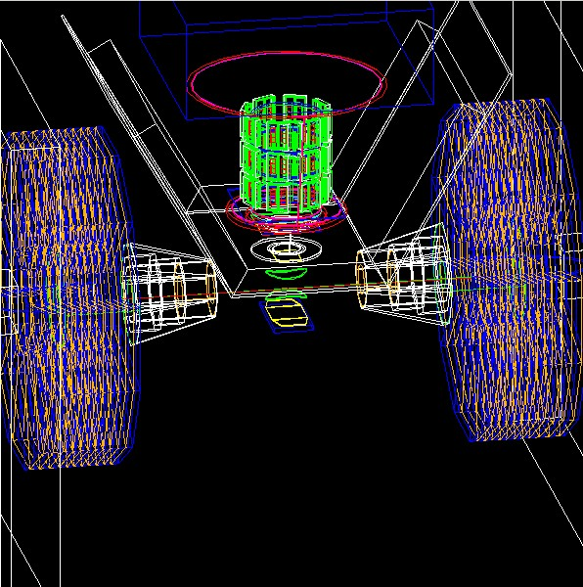
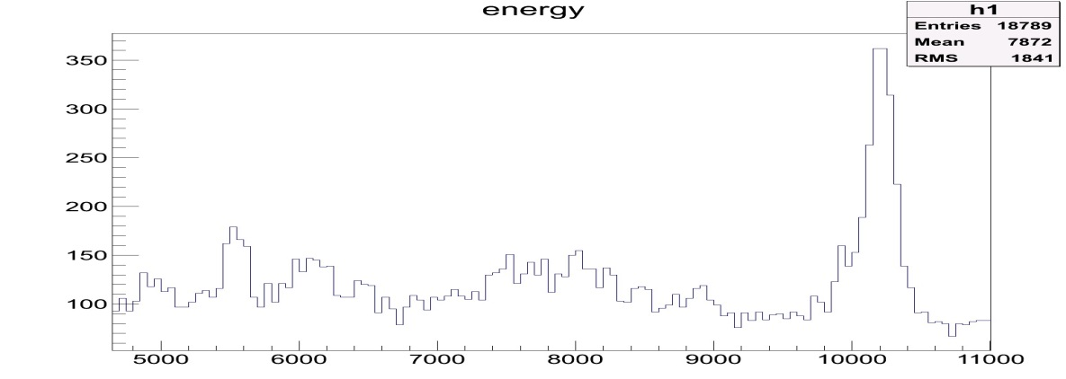
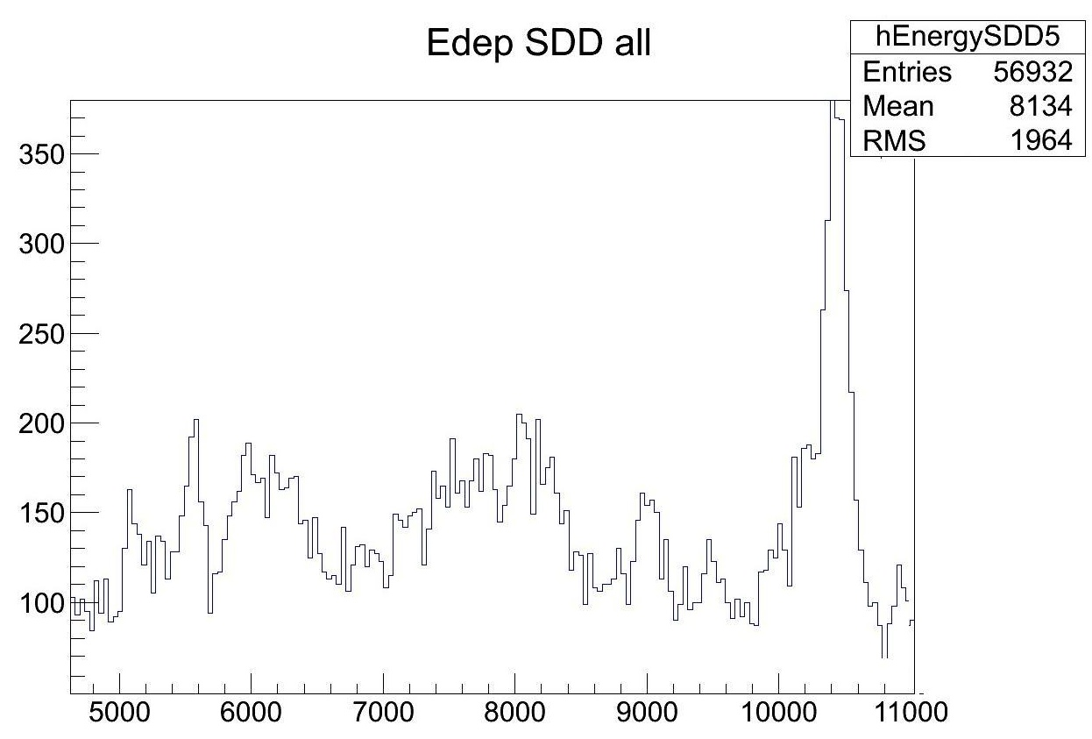
MC validation with SIDDHARTA 1 data
-The very same MC code (physics list, beam, materials) can
morph between SIDDHARTA and SIDDHARTA-2
KH 106 pb
SIDDHARTA2
REAL DATA
-Despite the machine
background is a result of a
“cascade” of two different
MCs (DAFNE and SIDDHARTA),
the overall match (EM and
hadronic) is below 14%.
KH 106 pb
SIDDHARTA1
MONTE CARLO

Slide 30
SIDDHARTA-2 New SDDs
A new set of SDDs with faster response time (500 ns FWHM vs 1 us in SIDDHARTA) and covering a larger area (246 cm² vs 144 cm² in SIDDHARTA) were designed and implemented, with the corresponding FE and DAQ.
SDD drift time at 140 K

Slide 31
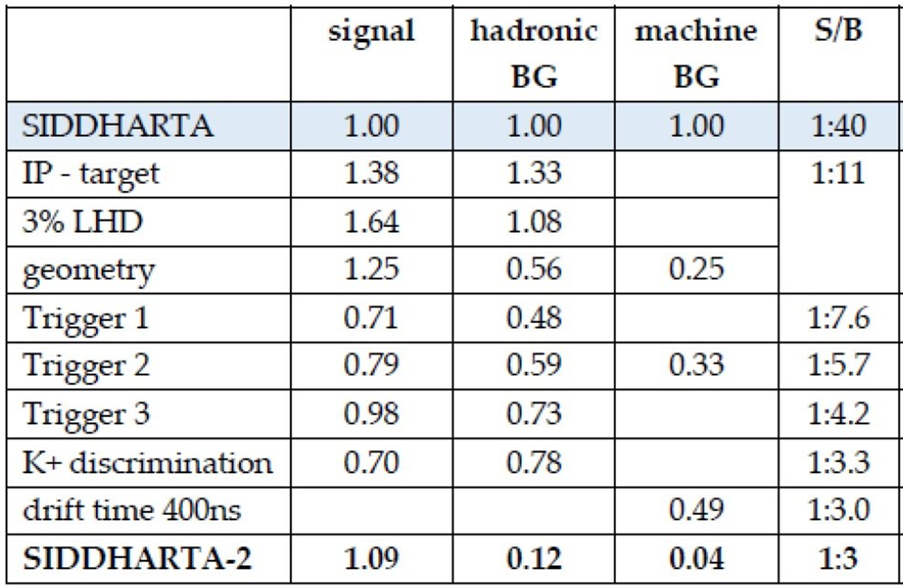
S/B gain in SIDDHARTA-2 vs SIDDHARTA
Comment: all gain factors were set at minimum level. Several features depending on the
signal quality (gamma rejection, double anticoincidence, etc) were not included.

Slide 32
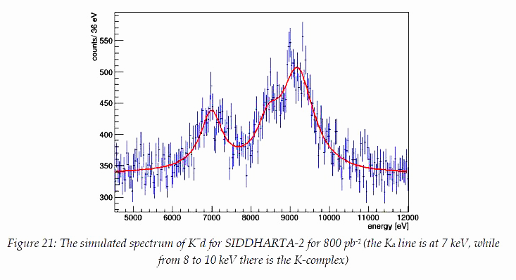
Expected Kaonic Deuterium signal in SIDDHARTA-2
Ka
e.m.
Δε(1s) = 30 eV and ΔΓ(1s) = 70 eV

Slide 33
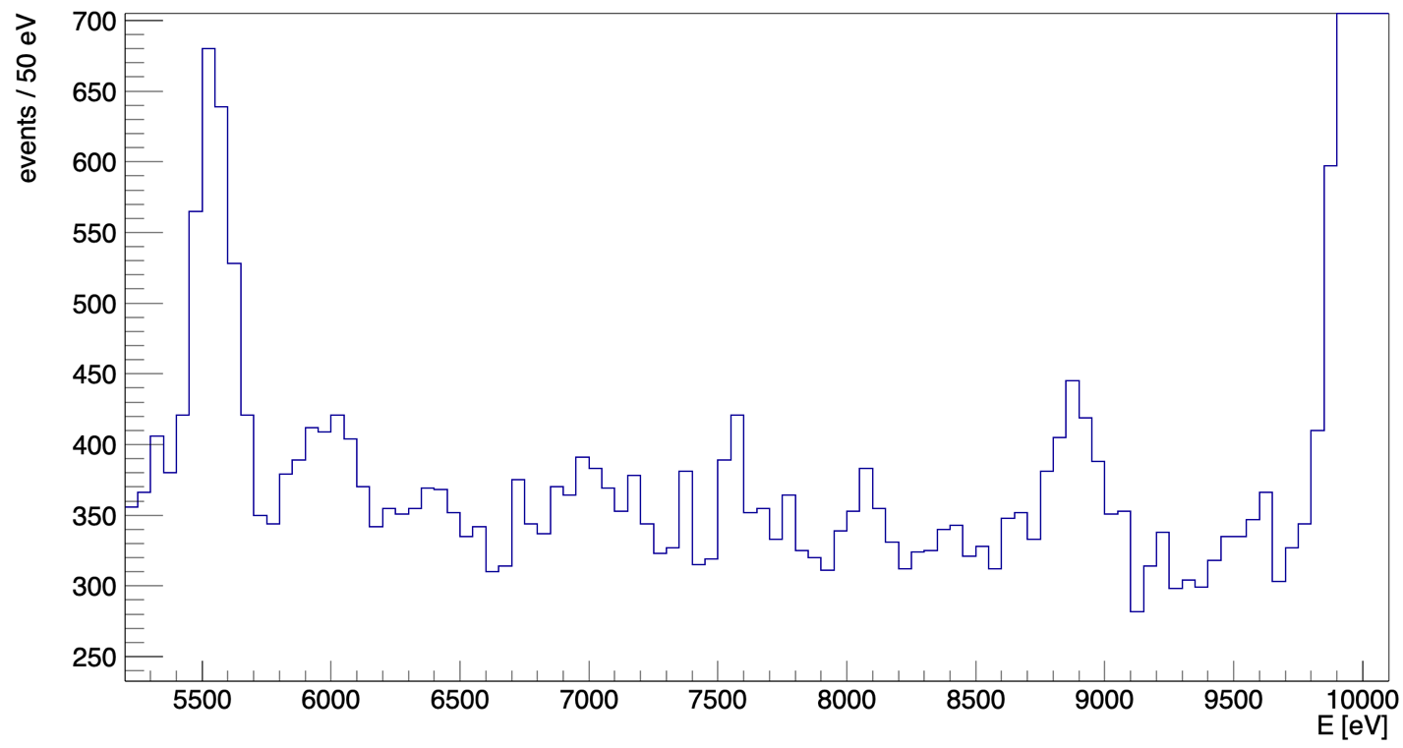


SIDDHARTA-2 Kaonic deuterium measurement
First run, May – July 2023, integrated luminosity 200 pb⁻¹ (with injections)
KC6->5
5545 eV
ROI
PRELIMINARY
KC5->4
10216 eV
strongly suppressed
in Run2
KC7->5
8886 eV
KO7->6
6007 eV
KN6->5
7595 eV
Fe $K_{α}$
6400 eV
Cu K$α$
8041 eV
Next Steps:
Refined calibration
Veto-1
Veto-3
Injection
selection
Data Analysis

Slide 34
SIDDHARTA-2 main results 2022-2023
The most precise KHe L-transition measurement in gas : J. Phys. G 49 (2022) 5, 055106
Kaonic helium-4 yields L-lines in gas : Nucl. Phys. A 1029 (2023) 122567
First measurement ever of intermediate mass kaonic atoms: Eur. Phys. J. A 59(2023)3, 56
First Measurement of KHe M-lines : paper submitted to J. Phys. G
First Measurement ever of kaonic Neon (record of precision < 1 eV) : analysis ongoing with implication on the possible charged kaon mass determination
First measurement of kaonic deuterium ( 200 pb⁻¹ ) : DAQ and analysis ongoing

Slide 35
SIDDHARTA-2 strategy
First run with SIDDHARTA-2 optimized setup for 200 pb-1 integrated luminosity: May – July 2023 - done
Second run Autumn – Winter 2023 (300 pb)
Third run: 2024 – 300 pb
Calibration runs: KHe; Neon; KH;…
Charged kaon mass exploring measurements:
-Runs with CdZnTe and HPGE in parallel with Kd
-Investigate diffractive techniques with crystal spectrometers with controlled mosaicity (VOXES)
Higher Z kaonic atoms transitions to fundamental level: new SDDs
1 mm thick produced, under test, to be installed at the end of kD run.
Possible development of a k+ low energy scattering setup

Slide 36
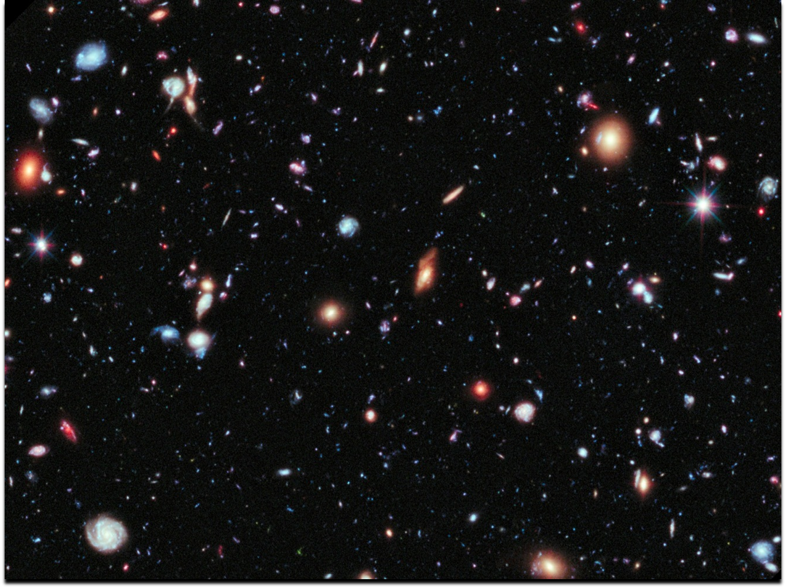
"There is no exquisite beauty," says Bacon, Lord Verulam, speaking truly of all the forms and genera of beauty, “without some strangeness in the proportion."
Edgar Allan Poe

Slide 37
SPARES

Slide 38
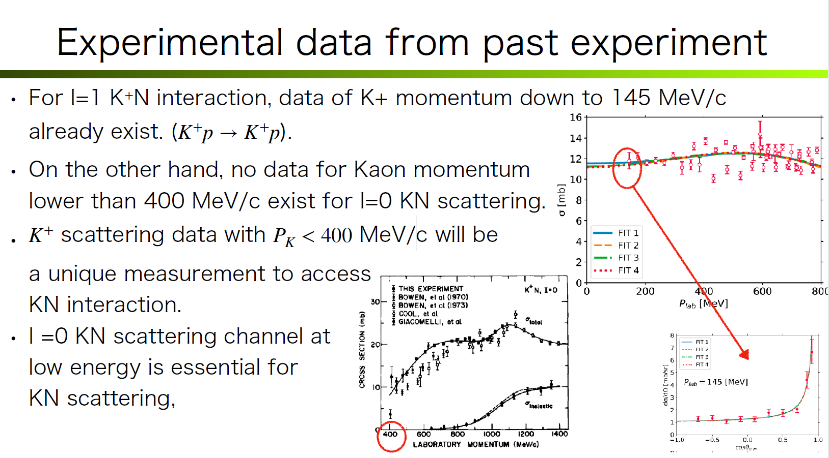

Slide 39
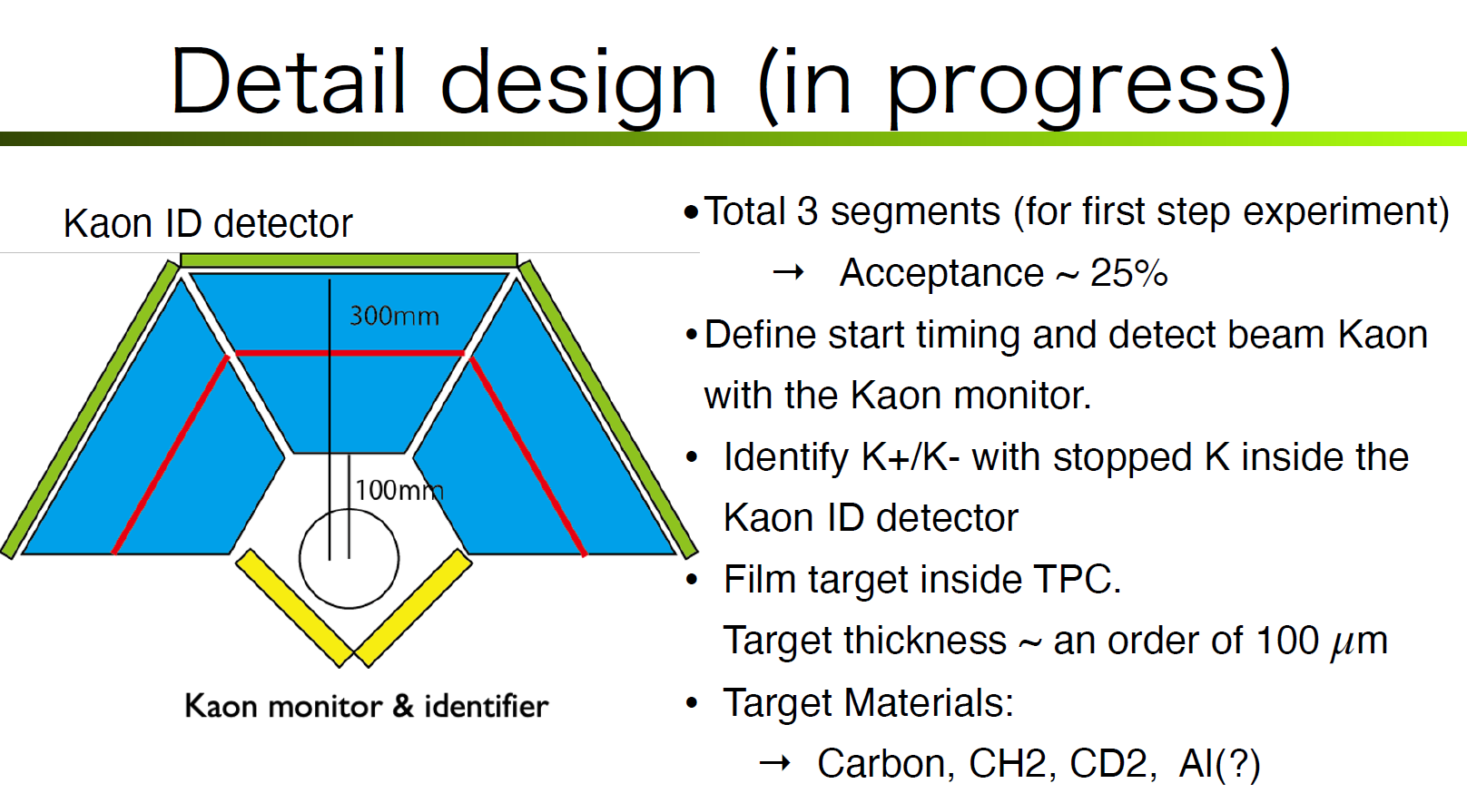

Slide 40
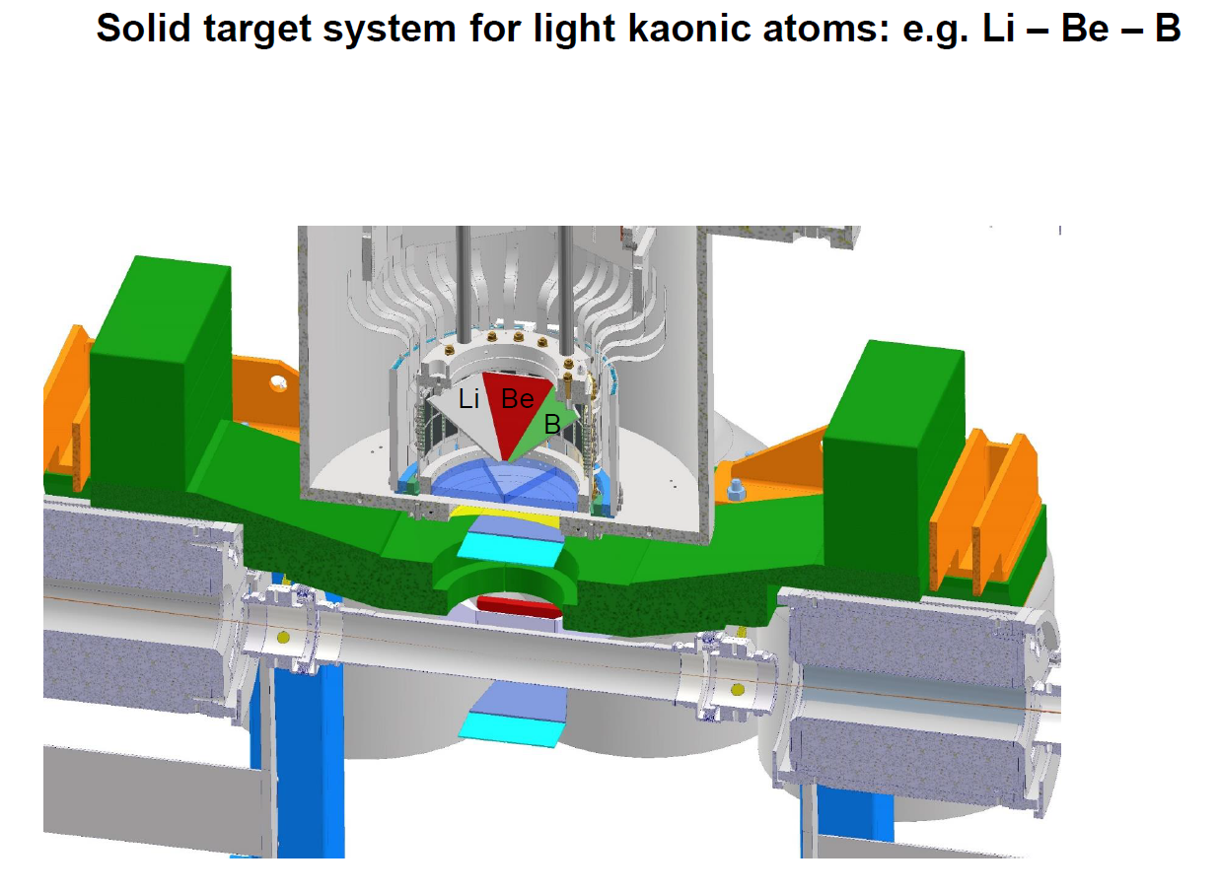

Slide 41
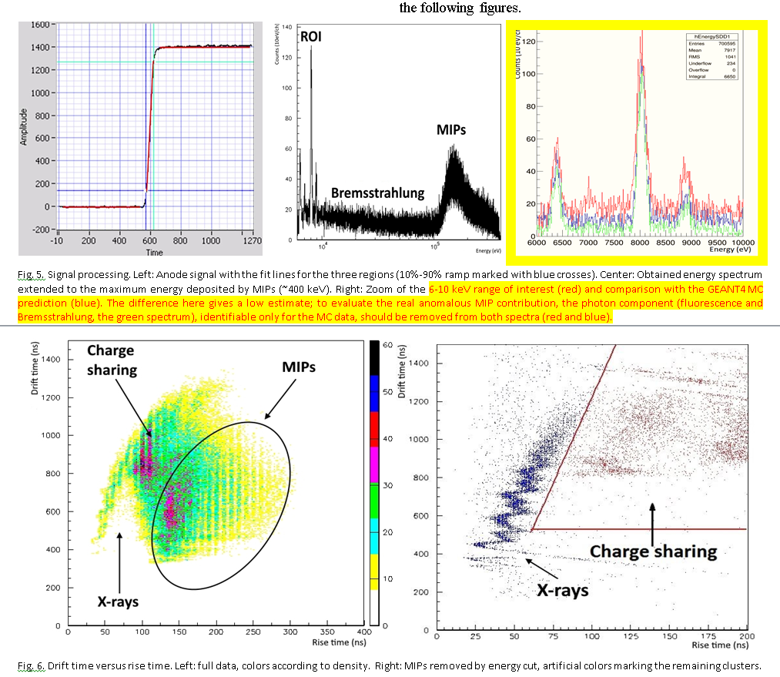
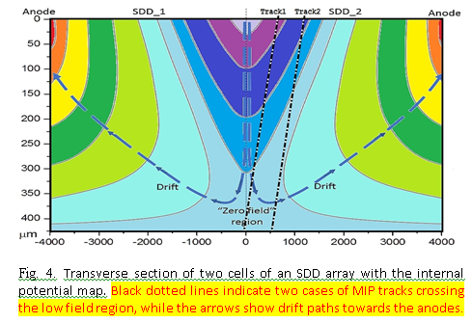
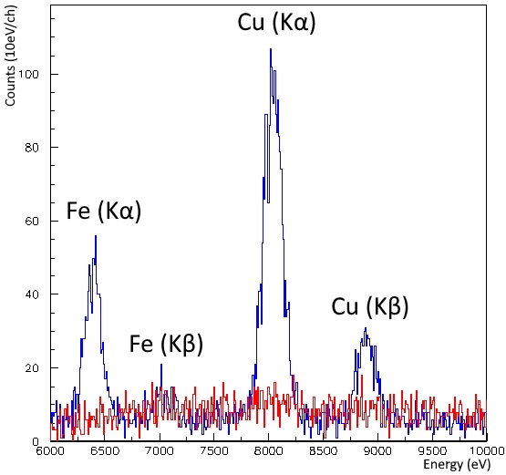
M. A. Iliescu et al., "Reducing the MIPs Charge-Sharing Background in X-Ray Spectroscopic SDD
Arrays," in IEEE Transactions on Instrumentation and Measurement, vol. 70, pp. 1-7, 2021,
Art no. 9507807, doi: 10.1109/TIM.2021.3068149.

Slide 42
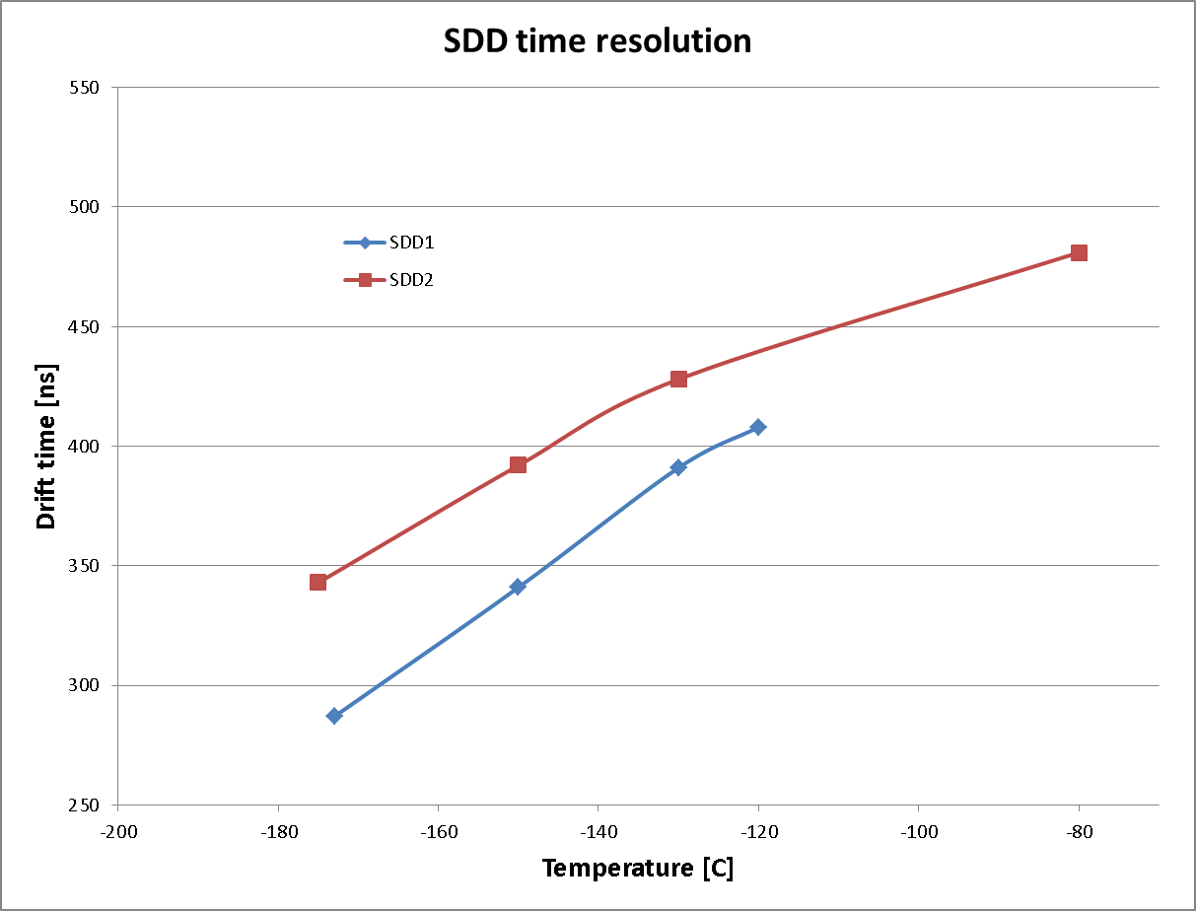
Timing measurements at LNF-BTF

Slide 43
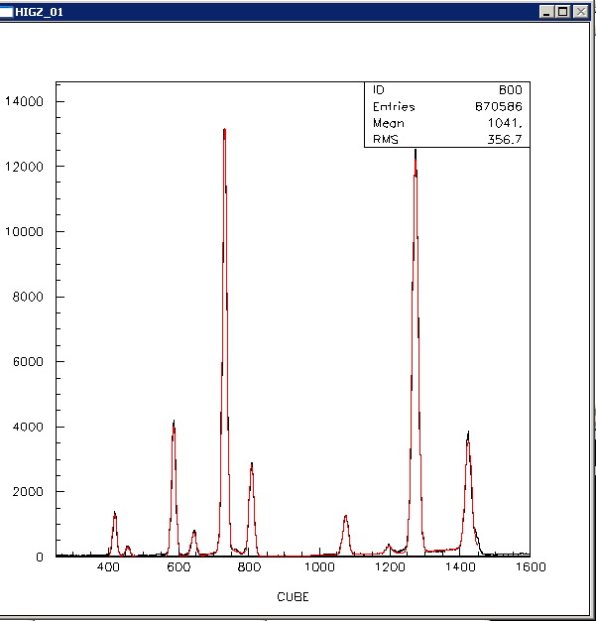

Linearity of the new SDDs equipped with CUBE reset amplifier

Slide 44

Linearity of the new SDDs equipped with CUBE reset amplifier
Range and calibration lines are very important: SIDDHARTA-2 cannot use so many lines due to kaonic atoms contamination.

Slide 45










Kaonic ⁴He – M-series transitions (2022)
First observation and measurement of kaonic helium M-series transition
New experimental data for cascade models calculations
The X-ray yield is the key observable to understand the de-excitation mechanism in kaonic atoms and develop more accurate kaonic atoms cascade models.
Line | Energy [eV]
K-⁴He M$β$ | 3300.8 $±$ 13.2 (stat) $±$ 2.0 (sys)
K-⁴He M$γ$ | 3860.4 $±$ 13.6 (stat) $±$ 2.2 (sys)
K-⁴He M$η$ | 4214.1 $±$ 19.6 (stat) $±$ 2.2 (sys)
First measurement of
K-⁴He M-series transition
KHe 6->3
(M$γ$)
KHe 7->3
(M$η$)
Ti K$α$
KHe 5->3
(M$β$)
SIDDHARTA-2
SIDDHARTINO
Study of yield density dependence for the K-⁴He L$α$ transition
Ti K$β$
Sgaramella F., et al, submitted to J. Phys. G Nucl. Part. Phys
45

Slide 46






First measurement of kaonic neon X-ray transitions
The Kaonic Neon measurement (2023)
First measurement of kaonic neon X-ray transitions ( record of precision $<1$ eV )
Line | Energy [eV]
K-Ne 9$⟶$8 | 4206.35$±$ 3.75 (stat)
K-Ne 8$⟶7$ | 6130.86 $±$ 0.71 (stat) $±$ 2 (sys.)
K-Ne 7$⟶6$ | 9450.08$±$ 0.41 (stat) $±$ 2 (sys.)
K-Ne 6$⟶5$ | 15673.30 $±$ 0.52 (stat) $±$ 5 (sys.)
K-Ne 7->6
K-Ne 6->5
Implications on
kaon - multinucleon interaction
and kaon mass
K-Ne 8->7
KO 6->5
KC 5->4
K-Ne 9->8
KAl 7->6
KC 6->4
KC 7->5
KAl 8->7
KO 5->4
Paper in preparation
46

Slide 47




The (charged) Kaon mass puzzle and kaonic Neon
Kaon mass (K-Ne $8⟶7$and K-Ne $7⟶6$) = $493.671 ±0.021 \left(stat\right) MeV$
(stat. error $\sim 15$keV including the K-Ne $6⟶5$ )
GALL 88
DENISOV 91
Preliminary
SIDDHARTA-2
Kaon mass discrepancy
BACKENSTO 73
The kaonic Neon measurement to determine the K⁻ (K⁺) mass
Particle Data Group, 2020, 083C01 (2020)
CHENG 75
BARKOV 79
LUM 81
Less systematic uncertainty with respect to DENISOV 91 and GALL 88 measurements, thanks to the use of a low Z gas (Ne) target
Kaon mass [MeV]
Impact on the charmonium spectrum and on all processes in which charged kaons are involved
It could solve the kaon mass discrepancy issue

Slide 48




SDD energy calibration with ML and Differential Programming
The method can correct for miscalibration improving the systematic error and the energy resolution allowing to perform high precision measurement with an accuracy below 1 eV
Cu $K_{α}$
Fabrizio Napolitano et al 2023 Meas. Sci. Technol. in press https://doi.org/10.1088/1361-6501/ad080a
Fabrizio Napolitano and Simone Manti

Slide 49


Slide 50

Energy loss
PRELIMINARY
Preliminary evaluation with 2-body decay

Slide 51


Slide 52


Slide 53


Slide 54


Slide 55


Slide 56


Slide 57


Σ⁰ π⁰ channel : the π⁰ momentum
P(π⁰) resolution: σ_{p} ≈ 12 MeV/c
m_{lim} ¹²C at-rest
m_{lim} ¹²C in-flight
At-rest
In-flight
Counts/(10MeV/c)
Counts/(10MeV/c)
In-flight component
M(Σ⁰π⁰) (MeV/c²)
M(Σ⁰π⁰ ) (MeV/c²)
P(π⁰) (MeV/c)
P(π⁰) could be used for in-flight/at-rest separation
P(π⁰) (MeV/c)

Slide 58


Slide 59
Conclusions for AMADEUS
AMADEUS has a strong potential to perform complete measurements of low-energy kaon-nuclei interactions in various targets
Data analyses ongoing

