Slide 1
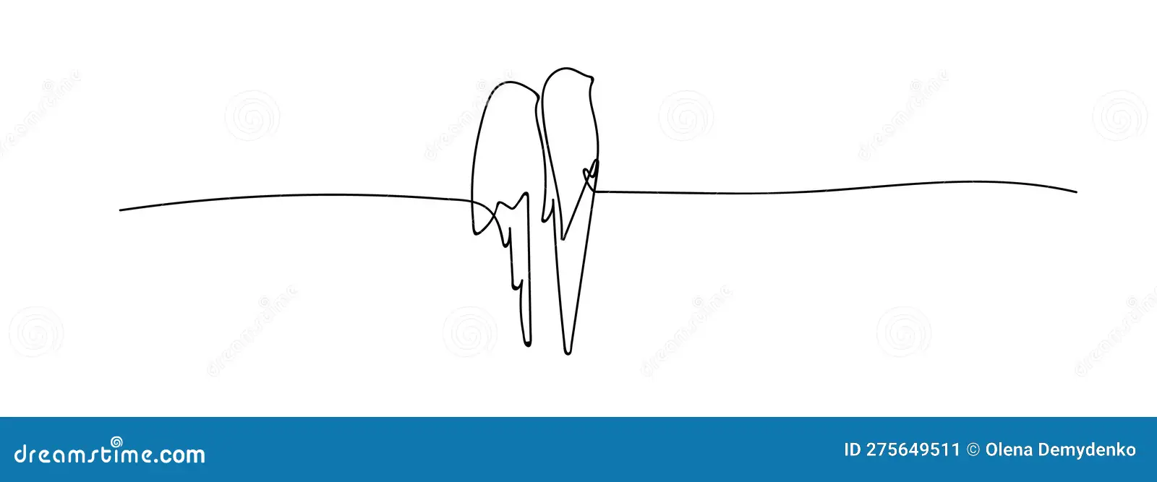
Possible CPT violation and the Baryon Asymmetry of the Universe
Tamar Mamadashvili Second-year Master student Supervisor: Assoc. Prof. Merab Gogberashvili Ivane Javakhishvili Tbilisi State University
**Poster presentation

Slide 2
Baryon Asymmetry of the Universe
The Baryon Asymmetry of the Universe(BAU) can be estimated by the baryon to photon ratio: $$η={\left.\frac{n_{b}−n_{\overline{b}}}{n_{γ}}\right|}_{T=3K}≈ {\left.\frac{n_{b}}{n_{γ}}\right|}_{T=3K}$$ From the experimental values: $$η \sim {10}^{−10}$$
The ratio of protons and antiprotons evaluated using direct probes(PAMELA,FERMI) from other parts of our galaxy in the form of cosmic rays: $$\frac{\overline{p}}{p}\sim {10}^{−4}$$
Baryogenesis – dynamical process of matter excess production
Standard Model:
Sakharov conditions(1967):
Baryon-number violation
C & CP violation( laws of nature must be biased so that a matter excess results and not an antimatter excess).
Departure from thermal equilibrium(an “arrow of time”) $Γ\left(Y+B→X\right)=Γ\left(X→Y+B\right)$
Instanon & sphaleron processes, $A\sim e^{−\frac{8π^{2}}{g^{2}}}\sim {10}^{−173}$
Weak interactions
Expansion of the universe

Slide 3
Estimating BAU on GUT scale
Another way to explain the observed value of BAU is the matter-antimatter mass difference in the early universe, which is accompanied to possible CPT violation and it can happen in FRW spaces. The effects of CPT violation caused by universe expansion is considered, such as: - the difference between direct and inverse particle decay rates - mass difference between particles and antiparticles.
In FRW universe the mass difference obtained between particles and antiparticles via Higgs mechanism is: $$\frac{{∆m}_{X}}{m_{X}}=\left({\dot{a}|}_{τ=0}\right)\frac{τ}{a_{0}}$$
leptoquark-antileptoquarks
Conformal time
evolution of the Universe is described by the de Sitter expansion law $$a=a_{0}∙e^{Ht}$$
Plugging in all above information, by the easiest calculations we estimate leptoquark-antileptoquark mass difference
$$\frac{{∆m}_{X}}{m_{X}} \sim {10}^{−8}−{10}^{−10}$$

Slide 4
References
[1]. Andro Barnaveli, Merab Gogberashvili. BARYON AND TIME ASYMMETRIES OF THE UNIVERSE (arXiv, 1995) [2]. James M. Cline. BARYOGENESIS (arXiv, 2006) [3]. Eric Sather. The mystery of the matter asymmetry (SLAC Beam Line 26N1, 1996) [4]. L. Canetti, M. Drewes, M. Shaposhnikov. Matter and Antimatter in the Universe (arXiv, 2012) [5]. C.S. Wu, E. Ambler, R.W. Hayward, D. D. Hoppess, R. P. Hudson. Experimental Test of Parity Conservation in Beta Decay (PhysRev., 1957) [6]. Aliaksei Kachanovich. Electroweak baryogenesis (KIT, 2019) [7]. Patrick Huet. Electroweak Baryogenesis and the Standard Model (arXiv, 1994) [8]. Gerard ‘t Hooft. Symmetry breaking through Bell-Jackiw Anomalies (Phys. Rev. 1976)
Thank you

