Slide 1
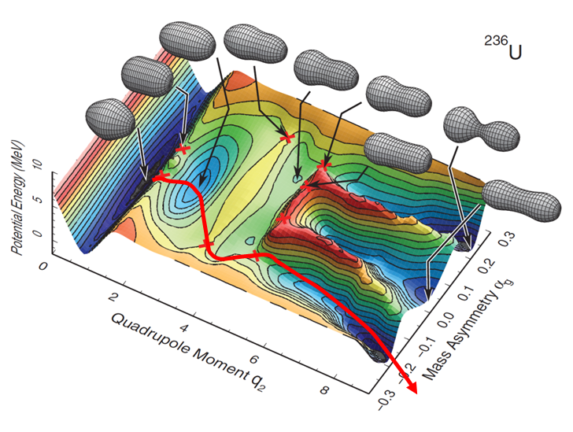
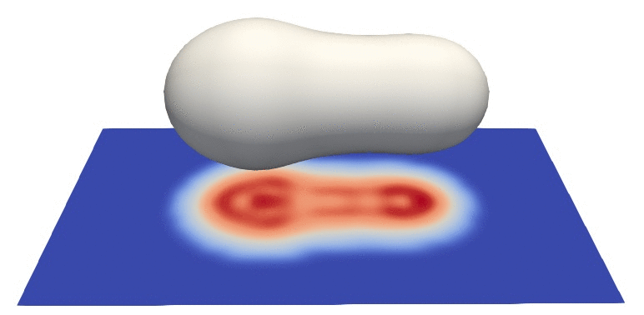
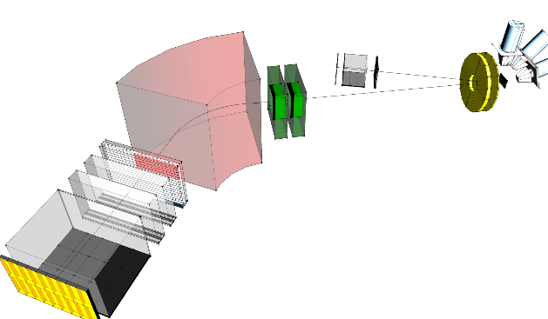
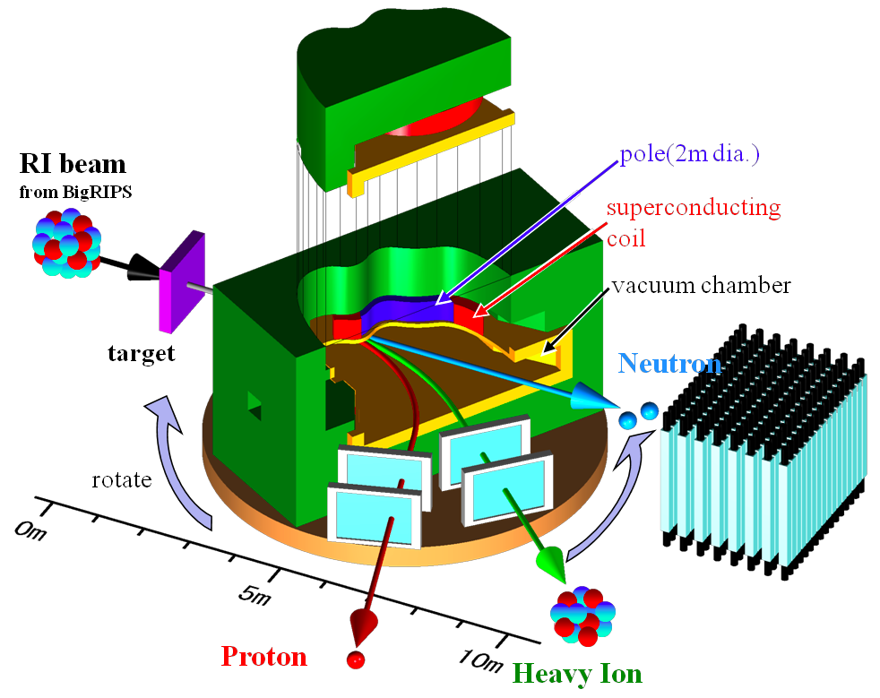
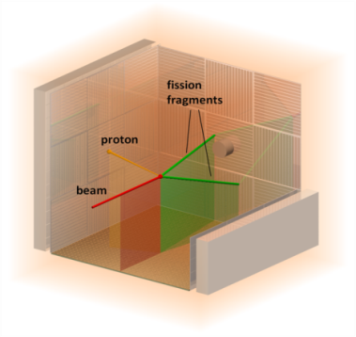
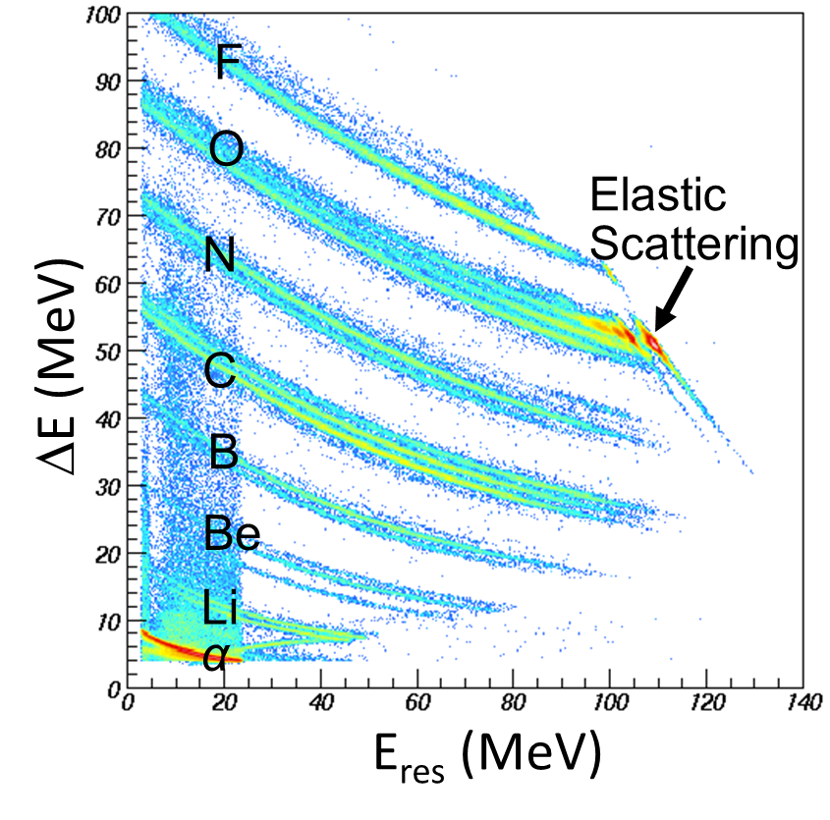
Nuclear Fission in the 21st Century
(mapping low-energy fission with radioactive ion beams)
Andrei Andreyev
University of York, UK
60th International Winter Meeting, Bormio, 22-26 January, 2024

Slide 2
Nuclear Fission in the 21st Century
(from an experimentalist’s point of view)
Fission in the new” regions of the Nuclear Chart“ –why?
Brief (experimental) review on low-energy fission
Beta-Delayed Fission at ISOLDE (CERN) at 60 keV
d,pf transfer–induced fission with post-accelerated RIBs at 5-7 AMeV
Coulex-induced fission with SOFIA@GSI at 1 AGeV
Spontaneous fission (SF) in heavy/SHE nuclei
Fusion-fission with heavy ions at Coulomb energies (Dubna, ANU, India..)
Transfer-induced fission at Coulomb energies (VAMOS@GANIL, JAEA)
n_ToF, n-induced fission experiments (ILL,n_ToF, LANSCE,J-PARC….)
Angular momentum generation in fission
Future techniques: Photofission at ELI-NP with CBS-technique
Future techniques: Fission in collision geometry with electrons (SCRIT@RIKEN)?
p,2pf studies at 300 AMeV at SAMURAI-RIBF@RIKEN (also GSI)
A.N. Andreyev, K. Nishio, K.-H. Schmidt, Reports on Progress in Physics, 1 (2018) Experimental review
A.N. Andreyev, M. Huyse, P. Van Duppen, Reviews of Modern Physics, 85, 1541 (2013)
K.-H. Schmidt, B. Jurado, Rep. Prog. Phys. 81 106301 (2018) Experiment and theory/GEF
N. Schunck, L. M. Robledo, Rep. Prog. Phys. 79, 116301 (2016) Theory review
F.-P. Hessberger. Eur. Phys. J. A, 53, 75 (2017) SF review
N. Colonna et al., Eur. Phys. J. A56, 48 (2020) CERN n_ToF CERN fission program (and similar)

Slide 3
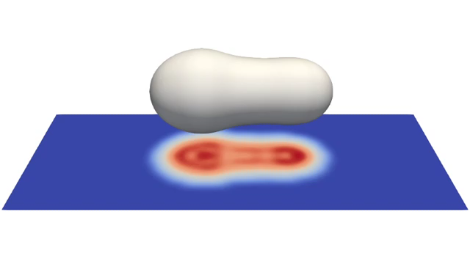
What is Fission?
Time scale for fission from ‘compound nucleus’ to scission ~20 zs (~20×10⁻²¹s)
Time-dependent Hartree-Fock + BCS simulations for ²⁴⁰Pu
G. Scamps, C.Seminel, Nature 564, 382–385 (2018)

Slide 4
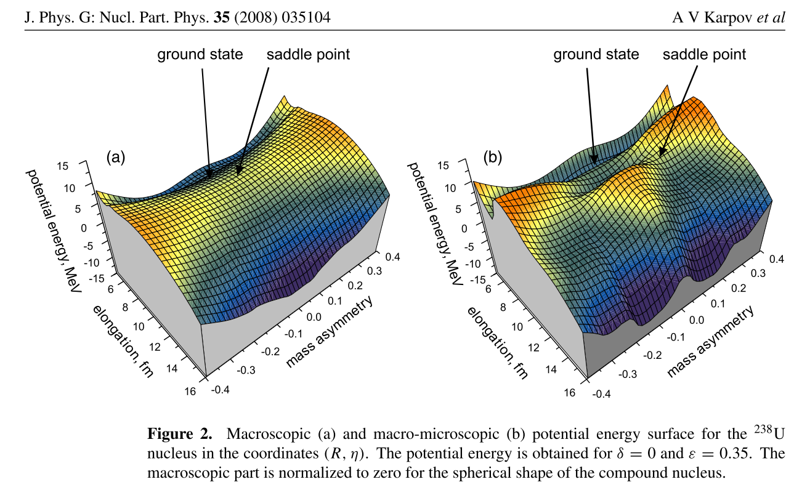
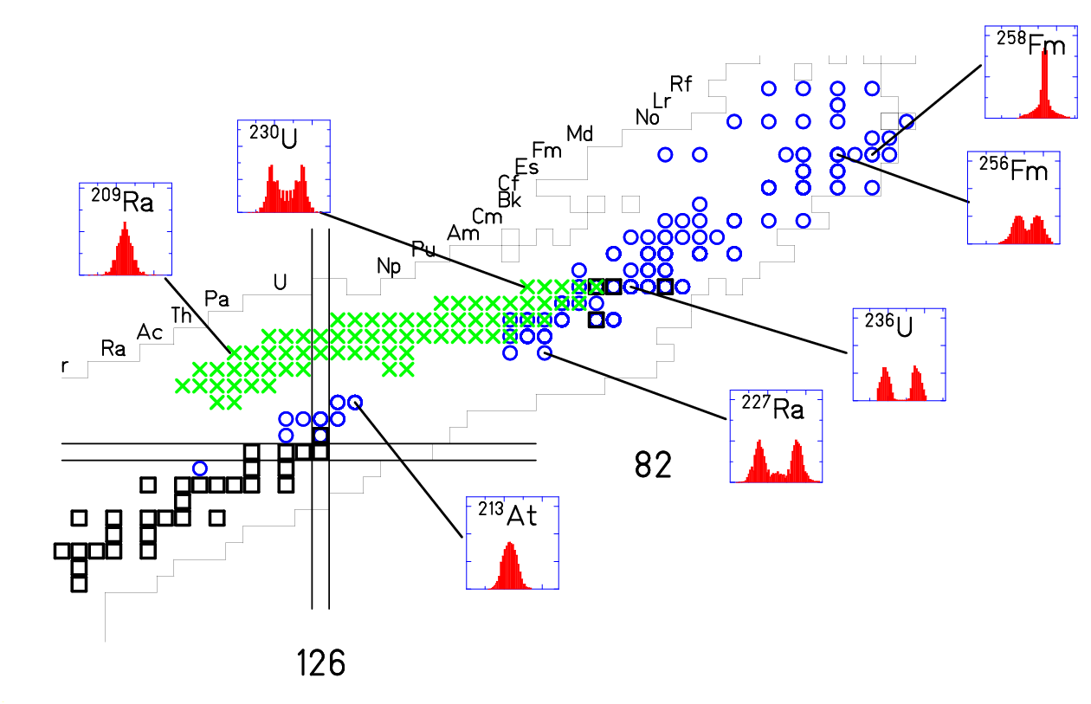
Symmetric vs Asymmetric Fission in 3D
A.N. Andreyev, K. Nishio, K.-H. Schmidt, Reports on Progress in Physics, 1 (2018)
Macroscopic only
(like a liquid drop)
Microscopic effects added
(nuclear shells and pairing)
Yield
Yield
Fragment mass
Fragment mass
Pure LDM (no shell effects): symmetric mass Split (single peak/mode)
Asymmetric Mass Split (two or more peaks/modes) if shell effects are included

Slide 5
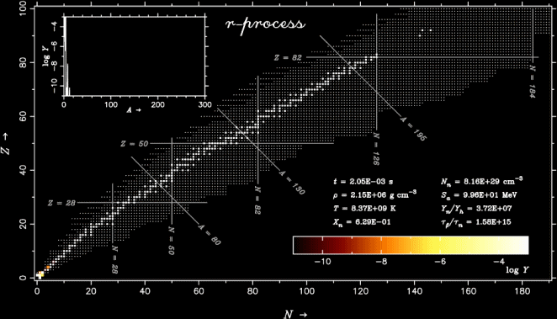
Why do we need fission of very exotic nuclei?
(e.g. r-process network calculations)
r-プロセス元素合成の動画
²³²Th,²³⁸U
¹³²Sn
⁷⁸Ni
和南城伸也氏（上智大）
r-process termination by fission: need to know fission barriers and FFs mass distributions for Z>82, N>180 nuclei! (hardly ever produced in the lab?)

Slide 6
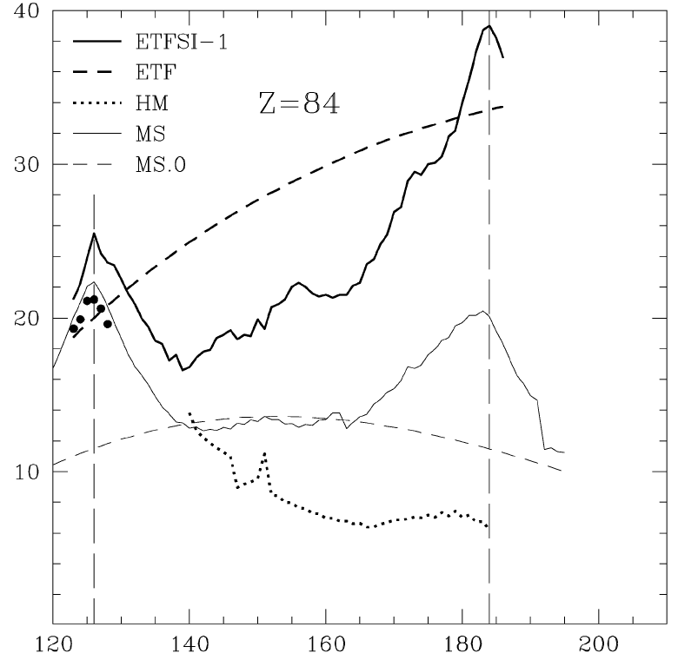
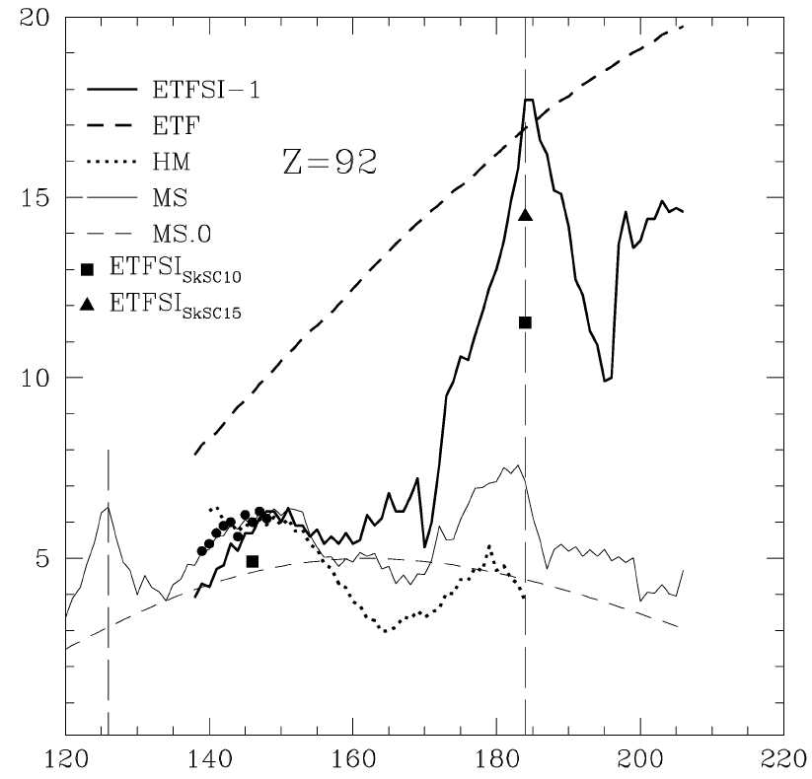
Example: Fission Barrier Calculations for r-process nuclei
Full symbols – experimental data
Lines – calculations
A. Mamdouh et al. NPA679 (2001), 337
Po
ETFSI
U
ETFSI
B_{f} [MeV]
TF
TF
LDM
LDM
Neutron Number Neutron Number
Good agreement between B_{f,cal} and B_{f,exp} for nuclei close to stability
Large disagreement far of stability (both on n-def. and n-rich sides)
Need measured fission data far of stability to ‘tune’ fission models

Slide 7
Fission re-cycling in r-process: influence of the fission fragments mass distributions modelling
²⁷⁴Pu
SPY,S.Goriely et al, PRL,2013
A=278
Recall: in r-process network calculations, we need fission data for e.g. ²⁷⁴Pu, but so far the fission around ²³⁹Pu was studied only

Slide 8
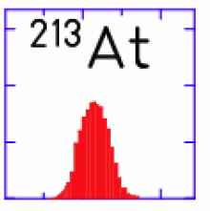
Experimental information on low-energy fission
Nuclei with measured charge/mass split (RIPL-2 + GSI)
Heavy Actinides, N/Z~1.56: predominantly asymmetric;
spontaneous fission, fission isomers, (bimodal)
Z=82
Z=82
Z=82
Z=82
- particle induced
x - e.m. –induced E*~11 MeV
¹⁸⁷Ir
¹⁹⁶Au
A.N. Andreyev, K. Nishio, K.-H. Schmidt, Reports on Progress in Physics, 1 (2018)

Slide 9
Experimental information on low-energy fission
Nuclei with measured charge/mass split (RIPL-2 + GSI)
Heavy Actinides, N/Z~1.56: predominantly asymmetric;
spontaneous fission, fission isomers, (bimodal)
Region of our interest: fission of nuclei with A~180-200,
N/Z~1.22-1.3: Hg,Pb,Po,Rn
ISOLDE(CERN)+ many other labs nowadays
Z=82
Z=82
Z=82
Z=82
¹⁸⁰Hg
N/Z=1.25
- particle induced
x - e.m. –induced E*~11 MeV
¹⁸⁷Ir
¹⁹⁶Au
Pre-actinides, light Ir-Th N/Z~1.4-1.5:
predominantly symmetric, e.g. FRS(GSI)
A.N. Andreyev, K. Nishio, K.-H. Schimidt, Reports on Progress in Physics, Invited review, v.1 (2018)

Slide 10
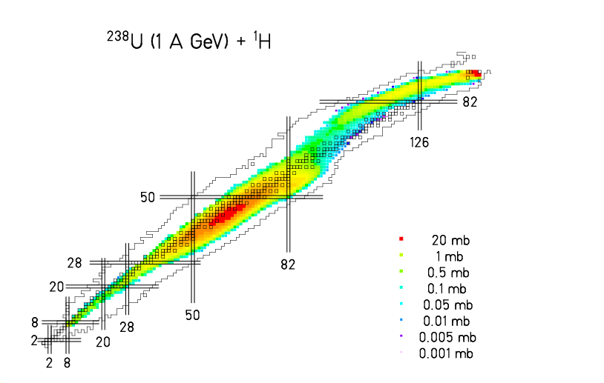
RIBs Production Reactions at ISOLDE (CERN)
(note, ISOLDE consumes >50% of CERN’s protons, not LHC ;) )
spallation
+
spallation
fragmentation
+
+
2
3
8
U
X
fission
+
+
Y

Slide 11
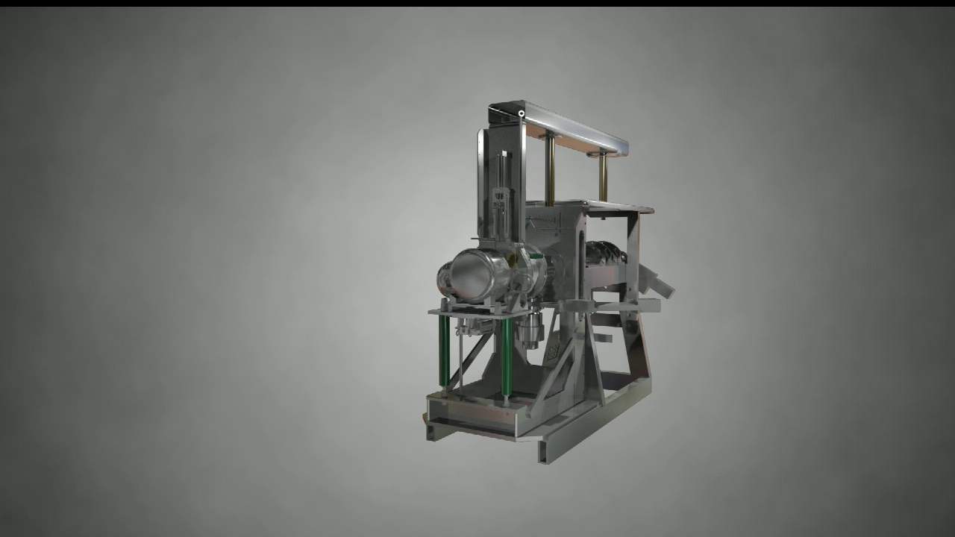
ISOLDE On-line Mass Separator Facility (CERN) (example of a surface-ionization ion source)

Slide 12
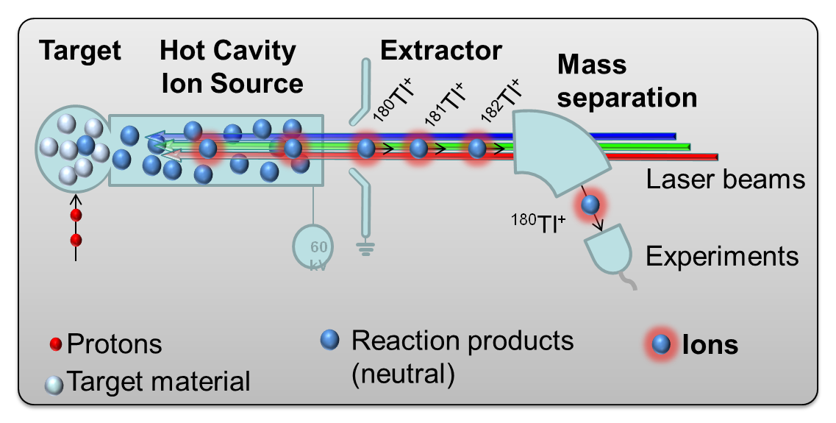
How to get a uniquely clean radioactive ion beam at ISOLDE?
Resonance Laser Ionization at ISOLDE

Slide 13
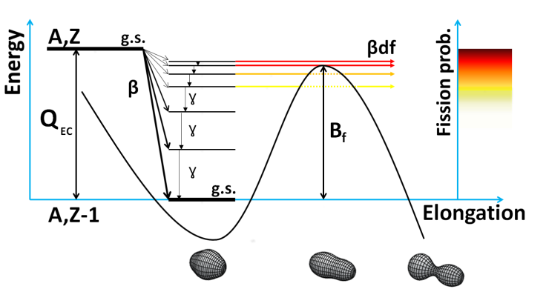
Beta-Delayed Fission of low-energy RIBs
(a sub-class of β-delayed particle decays)
¹⁸⁰Tl
¹⁸⁰Hg
Two step process: β decay followed by fission
Low-energy fission (E*~3-12 MeV, limited by Q_{EC})
e.g. ¹⁸⁰Tl: Q_{EC}=10.4 MeV, B_{f,calc}=9.8 MeV
Low angular momentum of the state e.g. ¹⁸⁰Tl: I=4 or 5
A.N. Andreyev, M. Huyse, P. Van Duppen, Reviews of Modern Physics, 85, 1541 (2013): ~30 cases known

Slide 14

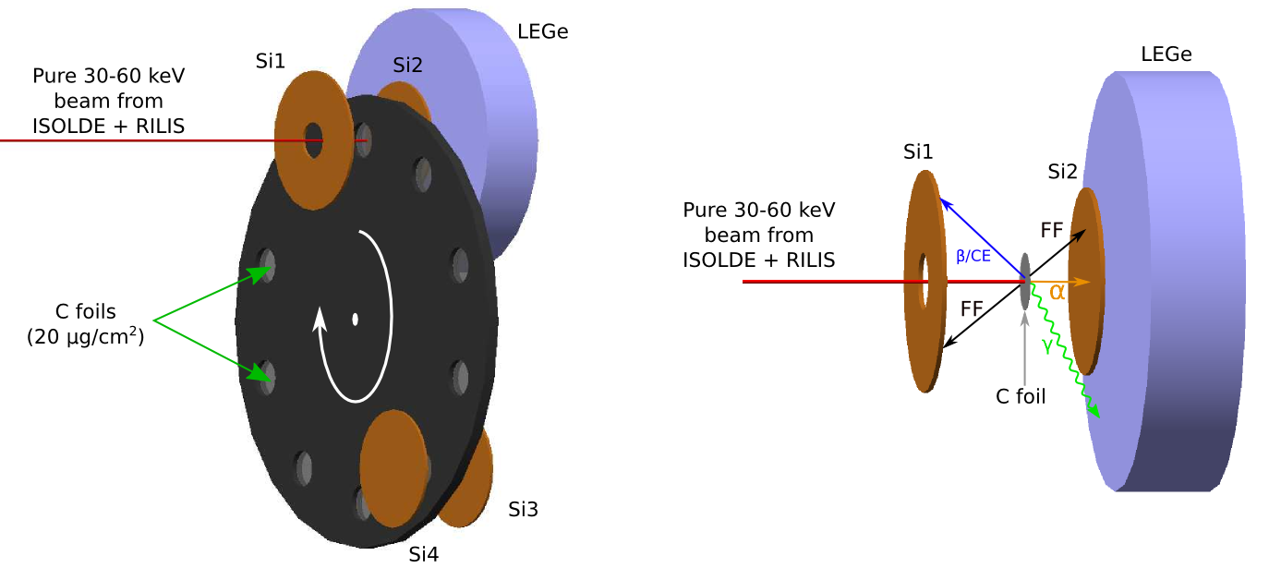

Detection system for βDF studies at ISOLDE
(small can be beautiful!)
Setup: Si detectors both sides of the C-foil
Simple setup & DAQ: 2 Surface barrier detectors (1
of them – annular) and 2 PIPS detectors.
34% geometrical efficiency at implantation site.
Alpha-gamma coincidences
Digital electronics

Slide 15
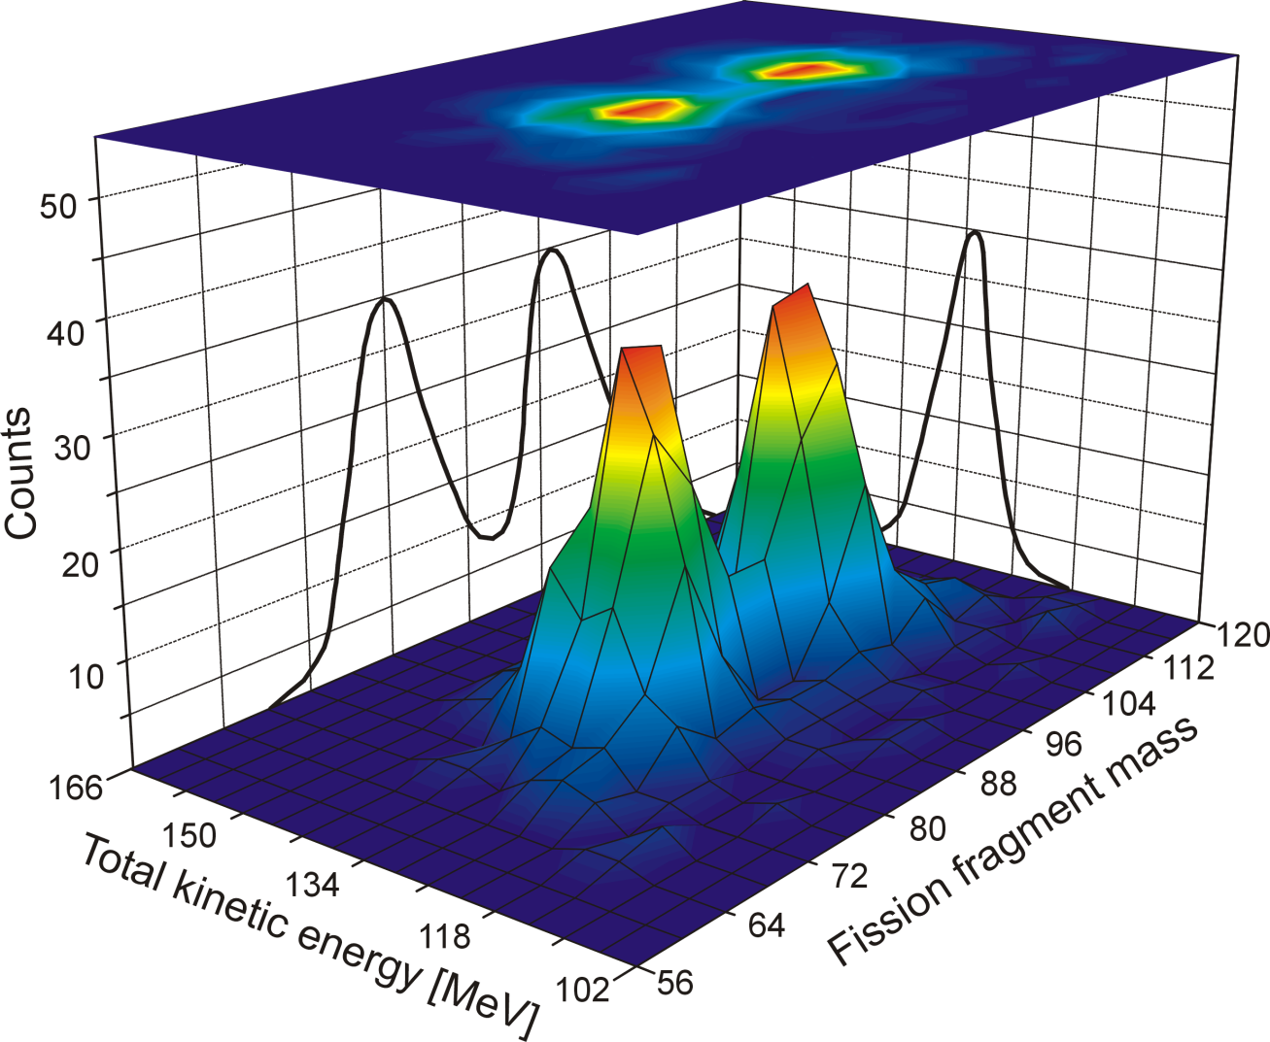
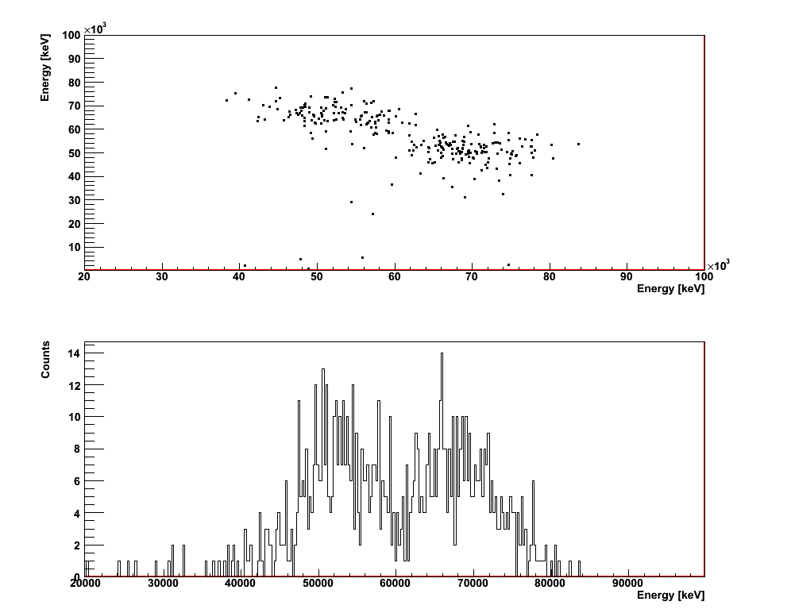
Mass distribution of fission fragments from βDF of ¹⁸⁰Tl
(recall – it’s daughter ¹⁸⁰Hg=2×⁹⁰Zr, who is actually fissionning!)
ASYMMETRIC energy split! Thus, asymmetric mass split: M_{H}=100(4) and M_{L}= 80(4)
E_{ff1}-E_{ff2} coincidences ~330 events
Singles 1111 ff
~20 ff/h
A problem: “low-energy” FF’s - 1 AMeV only, precise A and Z identification difficult, 4u
The most probable fission fragments are ¹⁰⁰Ru (N=56,Z=44) and ⁸⁰Kr (N=44,Z=36)

Slide 16
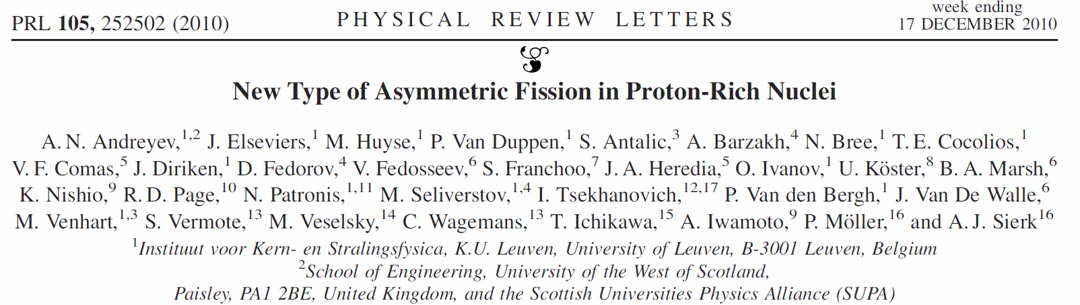
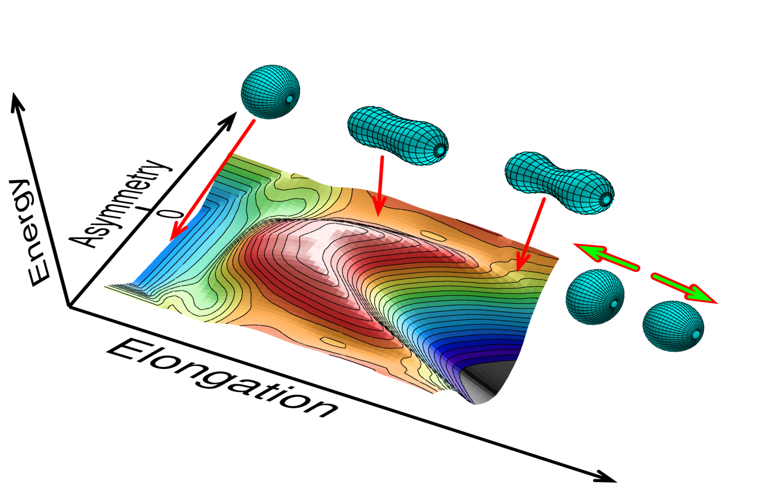
New Type of Asymmetric Fission in Proton-Rich Nuclei
via βDF of ¹⁸⁰Tl
Q_{EC}(¹⁸⁰Tl)-B_{f}(¹⁸⁰Hg)=0.63 MeV
P_{βDF}(¹⁸⁰Tl)=3.6(7)×10⁻⁵
Q_{EC}(¹⁸⁰Tl)=E*_{max}=10.44 MeV
E
⁸⁰Kr
¹⁰⁰Ru
⁹⁰Zr+⁹⁰Zr
Calculations according to 5D fission model, P. MÖller et al., Nature 409, 785 (2001)

Slide 17
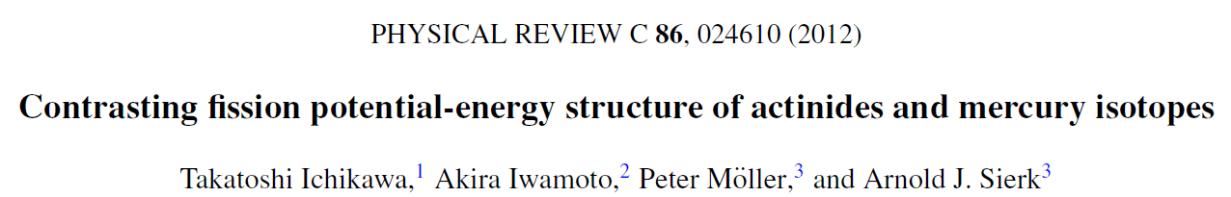
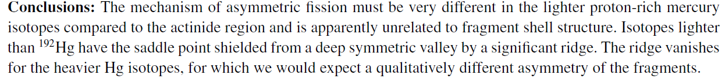
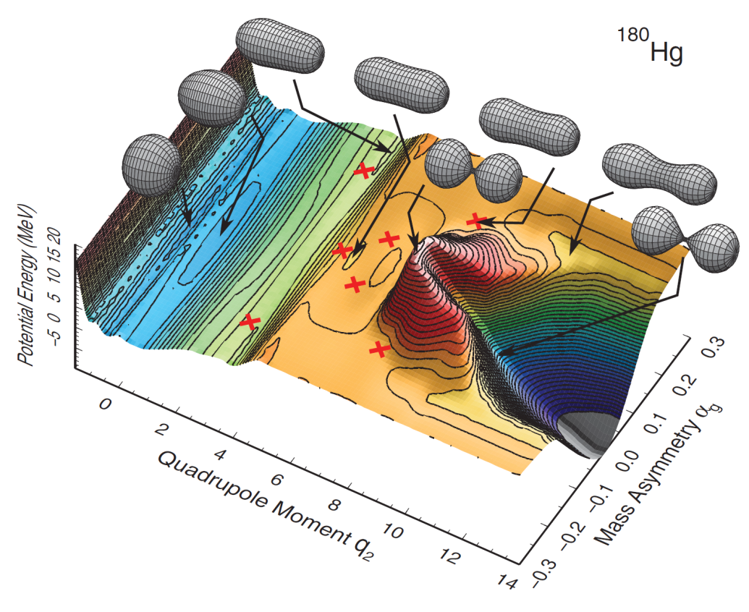
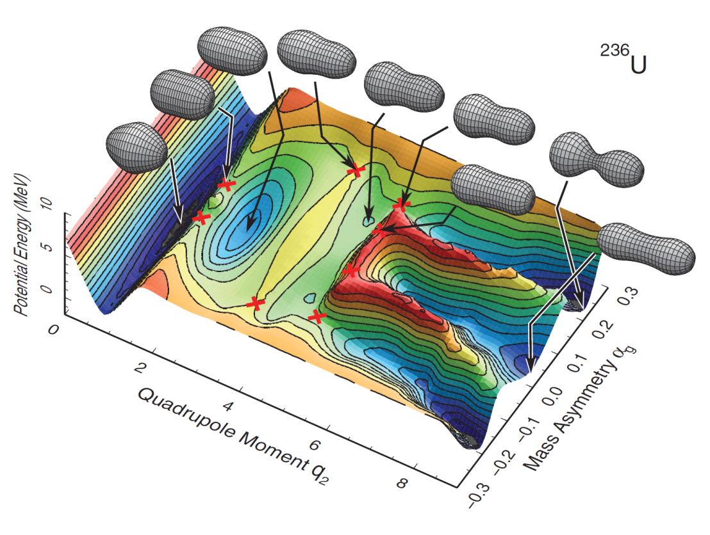
Two types of asymmetry: what’s the difference?
¹⁸⁰Hg
²³⁸U
Asymmetry in the U-region is due to strong shell effects of fission fragments around ¹³²Sn
Asymmetry in the neutron-deficient Pb-region – due to shell effects of CN

Slide 18
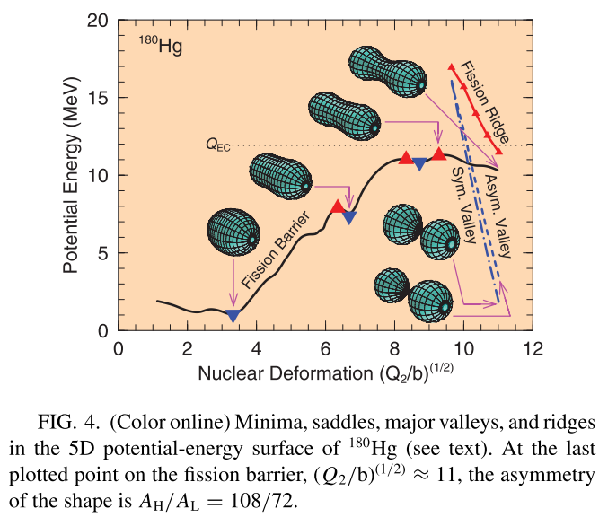
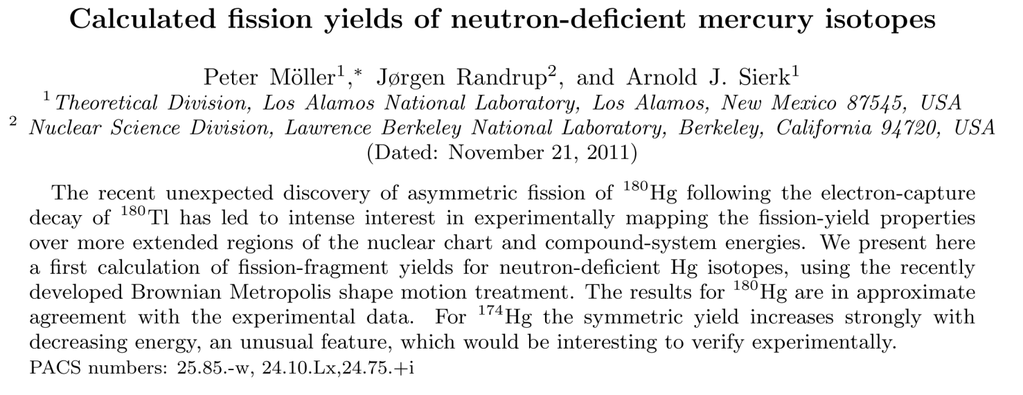
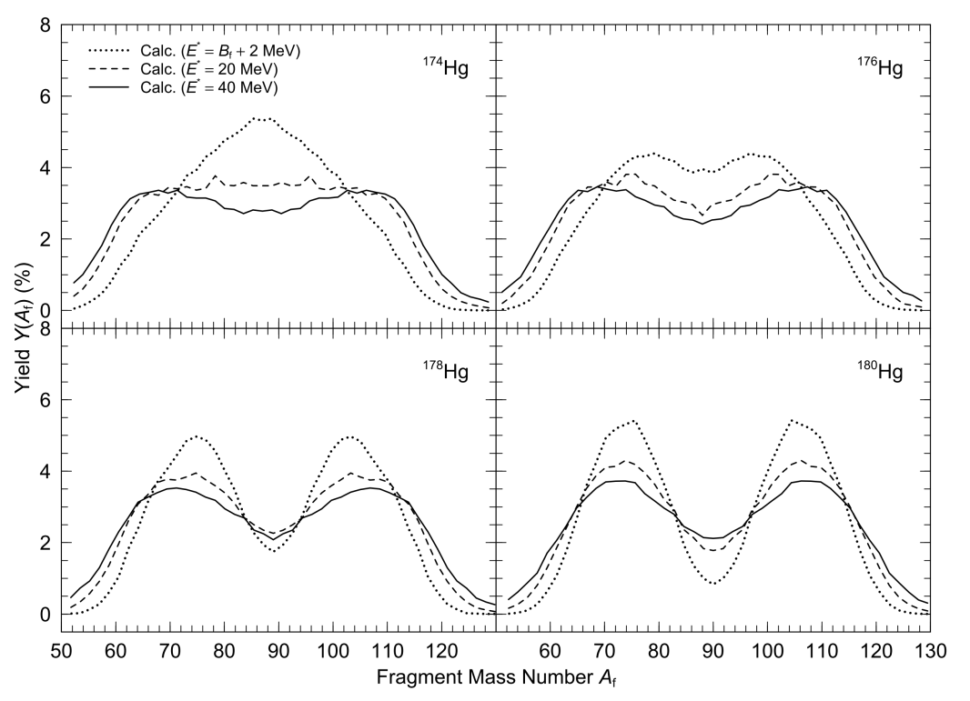
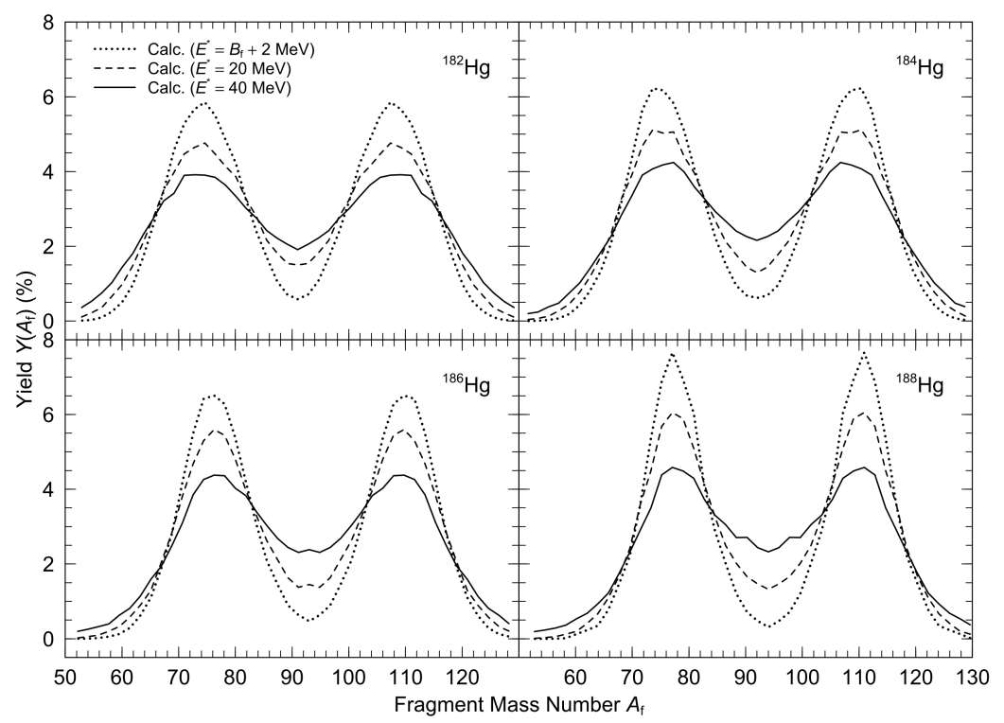
Brownian Metropolis Shape Motion based on J. Randrup and P. Moller, PRL 106, 132503 (2011)
Phys. Rev. C 85, 024306 (2012)
¹⁸⁰Hg

Slide 19
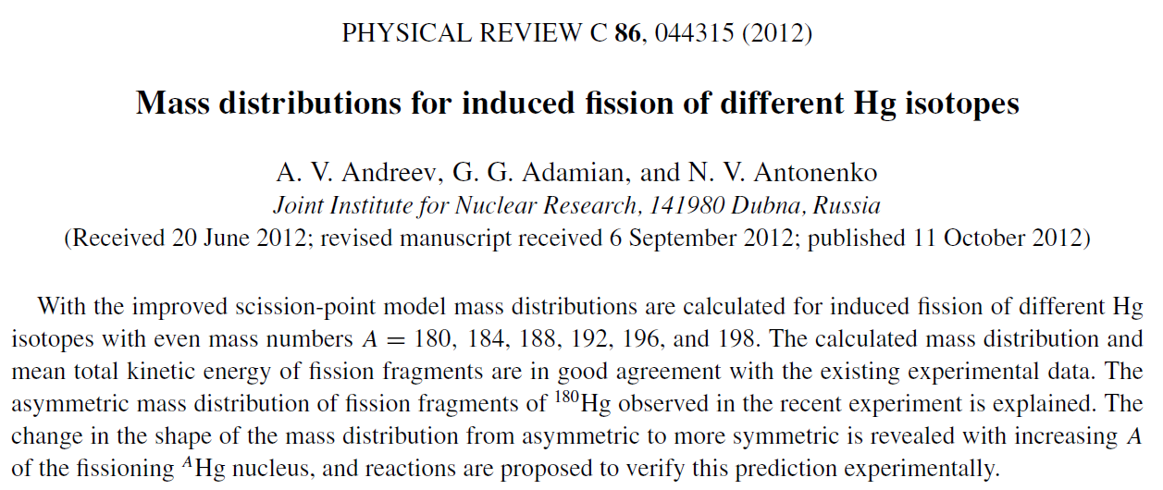
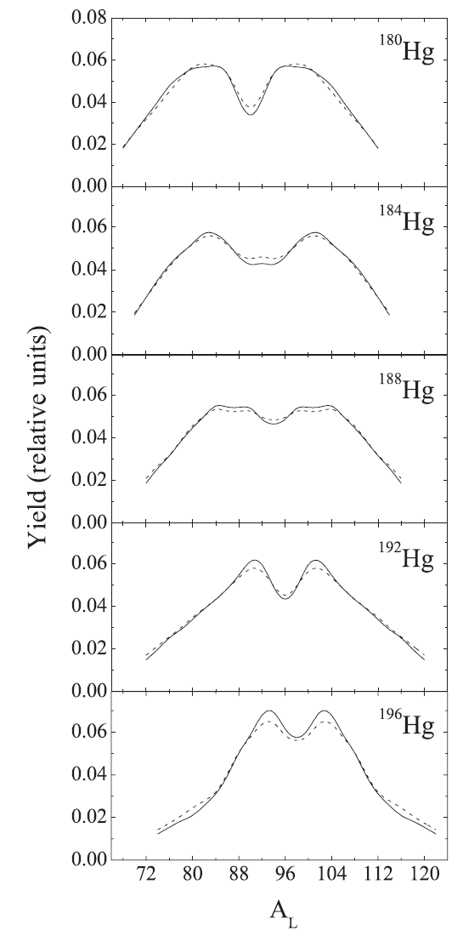
‘Improved’ Scission-Point Model
¹⁸⁰Hg
asymmetric
Inter-fragment distance is not fixed and calculated.
values of ~0.5-1 fm result (Wilkins – fixed at 1.4 fm)
Mass symmetry/asymmetry doesn’t change as a function of E* (up to E*~60 MeV) – good for future experiments
Symmetric!

Slide 20

SPY self-consistent Scission-Point Model

Slide 21
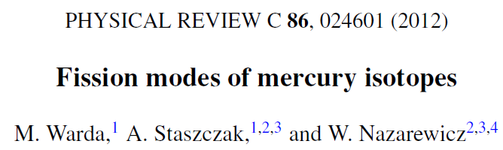
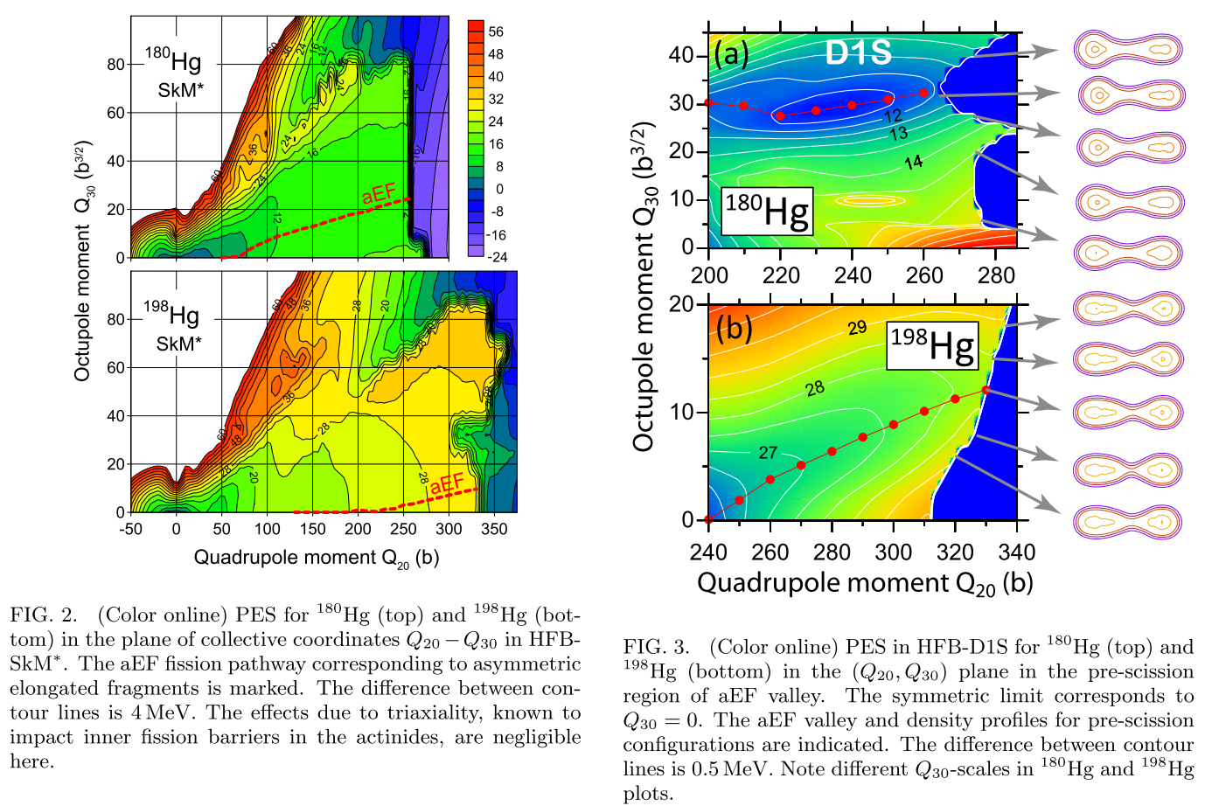
Mean-field HFB+Gogny D1S/SkM*

Slide 22
Octupole shapes of fission fragments as a culprit for mass-asymmetry?
G. Scamps, C.Seminel, Nature 564, 382–385 (2018)

Slide 23
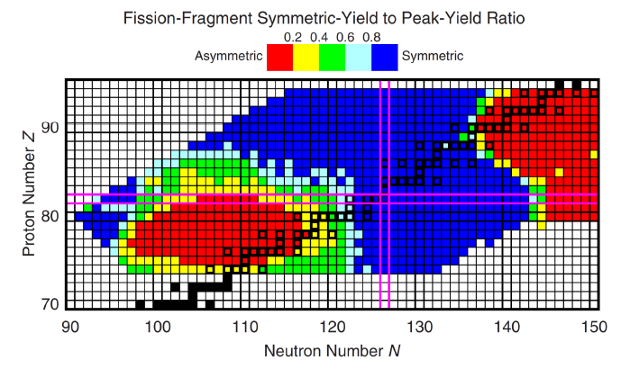

From Asymmetry to Symmetry
¹⁸⁰Hg
Heavy Actinides, N/Z~1.56: predominantly asymmetric;
spontaneous fission, fission isomers
Lightest Hg isotopes with
N/Z~1.25: asymmetric
P. Moller, J. Randrup, PRC91,944316(2015)
Z=82
Z=82
Z=82
Z=82
^{178,180}Hg
- particle induced
x - e.m. –induced E*~11 MeV
ISOLDE
¹⁸⁷Ir
¹⁹⁸Hg
Pre-actinides, light Ir-Th N/Z~1.4-1.5:
predominantly symmetric, e.g. FRS(GSI)
A.N. Andreyev, K. Nishio, K.-H. Schmidt, Reports on Progress in Fission, 1, (2018)

Slide 24
From Asymmetry to Symmetry
¹⁸⁰Hg
ISOLDE (CERN), SOFIA(GSI):
Asymmetry - symmetry – asymmetry transition
JAEA,ANU,Dubna,Delhi…
Inside the asymmetry island
P. Moller, J. Randrup, PRC91,944316(2015)

Slide 25
Back to classics: fission in d,pf approach
1970’ies: d,pf in direct kinematics with stable/long-lived targets
2020’ on..: d,pf in inverse kinematics with post-accelerated (7-10 AMeV) RIBs at ISOLDE
Notes:
I will show the normal kinematic study of fission
This is the ealier fission barrier studies with direct neutron transfer reactions.
They measured the cross sections of (d,p) reaction and (d,p+fission) reaction.
they made the ratio of these cross section, then the fission barrier height was decided.
Right figure is similar experiment. They decided the fission barrier for U and Pu
In order to decide the fission barrier height, we have to measure the fission probability as a function of excitation energy.
5 min

Slide 26
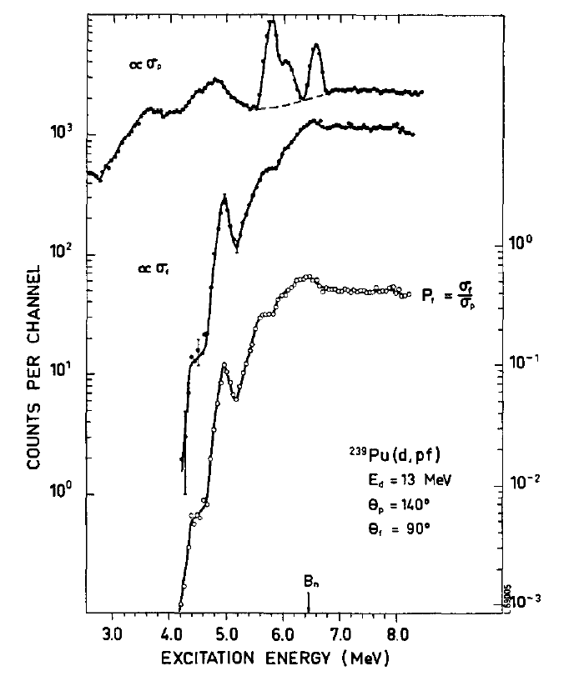
Fission probability as a function of E* : direct nucleon transfer, e.g. (d,pf) reactions with stable/long-lived targets.
1970’ies: Classical fission studies in d,pf approach: determination of fission modes and fission barriers
d+²³⁹Pu->²⁴⁰Pu*+p-> 2FF+p
Allows to deduce e.g. the fission barrier height (with some assumptions), also mass distributions
ϭ_{p}
(d,p)
C O
Ϭ_{f}
(d,pf)
P_{fis}(E*)=
Ϭ_{f}/ϭ_{p}
B_{f}
B.B. Back et al.; Nucl. Phys. A165 (1971) 449
E. Konecny et al.; Phys. Lett. B 45 (1973) 329

Slide 27
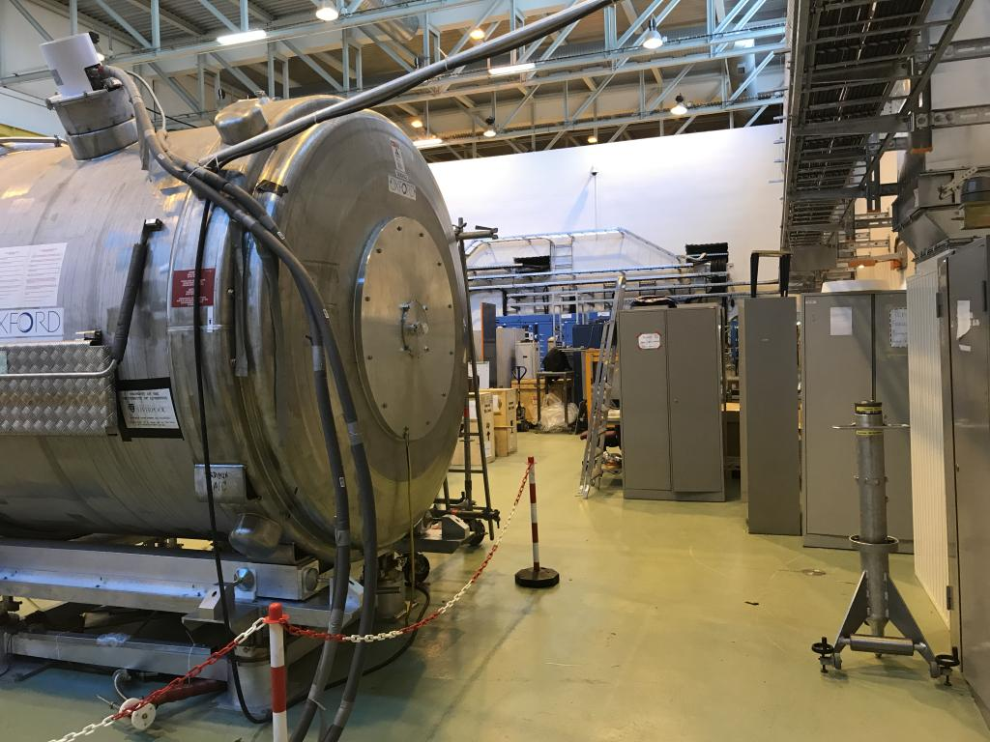
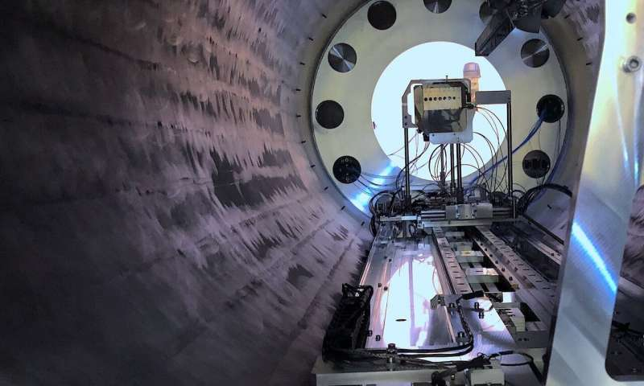
d,pf transfer-induced fission of post-accelerated RIBs in inverse kinematics with ISOLDE Solenoid (ISS-ISOLDE)

Slide 28
Proof of principles (ANL-ISS Collaboration)
PRL, 2023

Slide 29
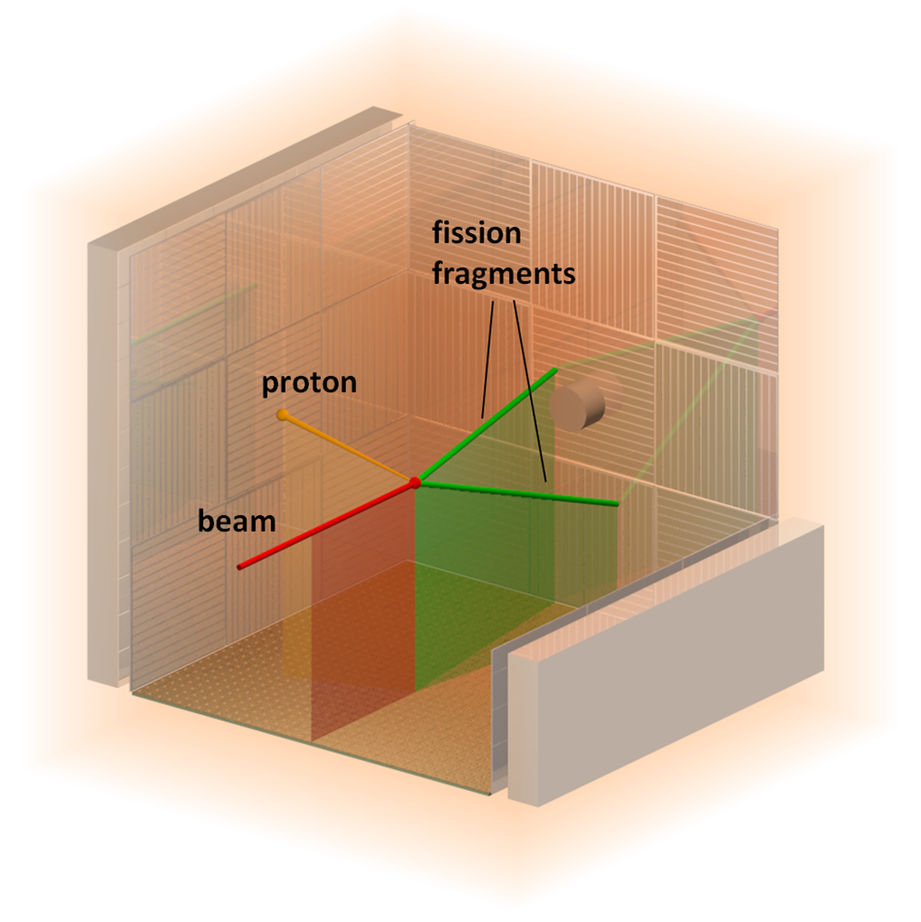
d,pf fission studies with post-accelerated RIBs in inverse kinematics and active gas target
A low-energy (30-60 keV) RIB is produced via usual ISOLDE method e.g. 220Fr in this example.
Then, RIB post-acceleration up to Coulomb energies with HIE-ISOLDE (a few AMeV)
The RIB is sent to ACTAR active target (gas=target) for d,pf measurements, 220Fr+d->221Fr*+p-> 2FF+p
Proton-FFs coincidence measurements in ACTAR
FFs energy boost, better energy/mass resolution
RIB,
e.g. 220Fr
5-10 AMeV

Slide 30
Low-Energy Fission of Relativistic RIBs in inverse kinematics at GSI and RIKEN
(Coulex-induced and p,2pf reactions)
Some of the Main advantages:
fission fragments are at much higher energies (~200-600 AMeV), thus much easier to identify their A and Z.
Emission of neutrons (neutron multiplicity) is easier to study (due to their kinematic focusing)
BUT: Needs a much more complex production method and detection system (e.g. R3B, SAMURAI)

Slide 31
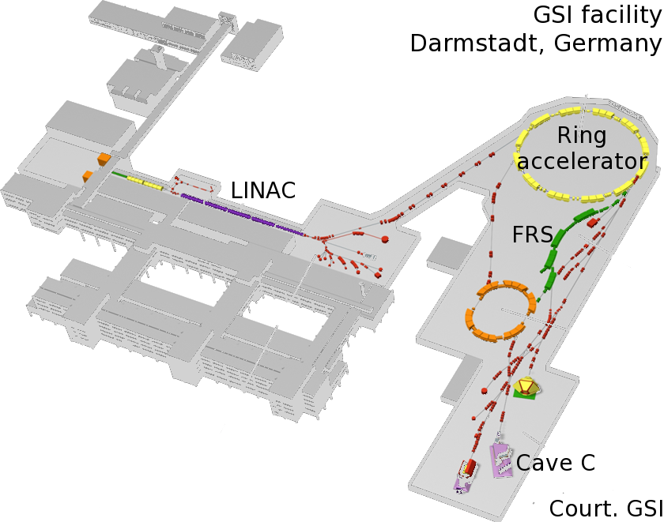
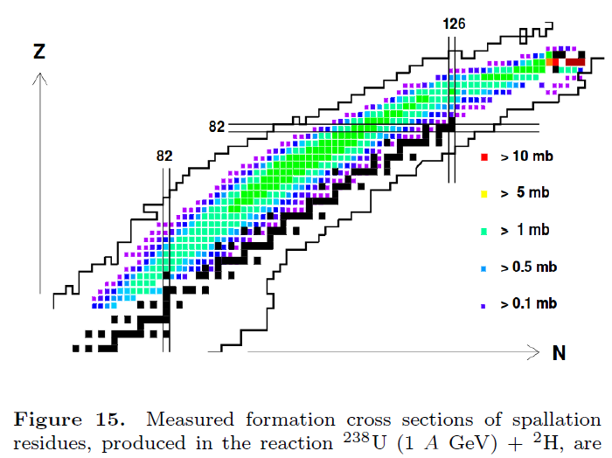
Two-step production at SOFIA@GSI
Primary beam of ²³⁸U, 1 A GeV
Fragmentation reaction on a light target, e.g. Be: produces secondary beam of fissile ions at ~700 AMeV (from Mercury up to Neptunium), sorted through FRS
Selected secondary ions from FRS sent to Cave C for the fission experiment
Fission induced in-flight by Coulomb excitation on a heavy secondary Pb target (E*~12 MeV)
Both fission fragments identified simultaneously, both in mass and in charge (FF’s are at ~600 AMeV!)

Slide 32
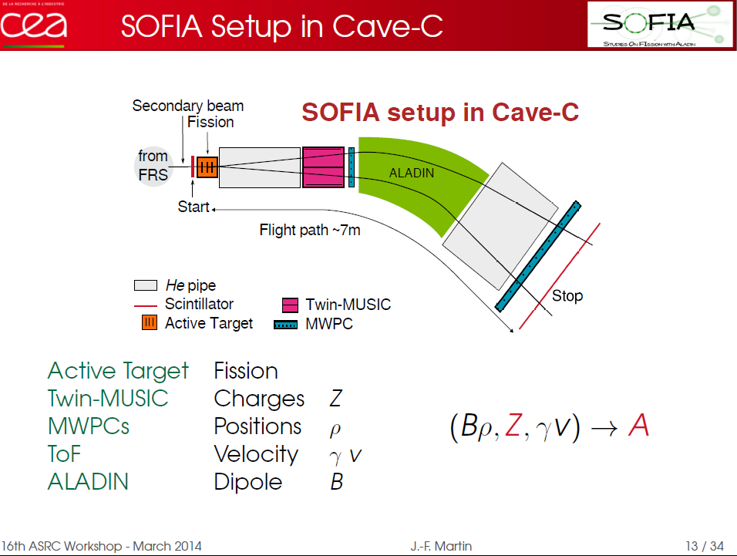
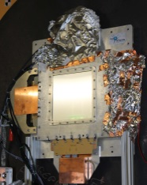
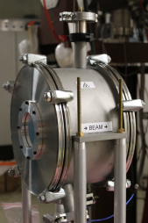
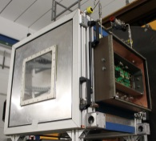
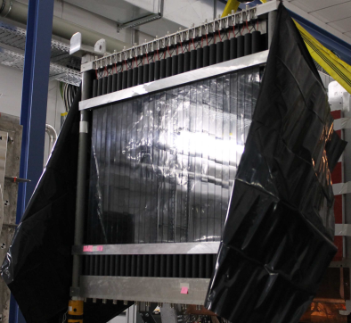
FF’s >300 AMeV
~700 AMeV
RIBs from FRS

Slide 33
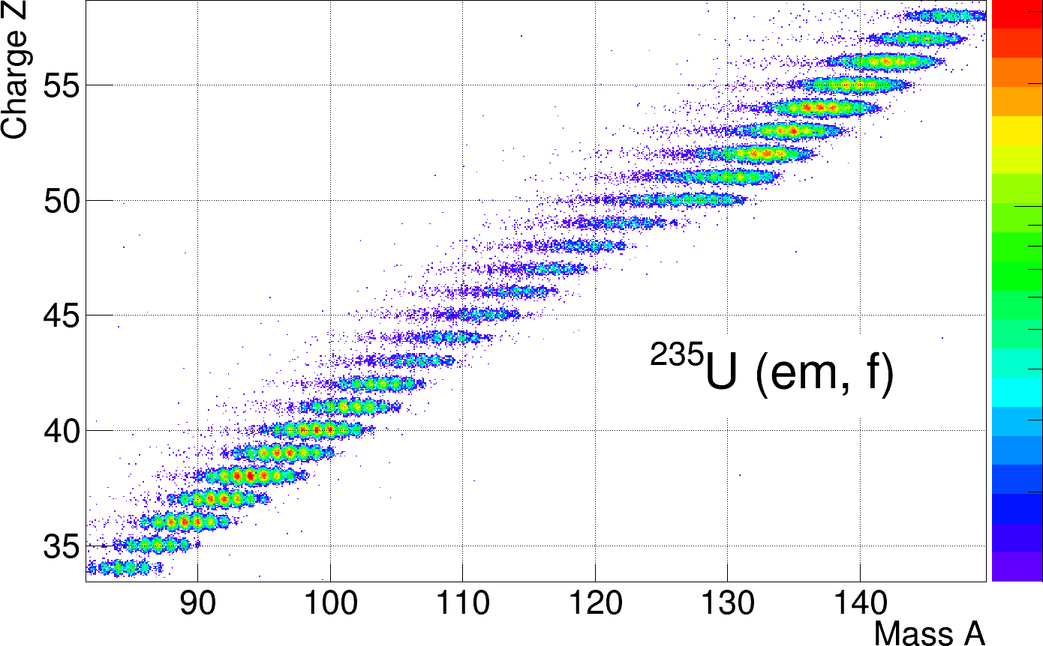
Result? Fantastic A and Z resolution, hardly achievable by other techniques!
E*~12 MeV
Heavy fragments group
Light fragments group

Slide 34
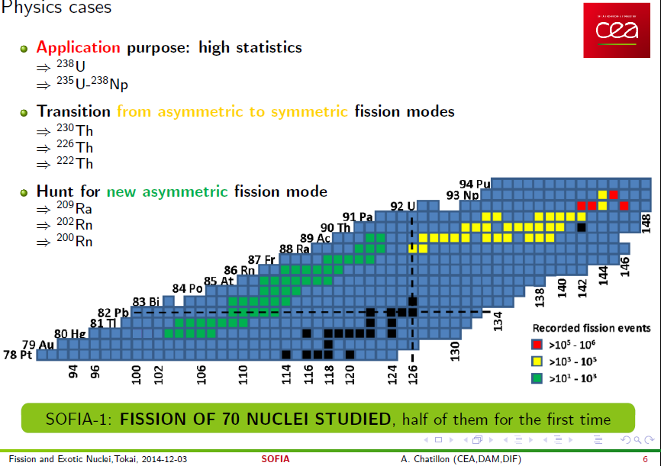
Physics cases of the SOFIA experiment
~2 days
a few hours

Slide 35
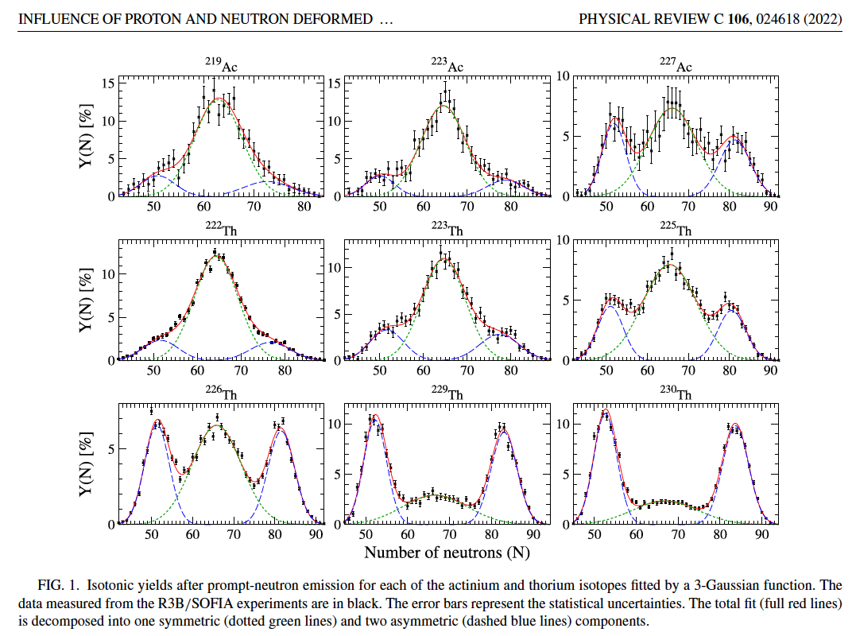
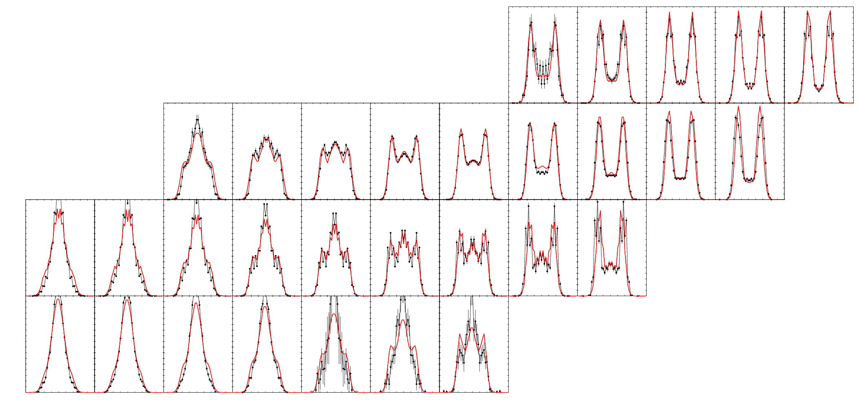
Recent Fission of secondary beams after the EM excitation: Detailed studies of multi-modal fission
Black - experiment (Schmidt et al, NPA 665 (2000))
Red - calculations
asymmetric
₉₂U
₉₁Pa
142
multimodal
140
141
₉₀Th
symmetric
138
139
₈₉Ac
With the same parameter set for all nuclei!
131
132
133
134
135
136
137
A. Chatillon et al. Phys. Rev. Lett. 124, 202502 (2020)
A. Chatillon et al., PHYSICAL REVIEW C 106, 024618 (2022)

Slide 36

Recent Fission of secondary beams after the EM excitation: Z=54 dominance in heavy nuclei

Slide 37
Fission in 21st Century: Some of the topics covered
Beta-Delayed Fission at ISOLDE (CERN) at 60 keV
d,pf transfer–induced fission with post-accelerated RIBs at 5-7 AMeV
Coulex-induced fission with SOFIA@GSI at 1 AGeV
Spontaneous fission (SF) in heavy/SHE nuclei
Fusion-fission with heavy ions at Coulomb energies (Dubna, ANU, India..)
Transfer-induced fission at Coulomb energies (VAMOS@GANIL, JAEA)
n_ToF, n-induced fission experiments (ILL,n_ToF, LANSCE,J-PARC….)
Angular momentum generation in fission
Future techniques: Photofission at ELI-NP with CBS-technique
Future techniques: Fission in collision geometry with electrons (SCRIT@RIKEN)?
p,2pf studies at 300 AMeV at SAMURAI-RIBF@RIKEN (also GSI)
Thank You for your Attention!
Bright future for fission studies with RIBs
Access to both proton- and neutron- rich nuclei
Unprecedented precision in Z,A determination!
Control of excitation energy event-by-event!
However, still the ‘classical’ methods work and allow to study both the isospin and excitation dependence of fission in the ‘new’ regions of Chart of Nuclides

Slide 38
Summary: Present Status of Fission Mass/Charge distribution measurements
A.N. Andreyev, K. Nishio, K.-H. Schmidt, Reports on Progress in Physics, 1 (2018)

Slide 39
Excitation Energy in Coulex-induced fission
Low-energy excitation, on average E*~12 MeV (but no “fine” control of E*)
Thus shell effects must be conserved
Can’t be applied for nuclei with high fission barrier (>12 MeV or so)

Slide 40
What are (typical) observables in fission?
Half-lives (e.g. for SF – from ms to billions of years)
Fission fragments mass and charge distributions (symmetric, asymmetric, multimodal)
Kinetic energies of FFs’, & their sum – Total Kinetic Energy(TKE)
Prompt neutron and γ-ray multiplicities, energies of γ’s and n’s
Fission barrier height (a derived value! Can’t be measured directly)
NB: typical FFs energies in SF or in d,pf are ~1 AMeV, difficult to measure with sufficient precision, mass resolution is 3-4 u. Can be overcome in inverse kinematics – the modern approach.

Slide 41
ISOLDE Target Unit
Proton beam

Slide 42


The ISOLDE facility at CERN
HRS Target
1.4 GeV Protons
From PSB
RILIS
GPS Target
WISARD
NICOLE
TAS
VITO
collections
MINIBALL
MR-ToF
Windmill
IDS
CRIS
COLLAPS

Slide 43

Resonance Laser Ionization of an Atom
ν₁
A,Z

Slide 44
Extensive βDF program at ISOLDE (Tl-Bi-At-Fr): first glance in multimodal fission in the neutron-deficient lead region
L.Ghys et al., PRC90 (2014)
J. D. McDonnell et al, PRC90, 2014
One of the main issues: poor FF’s mass resolution (~4 u) and absence of Z data
Typical for most of ‘low-energy’ fission studies (eg. SF), FF’s energies ~ 1AMeV
Need precise measurements of Z and A: e.g. SOFIA@GSI to rescue?!

Slide 45
Outlook: Why ‘new regions of fission’?
Many nuclear properties change far from stability line (e.g. disappearance of traditional magic numbers, appearance of new shell gaps, halos, skins…)
What happens to fission e.g. on the extremely neutron-rich or proton-rich sides? (isospin dependence of fission, r-process…)
Not simple to answer, as to fission these nuclei at low excitation energy (E*~B_{f}) is a very challenging task (most of them do not fissions from g.s.) – need data at low energy (SF, beta-delayed fission, n-induced fission)

Slide 46
Fission of secondary beams after the EM excitation
Detailed studies of multi-modal fission
Black - experiment (Schmidt et al, NPA 665 (2000))
Red - calculations
asymmetric
₉₂U
₉₁Pa
142
multimodal
140
141
₉₀Th
symmetric
138
139
₈₉Ac
With the same parameter set for all nuclei!
131
132
133
134
135
136
137

Slide 47


Fission-Fragment Detectors for ISS@ISOLDE
FiFI@ISS
SED MCP for ns FF timing
Bragg ion chamber for FF energy measurement (~1MeV Resolution)
Proton
Recoil Detector
FF
SED
Recoil
~9 MeV/u
BRAGG

