Slide 1
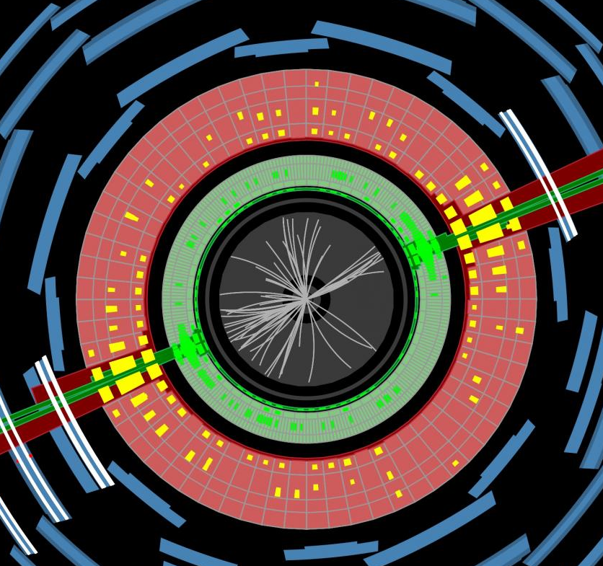


YoungSt@rs
19/10/2023
Jon Butterworth
What Contur can (and cannot?) do
…for a strongly interacting Dark Sector.

Slide 2
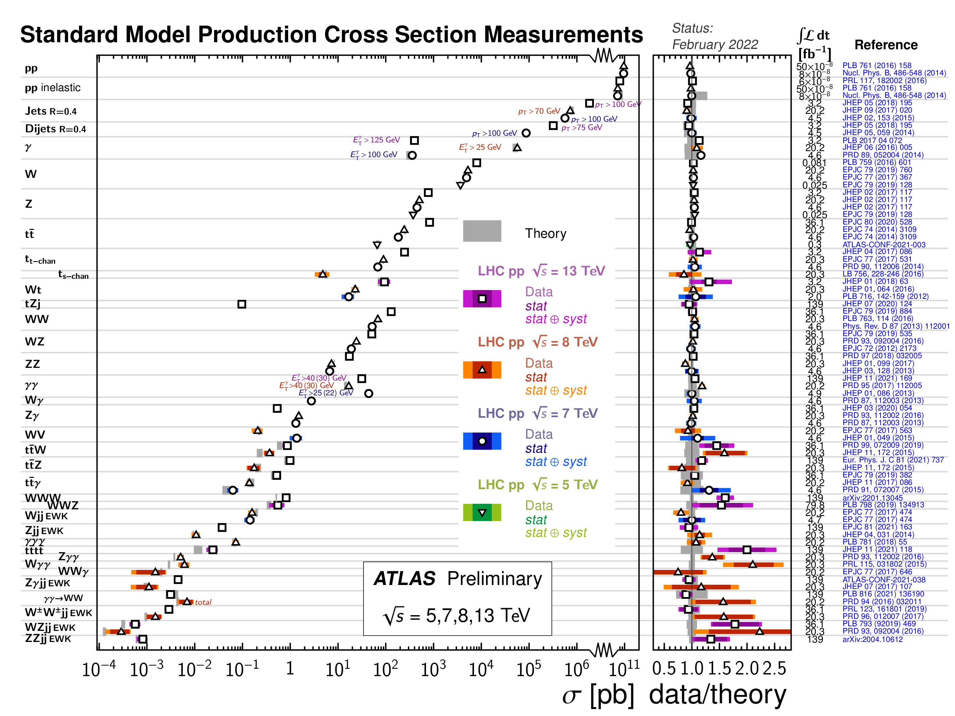

Slide 3
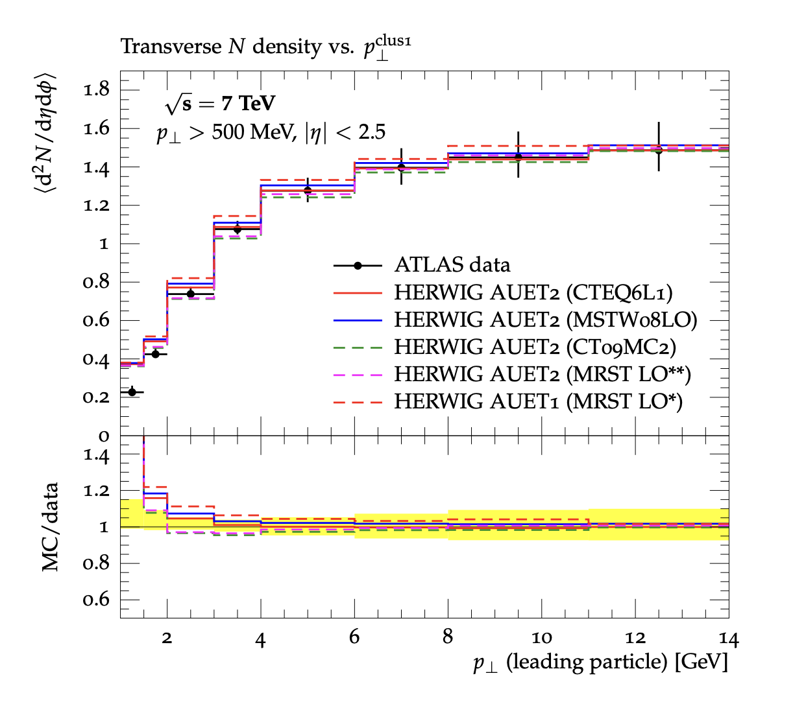
Introducing Rivet
“Robust Independent Validation of Experiment and Theory”
Direct legacy from HERA (1990s, HZTOOL)
Developed by MCnet for tuning and validation of new MC event generators
  e.g. What does the underlying event look like in 7 TeV pp collisions?
Vast library of measurements of final state particles produced in collisions, and variables derived from them
Buckley et al, Bierlich et al arXiv:1003.0694 (CPC), arXiv:1912.05451 (SciPost)
From ATL-PHYS-PUB-2011-008

Slide 4
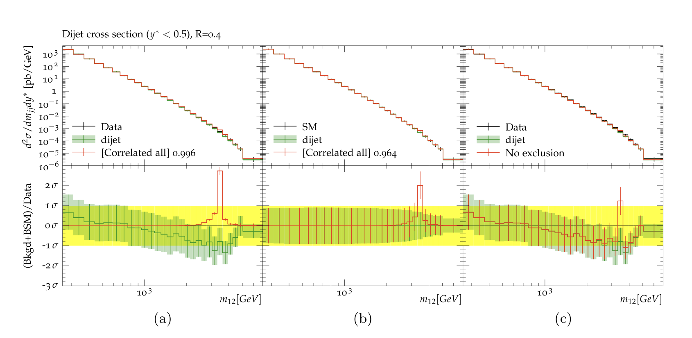
Introducing Contur
“Constraints On New Theories Using Rivet”
Extend the power of Rivet beyond the Standard Model
Signal-injection of final-state particles from Beyond-the-SM physics events on to the measured cross sections in Rivet
From Altakach, JMB, Ježo, Klasen, Schienbein arXiv:2111.15406 (SciPost Core)
Increasingly precise measurements and calculations together extend the reach
JMB, Grellscheid, Krämer, Sarrazin, Yallup; Buckley et al
arXiv:1606.05296 (JHEP), arXiv:2102.04377 (SciPost)

Slide 5
A Contur-friendly measurement
Is unfolded to particle-level
Is defined in terms of the final state, not production process
Has a fiducial phase space which is as inclusive as possible and reflects the actual selection
  No hidden vetos
  Minimal extrapolations
For example:

Slide 6
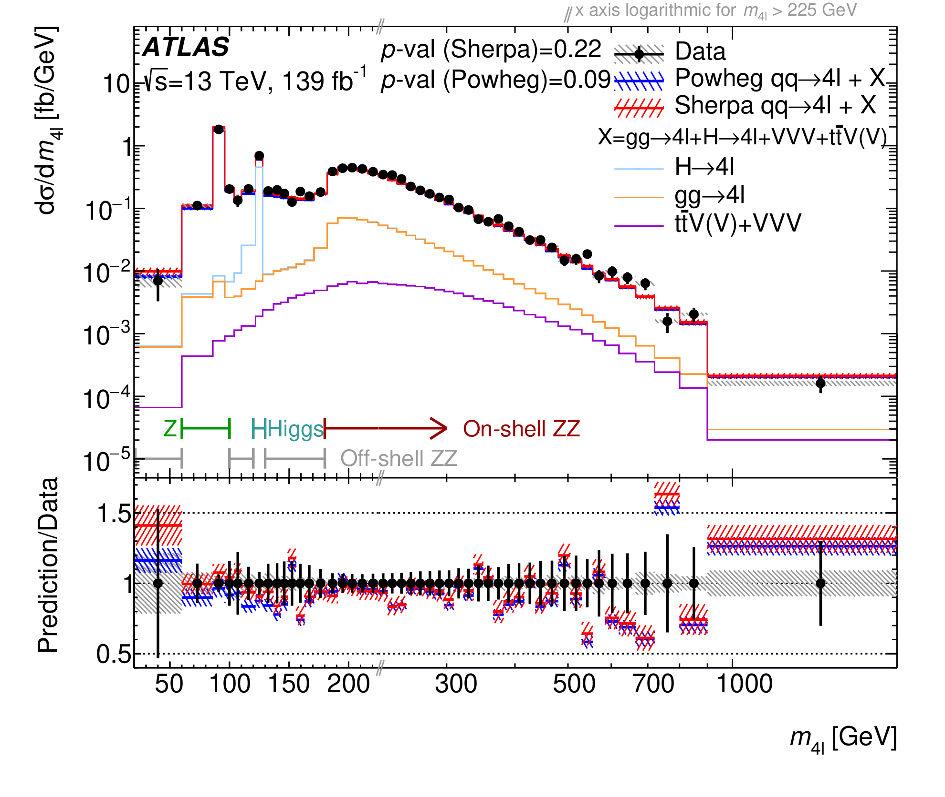
arXiv:2103.01918 (JHEP)

Slide 7
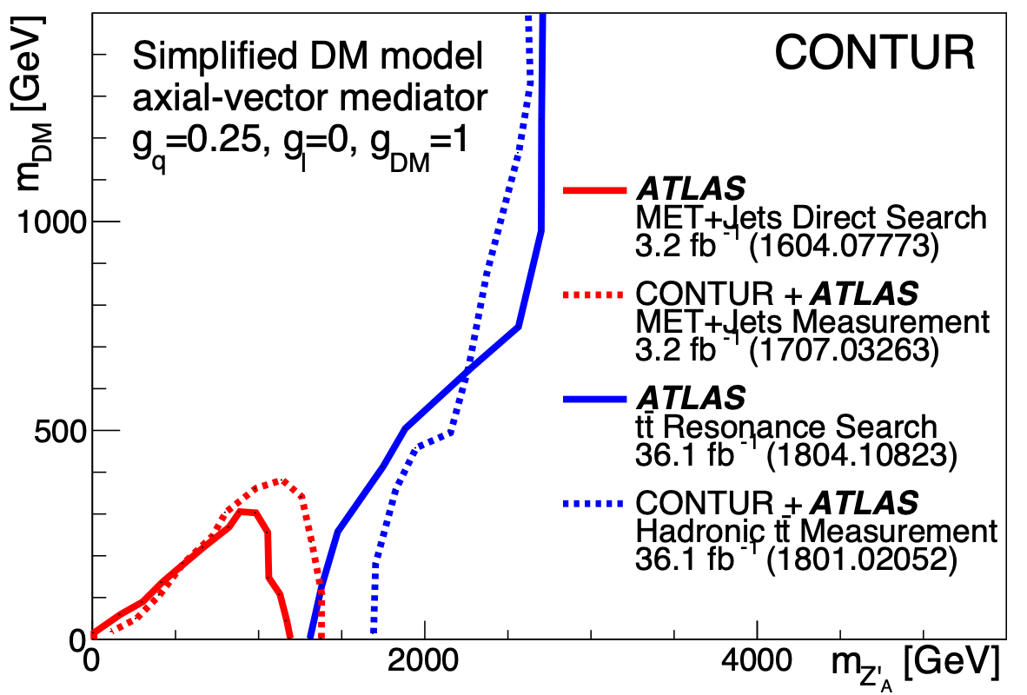
Unleashing the power of high luminosity LHC data
(some example case studies)
Composite Dark Matter
Custodial Symmetry breaking
EW Supersymmetry with a light gluino
Louie Corpe

Slide 8
Composite Dark Matter Models
What if Dark Matter is a composite particle arising from e.g. an SU(4) symmetry which confines at some scale Λ_{dark}?
Leads to bound states ”dark” mesons and baryons.
  Kribs et al. arXiv:1809.10183 (JHEP)
Dark fermions transform under electroweak part of the Standard Model: communication with SM
There are no direct searches* for this model by ATLAS or CMS:
instead to constrain this model using the bank of existing LHC measurements using Contur
Dynamics of the theory depend a lot on 𝜂=𝑚(𝜋_{𝐷})/𝑚(𝜌_{𝐷})
JMB, Corpe, Kong, Kulkarni, Thomas. arXiv:2105.08494 (PRD)

Slide 9
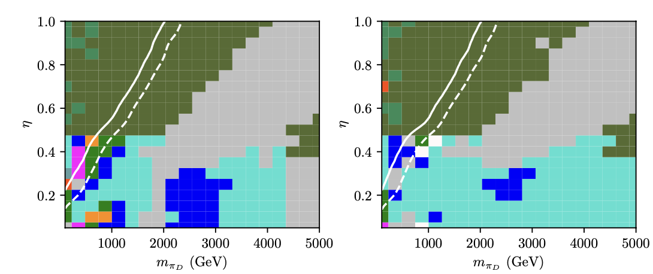
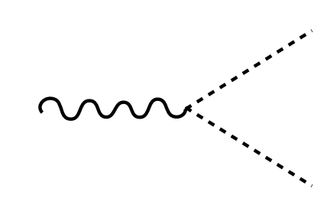
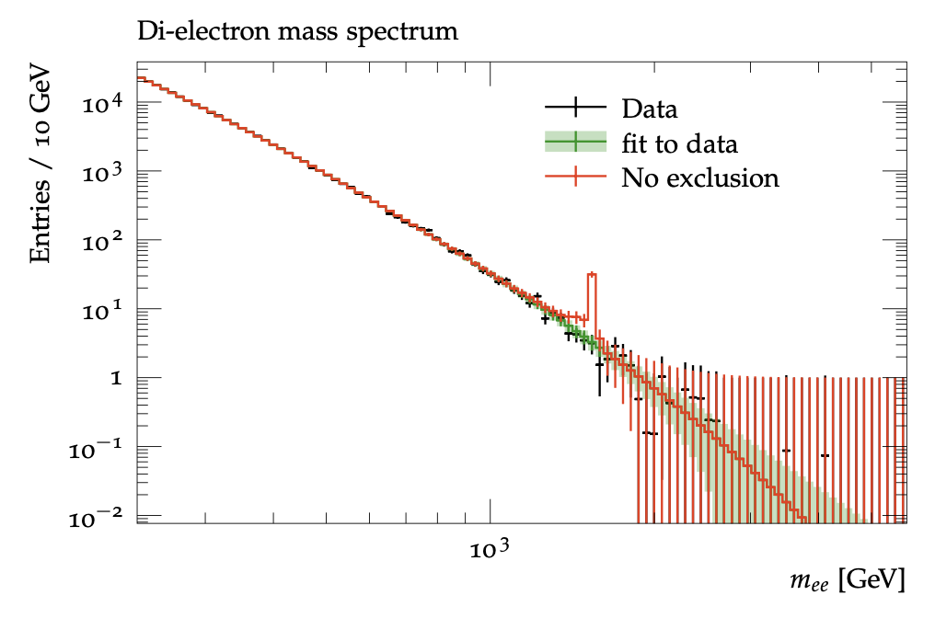
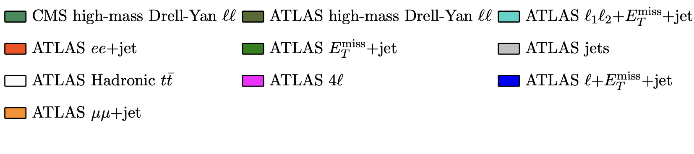





Composite Dark Matter Models
Left-handed model
ρ⁰D, ρ⁺D, ρ⁻D
Right-handed model
ρ⁰D only
$$p$$
$$l^{±}$$
$$ρ_{D}^{0},ρ_{D}^{±}$$
$$p$$
$$l^{±}$$
JMB, Corpe, Kong, Kulkarni, Thomas. arXiv:2105.08494 (PRD)

Slide 10
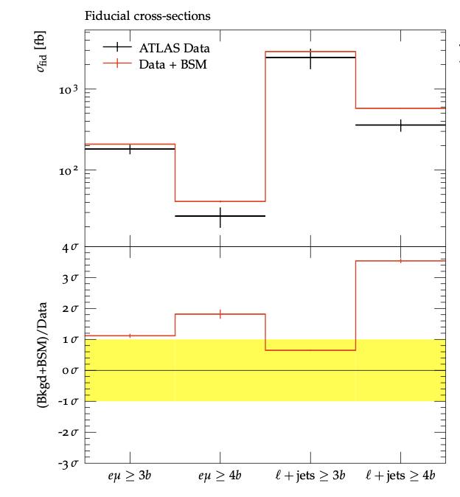
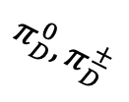
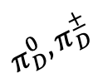



Composite Dark Matter Models
Left-handed model
ρ⁰D, ρ⁺D, ρ⁻D
Right-handed model
ρ⁰D only
$$p$$
$$π_{D}^{0},π_{D}^{±}$$
$$ρ_{D}^{0},ρ_{D}^{±}$$
$$π_{D}^{0},π_{D}^{±}$$
$$p$$
JMB, Corpe, Kong, Kulkarni, Thomas. arXiv:2105.08494 (PRD)

Slide 11
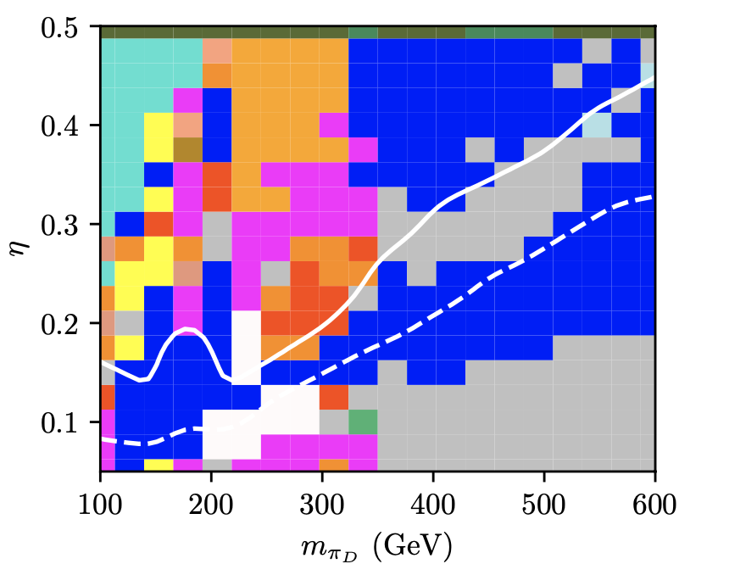
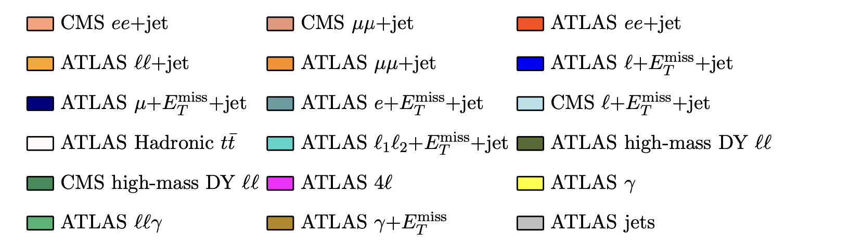
Composite Dark Matter Models
Large areas excluded:
  When pion mass is close to Higgs mass, H→γγ analysis contributes
  Boosted hadron ”top” measurements contribute when pion mass ~200 GeV: Pions decay to tb and are boosted from heavy ρ.
  Other sensitivity from Z-pole dileptons, and lepton+missing energy (Z, top, W production in decay chains)
Left-handed model
ρ⁰D, ρ⁺D, ρ⁻D
JMB, Corpe, Kong, Kulkarni, Thomas. arXiv:2105.08494 (PRD)

Slide 12
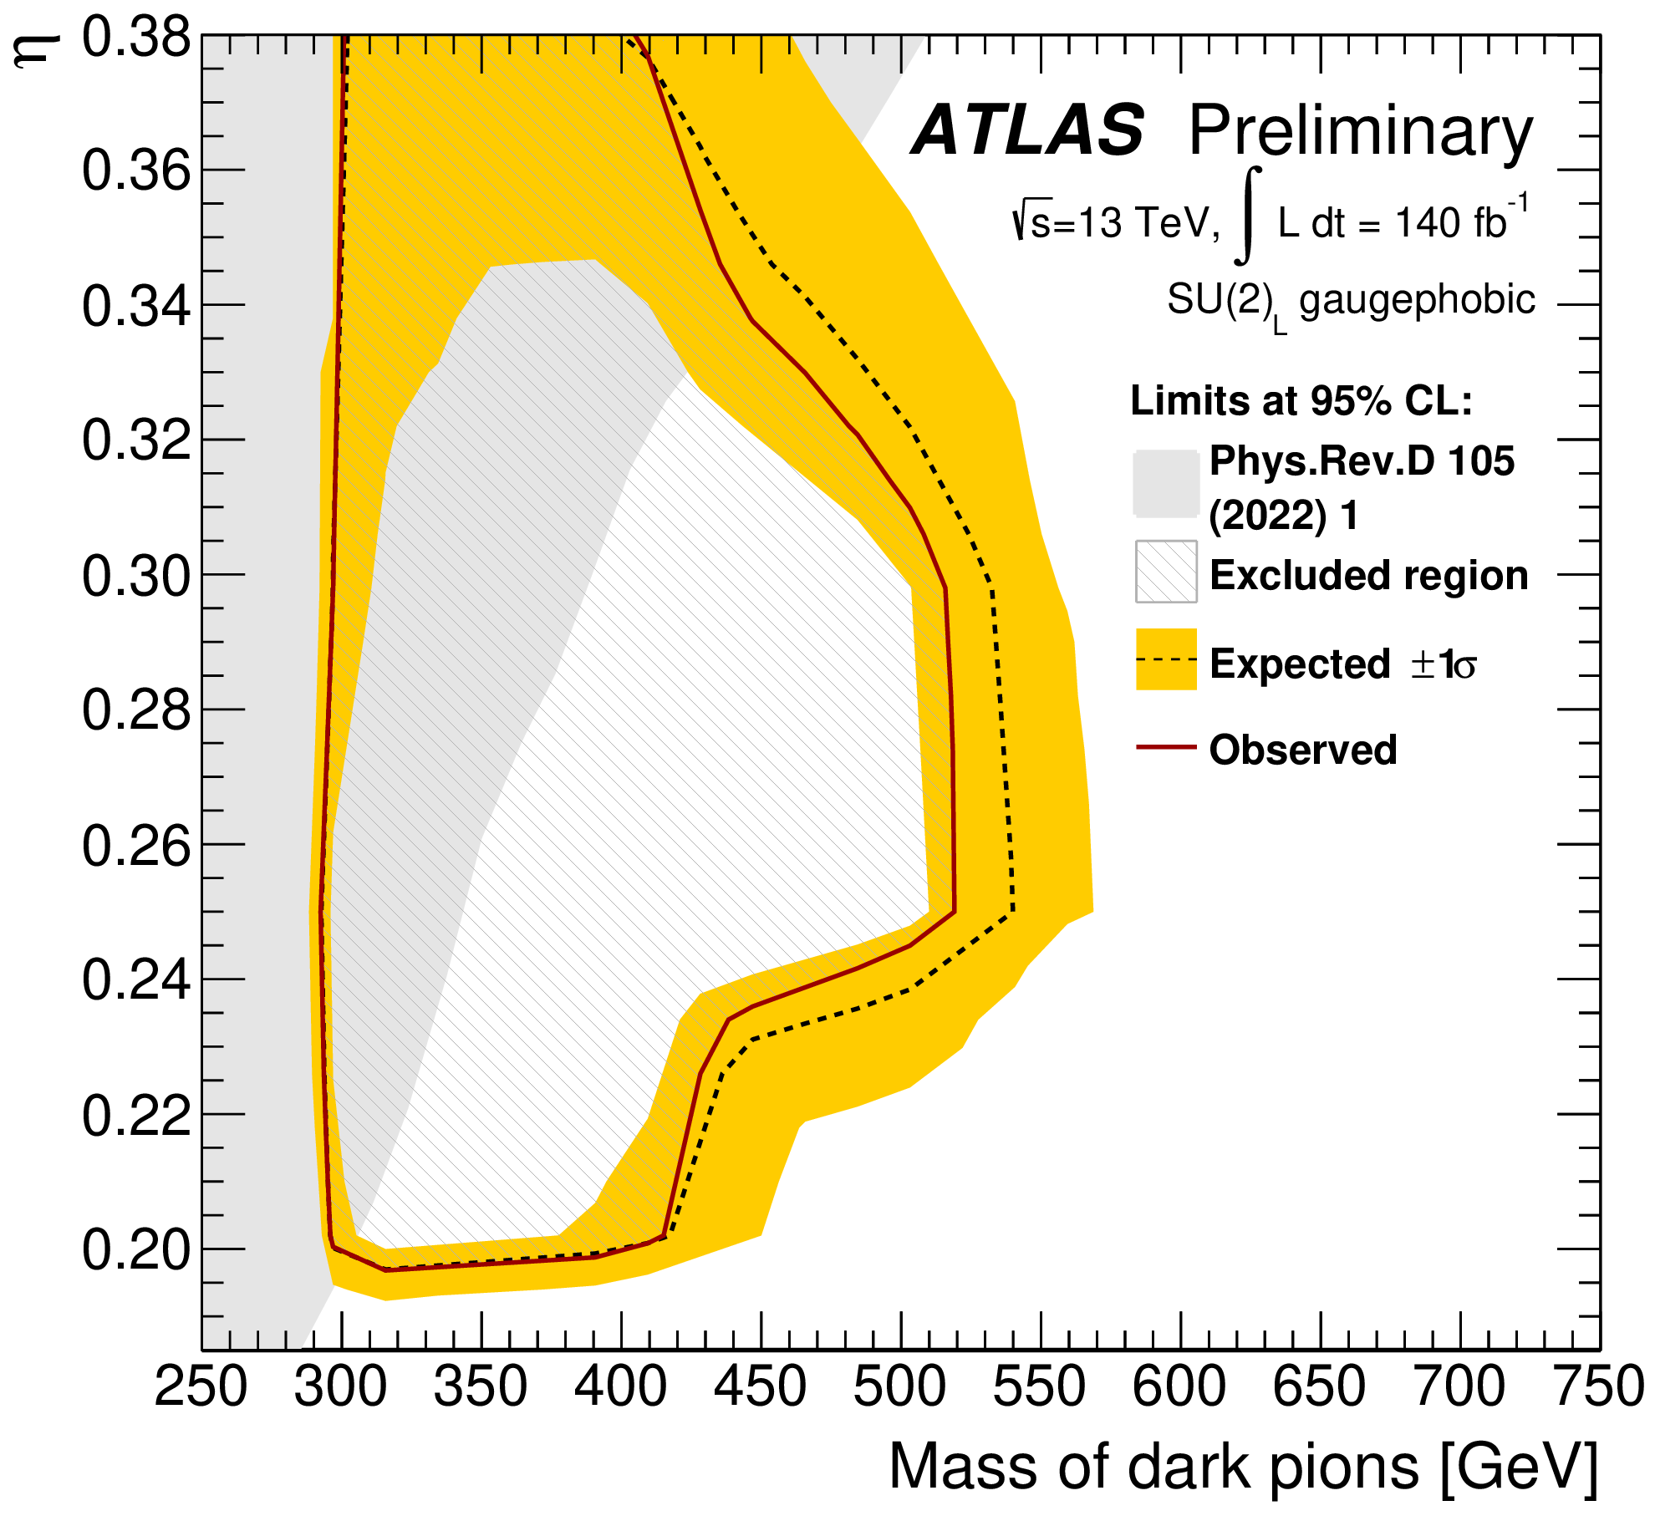
Composite Dark Matter Models
* Dedicated ATLAS search for same model:
  Focused on top and bottom final states
  Released this summer for conferences
  Extends the region already excluded by measurements, but doesn’t cover it all
ATLAS-CONF-2023-021

Slide 13
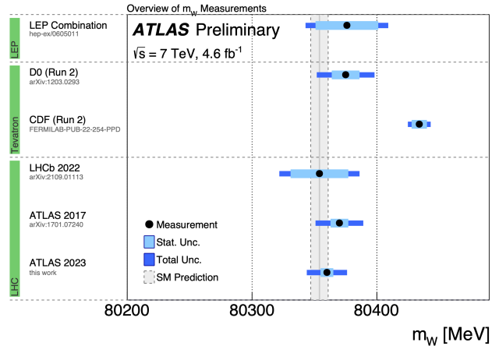
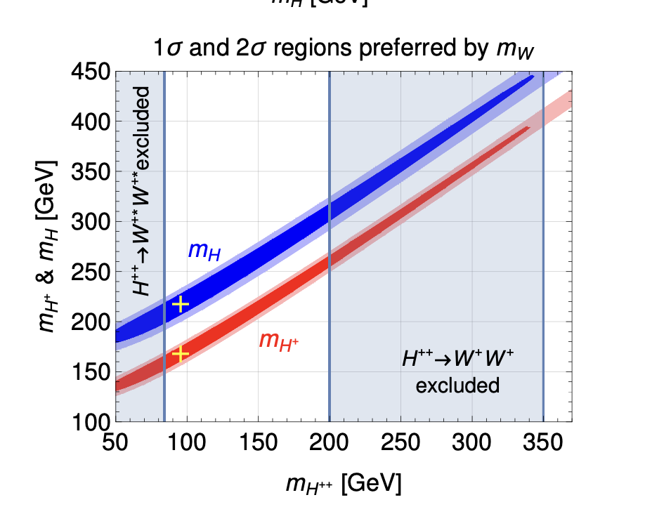
W Mass & Custodial Symmetry
Numerous possible explanations (not all BSM!)
Type-II seesaw model is well-motivated by other physics (neutrino masses)
  New scalars ∆±±,∆±,∆⁰,ξ⁰
  Predicts shifts in W/Z mass ratio
  Shift can be negative or positive depending on scalar mass splittings
  Region around 100 < M∆ < 300 GeV explains M_{W}, and evades LFV constraints and LHC searches
Does it survive our “SM” measurements?
J. Heeck, 2204.10274 , PRD

Slide 14
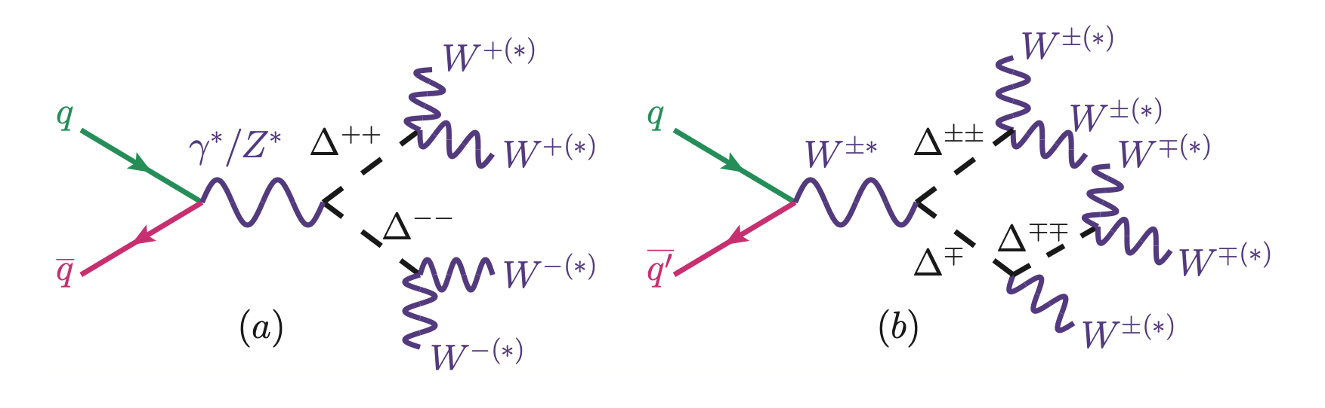
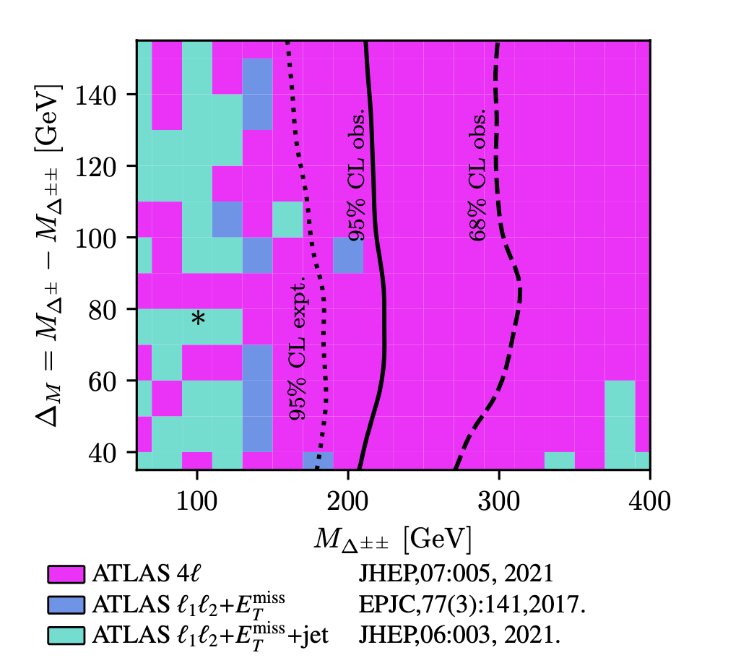
Does it survive our “SM” measurements?
In a word, no.
∆±± production leads to multilepton production
Would have been visible in several ATLAS measurements, most notably inclusive four-leptons
JMB, J. Heeck, S. Jeon, O. Matteler, R. Ruiz 2210.13496 (PRD, accepted)

Slide 15
Another Try
Simplest model that can move M_{W}
  Real scalar triplet: H⁺, H⁻, H⁰.
Still very much allowed, and can also produce a low mass diphoton resonance.
JMB, H Debnath, P Fileviez Perez, F Mitchell arXiv:2309.10027

Slide 16
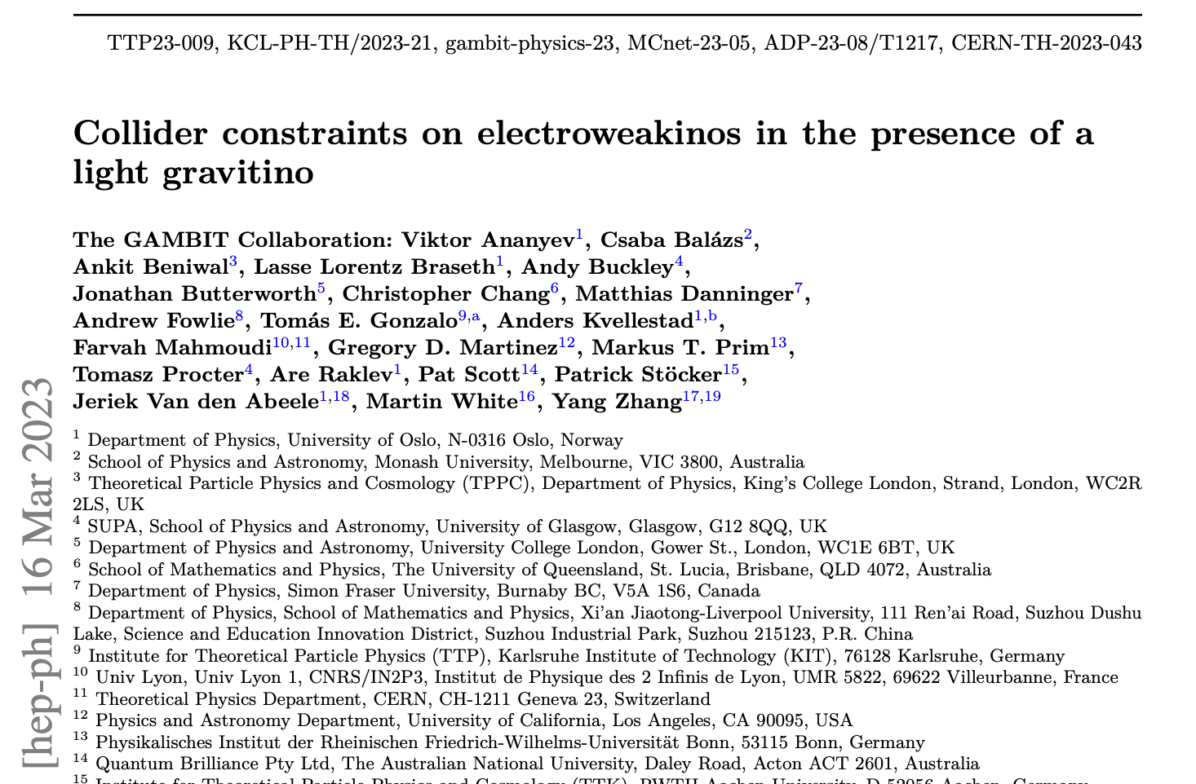
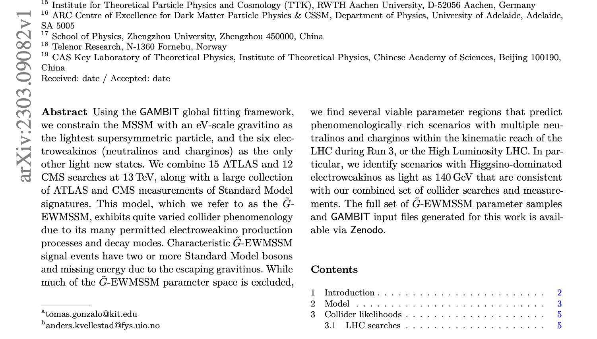
Back to SUSY?

Slide 17
Issues to consider
Contur covers a wide range of final states
  Good for models with a complex or highly variable / qualitative phenomenology
  See https://hepcedar.gitlab.io/contur-webpage/results/index.html
Targetted at final states made up of SM objects
  Is the unfolding, calibration, selection robust for more exotic signals?
    LLP: not at present?
    Emerging jets, semi-visible jets: maybe, but not optimal?
Probably worth a “due diligence” check anyway before embarking on a dedicated search

