Slide 1
Flavour phenomenology of axion-like particles
Open Questions and Future Directions
in Flavour Physics
MITP Scientific Program, JGU Mainz
Marvin Schnubel, BNL
Based on arXiv:1908.00008, 2012.12272, 2102.13112,2110.10698 with M.Bauer, M.Neubert, S.Renner & A.Thamm
arXiv:2403.00913 with M.Neubert
arXiv:2406.19455 with H.Davoudiasl

Slide 2
Motivation
Light and weakly coupled particles are an interesting alternative to heavy new physics with a rich phenomenology!
A spontaneously broken approximate
global symmetry produces light spin-0
particles (Goldstone’s theorem)
Axion-like particles (ALPs)
Ruled out
SMEFT
Couplings
SM + X
Hopeless
SMEFT
Mass of the new particle

Slide 3
Motivation
Direct analogy with pions in QCD, where m_{π} << Λ_{QCD} , we have m_{a} << Λ_{NP}
Many explicit models for ALPs: QCD axion, flavon, familon, combinations like axi-flavon, comp. Higgs…
In a model-agnostic manner we hence write down the most general Lagrangian for an ALP addition to the SM, with a shift symmetry surviving as the remnant of the PQ symmetry.
[Peccei, Quinn (1977)], [Alanne, Blasi, Goertz (2019)], [Gherghetta, Nguyen (2020)]

Slide 4
The ALP Lagrangian
Most general ALP Lagrangian up to dimension 5:
[Georgi, Kaplan, Randall (1986)]
Mass term softly breaks shift symmetry
Normalisation of gauge couplings ensures scale invariance of c_{VV} , but has further consequences

Slide 5
The ALP Lagrangian
Below the EW scale it is often most convenient to use PI & EOM to reformulate ALP-fermion couplings
This shifts the ALP-gauge boson couplings to

Slide 6
Outline
RG running & generation of couplings
Flavour probes
A light PQ scalar?

Slide 7
RG evolution
See also [Choi, Im, Park, Yun (2017)],
[Chala, Guedes, Ramos, Santiago (2020)]
Operators mix under renormalization
RG evolution generates effective couplings at lower energy scales
When a mass threshold is crossed, the respective particle is integrated out and the theory is matched to the lower scale EFT.
Below Λ_{QCD} change to χPT

Slide 8
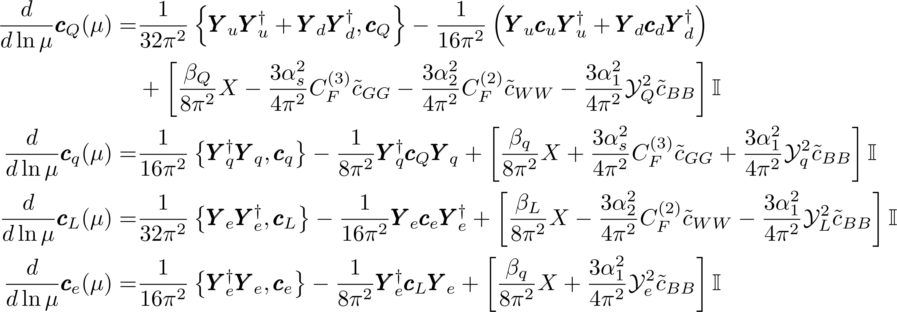
RG evolution
Where

Slide 9
RG evolution
Generate flavour conserving new couplings

Slide 10
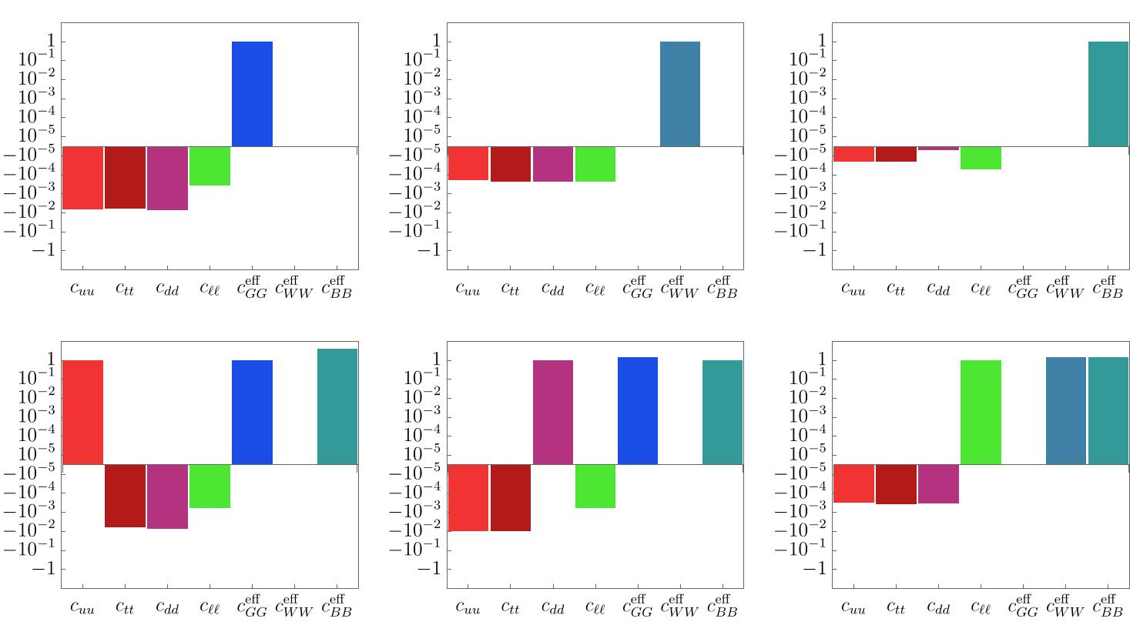
RG evolution
Generate flavour conserving new couplings

Slide 11
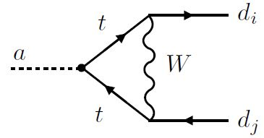
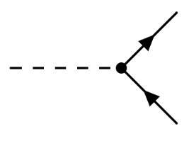
RG evolution
Generate flavour violating new couplings

Slide 12
RG evolution
An ALP coupling to any particle in the UV will generate an effective coupling to all SM particles (including flavour-changing ones)!
Through RG evolution SM features (like flavour violation) that were not present in the original model are imprinted onto the low-energy effective theory!
Flavour violating couplings are highly constrained → can use flavour physics to set bounds on generic ALP models

Slide 13
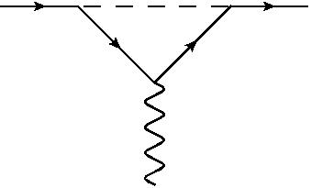
What about leptons?
Lepton flavour is an accidental symmetry of the SM → No generation of LFV through RG evolution
UV LFV couplings can still have implications for flavour conserving observables

Slide 14
A subtlety about gauge boson couplings
For a consistent phenomenological description we need to take certain two-loop diagrams into account when calculating form factors due to our choice of normalisation
Flavour-diagonal case see also: [Buen-Abad, Fan, Reece, Sun (2021)]

Slide 15
A subtlety about gauge boson couplings
Same scaling in

Slide 16
A subtlety about gauge boson couplings
Example: (g-2)_{μ}
1-loop function
2-loop function

Slide 17
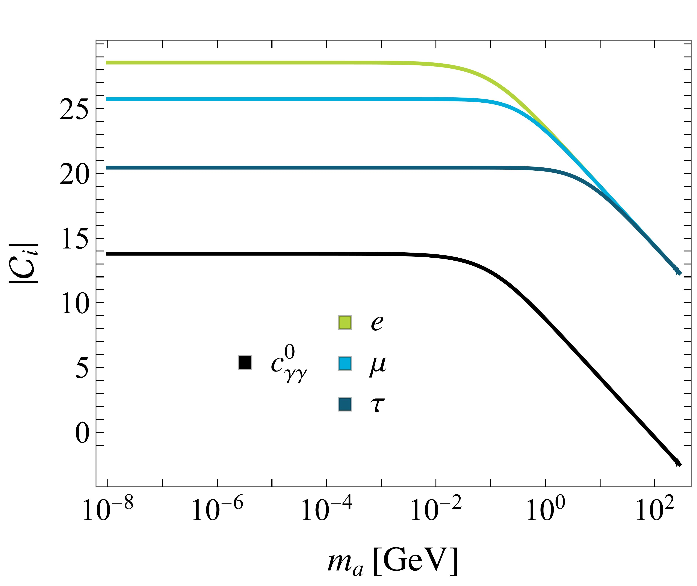
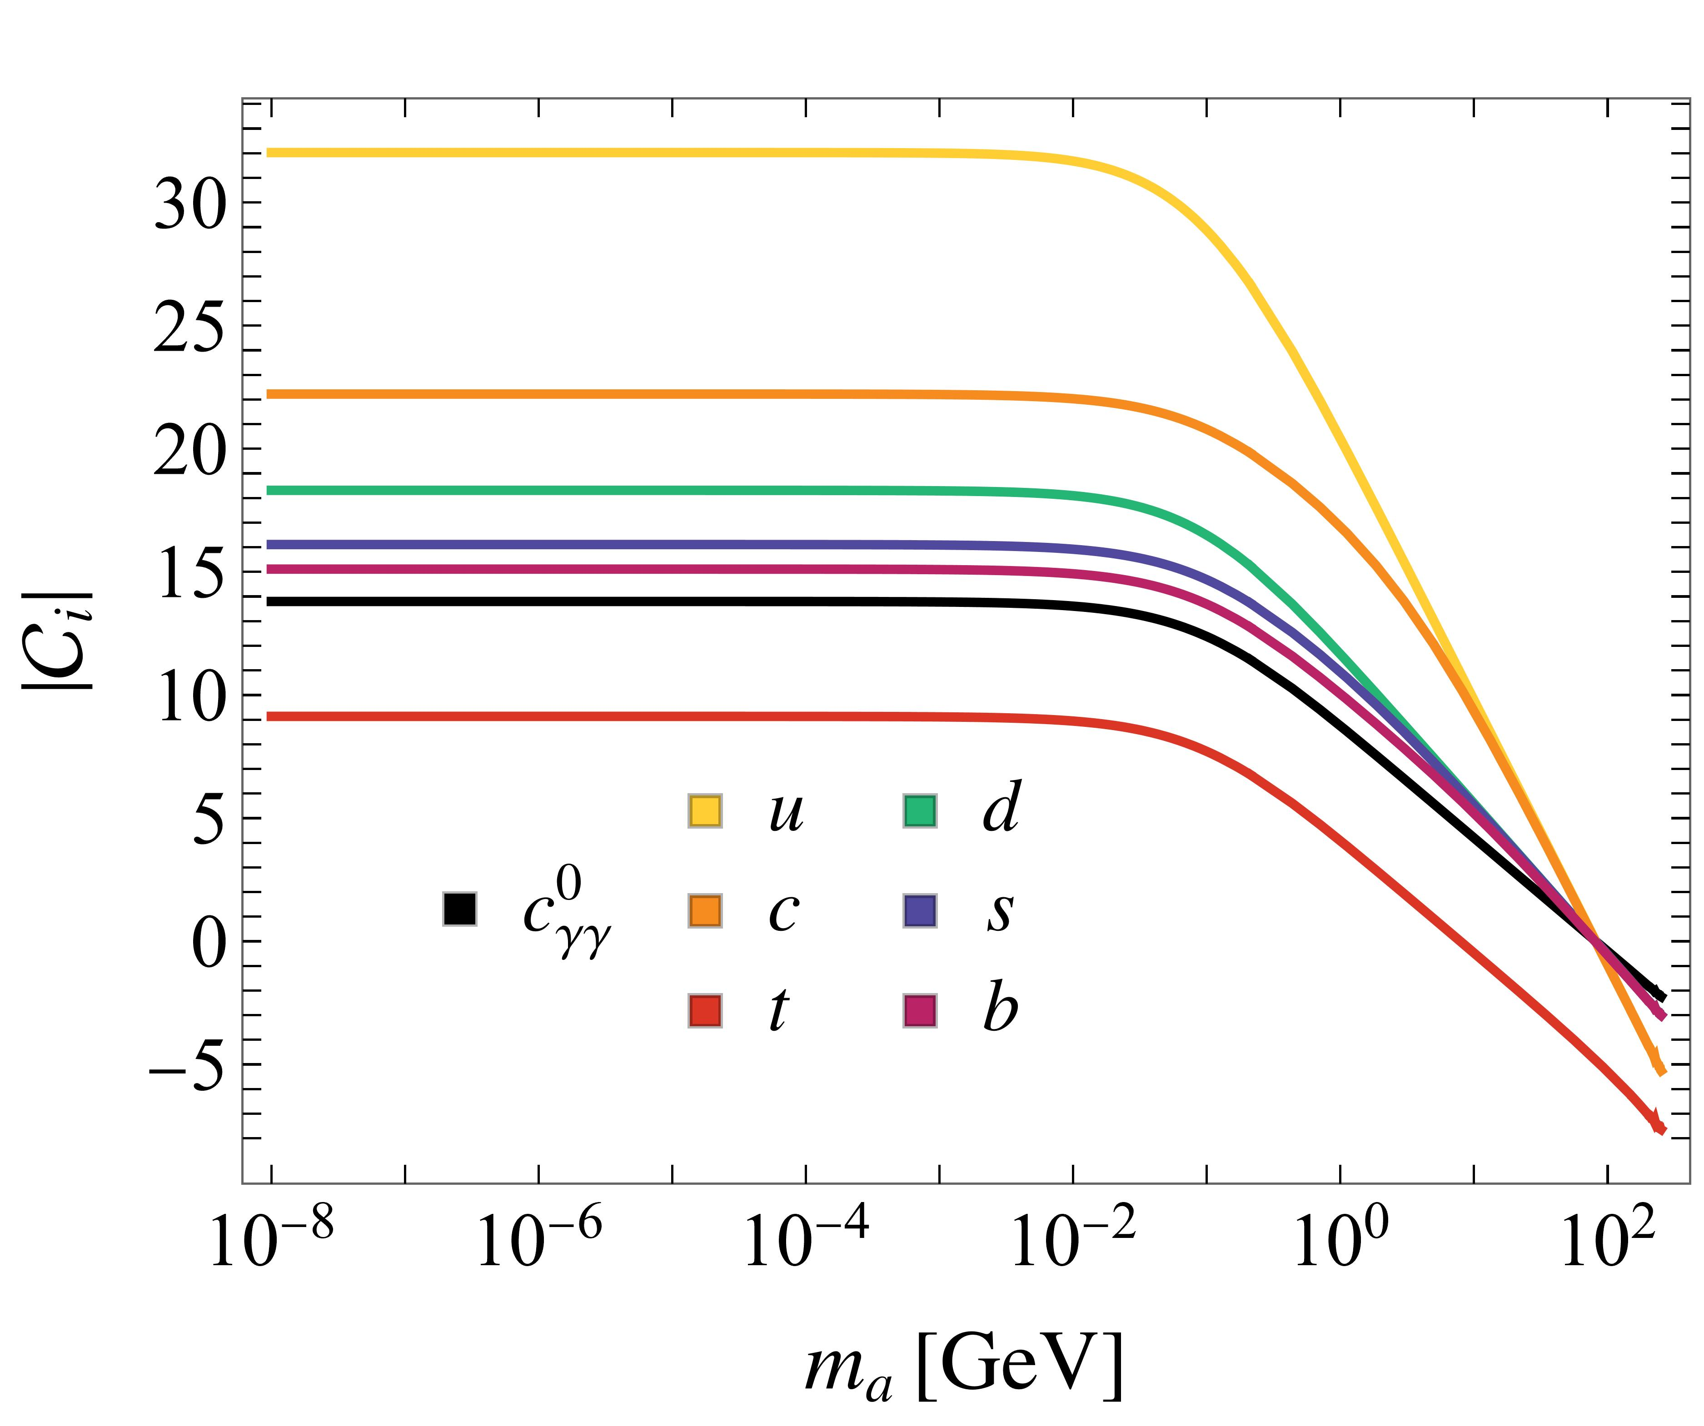
A subtlety about gauge boson couplings
Define
corrections!
leptons
quarks
January 17, 2024

Slide 18
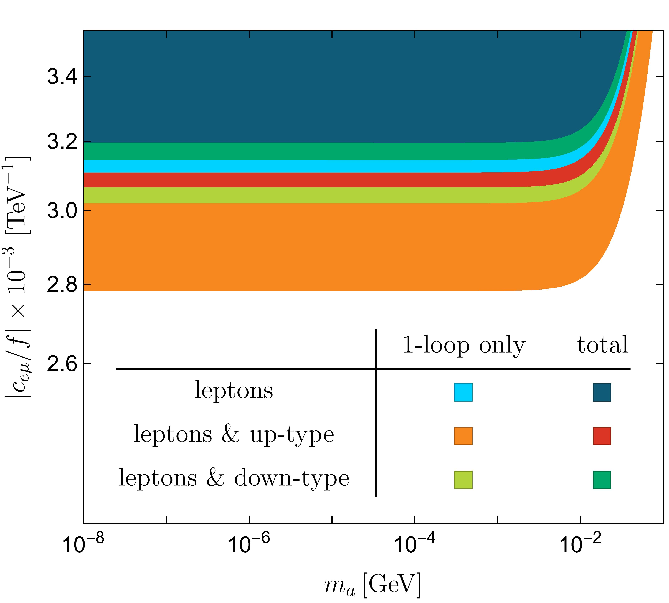
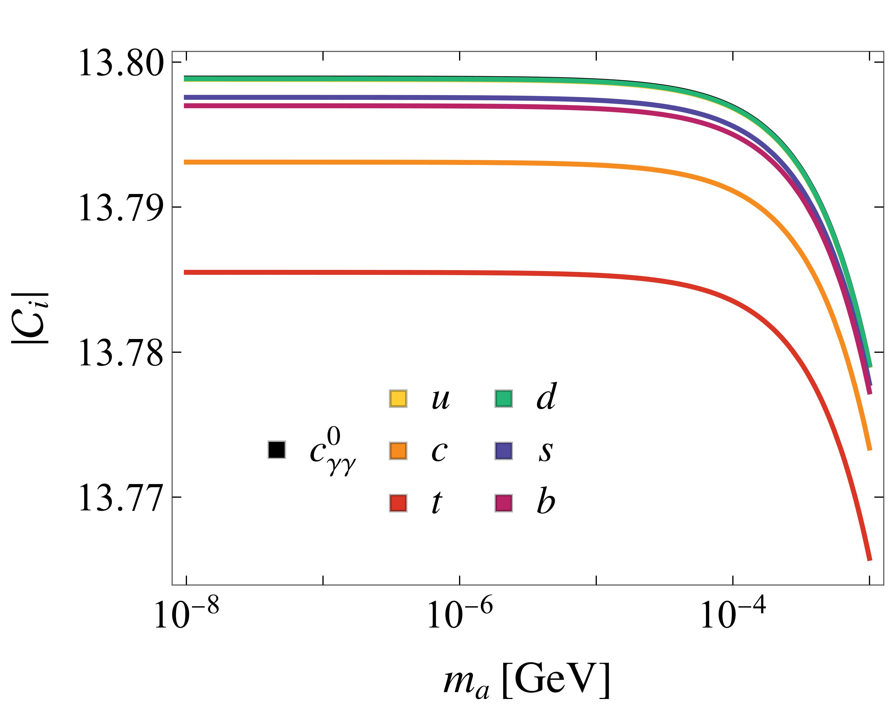
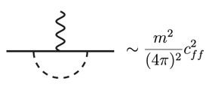
A subtlety about gauge boson couplings
Compare to different normalisation:
Two-loop diagrams are needed for theoretical consistency, but in phenomenological applications the effect is almost negligible
Contribution from
is dominant
January 17, 2024

Slide 19
Flavour probes

Slide 20
General remarks
For the phenomenological analysis we assume a benchmark scenario where one flavour universal or flavourless coupling to dominnat in the UV at Λ_{NP} = 4 π f, f = 1 TeV at a time (dependence on actual UV scale is minimal).
All other couplings are generated through RG running.
Note that UV structure also determines ALP decays, lifetime, etc.

Slide 21
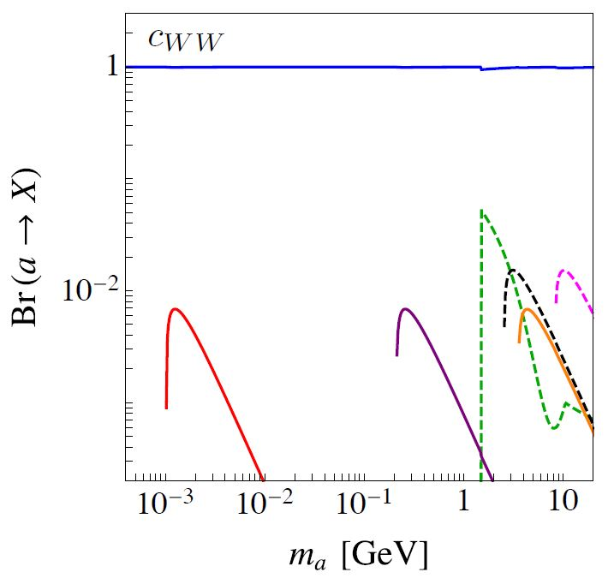
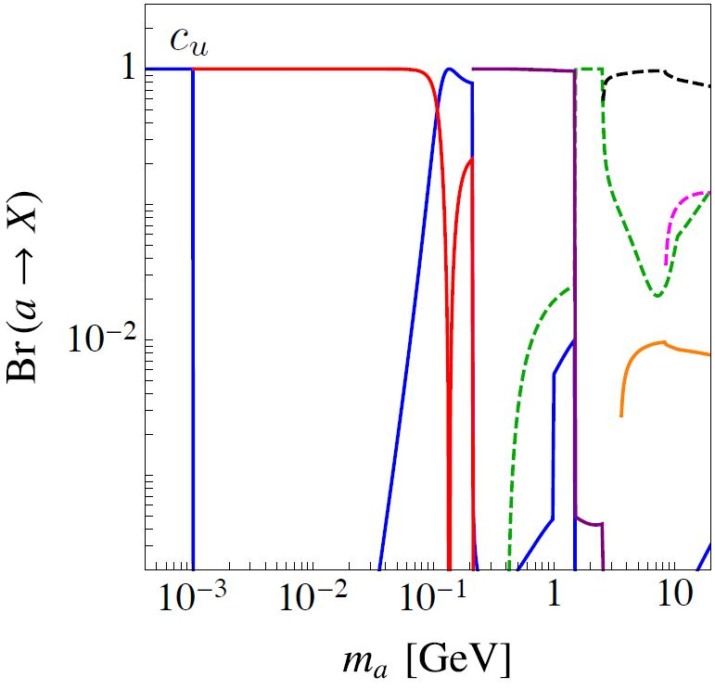
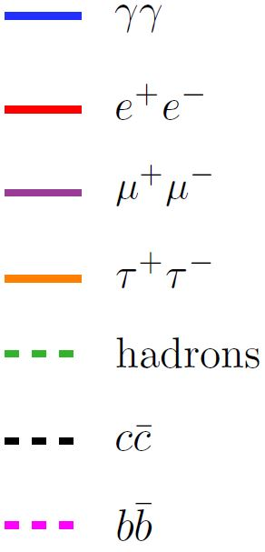
General remarks

Slide 22
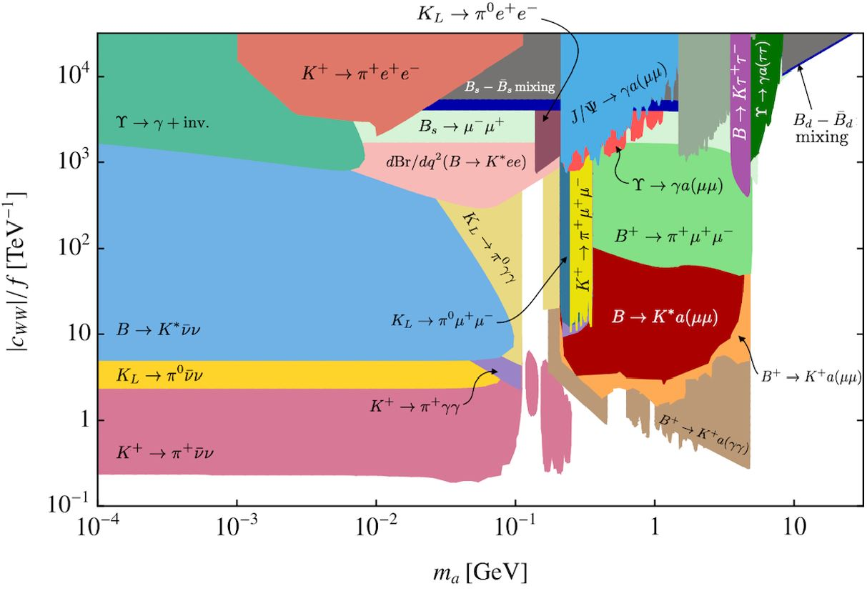
Benchmark scenario: coupling to SU(2)_{L} gauge bosons

Slide 23
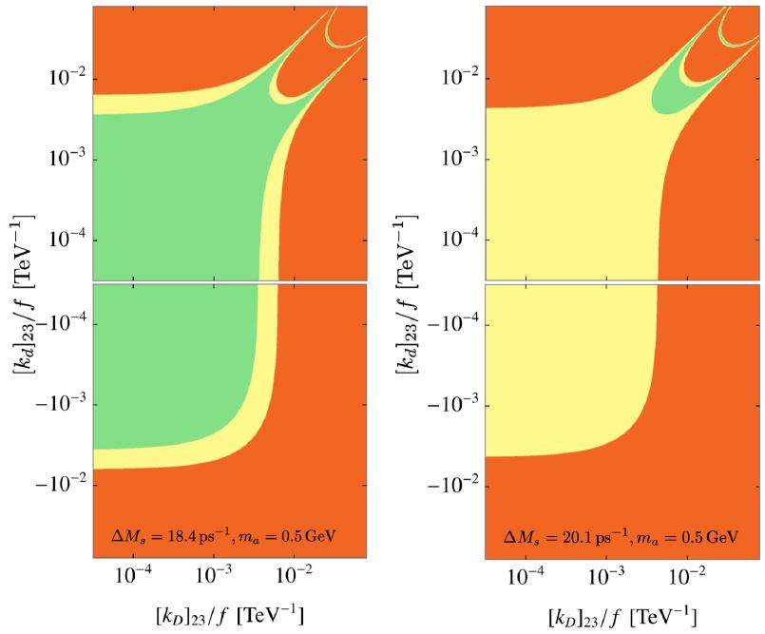
Benchmark scenario: coupling to SU(2)_{L} gauge bosons
B_{s} mixing is anomalous w.r.t SM expectation
ALP could lift the tension
weighted FLAG19
average
[HFLAV (2019)]

Slide 24
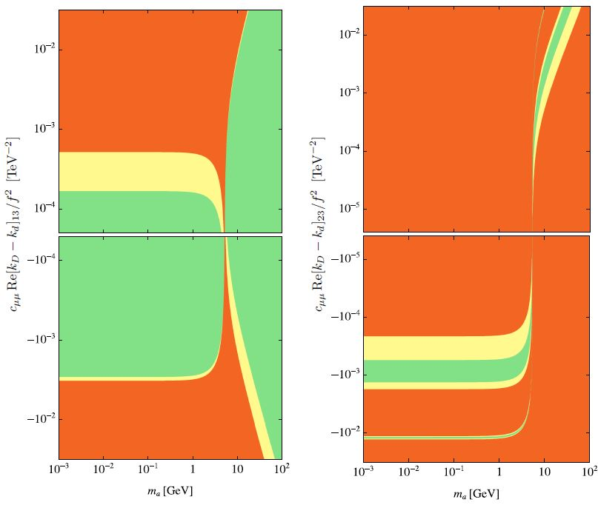
Benchmark scenario: coupling to SU(2)_{L} gauge bosons
Same for muonic B_{s}/B_{d} decays
B_{s} B_{d}
[ATLAS, CMS, LHCb (2020)]

Slide 25
Benchmark scenario: coupling to SU(2)_{L} gauge bosons
Radiative J/ψ and decays are flavour conserving and for comparison
[BaBar(2011, 2012), BESIII (2015)]

Slide 26
Benchmark scenario: coupling to SU(2)_{L} gauge bosons
B and K decays with invisible or photon final state give strongest constraints for m_{a}<m_{B}
Study K decays with χPT

Slide 27
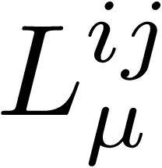
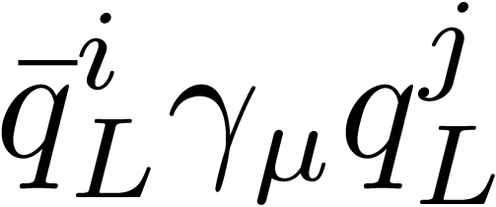
ALP χPT
K→ π a yield the strongest constraints for
Implementation into χPT is non-trivial due to ALP-pion mixing.
We find that the previously most widely used formula is inconsistent!
Object of interest: chiral implementation of leading SU(3) octet weak interaction operator
Here, is the chiral representation of the left-handed current
[Georgi, Kaplan, Randall (1986)]
Experimental constant
[Bernhard, Draper, Soni, Politzer, Weis (1985); Crewther (1986); Kambor, Missimer, Wyler (1990)]

Slide 28
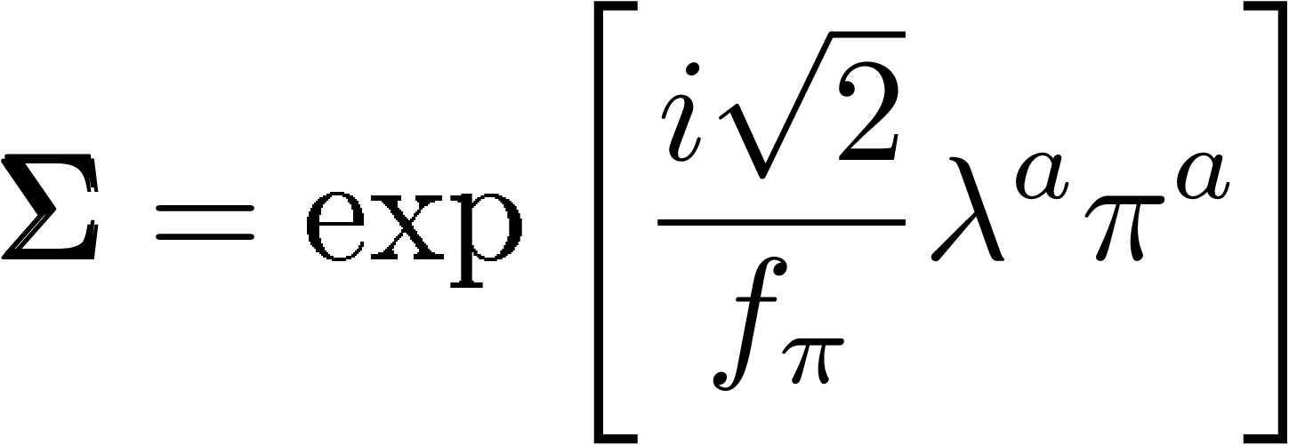
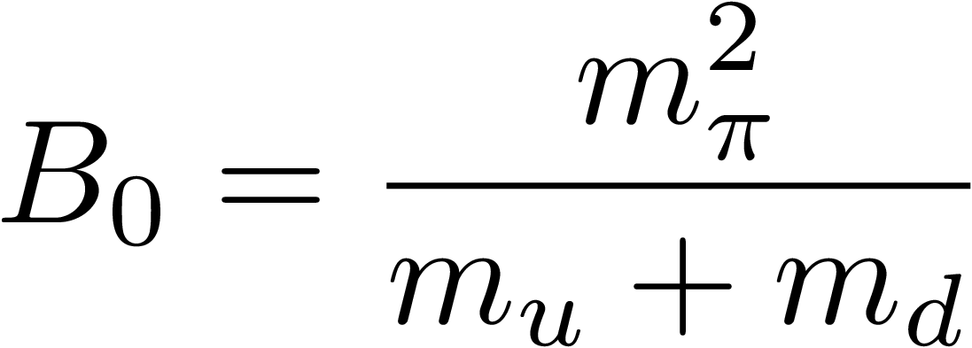
ALP χPT
Matching procedure: Remove ALP-gluon coupling by chiral rotation, with
We define the pion fields as
The effective Lagrangian is then
auxilliary parameter

Slide 29
ALP χPT
Under a quark rotation the mesons transform as
and the Lagrangian is invariant.
Using Noether‘s theorem we find that the correct representation of the left-handed quark current is
Previously used:

Slide 30
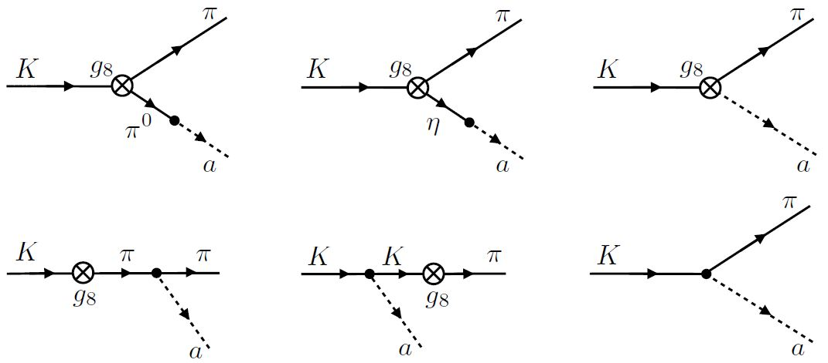
ALP χPT
Only in the sum of all diagrams the auxilliary parameters cancel out!
Including only kinetic mixing (1st diagram) gives in general an uncontrolled approximation.

Slide 31
ALP χPT
Comparison of phenomenological impact (assuming m_{a},m_{π}<<m_{K} and only c_{GG}≠0):
correct implementation inconsistent implementation
This leads to an underestimation of the branching ratio by a factor of ≈40
Remnant of choosing
and disregarding Noether theorem

Slide 32
Benchmark scenario: coupling to SU(2)_{L} gauge bosons
Exclude couplings |c_{WW}/f | > 0.25 TeV ⁻¹

Slide 33
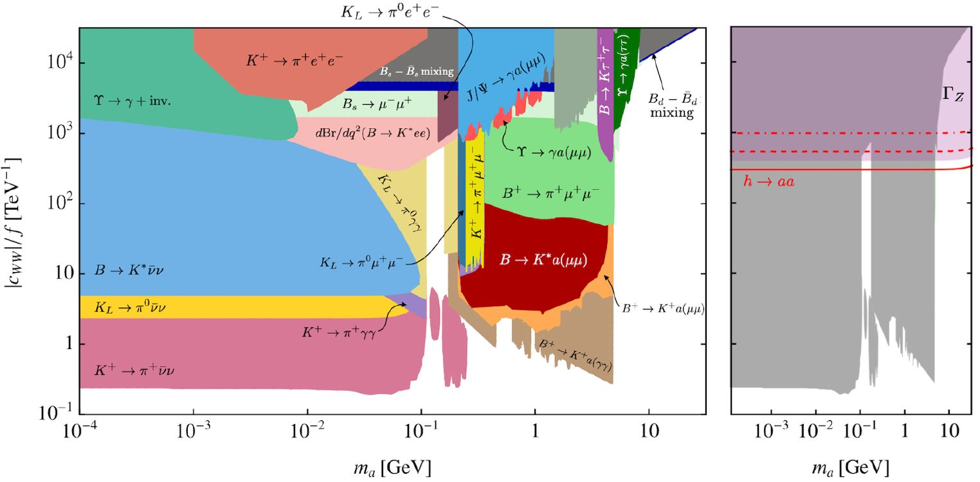
Comparison with collider experiments
[Bauer, Neubert, Thamm (2017)]

Slide 34
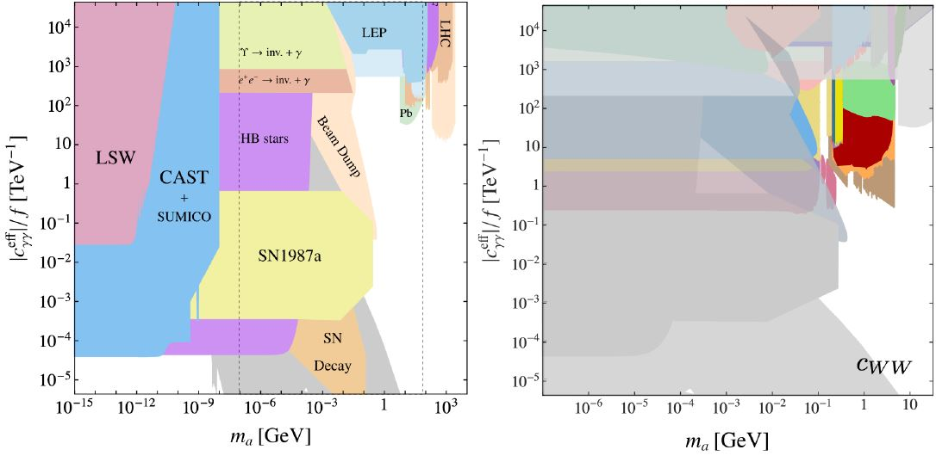
Comparison astrophysics

Slide 35
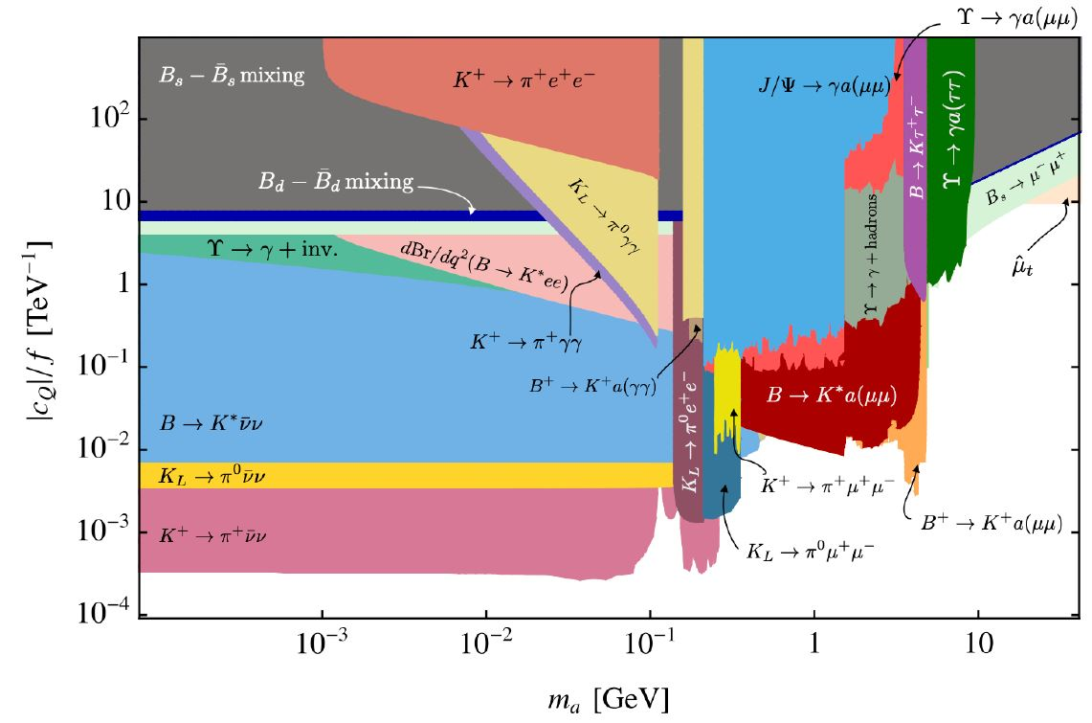
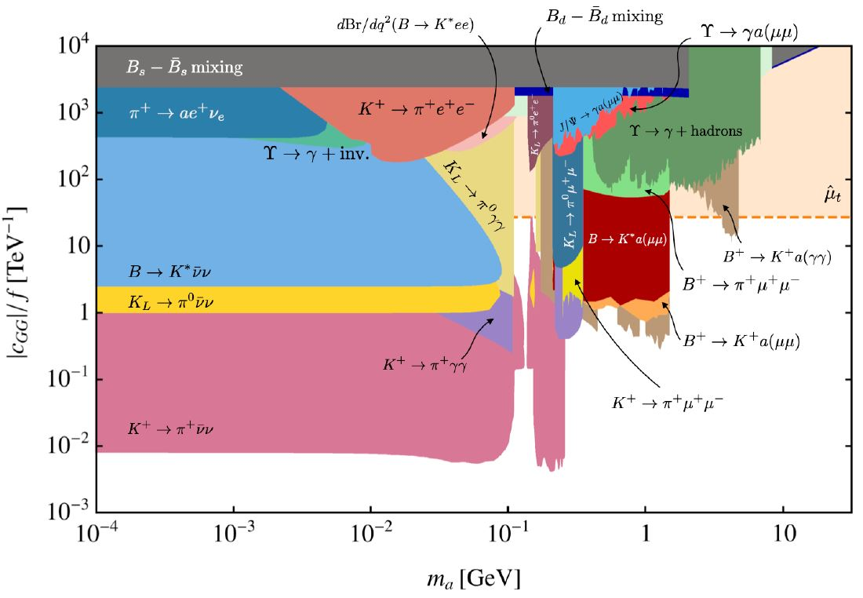
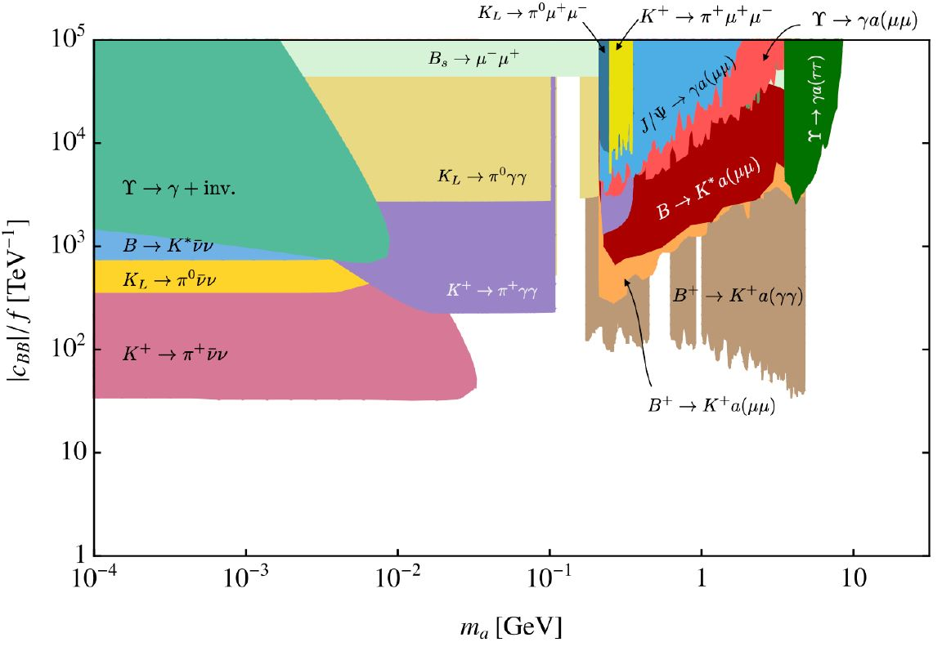
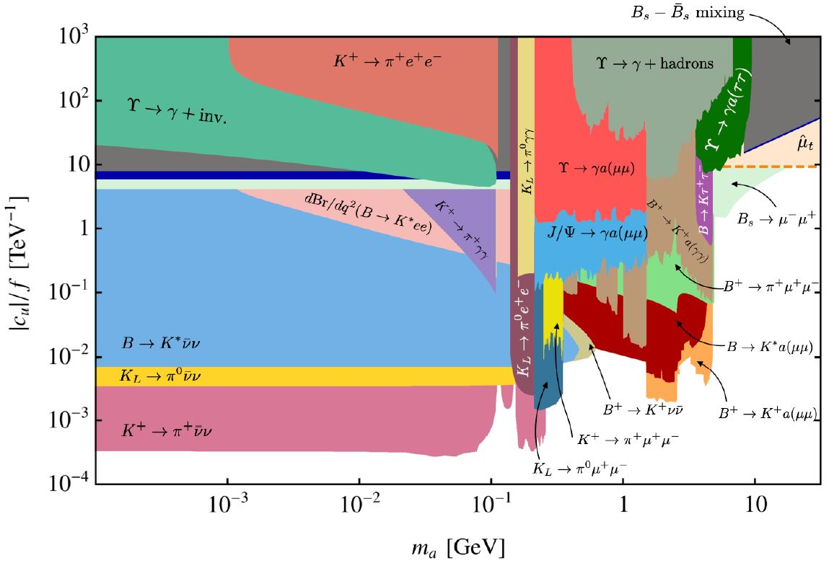
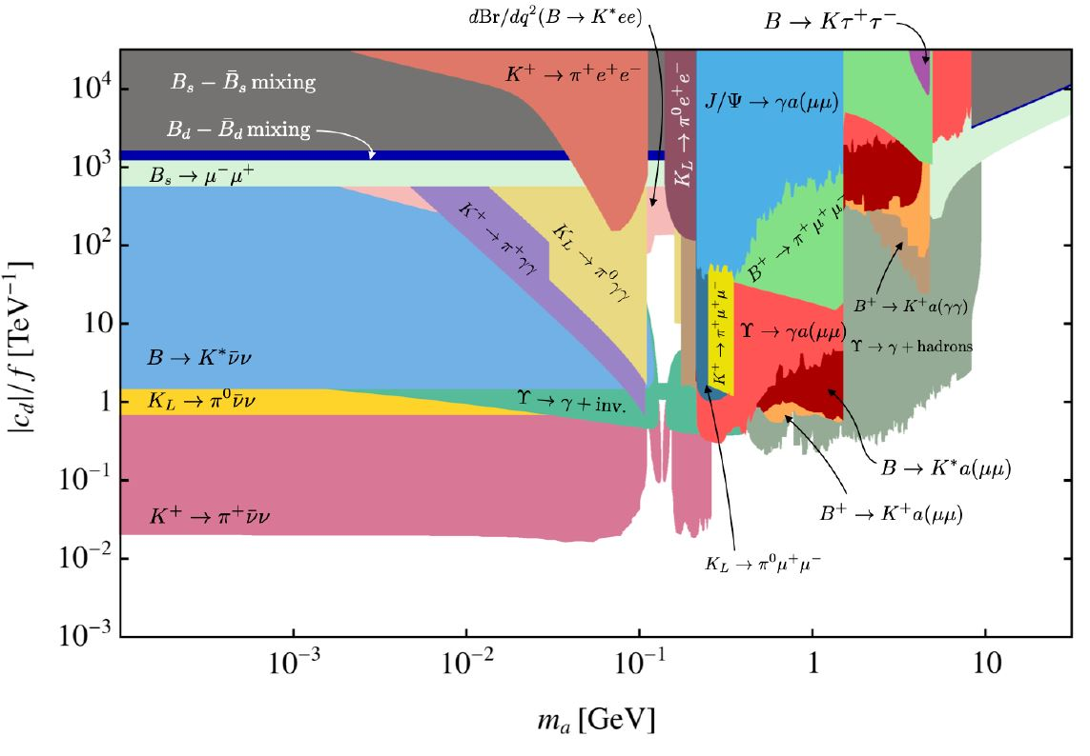
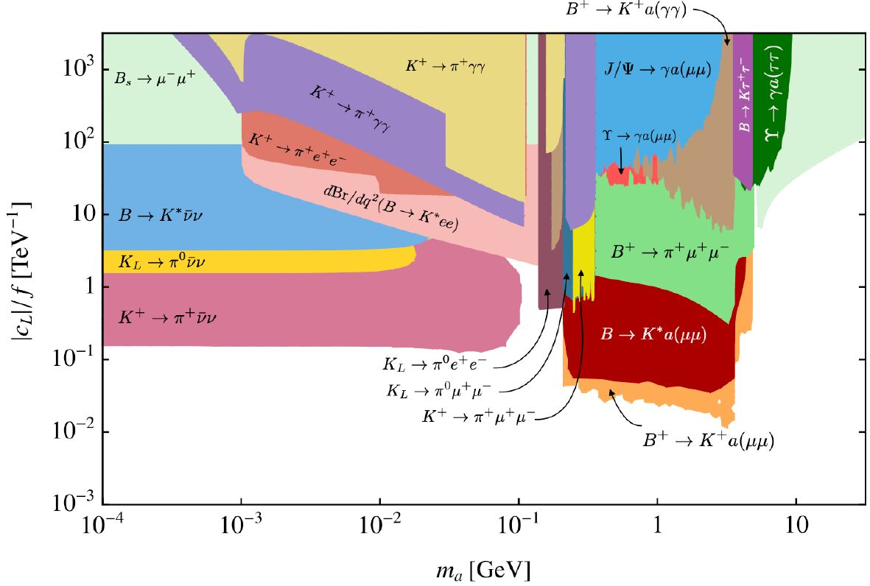
Other benchmark scenarios
LH quarks
gluons
U(1)_{Y} bosons
RH up quarks
RH down quarks
LH Leptons

Slide 36
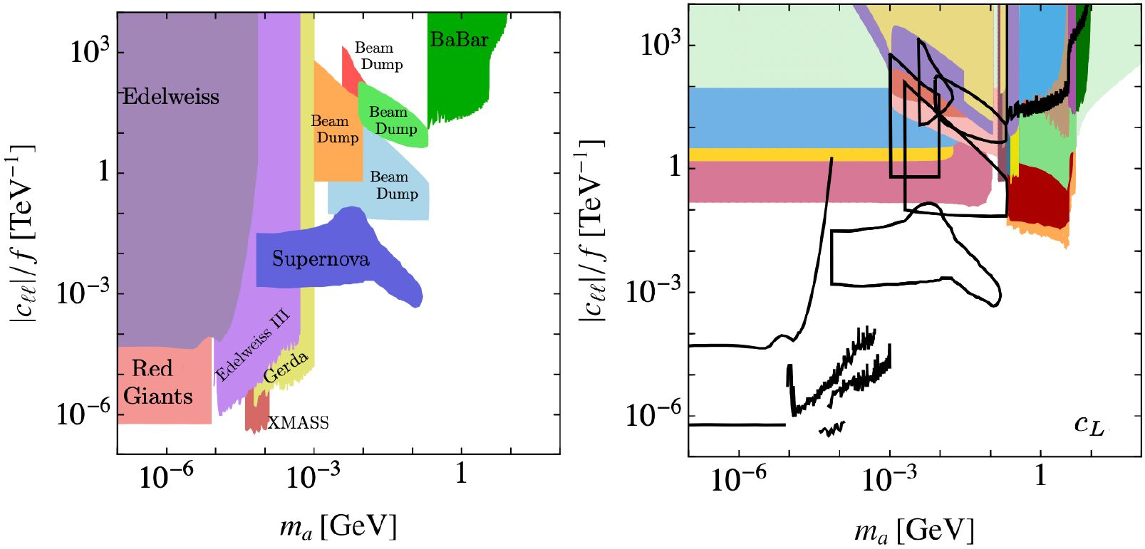
Comparison for lepton couplings

Slide 37
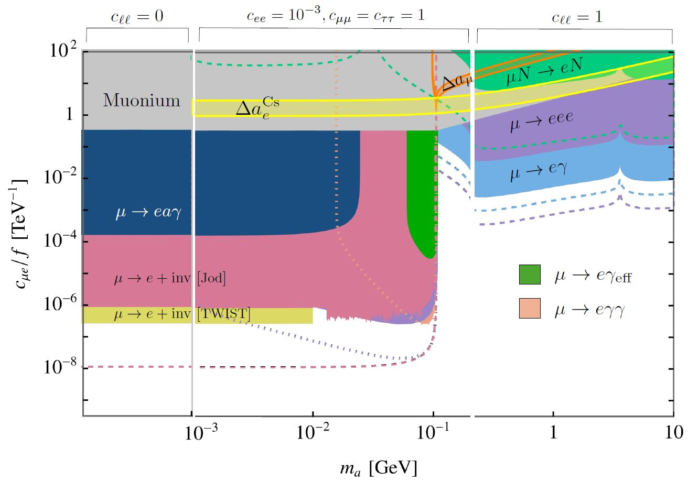
Lepton flavour violation
LFV can not be generated through RG evolution, and UV LFV couplings are strongly constrained
Boosted ALP in decay µ→ea(γγ) can mimic µ→eγ
Subsequent on-shell ALP decays enhance branching ratio

Slide 38
A light PQ scalar?

Slide 39
A light new scalar?
PQ field mixes with Higgs:
PQ mechanism occurs as in standard PQ scenario, and the coupling to gluons is achieved through loops of heavy PQ fermions F (KSVZ-like)
Choosing yields a quantum stable, light PQ scalar

Slide 40
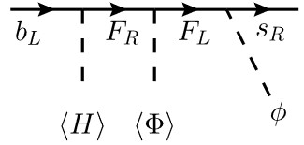
Phenomenology of the light PQ scalar
Standard axion pheno follows
Lifetime of scalar ≈ 3 x 10 ⁻⁴ s → stable on detector scales
Weak bounds from supernovae
Flavour mixing with down-type quarks possible:

Slide 41
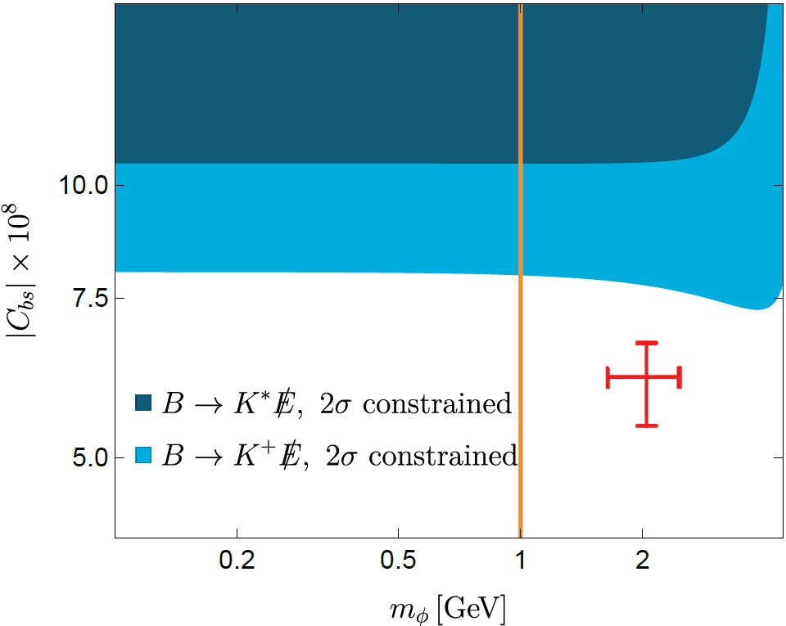
Phenomenology of the light PQ scalar
„Chasing“ the ambulance: Explain B→Kνν anomaly
Best fit value by
[Bolton, Fajfer, Kamenik, Novoa-Brunet (2024)] and [Fridell, Ghosh, Okui, Tobioka (2023)]

Slide 42
Summary
Light new physics models provide interesting alternatives to heavy new particles.
Couplings are generated through RG evolution that can be effectively probed by flavour observables.
Flavour physics is complementary to astrophysics and collider probes.
Also a light PQ scalar is possible and could have connections to current flavour anomalies.

Slide 43
Thank you!

Slide 44
Backup

Slide 45
The KTeV anomaly
Anomaly between measurement and prediction of π→ee

Slide 46
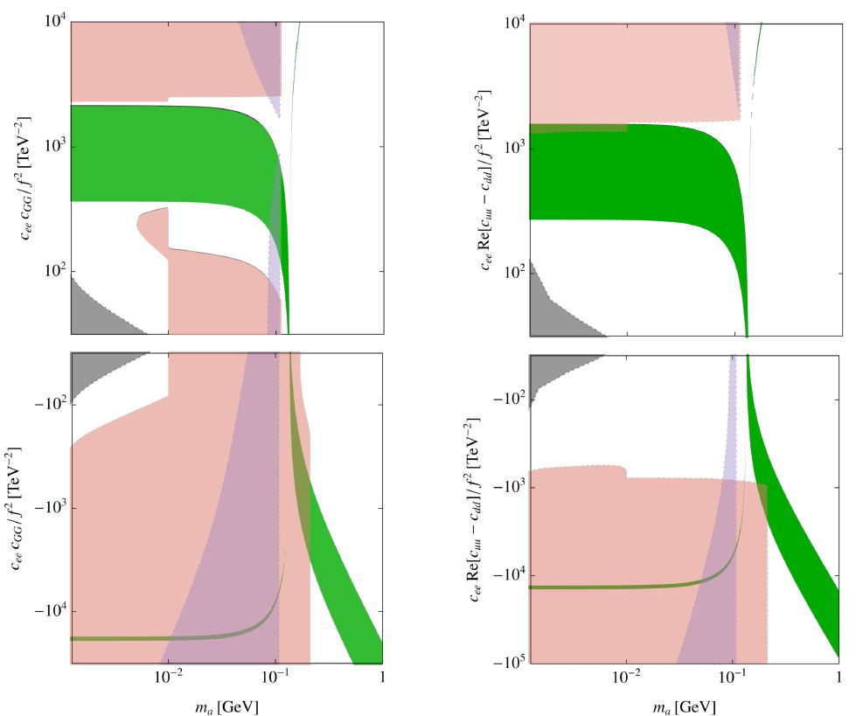
The KTeV anomaly
Coupling to gluon & electron
Coupling to quarks & electron
Anomaly explained at 1σ
K⁺ → π⁺ + inv.
K⁺ → π⁺ γγ
K⁺ → π⁺ e⁺ e⁻

Slide 47
The Atomki anomaly
Transition amplitudes of excited Berillium, Helium and Carbon to respective ground state
The Atomki group claims a strong evidence for an X17 particle
ALP explanation mostly ruled out

Slide 48
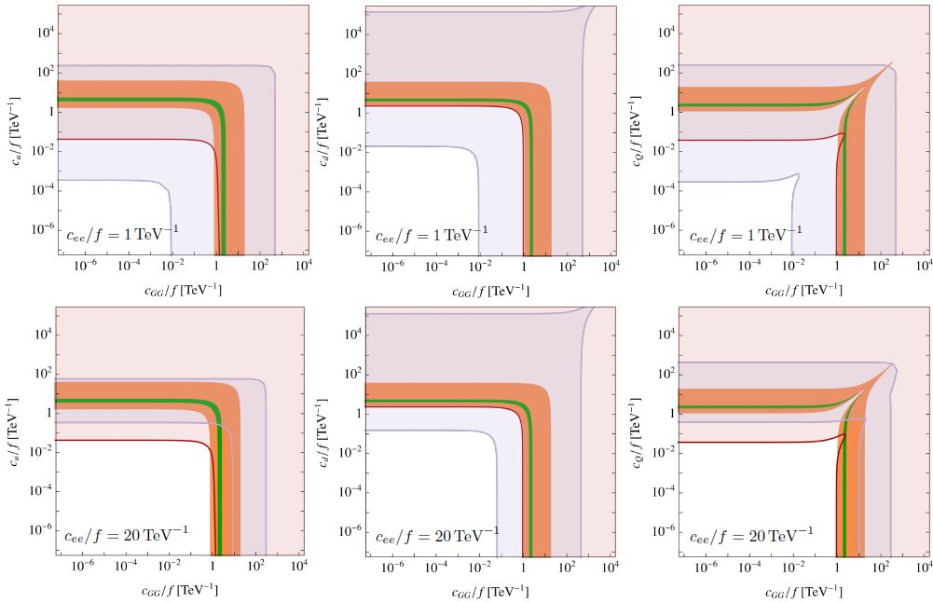
The Atomki anomaly
Green: Berillium explained
Orange: Helium explained
Blue: ruled our by K_{L}→πνν
Red: ruled out by K⁻→π⁻ a(e⁺e⁻)

Slide 49
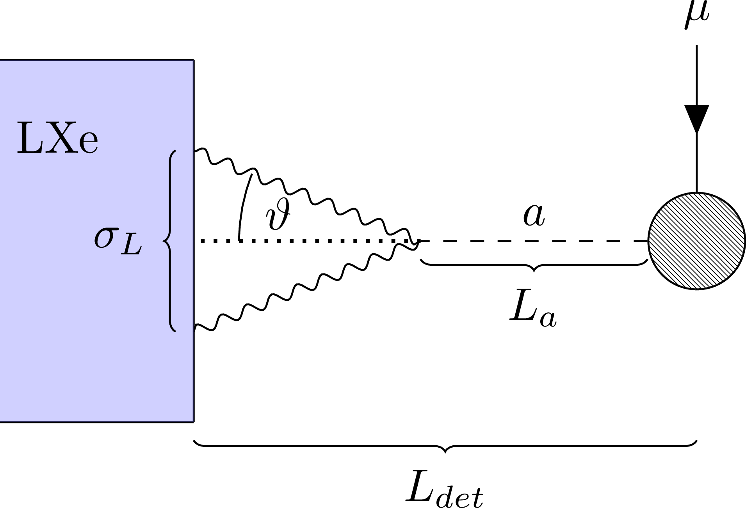
LFV: a→γγ
If ALP is lighter than muon, resonant ALP decays greatly enhance branching ration, and therefore reach of experiments
If ALP is boosted or decays close to detector, μ→e (a→γγ) can mimic μ→eγ

Slide 50
Anomalous magnetic/electric moments
Strong tension between data-driven and lattice evaluation of hadronic vacuum polarisation (HVP).
In light of inconsistent data (KLOE vs. BaBar, CMD3 vs rest) and consistent lattice results from multiple groups it seems that a (g-2)_{μ} consistent with the SM is the most plausible explanation.
Even if there was a discrepancy, an ALP would be a highly unlikely candidate to resolve the tension. ( , or )

Slide 51
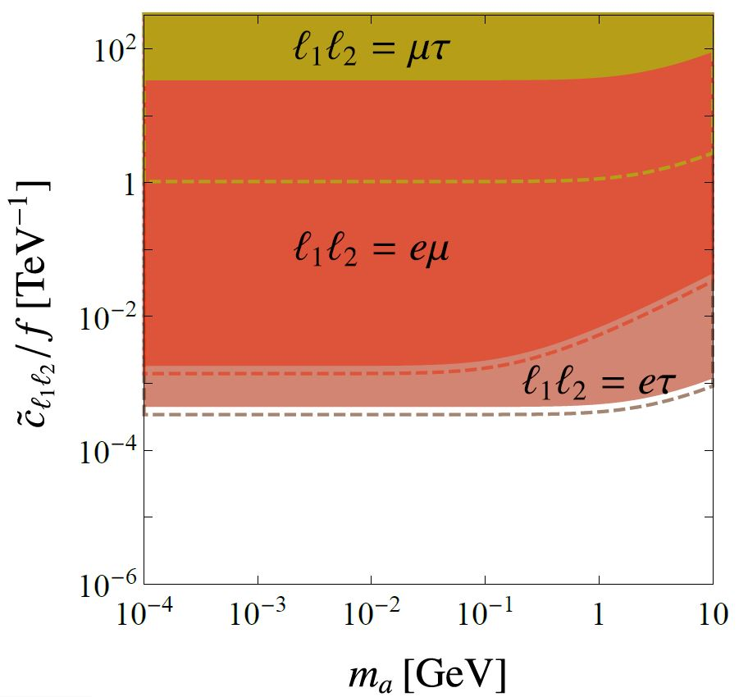
Anomalous magnetic/electric moments
EDMs are consistent, but only yield constraints on combinations of imaginary parts
Since SM predictions are ~10 orders weaker, there is still some hope left to discover new physics here

