Slide 1

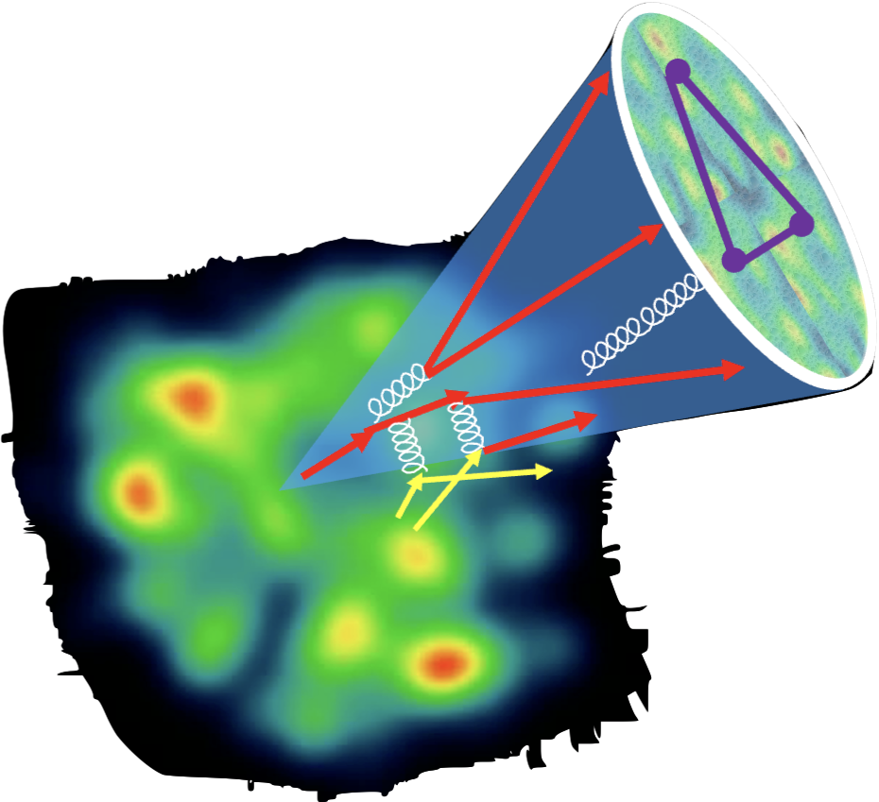

Jet evolution in medium and nuclear modification of single and γ-jet EEC
Xin-Nian Wang
Central China Normal University/Lawrence Berkeley Lab/Goethe-Universität Frankfurt
In collaboration with Yayun He, Ian Moult and Zhong Yang

Slide 2
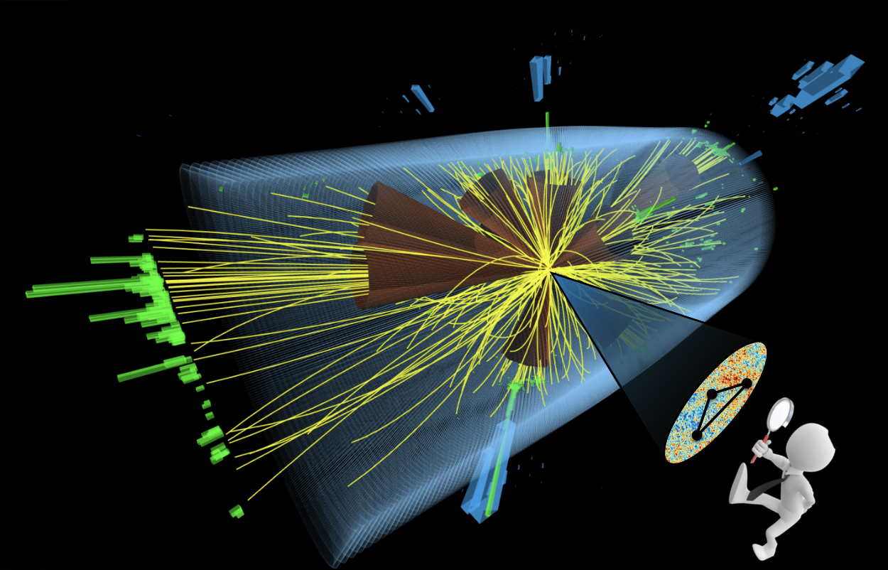
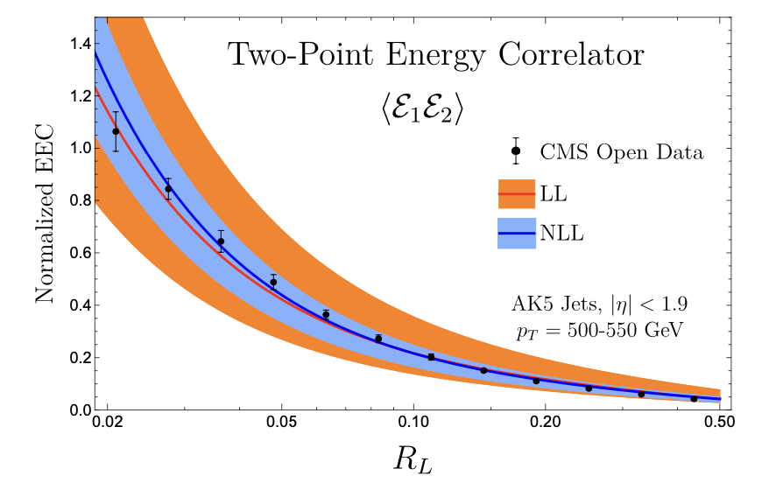
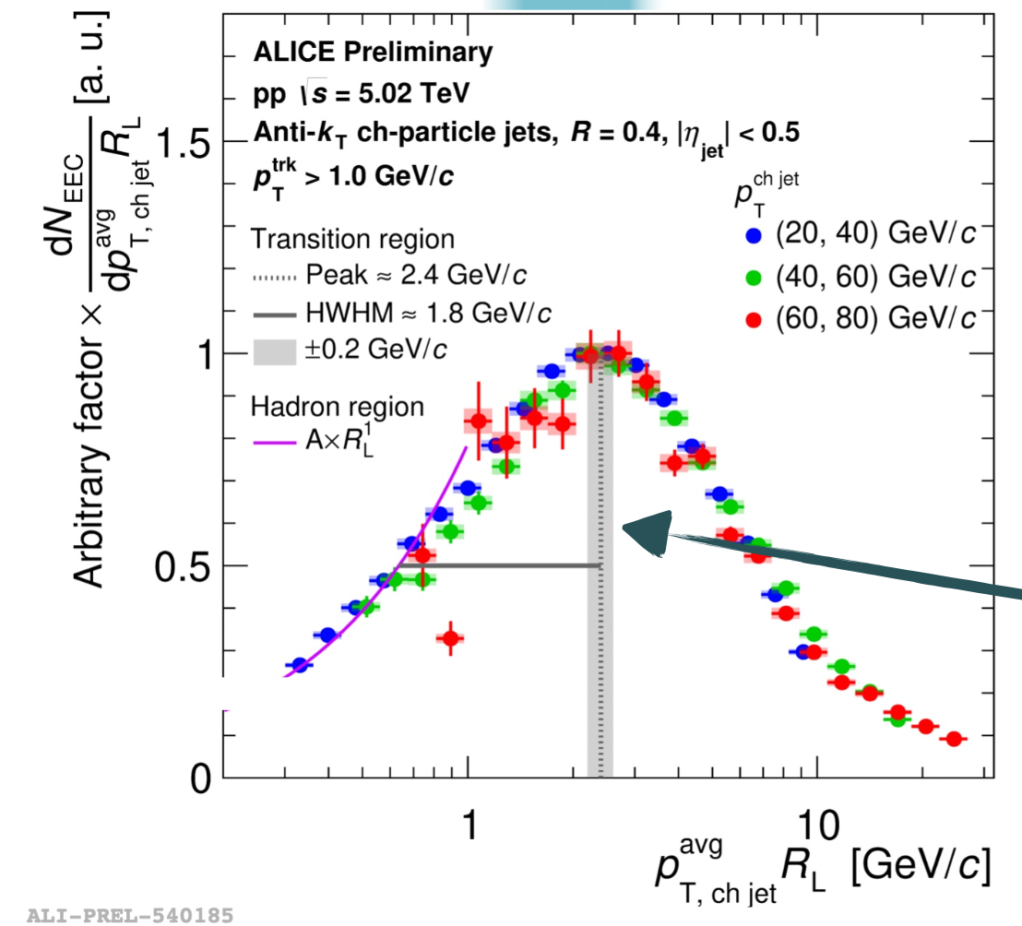
Energy-energy correlator (EEC)
A new jet substructure observable:
Moult, et al
Fan, QM23
Notes:
\frac{d\Sigma^{(n)}}{d\theta}=\frac{1}{\sigma}\sum_{i\neq j}\int d \vec n_{i,j} \frac{d\sigma_{ij}}{d\vec n_{i,j}} \frac{E_i^n E_j^n}{Q^{2n}} \delta(\vec n_1\cdot \vec n_2 -\cos\theta)

Slide 3
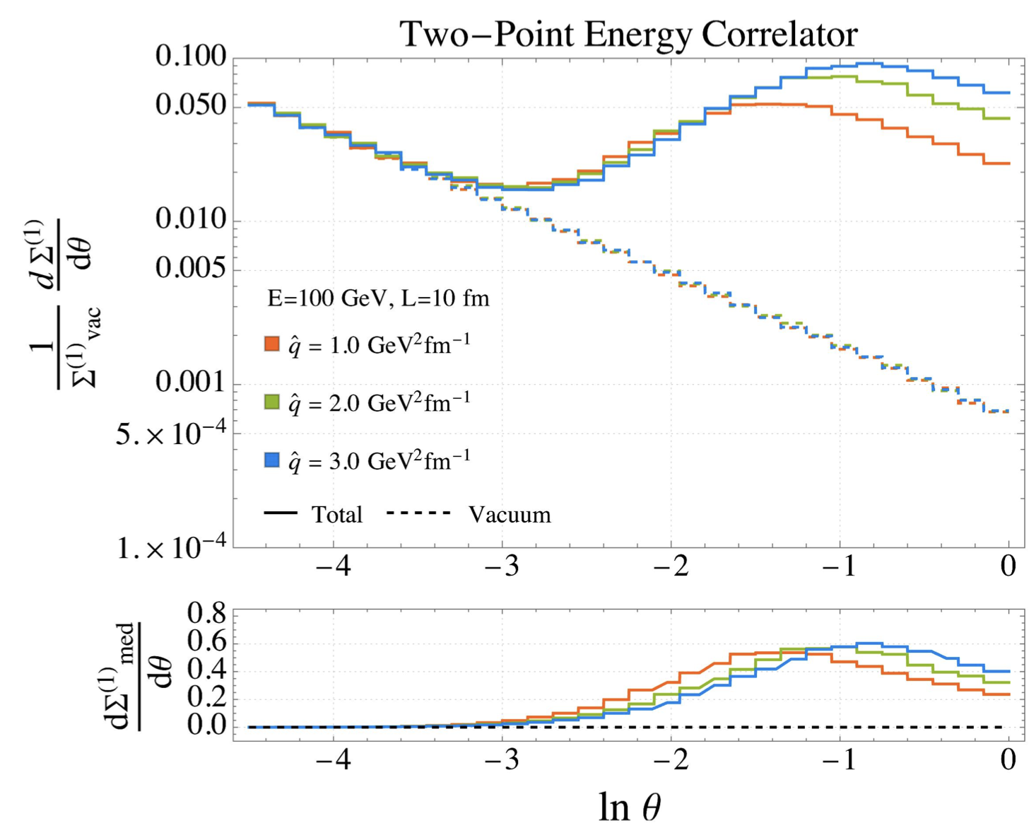
Resolving QGP scales with EEC
Andres, et al , PRL 130 (2023) 26, 262301 (2209.11236)

Slide 4
Resolving QGP scales with EEC
Can EEC resolve the induced gluon emission in realistic heavy-ion collisions?
Can EEC resolve recoil partons (medium response)?
Can EEC resolve the angular scale of in-medium parton collisions

Slide 5
EEC from HT in single emission
l
k
HT induced emission in a QGP brick:
Yang, He, Moult & XNW, PRL 132 (2024) 1, 011901
Notes:
\frac{d\Sigma^{\rm med}_q}{d\theta} \approx
\frac{ L^{2} \hat{q}}{2 E} \frac{\alpha_\mathrm{s} C_A}{\theta}, \theta> \sqrt{8\pi/EL}
\frac{d\Sigma^{\rm med}_q}{d\theta} \approx \frac{L^3 \hat{q} \alpha_\mathrm{s} C_A \theta}{64\pi}, \theta < \sqrt{8\pi/EL}

Slide 6
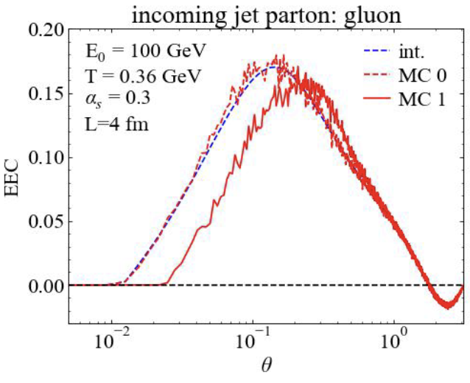
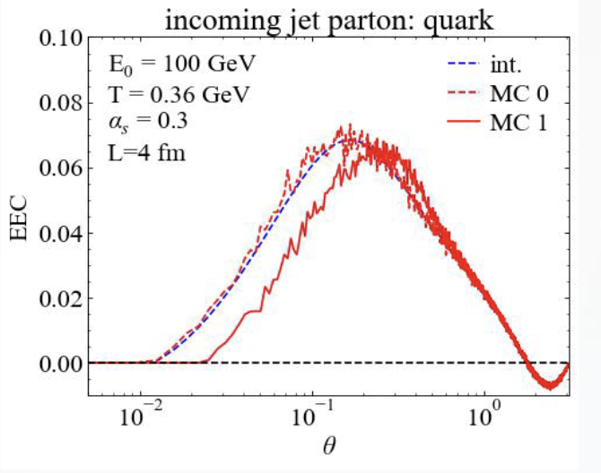
Contributions from medium response
2→ 2 elastic collisions:
1(a)
2(c)
k
Both recoil and
back-reaction (“negative partons”)
3 (d)
(b)
2→ 3 inelastic collisions:
l
θ₁₃
θ₂₃
θ₁₃
k
θ₂₃
Notes:
\frac{d\Sigma^{\rm med}_a}{d\theta}\hspace{-6pt} = \hspace{-6pt}\int dx \sum_{b,(cd)} \int \prod_{i=b,c,d}d[p_i] \times \left[\int d\vec n_{c,d}\delta(\vec n_c\cdot \vec n_d -\cos\theta)E_d f_b(1\pm f_c)(1\pm f_d)\right.\\
\left. - {\color{red} \int d\vec n_{c,b}\delta(\vec n_c\cdot \vec n_b -\cos\theta) E_b f_c(1\pm f_a)(1\pm f_b)}\right] \frac{E_c}{E_a^2}\\
\times \frac{\gamma_b}{2E_a} (2\pi)^4\delta^4(p_a+p_b-p_c-p_d) \left|\mathcal{M}_{ab\rightarrow cd}\right|^2,

Slide 7
Linear Boltzmann Transport model
LBT: Linear Boltzmann Transport
Induced radiation
jet parton
pQCD elastic and radiative processes (high-twist)
Transport of medium recoil partons ( and back-reaction)
CLVisc 3+1D hydro bulk evolution
Back-reaction
(particle hole)
recoil parton
He, Luo, Zhu & XNW, PRC 91 (2015) 054908
Notes:
f_i(p_i)=\frac{1}{e^{p_i\cdot u/T}\pm 1} (i=2,4)
f_i(p)=(2\pi)^3\delta^3(\vec p_i-\vec p_0)\delta^3(\vec x-\vec x_0-t\vec v_i) [i=1,3]
\frac{dN_g}{dzd^2k_\perp dt}=\frac{2\alpha_s N_c}{\pi k_\perp^4} P(z)
(\hat p\cdot u) \hat q \sin^2(\frac{t-t_0}{2\tau_f})
p_1\cdot \partial f_1=-\int dp_2dp_3dp_4(f_1f_2-f_3f_4)|M_{12 \rightarrow 34}|^2(2\pi)^4\delta^4(\sum_i p_i) + {\rm inelastic}
\frac{dN_g}{dzd^2k_\perp dt} \approx \frac{2C_A\alpha_s}{\pi k_\perp^4}P(z) \hat q (\hat p\cdot u) \sin^2\frac{k_\perp^2 (t-t_0)}{4z(1-z)E}

Slide 8
CoLBT-hydro
(Coupled Linear Boltzmann Transport hydro)
Concurrent and coupled evolution of bulk medium and jet showers
LBT for energetic partons (jet shower and recoil)
Hydrodynamic model for bulk and soft partons: CLVisc
Parton coalescence (thermal-shower)+ jet fragmentation
Hadron cascade using UrQMD
Chen, Cao, Luo, Pang & XNW, PLB777(2018)86
Notes:
\partial_\mu T^{\mu\nu}(x) = j^\nu (x)
\delta f(p,x) \ll f(p,x)
j^\nu(x) = \sum_i p^\nu_i \delta^{(4)}(x-x_i) \theta(p^0_{cut}-p\cdot u)
j^\nu(x) = \sum_a\int \frac{d^3p}{(2\pi)^3}\frac{p^\nu}{p^0}f_a(p)\theta(p\cdot u - p^0_{cut})
p\cdot \partial f(p) =- C(p) \;\;\; p\cdot u > p_{cut}^0

Slide 9
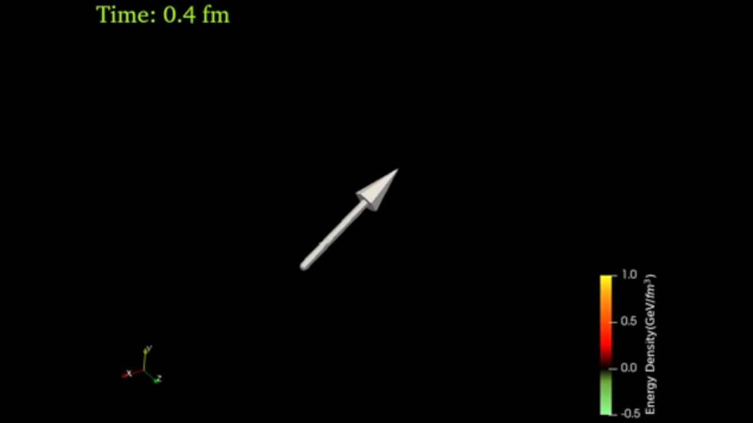
LBT & CoLBT: Jet-induced medium response
x
y
η_{s}
Energy transverse distribution of medium response in a static medium
3D energy density distribution of the medium response induced by a γ-jet in a 0-10% Pb+Pb event
Notes:
f_i(p_i)=\frac{1}{e^{p_i\cdot u/T}\pm 1} (i=2,4)
f_i(p)=(2\pi)^3\delta^3(\vec p_i-\vec p_0)\delta^3(\vec x-\vec x_0-t\vec v_i) [i=1,3]
\frac{dN_g}{dzd^2k_\perp dt}=\frac{2\alpha_s N_c}{\pi k_\perp^4} P(z)
(\hat p\cdot u) \hat q \sin^2(\frac{t-t_0}{2\tau_f})

Slide 10
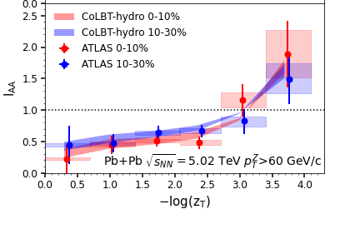
Modification of jets and medium response
r
CoLBT
e-Print: 2101.05422
Notes:
In order to Simultaneous description of hadron and jet RAA need to include jet-induced medium response

Slide 11
Search for jet-induced diffusion wake
Diffusion (DF) wake leads to depletion of soft hadron yield in the back of jet direction
γ-triggered-jet-hadron correlation
Jet
Yang, Tan, Chen,Pang & XNW, PRL, 130 (2023) , 052301
MPI
DF-wake
x
y
η_{s}
Jet-distr
MPI
DF-wake
Notes:
Diffusion wake a universal phenomenon accompanying the projectile induced Mach wake

Slide 12
EEC of single parton in a QGP brick
Single parton with multiple scattering in a brick in LBT
Debye mass:
We vary only K in sampling the transverse momentum transfer of 2→2 and kinematic limit of gluon bremsstrahlung. We however keep qhat and 2→2 rate unchanged.
Medium response
(recoil + ”negative” partons)
Is (more) important
Yang, He, Moult & XNW, PRL 132 (2024) 1, 011901
Notes:
\mu_D^2=\frac{3}{2} K g^2 T^2

Slide 13
EEC of a jet shower in a QGP brick
A jet shower in a brick in LBT
Initial γ-jet configurations generated from Pythia8
Energy loss and momentum
broadening lead to suppression
at small angles
Radiated gluon and medium response dominate at large angles
Yang, He, Moult & XNW, PRL 132 (2024) 1, 011901

Slide 14
EEC of γ-jets in Pb+Pb Collisions
CoLBT simulations:
Enhancement at large angles by soft hadrons from radiated gluons and medium response, sensitive to pT cuts
EEC by energetic hadrons from leading shower partons at small angles are suppressed, not affected by pT cuts
Yang, He, Moult & XNW, PRL 132 (2024) 1, 011901

Slide 15
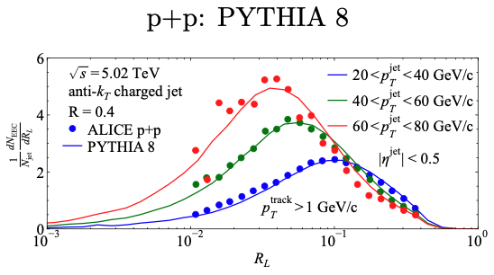
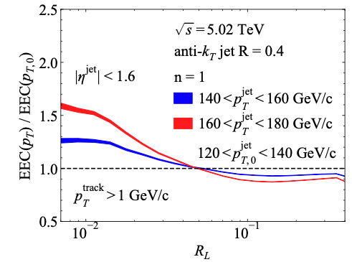
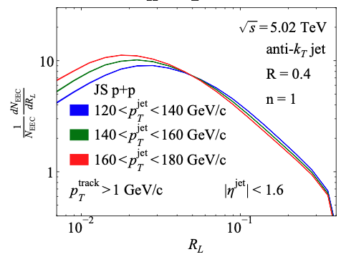
EEC of Single inclusive jets
If 120 GeV jets come from vacuum fragmentation of jets with energy loss from initial 140 or 160 GeV

Slide 16
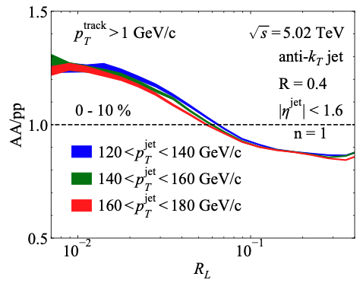
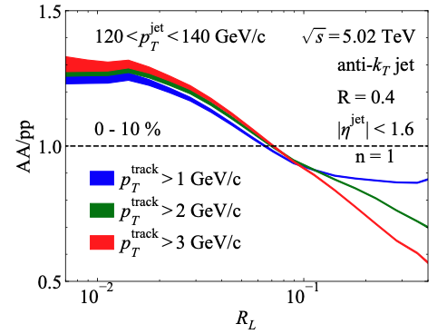
EEC modification in JETSCAPE
Preliminary JETSCAPE
Preliminary JETSCAPE
Large angle suppression: small effects from medium response
Small angle enhancement: Is it really caused by jets with reduced energy?

Slide 17
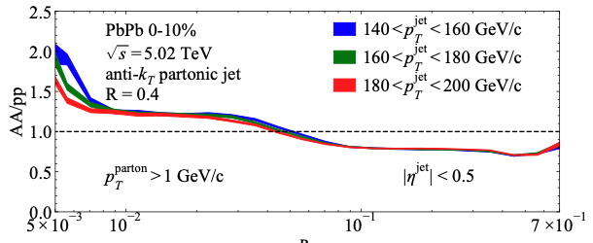
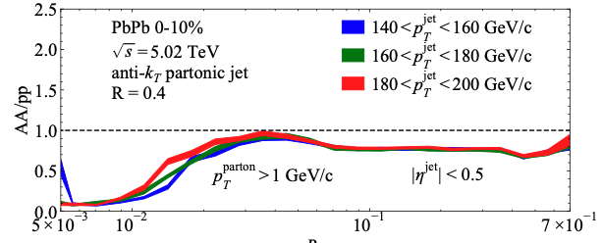
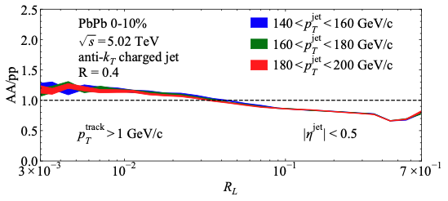
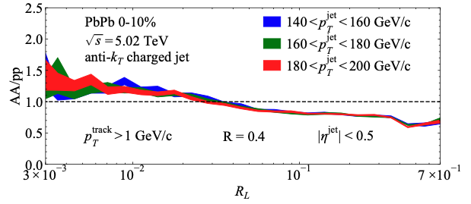
Enhancement due to jets with reduced energy?
With jet splitting outside medium
No jet splitting outside medium
partons
hadrons
Preliminary JETSCAPE
Preliminary JETSCAPE
Effect of hadronization dominates at small angle !

Slide 18
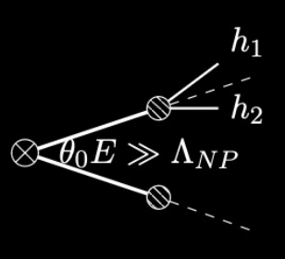
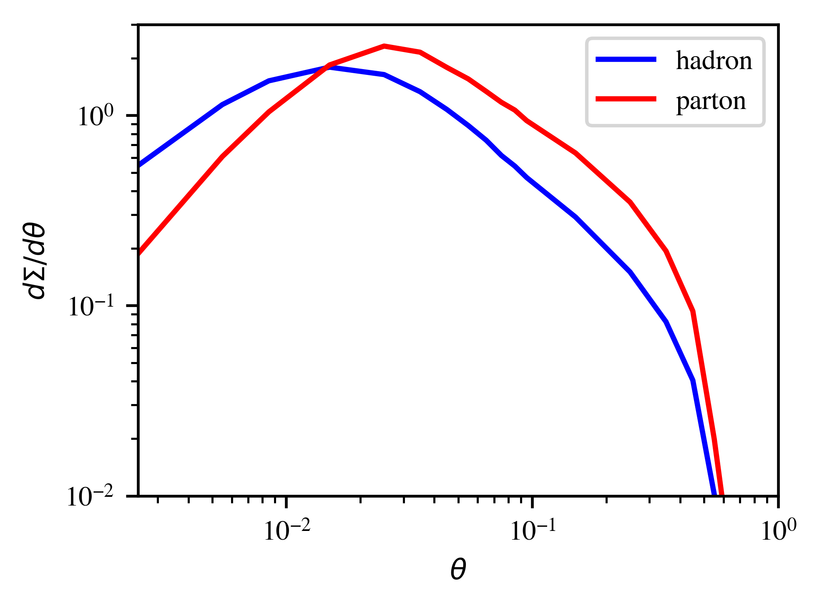
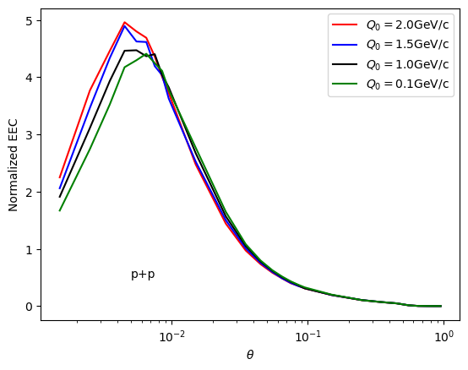
Effects of hadronization
Parton EEC at small angle due to random correlation
Hadron EEC sensitive to hadronization
Pythia γ-jet
p_{T}^{γ}>100 GeV/c
p_{T}^{jet}> 50 GeV/c, R=0.5
JETSCAPE: increase of the hadronization scale Q₀

Slide 19
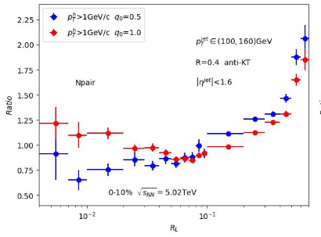
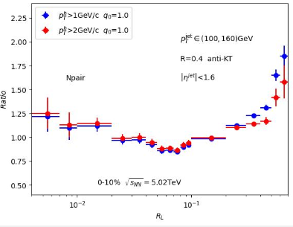
Single jet EEC from CoLBT
Increased virtuality scale in medium leads to enhancement of EEC at small angle
Medium response leads to enhancement at large angle R_{L}>0.3

Slide 20
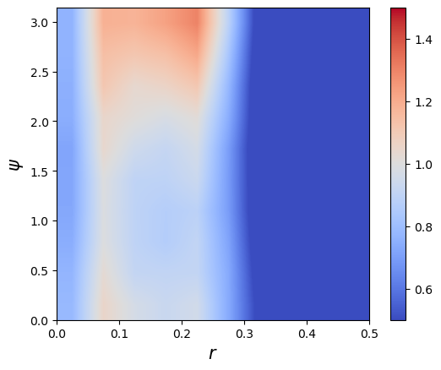
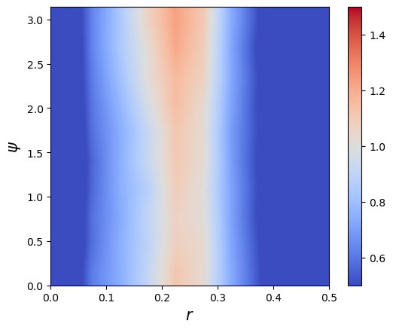
Seeing Mach-cone through 3p Azimuthal Correlation
p+p (γ+jet) p_{T}>40 GeV/c
0-10%Pb+Pb (γ+jet)
ψ
r
)
Back-to-back correlation due to momentum conservation of parton splitting
Azimuthal uniform correlation due to medium-response: Mach-cone – sound velocity?
r=(r1+r2)/2

Slide 21
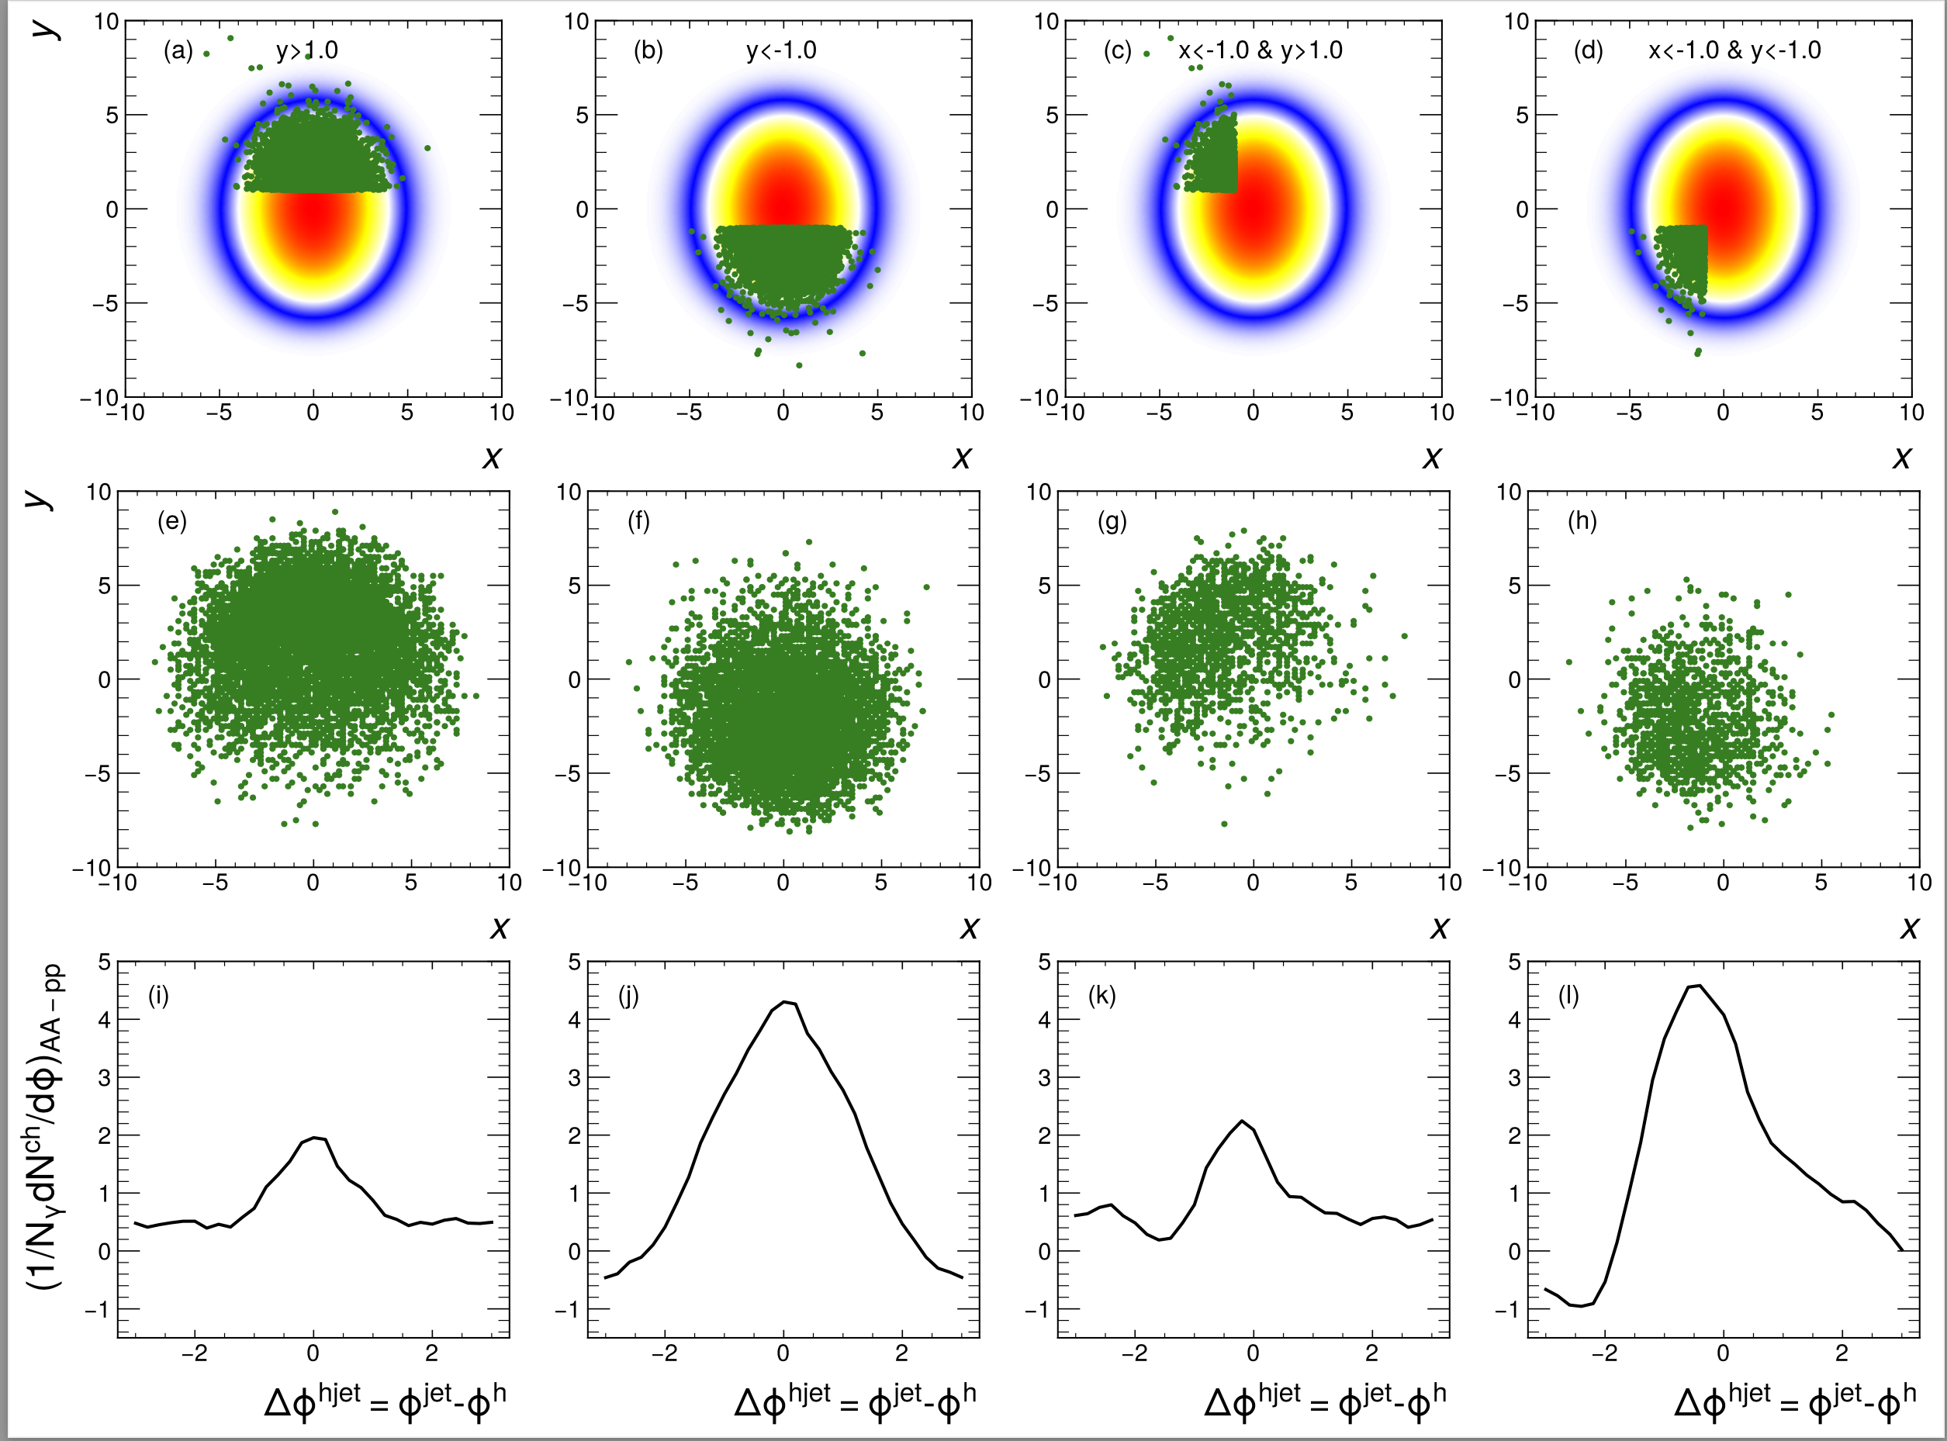
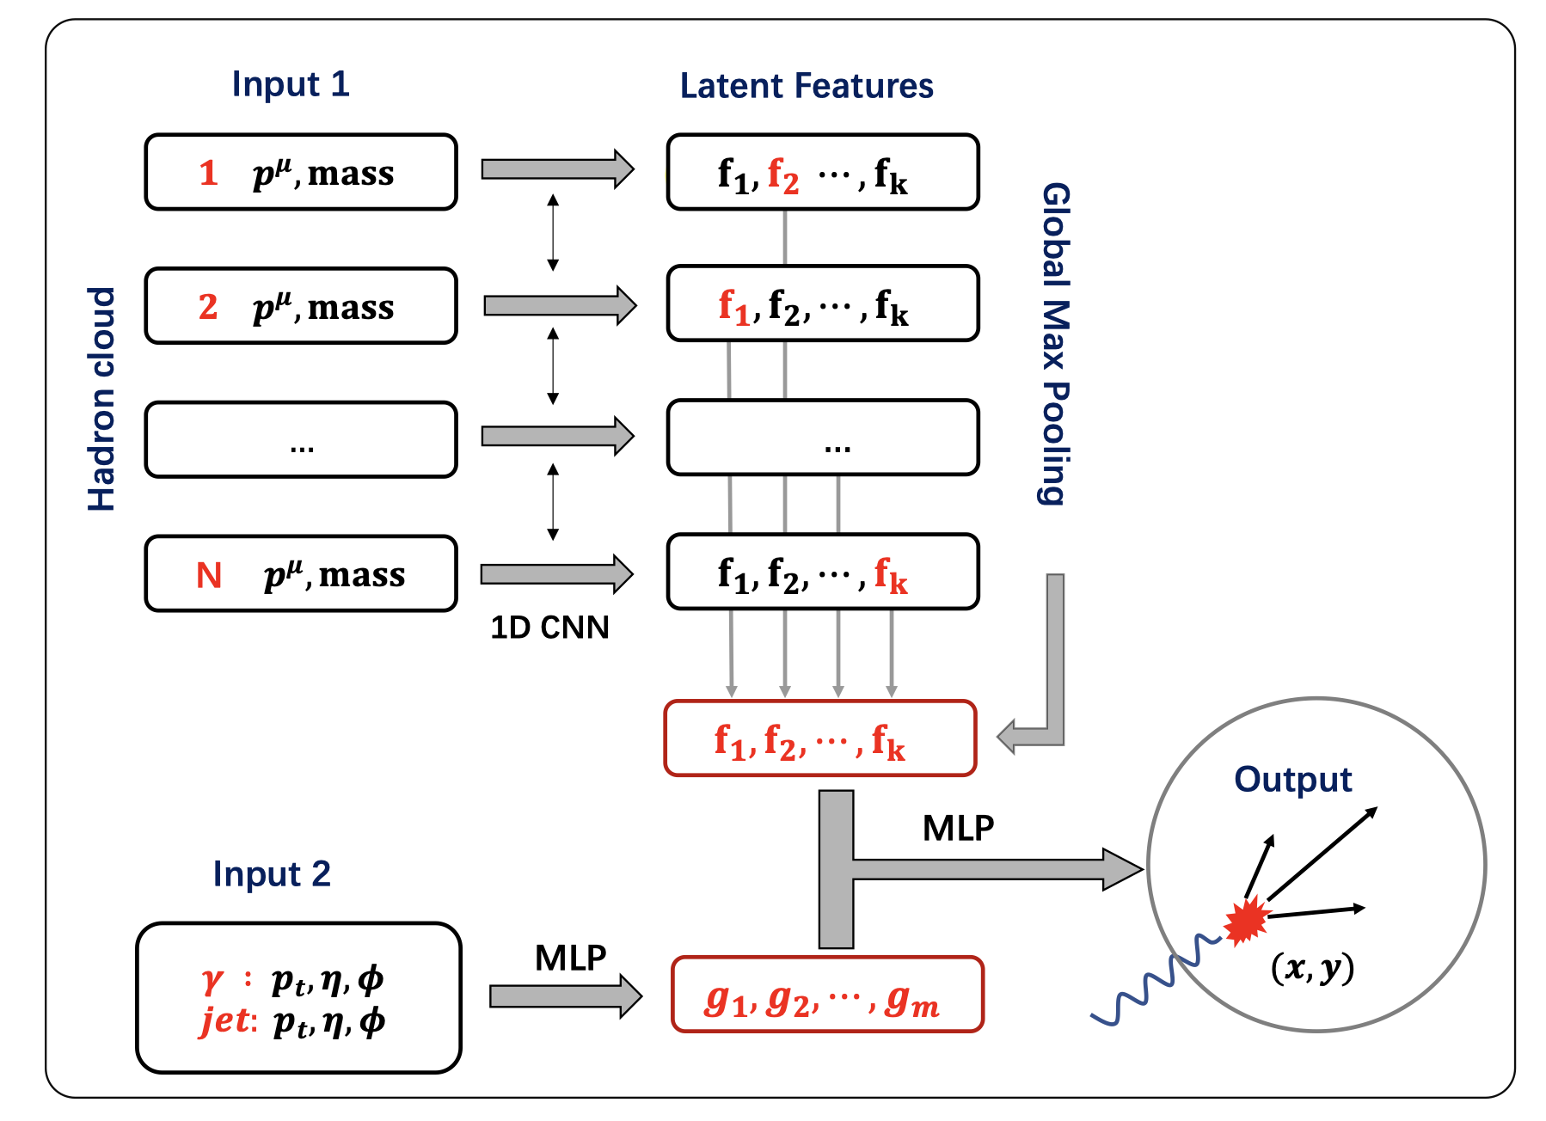
Deep learning assisted jet tomography
PCN (point cloud network)
DL network selection
Actual distribution
Eur.Phys.J.C 83 (2023) 7, 652
γ-soft hadron correlation
Yang, He，Chen，Ke，Pang & XNW
Notes:
Recently, the point could network as been applied to predict the transverse position of the initial jet production vertices

Slide 22
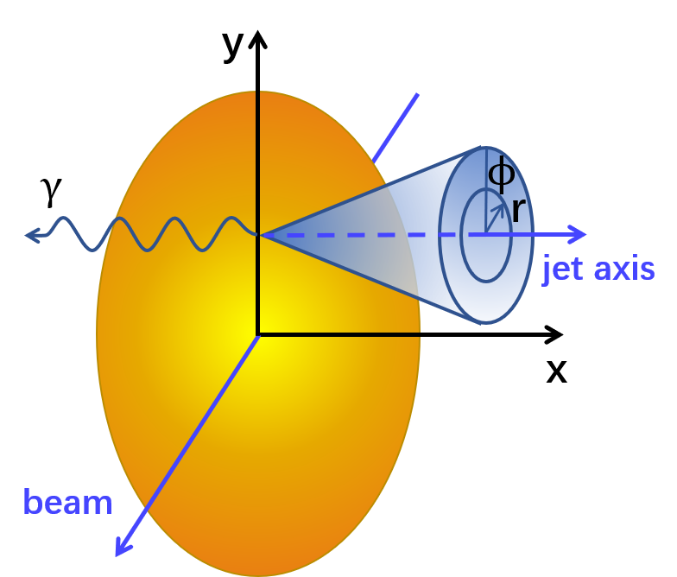
Asymmetric jet shape
Xiao, He, Pang, Zhang & XNW, PRC 109 (2024) 5, 054906 (e-print: 2402.00264)

Slide 23
Summary
First complete and realistic calculation of jet EEC in heavy-ion collisions
Medium-response dominates enhancement of EEC at large angles which is sensitive to interaction scale in medium
Increased parton scale in medium leads to enhancement of EEC at small angles
Azimuthal dependence of EEC – imaging Mach-cone

Slide 27
EEC of dijets
Leading jet
subleading jet
EEC_{leading} – EEC_{subleading} : robust measure of medium modification free of background

Slide 28
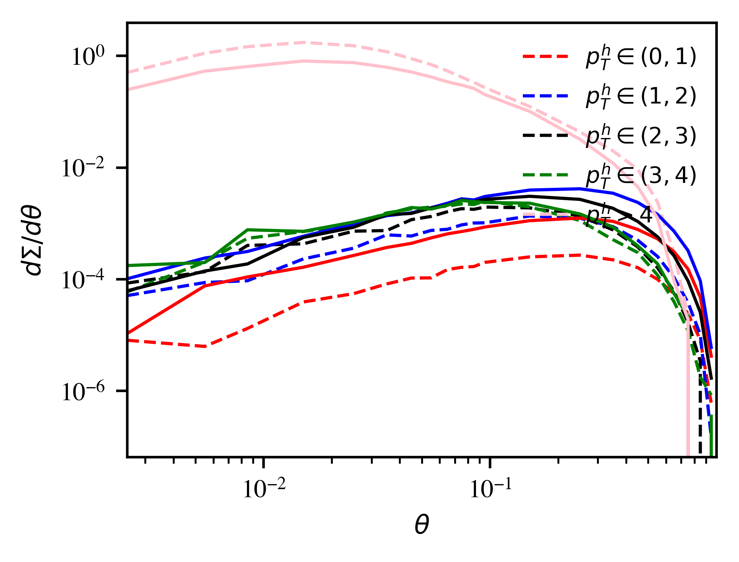
pT dependence of EEC

Slide 29
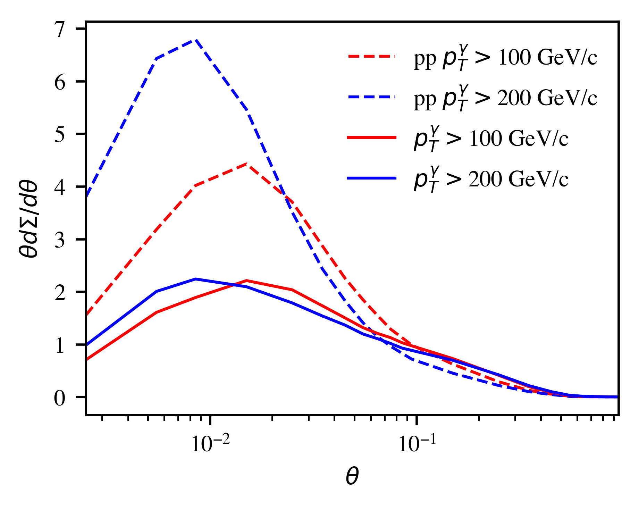
γ energy dependence

Slide 30
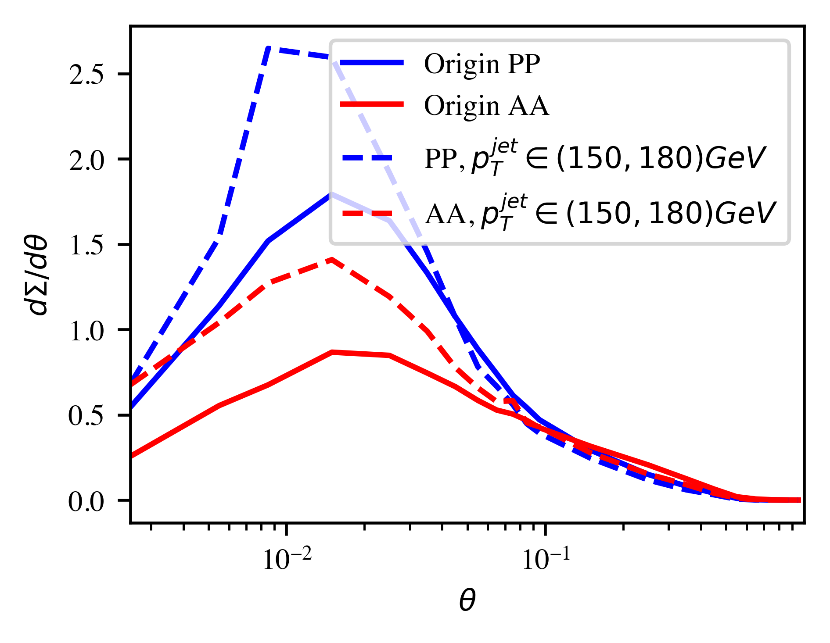
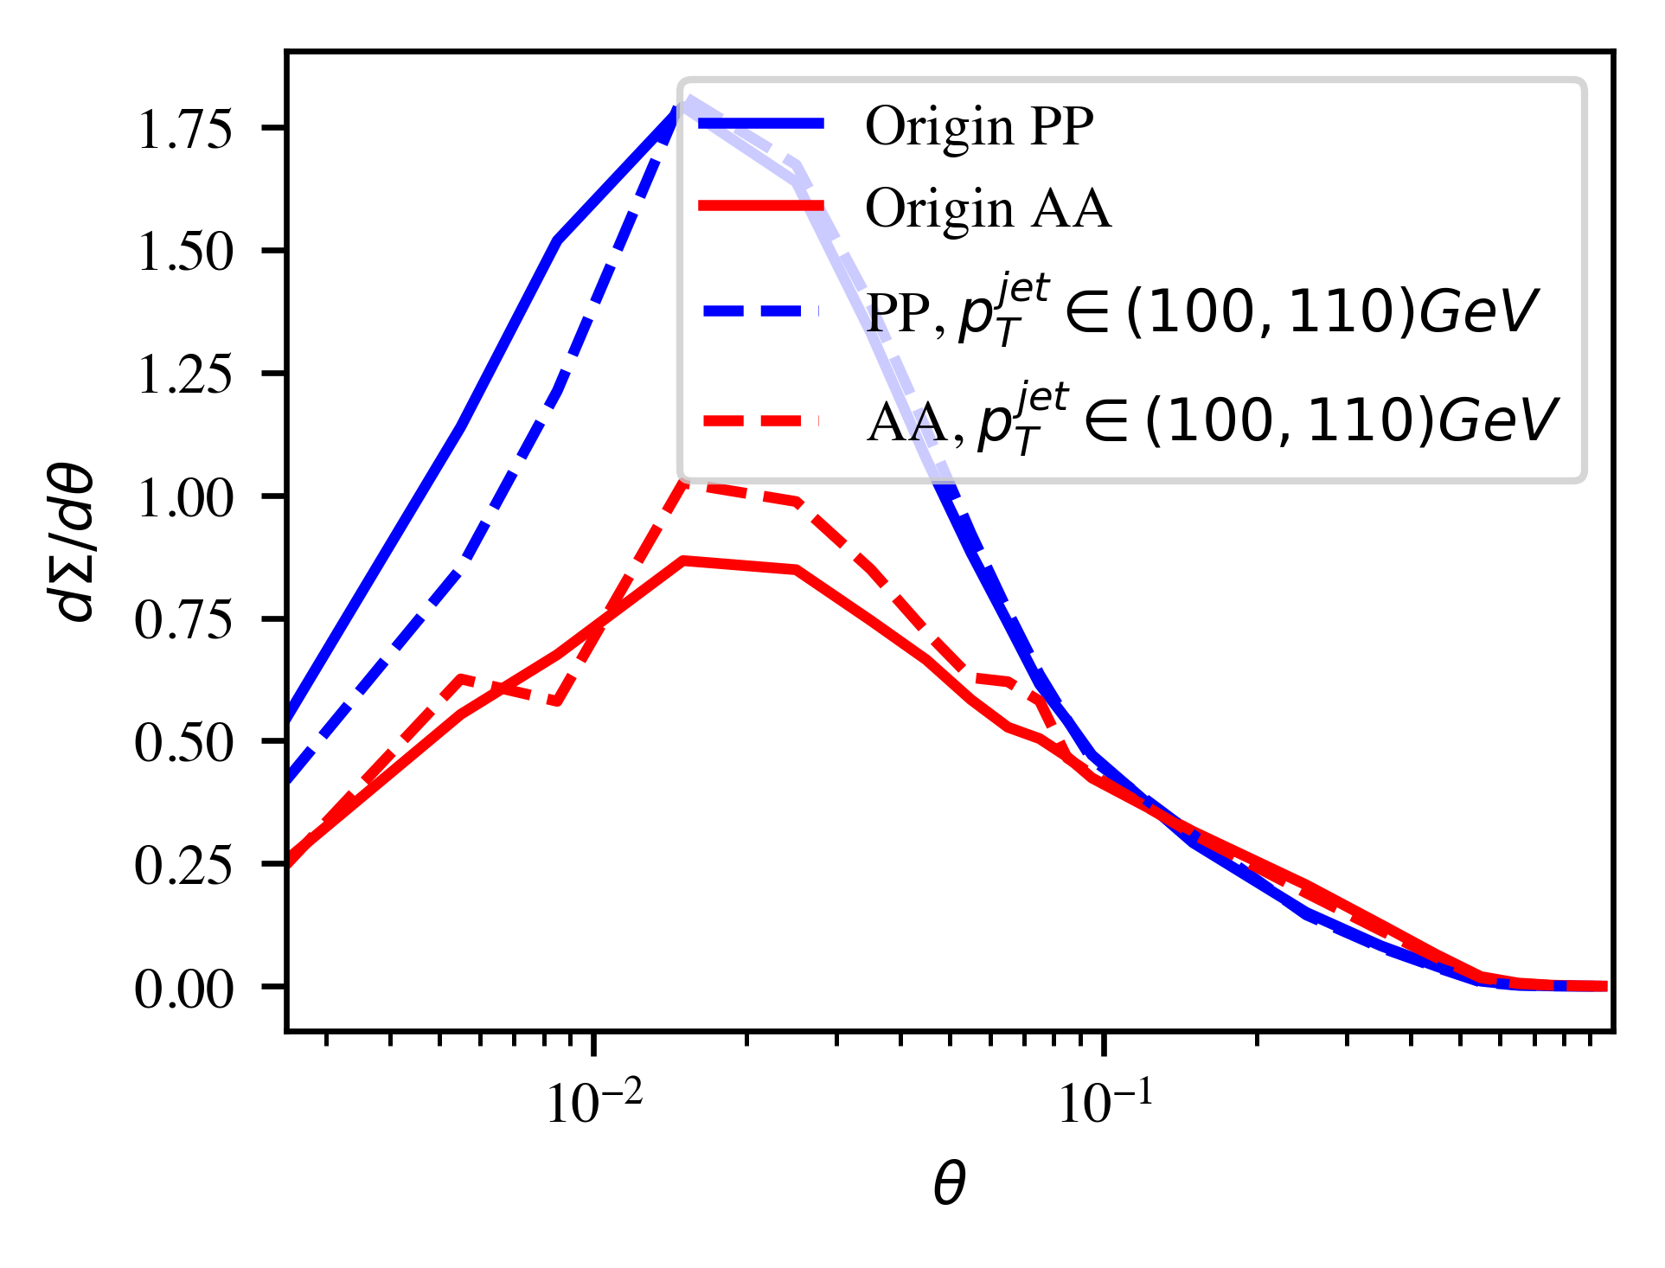
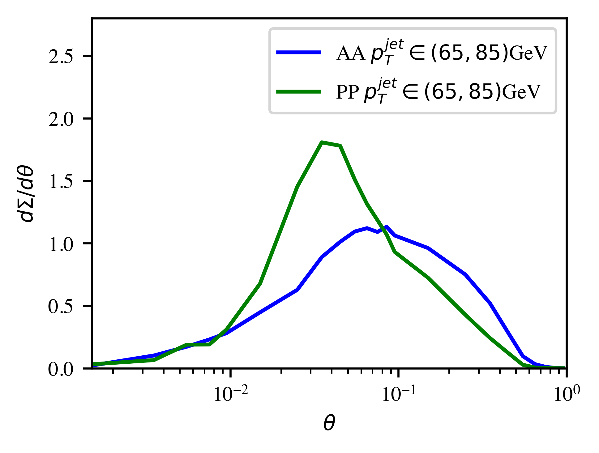
Jet energy dependence

Slide 31
MPI subtraction in Z-hadron correlation
Medium modification of MPI: low pT enhancement and high pT suppression
No correlation with Z/γ-jet
Jet
MPI
Mixed event subtraction

Slide 32
Sensitivity to EoS and shear viscosity
eosq: first order
s95p: rapid crossover from LQCD
Larger effective c_{s} in eosq → :
larger Mach cone angle → shallower DF valley
Stronger radial flow → smaller soft MPI
Competition of:
η/s increase transverse flow → suppression of soft MPI and DF valley
Negative shear correction of longitudinal pressure → impede longitudinal expansion → increase MPI and DF valley

Slide 33
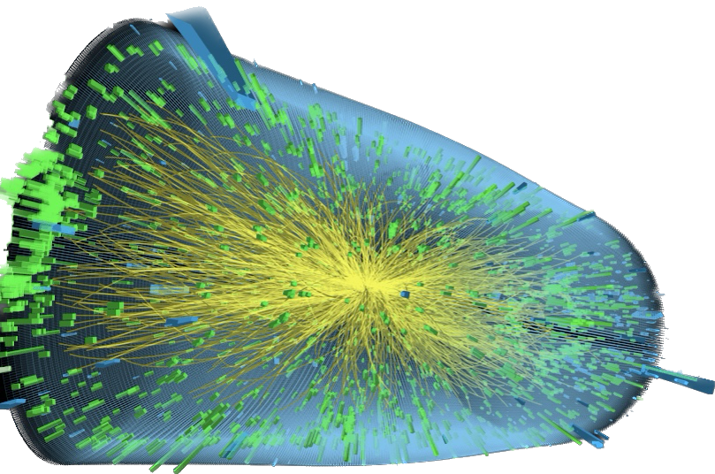
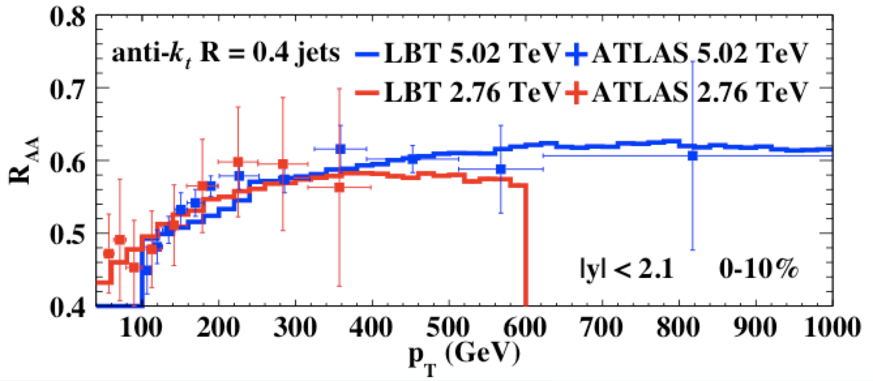
Jet suppression and medium response at LHC
Z-jet
Single inclusive jets
γ-jet
He, Cao, Chen, Luo, Pang & XNW 1809.02525
Zhang, Luo, XNW, Zhang, arXiv:1804.11041
Luo, Cao, He & XNW, arXiv:1803.06785

Slide 34
Gluon spectrum from single emission in GHT
Generalized HT induced emission in a QGP brick:
g(2)
For small angle emission:
a
l
a(1)
k
Change of variable
Notes:
\frac{dN_{g}^{a({\rm GHT})}}{dz d\ell^2_\perp}
= \frac{C_AC_2(R)}{N_c^2-1} \frac{\alpha_s}{2\pi} P_{ag}^{(0)}(z)
\int dy \rho_A(y) \int_0^{Q^2} d^2{\bf k}_\perp \frac{\alpha_s \phi_{g}(x_g, {\bf k}_\perp^2)}{k_\perp^2} \frac{2{\bf k}_\perp \cdot {\bf \ell}}{\ell_\perp^2({\bf \ell}_\perp-{\bf k}_\perp)^2}
\left[1-\cos\frac{y}{\tau_f}\right]
\tau_f =\frac{2z(1-z)E}{(\bf \ell_\perp-\bf k_\perp)^2}
\ell_\perp \ll zE, |\bf k_\perp-\bf \ell_\perp| \ll (1-z)E
\theta_{12}^2\approx 4\frac{(\bf \ell_\perp- z\bf k_\perp)^2}{z^2(1-z)^2E^2} \approx 4\frac{(\bf \ell_\perp- \bf k_\perp)^2}{z^2(1-z)^2E^2}
\int_0^{2\pi} d\phi \frac{\bf k_\perp\cdot\bf \ell_\perp+\bf k_\perp^2}{(\bf \ell+\bf k_\perp)^2}=2\pi \Theta(k_\perp^2-\ell_\perp^2)
\bf \ell_\perp -\bf k_\perp \rightarrow \bf \ell_\perp
\theta_{12} \approx \frac{2 \ell_\perp}{z(1-z)E}
\frac{d\Sigma^{\rm med}_q}{d\theta} =\frac{{L}^{5/2} \hat{q}}{\pi\sqrt{E}} \frac{8\alpha_\mathrm{s} C_A}{(\sqrt{EL}\theta)^3}
\int dz \frac{P_{qg}(z)}{z(1-z)} \left[1-\frac{\sin ELz(1-z)\theta^2/8}{ELz(1-z)\theta^2/8}\right]
\frac{d\Sigma^{\rm med}_q}{d\theta} \approx
\frac{ L^{2} \hat{q}}{2 E} \frac{\alpha_\mathrm{s} C_A}{\theta}, \theta> \sqrt{8\pi/EL}
\frac{d\Sigma^{\rm med}_q}{d\theta} \approx \frac{L^3 \hat{q} \alpha_\mathrm{s} C_A \theta}{64\pi}, \theta < \sqrt{8\pi/EL}

Slide 35
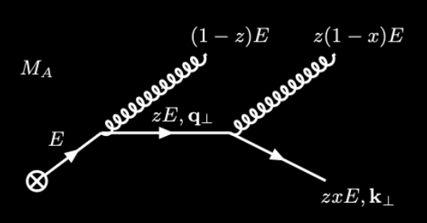
Jet EEC in Vacuum
LO emission in vacuum:
Leading Log evolution:
….
Non-leading log power corrections
Uncorrelated emission at small angle
Notes:
\frac{d\Sigma_q^{\rm vac}}{d\theta} \approx \frac{\alpha_s}{2\pi} C_F
\int_0^1 dz~ z(1-z) P_{qg}(z) \int_{\mu_0^2}^{Q^2} \frac{d{\bf \ell}_\perp^2}{\ell_\perp^2} \delta \left(\theta - \frac{\ell_\perp}{z(1-z)E}\right)
\approx \frac{\alpha_s}{2\pi}\frac{C_F}{2\theta} \left(3-\frac{2\mu_0}{E\theta}\right)\sqrt{1-\frac{4\mu_0}{E\theta}}
\frac{\partial \Sigma_q}{\partial \ln \mu^2} = \frac{\alpha_s(\mu^2)}{2\pi}\left[\gamma_{qq}(3)\Sigma_q +\cdots\right]

Slide 36
EEC in generalized high-twist
With a (GW) static potential model
For large angles
Recover HT results:
Notes:
\hat q=\int dk_\perp^2 \phi(0, k_\perp) \approx \rho \frac{C_2(R)C_2(T)}{N_c^2-1} 4\pi \alpha_s^2 \ln\frac{s^*}{4\mu_D^2}
\frac{d\Sigma^{\rm med}_q}{d\theta} =\frac{{L}^{5/2} }{\pi\sqrt{E}} \frac{\hat{q}}{\ln\frac{s^*}{4\mu_D^2}}\frac{8\alpha_\mathrm{s} C_A}{\theta\sqrt{EL}}
\int dz \frac{z(1-z)P_{qg}(z)}{z^2(1-z)^2\theta^2EL+4\mu_D^2} \left[1-\frac{\sin ELz(1-z)\theta^2/8}{ELz(1-z)\theta^2/8}\right]
\frac{d\Sigma^{\rm med}_q}{d\theta} =\frac{{L}^{5/2} \hat{q}_{HT}}{\pi\sqrt{E}} \frac{8\alpha_\mathrm{s} C_A}{(\sqrt{EL}\theta)^3}
\int dz \frac{P_{qg}(z)}{z(1-z)} \left[1-\frac{\sin ELz(1-z)\theta^2/8}{ELz(1-z)\theta^2/8}\right]

