Slide 1
Measurement of Full and Charged Two-Point EECs at STAR
Andrew Tamis (Yale University)
For the STAR Collaboration
Energy Correlators at the Collider Frontier
Week 1
8/7/24 – 12/7/24
Supported in part by

Slide 2
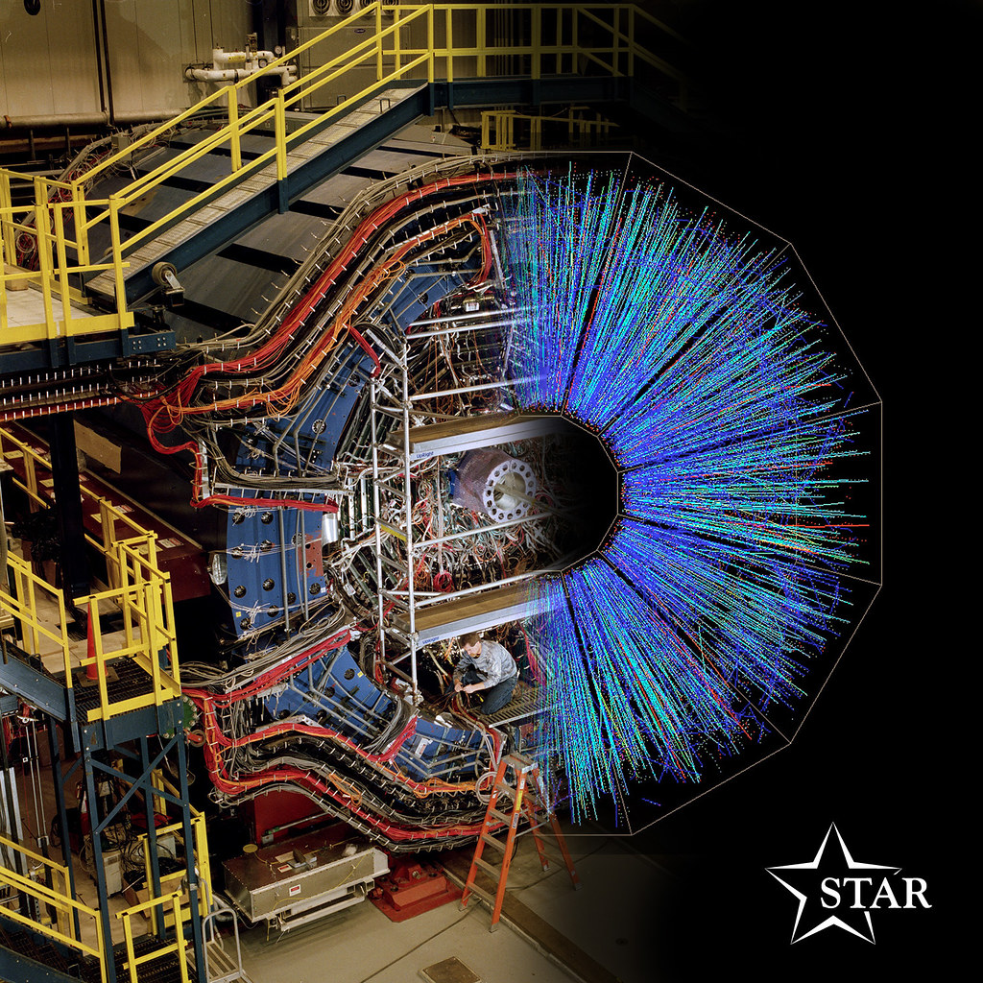
Measurement at STAR
STAR Time Projection Chamber (TPC) provides excellent charged track resolution
Barrel Electromagnetic Calorimeter (BEMC) allows for measurement of full jets
BEMC used for trigger in order to obtain jet-rich data sample
11/7/2024
Tamis - EECF 2024

Slide 3
Energy Energy Correlators (EEC)
Theoretical Definition of projected N-Point Correlator
Chen et al. 2020,
PRD 102, 5
$$E_{i}$$
ΔR
Normalized EEC = $\frac{1}{\sum_{Jets}{\sum_{i≠j}{\frac{E_{i}E_{j}}{{p_{T, Jet}}^{2}}}}}\frac{d\left(\sum_{Jets}{\sum_{i≠j}{\frac{E_{i}E_{j}}{{p_{T, Jet}}^{2}}}}\right)}{d ⁡(∆R)}$
η
$$E_{j}$$
Experimental Construction of Two-Point Correlator
φ
Note: Energy assumes pion mass
Use all final state charged particles, and examine how energy is distributed as a function of their separation
Allows for study of jet evolution using final state jet constituents as they are, no additional clustering or grooming after jet-finding
11/7/2024
Tamis - EECF 2024

Slide 4
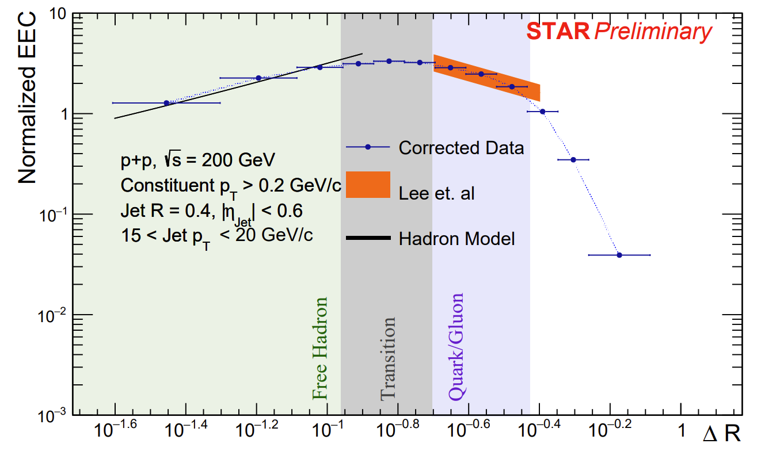
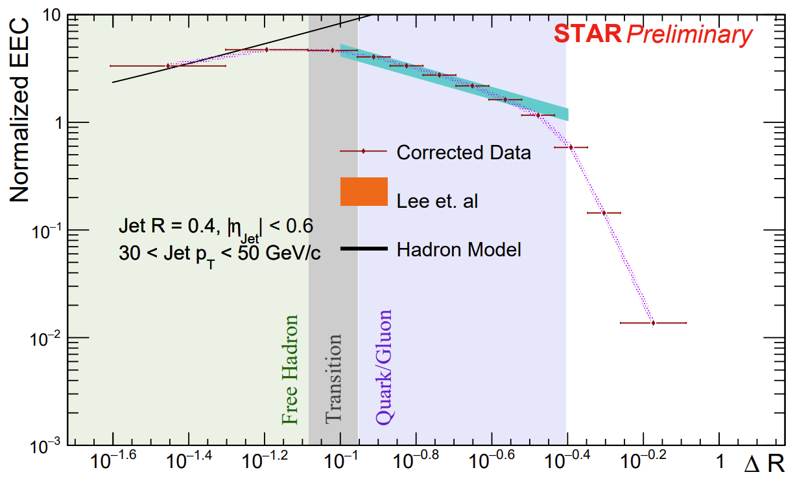
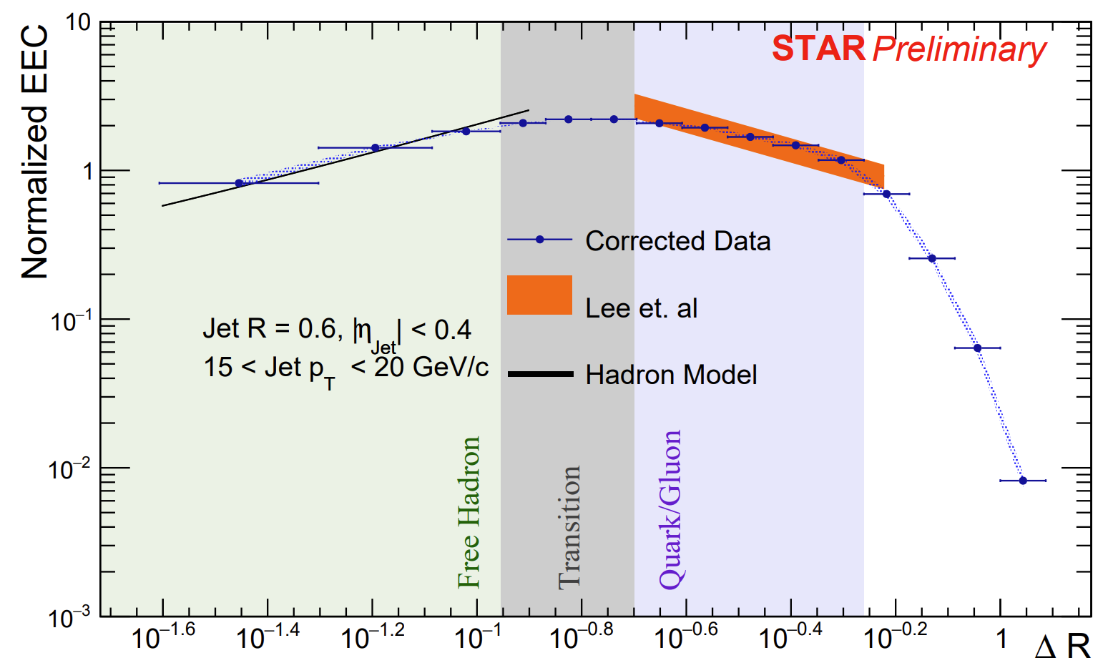
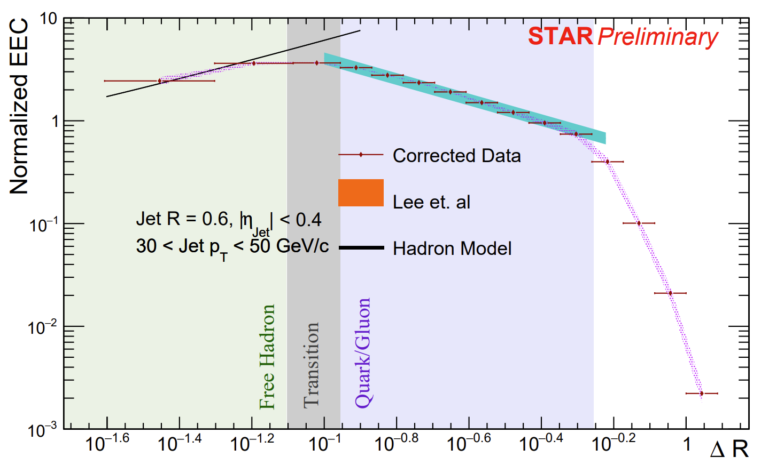
Measurement at STAR (R = 0.4)
15 < Full $Jet p_{T}$ < 20 GeV/c
30 < Full $Jet p_{T}$ < 50 GeV/c
$p_{T, jet}$
$p_{T, jet}$
Theoretical comparison calculated in the Perturbative Region ($\frac{3GeV}{{{p_{T}}^{Jet}}_{Low}}$ < $∆R$ < Jet R)
Behavior agrees well with theoretical expectations!
Low angle behavior compared with toy model of hadrons, assuming uniform energy distribution
Lee, Mecaj, Moult (2023): arXiv:2205.03414
$p_{T, jet}$
$p_{T, jet}$
$p_{T, jet}$
$p_{T, jet}$

Slide 5
Measurement at STAR (R = 0.6)
$p_{T, jet}$
$p_{T, jet}$
Theoretical comparison calculated in the Perturbative Region ($\frac{3GeV}{{{p_{T}}^{Jet}}_{Low}}$ < $∆R$ < Jet R)
Behavior agrees well with theoretical expectations!
Low angle behavior compared with toy model of hadrons, assuming uniform energy distribution
Lee, Mecaj, Moult (2023): arXiv:2205.03414

Slide 6
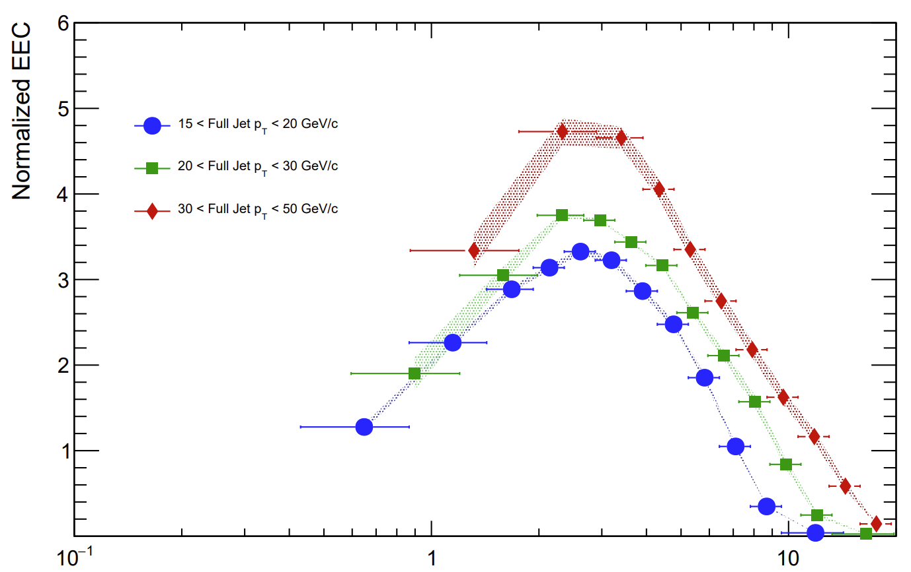
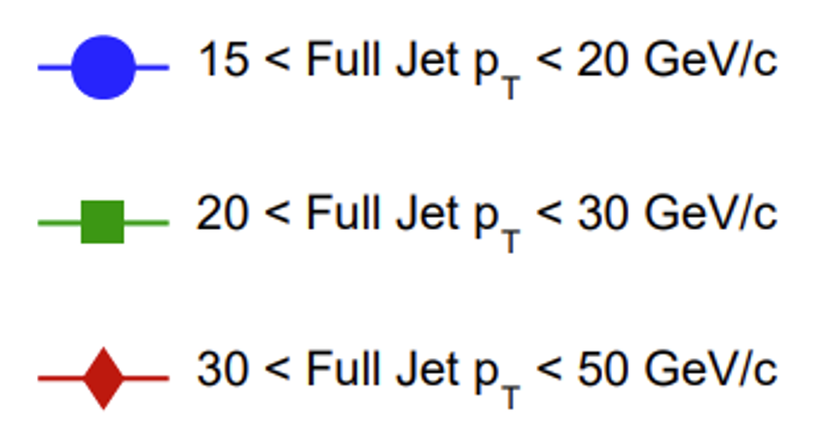
$p_{T}$-Shifted Distributions
Shift Corrected Result on x axis by average $p_{T, jet}$ in a given bin
As location of transition $∝$ $\frac{Λ_{QCD}}{{p_{T}}^{Jet}}$, this will collapse it onto a single point
In this case, average momentum is determined via PYTHIA and applied post-correction
STAR Preliminary
$\sqrt{s}$ = 200 GeV
R = 0.4
$\left|η_{Jet}\right|$< 0.6
Constituent $p_{T}>0.2$GeV/c
${<p}_{T, jet}>{∆R}_{Turnover} \sim 2−3 GeV$

Slide 7
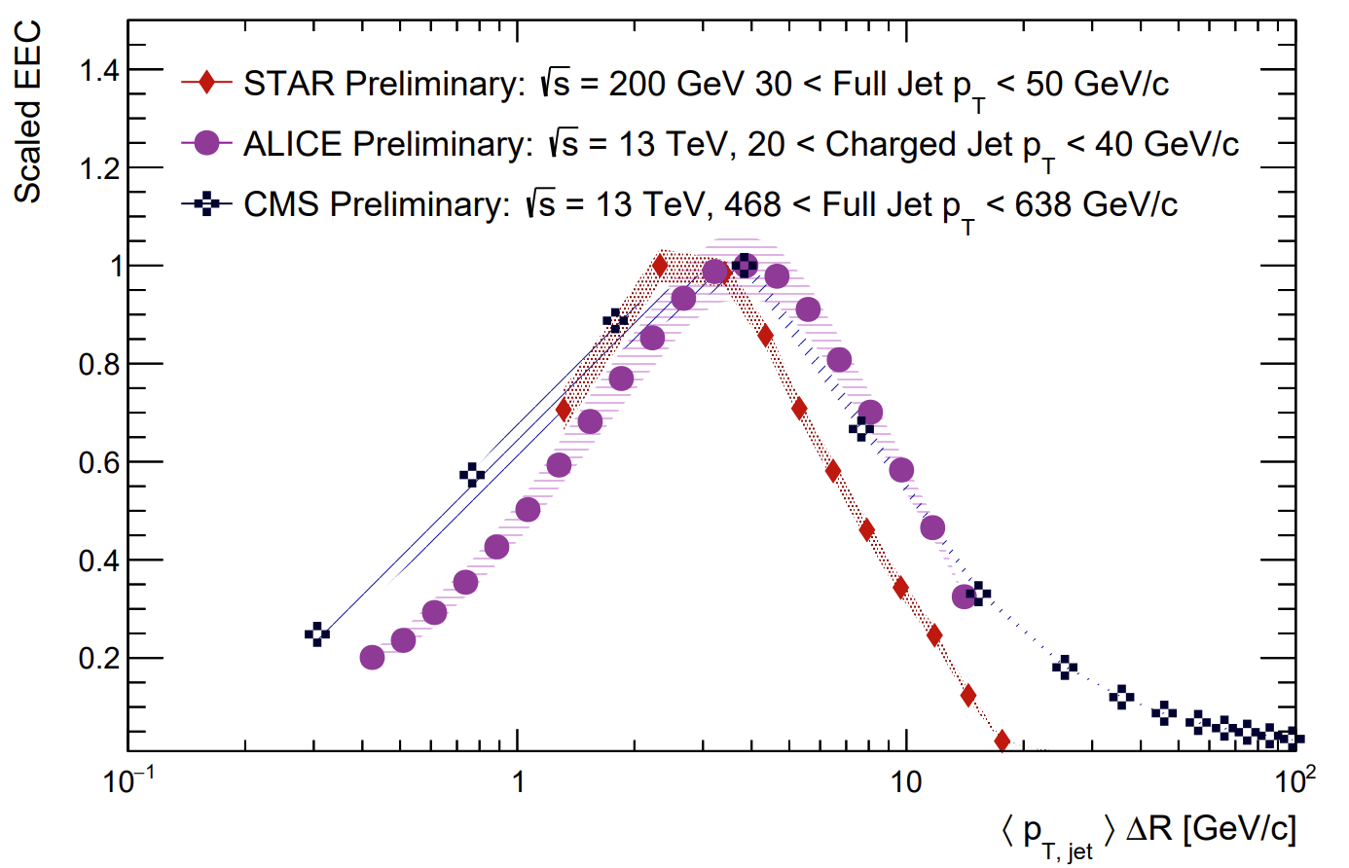
Comparison with ALICE and CMS Results
STAR result is comparable with both CMS and ALICE results – across a large gap in jet momentum
EEC scaled to have value at peak be one to more directly compare peak locations
Quark, gluon fragmentation differences transition region shifts based on initiator

Slide 8
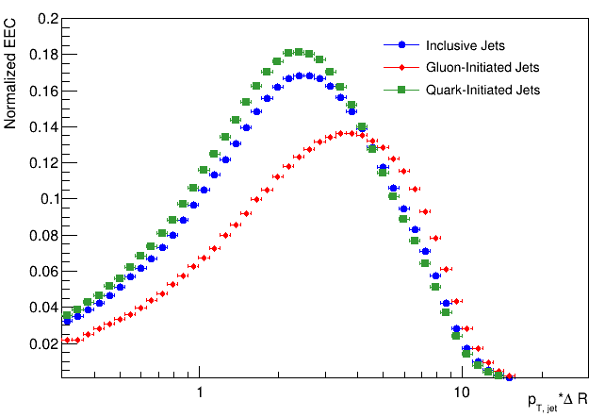
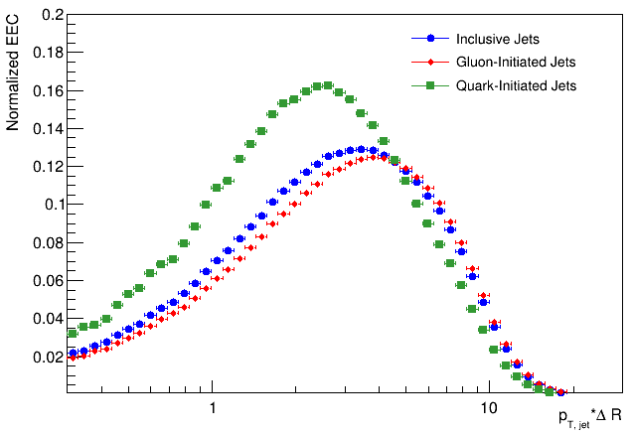
Impact of Quark/Gluon Fraction
Observed turnover region for ALICE result occurs at larger ${<p}_{T, jet}>{∆R}_{Turnover}$
This is largely due to difference in quark/gluon fraction as gluons fragment to larger angles
Quark-rich environment of STAR is unique place to study EECs
R = 0.4
$\left|η_{Jet}\right|$< 0.6
Constituent $p_{T}>0.2$GeV/c
20 GeV/c < $p_{T, jet}$ < 40 GeV/c
PYTHIA8
Multi-Parton Interactions OFF
$\sqrt{s}$ = 200 GeV
$\sqrt{s}$ = 13 TeV
$$Quark Dominated$$
$$Gluon Dominated$$

Slide 9
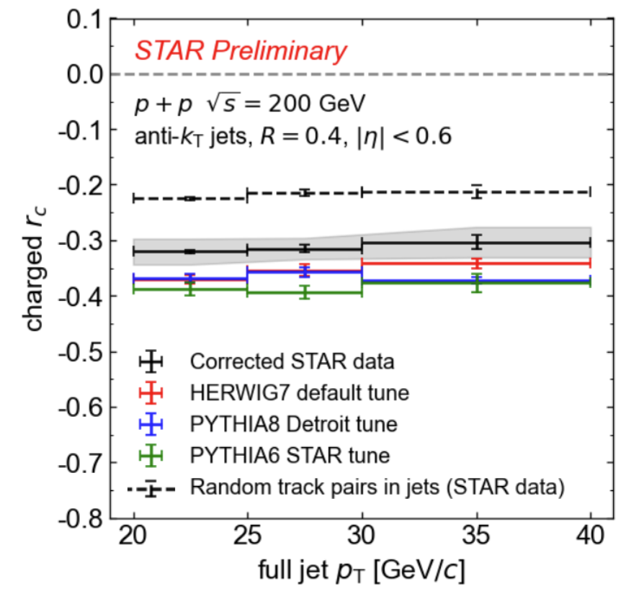
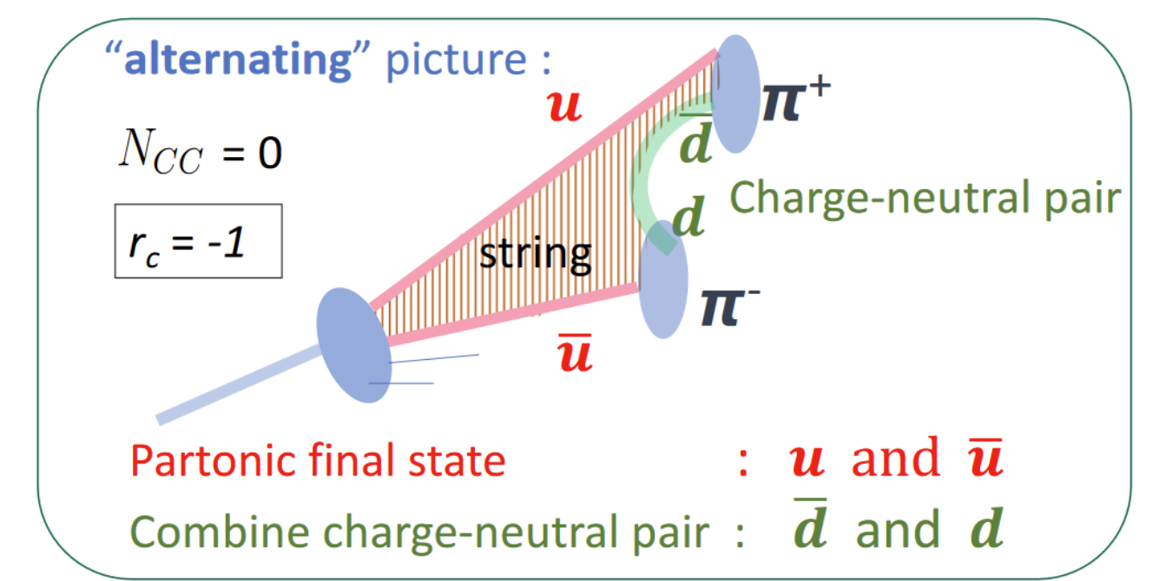
Charge-Dependent Hadronization
Hadronization may introduce explicit charge dependence dependent on mechanism
String-Like hadronization used by PYTHIA, while cluster hadronization used by HERWIG
Studied by several charge dependent observables, such as $r_{c}$
Figure: Mriganka Mouli Mondal

Slide 10
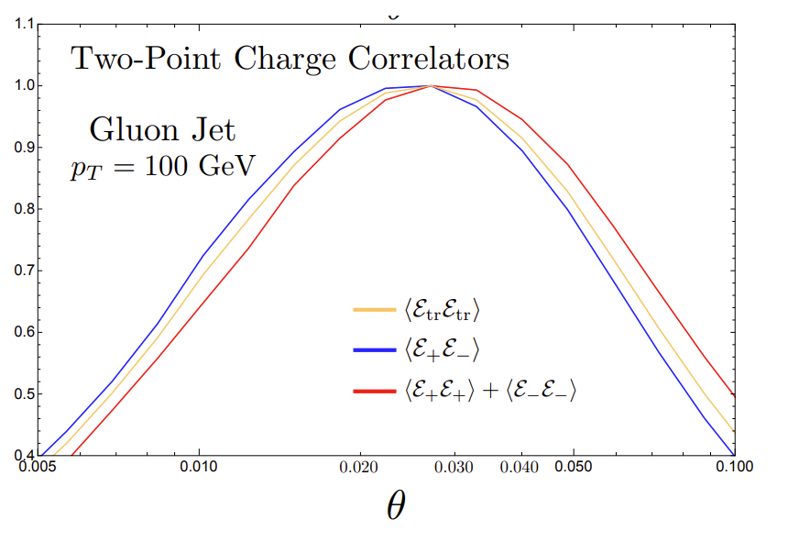
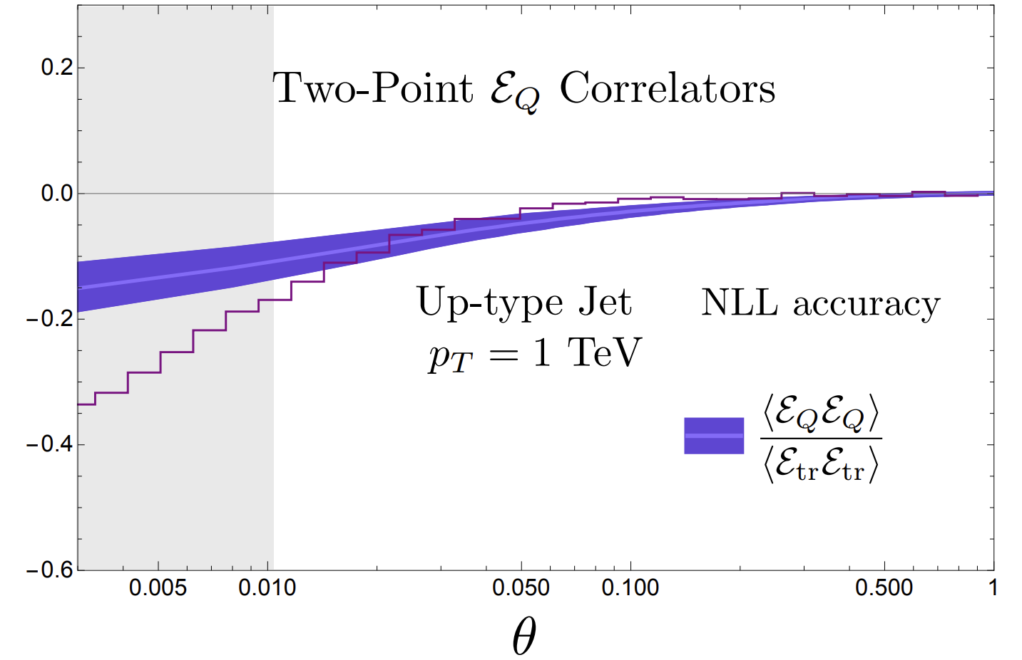
Charged EECs
Lee,Moult 2023: arXiv:2308.00746
Can further extend non-perturbative power of EEC by exploring correlation of both angle and charge distribution.
Replace energy flow operator with some selection on charge (Like or Opposite charge correlations)
Or by weighting energy flow operator by charge operator
Seen in Pythia simulations done by Lee and Moult, Transition region shifts on like- and opposite-charge selection
Opposite
Like

Slide 11
Charged EEC Experimental Measurement
Experimentally: Build distributions out of like-sign correlations and opposite-sign correlations
Perform 3D Bayesian unfolding separately to each distribution
Construct charge-weighted EEC via their difference
-
+
-
ΔR
+
-
-
-
η
+
+
Charged EEC = $\frac{d\left(\sum_{Jets}{\sum_{i≠j}{\frac{E_{i}Q_{i}E_{j}Q_{j}}{{p_{T, Jet}}^{2}}}}\right)}{d ⁡(∆R)}$ = ${EEC}_{Like}$ - ${EEC}_{Opposite}$
φ
+
+
+
-
-
-

Slide 12
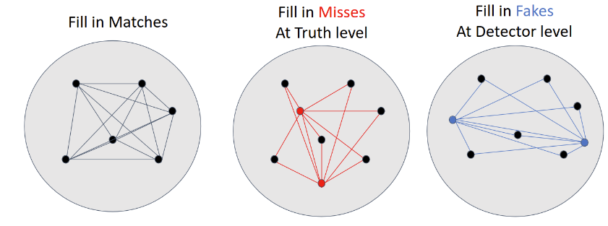
3D Unfolding – Method
Unfold separately for like-charge and opposite-charge correlations
Perform matching between particle and detector level
Once for Jets (Within Jet Radius) and once for constituents ( Within 0.01 in eta-phi)
Bayesian Unfolding in three variables per correlation
$p_{T, jet}, { R}_{L}, \frac{E_{1}E_{2}}{{p_{T, jet}}^{2}}$

Slide 13
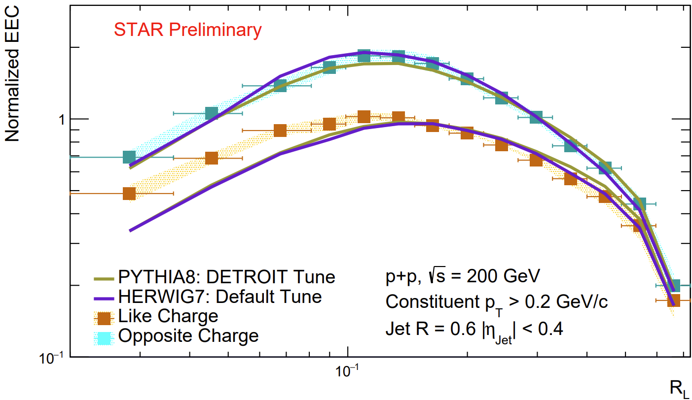
Like and Opposite charge Distributions
Both Like and Opposite sign follow expectations in perturbative region
Excess of like-charge correlations below transition region
Compared with Herwig 7 (Bellm et. al.) and Pythia 8 Detroit Tune (Aguilar et. al.)
Shift in location of transition region seen in Monte-Carlo, but not resolved in data
Perturbative Scaling
First measurement!
Transition

Slide 14
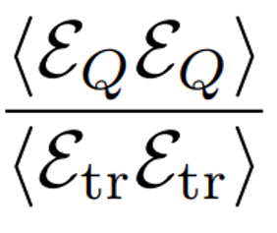
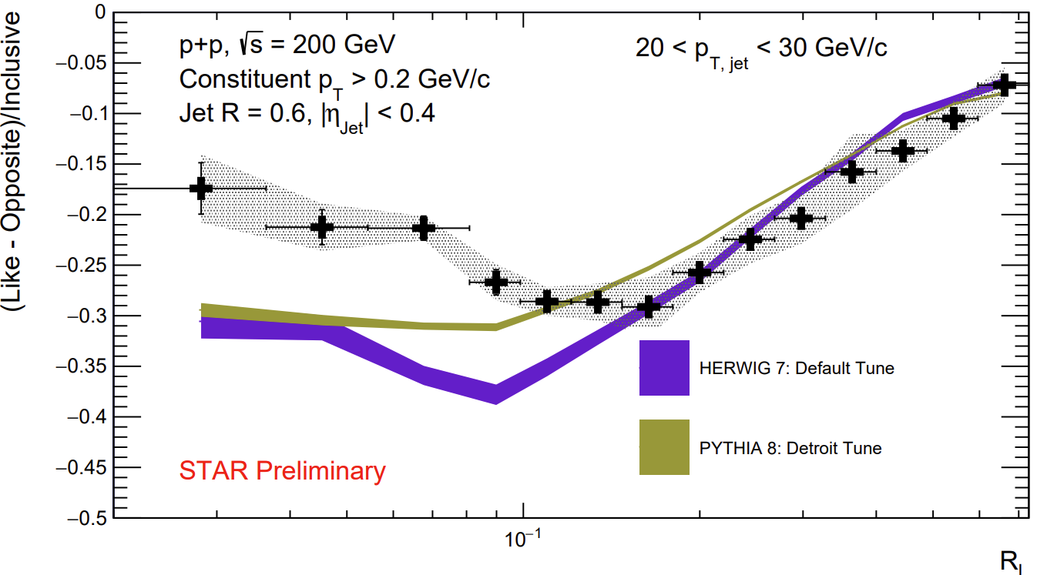
Charge Ratio
$\frac{d\left(\sum_{Jets}{\sum_{i≠j}{\frac{E_{i}Q_{i}E_{j}Q_{j}}{{p_{T, Jet}}^{2}}}}\right)}{d ⁡(∆R)}$ / $\frac{d\left(\sum_{Jets}{\sum_{i≠j}{\frac{E_{i}E_{j}}{{p_{T, Jet}}^{2}}}}\right)}{d ⁡(∆R)}$
≈
Cluster hadronization (Herwig) and String hadronization (Pythia) both predict same qualitative behavior
Both describe scaling of data in perturbative region, but neither describe data below transition region
Implementation of charge dependence/conservation in hadronization mechanism may not fully capture effects
First measurement!
Transition

Slide 15
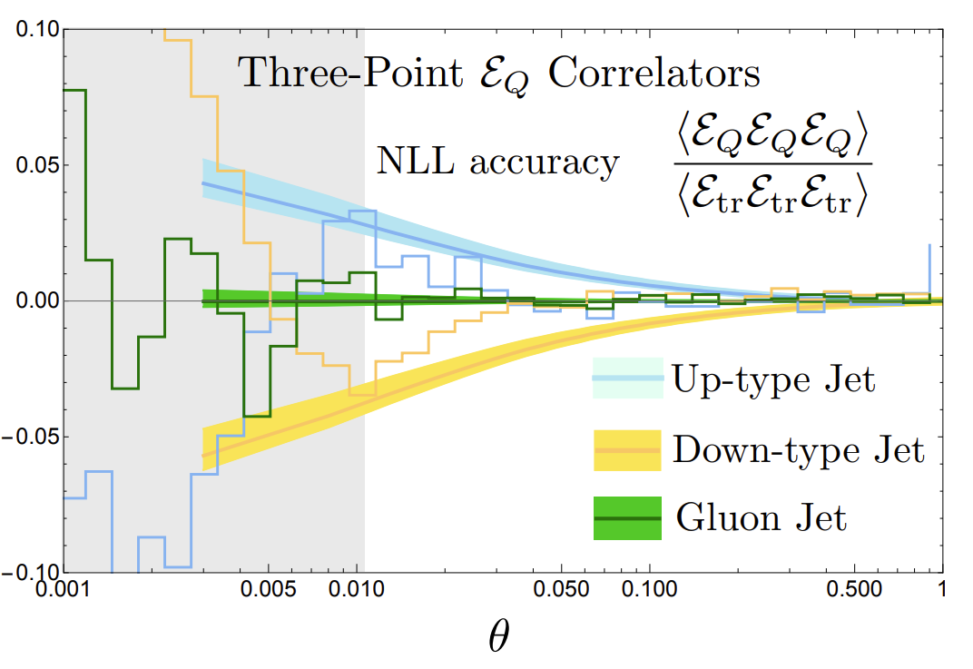
Extension to Three-Point
Lee,Moult 2023: arXiv:2308.00746
Extension to Three-point charge correlators extremely interesting
Charge odd – separates based on initiator charge
Identically zero for gluon jets
Well suited to be measured at STAR energies – high quark fraction with little antiquark cancellation

Slide 16
Conclusions
STAR is an extremely useful environment for study of ENCs, and an excellent complement to LHC measurements
Charged ENCs expand sensitivity of ENCs to non-perturbative effects and the hadronization mechanism
Observe tension with current Monte-Carlo models in charge-dependent hadronization
First measurements of Two-Point Charged EECs shown, with three-point extension in progress

Slide 17
Backup

Slide 18
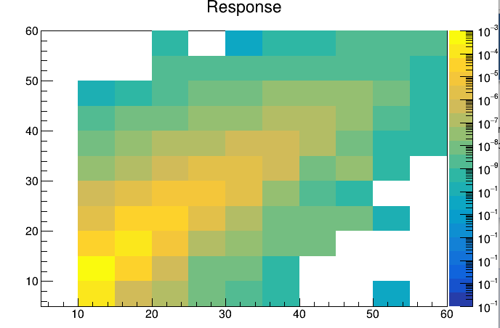
$p_{T}^{Jet}$Correction Method
Inform correction via use of PYTHIA6 (Truth) and PYTHIA6 + GEANT Embedded in min-bias data (Reconstructed)
Matched Correlations
Match jets between Truth and Reconstructed samples within a $∆R$of 0.4 and then match constituents inside of jets within a $∆R$ of 0.02 and form response matrix
$${10}^{−3}$$
$${10}^{−4}$$
$${10}^{−5}$$
$${10}^{−6}$$
$${10}^{−7}$$
$${10}^{−8}$$
$${10}^{−9}$$
$${10}^{−10}$$
$${10}^{−11}$$
$${10}^{−12}$$
$${10}^{−13}$$
$${10}^{−14}$$
$${10}^{−15}$$
$\sqrt{s}$ = 200 GeV
R = 0.4
$\left|η_{Jet}\right|$< 0.6
Constituent $p_{T}>0.2$GeV/c
PYTHIA 6 + GEANT
Truth Jet $p_{T}$ (GeV/c)
Reconstructed Jet $p_{T}$ (GeV/c)
Preliminary results use a correction procedure in which $p_{T, jet}$ is the only variable in which a response matrix is formed
Detailed in Proceedings from HardProbes2023
Planning to expand to full three-dimensional unfolding
11/7/2024
Tamis - EECF 2024

Slide 19
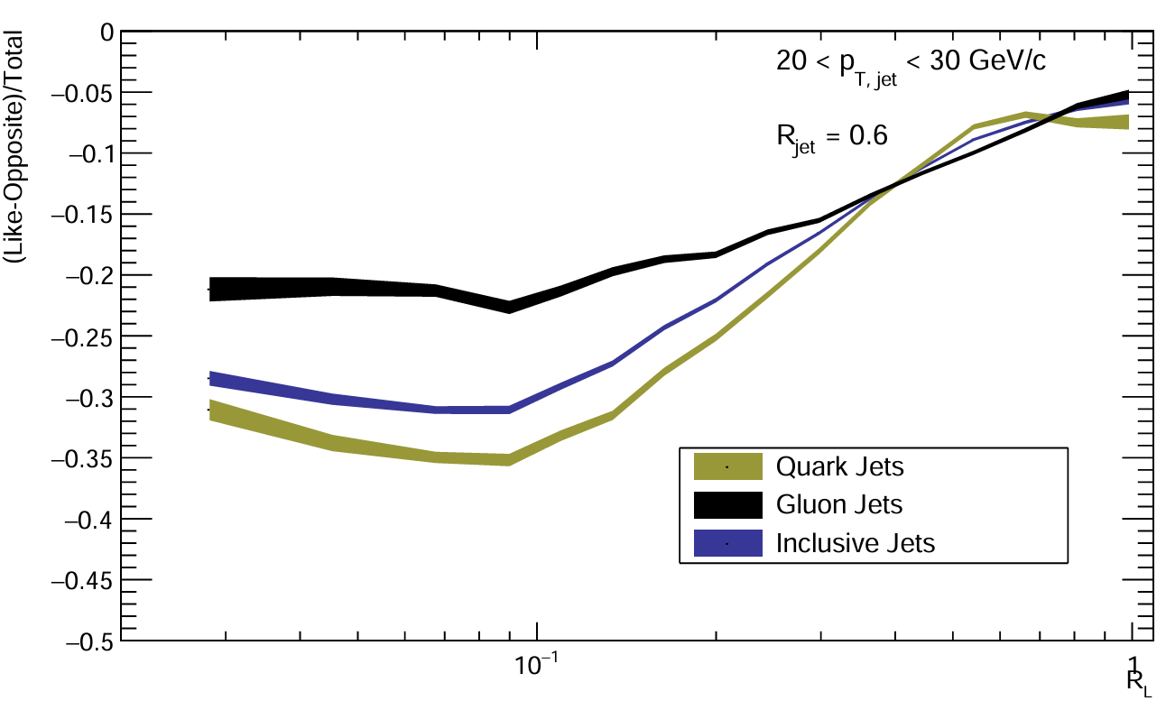
Quark/Gluon Behavior of Charged Ratio
Pythia8 – Detroit Tune

Slide 20
Torbjörn Sjöstrand
50 Years of Quantum Chromodynamics
UCLA
ucla23ts.pdf (cern.ch)

Slide 21
