Slide 1
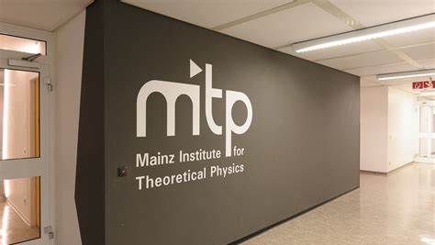



Energy-Energy Correlators in e⁺e⁻, pp and PbPb with ALEPH and CMS
Yen-Jie Lee (MIT)
Energy Correlators at the Collider Frontier
MITP, Mainz, Germany
July 8th 2024
MIT HIG group's work was supported by US DOE-NP
Notes:
(0:00) I would like to thank the organizer for the kind invitation to talk about what we learned from collectivity searches in smallest systems

Slide 2
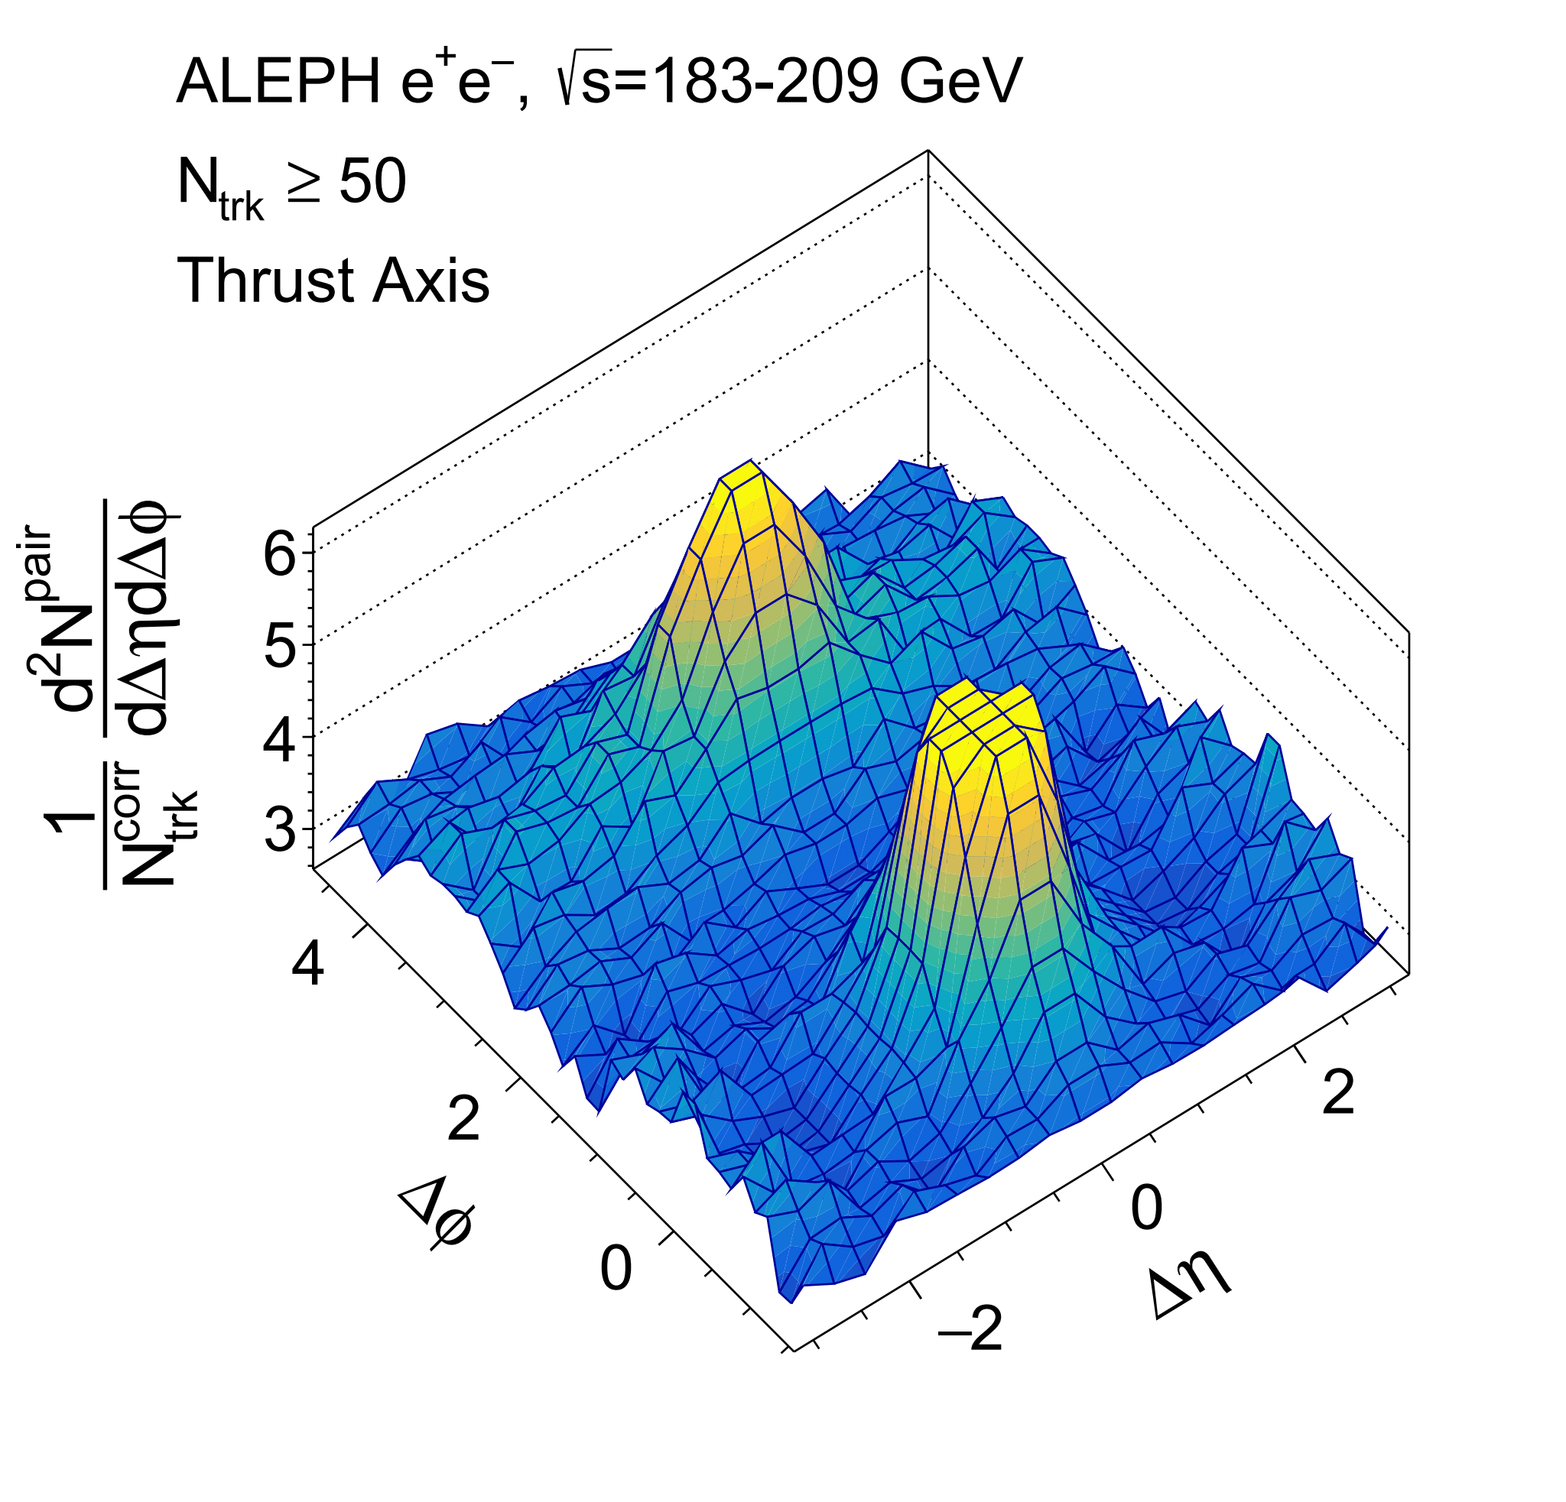
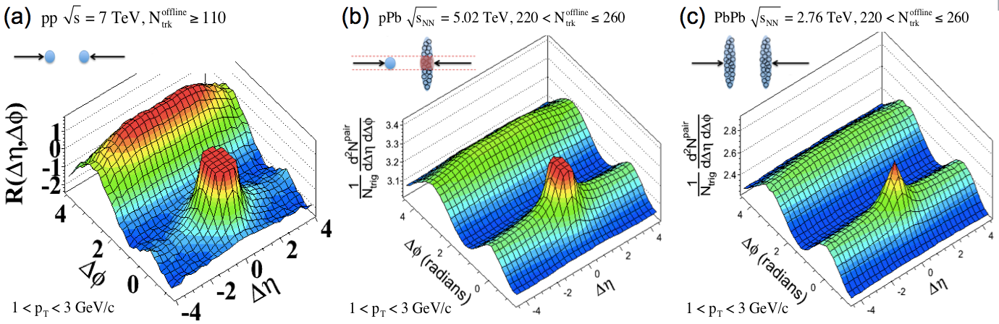
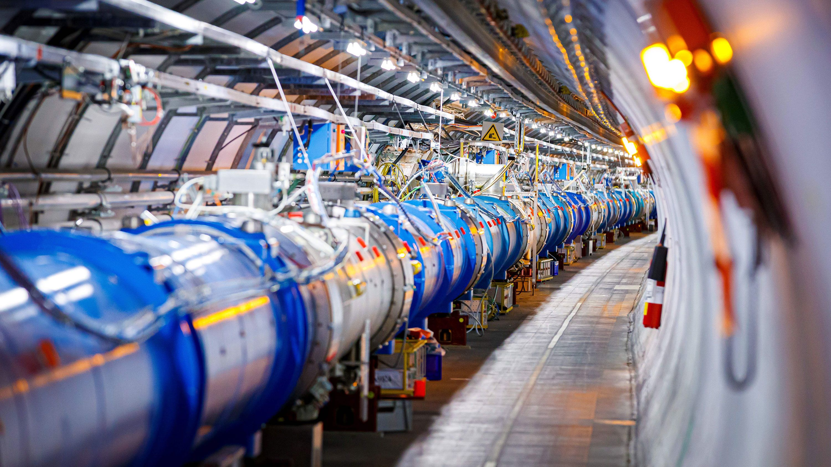
Motivation
e⁺e⁻
pp
pPb
PbPb
MIT-MOD-23-001
arXiv: 2312.05084
Submitted to PLB
Two-particle correlation functions have been studied in large collision systems.
Recent efforts have been extended to smaller and smaller collision systems
Comprehensive studies from e⁺e⁻, pp to pA and AA collisions:
Understand how the strongly interacting medium in AA was produced
EEC has been studied first in e⁺e⁻ and now extended to larger and larger systems

Slide 3
Motivation
e⁺e⁻
pp
pPb
PbPb
MIT-MOD-23-001
arXiv: 2312.05084
Submitted to PLB
Jet substructure and EEC in e⁺e⁻:
  Utilize the new jet clustering tools developed after LEP operation
  New tool for α_{s} extraction
  Revisit EEC with fine binning and extended it to full event.
  Further test of event generators, reference of pp
  Important preparation for EIC analyses as its reference

Slide 4
Motivation
e⁺e⁻
pp
pPb
PbPb
MIT-MOD-23-001
arXiv: 2312.05084
Submitted to PLB
EEC in pp:
  New tool for α_{s} extraction
  Test on pQCD and compared to event generators, such as PYTHIA 6, PYTHIA 8, SHERPA and HERWIG are tuned with hadronic event shape observables and hadron spectra in e⁺ e⁻
  Reference for pA and AA

Slide 5
Motivation
e⁺e⁻
pp
pPb
PbPb
MIT-MOD-23-001
arXiv: 2312.05084
Submitted to PLB
EEC in PbPb:
  Inclusive jet: reveal medium induced modification of EEC in jet
    Jet quenching, medium induced momentum broadening, induced radiation and medium response
    CMS: First inclusive jet E2C in AA will be shown by Jussi on Friday
  Z-tagged EEC: access to full event, without jet selection bias

Slide 6
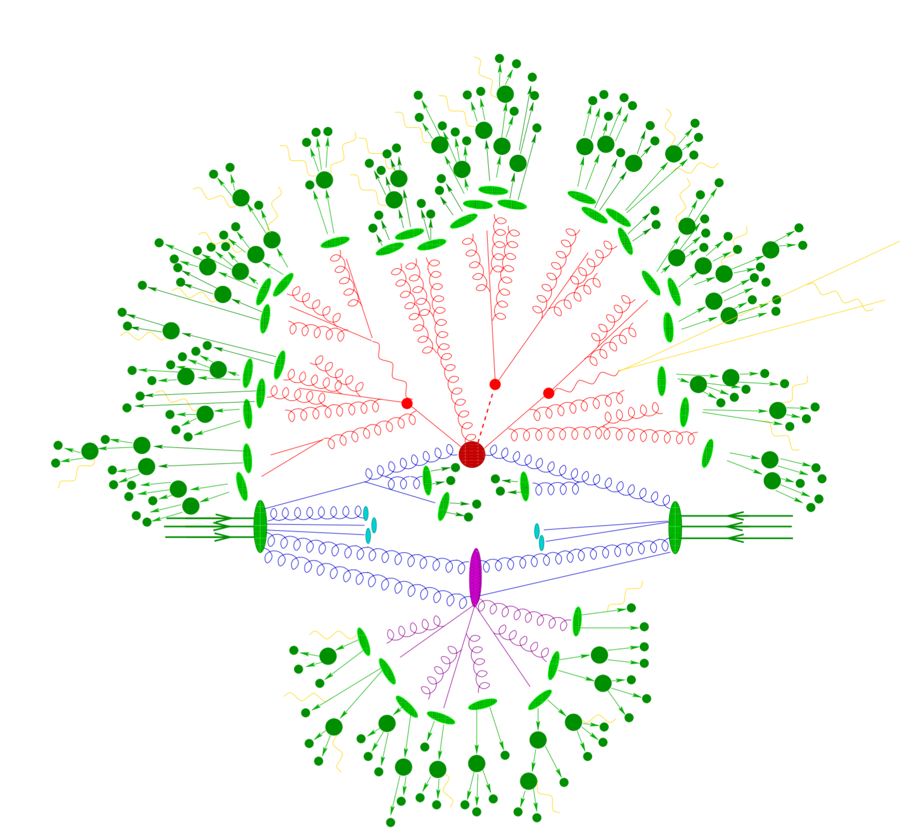
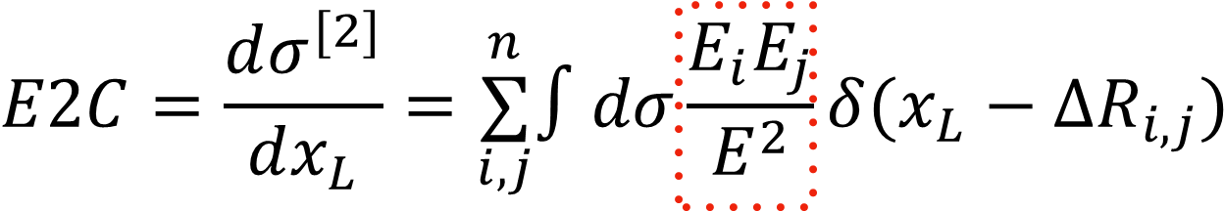
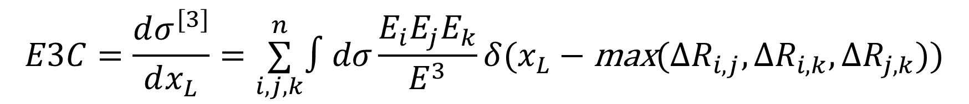
EEC in pp with CMS
(1) Energy-energy correlators in CMS pp
R_{L}
R_{L}
pp
Notes:
The energy of charged hadrons is determined by combining the momenta measured in the tracker with the
corresponding ECAL and HCAL energy deposits, corrected for the response function of the
calorimeters to hadronic showers. Finally, the energy of neutral hadrons is obtained from the
ECAL and HCAL corrected energies.

Slide 7
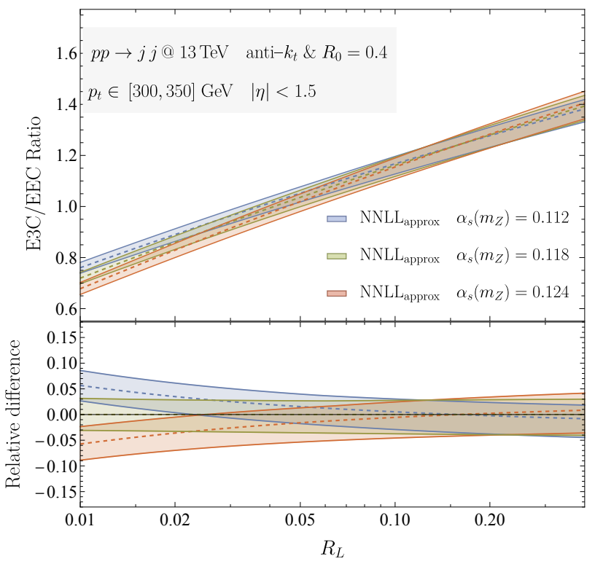



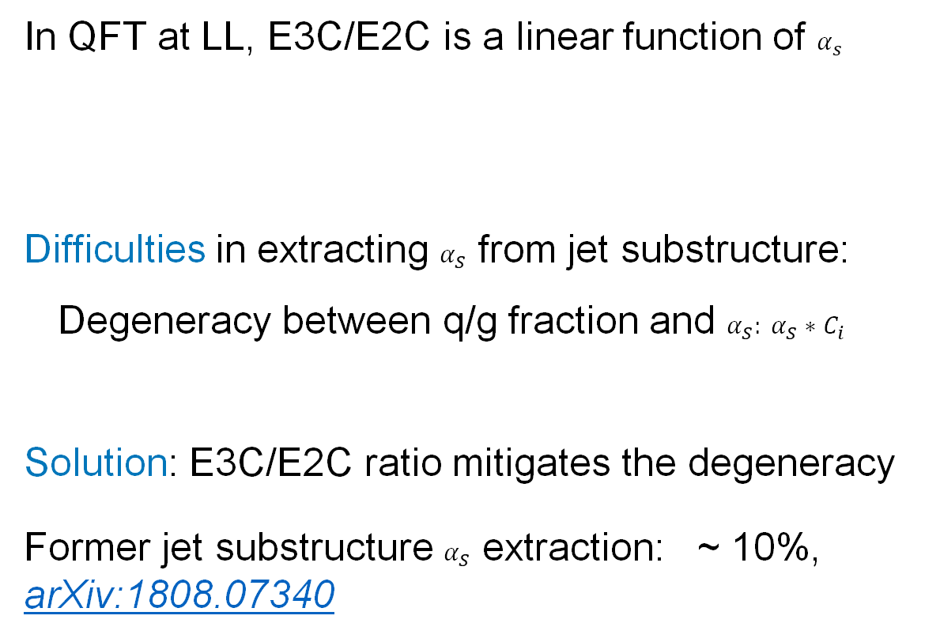
First Measurement of E3C and E3C/E2C in pp
Chen, Gao, Li, Xu, Zhang, and Zhu, arXiv:2307.07510
In QFT at LL, E3C/E2C is a linear function of $α_{s}$
Difficulties in extracting $α_{S}$ from jet substructure:
  Degeneracy between q/g fraction and $α_{S}: α_{S}∗C_{i}$
Solution: E3C/E2C ratio mitigates the degeneracy
Former jet substructure $α_{S}$ extraction: ~ 10%, arXiv:1808.07340
$$∝α_{S}(Q)lnx_{L}+O(α_{s}^{2})$$
  $α_{S}(M_{Z})$ $↑$ Slope $↑$

Slide 8
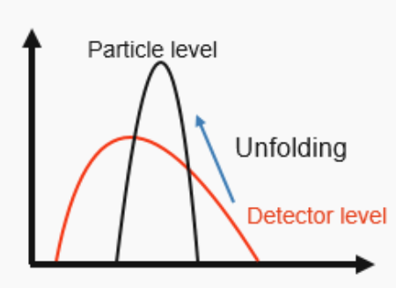

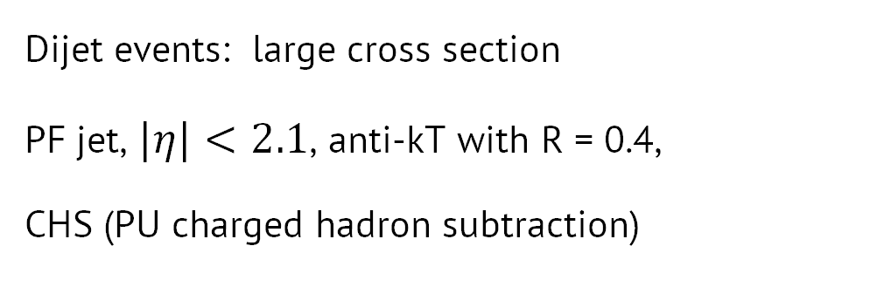

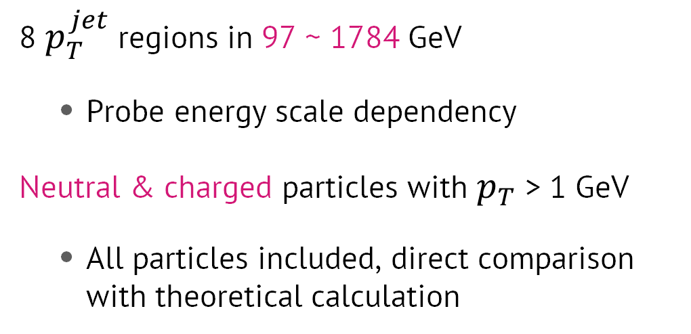


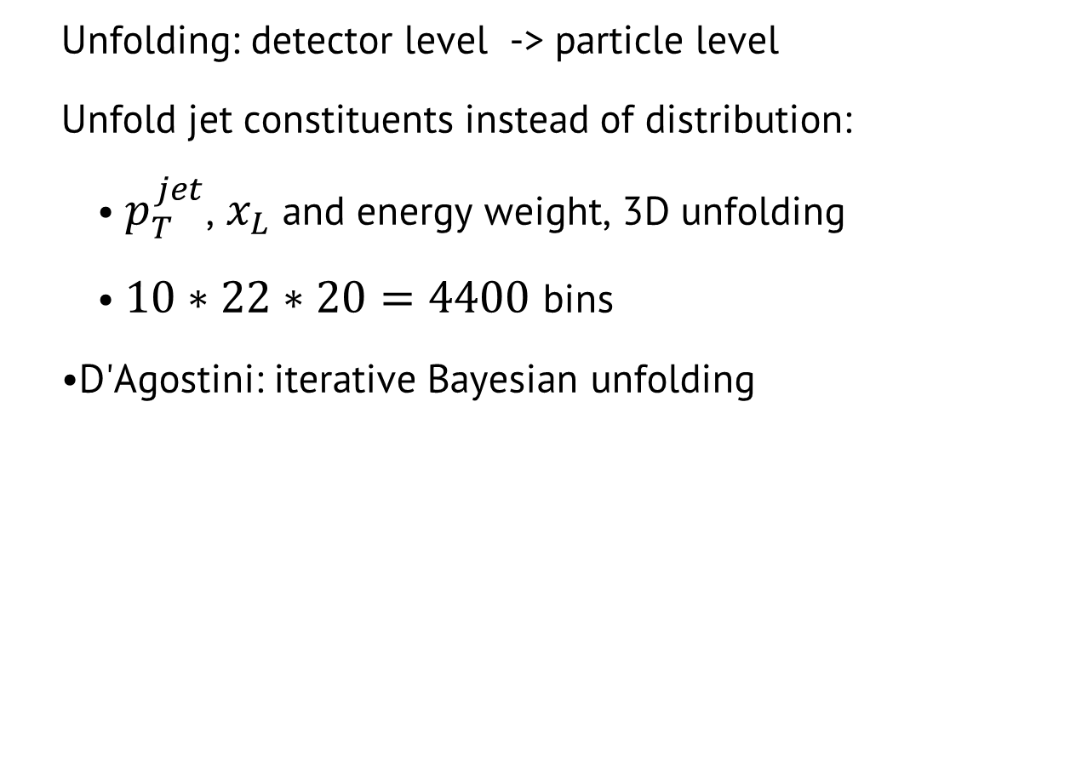


Analysis Procedure (13 TeV)
Event selection:
Unfolding:
$$\frac{E_{1}∗E_{2}}{Q^{2}}$$
$$\frac{E_{1}^{′}∗E_{2}^{′}}{Q^{′2}}$$
Dijet events: large cross section
PF jet, $|η|<2.1$, anti-kT with R = 0.4,
CHS (PU charged hadron subtraction)
Particle level
Unfolding
Detector level
$$x_{L}$$
$$x_{L}^{′}$$
$$p_{T}^{jet}$$
$$p_{T}^{jet^{′}}$$
Object selection:
  Particle level
  Detector level
8 $p_{T}^{jet}$ regions in 97 ~ 1784 GeV
  Probe energy scale dependency
Neutral & charged particles with $p_{T}$ > 1 GeV
  All particles included, direct comparison with theoretical calculation
  Unfolding: detector level -> particle level
  Unfold jet constituents instead of distribution:
    $p_{T}^{jet}$, $x_{L}$ and energy weight, 3D unfolding
    $10∗22∗20=4400$ bins
  D'Agostini: iterative Bayesian unfolding

Slide 9
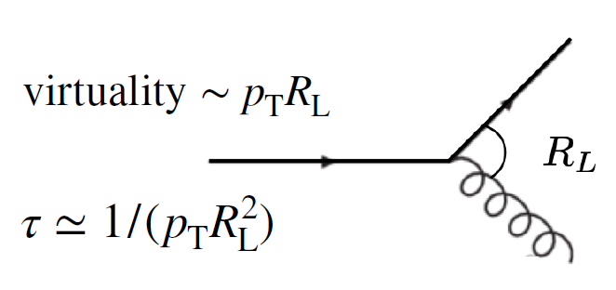
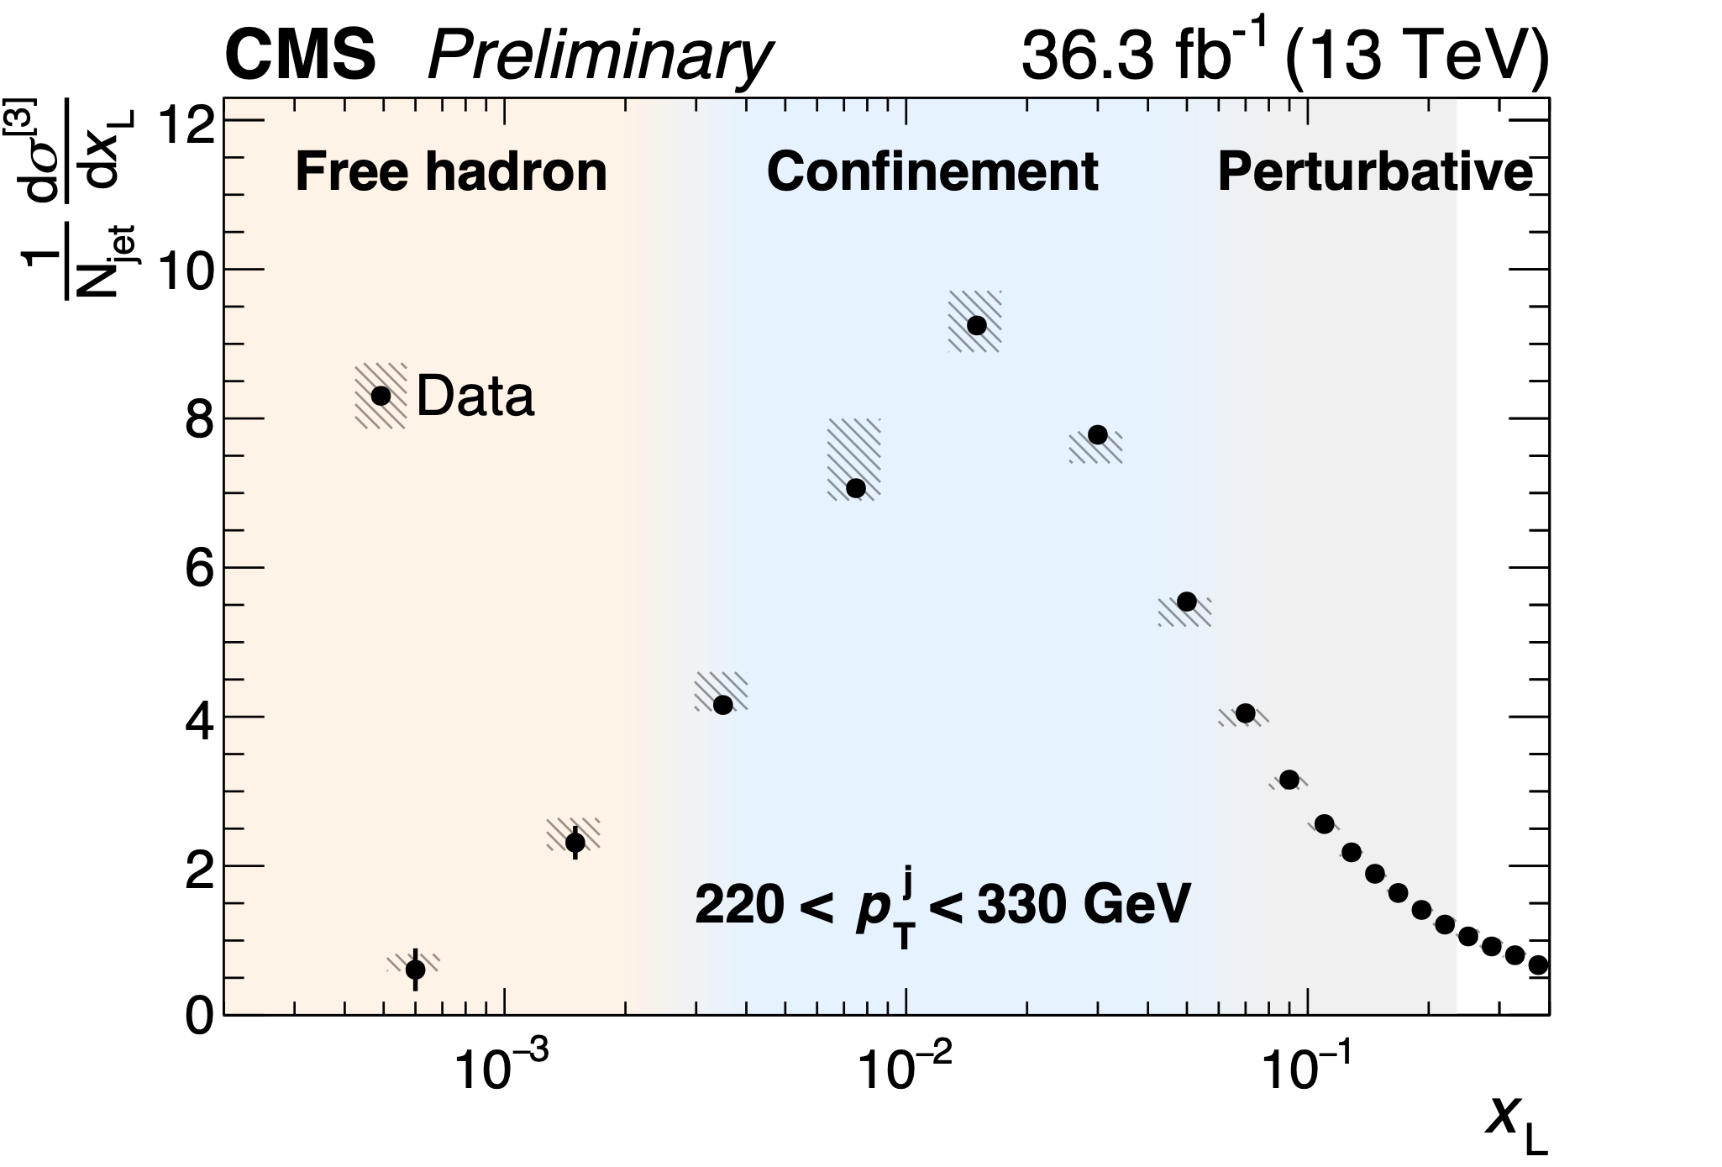

Unfolded E2C in pp at 13 TeV
Confinement
Phase transition
from parton to hadron
9
Non-interacting hadron random distribution integer power-law scaling
Interacting partons non-integer scaling
Time

Slide 10
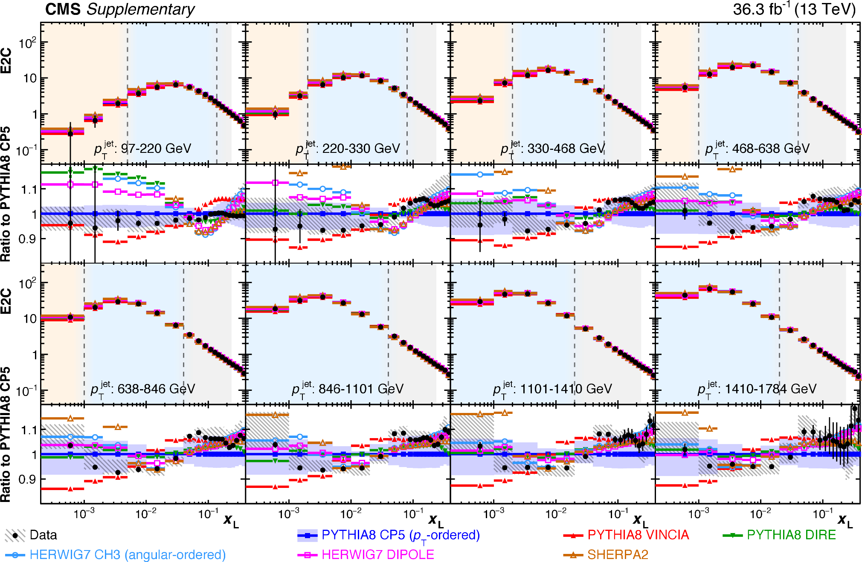
Unfolded E2C vs MC Generators in pp at 13 TeV
Results compared to PYTHIA8, HERWIG and SHERPA2
None of the generator fully describes the E2C data
Spread of the predictions from generators at the 10-20% level
Peak position at around
p_{T}X_{L}~ 2-3 GeV

Slide 11
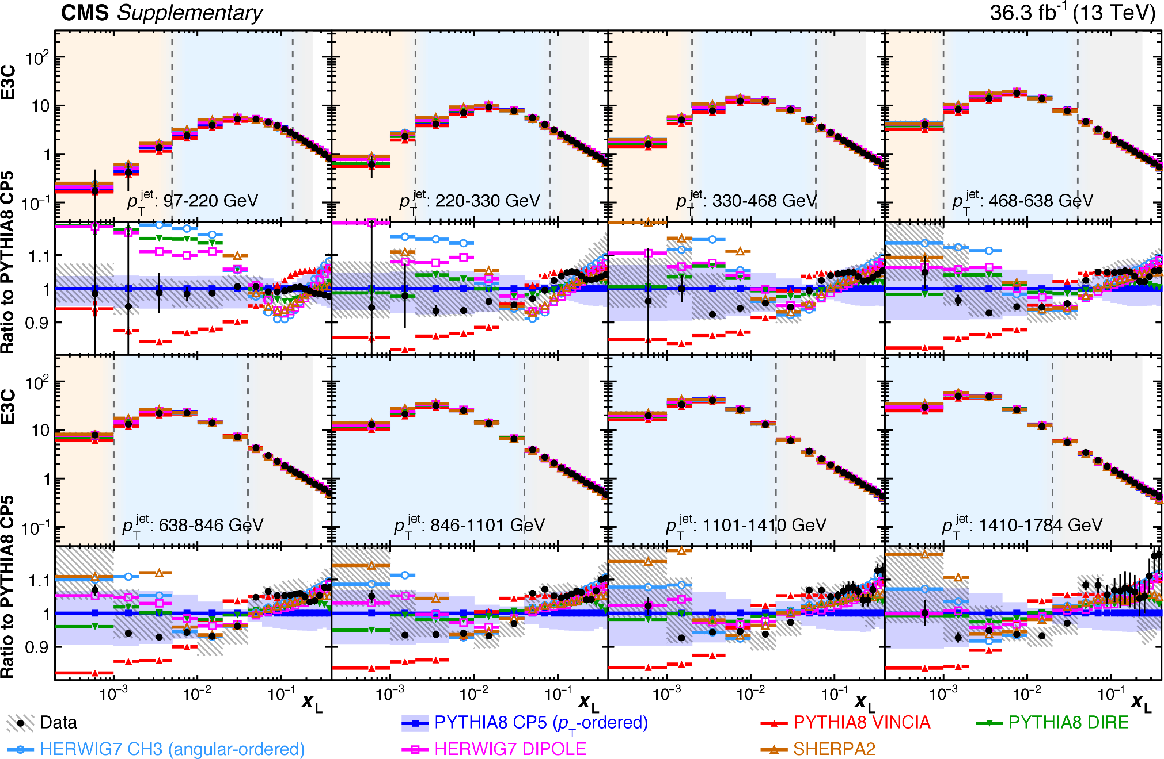
Unfolded E3C vs MC Generators in pp at 13 TeV
Results compared to PYTHIA8, HERWIG and SHERPA2
None of the generator fully describes the E3C data
Spread of the predictions from generators at the 10-20% level

Slide 12
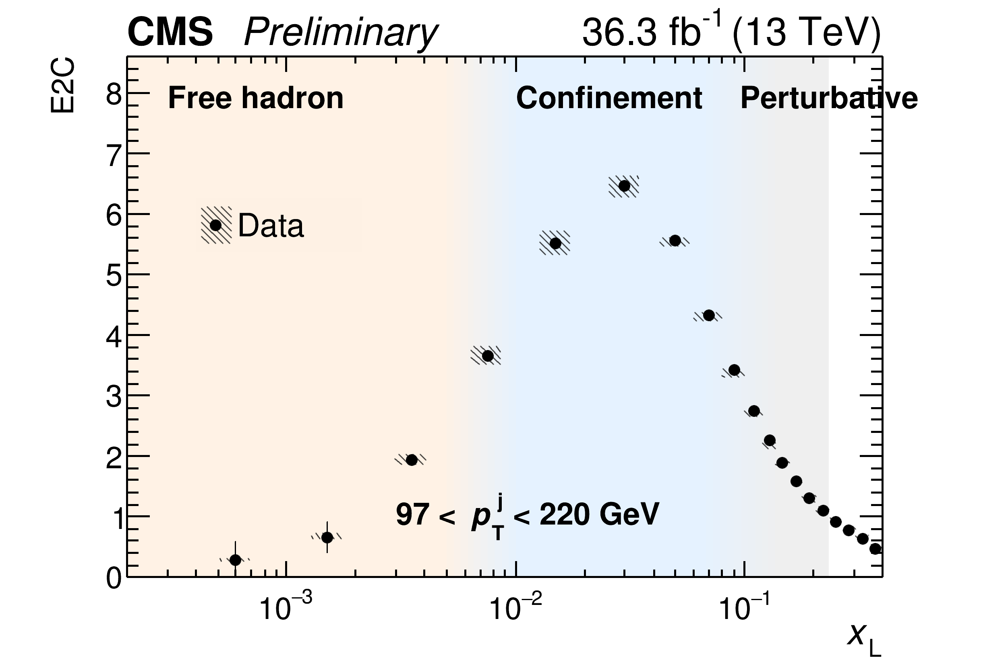



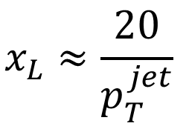
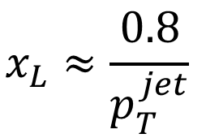
Unfolded E2C vs. Jet p_{T}
Boundary shifts with jet p_{T}
Q$∝x_{L}$*$p_{T}^{jet}$
$p_{T}^{jet}↑$, $x_{L}↓$
12
Boundary
$$x_{L}≈\frac{0.8}{p_{T}^{jet}}$$
$$x_{L}≈\frac{20}{p_{T}^{jet}}$$
Time

Slide 13
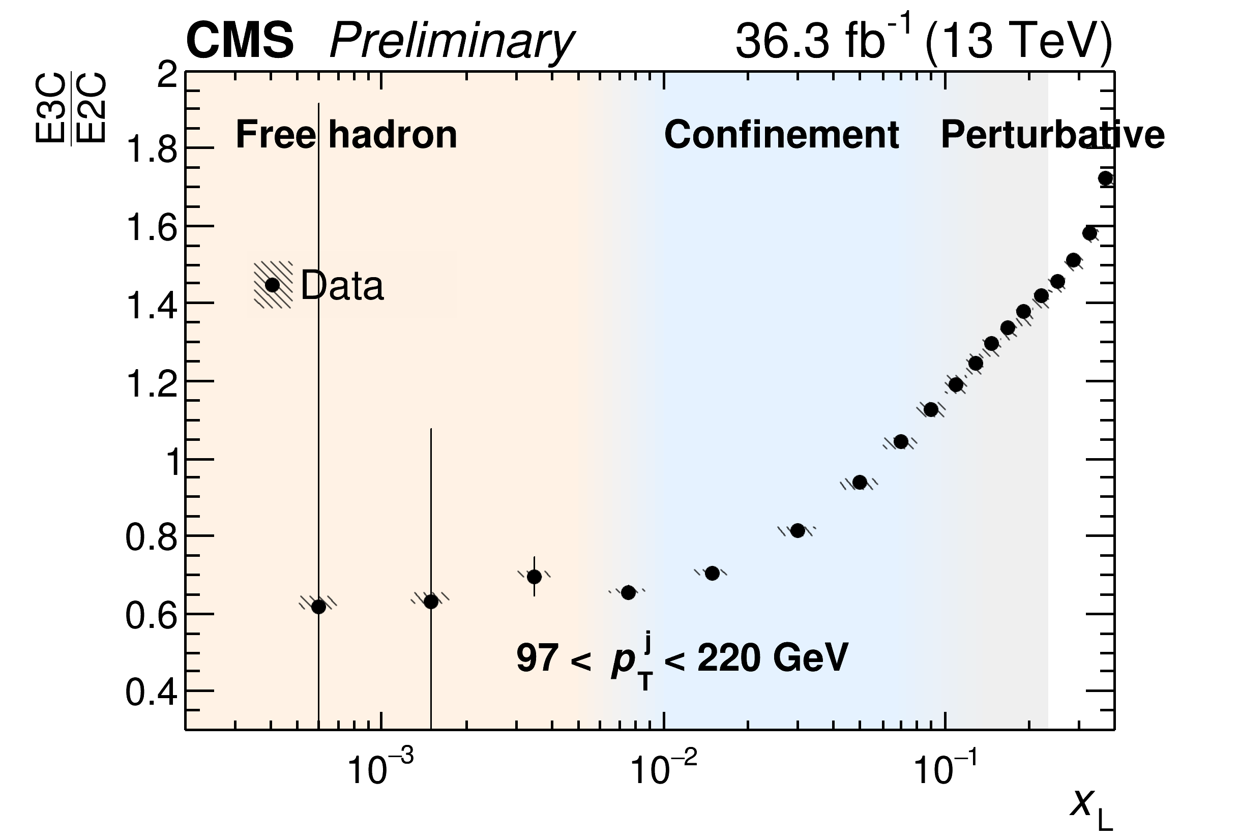

E3C/E2C ratios as a function of Jet p_{T}
$p_{T}^{jet}↑$, Slope $↓$
13

Slide 14
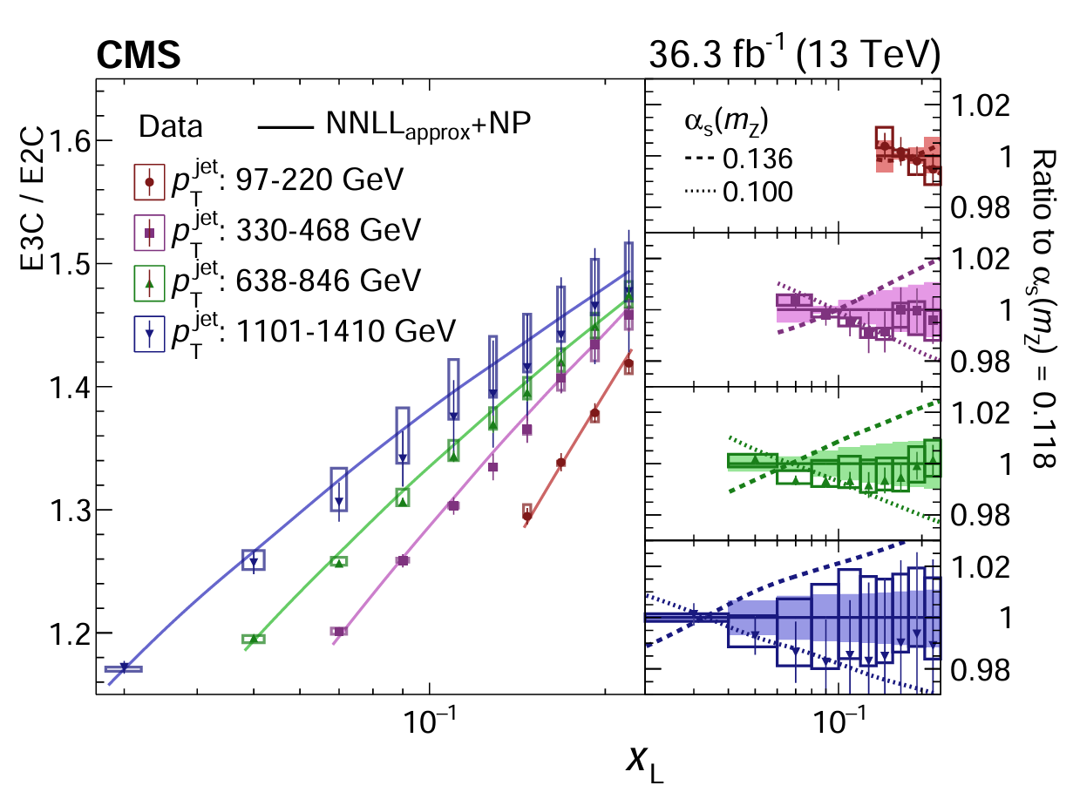

Extraction of α_{s} by data NNLL comparison
Perturbative Region
Shape of data agrees with within uncertainty
Theory systematics includes:
(shape only，no normalization effect)
QCD scale of NNLL prediction
Hadronization factors
QCD scale in hard scattering
Underlying event + parton shower tune
PDF
Error band: shape only
$$α_{s}(m_{Z})=0.118$$

Slide 15
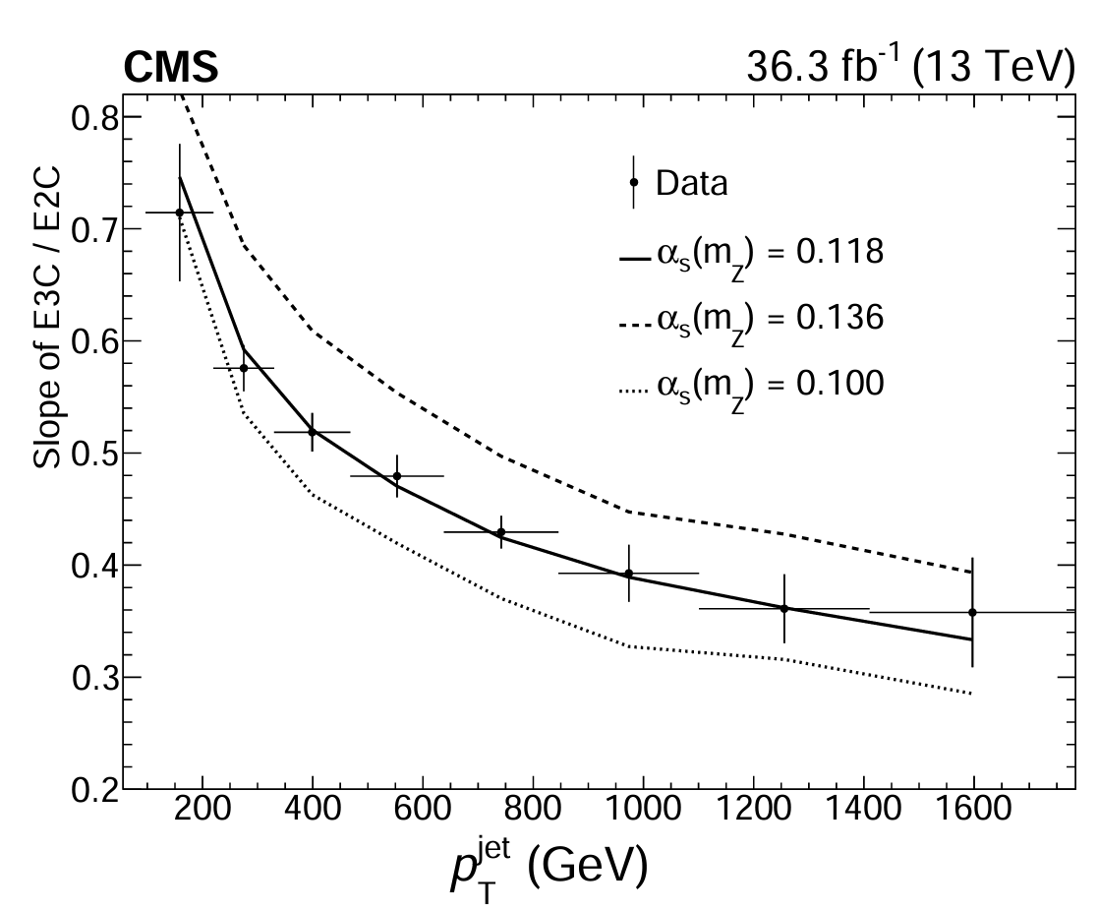

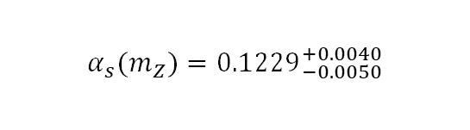
Extraction of α_{s} by data NNLL comparison
Perturbative Region
Shape of data agrees with within uncertainty
Theory systematics includes:
(shape only，no normalization effect)
QCD scale of NNLL prediction
Hadronization factors
QCD scale in hard scattering
Underlying event + parton shower tune
PDF
Extracted coupling constant:
$α_{s}(m_{Z})={0.1229}_{−0.0050}^{+0.0040}$
$={0.1229}_{−0.0012(stat.)−0.0033(theo.)−0.0036(exp.)}^{+0.0014(stat.)+0.0030(theo.)+0.0023(exp.)}$
Covariance matrix
QCD scale of ${\text{NNLL}}_{\text{approx}}$
Neutral hadron energy scale

Slide 16
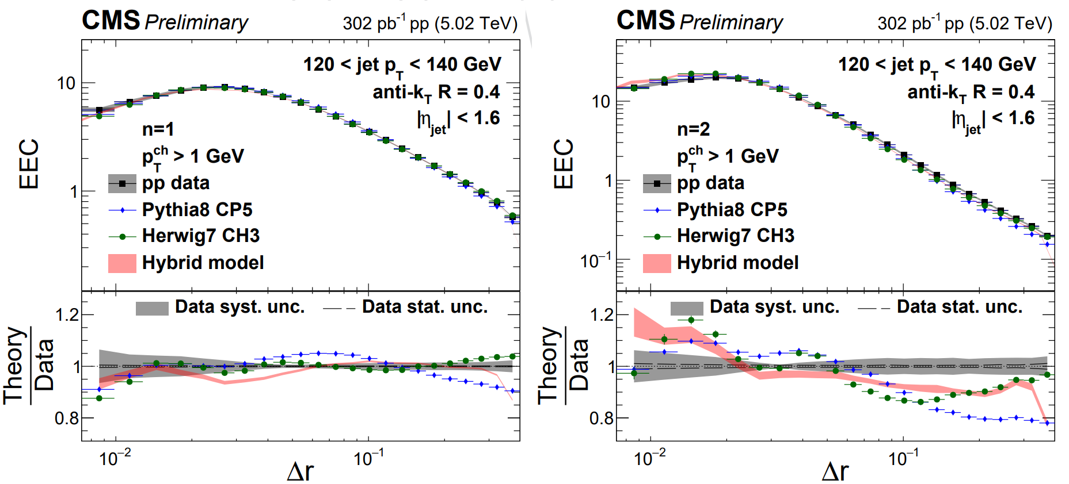

Charged Hadron-Based E2C vs MC in pp at 5 TeV
NEW!
See talk on Friday by Jussi
Jussi Viinikainen (Vanderbilt U.)
E2C calculated with charged particles only, fully corrected with resolution effects
Compared to Hybrid pp, Pythia 8 and Herwig 7
None of the event generators describe the pp data at 5 TeV
CMS-PAS-HIN-23-004

Slide 17
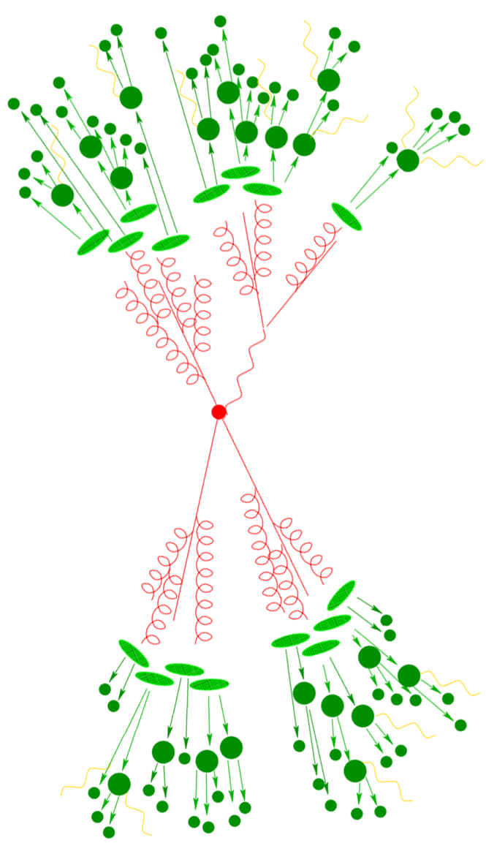



(2) Jets and energy-energy correlators in e⁺e⁻
e⁺
e⁻
Yi Chen (Vanderbilt U.)
Hannah Bossi (MIT)
Yu-Chen "Janice" Chen (MIT)

Slide 18

Jet in Electron-Positron Annihilation
Jets in e⁺e⁻ with identical algorithms as those used in hadron colliders are of great interest
  No gluonic initial state radiation
  No complications of parton distribution functions
  No beam remnants and multi-parton interactions
  → Cleanest test of pQCD and phenomenological models
Serve as a reference for the pp
and future EIC measurements
Inform the QCD studies
at the future FCC.
pp
e⁺e⁻
A
e⁻
e⁺
e⁻
p
p

Slide 19
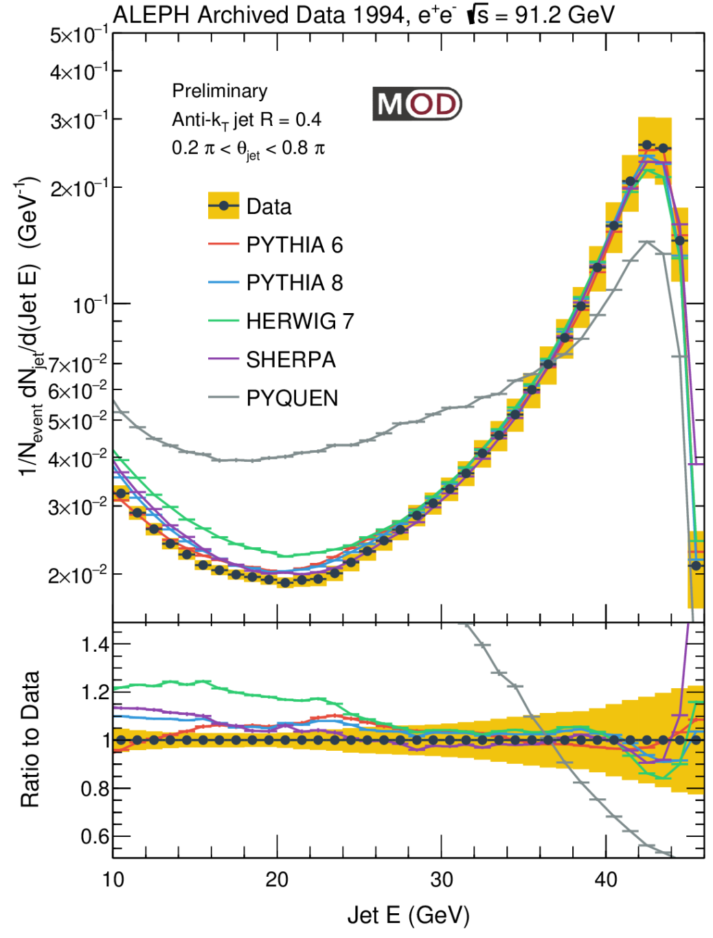






Inclusive Jet Spectrum vs. Generators
The closest observable to the jet spectra analyses in hadron-hadron collisions!
Peak at around 43 GeV: from and parton shower of the (anti-)quark almost fully captured by the anti-k_{T} algorithm with R=0.4
Minimum at around 20 GeV
At low E: increase due to a large number of jets from soft emissions or combinatorial
Generators capture those general features,
overpredict the spectra at low jet E
e⁺
e⁻
$$e^{+}$$
$$\overline{q}$$
MITHIG-MOD-21-001
arXiv:2111.09914
JHEP 06 (2022) 008
$$Z^{0}/γ$$
$$e^{−}$$
$$q$$

Slide 20
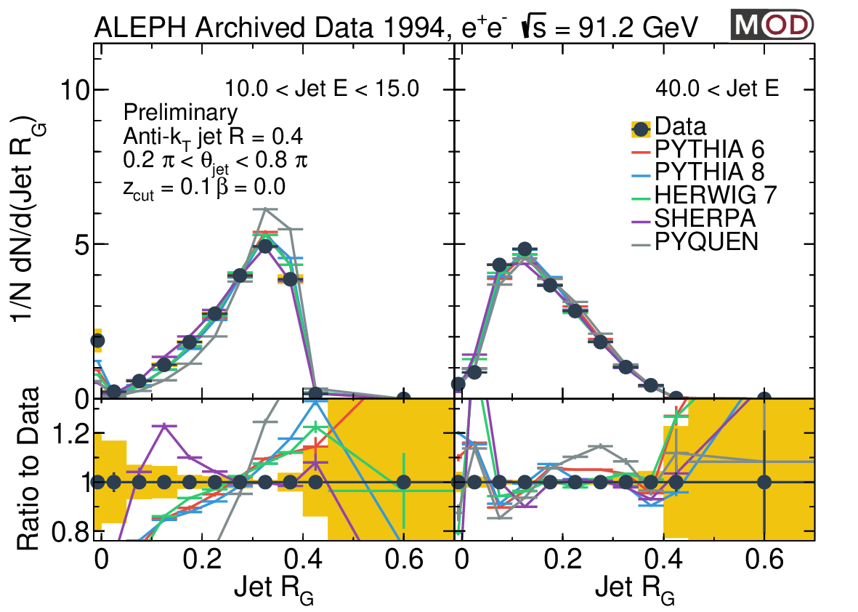
Groomed Jet Radius R_{G} vs. Event Generators
High jet E (mainly quark jets):
  Peak at smaller R_{G} value
  Generators give a better description of the data
Low jet E (mainly from soft emissions and combinatorial):
  Peak at larger R_{G} value as one would expect
  SHERPA gives a better description of the data
  PYTHIA 6, PYTHIA 8, HERWIG, and PYQUEN overpredict the R_{G}
Low jet E
High jet E
MITHIG-MOD-21-001
arXiv:2111.09914
JHEP 06 (2022) 008

Slide 21
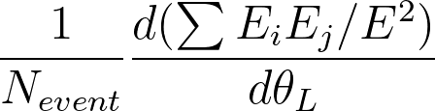
Definition of EEC in e⁺e⁻
No Jet reconstruction, Full event
  Sum over pairs of charged particles in the event
  Normalize by total energy E in the event (91.2 GeV by definition in LEP1)
  Θ_{L} is the opening angle (in rad.) as opposed to the R_{L} or x_{L} which is eta-phi
  Average over all events considered
Similar for 3-particle or higher correlators
  For N-particle correlators, Θ_{L} is defined as the largest angle of the pairs
Yi Chen (Vanderbilt U.)
Θ_{L}
E2C
E3C
Θ_{L}
E4C
Θ_{L}

Slide 22
EEC in e⁺e⁻: Extending to back-to-back region
Back-to-back (Sudakov Limit)
  At Θ ~ π
  Study correlations of the full set of particles, not just those within jets
Not possible to explore with jet substructure
  Presents a unique opportunity in e⁺e⁻!
Important ingredient into theory calculations to control non-perturbative effect
Similar to collinear limit, this can also be used to study confinement transition and strong coupling constant
Yi Chen (Vanderbilt U.)
e⁺e⁻
Back to back Θ_{L}~ π
Collinear Θ_{L}~ 0

Slide 23
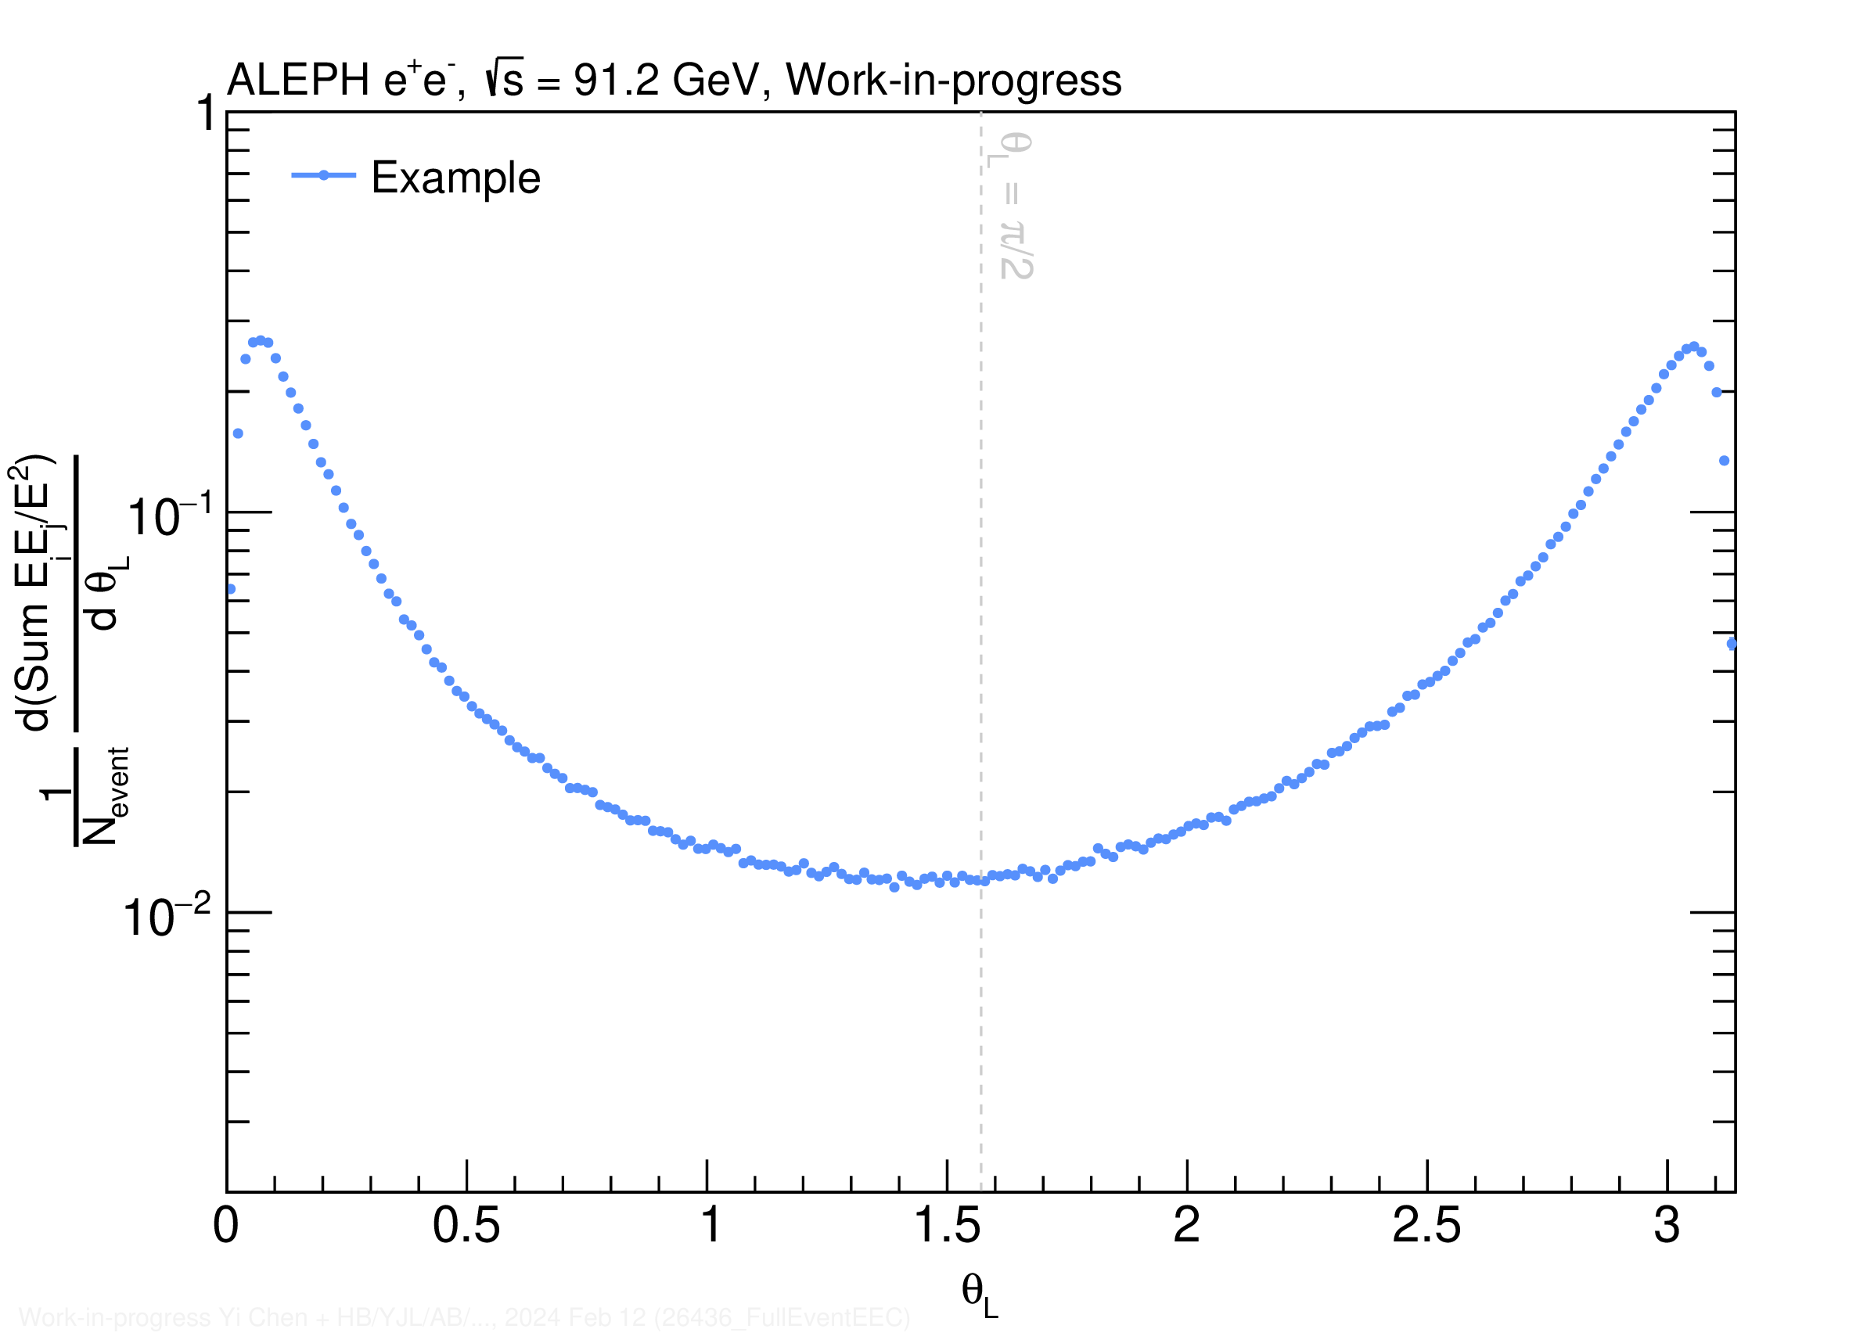
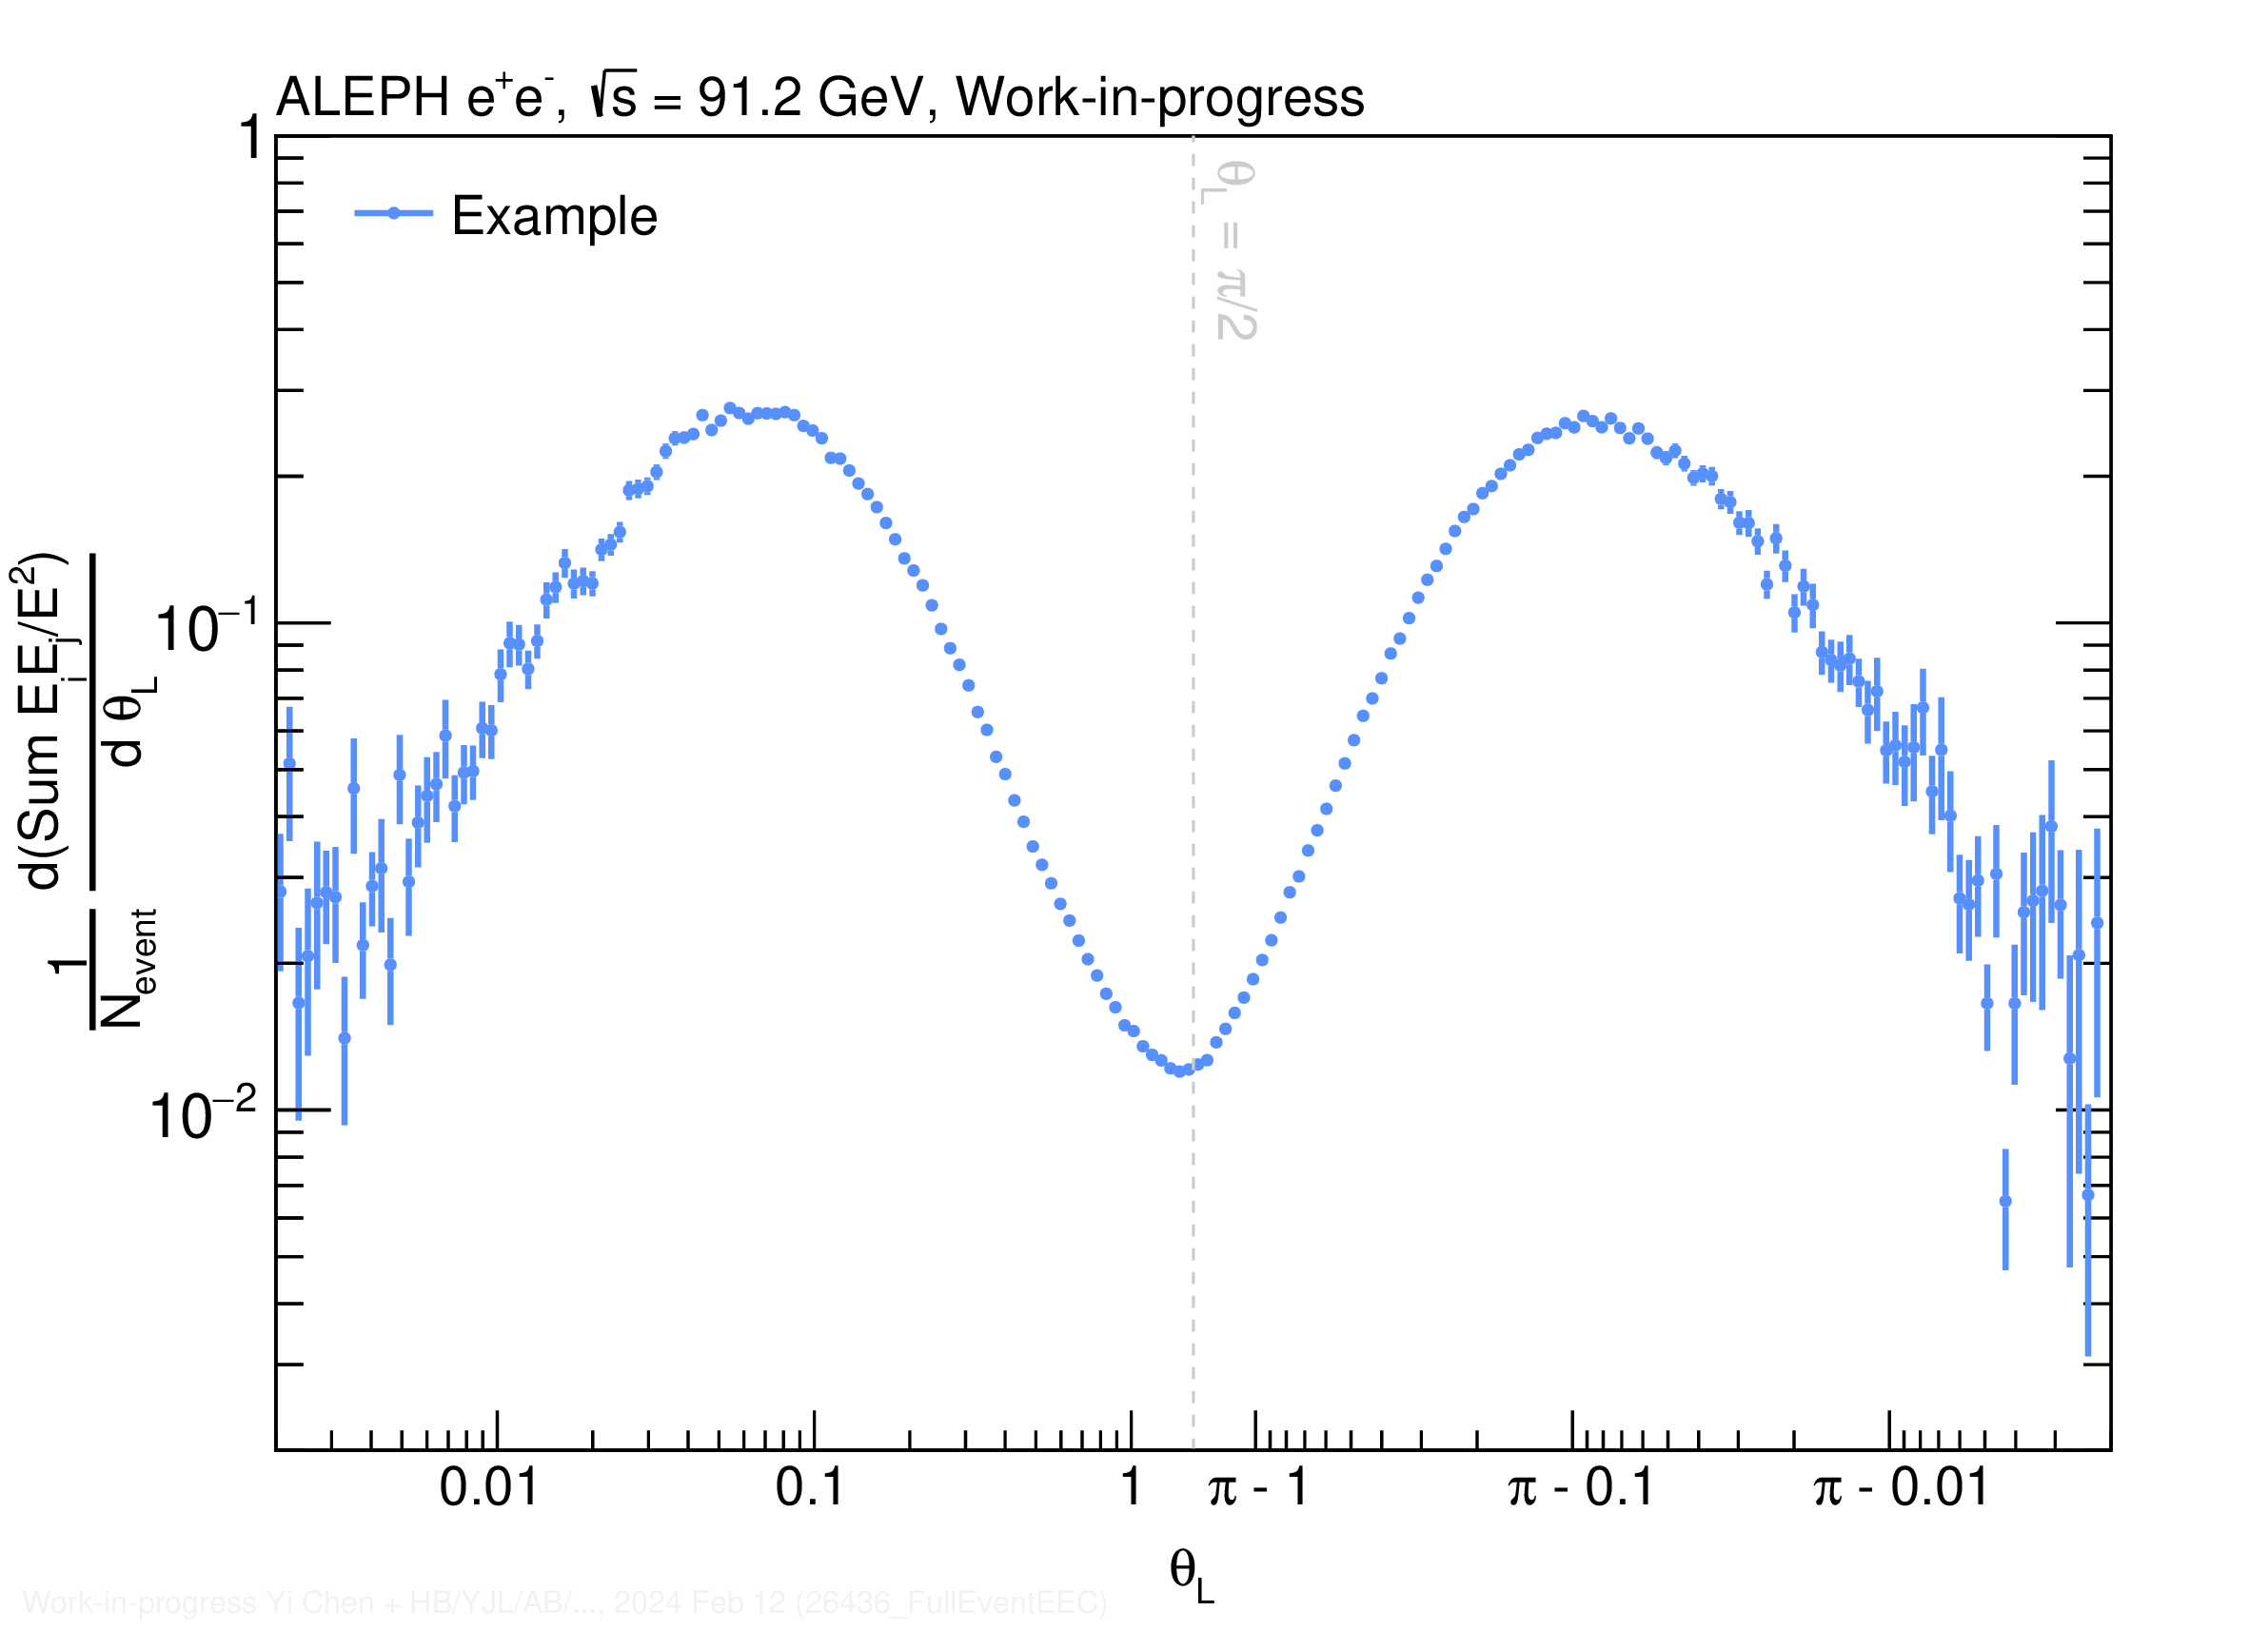
2-Particle EEC (E2C) from Archived MC
Presented in double-log-x scale to focus on the tail region
Log scale​ [0,π/2]
Flipped log scale​ π-[0,π/2]

Slide 24
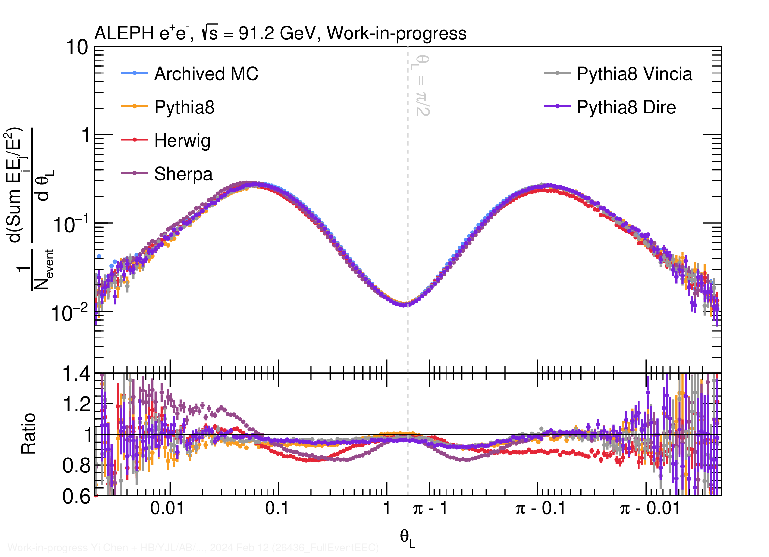
E2C from MC Generators
Dominant structures
  Dijet back to back
  Left peak is what people are familiar with
  No reason to be symmetric a priori
Left peak (collinear)
  Parton shower region
    Different shower, different slope
  Hadronization region
    MCs roughly parallel to each other
  Peak location
    Correspond to 45 GeV scale
    Different MC are a bit different
Right peak (back-to-back)
  Also a peak and transition between
  Sudakov limit and parton shower
Θ_{L}

Slide 25
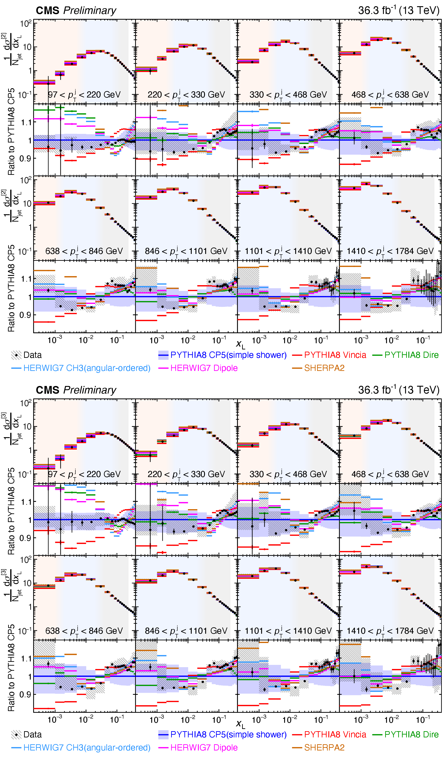
E2C from MC in pp and e⁺e⁻
Similar MC hierarchy between e⁺e⁻ generators and pp generators
(SHERPA→HERWIG→PYTHIA)
Larger x_{L} not comparable due to jet boundary effects in pp measurement
Yi Chen (Vanderbilt U.)
CMS
pp 13 TeV
SHERPA
HERWIG
HERWIG
SHERPA
PYTHIA Vincia
PYTHIA Vincia
Θ_{L}
R_{L}

Slide 26
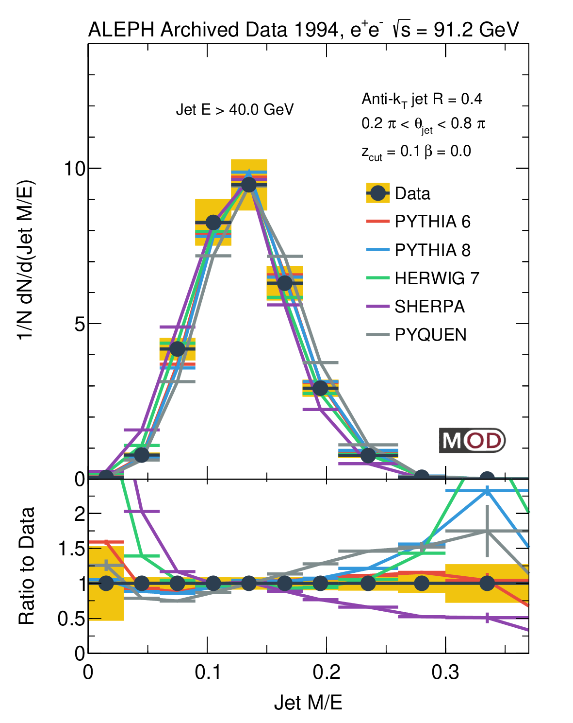
Comparison between E2C with Jet Mass
Mass scale for SHERPA is smaller → smaller SHERPA angular scale in EEC
Θ_{L}
MITHIG-MOD-21-001
arXiv:2111.09914
JHEP 06 (2022) 008

Slide 27
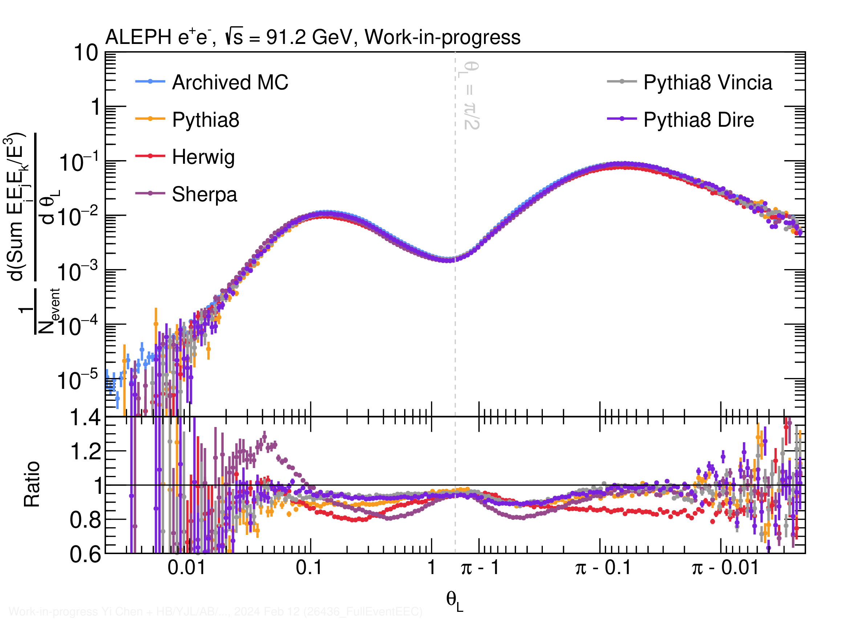
3-particle EEC (E3C) from MC in e⁺e⁻
E3C is by definition not symmetric
  Due to intrinsic max(pair)
  Other variants of E3C are possible
At the away-side
  Dominant contribution from dijet
  Higher peak value due to Θ_{L} definition
  Mostly 1 particle from one shower +
  2 particles from the other shower
Agreement between MC generators
similar to E2C:
  The predictions differ by up to 20%!
Θ_{L}
Yi Chen (Vanderbilt U.)

Slide 28
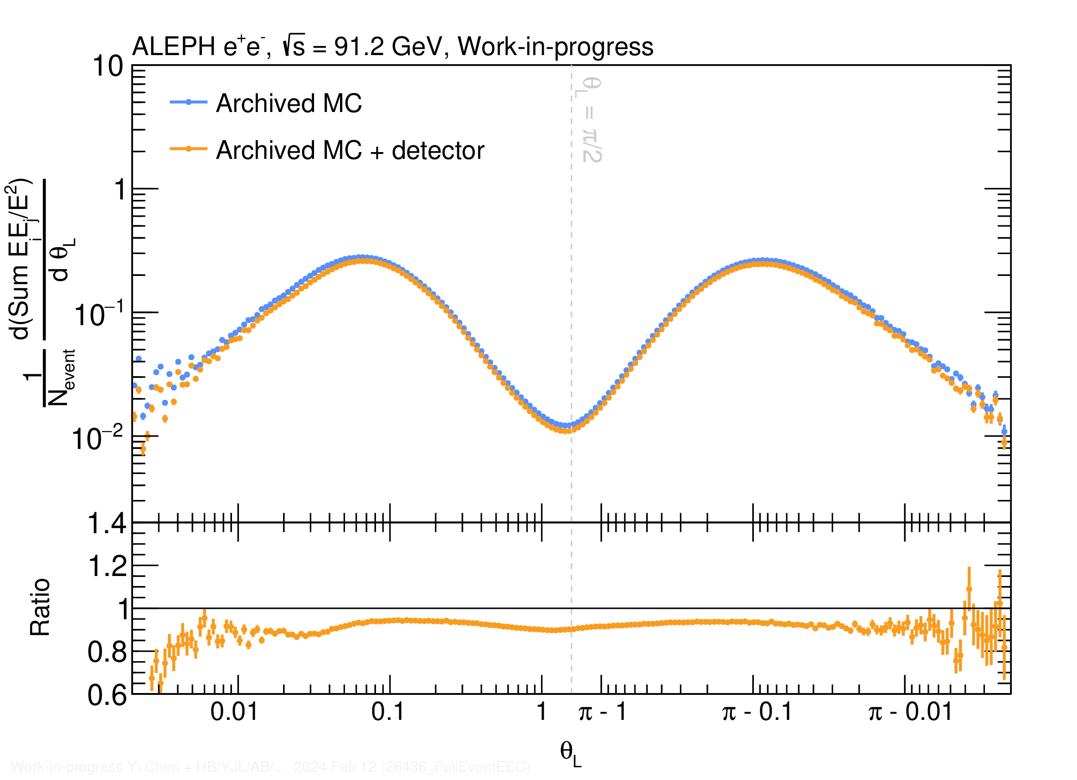
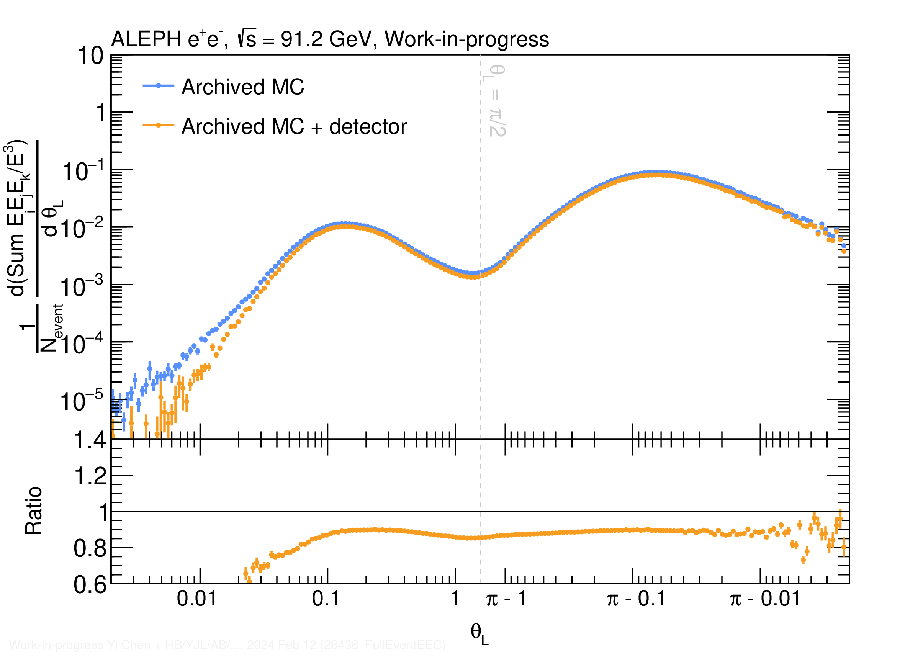
Detector Effects based on Archived ALEPH MC
Will we be able to measure the correlators? Yes!
Generator- and detector-level results are similar over a large phase space
E2C
E3C

Slide 29
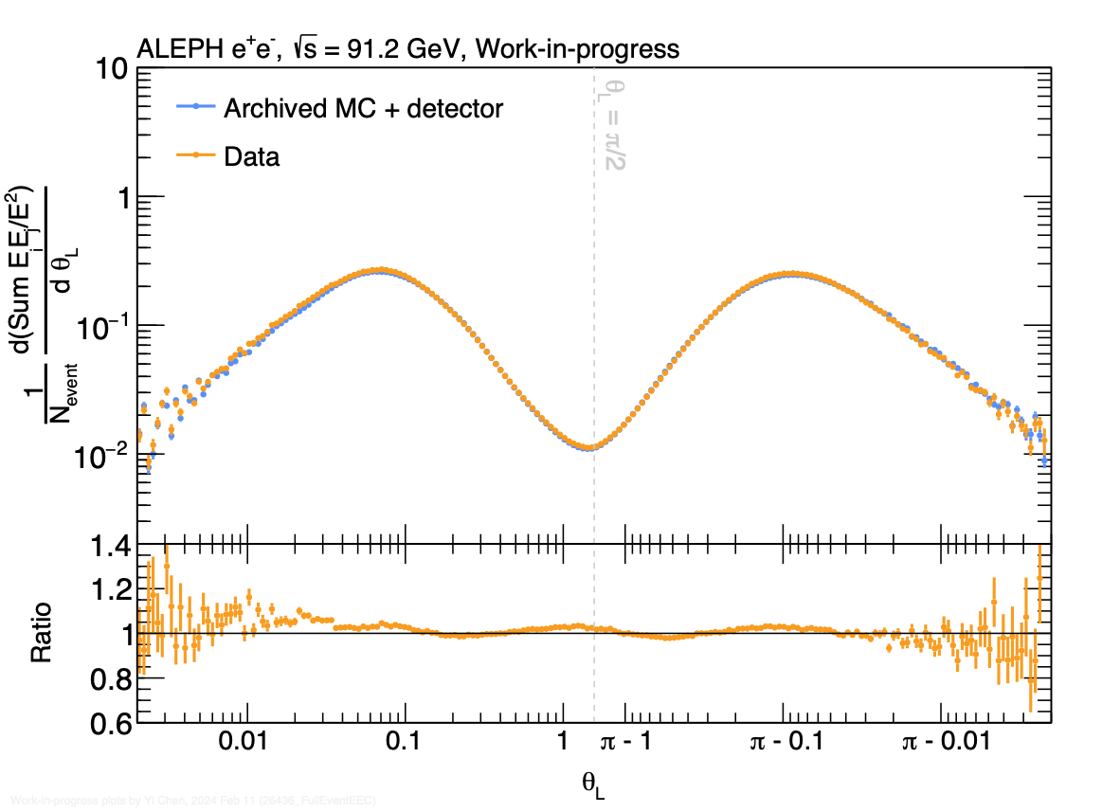
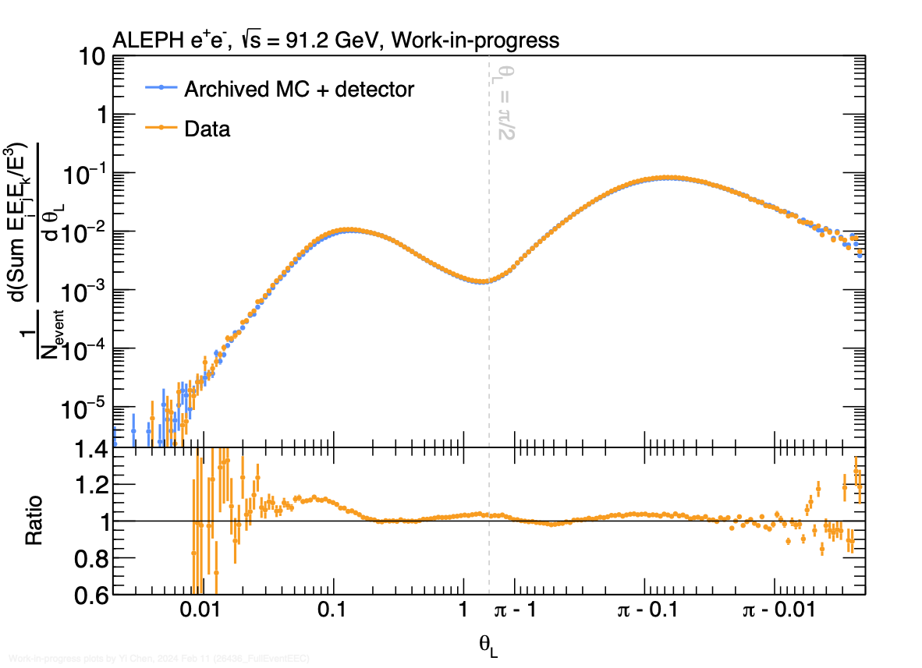
Detector Level MC vs Data in E2C and E3C
E2C
E3C
Comparison between detector level archived PYTHIA 6.1 MC and Data
Reasonable description of the E2C and E3C data
NEW!
Yi Chen (Vanderbilt U.)

Slide 30
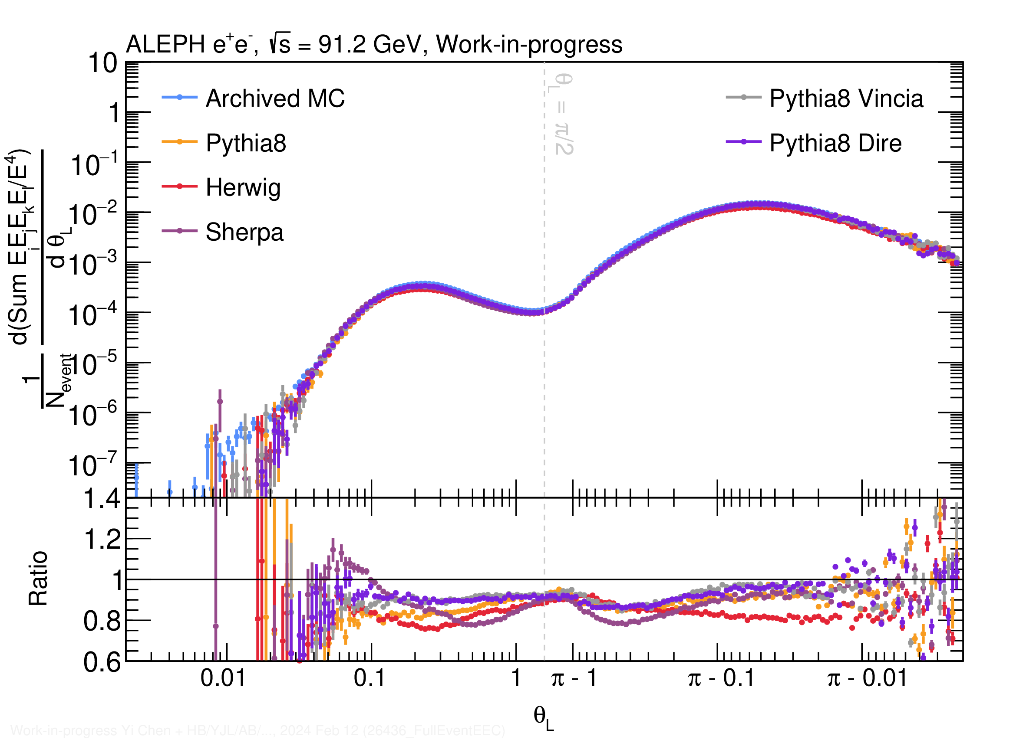
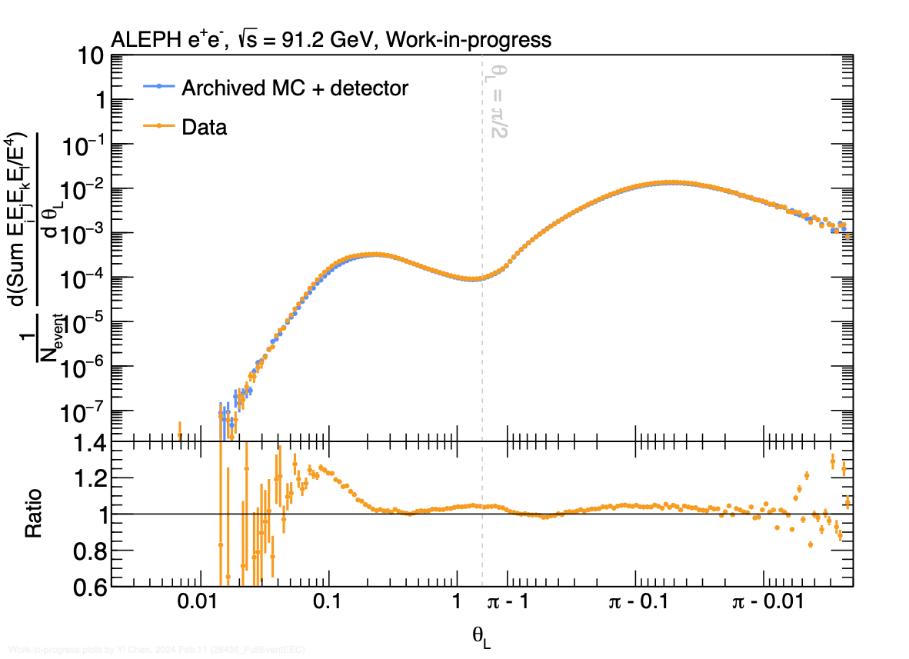
E4C and E4C/E2C ratio in e⁺e⁻
Predictions of E4C and E4C/E2C from event generators
NEW!
E4C

Slide 31
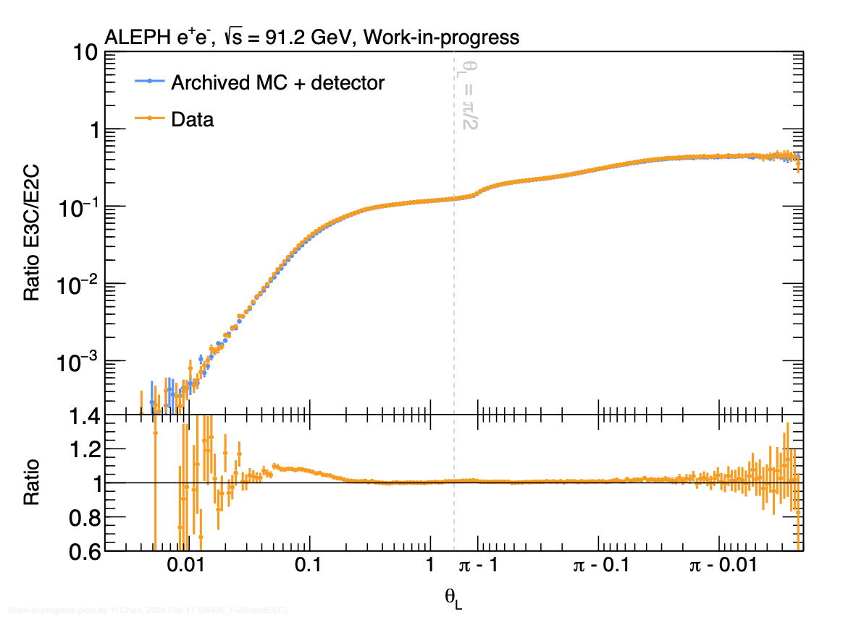
E3C / E2C in e⁺e⁻ at 91 GeV
Observe non-trivial slope in the
hadronization region
  Away-side (Θ_{L}>π/2) region: roughly flat
  A small structure around 2π/3:
    Reject 3-jet event removes this
    particular structure
  Further increase beyond 2π/3: di-jet
Overall excellent agreement between
archived MC and data
Θ_{L}
Yi Chen (Vanderbilt U.)
NEW!

Slide 32
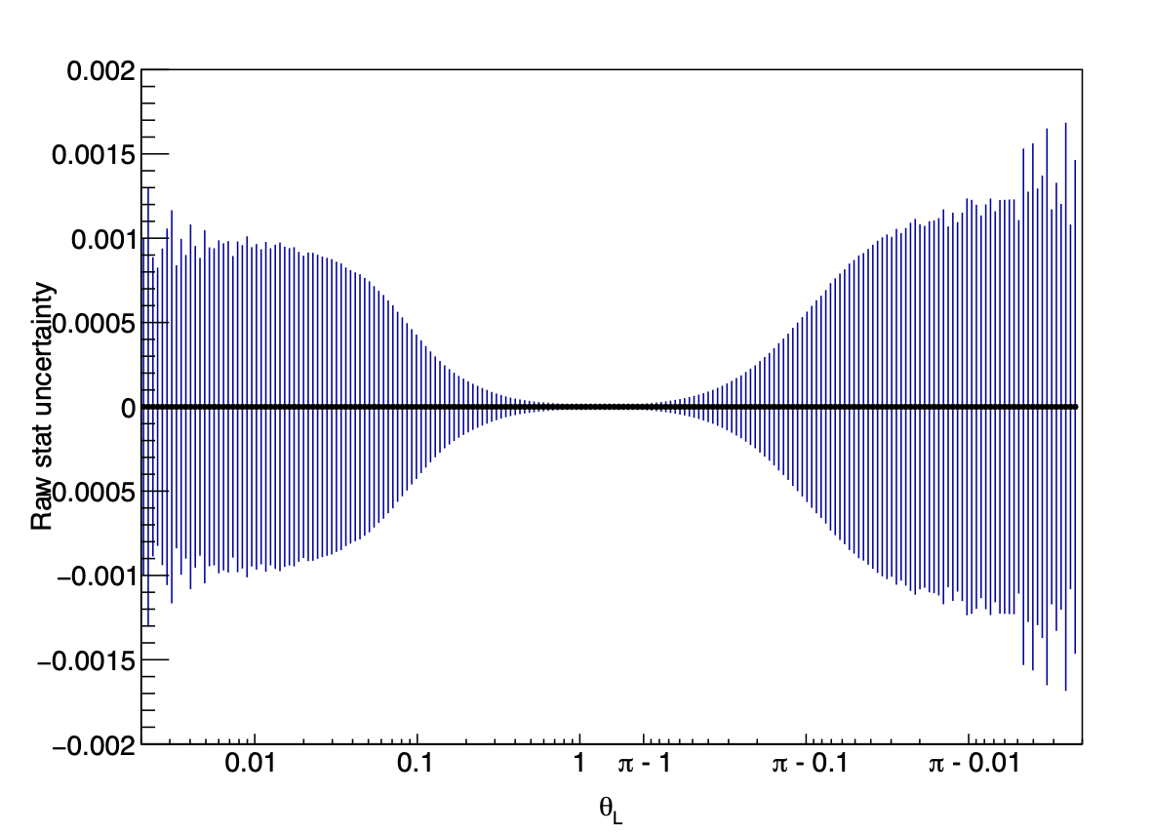
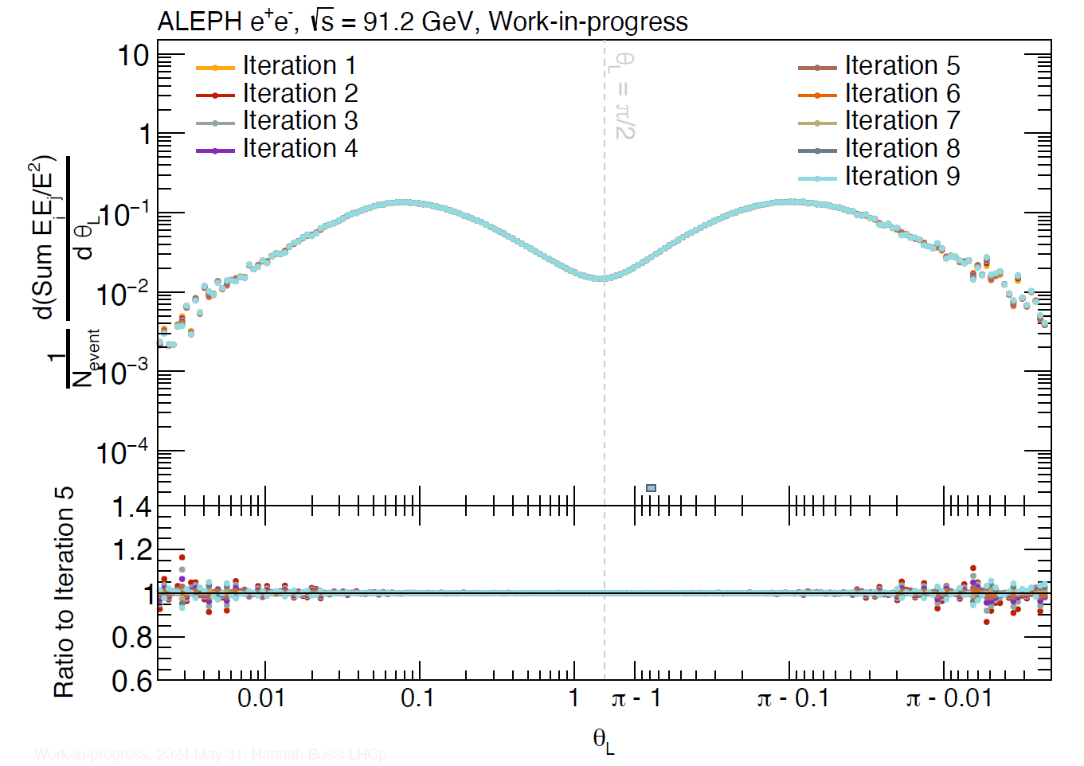
Statistical Accuracy and Unfolding Performance
Detector Level
High accuracy over large θ_{L} interval
Correct for detector-level smearing using a 2D Bayesian unfolding procedure.
  Q² fixed in e⁺e⁻
  2D Unfolding: Energy Weighting (E₁E₂) and Angle (θ_{L})
Fully unfolded results to be shown in Hard Probes 2024
NEW!
Hannah Bossi (MIT)

Slide 33
Long-range Correlation in e⁺e⁻ collisions
e⁺e⁻
pp
pPb
PbPb
In PbPb Collisions, long-range ridge-like correlation in two-particle correlation function is interpretated as hydrodynamics flow of QGP
Recent Excitement:
Long-range correlation in e⁺e⁻ collisions!
  Not described by ALEPH archived MC
MIT-MOD-23-001
arXiv: 2312.05084
Submitted to PLB
Yu-Chen "Janice" Chen (MIT)

Slide 34
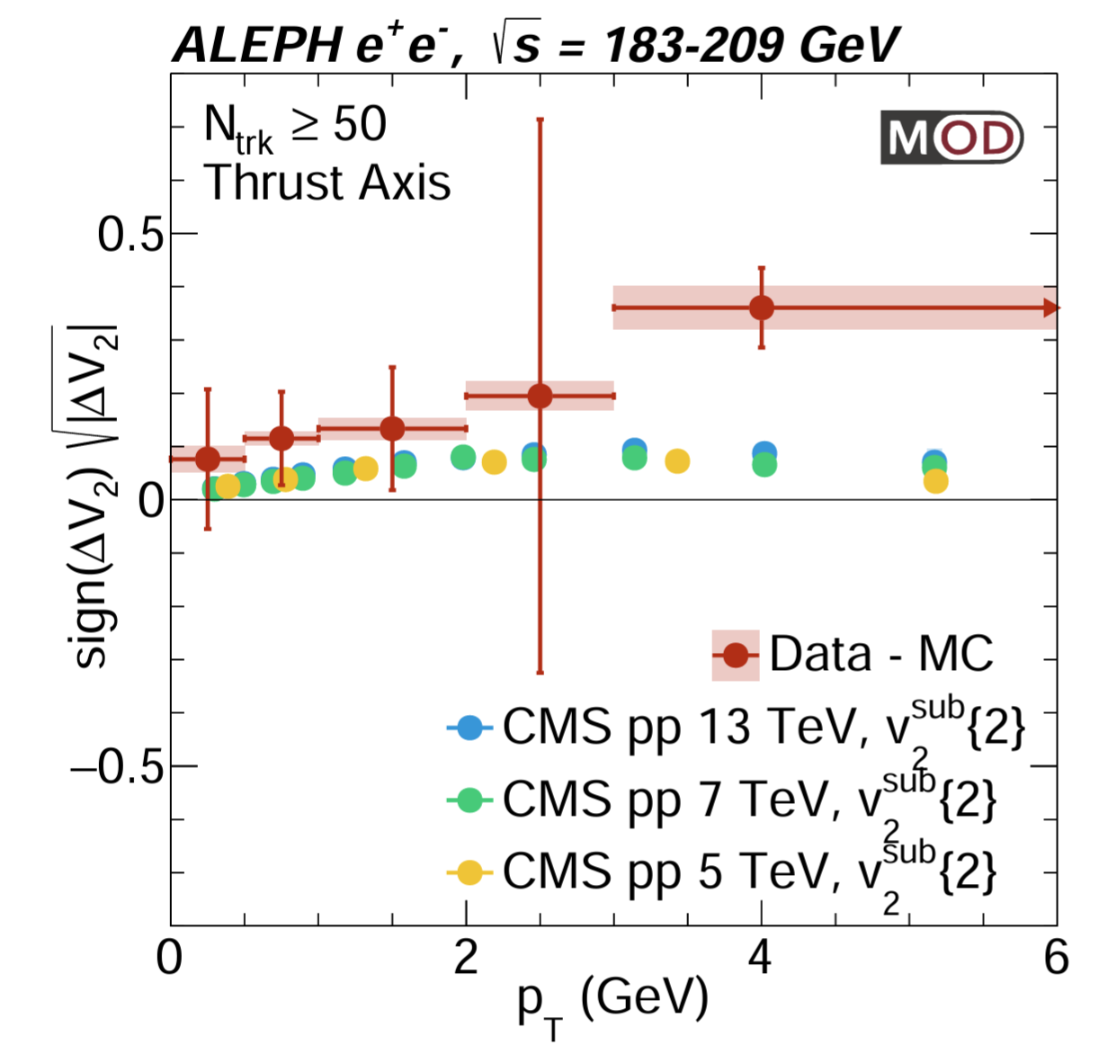
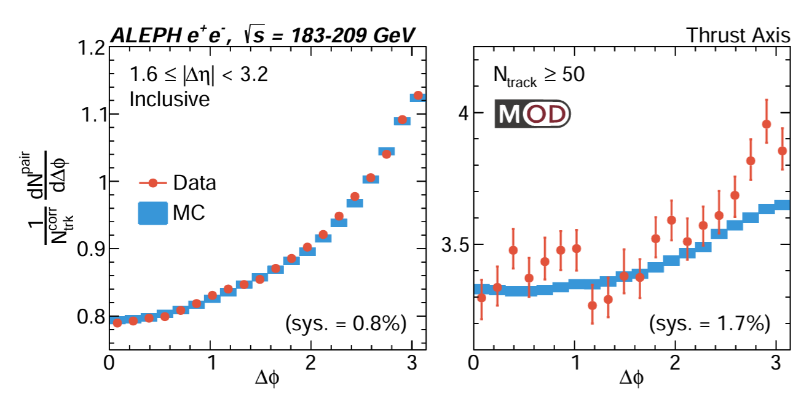
Flow-like Correlation in e⁺e⁻ at LEP2 Energies
Long-range correlation in e⁺e⁻ collisions!
  Not described by ALEPH archived MC
→ Interesting to study EEC the difference between
archived data and MC in different multiplicity intervals
MIT-MOD-23-001
arXiv: 2312.05084
Submitted to PLB
Yu-Chen "Janice" Chen (MIT)

Slide 35
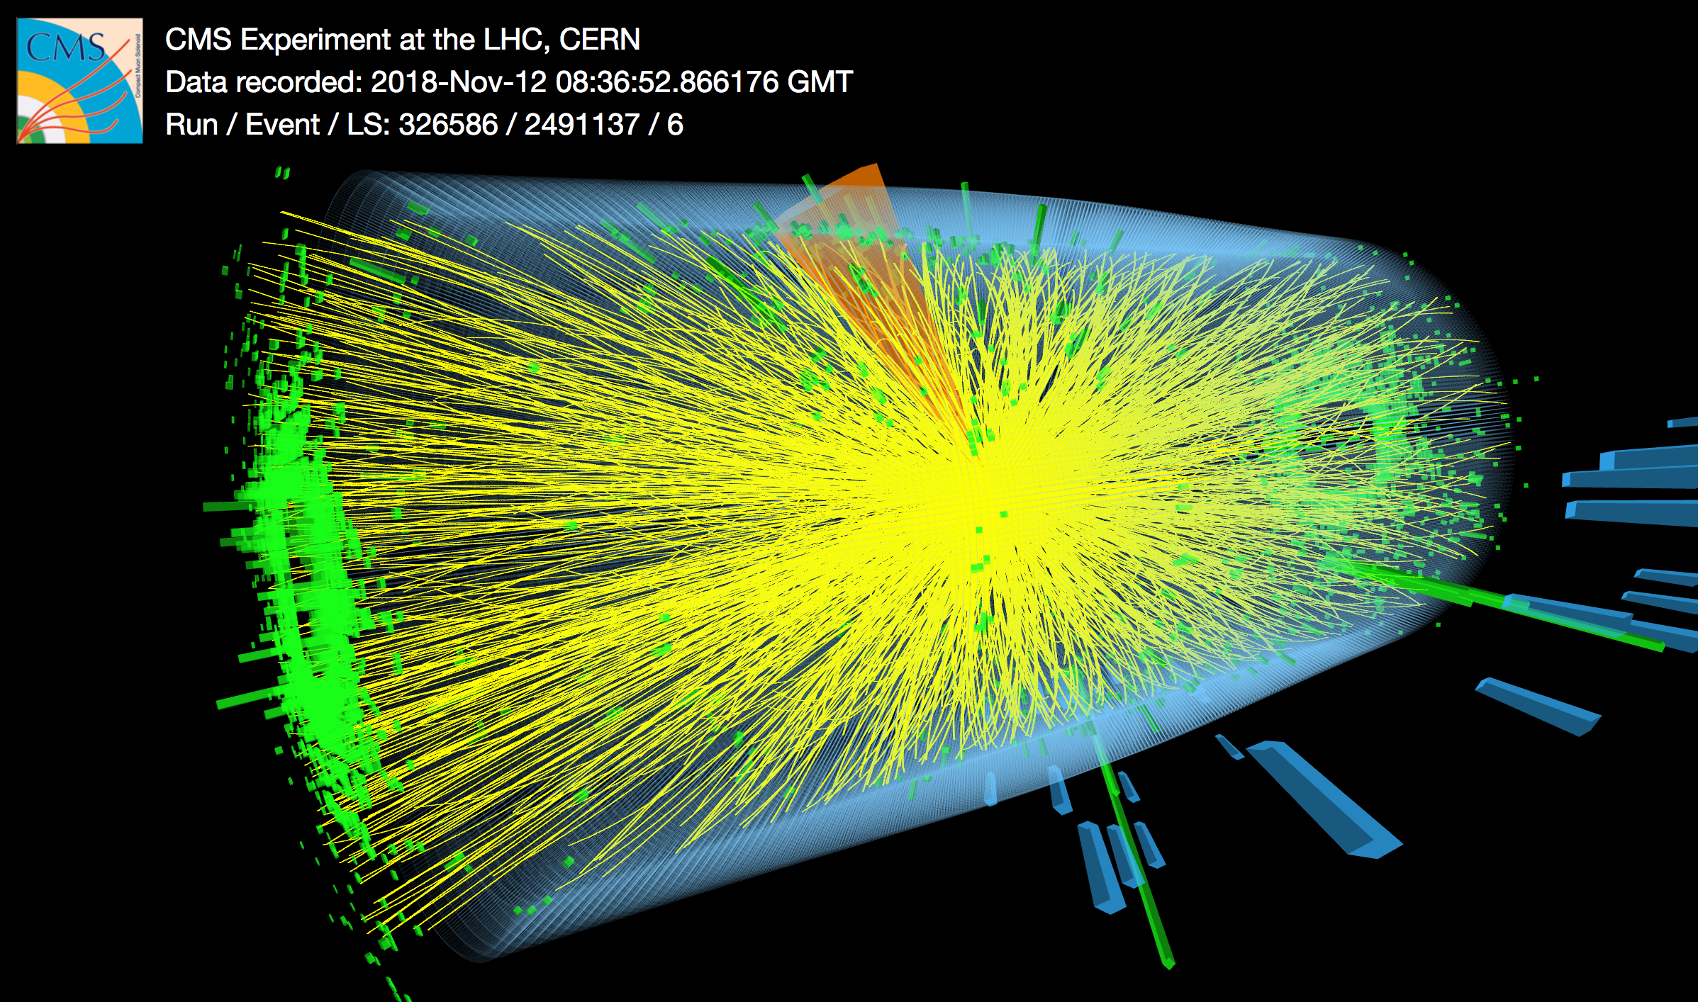

(3) EEC in PbPb Collisions
Hadron Energy
EM Energy
Charged Particle
A Higgs to two photons candidate
Notes:
This is a head-on lead-lead collisions, you can see that there are 10s of thousands of particles created in this collisions. It is immediately clear that it is going to be very difficult to analyze this data due to the really large number of particles produced. If nature choose to give us 3 times more particles, then CMS will not be able to handle it. We are really lucky.

Slide 36

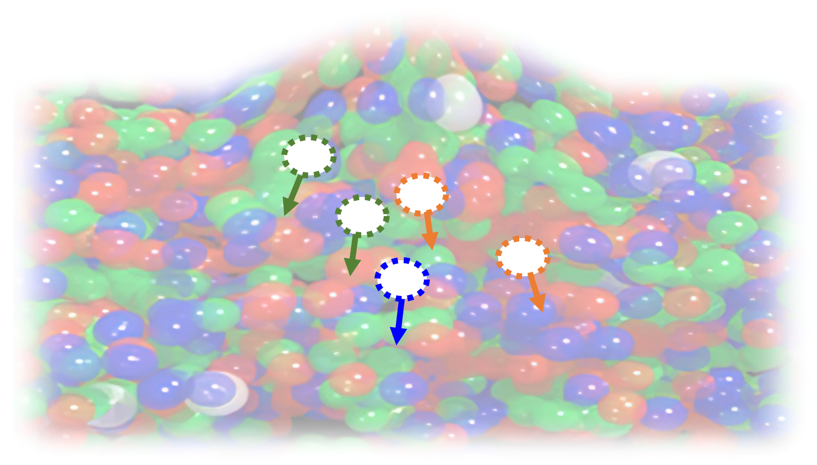
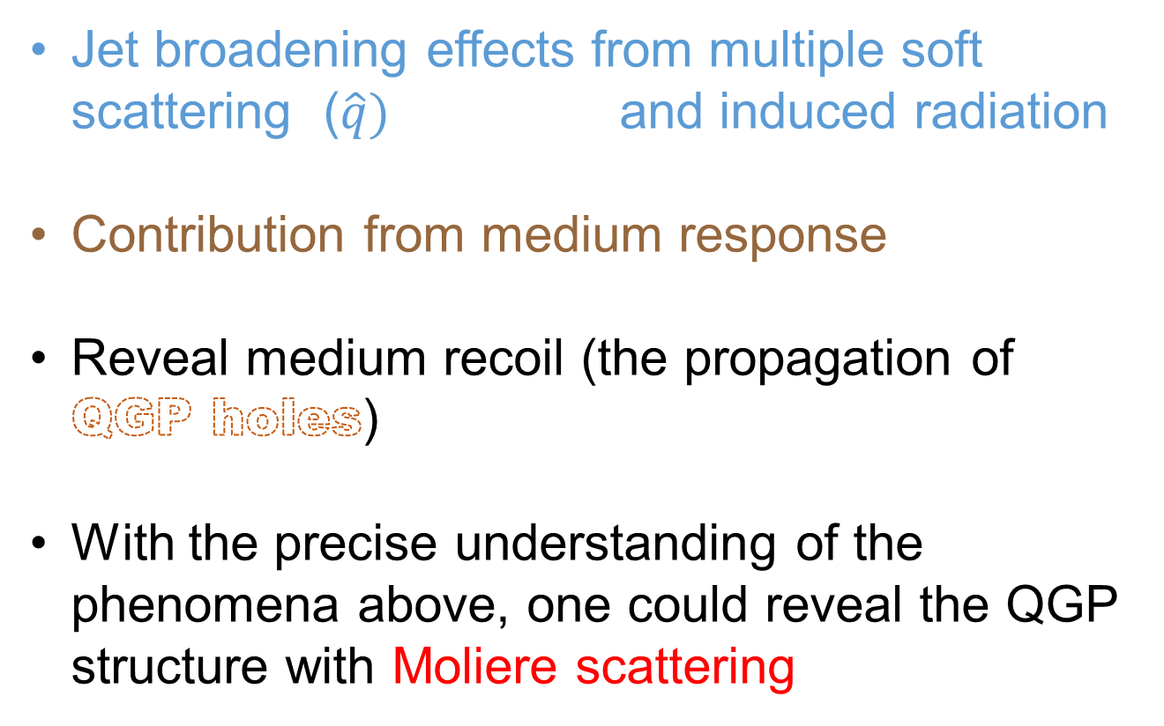
QGP Transport Properties and Structure with Jets
Jet broadening effects from multiple soft scattering ($\hat{q})$ and induced radiation
Contribution from medium response
Reveal medium recoil (the propagation of QGP holes)
With the precise understanding of the phenomena above, one could reveal the QGP structure with Moliere scattering
Jet
“Hole”

Slide 37


Reveal Wake Contribution With Z-tagged Jets and Hadrons
Enhancement of particle
“Positive wake”
Depletion of particle
“Recoil”
“QGP hole”
“Negative wake”
Position space
Z⁰ and wake hadron correlation in Hybrid model
Daniel Pablo, Krishna Rajagopal, YJL
Momentum space

Slide 38


Z Tagged E2C in Event Generators
Event selection:
Wake / Recoil particle:
Weight (W_{i}) the negative wake (Hybrid model) and
parton hole (Jewel model) by a factor of -1 in the P_{T,1} x P_{T,2} calculation
Normalization:
Z Boson 60 < M_{Z} < 120 GeV
Z p_{T} > 40 GeV, |y_{z}|<2.4
No jet reconstruction
Object selection:
All Hadron analysis: all neutral & charged final state particles with $p_{T}$ > 1 GeV included
Charged Hadron analysis: only charged final state particles with $p_{T}$ > 1 GeV included
Normalization by number of Z

Slide 39

JEWEL (All Hadrons)
At small ΔR, PbPb 0-30% is lower than pp reference
→ Jet Quenching
Shower only result shows a larger suppression in the phase space ΔR> 0.1
→ There is a characteristic scale of the medium recoil effect
Large cancellation effect between Positive Recoil and Hole Contributions
Note that hole partons are not hadronized in this calculation
No η_{hadron} cut
Yi Chen, YJL

Slide 40

Z-Tagged E2C in HYBRID Model (All Hadrons)
VERY preliminary results
At small ΔR, PbPb 0-30% is lower than pp reference
→ Jet Quenching
Shower only result (no Wake) shows a larger suppression in the phase space ΔR> 0.1
→ There is a characteristic scale of the medium wake effect
At ΔR=π, PbPb 0-30% shows a kink structure
Associated with the angular scale between positive and negative wake contribution
Without Negative wake, the structure at ΔR=π is gone
No η_{hadron} cut
Daniel Pablo, Krishna Rajagopal, Yi Chen, YJL

Slide 41

Z-Tagged E2C in HYBRID Model (All Hadrons)
VERY preliminary results
No η_{hadron} cut
|η_{hadron}|<2.4
Daniel Pablo, Krishna Rajagopal, Yi Chen, YJL
CMS acceptance cut keep essential physics

Slide 42

Z-Tagged E2C in HYBRID Model (Charged Hadrons)
VERY preliminary results
Hybrid Model is fully hadronized
→ Results with charged hadrons only could be calculated
E2C based on charged hadron keeps all the physics message with inclusive hadron
Significantly simplify the experimental measurement and enable statistical subtraction with mixed event
No η_{hadron} cut
Daniel Pablo, Krishna Rajagopal, Yi Chen, YJL

Slide 43

Z-Tagged E2C in PYQUEN (Charged Hadrons)
PYQUEN model which use a simple implementation jet quenching mechanism without conservation of energy shows little modification of the shape
Jet Quenching shows as area change and E2C broadening effect
At small ΔR: sensitive to wide angle radiation
→ Lead to further suppression at large angle as well as broadening of the E2C correlation function
Can we measure Z-tagged EnC in the actual AA data?
No η_{hadron} cut
Yi Chen, YJL
Notes:
Wide-Angle Radiation in PYQUEN
Physical Mechanism:
The wide-angle radiation is primarily due to the multiple scatterings of the partons as they traverse the QGP medium. Each scattering can cause the parton to emit gluons, leading to energy loss through both collisional (elastic) and radiative (inelastic) processes.
The radiative energy loss includes the Landau-Pomeranchuk-Migdal (LPM) effect, which accounts for the suppression of gluon radiation when the formation time of the emitted gluon is comparable to the mean free path between scatterings.

Slide 44
Background Subtraction of Z-Tagged Hadron Spectra
PbPb Z event:
Z-Jet + UE
Minimum-bias
PbPb Event
MC: should reproduce pp Z event
Data: Subtracted event
Correlated hadrons
with Z (S1)
Correlated hadron with Z (S1)
Uncorrelated hadrons with Z (B1)
– =
Uncorrelated hadrons with Z (B2)
We can then compare this with pp
For Z-tagged Hadron Spectrum, we could calculate S1 by
(S1 + B1) – (B2) ~ S1 (if we do a statistical subtraction <B1> = <B2>)

Slide 45
Background Subtraction of Z-Tagged E2C
PbPb Z event:
Z-Jet + UE
Minimum-bias
PbPb Event
MC: should reproduce pp Z event
Data: Subtracted event
Correlated hadrons
with Z (S1)
Correlated hadron with Z (S1)
Uncorrelated hadrons with Z (B1)
– =
Uncorrelated hadrons with Z (B2)
We want to measure S1 x S1 and compare this with pp
Experimentally, we could calculate (S1 x S1) by …
[Z event]²: (S1 + B1) x (S1 + B1) = S1 x S1 + 2 S1 x B1 + B1 x B1
[Z event x MB]: (S1+ B1) x B2 = S1 x B2 + B1 x B2
However, cross terms B1 x B2 won’t cancel B1 x B1 due to correlations in UE particles

Slide 46
Background Subtraction of Z-Tagged E2C
PbPb Z event:
Z-Jet + UE
Minimum-bias
PbPb Event
MC: should reproduce pp Z event
Data: Subtracted event
Correlated hadrons
with Z (S1)
Correlated hadron with Z (S1)
Uncorrelated hadrons with Z (B1)
– =
Uncorrelated hadrons with Z (B2)
We want to measure S1 x S1 and compare this with pp
Experimentally, we could calculate (S1 x S1) by all the following mixed-event pairs:
[Z event]²: (S1 + B1) x (S1 + B1) = S1 x S1 + 2 S1 x B1 + B1 x B1
[Z event x MB]: (S1+ B1) x B2 = S1 x B2 + B1 x B2
[MB]²: B1 x B1
[MB1 x MB2]: B1 x B2

Slide 47
Background Subtraction of Z-Tagged E2C
PbPb Z event:
Z-Jet + UE
Minimum-bias
PbPb Event
MC: should reproduce pp Z event
Data: Subtracted event
Correlated hadrons
with Z (S1)
Correlated hadron with Z (S1)
Uncorrelated hadrons with Z (B1)
– =
Uncorrelated hadrons with Z (B2)
We want to measure S1 x S1 and compare this with pp
Experimentally, we could calculate (S1 x S1) by all the following mixed-event pairs:
[Z event]²: (S1 + B1) x (S1 + B1) = S1 x S1 + 2 S1 x B1 + B1 x B1
[Z event x MB]: (S1+ B1) x B2 = S1 x B2 + B1 x B2
[MB]²: B1 x B1
[MB1 x MB2]: B1 x B2
Signal = S1 x S1
= [Z event]² - 2 [Z event x MB] – [MB]² + 2 [MB1 x MB2]

Slide 48

Background Subtraction Closure Test
Closure test with Embedded
(PYTHIA + HYDJET) for E2C
Following the event-mixing and subtraction scheme:
Reproduce the embedded pp signal with the proposed fully data-driven method
Used in inclusive jet and Z-tagged EEC in CMS PbPb analyses
Extension to EnC with similar ideas
Combined = [Z event]² - 2 [Z event x MB] – [MB]² +
2 [MB1 x MB2]
Yi Chen, YJL

Slide 49



Teaser: Inclusive Jet EEC in PbPb Collisions
CMS is releasing the PbPb results
at this workshop!
Background subtraction method: Identical to Z-tagged EEC, with jet replacing the role of Z boson
Technical details are in Jussi’s talk on Friday
Peak at around Δr =0.02
Exciting to see the “Free Hadron” “Confinement” and “Perturbative” regions in PbPb 0-10% results!
See Jussi’s talk on Friday
Jussi Viinikainen (Vanderbilt U.)
CMS-PAS-HIN-23-004

Slide 50


Summary
CMS pp EEC
  Widest p_{T}^{jet} range measurement of E2C, the first measurement on E3C
  Multi-dimensional unfolding: accounts for correlation between variables
  Features of QCD observed: color confinement, asymptotic freedom
  α_{s} Uncertainty ~ 4%, “most precise extraction from jet-substructure”
e⁺e⁻ EEC with archived ALEPH data
  Progress on data MC comparison and unfolding
  Full event analysis without jet: exploration of the back-to-back region
  Up to 20% spread across MC generators
    Identify interesting length scales related to Z mass, 2 and 3 jet event
    Collinear regions are consistent with our understanding in pp
CMS PbPb EEC:
  Studies with JEWEL, HYBRID and PYQUEN show new insights
  into jet quenching and medium response could be extracted
  Background subtraction strategy for Z-tagged Full event EEC
  First measurement of PbPb E2C! → Jussi’s talk on Friday

Slide 51

Acknowledgement
We would like to thank Roberto Tenchini and Guenther Dissertori from the ALEPH collaboration for the useful comments and suggestions on the use of ALEPH archived data.
We would like to thank Ian Moult, Felix Ringer, Jesse Thaler, Andrew Lakoski,
Liliana Apolinário, Ben Nachman, Camelia Mironov, Jing Wang, Ian Moult, Krishna Rajagopal, Daniel Pablos Alfonso, Jussi Viinikainan for the useful discussions on the analysis and presentation.
The MIT group's work was supported by US DOE-NP

Slide 52
Backup slides

Slide 53
Observable Wishlist in e⁺e⁻
Two point and higher particle correlator (EnC) and their ratios
  How high can we go??
Charged Correlators (plus/minus) and Charge-Weighted Correlators
  Probes correlations between charges, modification of scaling behavior, and changes in hadronization transitions
E^{n}E^{m} Correlators
  Potentially useful for suppressing soft radiation & studying transition region
… also a lot of other possibilities
  (As usual we have way too many interesting observables to measure)

Slide 54


The Highest Multiplicity Events in Archived LEP2 Data
64 Charged Particles
Thrust T=0.71
64 Charged Particles
Thrust T=0.80

Slide 55


Comparison with ALICE pp
Mostly similar story from MC comparisons

Slide 56





Rejecting 3-jet events in EEC's

Slide 57
E2C

Slide 58
E3C

Slide 59
E3C/E2C

Slide 60
E4C

Slide 61

E4C/E2C

Slide 62

E4C and E4C/E2C ratio in e⁺e⁻
Predictions of E4C and E4C/E2C from event generators

Slide 63
Motivation
Monte Carlo generators such as PYTHIA 6, PYTHIA 8, SHERPA and HERWIG are tuned with hadronic event shape observables and hadron spectra in e⁺ e⁻
  Then used to predict the jet spectra and substructure in more complicated hadron collisions
EEC in pp:
  New tool for α_{s} extraction
  Test on pQCD and compared to event generators.
  Reference for AA
Jet substructure and EEC in e⁺e⁻:
  Utilize the new jet clustering tools developed after LEP operation
  Revisit EEC with fine binning and extended it to full event.
  Further test of event generators, reference of pp
A
A
e⁻
e⁺
p
p

Slide 64
JEWEL vs HYBRID (All Hadrons)

Slide 65

Z-Tagged E2C in HYBRID Model (All Hadrons)
Description
Zoom
Daniel Pablo, Krishna Rajagopal, Yi Chen, YJL

Slide 66

Track-based EEC in e⁺e⁻ Collisions
Hannah Bossi (MIT)

