Slide 1
Accurate nuclear calculations are needed to support experiments studying violation of fundamental symmetries, testing unification theories, searching for dark matter and space-time variation of fundamental constants,
Nuclear anapole moment, Parity violating (PV) nuclear forces.
Nuclear Schiff and electric dipole moments. Time reversal violating (TV)
Nuclear TV - PV polarizability (mixed electric and magnetic )
10⁶ times enhanced PV and TV effects in neutron reactions
Collective Magnetic quadrupole and Schiff moments in deformed nuclei
Axion dark matter producing PV and TV effects listed above
Neutron skin affecting atomic PV in isotope chain, search for Z’ boson
Nuclear clock - best device to search for space-time variation of fundamental constants (fine structure constant α, quark mass, Λ_{QCD}). Effects in Mossbauer nuclear transitions
Dependence of nuclear magnetic moments on fundamental constants
Search for dark matter producing variation of the fundamental constants
Anisotropy of speed of light→ Anisotropy of Coulomb interaction in nuclei
→ 10⁷ times improvement compare to Michelson-Morley type experiments
Test of unification theories predicting matter –antimatter asymmetry and explaining baryogenesis.
PV , TV →CP violation from CPT theorem.
Minimal supersymmetric theory is cornered.

Slide 2
Local Lorentz Invariance Violation (LLIV) in Coulomb Interaction
Anisotropy in the speed of light, that has been constrained by Michelson-Morley-type experiments, also generates anisotropy in the Coulomb interactions. Q. G. Bailey and V. A. Kostelecký, Phys. Rev. D 70, 076006, 2004
We used ²¹Ne data to find dependence of the Coulomb energy on the orientation of the deformed nucleus→ Improvement by 7 orders of magnitude in comparison with previous anisotropy of c experiments, the speed of light is isotropic to a part in 10²⁸.
V.F. and M. Romalis. Phys. Rev. Lett. 118,14250,2017
Asymmetry in maximal attainable speed c for massive particles,
Einstein equivalence principle violations
LLIV for proton improved by 4 orders of magnitude.
²²⁹Th nuclear clock: 10⁵ enhancement compare to atoms
V.F. Phys. Rev. Lett. 117, 072501, 2016

Slide 3
Atomic parity violation (PV) and neutron skin
e
e
Dominated by Z-boson exchange between electrons and nucleons
Z
n
n
Standard model tree-level couplings:
In atom with Z electrons and N neutrons obtain effective Hamiltonian parameterized by “nuclear weak charge” Q_{W}
Neutron skin Cs 0.2%, Fr, Ra+ 0.6%. PV effect ~ Z³
Discovered in 1978 Bi; Tl, Pb, Cs –accuracy 0.35 %
Our calculations accuracy Bi 11%,Pb 8%,Tl 3%, Fr,Ra,Cs 0.5%

Slide 4
PV : Chain of isotopes and neutron skin
Dzuba, Flambaum, Khriplovich
Rare-earth atoms:
close opposite parity levels-enhancement
Many stable isotopes
Ratio of PV effects gives ratio of weak charges. Uncertainty in atomic calculations cancels out.
Dy and Yb; PV amplitude 100 x Cs! Experiment: PV in Yb isotopes
D. Antypas, A. Fabricant, J.E. Stalnaker, K. Tsigutkin, V.V Flambaum, D. Budker, Nature Phys. 15, 120, 2018
Fortson,Pang,Wilets - neutron distribution problem
Test of Standard model or measurement of neutron distribution?
Brown, Derevianko,Flambaum 2009. Uncertainties in neutron distributions cancel in differences of PV effects in isotopes of the same element. Measurements of ratios of PV effects in isotopic chain can compete with other tests of Standard model!
Limit on new physics : Z’ boson

Slide 5
Nuclear anapole moment
Source of nuclear spin-dependent PV effects in atoms
Nuclear magnetic multipole violating parity
Arises due to parity violation inside the nucleus
Interacts with atomic electrons via usual magnetic interaction (PV hyperfine interaction):
j
⬆ a
B
[Flambaum,Khriplovich,Sushkov]
E_{PV} ∝ Z² A^{2/3} measured as difference of PV effects for transitions between hyperfine components
Cs: |6s,F=3> – |7s,F‘=4> and |6s,F’=4> – |7s,F=3>
Probe of weak nuclear forces via atomic experiments!

Slide 6
Nuclear anapole moment is produced by PV nuclear forces. Measurements +our calculations give the strength constant g.
Boulder Cs: g=6(1) in units of Fermi constant, too big?
Seattle Tl: g=-2(3) Theory g=4 ?
More accurate calculations Flambaum,Hanhart; Haxton,Liu,Ramsey-Musolf; Auerbach, Brown; Dmitriev, Khriplovich,Telitsin:
problem remains ?
Experiments: Fr (TRIUMF), Dy,Yb(Mainz), Cs, Ra
10⁵ enhancement of nuclear anapole effects in molecules (Labzovsky;Sushkov,Flambaum 1978)
experiments : Chicago, Groningen, NWU
Many molecular calculations : Borschevsky,Ilias,Beloy,Dzuba,Flambaum,Schwerdtfeger, et al

Slide 7
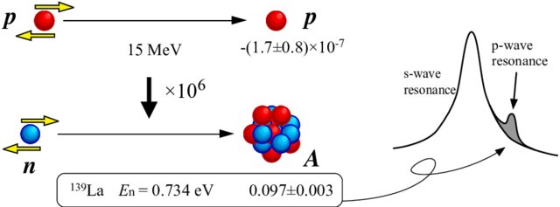
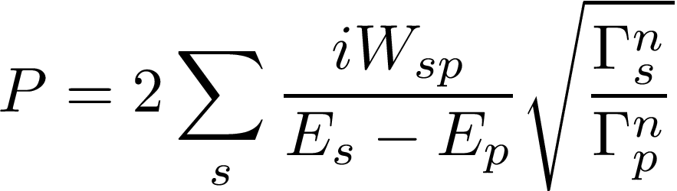
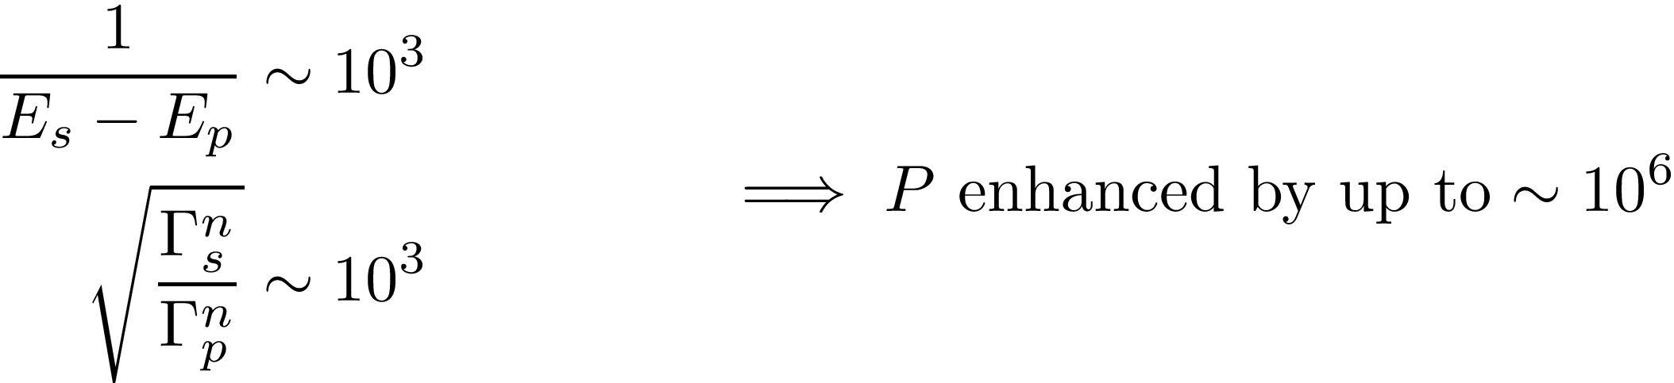

10⁶ enhancement of Parity and Time-reversal violation in neutron reactions near p-wave compound resonances
PV Sushkov and Flambaum, 1980.
TV,PV Bunakov and Gudkov 1983
PV confirmed by numerous experiments
TV,PV experiments in Japan and USA
Notes:
Now the longitudinal asymmetry of neutrons P can be rewritten in this form by explicitly calculating expressions for the cross sections for positive and negative helicity, where here Wsp is the matrix element between s and p wave resonances. Here we note that this is in the case of an unpolarised target with zero spin.
And whats interesting about this expression is we see that the value of the P is enhanced as a result of entrance channel interference between close s and p wave resonances. (close to s-resonance)
The first reason for this enhancement is the small energy interval between the s and p-wave resonance energies in the denominator. This referred to as dynamical enhancement.
And the second reason is that at sufficiently low neutron energies, the s-wave resonance width Gamma s is approx. 3 orders of magnitude larger than the width of the p-wave resonance Gamma p. This is called kinematic enhancement.
These two factors can combine meaning the parity violating effect can be enhanced by a magnitude of 10^6.
-----
Add reference sushkov flambaum 1980.

Slide 8
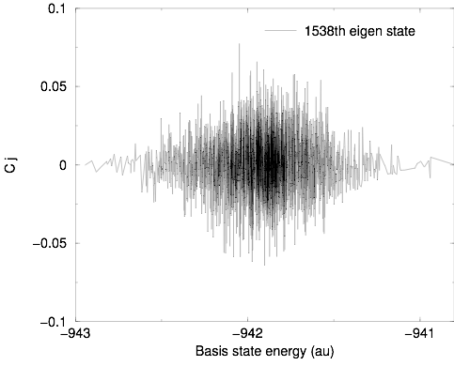



Typical chaotic eigenstate in excited Au²⁴⁺
Graph shows eigen-
state components
as a function of the HF basis-state energies
Components fluctuate (are uncorrelated - “quantum chaos”). Random variables, <C_{j} >= 0
Breit-Wigner type dependence of <C_{j}² > on

Slide 9
Statistical theory based on properties of chaotic eigenstates
Theory predicts matrix elements between chaotic states: Orbital occupation numbers, magnetic moments, electromagnetic amplitudes, enhancement of weak interactions and recombination, increase of entropy, etc. Accurate predictions, tested!
Similar to gas in this room: we do not know motion of each molecule but can very accurately predict occupation numbers, distribution of velocities, pressure, etc.
We calculated P-odd and T,P-odd matrix elements between chaotic nuclear compound states. Due to the million times enhancements, the measurements should improve limits on T,P-odd interactions by an order of magnitude or more.
V.F. 1992, V.F. and Vorov 1993-1995, Fadeev and V.F 2020, V.F. and Mansour 2022.

Slide 10
Nuclear Electric Dipole Moment:
TV,PV NN interaction gives 40 times larger contribution than nucleon EDM. Sushkov, Flambaum, Khriplovich 1984, x 10¹ - 10³ in deformed nuclei, with collective TV,PV moments

Slide 11
Nuclear EDM is screened in atoms: d_{N} E_{N}=0
E_{N} is electric field on the nucleus
Schiff theorem: E_{N}=0 in neutral systems
Extension for ions and molecules:
Ion acceleration a= Z_{i} eE/M
Nucleus acceleration a=Z eE_{N}/M
E_{N}=E Z_{i}/Z
In molecules screening is stronger:
a= Z_{i} eE/(M+m)→ E_{N}= E (Z_{i}/Z)(M/(M+m))
In ions nuclear EDM may be measured
In neutral systems Z_{i} =0 → E_{N}= 0

Slide 12
Diamagnetic atoms and molecules
Source-nuclear Schiff moment
Schiff moment appears when screening of external electric field by atomic electrons is taken into account.
Nuclear T,P-odd moments:
EDM – non-observable due to total screening (Schiff theorem)
Nuclear electrostatic potential with screening (our 1984 calculation following ideas of Schiff and Sandars):
d is nuclear EDM, the term with d is the electron screening term
ϕ(R) in multipole expansion is reduced to
where is Schiff moment.
This expression is not suitable for relativistic calculations since Dirac electron wave function is infinite on the point-like nucleus.
Atomic EDM is proportional to Z² x Relativistic factor, which is infinite for the point-like nucleus

Slide 13
V.F., Ginges, 2002:
where
Nuclear spin
j
Electric field induced
by T,P-odd nuclear
forces which influence
proton charge density
R
E
This potential has no singularities and may be used in relativistic calculations.
Schiff moment electric field polarizes atom and produce EDM.
Relativistic corrections Z²a² originating from electron wave functions can be
incorporated into Local Dipole Moment (L) containing sum of powers of r²

Slide 14
Nuclear enhancement
Auerbach, V.F. , Spevak 1996
The strongest enhancement is due to octupole deformation (Rn,Ra,Fr,…)
Intrinsic Schiff moment:
- quadrupole deformation
- octupole deformation
No T,P-odd forces are needed for the Schiff moment and EDM in intrinsic
reference frame
However, in laboratory frame S=d=0 due to rotation of deformed nucleus

Slide 15
In the absence of T,P-odd forces: doublet (+) and (-)
and
I
n
n
I
T,P-odd mixing (b) with opposite parity state (-) of doublet:
and
EDM and Schiff moment

Slide 16
Simple estimate
Three factors of enhancement:
Large collective moment in the body frame
Small energy interval (E₊-E₋), 0.05 instead of 8 MeV
Large matrix element <IMK | H_{TP}|IMK>
²²⁵Ra,²²³Rn, Fr,… -100-1000 times enhancement
Results are stable – screening term is small, no cancellation
Static octupole deformation is not essential, nuclei with soft
octupole vibrations also have the enhancement.
Engel, Friar, Hayes (2000); Flambaum, Zelevinsky (2003)

Slide 17
Octupole deformation and enhanced Schiff moments in long-lifetime nuclei
V.F. and Feldmeier 2019; V.F. and Dzuba 2019
²²⁵Ra lifetime15 days –experiment in Argonne laboratory
²²⁷Ac 22 years, atomic EDM 6 times larger than in Ra
²³⁷Np 2 million years , EDM 4 times larger than in Ra
¹⁵³Eu stable, EDM comparable to Ra ?
Other candidates: ^{233,235}U (0.7 billion years), ^{161,163}Dy,¹⁵⁵Gd (stable), ²²⁹Th (8 thousand years),
²²⁹Pa (unstable but possibly huge SM due to very close nuclear level– 100 eV ?, Haxton, Henly 1983
Several sophisticated many-body calculations for ¹⁹⁹Hg (no reliable result)
and ²²⁵Ra, Dobaczewski, Engel, et al Phys. Rev. Lett. 121, 232501 (2018), Prog. Part. Nucl. Phys. 71, 21 (2013), …

Slide 18
Enhanced effects of Schiff moment in molecules Sandars 1967
TlF experiments: Hinds et al, DeMille, T. Zelevinsky et al
Enhancement in Ra, Ac, Th, Np, Eu, … molecules
Biggest Schiff moment
Highest nuclear charge
²²⁵RaO= 200 TlF V.F. 2008; Kudashov,Petrov,Skripnikov,Mosyagin, Titov, V.F. 2013,
²²⁷AcF, ²²⁷AcN, ²²⁷AcO⁺, ²²⁹ThO, ¹⁵³EuO⁺ and ¹⁵³EuN
V.F., Feldmeier 2019; V.F. ,Dzuba 2019
²²⁷AcN=²²⁷AcO⁺ =400 TlF Skripnikov, Mosyagin, Titov, V. F. 2020
Experiment with ferroelectric solids to search for oscillating Schiff moment produced by axion dark matter: CASPEr Budker, A. Sushkov et al

Slide 19
EDMs of atoms of experimental interest
Z | Atom | [S/(e fm3)]e cm | [10⁻²⁵ η] e cm | Expt.
2 | ³He | 0.00008 | 0.0005
54 | ¹²⁹Xe | 0.38 | 0.7 | Seattle, Ann Arbor, Heidelberg, …
70 | ¹⁷¹Yb | -1.9 | 3 | Bangalore,KyotoHeifei
80 | ¹⁹⁹Hg | -2.8 | 4 | Seattle
86 | ²²³Rn | 3.3 | 3300 | TRIUMF
88 | ²²⁵Ra | -8.2 | 2500 | Argonne,KVI
88 | ²²³Ra | -8.2 | 3400
Standard Model h =0.3 10⁻⁸ d_{n} = 5 x 10⁻²⁴ e cm h, d(¹⁹⁹Hg)/ d_{n} = 10⁻¹
Best limit from Hg EDM q < 0.5 10⁻¹⁰ Seattle, V.F. and Dzuba, PRA101, 042504,2020

Slide 20
Violation of the Schiff theorem due to magnetic interaction
Magnetic interaction + electric interaction=zero force acting on the atomic nucleus. Electric field E_{N} and interaction with nuclear EDM d_{N} E_{N} are nonzero. Schiff 1963
Atomic EDM d_{A}=10⁻⁷Z M_{N} d_{N} M_{N} is nuclear magnetic moment in nuclear magnetons. Porsev, Ginges and V.F. PRA 83, 042507, 2011 This mechanism is important in light atoms since effect of Schiff moment increases faster than Z² .
EDM of F nucleus and Schiff moment of Tl in TlF molecule experiment

Slide 21
Violation of Schiff theorem in non-stationary states. V.F. 2023
Non-stationary states may be expanded as a sum of stationary states
c₁|1> + c₂|2 > + …
Such state may be produced by laser excitation of atom or molecule.
Electrons and nuclei perform oscillating motion keeping center of mass at rest
Electric field on the nucleus
In atoms m=m_{e} is electron mass.
In molecules m=M_{N} is nuclear mass, since nuclei also produce screening in stationary case. Nuclei are very slow in molecules. They are not efficient screeners in time-dependent case. Field on the nucleus in molecules is M_{N}/m_{e} ~ 3-5 orders of magnitude bigger than in atoms.
Atomic unit of electric field is 5 x 10⁹ V/cm, so, in principle, electric field on the nucleus may be several orders of magnitude bigger than fields used to measure neutron and atomic EDM. However, the field is strongly suppressed if energy difference=frequency of oscillations is small compare to atomic unit 27 eV.
This electric field may affect nuclear reactions

Slide 22
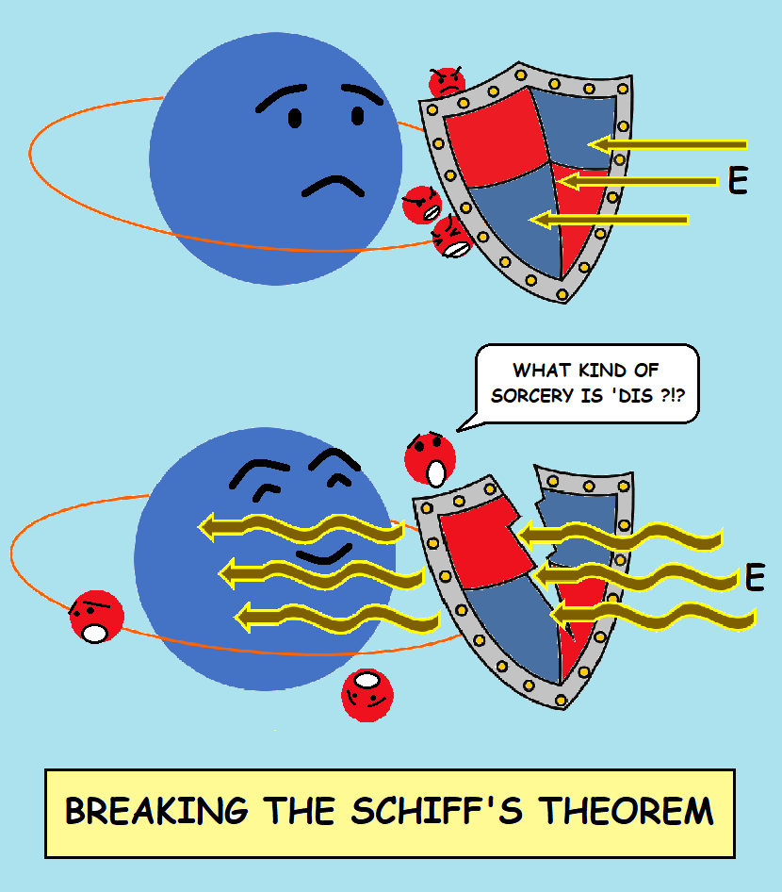
Breaking Schiff’s theorem
Schiff’s theorem: Constant electric fields is screened.
Solution: Oscillating electric fields is NOT screened!

Slide 23
Nuclear EDM-screening: d_{N} E_{N}
Oscillating field: incomplete screening!
E_{N}=-E ϖ² α_{zz}/Z V.F. 2018
In molecules field is much bigger, by factor (M_{mol}/m_{e})², since nuclei moves slowly and do not provide efficient screening
V.F. , Samsonov, Tran Tan 2019
Enhancement in resonance E=A sin ςt cos ϖt
ς=2eE₀<0|D_{z}|n> is the Rabi oscillation frequency
A=ϖ²D_{z} x 5.14 10⁹ V/cm
This electric field may affect nuclear reactions

Slide 24
Magnetic quadrupole moment.
TV,PV nuclear MQM Khriplovich 1976, Haxton, Henley 1983
Magnetic quadrupole moments (MQM) produce EDM in atoms and molecules
Magnetic interaction is not screened! Effect may be bigger than that of Schiff moment, generically ~10 times
Sushkov, Flambaum, Khriplovich 1984
Magnetic interaction of atomic electrons with nuclear MQM mixes atomic orbitals of opposite parity and produces atomic EDM

Slide 25






Atomic EDMs
Mechanisms for EDM generation- mixing of atomic orbitals of opposite parity
fundamental CP-violating phases
quark/lepton
level
neutron EDM
nucleon
level
Schiff moment,
nuclear
level
EDMs of diamagnetic
systems (Hg,Ra,TlF)
EDMs of paramagnetic
systems (Tl,ThO,HF+)
atomic
level
+
+
+
=
-

Slide 26
Collective magnetic quadrupole moment in deformed nuclei
MQM produced by nuclear T,P-odd forces
Collective enhancement in deformed nuclei
Mechanism: T,P-odd nuclear interaction produces spin hedgehog- correlation (s r)
Spherical – magnetic monopole forbidden
Deformed- collective magnetic quadrupole
V.F. 1994
Enhancement factor is similar to that for electric quadrupole in deformed nuclei

Slide 27
Nuclear estimates and molecular calculations of MQM effects
Nuclear and molecular estimates for
TaN, ThO, BaF, HgF, YbF, HfF+ V.F. , DeMille, Kozlov 2014
(TaO+, WN+)
Accurate molecular calculations
ThO: Skripnikov, Petrov, Titov and V.F. 2014
TaN: Skripnikov, Petrov, Mosyagin, Titov, and V.F. 2015
TaO+ T. Fleig 2017
HfF+ Petrov,Skripnikov, Titov, and V.F. 2017, 2018
YbOH Maison, Skripnikov and V.F. 2019. Experiment in progress
LuOH+ Maison, Skripnikov, V.F., Grau 2020

Slide 28
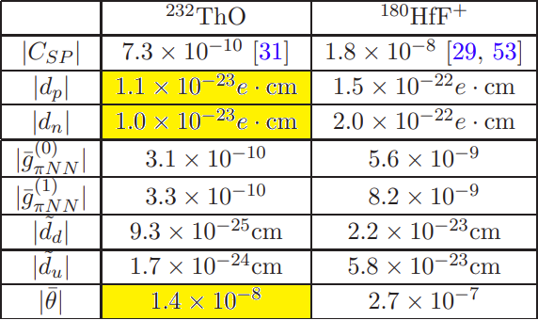
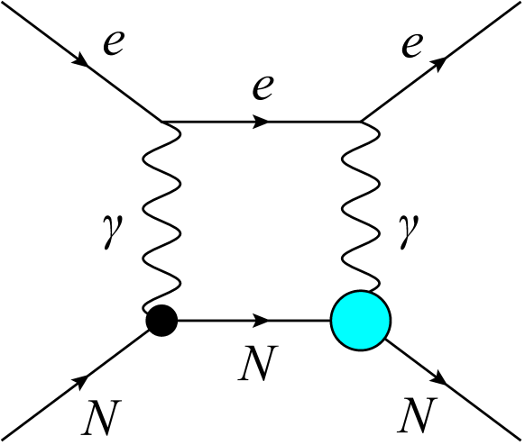
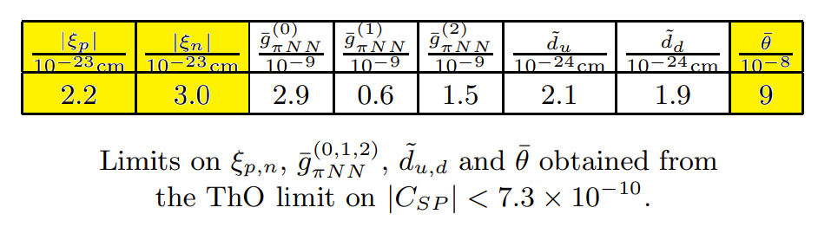
P,T-odd nuclear polarization
atomic EDM due to nuclear T,P-odd polarizability.
electric + magnetic vertices instead of 2 electric vertices for usual polarisabilty
We studied this → electron EDM experiments are sensitive to hadron CP-violation, theta-term, axion dark matter, etc.
Nuclear spin may be zero as in electron EDM experiments
μ – d
d
μ
Internal nuclear excitations
V.V. Flambaum, J.S.M. Ginges, G. Mititelu, arXiv:nucl-th/0010100 (2000)
V.V. Flambaum, M. Pospelov, A. Ritz, and Y.V. Stadnik, PRD 102, 035001 (2020)
V.V. Flambaum, I.B. Samsonov, H.B. Tran Tan, JHEP 2020, 77 (2020)
V.V. Flambaum, I.B. Samsonov, H.B. Tran Tan, PRD 102, 115036 (2020)

Slide 29
Axion dark matter in JILA EDM experiment
Experimental Constraint on Axionlike Particles over Seven Orders of Magnitude in Mass.
Tanya S. Roussy, Daniel A. Palken, William B. Cairncross, Benjamin M. Brubaker, Daniel N. Gresh, Matt Grau, Kevin C. Cossel, Kia Boon Ng, Yuval Shagam, Yan Zhou, Victor V. Flambaum, Konrad W. Lehnert, Jun Ye, and Eric A. Cornell. Phys. Rev. Lett. 126, 171301 (2021)
Low-mass spin-0 particles form oscillating classical field φ(t) = φ₀ cos(m_{φ}c²t/ℏ),
with energy density <ρ_{φ}> ≈ m_{φ}²φ₀²/2 ρ_{DM,local}
Oscillating EDM = d cos(m_{φ}c²t/ℏ),

Slide 30
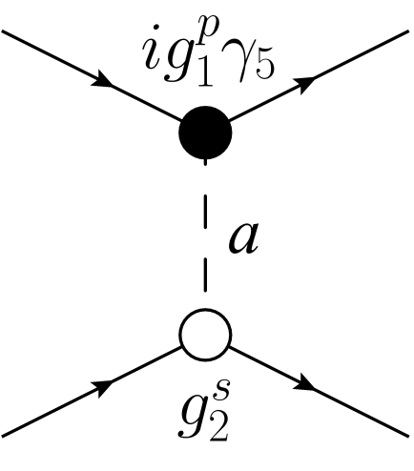
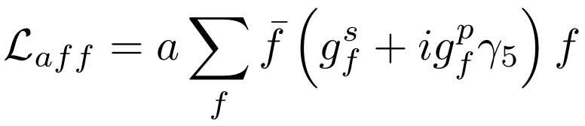
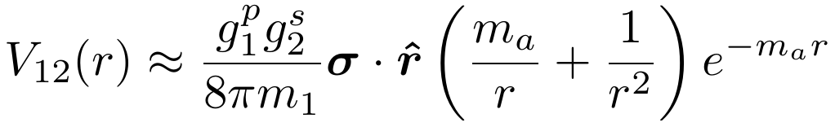
EDM produced by axion exchange
Macroscopic fifth-forces [Moody, Wilczek, PRD 30, 130 (1984)]
P,T-violating forces => Atomic and Molecular EDMs
[Stadnik, Dzuba, Flambaum PRL 2018, Dzuba,Flambaum,Samsonov,Stadnik 2018]
Atomic EDM experiments: Cs, Tl, Xe, Hg
Molecular EDM experiments: YbF, HfF⁺, ThO
YbOH Maison,Flambaum,Hutzler,Skripnikov 2021
Notes:
30

Slide 31
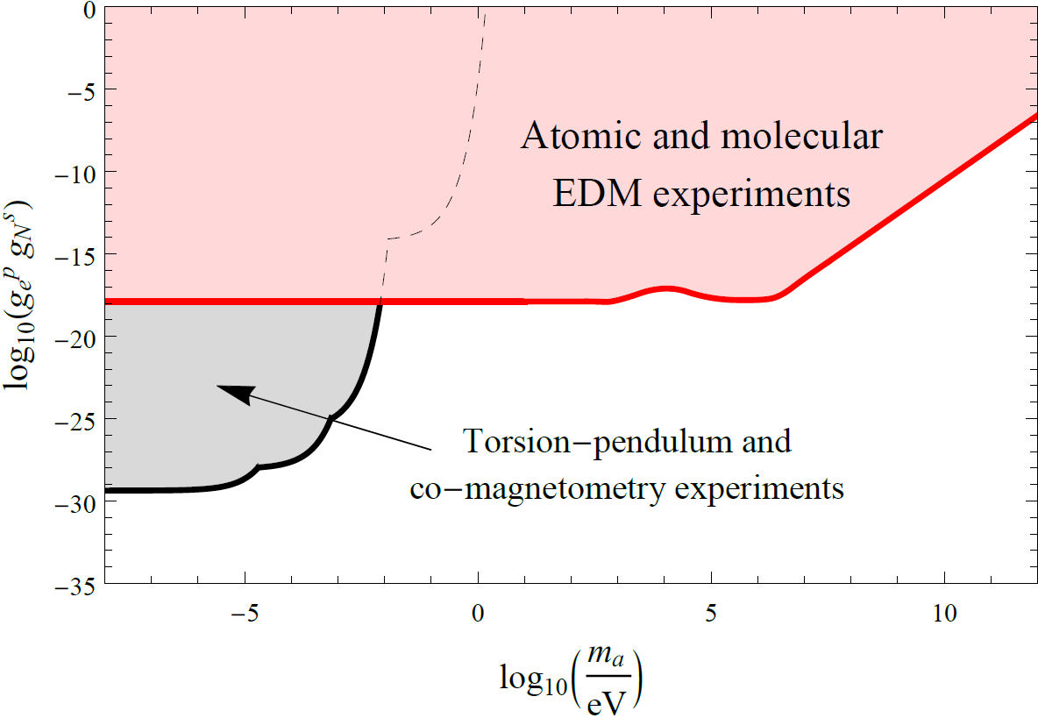
Constraints on Scalar-Pseudoscalar Nucleon-Electron Interaction
EDM constraints: [Stadnik, Dzuba , Flambaum PRL 2018]
Many orders of magnitude improvement!
Notes:
31

Slide 32
Low-mass Spin-0 Dark Matter
Low-mass spin-0 particles form a coherently oscillating classical field φ(t) = φ₀ cos(m_{φ}c²t/ℏ), with energy density <ρ_{φ}> ≈ m_{φ}²φ₀²/2 (ρ_{DM,local} ≈ 0.4 GeV/cm³)
Coherently oscillating field, since cold (E_{φ} ≈ m_{φ}c²)
Classical field for m_{φ} ≤ 0.1 eV, since n_{φ}(λ_{dB,φ} /2π)³ >> 1
Coherent + classical DM field = “Cosmic maser”
10⁻²² eV ≤ m_{φ} ≤ 0.1 eV <=> 10⁻⁸ Hz ≤ f ≤ 10¹³ Hz
m_{φ} ~ 10⁻²² eV <=> T ~ 1 year
λ_{dB,φ} ≤ L _{dwarf galaxy} ~ 1 kpc
Classical field
Notes:
32
1 parsec = 3.26 light years; R_{dwarf galaxy} ~ 1 kpc.
Energy scales: Hubble scale ~ 10^{-33} eV; Planck scale ~ 10^{28} eV. i.e. ~ 61 orders of magnitude in range.

Slide 33
Low-mass Spin-0 Dark Matter
Dark Matter
Scalars
(or squared axion field φ²):
φ^{n} → +φ^{n}
Pseudoscalars
(Axions):
φ → -φ
P
→ Time-varying spin-dependent effects, EDM and other T,P-violating moments
10³ improvement
→ Time-varying fundamental constants
10¹⁵ improvement
Notes:
33

Slide 34
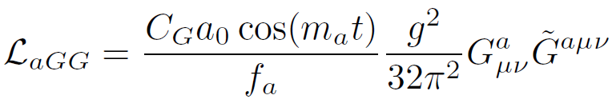

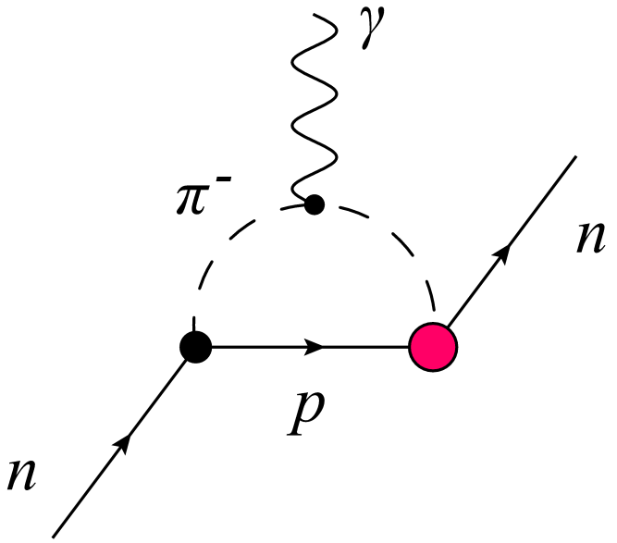


Axion-Induced Oscillating Neutron EDM
[Crewther, Di Vecchia, Veneziano, Witten, PLB 88, 123 (1979)], [Pospelov, Ritz, PRL 83, 2526 (1999)], neutron EDM due to θQCD
[Graham, Rajendran, PRD 84, 055013 (2011)] θ(t)=a(t)/f_{a} , a(t) is axion field
Notes:
34
Chiral-log enhancement in soft pion limit.

Slide 35
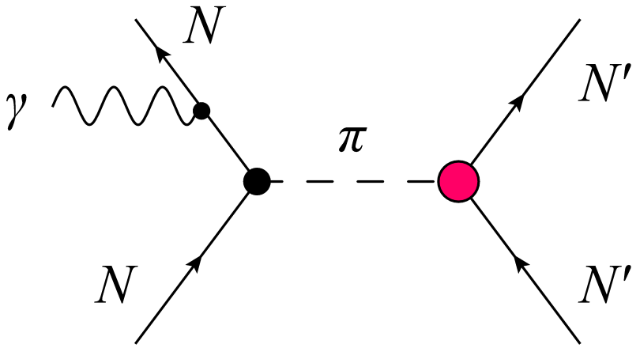
Axion-Induced Oscillating Atomic and Molecular EDMs
[O. Sushkov, Flambaum, Khriplovich, JETP 60, 873 (1984)], [Stadnik , Flambaum, PRD 89, 043522 (2014)]
Induced through hadronic mechanisms:
Oscillating nuclear Schiff moments (I ≥ 1/2 => J ≥ 0)
Oscillating nuclear magnetic quadrupole moments (I ≥ 1 => J ≥ ½) Oscillating mixed nuclear polarization (I ≥ 0 => J ≥ ½)
Underlying mechanisms:
Intrinsic oscillating nucleon EDMs (1-loop level)
Oscillating P,T-violating intranuclear forces (tree level => larger by ~4π² ≈ 40; up to extra 1000-fold enhancement in deformed nuclei)
(1)
(2)
Notes:
35
Axion-induced P,T-odd forces due arise at tree level, while axion-induced intrinsic nucleon EDMs arise at 1-loop level -> avoid ~4*pi (or 8*pi^2 – check) loop suppression factor! (Which far outweighs the chiral log enhancement factor for instrinic nucleon EDM: ln(m_N^2/m_\pi^2) \approx 4 numerically).
Nuclear enhancement factor: for d_nucleus c.f. d_nucleons! [Read up more!]
Closely-spaced energy spacing enhancement and collective enhancement are possible in deformed nuclei → (Is this only for P,T-odd forces??!)

Slide 36
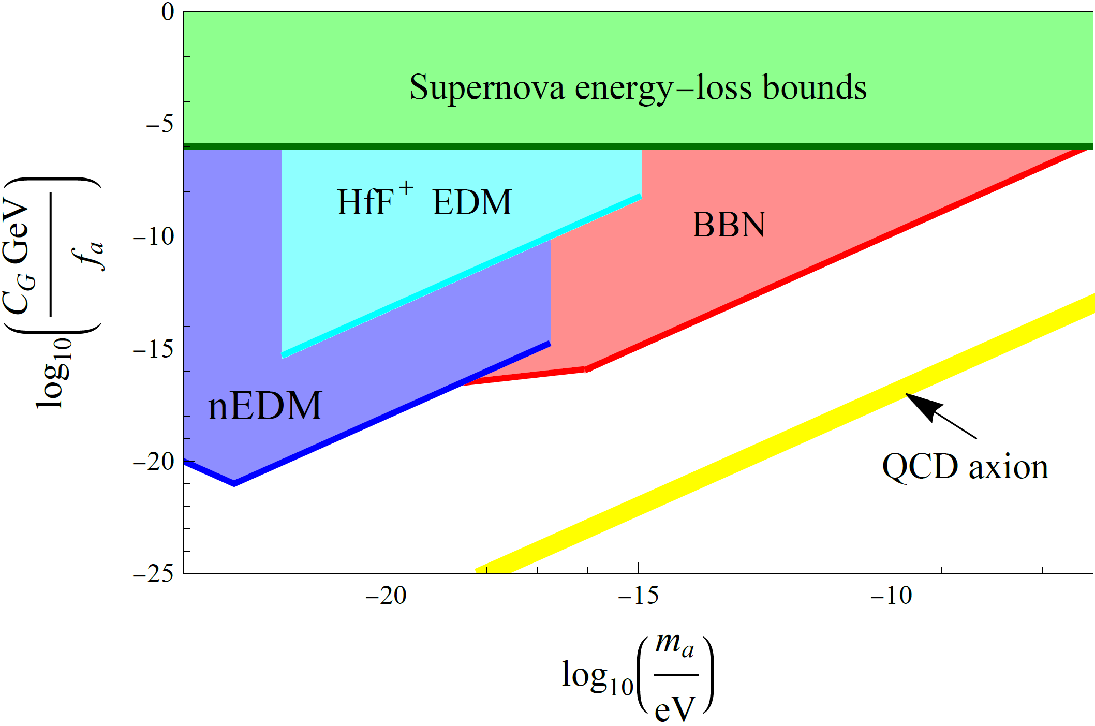
Constraints on Interaction of Axion Dark Matter with Gluons
nEDM constraints: [nEDM collaboration, PRX 7, 041034 (2017)]
HfF⁺ EDM constraints: [Roussy et al., PRL 126, 171301 (2021)]
Notes:
36
Point out the Planck scale for comparison --- Note that the CASPEr-Electric phase I projections “weakened” by a factor of a few thousand in going from Fig. 2 of 1306.6089 to Fig. 3 of 1711.08999 …

Slide 37
OSCILLATING NUCLEAR ELECTRIC DIPOLE, MAGNETIC QUADRUPOLE AND SCHIFF MOMENTS, INDUCED BY AXIONIC DARK MATTER, PRODUCE MOLECULEAR TRANSITIONS
M2 transition: photon suppressed, axion is not suppressed!
Smaller systematics
V.F., Tran Tan, Budker, Wickenbrock Phys. Rev. D 101, 073004 (2020)
Oscillating magnetic moment leads to oscillating magnetic field of a permanent magnet.
Bloch, Budker, Flambaum, Samsonov, A.Sushkov, Tretiak. Phys. Rev D107, 0750332023 (2023),
Results of experiment will be published soon.

Slide 38
Low-mass Spin-0 Dark Matter
Dark Matter
Scalars
(or squared axion field φ²):
φ^{n} → +φ^{n}
Pseudoscalars
(Axions):
φ → -φ
P
→ Time-varying spin-dependent effects, EDM and other T,P-violating moments
10³ improvement
→ Time-varying fundamental constants
10¹⁵ improvement
Notes:
38

Slide 39
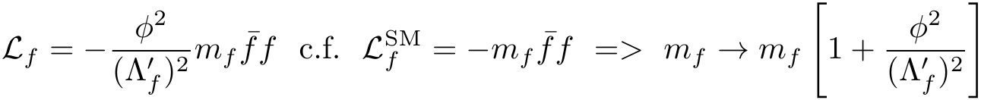
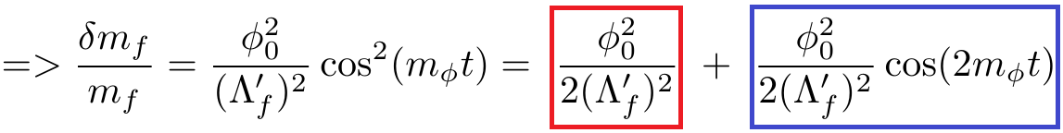
Dark Matter-Induced Cosmological Evolution of the Fundamental Constants
Consider an oscillating classical scalar or axion field, φ(t) = φ₀ cos(m_{φ}t), that interacts with SM fields (e.g. a fermion f) via quadratic couplings in φ.
‘Slow’ drifts [Astrophysics (high ρ_{DM}): BBN, CMB]
Oscillating variations [Laboratory (high precision)]
Notes:
39
Update references… Explain that electromagnetic fine-structure constant governs the strength of all electromagnetic processes in Nature and interactions.
RA: less talk --- only explain cos()^2 part…

Slide 40
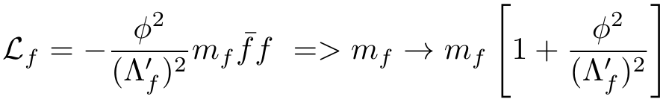
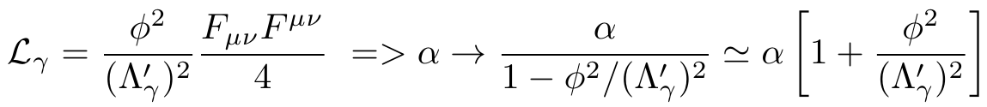
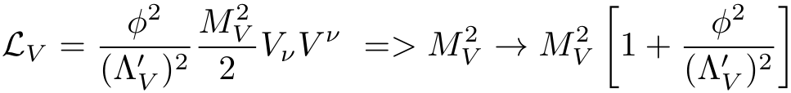
Dark Matter-Induced Cosmological Evolution of the Fundamental Constants
[Stadnik, and V.F. PRL 114, 161301 (2015); PRL 115, 201301 (2015)]
Fermions:
Photon:
W and Z Bosons:
Notes:
40

Slide 41
Arguments in favour of fundamental constants variation
“ Fine tuning” of fundamental constants is needed for life to exist. If fundamental constants would be even slightly different, life could not appear!
Variation of coupling constants in space provide natural explanation of the “fine tuning”: we appeared in area of the Universe where values of fundamental constants are suitable for our existence.
There are theories which suggest variation of the fundamental constants in expanding Universe: interaction with dark matter or dark energy

Slide 42
We performed atomic and nuclear calculations to link change of transition frequencies to change of constants:
Optical transitions: atomic calculations for quasar absorption spectra and for atomic clocks
ω = ω₀ + q(α²/α₀²−1), δω/ ω= K δα/α
Molecular transitions
Nuclear calculations:
Microwave transitions sensitive to nuclear magnetic moments variation
Mossbauer transitions
²²⁹Th nuclear clock is most sensitive to variation of the fundamenatal constants

Slide 43
Evidence for spatial variation of the fine structure constant α
Quasar spectra
Webb, King, Murphy, Flambaum, Carswell, Bainbridge, PRL2011,MNRAS2012
α(x)= α(0) + α ‘(0) x + …
x=r cos(φ), r=ct – distance (t - light travel time, c - speed of light)
Reconciles all measurements of the variation

Slide 44
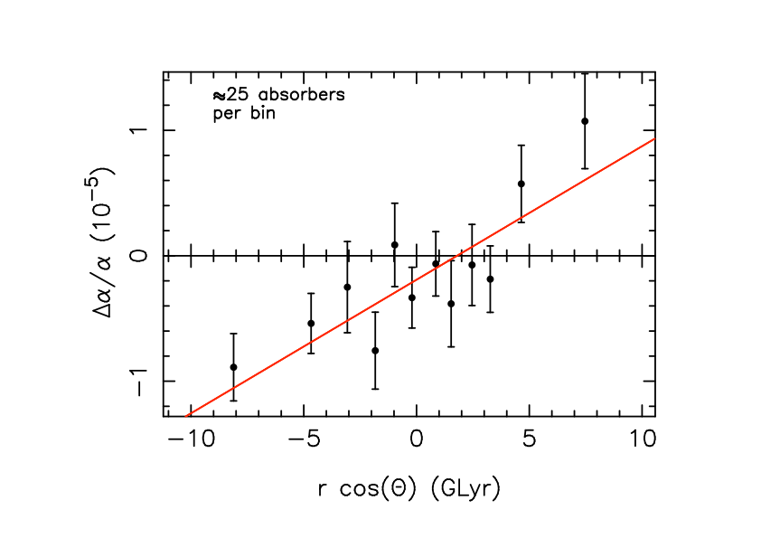
Distance dependence
∆α/α vs BrcosΘ for the model ∆α/α=BrcosΘ+m showing the gradient in α along the best-fit dipole. The best- fit direction is at right ascension 17.4 ± 0.6 hours, declination −62 ± 6 degrees, for which B = (1.1 ± 0.2) × 10⁻⁶ GLyr⁻¹ and m = (−1.9 ± 0.8) × 10−6. This dipole+monopole model is statistically preferred over a monopole-only model also at the 4.1σ level. A cosmology with parameters (H₀ , Ω_{M} , Ω_{Λ} ) = (70.5, 0.2736, 0.726).

Slide 45
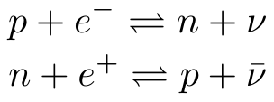
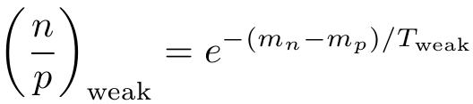
Astrophysical Constraints on ‘Slow’ Drifts in Fundamental Constants Induced by Scalar Dark Matter (BBN)
[Stadnik, Flambaum, PRL 115, 201301 (2015)]
Largest effects of scalar dark matter are in the early Universe (highest ρ_{DM} => highest φ₀²).
Earliest cosmological epoch that we can probe is Big Bang nucleosynthesis (from t_{weak} ≈ 1s until t_{BBN} ≈ 3 min).
Primordial ⁴He abundance is sensitive to relative abundance of neutrons to protons (almost all neutrons are bound in ⁴He by the end of BBN).
Weak interactions: freeze-out of weak interactions occurs at t_{weak} ≈ 1s (T_{weak} ≈ 0.75 MeV).
Notes:
45

Slide 46
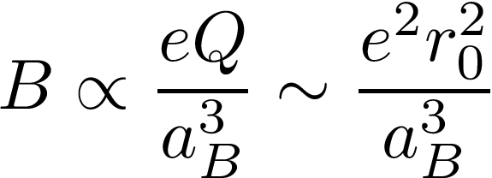
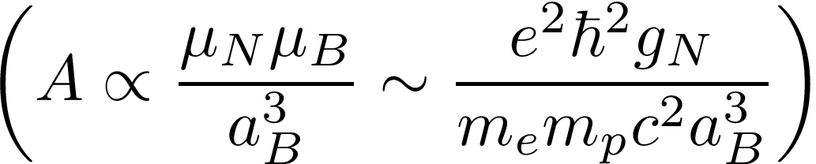

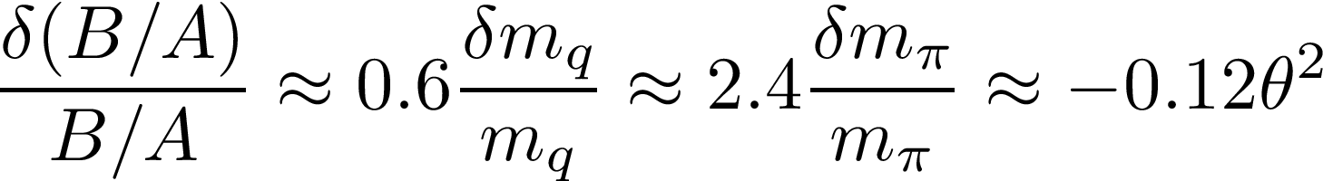
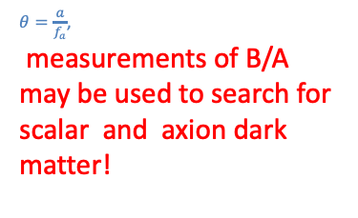
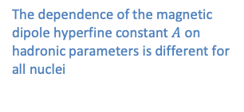
Variation of nuclear magnetic and electric quadrupole moments→ variation of atomic hyperfine structure →search for dark matter Rb/Cs experiment in Paris
The dependence of the magnetic dipole hyperfine constant $A$ on hadronic parameters is different for all nuclei
$θ=\frac{a}{f_{a}}$,
measurements of B/A may be used to search for scalar and axion dark matter!

Slide 47
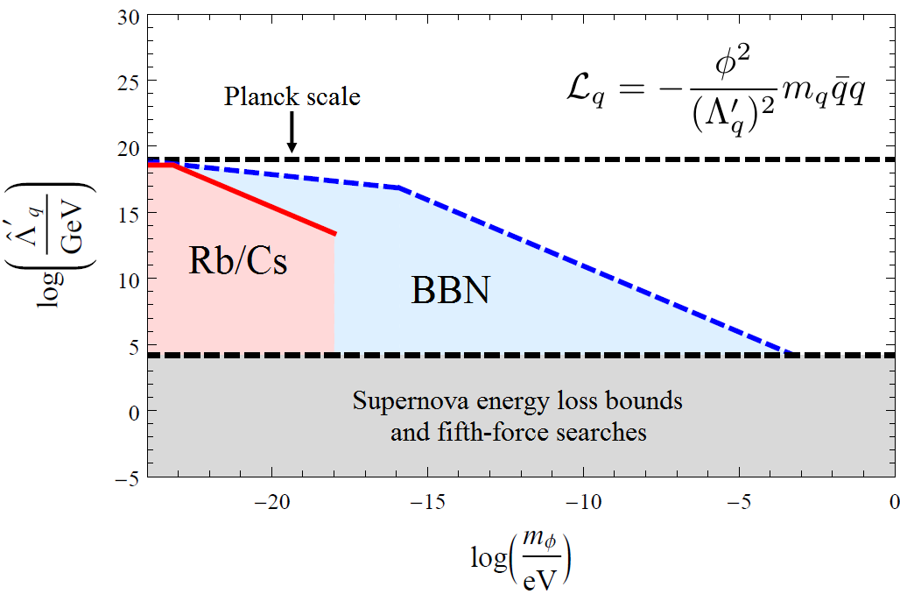
Constraints on Quadratic Interactions of Scalar and Axion Dark Matter with Light Quarks
BBN and Rb/Cs constraints: 15 orders of magnitude improvement! [Stadnik and V.F., PRL 115, 201301 (2015) + Phys. Rev. D 2016]
Notes:
47
Emphasise 15 orders of magnitude improvement for the lightest masses! – Mention also constraints on other interactions (photon, electron, light quarks (u,d), massive vector bosons (W+/-,Z)

Slide 48
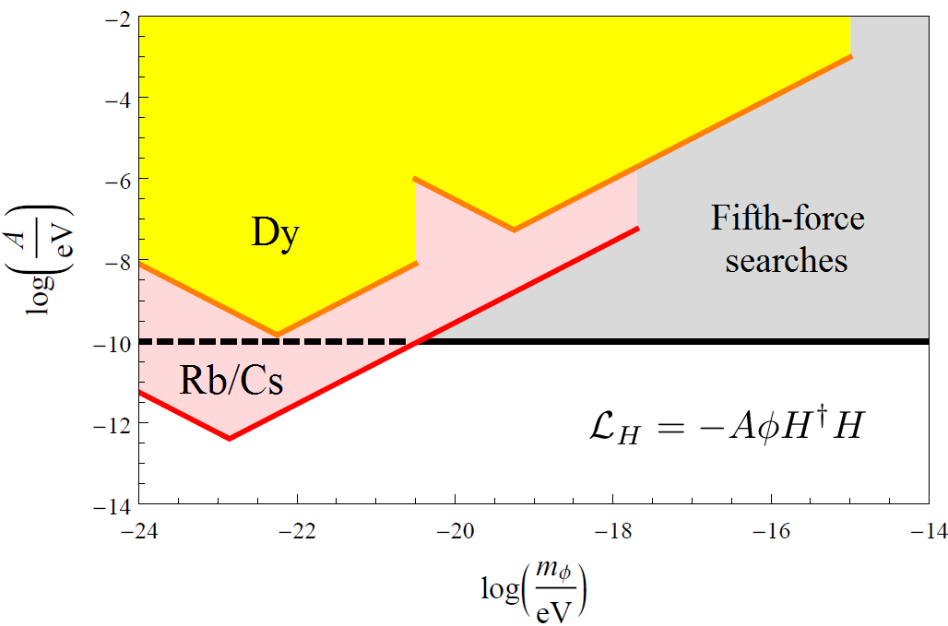
Constraints on Linear Interaction of Scalar Dark Matter with the Higgs Boson
Rb/Cs constraints: [Stadnik and V.F., PRA 94, 022111 (2016)]
2 – 3 orders of magnitude improvement!
Notes:
48

Slide 49
Enhanced sensitivity to variation of fundamental constants in nuclear clocks
Peik, Tamm 2003: UV transition between first excited and ground state in ²²⁹Th nucleus. Energy 8 eV, width 10⁻³ Hz, small systematics. Perfect clock!
V.F. PRL 2006: Nuclear/QCD estimate- Enhancement of variation 10⁴ - 10⁵
Δω/ω₀ = 10⁴ ( Δα/α + 10 ΔX_{q}/X_{q} ),
X_{q}=m_{q}/ Λ_{QCD} -strong interaction parameter.
Shift 20 Hz for Δα/α=10⁻¹⁸
Compare with atomic clock shift 0.001 Hz
Nuclear calculations gave very different results
He,Re; V.F. and Wiringa; V.F., Auerbach,Dmitriev;
Hayes,Friar,Moller; Litvinova,Felmeier,Dobaczewski and V.F.;
Shift 20 Hz for Δα/α=10⁻¹⁸
Compare with atomic clock shift 0.001 Hz

Slide 50
Enhanced sensitivity to variation of fundamental constants in nuclear clocks –semiempirical method
Berengut, Dzuba, V.F., Porsev PRL 2009: Fadeev, Berengut, V.F. 2020, 2022
Sensitivity to Δα/α is expressed via difference of <r²> between ground excited nuclear states.
To find Δ<r²>, measure isomeric shifts of ²²⁹Th atomic lines
(atomic frequency in ²²⁹ Th) - (atomic frequency in ²²⁹Th *).
Measured J. Thielking et al, Nature 556, 321, 2017 and recent work.
Δω/ω₀ = − 0.8 10⁴ Δα/α − 1.2 10⁴ ΔX_{q}/X_{q}
We also calculated sensitivity of Mossbauer transitions to Δα/α and X_{q}=m_{q}/ Λ_{QCD} -strong interaction parameter

Slide 51
Why enhancement is so large?
Total Coulomb energy E_{C}=10⁹ eV in ²²⁹ Th
Using the measured Δ<r²> we found difference of the Coulomb energies between the excited and ground state
ΔE_{C}=67(19) keV ( = 10⁻⁴ E_{C})
Δω/ω₀ = (ΔE_{C}/ω₀)Δα/α =
( 7. 10⁴ eV / 8 eV) Δα/α = 0.8 10⁴ Δα/α
Strong interaction Δω/ω₀ = 1.2 10⁴ ΔX_{q}/X_{q}

Slide 52
Accurate nuclear calculations are needed to support experiments studying violation of fundamental symmetries, testing unification theories, searching for dark matter and space-time variation of fundamental constants,
Nuclear anapole moment, Parity violating (PV) nuclear forces.
Nuclear Schiff and electric dipole moments. Time reversal violating (TV)
Nuclear TV - PV polarizability (mixed electric and magnetic )
10⁶ times enhanced PV and TV effects in neutron reactions
Collective Magnetic quadrupole and Schiff moments in deformed nuclei
Axion dark matter producing PV and TV effects listed above
Neutron skin affecting atomic PV in isotope chain, search for Z’ boson
Nuclear clock - best device to search for space-time variation of fundamental constants (fine structure constant α, quark mass, Λ_{QCD}). Effects in Mossbauer nuclear transitions
Dependence of nuclear magnetic moments on fundamental constants
Search for dark matter producing variation of the fundamental constants
Anisotropy of speed of light→ Anisotropy of Coulomb interaction in nuclei
→ 10⁷ times improvement compare to Michelson-Morley type experiments
Test of unification theories predicting matter –antimatter asymmetry and explaining baryogenesis.
PV , TV →CP violation from CPT theorem.
Minimal supersymmetric theory is cornered.

Slide 53
Summary
  Schiff moment is enhanced up to 1000 times in nuclei with octupole deformation → radioactive molecules RaO, AcN, ThO, Np ,… Stable EuN ? Experiments with solids. Nuclear spin I ≥ ½
  Limit from Hg EDM: θ< 0.5 10⁻¹⁰
  Magnetic quadrupole moment has collective nature in nuclei with quadrupole deformation. YbF, HfF+, YbOH,TaN, ThO, …
  Nuclear spin I ≥ 1, electron J ≥ 1/2; magnetic interaction => no Schiff screening
  T,P-violating nuclear polarization gives atomic and molecular EDM , may be measured in molecules used to search for electron EDM : ThO, HfF+, …
  Any nuclear spin including I=0, electron J ≥ 1/2
  Schiff theorem is violated in non-stationary states or by oscillating electric field, resonance enhancement in molecules
  Axion exchange produces static EDM, limits from molecular EDM experiments ThO, HfF+, also from Hg and Xe EDM experiments.
  Axion dark matter field produces oscillating EDM
  nEDM collaboration, CASPEr electric, JILA (E. Cornell and Jun Ye group)
  Axion dark matter field produces M2 transitions in molecules induced by oscillating nuclear magnetic quadrupole
  10⁶ enhancement of P-odd and P,T-odd effects in neutron reactions near p-wave nuclear compound resonances

Slide 54
Mechanism generating quadratic dependence on axion field: pion mass depends on θ²=(a/f_{a})²
^{Ubaldi 2010 ; Kim, Perez 2022}
Nuclear magnetic moments, mass and radius depend on pion mass.
V.F. and Tedesco 2006, V.F. and Wiringa 2007, 2009,
Effects in hyperfine transitions in Cs and Rb. Measurements Guena et al 2012, Hees et al 2016. Pion- axion interpretation Kim, Perez 2022
Recently measured effect of variation of nuclear radius in optical atomic transitions in Yb+, Banerjee et al 2023. New limits in V.F. and Mansour 2023
Averaging over fast oscillations (frequency=m_{a}) allows one to measure 10⁶ times slower fluctuations of the scalar and axion dark matter density and extend covered interval of dark matter particle masses. Masia –Roig et al 2022. New limits in V.F. and Samsonov 2023

Slide 55
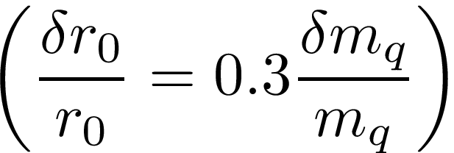
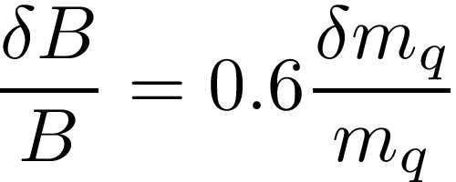
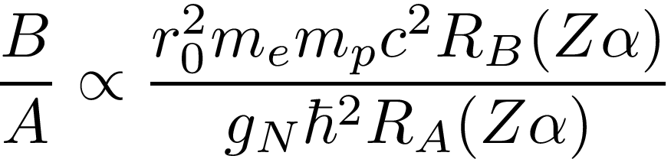
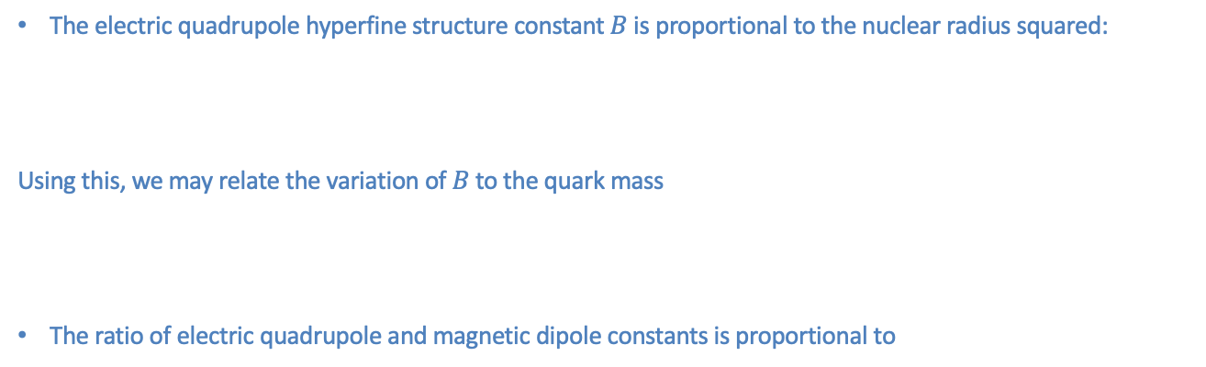
Variation of nuclear magnetic and electric quadrupole moments→ variation of atomic hyperfine structure →search for dark matter Rb/Cs experiment
The electric quadrupole hyperfine structure constant $B$ is proportional to the nuclear radius squared:
Using this, we may relate the variation of $B$ to the quark mass
The ratio of electric quadrupole and magnetic dipole constants is proportional to
The dependence of the magnetic dipole hyperfine constant $A$ on hadronic parameters is different for all nuclei
Relativistic factors
$θ=\frac{a}{f_{a}}$,
measurements of B/A may be used to search for scalar and axion dark matter!

Slide 56
Electric field of Schiff moment
(exponentially small outside nucleus, zero at two poles)

Slide 57
Enhancement of electron EDM
Sandars: atomic EDM induced by interaction of electron EDM with atomic electric field increases as Z^{3.} . Enhancement >100
Enhancement factor in atoms 3 Z Z²α² R(Zα) V.F. 1976
Tl enhancement d(Tl)= -500 d_{e} . Many new calculations.
Tl experiment – Berkeley;
Cs, Fr, Xe*,
Molecules –close rotational levels, huge enhancement of electron EDM:
Z³ α² R(Zα) Μ/m_{e} Sushkov , Flambaum 1978 .
=1/2 10⁷ YbF London
Ω=1 10¹⁰ PbO,ThO Yale, Harvard
HfF⁺ ThF+ Boulder YbOH
Weak electric field is sufficient to polarise the molecule. Molecular electric field is several orders of magnitude larger than external field (Sandars). Accurate calculations by several groups
ThO : dramatic improvement 100 times! HfF+ JILA higher accuracy

Slide 58
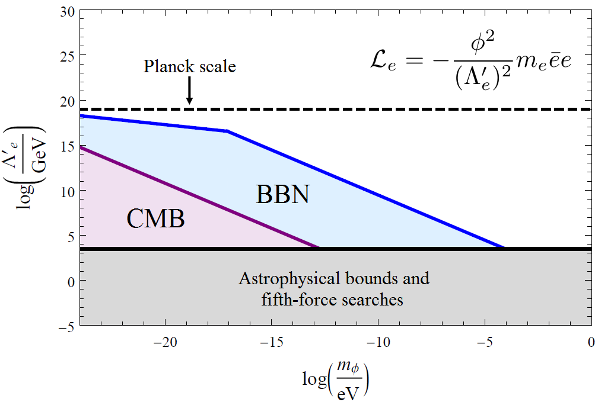
Constraints on Quadratic Interaction of Scalar Dark Matter with the Electron
BBN and CMB constraints: [Stadnik and V.F., PRL 115, 201301 (2015)]
Notes:
58
Emphasise 15 orders of magnitude improvement for the lightest masses! – Mention also constraints on other interactions (photon, electron, light quarks (u,d), massive vector bosons (W+/-,Z)

Slide 59
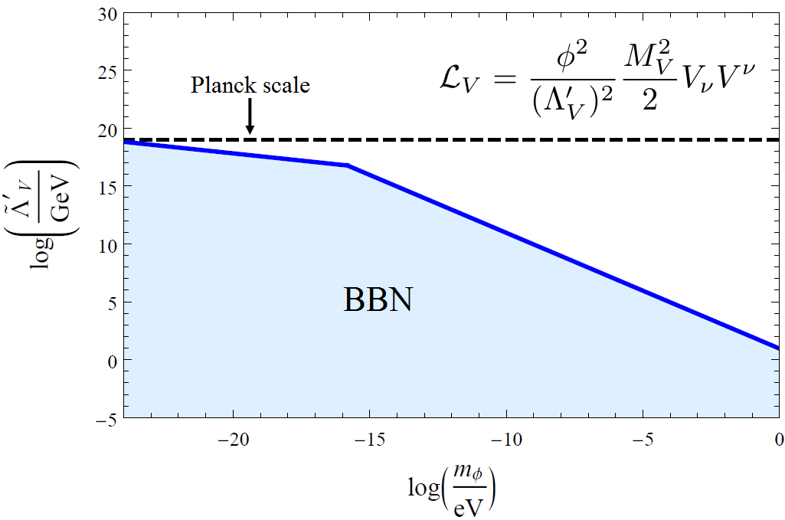
Constraints on Quadratic Interactions of Scalar Dark Matter with W and Z Bosons
BBN constraints: [Stadnik and V.F., PRL 115, 201301 (2015)]
Notes:
59
Emphasise 15 orders of magnitude improvement for the lightest masses! – Mention also constraints on other interactions (photon, electron, light quarks (u,d), massive vector bosons (W+/-,Z)

Slide 60
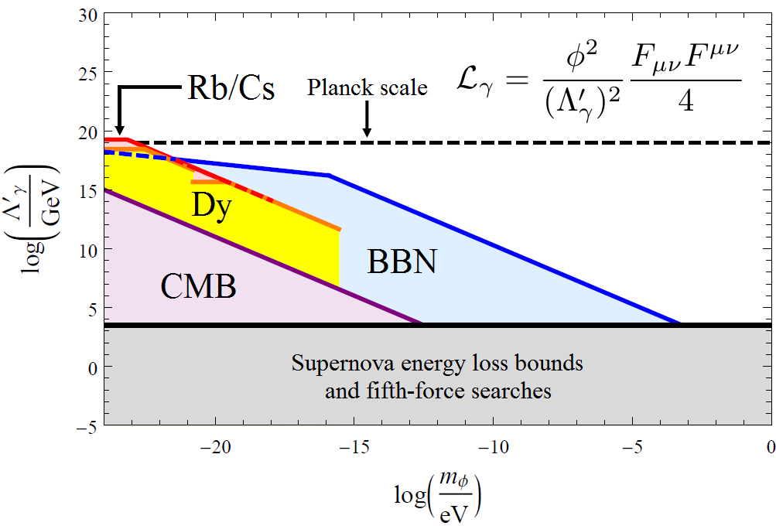
Constraints on Quadratic Interaction of Scalar Dark Matter with the Photon
BBN, CMB, Dy and Rb/Cs constraints: [Stadnik and V.F., PRL 115, 201301 (2015) + Phys. Rev. D 2016] 15 orders of magnitude improvement!
Notes:
60
Emphasise 15 orders of magnitude improvement for the lightest masses! – Mention also constraints on other interactions (photon, electron, light quarks (u,d), massive vector bosons (W+/-,Z)

Slide 61
10⁵ enhancement of nuclear anapole effects in molecules
10⁵ enhancement of the anapole contribution in diatomic molecules due to mixing of close rotational levels of opposite parity.
Theorem: only nuclear-spin-dependent (anapole) contribution to PV is enhanced (Labzovsky;Sushkov,Flambaum 1978).
Weak charge can not mix opposite parity rotational levels and Λ−doublet. Anapole can.
Ω=1/2 terms: Σ_{1/2} , Π_{1/2} . Heavy molecules, effect Z² A^{2/3} R(Zα)
YbF,BaF, PbF,LuS,LuO,LaS,LaO,HgF,…Cl,Br,I,…BiO,BiS,…
Molecular experiments : Chicago- Yale, Groningen, NWU, …
Calculations for many molecules and molecular ions: Borschevsky,Ilias,Beloy,Dzuba,Flambaum,Schwerdtfeger, et al

Slide 62
Enhanced effects of Schiff moment in molecules and solids
Enhancement due to strong internal electric field in polar molecules Sandars 1967
TlF experiments: Hinds et al, DeMille, T. Zelevinsky et al
Enhancement factors in Ra, Ac, Th, Np, Eu, … molecules
Biggest Schiff moment
Highest nuclear charge Largest T,P-odd nuclear spin-molecuar axis interaction κ(I n)
²²⁵RaO= 200 TlF V.F. 2008; Kudashov,Petrov,Skripnikov,Mosyagin, Titov, V.F. 2013,
²²⁷AcF, ²²⁷AcN, ²²⁷AcO⁺, ²²⁹ThO, ¹⁵³EuO⁺ and ¹⁵³EuN
V.F., Feldmeier 2019; V.F. ,Dzuba 2019
²²⁷AcN=²²⁷AcO⁺ =400 TlF Skripnikov, Mosyagin, Titov, V. F. 2020
Experiment with ferroelectric solids to search for oscillating Schiff moment produced by axion dark matter: CASPEr Budker et al 2014 -2024

