Slide 1





Overview of Uncertainty Quantification for Nuclear Physics
Dick Furnstahl
MITP Workshop, June 2024
Slides:
https://go.osu.edu/mitp2024
https://nuclei.mps.ohio-state.edu/
https://buqeye.github.io/
Jupyter notebooks here!
https://www.lenpic.org/
https://bandframework.github.io/
Collaboration symposium 2024

Slide 2
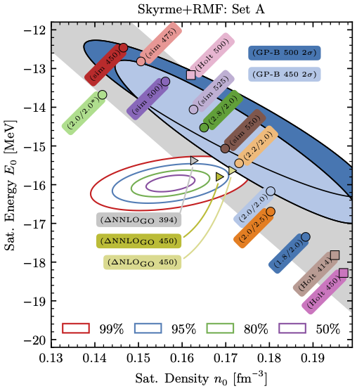
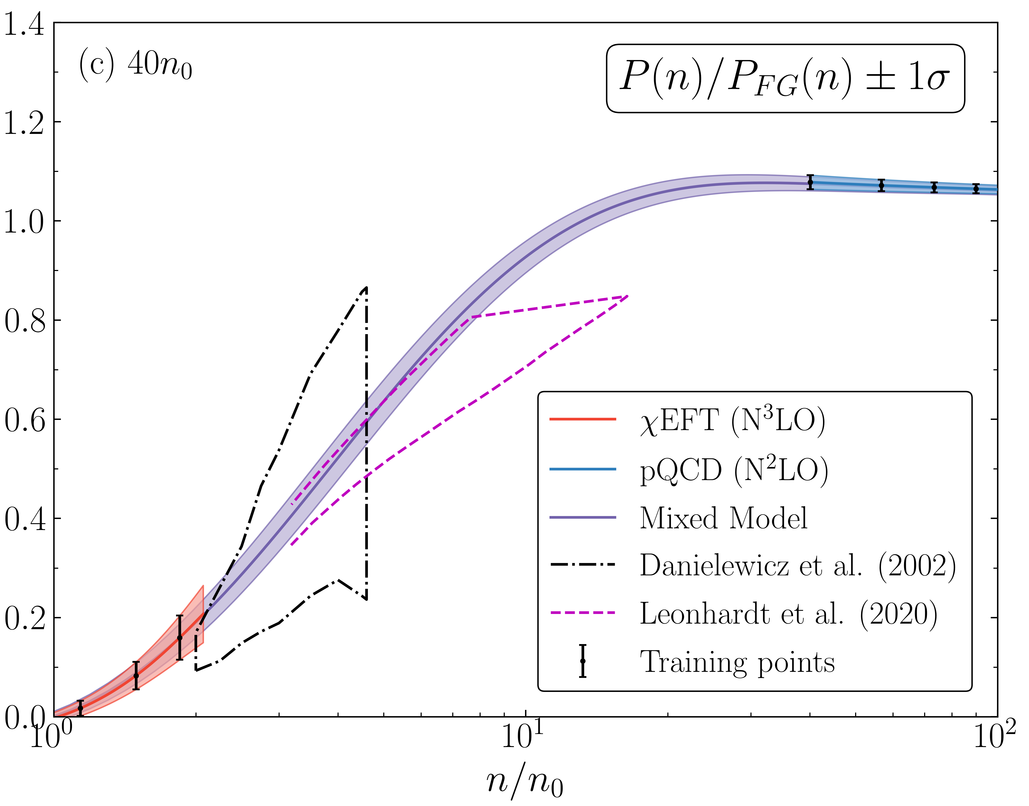
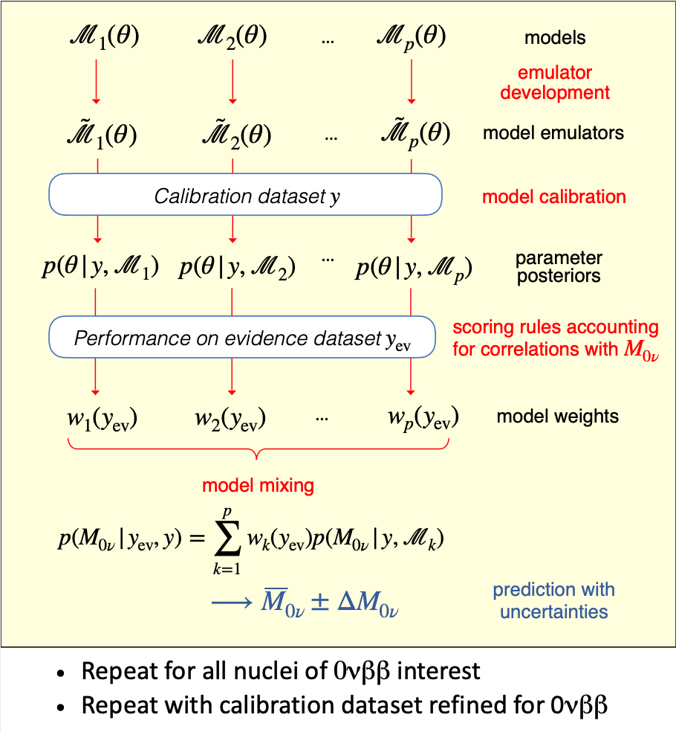

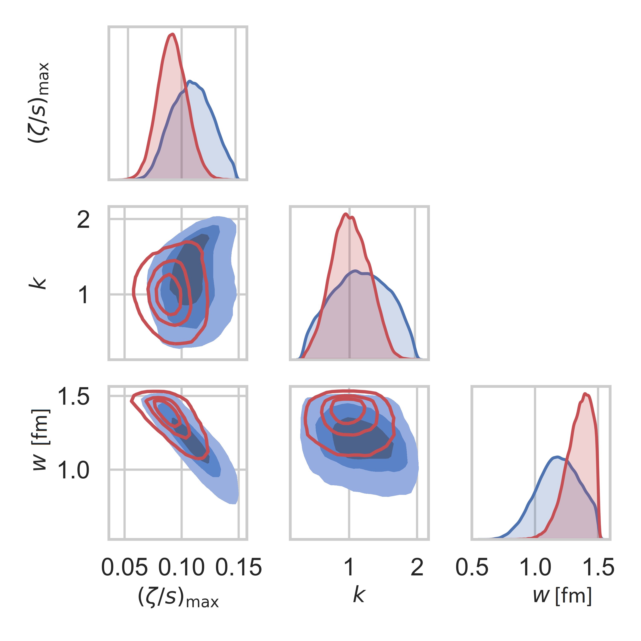

Robust UQ is needed everywhere in nuclear physics!
C. Drischler et al.,
arXiv:2405.02748 (2024)
A. Semposki et al.
arXiv:2404.06323 (2024)
Posterior pdfs for nuclear DFT parameters
arXiv:2404.12039 (2024)
S. Steltzer et al., (2022)
D. Everett et al.
PRC 106 (2022)

Slide 3
Outline
Ingredients for principled uncertainty quantification (UQ)
Calibration, model mixing, expt. design, emulators
Challenges: Frontiers of UQ for nuclear physics
Extra slides (more details, other topics, …)
Slides:
https://go.osu.edu/mitp2024

Slide 4
Outline
Ingredients for principled uncertainty quantification (UQ)
Calibration, model mixing, expt. design, emulators
Challenges: Frontiers of UQ for nuclear physics
Extra slides (more details, other topics, …)

Slide 5
Checklist for statistically sound Bayesian inference
Incorporate all sources of experimental and theoretical errors
Formulate statistical models for uncertainties
Use as informative priors as is reasonable; test sensitivity to priors
Account for correlations in inputs (type x) and observables (type y)
Properly propagate uncertainties through the calculation
Use model checking to validate our models
Interact with the experts (i.e., statisticians, applied mathematicians)
[more]
Bayesian updating of knowledge

Slide 6
State of knowledge as probability distributions (pdfs)
pr(A, B | C) “joint probability (density) of A and B given C” (contingent on C)
A, B, C can be observables, parameters, uncertainties, propositions, models, …
cf. quantum mechanics |ψ(x₁, x₂)|² or |ψ(x₁)|² = ∫|ψ(x₁, x₂)|² dx₂ (marginalization)
Bayesian confidence (credible) interval:
68%
95%

Slide 7
State of knowledge as probability distributions (pdfs)
pr(A, B | C) “joint probability (density) of A and B given C” (contingent on C)
A, B, C can be observables, parameters, uncertainties, propositions, models, …
cf. quantum mechanics |ψ(x₁, x₂)|² or |ψ(x₁)|² = ∫|ψ(x₁, x₂)|² dx₂ (marginalization)
Bayesian confidence (credible) interval:
pr(θ | y_{exp} , Σ_{exp} , Σ_{th} , I) ⇒
pdf of model parameters θ given data y_{exp} and experiment/theory errors Σ, plus other information I
Examples of pdfs for model UQ:
68%
95%

Slide 8
State of knowledge as probability distributions (pdfs)
pr(A, B | C) “joint probability (density) of A and B given C” (contingent on C)
A, B, C can be observables, parameters, uncertainties, propositions, models, …
cf. quantum mechanics |ψ(x₁, x₂)|² or |ψ(x₁)|² = ∫|ψ(x₁, x₂)|² dx₂ (marginalization)
Bayesian confidence (credible) interval:
pr(δy_{th} |y_{th} , I) ⇒
pdf of model discrepancy δy_{th} (model error) given order-by-order theory calculations y_{th} plus other information I
Examples of pdfs for model UQ:
68%
95%

Slide 9
State of knowledge as probability distributions (pdfs)
pr(A, B | C) “joint probability (density) of A and B given C” (contingent on C)
A, B, C can be observables, parameters, uncertainties, propositions, models, …
cf. quantum mechanics |ψ(x₁, x₂)|² or |ψ(x₁)|² = ∫|ψ(x₁, x₂)|² dx₂ (marginalization)
Bayesian confidence (credible) interval:
pr(Λ_{b} | y_{th}, I) ⇒
pdf of breakdown scale of EFT expansion given order-by-order theory calculations y_{th} plus other information I
Examples of pdfs for model UQ:
68%
95%

Slide 10
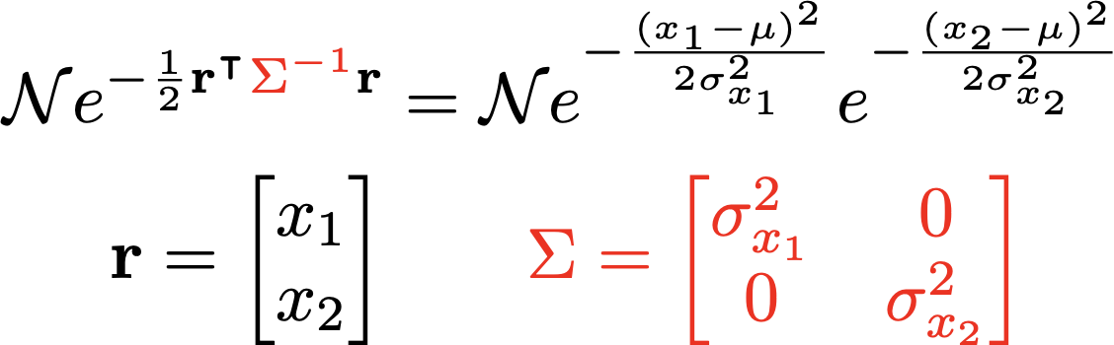
Account for correlations in inputs and observables
pr(x₁, x₂| y) “joint probability (density) of x₁ and x₂ given y” (contingent on y)
marginalized
pr(x₁|y)
pr(x₂|y)
joint
x₂
pr(x₁ ,x₂|y)
[more on sampling]
x₁
x₂
Notes:
\mbox{e.g.,}\ X_1 - X_2 \sim \mathcal{N}(\mu_{1}-\mu_{2}, \sigma_1^2 + \sigma_2^2)
%X_1 - X_2 \sim \mathcal{N}(\mu_{1}-\mu_{2}, \sigma_1^2 + \sigma_2^2 - 2\rho\sigma_1\sigma_2)
\mathcal{N}e^{-\frac12 \mathbf{r}^{\intercal}{\color{red}\Sigma^{-1}}\mathbf{r}}
&= \mathcal{N} e^{-\frac{(x-\mu)^2}{2\sigma_x^2}} e^{-\frac{(y-\mu)^2}{2\sigma_y^2}}
\\
\mathbf{r} = \begin{bmatrix} x \\ y \end{bmatrix} &
\qquad
{\color{red}\Sigma = \begin{bmatrix} \sigma_x^2 & 0 \\
0 & \sigma_y^2
\end{bmatrix}}
\mathcal{N}e^{-\frac12 \mathbf{r}^{\intercal}{\color{red}\Sigma^{-1}}\mathbf{r}}
&= \mbox{correlated gaussian}
% = \mathcal{N} e^{-\frac{(x-\mu)^2}{2\sigma^2}} e^{-\frac{(y-\mu)^2}{2\sigma^2}}
\\
\mathbf{r} = \begin{bmatrix} x \\ y \end{bmatrix}
\qquad &
{\color{red}\Sigma = \begin{bmatrix} \sigma_x^2 & \rho\sigma_x\sigma_y \\
\rho\sigma_x\sigma_y & \sigma_y^2
\end{bmatrix}}

Slide 11
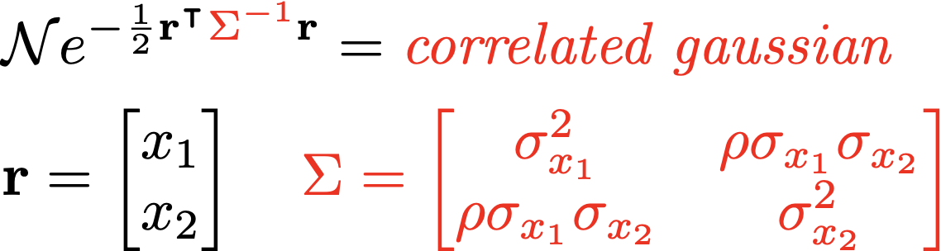
Account for correlations in inputs and observables
pr(x₁, x₂| y) “joint probability (density) of x₁ and x₂ given y” (contingent on y)
marginalized
pr(x₁|y)
pr(x₂|y)
joint
y
x₂
pr(x₁ ,x₂|y)
Excitation spectra in nuclei
Symmetry energy of nuclear matter
x₁
X
y
x₂
Notes:
%\mbox{e.g.,}\ X_1 - X_2 \sim \mathcal{N}(\mu_{1}-\mu_{2}, \sigma_1^2 + \sigma_2^2)
X_1 - X_2 \sim \mathcal{N}(\mu_{1}-\mu_{2}, \sigma_1^2 + \sigma_2^2 - 2\rho\sigma_1\sigma_2)
\mathcal{N}e^{-\frac12 \mathbf{r}^{\intercal}{\color{red}\Sigma^{-1}}\mathbf{r}}
&= \mathcal{N} e^{-\frac{(x-\mu)^2}{2\sigma_x^2}} e^{-\frac{(y-\mu)^2}{2\sigma_y^2}}
\\
\mathbf{r} = \begin{bmatrix} x \\ y \end{bmatrix} &
\qquad
{\color{red}\Sigma = \begin{bmatrix} \sigma_x^2 & 0 \\
0 & \sigma_y^2
\end{bmatrix}}
\mathcal{N}e^{-\frac12 \mathbf{r}^{\intercal}{\color{red}\Sigma^{-1}}\mathbf{r}}
&= \mbox{correlated gaussian}
% = \mathcal{N} e^{-\frac{(x-\mu)^2}{2\sigma^2}} e^{-\frac{(y-\mu)^2}{2\sigma^2}}
\\
\mathbf{r} = \begin{bmatrix} x \\ y \end{bmatrix}
\qquad &
{\color{red}\Sigma = \begin{bmatrix} \sigma_x^2 & \rho\sigma_x\sigma_y \\
\rho\sigma_x\sigma_y & \sigma_y^2
\end{bmatrix}}

Slide 12
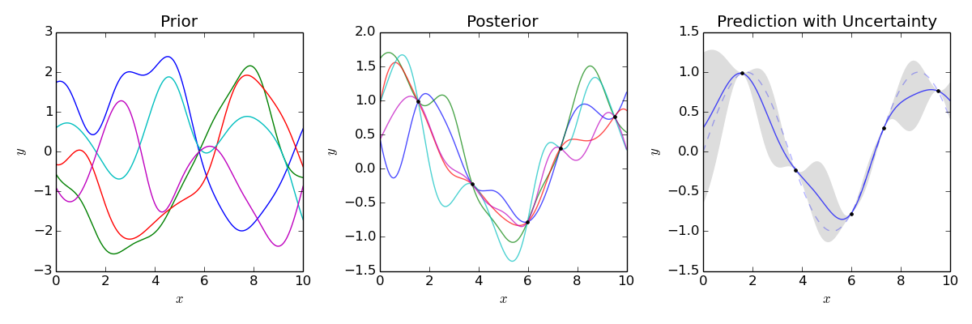
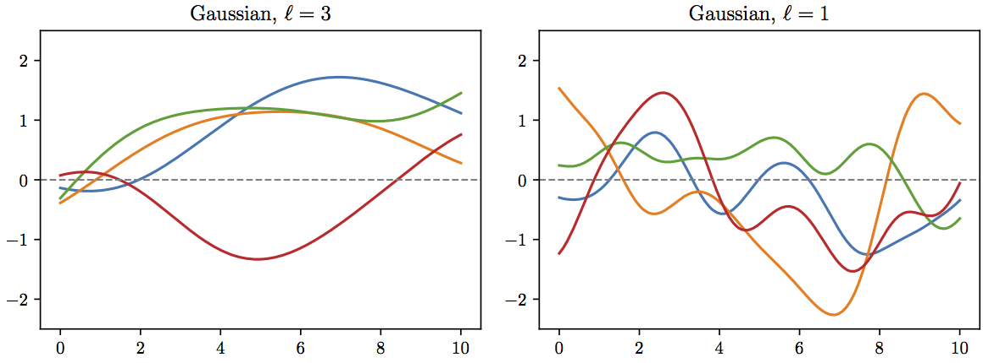
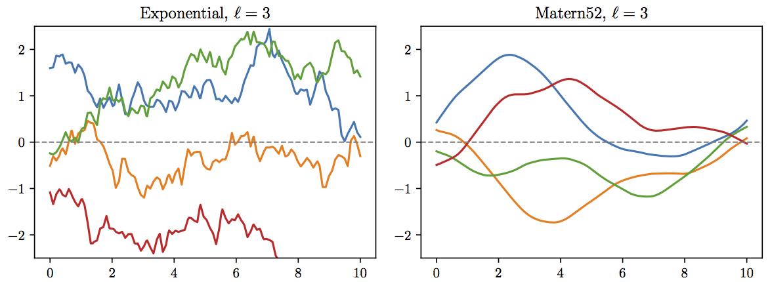
Gaussian Processes: Distributions over functions
By Cdipaolo96 - Own work, CC BY-SA 4.0
A Gaussian process (GP) is a collection of random variables, any finite number of which have a joint Gaussian distribution
Training data
Account for correlations in inputs (type x)
correlation length 3 → 1
smoothness (kernel choice → can be combined)

Slide 13
Formulate statistical models for uncertainties
Interact with the experts: statisticians say any model better than none!
George Box: “All models are wrong, but some are useful”
In what ways can a theoretical model be wrong?
Uncertainty from numerical method (e.g., differential equation error)
Truncation of Hilbert space (e.g., lattice volume/spacing or ho model space)
Model discrepancy
  Incomplete or in parts incorrect physical model
  Effective field theory expansion truncation error
Incorporate all sources of
expt. and theoretical errors
Mostly systematic and correlated (doesn’t mean they can’t be treated as random!).
  Systematic: error is not reduced when more observations are averaged
  Correlated: e.g., model error in binding energy for oxygen chain all in same direction
Bayesian statistics is ideal for modeling, combining, and propagating theory errors!

Slide 14
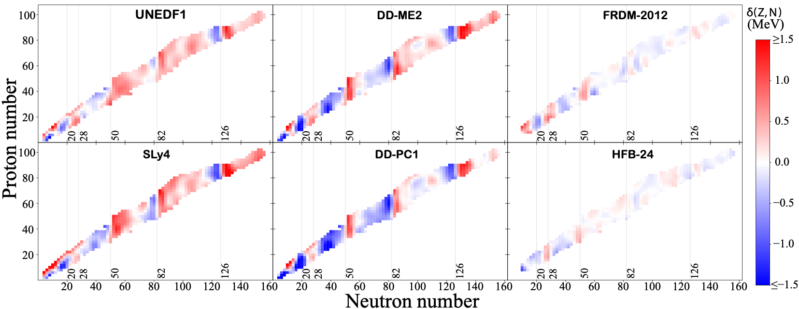
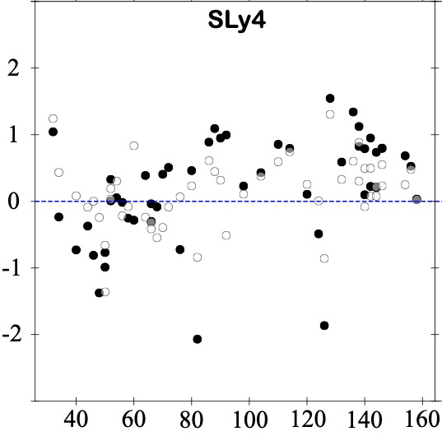
Formulate statistical models for uncertainties
Interact with the experts: statisticians say any model better than none!
George Box: “All models are wrong, but some are useful”
Model distribution of residuals:
Train the residuals on Gaussian Process model or with Bayesian Neural Network on one set; test on another set
S_{2n} residuals (MeV)
original
with GP model
Figures adapted from Mass extrapolations with BNN and GP, L. Neufcourt et al. Phys. Rev. C 98, 034318 (2018)
Neutron number
Notes:
Informed is better than uninformed, but anything better than nothing.
Figures 5 and Fig. 6 show the residuals of six representative nuclear mass models as a function of the neu- tron number before and after statistical corrections with GP(T+H) and BNN(T+H) respectively. In both GP and BNN, one observes that nearly every white circle, cor- responding to a prediction error of our emulator for a given nucleus, is closer to the data than its corresponding black dot, representing a global mass model prediction error without GP or BNN. This indicates that both GP and BNN corrections improve the predictions systemat- ically. Additionally, several local trends of the residuals are visibly attenuated, and the distributions of the cor- rected residuals are closer to having zero means and to being independent Gaussian. We observe that the im- provement in performance for our statistical correction is strongest for the relativistic DFT models (DD-ME2 and DD-PC1), and weakest for the more phenomenological models FRDM-2012 and HFB-24. This is not surprising, as we expect the residuals of more microscopic models to exhibit appreciable structure, whereas there is little hope to improve much the phenomenological models which are fitted closely to the data.

Slide 15

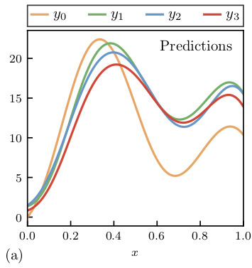
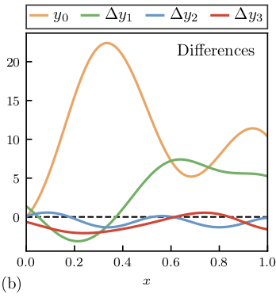
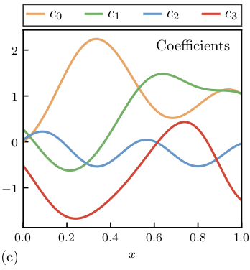
Formulate statistical models for uncertainties
Interact with the experts: statisticians say any model better than none!
Revised George Box: “All models are wrong, but some models that know when they are wrong, are useful.”
For EFTs, learn from convergence pattern of observables
Use model checking to validate our models
[dimensionless]
}
Estimate variance
→ c
See talks by C. Forssén, J. Bub, A. Semposki, …
Theory at order k:
Omitted orders:

Slide 16
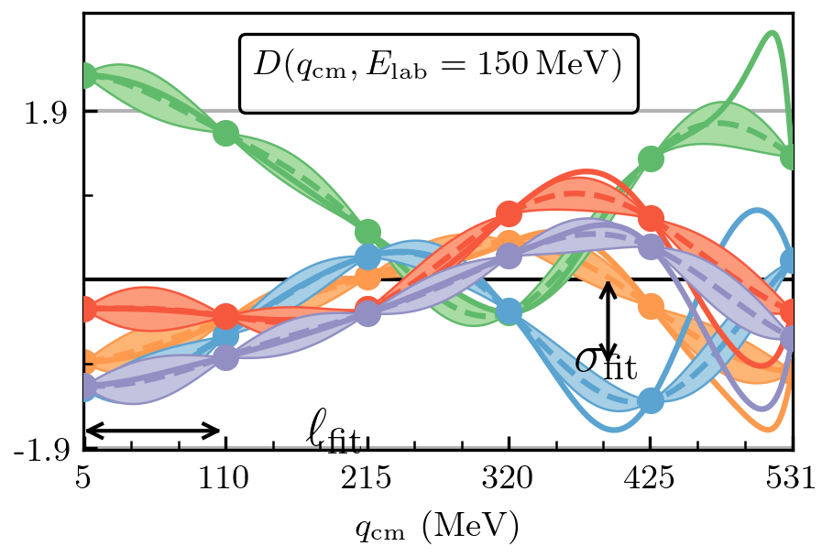
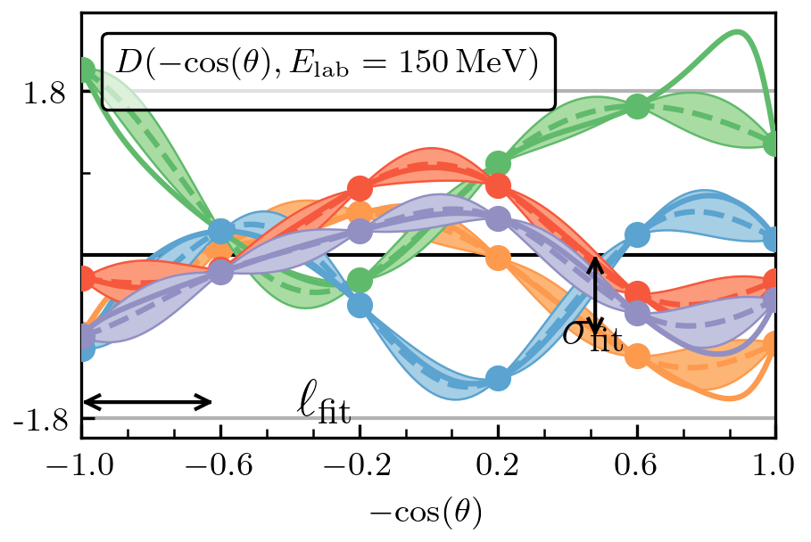
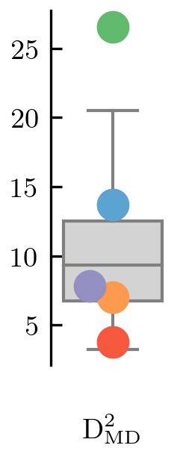
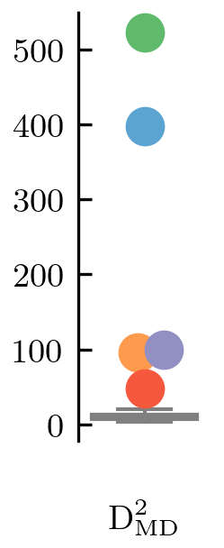
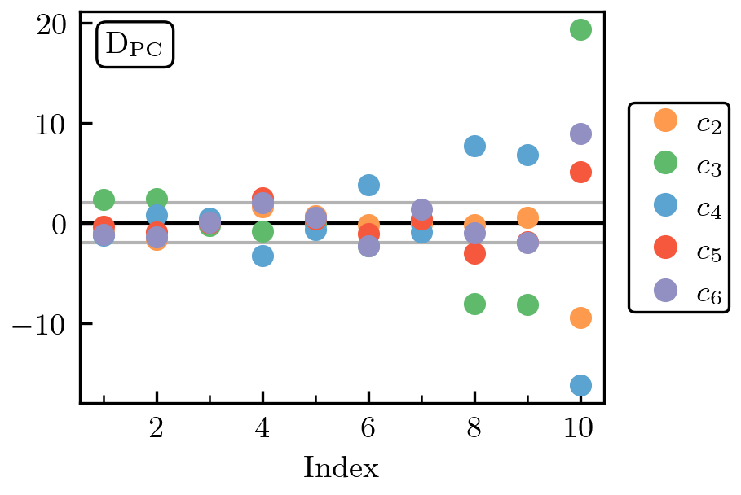
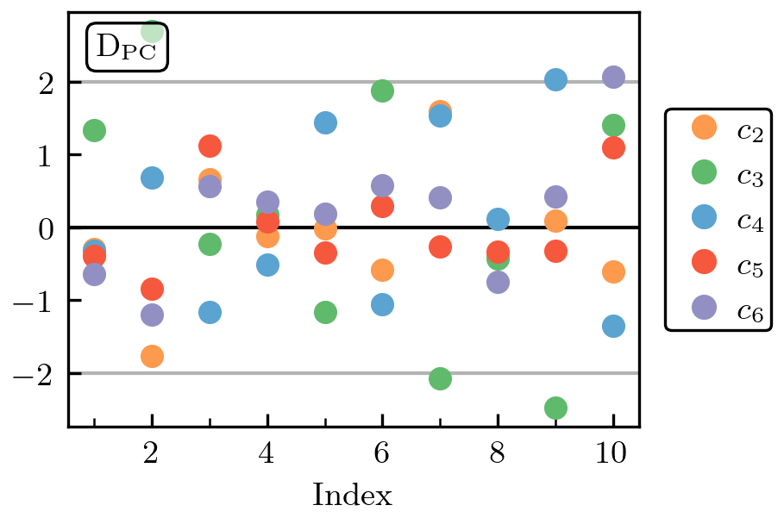

Optimizing for stationarity [Millican et al. (2024)]
Use model checking to validate our models (Interact with the experts)
[more on diagnostics]
For this choice of parametrization:
$Λ_{b}=650 →570 \text{MeV}$,
$$m_{eff}=184 →138 \text{MeV}$$
Plots of the spin observable D generated with the potential from Reinert et al., EPJA (2018). Figs. 14 (left) and 13 (right) in Millican et al. (2024).

Slide 17
Outline
Ingredients for principled uncertainty quantification (UQ)
Calibration, model mixing, expt. design, emulators
Challenges: Frontiers of UQ for nuclear physics
Extra slides (more details, other topics, …)

Slide 18
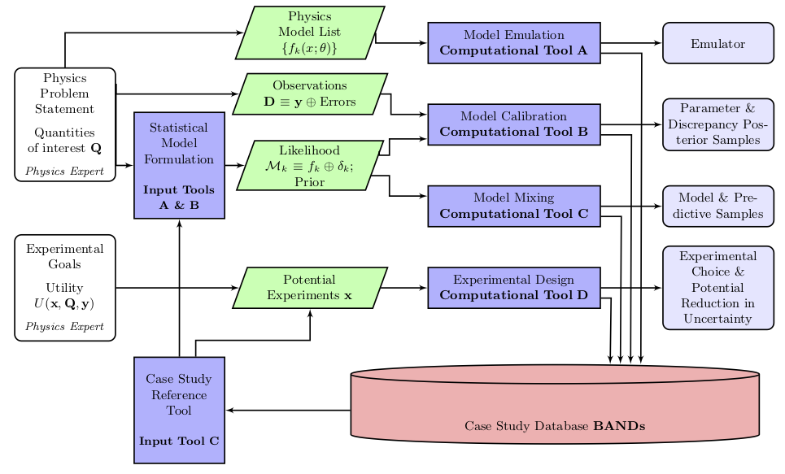
BAND (Bayesian Analysis of Nuclear Dynamics)
Goal: Facilitate principled Uncertainty Quantification in Nuclear Physics
An NSF CSSI Framework (5 years until 2026)
Look to https://bandframework.github.io/ for papers, talks, and software!
v0.3 released 10/23
Notes:
Cyberinfrastructure for Sustained Scientific Innovation

Slide 19
Fast & rigorous constraints on chiral three-nucleon forces from few-body observables [original title]
Wesolowski, Svensson, Ekström, Forssén, rjf, Melendez, and Phillips, PRC 104, 064001 (2021)
BUQEYE Collaboration
See also: Djärv et al., PRC (2022) on A=6 nuclei; Svensson et al., PRC (2023) on Bayesian LEC estimation; Alnamlah et al., Front. Phys. (2022) on EFT for rotational bands; Acharya et al. Front. Phys. (2023) on E&M observables; Poudel et al., J. Phys. G (2022) on 3He-α scattering; Baker et al., PRC (2022) on N-A, …
Notebook with all figures at
https://buqeye.github.io
See talks by C. Forssén and J. Bub
expansion
Q⁰
Chiral 3N forces: estimate constraints on c_{D} and c_{E}
Few-body observables (cf. other possibilities):
³H ground-state energy; ³H β-decay half-life;
⁴He ground-state energy; ⁴He charge radius
Q²
c_{E}
c_{D}
Q³
Rigorous: statistical best practices for parameter estimation
Fast: uses eigenvector continuation emulators for observables
Q ~ 1/3
Notes:
Sarah Wesolowski, Isak Svensson

Slide 20
Full Bayesian approach to calibration parameters
Experimental data
Other info (EFT scheme/scale, etc.)
NN and
3N LECs
Truncation
error
variance
EFT expansion
parameter
Use as informative priors as is reasonable
All experiment and theory errors
Likelihood:
Uses NNLO chiral EFT without Δ’s based on Carlsson et al. PRX 6, 011019 (2016),
but methods are general (other regulators, Δ’s, other observables)
Sample pdf with MCMC over 15 dimensions (11 NN LECs + c_{D}, c_{E} + Q, c²)
→ marginalize (integrate out) what you are not considering (trivial!)

Slide 21
Full Bayesian approach to calibration parameters
Experimental data
Other info (EFT scheme/scale, etc.)
NN and
3N LECs
Truncation
error
variance
EFT expansion
parameter
Individual posteriors; everything has priors!
✓
Interact with the experts (i.e., statisticians, applied mathematicians)
Incorporate all sources of experimental and theoretical errors
Formulate statistical models for uncertainties
Use as informative priors as is reasonable; test sensitivity to priors
Account for correlations in inputs (type x) and observables (type y)
Properly propagate uncertainties through the calculation
Use model checking to validate our models
All experiment and theory errors
✓
Likelihood:
✓
✓
Uses NNLO chiral EFT without Δ’s based on Carlsson et al. PRX 6, 011019 (2016),
but methods are general (other regulators, Δ’s, other observables)
✓
✓
Sample pdf with MCMC over 15 dimensions (11 NN LECs + c_{D}, c_{E} + Q, c²)
→ marginalize (integrate out) what you are not considering (trivial!)
✓

Slide 22
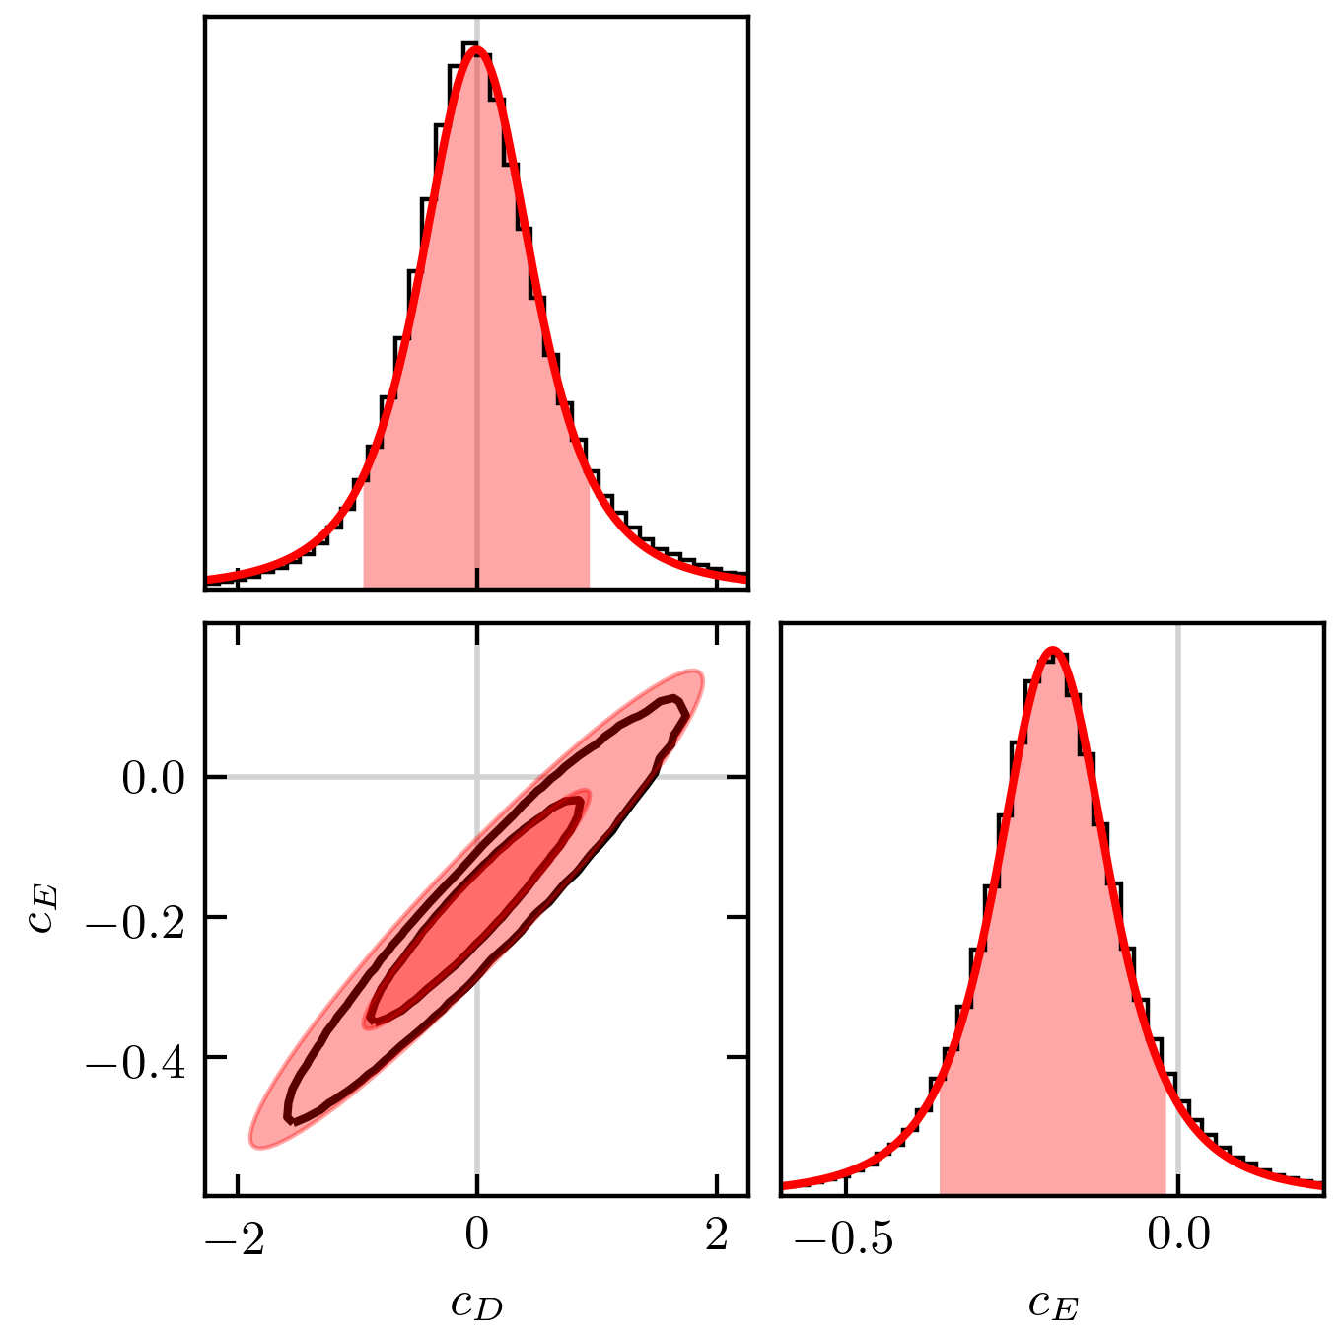
Posteriors from “Fast & Rigorous” [PRC 104, 064001 (2021)]
Posterior for c_{D} and c_{E}
Correlation of ρ ≈ 0.96 for this χEFT Hamiltonian
Tails are not well approximated by a Gaussian! (But do look like t’s!)
Sample pdf with MCMC over 11 NN LECs + c_{D}, c_{E} + Q, c² → marginalize (integrate out) what you are not considering
Notes:
Two mistakes in using results in first graph by the peak and sd treated as Gaussian: you miss the correlation and you miss the tails – not a Gaussian but essentially a Student t distribution.
Emphasize that these are specific results, but it is a *framework* available to all through Jupyter notebooks.
For PPD, statistically consistent *only* if the truncation error is included.
&{\color{black}\pr(\mathbf{y}|\mathbf{x},\mathbf{y}_{\rm exp})} = \\ & \quad\int\! \pr(\mathbf{y}|\mathbf{x},\bm{\theta}) p(\bm{\theta}|\mathbf{y}_{\rm exp}) d\bm{\theta}
The distribution for Q peaks at about 1/3 with a 20% uncertainty.
This is consistent with χEFT considerations for few-body observables [(m_{π})^{eff}/Λ_{b}] and with other estimations (cf. LENPIC papers).
This is what the data prefer for the size of the N³LO uncertainty.
Propagate errors from pdf for LECs learned from data to the observables.
Analysis is statistically consistent (experimental data are black circles) as long as truncation errors included.
Some observables are highly correlated; some are not.

Slide 23
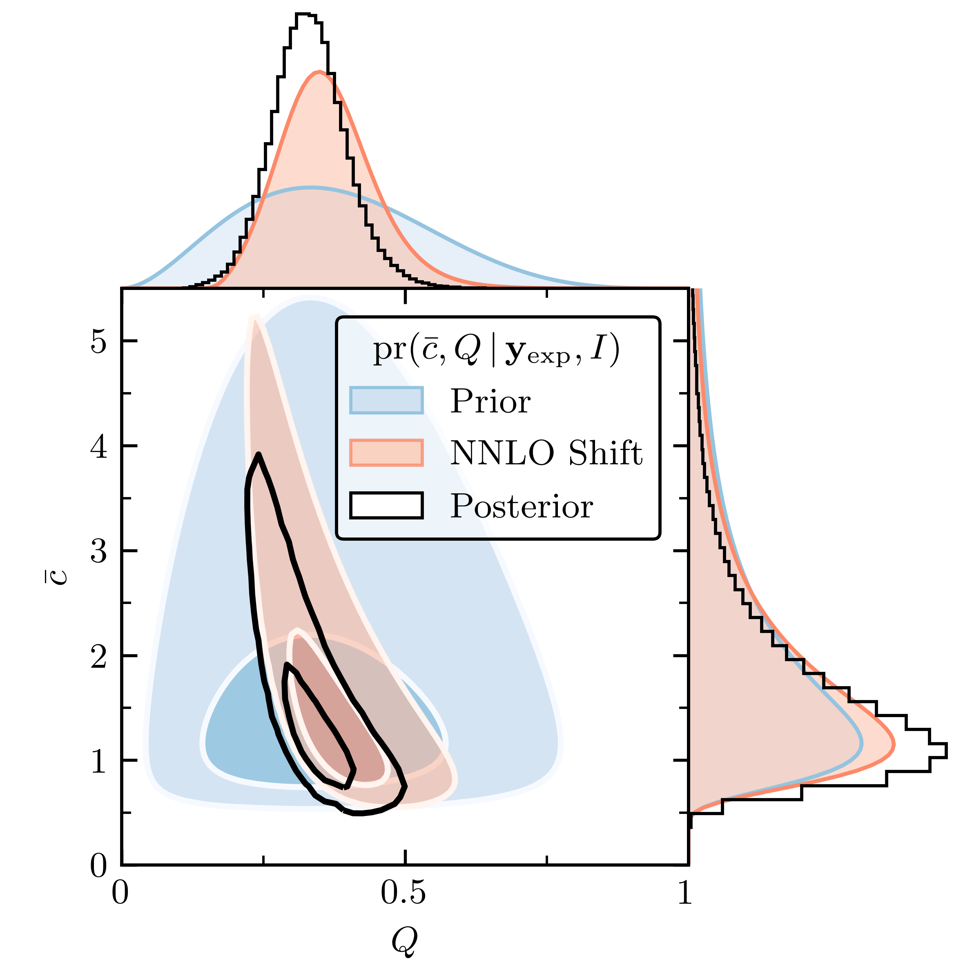
Posteriors from “Fast & Rigorous” [PRC 104, 064001 (2021)]
Posterior for c_{D} and c_{E}
Posterior for Q and c
Correlation of ρ ≈ 0.96 for this χEFT Hamiltonian
[more]
Tails are not well approximated by a Gaussian! (But do look like t’s!)
Truncation error for observables:
Sample pdf with MCMC over 11 NN LECs + c_{D}, c_{E} + Q, c² → marginalize (integrate out) what you are not considering
Notes:
Two mistakes in using results in first graph by the peak and sd treated as Gaussian: you miss the correlation and you miss the tails – not a Gaussian but essentially a Student t distribution.
Emphasize that these are specific results, but it is a *framework* available to all through Jupyter notebooks.
For PPD, statistically consistent *only* if the truncation error is included.
&{\color{black}\pr(\mathbf{y}|\mathbf{x},\mathbf{y}_{\rm exp})} = \\ & \quad\int\! \pr(\mathbf{y}|\mathbf{x},\bm{\theta}) p(\bm{\theta}|\mathbf{y}_{\rm exp}) d\bm{\theta}
The distribution for Q peaks at about 1/3 with a 20% uncertainty.
This is consistent with χEFT considerations for few-body observables [(m_{π})^{eff}/Λ_{b}] and with other estimations (cf. LENPIC papers).
This is what the data prefer for the size of the N³LO uncertainty.
Propagate errors from pdf for LECs learned from data to the observables.
Analysis is statistically consistent (experimental data are black circles) as long as truncation errors included.
Some observables are highly correlated; some are not.

Slide 24
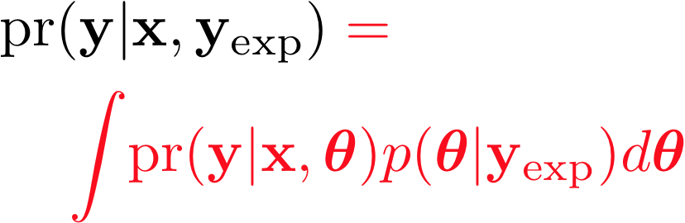
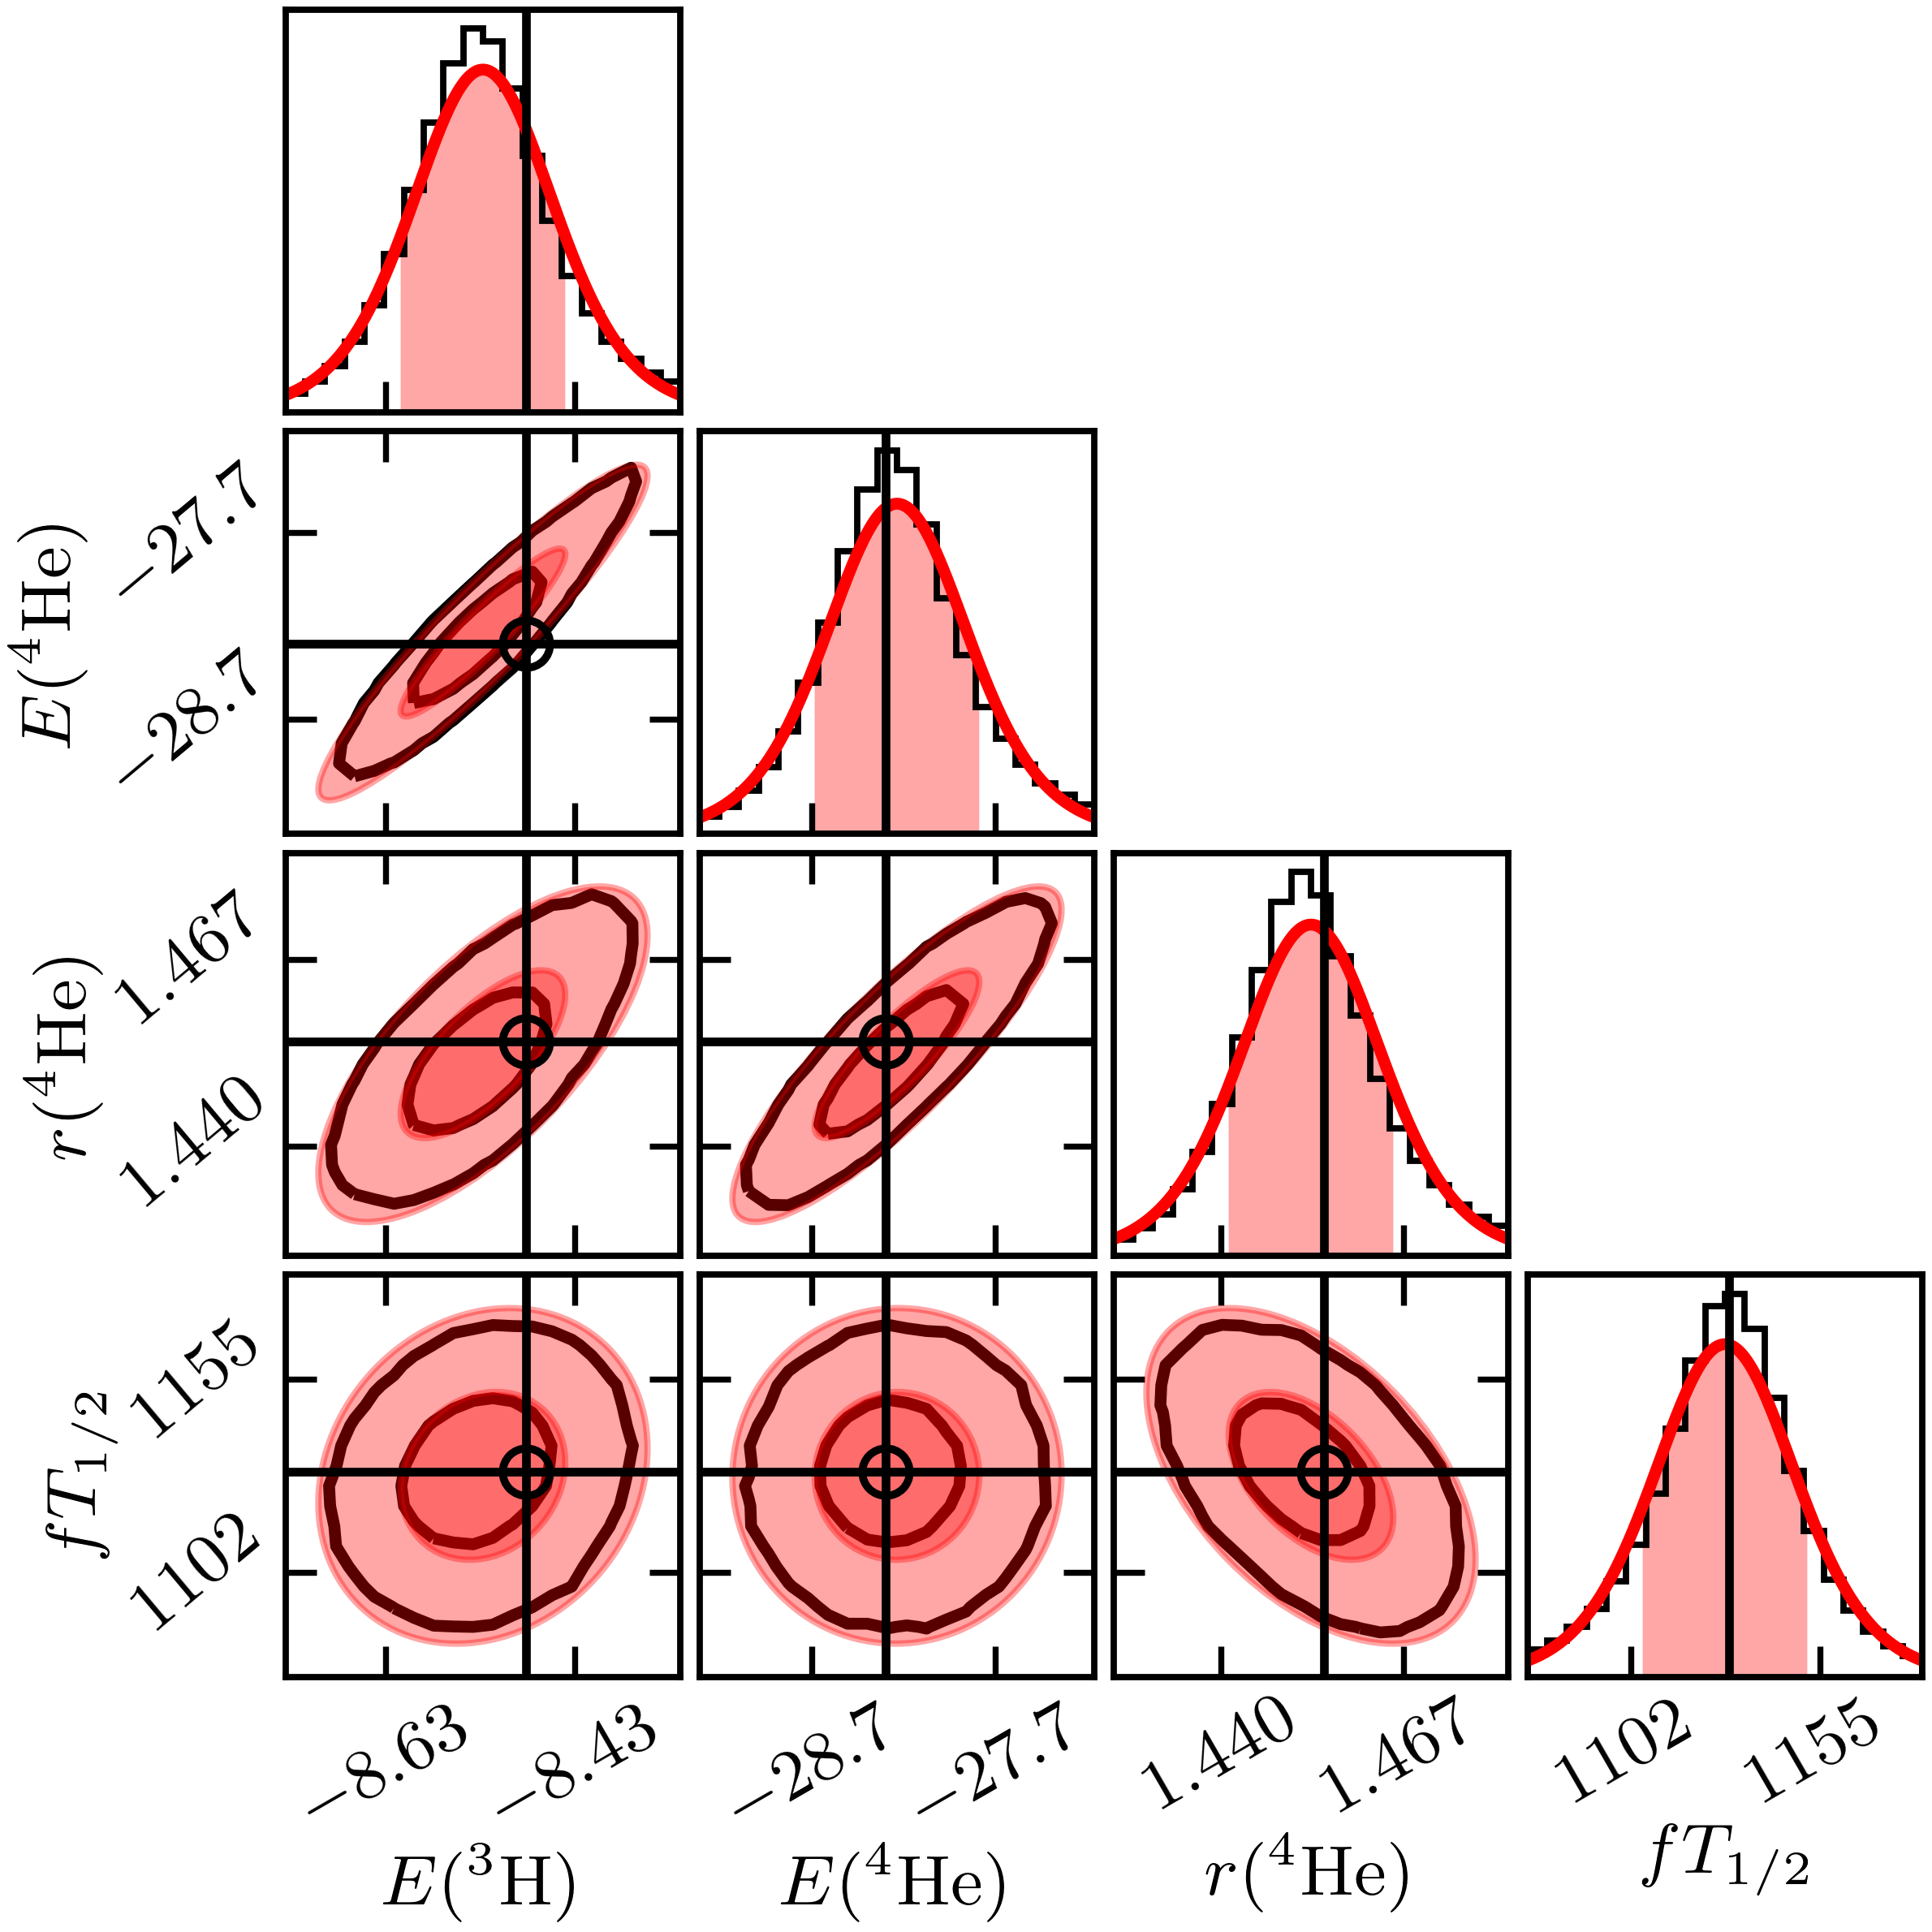
Posteriors from “Fast & Rigorous” [PRC 104, 064001 (2021)]
Properly propagate uncertainties through the calculation
Posterior for c_{D} and c_{E}
Posterior for Q and c
Posterior predictive distribution
Correlation of ρ ≈ 0.96 for this χEFT Hamiltonian
Statistically
consistent!
Tails are not well approximated by a Gaussian! (But do look like t’s!)
Truncation error for observables:
Sample pdf with MCMC over 11 NN LECs + c_{D}, c_{E} + Q, c² → marginalize (integrate out) what you are not considering
Notes:
Two mistakes in using results in first graph by the peak and sd treated as Gaussian: you miss the correlation and you miss the tails – not a Gaussian but essentially a Student t distribution.
Emphasize that these are specific results, but it is a *framework* available to all through Jupyter notebooks.
For PPD, statistically consistent *only* if the truncation error is included.
&{\color{black}\pr(\mathbf{y}|\mathbf{x},\mathbf{y}_{\rm exp})} = \\ & \quad\int\! \pr(\mathbf{y}|\mathbf{x},\bm{\theta}) p(\bm{\theta}|\mathbf{y}_{\rm exp}) d\bm{\theta}
The distribution for Q peaks at about 1/3 with a 20% uncertainty.
This is consistent with χEFT considerations for few-body observables [(m_{π})^{eff}/Λ_{b}] and with other estimations (cf. LENPIC papers).
This is what the data prefer for the size of the N³LO uncertainty.
Propagate errors from pdf for LECs learned from data to the observables.
Analysis is statistically consistent (experimental data are black circles) as long as truncation errors included.
Some observables are highly correlated; some are not.

Slide 25
Posteriors from “Fast & Rigorous” [PRC 104, 064001 (2021)]
Propagate uncertainties through the calculation
Posterior for c_{D} and c_{E}
Posterior for Q and c
Posterior predictive distribution
Correlation of ρ ≈ 0.96 for this χEFT Hamiltonian
Statistically
consistent!
Tails are not well approximated by a Gaussian! (But do look like t’s!)
Truncation error for observables:
Sample pdf with MCMC over 11 NN LECs + c_{D}, c_{E} + Q, c² → marginalize (integrate out) what you are not considering
Notes:
Two mistakes in using results in first graph by the peak and sd treated as Gaussian: you miss the correlation and you miss the tails – not a Gaussian but essentially a Student t distribution.
Emphasize that these are specific results, but it is a *framework* available to all through Jupyter notebooks.
For PPD, statistically consistent *only* if the truncation error is included.
&{\color{black}\pr(\mathbf{y}|\mathbf{x},\mathbf{y}_{\rm exp})} = \\ & \quad\int\! \pr(\mathbf{y}|\mathbf{x},\bm{\theta}) p(\bm{\theta}|\mathbf{y}_{\rm exp}) d\bm{\theta}
The distribution for Q peaks at about 1/3 with a 20% uncertainty.
This is consistent with χEFT considerations for few-body observables [(m_{π})^{eff}/Λ_{b}] and with other estimations (cf. LENPIC papers).
This is what the data prefer for the size of the N³LO uncertainty.
Propagate errors from pdf for LECs learned from data to the observables.
Analysis is statistically consistent (experimental data are black circles) as long as truncation errors included.
Some observables are highly correlated; some are not.

Slide 26
BAND (Bayesian Analysis of Nuclear Dynamics)
Multiple models predict an observable: how to combine for the best prediction?
An NSF CSSI Framework (started 7/2020)
Look to https://bandframework.github.io/ for papers, talks, and software!
Notes:
Cyberinfrastructure for Sustained Scientific Innovation

Slide 27


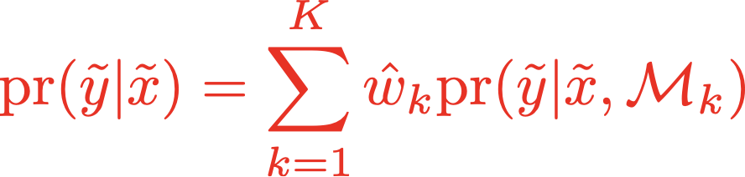

Bayesian model mixing → BMA
General: K models
Specify a model by predictions for observations y_{i} at points x_{i} →
Predictions at new input points:
Bayesian Model Averaging (BMA) has constant weights , determined by predictive power.
Improves predictive performance in weather forecasting [Raftery et al., (2005)]
BMA predictive PDF for temperature forecast
Observation
BMA
Models
Temperature
Notes:
Compare weighting for BMA by evidence vs. model mixing strategies (stacking, BART, others)
\mathcal{M}_k, (k=1,\ldots, K)
\mathcal{M}_k : y_i = f_k(x_i) + \varepsilon_{i,k}
{\rm pr}(\tilde y | \tilde x) = \sum_{k=1}^{K} \hat w_k {\rm pr}(\tilde y | \tilde x, \mathcal{M} _k)
F(g) = \int_{-\infty}^{\infty} dx~ e^{-\frac{x^{2}}{2} - g^{2} x^{4}}

Slide 28
Limits of the nuclear landscape: Bayesian model averaging (BMA)
Uses 11 global nuclear mass models
Total: 7708 ± 534 nuclei
L. Neufcourt et al., Phys. Rev. C 101, 014319 (2020); arXiv:2001.05924
Probability for each nucleus (Z,N) to be bound shown as a color. Dripline at 50%.

Slide 29
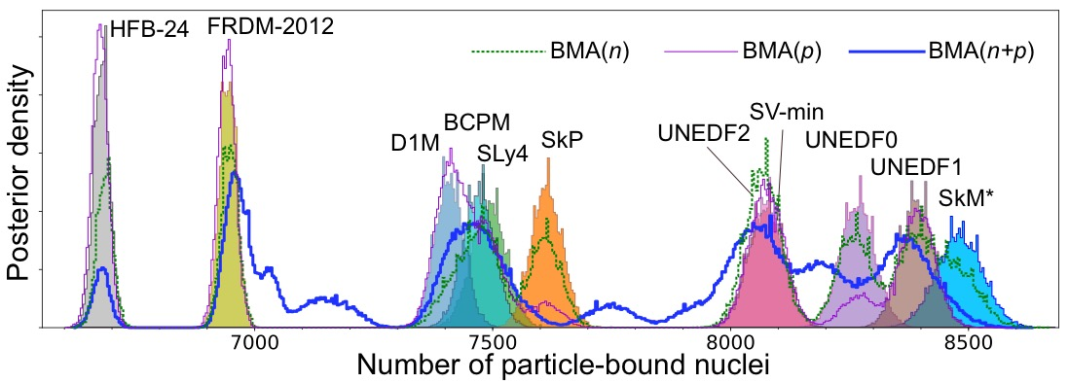
Limits of the nuclear landscape: Bayesian model averaging (BMA)
Rather than equal weights, average the models according to their predictive abilities: BMA
Uses 11 global nuclear mass models
Total: 7708 ± 534 nuclei
L. Neufcourt et al., Phys. Rev. C 101, 014319 (2020); arXiv:2001.05924
Probability for each nucleus (Z,N) to be bound shown as a color. Dripline at 50%.

Slide 30
Bayesian model mixing (BMM) examples
General: K models
Specify a model by predictions for observations y_{i} at points x_{i} →
Predictions at new input points:
Bayesian Model Averaging (BMA) has constant weights ; for BMM they depend on x_{i}.
Local Bayesian Dirichlet mixing of imperfect models, V. Kejzar et al., Sci. Rep. (2023)
Weight different nuclear mass models based on predictive ability → improved!
Notes:
Compare weighting for BMA by evidence vs. model mixing strategies (stacking, BART, others)
\mathcal{M}_k, (k=1,\ldots, K)
\mathcal{M}_k : y_i = f_k(x_i) + \varepsilon_{i,k}
{\rm pr}(\tilde y | \tilde x) = \sum_{k=1}^{K} \hat w_k {\rm pr}(\tilde y | \tilde x, \mathcal{M} _k)
F(g) = \int_{-\infty}^{\infty} dx~ e^{-\frac{x^{2}}{2} - g^{2} x^{4}}

Slide 31
Bayesian model mixing (BMM) example
A. Semposki et al.
arXiv:2404.06323 (2024)
General: K models
Specify a model by predictions for observations y_{i} at points x_{i} →
Predictions at new input points:
Bayesian Model Averaging (BMA) has constant weights ; for BMM they depend on x_{i}.
Spanning the gap in density for pressure of symmetric nuclear matter by informing a GP from 𝜒EFT and pQCD
Notes:
Compare weighting for BMA by evidence vs. model mixing strategies (stacking, BART, others)
\mathcal{M}_k, (k=1,\ldots, K)
\mathcal{M}_k : y_i = f_k(x_i) + \varepsilon_{i,k}
{\rm pr}(\tilde y | \tilde x) = \sum_{k=1}^{K} \hat w_k {\rm pr}(\tilde y | \tilde x, \mathcal{M} _k)
F(g) = \int_{-\infty}^{\infty} dx~ e^{-\frac{x^{2}}{2} - g^{2} x^{4}}

Slide 32
BAND (Bayesian Analysis of Nuclear Dynamics)
Experimental design requires uncertainties from both experiment and models
An NSF CSSI Framework (started 7/2020)
Look to https://bandframework.github.io/ for papers, talks, and software!
Notes:
Cyberinfrastructure for Sustained Scientific Innovation

Slide 33
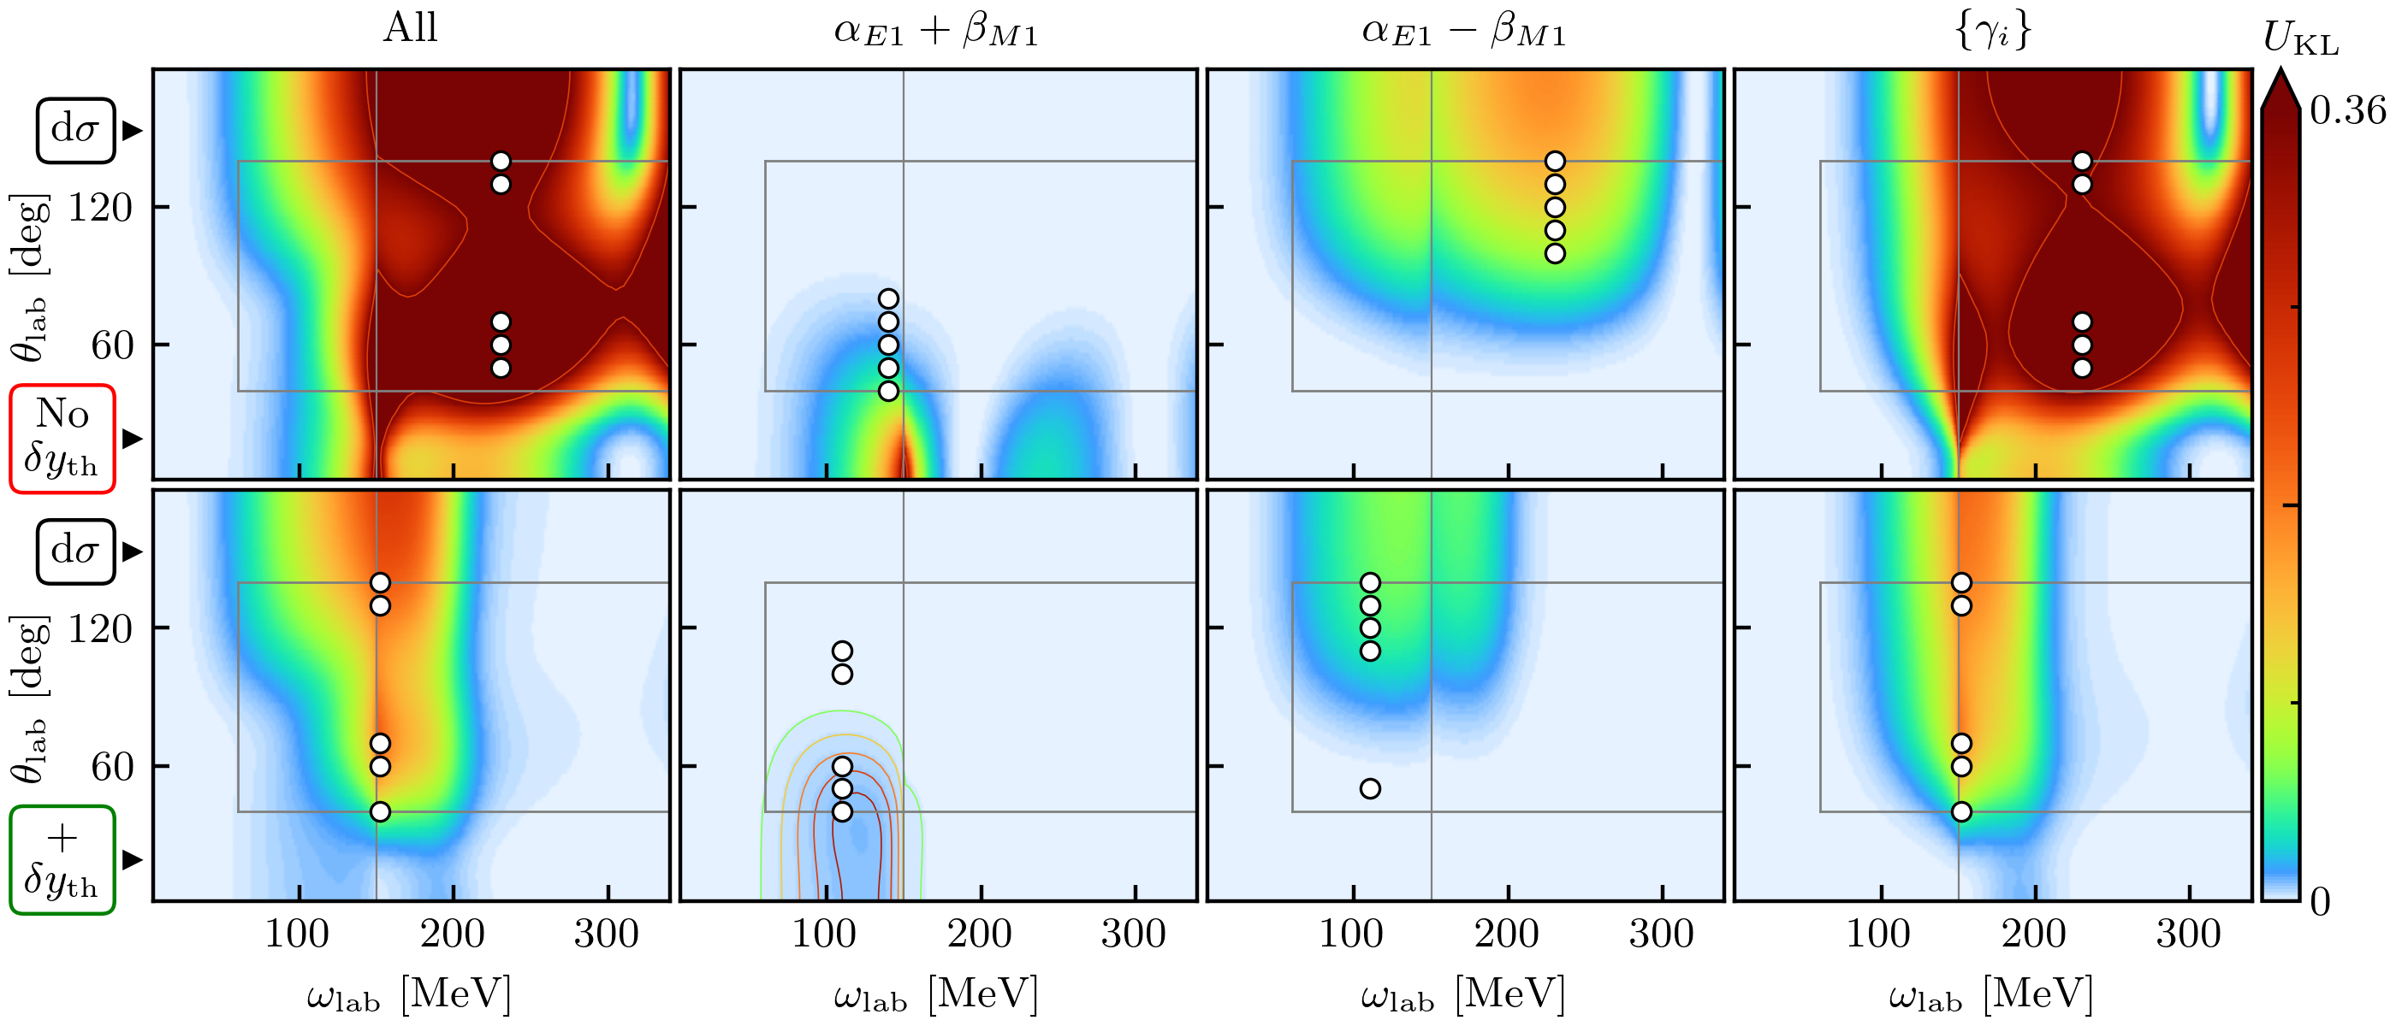
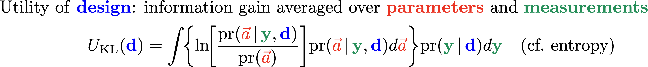
Example: Design of future 𝛾p Compton scattering experiments
What experimental (ω, 𝜃) are most useful for constraining polarizabilities and testing theory?
Given: (1) Present polarizability error bars; (2) experimental constraints; (3) χEFT accuracy decreases as ω↑.
Teaser for Harald G.’s talk!
J. Melendez et al. (2021)
✓
Interact with the experts (i.e., statisticians, applied mathematicians)
Incorporate all sources of experimental and theoretical errors
Formulate statistical models for uncertainties
Use as informative priors as is reasonable; test sensitivity to priors
Account for correlations in inputs (type x) and observables (type y)
✓
✓
✓
✓
Notes:
How much does the posterior shrink the prior region?
The expected utility eq. (23) of proton differential cross section (dσ) measurements. Colors indicate
the utility of one measurement conducted at each kinematic point (ωlab, θlab), with the point of largest utility UKL being
by definition the optimal 1-point design. (The color bar is on a linear scale, though the hue varies much more quickly for
small UKL.) The top row (with the red, “No δyth” box) does not include EFT truncation estimates, whereas the bottom
row does include the EFT uncertainty. Each column shows the utility one could expect to achieve for a subset of the proton
polarizabilities: the first column considers all polarizabilities together, while the second and third show the gain for αE1 ± βM 1
individually, and the final column reflects the collective information to be learned about the four spin polarizabilities {γi}. The
interior box that excludes ω < 60 MeV along with forward and backward angles marks the experimentally accessible regime (see
text for further discussion). The vertical line marks the cusp at the pion-production threshold. To visualize the full range of
variation in the subplots, the color ranges from zero to a saturation point calculated by averaging the optimal utilities across all
subplots. Contour lines are added for utilities above the saturation point, with the first contour at saturation and subsequent
contour lines at intervals of 50% of the color range, see the top left subplot. To help visualize the utilities from less-constraining
measurements, additional contours are added to any subplot whose maximum utility is less than 10% of the color range, see,
e.g., fig. 6. Unless otherwise stated, the color ranges are common to all subplots within a figure, but different between figures.
The white circles with black borders show the optimal five-point design kinematics, as described in the text. The effect of
including EFT truncation errors is striking: it shifts the region of optimal utility to lower energies and moderates the expected
utility.
\documentclass[10pt]{article}
\usepackage[usenames]{color} %used for font color
\usepackage[dvipsnames]{xcolor}
\usepackage{amssymb} %maths
\usepackage{amsmath} %maths
\usepackage[utf8]{inputenc} %useful to type directly diacritic characters
\newcommand{\design}{{\color{blue}\mathbf{d}}}
\DeclareMathOperator*{\argmax}{arg\,max}
\newcommand{\shrinkage}{\mathcal{S}}
\newcommand{\omegalab}{\omega_{\text{lab}}}
\newcommand{\given}{\,|\,} % Use for | in \pr
\DeclareMathOperator{\pr}{pr} % Good, but want to handle sizing and | spacing?
%\DeclareMathOperator{\pr}{p} % Good, but want to handle sizing and | spacing?
% Now add spacing:
% Derivatives
\newcommand{\dd}{d}
\newcommand{\diffcs}{d\sigma} % differential cross section
\newcommand{\genobs}{y}
\newcommand{\genobsset}{{\color{ForestGreen}\inputvec{\genobs}}}
\newcommand{\inputvec}{\mathbf}
\newcommand{\lecs}{{\color{red}\vec{a}}}
\mbox{Utility of \textbf{{\color{blue}design}}: }& \mbox{information gain averaged over \textbf{{\color{red}parameters}} and \textbf{{\color{ForestGreen}measurements}}}
\\
U_{\text{KL}}(\design)
& = \int \!\!\left\{ \ln\!\!\left[\frac{\pr(\lecs \given \genobsset, \design)}{\pr(\lecs)}\right]\! \pr(\lecs \given \genobsset, \design) \dd{\lecs}\right\}\!
\pr(\genobsset \given \design) \dd{\genobsset} \quad\mbox{(cf.\ entropy)}
% & \longrightarrow \frac{1}{2} \ln \frac{|V_0|}{|V(\design)|} \equiv \ln\shrinkage(\design) \quad\mbox{``Posterior shrinkage''}

Slide 34
Example: Design of future 𝛾p Compton scattering experiments
What experimental (ω, 𝜃) are most useful for constraining polarizabilities and testing theory?
Given: (1) Present polarizability error bars; (2) experimental constraints; (3) χEFT accuracy decreases as ω↑.
J. Melendez et al. (2021)
Notes:
How much does the posterior shrink the prior region?
The expected utility eq. (23) of proton differential cross section (dσ) measurements. Colors indicate
the utility of one measurement conducted at each kinematic point (ωlab, θlab), with the point of largest utility UKL being
by definition the optimal 1-point design. (The color bar is on a linear scale, though the hue varies much more quickly for
small UKL.) The top row (with the red, “No δyth” box) does not include EFT truncation estimates, whereas the bottom
row does include the EFT uncertainty. Each column shows the utility one could expect to achieve for a subset of the proton
polarizabilities: the first column considers all polarizabilities together, while the second and third show the gain for αE1 ± βM 1
individually, and the final column reflects the collective information to be learned about the four spin polarizabilities {γi}. The
interior box that excludes ω < 60 MeV along with forward and backward angles marks the experimentally accessible regime (see
text for further discussion). The vertical line marks the cusp at the pion-production threshold. To visualize the full range of
variation in the subplots, the color ranges from zero to a saturation point calculated by averaging the optimal utilities across all
subplots. Contour lines are added for utilities above the saturation point, with the first contour at saturation and subsequent
contour lines at intervals of 50% of the color range, see the top left subplot. To help visualize the utilities from less-constraining
measurements, additional contours are added to any subplot whose maximum utility is less than 10% of the color range, see,
e.g., fig. 6. Unless otherwise stated, the color ranges are common to all subplots within a figure, but different between figures.
The white circles with black borders show the optimal five-point design kinematics, as described in the text. The effect of
including EFT truncation errors is striking: it shifts the region of optimal utility to lower energies and moderates the expected
utility.
\documentclass[10pt]{article}
\usepackage[usenames]{color} %used for font color
\usepackage[dvipsnames]{xcolor}
\usepackage{amssymb} %maths
\usepackage{amsmath} %maths
\usepackage[utf8]{inputenc} %useful to type directly diacritic characters
\newcommand{\design}{{\color{blue}\mathbf{d}}}
\DeclareMathOperator*{\argmax}{arg\,max}
\newcommand{\shrinkage}{\mathcal{S}}
\newcommand{\omegalab}{\omega_{\text{lab}}}
\newcommand{\given}{\,|\,} % Use for | in \pr
\DeclareMathOperator{\pr}{pr} % Good, but want to handle sizing and | spacing?
%\DeclareMathOperator{\pr}{p} % Good, but want to handle sizing and | spacing?
% Now add spacing:
% Derivatives
\newcommand{\dd}{d}
\newcommand{\diffcs}{d\sigma} % differential cross section
\newcommand{\genobs}{y}
\newcommand{\genobsset}{{\color{ForestGreen}\inputvec{\genobs}}}
\newcommand{\inputvec}{\mathbf}
\newcommand{\lecs}{{\color{red}\vec{a}}}
\mbox{Utility of \textbf{{\color{blue}design}}: }& \mbox{information gain averaged over \textbf{{\color{red}parameters}} and \textbf{{\color{ForestGreen}measurements}}}
\\
U_{\text{KL}}(\design)
& = \int \!\!\left\{ \ln\!\!\left[\frac{\pr(\lecs \given \genobsset, \design)}{\pr(\lecs)}\right]\! \pr(\lecs \given \genobsset, \design) \dd{\lecs}\right\}\!
\pr(\genobsset \given \design) \dd{\genobsset} \quad\mbox{(cf.\ entropy)}
% & \longrightarrow \frac{1}{2} \ln \frac{|V_0|}{|V(\design)|} \equiv \ln\shrinkage(\design) \quad\mbox{``Posterior shrinkage''}

Slide 35
Example: Design of future 𝛾p Compton scattering experiments
What experimental (ω, 𝜃) are most useful for constraining polarizabilities and testing theory?
Given: (1) Present polarizability error bars; (2) experimental constraints; (3) χEFT accuracy decreases as ω↑.
J. Melendez et al. (2021)
Without 𝛿y_{th}
With 𝛿y_{th}
Compare utility without to with model discrepancy 𝛿y_{th} ⇒ very different implications!
Notes:
The expected utility eq. (23) of proton differential cross section (dσ) measurements. Colors indicate
the utility of one measurement conducted at each kinematic point (ωlab, θlab), with the point of largest utility UKL being
by definition the optimal 1-point design. (The color bar is on a linear scale, though the hue varies much more quickly for
small UKL.) The top row (with the red, “No δyth” box) does not include EFT truncation estimates, whereas the bottom
row does include the EFT uncertainty. Each column shows the utility one could expect to achieve for a subset of the proton
polarizabilities: the first column considers all polarizabilities together, while the second and third show the gain for αE1 ± βM 1
individually, and the final column reflects the collective information to be learned about the four spin polarizabilities {γi}. The
interior box that excludes ω < 60 MeV along with forward and backward angles marks the experimentally accessible regime (see
text for further discussion). The vertical line marks the cusp at the pion-production threshold. To visualize the full range of
variation in the subplots, the color ranges from zero to a saturation point calculated by averaging the optimal utilities across all
subplots. Contour lines are added for utilities above the saturation point, with the first contour at saturation and subsequent
contour lines at intervals of 50% of the color range, see the top left subplot. To help visualize the utilities from less-constraining
measurements, additional contours are added to any subplot whose maximum utility is less than 10% of the color range, see,
e.g., fig. 6. Unless otherwise stated, the color ranges are common to all subplots within a figure, but different between figures.
The white circles with black borders show the optimal five-point design kinematics, as described in the text. The effect of
including EFT truncation errors is striking: it shifts the region of optimal utility to lower energies and moderates the expected
utility.
\documentclass[10pt]{article}
\usepackage[usenames]{color} %used for font color
\usepackage{amssymb} %maths
\usepackage{amsmath} %maths
\usepackage[utf8]{inputenc} %useful to type directly diacritic characters
\newcommand{\design}{{\color{blue}\mathbf{d}}}
\DeclareMathOperator*{\argmax}{arg\,max}
\newcommand{\shrinkage}{\mathcal{S}}
\newcommand{\omegalab}{\omega_{\text{lab}}}
\newcommand{\given}{\,|\,} % Use for | in \pr
%\DeclareMathOperator{\pr}{pr} % Good, but want to handle sizing and | spacing?
\DeclareMathOperator{\pr}{p} % Good, but want to handle sizing and | spacing?
% Now add spacing:
% Derivatives
\newcommand{\dd}{d}
\newcommand{\diffcs}{d\sigma} % differential cross section
\newcommand{\genobs}{y}
\newcommand{\genobsset}{{\color{green}\inputvec{\genobs}}}
\newcommand{\inputvec}{\mathbf}
\newcommand{\lecs}{{\color{red}\vec{a}}}
\mbox{Utility of {\color{blue}design}: }& \mbox{information gain averaged over {\color{red}parameters} and {\color{green}measurements}}
\\
U_{\text{KL}}(\design)
& = \int \!\!\left\{ \ln\!\!\left[\frac{\pr(\lecs \given \genobsset, \design)}{\pr(\lecs)}\right]\! \pr(\lecs \given \genobsset, \design) \dd{\lecs}\right\}\!
\pr(\genobsset \given \design) \dd{\genobsset} \quad\mbox{(cf.\ entropy)} \\
& \longrightarrow \frac{1}{2} \ln \frac{|V_0|}{|V(\design)|} \equiv \ln\shrinkage(\design) \quad\mbox{``Posterior shrinkage''}

Slide 36
BAND (Bayesian Analysis of Nuclear Dynamics)
High-fidelity models may be too expensive → use an emulator instead!
An NSF CSSI Framework (started 7/2020)
Look to https://bandframework.github.io/ for papers, talks, and software!
Notes:
Cyberinfrastructure for Sustained Scientific Innovation

Slide 37
Universe of model reduction methods
Need: to vary parameters for design, control, optimization, UQ.
Exploit: much information in high-fidelity models is superfluous.
Solution: reduced-order model (ROM) → emulator (fast & accurate™).
[Parametric] MOR (model order reduction)
General classification of ROMs
…
RB (reduced basis) method
…
Data driven
non-intrusive
Model driven
intrusive
EC (eigenvector continuation)
hybrid
…
…
Data driven: interpolate output of high-fidelity model w/o understanding → non-intrusive
Examples: Gaussian processes; dynamic mode decomposition; artificial neural network, also hybrid ML
Model driven: derive reduced-order equations from high-fidelity equations → intrusive
Features: physics-based, respects underlying structure → can extrapolate; often uses projection
See Melendez et al., 2022 for many references from the wide MOR literature;
various types of emulators already successful in NP (e.g., refs. in Drischler et al., 2022)
Notes:
”Superfluous” could be redundant or decoupled, for example.
Tremendous opportunities for nuclear physics to adapt methods from the MOR literature. In arXiv:2203.05528 we provide pointers to the pointers (MOR reviews).
There are many outside MOR experts that could be consulted/involved in nuclear problems.
Don’t actually need to say emulator; just reduced-order model (ROM) *is* an emulator.
Data driven uses high-fidelity calculations (Full-Order Model or FOM) as black box: interpolate output but we don’t need to know how it is generated (in the extreme case; we can also build in some knowledge).
Some machine learning approaches in recent literature combine data-driven and model-driven (non-intrusive and intrusive) approaches (also PMM approach)
In the MOR -> RBM -> EC figure, the extra boxes denote other MOR approaches.
Parametric MOR is opposed to fixed parameter MOR (which is how it started).

Slide 38
Snapshot RBM emulators for nuclear observables
Ground-state eigenvectors from a selection of parameter sets is an extremely effective variational basis for other parameter sets.
Characteristics: fast & accurate! Scales!
Already applied to many observables:
Ground-state properties (energies, radii)
Transition matrix elements
Excited states
Resonances
Adapted to special situations and methods
Pairing; shell model
Coupled cluster approach; MBPT
Systems in a finite box
Subspace diag. on quantum computers
Extended to non-eigenvalue problems
Reactions and scattering; fission
Quantum spin system phase diagrams
⁴He energy
EC from Frame et al., (2018)
EC as emulator: König et al. (2020)
See Duguet et al., RMP (2024) for latest updates.

Slide 39
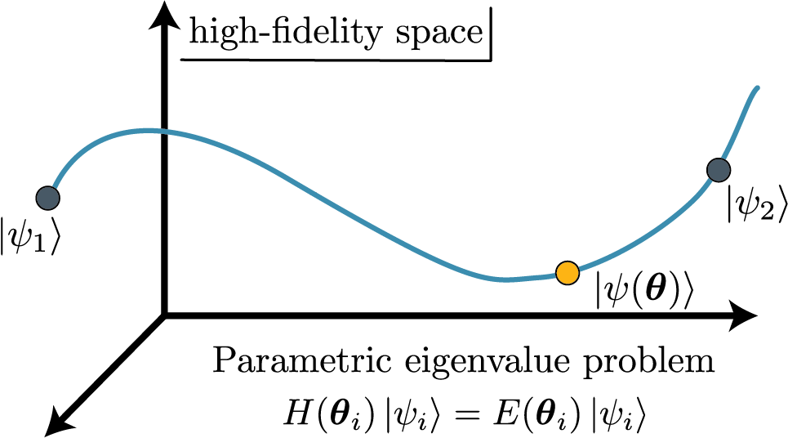
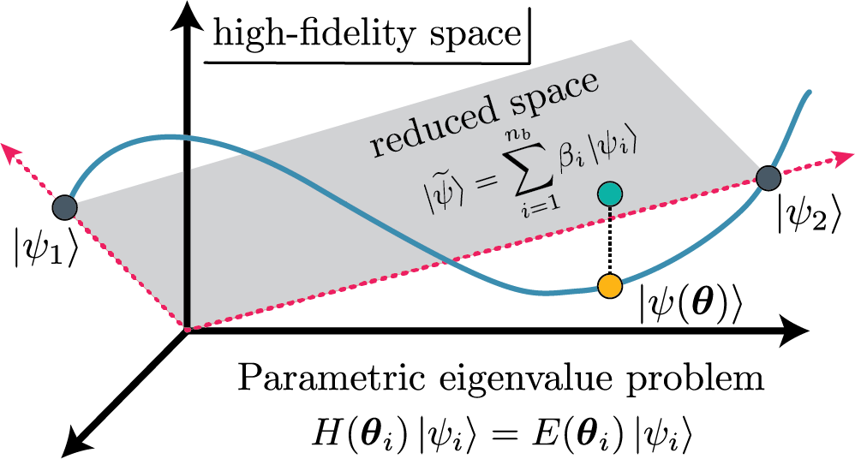
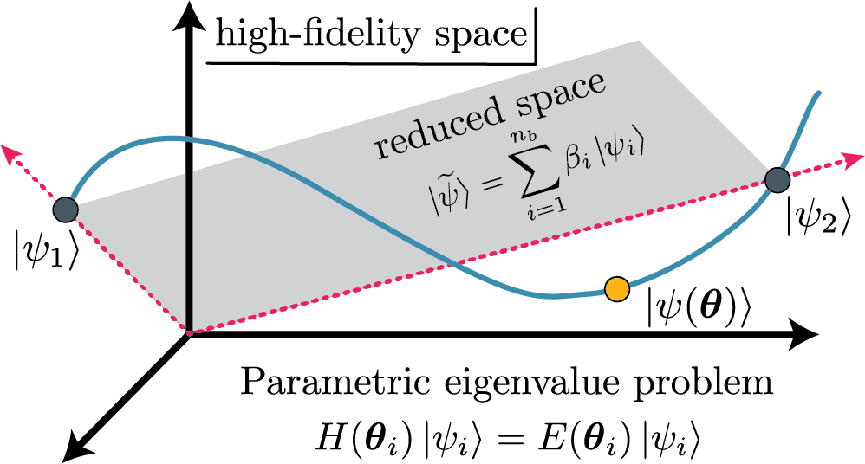
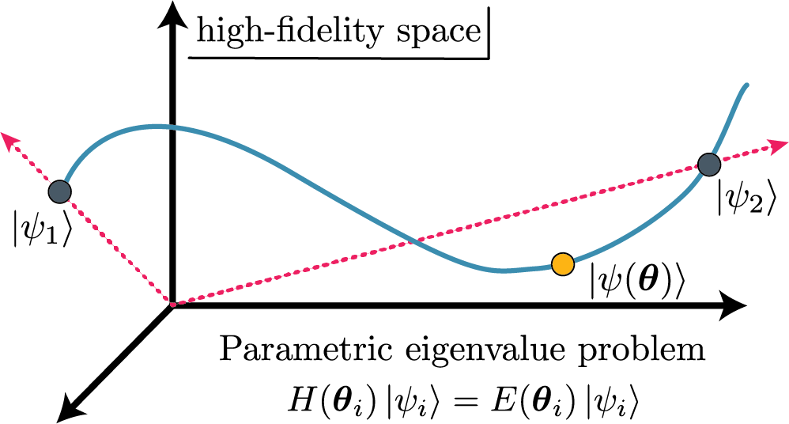
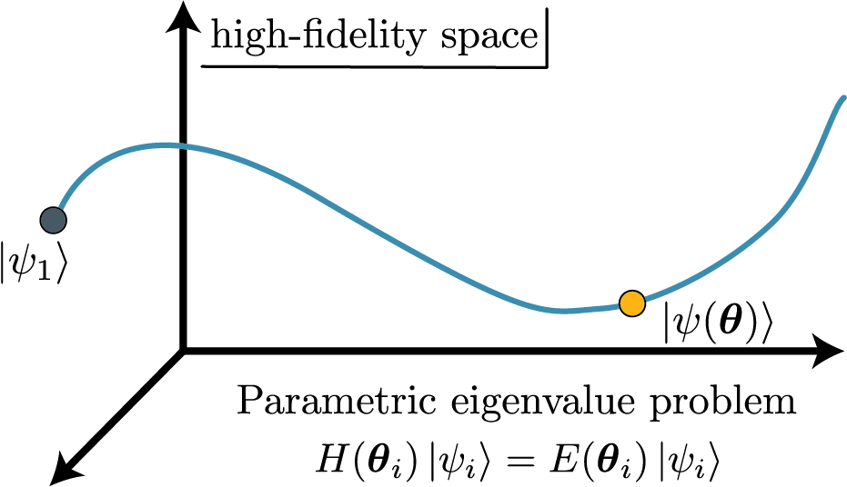
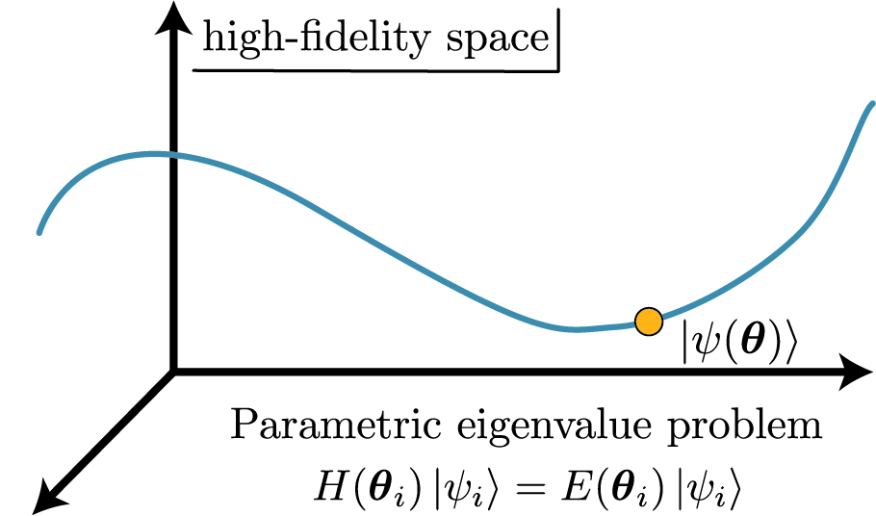
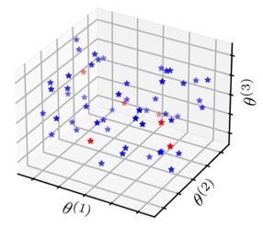

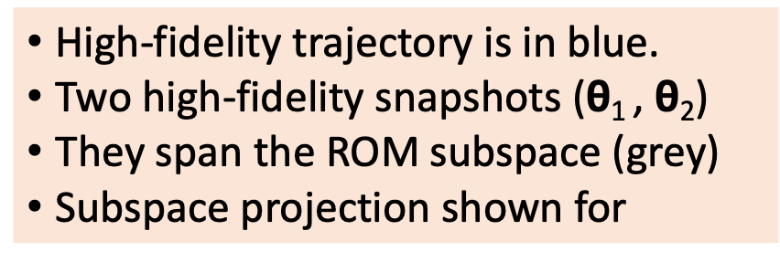
Schematic picture of projection-based emulators
How to choose the snapshot basis?
Space-filling sampling (e.g., LHC) then singular value decomposition (POD)
Develop error estimator and greedy algorithm [E. Bonilla et al. (2022); A. Sarkar et al. (2022); J. Maldonado et al. (coming soon!)]
High-fidelity trajectory is in blue.
Two high-fidelity snapshots ($\text{θ}$₁ , $\text{θ}$₂)
They span the ROM subspace (grey)
Subspace projection shown for

Slide 40






Schematic picture of projection-based emulators
Variational → stationary functional
Use trial and
Solve generalized eigenvalue problem:
Galerkin projection ← use weak form
Reduce dimension:
Limit orthogonality:
Choose (Ritz) ≡ variational
More general: (Petrov-Galerkin)
High-fidelity trajectory is in blue.
Two high-fidelity snapshots ($\text{θ}$₁ , $\text{θ}$₂)
They span the ROM subspace (grey)
Subspace projection shown for

Slide 41
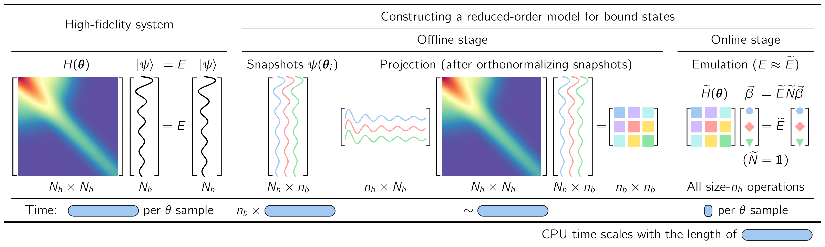
Constructing a reduced-basis model (aka emulator)
J. A. Melendez et al., J. Phys. G 49, 102001 (2022)
E. Bonilla, P. Giuliani et al.,
Phys. Rev. C 106, 054322 (2022)
P. Giuliani, K. Godbey et al., Front. Phys. 10, 1212 (2022)
C. Drischler et al., Quarto + Front. Phys. 10, 1365 (2022)

Slide 42
Constructing a reduced-basis model (aka emulator)
J. A. Melendez et al., J. Phys. G 49, 102001 (2022)
E. Bonilla, P. Giuliani et al.,
Phys. Rev. C 106, 054322 (2022)
P. Giuliani, K. Godbey et al., Front. Phys. 10, 1212 (2022)
C. Drischler et al., Quarto + Front. Phys. 10, 1365 (2022)
Offline stage (pre-calculations of size N_{h}):
  Construct basis using snapshots from high-fidelity system (simulator)
  Project high-fidelity system to small-space using snapshots

Slide 43
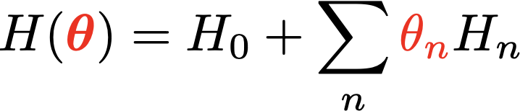
Constructing a reduced-basis model (aka emulator)
For speed: only size-n_{b} operations in online stage → affine structure
What if non-affine?
Implemented for scattering by the ROSE
emulator [slides].
[Odell et al., PRC (2024)]
← affine in 𝜃_{n}
⇒
Notes:
%H({\color{red}\bm\theta}) = H_0 + \sum_n {\color{red}\theta_n} H_n
\langle \psi_i | H({\color{red}\bm\theta}) | \psi_j \rangle = \langle \psi_i | H_0 | \psi_j \rangle + \sum_{n} {\color{red}\bm\theta_n} \langle \psi_i | H_n | \psi_j \rangle \ {\color{blue}\longleftarrow n_b \times n_b\ \mbox{matrices}}

Slide 44
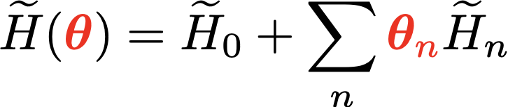
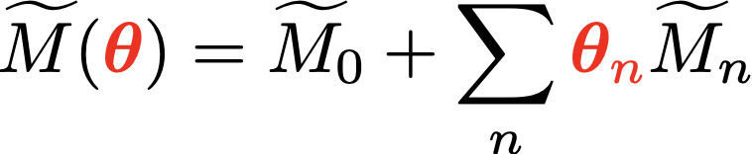
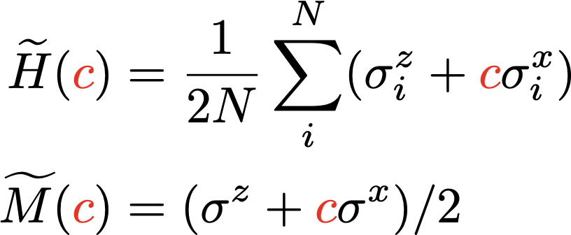
Hybrid approach: Parametric Matrix Models (PMMs)
RBM/EC: matrix elements of eigenvector snapshots → model driven
R. Somasundaram et al.,
arXiv:2404.11566 (2024)
PMM: learn mat. elements from data (eigenvalues)
→ hybrid data driven
Application to emulate noisy AFDMC calculations
P. Cook, D. Jammooa et al., arXiv:2401.11694 (2024)
N non-interacting spin-1/2
PMM more flexible;
→ wins for large N
Notes:
%H({\color{red}\bm\theta}) = H_0 + \sum_n {\color{red}\theta_n} H_n
%\langle \psi_i | H({\color{red}\bm\theta}) | \psi_j \rangle = \langle \psi_i | H_0 | \psi_j \rangle + \sum_{n} {\color{red}\bm\theta_n} \langle \psi_i | H_n | \psi_j \rangle \ {\color{blue}\longleftarrow n_b \times n_b\ \mbox{matrices}}
% \widetilde H({\color{red}\bm\theta}) = \widetilde H_0 + \sum_{n} {\color{red}\bm\theta_n} \widetilde H_n
%\ {\color{blue}\longleftarrow n_b \times n_b\ \mbox{symmetric matrices}}
%\widetilde M({\color{red}\bm\theta}) = \widetilde M_0 + \sum_{n} {\color{red}\bm\theta_n} \widetilde M_n
%\ {\color{blue}\longleftarrow \mbox{\textit{learn} symmetric matrices}}
\widetilde H({\color{red}c}) &= \frac{1}{2N}\sum_{i}^{N} (\sigma^z_i + {\color{red}c} \sigma_i^x) \\
\widetilde M({\color{red}c}) &= (\sigma^z + {\color{red}c} \sigma^x)/2

Slide 45
Outline
Ingredients for principled uncertainty quantification (UQ)
Calibration, model mixing, expt. design, emulators
Challenges: Frontiers of UQ for nuclear physics
Extra slides (more details, other topics, …)

Slide 46
Strive for statistically sound Bayesian inference
✓
Incorporate all sources of experimental and theoretical errors
Formulate statistical models for uncertainties
Use as informative priors as is reasonable; test sensitivity to priors
Account for correlations in inputs (type x) and observables (type y)
Propagate uncertainties through the calculation
Use model checking to validate our models
Interact with the experts (i.e., statisticians, applied mathematicians)
✓
✓
✓
✓
✓
✓

Slide 47
Calibration: full Bayesian parameter estimation and uncertainty propagation. Technologies to apply: history matching, sampling (HMC), VBI, …
Model mixing: Multiple projects (BAND, …) on nuclear EOS, EDFs, EFTs, …
Experimental design: exploring alternative approaches and existing software libraries (e.g., pyOED); sampling is feasible with emulators!
Emulators: infinite matter, pairing, new applications to 3N scattering, …;
new technologies to explore (e.g., MOR, active learning, AI/machine learning, PMMs, …); implement new workflows (bypass specialized knowledge).
Software sharing: e.g., BAND github repository → surmise, Taweret, ROSE, …
Physics discovery through statistics: e.g., exploit statistical correlations using Bayesian tools (spectra, 0𝜈𝛽𝛽, …); uncover/test power counting of EFT; …
Notes:
Variational inference
sampling/importance resampling Christian Forssen Front.in Phys. 10 (2022) 1058809

Slide 48
Thank you!
Slides:
https://go.osu.edu/mitp2024
Later this year: ISNET-10, November 10th - 15th, 2024, in Shanghai, China (hybrid)
Jupyter and Quora books:
Learning from Data (Chalmers course by Forssén)
Learning from Data (OSU/OU course by Furnstahl/Phillips)
BUQEYE Guide to Projection-Based Emulators in Nuclear Physics
Reduced Basis Methods in Nuclear Physics
See Duguet et al., RMP (2024) for latest updates on EC/RBM emulators
Notes:
2013-present: ISNET: Information and Statistics in Nuclear Experiment and Theory

Slide 49
Outline
Ingredients for principled uncertainty quantification (UQ)
Calibration, model mixing, expt. design, emulators
Challenges: Frontiers of UQ for nuclear physics
Extra slides (more details, other topics, …)

Slide 50
Thanks to many UQ collaborators!
Kyle Beyer (UM)
Edgard Bonilla (Stanford)
Manuel Catacora-Rios (MSU)
Moses Chan (NWU)
Christian Drischler (OU)
Thomas Duguet (Orsay)
Andreas Ekström (Chalmers)
Christian Forssen (Chalmers)
Alberto Garcia (OSU)
Pablo Giuliani (MSU/FRIB)
Kyle Godbey (MSU/FRIB)
Sebastian König (NC State)
Dean Lee (MSU/FRIB)
Joshua Maldonado (OU)
Pieter Maris (IA)
Jordan Melendez (OSU)
Patrick Millican (OSU)
Filomena Nunes (MSU/FRIB)
Daniel Odell (OU)
Matt Pratola (OSU)
Ozge Surer (Miami U.)
Stefan Wild (LBNL)
Xilin Zhang (FRIB)
and others in collaborations!
https://www.lenpic.org/

Slide 51
Historical perspective: UQ for nuclear models
Pre-2010: If given, model uncertainties usually from conventional regression
2011: Physical Review A editorial calling for theory uncertainty estimates
2013: ISNET: Information and Statistics in Nuclear Experiment and Theory
2014: “Error Estimates of Theoretical Models: a Guide” [Dobaczewski et al]
2015: Journal of Physics G Special Focus Issue: ISNET
2016: Bayesian Methods in Nuclear Physics (ISNET-4) [INT, Seattle]
2020-21: J. Phys. G Special Focus Issue: ISNET 2.0
2022: Frontiers in Physics issue: Uncertainty Quantification in Nuclear Physics
2023: ISNET-9 + BAND CAMP, May 22-26, at Washington U. in St. Louis
2024: ISNET-10, November 10th - 15th, 2024, in Shanghai, China (hybrid)
Notes:
Model uncertainties from standard regression or range of models

Slide 52
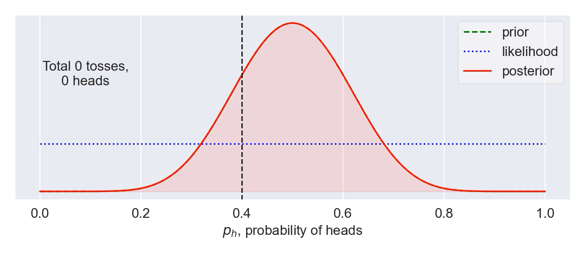
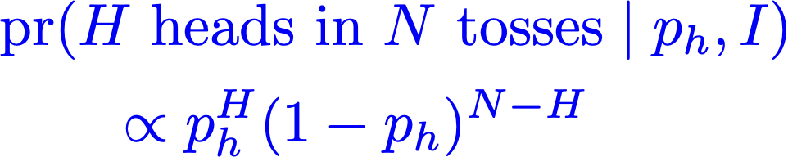
Bayes’ Theorem: How to update knowledge in PDFs
[back]
Bayesian updating of knowledge
Example: tossing a biased coin. True probability of heads is p_{h}=0.4, but we don’t know that. So p_{h} is a distribution updated with each toss of the coin.
Likelihood is
Priors are important when few data; can suppress too-wide likelihoods to inhibit overfitting (cf. regularization for ANNs).
Notes:
\usepackage{bm}
\DeclareMathOperator{\pr}{\text{pr}} % Good, but want to handle sizing and | spacing?
{\color{red}\pr(A|B,I)} = \frac{{\color{blue}\pr(B|A,I)} {\color[rgb]{0.000000,0.493151,0.000000}\pr(A|I)}}{\pr(B|A)}
\Longrightarrow
{\color{red}\underbrace{\pr(\bm{\theta} | \mathbf{y}_{\rm exp}, I)}_{\mbox{\scriptsize posterior}}}
\propto
{\color{blue}\underbrace{\pr(\mathbf{y}_{\rm exp} | \bm{\theta}, I)}_{\mbox{\scriptsize likelihood}}}
\times
{\color[rgb]{0.000000,0.493151,0.000000}\underbrace{\pr(\bm{\theta} | I)}_{\mbox{\scriptsize prior}}}
{\color{red}\pr(A|B,I)} = \frac{{\color{blue}\pr(B|A,I)} {\color[rgb]{0.000000,0.493151,0.000000}\pr(A|I)}}{\pr(B|A)}
\Longrightarrow
{\color{red}\underbrace{\pr(x | \mbox{data}, I)}_{\mbox{posterior}}}
\propto
{\color{blue}\underbrace{\pr(\mbox{data} | x, I)}_{\mbox{likelihood}}}
\times
{\color[rgb]{0.000000,0.493151,0.000000}\underbrace{\pr(\mbox{data} | I)}_{\mbox{prior}}}
{\color{red}\pr(\bm{\theta} | \mathrm{y}_{\rm exp}, \Sigma_{\rm exp}, \Sigma_{\rm th}, I)}
\propto {\color{blue}e^{-\frac12 \mathbf{r}^{\intercal}(\Sigma_{\rm exp}+\Sigma_{\rm th})^{-1}\mathbf{r}}}
\times {\color[rgb]{0.000000,0.493151,0.000000} e^{-\bm{\theta}^2/2\bar\theta} }
\usepackage{bm}
\newcommand{\pr}{\text{pr}}
&{\color{blue}
%\mbox{likelihood: }
\pr(\mathbf{y}_{\rm exp} | \bm{\theta}, I) \propto e^{-\chi^2/2}
}
\quad\underset{\rm uncorrelated}{\Longrightarrow}\quad
{\color{blue}
\chi^2 = \sum_i^{\rm data} \mathbf{r}_i\frac{1}{\sigma_i^2}\mathbf{r}_i \;,
\quad
\mathbf{r} \equiv \mathbf{y}_{\rm exp} - \mathbf{y}_{\rm th}(\bm{\theta})
} \\[10pt]
&\quad\mbox{correlated: }
{\color{red}\pr(\bm{\theta} | \mathrm{y}_{\rm exp}, \Sigma_{\rm exp}, \Sigma_{\rm th}, I)}
\propto {\color{blue}e^{-\frac12 \mathbf{r}^{\intercal}(\Sigma_{\rm exp}+\Sigma_{\rm th})^{-1}\mathbf{r}}} \times {\color[rgb]{0.000000,0.493151,0.000000} e^{-\bm{\theta}^2/2\bar\theta^2} }
&{\color{blue}
%\mbox{likelihood: }
\pr(\mathbf{y}_{\rm exp} | \bm{\theta}, I) \propto e^{-\chi^2/2}
}
\quad\underset{\rm uncorrelated}{\Longrightarrow}\quad
{\color{blue}
\chi^2 = \sum_i^{\rm data} \mathbf{r}_i\frac{1}{\sigma_i^2}\mathbf{r}_i \;,
\quad
\mathbf{r} \equiv \mathbf{y}_{\rm exp} - \mathbf{y}_{\rm th}(\bm{\theta})
} \\[10pt]
&\quad\mbox{correlated: }
{\color{red}\pr(\bm{\theta} | \mathrm{y}_{\rm exp}, \Sigma_{\rm exp}, \Sigma_{\rm th}, I)}
\propto {\color{blue}e^{-\frac12 \mathbf{r}^{\intercal}(\Sigma_{\rm exp}+\Sigma_{\rm th})^{-1}\mathbf{r}}} \times {\color[rgb]{0.000000,0.493151,0.000000} e^{-\bm{\theta}^2/2\bar\theta^2} }

Slide 53
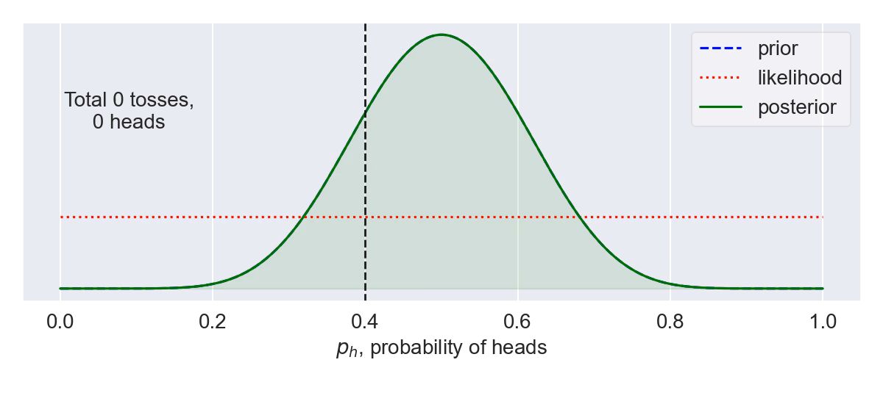
Bayes’ Theorem: How to update knowledge in PDFs
[back]
Bayesian updating of knowledge
Example: tossing a biased coin. True probability of heads is p_{h}=0.4, but we don’t know that. So p_{h} is a distribution updated with each toss of the coin.
Likelihood is
Priors are important when few data; can suppress too-wide likelihoods to inhibit overfitting (cf. regularization for ANNs).
Notes:
\usepackage{bm}
\DeclareMathOperator{\pr}{\text{pr}} % Good, but want to handle sizing and | spacing?
{\color{red}\pr(A|B,I)} = \frac{{\color{blue}\pr(B|A,I)} {\color[rgb]{0.000000,0.493151,0.000000}\pr(A|I)}}{\pr(B|A)}
\Longrightarrow
{\color{red}\underbrace{\pr(\bm{\theta} | \mathbf{y}_{\rm exp}, I)}_{\mbox{\scriptsize posterior}}}
\propto
{\color{blue}\underbrace{\pr(\mathbf{y}_{\rm exp} | \bm{\theta}, I)}_{\mbox{\scriptsize likelihood}}}
\times
{\color[rgb]{0.000000,0.493151,0.000000}\underbrace{\pr(\bm{\theta} | I)}_{\mbox{\scriptsize prior}}}
{\color{red}\pr(A|B,I)} = \frac{{\color{blue}\pr(B|A,I)} {\color[rgb]{0.000000,0.493151,0.000000}\pr(A|I)}}{\pr(B|A)}
\Longrightarrow
{\color{red}\underbrace{\pr(x | \mbox{data}, I)}_{\mbox{posterior}}}
\propto
{\color{blue}\underbrace{\pr(\mbox{data} | x, I)}_{\mbox{likelihood}}}
\times
{\color[rgb]{0.000000,0.493151,0.000000}\underbrace{\pr(\mbox{data} | I)}_{\mbox{prior}}}
{\color{red}\pr(\bm{\theta} | \mathrm{y}_{\rm exp}, \Sigma_{\rm exp}, \Sigma_{\rm th}, I)}
\propto {\color{blue}e^{-\frac12 \mathbf{r}^{\intercal}(\Sigma_{\rm exp}+\Sigma_{\rm th})^{-1}\mathbf{r}}}
\times {\color[rgb]{0.000000,0.493151,0.000000} e^{-\bm{\theta}^2/2\bar\theta} }
\usepackage{bm}
\newcommand{\pr}{\text{pr}}
&{\color{blue}
%\mbox{likelihood: }
\pr(\mathbf{y}_{\rm exp} | \bm{\theta}, I) \propto e^{-\chi^2/2}
}
\quad\underset{\rm uncorrelated}{\Longrightarrow}\quad
{\color{blue}
\chi^2 = \sum_i^{\rm data} \mathbf{r}_i\frac{1}{\sigma_i^2}\mathbf{r}_i \;,
\quad
\mathbf{r} \equiv \mathbf{y}_{\rm exp} - \mathbf{y}_{\rm th}(\bm{\theta})
} \\[10pt]
&\quad\mbox{correlated: }
{\color{red}\pr(\bm{\theta} | \mathrm{y}_{\rm exp}, \Sigma_{\rm exp}, \Sigma_{\rm th}, I)}
\propto {\color{blue}e^{-\frac12 \mathbf{r}^{\intercal}(\Sigma_{\rm exp}+\Sigma_{\rm th})^{-1}\mathbf{r}}} \times {\color[rgb]{0.000000,0.493151,0.000000} e^{-\bm{\theta}^2/2\bar\theta^2} }
&{\color{blue}
%\mbox{likelihood: }
\pr(\mathbf{y}_{\rm exp} | \bm{\theta}, I) \propto e^{-\chi^2/2}
}
\quad\underset{\rm uncorrelated}{\Longrightarrow}\quad
{\color{blue}
\chi^2 = \sum_i^{\rm data} \mathbf{r}_i\frac{1}{\sigma_i^2}\mathbf{r}_i \;,
\quad
\mathbf{r} \equiv \mathbf{y}_{\rm exp} - \mathbf{y}_{\rm th}(\bm{\theta})
} \\[10pt]
&\quad\mbox{correlated: }
{\color{red}\pr(\bm{\theta} | \mathrm{y}_{\rm exp}, \Sigma_{\rm exp}, \Sigma_{\rm th}, I)}
\propto {\color{blue}e^{-\frac12 \mathbf{r}^{\intercal}(\Sigma_{\rm exp}+\Sigma_{\rm th})^{-1}\mathbf{r}}} \times {\color[rgb]{0.000000,0.493151,0.000000} e^{-\bm{\theta}^2/2\bar\theta^2} }

Slide 54
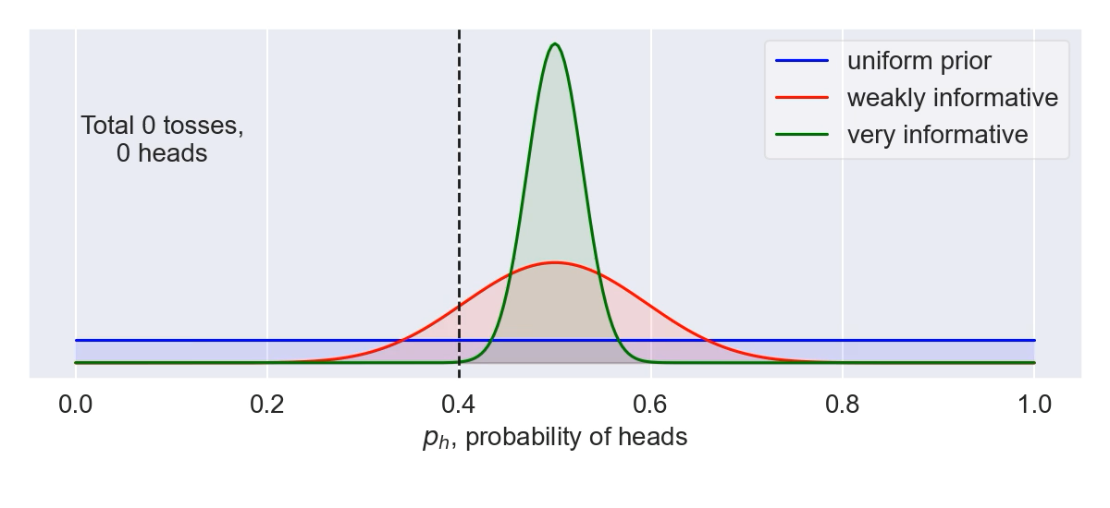
Bayes’ Theorem: How to update knowledge in PDFs
[back]
Bayesian updating of knowledge
Use as informative priors as is reasonable; test sensitivity to priors
Example: tossing a biased coin. True probability of heads is p_{h}=0.4, but we don’t know that. So p_{h} is a distribution updated with each toss of the coin.
Likelihood is
Use model checking to validate our models
Notes:
\usepackage{bm}
\DeclareMathOperator{\pr}{\text{pr}} % Good, but want to handle sizing and | spacing?
{\color{red}\pr(A|B,I)} = \frac{{\color{blue}\pr(B|A,I)} {\color[rgb]{0.000000,0.493151,0.000000}\pr(A|I)}}{\pr(B|A)}
\Longrightarrow
{\color{red}\underbrace{\pr(\bm{\theta} | \mathbf{y}_{\rm exp}, I)}_{\mbox{\scriptsize posterior}}}
\propto
{\color{blue}\underbrace{\pr(\mathbf{y}_{\rm exp} | \bm{\theta}, I)}_{\mbox{\scriptsize likelihood}}}
\times
{\color[rgb]{0.000000,0.493151,0.000000}\underbrace{\pr(\bm{\theta} | I)}_{\mbox{\scriptsize prior}}}
{\color{red}\pr(A|B,I)} = \frac{{\color{blue}\pr(B|A,I)} {\color[rgb]{0.000000,0.493151,0.000000}\pr(A|I)}}{\pr(B|A)}
\Longrightarrow
{\color{red}\underbrace{\pr(x | \mbox{data}, I)}_{\mbox{posterior}}}
\propto
{\color{blue}\underbrace{\pr(\mbox{data} | x, I)}_{\mbox{likelihood}}}
\times
{\color[rgb]{0.000000,0.493151,0.000000}\underbrace{\pr(\mbox{data} | I)}_{\mbox{prior}}}
{\color{red}\pr(\bm{\theta} | \mathrm{y}_{\rm exp}, \Sigma_{\rm exp}, \Sigma_{\rm th}, I)}
\propto {\color{blue}e^{-\frac12 \mathbf{r}^{\intercal}(\Sigma_{\rm exp}+\Sigma_{\rm th})^{-1}\mathbf{r}}}
\times {\color[rgb]{0.000000,0.493151,0.000000} e^{-\bm{\theta}^2/2\bar\theta} }
\usepackage{bm}
\newcommand{\pr}{\text{pr}}
&{\color{blue}
%\mbox{likelihood: }
\pr(\mathbf{y}_{\rm exp} | \bm{\theta}, I) \propto e^{-\chi^2/2}
}
\quad\underset{\rm uncorrelated}{\Longrightarrow}\quad
{\color{blue}
\chi^2 = \sum_i^{\rm data} \mathbf{r}_i\frac{1}{\sigma_i^2}\mathbf{r}_i \;,
\quad
\mathbf{r} \equiv \mathbf{y}_{\rm exp} - \mathbf{y}_{\rm th}(\bm{\theta})
} \\[10pt]
&\quad\mbox{correlated: }
{\color{red}\pr(\bm{\theta} | \mathrm{y}_{\rm exp}, \Sigma_{\rm exp}, \Sigma_{\rm th}, I)}
\propto {\color{blue}e^{-\frac12 \mathbf{r}^{\intercal}(\Sigma_{\rm exp}+\Sigma_{\rm th})^{-1}\mathbf{r}}} \times {\color[rgb]{0.000000,0.493151,0.000000} e^{-\bm{\theta}^2/2\bar\theta^2} }
&{\color{blue}
%\mbox{likelihood: }
\pr(\mathbf{y}_{\rm exp} | \bm{\theta}, I) \propto e^{-\chi^2/2}
}
\quad\underset{\rm uncorrelated}{\Longrightarrow}\quad
{\color{blue}
\chi^2 = \sum_i^{\rm data} \mathbf{r}_i\frac{1}{\sigma_i^2}\mathbf{r}_i \;,
\quad
\mathbf{r} \equiv \mathbf{y}_{\rm exp} - \mathbf{y}_{\rm th}(\bm{\theta})
} \\[10pt]
&\quad\mbox{correlated: }
{\color{red}\pr(\bm{\theta} | \mathrm{y}_{\rm exp}, \Sigma_{\rm exp}, \Sigma_{\rm th}, I)}
\propto {\color{blue}e^{-\frac12 \mathbf{r}^{\intercal}(\Sigma_{\rm exp}+\Sigma_{\rm th})^{-1}\mathbf{r}}} \times {\color[rgb]{0.000000,0.493151,0.000000} e^{-\bm{\theta}^2/2\bar\theta^2} }

Slide 55
Bayes’s Theorem: How to update knowledge in PDFs
[back]
Bayesian updating of knowledge
Likelihood overwhelms prior
Prior suppresses unconstrained likelihood
cf. regularization
in neural networks
Notes:
\usepackage{bm}
\DeclareMathOperator{\pr}{\text{pr}} % Good, but want to handle sizing and | spacing?
{\color{red}\pr(A|B,I)} = \frac{{\color{blue}\pr(B|A,I)} {\color[rgb]{0.000000,0.493151,0.000000}\pr(A|I)}}{\pr(B|A)}
\Longrightarrow
{\color{red}\underbrace{\pr(\bm{\theta} | \mathbf{y}_{\rm exp}, I)}_{\mbox{\scriptsize posterior}}}
\propto
{\color{blue}\underbrace{\pr(\mathbf{y}_{\rm exp} | \bm{\theta}, I)}_{\mbox{\scriptsize likelihood}}}
\times
{\color[rgb]{0.000000,0.493151,0.000000}\underbrace{\pr(\bm{\theta} | I)}_{\mbox{\scriptsize prior}}}
{\color{red}\pr(A|B,I)} = \frac{{\color{blue}\pr(B|A,I)} {\color[rgb]{0.000000,0.493151,0.000000}\pr(A|I)}}{\pr(B|A)}
\Longrightarrow
{\color{red}\underbrace{\pr(x | \mbox{data}, I)}_{\mbox{posterior}}}
\propto
{\color{blue}\underbrace{\pr(\mbox{data} | x, I)}_{\mbox{likelihood}}}
\times
{\color[rgb]{0.000000,0.493151,0.000000}\underbrace{\pr(\mbox{data} | I)}_{\mbox{prior}}}
{\color{red}\pr(\bm{\theta} | \mathrm{y}_{\rm exp}, \Sigma_{\rm exp}, \Sigma_{\rm th}, I)}
\propto {\color{blue}e^{-\frac12 \mathbf{r}^{\intercal}(\Sigma_{\rm exp}+\Sigma_{\rm th})^{-1}\mathbf{r}}}
\times {\color[rgb]{0.000000,0.493151,0.000000} e^{-\bm{\theta}^2/2\bar\theta} }
\usepackage{bm}
\newcommand{\pr}{\text{pr}}
&{\color{blue}
%\mbox{likelihood: }
\pr(\mathbf{y}_{\rm exp} | \bm{\theta}, I) \propto e^{-\chi^2/2}
}
\quad\underset{\rm uncorrelated}{\Longrightarrow}\quad
{\color{blue}
\chi^2 = \sum_i^{\rm data} \mathbf{r}_i\frac{1}{\sigma_i^2}\mathbf{r}_i \;,
\quad
\mathbf{r} \equiv \mathbf{y}_{\rm exp} - \mathbf{y}_{\rm th}(\bm{\theta})
} \\[10pt]
&\quad\mbox{correlated: }
{\color{red}\pr(\bm{\theta} | \mathrm{y}_{\rm exp}, \Sigma_{\rm exp}, \Sigma_{\rm th}, I)}
\propto {\color{blue}e^{-\frac12 \mathbf{r}^{\intercal}(\Sigma_{\rm exp}+\Sigma_{\rm th})^{-1}\mathbf{r}}} \times {\color[rgb]{0.000000,0.493151,0.000000} e^{-\bm{\theta}^2/2\bar\theta^2} }
&{\color{blue}
%\mbox{likelihood: }
\pr(\mathbf{y}_{\rm exp} | \bm{\theta}, I) \propto e^{-\chi^2/2}
}
\quad\underset{\rm uncorrelated}{\Longrightarrow}\quad
{\color{blue}
\chi^2 = \sum_i^{\rm data} \mathbf{r}_i\frac{1}{\sigma_i^2}\mathbf{r}_i \;,
\quad
\mathbf{r} \equiv \mathbf{y}_{\rm exp} - \mathbf{y}_{\rm th}(\bm{\theta})
} \\[10pt]
&\quad\mbox{correlated: }
{\color{red}\pr(\bm{\theta} | \mathrm{y}_{\rm exp}, \Sigma_{\rm exp}, \Sigma_{\rm th}, I)}
\propto {\color{blue}e^{-\frac12 \mathbf{r}^{\intercal}(\Sigma_{\rm exp}+\Sigma_{\rm th})^{-1}\mathbf{r}}} \times {\color[rgb]{0.000000,0.493151,0.000000} e^{-\bm{\theta}^2/2\bar\theta^2} }

Slide 56
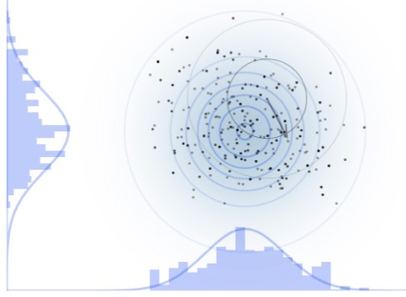
How do we sample efficiently?
[back]
Random walk (Metropolis-Hastings)
Used for most Bayesian sampling to date
For animations, see: McElreath blog entry on sampling and Chi Feng’s Markov-chain Monte Carlo Interactive Gallery

Slide 57
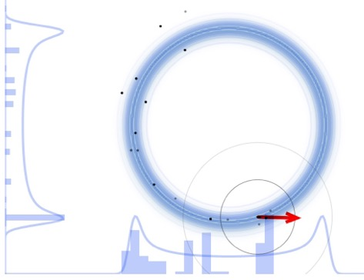
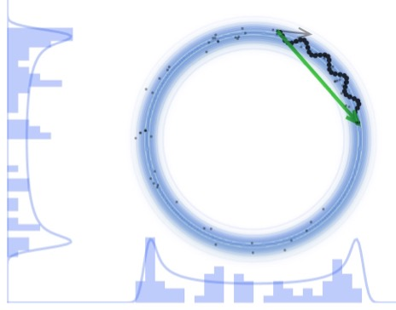
How do we sample efficiently?
[back]
Random walk (Metropolis-Hastings)
Hamiltonian Monte Carlo (HMC)
Used for most Bayesian sampling to date
Recent work by Chalmers group (arXiv:2206.08250) → HMC much more effective for many parameters!
For animations, see: McElreath blog entry on sampling and Chi Feng’s Markov-chain Monte Carlo Interactive Gallery

Slide 58
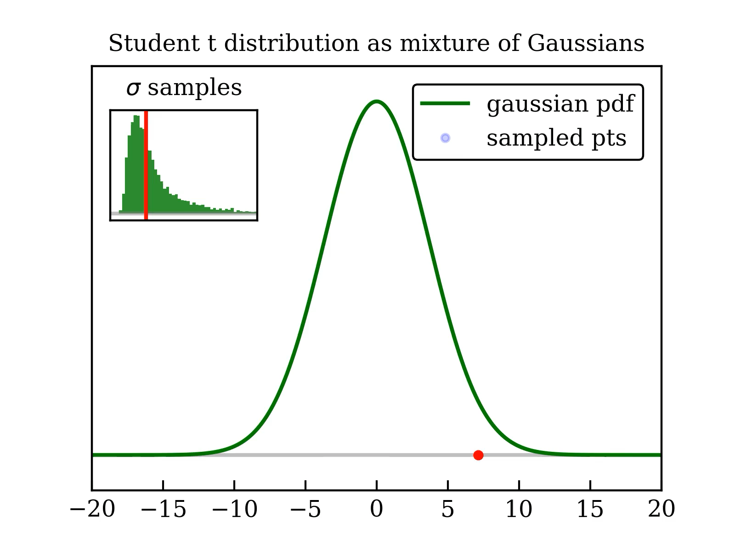
How do student t distributions arise?
Link to blog page
Link to D. Bailey
Posterior for c_{D} and c_{E}
[back]
Correlation of ρ ≈ 0.96 for this χEFT Hamiltonian
Tails are not well approximated by a Gaussian! (But do look like t’s!)
See appendix A of arXiv:2104.04441
Sample pdf with MCMC over 11 NN LECs + c_{D}, c_{E} + Q, c² → marginalize (integrate out) what you are not considering
Notes:
https://stats.stackexchange.com/questions/52906/student-t-as-mixture-of-gaussian/59520#59520

Slide 59



Limits of EFTs: Learning the expansion parameter
[back]
Model:
Melendez et al. (2019):
Expectation:
With
the posterior favors Λ_{b} with same c_{n} variance for all n
Notes:
Consistent with mpi^{eff}/\Lambda_b
Other ways to determine limits? RG? Lepage plots (residuals with experiment as opposed to internal)
{\rm pr}(\Lambda_b | \{y_n\}, y_{\rm ref}) \propto \frac{\rm pr(\Lambda_b)}{\tau^{\nu}\prod_n Q^n}

Slide 60

Limits of EFTs: Learning the expansion parameter
[back]
Melendez et al. (2019):
Model:
Expectation:
Λ_{b} from NN observables
Λ_{b} from infinite matter
With
the posterior favors Λ_{b} with same c_{n} variance for all n
Millican et al., in prep [also Melendez et al., PRC (2017) and PRC (2019).]
SMS
450 MeV
Are different Λ_{b} posteriors consistent? Other ways?
How do correlations affect the estimation of the breakdown scale?
…
Drischler et al., PRC (2020)
Notes:
Consistent with mpi^{eff}/\Lambda_b
Other ways to determine limits? RG? Lepage plots (residuals with experiment as opposed to internal)
{\rm pr}(\Lambda_b | \{y_n\}, y_{\rm ref}) \propto \frac{\rm pr(\Lambda_b)}{\tau^{\nu}\prod_n Q^n}

Slide 61

Limits of EFTs: Learning the expansion parameter
[back]
What about spectra of light nuclei? Convergence pattern obscured at low order by KE vs. PE cancellation. → only use higher orders → Q ≈ 0.3
[consistent with (m_{π})^{eff.}/Λ_{b} (see Ref.) ]
Model:
Expectation:
Q from few-body observables
Q from nuclear energies (A < 8 vs. A ≥ 8)
Wesolowski et al.,
PRC (2021)
Maris, Roth et al.,
PRC (2022)
Notes:
Consistent with mpi^{eff}/\Lambda_b

Slide 62
Light nuclei with semilocal momentum-space regularized
chiral interactions up to [and beyond] N²LO
[back]
LENPIC Collaboration
P. Maris et al.,
PRC 103,
054001 (2021)
arXiv:2104.04441
P. Maris, R. Roth et al.,
PRC 106,
064002 (2022)
arXiv:2206.13303
https://www.lenpic.org/
Consistent NN and 3N potentials to N²LO [2022: NN to N⁴LO]
“Semilocal” to reduce regulator artifacts
c_{E} and c_{D} from ³H binding and Nd diff. cross section minimum
Calculations for few-body and p-shell+ nuclei (NCCI plus SRG)
Bayesian estimates of EFT truncation errors (also method error)
Many results (e.g., overbinding at N²LO and cutoff dependence reduced with higher-order NN; but radii still underpredicted).
c_{E}
c_{D}
Notes:
“Consistent” in multiple senses here: Evgeny will say more

Slide 63

Excitation energies are highly correlated
[back]
Theory minus experiment for selected excitation energies
Empirically: calculated excitation energies are better determined than each level.
Why? If E₁ and E₂ have δy_{th} variance σ², then E₂ – E₁ has 2σ² if uncorrelated but 2(1-ρ)σ² if correlated with ρ!
Plan: learn ρ from y_{th} coefficients c_{n}:
Bayesian 95% intervals for two cutoffs (blue & red)
Model checking: empirical coverage in agreement with experiment if correlations used for errors.
Diagnostic of physics: exceptions in ¹²C and ¹²B point to different theoretical correlations in the nuclear structure.
Higher order: >N²LO enables better estimates of correlations → more insight
Check if ≈95% of bars overlap zero
Coefficients for all the levels
Notes:
Use c3 to learn Q.
Use c2,c3 to learn rho.
Better estimates of correlations and Q.
Look for other opportunities to exploit correlations for physics in other nuclei!

Slide 64

Statistical diagnostics [Melendez et al. (2019), Millican et al. (2024)]
[back]
Mahalanobis distance (MD) squared
  Chi-squared with correlations
Pivoted Cholesky (PC) decomposition
  Indexed breakdown of MD
  linear algebra
Credible interval
  “Do 68% of actual truncation
  errors fall within the 68%
  confidence intervals?”
$Λ_{b}/l_{C}$ posterior pdf
  Uses Bayesian statistics to
  find joint probabilities
Plots of the differential cross section at 150 MeV lab energy generated with the potential from Reinert et al., EPJA (2018)

Slide 65


Workflow
[back]

Slide 66
Goal: maximize benefits – minimize cost (time, money, workforce)
Example: Design of future 𝛾p Compton scattering experiments
What experimental (ω, 𝜃) are most useful for constraining polarizabilities and testing theory?
Given: (1) Present polarizability error bars; (2) experimental constraints; (3) χEFT accuracy decreases as ω↑.
Nucleon polarizabilities from Compton scattering with 𝝌EFT
Griesshammer, McGovern, Phillips, EPJA (2018)
Experiments: HI𝛾S; A2@MAMI
→ tension with 𝝌EFT valid range
What does a Bayesian analysis of experimental design look like?
[J. Melendez et al, Eur. Phys. J. A 57, 3 (2021)]
Notes:
The expected utility eq. (23) of proton differential cross section (dσ) measurements. Colors indicate
the utility of one measurement conducted at each kinematic point (ωlab, θlab), with the point of largest utility UKL being
by definition the optimal 1-point design. (The color bar is on a linear scale, though the hue varies much more quickly for
small UKL.) The top row (with the red, “No δyth” box) does not include EFT truncation estimates, whereas the bottom
row does include the EFT uncertainty. Each column shows the utility one could expect to achieve for a subset of the proton
polarizabilities: the first column considers all polarizabilities together, while the second and third show the gain for αE1 ± βM 1
individually, and the final column reflects the collective information to be learned about the four spin polarizabilities {γi}. The
interior box that excludes ω < 60 MeV along with forward and backward angles marks the experimentally accessible regime (see
text for further discussion). The vertical line marks the cusp at the pion-production threshold. To visualize the full range of
variation in the subplots, the color ranges from zero to a saturation point calculated by averaging the optimal utilities across all
subplots. Contour lines are added for utilities above the saturation point, with the first contour at saturation and subsequent
contour lines at intervals of 50% of the color range, see the top left subplot. To help visualize the utilities from less-constraining
measurements, additional contours are added to any subplot whose maximum utility is less than 10% of the color range, see,
e.g., fig. 6. Unless otherwise stated, the color ranges are common to all subplots within a figure, but different between figures.
The white circles with black borders show the optimal five-point design kinematics, as described in the text. The effect of
including EFT truncation errors is striking: it shifts the region of optimal utility to lower energies and moderates the expected
utility.
\documentclass[10pt]{article}
\usepackage[usenames]{color} %used for font color
\usepackage{amssymb} %maths
\usepackage{amsmath} %maths
\usepackage[utf8]{inputenc} %useful to type directly diacritic characters
\newcommand{\design}{{\color{blue}\mathbf{d}}}
\DeclareMathOperator*{\argmax}{arg\,max}
\newcommand{\shrinkage}{\mathcal{S}}
\newcommand{\omegalab}{\omega_{\text{lab}}}
\newcommand{\given}{\,|\,} % Use for | in \pr
%\DeclareMathOperator{\pr}{pr} % Good, but want to handle sizing and | spacing?
\DeclareMathOperator{\pr}{p} % Good, but want to handle sizing and | spacing?
% Now add spacing:
% Derivatives
\newcommand{\dd}{d}
\newcommand{\diffcs}{d\sigma} % differential cross section
\newcommand{\genobs}{y}
\newcommand{\genobsset}{{\color{green}\inputvec{\genobs}}}
\newcommand{\inputvec}{\mathbf}
\newcommand{\lecs}{{\color{red}\vec{a}}}
\mbox{Utility of {\color{blue}design}: }& \mbox{information gain averaged over {\color{red}parameters} and {\color{green}measurements}}
\\
U_{\text{KL}}(\design)
& = \int \!\!\left\{ \ln\!\!\left[\frac{\pr(\lecs \given \genobsset, \design)}{\pr(\lecs)}\right]\! \pr(\lecs \given \genobsset, \design) \dd{\lecs}\right\}\!
\pr(\genobsset \given \design) \dd{\genobsset} \quad\mbox{(cf.\ entropy)} \\
& \longrightarrow \frac{1}{2} \ln \frac{|V_0|}{|V(\design)|} \equiv \ln\shrinkage(\design) \quad\mbox{``Posterior shrinkage''}

Slide 67
Experimental design: A case study
Maximize benefits – minimize cost (time, money, workforce)
Nucleon polarizabilities from Compton scattering with ChiEFT
[Harald Griesshammer, Judith McGovern, Daniel Phillips, EPJA (2018)]
How do constituents of the nucleon react to external fields?
How to reliably extract proton, neutron, spin polarizabilities?
How to plan effective experiments and test theory?
Experiments: HI𝛾S; A2@MAMI → tension with ChiEFT valid range

Slide 68
Optimizing the design of future Compton scattering experiments
How to plan effective experiments & test theory? What (ω, 𝜃) are most useful for constraining?
Ingredient: Calculate a utility function for sum of variances for each kinematic point on a grid.
Apply to decide on trade-off between different allocations of experimental resources (exploration vs. exploitation).
1-point vs 5-point?
Increase precision or more points?
J. Melendez et al. (in prep.)

Slide 69
Correlated theory errors for EOS properties
C. Drischler et al.
PRL (2020); PRC (2020)
at 0.17 ± 0.01 fm³
Correlated GP treatment gives better estimates for truncation errors and clean propagation of uncertainties to derived quantities.
[back]

Slide 70

Role of emulators: new workflows for complex applications
From Xilin Zhang, rjf, Fast emulation of quantum three-body scattering, Phys. Rev. C 105, 064004 (2022).
See also Drischler and Zhang, Few-Body Emulators Based on Eigenvector Continuation, in Few-Body Syst. (2022).
If you can create fast & accurate™ emulators for observables, you can do calculations without specialized expertise and expensive resources!
Notes:
Emulators run fast, often with a small memory footprint, and can be easily shared. These properties make emulators effective interfaces for large expensive calculations, through which uses can access sophisticated physical models at a minimum cost of computational resources and without specialized expertise, creating a more efficient workflow for nuclear science. As such, emulators can become a collaboration tool that can catalyze new direct and indirect connections between different research areas and enable novel studies

Slide 71

RBM references for more information
References with nuclear applications (with pointers to the broad RBM literature):
  Eigenvector Continuation and Projection-Based Emulators (Duguet et al., 2024)
  BUQEYE Guide to Projection-Based Emulators in Nuclear Physics (Drischler et al., 2022)
  Model reduction methods for nuclear emulators (Melendez et al., 2022)
  Training and Projecting: A reduced basis method emulator for many-body physics (Bonilla et al., 2022)
  Bayes goes fast: Uncertainty Quantification for a Covariant Energy Density Functional emulated by the Reduced Basis Method (Giuliani et al, 2023)
  ROSE: A reduced-order scattering emulator for optical models (Odell et al., 2024)
Jupyter and Quarto books for nuclear applications:
  BUQEYE Guide to Projection-Based Emulators in Nuclear Physics
  Reduced Basis Methods in Nuclear Physics
Websites:
  BAND (Bayesian Analysis of Nuclear Dynamics)
  BUQEYE (Bayesian Uncertainity Quantification: Errors for Your EFT)
Slides:
https://go.osu.edu/ws2024

Slide 72


Summary of key RBM elements
Vast range of problems have been attacked with RBM in science and engineering, including heat transfer, fluid dynamics, electronic DFT, …→ coupled ode’s and pde’s (incl. time-dependent and nonlinear); eigenvalue problems; and more!
There’s likely something out there in the RBM literature analogous to what you do!
Large speed-ups from offline-online paradigm if heavy compute resources are offline.
→ move size-ψ operations offline so that emulation varying $\text{θ}$ online is efficient.
Key: exploit affine parameter dependence in operators, e.g.,
For non-linear systems and non-affine parameters, use hyper-reduction methods.
Projection-based: (i) choose low-dimensional rep. of $ψ and$ (ii) write in integral form.
For (i): with X found offline.
Snapshot approaches: construct X from high-fidelity solutions $ψi= ψ(\text{θ}$_{i}) at set {θ_{i}}.
Notes:
* A comment on my personal eigenvector continuation experience: just hearing about the general snapshot concept and its role in a variational formulation was enough to drive the application to scattering. This could have come from many other fields where the applications have little in common.
In the MOR literature, the parameters are denoted by \mu, not \theta.
Here \psi could be a few- or many-body wave function, any quantities determined in a differential equation (e.g., in relativistic viscous hydrodynamics), etc. Or any eigenvalue problem.
Projection-based is a large class, but not everything!
For the large-size (”full-order model”) \psi, we can think of a discretized version of a solution within \Omega.
{\color[rgb]{0.000111,0.001760,0.998218}D(\psi;\thetavec) = 0 \underbrace{\,\mbox{in } \Omega\,}_{\text{\red domain}}; \ B(\psi;\thetavec) = 0 \underbrace{\,\mbox{on }\Lambda\,}_{\text{\red boundary}}}
H(\thetavec)|\psi\rangle = E |\psi\rangle
H(\thetavec) = \sum_n h_n(\thetavec) H_n
\tilde\psi(\thetavec) \equiv \sum_{i=1}^{N_b} \beta_i\psi_i = X\vec\beta, \ \ X \equiv[\psi_1\, \psi_2\, \cdots\, \psi_{N_b}]
\tilde\psi(\thetavec) \equiv \sum_{i=1}^{N_b} \beta_i\phi_i = X\vec\beta, \ \ X \equiv[\phi_1\, \phi_2\, \cdots\, \phi_{N_b}]

Slide 73
Lexicon for Model Order Reduction (MOR)
Term | Definition or usage
High fidelity | Highly accurate, usually for costly calculation [Full-Order Model (FOM)]
Reduced-order model | General name for an emulator resulting from applying MOR techniques.
Intrusive | Non-intrusive treats FOM as black box; intrusive requires coding.
Offline-online paradigm | Heavy compute done once (offline); cheap to vary parameters (online).
Affine | Parameter dependence factors from operators, e.g.,
Snapshots | High-fidelity calculations at a set of parameters and/or times.
Proper Orthogonal Decomposition (POD) | Generically the term POD is used for PCA-type reduction via SVD. In snapshot context, PCA is applied to reduce/orthogonalize snapshot basis.
Greedy algorithm | Serially find snapshot locations $\text{θ}$_{i} at largest expected error (fast approx.).
Reduced basis methods | Or RBMs. Implement snapshot-based projection methods.
Hyper-reduction methods | Approximations to non-linearity or non-affineness (e.g., EIM).

Slide 74

Snapshot RBM emulators for nuclear observables
Ground-state eigenvectors from a selection of parameter sets is an extremely effective variational basis for other parameter sets.
Characteristics: fast & accurate! Scales!
Emulator residuals for
energies, radii, lifetimes
3N force constraints, Wesolowski et al. (2021)
⁴He energy
EC from Frame et al., (2018)
EC as emulator: König et al. (2020)
Using emulator doesn’t require specialized calculations!

Slide 75


Challenges of nuclear many-body theory
Tremendous progress in ab initio calculations with multiple many-body methods
Precision calculations need uncertainty quantification but calculations are expensive
Largest uncertainties from Hamiltonian (2N + 3N forces)
Systematic EFT expansion but many parameters to determine → not best fits but distributions
Constrained by chiral symmetry
Notes:
\newcommand{\param}{\theta}
\newcommand{\params}{\boldsymbol{\theta}}
\newcommand{\red}[1]{{\color{red}#1}}
\red{\frac{Q}{\Lambda_b} \approx \frac{\{{\rm momentum}, m_\pi\}}{600\,{\rm MeV}}}
\wh H(\params) &= \wh H_0 + \red{\param^{(1)}} \wh V_1 \\ & \quad + \red{\param^{(2)}} \wh V_2 + \red{\param^{(3)}} \wh V_3 + \cdots

Slide 76


J. Melendez
C. Drischler
RBM emulators for NN and 3N scattering
NN scattering by rjf et al., PLB (2020) using the Kohn variational principle.
Improved by Drischler et al., PLB (2021) (e.g., mitigate Kohn anomalies).
Two-body emulation w/o wfs by Melendez et al., PLB (2021).
NN phase shifts
for χEFT potential (SMS)
A. Garcia
X. Zhang
3-body scattering?
E.g, for Bayesian χEFT LEC estimation.
→ X. Zhang, rjf proof of principle (2022).
A. Garcia et al., arXiv:2301.05093
Notes:
Developments at top were proof of principle until NVP

Slide 77
RBM emulators for NN scattering in chiral EFT (affine!)
Compare three implementations
A. Garcia et al., PRC 107 (2023)
NN phase shifts
for χEFT potential (SMS)
Notes:
Note that coupled channel emulators are independent!

Slide 78

RBM emulators for non-affine scattering problems
Nuclear ROSE in BAND Framework v0.3.
Reduced Order Scattering Emulator can handle local, complex, non-affine interactions. [Future: non-local, …]
[back]
Strategy: convert non-affine to affine → hyper-reduction methods
Example: calibrating phenomenological optical potential with EIM
Scattering → Galerkin projection but potential is non-affine in the parameters to fit ( ):
Problem: U doesn’t factor into products of r and 𝞱 functions, so integrals between test and basis functions have to be calculated every time → no offline-online speed-up!
Notes:
\params = \{V_v, \red{R_v}, \red{a_v}, \ldots\}

Slide 79


RBM emulators for non-affine scattering problems
Nuclear ROSE in BAND Framework v0.3.
Reduced Order Scattering Emulator can handle local, complex, non-affine interactions. [Future: non-local, …]
[back]
Strategy: convert non-affine to affine → hyper-reduction methods
Example: calibrating phenomenological optical potential with EIM
Scattering → Galerkin projection but potential is non-affine in the parameters to fit:
⇒
Notes:
Developments at top were proof of principle until NVP

Slide 80

RBM emulators for non-affine scattering problems
Nuclear ROSE in BAND Framework v0.3.
Reduced Order Scattering Emulator can handle local, complex, non-affine interactions. [Future: non-local, …]
[back]
  [Odell et al., PRC (2024)]
Notes:
Developments at top were proof of principle until NVP

Slide 81

Use as informative priors as is reasonable
Priors can help mitigate non-identifiability and overfitting; e.g., naturalness prior for EFT,
cf. regularization in ML.
Essential to have informative priors for model discrepancy (MD) if extracting physical parameters [Brynjardottir and O’Hagen (2014)]
Interpolation works with MD but extrapolation fails
Accurate physical 𝜃 found only with constrained GP

