Slide 1
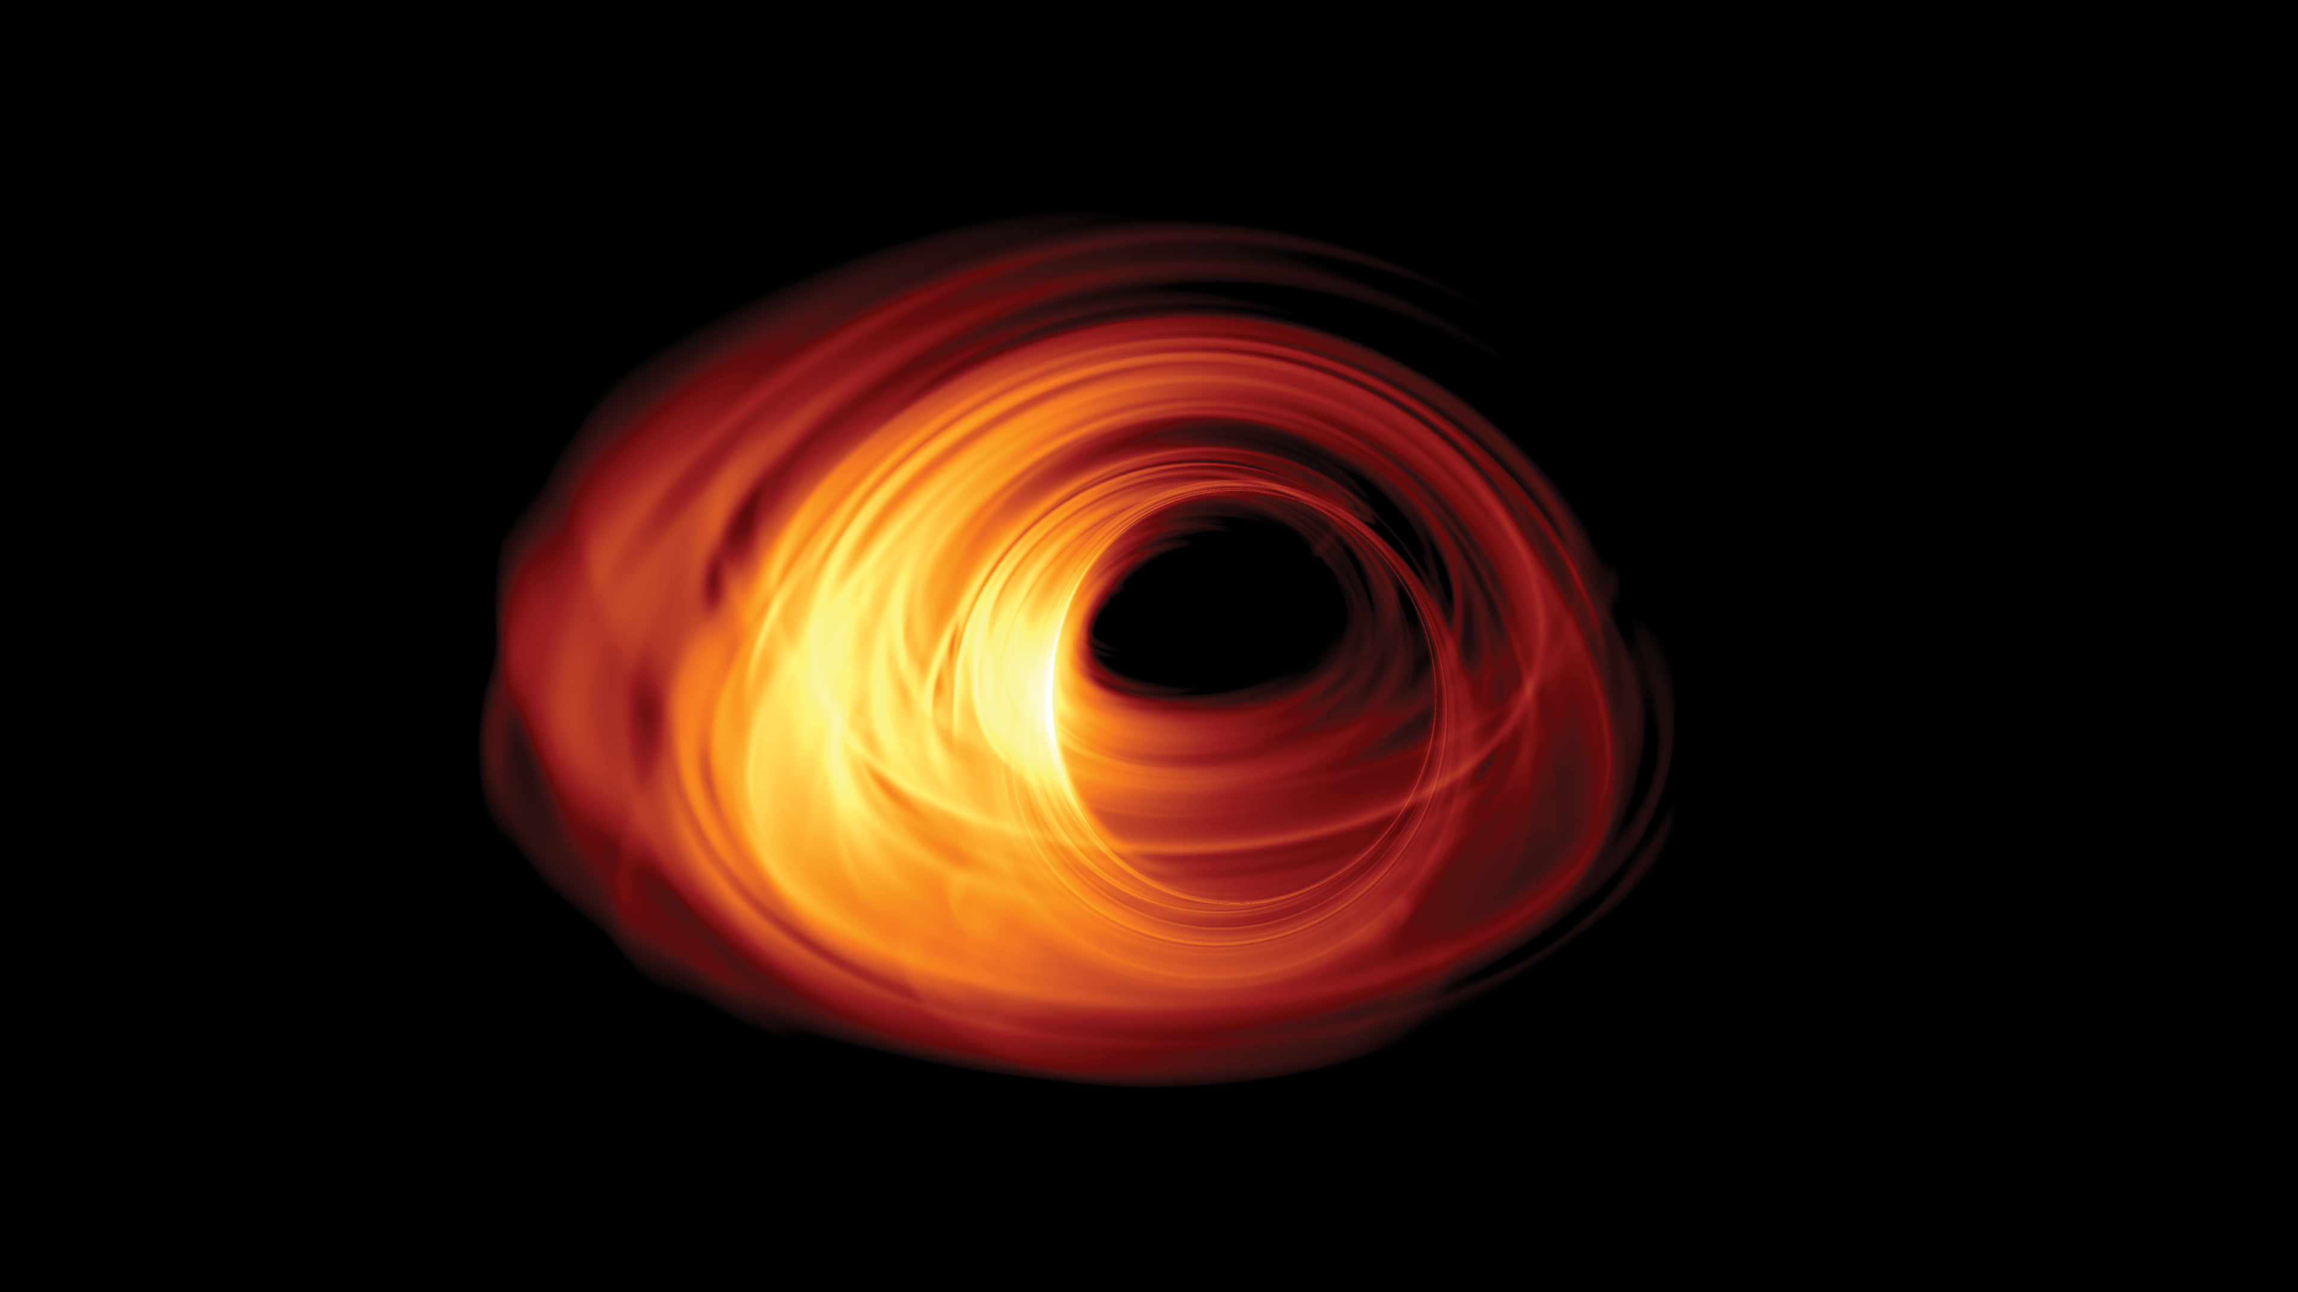
Physics at the Event Horizon
Event Horizon Telescope Collaboration (2019-2022)
De Kleuver et al. (2023), A&A, in prep.
Wondrak, van Suijlekom, & Falcke (2023), Phys. Rev. Lett., in press
Heino Falcke¹
with Michael Wondrak^{1,2} & Walter van Suijlekom² ¹ Dept. Astrophysics ² Dept. Mathematics
Institute for Mathematics, Astrophysics, & Particle Physics (IMAPP) Radboud University, Nijmegen
@hfalcke
@hfalcke@mastodon.social
Image: Simulation by T. Bronzwaer
Notes:
3.5.2022 Planetarium Nürnberg

Slide 2
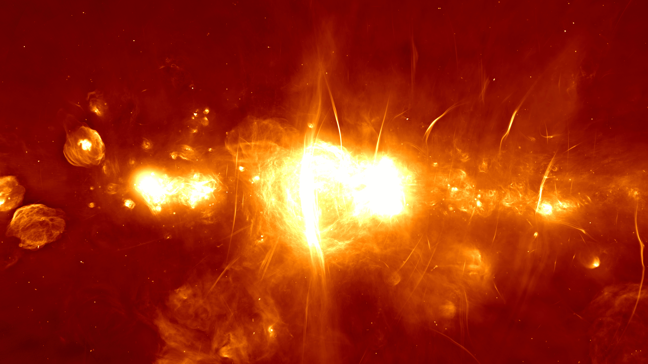
Central parsec in radio
VLA: Zhao & Morris
Sgr A*: Balick & Brown (1974)
Sgr A*
0.5°~ 75 pc ~ 240 ly
MeerKat (SouthAfrica)
Heywood et al. (2019)

Slide 4
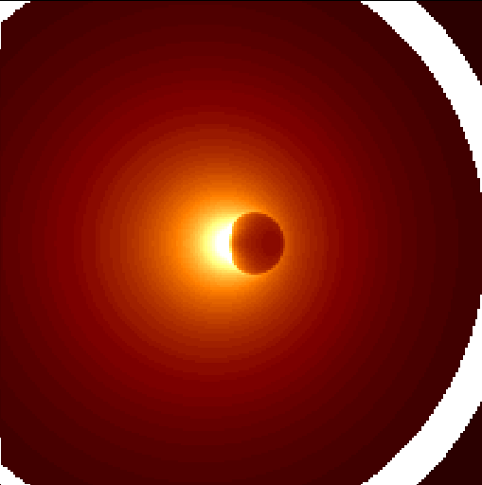
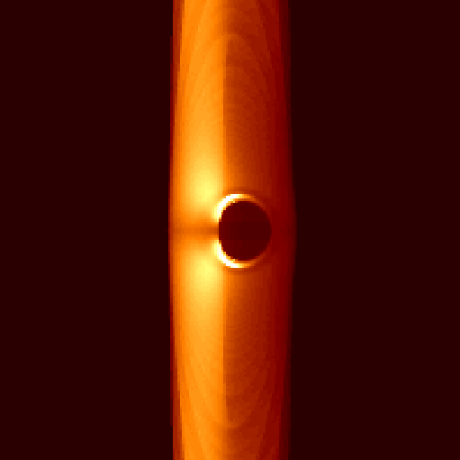
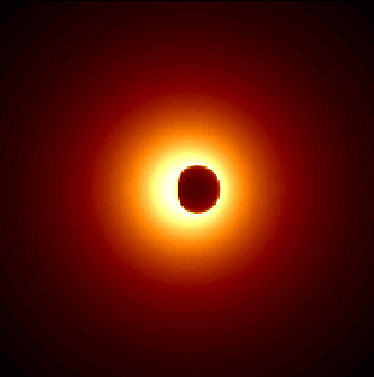
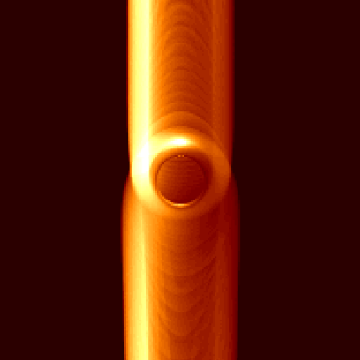
The Black Hole Shadow
If you surround a black hole with an optically thin emission region, you will see a “shadow” that is robust against variations of spin and astrophysical model!
Infall: a=0.998 i=90º I=r⁻²
Jet: a=0.998 i=90º I=hollow
Infall, no rot.: a=0.998 i=90º I=r⁻²
Jet: a=0 i=45º I=hollow
Falcke, Melia, Agol (2000, ApJL & AIPC 522, 317)
(original slide from 2000…)

Slide 5
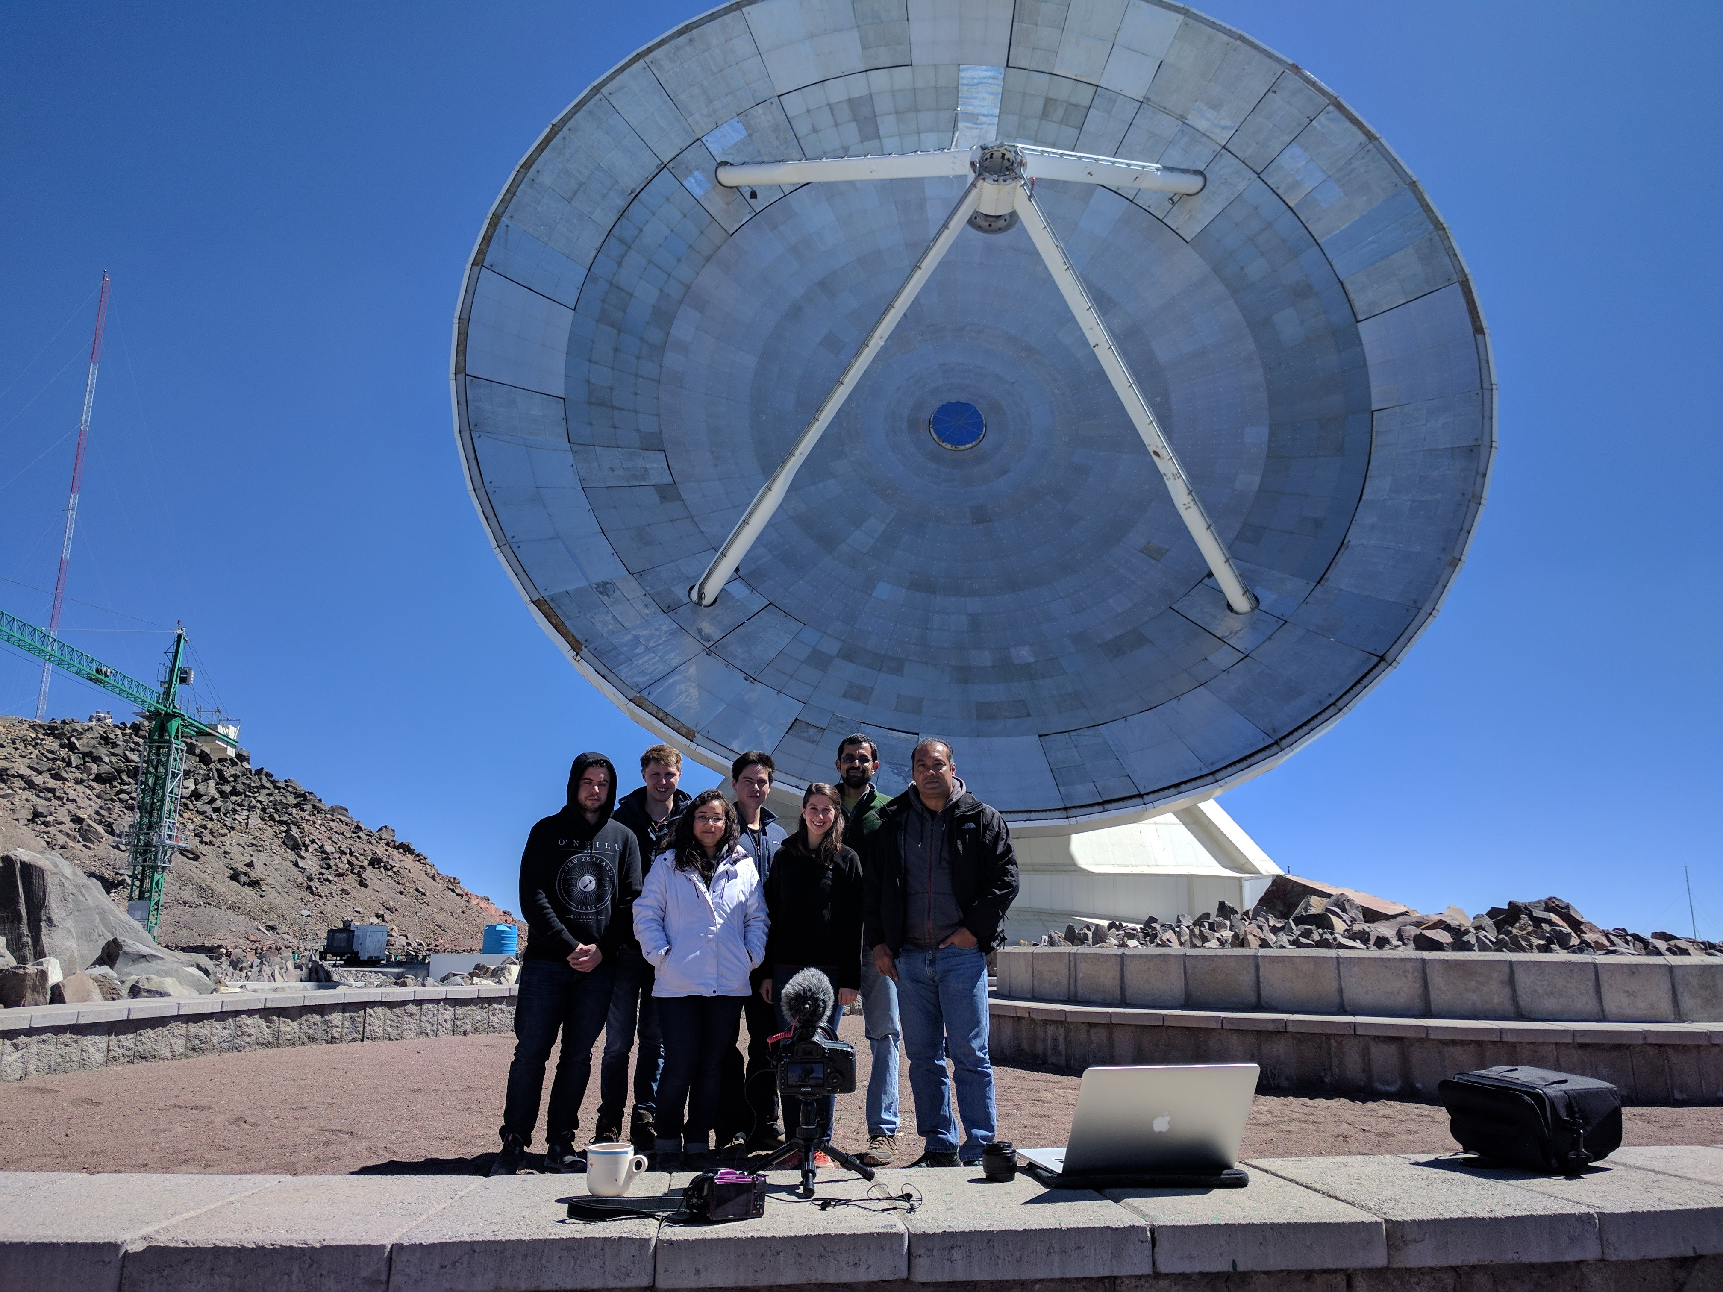
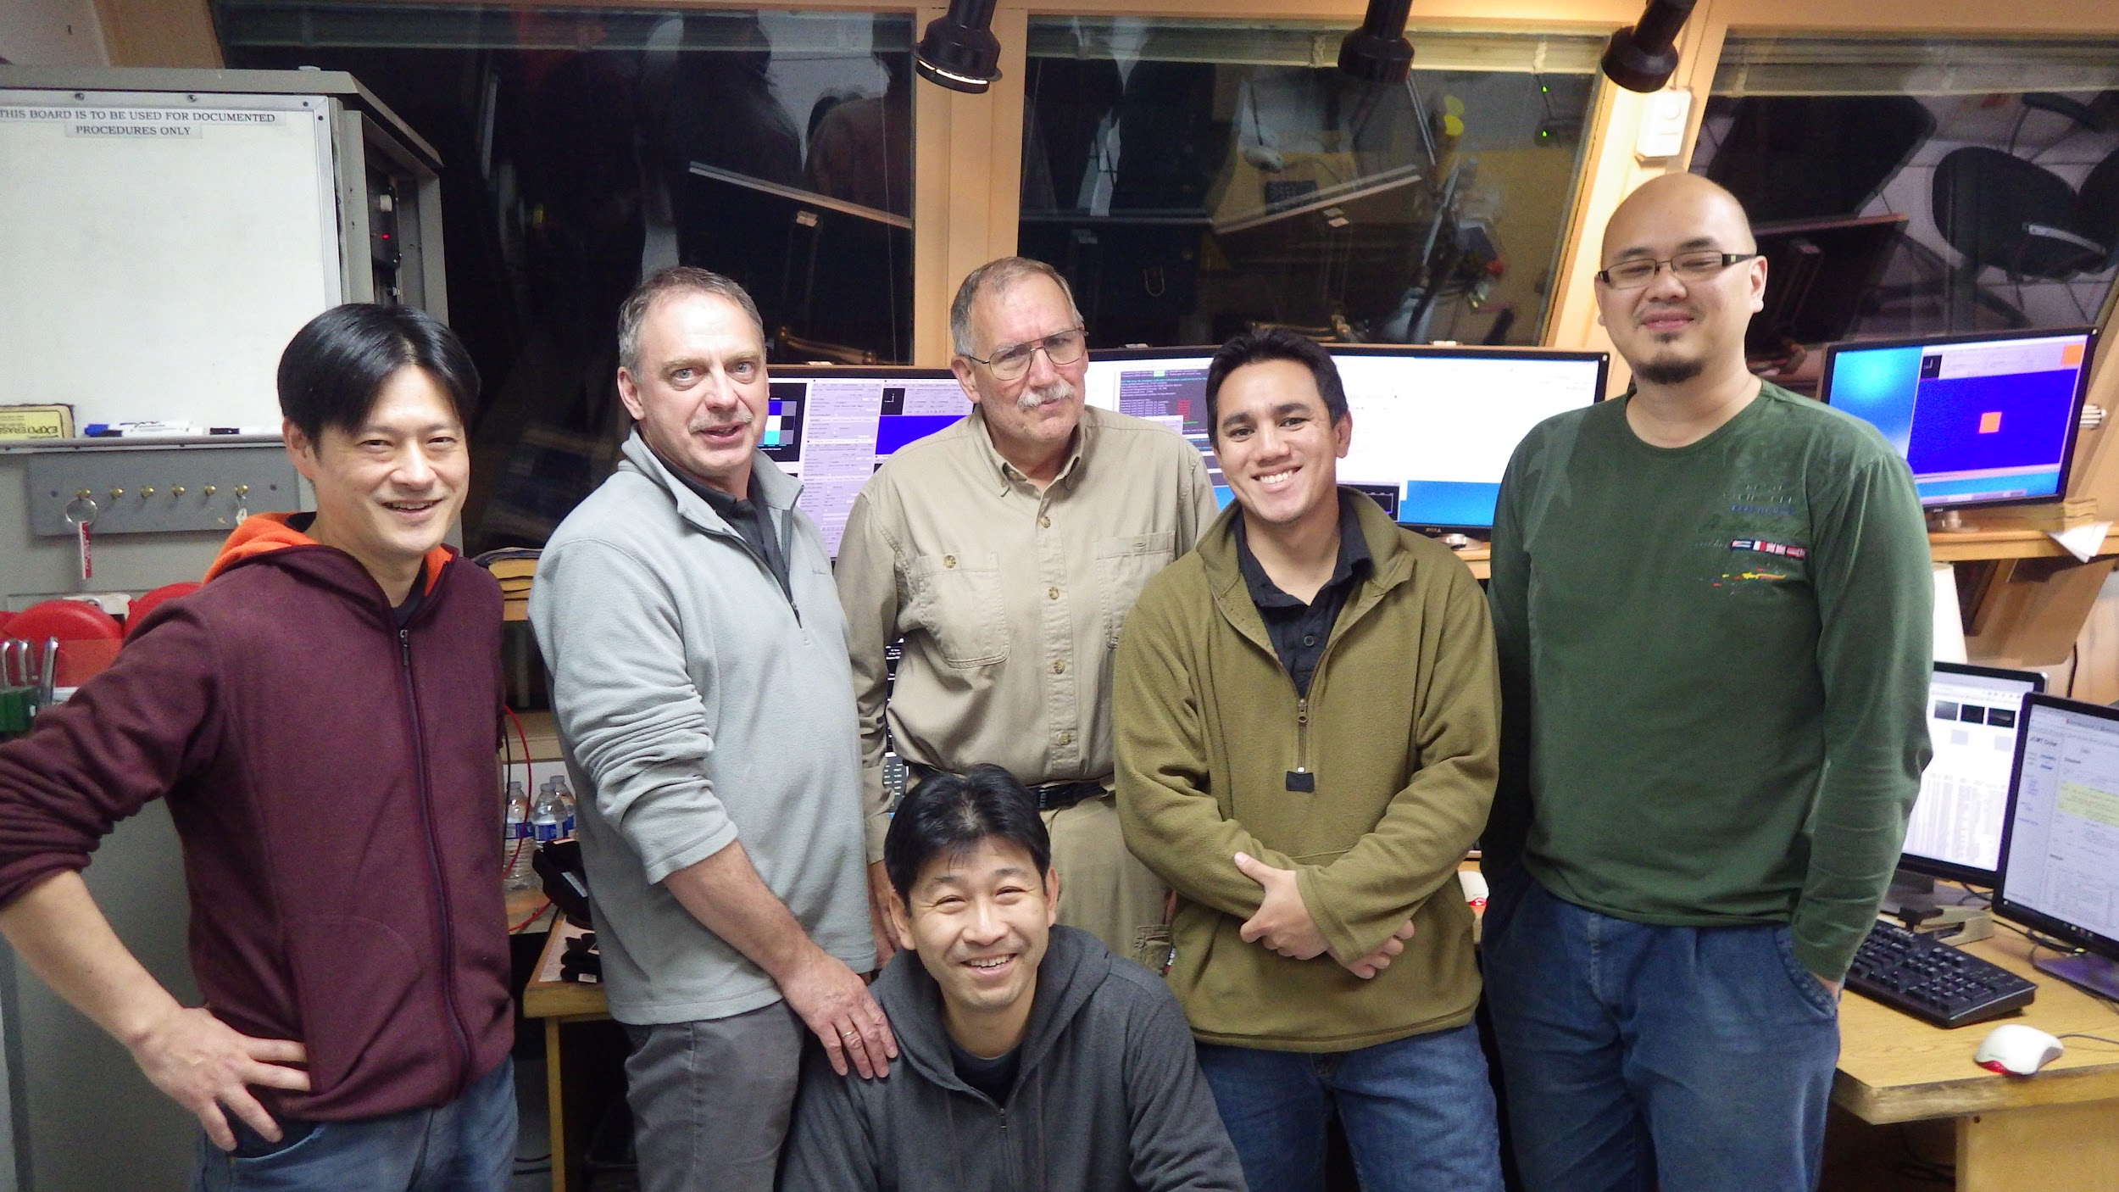
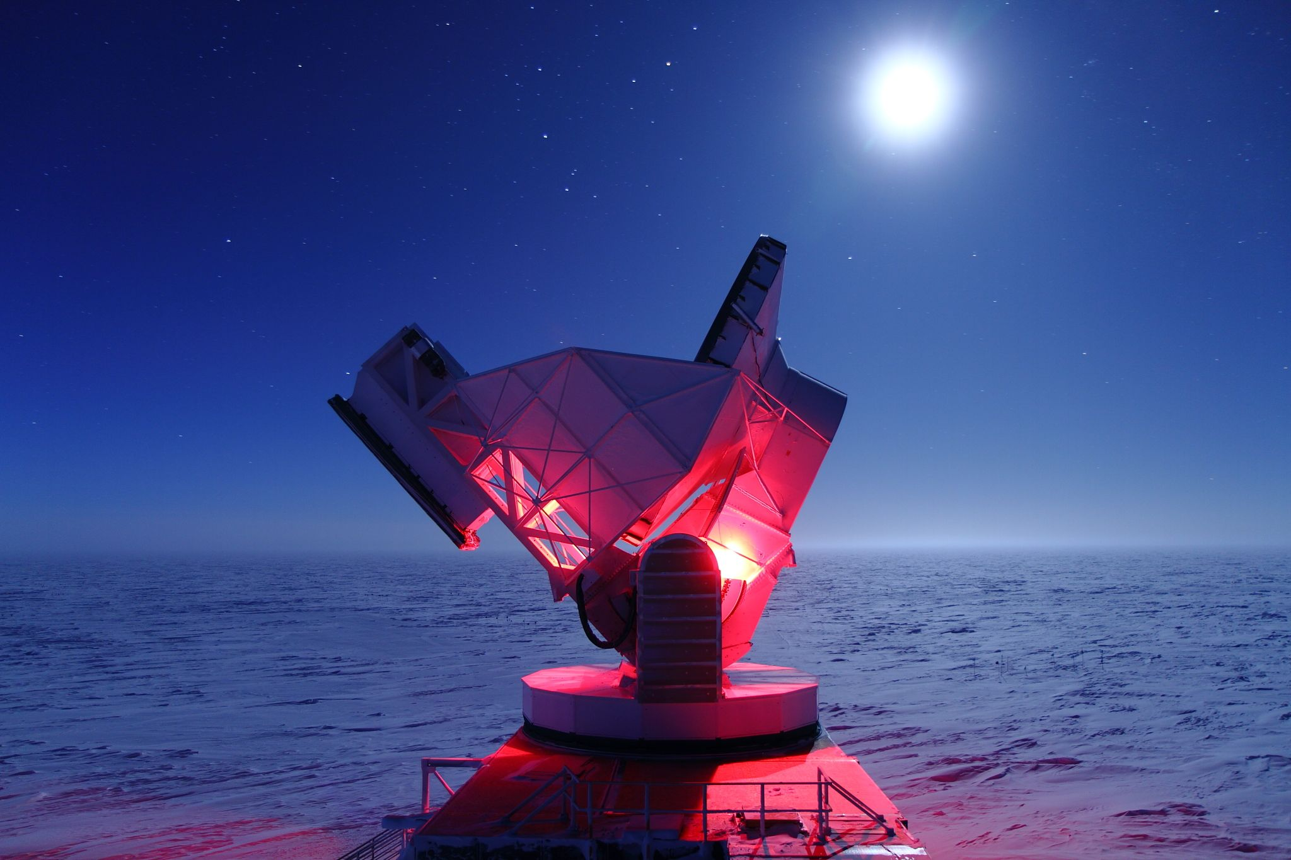
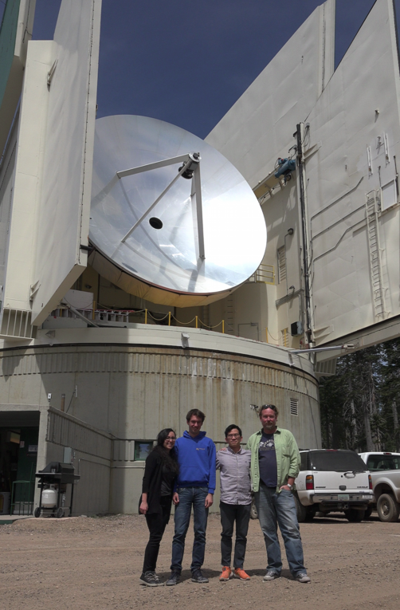
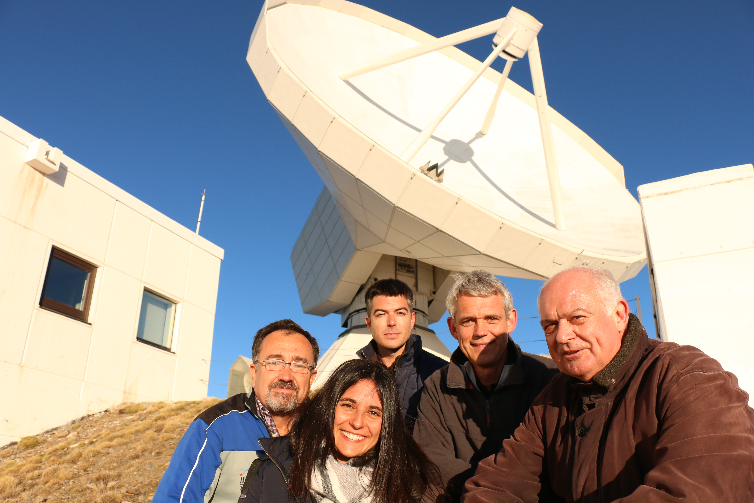
Hawaii
Mexico
Southpole
April 2017
Chile
Spain
Arizona

Slide 6
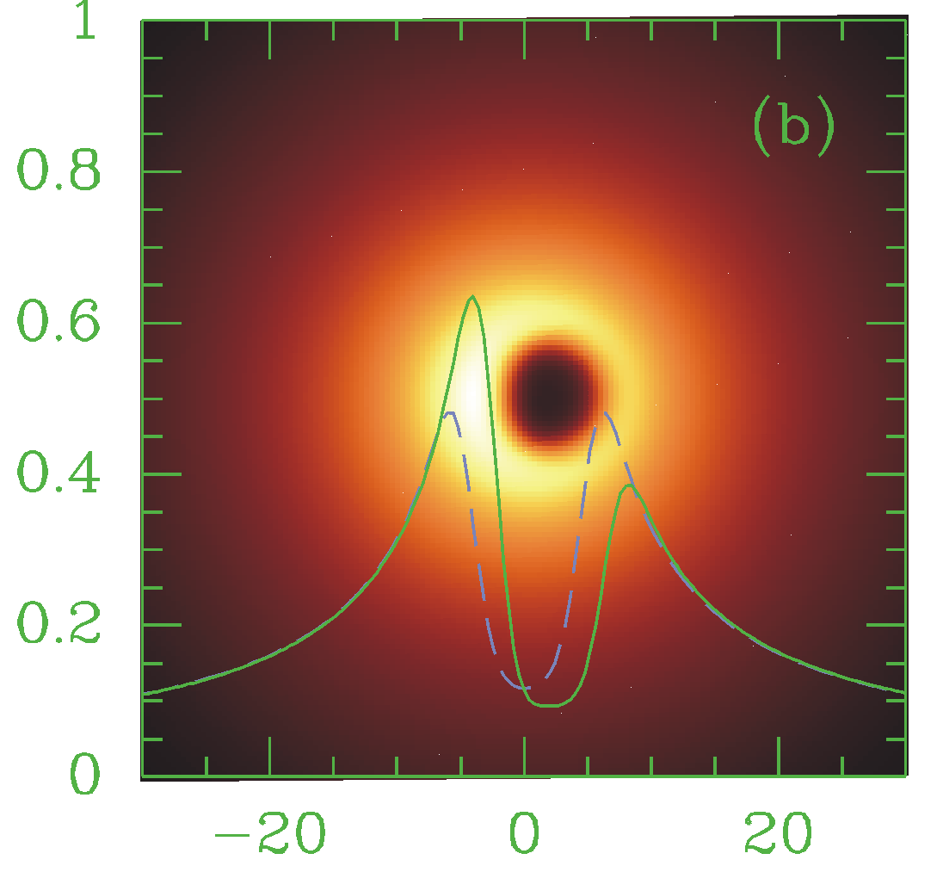
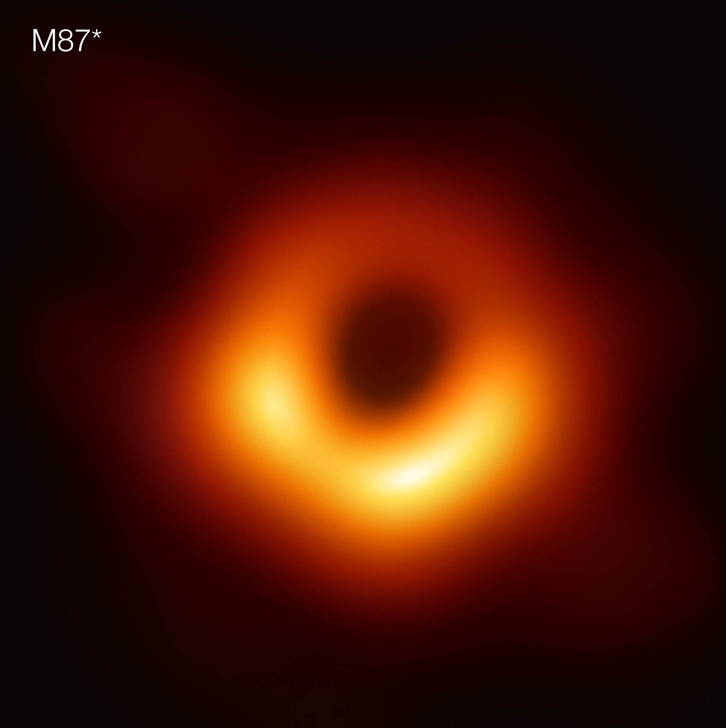
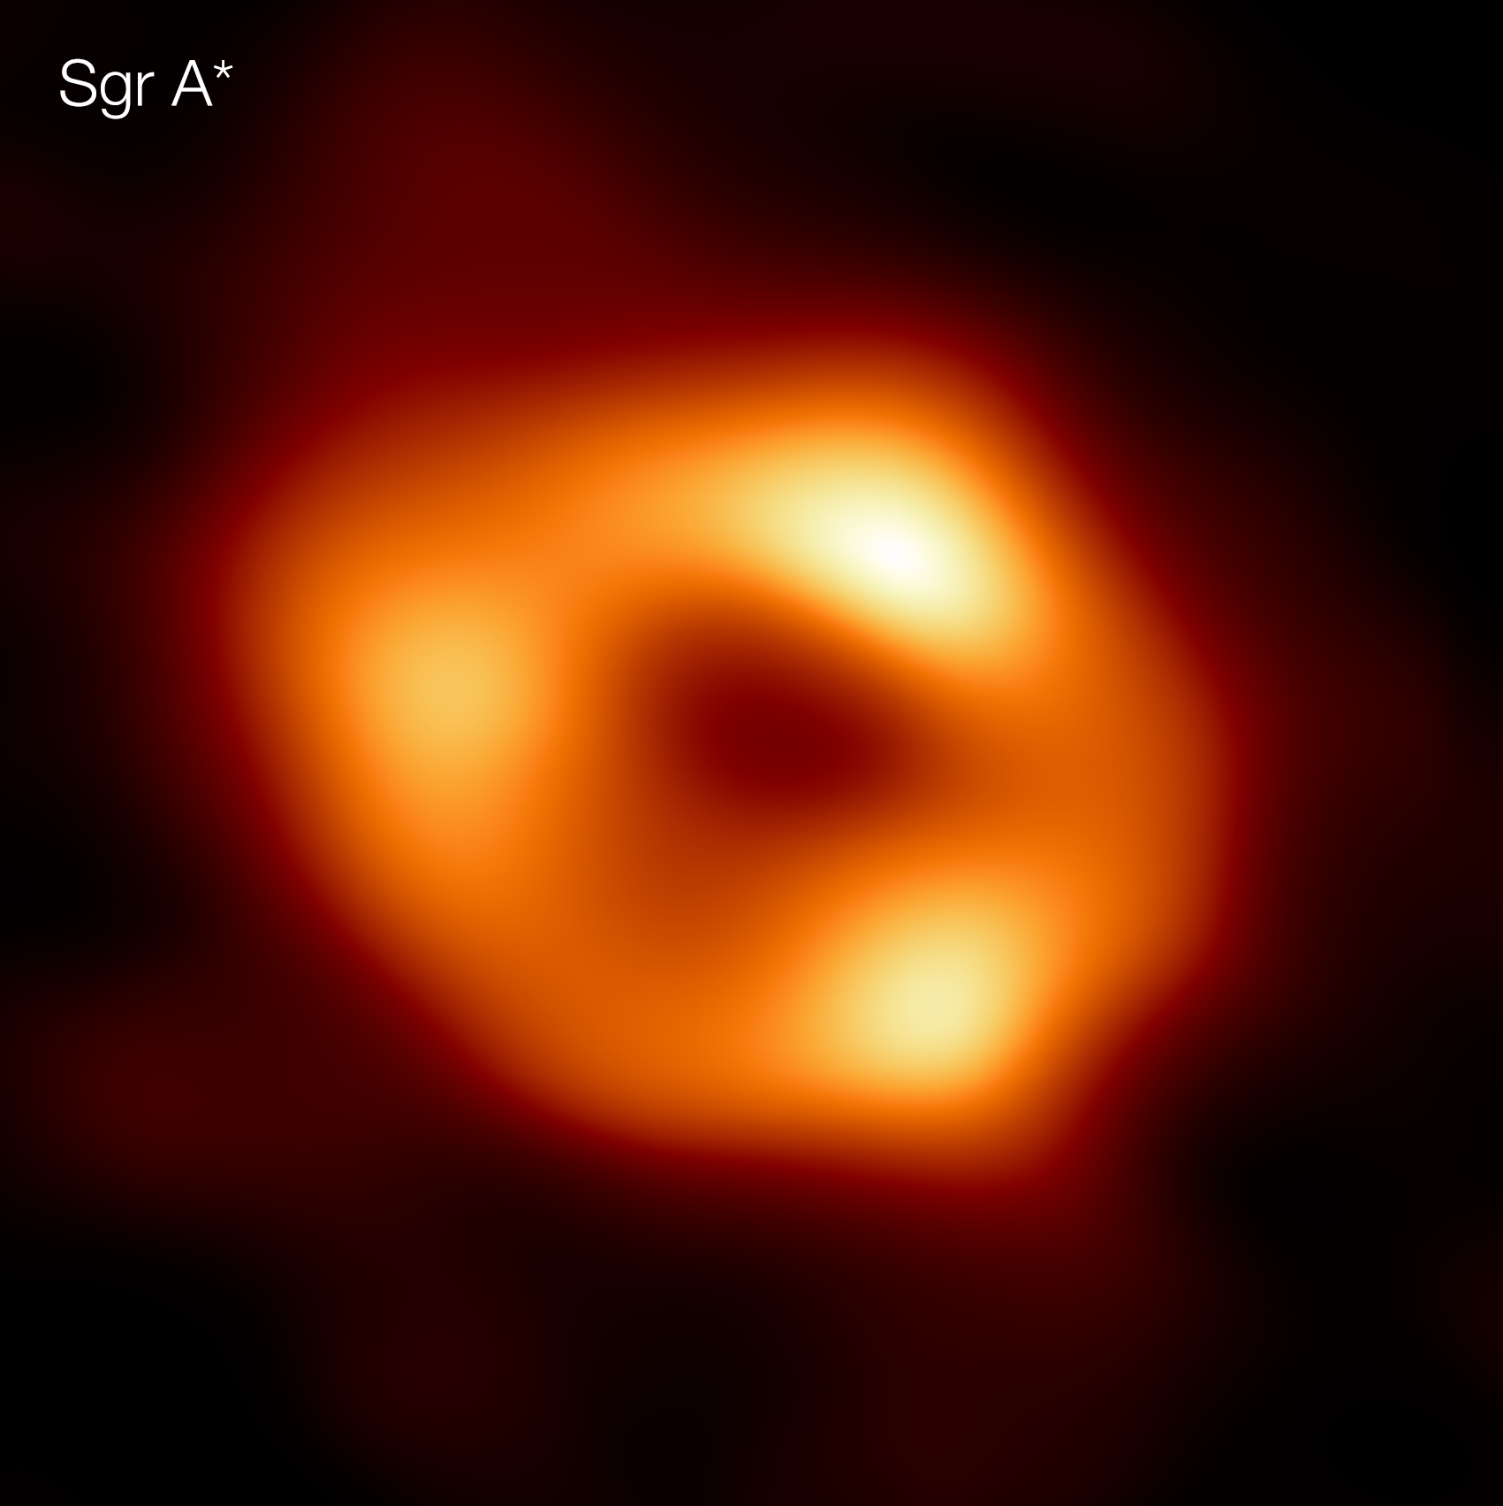
Event Horizon Telescope Images
Giant galaxy (M87*)
Our Milky Way (Sgr A*)
Mass: 6 billion × mass of sun
Mass: 4 million × mass of sun
model prediction
12 days
12 min
Sun
Sun
Neptune’s orbit
Falcke et al. (2000)
EHT (2019)
EHT (2022)
Mercury’s orbit
EHT (2019)
EHT (2022)
Notes:
Bring books with EHT science papers 1000+ pages …

Slide 7
All you need to know is mass ...
Testing the scale invariance of general relativity over 8 orders of magnitude.
(Prediction – not a fit!)
Based on Psaltis et al. (2020, PRL, 2021, Phys. Rev. D)
Notes:
FIG. 8. Comparison of the correlated posteriors over the
two PN parameters 1 and 2 as inferred from the black-hole
shadow test (green slanted contours) and the two coalescing
events GW170608 (blue) and GW190924 021846 (orange).
The blue and orange contours show the 1-, 2-, and 3- credible
regions. For both tests, we assume that the 3PN parameter
j3j < 10 and all higher-order PN parameters introduce negligible
corrections. Because of a fortuitous coincidence, the inspiral
tests for binary black holes with a total mass of 20M
and detectors with a peak sensitivity around 100 Hz lead
to correlated uncertainties that are parallel to those of the
black-hole shadow tests. The dashed lines indicate the expected
correlation from Eq. (61). The red curve indicates the
expected correlation for a binary black hole system with a low
total mass of 6M. The detection of such a binary system
can assist in breaking the degeneracies between the deviation
parameters.

Slide 8
All you need to know is mass ...
Testing the scale invariance of general relativity over 8 orders of magnitude.
LIGO/VIRGO
(Prediction – not a fit!)
Based on Psaltis et al. (2020, PRL, 2021, Phys. Rev. D)
Notes:
FIG. 8. Comparison of the correlated posteriors over the
two PN parameters 1 and 2 as inferred from the black-hole
shadow test (green slanted contours) and the two coalescing
events GW170608 (blue) and GW190924 021846 (orange).
The blue and orange contours show the 1-, 2-, and 3- credible
regions. For both tests, we assume that the 3PN parameter
j3j < 10 and all higher-order PN parameters introduce negligible
corrections. Because of a fortuitous coincidence, the inspiral
tests for binary black holes with a total mass of 20M
and detectors with a peak sensitivity around 100 Hz lead
to correlated uncertainties that are parallel to those of the
black-hole shadow tests. The dashed lines indicate the expected
correlation from Eq. (61). The red curve indicates the
expected correlation for a binary black hole system with a low
total mass of 6M. The detection of such a binary system
can assist in breaking the degeneracies between the deviation
parameters.

Slide 9
All you need to know is mass ...
Testing the scale invariance of general relativity over 8 orders of magnitude.
LIGO/VIRGO
(Prediction – not a fit!)
Based on Psaltis et al. (2020, PRL, 2021, Phys. Rev. D)
Notes:
FIG. 8. Comparison of the correlated posteriors over the
two PN parameters 1 and 2 as inferred from the black-hole
shadow test (green slanted contours) and the two coalescing
events GW170608 (blue) and GW190924 021846 (orange).
The blue and orange contours show the 1-, 2-, and 3- credible
regions. For both tests, we assume that the 3PN parameter
j3j < 10 and all higher-order PN parameters introduce negligible
corrections. Because of a fortuitous coincidence, the inspiral
tests for binary black holes with a total mass of 20M
and detectors with a peak sensitivity around 100 Hz lead
to correlated uncertainties that are parallel to those of the
black-hole shadow tests. The dashed lines indicate the expected
correlation from Eq. (61). The red curve indicates the
expected correlation for a binary black hole system with a low
total mass of 6M. The detection of such a binary system
can assist in breaking the degeneracies between the deviation
parameters.

Slide 10
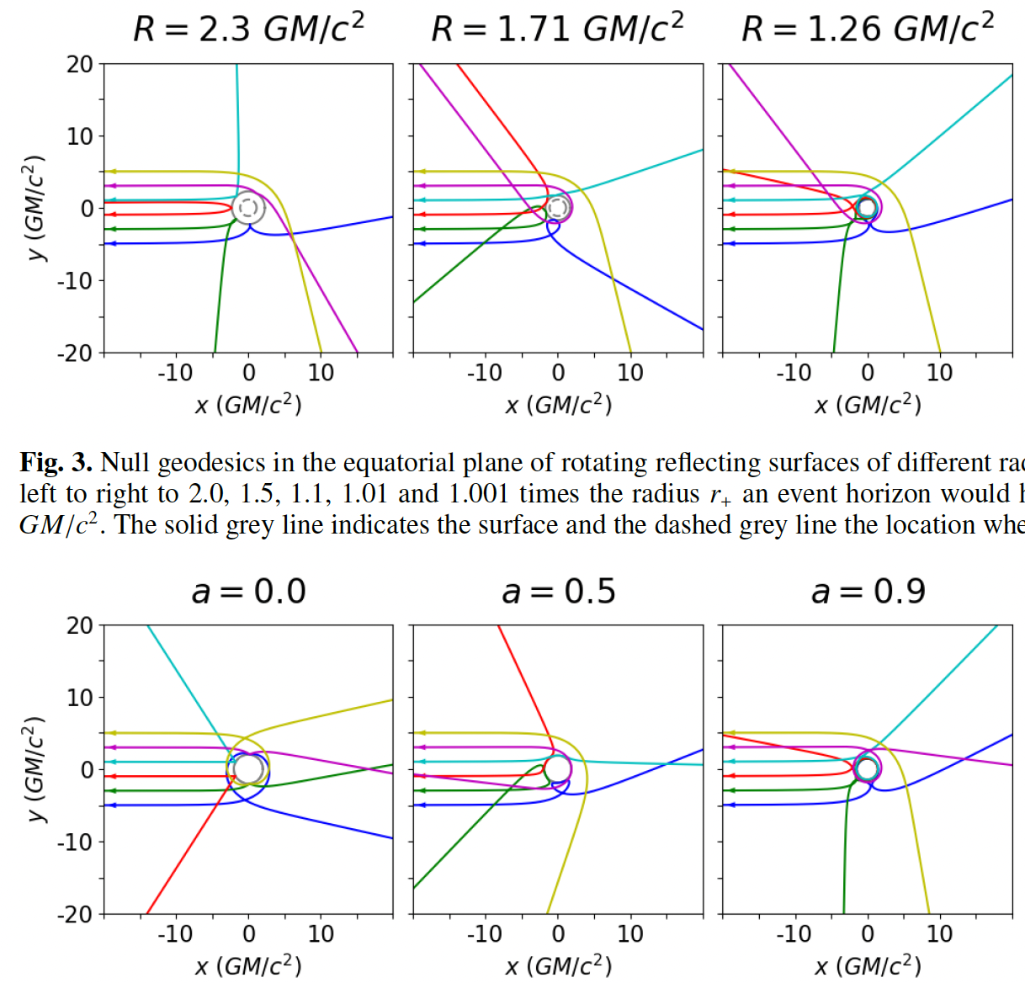
Testing for an event horizon: Reflecting Surfaces
spin a=0.9
R(surface)=1.01 R_{g}
de Kleuver, Bronzwaer, Falcke, Narayan (2022, to be subm.)

Slide 11
Event Horizon and Hawking Radiation
e⁻
e⁻
e⁺
e⁺
e⁻
e⁺
Notes:
A black hole of one solar mass (M☉) has a temperature of only 60 nanokelvin (60 billionths of a kelvin); in fact, such a black hole would absorb far more cosmic microwave background radiation than it emits. A black hole of 4.5 × 1022 kg (about the mass of the Moon, or about 13 micrometers across) would be in equilibrium at 2.7 kelvin, absorbing as much radiation as it emits. Yet smaller primordial black holes would emit more than they absorb and thereby lose mass.[10]
Simulated view of a black hole in front of the Large Magellanic Cloud. The ratio between the black hole Schwarzschild radius and the observer distance to it is 1:9. Of note is the gravitational lensing effect known as an Einstein ring, which produces a set of two fairly bright and large but highly distorted images of the Cloud as compared to its actual angular size.
Simulated view of a black hole (center) in front of the Large Magellanic Cloud. Note the gravitational lensing effect, which produces two enlarged but highly distorted views of the Cloud. Across the top, the Milky Way disk appears distorted into an arc.

Slide 12
Black Hole & Unruh Radiation
Metal Plate
T<T_{H}
Black Hole
or
Neutron Star

Slide 13
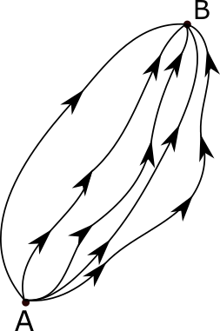
Calculate a path integral of quantum field excitations in the presence of another background field (e.g. curved space time).
meeting point with antiparticle
particle
starting point

Slide 14
Description of Particle Production
Central question: Does a vacuum state evolve into a non-vacuum state?
Consider a real scalar field $φ$ on a curved background spacetime with metric $g_{μν}$.
For a classical field, the evolution follows from the equations of motion (stationary phase solutions). For a quantum field, all possible evolutions need to be considered, “weighted” by their non-stationarity.
The vacuum-to-vacuum amplitude is a special case of the generating functional:
Overall probability for particle creation:
Creation event rate density:
Wondrak, van Suijlekom, Falcke (2023), PRL, in press

Slide 15
Effective Action
Free massless scalar field, coupling parameter $ξ$ irrelevant for Ricci-flat spacetimes.
Euclidean effective action:
Wondrak, van Suijlekom, Falcke (2023), PRL, in press

Slide 16
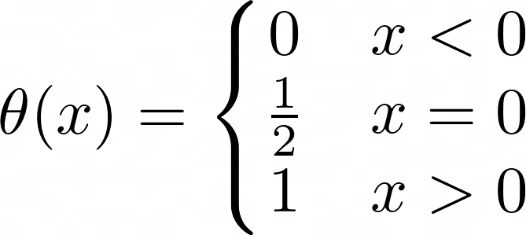
Effective Action
Covariant heat-kernel expansion to second order in derivatives, involving form factors.
The imaginary part of the effective action implies particle production!
IR cutoff
Barvinsky, Vilkovisky, Nucl. Phys. B333 (1990) 471;
Codello, Zanusso, J. Math. Phys. 54 (2013) 013513
Wondrak, van Suijlekom, Falcke (2023), PRL, in press

Slide 17
Rederivation of Schwinger Effect
Imaginary part of the effective action:
Complex scalar in strong electric background field in flat spacetime. Only contributing term:
Closed-form Schwinger solution:
e⁺
e⁻
e⁺
e⁻
e⁺
e⁻
e⁺
e⁻
e⁺
e⁻
e⁺
e⁻
e⁺
e⁻
e⁺
e⁻
e⁺
e⁻
e⁺
e⁻
e⁺
e⁻
e⁺
e⁻
e⁺
e⁻
e⁺
e⁻
e⁺
e⁻
e⁺
e⁻
e⁺
e⁻
Wondrak, van Suijlekom, Falcke (2023), PRL, in press
Notes:
Interpretation in terms of instantons paths

Slide 18
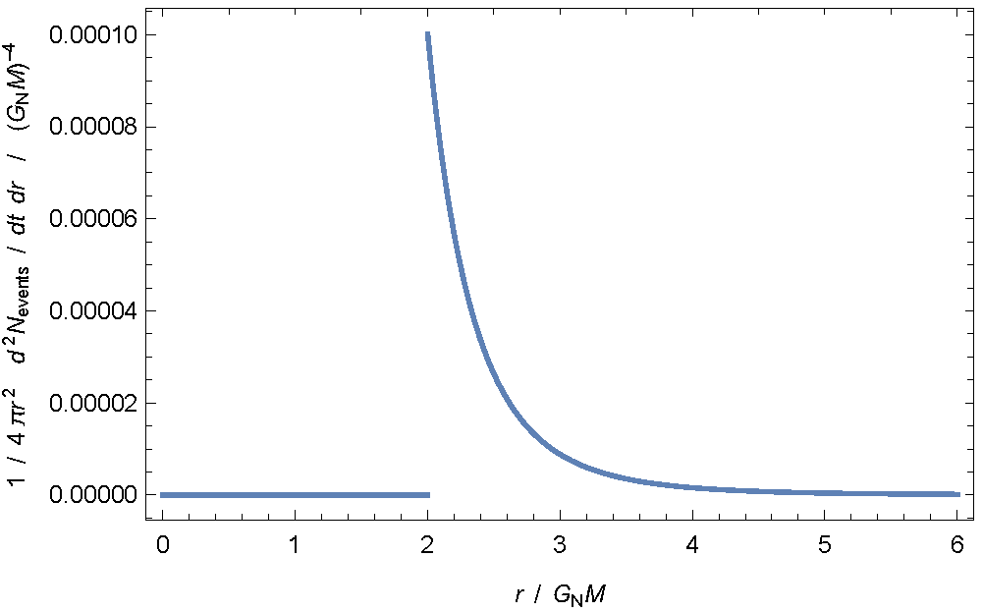
Application to black hole spacetimes
Imaginary part of the effective action:
Real scalar field in curved Schwarzschild spacetime:
Ricci-flat spacetime: only contribution from Weyl tensor (volume-preserving, hinting at tidal forces)
Event rate density:
Wondrak, van Suijlekom, Falcke (2023), PRL, in press

Slide 19
Local effective temeperature
Characteristic energy of emitted particles (from comparison with Schwinger effect) is proportional to spacetime curvature:
This gives an effective temperature (if thermal):
$$\frac{T(WSF2023)}{T(Hawking)}=\frac{164 nK}{138 nK}\sim 1.19≈2^{1/4}$$
Local temperature ($r=2.5 GM$, $M=M_{⨀}$)
$$\frac{F\left(WSF2023\right)}{F(Hawking)}\sim 1.9$$
Energy flux:
$12.8 ×{10}^{−5} ℏ {(G_{N}M)}^{−2}$
(note: flux = 𝜎T⁴)

Slide 20
Geometric optics around black holes
At least one photon into event horizon
(classical Hawking effect)
Wondrak, van Suijlekom, Falcke (2023), PRL, in press

Slide 21
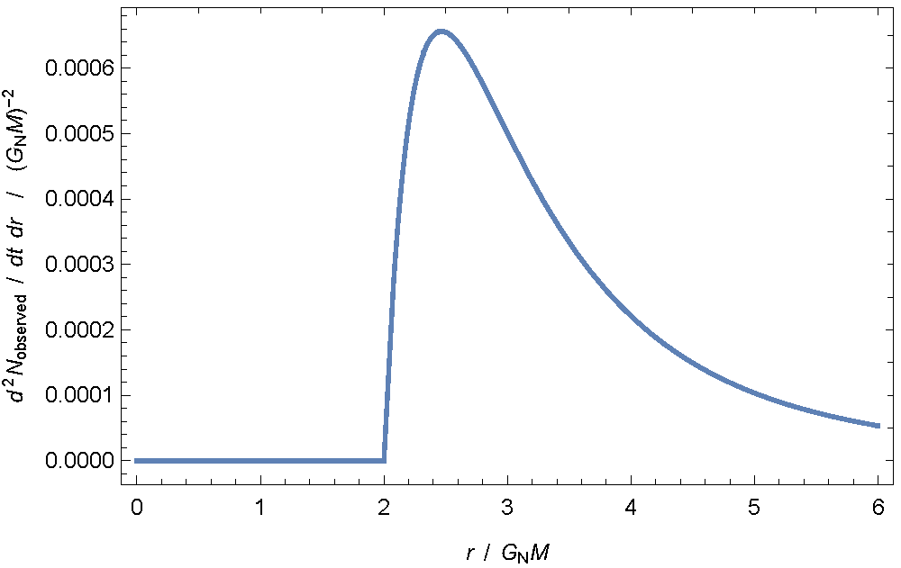
Gravitational pair production around BH
Particle Flux
Particles per shell of unit thickness
event horizon
unstable photon orbit
Wondrak, van Suijlekom, Falcke (2023), PRL, in press

Slide 22
Conclusions
New method to calculate the production of massless particles in a strong background field.
Reproduces exact expression for the Schwinger effect.
Reproduces Hawking emission within factor ~2.
Most emission emitted between horizon and photon orbit, where at least one particle has to end in the event horzion (optics) = Hawking.
There is additional emission outside the photon orbit which includes entangled particles.
Scalar field serves as a model for photons and gravitons. For a black hole, only emission of massless particles over almost entire lifetime.
Particle creation described in local curvature terms: independent of choice of vaccuum.
The presence of a black hole event horizon is not a necessary requirement.

Slide 23
Consequences
All gravitational fields and curved spacetimes would eventually “relax” and evaporate – not just black holes.
Normal matter (e.g. neutron stars) would decay
There needs to be a particle physics interaction that makes protons decay due to interaction with their gravitational field.
Information paradox:
Pairs created in this process cannot carry information about the star – whether particle or anti-particle escapes is completely random.
Captured particles will increase entropy of the “star”.

Slide 24
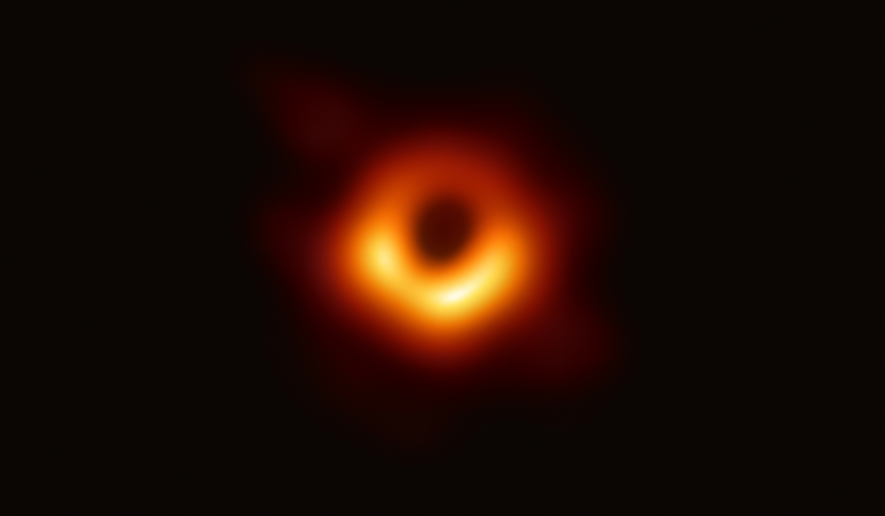
Final words
Yes, there is an event horizon…
…but that is not your main problem any more. 😉
(when you think about quantum gravity and the information paradox – evaporation is a general property of gravitational fields).

Slide 25
Hawking Radiation – alternative view
Heisenberg uncertainty cloud
Δx ~ c⋅Δt ≥ ℏ/2Δp
e⁻
e⁺
Notes:
A black hole of one solar mass (M☉) has a temperature of only 60 nanokelvin (60 billionths of a kelvin); in fact, such a black hole would absorb far more cosmic microwave background radiation than it emits. A black hole of 4.5 × 1022 kg (about the mass of the Moon, or about 13 micrometers across) would be in equilibrium at 2.7 kelvin, absorbing as much radiation as it emits. Yet smaller primordial black holes would emit more than they absorb and thereby lose mass.[10]
Simulated view of a black hole in front of the Large Magellanic Cloud. The ratio between the black hole Schwarzschild radius and the observer distance to it is 1:9. Of note is the gravitational lensing effect known as an Einstein ring, which produces a set of two fairly bright and large but highly distorted images of the Cloud as compared to its actual angular size.
Simulated view of a black hole (center) in front of the Large Magellanic Cloud. Note the gravitational lensing effect, which produces two enlarged but highly distorted views of the Cloud. Across the top, the Milky Way disk appears distorted into an arc.

Slide 26
Hawking Radiation – alternative view
Δx₁ ~c⋅Δt₁ ≠ Δx₁ ~c⋅Δt₁
e⁻
e⁺
Hypothesis: it is not the event horizon of the black hole, but it’s curved spacetime (esp. tidal forces) creating the radiation.
Notes:
A black hole of one solar mass (M☉) has a temperature of only 60 nanokelvin (60 billionths of a kelvin); in fact, such a black hole would absorb far more cosmic microwave background radiation than it emits. A black hole of 4.5 × 1022 kg (about the mass of the Moon, or about 13 micrometers across) would be in equilibrium at 2.7 kelvin, absorbing as much radiation as it emits. Yet smaller primordial black holes would emit more than they absorb and thereby lose mass.[10]
Simulated view of a black hole in front of the Large Magellanic Cloud. The ratio between the black hole Schwarzschild radius and the observer distance to it is 1:9. Of note is the gravitational lensing effect known as an Einstein ring, which produces a set of two fairly bright and large but highly distorted images of the Cloud as compared to its actual angular size.
Simulated view of a black hole (center) in front of the Large Magellanic Cloud. Note the gravitational lensing effect, which produces two enlarged but highly distorted views of the Cloud. Across the top, the Milky Way disk appears distorted into an arc.

Slide 27
Expected Lifetimes
𝛴=surface gravity
𝜏_{WSF}(BH, M=1.44 M⊙)=10⁶⁸ yr
𝜏_{WSF}(NS, R=13 km, M=1.44 M⊙)=8×10⁷⁰ yr
𝜏_{WSF}(WD, R=2550 km, M=1.3 M⊙)=6×10⁸⁴ yr
𝜏_{WSF}(M87*, R=R_{S}, M=6×10⁹ M⊙)=1.3×10⁹⁷ yr
𝜏_{WSF}(Asteroid Bennu, R=535 m, M=7×10¹⁰ kg)=5.4×10¹²¹ yr
𝜏_{WSF}(MITP)=6×10¹³⁰ yr
𝜏_{WSF}(Laniakea Supercluster)=10¹⁴⁴ yr
Falcke, Wondrak, van Suijlekom (2023), A&A, in prep.

Slide 28
Sanity check:
Temperature: $T_{H}=\frac{ℏ}{2πck_{B}}\left(\frac{GM}{R^{2}}\right)$
Lifetime: $τ_{H}={\left(\frac{σT_{H}^{4}⋅4πR^{2}}{Mc^{2}}\right)}^{−1}$
𝜏_{WSF}(M87*, R=R_{S}, M=6×10⁹ M⊙)=1.3×10⁹⁷ yr
𝜏_{WSF}(PSR J0030+0451, R=13 km, M=1.44 M⊙)=1.5×10⁷¹ yr
𝜏_{WSF}(Asteroid Bennu, R=535 m, M=7×10¹⁰ kg)=5.4×10¹²¹ yr
𝜏_{WSF}(proton)=2×10¹¹² yr
𝜏_{WSF}(MITP)=6×10¹³⁰ yr
Surface gravity

Slide 29
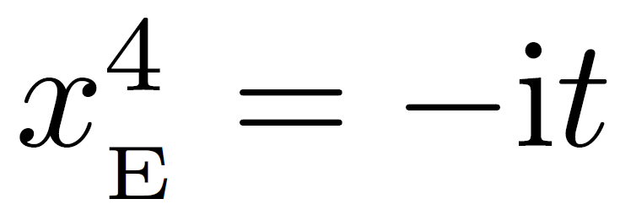
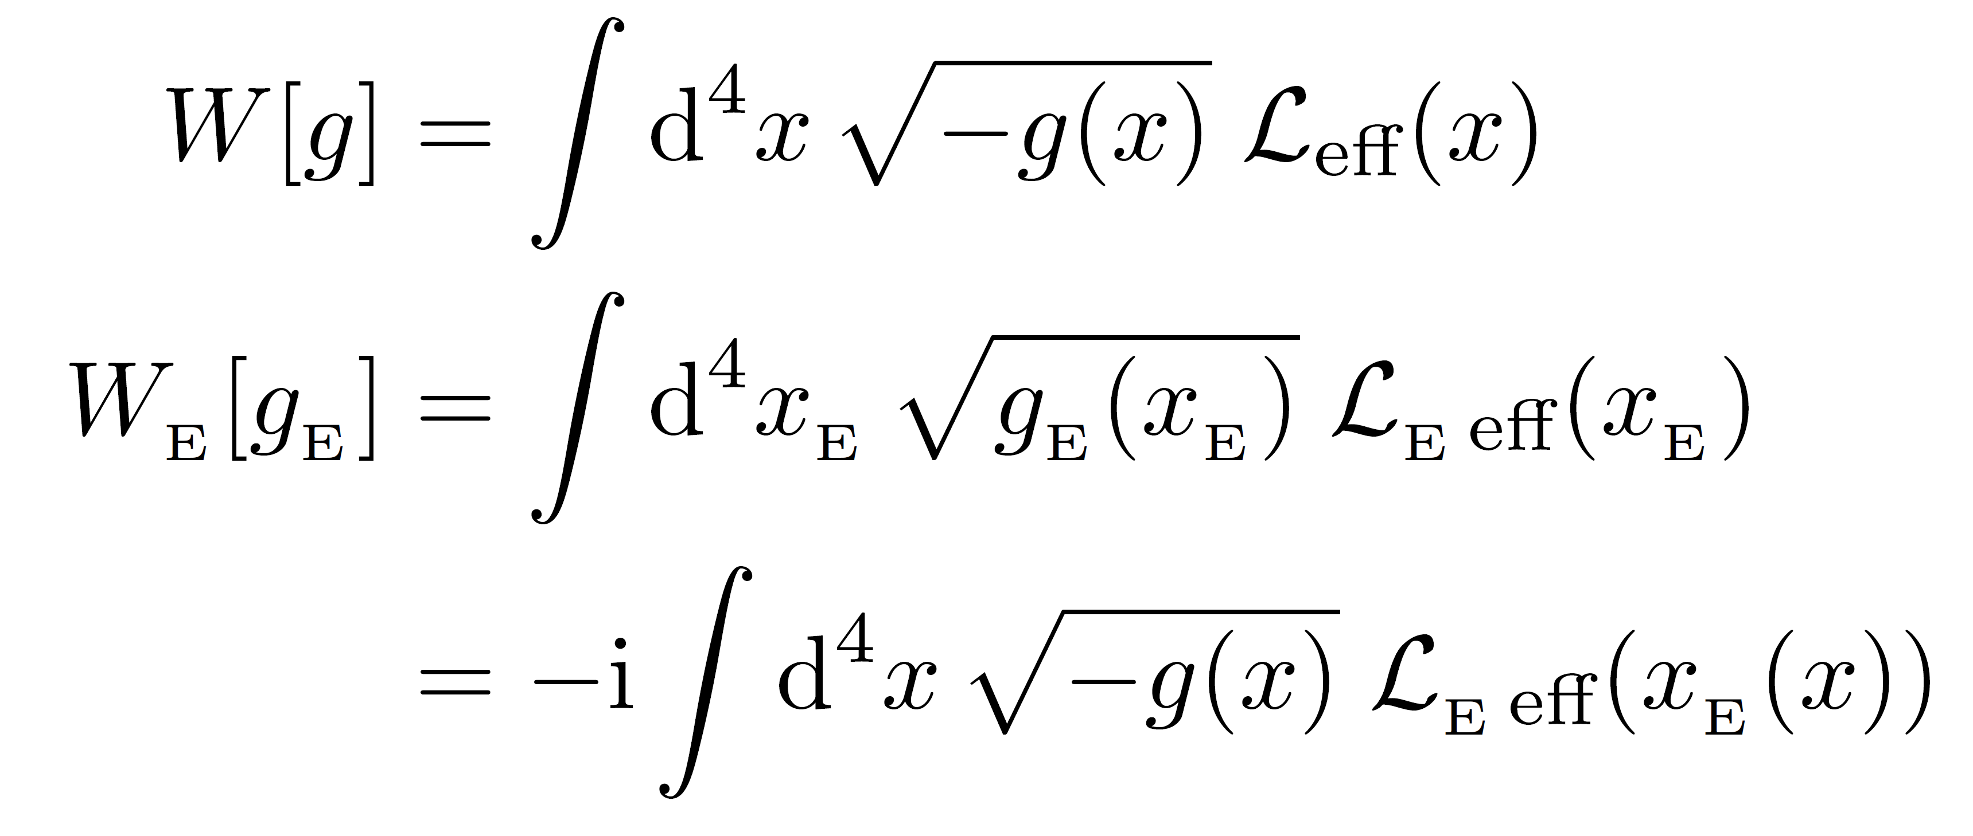
Wick Rotation

Slide 30
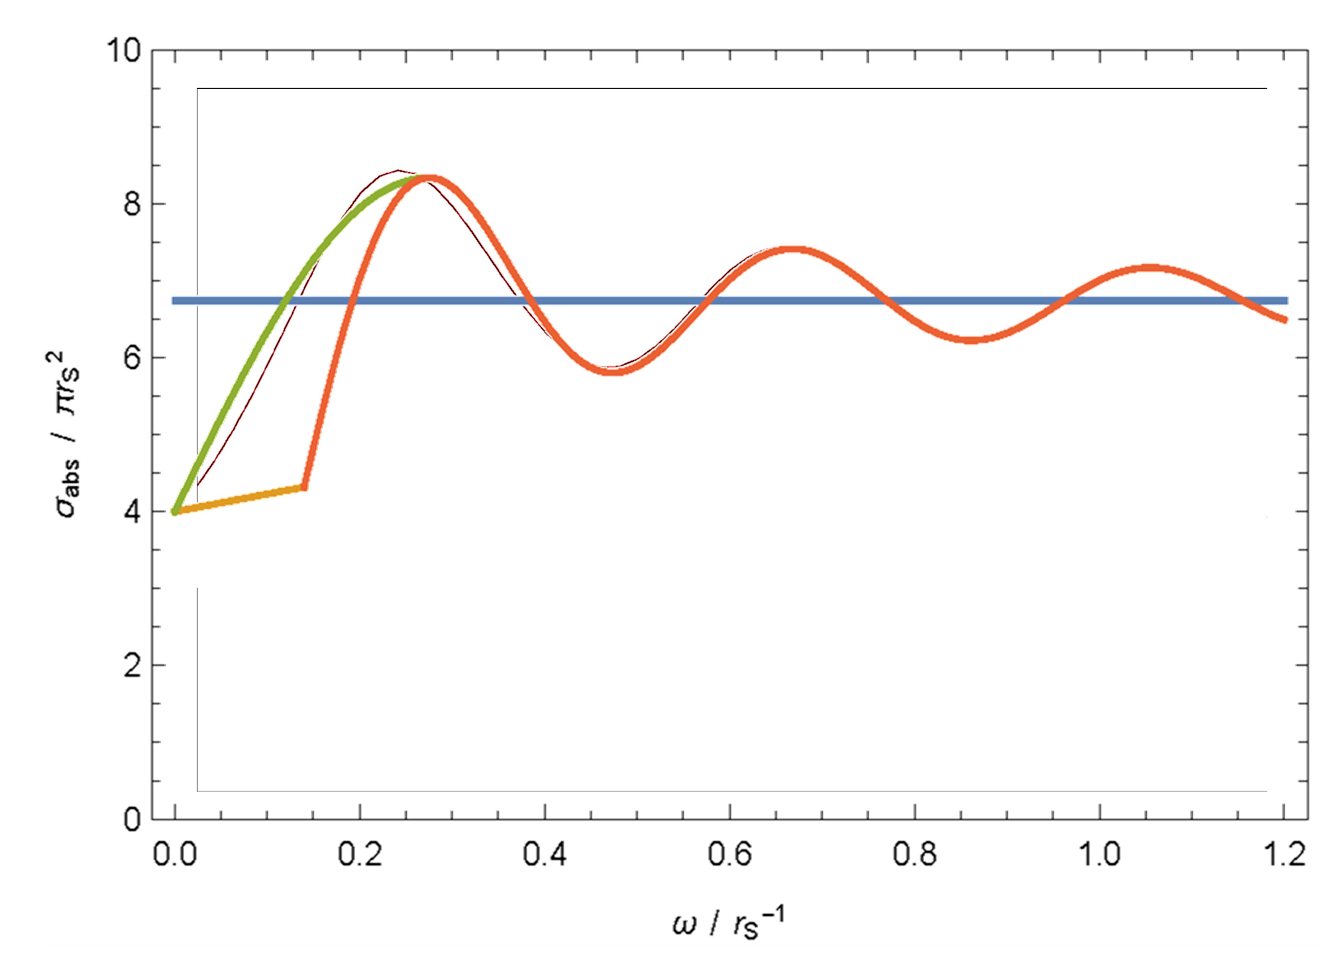
Graybody Factor
Numerical

Slide 31
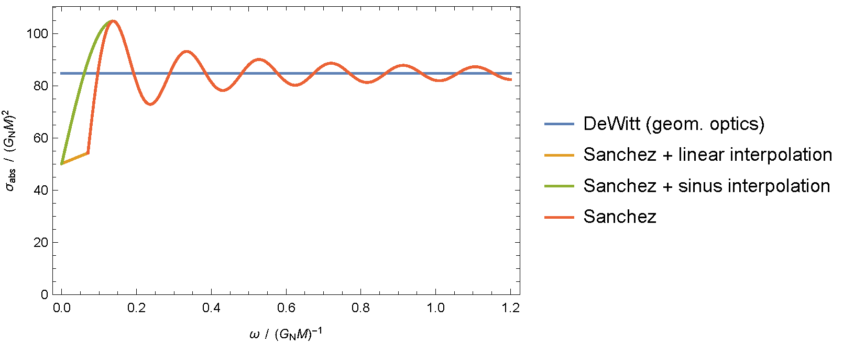
Graybody Factor

Slide 32
Path Integrals
Calculate all paths that start and end in the same point: B=A(t0+Δt)
e⁺
e⁻

Slide 33
e⁻
e⁺

Slide 34
Event Horizon and Information Loss
e⁻
e⁻
e⁻
e⁻
e⁺
Notes:
A black hole of one solar mass (M☉) has a temperature of only 60 nanokelvin (60 billionths of a kelvin); in fact, such a black hole would absorb far more cosmic microwave background radiation than it emits. A black hole of 4.5 × 1022 kg (about the mass of the Moon, or about 13 micrometers across) would be in equilibrium at 2.7 kelvin, absorbing as much radiation as it emits. Yet smaller primordial black holes would emit more than they absorb and thereby lose mass.[10]
Simulated view of a black hole in front of the Large Magellanic Cloud. The ratio between the black hole Schwarzschild radius and the observer distance to it is 1:9. Of note is the gravitational lensing effect known as an Einstein ring, which produces a set of two fairly bright and large but highly distorted images of the Cloud as compared to its actual angular size.
Simulated view of a black hole (center) in front of the Large Magellanic Cloud. Note the gravitational lensing effect, which produces two enlarged but highly distorted views of the Cloud. Across the top, the Milky Way disk appears distorted into an arc.

Slide 35
Event Horizon and Hawking Radiation
e⁺
e⁻
Notes:
A black hole of one solar mass (M☉) has a temperature of only 60 nanokelvin (60 billionths of a kelvin); in fact, such a black hole would absorb far more cosmic microwave background radiation than it emits. A black hole of 4.5 × 1022 kg (about the mass of the Moon, or about 13 micrometers across) would be in equilibrium at 2.7 kelvin, absorbing as much radiation as it emits. Yet smaller primordial black holes would emit more than they absorb and thereby lose mass.[10]
Simulated view of a black hole in front of the Large Magellanic Cloud. The ratio between the black hole Schwarzschild radius and the observer distance to it is 1:9. Of note is the gravitational lensing effect known as an Einstein ring, which produces a set of two fairly bright and large but highly distorted images of the Cloud as compared to its actual angular size.
Simulated view of a black hole (center) in front of the Large Magellanic Cloud. Note the gravitational lensing effect, which produces two enlarged but highly distorted views of the Cloud. Across the top, the Milky Way disk appears distorted into an arc.

Slide 36
Particle creation in general space times
L. Parker & D. Toms (2009), „Quantum Field Theory in Curved Spacetime: Quantized Fields and Gravity”, p. 53

Slide 37
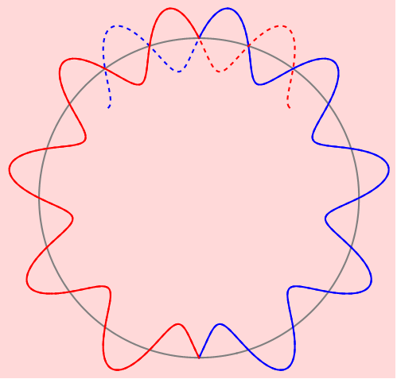
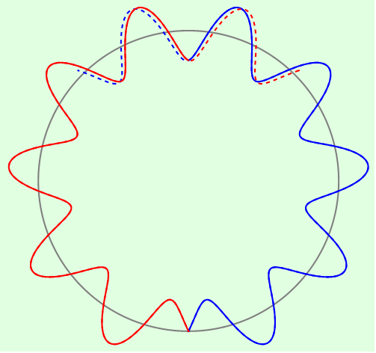
Event Horizon and Particle Production
Destructive interference of particle and antiparticle → no contribution to particle production
Constructive interference of particle and antiparticle → contribution to particle production
meeting point
meeting point
antiparticle
particle
antiparticle
particle
starting point
starting point

