Slide 1
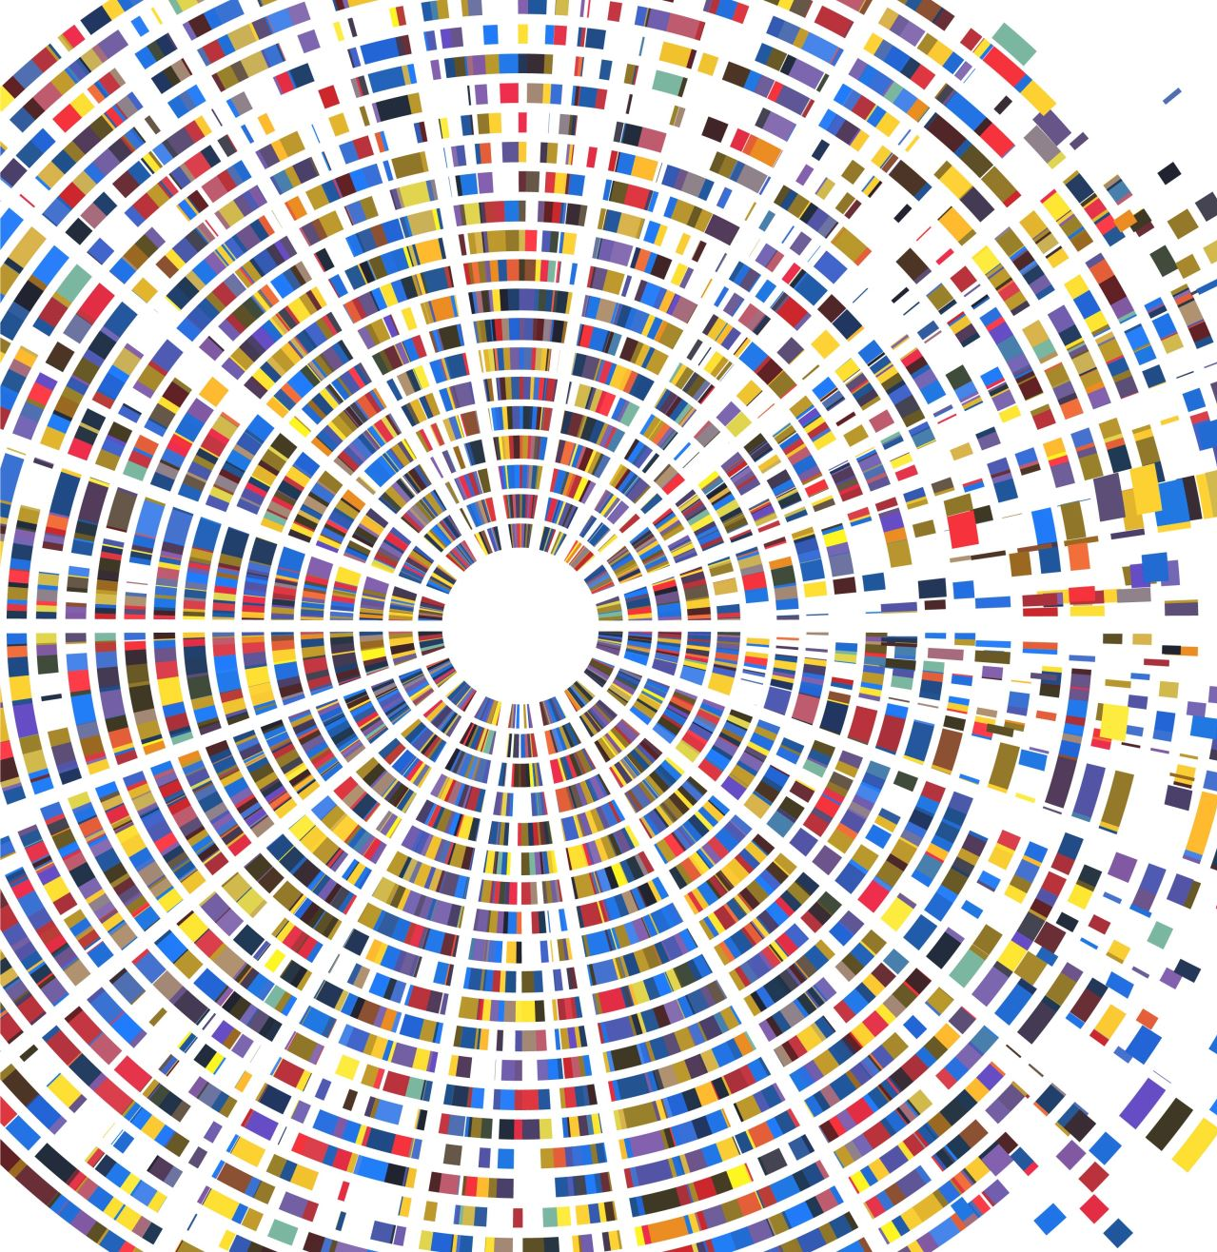
Low Photon Advantages in Optical Fiber Communication
Presentation by Aakash Warke,
Peter van Loock’s Group in Mainz

Slide 2
Optical Fiber Channel
MPA Summer School 2023
$$link 1$$
$$link 2$$
$$link 3$$
. . .
$$link K$$
$$η$$
$$η$$
$$η$$
$$η$$
Phase-Insensitive Amplification (PIA)
(or)
Phase-Sensitive Amplification (PSA)
Shannon
(or)
Holevo Limits
$$η=e^{−0.05 L/K}$$

Slide 3
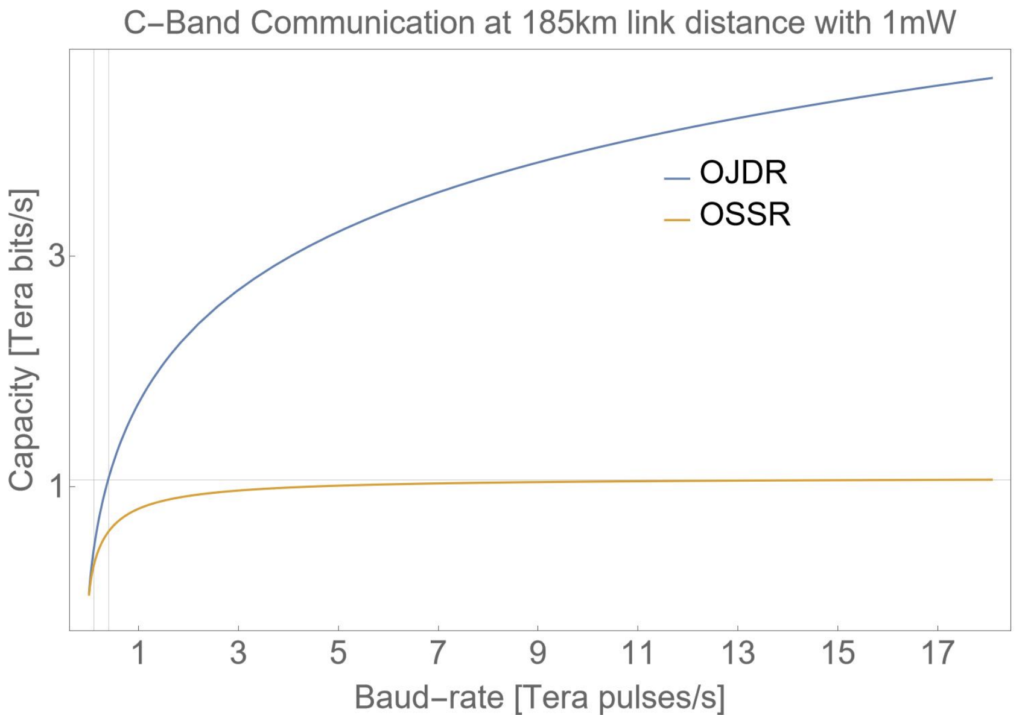
Detection Methods
MPA Summer School 2023
Heterodyne
Shannon Limits
Homodyne
Holevo Limits
Optical Joint Detection Receivers
Collective Quantum
Measurements
J. Nötzel and M. Rosati, "Operating Fiber Networks in the Quantum Limit,” in Journal of Lightwave Technology (2023)

Slide 4
Are there any regimes within which PSA is advantageous?
MPA Summer School 2023

Slide 5
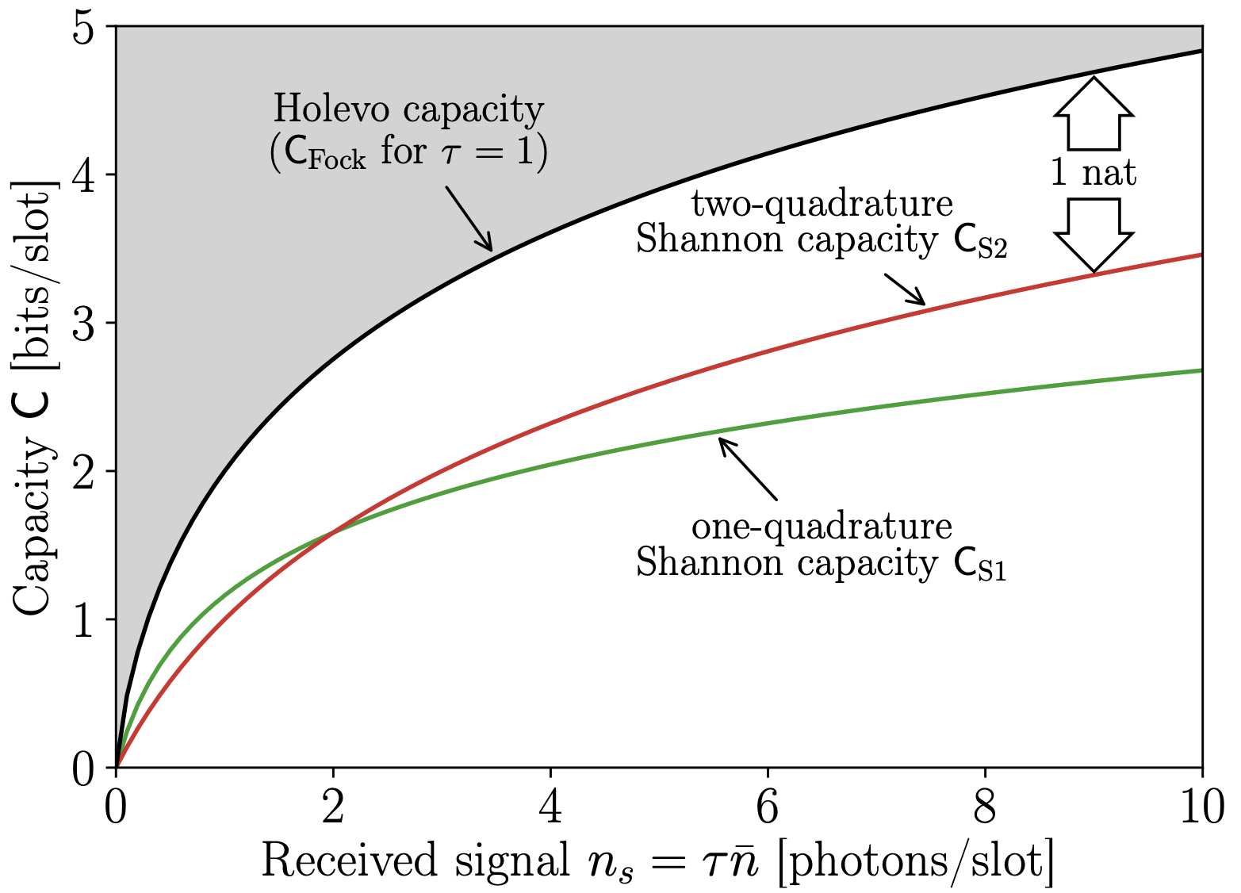
MPA Summer School 2023
K. Banaszek, L. Kunz, M. Jachura and M. Jarzyna, "Quantum Limits in Optical Communications," in Journal of Lightwave Technology, Vol. 38, No. 10 (2020)

Slide 6
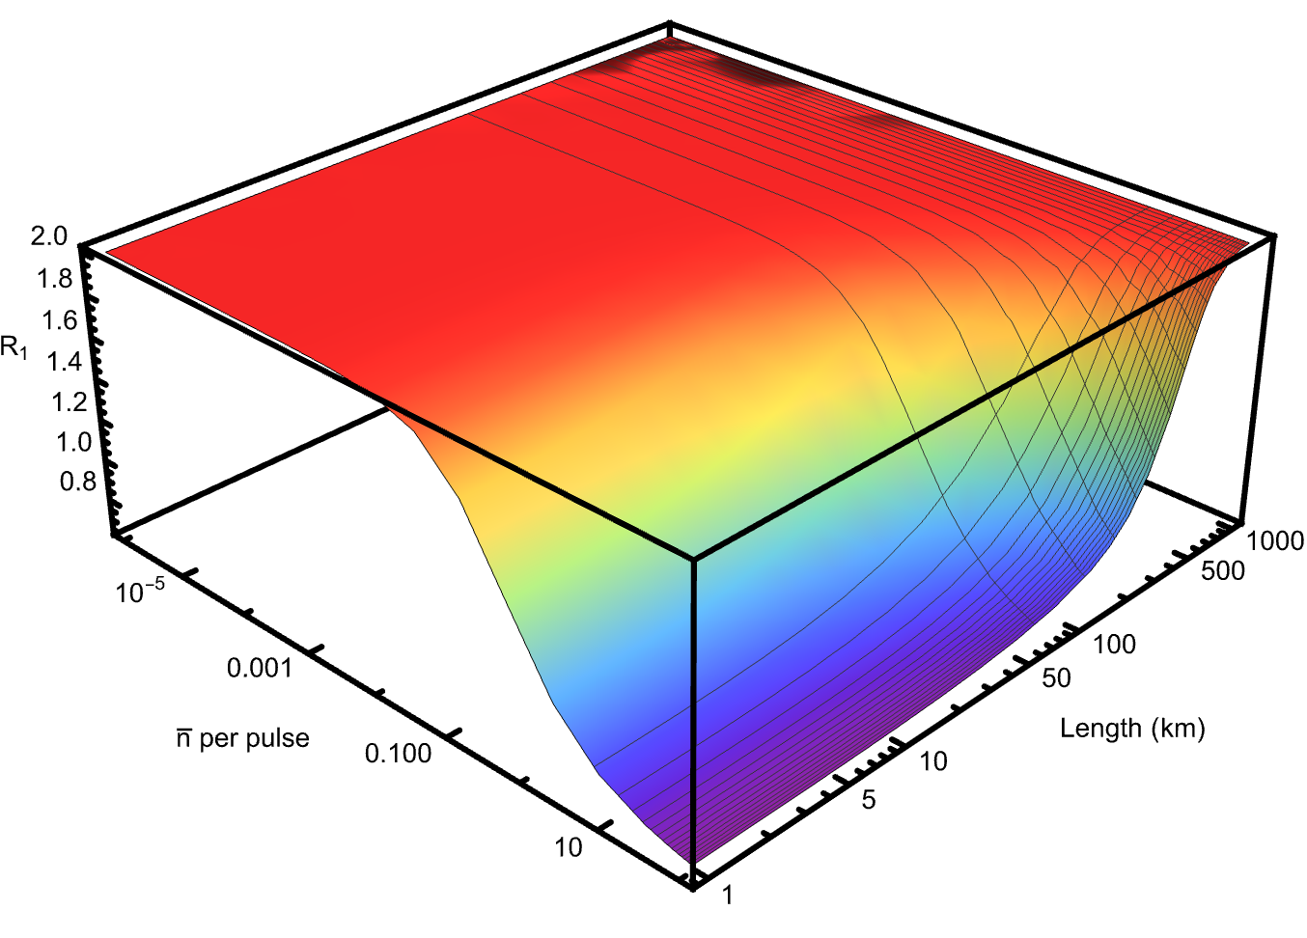
Shannon Limits
MPA Summer School 2023
$$\frac{ηn}{η+K(1−η)}≤2$$
*example of a channel with 4 links
Ratio of the capacity of PSA channel
to the capacity of PIA channel (4 links)

Slide 7
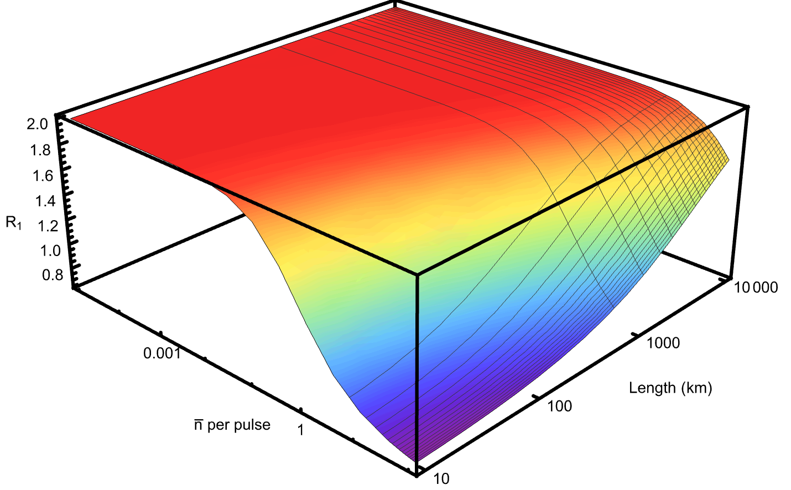
Shannon Limits
MPA Summer School 2023
$$\frac{n}{1+αL}≤2$$
…
*continuous amplification
Ratio of the capacity of PSA channel
to the capacity of PIA channel under
continuous amplification

Slide 8
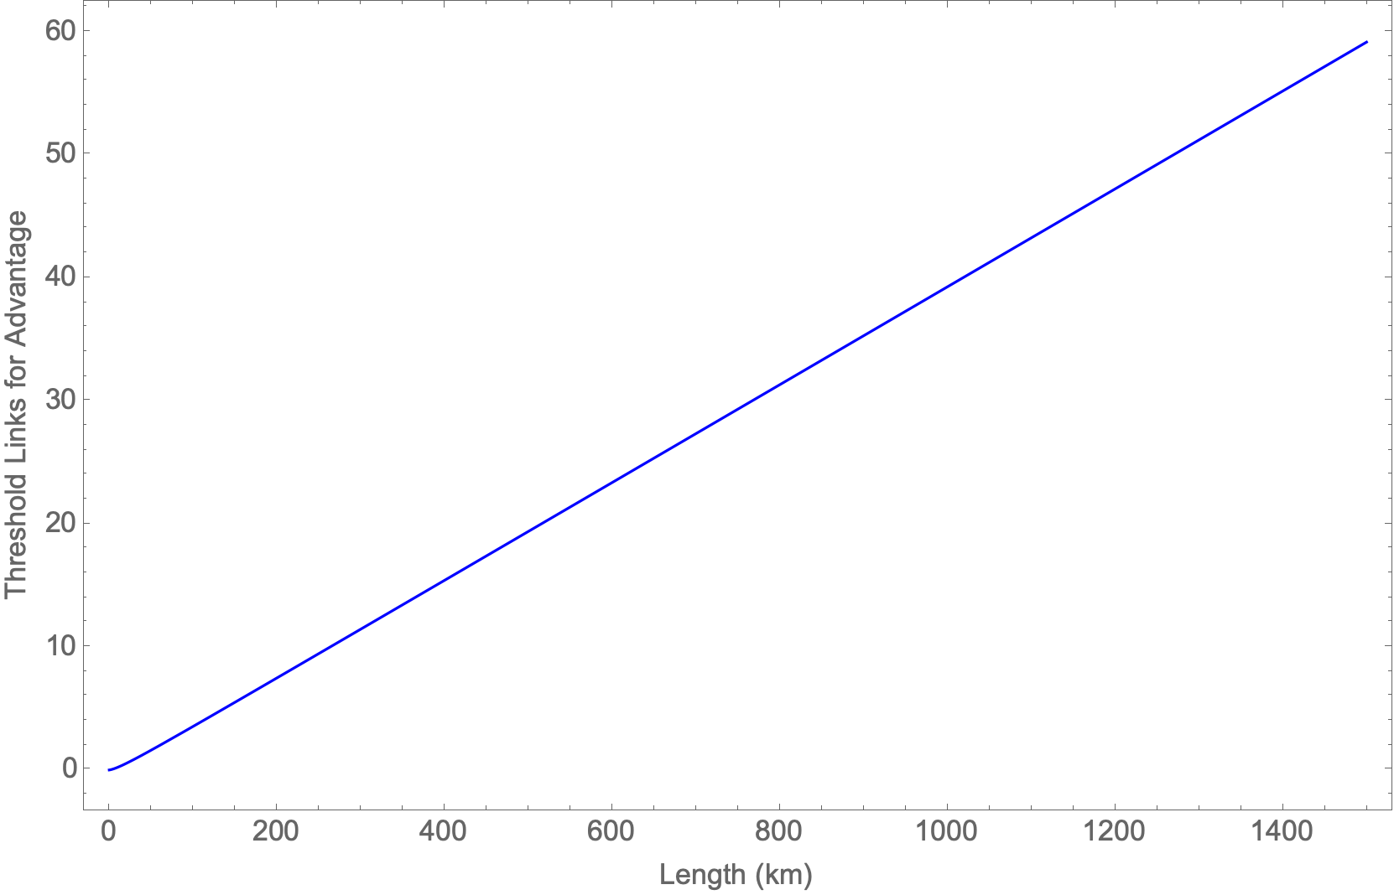
MPA Summer School 2023
In the low photon regime, there exists a threshold value of the number of PSA links, after which phase-sensitive amplification obtains higher spectral efficiencies compared to phase-insensitive continuous amplification (PICA)
L = 100 km
$$K_{thr}=\frac{−2α^{2}L^{2}−αL}{αL+\left(2αL+1\right) W_{−1}\left(−\frac{αLe^{−\frac{αL}{2αL+1}}}{2αL+1}\right)}$$
PSA: PHASE-SENSITIVE AMPLIFIER

Slide 9
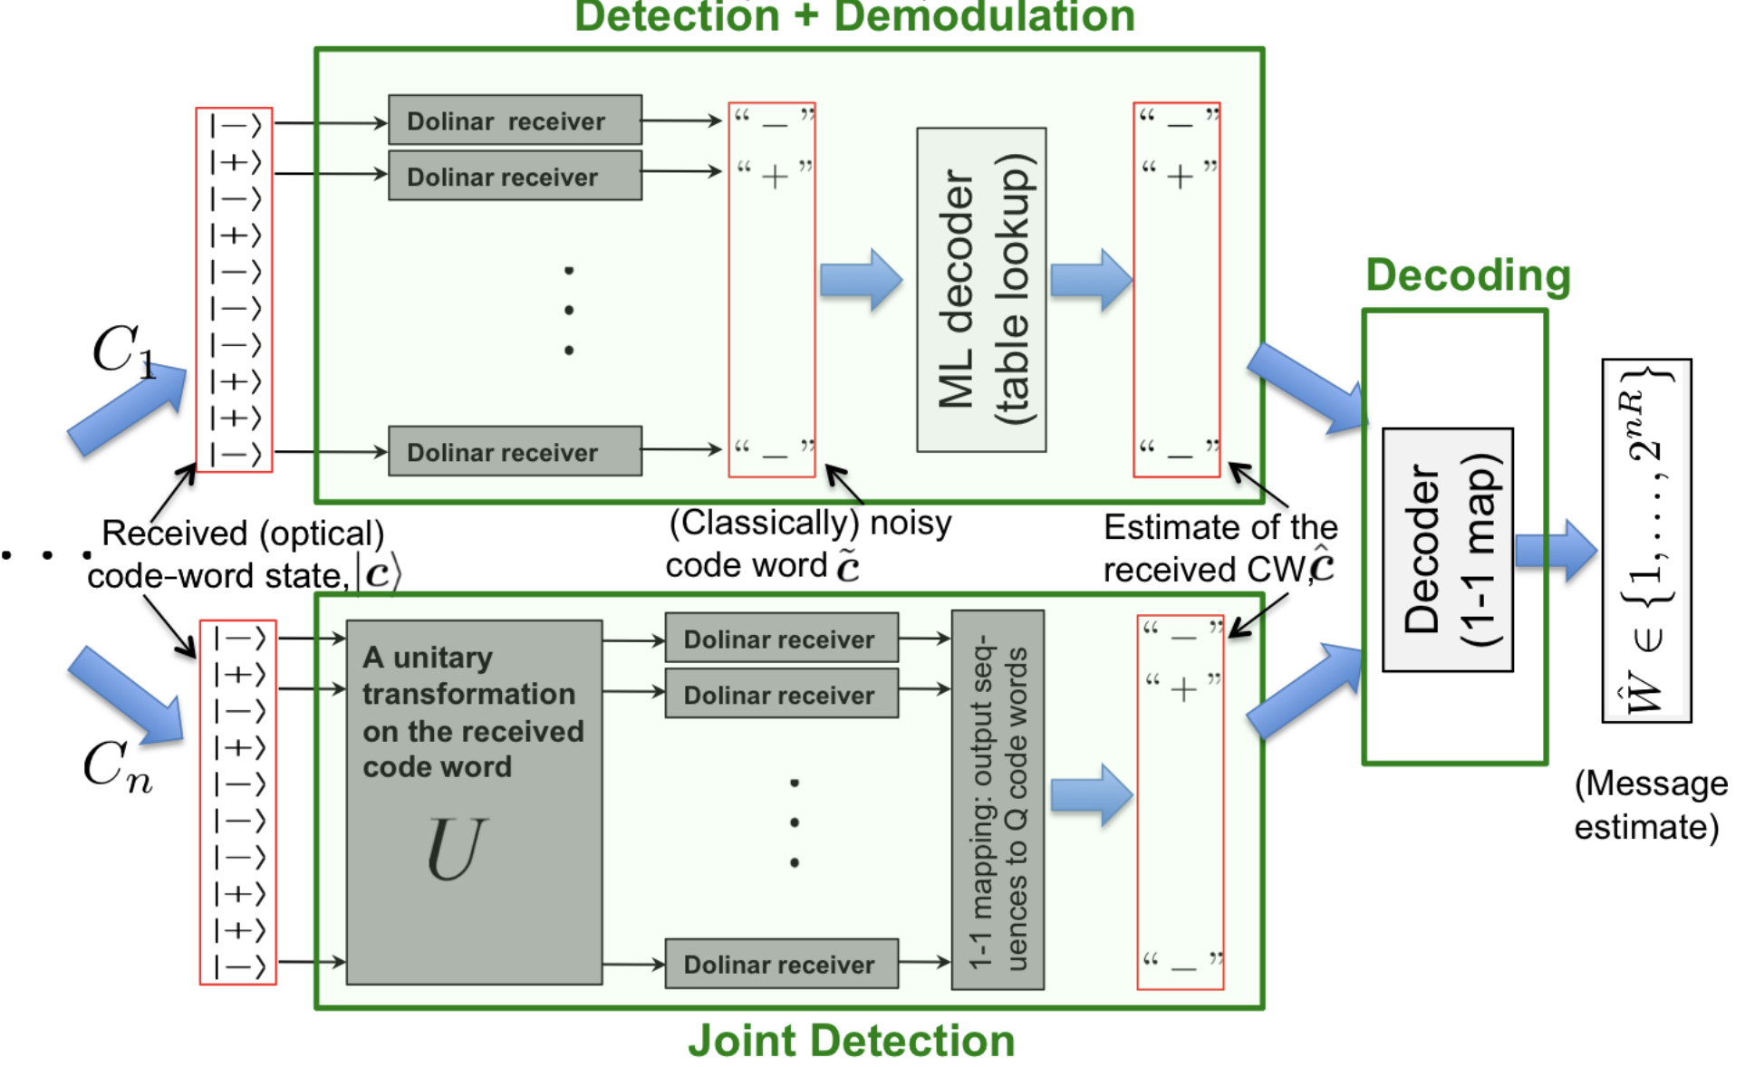
Optical Joint Detection Receiver Holevo limits
Saikat Guha, "Structured Optical Receivers to Attain Superadditive Capacity and the Holevo Limit”, Phys. Rev. Lett. 106, 240502 (2011)

Slide 10
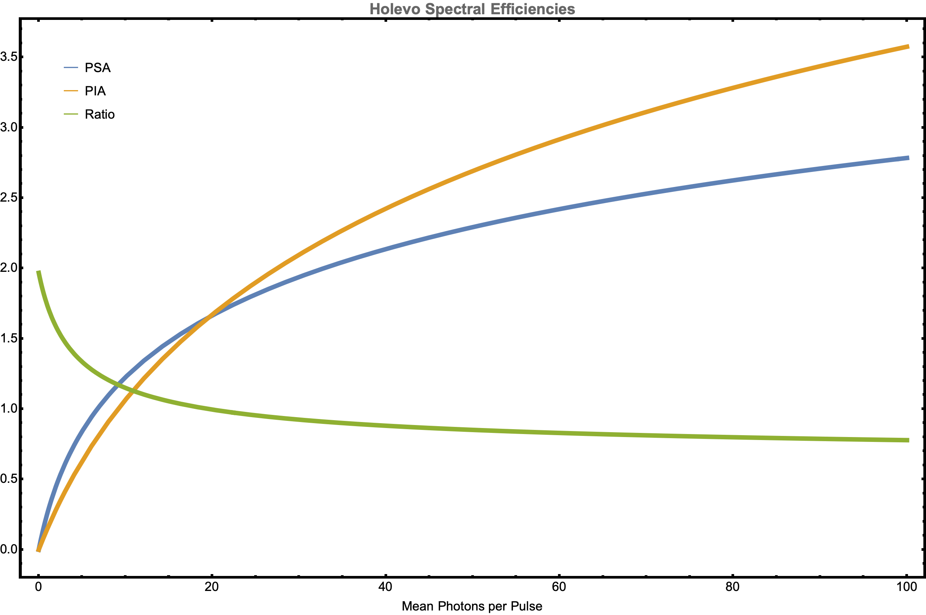
MPA Summer School 2023
L = 100 km, 4 links

Slide 11
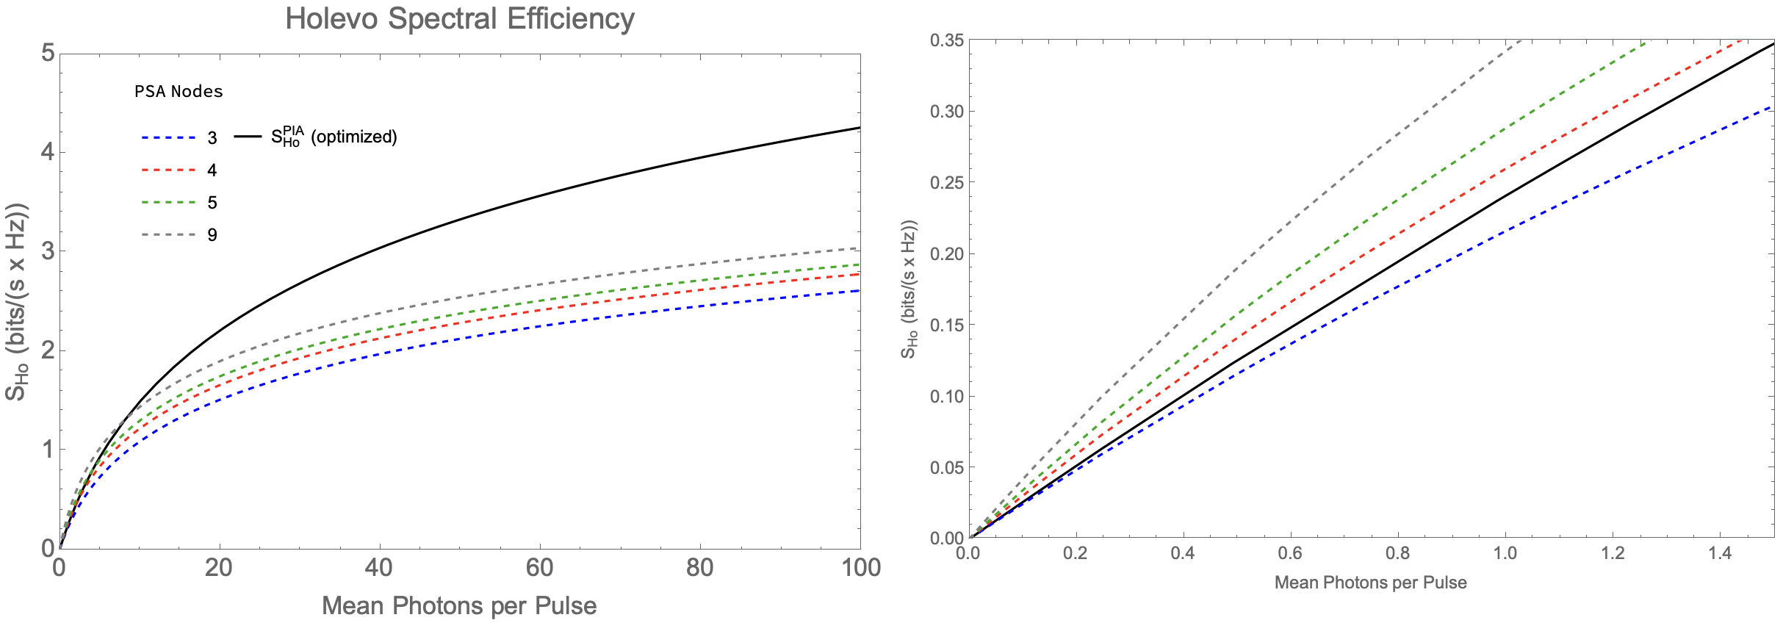
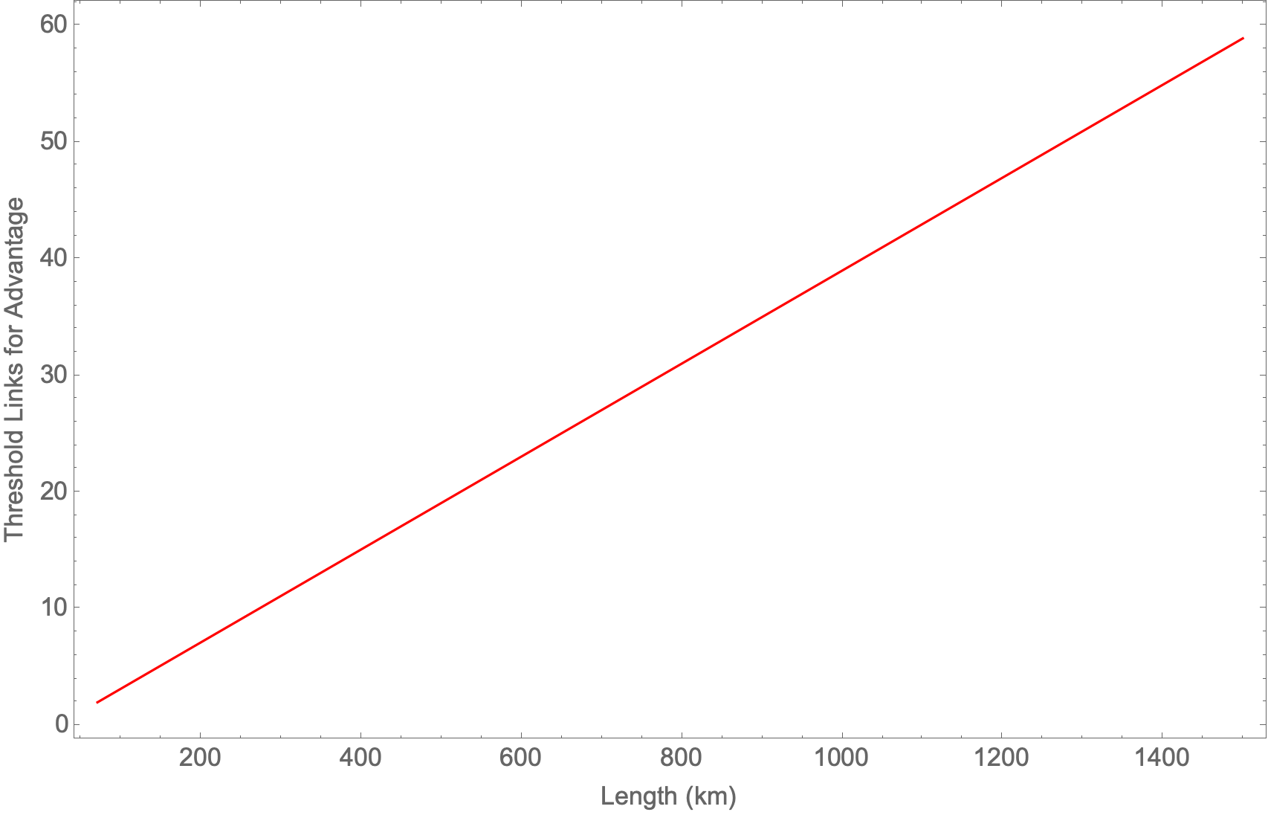
L = 100 km
Minimum number of PSA links required to obtain advantage
against PICA with Holevo detection in the low-photon regime
$$K_{thr}=0.0398193 L − 0.8091$$

Slide 12
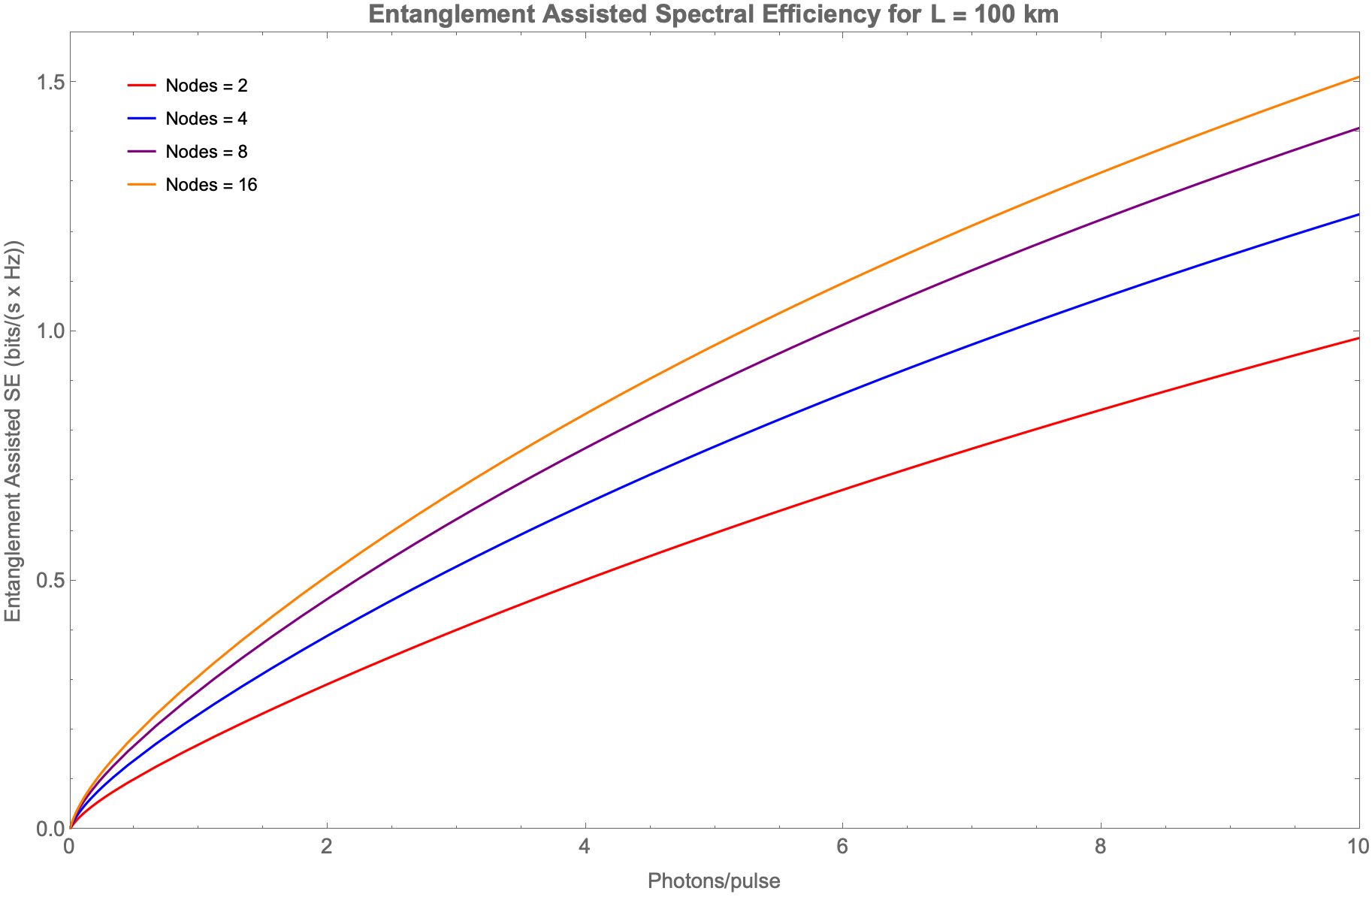
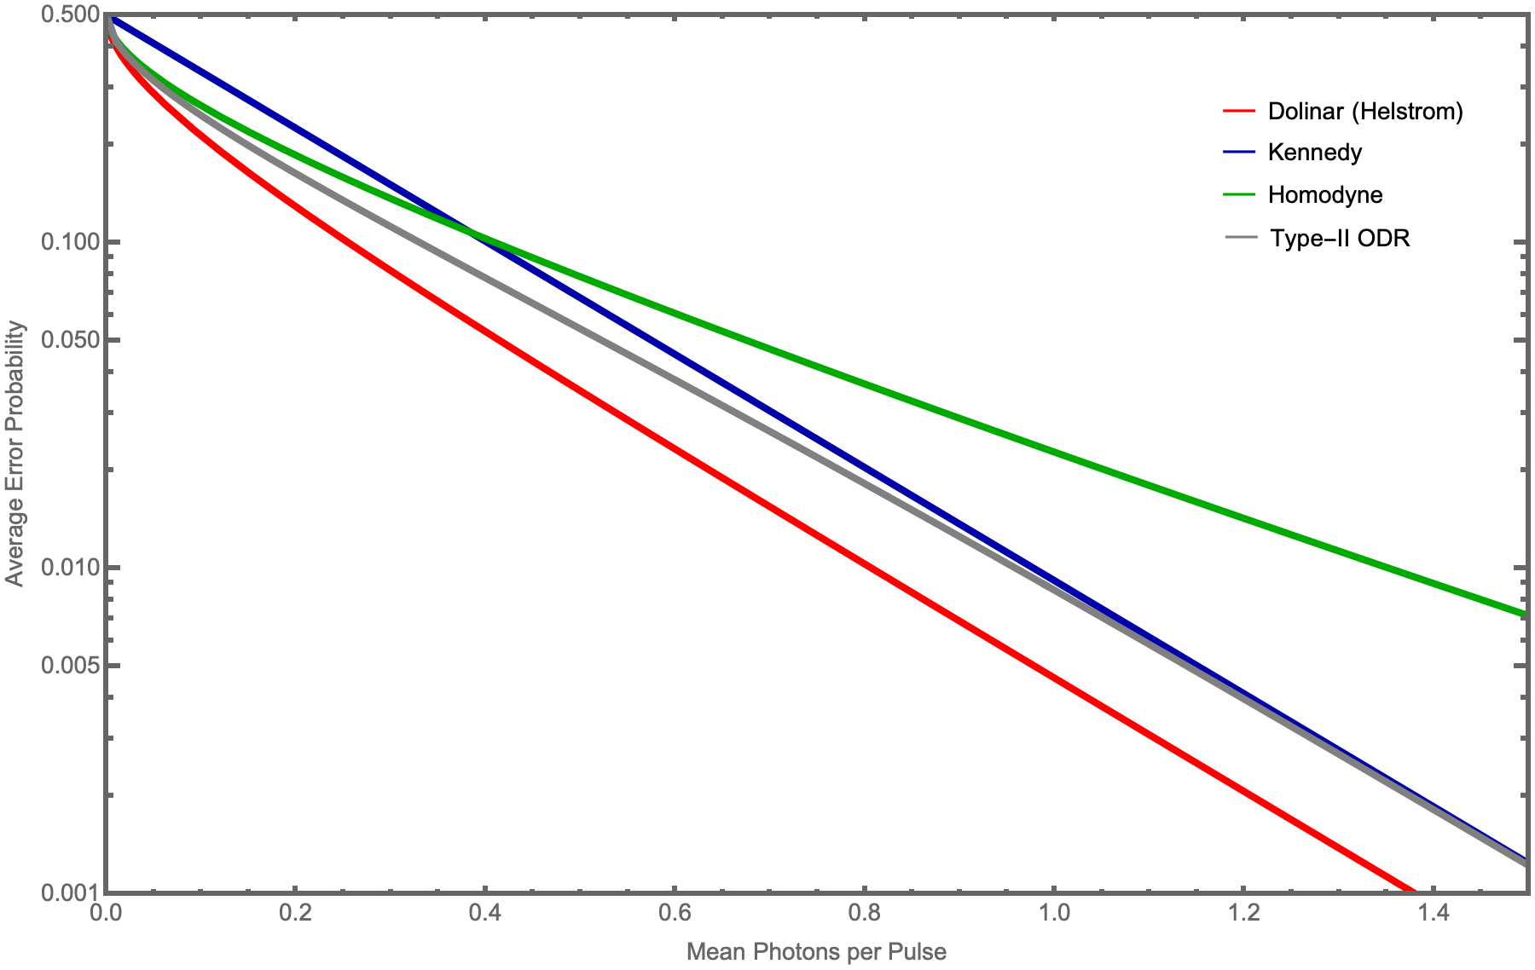
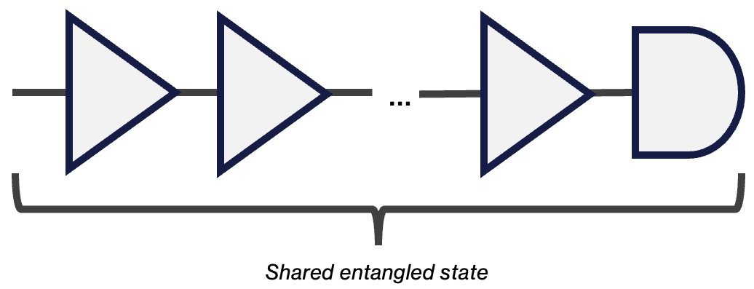
Future Work
MPA Summer School 2023
1. RECEIVER CONFIGURATIONS
2. EXPLORING ENTANGLEMENT ADVANTAGES
PIA

