Slide 1
The Mainz Radius EXperiment (MREX): neutron skin measurement at MESA
Nikita Kozyrev
AG Sfienti - Institute for Nuclear Physics - JGU Mainz

Slide 2
Outline
Neutron skin and nuclear equation of state
Theoretical predictions and experimental measurement of neutron skin
Mainz Energy-Recovering Superconducting Accelerator and P2 experiment
The Mainz Radius EXperiment (MREX)

Slide 3
Nucleon density distribution
Neutrons and protons inside a nucleus are hold by various potentials, resulting in nucleon “droplet”
Nucleon densities in this droplet are well described by 2-parameter Fermi distribution:
Proton density distributions are measured by elastic electron-nucleus scattering experiments
But what about neutrons?
Fig.1 Potential between two interacting protons
Fig.2 Schematic visualization of electron scattering

Slide 4
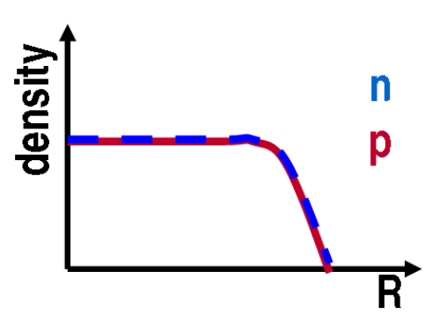
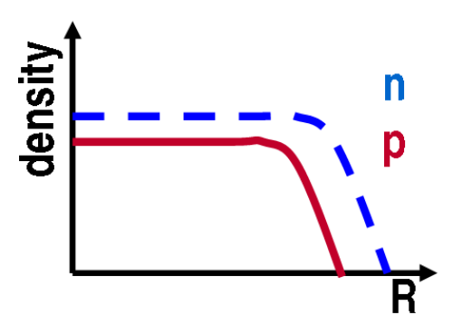
Neutron skin
N = Z: a_{n} = a_{p}, R_{n} = R_{p}
For symmetrical (N = Z) matter, neutron and proton densities are almost the same.
In case of heavy neutron rich (N >> Z) nuclei neutrons are pushed out towards the nuclear surface, creating neutron skin
As a result, root-mean-square radiuses of protons and neutron distributions differ by the value referred to as neutron skin thickness:
N >> Z: a_{n} = a_{p}, R_{n} > R_{p}
J. Phys. G, 46 (2019), 093003
Fig.3 Schematic representation of neutron and proton density distributions in nuclei

Slide 5
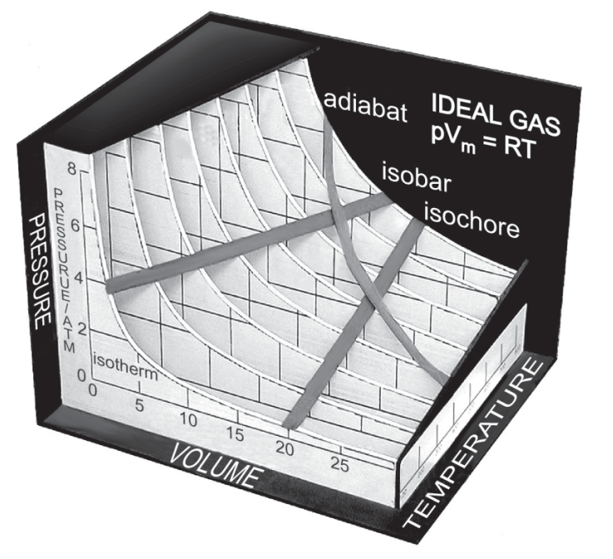
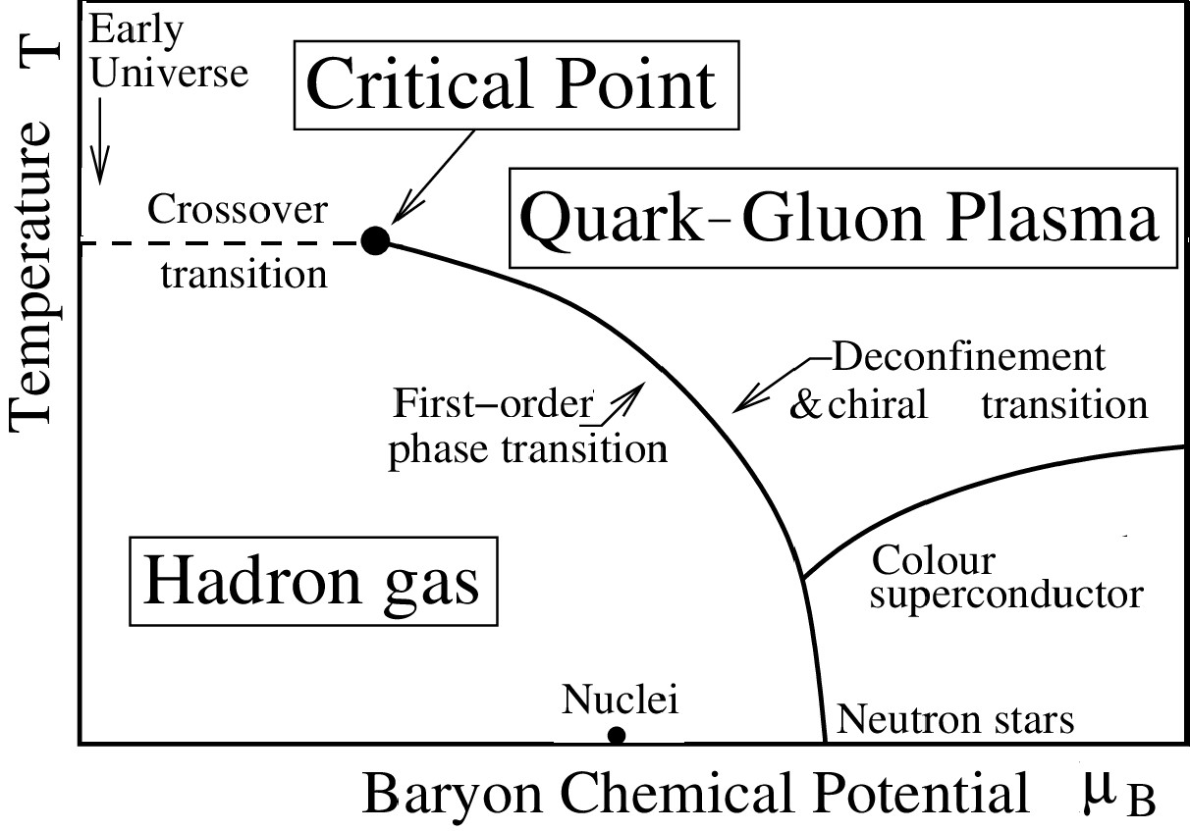
Equation of State
Equation of state (EOS) - nontrivial relation between thermodynamic variables characterizing a medium
Necessary for description of any kind of matter
Nuclear EOS describe the energy per nucleon as a function of the neutron and proton densities
Plays role in description of early Universe, nucleosynthesis, neutron stars, supernovae, heavy-ion collision and nuclear structure (including neutron skin).
Fig.4 Ideal gas EOS representation
Fig.5 QCD phase diagram

Slide 6
Liquid drop model and nuclear EOS
Empirical parameterization of nucleus binding energy within Liquid Drop Model (LDM):
It is assumed that the drop is incompressible and has constant density:
To meet EOS definition, one must go to thermodynamic limit, when A->ထ, but N:Z remains:
This can not describe density fluctuations, so, one must introduce density dependence:
Pauli exclusion principle + strong isovector interactions that favors symmetric systems
Binding energy per nucleon
Surface tension
Coulomb repulsion among protons
Symmetric nuclear matter: N = Z
Symmetry energy

Slide 7
Symmetry energy and its slope
The nuclear symmetry energy S describes an increase in energy as matter changes from a symmetric configuration of equal numbers of neutrons and protons
Performing a Taylor series expansion around saturation density we get:
symmetry energy slope parameter (a measure of the slope of the symmetry energy at saturation)
Thus, neutron skin can be explained as a result of a balance between the symmetry energy, which is smaller on the nuclear periphery because of lower density, and surface tension, which rises towards nuclear surface
Fig.6 Schematic representation of neutron skin

Slide 8
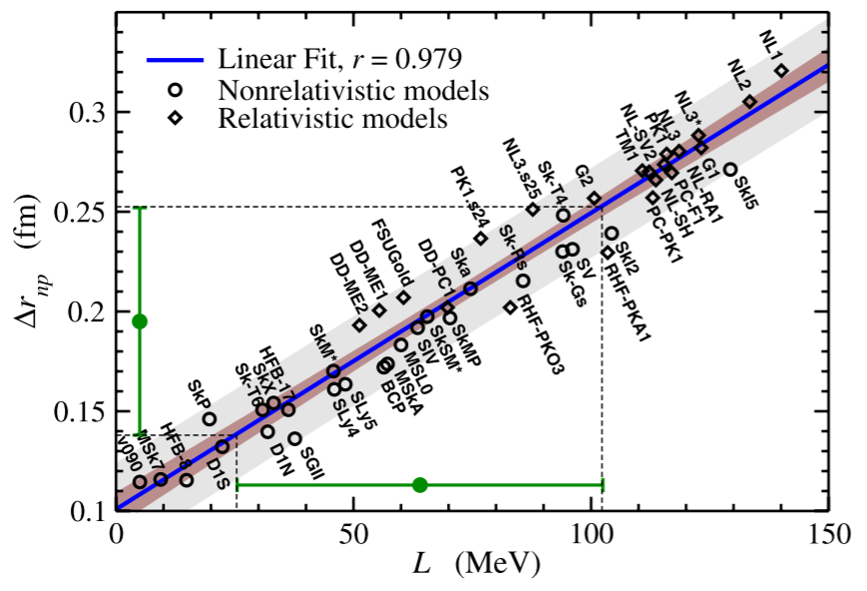
Relation between Δr_{np} and L
For ²⁰⁸Pb nucleus, many theoretical models predict substantially different neutron skin thickness Δr_{np}
However, there is clear linear dependence between Δr_{np} and L predicted by these models
This allows for model-independent extraction of L from a measurement of neutron skin thickness in ²⁰⁸Pb
PRL 106, 252501 (2011)
Fig.7 Correlation between theoretically predicted neutron skin thickness values in ²⁰⁸Pb and symmetry energy slope

Slide 9
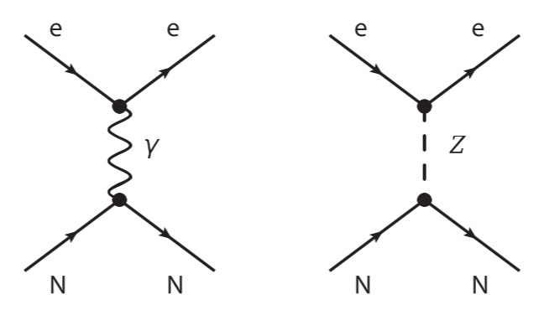
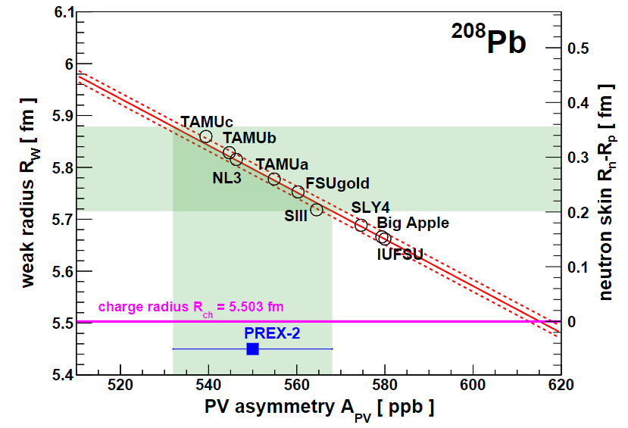
Parity-violating electron scattering
Coupling of the Z⁰ boson to neutrons is significantly larger than to protons, and right- and left-handed electrons interact with neutrons with different cross-sections.
This leads to parity-violating asymmetry in electron-nucleus scattering:
Fig.8 Feynman diagrams for electron scattering of nucleus
PRL 126(17), 172502 (2021)
PREX experiment used that to determine the neutron skin thickness of ²⁰⁸Pb: Δr_{np} = 0.28 ± 0.07 fm
PRL 106, 252501 (2011)
Fig.9 Correlation between A_{PV}, R_{W} and Δr_{np} in ²⁰⁸Pb at PREX

Slide 10
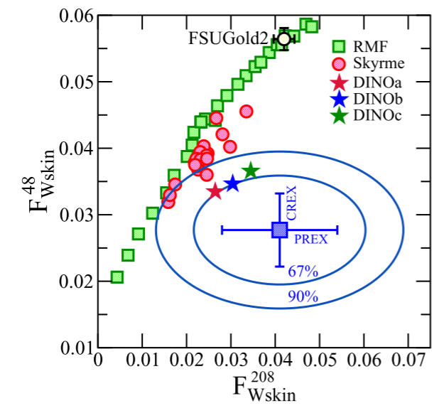
Motivation for the Mainz Radius EXperiment
MREX is intended to reproduce or confront the PREX measurement. This is necessary because:
PREX contradict multiple previous measurements of Δr_{np} of ²⁰⁸Pb, obtained through different methodology
PREX result has substantial statistical uncertainty
PREX contradict CREX (same setup but ⁴⁸Ca target) in measured L, and no theoretical model reproduce both PREX and CREX results within 1σ
arxiv.org/abs/2305.19376 (2023)
Fig.10 PREX and CREX results for weak form-factor of ²⁰⁸Pb and ⁴⁸Ca and theoretical prediction of different models

Slide 11
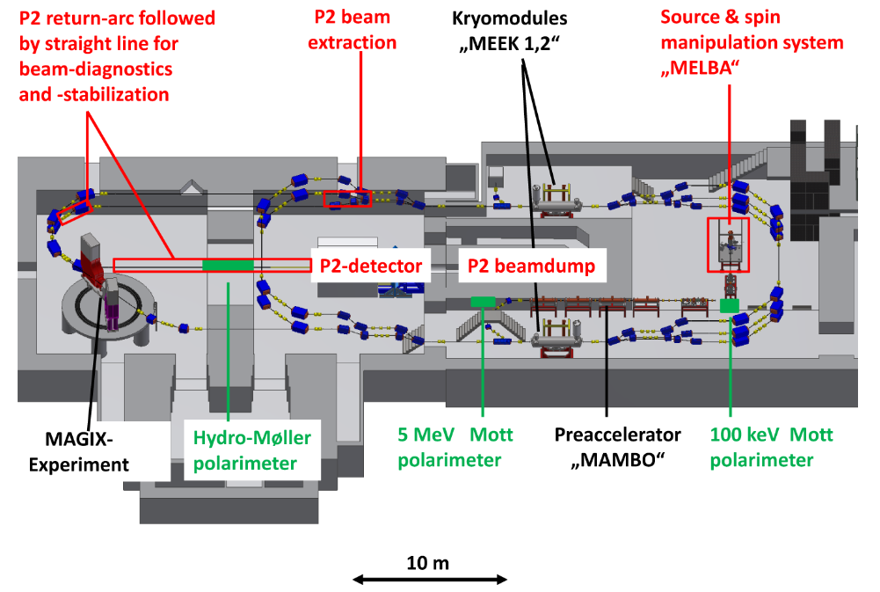
Mainz Energy-Recovering Superconducting Accelerator
Electron beam with kinetic energy of 55 or 155 MeV
85% polarization efficiency
150 μA beam current
Polarization measurement with accuracy better than 1%
EPJ A, 54(11), 2018
Fig.11 Schematic view of MESA

Slide 12
The P2 experiment
Aimed to measure weak mixing angle sin²θ_{W} through parity-violating elastic electron scattering on hydrogen
Uses solenoid spectrometer with tracking detectors and Cherenkov detector
The same setup but with ²⁰⁸Pb target can be used for neutron skin measurement to confirm/confront PREX results
EPJ A, 54(11), 2018
Fig.12 CAD drawing of the P2 detector

Slide 13
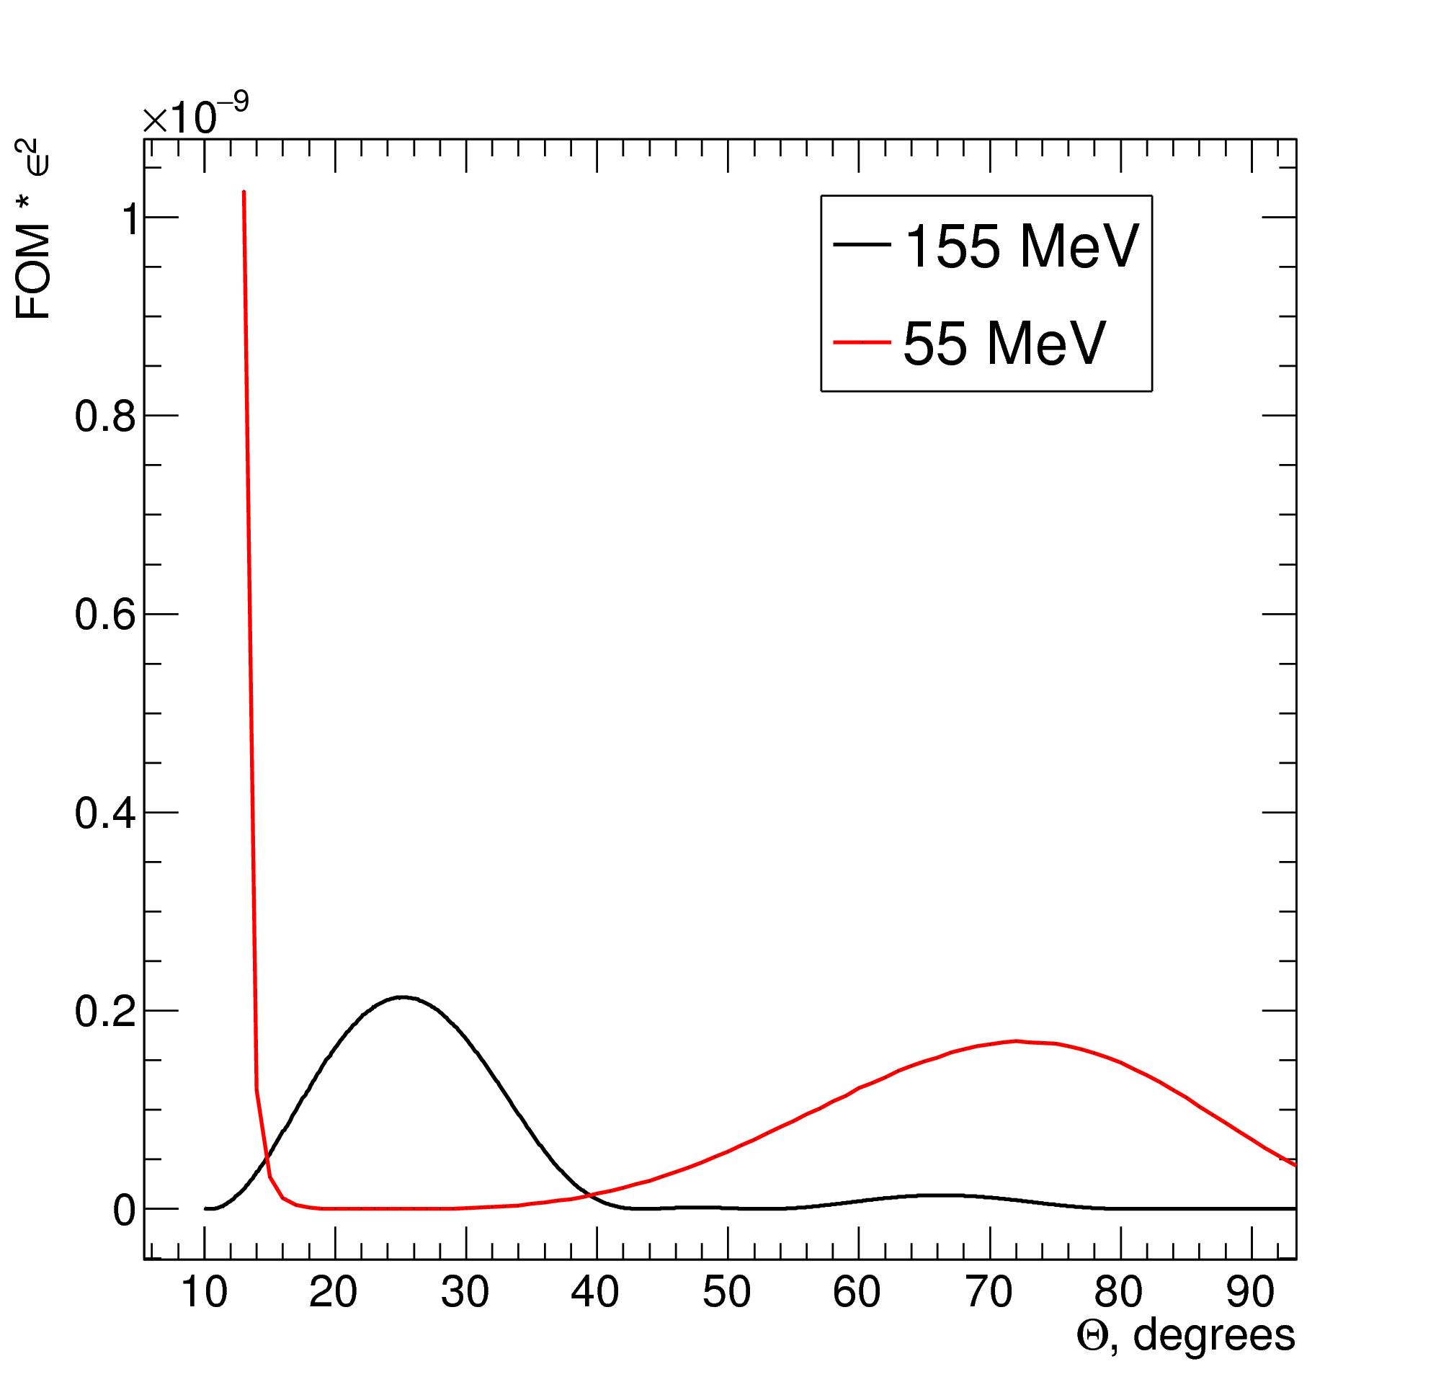
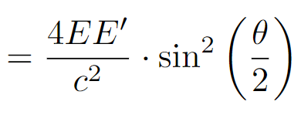
Outline for MREX
Average momentum transfer <Q²>= 0.0062 GeV² to match PREX kinematics
Achieve neutron radius precision δR_{n}/R_{n} of at least 1%, best case scenario: δR_{n}/R_{n} = 0.5%
²⁰⁸Pb target with thickness of 0.5 mm for balance between rate and radiative losses increase
Fig.13 R_{n} measurement “quality” dependence on scattering angle

Slide 14
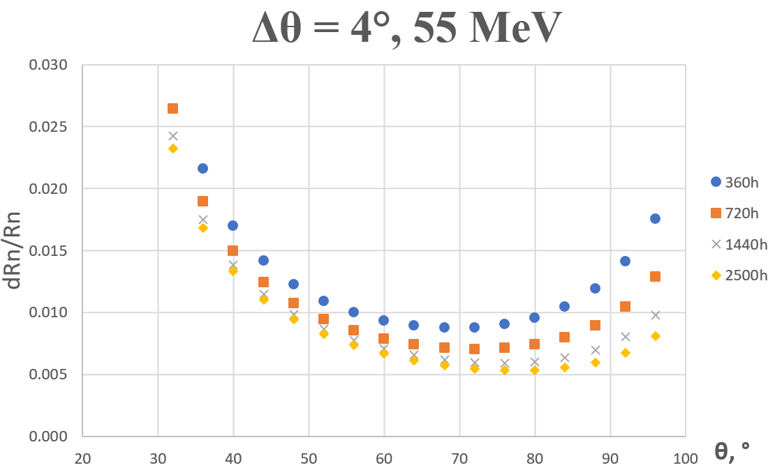
MREX achievable uncertainty
Necessary uncertainty can be achieved at both energies that are possible at MESA
Desirable Q² corresponds to:
29° average scattering angle at 155 MeV – fits uncertainty and detector geometry
91° average scattering angle at 55 MeV – impossible with solenoid geometry
Fig.14 Achievable relative uncertainty of R_{n} for certain measuring time in case of detection of all electrons with 4° acceptance. 1% systematic uncertainty for A^{PV} assumed

Slide 15
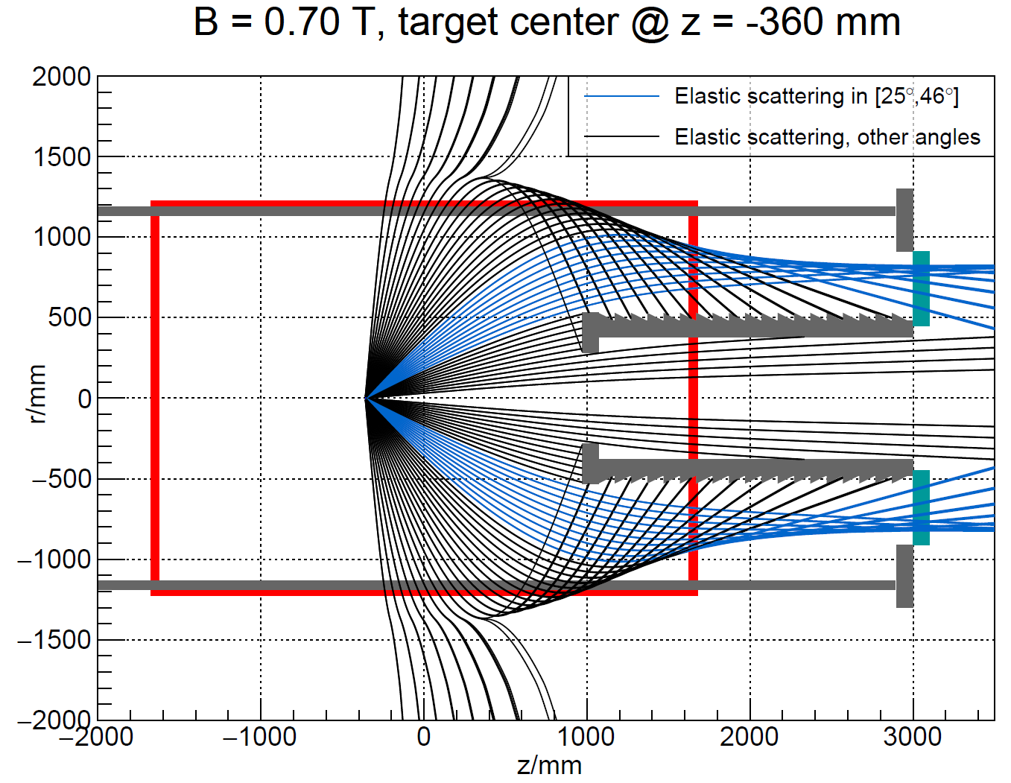
Target position and field strength
Criteria for choosing detector setup:
Maximizing signal from elastically scattered electrons
Matching necessary Q² value
Minimizing signal from secondary produced particles
Minimizing signal from target background
Decrease influence of inelastic events
Chosen optimal geometry configuration:
Fig.15 Tracks of elastically scattered electrons in consideration with magnetic field map

Slide 16
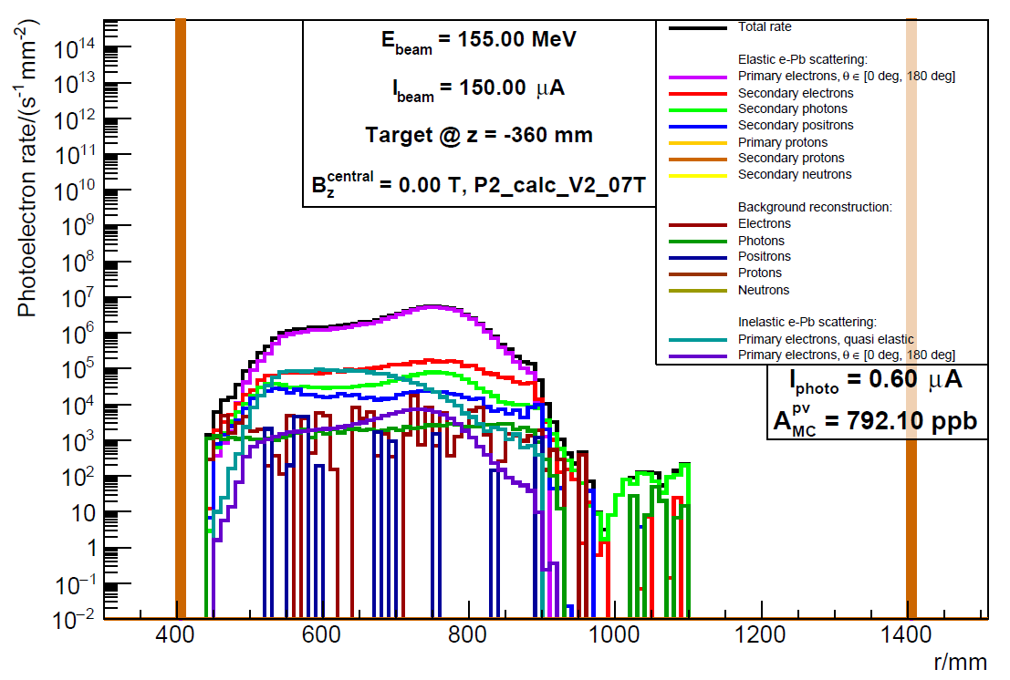
Full Monte-Carlo simulation
P2 simulation framework was modified to be able to produce calculations for MREX
Geant4 as a base, custom event generator of elastically, inelastically and quasielastically scattered electrons
Includes detector response function, allowing to account for detection probability of different particles at different momenta
Fig.16 Photoelectron rate distribution in Cherenkov detector from different particles considered in the simulation as a function of the distance r to the beam axis

Slide 17
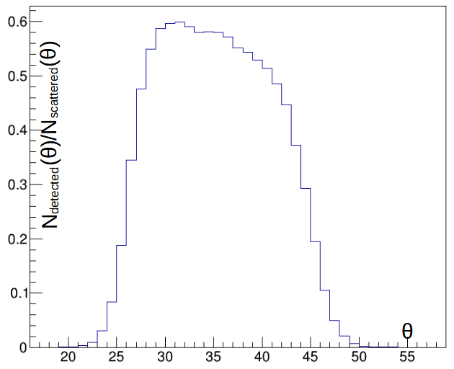
Acceptance and measuring time
Currently, the measuring times extracted from theoretical predictions and simulated acceptance function, assuming 1% systematic uncertainty for A^{PV}, are:
80 hours to reach 1% uncertainty for R_{n}
1000 hours to reach 0.5% uncertainty for R_{n}
However, further analysis of systematic uncertainties both from theory and experiment is necessary
Fig.17 Fraction of scattered electrons reaching the detector as a function of scattering angle

Slide 18
Summary
Nuclear Equation of State is necessary for descriptions of any nuclear systems, from nuclei to neutron stars.
Experimental measurement of neutron skins in nuclei allow to constrain Nuclear Equation of State parameterization.
PREX measurement of neutron skin in ²⁰⁸Pb must be cross-checked
MESA and P2 experimental setup allow for MREX to do that
Monte-Carlo simulation confirm that MREX could reach necessary neutron radius uncertainty in reachable measuring time

Slide 19
Back-up

Slide 20
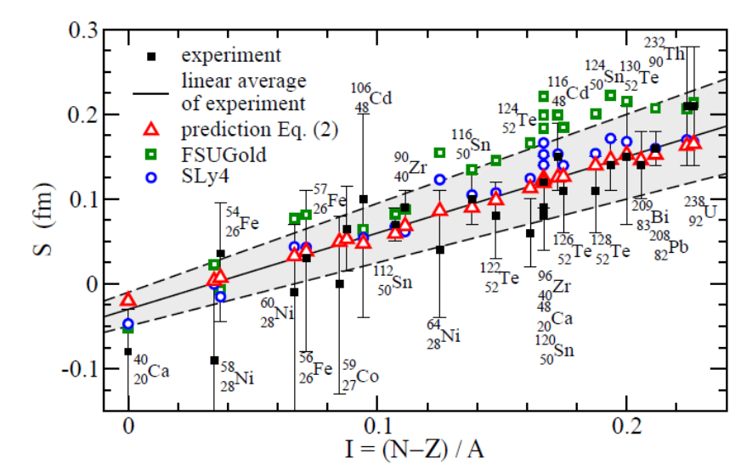
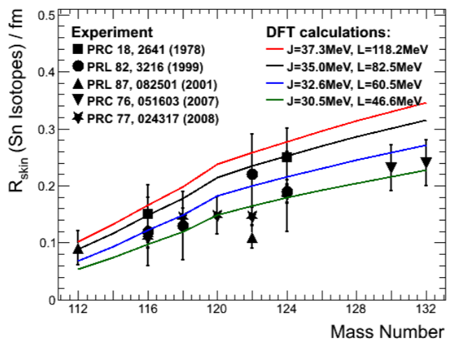
Experimental measurements of neutron skin
Fig.5 Neutron skin thickness from antiprotonic atoms and theoretical predictions for wide range of nuclei
Hadronic probes
Antiprotonic atoms
Proton-nucleus scattering
α-nucleus and π-nucleus scattering
Electric dipole strength function
Electric dipole polarizability
Pygmy dipole resonances
Coherent π⁰ photoproduction
PRL, 102 (2009), 122502
However, most of these measurements are highly model depended
J. Phys. G, 46 (2019), 093003
Fig.6 Neutron skin thickness of Sn isotopes from hadronic probes and theory

Slide 21
Symmetry energy and L impact on physics
L defines the properties of any asymmetric baryonic systems with unequal numbers of protons and neutrons (or up and down quarks), as in:
Nuclei (e.g. neutron skin, isoscalar monopole resonance, electric dipole polarizability)
Neutron stars (e.g. neutron star radii, cooling, gravitational waves from collision)
Supernovae (e.g. core collapse supernovae with following neutrino burst)
Heavy ion collisions (e.g. nucleon emission, π⁻/π⁺ ratio, Δ and K production)

Slide 22
Changes in the simulation
Upgraded to run in batch mode on MOGON cluster for higher statistics
Updated physics list to include necessary physics
Revised beam-target interaction model to better describe energy deposition and scattering angles
Changed target vertex generation algorithm to produce more physical special vertex distribution
Corrected formfactor in the event generator to better describe experimental data
Introduced new variables for new plots and observables

