Slide 1
Current Status of the ULQ2 Experiment
Yuki Honda
Research Center for Electron Photon Science (ELPH), Tohoku Univ., Japan

Slide 2
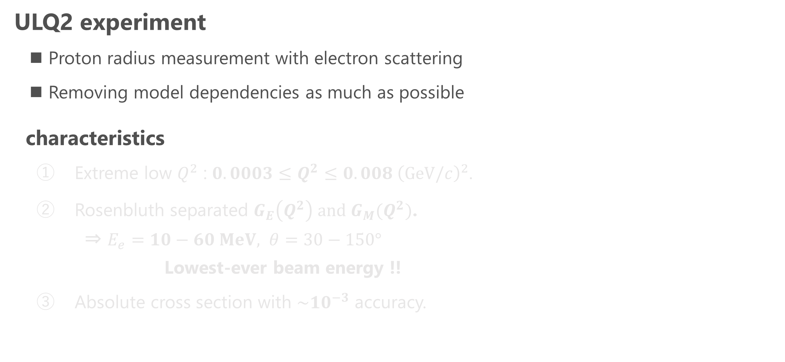
Ultra Low Q² (ULQ2) experiment
ULQ2 experiment
  Proton radius measurement with electron scattering
  Removing model dependencies as much as possible
characteristics
  Extreme low $Q^{2}$ : $0.0003≤Q^{2}≤0.008 {\left(GeV/c\right)}^{2}$.
  Rosenbluth separated $G_{E}\left(Q^{2}\right) and{ G}_{M}(Q^{2})$.
  ⇒ $E_{e}=10−60 MeV, θ=30−150°$
  Lowest-ever beam energy !!
  Absolute cross section with ${\sim 10}^{−3}$ accuracy.

Slide 3
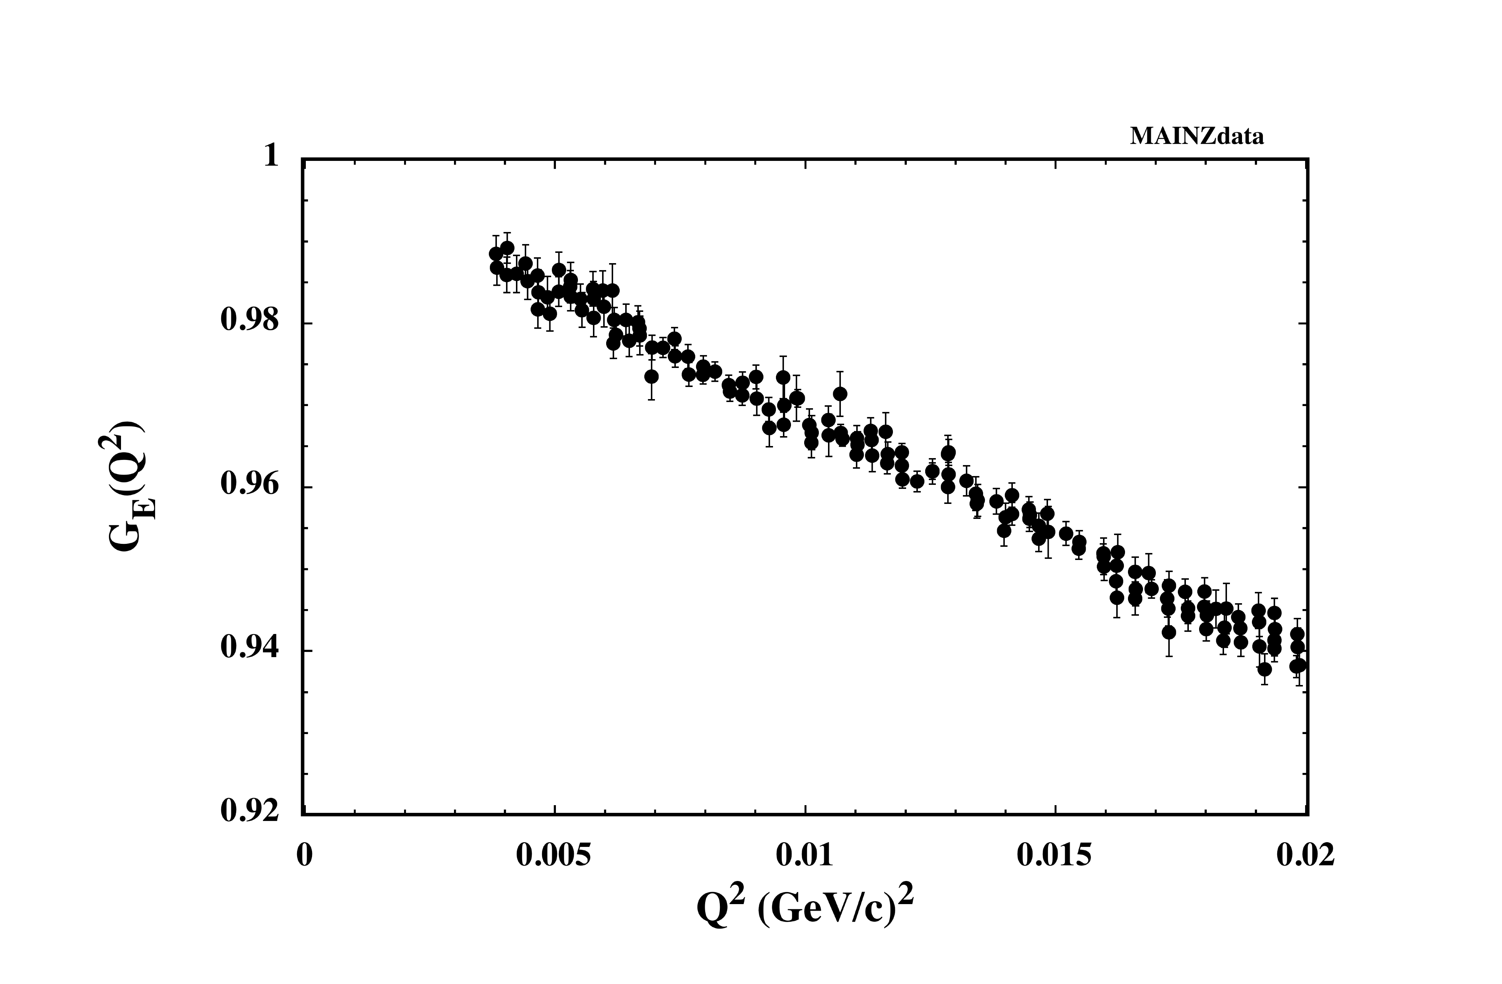



Ultra Low Q² (ULQ2) experiment
ULQ2 experiment
  Proton radius measurement with electron scattering
  Removing model dependencies as much as possible
characteristics
  Extreme low $Q^{2}$ : $0.0003≤Q^{2}≤0.008 {\left(GeV/c\right)}^{2}$.
  Rosenbluth separated $G_{E}\left(Q^{2}\right) and{ G}_{M}(Q^{2})$.
  ⇒ $E_{e}=10−60 MeV, θ=30−150°$
  Lowest-ever beam energy !!
  Absolute cross section with ${\sim 10}^{−3}$ accuracy.
  $r_{p}^{2} ≡−6\frac{dG_{E}\left(Q^{2}\right)}{dQ^{2}}{\left.​\right|}_{Q^{2}→0}$
$$∝r_{p}^{2}$$
Mainz data (2014)
Ee = 180 - 855 MeV

Slide 4
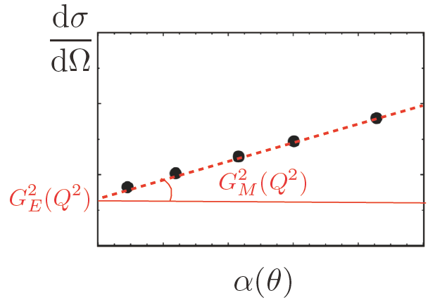


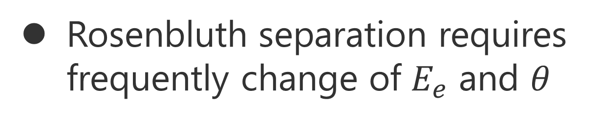
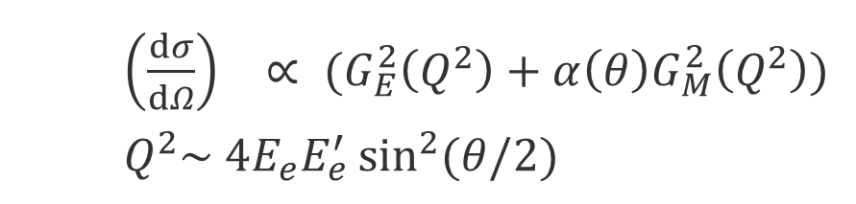
Ultra Low Q² (ULQ2) experiment
$$\frac{\left(1+τ\right)\left(\frac{dσ}{dΩ}\right)}{{\left(\frac{dσ}{dΩ}\right)}_{Mott}}$$
ULQ2 experiment
  Proton radius measurement with electron scattering
  Removing model dependencies as much as possible
characteristics
  Extreme low $Q^{2}$ : $0.0003≤Q^{2}≤0.008 {\left(GeV/c\right)}^{2}$.
  Rosenbluth separated $G_{E}\left(Q^{2}\right) and{ G}_{M}(Q^{2})$.
  ⇒ $E_{e}=10−60 MeV, θ=30−150°$
  Lowest-ever beam energy !!
  Absolute cross section with ${\sim 10}^{−3}$ accuracy.
Rosenbluth separation
  ${\left(\frac{dσ}{dΩ}\right)}_{}∝ (G_{E}^{2}\left(Q^{2}\right)+α\left(θ\right)G_{M}^{2}\left(Q^{2}\right))$
  $Q^{2}\sim 4E_{e}E_{e}^{′}\sin^{2}{(θ/2)}$
Rosenbluth separation requires frequently change of $E_{e}$ and $θ$

Slide 5
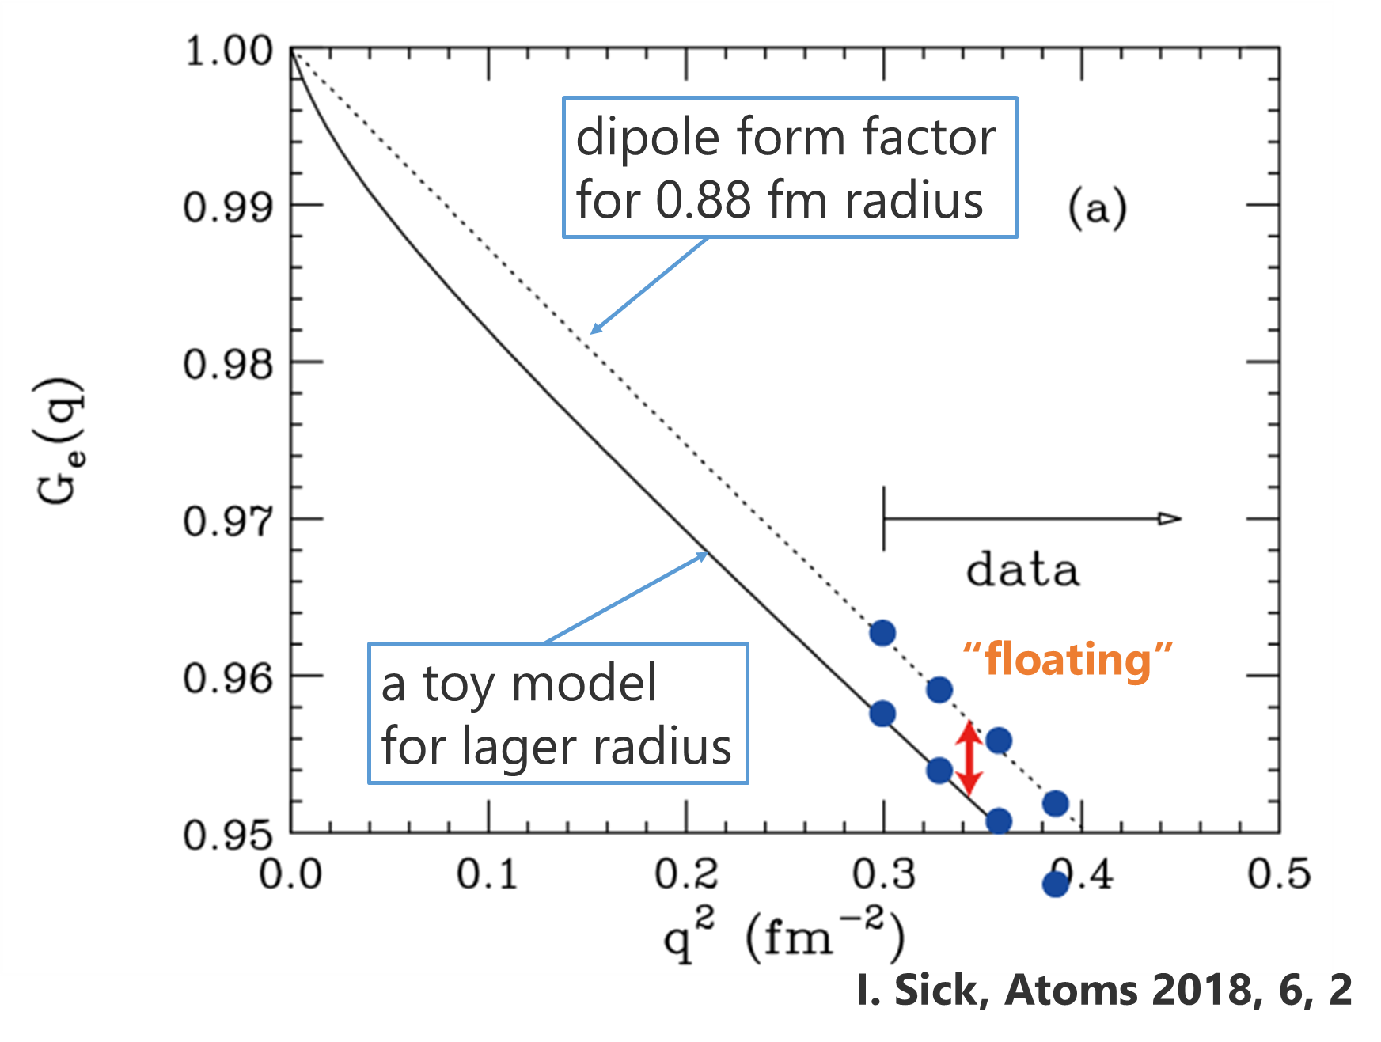


Ultra Low Q² (ULQ2) experiment
$$∝r_{p}^{2}$$
ULQ2 experiment
  Proton radius measurement with electron scattering
  Removing model dependencies as much as possible
characteristics
  Extreme low $Q^{2}$ : $0.0003≤Q^{2}≤0.008 {\left(GeV/c\right)}^{2}$.
  Rosenbluth separated $G_{E}\left(Q^{2}\right) and{ G}_{M}(Q^{2})$.
  ⇒ $E_{e}=10−60 MeV, θ=30−150°$
  Lowest-ever beam energy !!
  Absolute cross section with ${\sim 10}^{−3}$ accuracy.

Slide 6
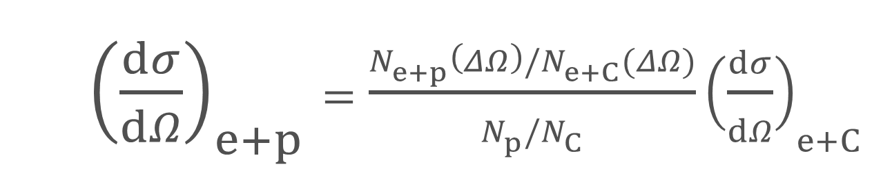
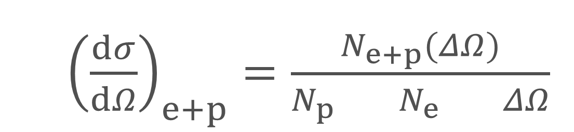
Ultra Low Q² (ULQ2) experiment
ULQ2 experiment
  Proton radius measurement with electron scattering
  Removing model dependencies as much as possible
characteristics
  Extreme low $Q^{2}$ : $0.0003≤Q^{2}≤0.008 {\left(GeV/c\right)}^{2}$.
  Rosenbluth separated $G_{E}\left(Q^{2}\right) and{ G}_{M}(Q^{2})$.
  ⇒ $E_{e}=10−60 MeV, θ=30−150°$
  Lowest-ever beam energy !!
  Absolute cross section with ${\sim 10}^{−3}$ accuracy.
Relative measurement to
well-known cross section.
e+p / e+C scattering → CH2 target
  ${\left(\frac{dσ}{dΩ}\right)}_{e+p}=\frac{N_{e+p}(ΔΩ)}{N_{p} { N}_{e} ΔΩ}$
  p target
  number
  Beam
  dose
  Solid
  angle
  ${\left(\frac{dσ}{dΩ}\right)}_{e+p}=\frac{N_{e+p}\left(ΔΩ\right)/N_{e+C}(ΔΩ)}{N_{p}/N_{C}}{\left(\frac{dσ}{dΩ}\right)}_{e+C}$
Ratio of p and C
Well known
measure with LC/MS

Slide 7
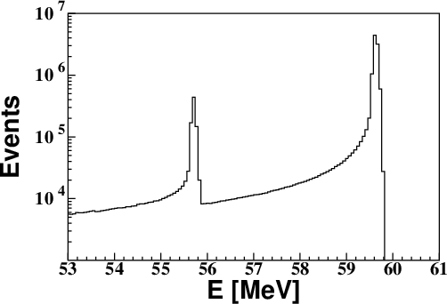

Ultra Low Q² (ULQ2) experiment
ULQ2 experiment
  Proton radius measurement with electron scattering
  Removing model dependencies as much as possible
characteristics
  Extreme low $Q^{2}$ : $0.0003≤Q^{2}≤0.008 {\left(GeV/c\right)}^{2}$.
  Rosenbluth separated $G_{E}\left(Q^{2}\right) and{ G}_{M}(Q^{2})$.
  ⇒ $E_{e}=10−60 MeV, θ=30−150°$
  Lowest-ever beam energy !!
  Absolute cross section with ${\sim 10}^{−3}$ accuracy.
Relative measurement to
well-known cross section.
e+p / e+C scattering → CH2 target
$E_{e}=60 MeV$
$θ=100°$
e+C
e+p

Slide 8
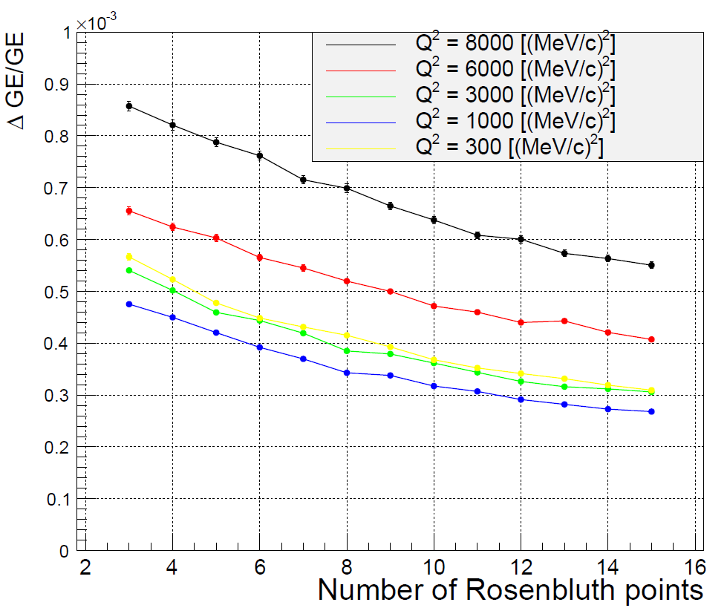
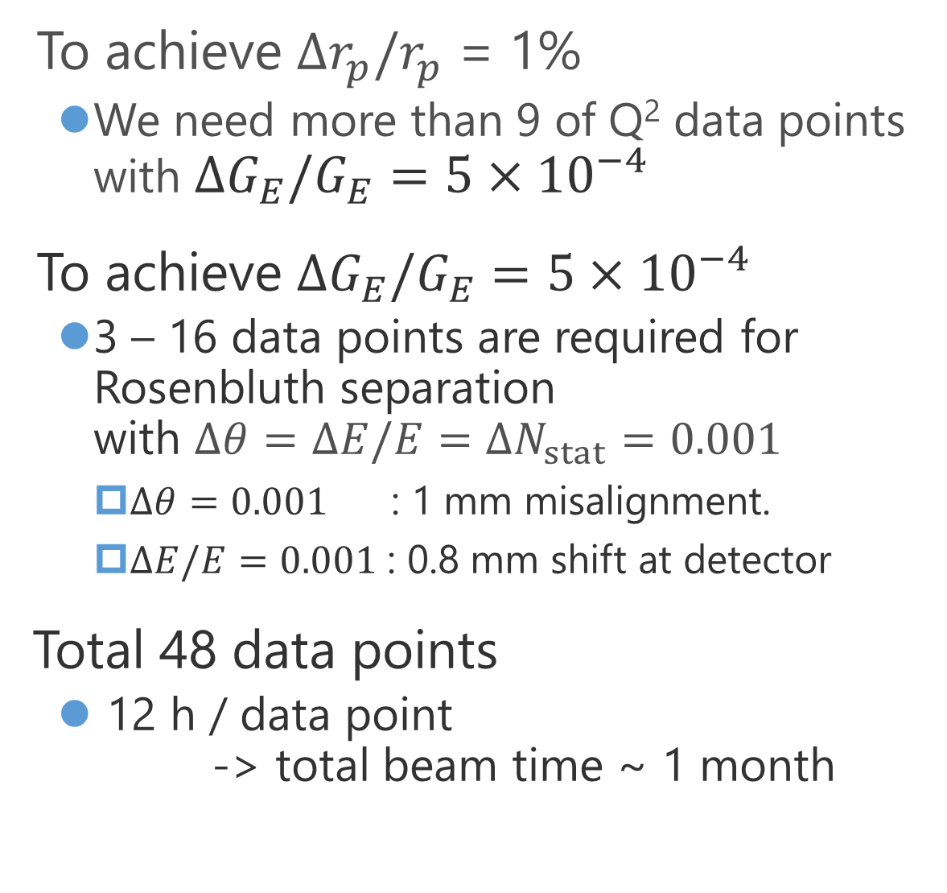
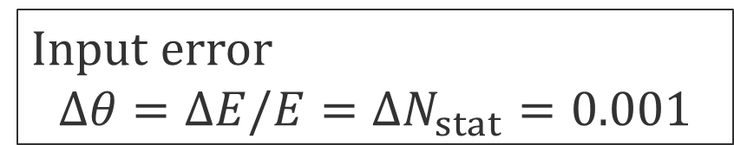
Ultra Low Q² (ULQ2) experiment
To achieve $Δr_{p}/r_{p}$ = 1%
  We need more than 9 of Q² data points with $ΔG_{E}/G_{E}=5×{10}^{−4}$
To achieve $ΔG_{E}/G_{E}=5×{10}^{−4}$
  3 – 16 data points are required for Rosenbluth separation
  with $Δθ=ΔE/E=ΔN_{stat}=0.001$
    $Δθ=0.001$ : 1 mm misalignment.
    $ΔE/E=0.001$ : 0.8 mm shift at detector
Total 48 data points
  12 h / data point
  -> total beam time ~ 1 month
Input error
$$Δθ=ΔE/E=ΔN_{stat}=0.001$$

Slide 9

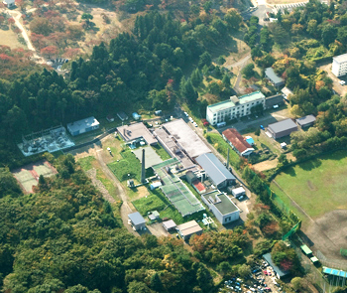
Research Center for Electron Photon Science (ELPH)
Japan
ELPH,
Tohoku Univ.
350 km
Tokyo

Slide 10
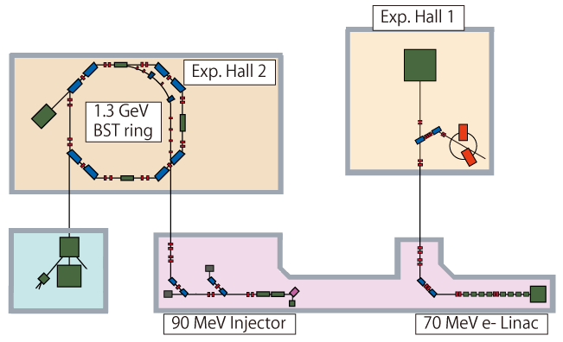
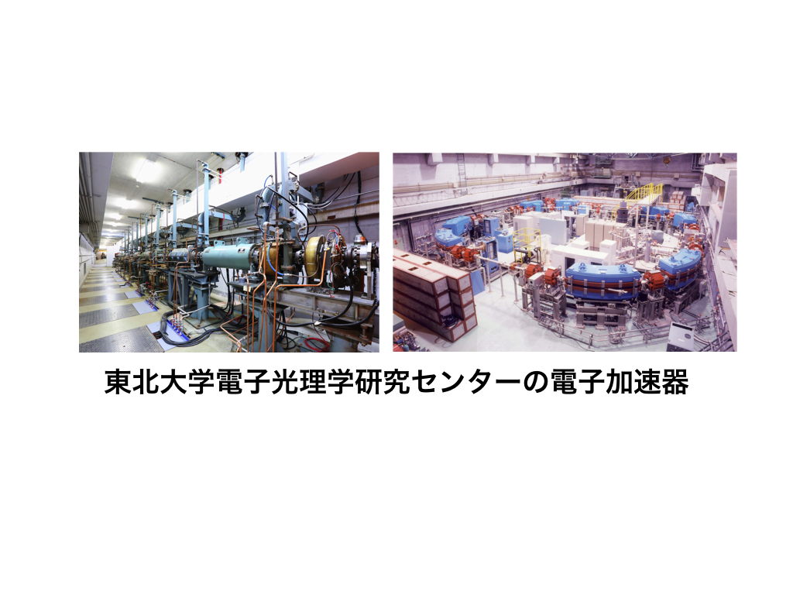
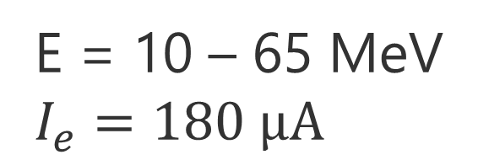
Research Center for Electron Photon Science (ELPH)
1.3 GeV BST ring
70 MeV e- Linac
E = 10 – 65 MeV
$I_{e}=180 μA$

Slide 11
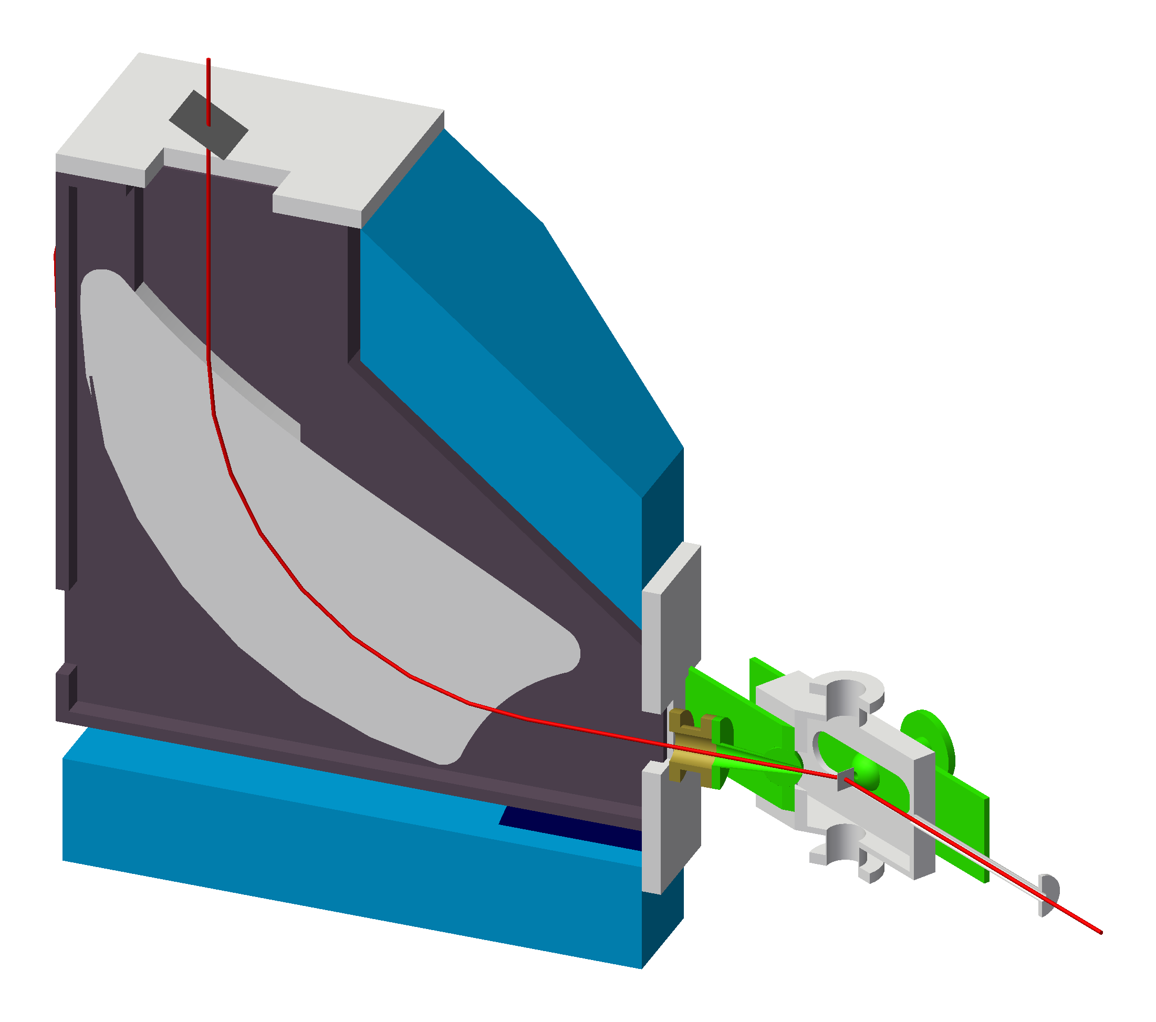
Spectrometer for low-energy electron
③
Simple structure
  Target chamber
  Dipole magnet
  Focal plane detector
Specialized for low-energy electron
  Windowless
  Tracking less
②
1175 mm
①
~3700 kg
910 mm
Notes:
This slide is about a new spectrometer.
Sorry, the color is different but this is the same one.
Our spectrometer has very simple structure, scattering chamber, dipole magnet and focal plane detector.
Electron beam is scattered in chamber by target and incident on the magnet, and bended 90 degree vertically, finally go across the detector.
Size of the dipole is not so large, about 1 m in length, 1 m in height and weight is about four thousand kilo glam.
The spectrometer is specialized for low-energy electron.
First the spectrometer has no window.
It means all of the passages of the electrons are vacuum.
For our low energy electrons, multiple scattering with windows or air will worsen resolutions critically.
Second, the spectrometer does not need tracking to determine a momentum and scattering angle of the electron.
These are determined by only a detecting potion on the detector.
Next slide, I will explain how to realize it.

Slide 12
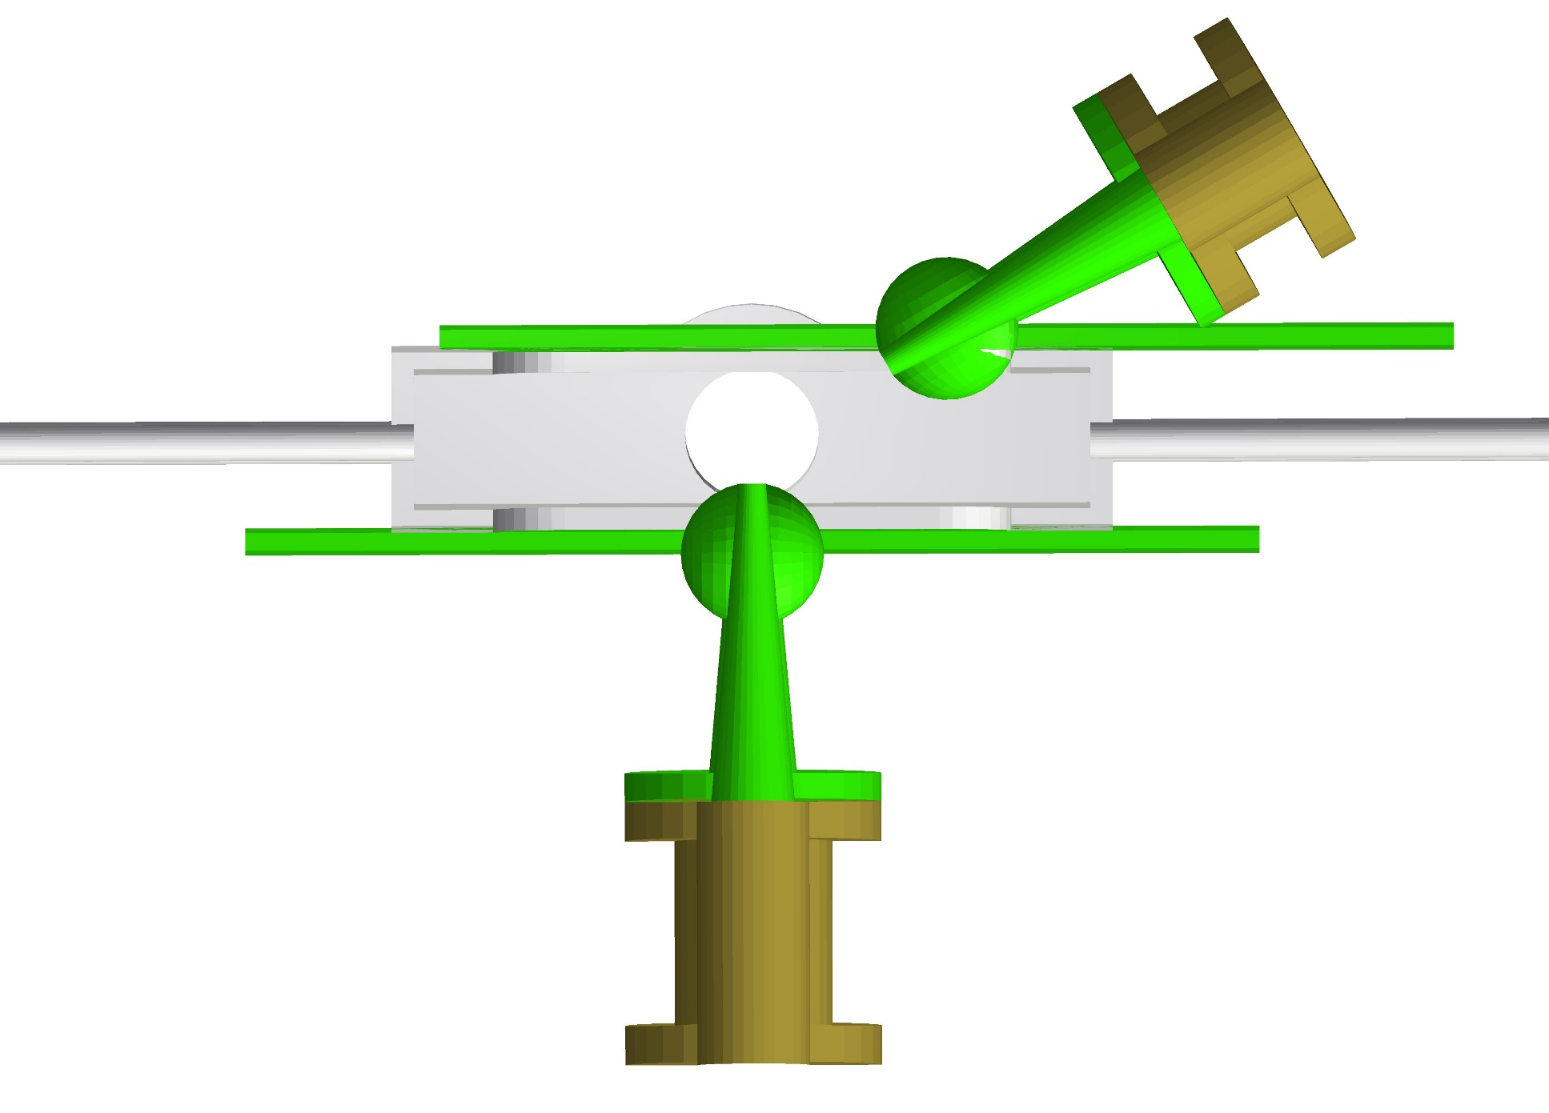
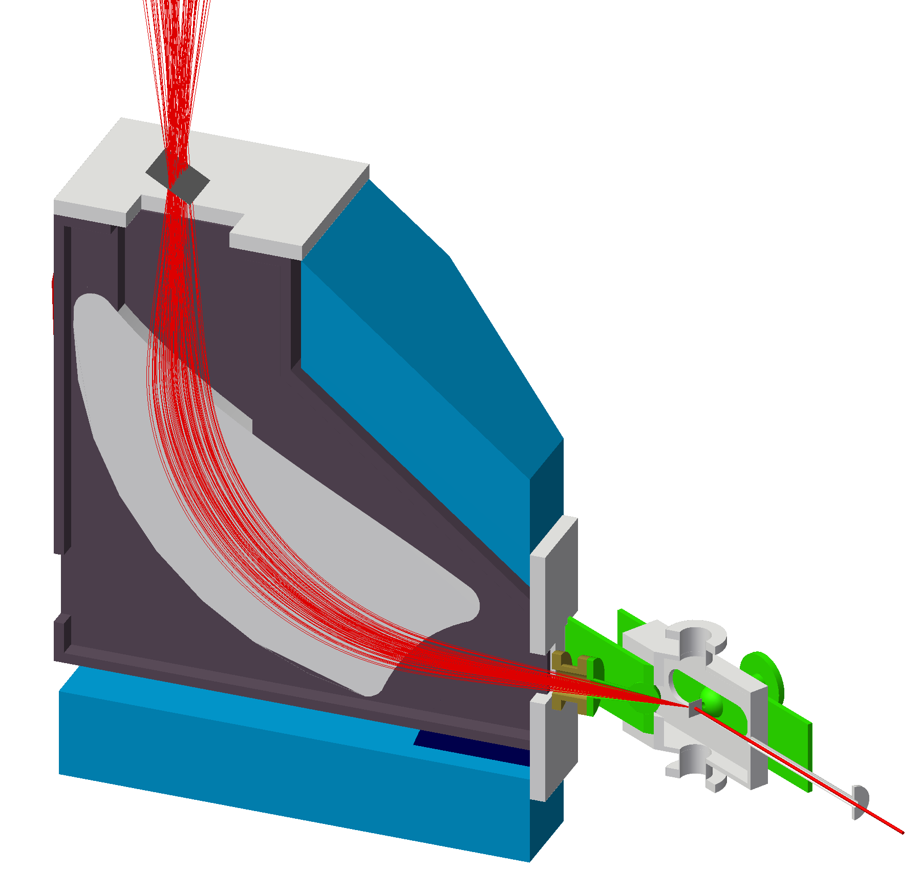

Angle changeable target chamber
Target chamber top view
Vacuum seal : O-ring
$$320 mm×80 mm$$
$$ΔΩ \sim 24 mSr$$
$$30°≤θ≤150°$$
e⁻
Notes:
To avoid the multiple scattering, all of the electron’s passages are vacuum.
Of course, the scattering chamber and magnet are connected with vacuum duct.
However, we will change the angle of the magnet because we do the Rosenbluth separation.
So, we have developed angle changeable target chamber.

Slide 13
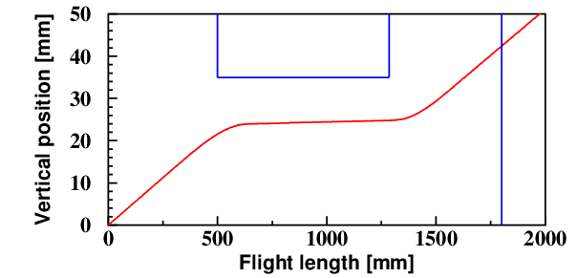
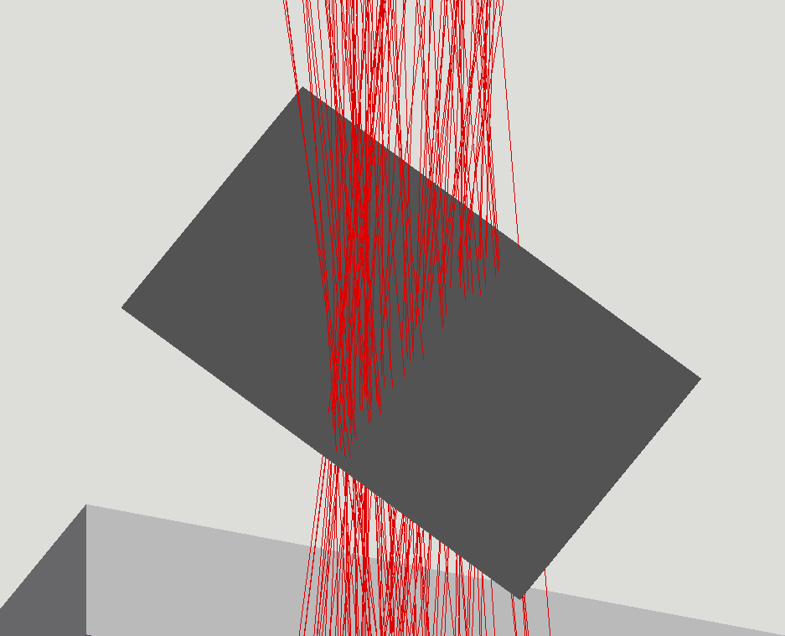
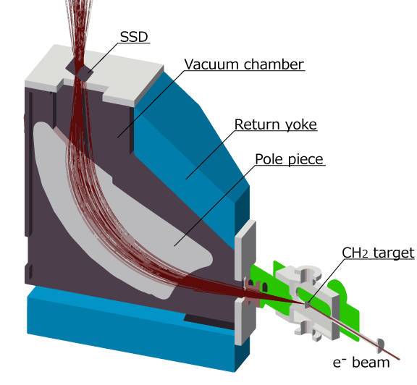
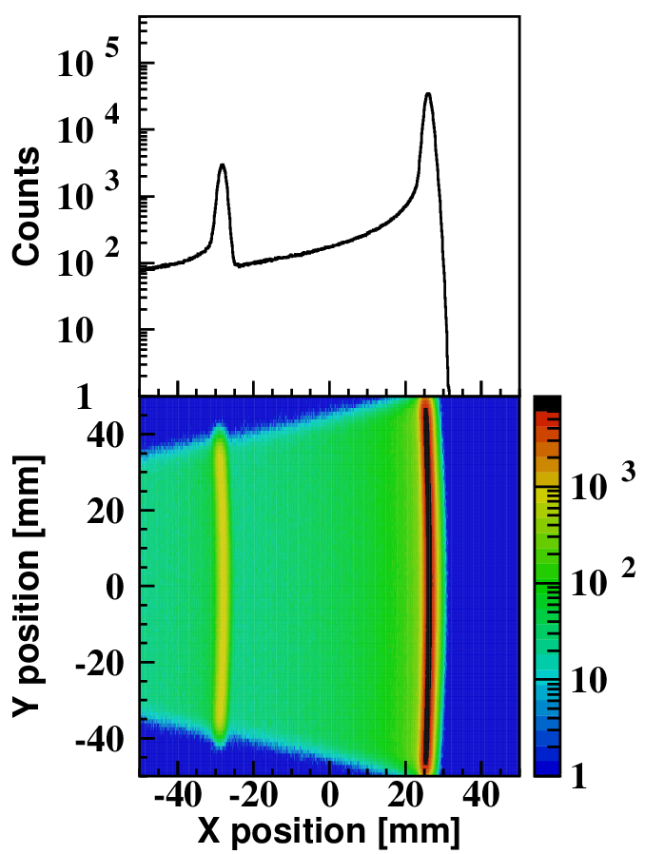
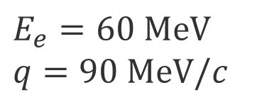





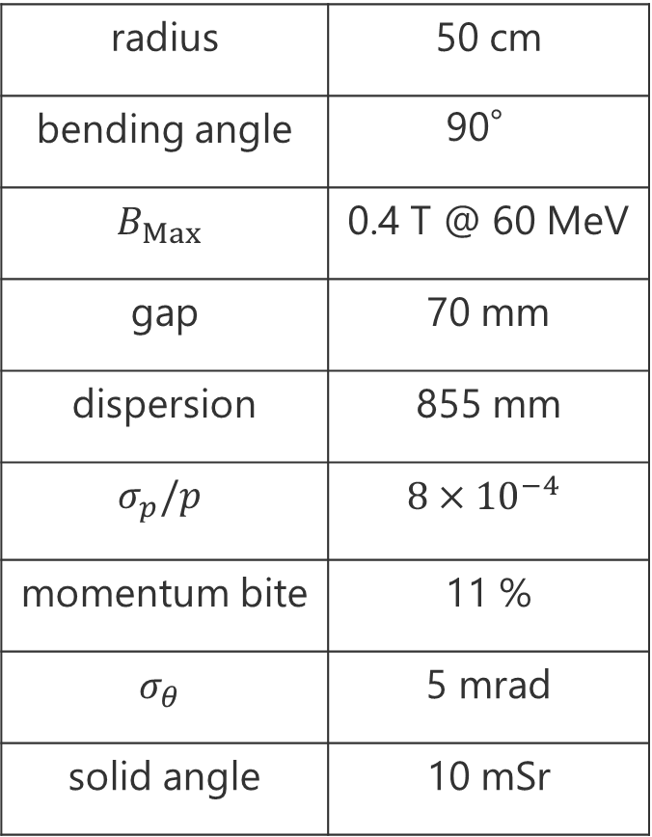
Spectrometer
Vertical trajectory
Pole piece
$$y$$
$$50 mrad$$
Focal plane
$$x$$
$$P_{e}$$
$$Δθ$$
$E_{e}=60 MeV$
$q=90 MeV/c$
radius | 50 cm
bending angle | 90°
$$B_{Max}$$ | 0.4 T @ 60 MeV
gap | 70 mm
dispersion | 855 mm
$$σ_{p}/p$$ | $$8×{10}^{−4}$$
momentum bite | 11 %
$$σ_{θ}$$ | 5 mrad
solid angle | 10 mSr
H
C
1175 mm
Vertical position [mm]
Scattering angle
910 mm
Horizontal position [mm]
Momentum

Slide 14
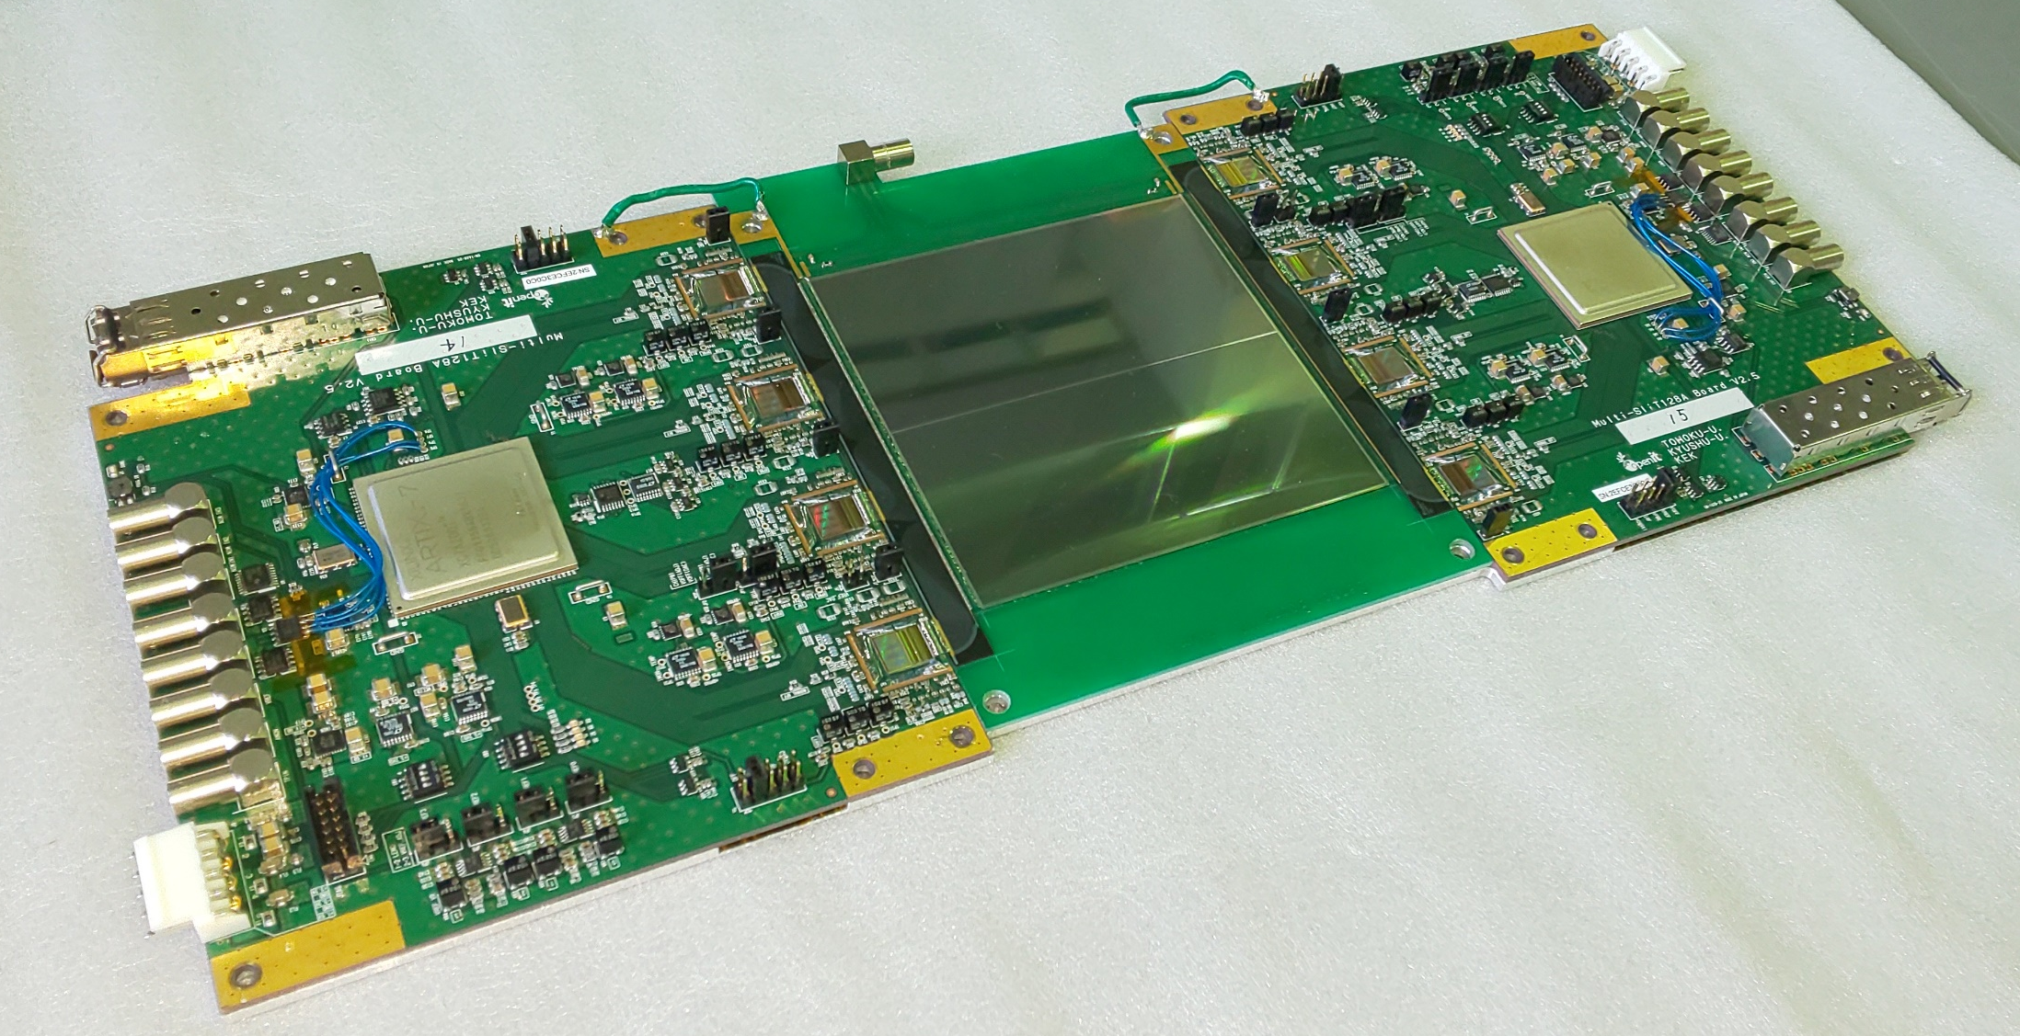
Focal plane detector
J-PARC muon g-2/EDM Test module2
Single-sided silicon detector (SSSD)
Active area | 97.28 mm × 97.28 mm
Thickness | 0.32 mm
Strip length | 48.575 mm
Strip pitch | 0.19 mm
No. of strips | 512 ch × 2
Readout boards
“Multi-Slit128A board”
Four ASICs “Slit128A”
(128 ch/chip)

Slide 15
ULQ2 exp. up to now
Mar. 2019 1st spectrometer construction
Sep. 2020 First beam @ ULQ2 beamline
Sep. 2020 ～ 1st spectrometer commissioning
Aug. 2021 2nd spectrometer construction
Nov. 2021 ～ 2nd spectrometer commissioning
Dec. 2021 ～ New rotational vacuum chamber
installation and test.

Slide 16
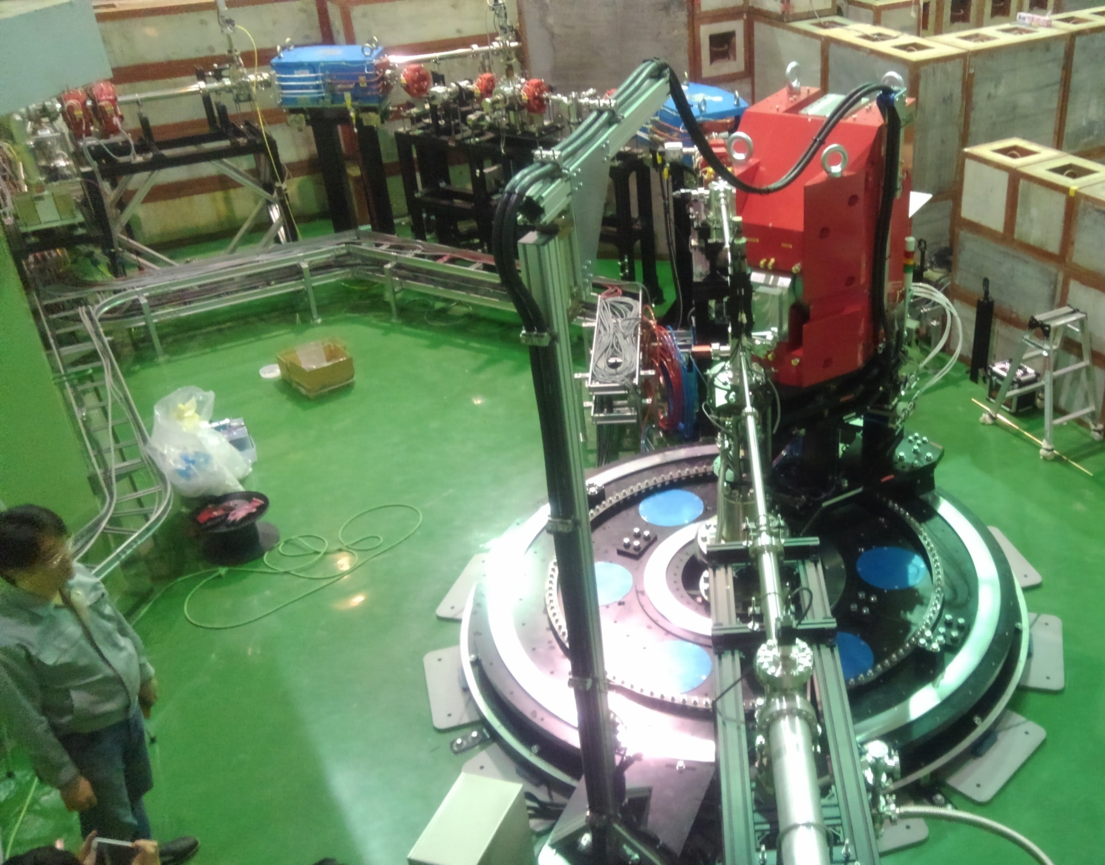
ULQ2 exp. up to now
Mar. 2019 1st spectrometer construction
Sep. 2020 First beam @ ULQ2 beamline
Sep. 2020 ～ 1st spectrometer commissioning
Aug. 2021 2nd spectrometer construction
Nov. 2021 ～ 2nd spectrometer commissioning
Dec. 2021 ～ New rotational vacuum chamber
installation and test.
Apr. 3, 2019

Slide 17
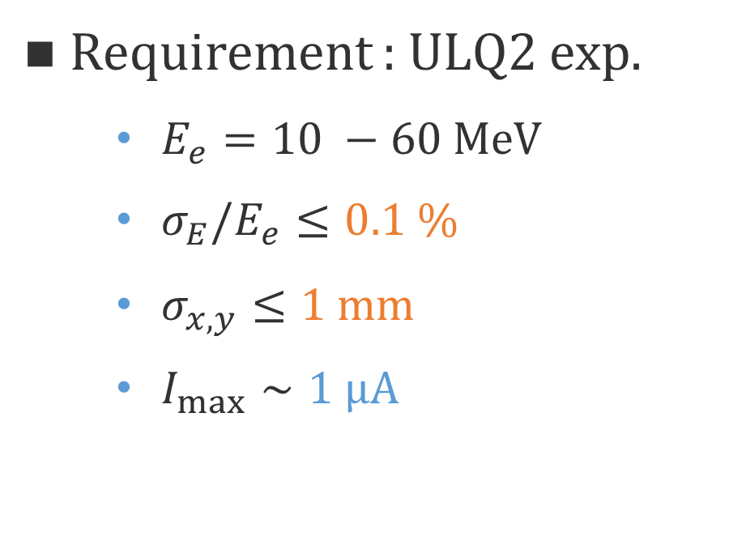
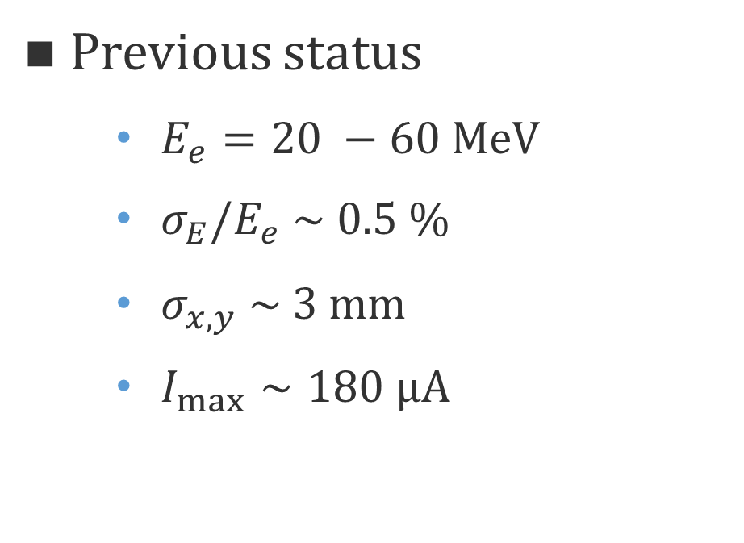
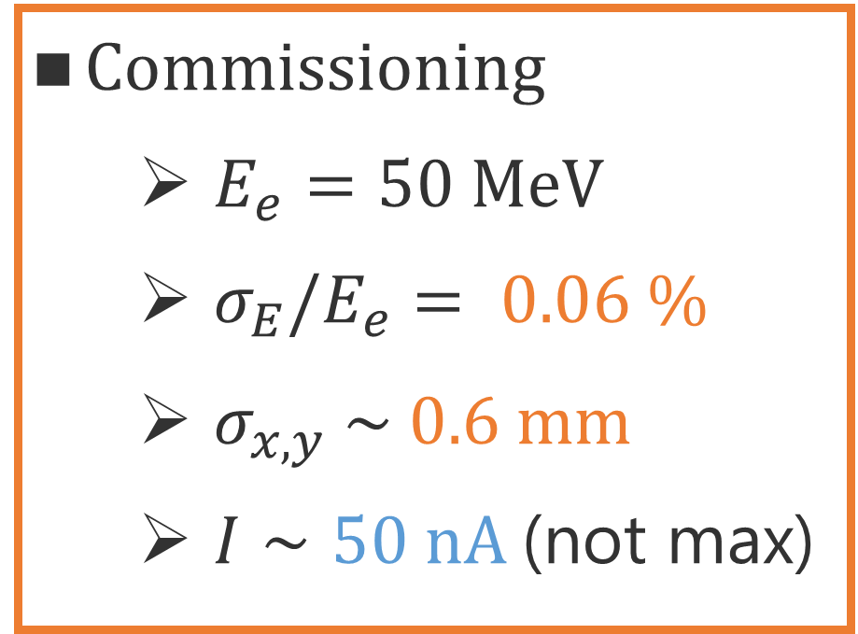
ULQ2 exp. up to now
Previous status
  $E_{e}=20 −60 MeV$
  $σ_{E}/E_{e} \sim 0.5 \%$
  $σ_{x,y} \sim 3 mm$
  $I_{max}∼180 μA$
Requirement : ULQ2 exp.
  $E_{e}=10 −60 MeV$
  $σ_{E}/E_{e}≤0.1 \%$
  $σ_{x,y}≤1 mm$
  $I_{max}∼1 μA$
Mar. 2019 1st spectrometer construction
Sep. 2020 First beam @ ULQ2 beamline
Sep. 2020 ～ 1st spectrometer commissioning
Aug. 2021 2nd spectrometer construction
Nov. 2021 ～ 2nd spectrometer commissioning
Dec. 2021 ～ New rotational vacuum chamber
installation and test.
Commissioning
  $E_{e}=50 MeV$
  $σ_{E}/E_{e}= 0.06 \%$
  $σ_{x,y} \sim 0.6 mm$
  $I∼50 nA$(not max)
First beam@ULQ2
Sep. 11th, 2020

Slide 18
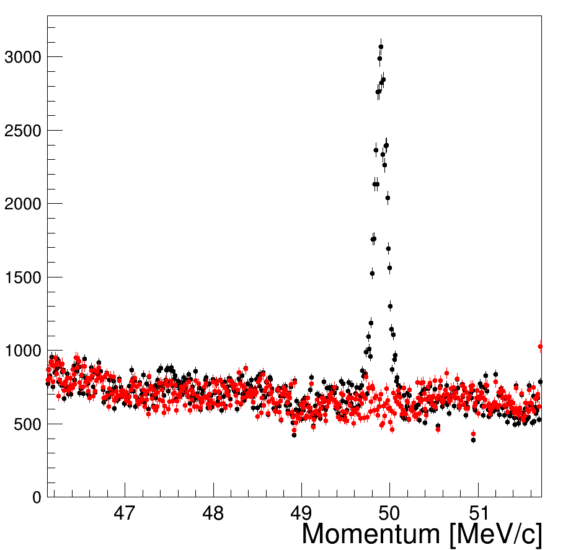
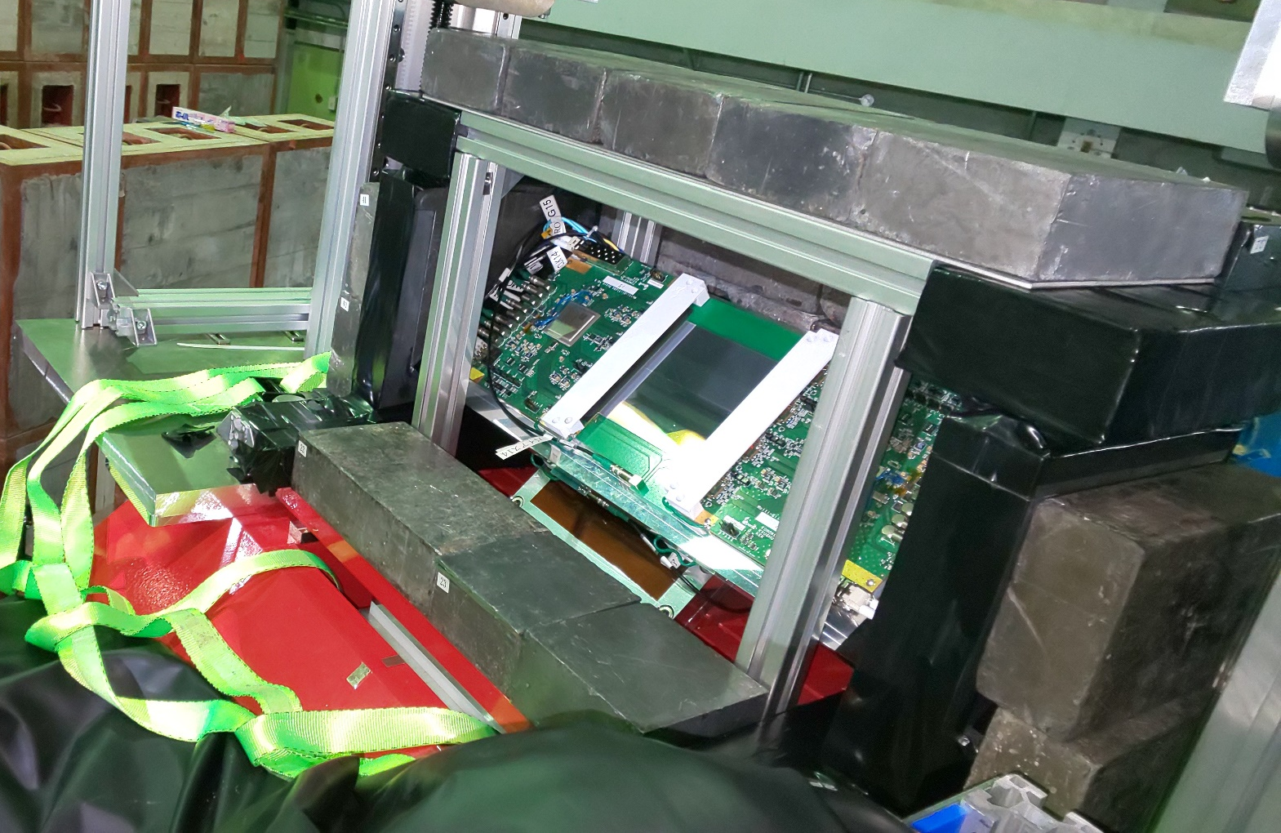
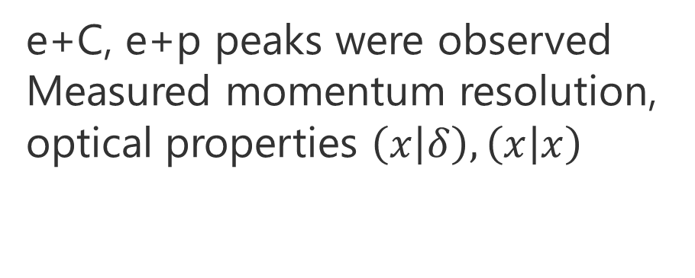
ULQ2 exp. up to now
Mar. 2019 1st spectrometer construction
Sep. 2020 First beam @ ULQ2 beamline
Sep. 2020 ～ 1st spectrometer commissioning
Aug. 2021 2nd spectrometer construction
Nov. 2021 ～ 2nd spectrometer commissioning
Dec. 2021 ～ New rotational vacuum chamber
installation and test.
● : Foreground
● : Background
(Spectrometer magnet off)
e+C
Focal plane detector
e+p
Scattered e⁻
SSD
e+C, e+p peaks were observed
Measured momentum resolution, optical properties $\left(x | δ\right), \left(x | x\right)$

Slide 19
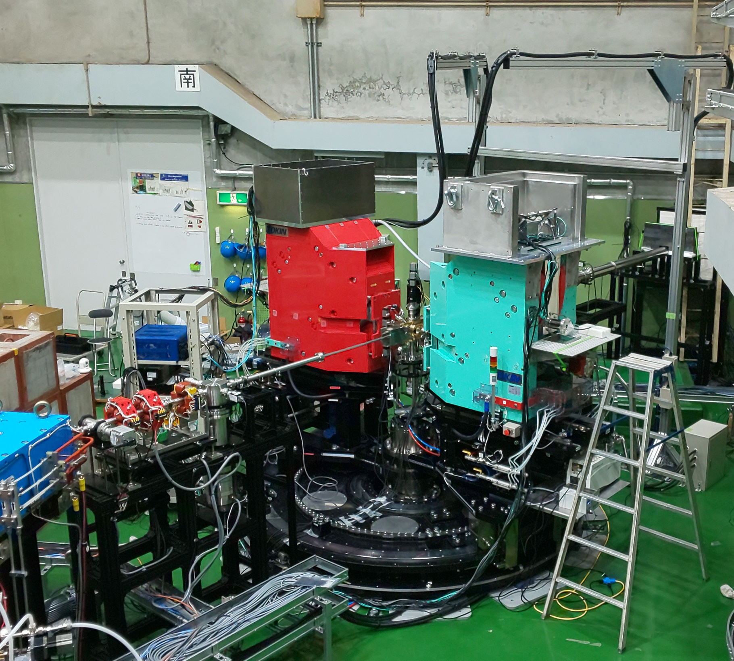
ULQ2 exp. up to now
Mar. 2019 1st spectrometer construction
Sep. 2020 First beam @ ULQ2 beamline
Sep. 2020 ～ 1st spectrometer commissioning
Aug. 2021 2nd spectrometer construction
Nov. 2021 ～ 2nd spectrometer commissioning
Dec. 2021 ～ New rotational vacuum chamber
installation and test.
Dec. 2021
2nd spectrometer for luminosity monitor.
Monitor C H ratio during experiment.

Slide 20
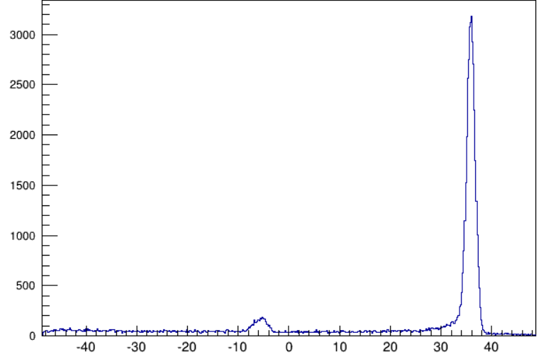
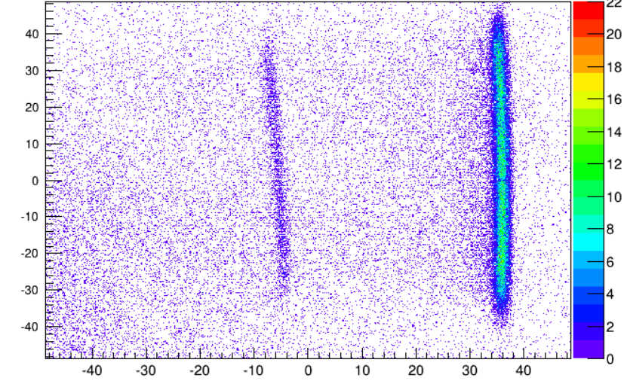
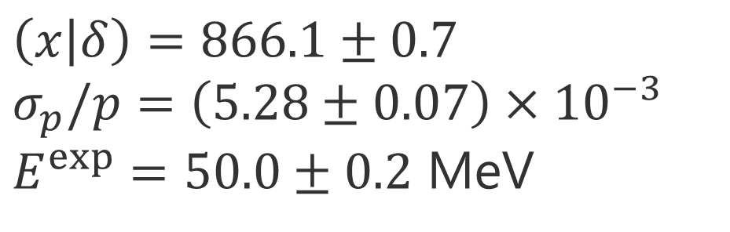
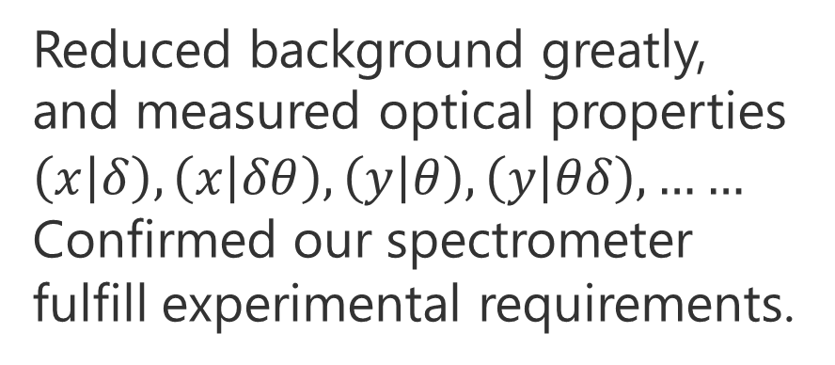
ULQ2 exp. up to now
e+C
Add and improve shield
Mar. 2019 1st spectrometer construction
Sep. 2020 First beam @ ULQ2 beamline
Sep. 2020 ～ 1st spectrometer commissioning
Aug. 2021 2nd spectrometer construction
Nov. 2021 ～ 2nd spectrometer commissioning
Dec. 2021 ～ New rotational vacuum chamber
installation and test.
e+p
$\left(x | δ\right)=866.1±0.7$
$σ_{p}/p=\left(5.28±0.07\right)×{10}^{−3}$
$E^{exp}=50.0±0.2$ MeV
Reduced background greatly, and measured optical properties $\left(x | δ\right), \left(x | δθ\right), \left(y | θ\right), \left(y | θδ\right),……$
Confirmed our spectrometer fulfill experimental requirements.

Slide 21
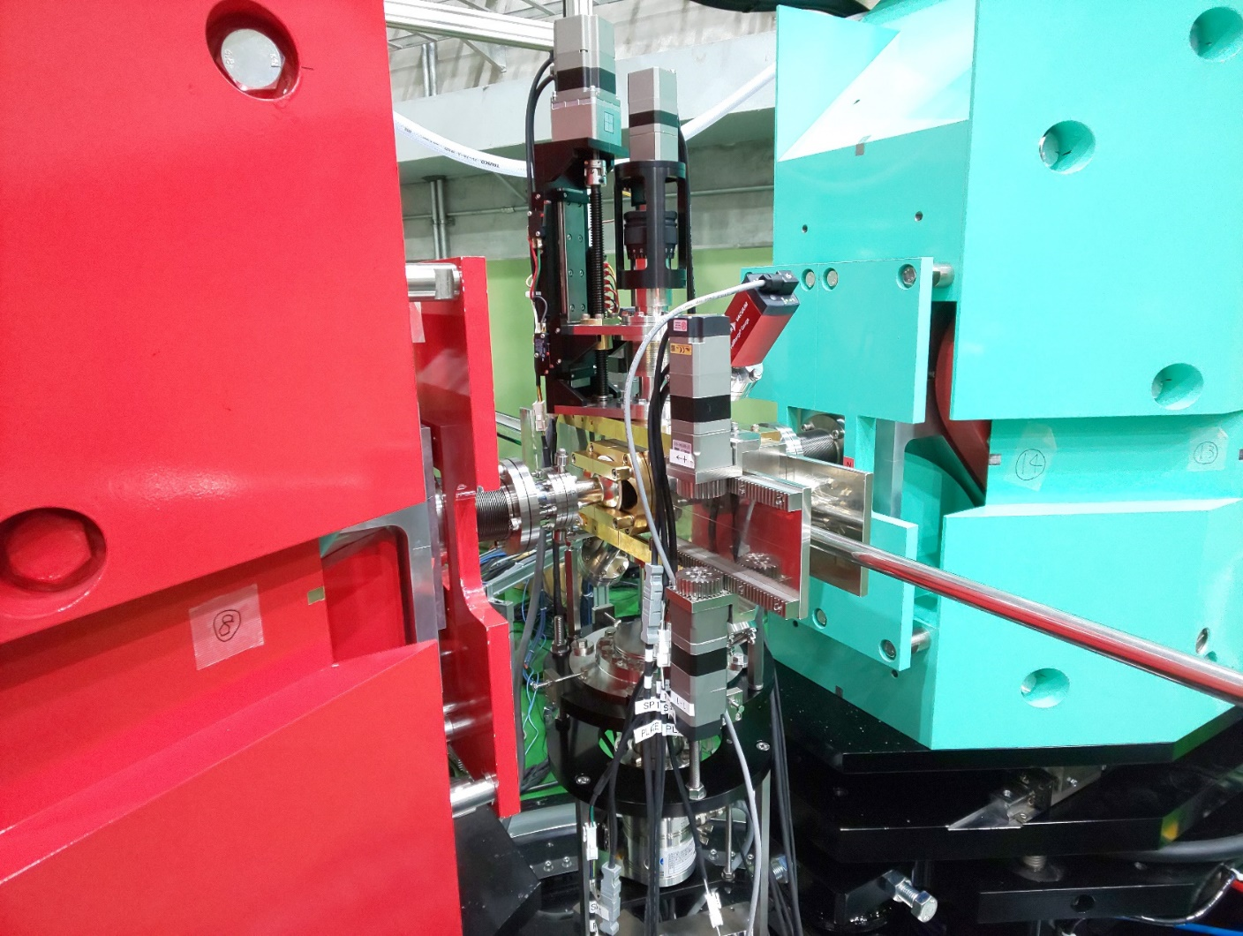
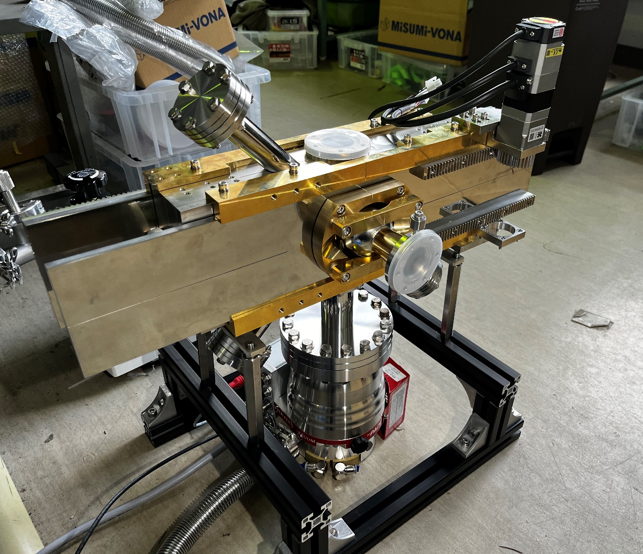
ULQ2 exp. up to now
Mar. 2019 1st spectrometer construction
Sep. 2020 First beam @ ULQ2 beamline
Sep. 2020 ～ 1st spectrometer commissioning
Aug. 2021 2nd spectrometer construction
Nov. 2021 ～ 2nd spectrometer commissioning
Dec. 2021 ～ New rotational vacuum chamber
installation and test.

Slide 22
ULQ2 exp. up to now
Mar. 2019 1st spectrometer construction
Sep. 2020 First beam @ ULQ2 beamline
Sep. 2020 ～ 1st spectrometer commissioning
Aug. 2021 2nd spectrometer construction
Nov. 2021 ～ 2nd spectrometer commissioning
Dec. 2021 ～ New rotational vacuum chamber
installation and test.
The essential experimental equipment have been constructed, and their performances fulfill the experimental requirements.

Slide 23
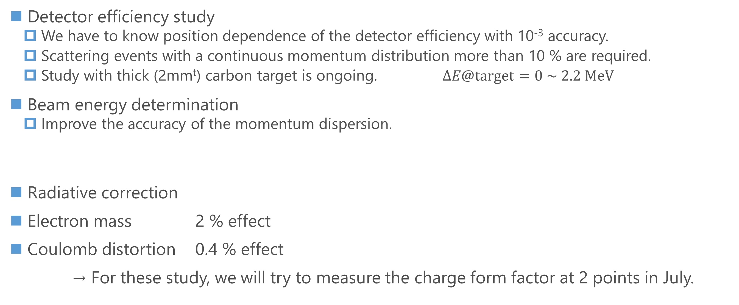
Future tasks
Detector efficiency study
  We have to know position dependence of the detector efficiency with 10⁻³ accuracy.
  Scattering events with a continuous momentum distribution more than 10 % are required.
  Study with thick (2mm^{t}) carbon target is ongoing. $ΔE@target=0 \sim 2.2 MeV$
Beam energy determination
  Improve the accuracy of the momentum dispersion.
Radiative correction
Electron mass 2 % effect
Coulomb distortion 0.4 % effect
→ For these study, we will try to measure the charge form factor at 2 points in July.
We will start physics run in FY2022.

Slide 24
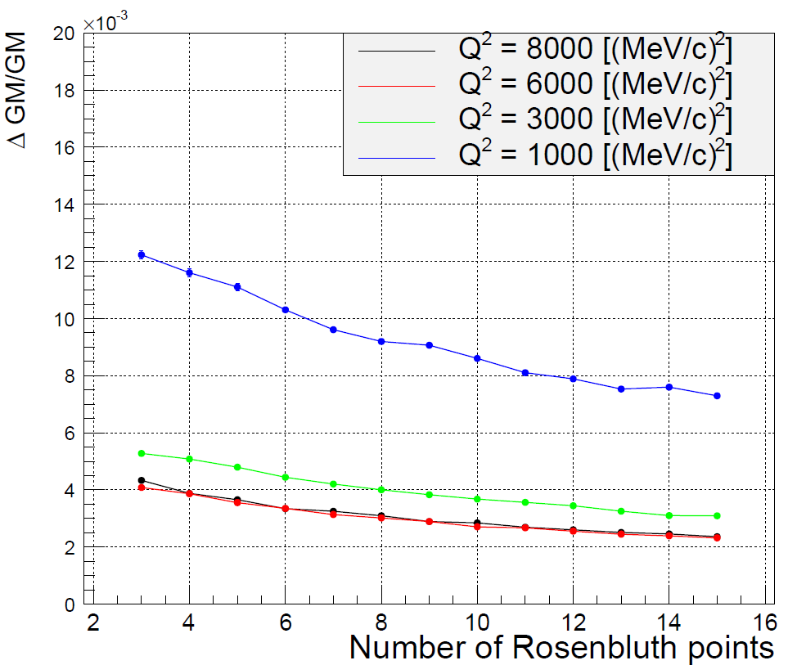
Magnetic form factor

