Slide 1
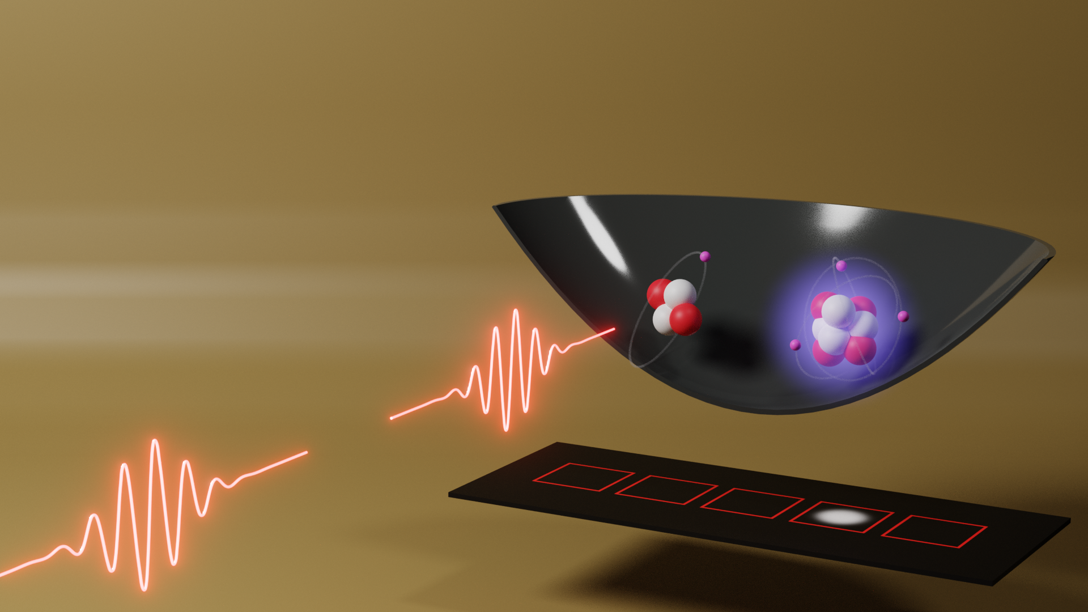
Towards Ramsey-Comb Spectroscopy of the 1S-2S transition in He⁺
Elmer Gründeman Vrije Universiteit Amsterdam
22.06.2022

Slide 2
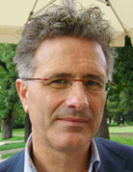
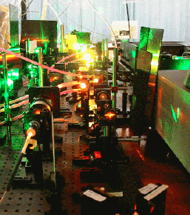
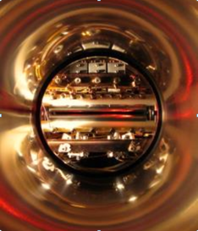
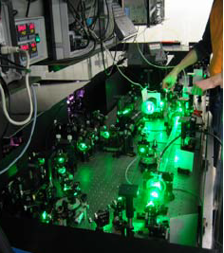
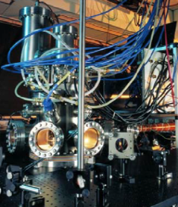
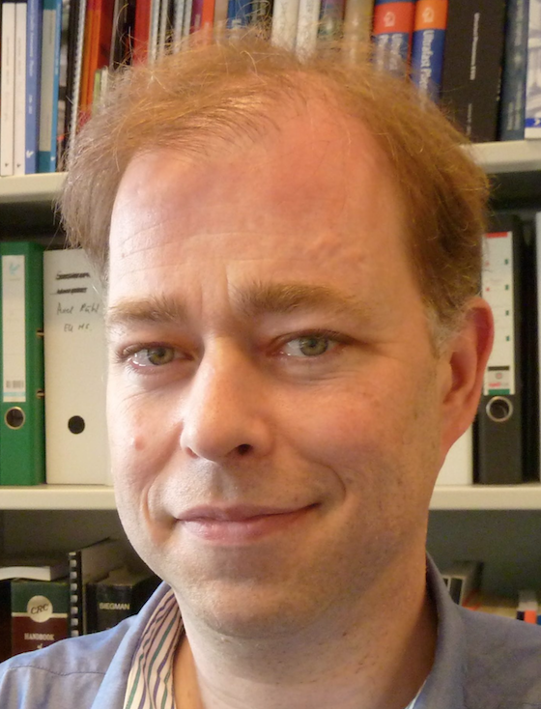
Activities relating to the PRP
Precision spectroscopy, from IR to XUV
Test of QED, values of r_{p}, r_{d}
Hilico
Karr
Korobov
m_{p}/m_{e} ratio from HD+ spectroscopy
S. Patra et al., Science 369, 1238 (2020)
Pachucki
Theory
Theory
H₂, HD, D₂ spectroscopy
HD⁺ spectroscopy
Shared research infrastructure:
Hz-linewidth laser
Optical frequency comb lasers
Fiber-linked atomic clocks
Beyer
Ubachs
Bethlem
Koelemeij
^{3,4}He⁺, H₂ spectroscopy
³He*, ⁴He* spectroscopy
Eikema
Theory
Theory
Vassen: passed away 11-2-2019
Pachucki
Pachucki
Program leader
proton size program
Test of QED, values of r_{α}² − r_{h}², r_{α}, r_{h}
Notes:
Theory contributions

Slide 3
1S-2S in He⁺
Hydrogen-like, calculable
QED and nuclear size effects bigger in He⁺ than H
Compare with (μ⁴He)⁺ measurements
See: J.J. Krauth et al. Nature 589, 527–531 (2021)
Can be trapped in a Paul trap for long observation times
No nuclear spin for ⁴He
He⁺
μHe⁺
2P
812 nm
2S
2S
2P
CREMA
2x 60 nm
MPQ
Munich
32 nm + 790 nm
LaserLaB VU
Amsterdam
0.15 nm
(8.2 keV)

Slide 4
1S-2S in He⁺
He⁺
Fine/Hyperfine structure, QED, rel. effects
Bohr levels
Nuclear size
2S
2P
2x 60 nm
MPQ
Munich
32 nm + 790 nm
Uncertainties on the 1S-2S transition:
19 kHz
~41 kHz
~60 kHz
LaserLaB VU
Amsterdam
From new CODATA 2018
Karshenboim et al.,
Phys. Lett. B 795, 432 (2019)
J.J. Krauth et al.
Nature 589, 527–531 (2021)
Initial experiment goal: <1 kHz or Δν/ν = 10⁻¹³

Slide 5
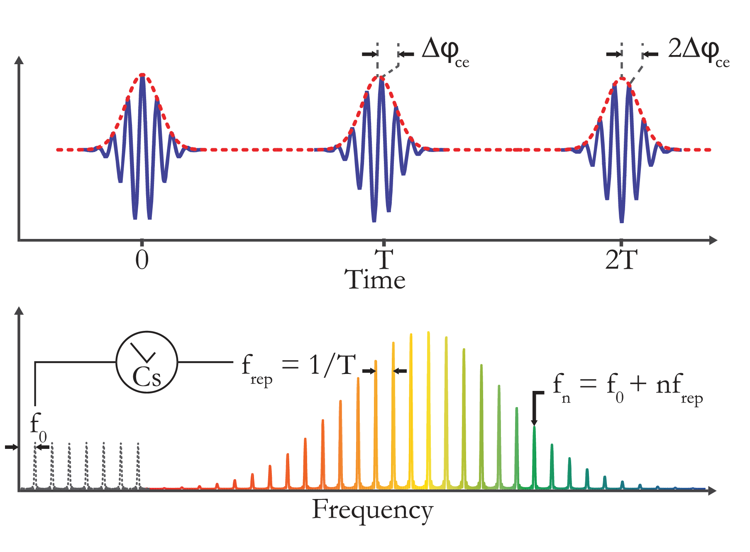
High precision spectroscopy in the XUV
Generate extreme ultraviolet (XUV) wavelengths (high peak intensity)
Perform high precision spectroscopy

Slide 6
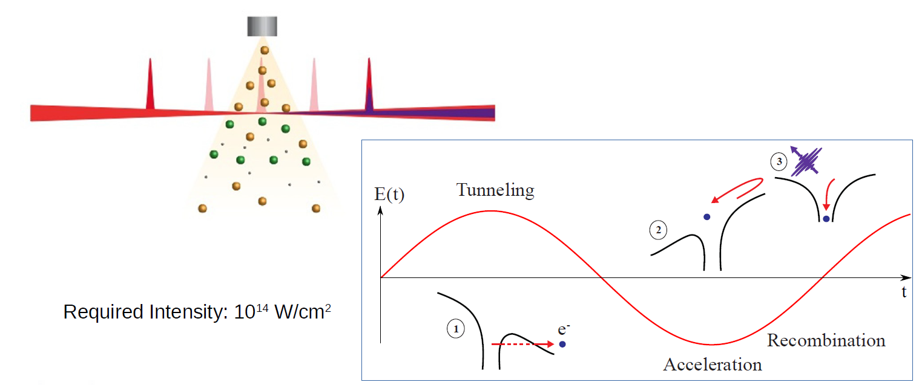
High Harmonic Generation (HHG)
Notes:
Versimpeld model!

Slide 7
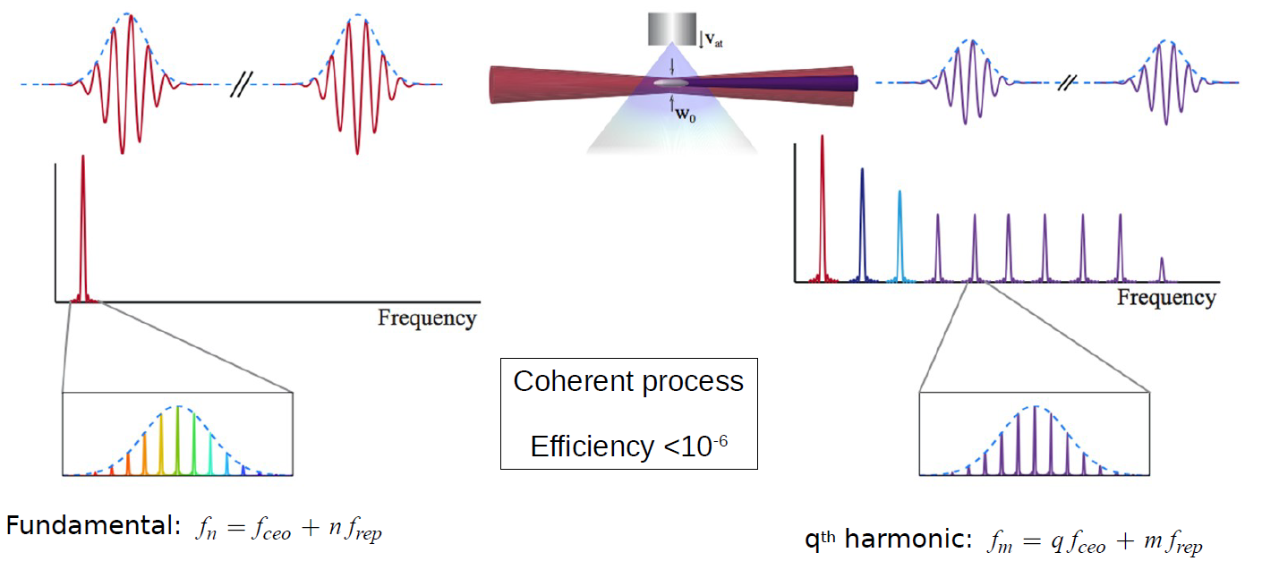
High Harmonic Generation (HHG)

Slide 8
High precision spectroscopy in the XUV
Nonlinear upconversion of a frequency comb (FC) laser
Direct FC spectroscopy: Amplify full repetition rate comb and upconvert in an enhancement cavity
Requires HHG in enhancement cavity
Maintains the comb structure
Ramsey Comb Spectroscopy: Select, amplify and convert 2 pulses and perform a pair of Ramsey measurements
High peak intensities achievable
Straightforward harmonic generation
Narrow comb structure restored by measuring at different delays
MPQ, Garching
VU, Amsterdam
For direct frequency comb excitation see e.g. review by : N. Picqué and T.W. Hänsch, Nature Photonics 13, 146-157 (2019)

Slide 9
Ramsey-Comb Spectroscopy
Selection of two subsequent comb pulses
Signal
Excitation
pulse
Atomic
state
δt

Slide 10
Ramsey-Comb Spectroscopy
Selection of any two comb pulses
N=1
N=2
N=3
N=4
Signal
Excitation
pulse
Atomic
state
δt
δt

Slide 11
The laser
Selectively amplify 2 FC pulses in non-collinear parametric chirped pulse amplifier (OPA)
532 nm
45 mJ, 50 ps
4.5 mJ/pulse
15 ps
3 mJ/pulse
50 fs
3 nJ/pulse
10 fs
.3 nJ/pulse
15 ps

Slide 12
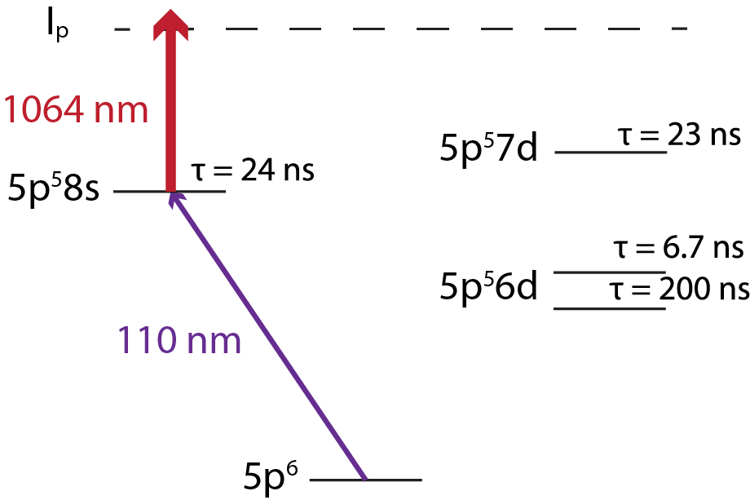
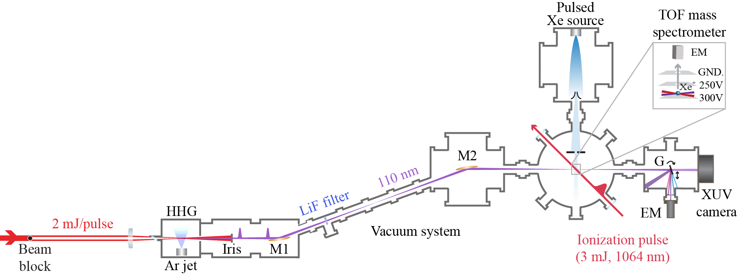
Xenon experiment
Test of RCS + HHG in an atomic beam of xenon

Slide 13
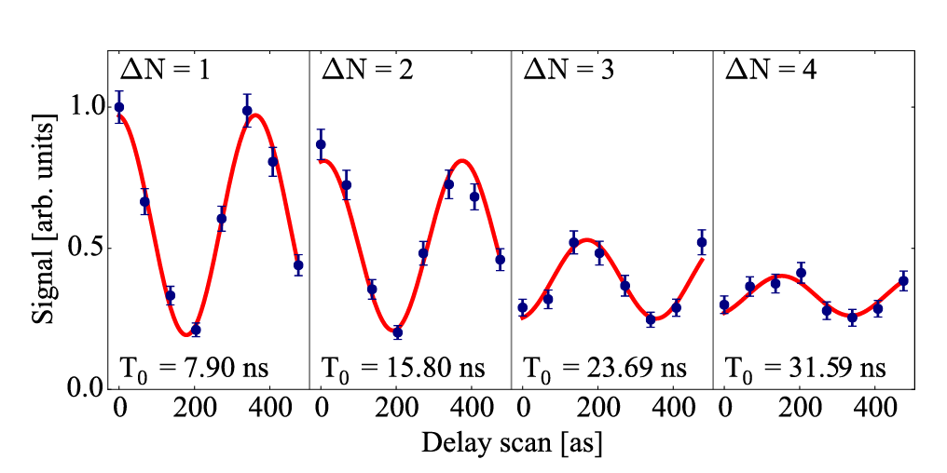
Xenon experiment
Highest spectroscopic accuracy obtained so far using HHG
Mainly limited by the transit time, the lifetime and Doppler broadening
f = 2726086012474 (630) kHz,
$\frac{∆ν}{ν}$ = 2.3 · 10 ⁻¹⁰
L.S. Dreissen et al. Phys. Rev. Lett. 123, 143001 (2019)
Notes:
Check the influence of the phase shift of the HHG: conclusion if the pulse are >100 ns apart there is a negligble effect

Slide 14
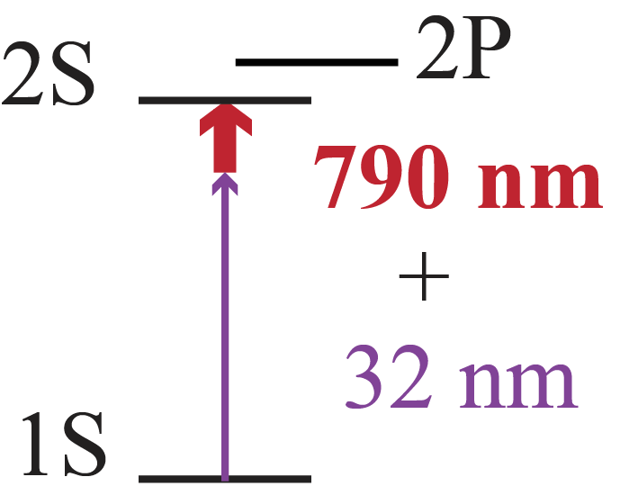
Key features He⁺ spectroscopy
1S-2S transition at 30 nm in He⁺ → two unequal photons for enhancement of the transition probability
Vibrational spacing of He⁺ matched to pulse delay to circumvent 1st order Doppler effect
Sympathetic cooling and quantum logic type read-out through Be⁺

Slide 15
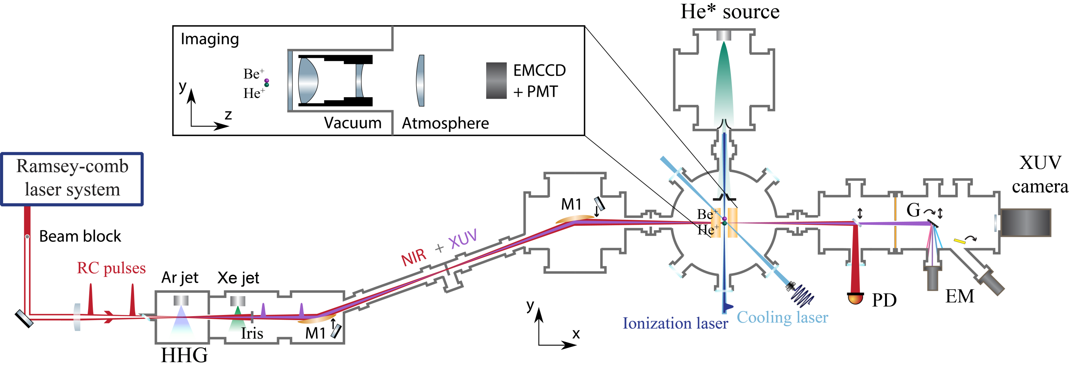
Setup

Slide 16
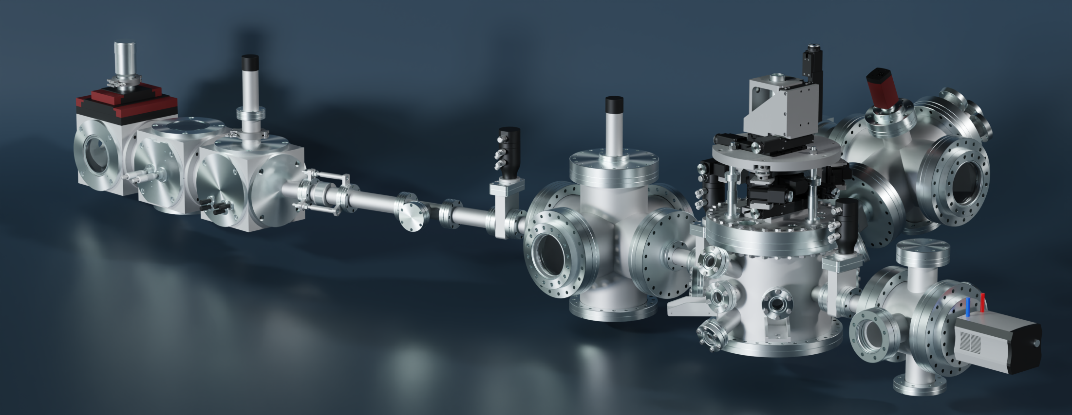
Vacuum system
Notes:
Old picture

Slide 17
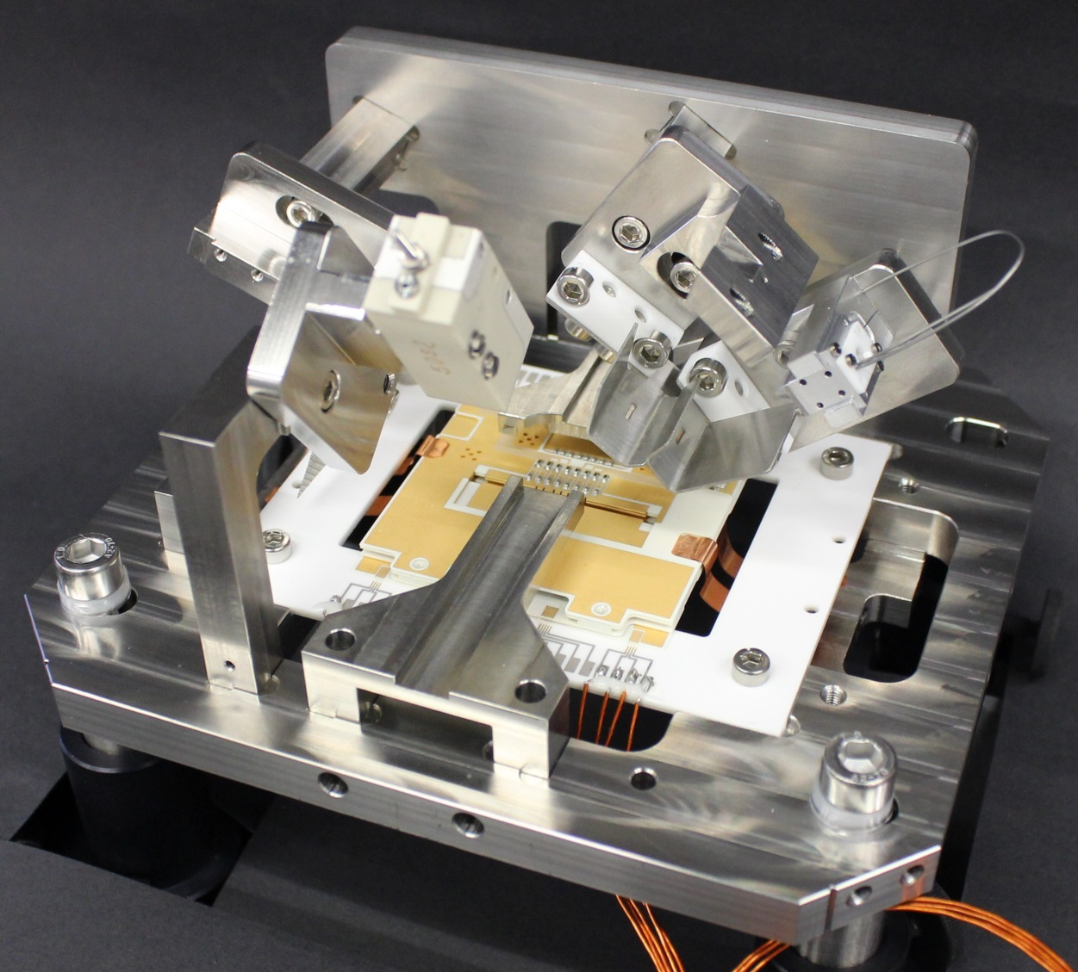
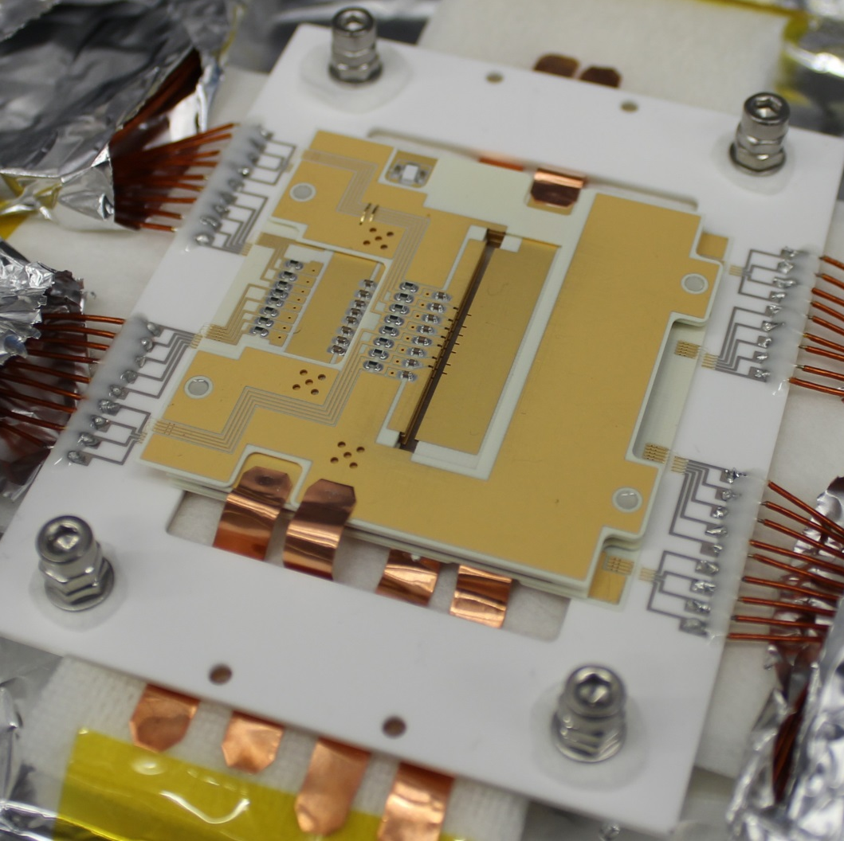
Ion trap
Made after the design and with help of the group of Tanja Mehlstäubler (PTB)
Pyka, K. et al. Appl. Phys. B 114, 231–241 (2014)

Slide 18
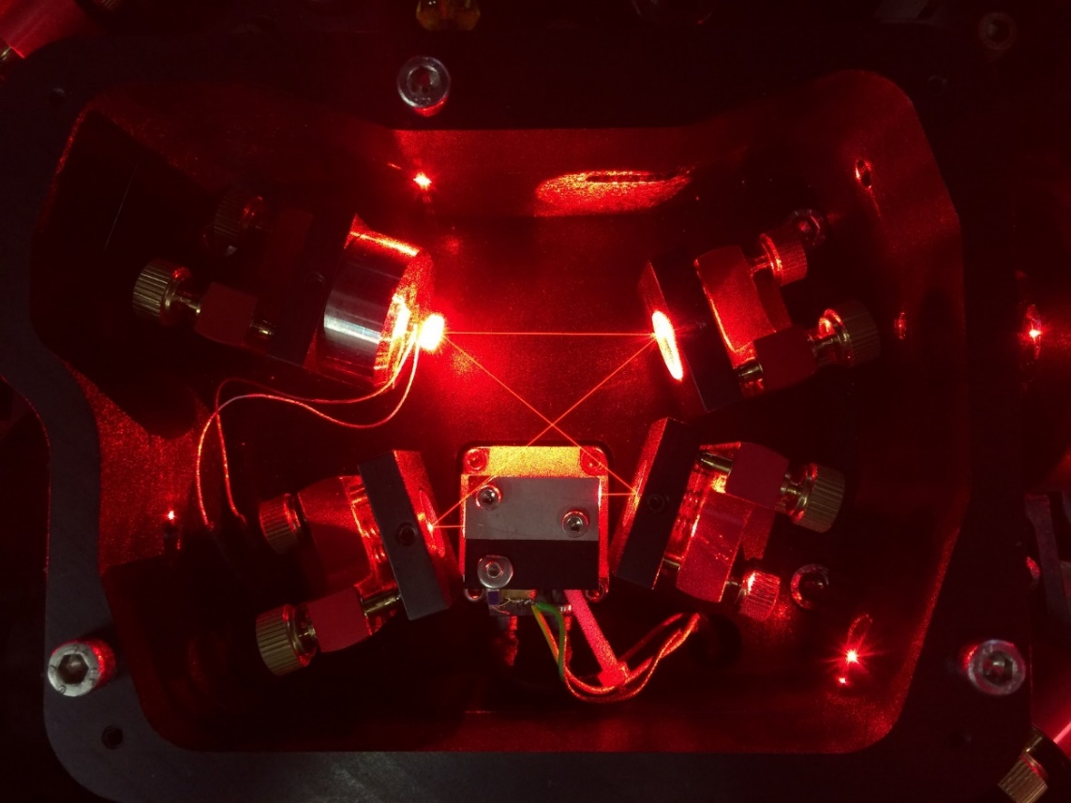
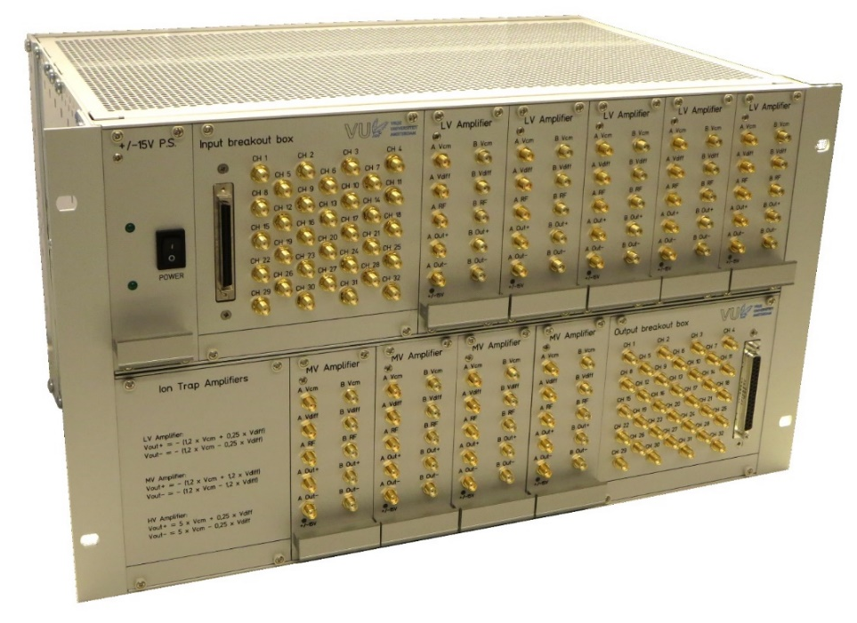
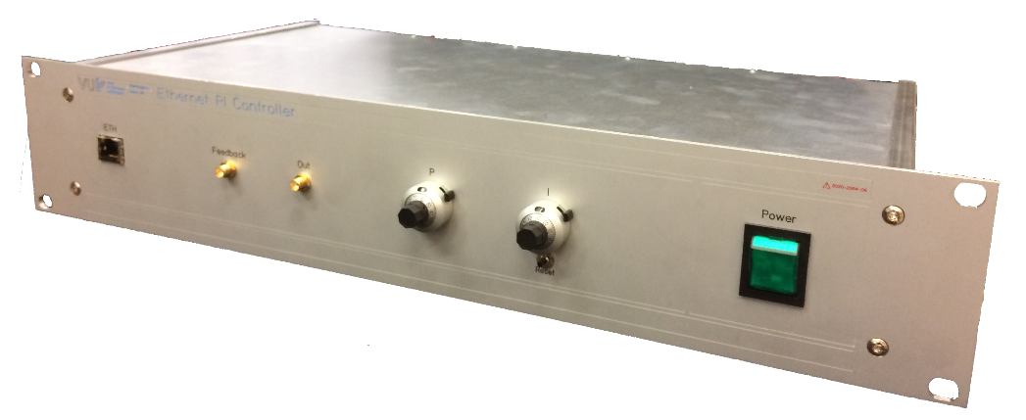
Cooling laser
313 nm cooling laser built, ion trap electronics finished

Slide 19
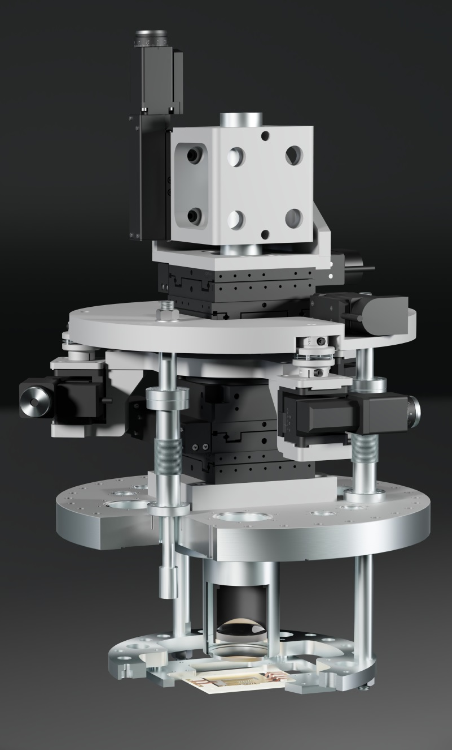
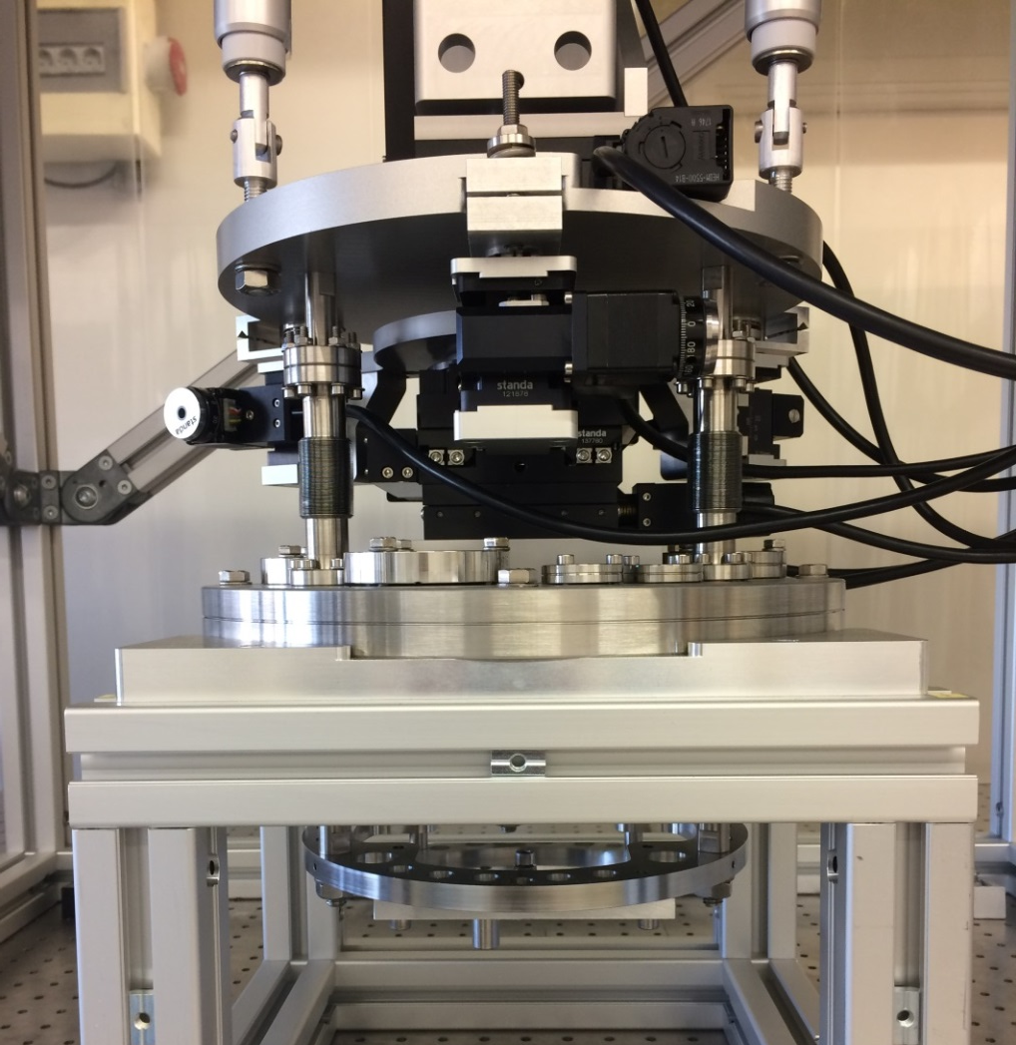
Moveable trap mount
Need to align the beam onto the ions... ... or the ions on the beam
Notes:
Accuracy ~um, stability fraction of a nm for short timescales

Slide 20
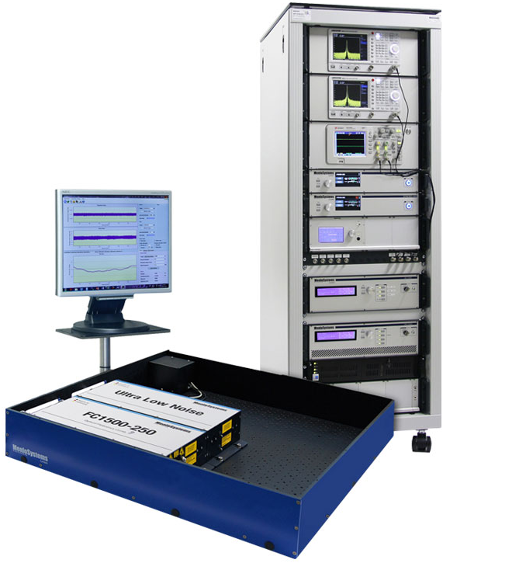
Brand new laser system
Selectively amplify 2 FC pulses in NOPCPA
New OPA based on LBO crystals for reduced phase noise
532 nm
45 mJ, 50 ps
4 mJ/pulse
15 ps
2 mJ/pulse
100 fs
Menlo systems FC1500-250-ULN
3 nJ/pulse
10 fs
.3 nJ/pulse
15 ps
ULN comb phase stability is ~30 mrad, LBO OPA expected <30 mrad
Total RMS <45 mrad, good enough for first experiment!
Notes:
ULN phase stability for short timescale

Slide 21
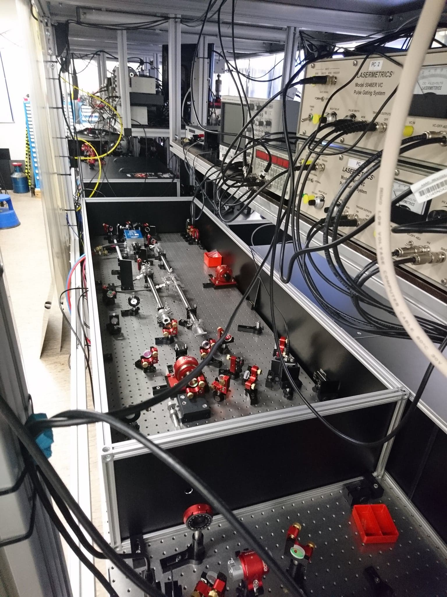
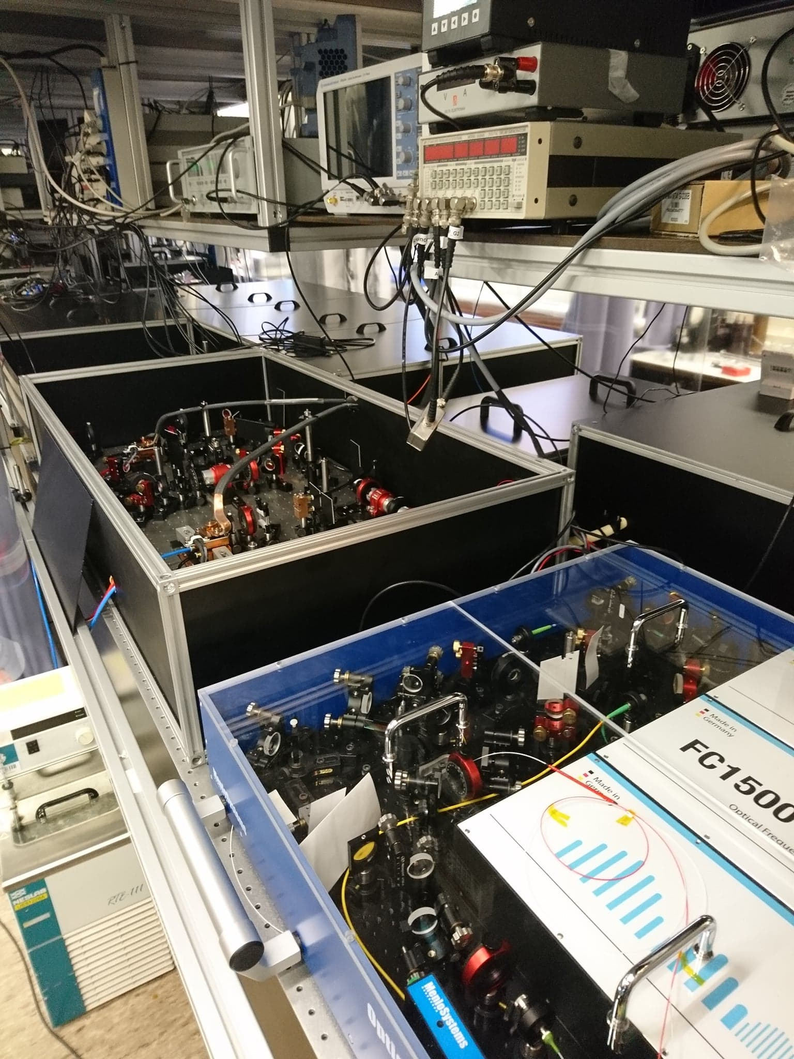
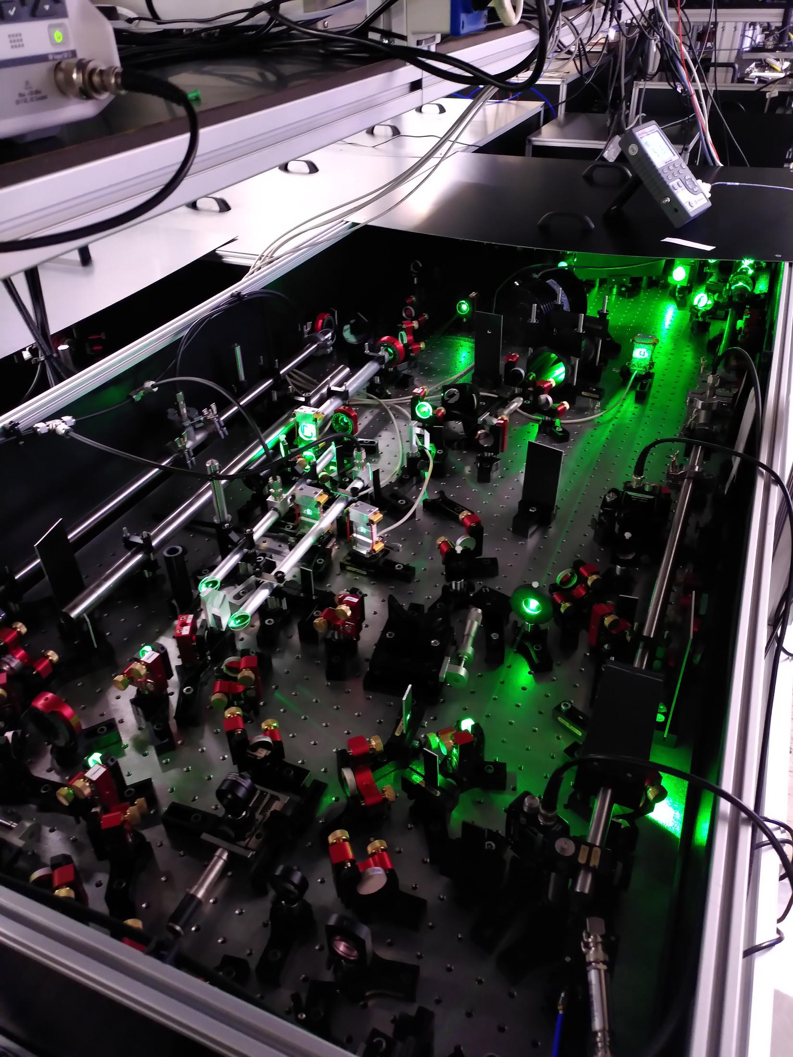
Brand new laser system
New Ramsey-Comb laser ready!
Pump laser
Bounce amp & ULN Comb laser
New parametric amplifier
Notes:
ULN phase stability for short timescale

Slide 22
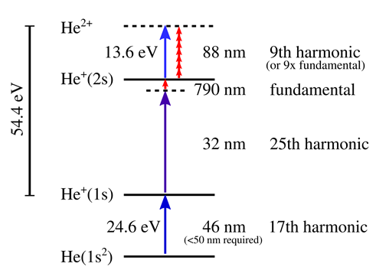
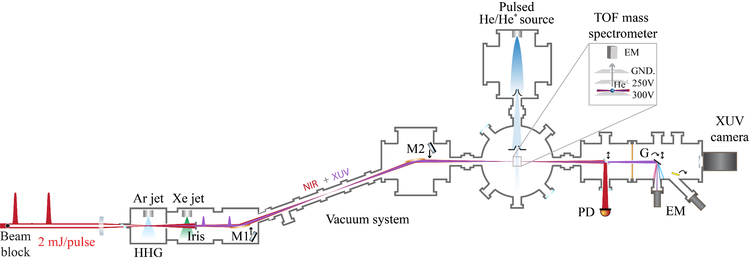
Current goal
See the transition using an atomic beam of He

Slide 23
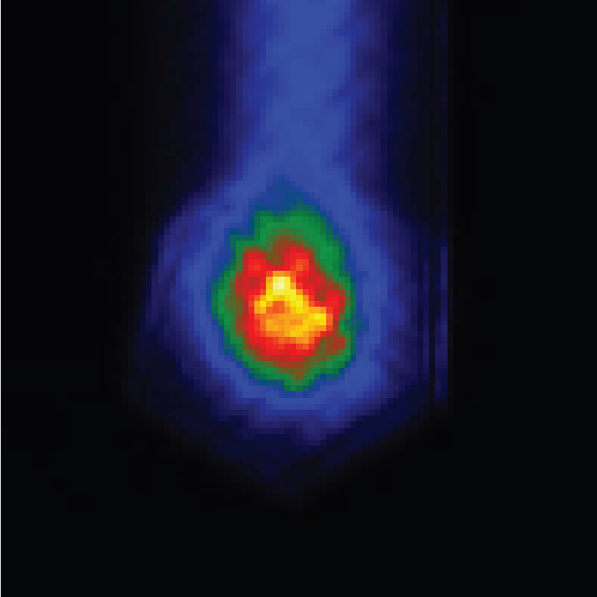
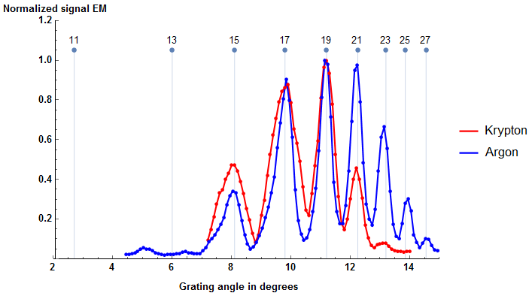
Harmonic spectrum
See the transition in an atomic beam of He
32 nm!
Notes:
1 to 10 nJ at 32 nm at 30 Hz

Slide 24
Status
New laser system is working: 4.5 mJ pulses after the OPA
We are generating (and refocussing) harmonics again, making 25th harmonic (32 nm)
Trap, cooling laser, electronics and basis of experimental control finished
Single pulse experiment to see (not measure!!) the transition and calibrate the transition rate ongoing
Then install the trap and look for the real signal

Slide 25
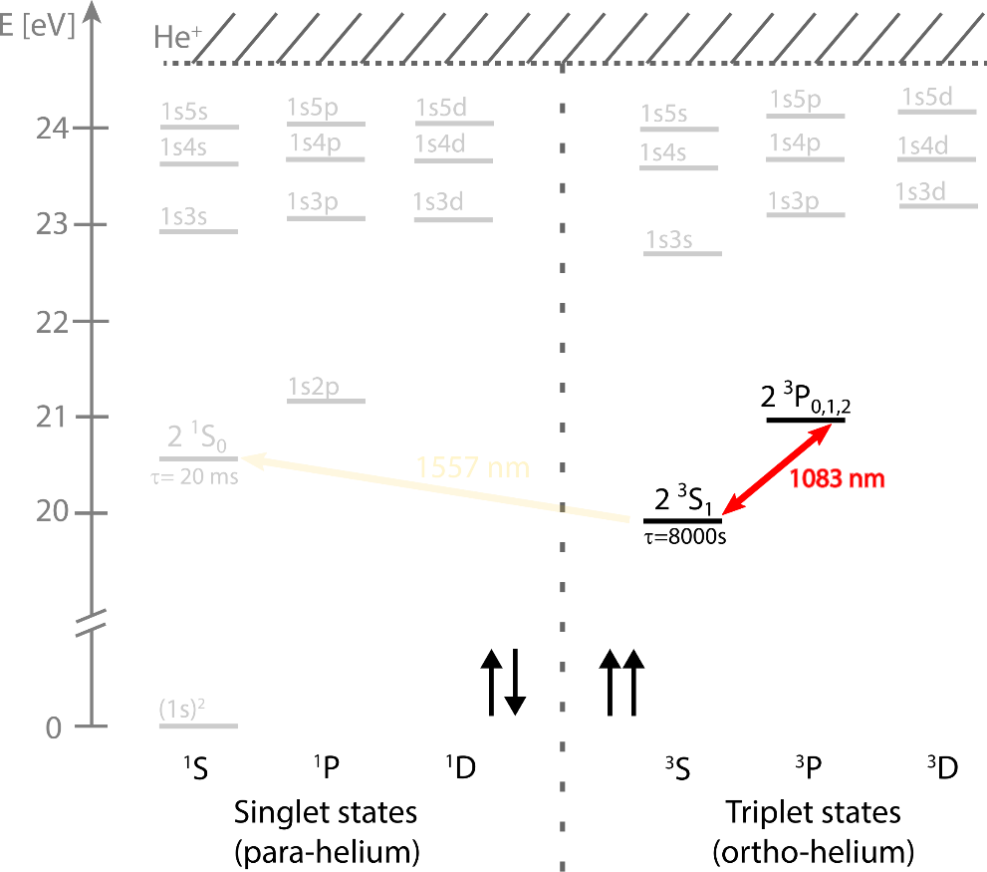
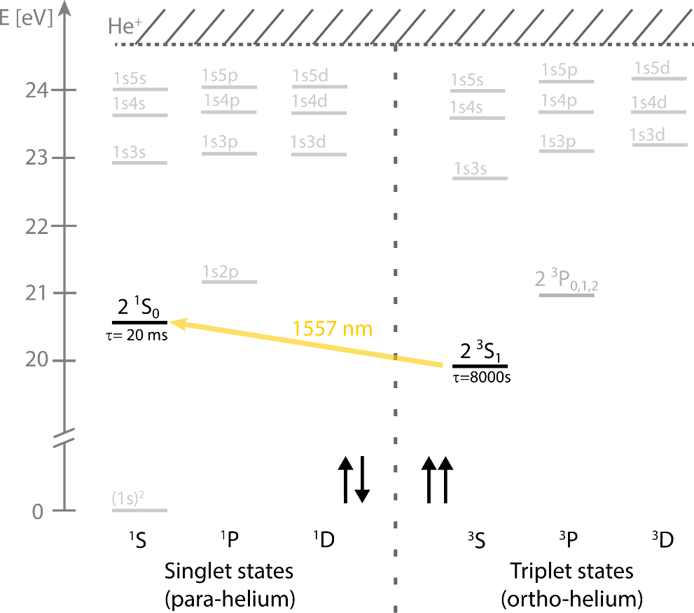
Metastable helium experiment
Metastable $2^{3}S_{1}$ state:
$20 eV$ internal energy
$τ≈8000 s$
Single-particle detection
Accessible narrow transition:
Doubly forbidden $2^{3}S_{1}→2^{1}S_{0}$ (1557 nm)
$8 Hz$ natural linewidth
Einstein A coefficient $\sim 9.8⋅{10}^{−8}$
Laser cooling
Cycling $2^{3}S_{1}→2^{3}P_{2}$transition (1083 nm)
Trapped Quantum degenerate gases:
Reduce Doppler, long interrogation times

Slide 26
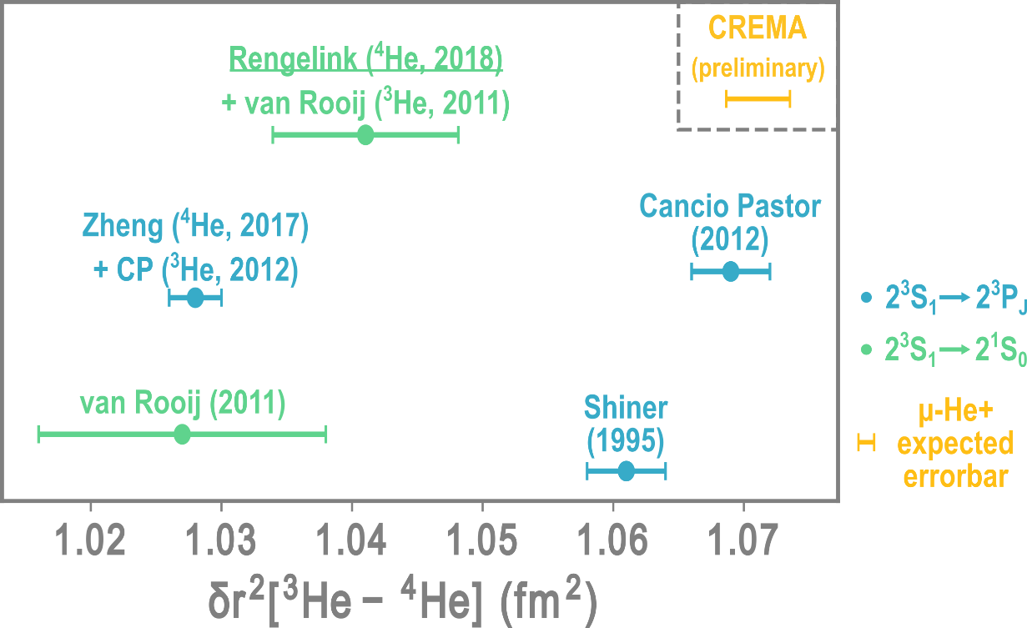
Metastable helium experiment
ab initio calculations
Two-electron correlations
Measure ⁴He – ³He isotope shift
Fundamental constants:
(differential) nuclear charge radius
⁴He measured, ${10}^{−12}$ level [Nat Phys 14, 2018]
Goal: Measure ³He with same accuracy

Slide 27
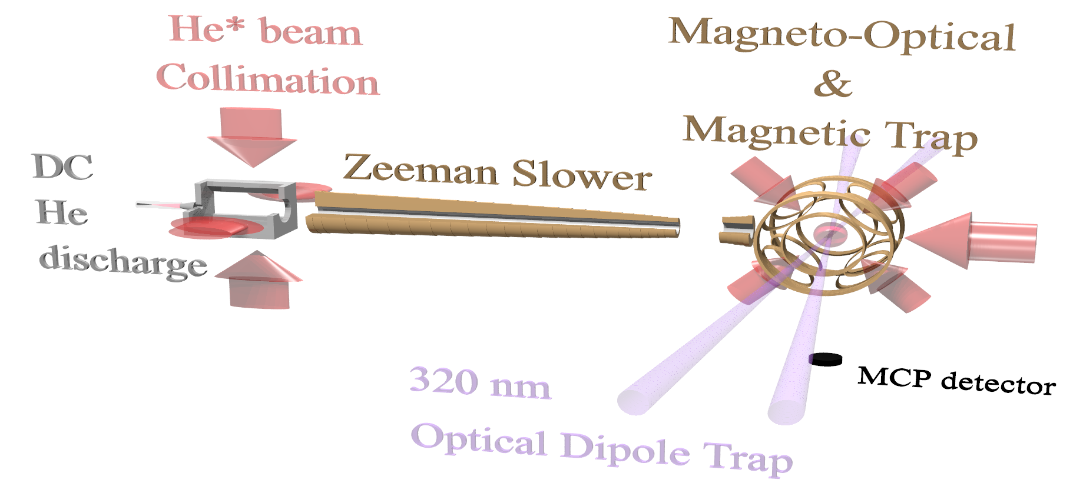
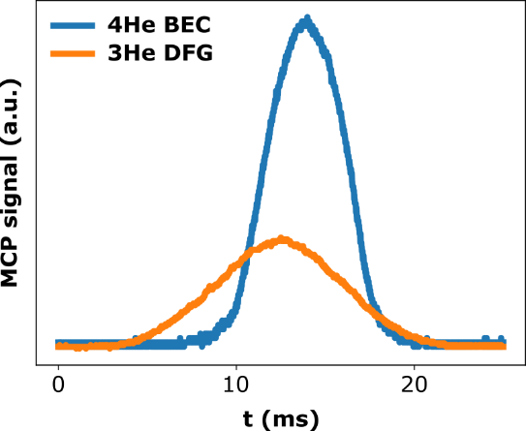
He* setup
Atom detection
Microchannel plate
$20 eV$ internal energy
Time-of-flight fitting: $N,μ,T$
Spectroscopy: $N_{atom}(f_{laser})$

Slide 28
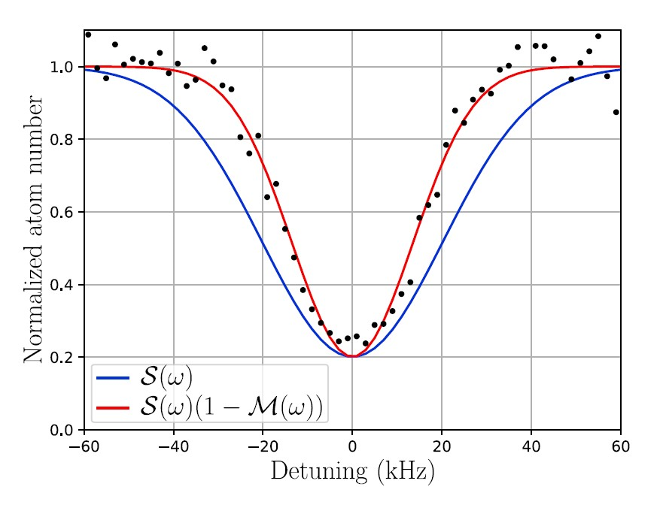
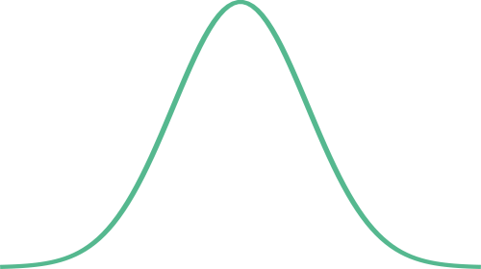
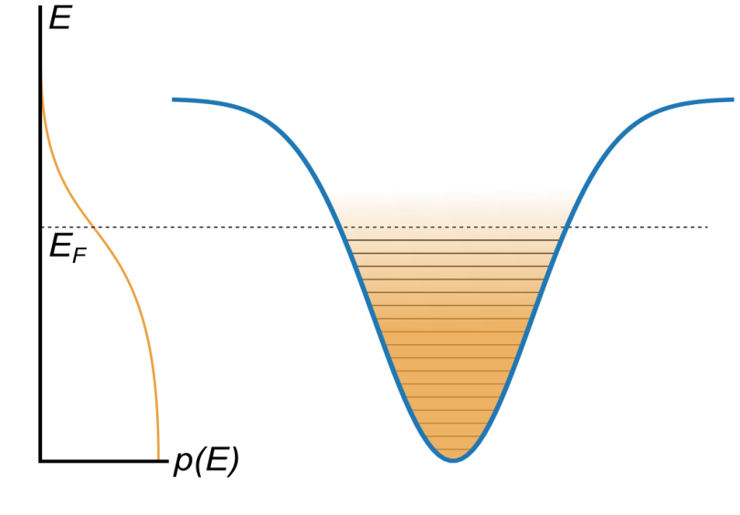
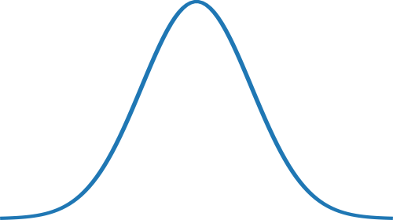
Magic wavelength
Dipole trap at 320 nm
Same AC stark shift for ground and excited state
Narrowing of the line for ³He!
$$|2{{}_{ }^{1}S}_{0}〉$$
$$|2{{}_{ }^{1}S}_{0}〉$$
Fermi-Dirac
state
occupation
Fermi-Dirac
state
occupation
First observation of Pauli blockade of coherent atom dynamics
paper in review!
arXiv:2204.00439
Pauli blocked
$$|2{{}_{ }^{1}S}_{0}〉$$
$$τ=20 ms$$
$$|2{{}_{ }^{3}S}_{1}〉$$
$$|2{{}_{ }^{3}S}_{1}〉$$
Stimulated emission
excitation
Doppler
Pauli blockade
[Model developed
by Raphael Jannin]
$$|2{{}_{ }^{3}S}_{1}〉$$

Slide 29
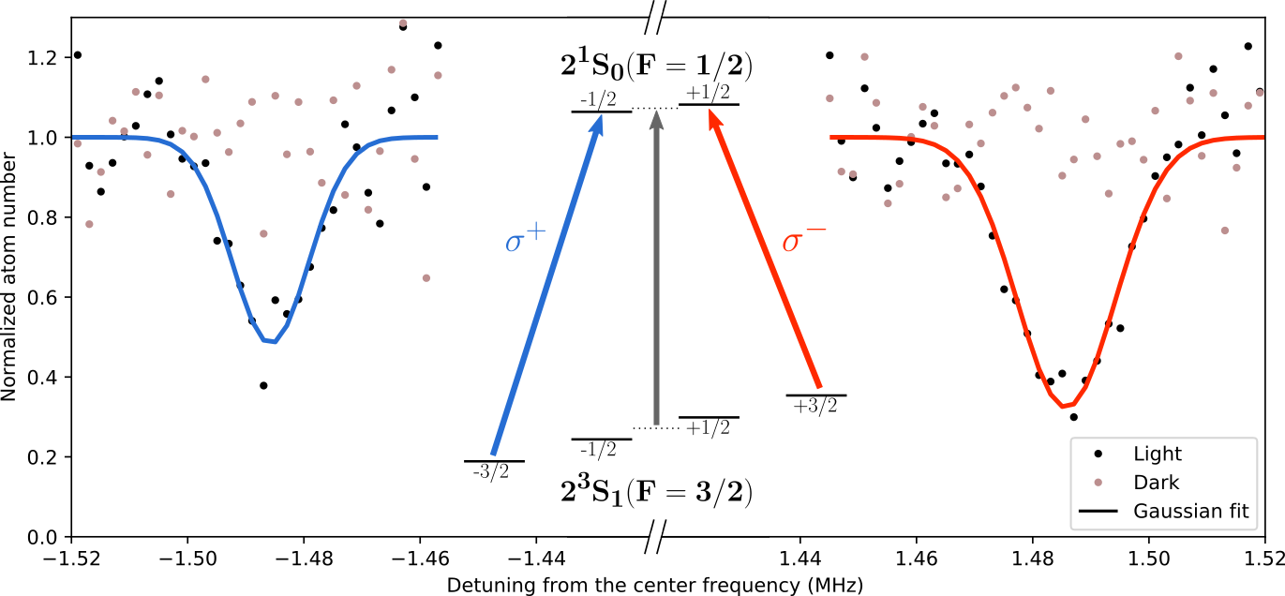
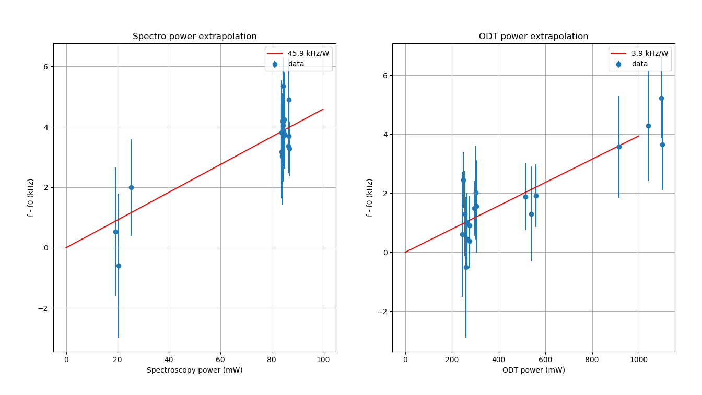
Systematics analysis
Zeeman
PRELIMINARY
PRELIMINARY
$f_{0}=192.504914…?THz$
$$± 0.0000000002 THz?$$
AC Stark
Spectroscopy laser Stark shift
Dipole trap Stark shift

Slide 30
Preliminary result
$f_{0}=192.504914…?THz$
$$± 0.0000000002 THz?$$
$δr2=1.0???±$ 0.0015 fm²
More on ECAMP 2022 by Yuri van der Werf
Amsterdam 2022?

Slide 31
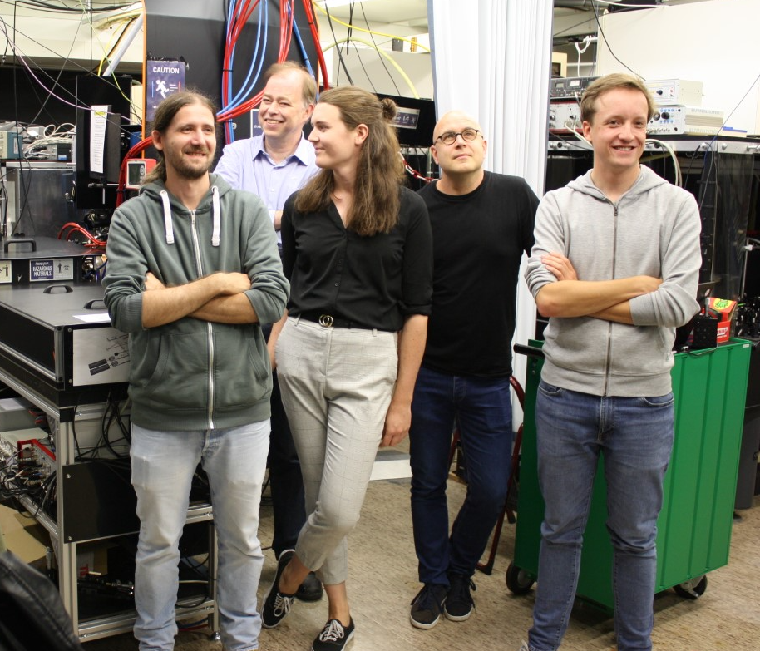
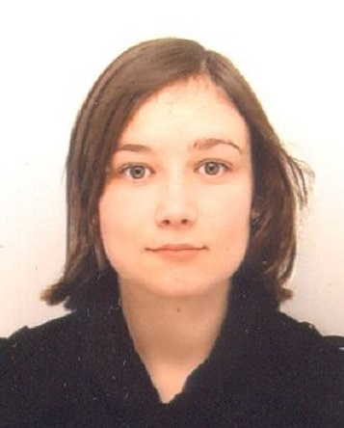
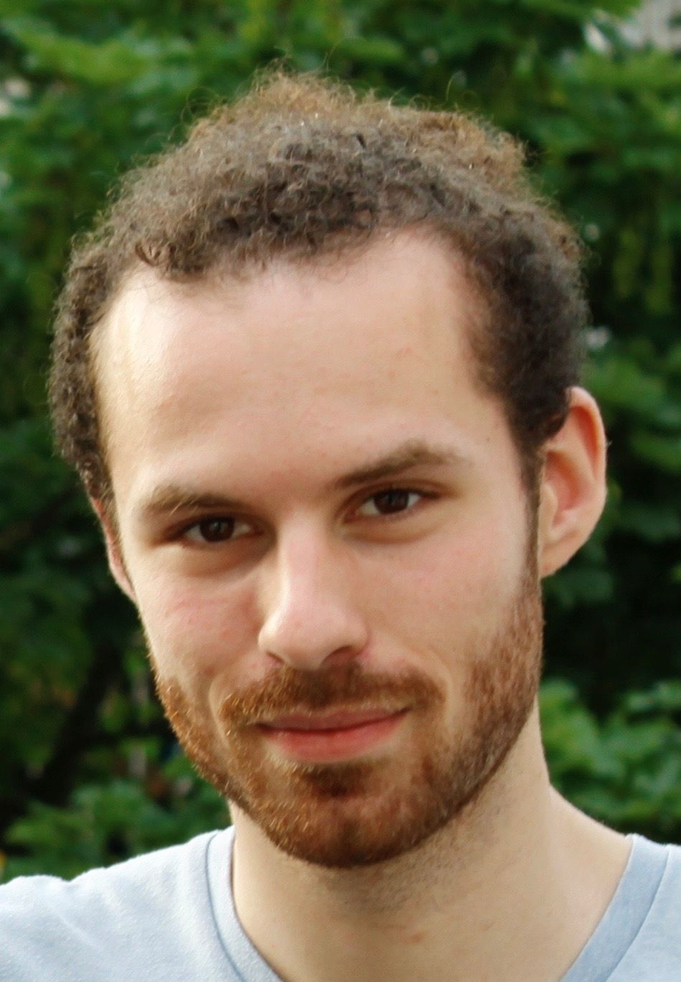
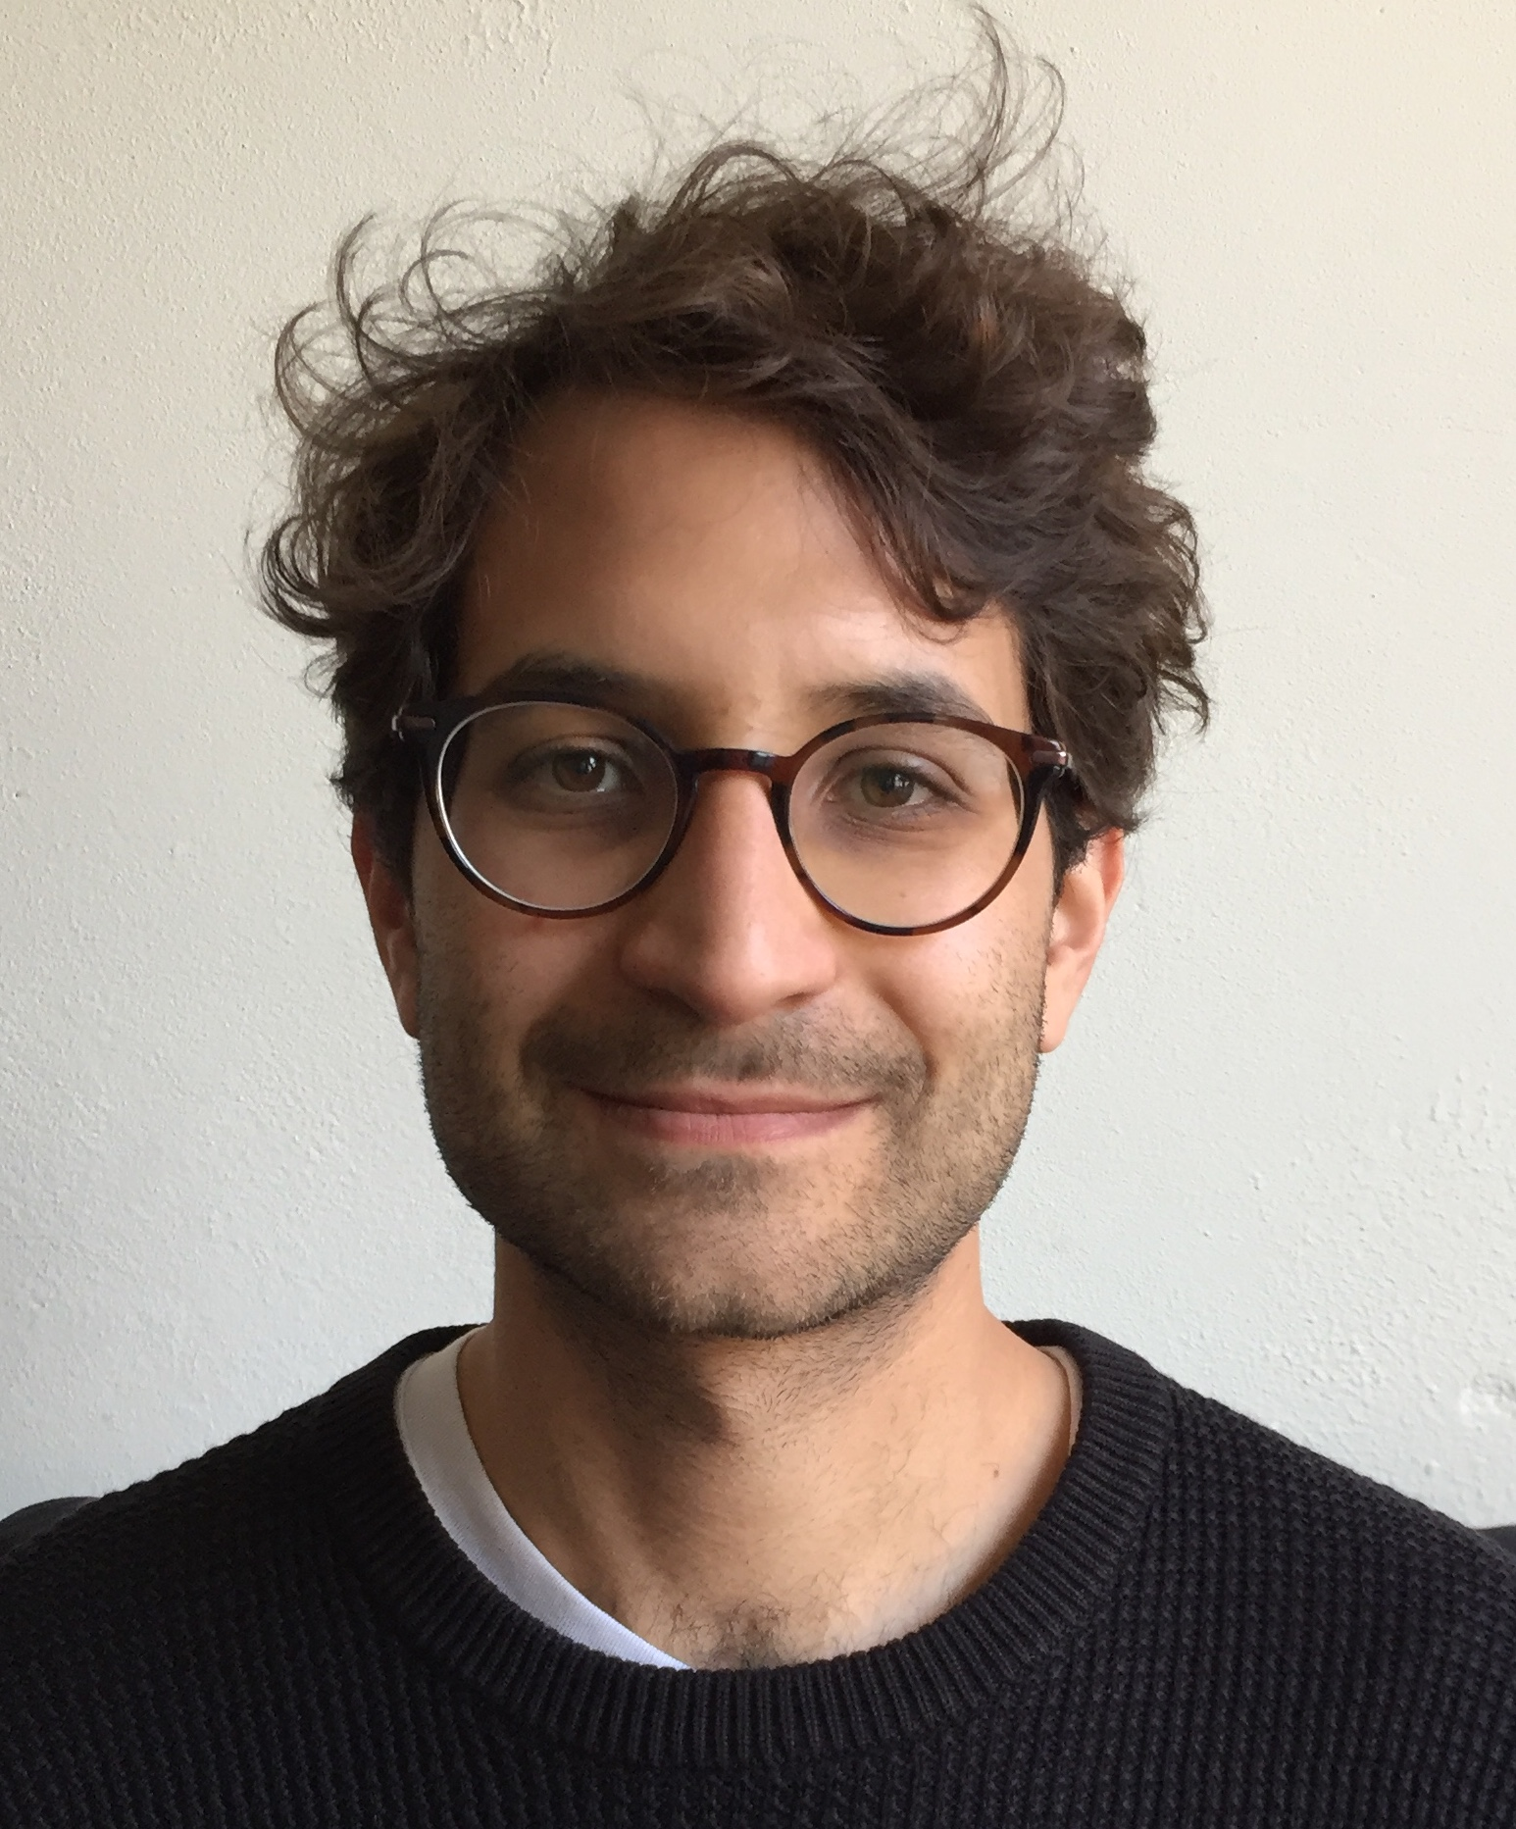
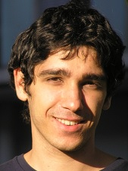
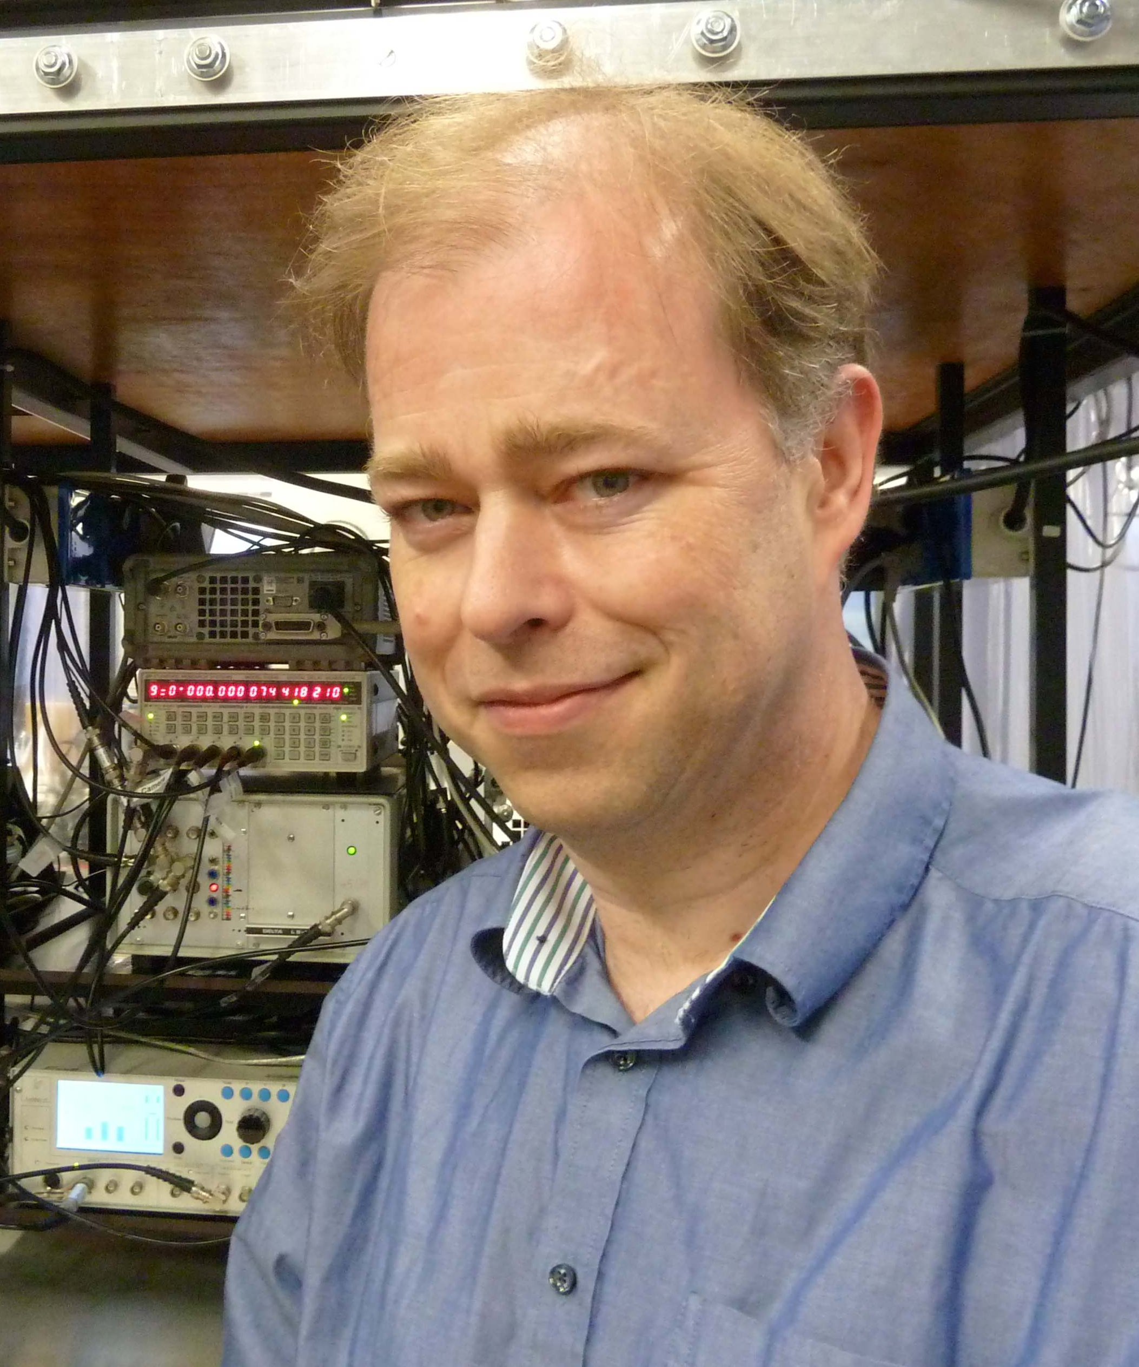
Thank you for your attention!
The H₂ / He⁺ group
The He* group

