Slide 1

Towards High-Precision Spectroscopy
of the 1S–2S Transition in He⁺
Akira Ozawa
Fabian Schmid
Jorge Moreno
Johannes Weitenberg
Theodor. W. Hänsch
Thomas Udem
Max Planck Institute of Quantum Optics, Germany
MAX PLANCK INSTITUTE
OF QUANTUM OPTICS
PREN2022, Paris
22, June 2022

Slide 2
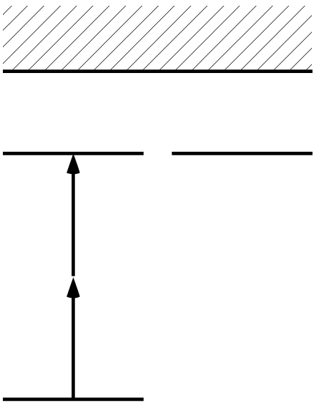
Spectroscopy of the 1S–2S Transition in He⁺
He⁺⁺
2S
2P
Γ ≈ 2π × 84 Hz
2 x 60.8 nm
1S
Difference from Hydrogen spectroscopy:
Trapped and cooled target → smaller systematics
QED test for Z=2 system
Frequency comb spectroscopy in XUV (extreme ultraviolet) wavelength

Slide 3
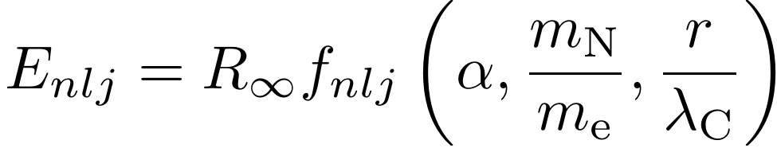
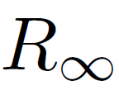

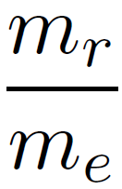

QED for He⁺
Nucleus/electron mass ratio
Fine structure constant
State energy in
SI units (m⁻¹)
Rydberg
constant
Normalized nuclear charge radius
Parameters | Contribution to Uncertainty (He⁺ 1S2S)
 | 1.9x10⁻¹² (19 kHz )
 | 6x10⁻¹² (61 kHz)
 | 5x10⁻¹⁵ (45 Hz)
 | 2x10⁻¹⁴ (166 Hz)
Rydberg constant
Hydrogen spectroscopy
μ-H + H (1s-2s), CODATA2018
Nuclear charge radius
μ-He spectroscopy
J. Krauth et al. Nature (2021)
Nucleus/electron mass
Mass ratio measurements
in Penning trap
Fine structure constant
Atomic recoil (atom interferometer)
g-2 measurement

Slide 4
Uncertainty due to QED theory for He⁺ 1S-2S transition
[1] Physics Letters B 795, 432–437 (2019)
[2] Phys. Rev. A 100, 032515 (2019).
[3] Phys. Rev. A 98, 022522 (2018)
[4] Physics Letters B 800, 135137 (2020).
[5] Annalen der Physik 531, 1800324 (2019).
[6] Phys. Rev. A 94, 060501 (2016).
[7] Phys. Rev. A 93, 062514 (2016).
CODATA 2014
Recent improvements
(Not all are included in CODATA2018)
Contribution | Uncertainty (in kHz)
Relativistic Recoil | 11
Nuclear Polarizability | 3
Self Energy | 0
Vacuum Polarization | 1
Two Photon Corrections | 111
Three Photon Corrections | 28
Nuclear Size Correction to Self Energy | 0
Nuclear Size Correction to Vacuum Polarization | 0
Radiative Recoil | 9
Nuclear Self Energy | 0.6
Total | 116 kHz (1x10⁻¹¹)
~ 0 kHz
Yerokhin. A and Shabaev V. M [7]
<30 kHz
Karshenboim, S. G et al. [1,2,3]
V. Yerokhin et al. [5]
A.Czarnecki st al. [6]
<10 kHz
Karshenboim, S. G et al. [1,2]
Four loop (photon) corrections S. Laporta [4]
< 40 kHz (4x10⁻¹² )
Total QED uncertainty : 40 kHz = 4x10⁻¹² (preliminary)

Slide 5

He⁺ spectroscopy for testing QED
Measuring the 1S-2S transition
better than 400kHz (4x10⁻¹¹)
Determine and contribute to the proton charge radius puzzle
better than 60 kHz (6x10⁻¹²)
Determine charge radius, which can be compared with μ-He measurement
better than 40 kHz (4x10⁻¹²)
QED theory uncertainty will be a limitation
Measuring other transitions in ⁴He⁺
QED test more independent from μ-He and Hydrogen
Measuring ³He⁺
Charge radii difference, which can be compared with neutral He spectroscopy

Slide 6
⁴He⁺ Nuclear charge radius
r_{α} = 1.681(4)
Scattering
I.Sick (2008)
r_{α} = 1.67824(13)_{exp}(82)_{theo}
μ-He spectroscopy
J. Krauth et al. (2021)
r_{α} uncertainty J. Krauth et al. (2021) | Contribution to He⁺ 1S-2S uncertainty
QED (r-independent) 0.04 am | 2.9x10⁻¹³
2PE 0.70 am | 5.2x10⁻¹² =52 kHz
3PE 0.42 am | 3.1x10⁻¹²
1PE 0.06 am | 4.5x10⁻¹³
Theory Total: 0.82 am | 6.1x10⁻¹²
Experiment (statistics) : 0.13 am | 9.7x10⁻¹³ = 9.6 kHz
4x10⁻¹²: He⁺ QED theory uncertainty

Slide 7
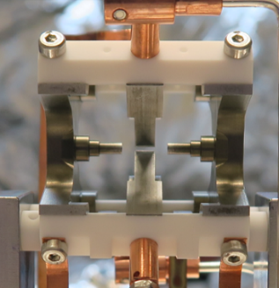
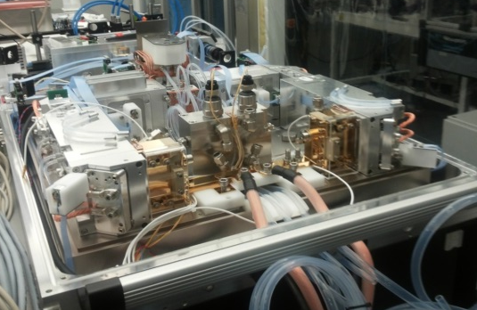
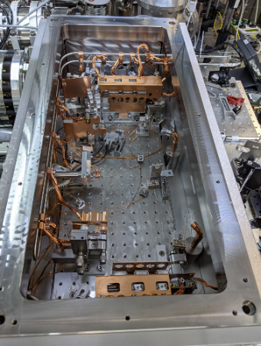
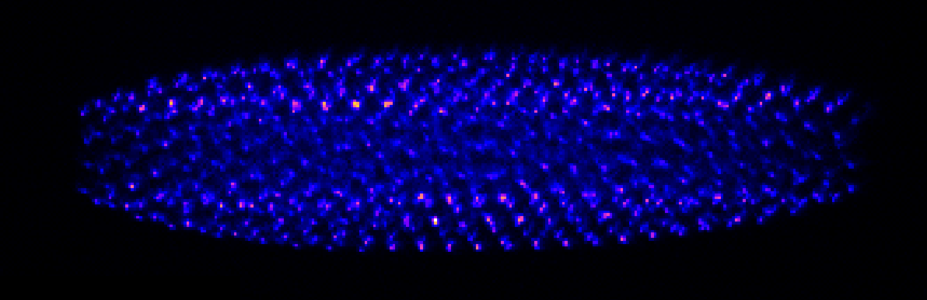
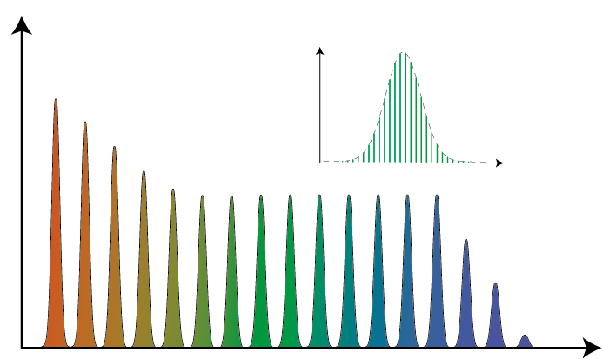
He⁺ spectroscopy setup: overview
High-power IR
frequency comb
Frequency comb
at 60.8 nm
Trapped He⁺ ions
Yb:KYW laser + amplifiers
@1030 nm
Intracavity HHG
17th harmonic
300 W Innoslab amplifier
(Fraunhofer ILT)
H3
XUV
comb
H5
H7 …
HH Spectrum
Frequency

Slide 8



Direct frequency comb spectroscopy
Spectroscopy signal: He²⁺
2S
XUV comb at 60.8 nm
2 x
60.8 nm
1S

Slide 9
61nm Laser system
Yb:KYW frequency comb
1030 nm, 40 MHz
Yb:LuAG
Solid state preamplifier
2.5 W
Multi-pass cell spectral broadening
Yb:YAG Innoslab amplifier
260 W, 50 fs
280 W, 850 fs
Enhancement resonator
To He⁺ trap
HHG
XUV frequency comb
5 kW, <100fs

Slide 10
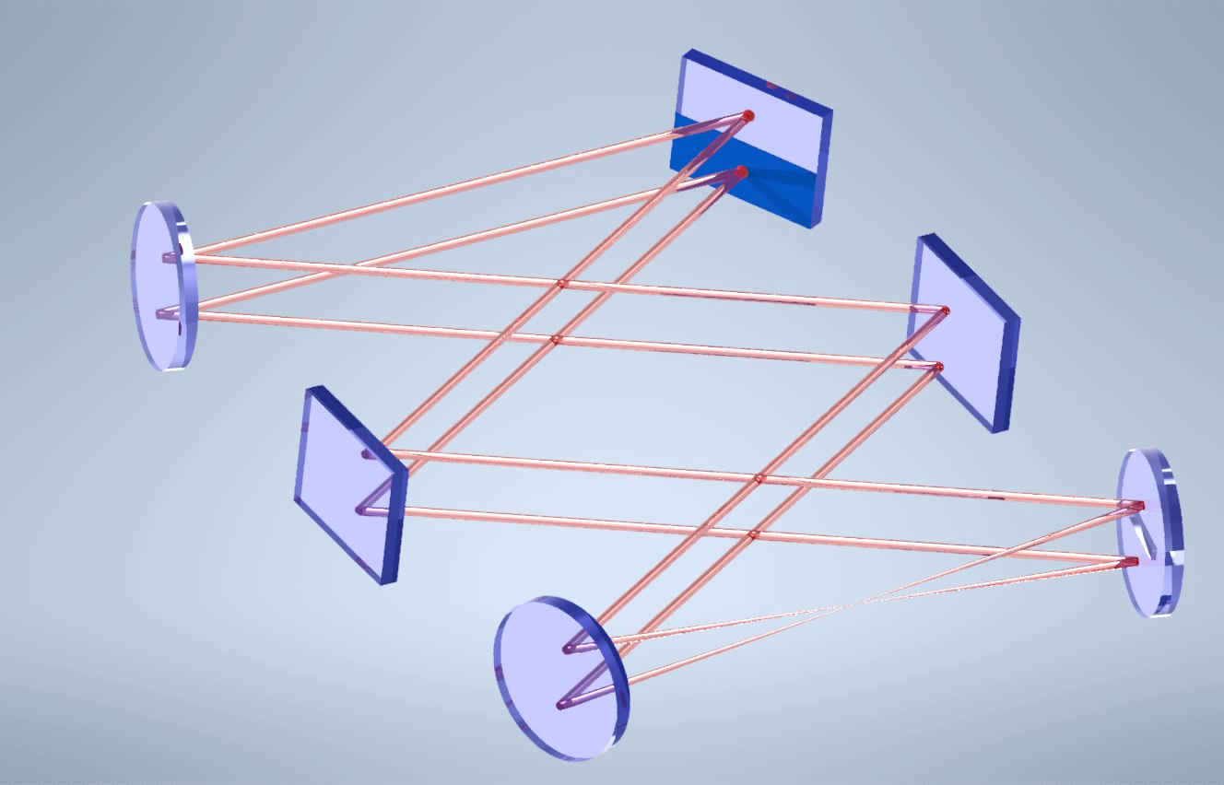
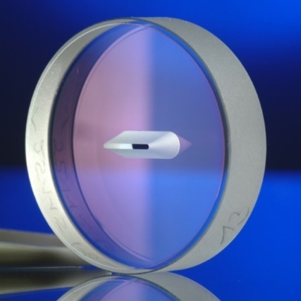
Enhancement Resonator for HHG
Mirror with slit
to He⁺ trap
Xe gas for HHG

Slide 11

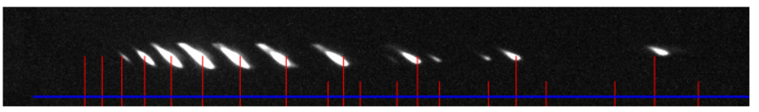
Enhancement Resonator for HHG
H23
H19
H25
41nm
H21
H17
61nm
H15
H13
H11
H9
115nm
~30 µW at 60.8 nm (preliminary)
~ 0.1 Hz signal rate (ionization)

Slide 12
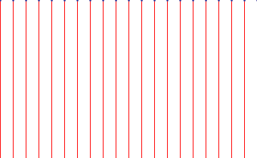

Stabilization of frequency comb
fixed point (noise source dependent)
Comb w/o
stabilization
frequency
Cavity stabilized
cw laser
= 60.8nm x 17th
(transition frequency)
1033nm
Comb stabilized
to cw reference laser
frequency
Noise cancellation by two-photon excitation

Slide 13
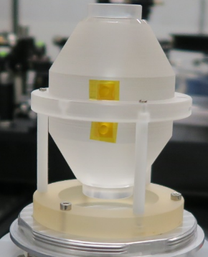
Stabilization of frequency comb
double-pulse
generation
Yb:YAG Innoslab amplifier
nonlinear pulse compression
HHG enhancement resonator
Yb:KYW
mode-locked
oscillator
fast
AOM
Pre-Amplifier
Yb:LuAG
Pre-Amplifier
Yb:LuAG
slow
AOM
PZT
Beat detection
Beat detection
Beat detection
Cavity-stabilized
CW laser (ECDL)
frequency
comb

Slide 14
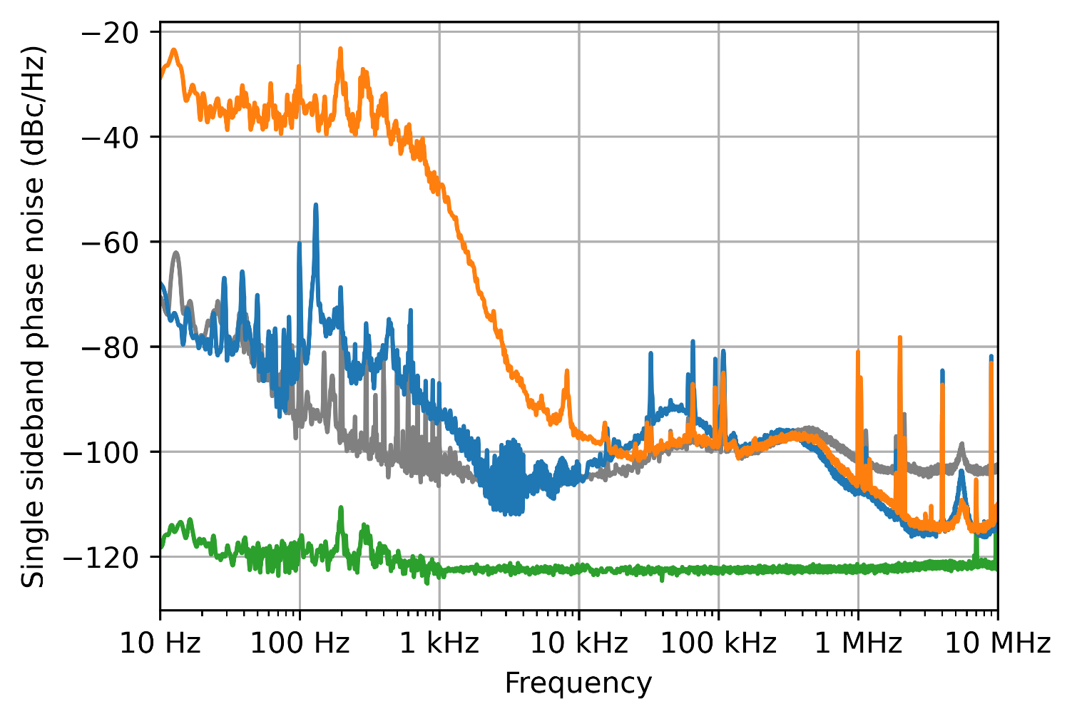
Stabilization of frequency comb
OFF path length stabilization
ON path length stabilization
Noise at oscillator output
Noise floor
80% of power in carrier at XUV
Less than 20% of signal loss due to phase noise

Slide 15
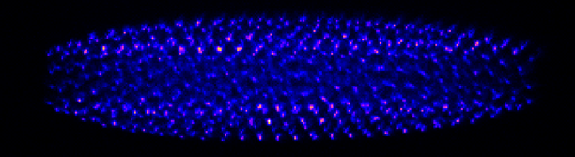
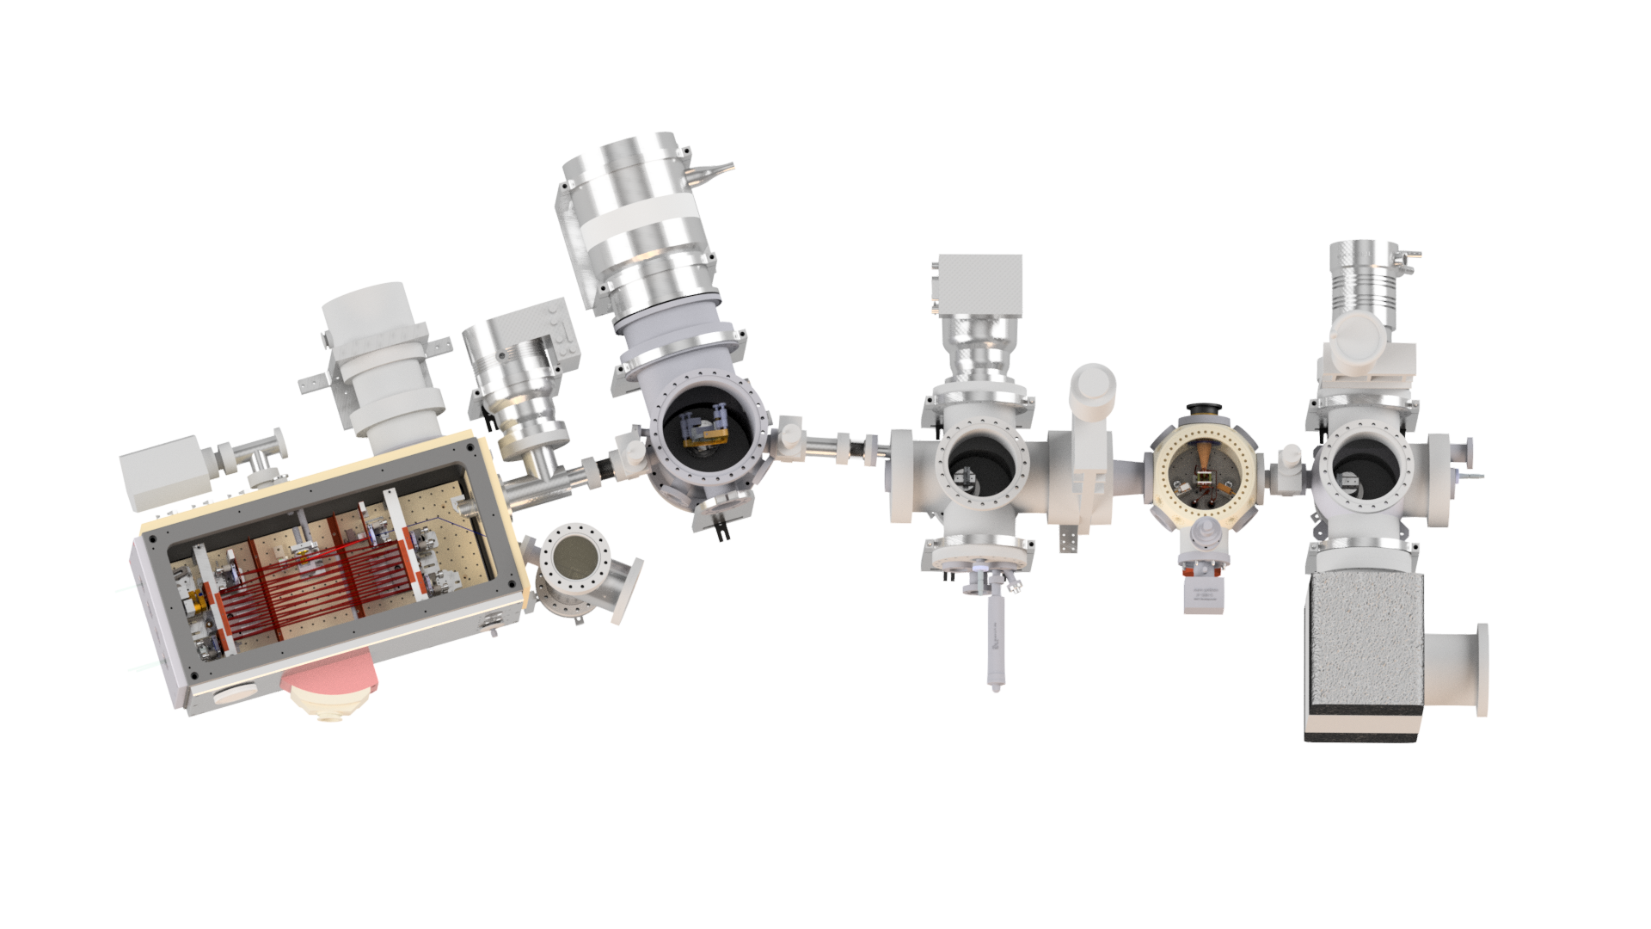

XUV beam delivery to trapped He⁺
Sympathetically cooled He⁺
in mixed ion crystal (He⁺/Be⁺)
Ion trap
HHG chamber
XUV grazing incidence mirror
(R=70% @ 61 nm)
XUV focusing mirrors
(R=30% @ 61 nm)
Doppler-free
Anti-collinear excitation

Slide 16
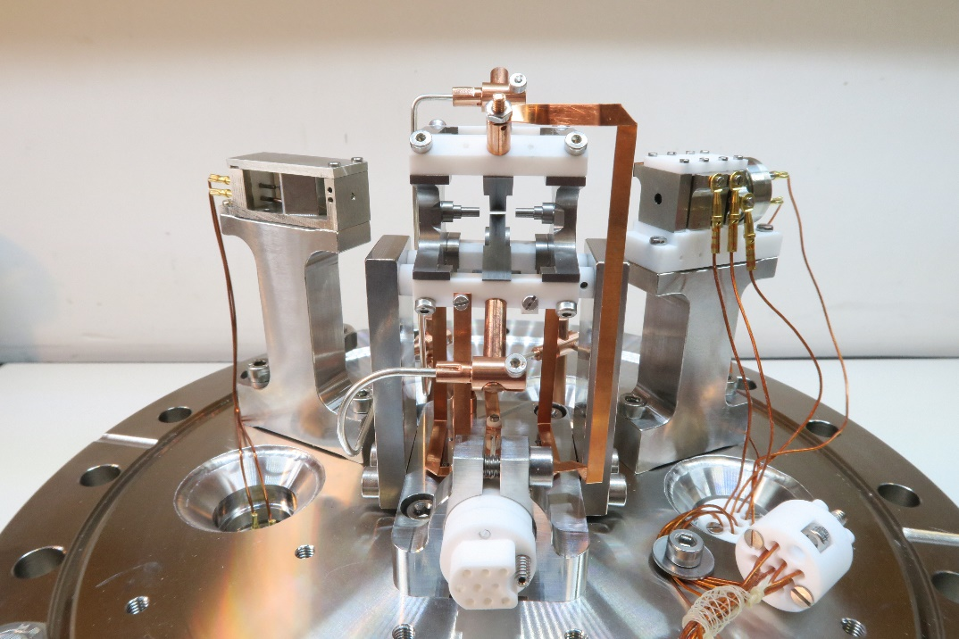
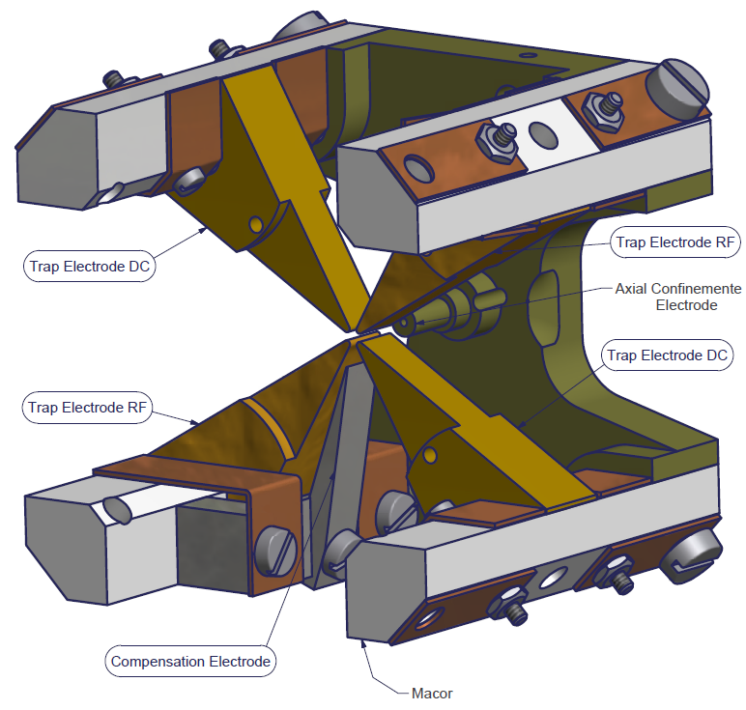
Be⁺/He⁺ ion trap
3 cm
RF electrodes

Slide 17
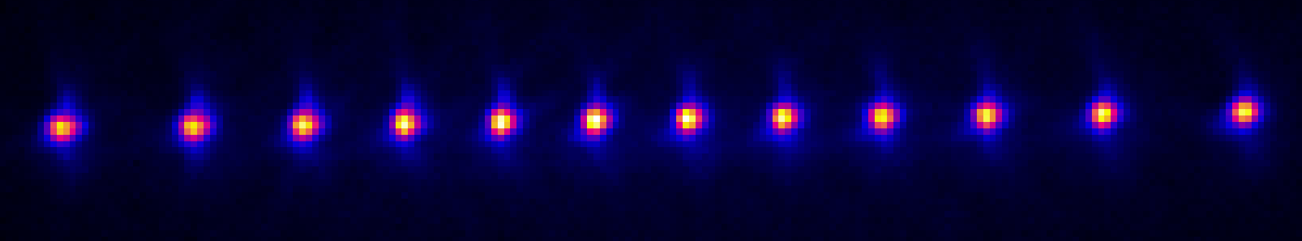
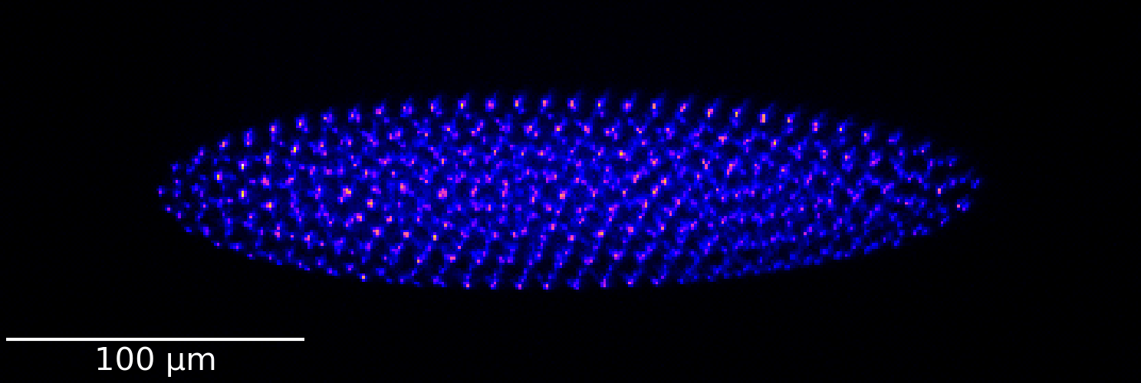
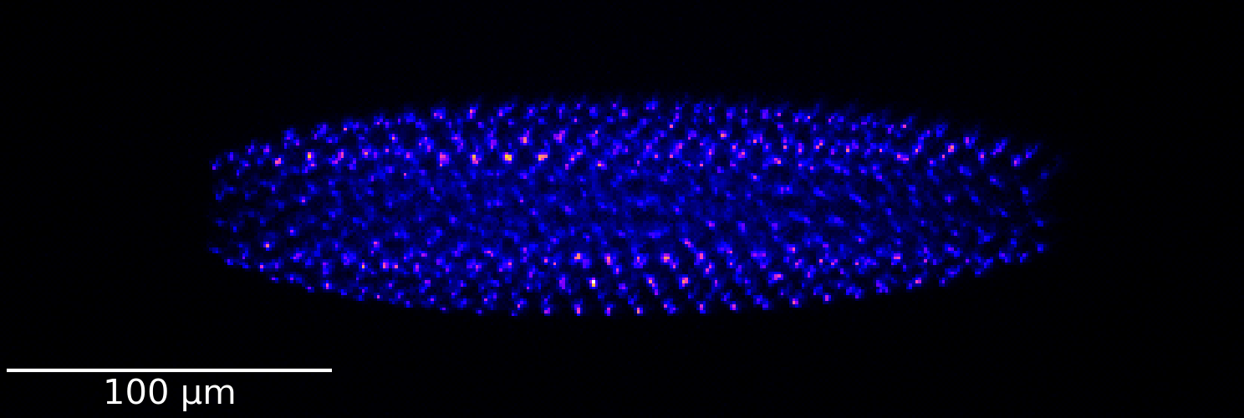
Ion crystals and sympathetic cooling
≈15 µm
Be⁺ laser cooled to a few mK
He⁺
Be⁺
He⁺ sympathetically cooled

Slide 18
Spectroscopy signal
He⁺⁺
2S
2P
91.1nm
Γ ≈ 2π × 84 Hz
2 x 60.8 nm
1S

Slide 19
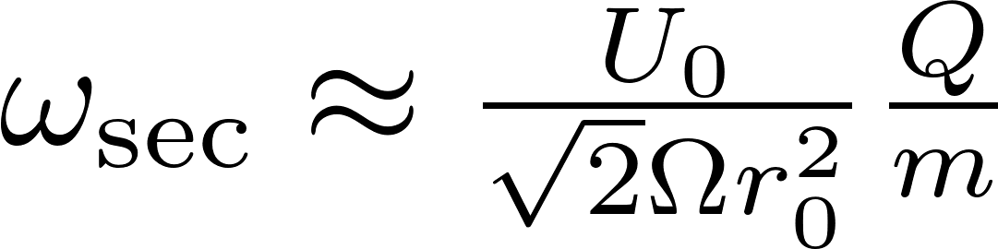
Spectroscopy signal:
Secular excitation detection
Motional resonance :
Trap
Species
PMT
Signal: fluorescence from Be⁺ ions
Signal generator:
scan frequency

Slide 20
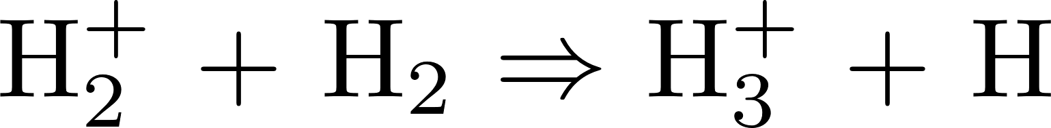
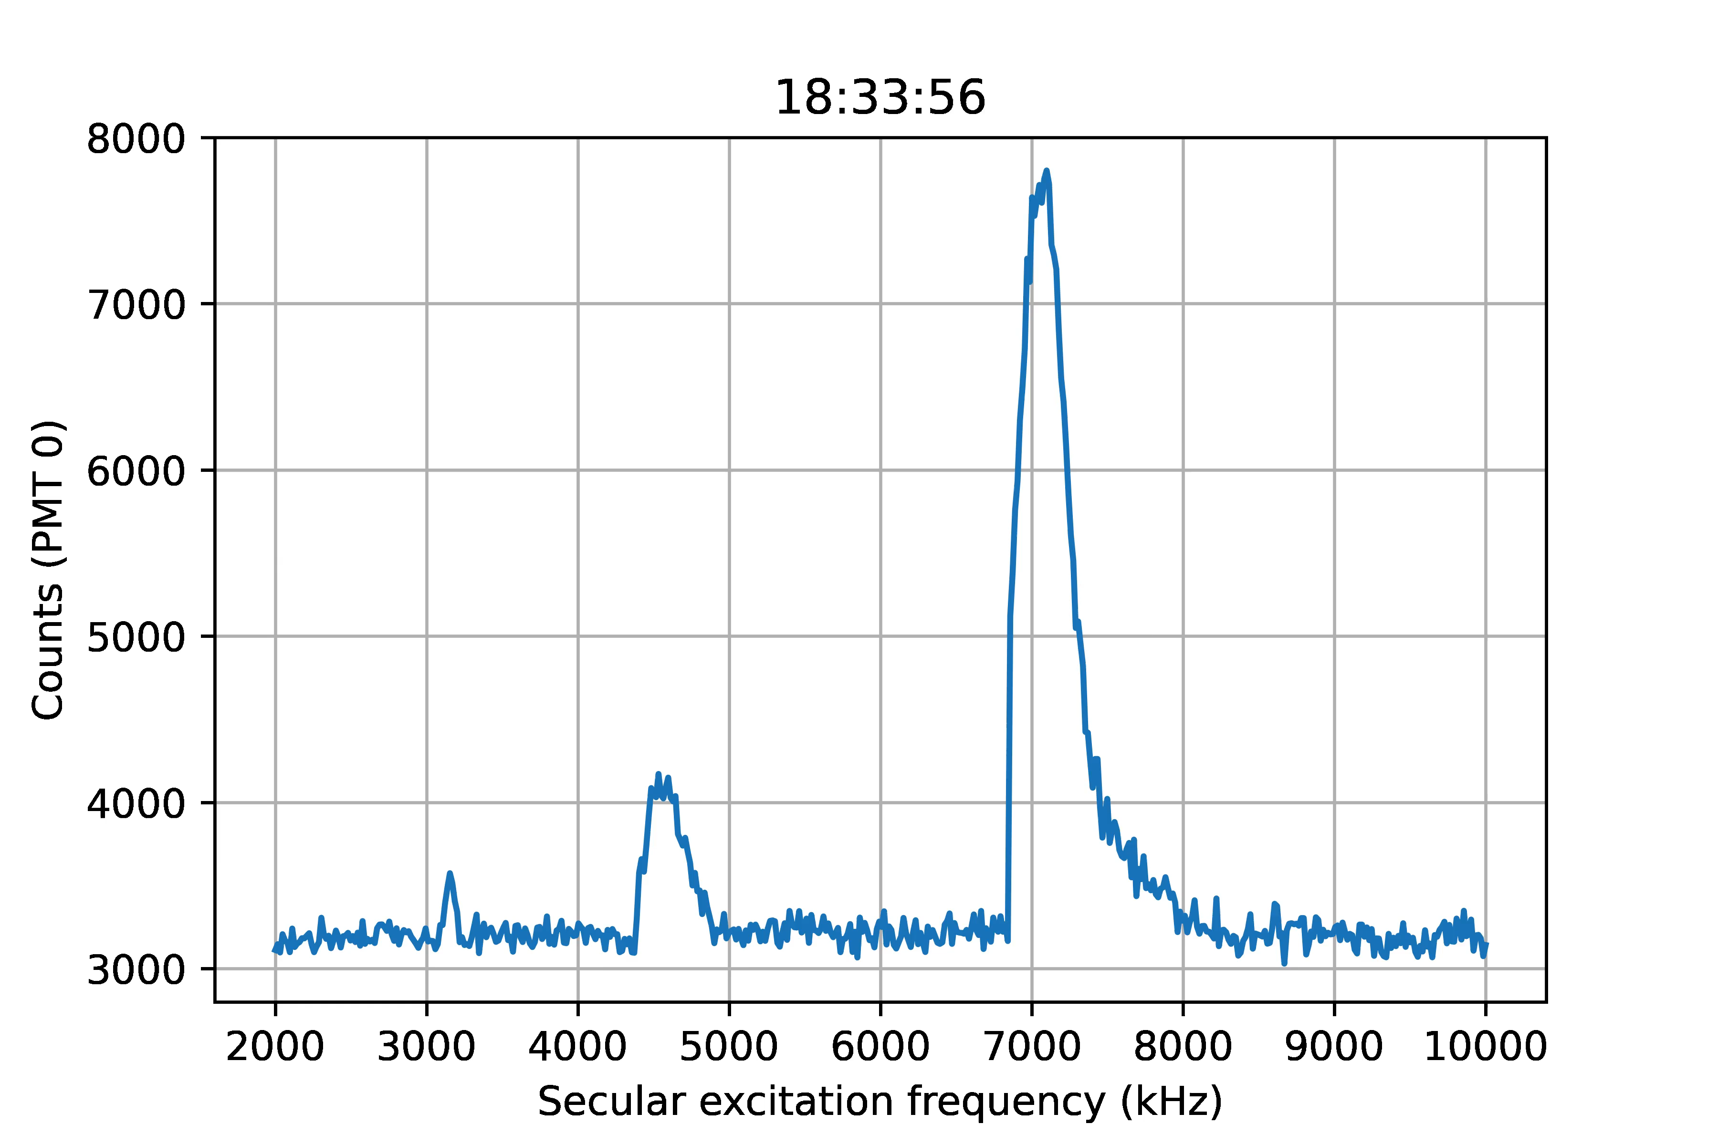
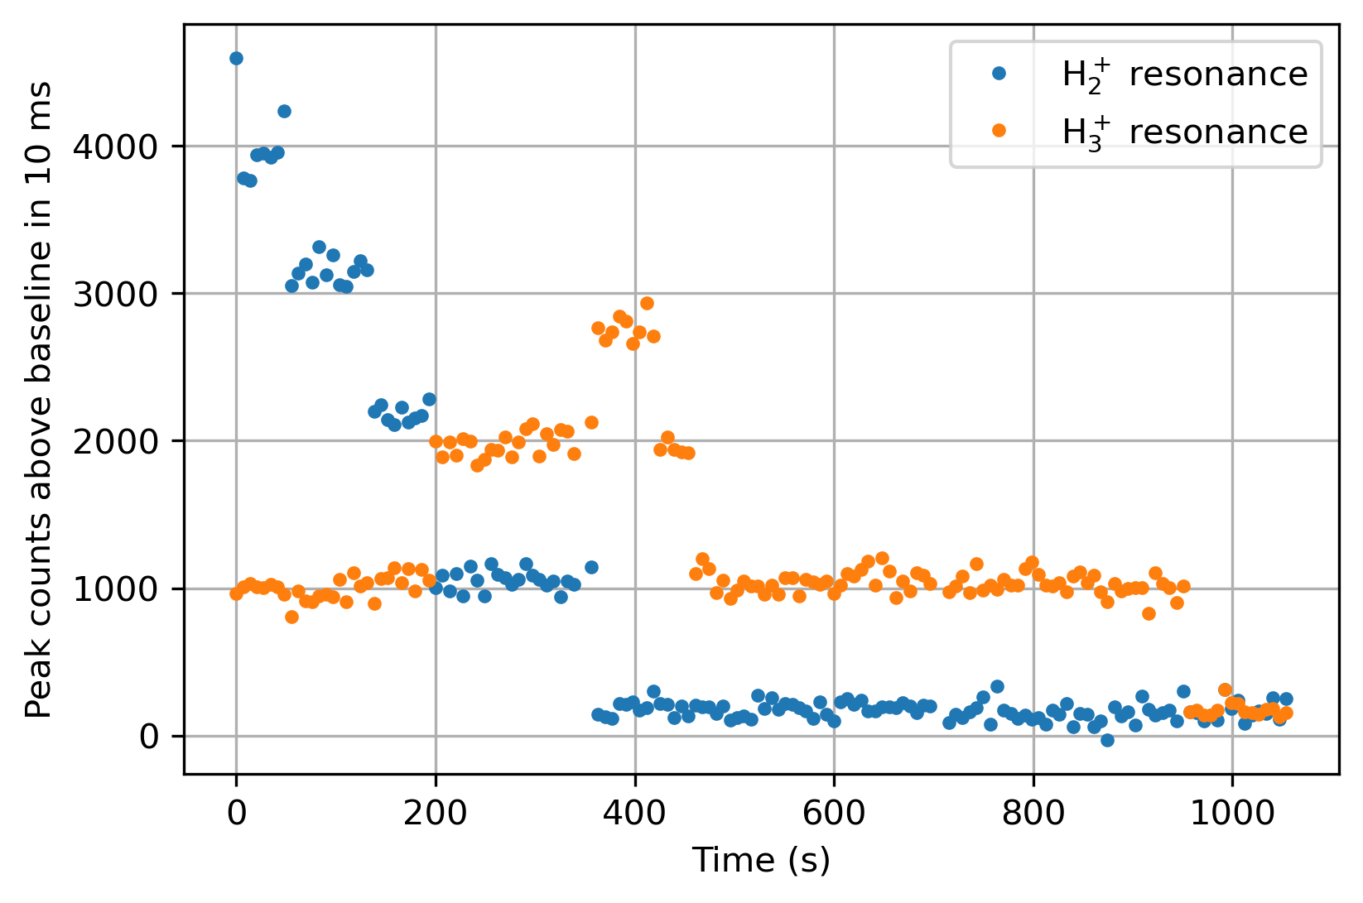
Single event sensitive detection
Testing secular excitation detection
H₂⁺: Same charge-to-mass ratio as He²⁺
H₂⁺
H₃⁺

Slide 21
Achieved:
Generation of 61nm comb
Trapped and cooled He⁺
Demonstrated sensitive He²⁺ detection
Plans :
Optimization of 61nm comb
(power, spectrum)
Testing spectroscopy setup with easier transition
(Two-photon transition at 204 nm with Be⁺)
Finding He⁺ 1S-2S signal:
QED predication: ~ 70 kHz
Expected linewidth of signal: ~ 1 kHz

Slide 22
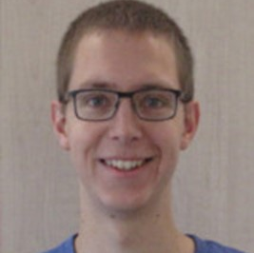
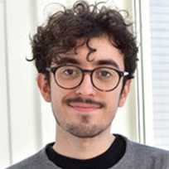
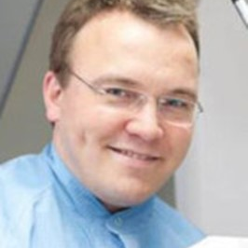
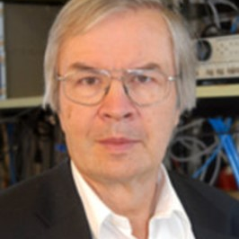
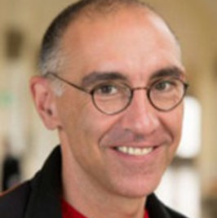
The He⁺ team
Fabian Schmid
Jorge Moreno
Johannes Weitenberg
Theodor W. Hänsch
Thomas Udem

Slide 23
