Slide 1
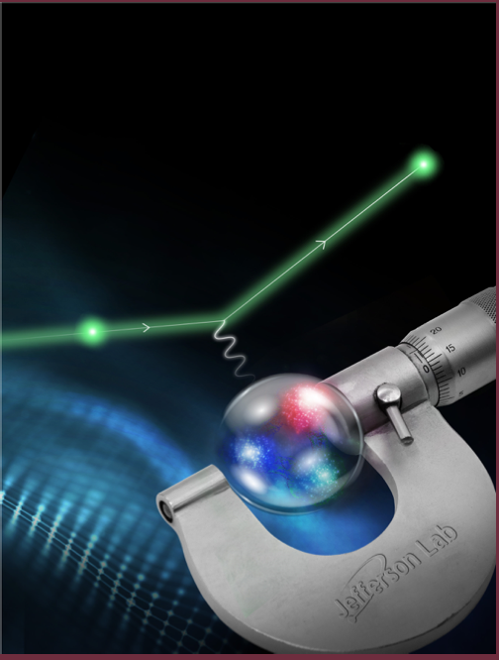
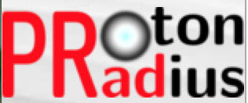
The Present and Future of the PRad Experiment at Jefferson Lab
A. Gasparian
NC A&T State University, NC USA
for the PRad collaboration
Outline
  the PRad approach for a new ep-experiment
  PRad experiment and the results
  new planned experiment, PRad-II
  summary

Slide 2
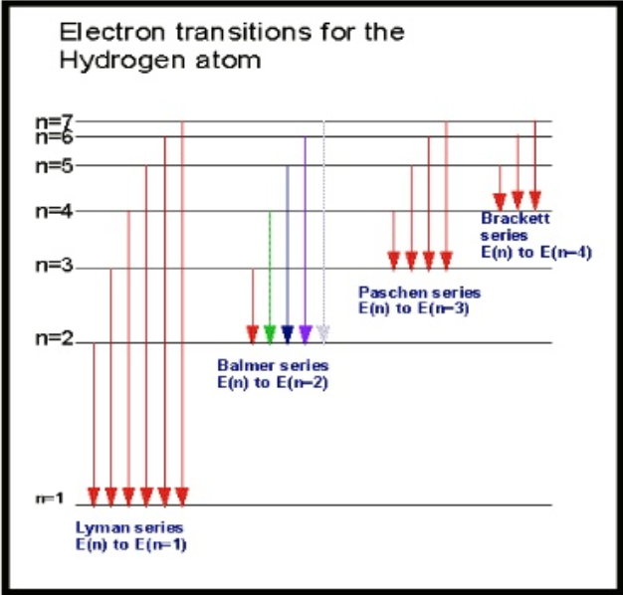
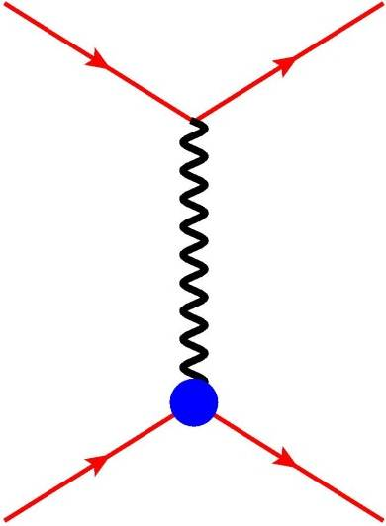

Proton Charge Radius
One of the most fundamental quantities in physics:
atomic physics:
  precision atomic spectroscopy (QED, Lamb shifts, Rydberg constant R∞);
  r_{p} is strongly correlated to R∞
nuclear physics:
  QCD, test of nuclear/particle models
connects atomic and subatomic physics.
Methods to measure the Proton rms charge radius (r_{p}):
Hydrogen spectroscopy (lepton-proton bound state,
Atomic Physics):
  regular hydrogen
  muonic hydrogen
Lepton-proton elastic scattering (Nuclear Physics):
  ep- scattering (like PRad)
  μp- scattering (like MUSE)
e⁻ $,μ$
e⁻ $,μ$
G_{E} ,G_{M}
p
p

Slide 3


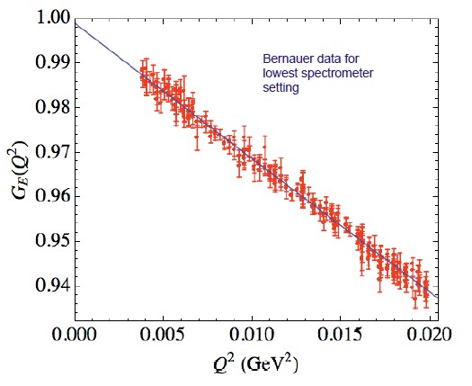
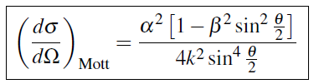

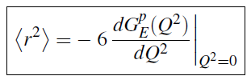

Proton Radius from ep→ep Scattering Experiments
In the limit of first Born approximation the elastic ep scattering
(one photon exchange):
e⁻
e⁻
$γ∗$
p
G_{E} ,G_{M}
p
Structureless proton:
G_{E} and G_{M} can be extracted using Rosenbluth separation
for extremely low Q², the cross section is dominated by G_{E}
Taylor expansion of G_{E} at low Q²
derivative at Q² = 0:
Mainz low Q² data set
Phys. Rev. C 93, 065207, 2016
definition of the proton rms charge radius

Slide 4
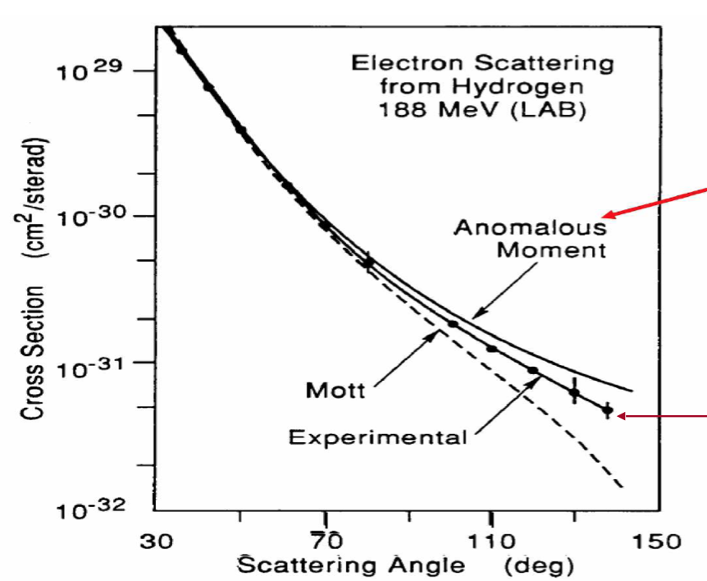
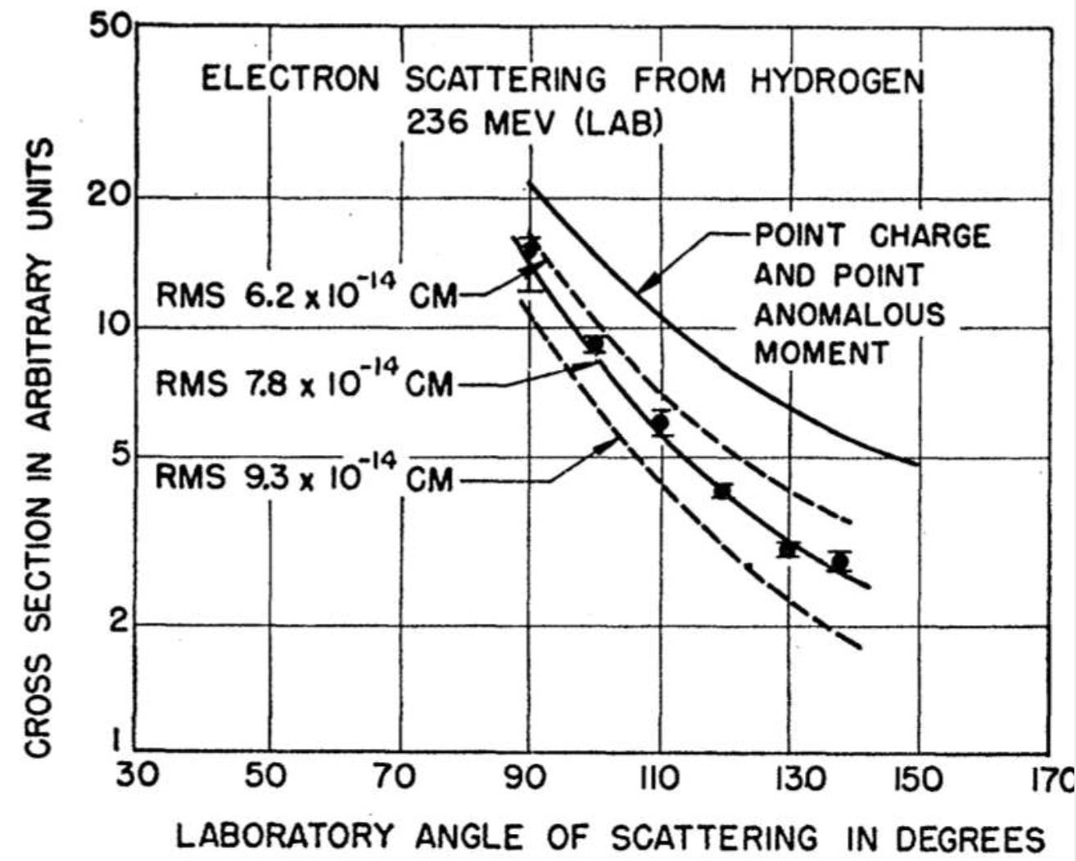
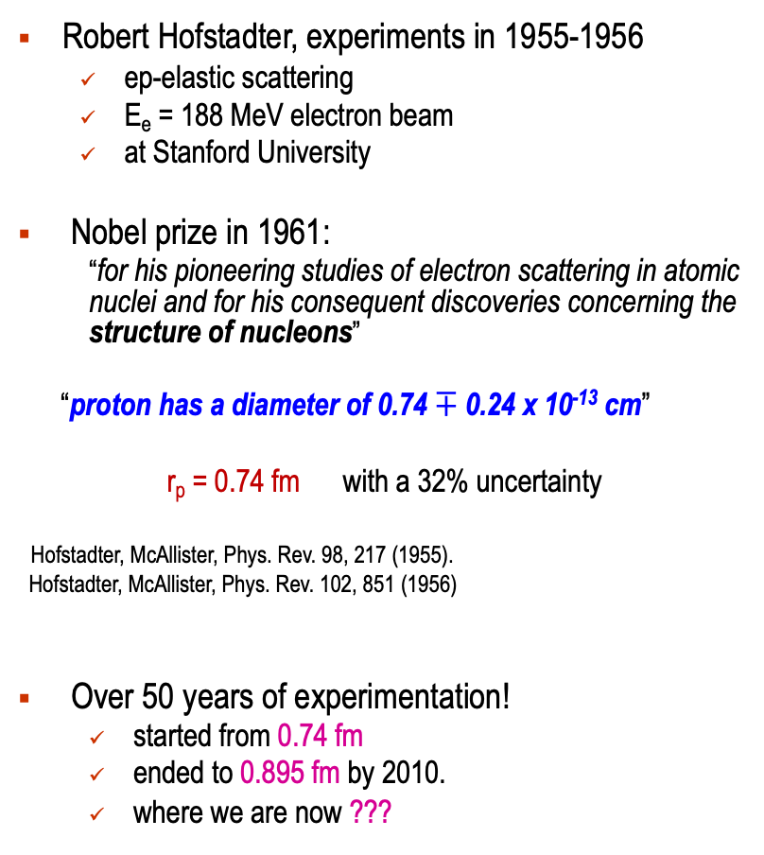
First Measurement of the Proton Radius
Robert Hofstadter, experiments in 1955-1956
  ep-elastic scattering
  E_{e} = 188 MeV electron beam
  at Stanford University
Nobel prize in 1961:
  “for his pioneering studies of electron scattering in atomic nuclei and for his consequent discoveries concerning the structure of nucleons”
“proton has a diameter of 0.74 $∓$ 0.24 x 10⁻¹³ cm”
r_{p} = 0.74 fm with a 32% uncertainty
Hofstadter, McAllister, Phys. Rev. 98, 217 (1955).
Hofstadter, McAllister, Phys. Rev. 102, 851 (1956)
Over 50 years of experimentation!
  started from 0.74 fm
  ended to 0.895 fm by 2010.
  where we are now ???

Slide 5
Proton Radius before the Puzzle (2010)
CODATA average: 0.8751 ± 0.0061 fm
ep-scattering average (CODATA): 0.879 ± 0.011 fm
Regular H-spectroscopy average (CODATA): 0.859 ± 0.0077 fm
  Very good agreement between ep-scattering and H-spectroscopy results !

Slide 6

The Proton Radius Puzzle before the PRad Experiment (2016)
New York Times
Regular hydrogen average (CODATA): 0.8751 ± 0.0061 fm
Muonic hydrogen (CREMA coll. 2013): 0.8409 ± 0.0004 fm
  Muonic hydrogen (CREMA coll. 2010): 0.84184 ± 0.00067 fm

Slide 7
Possible Resolutions to the Proton Radius Puzzle
Some initial open questions about QED calculations:
  additional corrections to muonic-hydrogen. Not found
  missing contributions to electronic-hydrogen. Not found
  higher moments in electric form factor; Not significant
  …
Is the ep-interaction the same as μp-interaction (the lepton universality principle)?
New Physics (forces) beyond the Standard Model? Not found yet
  many models, discussions, suggestions …
Potential solutions:
  need new high precision, high accuracy experiments:
      ep-scattering experiments:
        reaching extremely low Q² range (10⁻⁴ Gev/c²)
        possibly with new independent methods PRad at JLab
        measure absolute cross sections in ONE experimental setting!
        MUSE at PSI, ISR at Mainz, ULQ² in Japan, AMBER at CERN …
      ordinary hydrogen spectroscopy experiments:
        York University in Canada, LKB in Paris, France, CREMA in Germany …

Slide 8
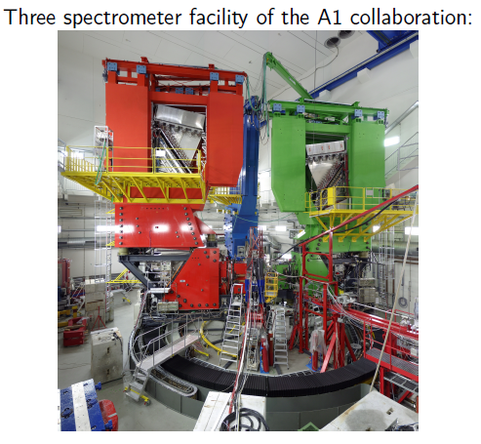
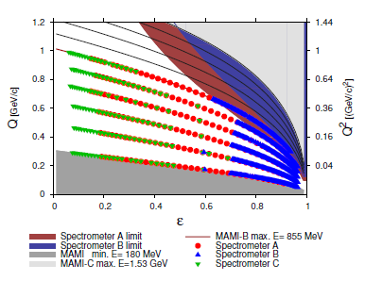
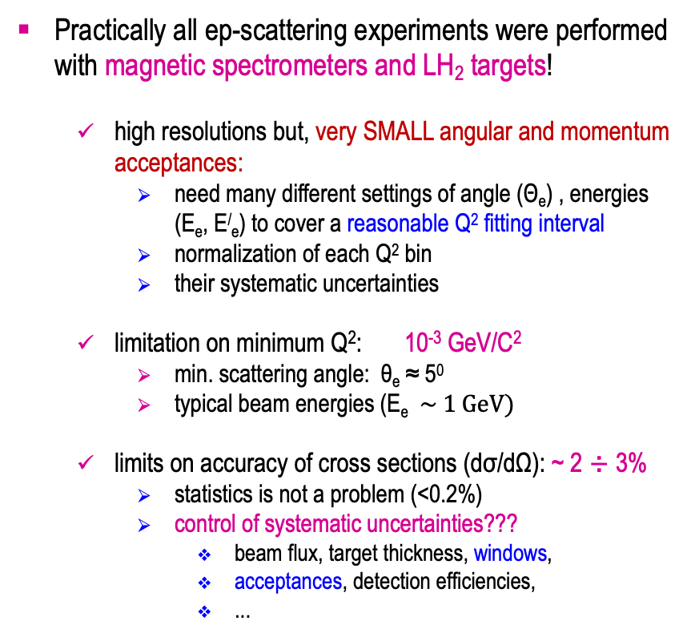
Planning a New ep→ep Scattering Experiment
Practically all ep-scattering experiments were performed with magnetic spectrometers and LH₂ targets!
  high resolutions but, very SMALL angular and momentum acceptances:
    need many different settings of angle (Θ_{e}) , energies (E_{e}, E/_{e}) to cover a reasonable Q² fitting interval
    normalization of each Q² bin
    their systematic uncertainties
  limitation on minimum Q²: 10⁻³ GeV/C²
    min. scattering angle: θ_{e} ≈ 5⁰
    typical beam energies (E_{e} $\sim 1 GeV)$
  limits on accuracy of cross sections (dσ/dΩ): ~ 2 ÷ 3%
    statistics is not a problem (<0.2%)
    control of systematic uncertainties???
      beam flux, target thickness, windows,
      acceptances, detection efficiencies,
      ...

Slide 9
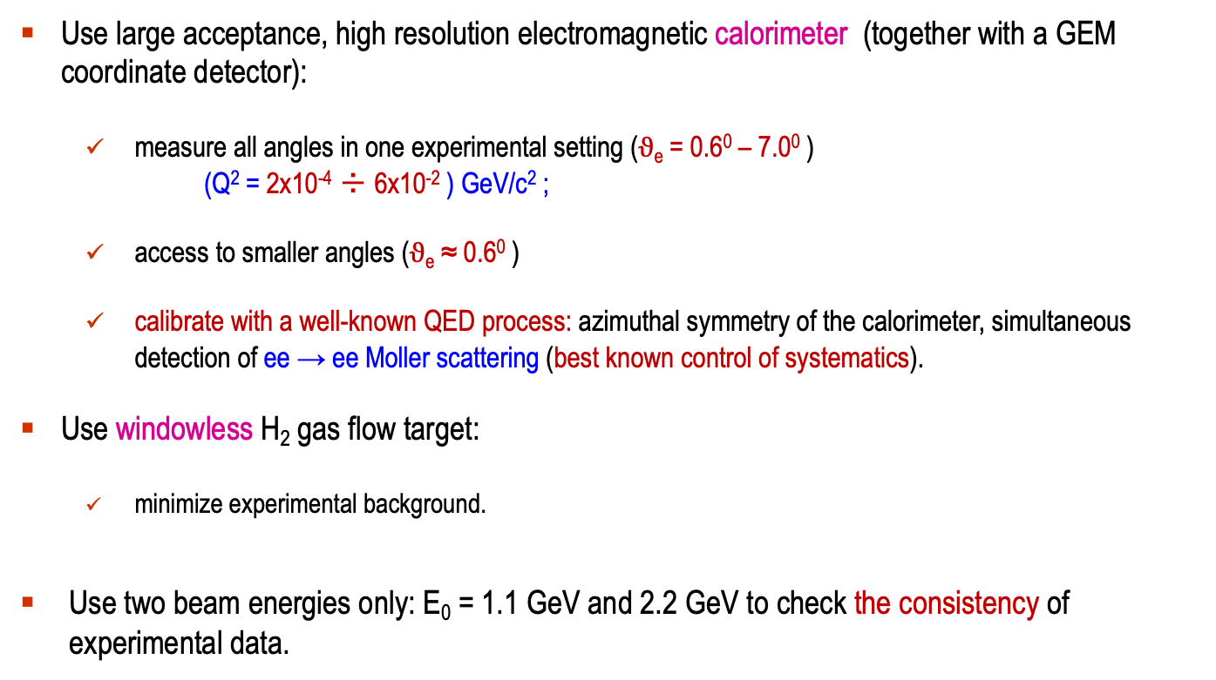
A Possible Solution: the PRad Experimental Approach
Use large acceptance, high resolution electromagnetic calorimeter (together with a GEM coordinate detector):
  measure all angles in one experimental setting ($ϑ$_{e} = 0.6⁰ – 7.0⁰ )
  (Q² = 2x10⁻⁴ ÷ 6x10⁻² ) GeV/c² ;
  access to smaller angles ($ϑ$_{e} ≈ 0.6⁰ )
  calibrate with a well-known QED process: azimuthal symmetry of the calorimeter, simultaneous detection of ee → ee Moller scattering (best known control of systematics).
Use windowless H₂ gas flow target:
  minimize experimental background.
Use two beam energies only: E₀ = 1.1 GeV and 2.2 GeV to check the consistency of experimental data.

Slide 10
PRad Experiment Timeline
Initial proposal development: 2011-12
Approved by JLab PAC39: 2012
Funding proposal for windowless H₂ gas flow 2012
target (NSF MRI #PHY-1229153)
Development, construction of the target: 2012 – 15
Funding proposals for the GEM detectors: 2013
(DOE awards)
Development, construction of the GEM detectors: 2013-15
Beam line installation, commissioning,
data taking in Hall B at JLab: January /June 2016
Data analysis 2016 – 2019
Publication in Nature journal November, 2019

Slide 11
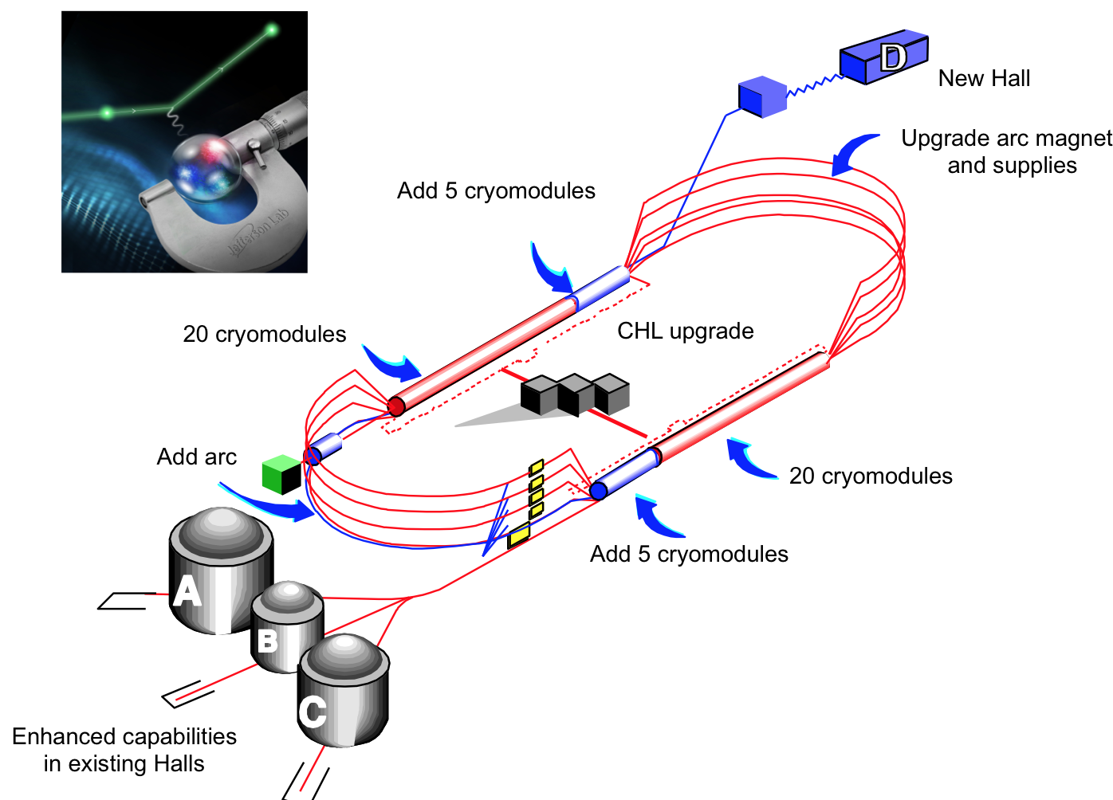
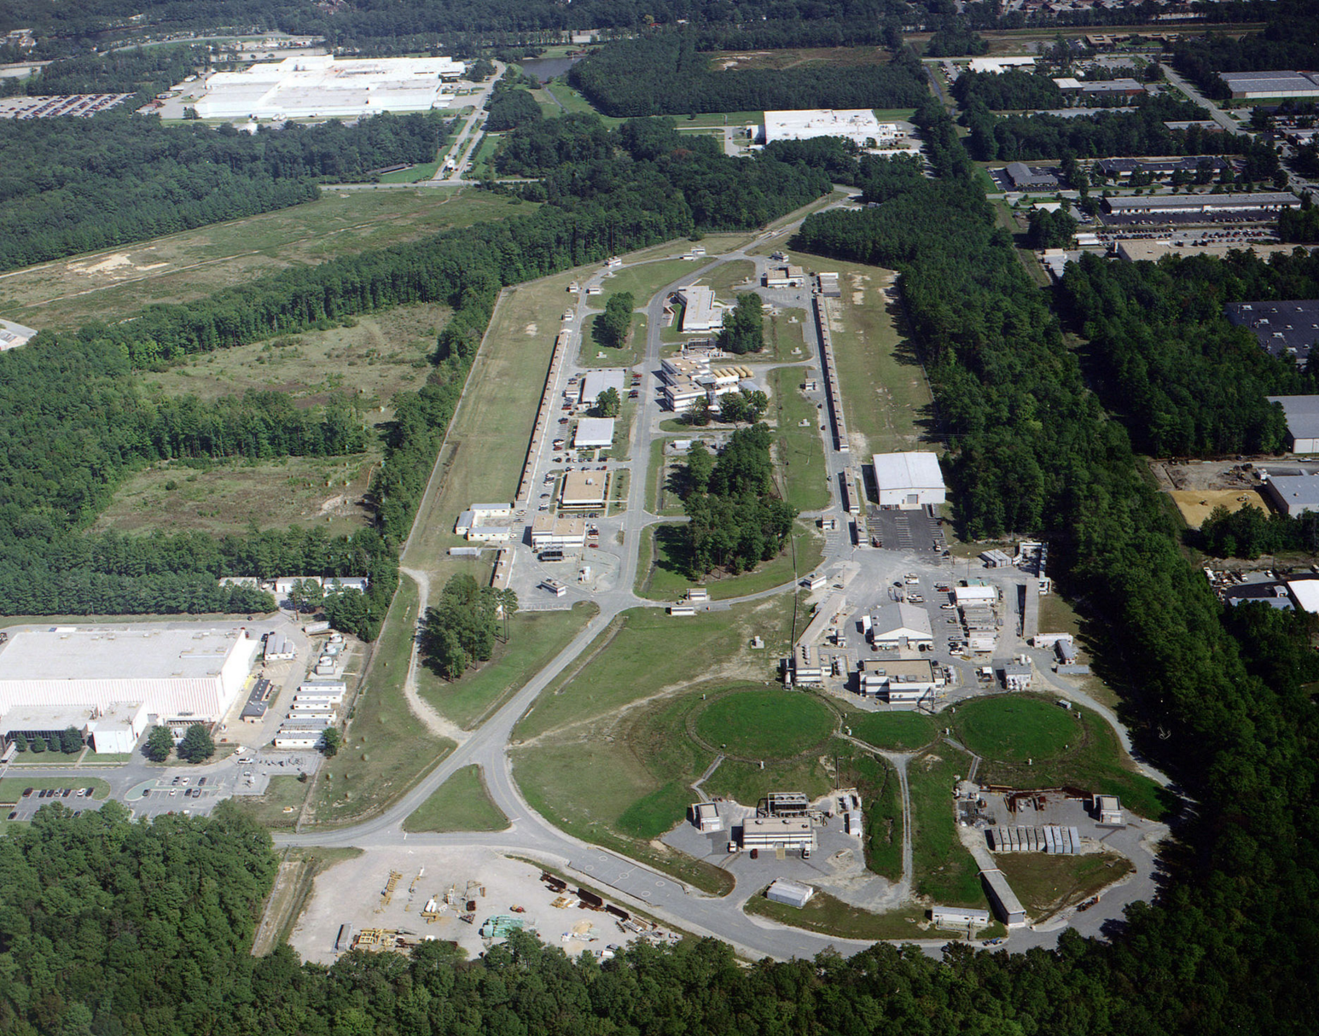
PRad Experiment Performed in Hall B at Jefferson Lab
PRad was performed in Hall B at JLab
in January – June of 2016

Slide 12
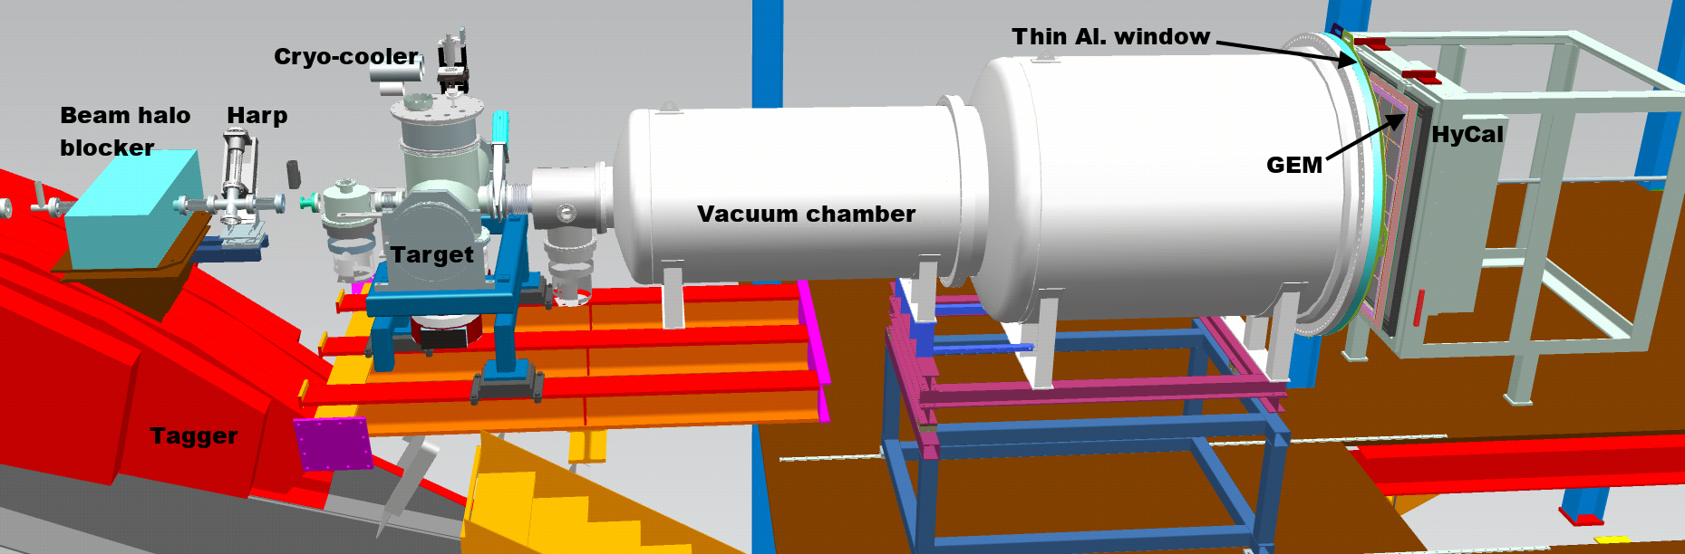
PRad Experimental Setup in Hall B at JLab (schematics)
Main detector elements:
  windowless H₂ gas flow target
  PrimEx HyCal calorimeter
  vacuum box with one thin window at HyCal end
  X,Y – GEM detectors on front of HyCal
Beam line equipment:
  standard beam line elements (0.1 – 50 nA)
  photon tagger for HyCal calibration
  collimator box (6.4 mm collimator for photon beam, 12.7 mm for e⁻ beam halo “cleanup”)
  Harp 2H00 l
e - beam

Slide 13
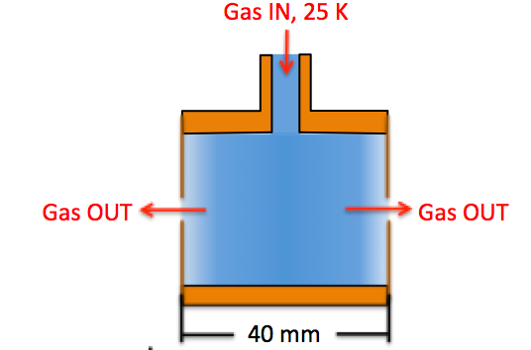
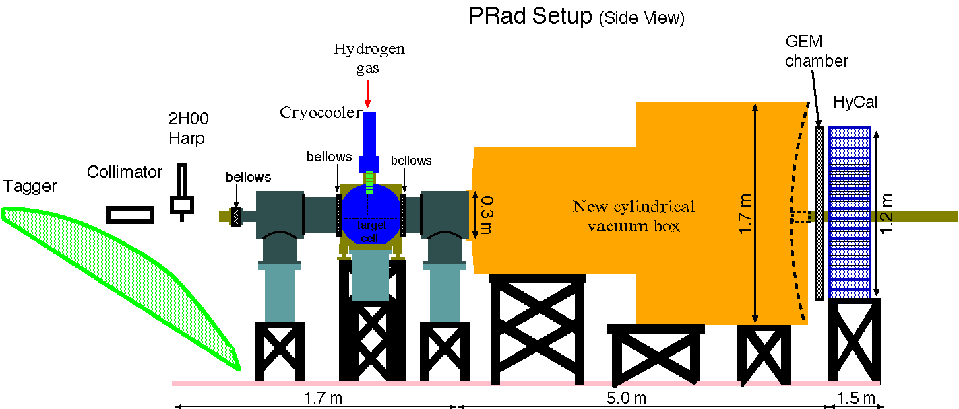
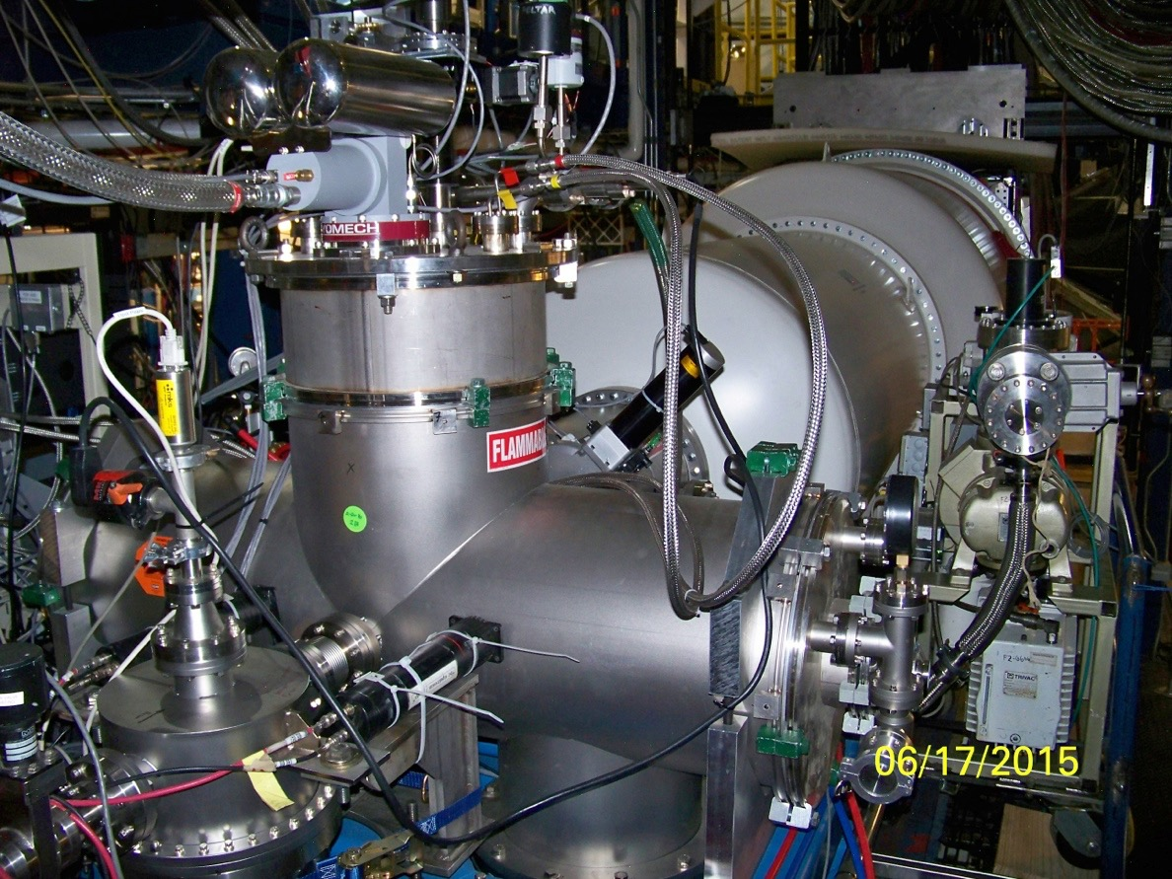
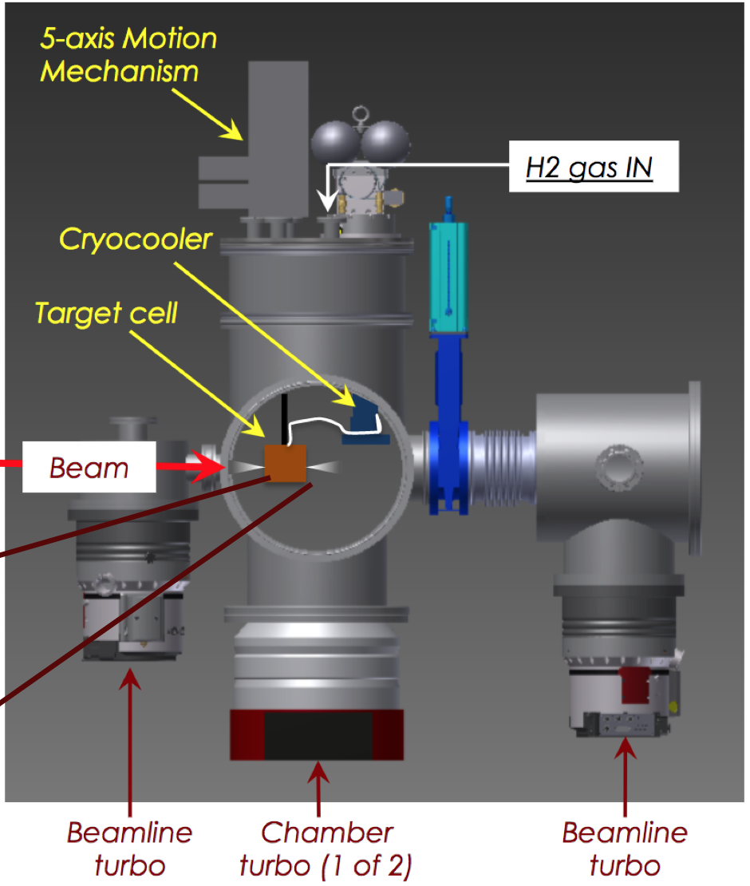
Windowless Hydrogen Gas Flow Target
e-beam
Electron Beam
New Cylindrical Vacuum Chamber
Electron beam
8 cm diam. X 4 cm long target cell
2 mm holes open at front and back of kapton foils for the beam passage
areal density: 1.8x10⁺¹⁸ H atoms/cm²
  cell pressure: 471 mTorr
  chamber pressure: 2.34 mTorr: cell vs. chamber pressures: 200:1
  vacuum tank pressure 0.3 mTorr: cell vs. vacuum tank pressures: 1000:1
  at temperature: 19.5 K

Slide 14
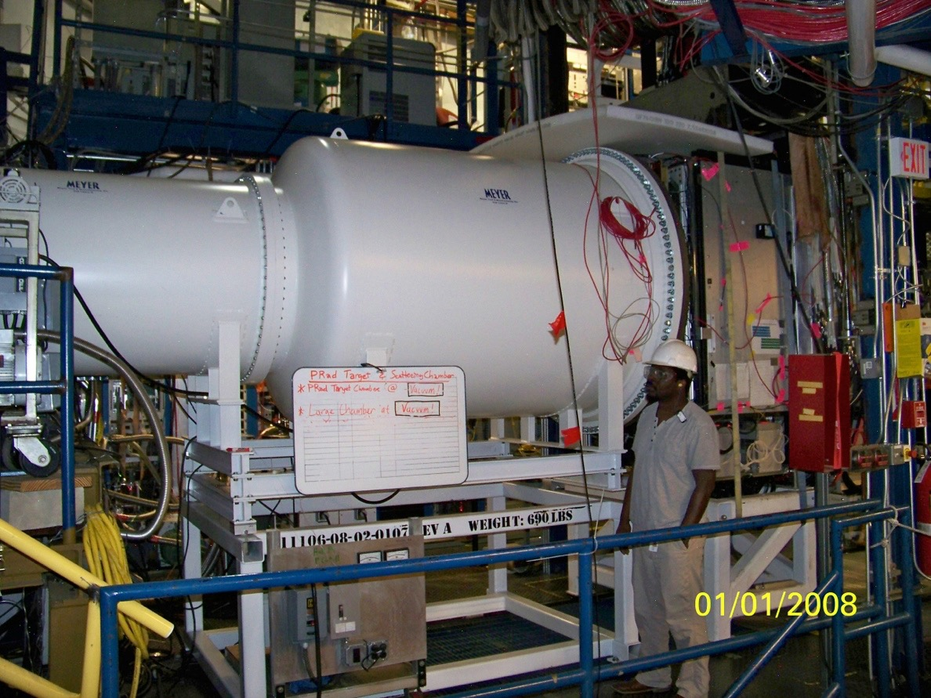
PRad Experimental Apparatus: Vacuum Chamber
New Cylindrical Vacuum Chamber
Electron beam
5 m long two stages vacuum chamber,
1.7 m diameter, 2 mm Al vacuum window
vacuum chamber pressure: 0.3 mTorr

Slide 15
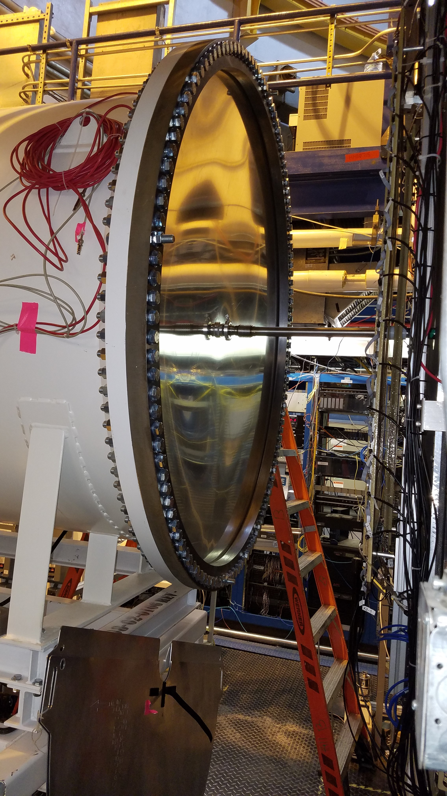
PRad Experimental Apparatus: Vacuum Chamber and Window
2-stage vacuum box in Hall B beam line
1.7 m diameter, 2 mm Al vacuum window

Slide 16
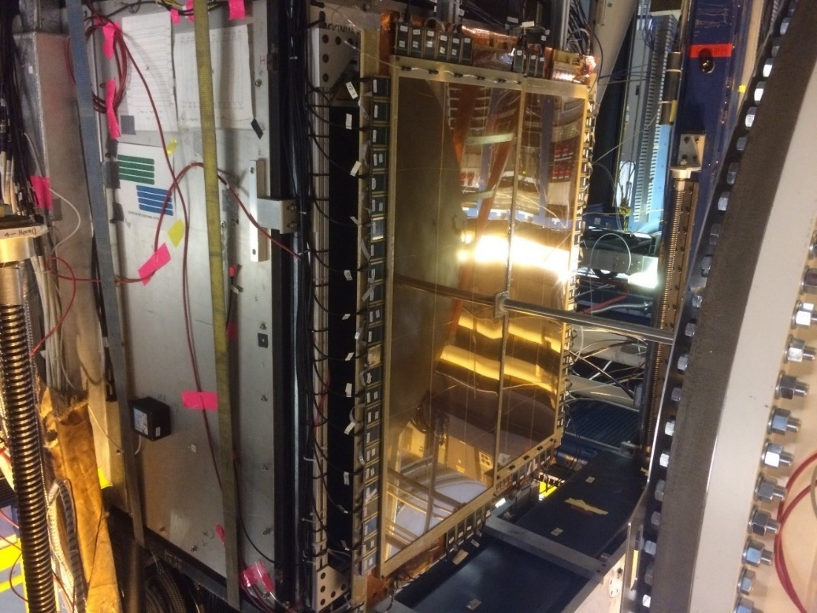
PRad Experimental Apparatus: GEM Coordinate Detectors
Two large area GEM detectors
Small overlap region in the middle
Excellent position resolution (72 µm)
Improve position resolution of the setup by > 20 times
Large improvements in Q² determination
New Cylindrical Vacuum Chamber
Electron beam

Slide 17
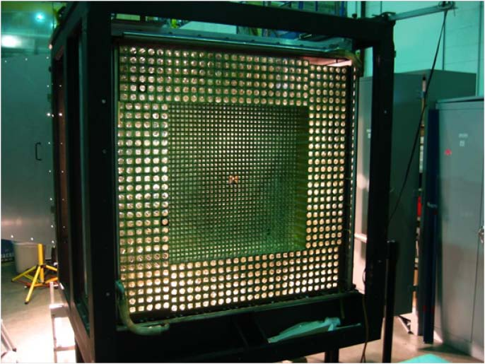
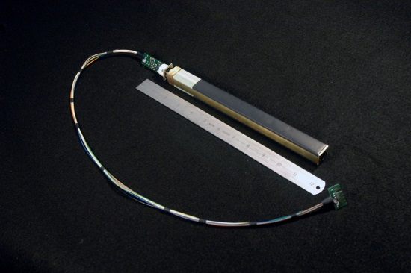
PRad Experimental Apparatus: HyCal El. Mag. Calorimeter
hybrid EM calorimeter (HyCal)
  inner 1156 PbWO₄ modules.
  outer 576 lead glass modules.
5.8 m from the target.
scattering angle coverage: ~ 0.6˚ to 7.5˚
full azimuthal angle coverage
high resolution and efficiency
  2.5% at 1 GeV for crystal part
  6.1% at 1 GeV for lead glass part
energy calibration done with tagged photons
e-beam
New Cylindrical Vacuum Chamber
Electron beam

Slide 18
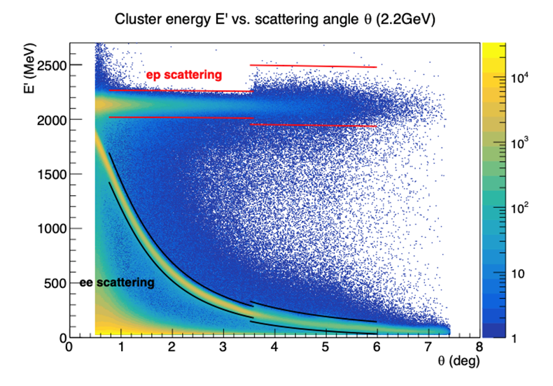
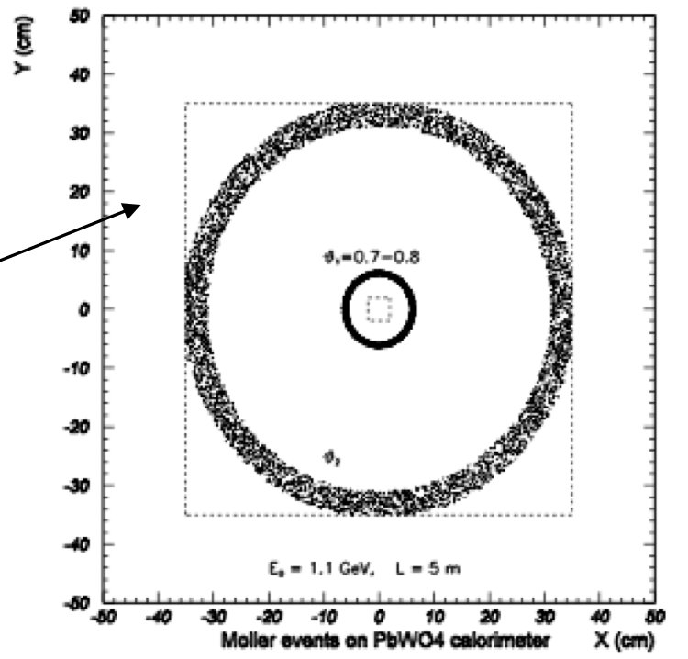
Data Analysis: Event Selection
Experimental data was taken with two beam energies:
  1.1 GeV (604 M events)
  2.2 GeV (756 M events)
For all events, require hit matching between GEMs and HyCal
For ep and ee events, apply angle dependent energy cut based on kinematics:
  cut size depend on local detector resolution
For ee, if requiring double-arm events, apply additional cuts:
  elasticity
  co-planarity
  vertex z (kinematics)
2.2 GeV

Slide 19
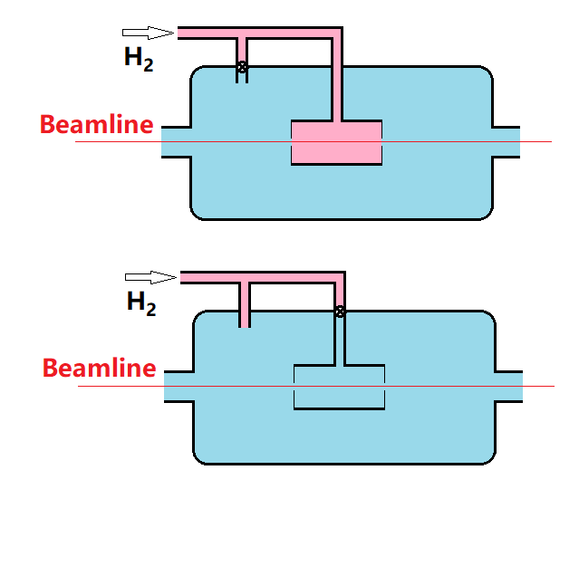
Data Analysis: Empty Target Runs for Background Subtraction
ep background rate ~ 10% at forward angle (<1.1 deg, dominated by upstream beam halo blocker),
less than 2% otherwise
ee background rate ~ 0.8% at all angles
(a)
(b)
2.2 GeV ep data
(c)
(d)
Residual hydrogen gas: hydrogen gas filled during background runs

Slide 20
Data Analysis: ep-inelastic Contribution
Using Christy 2018 empirical fit* to study inelastic ep contribution
Good agreement between data and simulation
Negligible for the PbWO₄ region (<3.5º)
Less than 0.2%(2.0%) for 1.1GeV(2.2GeV) in the Lead glass region
PbWO₄ region
Lead glass region
* M. E. Christy and P. E. Bosted, PRC 81, 055213 (2010)

Slide 21
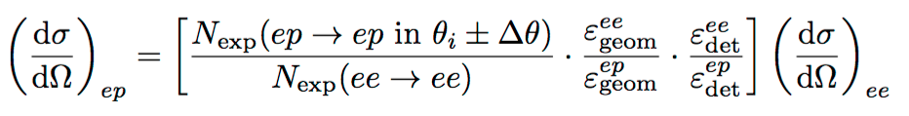
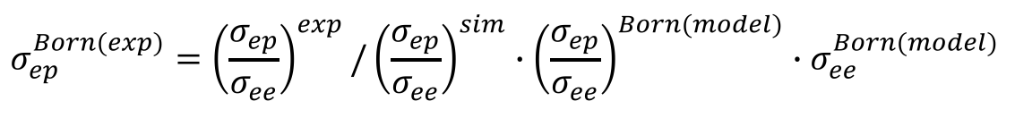
Extraction of the ep → ep Elastic Scattering Cross Section
To reduce the systematic uncertainty, the ep cross section was normalized to the Møller cross section:
  method 1: bin by bin method – taking ep/ee counts from the same angle bin
  method 2: integrated Moller method – integrate Møller in a fixed angle range and use it as common normalization for all angle bins
Luminosity cancelled from both methods
Radiative effects corrected by Monte Carlo method:
  GEANT4 based simulation package with full geometry setup
  event generators with complete calculations of radiative corrections^{1),2)}
  iterative procedure applied for radiative corrections
    1) A. V. Gramolin et al., J. Phys. G Nucl. Part. Phys. 41(2014)115001;
    2) I. Akushevich et al., Eur. Phys. J. A 51(2015)1 (fully beyond ultra relativistic approximation).

Slide 22

Extracted ep→ep Elastic Differential Cross Sections
Extracted differential cross sections vs. Q², with 1.1 and 2.2 GeV data.
Statistical uncertainty: ~0.2% for 1.1 GeV and ~0.15% for 2.2 GeV per point.
Systematic uncertainties: 0.3% - 0.5% for 1.1 GeV and 0.3 – 1.1% for 2.2 GeV per point.
33 data points from 1.1 GeV data set
38 data points from 2.2 GeV data set

Slide 23
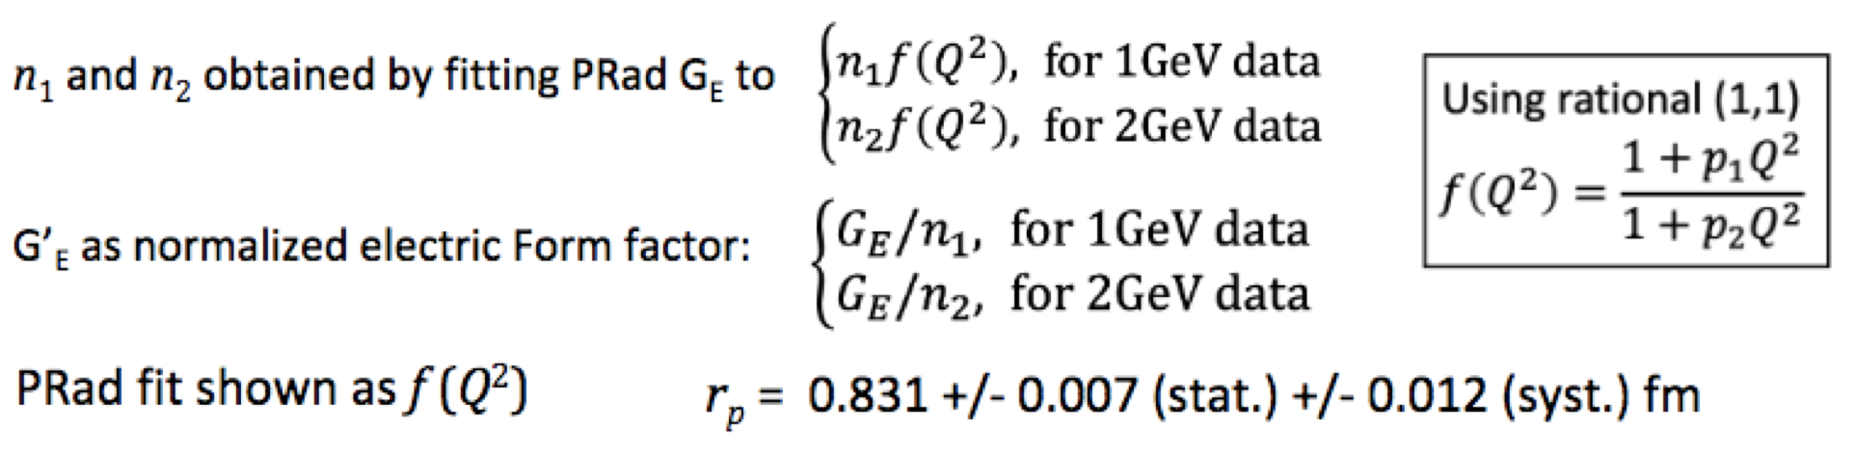
Fit to Extract the Proton Radius
PRad final result: R_{p} = 0.831 ± 0.007 (stat.) ± 0.012 (syst.) fm

Slide 24
The Proton Radius Puzzle before the PRad Publication
Regular hydrogen average (CODATA): 0.8751 ± 0.0061 fm
Muonic hydrogen (CREMA coll. 2013, PSI): 0.8409 ± 0.0004 fm
  Regular H-spectr. (2S ➔ 4P, Garching, PSI): 0.8335 ± 0.0095 fm
  Regular H-spectr. (1S ➔ 3S, LKB, Paris): 0.877 ± 0.013 fm
  Regular H-spectr. (2S_{1/2} ➔ 2P_{1/2} , York Un. Canada) 0.833 ± 0.010 fm

Slide 25
The PRad Final Result on the Radius
PRad final result: R_{p} = 0.831 ± 0.007 (stat.) ± 0.012 (syst.) fm
published in: Nature 575, 145–150 (2019)

Slide 26
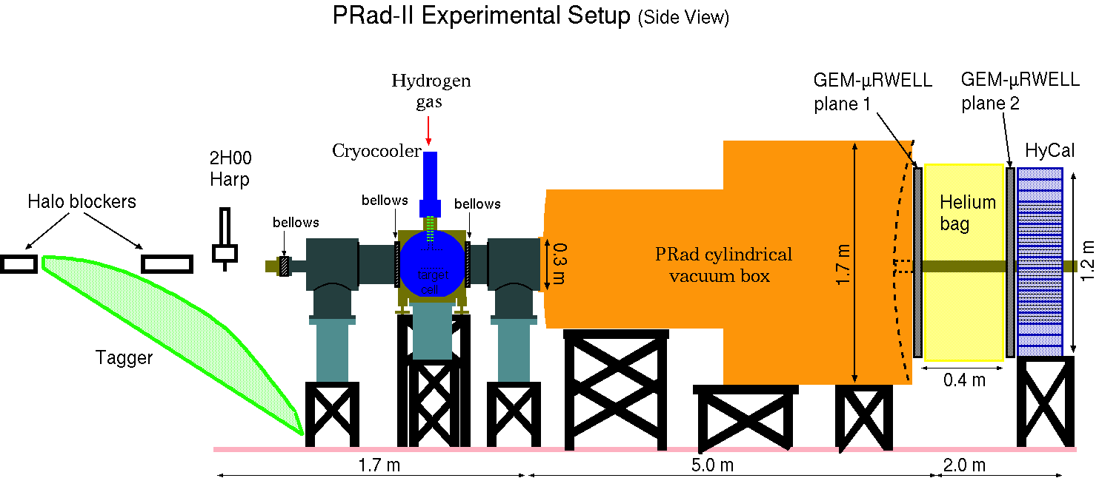
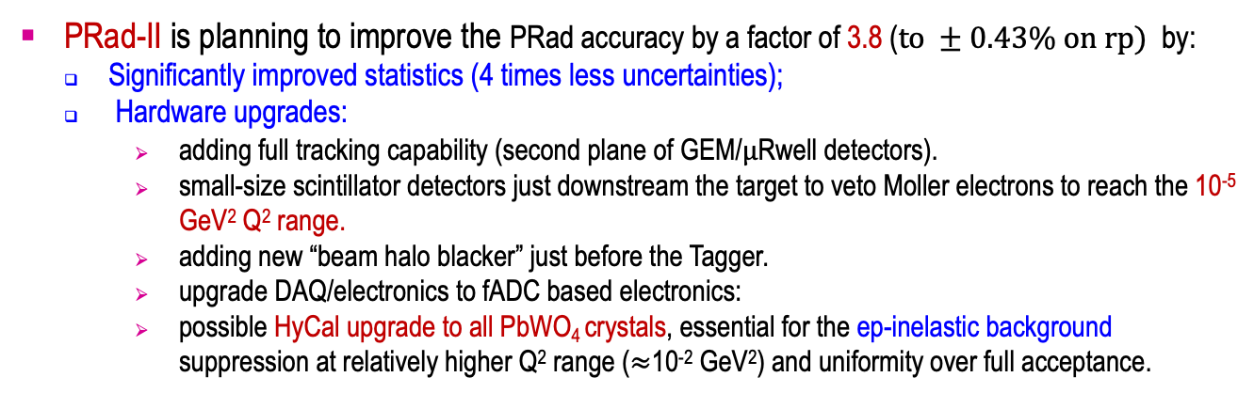
Planed New Experiment: PRad-II at JLab
PRad-II is planning to improve the PRad accuracy by a factor of 3.8 ($to ±0.43\% on rp)$ by:
Significantly improved statistics (4 times less uncertainties);
Hardware upgrades:
  adding full tracking capability (second plane of GEM/$μ$Rwell detectors).
  small-size scintillator detectors just downstream the target to veto Moller electrons to reach the 10⁻⁵ GeV² Q² range.
  adding new “beam halo blacker” just before the Tagger.
  upgrade DAQ/electronics to fADC based electronics:
  possible HyCal upgrade to all PbWO₄ crystals, essential for the ep-inelastic background suppression at relatively higher Q² range ($≈$10⁻² GeV²) and uniformity over full acceptance.

Slide 27
PRad-II Experiment
The new PRad-IIl includes:
  Adding tracking capacity (second GEM plane)
  Upgraded HyCal with all high resolution PbWO₄ modules
  Convert to FADC based readout for HyCal
  Four times smaller stat. uncertainty
  Better RC calculating including NNLO diagrams

Slide 28
PRad-II: Projected Result
Approved by JLab’s PAC-48 in August, 2020
Projected total uncertainty on radius: 0.43%

Slide 29
PRad-II: Current Status
Approved by JLab’s PAC-48 in August, 2020, (E12-004)
NSF funding proposal was submitted in January 2022:
  Major Research Instrumentation (MRI) Track-2 development type proposal, ~$4M total for:
    HyCal partial upgrade to PbWO₄ crystals
    second GEM detector
    scintillator detectors to veto the Moller electrons at very small Q² range
  Results are expected before July
Also, for the calorimeter upgrade, we are looking for used crystal detectors from other experiments/institutions matching the PbWO₄ part of the HyCal

Slide 30
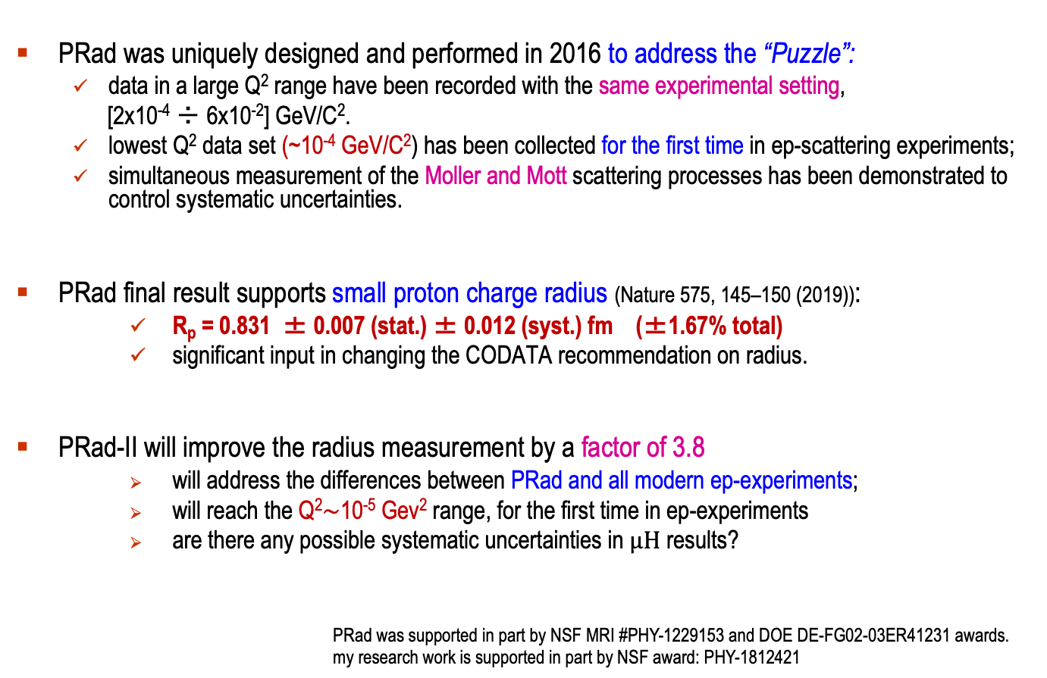
Summary
PRad was uniquely designed and performed in 2016 to address the “Puzzle”:
  data in a large Q² range have been recorded with the same experimental setting,
  [2x10⁻⁴ ÷ 6x10⁻²] GeV/C².
  lowest Q² data set (~10⁻⁴ GeV/C²) has been collected for the first time in ep-scattering experiments;
  simultaneous measurement of the Moller and Mott scattering processes has been demonstrated to control systematic uncertainties.
PRad final result supports small proton charge radius (Nature 575, 145–150 (2019)):
    R_{p} = 0.831 ± 0.007 (stat.) ± 0.012 (syst.) fm (±1.67% total)
    significant input in changing the CODATA recommendation on radius.
PRad-II will improve the radius measurement by a factor of 3.8
    will address the differences between PRad and all modern ep-experiments;
    will reach the Q²$\sim$10⁻⁵ Gev² range, for the first time in ep-experiments
    are there any possible systematic uncertainties in $μH$ results?
PRad was supported in part by NSF MRI #PHY-1229153 and DOE DE-FG02-03ER41231 awards.
my research work is supported in part by NSF award: PHY-1812421

Slide 31
Thank you!

Slide 32
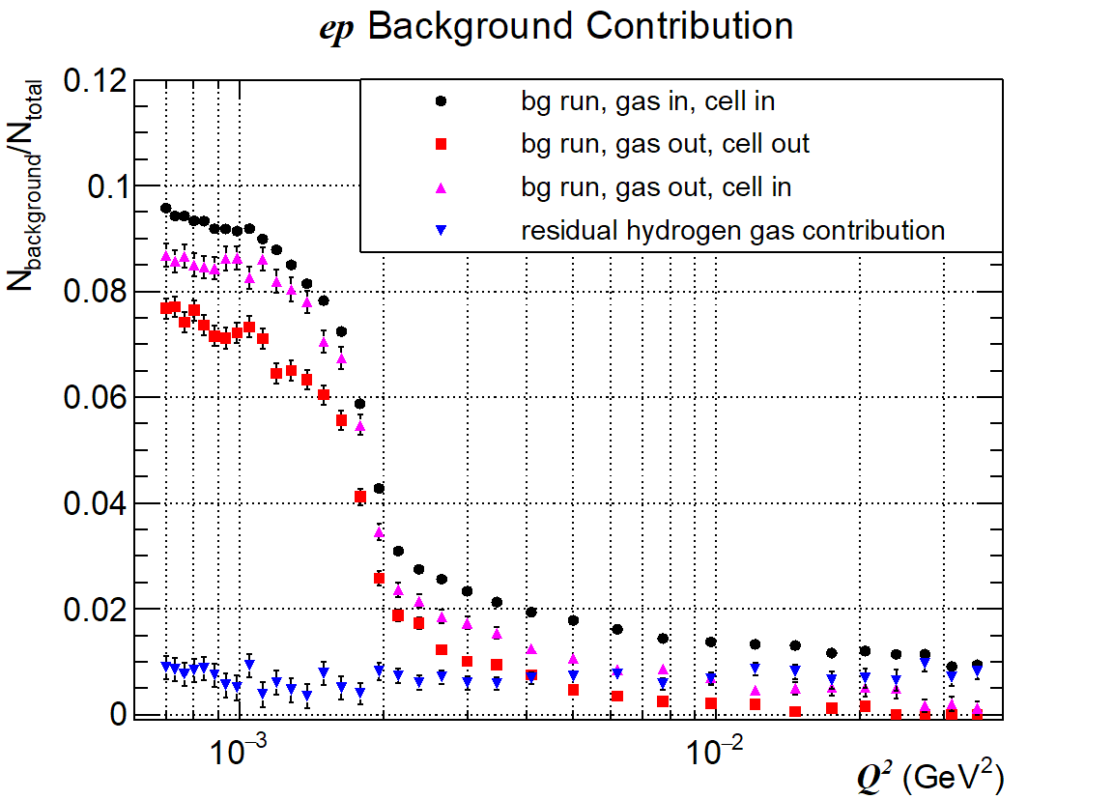
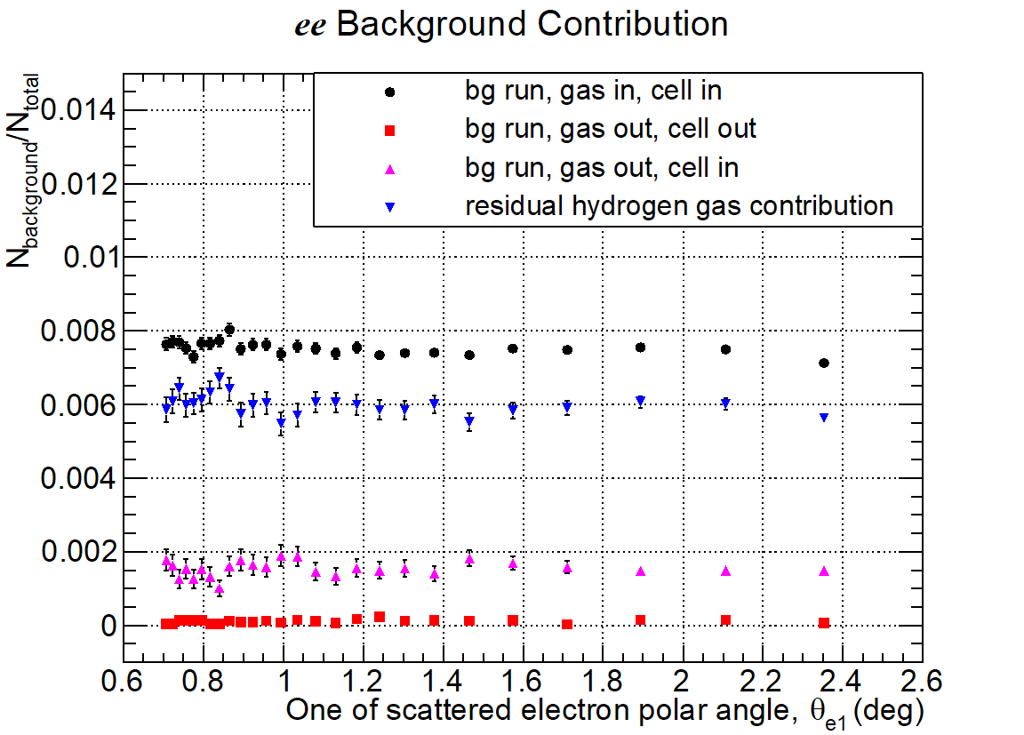
Data Analysis: Beam Background Subtraction
ep background rate ~ 10% at forward angles (<1.3⁰, dominated by upstream “collimator”),
less than 2% otherwise.
ee background rate ~ 0.8% at all angles .
2.2 GeV data
2.2 GeV data

Slide 33
Data Analysis: Stability vs. Run Number
Normalized ep/ee ratio vs. run number, (background subtracted with neighboring empty target runs).
Sensitive to systematics like time variation of beam line background, …

Slide 34
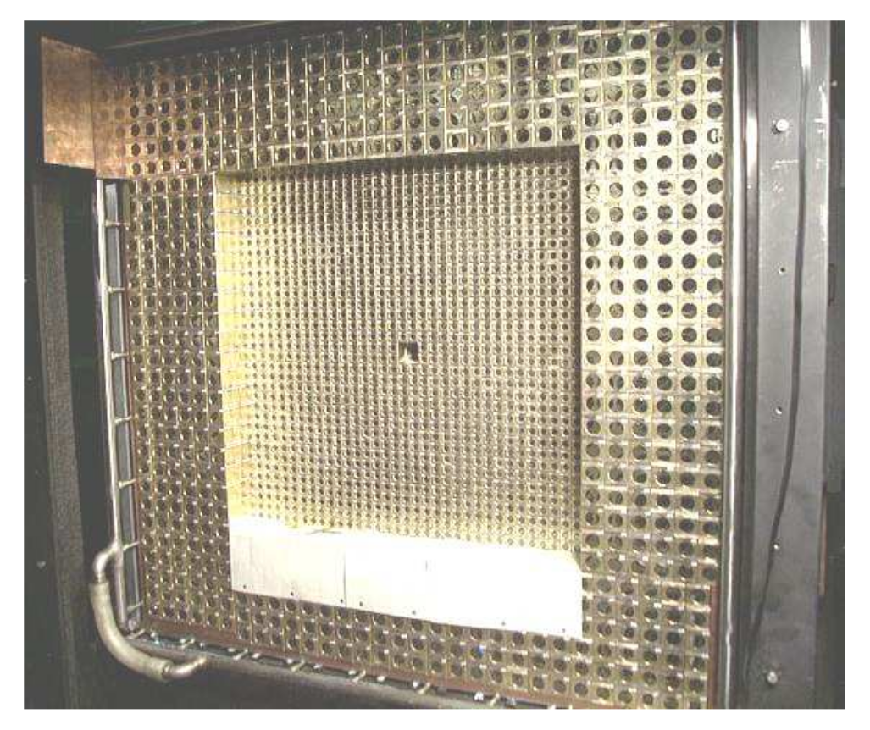
Data Analysis: Azimuthal Uniformity
Ratio (ep/ee)_{dat} / (ep/ee)_{sim} vs. azimuthal quadrants
Sensitive to detector efficiency, beam position, tilting angles, …
2nd
1st
2.2 GeV data
3rd
4th

Slide 35
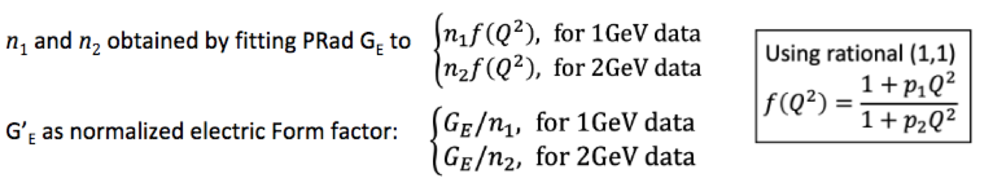
Extracted Proton Electric Form Factor, G_{E} vs. Q²
33 data points from 1.1 GeV data set
38 data points from 2.2 GeV data set
n₁ = 1.0002 +/- 0.0002(stat.) +/- 0.0020 (syst.), n₂ = 0.9983 +/- 0.0002(stat.) +/- 0.0013 (syst.)

Slide 36
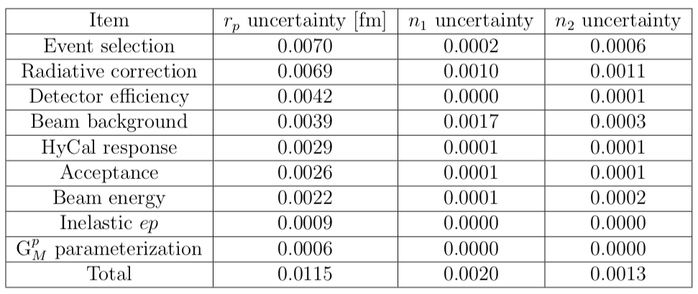
PRad Systematic Uncertainties

Slide 37
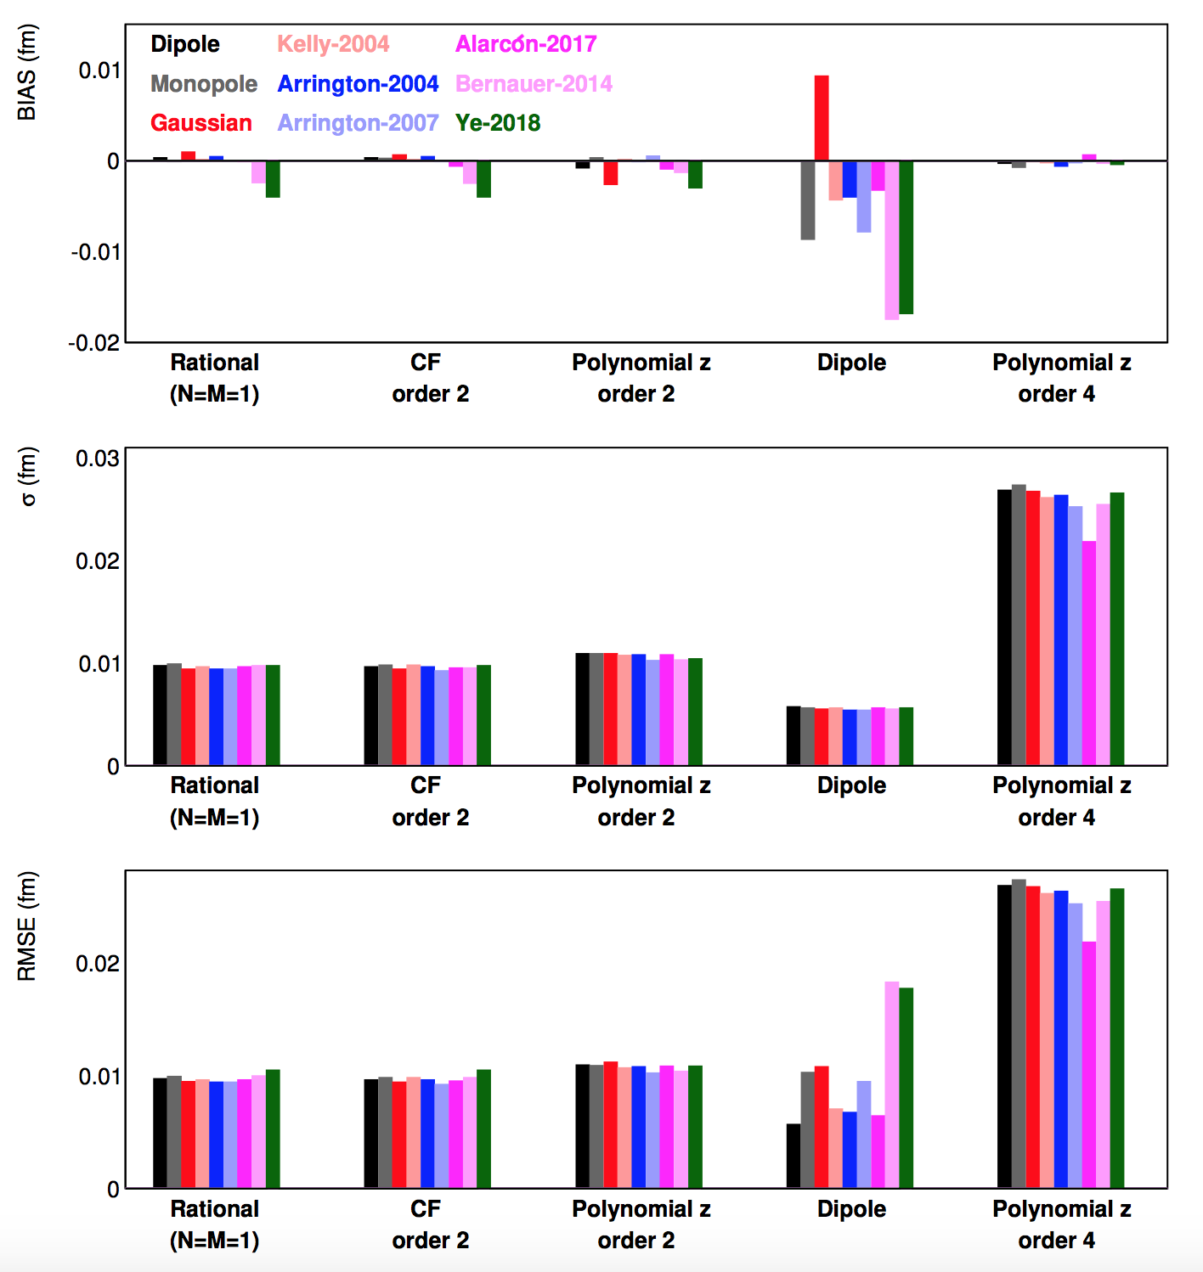
Recent Developments in Fitting Procedures
The input form factors (with known r_{p}) are used to generate pseudo data using PRad kinematic range and uncertainties.
All combinations of input functions and fit functions can then be tested repeatedly against regenerated pseudo data.
Since the input radius is known, this allowed to find fitting functions that are robust for proton radius extractions in an objective fashion.
The following fitters:
  two-parameter rational function
  two-parameter continued fraction
  second-order polynomial expansion of z
are identified as robust fitters with small uncertainties
RMSE = sqrt(bias² + σ²)
X. Yan, et al.
“Robust extraction of the proton charge radius from electron-proton scattering data”, PRC 98, 2, 025204, 2018

Slide 38
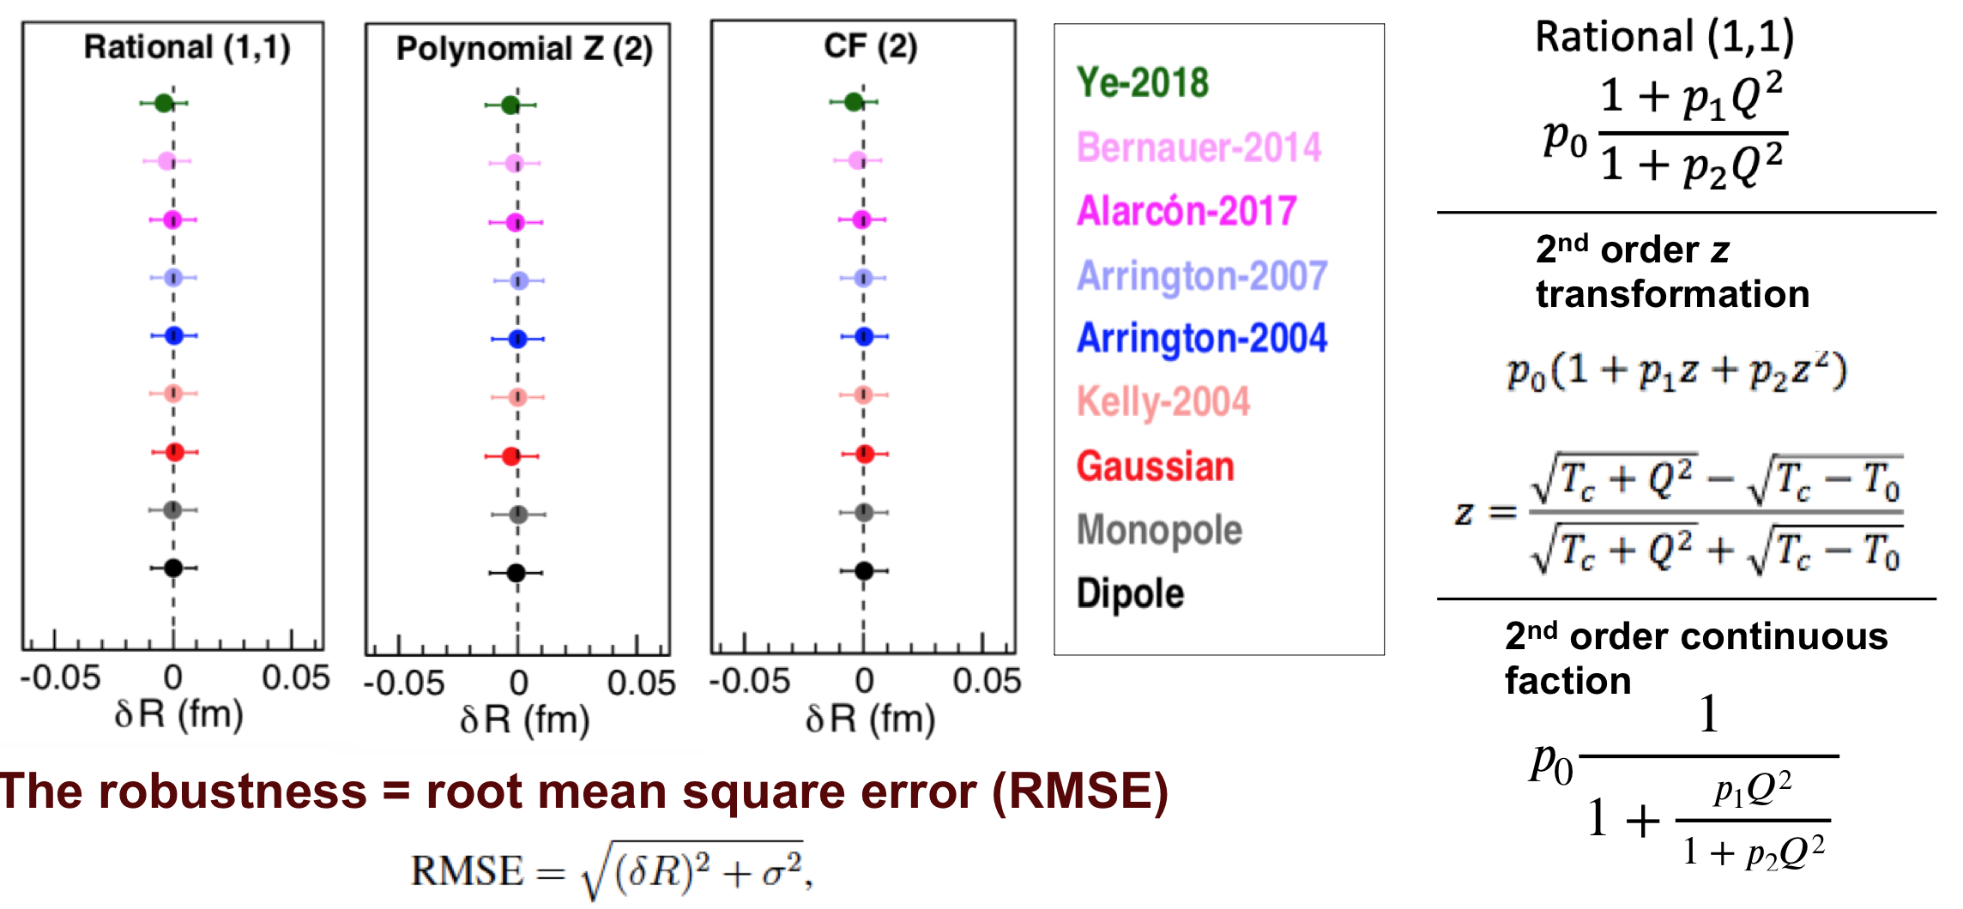
Recent Developments in Fitting Procedures

Slide 39
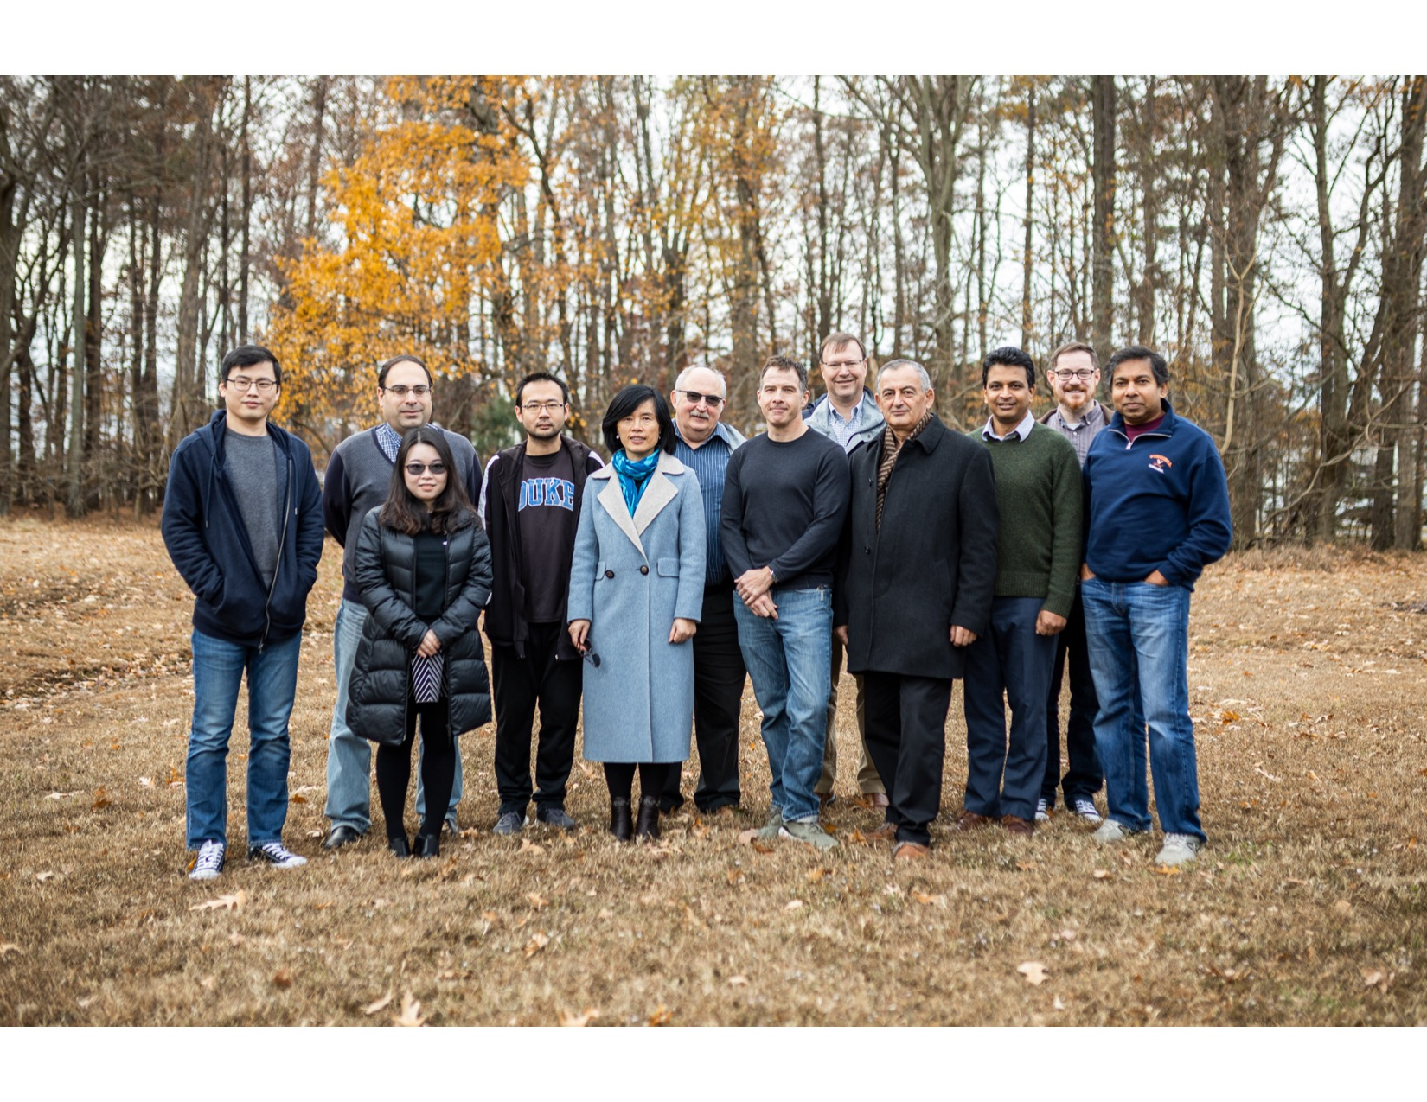
PRad Collaboration
A part of the PRad collaboration
in December, 2019 at JLab
Currently 14 collaborating universities and institutions:
Jefferson Laboratory, NC A&T State University,
Duke University, Idaho State University,
Mississippi State University, Norfolk State University,
University of Virginia, Argonne National Laboratory,
University of North Carolina at Wilmington, Hampton University,
College of William & Mary, Tsinghua University, China,
Old Dominion University, ITEP Moscow, Russia.
Graduate students:
Chao Peng (Duke), Weizhi Xiong (Duke),
Xinzhan Bai (UVa), Li Ye (MSU)
Postdocs:
Chao Gu (Duke), Xuefei Yan (Duke), Mehdi Meziane
(Duke), Zhihong Ye (Duke), Tyler Hague (NC A&T SU),
Maxime Lavilain (NC A&T), Krishna Adhikari (MSU),
Latif-ul Kabir (MSU), Chandra Akondi (NC A&T)

