Slide 1
Hydrogen Atom Spectroscopy at Colorado State University
Dylan Yost
PREN Conference 2022
June 20th 2022

Slide 2
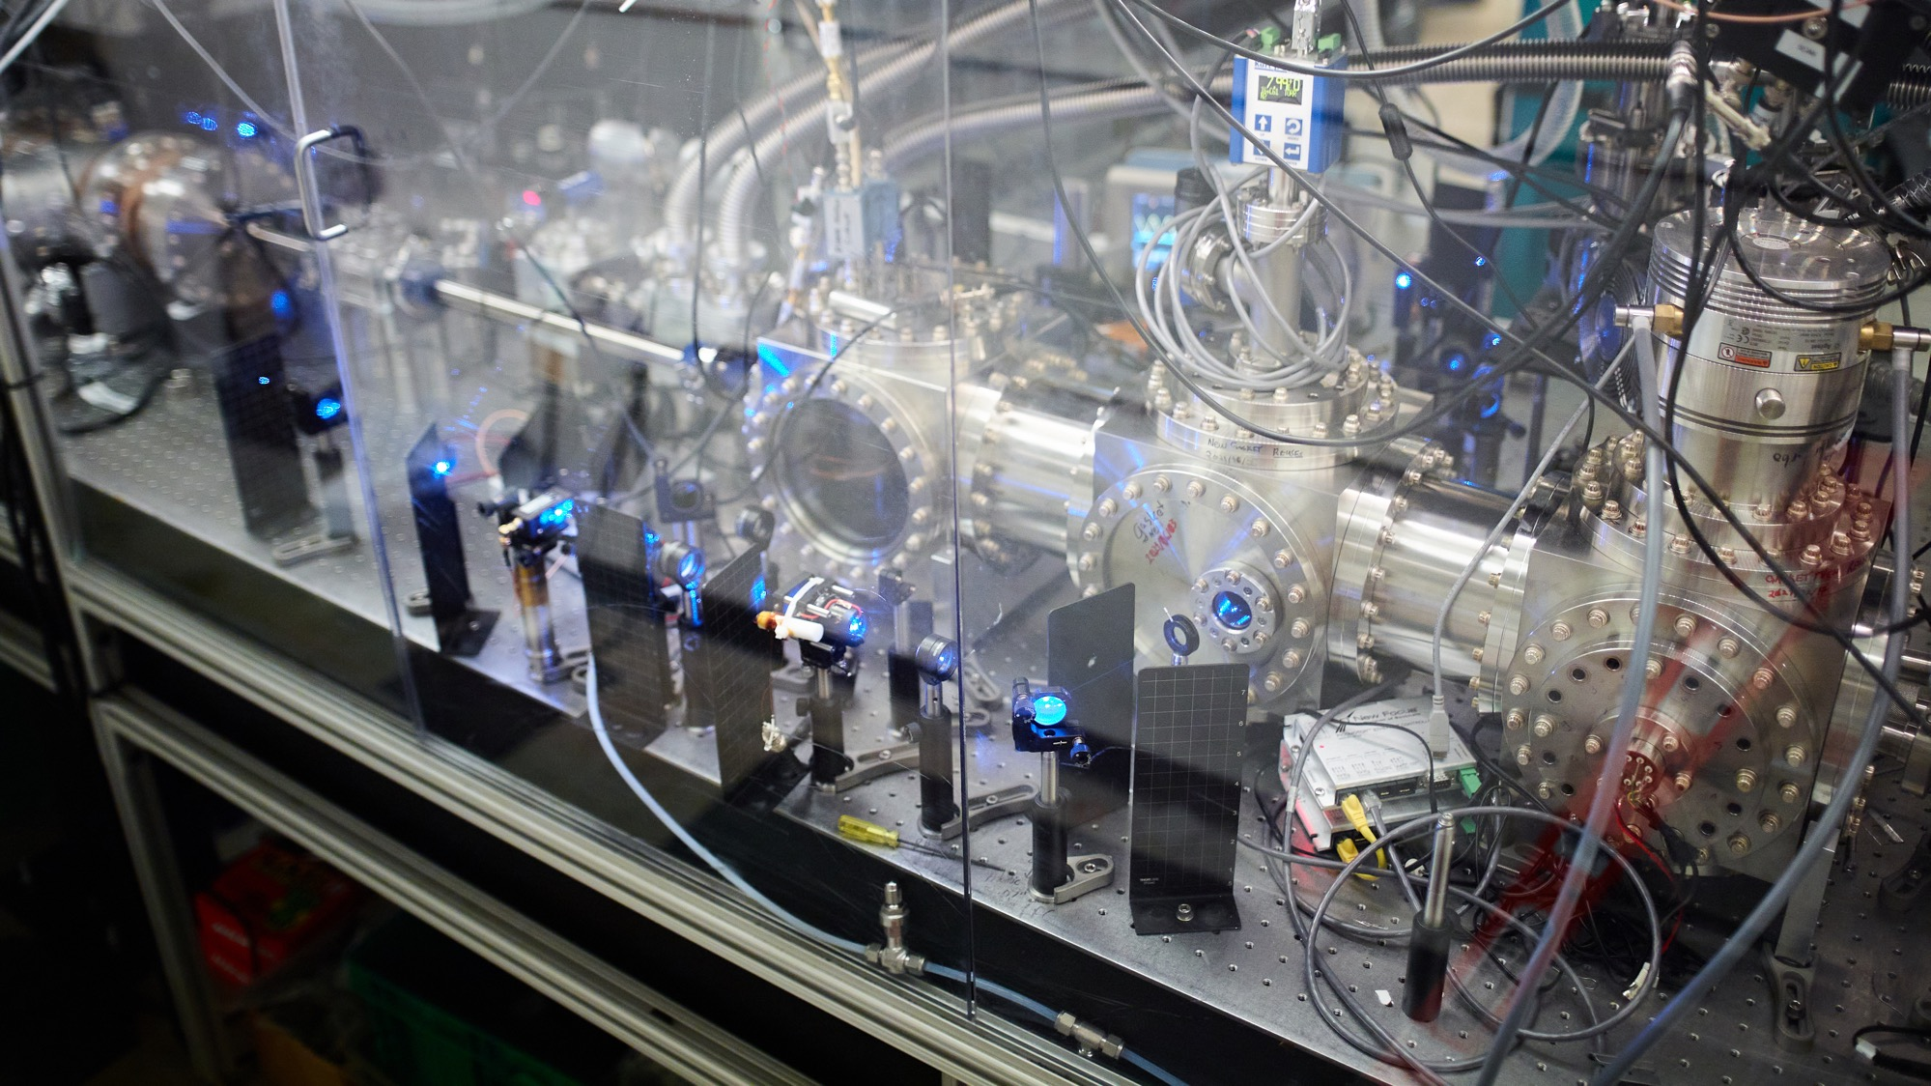

Slide 3
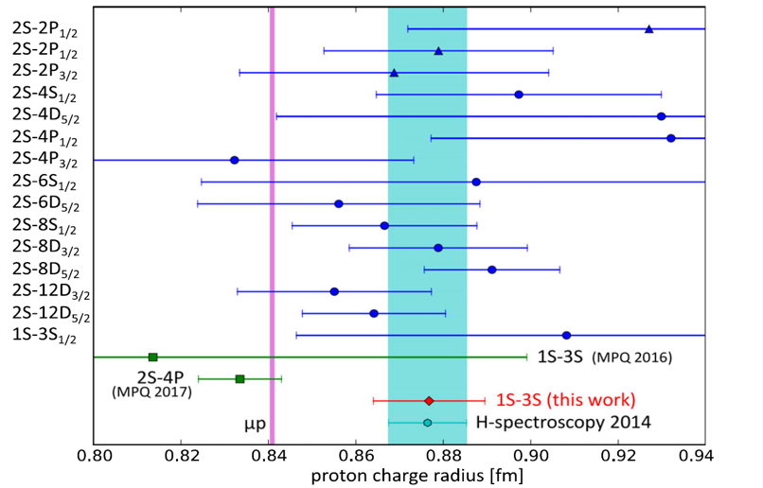
Proton Radius Puzzle
B. De Beauvoir, F. Nez, L. Julien, B. Cagnac, F. Biraben, D. Touahri, L. Hilico, O. Acef, A. Clairon,
J. J. Zondy, Phys. Rev. Lett. 78, 440 (1997).
See CODATA 2018 and

Slide 4
2S/8D Overview of measurement
8D
8D
8D
2S
2S
2S
2P
1S
1S
1S
Metastable Excitation
~5 K Beam
8D Excitation
Count Metastables

Slide 5
Experimental Geometry
photodiode
10⁻⁷ Torr
From RF discharge
And cryo nozzle
~10 W
243 nm
778 nm
To Counter
Channeltron
~2% efficiency
~50 W
Faraday cage and Mag. Shields
Divergence ~ 1 mrad
(2 mm nozzle 1.5 meter away)
w=650 um
w=130 um
15 cm

Slide 6
AC Stark shift extrapolation
~10 kHz count rates, 1 second per point, 30 seconds/scan
~200 scans per day
~ 5 kHz determination (6e-12)

Slide 7
DC Stark Shift Characterization – Comparison with experiment
2S-12D_{5/2} Simulation with 3 mV/cm

Slide 8
Total Result of Measurement run
Summary
Proton radius puzzle: ~20 kHz
Total uncertainty: 2.0 kHz
17 days of data
2.6e-12 fractional uncertainty

Slide 9
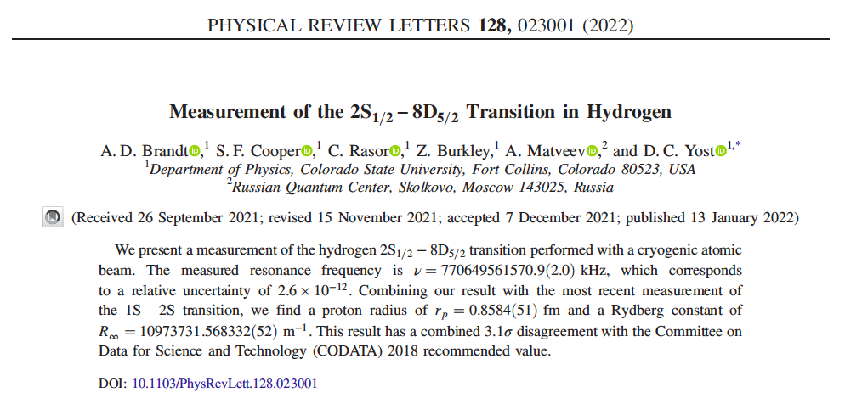
Proton Radius Puzzle
See CODATA 2018 and
A. Grinin et al, Science 370, 1061 (2020).
N. Bezginov et al, Science 365, 1007 (2019)

Slide 10
Hydrogen Theory Simplified

Slide 11
Rydberg Constant Puzzle
Reduced Chi Squared of 4.8

Slide 12
Variation of Rydberg constant with principal quantum number?
See also S. G. Karshenboim,
“Precision Physics of Simple Atoms and Constraints
on a Light Boson with Ultraweak Coupling“
PRL 104, 220406 (2010).

Slide 13
Rydberg Constant Puzzle
Perturbation to Rydberg Constant
from Yukawa potential
Effect on Rydberg constant extractions
Length Scale of 34 a₀
P. J. Mohr, D. B. Newell, and B. N. Taylor (CODATA), Rev. Mod. Phys. 88, 035009 (2016).
Yost et al Phys. Rev. A 93, 042509 (2016)
A. Grinnin, et al, Science 370 1061 (2020)
N. Bezginov et al Nature 365, 1007 (2019)
R. Pohl et al Nature 466, 213 (2010)
Hélène Fleurbaey, et al
Phys. Rev. Lett. 120, 183001 (2018)
A. Beyer et al Science 358, 79 (2017).

Slide 14
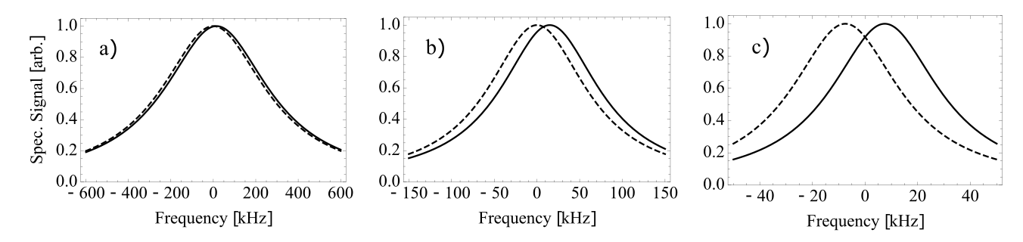
What’s Next? 2S-nS transitions
Proton Radius Puzzle when measured using different transitions
(natural linewidths)
2S-8D_{5/2} (572 kHz)
2S-8S (144 kHz)
2S-12S (50 kHz)

Slide 15
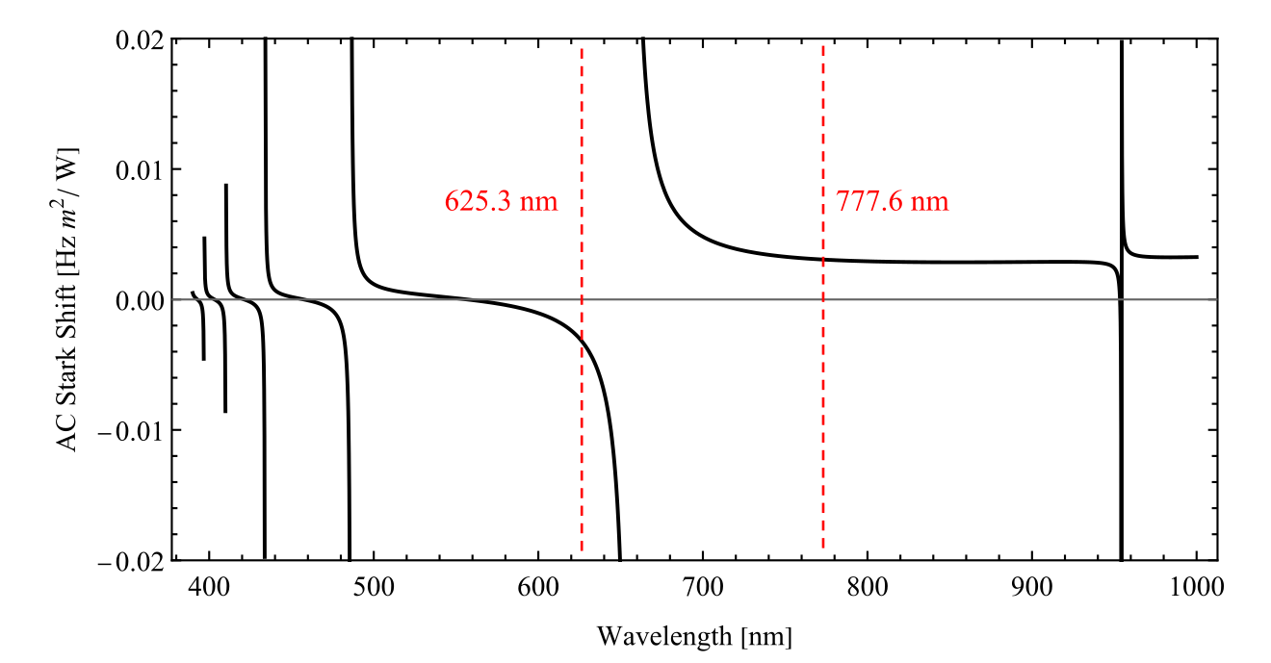
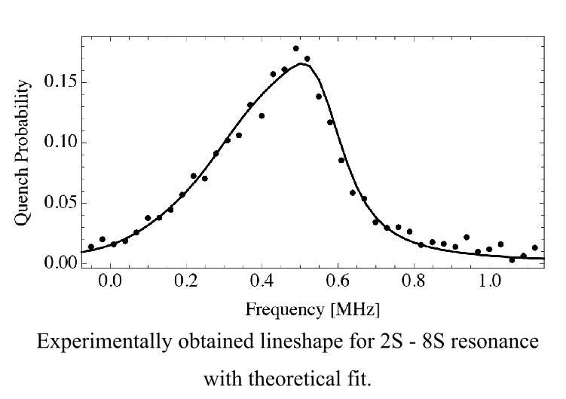
AC Stark shift more challenging

Slide 16
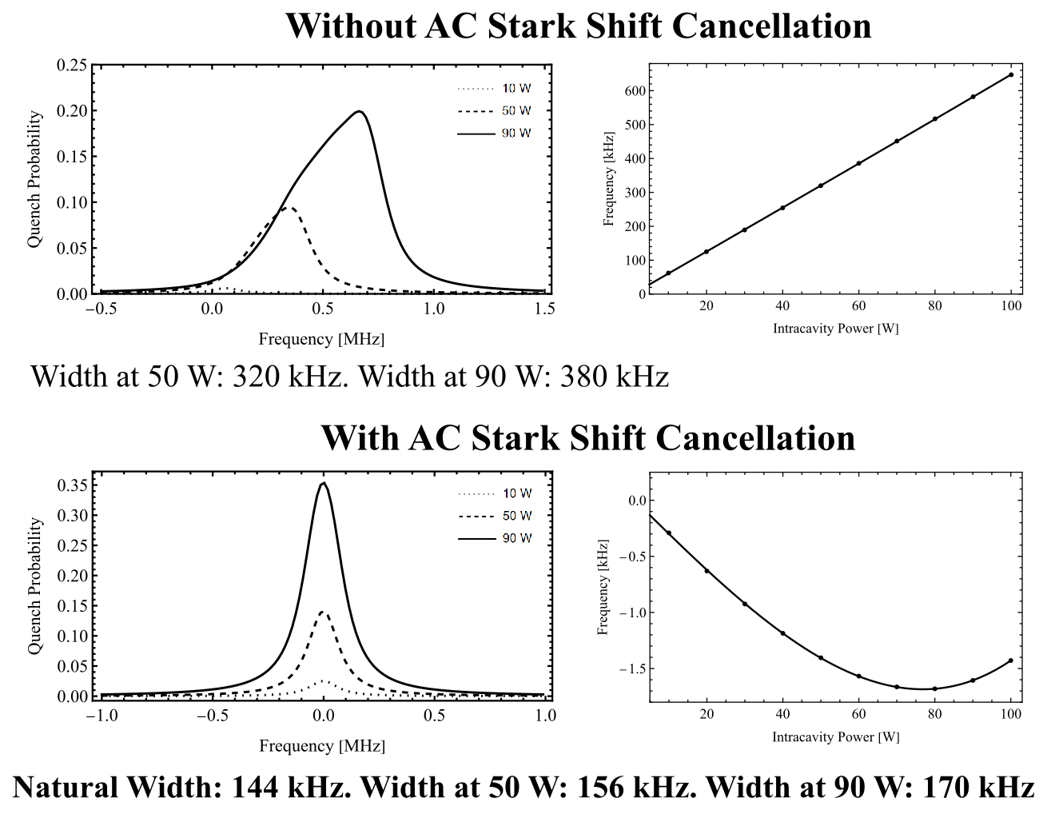
AC Stark Shift
Compensation

Slide 17
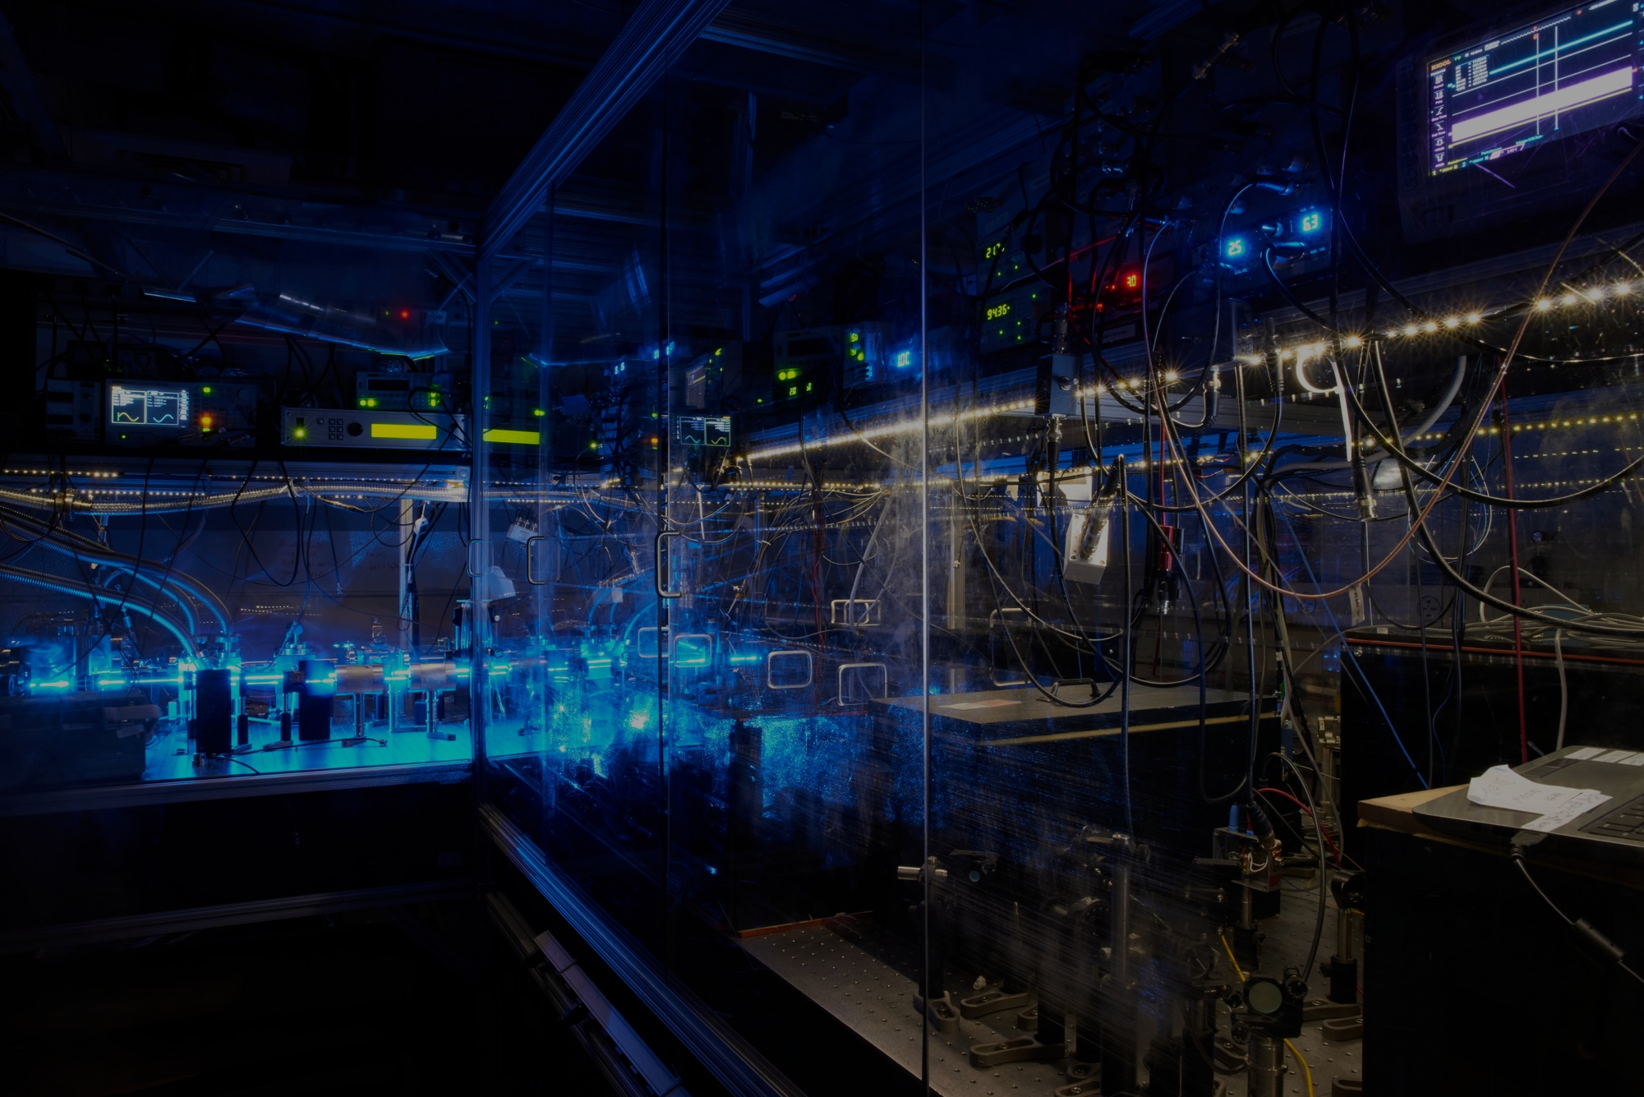

Optical deceleration of atomic hydrogen
Notes:
Hi, Thank you for your interest in this work. My name is Samuel Cooper and I’m going to talk about some of the work we’ve been doing at CSU on the Optical Deceleration of Atomic Hydrogen. SO, in 2022, why is atomic hydrogen still interesting after being studied for the past 100+ years.

Slide 18
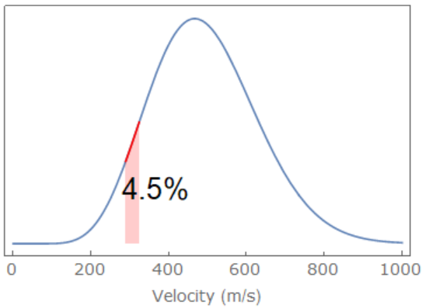





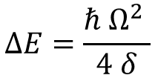

1D Lattice slower
Lattice comoving with atomic beam at 300 m/s
4P_{3/2}
$$δ$$
486 nm
$$ω_{L}$$
$$ω_{L}$$
2S_{1/2}
122 ms
243 nm
$$1800 E_{R},74 mK, ∆v≈35 m/s$$
~1 W with 80 um spot size
$$∆E=\frac{ℏ Ω^{2} }{4 δ}$$
$$δ≈2π×2 GHz$$
243 nm
$$Ω_{max}≈2π×2 GHz$$
1S_{1/2}
Notes:
The method we constructed is based on these three levels of atomic hydrogen. We use a high power 243 nm radiation source to excite the two-photon 1S-2S transition to populate the metastable state. The atoms that are here have an average lifetime of 122 ms. This allows us to interact a second laser beam that is detuned from the 2S-4P transition generating an optical lattice potential. Because our source of atoms is moving at median speed of approximately 300 m/s we offset one direction of the optical lattice by a small frequency shift so that the lattice is comoving with the atomic beam. For reasonable laser intensities and laser detunings from the 2S-4p transition, the optical lattice depth is approximately 15 m/s deep which allows us to capture a macroscopic fraction of the velocity distribution into the standing wave. A static-moving lattice like this would dnot be able to affect the velocities that are trapped however, so we must perform some transformations of the lattice in order to affect the atomic trajectories.

Slide 19
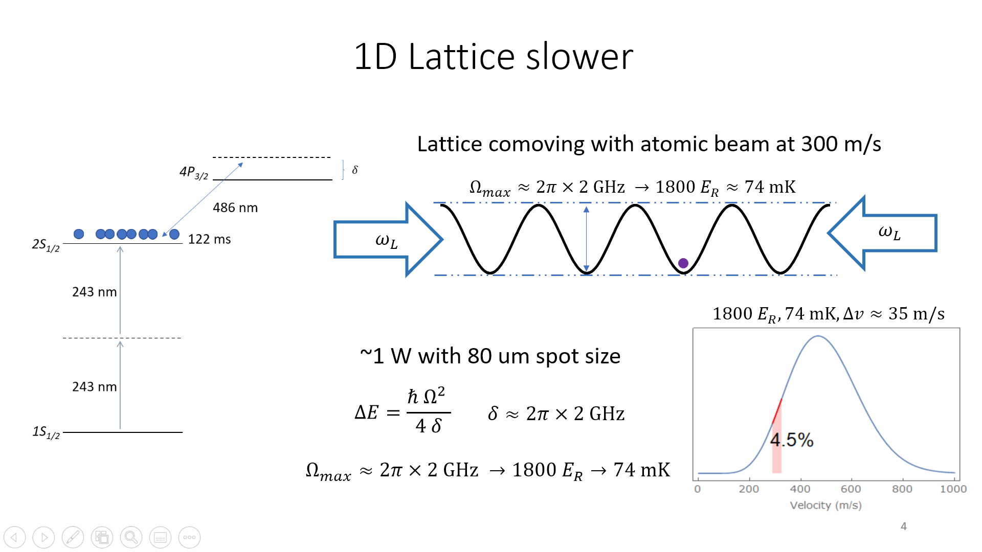

$$ω_{L}(t)$$
By controlling the forward and back relative frequencies with electro-optics the lattice will move and accelerate.
Can move trapped region of velocity distribution to slower speeds

Slide 20
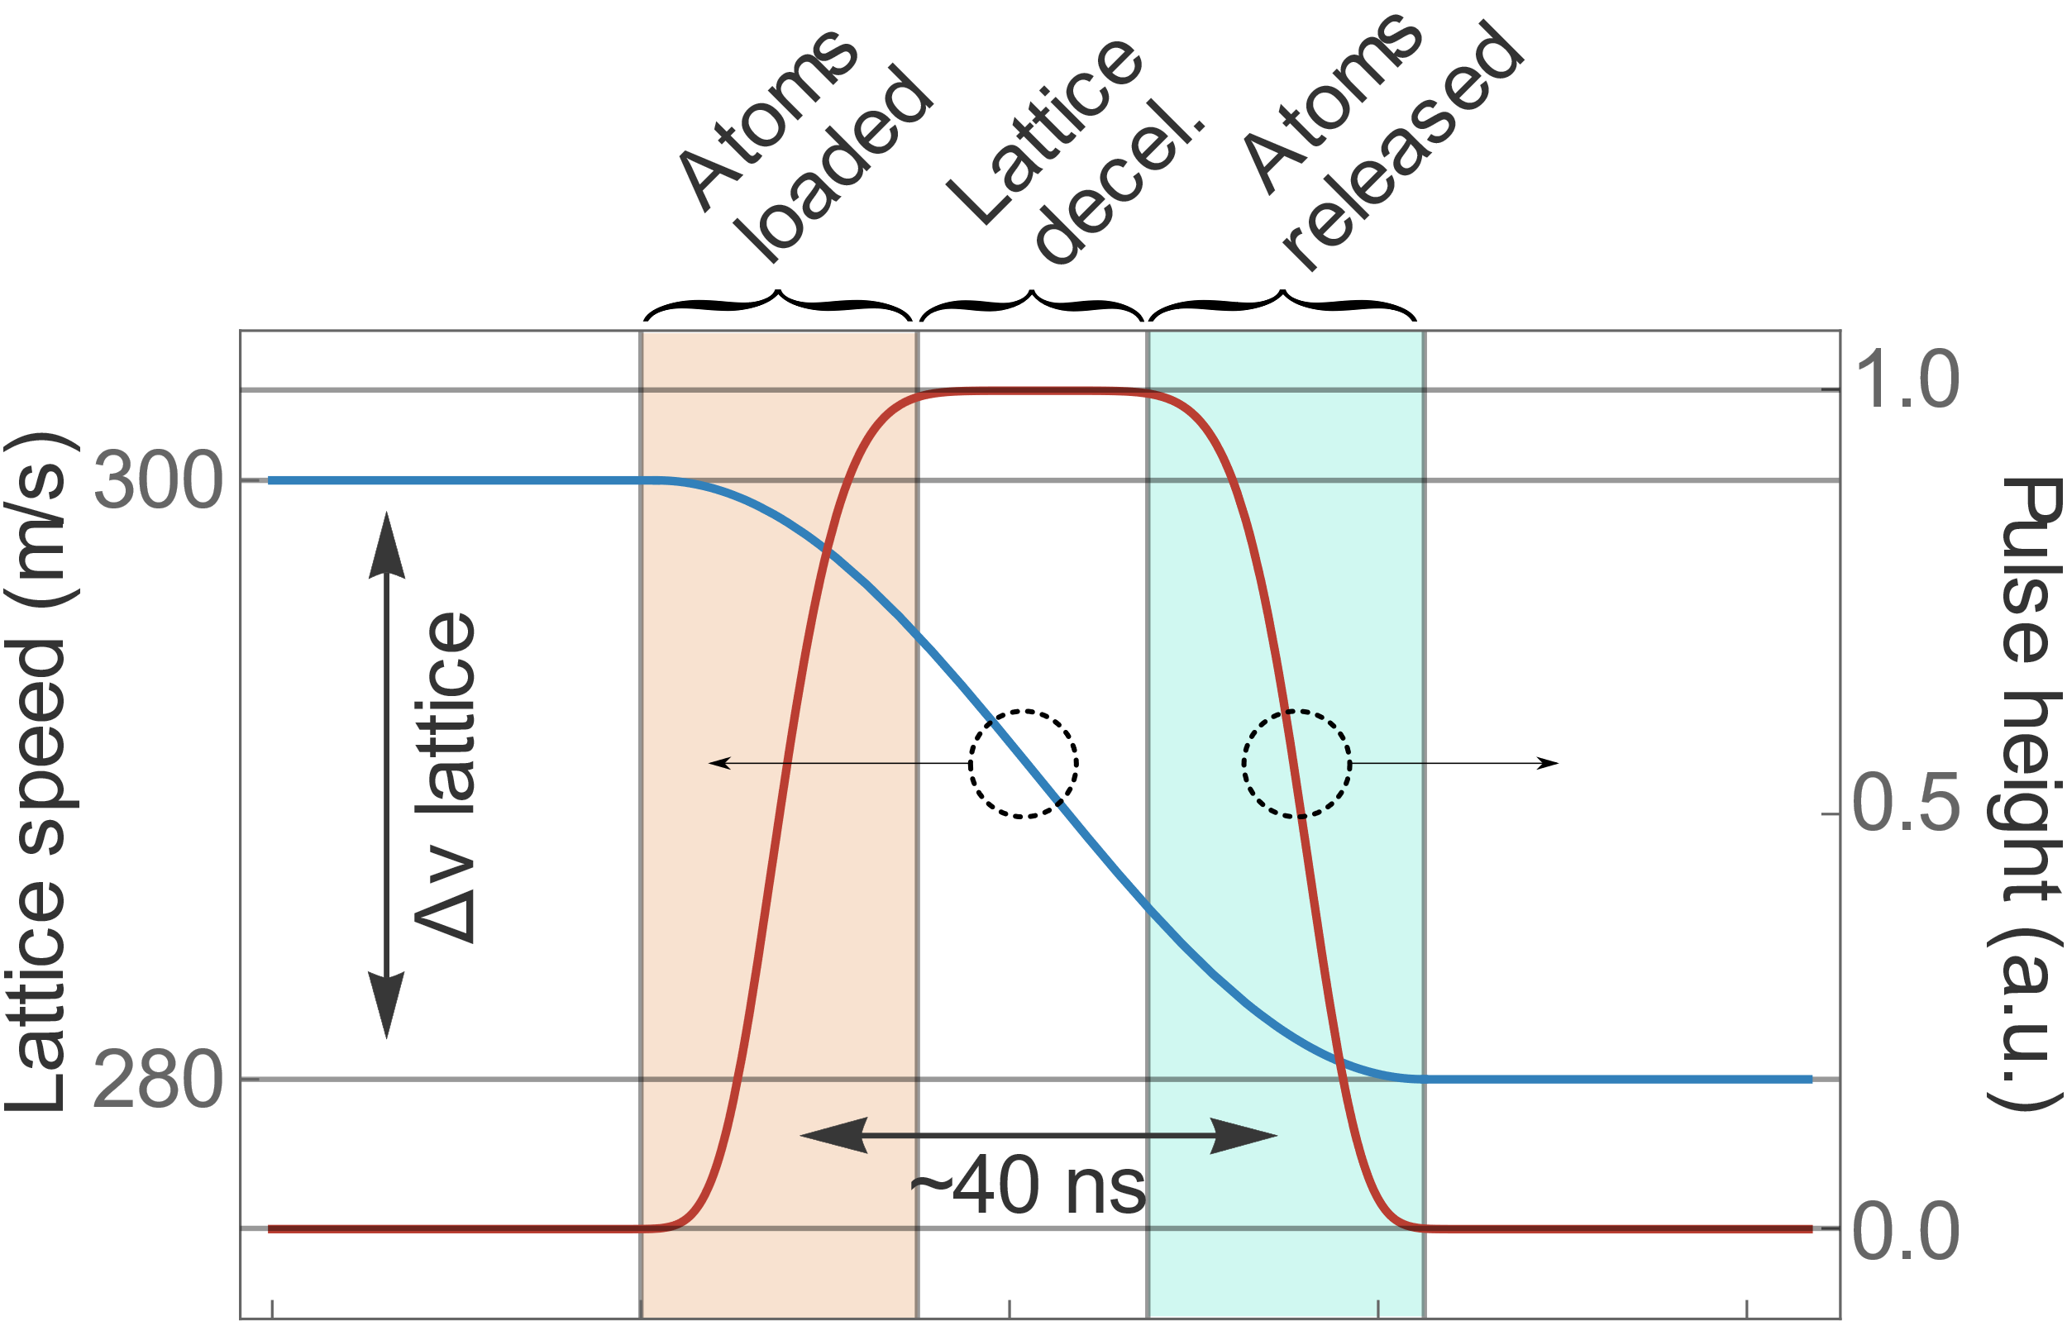
Slowing process
Lattice is initially off
Atoms are loaded into optical lattice by turning on beam
Lattice is decelerated
Atoms are released by shutting off beam
Atoms propagate for use/detection
1
2
3
4
5
Optical trap motion similar to Bloch oscillations experiments [4].
Constant velocity lattice slowing previously demonstrated with molecules [5].
  [4] Dahan, M. et al. Phys. Rev. Lett. 76, 4508 (1996)
  [5] Fulton, R., et al. Nature Phys 2, 465–468 (2006).
Notes:
The method we use to then manipulate and control the atomic beam is outlined here on this slide. In the graphic on the left, the blue function indicates the velocity of the lattice which initially begins around 300 m/s. The lattice is intensity is shown in red however, so it begins shut off. As soon as the lattice is beginning to decelerate we quickly snap on the lattice intensity with an amplitude modulator which loads atoms in to the standing wave potential. We then decelerate the potential quickly over the pulse of the beam and when we’ve moved the lattice to a new selected speed, we rapidly shut the lattice off allowing the atoms to be release for detection or experiments. A monte-carlo simulation for atoms near the lattice initial speed is shown in the density plot here which shows that the atoms oscillate within the potential wells while the intensity is on, but end up slower at the shutoff of the lattice.

Slide 21
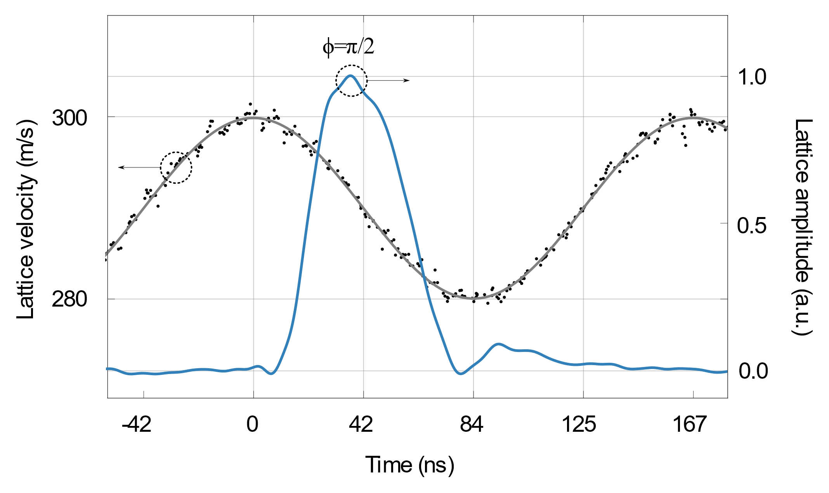
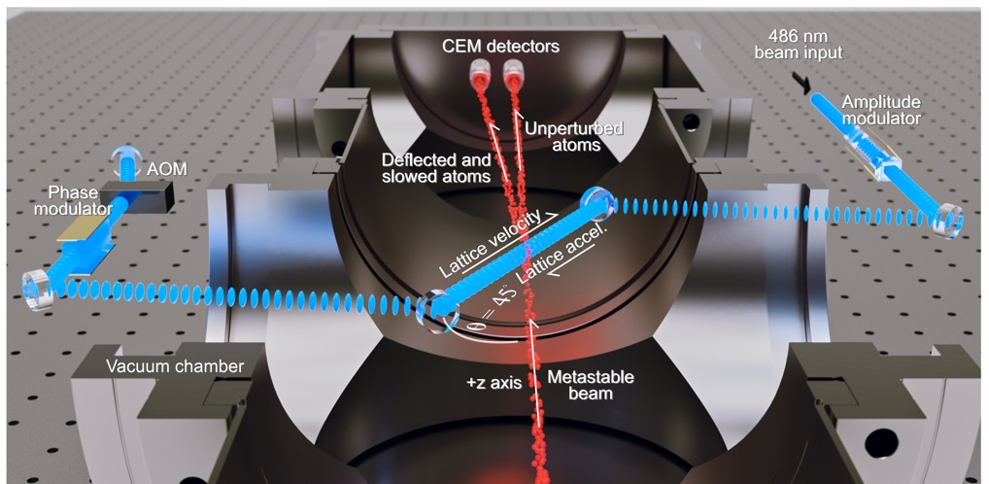

Deceleration method
RF generator
$$φ$$
Phase control
Ch. 1
Ch. 2
Pulse on for decreasing lattice velocity
Pulsed at 1 MHz repetition rate
Observe 100 cps in off axis detector
  5% of trapped velocity distribution
  Slowing beam 50% coverage of metastable beam
  Using 1 W at 486 nm, in [6] we show more than 4 W at 486 nm
+ x
  [6] Z. Burkley, et al., Appl. Opt. 58, 1657-1661(2019)
Notes:
We are able to modulate the optical lattice with both an acceleration and a deceleration. By controlling the Pockels Cell and Phase modulator simultaneously with a two channel RF generator, we are able to align the lattice intensity with varied portions of the lattice velocity profile. Shown here are traces taken from a Michelson interferometer of the lattice pulse and lattice velocity. Shown on the bottom right is a plot of the expected flux at the detector plane as we change the phase of the pulse from decelerating, to a quasi-stationary lattice, to an accelerating lattice. Where we have highlighted this plot, there is a CEM which will see variation of the integrated signal off axis from the metastable beam which varies as we change the timing alignment of the pulse and modulation.

Slide 22
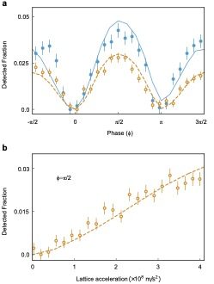
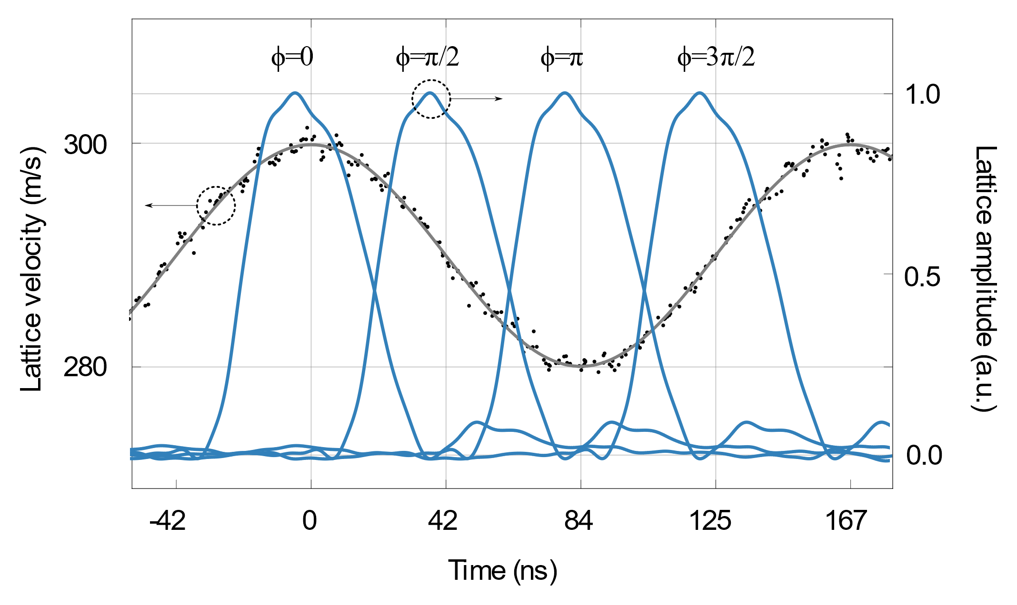
Deceleration characterization
Notes:
We are able to modulate the optical lattice with both an acceleration and a deceleration. By controlling the Pockels Cell and Phase modulator simultaneously with a two channel RF generator, we are able to align the lattice intensity with varied portions of the lattice velocity profile. Shown here are traces taken from a Michelson interferometer of the lattice pulse and lattice velocity. Shown on the bottom right is a plot of the expected flux at the detector plane as we change the phase of the pulse from decelerating, to a quasi-stationary lattice, to an accelerating lattice. Where we have highlighted this plot, there is a CEM which will see variation of the integrated signal off axis from the metastable beam which varies as we change the timing alignment of the pulse and modulation.

Slide 23
Results
Affected atomic kinetic energy by 12% in 40 ns
Deceleration amount not limited by what is shown here.
  More power -> greater detunings -> longer slowing times
  Higher voltages to phase modulator
1-D slowing can be used to load trap similar to pulsed magnetic decelerators [7,8].
  [7] Hogan, S.D. et al. Phys. Rev. Lett. 101, 143001 (2008)
  [8] Narevicius, E., et al. New J. Phys. 9, 358 (2007)
Notes:
Could be interesting to look at dedicated high pulse energy pulsed laser sources instead of switching CW and dumping the extra power
Acceleration defined by electro-optical phase modulator, there’s no immediate fundamental limit to the voltage applied
More power could be larger beams
Here is an example of a result of tuning this pulse alignment with the RF generator which shows the control of the atomic trajectories with the optical lattice. We notice a minimum signal when the lattice is tuned to the “stationary” places on the sinusoidal lattice velocity modulation, and a maximum where the lattice is in deceleration mode. It is interesting to note that the lattice is additionally able to decelerate atoms when the lattice is speeding up. This can easily be understood as the method akin to the “paddle slower” where atoms that are starting on a slope that rapid accelerates away from it wind up being imparted with a backward going momentum in the original frame. This data represents 5 seconds of integration time at each point, and shows the modulation of nearly 10% of their original velocity in a 40 ns duration.

Slide 24
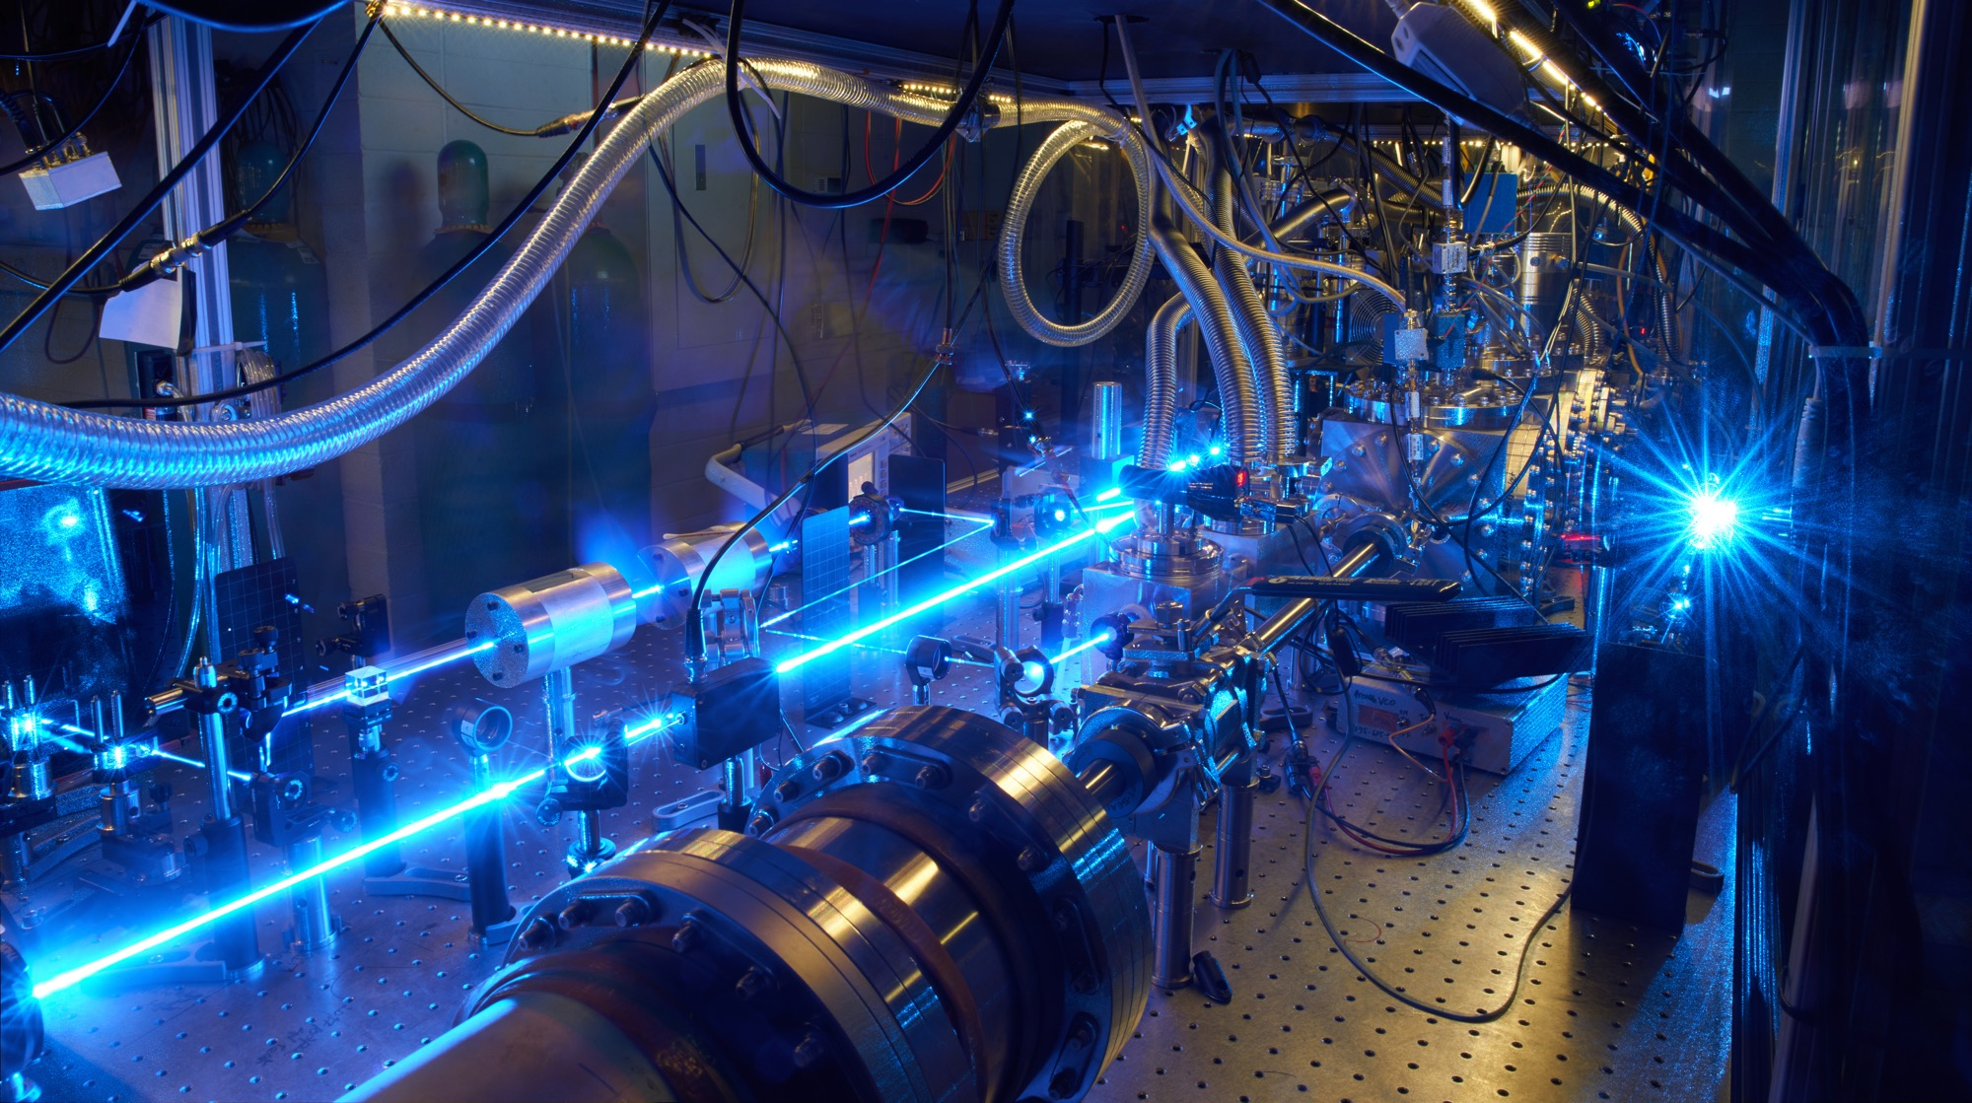
Thank you!
GRAs
Sam Cooper
Adam Brandt
Cory Rasor
Ryan Bullis
Will Tavis
Zak Burkley
PREN!
Collaborators
The Hänsch group
Funding
CSU Physics/CNS Startup
NIST (Precision Measurement Grant)
NSF (Career Award)
Center for Fundamental Physics (Northwestern)

