Slide 1

„Ultimate“ Precision polArimEtry for Future PVES experiments
Precision tests with neutral current coherent interactios with nuclei
Workshop at the Mainz institute for theoretical physics
2022, May 24
An approach by Kurt Aulenbacher

Slide 2
Precision polarimeters - overview
Process for analyzing power S | Target | Exp. Complexity/ ONLINE? | Main error source | Typical Energy/ Beam Current | ΔP/P [%] Ultimate??
Double Mott scattering (DSMP) | 2*Gold | High NO | Instrumental asymmetry | 0.1 MeV < 10nA | 0.6 [1] <0.3 ??
Single Mott scattering | Gold | Low-medium NO | Theory | <10MeV 0.01-100muA | 0.61 [2] <0.5 ??
„Iron“-Möller scattering | Solid Iron | High NO | Levchuk, Target pol | >100 MeV 1muA | 0.5 [3]
„Hydro“-Möller (proposed - [4]) | trapped Hydrogen-Atoms | Very high YES | Ion/Plasma-Contamination (?) | >100 MeV >100muA | <0.3 ??
Laser-Compton | Laser beam | High YES | Calibration, circular polarization | >1000 MeV | 0.5 [5]
[1]A. Gellrich and J. Kessler, Phys. Rev. A 43 (1991) 204, doi:10.1103/PhysRevA. 43.204. [2] J. M. Grames, et al. Phys. Rev. C 102, 015501
[3] M. Hauger et al., Nucl. Instrum. Methods A 462 (2001) 382, arXiv:nucl-ex/9910013 [nucl-ex], doi:10.1016/S0168-9002(01)00197-8.
[4] E. Chudakov and V. Luppov, Eur. Phys. J. 24 (2005) 123, doi:10.1140/epjad/s2005- 04-028-8.
[5] SLD Collab. (K. Abe et al.), Phys. Rev. Lett. 84 (2000) 5945, arXiv:hep-ex/0004026 [hep-ex], doi:10.1103/PhysRevLett.84.5945.

Slide 3
Precision polarimeters- for MESA
Process for analyzing power S | Target | Exp. Complexity/ ONLINE? | Main error source | Typical Energy/ current | ΔP/P [%] Ultimate??
Double Mott scattering (DSMP) | 2*Gold | High NO | beam asymmetry | 0.1 MeV 10nA | 0.6 [1] <0.3 ??
Single Mott scattering | Gold | Low-medium NO | theory | <10MeV 0.01-100muA | 0.61 [2] <0.5 ??
„Iron“-Möller scattering | Solid Iron | High NO | Levchuk, Target pol | >100 MeV 1muA | 0.5 [3]
„Hydro“-Möller [4] | trapped Hydrogen-Atoms | Very high YES | Contamination (?????) | >100 MeV >100muA | <0.3 ?????
Laser-Compton | Laser beam | High YES | Calibration, circular polarization | >1000 MeV | 0.5 [5]
[1]A. Gellrich and J. Kessler, Phys. Rev. A 43 (1991) 204, doi:10.1103/PhysRevA. 43.204. [2] J. M. Grames, et al. Phys. Rev. C 102, 015501
[3] M. Hauger et al., Nucl. Instrum. Methods A 462 (2001) 382, arXiv:nucl-ex/9910013 [nucl-ex], doi:10.1016/S0168-9002(01)00197-8.
[4] E. Chudakov and V. Luppov, Eur. Phys. J. 24 (2005) 123, doi:10.1140/epjad/s2005- 04-028-8.
[5] SLD Collab. (K. Abe et al.), Phys. Rev. Lett. 84 (2000) 5945, arXiv:hep-ex/0004026 [hep-ex], doi:10.1103/PhysRevLett.84.5945.

Slide 4
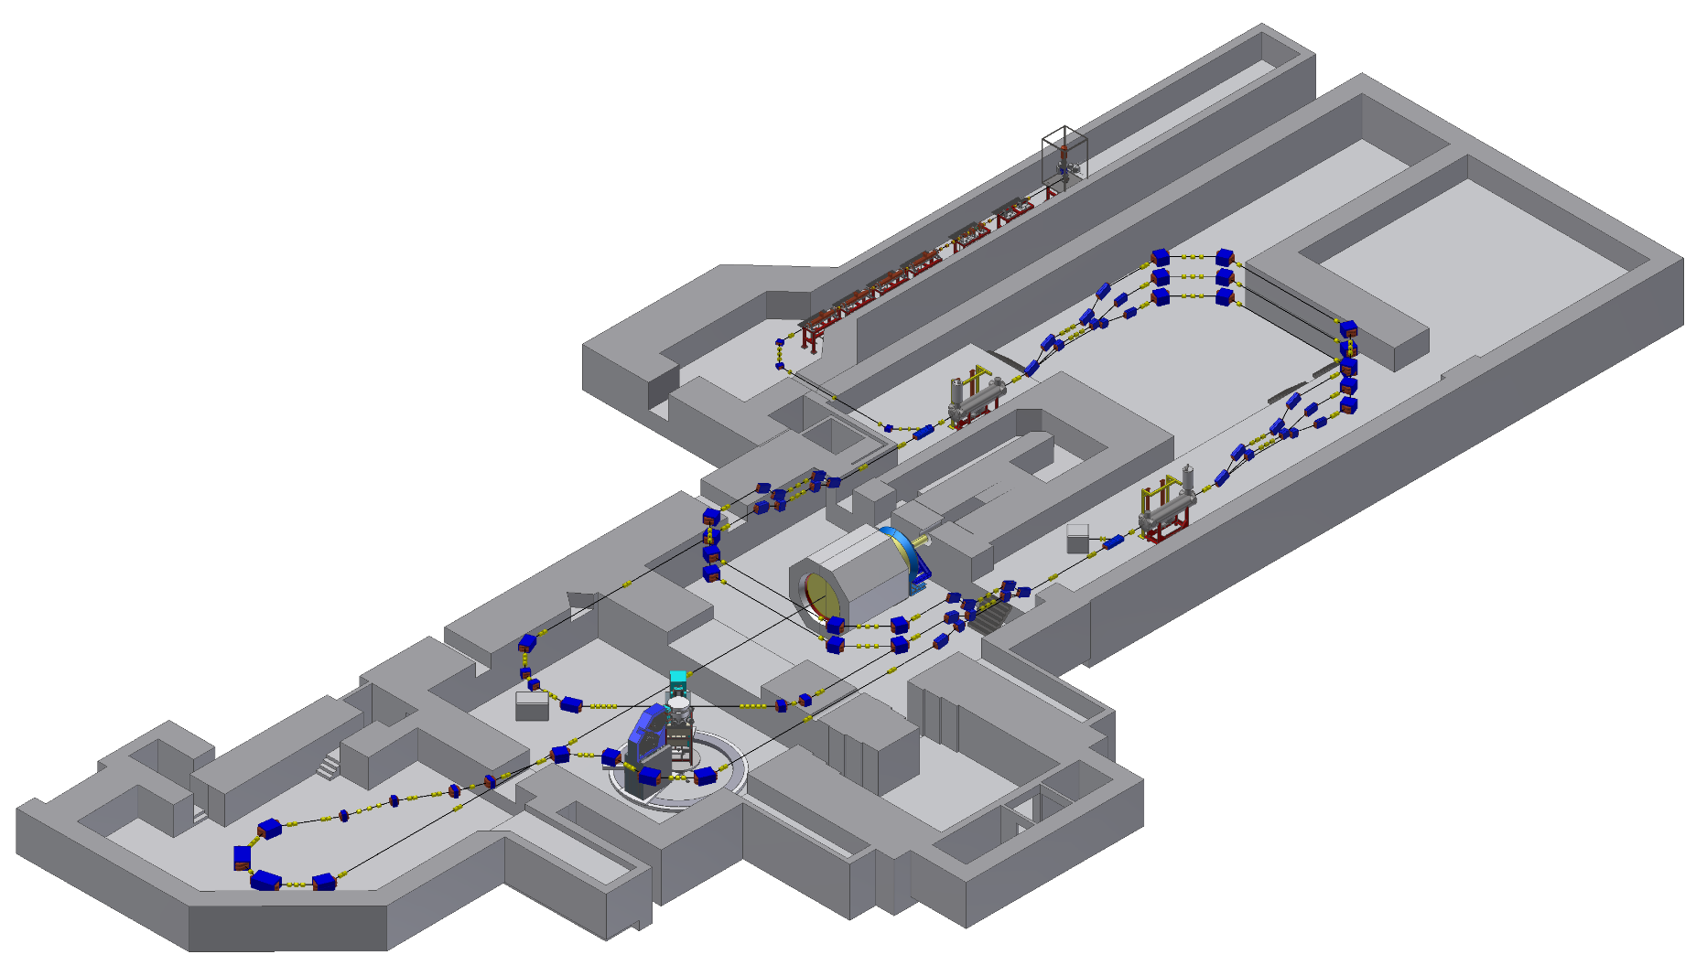
Polarimeters for P2
5 MeV Mott
MAGIX-Beamline
P2-Beamline
Hydro-Möller
In 2025 we will have at least one polarimeter which will achieve ΔP/P <1% and could realize “quasi” online measurement. Team: R. Thapa (MPA), V. Tioukine, Chr. Matejcek
The Hydro-Möller may achieve ΔP/P <0.5% and could provide a real online measurement
The Hydro Möller is delayed because of technological, budgetary and, meanwhile, also political problems

Slide 5
Multi- MeV Mottpolarimeter
V. Tioukine et al. REVIEW OF SCIENTIFIC INSTRUMENTS 82, 033303 (2011),
- PRISMA/P2 Team: R. Thapa/V. Tioukine: Explore Multiple scattering/Background
- Full P2 beam power capability expected, “quasi”- online capability being explored
→ Accuracy should be sufficient for P2-H , but not for P2-C

Slide 6
Spin diffusion and background
0.1 MeV
1 MeV
2 MeV
K. Aulenbacher and V. Tioukine proceedings PESP2008
The MC simulation has in principle no parameters to „fit“ the data.
But the experimental data comprise (target induced) background from the beam dump !
→ Both effects can nowadays be simulated simultaneously! → error will be limited by theory

Slide 7
Mitigation of theory problem?
Difficult to calculate self-energy effect
X. Roca-Maza, EPL, 120 (2017) 33002 www.epljournal.org
doi: 10.1209/0295-5075/120/33002
Observation: The extracted value does
not depend on energy at the 0.5% level.
(based on solution of Dirac equation and
no radiative corrections)
Could this indicate that radiative corrections are
Not „so“ important
Other option: Different Z- targets
V. Tioukine et al. REVIEW OF SCIENTIFIC INSTRUMENTS 82, 033303 (2011),

Slide 8

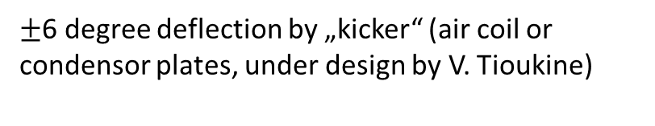
MESA-ARC-0 layout
Jefferson-Lab-type polarimeter/or magnetic spectrometer (MAMI-type) (under investigation by R.Thapa)
MESA MARC-0
Side view
$±$6 degree deflection by „kicker“ (air coil or condensor plates, under design by V. Tioukine)
MESA MARC-0
Top view
Beam dump with longitudinal
Compton-Absorber
-allows pol control even at not
completely transverse angles.
-independent check for drifts
and jumps
!
R Barday et al 2011 J. Phys.: Conf. Ser. 298 012022

Slide 9
Hydro- möller @ MESA
5 MeV Mott
MAGIX-Beamline
P2-Beamline
Hydro-Möller

Slide 10
Hydro-Möller: Promise
[4] E. Chudakov and V. Luppov, Eur. Phys. J. 24 (2005) 123, doi:10.1140/epjad/s2005- 04-028-8.
Areal density about 10¹⁵ electron spins/cm²→ sufficiently low for online operation
but reasonable statistical efficiency…
Hydrogen Polarization 1-ε with ε<10⁻⁴→ suppression of error from target polarization
No Levchuk effect
→ ΔP/P < 0.5%?
Figure from: D. Becker et al., Eur. Phys. J. A (2018) 54 : 208
Schematic of Hydro-Möller-Target, More: V. Tyukin et al. PSTP2019 (2020) 005 doi 10.22323/1.379.0005

Slide 11
Hydro-Möller: Challenges and status
Powerful dilution refrigerator needed
(50mW at 0.3K ????)
→ expensive (cooling power!)
Cold electron spin polarized
Hydrogen dissociator to be incorporated
→ new technology, to be tested at HIM
Plasma effects – electron trapping?
→ further investigations needed
To P2
Upper frame: Schematic of Refrigerator
Lower frame: cross section
of trap with refrigerator

Slide 12
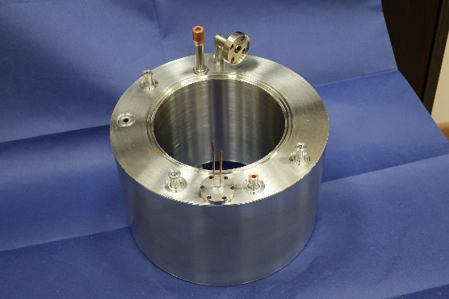
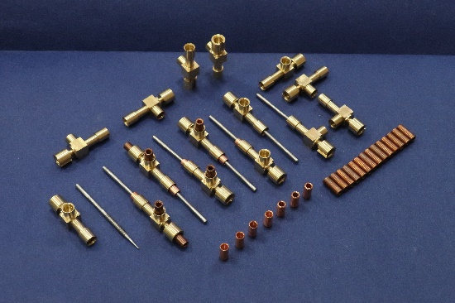
Political issue: Refrigerator parts…
KPH/Swagelock: German products
JINR - Russian products
(examples)
Beam insert and
“Pumping line”
He-4 evaporator
All welded
heat exchangers
For precooling stage
Needle valves
Unavailability of russian institution can be compensated by Mainz machine shops and industry from Rhein Main area.
(but at the expense of long delays due to learning curve and limited capacities.)

Slide 13
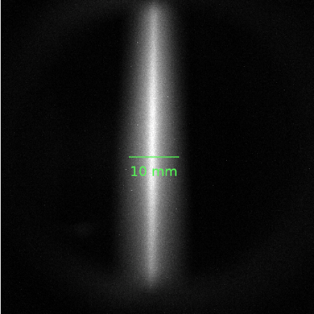
Hydro-Möller – unknown unknowns?
Effect of beam potential – example: trapping of ions in UHV
→ Thouroughly investigate plasma induced contaminations , magnetic bottle effects by field variations,….
Sideview of 0.5A magnetized electron beam in vacuum of < 10⁻⁹ mbar
Spectrum of emitted radiation
H₂⁺ recombination?
Space charge neutralization ??
Th. Beiser,
January 21
Th. Beiser,
Talk at DPG
Spring meeting
March 22

Slide 14
Consequences
Hydro Möller cannot be realized soon, but a conventional Möller could be done with 8T solenoid to be used later for the real thing.
HIM offers good possibilitiy to test components in the future, in particular cold hydrogen dissociator.
the present problems will be resolved by „local“ (or other) means but year long delays unavoidable.
Goal: Optimized online performance and ΔP/P <0.3% for Carbon measurements at P2.

Slide 15
Thank you!

