Slide 1
MUonE
U. Marconi
MUonE2022, 2022 November 14th

Slide 2
Content
The MUonE project
Status of the detector, software and analysis tools
2S modules
Tracking system
Data acquisition
Electromagnetic calorimeter
Software
Analysis
Plans

Slide 3
A novel method to measure Δα_{had}(t)
By 160 GeV muons hitting electrons at rest in a target of low Z material. A high intensity muon beam, the M2 muon beam, exists in CERN. I_{μ} ~ 2×10⁸ muon/spill equivalent to ~40M muon/s
The collisions result in a boosted kinematics with scattering angles θ_{μ} < 5 mrad, θ_{e} < 30 mrad (E_{e} > 1 GeV) Angles have to be measured with respect to the incoming muon direction.
The shape of the differential cross section as a function of t = q² ( q² < 0 ) depends on the hadron running Δα_{had}(t)
Target
θ_{μ}
incoming muon
θ_{e}

Slide 4
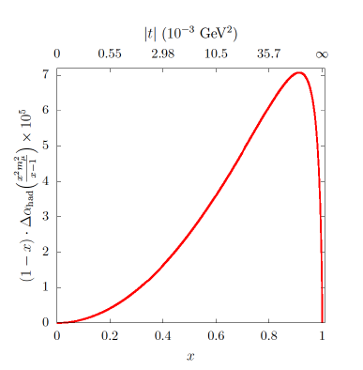
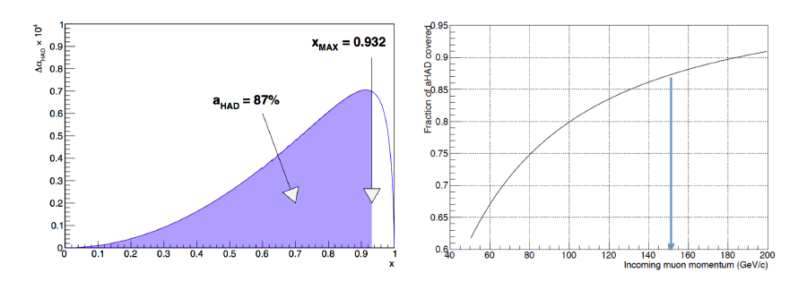
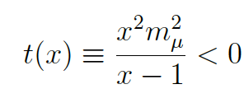
Correlation between the scattering angles
x_{peak} = 0.914
x_{max} = 0.932
At 150 GeV we could cover 87% of the integral for a_{μ}

Slide 5
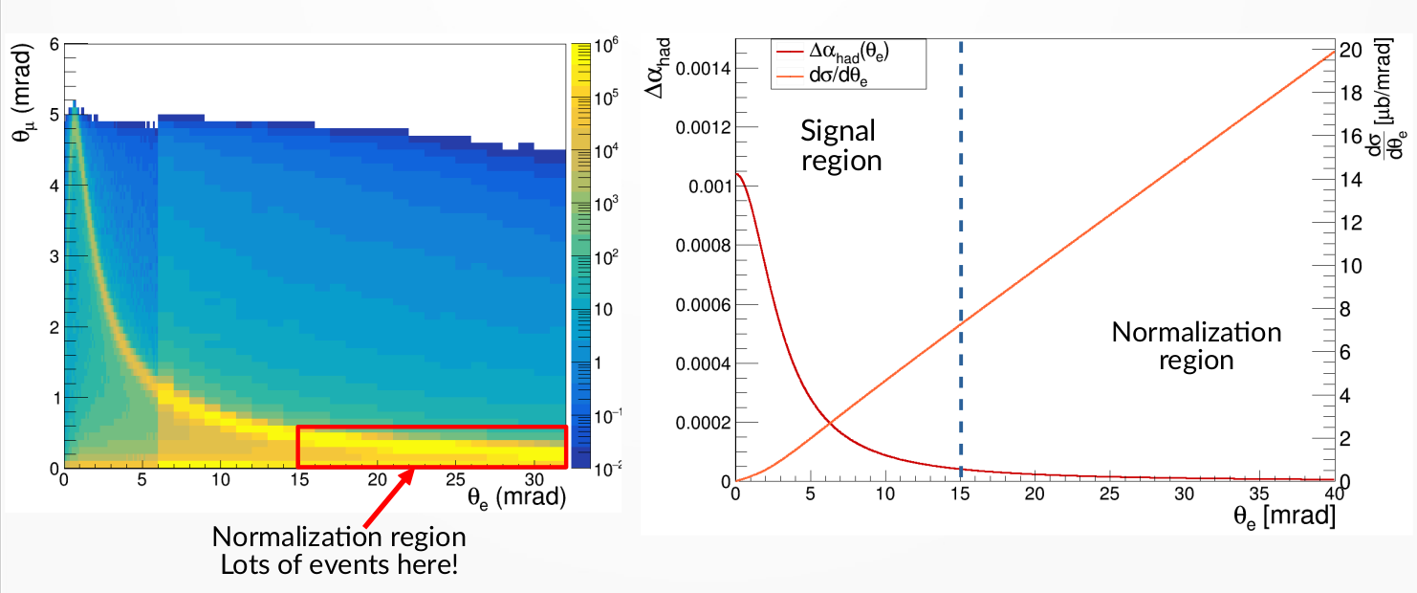
The 2D angular distribution and the cross section
f (θ_{e},θ_{μ}) ⊗ Resolution
cross section
No effect here: the normalization region

Slide 6
Parameterization of the hadronic running

Slide 7
Elastic events in the Test Beam of 2018

Slide 8
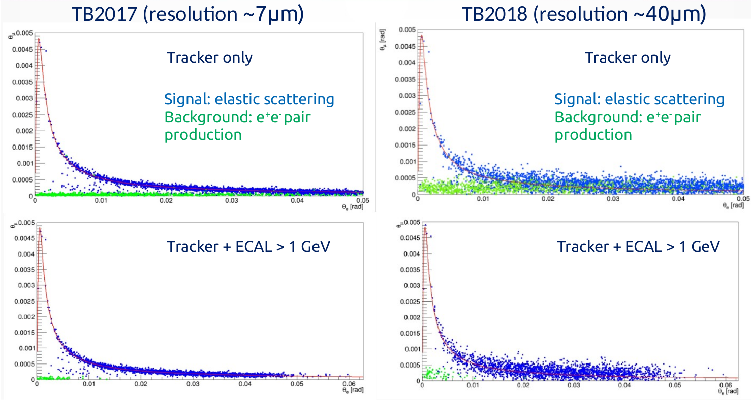
The detector resolution

Slide 9
The detector
muon spectrometer

Slide 10
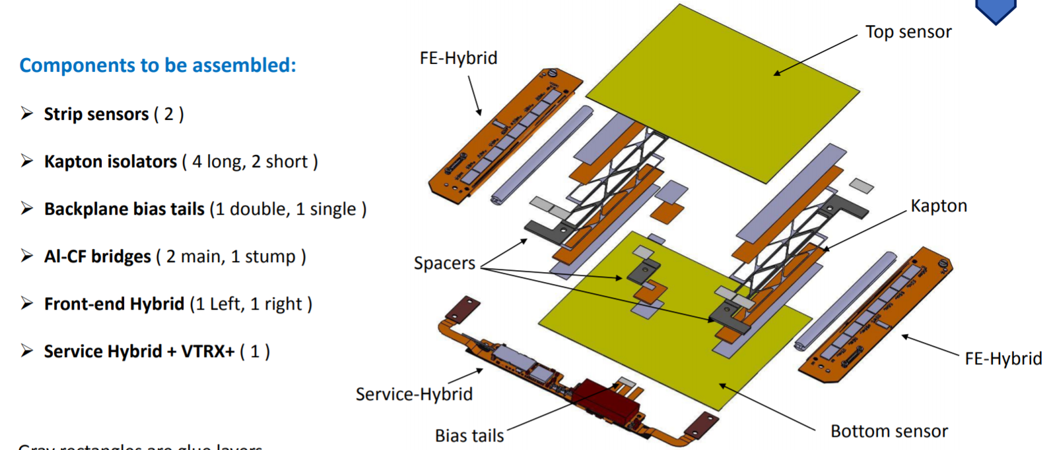
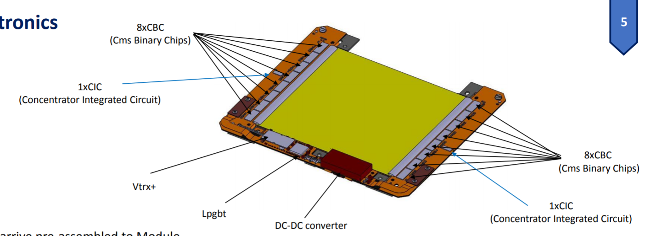
2S modules
￼
Digital readout at 40 MHz
Expected resolution 22 μm
We use stubs i.e. trigger primitives for the CMS L1 trigger
x₁ + w
top sensor
x₁
bottom sensor

Slide 11
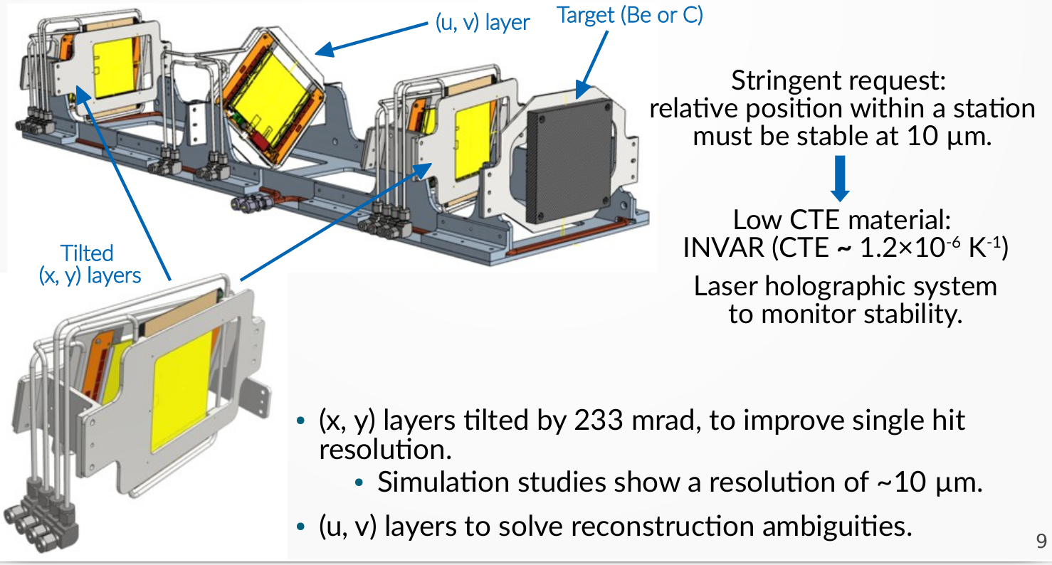
The tracking station
Positions of the modules must be stable within 10 μm
Tilted X and Y modules to improve the resolution
UV modules to solve reconstruction ambiguities

Slide 12
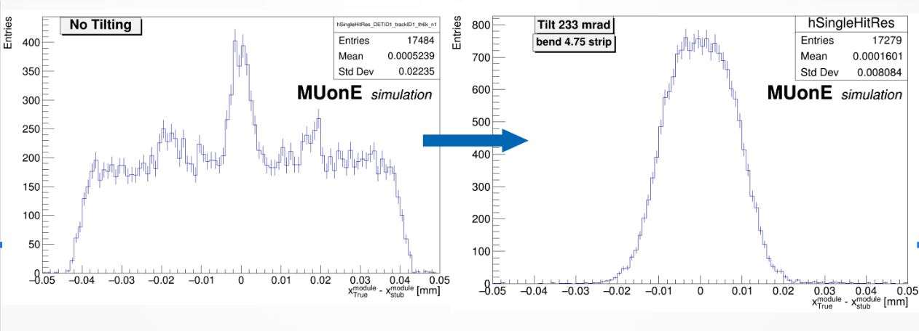
To improve the spatial resolution
By tilting the module we do expect to improve the resolution: 22 μm →10 μm The tilting angle is 14 degrees

Slide 13
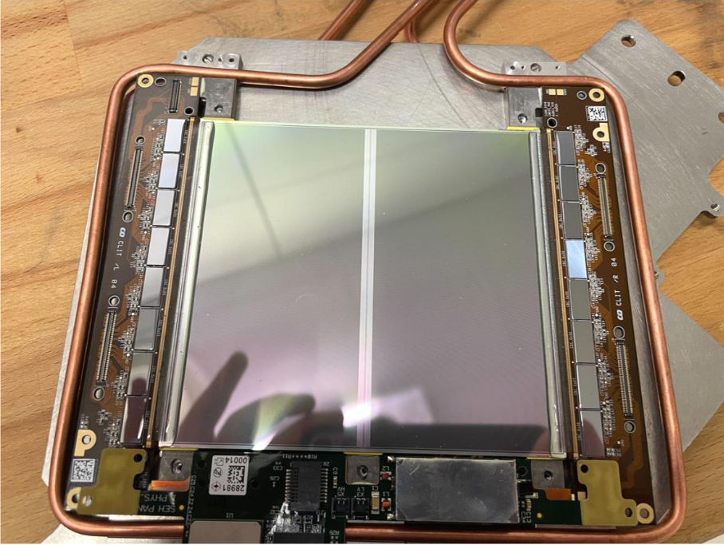
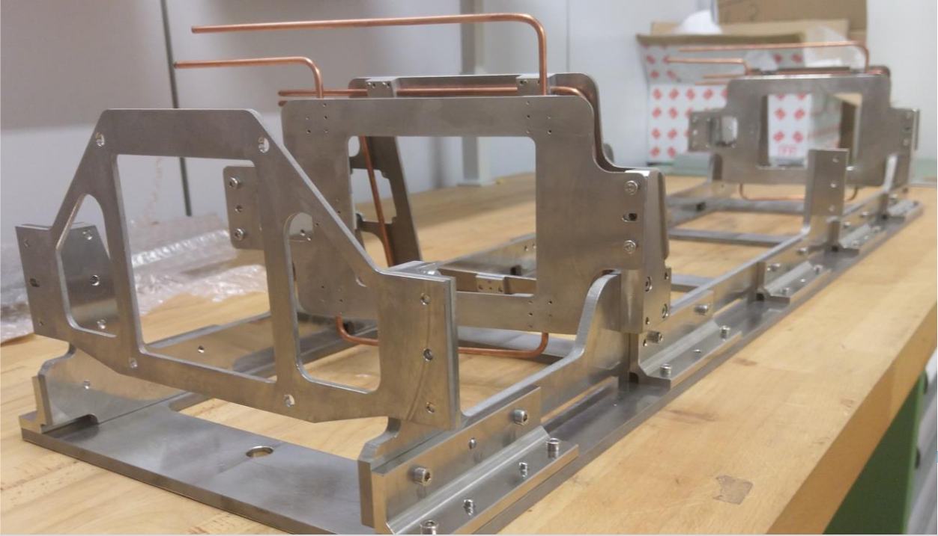
2S module on its frame
The support structure in INVAR
Very expensive
Difficult to machine

Slide 14
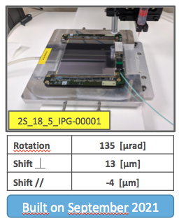
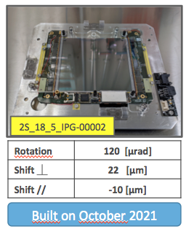
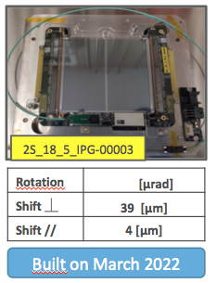
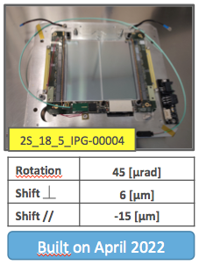
Status of the CMS 2S modules
Four 2S modules assembled in Perugia.
First 2 built in 2021 and successfully tested in the first MUonE-CMS combined test performed in November 2021
The second pair of modules built in 2022 show problems:
Module-3: is presently unusable, because of electronics problems appeared after the assembling. It has to be returned to Perugia to try fixing the issue. The same problem has been observed in the Bruxelles laboratory.
Modules-4: half the module is effectively working. It’s a well known problem due to a faulty CIC. A fix exists and it’s relatively easy to apply.
A fifth module could be built, but again there is an issue with the electronics.

Slide 15
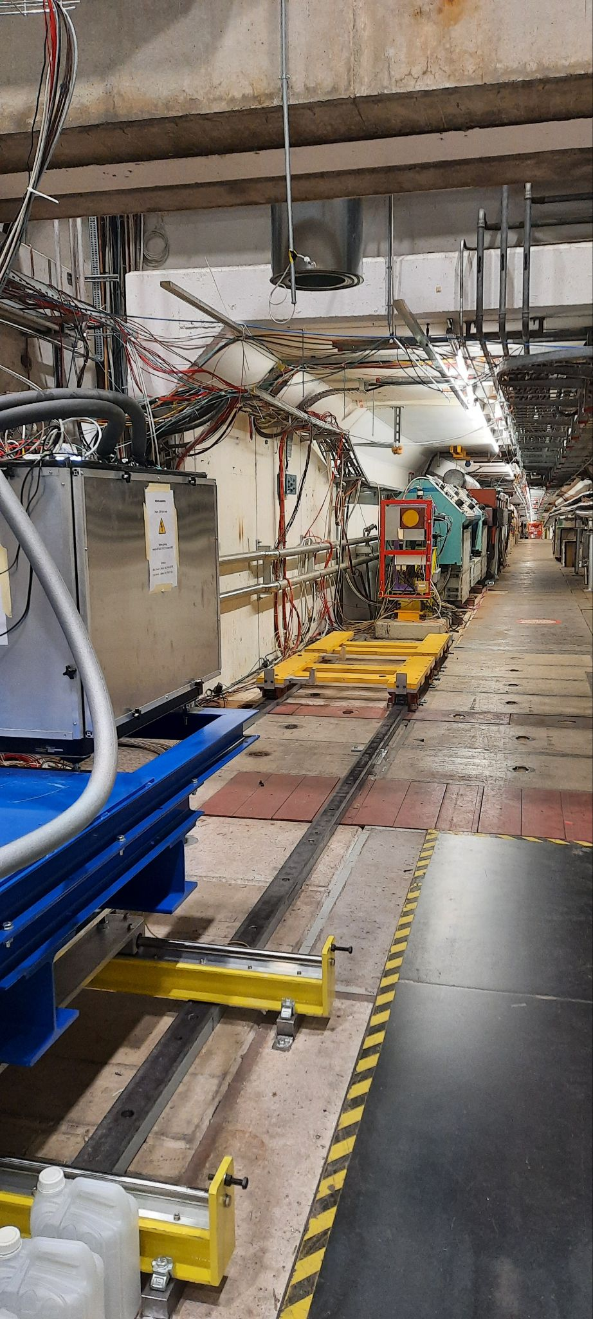
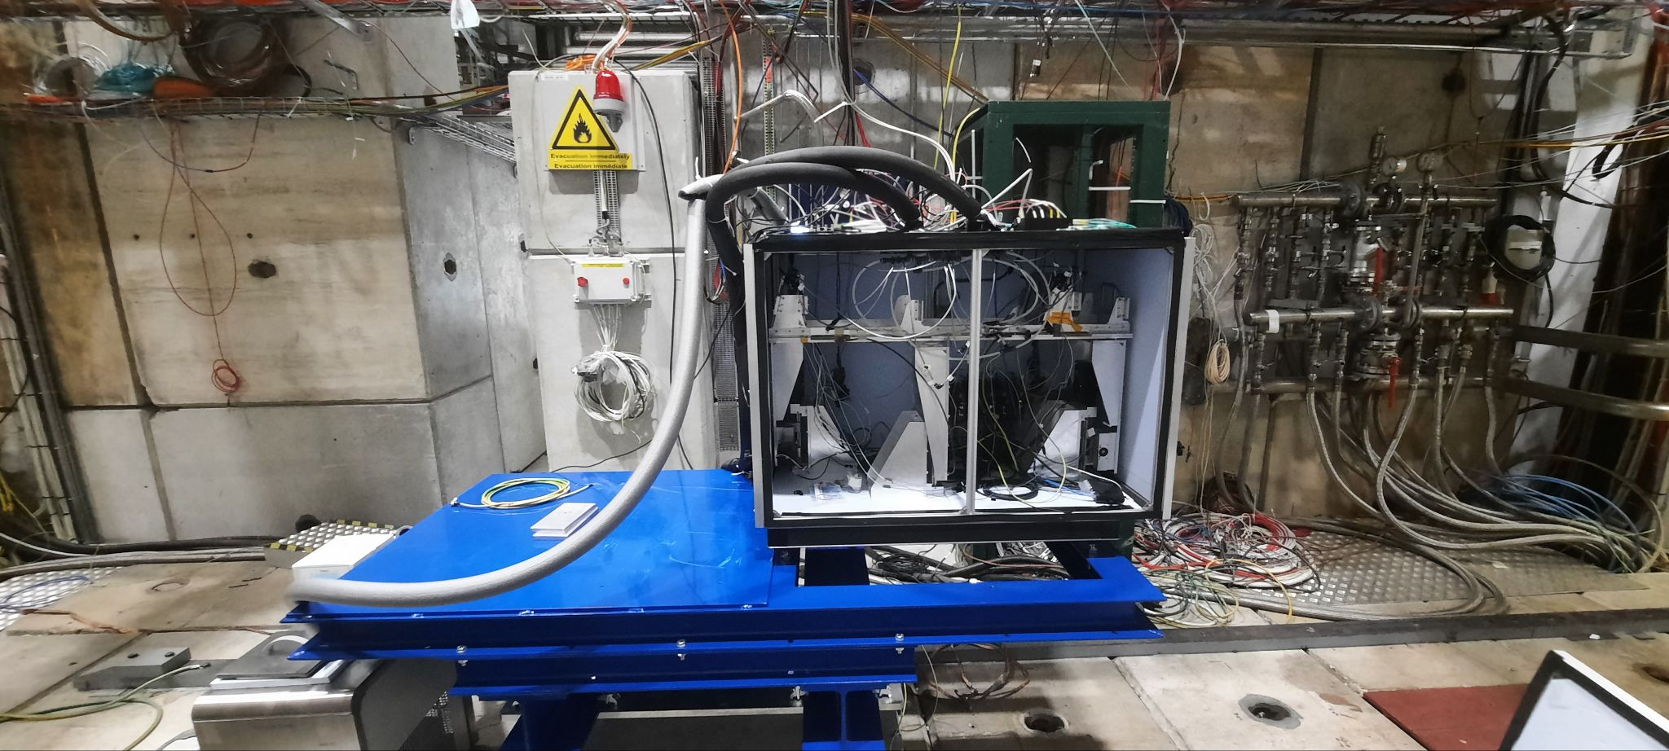
Tracker beam test setup
We managed to keep running for debugging the DAQ and testing the 2S modules available
The station placed on rails to allow easy movements in and out the M2 beam

Slide 16
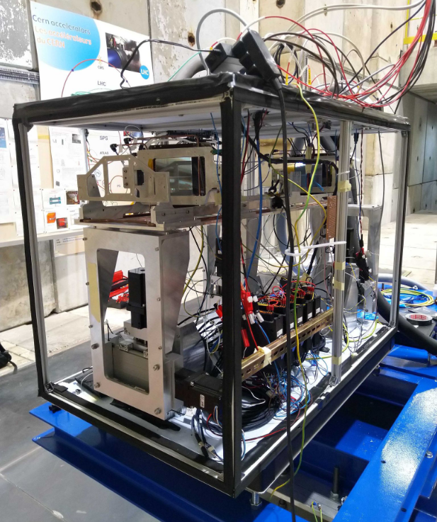
Tracker beam test setup in M2
4 of 6 2S modules installed into the station
X and Y modules at front and back mounted
U, V modules in centre are missing
40 MHz readout to Serenity DAQ card, then 10 Gbps Ethernet link to PC
Data saved locally and on EOS
Still possible to take data using the beam halo 1kHz vs 10 MHz counting rate

Slide 17
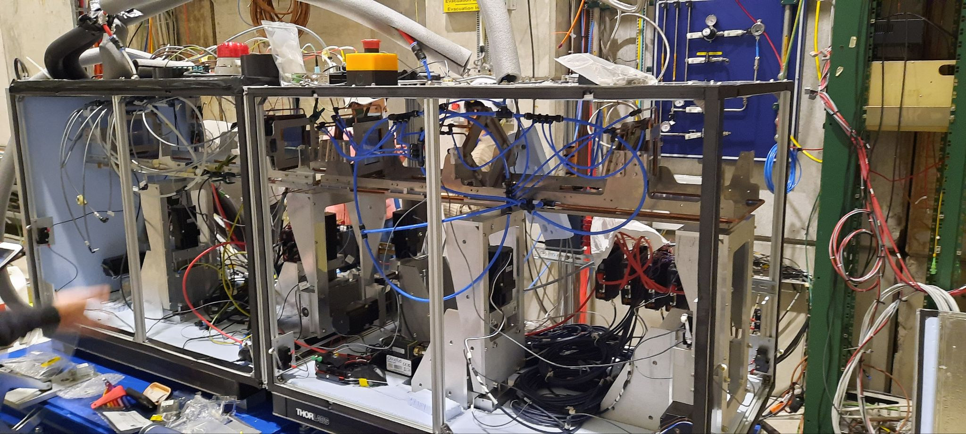
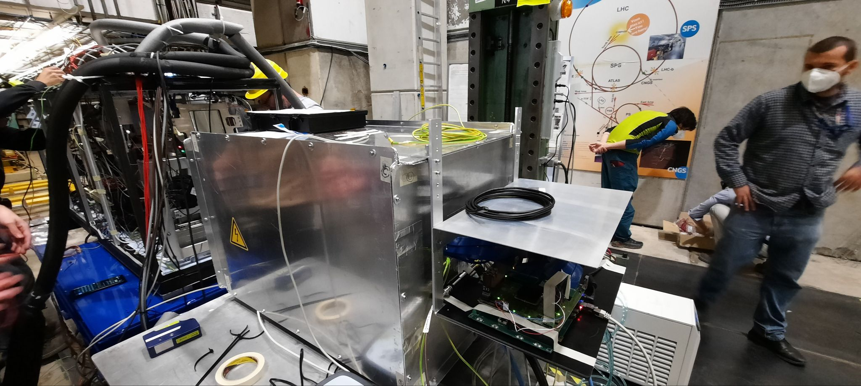
Test with a full station and a calorimeter (October ‘22)
A fully equipped tracking station and the calorimeter
One week of test in M2 as main users performed the last October
High intensity muon beam, up to 2×10⁸ muon/spill, for the first time

Slide 23
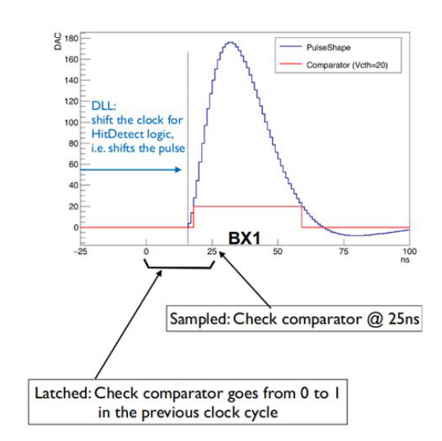
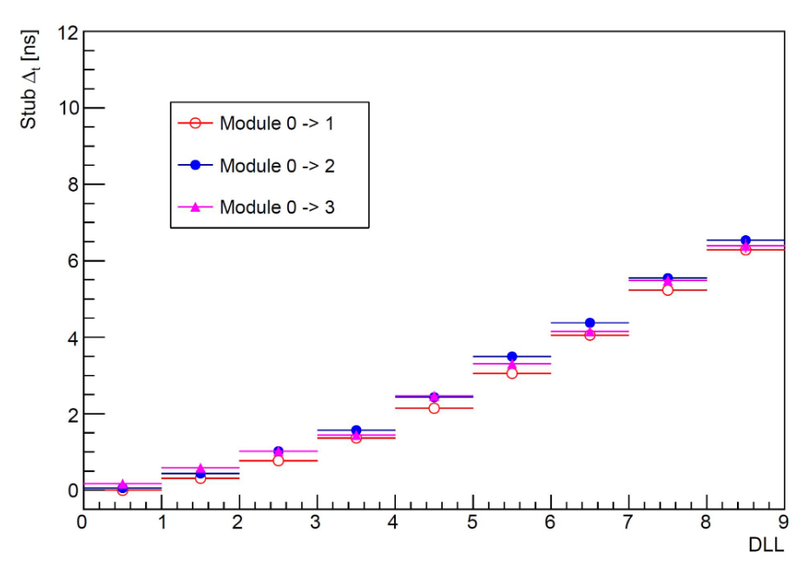
Synchronization
Need to ensure the sampling point for each module is in sync for any given muon
Asynchronous beam: no absolute timing reference
Method: for a pair of modules take time difference in BX between captured stubs in each module: the first module is taken as reference, next modules checked in comparison. Check delta as function of DLL settings and plot the mean at each setting
The procedure can correct for offsets in the modules to maximise detetction efficiency to 0.5 ns

Slide 25
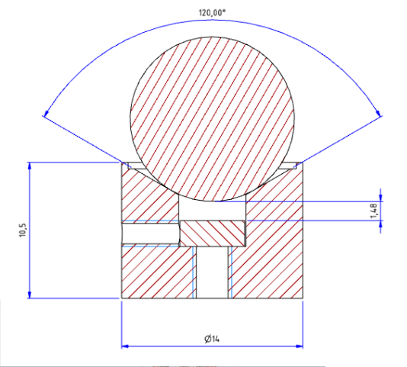
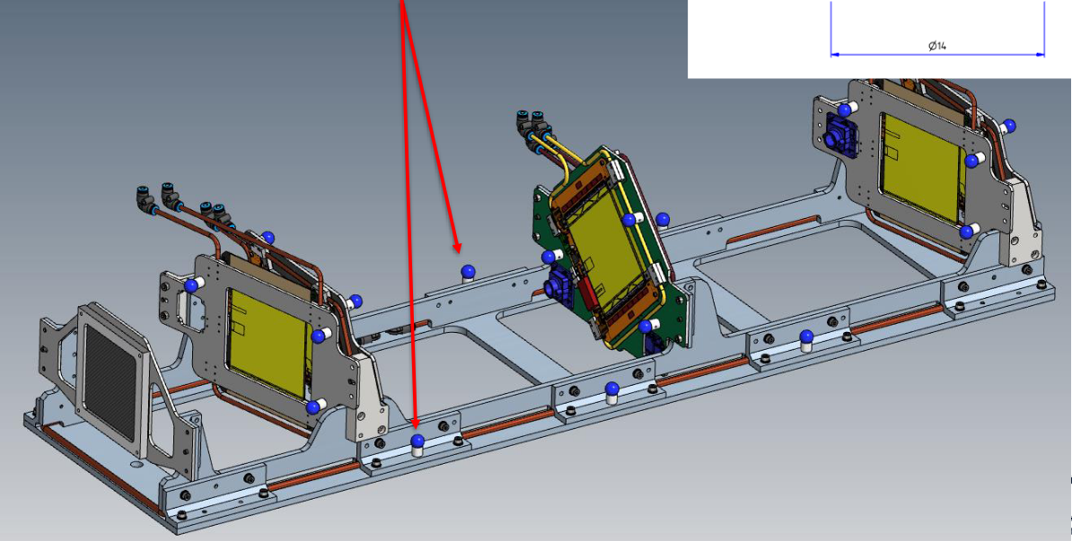
Mechanical Survey
Fiducial markers ordered (2 spheres, 1/2 inch)
Design of the aluminum holders for spheres done
To set the alignment initial conditions

Slide 26
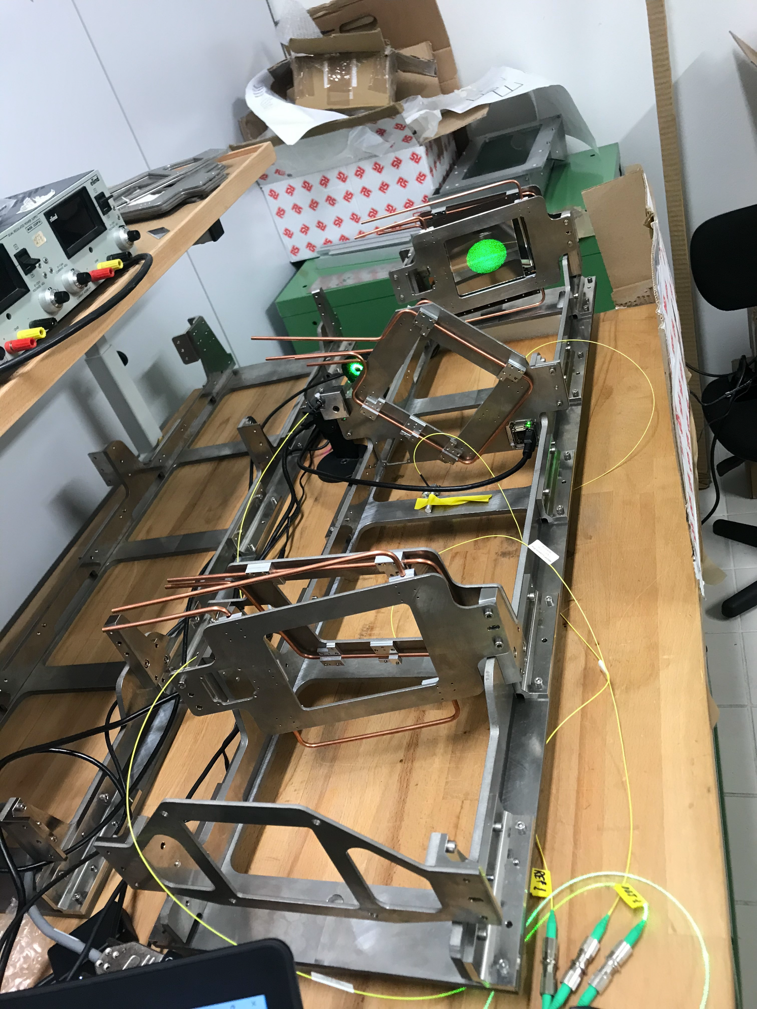
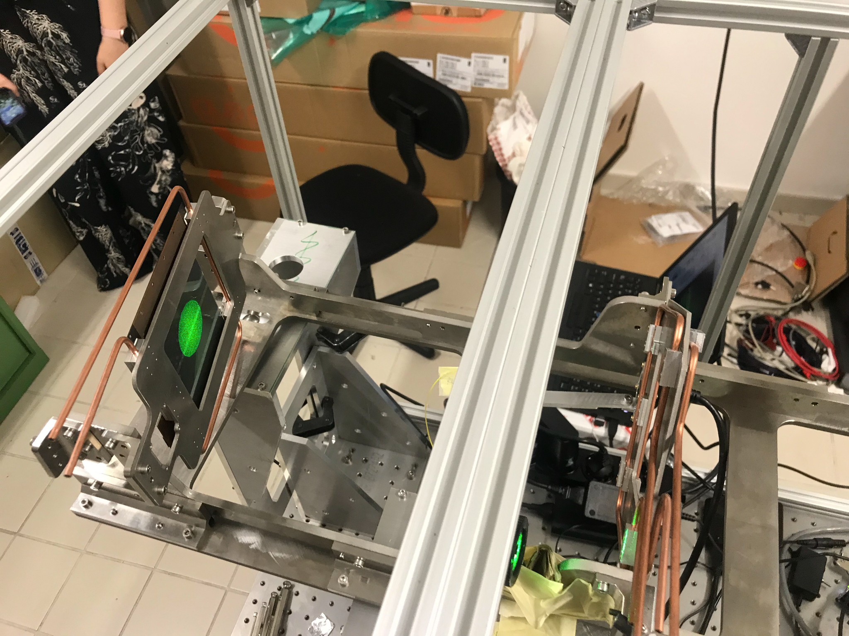
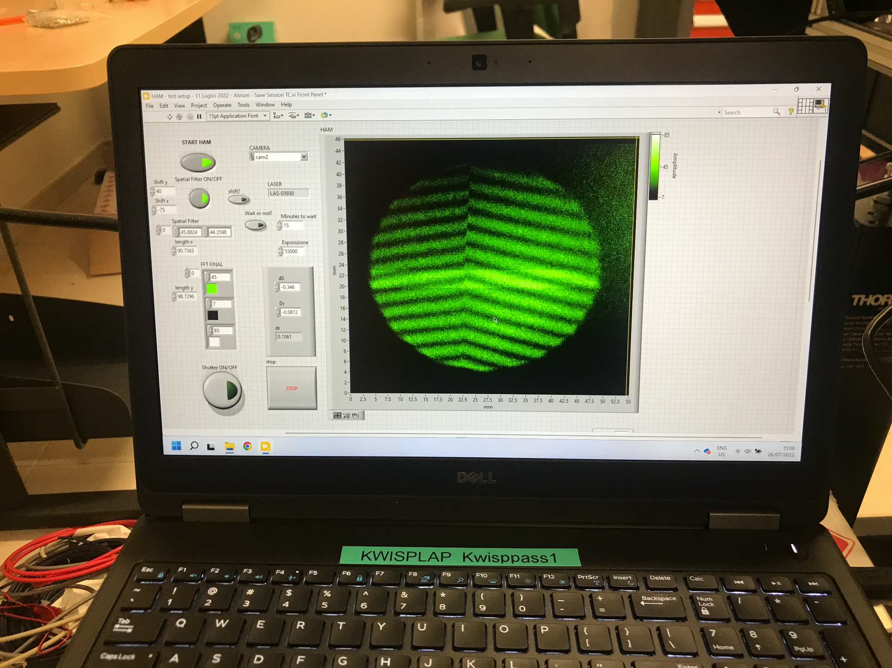
The holographic system
Laser interferometry of rays going through different paths
It allows monitoring the position of two sensors with respect to a reference one with resolution of ~0.25 μm
To be used during alignment and data taking
The system is ready to monitor one station Extensible to a second station easily

Slide 27
The holographic system (cont.)
Thermal load corresponding to a power of 2W applied to the mechanical structure of the Aluminium prototype. Module’s consumption ~5 W: cooling system foreseen.
Initial state
Steady power on
Power off
Estimated relative displacement between planes 1.5 μm

Slide 28
ECAL

Slide 29
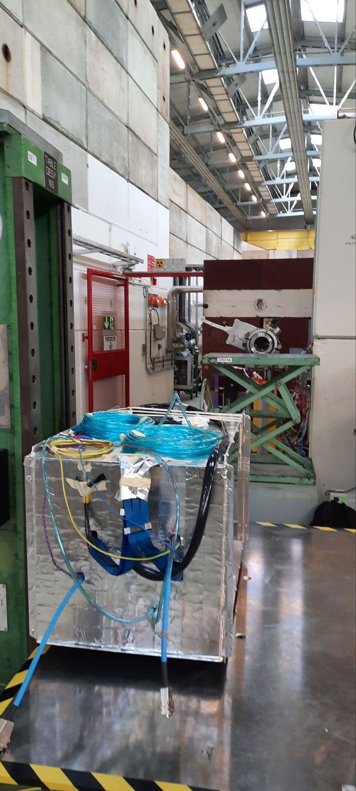
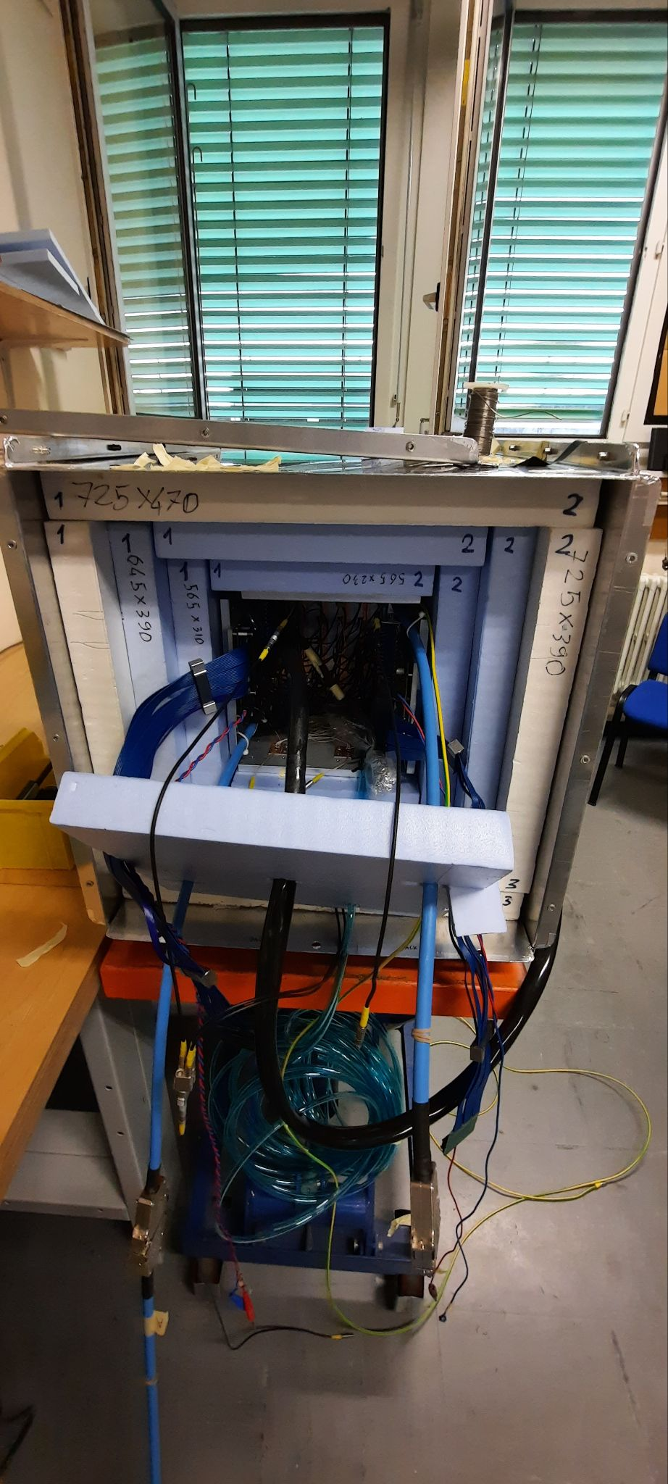
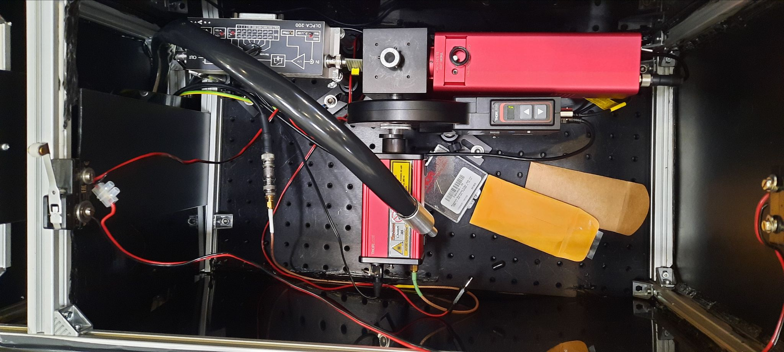
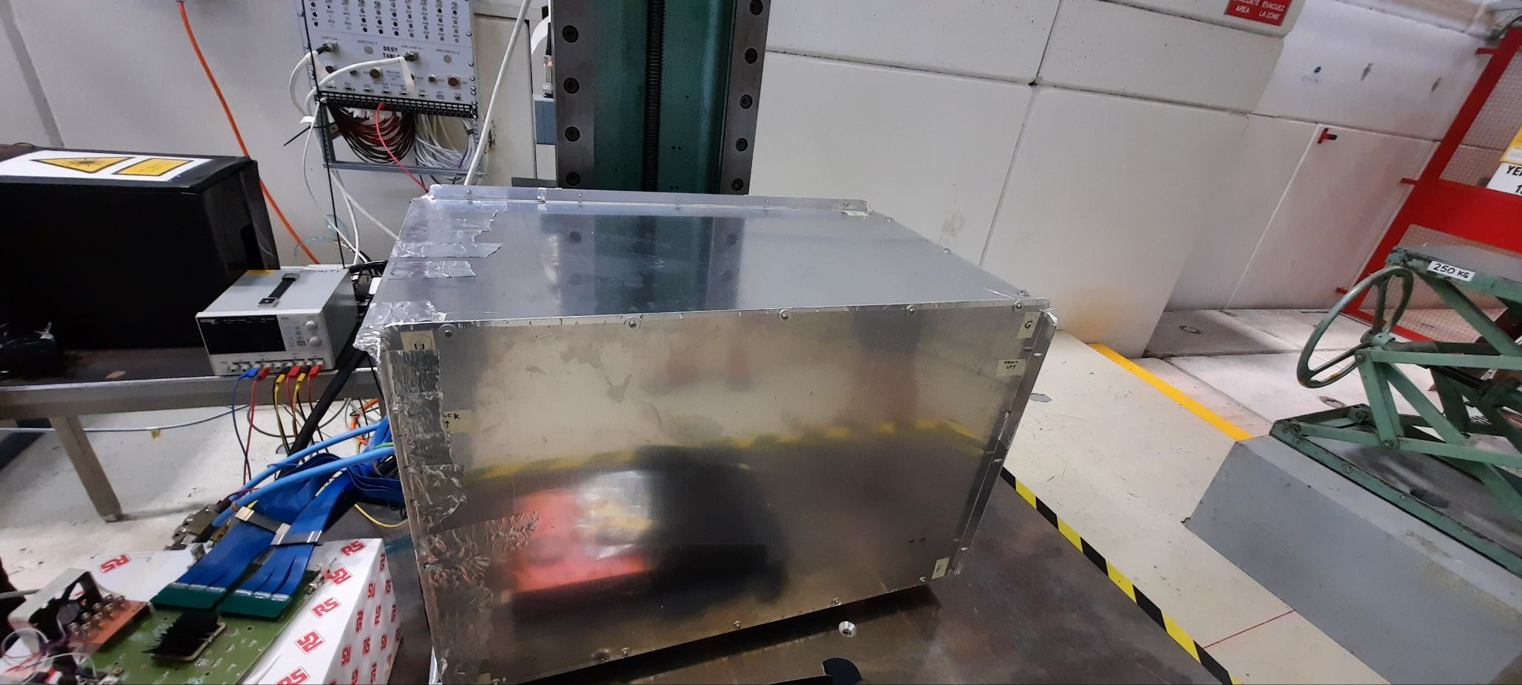
ECAL tests in CERN’sT9
ECAL assembled and tested at the end of July in the CERN T9 electron beam line
Laser pulses

Slide 30
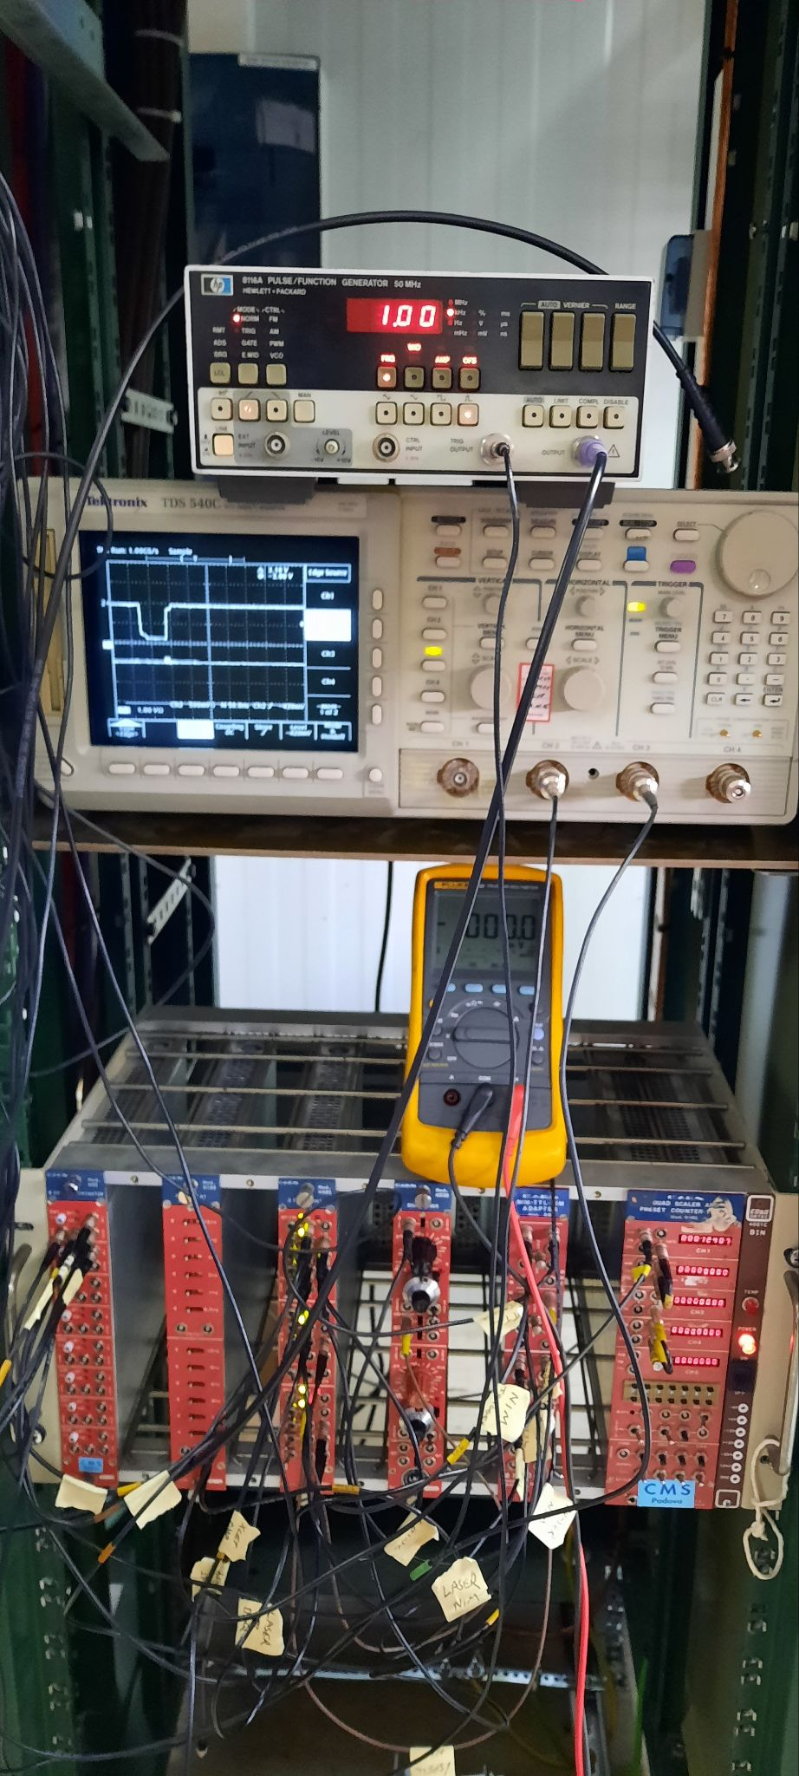
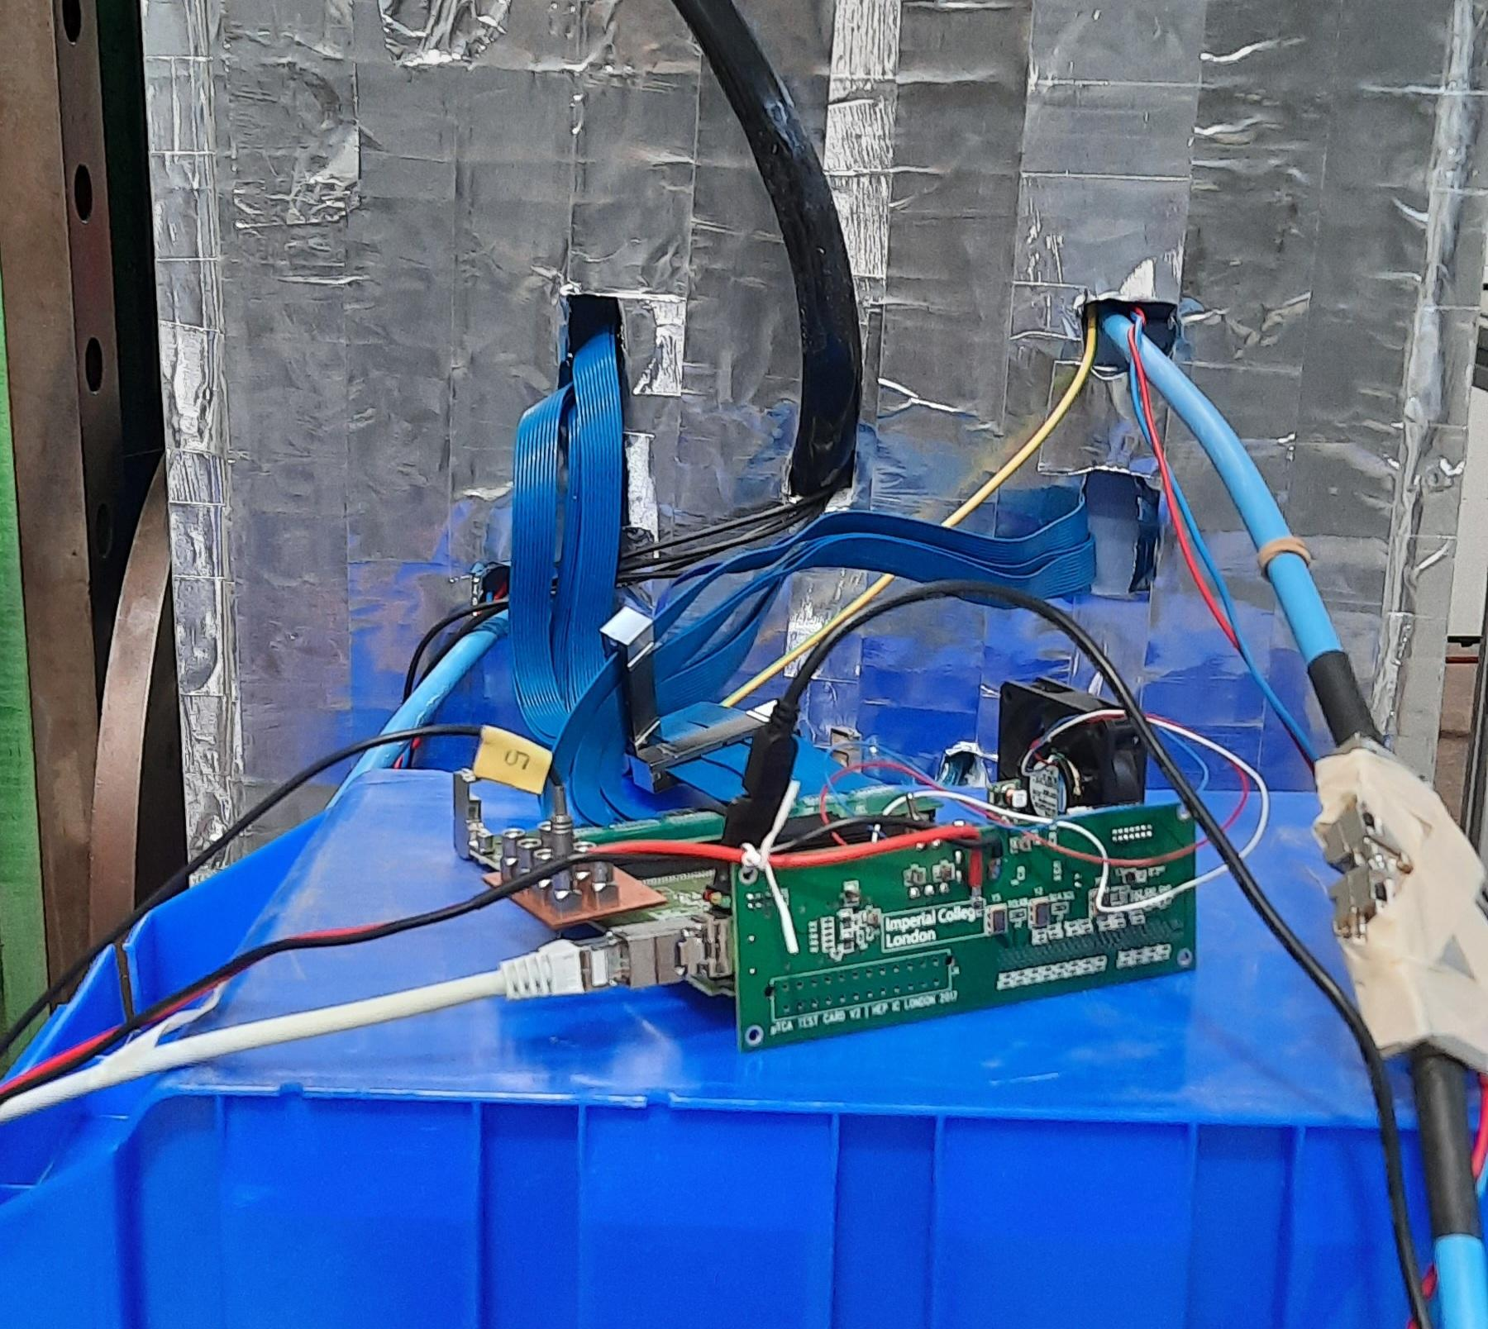
ECAL test setup and DAQ
The FC7 FEBs are used to read out the digitizers and to transmit data to the PC through a 10 Gbps Ethernet link.
Self trigger modes, relying of the ECAL’s cells energy content and external trigger successfully exploited.
Counting rate capability ~1.5 kHz
The laser system confirmed to be crucial for settings and monitoring the stability of the channels
The readout
External trigger
Beam scintillators and Cherenkov counters

Slide 32
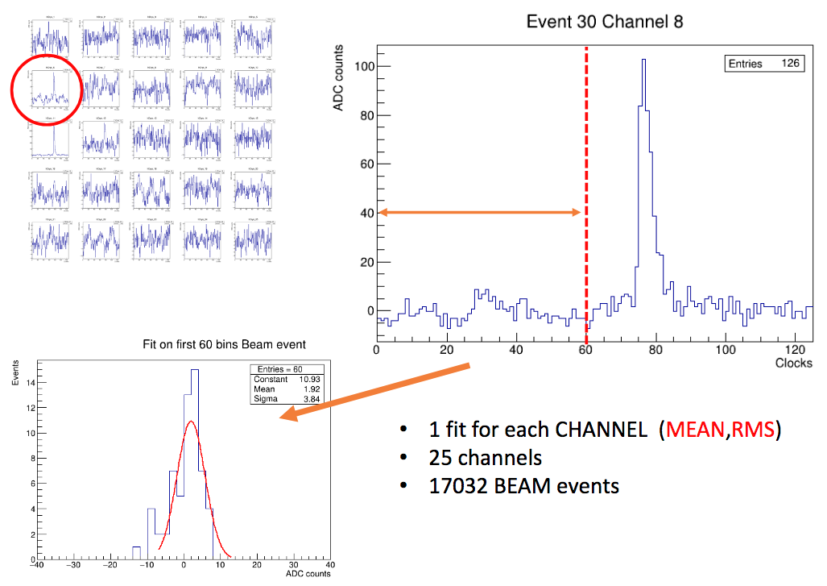
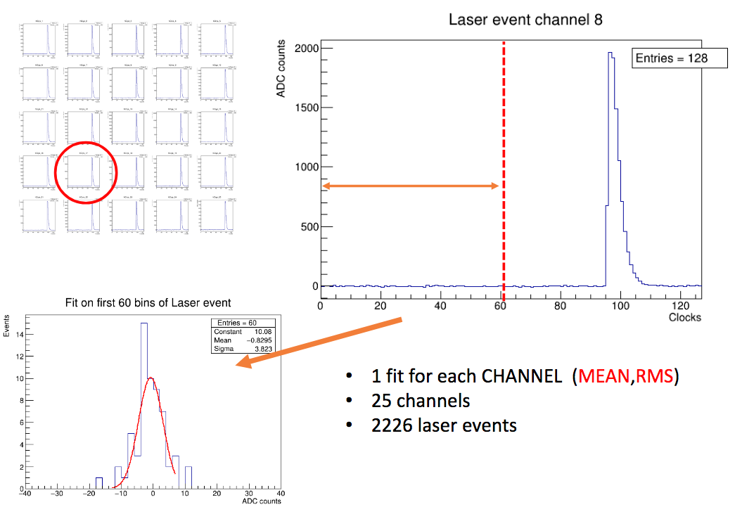
ECAL test setup: main achievements
The light yields have to be improved: the APD-PbWO4 optical coupling has to match.
Electronic noise has to be reduced: the analysis of the main sources is ongoing.
Cooling of the ADPs was not entirely satisfactory
The monitoring system of the APD temperature has to be improved/replaced
Laser stability is monitored by a dedicated Photodiode, whose output signals has to be registered for reference checks
4 GeV electrons
Laser pulses

Slide 33
Software
FairMUonE: FairRoot based software, for generation, simulation, digitization and reconstruction
Event generation: NLO Mesmer generator for μ - e scattering Accurate beam profile description
Simulation: Geant4 v10.7.1 implemented in FairRoot Detailed geometry description implemented, scalable to any number of stations Common geometry files (.yaml files) for simulation/digitization/reconstruction
Digitization: Digitization for tracking stations ready Realistic electronic noise and channel cross-talk added Calorimeter digitization is ongoing

Slide 34
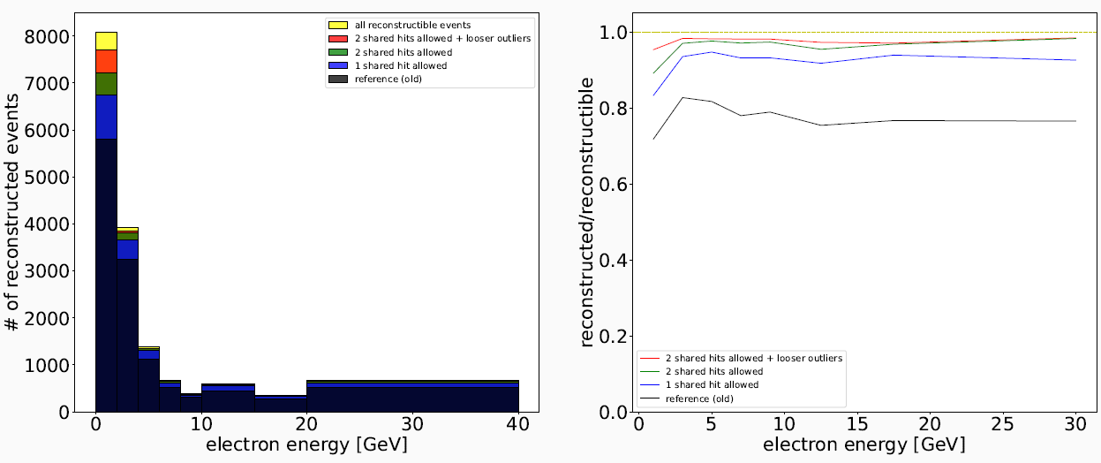
Software (cont.)
Track reconstruction: Kalman filter for tracking implemented Tracking efficiency studies ongoing: Allowing shared hits improves track reconstruction efficiency dramatically in the whole energy range
Vertex reconstruction: Kinematic fit constraining three tracks to meet in the middle of a given target Adaptive vertex fitter developed for the alignment

Slide 35
Detector alignment
Initial conditions set by means of the mechanical survey: Δz ~ 50 - 100 μm
Software alignment shall reach the ultimate precision
Alignment parameters will be determined by minimizing the global χ² MUonE is perfectly suited for the global χ² approach because of the linearity.
Residuals ρ depend on the alignment parameters α as well as track parameters π
The required precision for the alignment is Δz ~ 10 μm
How to get the longitudinal scale to such a precision? Use thin targets located to a known distance and reconstruct vertices from these targets to gauge the scale

Slide 36
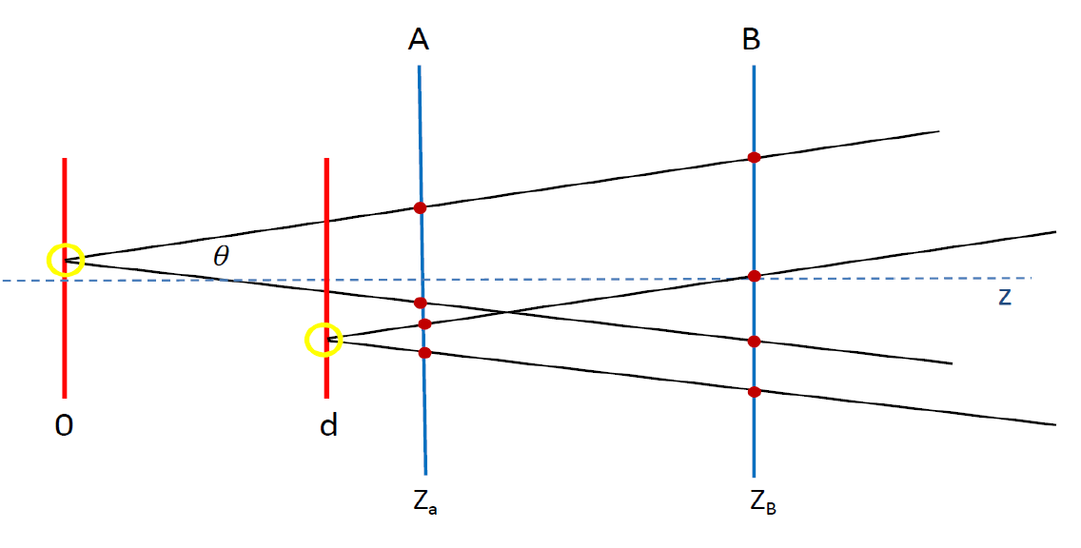
Detector alignment (cont.)
Design and construction of the targets system by the CERN accelerator group
Use pion beams to enhance the multiplicity of tracks from the vertices in the thin targets
Use the adaptive vertex fitter to determine the vertices positions
Use the global alignment method to get the alignment parameters

Slide 37
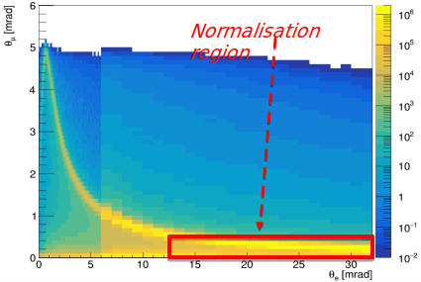
Analysis
For a detailed description of the analysis strategy see: G.Abbiendi, Phys. Scr. 97 (2022) 054007 [arXiv: 2201.13177]
Template fit of the 2D distribution using the CMS Combine tool: Fit with systematic effects included as nuisance parameters, and extracted along with the signal parameters.
Use normalization region to calibrate the larger systematic effects: beam energy, angular intrinsic resolution.
MESMER MC + fast detector simulation
to generate template distributions.
Combine analysis tool to perform the combined likelihood fit to the signal and systematics.

Slide 38
Plans
Prove the feasibility of the proposed MUonE method in 2023
Detect elastic scattering at 40 MHz
Reconstruction efficiency
Background studies
Study the alignment in test beams to then measure the beam energy
Integrate ECAL and correlate its response to the tracker
Write the experimental proposal
Move to the experiment with 10 stations to get a first measurement before the LS3

