Slide 1
The Most Compact Formulas for Neutrino Oscillation Probabilities in Matter
Hisakazu Minakata
U. Sao Paulo

Slide 2
ν physics at crossroads
(1) One can be more brave, hoping to discover something totally beyond νSM (steriles, NSI, …)
(2) Establish νSM:
Experimentally, measure δ and determine mass ordering aiming at contributing this line of thought
Theoretically, pin down the origin of ν mass

Slide 3
3 ν mixing: nature’s choice

Slide 4
Do we understand 3 ν oscillations?
Basic understanding achieved:
See e.g., M. Blennow and A. Y. Smirnov, Adv.HEP 2013
Of course, there is a frontier:
high density ν oscillation, nonlinear effects
see the wave packet
etc.

Slide 5
Can we solve 3 ν oscillations?
From now on restrict myself to LBL settings (Δm²_{atm} scale oscillations)
Numerically, Yes ! Simple to solve
How about analytically ? amazingly YES ! (for constant matter density) see next page
Illuminating ? You will see..

Slide 6
Exact formula for oscillation probability in matter

Slide 7
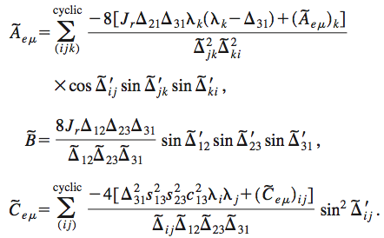
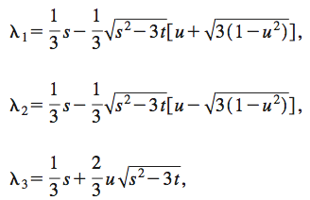
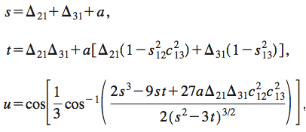
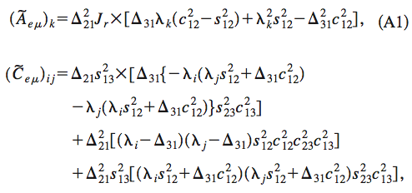
Kimura-Takamura-Yokomakura formula
PLB, PRD 2002

Slide 8
Perturbation theory

Slide 9
There were a lot of activities in perturbative treatment of neutrino oscillations
If matter effect of small, “matter pertubation”: a/Δm₃₁² (a=2√2G_{F}N_{e}E)
If distance is short, “short distance expansion”: (Δm₃₁² L /E ) << 1
If generic, most often used expansion parameters are: Δm₂₁² /Δm₃₁² , and sinθ₁₃
Panoramic reference: E. K. Akhmedov, R. Johansson, M. Lindner, T. Ohlsson and T. Schwetz, JHEP 2004

Slide 10
Issues and limitations of the perturbative treatment
The most popular expansion parameters:
Δm₂₁² /Δm₃₁² ~= 0.031, and s²₁₃= sinθ₁₃
But, θ₁₃ not so small: sinθ₁₃ =0.146 ~ √ε (s²₁₃ = 0.021)
K. Asano, HM, JHEP 2011 (before T2K, Daya Bay!)
Lengthy expressions, not perfect at around resonance enhancement (see next page)
From now on I call:
Δm₂₁² /Δm₃₁² = ε
Perturbation theory assuming s₁₃ = √ε

Slide 11
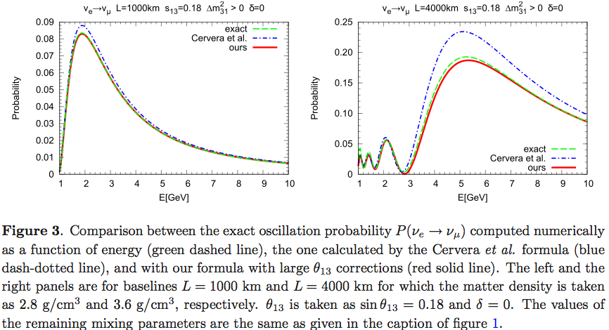
s₁₃=√ε vs. s₁₃=ε perturbation theories
√ε

Slide 12
Nature is simple: unique expansion parameter ε!

Slide 13
ε = Δm²₂₁ / Δm²₃₁ ~ 0.03 as a unique expansion parameter
J. Arafune, J. Sato, PRD 1997
A. Cervera et al. NPB 2000
M. Freund, PRD 2001
E. K. Akhmedov, R. Johansson, M. Lindner, T. Ohlsson and T. Schwetz, JHEP 2004
May be many more refs.

Slide 14
Simple and Compact formula for oscillation probability in matter
HM-S.J.Parke, arXiv: 1505.01826

Slide 15
What we want to do
Unique expansion parameter
ε = Δm²₂₁ / Δm²₃₁ ~ 0.03
We restrict to first order in ε (ε² = 10⁻³ << 1)
Then, you may ask: what is new?
(1) Simplicity in the expression (see P_{ee} below)
(2) Structural simplicity (as I will explain)
Contains all order effect of s13 and matter

Slide 16
In a nutshell,
E. K. Akhmedov et al. JHEP 2004
A=a/Δm²₃₁
(a=2√2G_{F}N_{e}E)
Redefine the quantities such that
Can you do it systematically ?

Slide 17
Helio- perturbation theory
ε = Δm²₂₁ / Δm²₃₁
More precisely,
helio-to-terrestrial ratio perturbation theory

Slide 18
Helio P theory (expansion by ε)
Tilde basis
Conventional way:
Zeroth order, 1st order

Slide 19
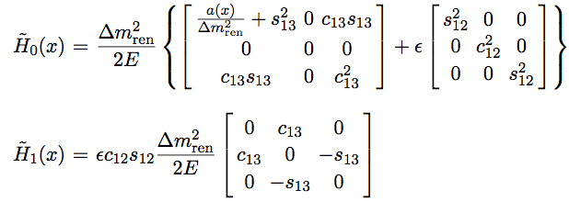
Renormalized helio-perturbation theory
= Δm²_{ee}
NOTAION ISSUE
THAT IS ALL YOU NEED TO KNOW. JUST DO IT !

Slide 20
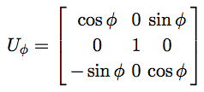
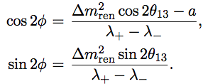
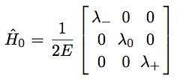
Diagonalization of tilde{H} → Hat basis

Slide 21
There are two ways to compute P: V-matrix & S-matrix methods
Agree nontrivially !

Slide 22
S-matrix method: Doing perturbation theory with hat basis
Hat-S matrix is computed as
Then, finally

Slide 23
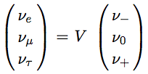
V matrix method
mass eigenstate in matter to O(ε)
Zeroth order=basis of perturbation theory
1st order correction

Slide 24
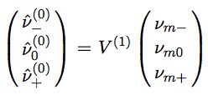
Inverting ν_{mi} = […] ν(hat)_{I} to obtain
Then, inserting this to

Slide 25
V matrix result
Mass eigenstate in matter to O(ε)
This zero is important ! → No ν_{e} in “0” state

Slide 26
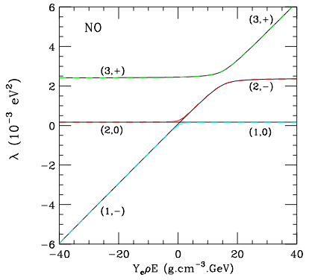
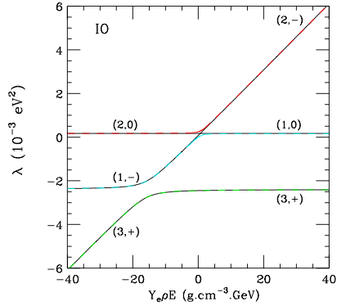
3 ν level crossing diagram
Black solid: ours (-0+)
Colored dashed: = exact (123)

Slide 27
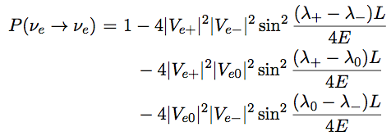
Then, use the general formula
O(ε²)

Slide 28
How simple is our formula?
versus

Slide 29
P_{ee} and P_{eμ} to order ε
P_{ee}
P_{eμ}
~ as simple as Cervera et al formula NPB 2000

Slide 30
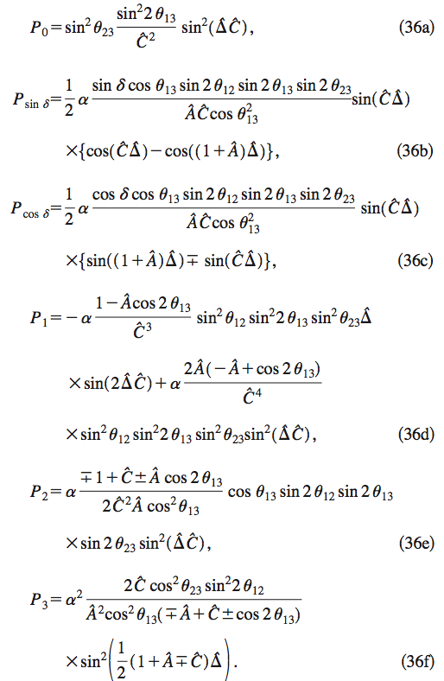
M.Freund PRD01
P_{eμ}

Slide 31
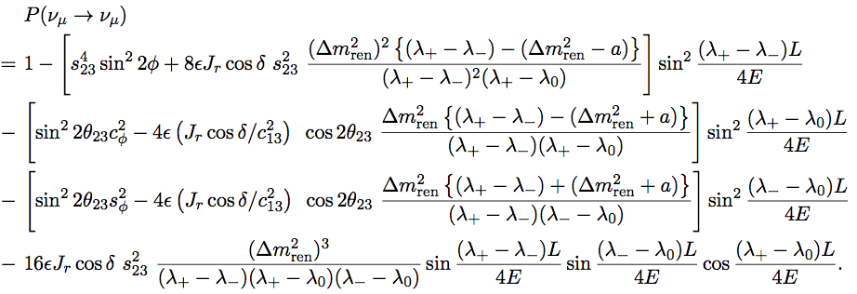
P_{μμ} to order ε
P_{μμ}

Slide 32
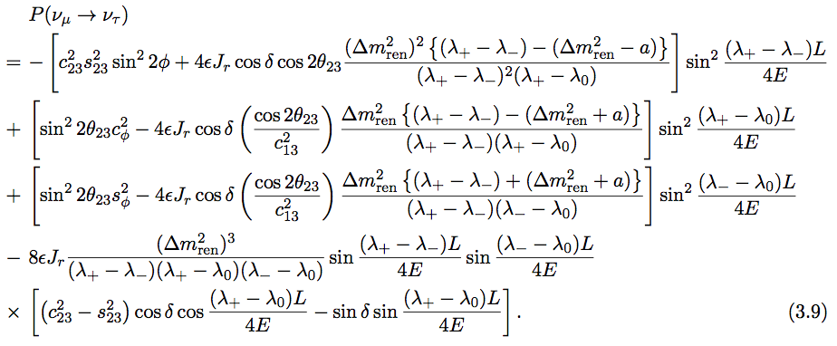
P_{μτ} to order ε
P_{μτ}

Slide 33
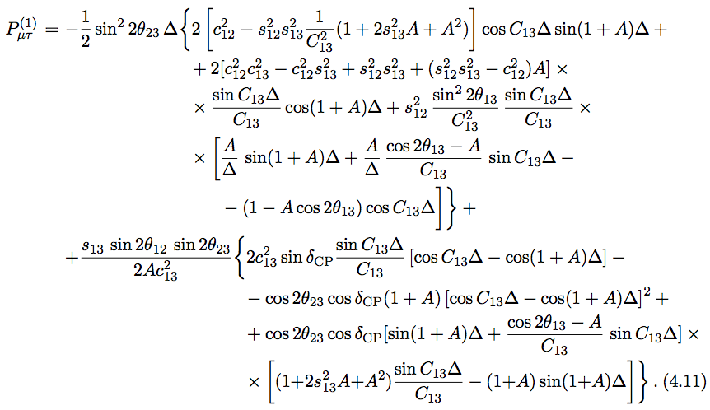
P_{μτ} by E. K. Akhmedov, T. Ohlsson et al. (JHEP04)
P_{μτ}

Slide 34
What is the charm of the formulas?

Slide 35
Harmony between perturbation theory and general expression
Perturbation theory is good: relative simplicity of the elements of expressions
The general expression
Is good, because “structure revealing”
Oscillation in matter ~ as simple as oscillation in vacuum

Slide 36
How accurate is the formula?

Slide 37
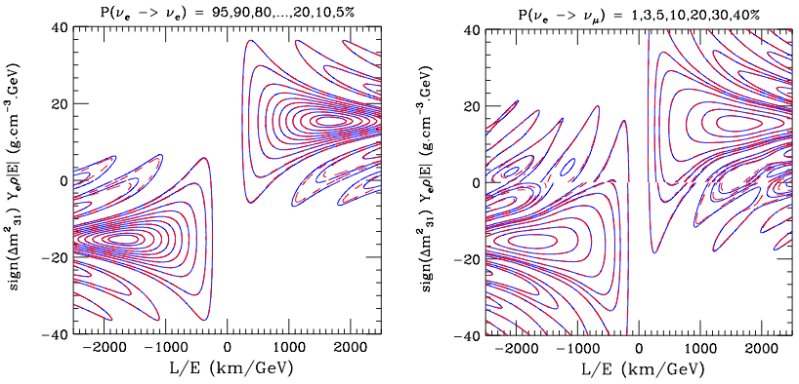
How accurate is the formula?: equi-probability contour
P_{ee}
P_{eμ}

Slide 38
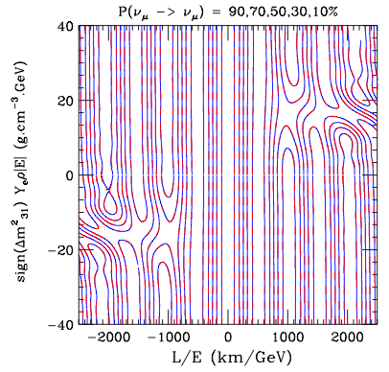
How accurate is the formula? #2
P_{μμ}

Slide 39
Not without problem
The problem is common for all the perturbative framework in the market

Slide 40
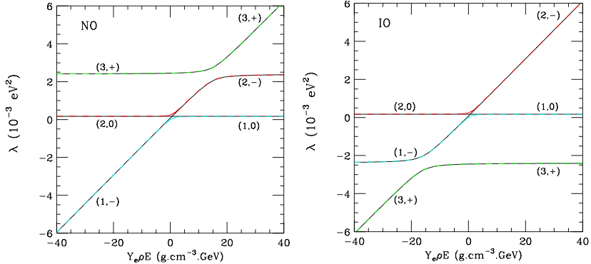
Not without problem: ν₋ and ν₀ level crossing
ν₋ and ν₀ level cross !

Slide 41
Flavor content of ν₋ and ν₀
Despite the failure of treating the solar resonance, the flavor content of the states (which participate the solar resonance) are properly reproduced off resonance

Slide 42
Summary

Slide 43
We have formulated a perturbative framewok and derived simple formulas
P_{ee}
P_{eμ}

Slide 44
Some insights, problems, .. (personal opinion)
So far P theorists (incl. myself) were lazy..
I mean, produced lengthy formulas, but didn’t try to make them simpler by combining terms
What is the real merit of doing it?
Resulting formula=general form
by which the meaning of the elements, V for example, are clear

Slide 45
Some insights, problems, .. (personal opinion)
In any way, you can calculate higher order
The real issue is whether the expression remains simple and compact → renormalization to order ε² ?
I suspect YES
To all order P has simple general form
Order ε OK, so probably OK to order ε^{N} (my guess)

Slide 46
Back up slides

Slide 47
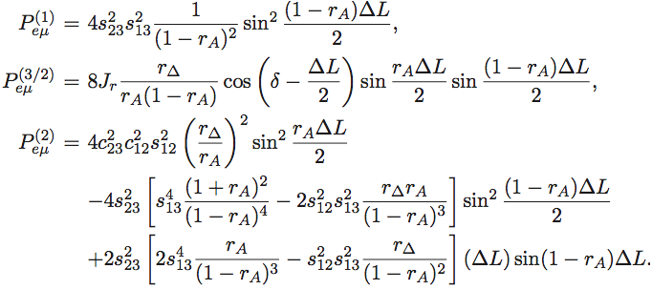
√ε perturbation theory: P_{eμ}

Slide 48
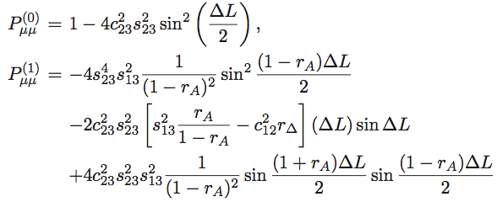
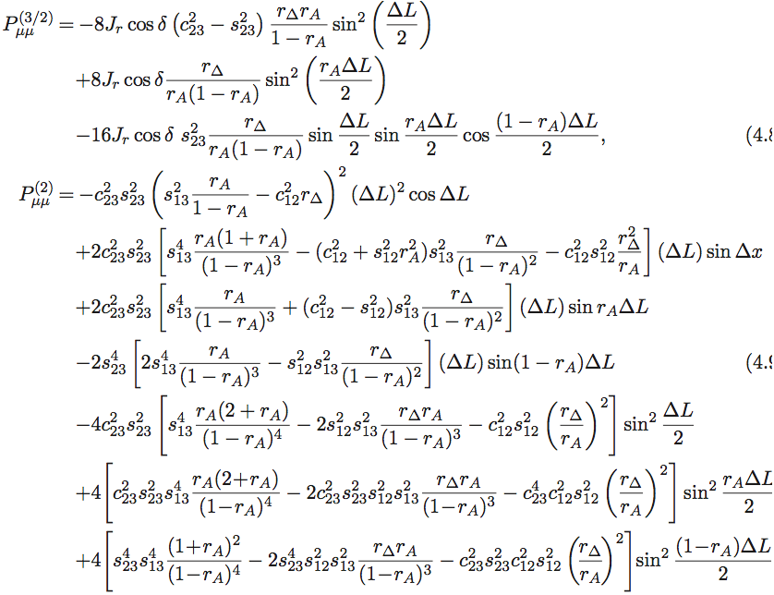
√ε perturbation theory: P_{μμ}

