Slide 1
Solar Neutrinos:
Status and Perspectives
A. Y. Smirnov

Slide 2
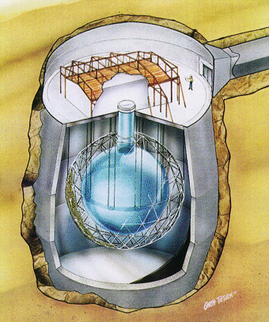
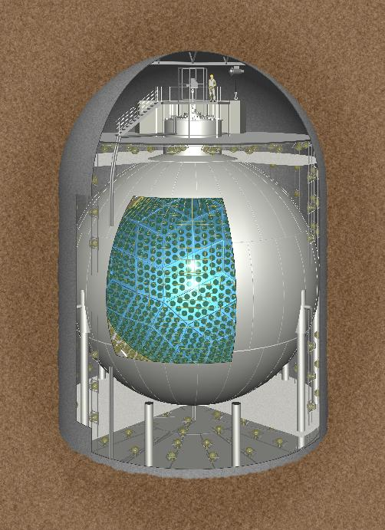
11 years
later
2002 - SNO: establishing flavor
conversion of the Solar neutrinos
2014 - BOREXINO direct
measurement of the pp-neutrinos
2004 – KAMLAND identified
the LMA MSW solution
of the solar neutrino problem
2015 – back to the Sun?

Slide 3
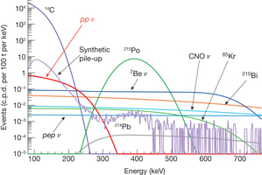
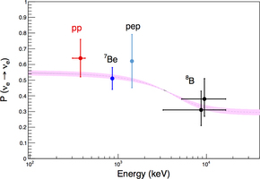
Solar pp-neutrinos
Neutrinos from the primary
pp-reactions in the Sun BOREXINO Collaboration
(G. Bellini et al.) Nature 512 (2014) 7515, 383
Higher accuracy
Upturn?
Higher accuracy on pp will
contribute to global fit substantially
cos⁴ θ₁₃ (1 - ½ sin²2θ₁₂)

Slide 4
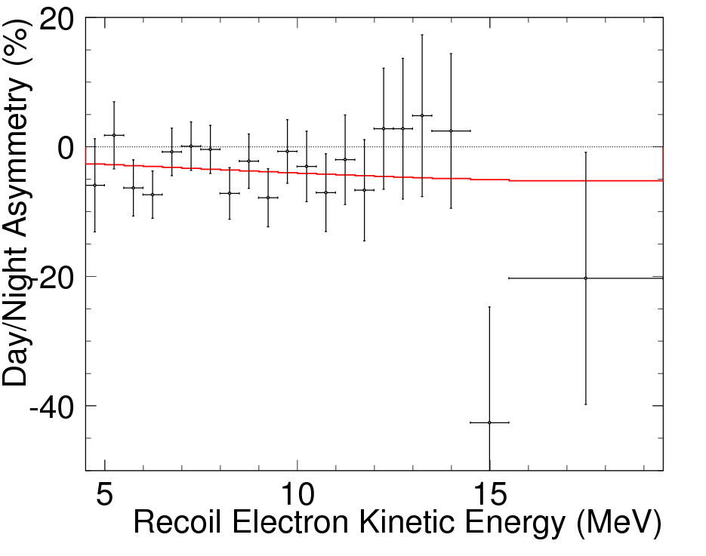
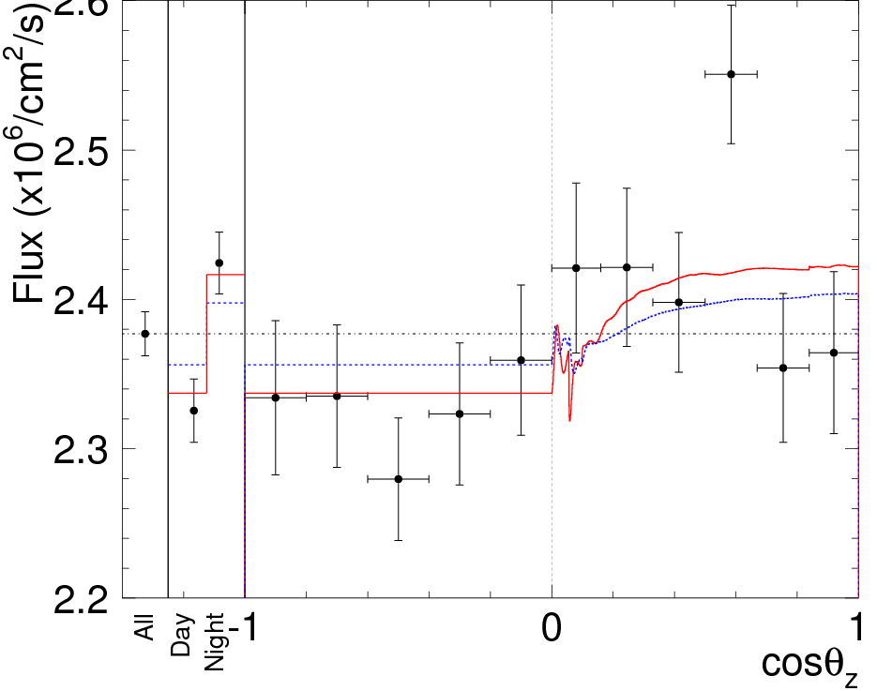
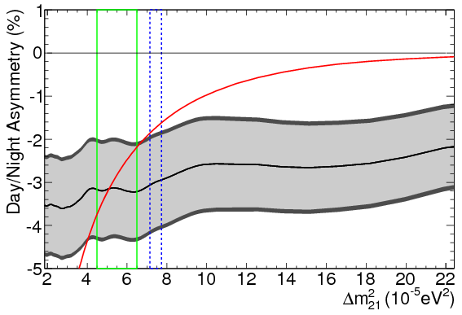
Day-Night effect
First Indication of Terrestrial Matter Effects on Solar Neutrino Oscillation
Super-Kamiokande collaboration
(Renshaw, A. et al.)
Phys.Rev.Lett. 112 (2014) 091805 arXiv:1312.5176
positive
Core is not seen - attenuation
solar
KL
Below average
Large fluctuations of data

Slide 5
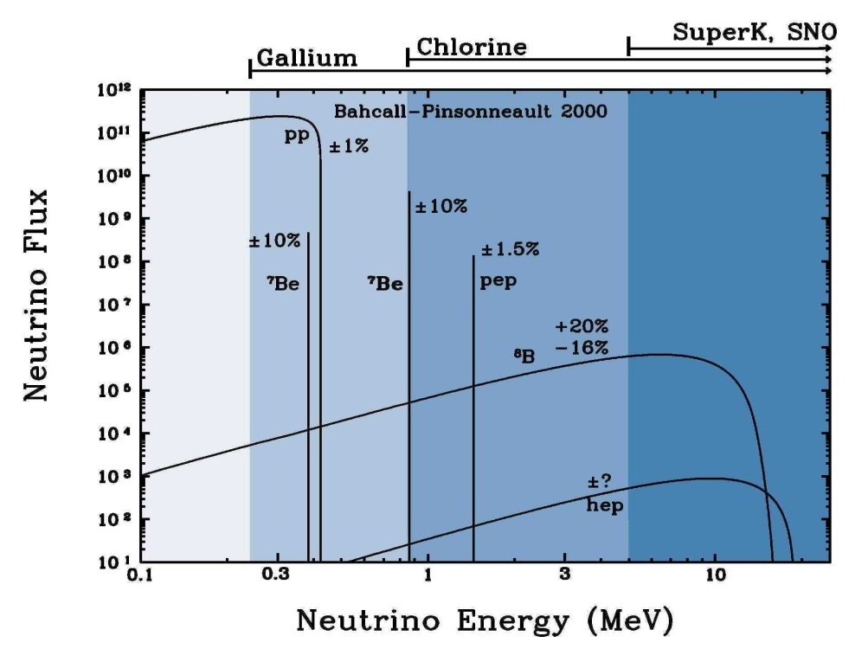
Solar neutrinos
4p + 2e⁻ → ⁴He + 2ν_{e} + 26.73 MeV
Adiabatic
conversion
LMA MSW
BOREXINO
ν
Loss of
coherence
Oscillations
in matter
of the Earth
Mass states split and oscillate

Slide 6
Content:
1. Status
M. Maltoni, AYS.
Review Solar neutrinos and Neutrino physics
EJP, to appear
Parameters and Problems
2. Perspectives:
Ioannisian,
AYS, D. Wyler
1503.02183 [hep-ph]
PRD
Oscillations of Be7 neutrinos
3. Conclusion

Slide 7
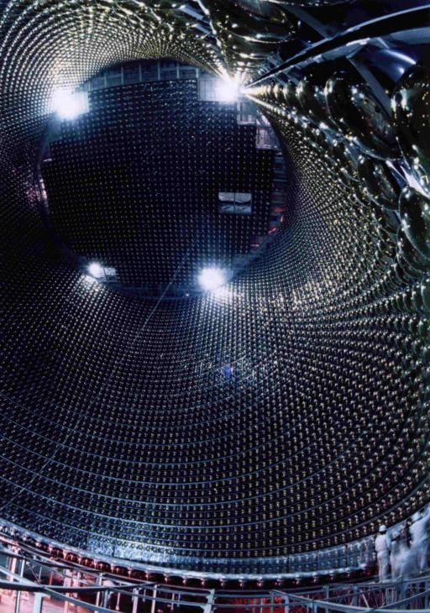
Status

Slide 8
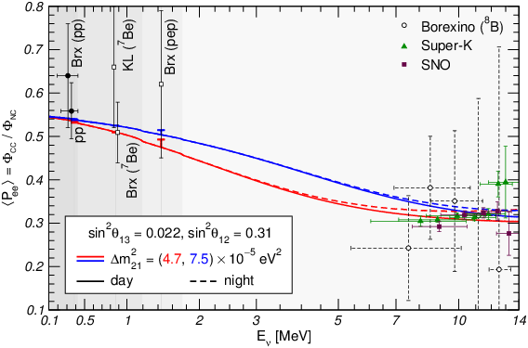
Profile of the effect
M. Maltoni, A.Y.S.
to appear
for two different values of Δm₂₁²
best fit value
from solar data
upturn
best global fit
Reconstructed exp. points for
SK, SNO and BOREXINO
at high energies
Vacuum
dominated
Transition region
resonance turn on
Matter dominated
region

Slide 9
Upturn?
Best global
SK
Solar only
SNO
SNO+

Slide 10
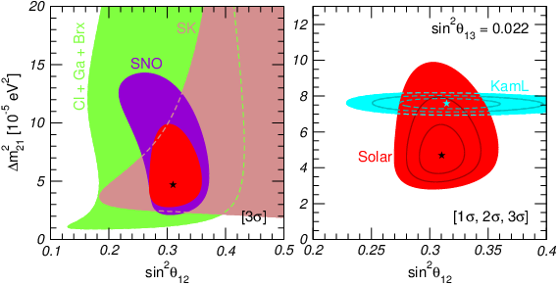
Neutrino parameters
Solar neutrinos
Vs. KamLAND
M. Maltoni, A.Y.S.
to appear
Δm²₂₁ : about
2σ descrepancy of the KL and solar values
KamLAND data reanalized in view of reactor anomaly (no front detector) bump at 4 -6 MeV
Red regions: all solar neutrino data
also restrictions from
individual experiments
sin² θ₁₃ fixed by reactor experiments
Δm²₂₁ increases by 0.5 10⁻⁵ eV²

Slide 11
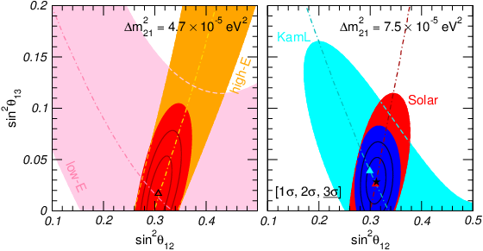
1-3 mixing
allowed regions
sin² θ₁₃ and sin² θ₁₂
Solar only
Solar + KamLAND
b.f.: sin² θ₁₃ = 0.017
b.f.: sin² θ₁₃ = 0.028

Slide 12
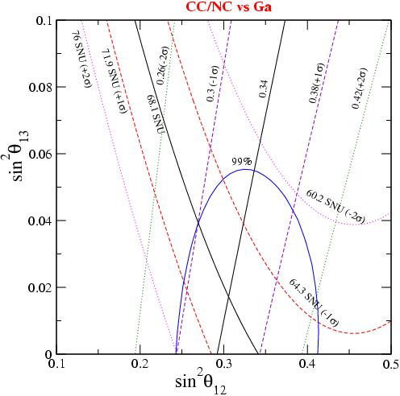
Theta 1-3 and solar neutrinos
S. Goswami, A. Yu. S.:
hep-ph/0411359
Phys.Rev. D72 (2005) 053011
Effect is not just overall normalization of the flux
Measuring 1-2 and 1-3 mixings
New SNO
sin²θ ₁₃ = 0.017+/- 0.026

Slide 13
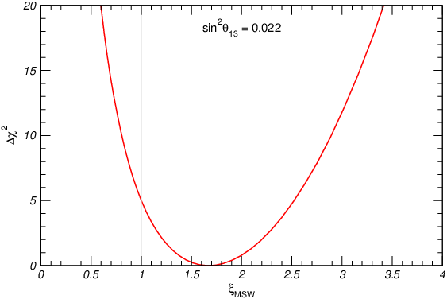
Matter potential
G. L Fogli et al hep-ph/0309100
C. Pena-Garay, H. Minakata, hep-ph 1009.4869 [hep-ph]
M. Maltoni, A.Y.S. to appear
V = a_{MSW} V_{stand}
a_{MSW} = 0 is disfavoured by > 15 σ
the best fit value a_{MSW} = 1.66
a_{MSW} = 1.0 is disfavoured by > 2 σ
related to discrepancy of Δm²₂₁
from solar and KamLAND:
Δm²₂₁ (KL)
Δm²₂₁ (Sun)
a_{MSW}
= 1.6
Potential enters the probability in combination
Determination of the matter potential from the solar plus KamLAND data
using a_{MSW} as free parameter
V
Δm²₂₁

Slide 14
Scaling
Inside the Sun highly adiabatic conversion →
The averaged survival probability is scale invariant = no dependence on distance, scales of the density profile, etc.
Function of the combinations
2VE
Δm₂₁²
2VE
Δm₃₁²
Very weak dependence
ε₁₂ =
ε₁₃ =
With oscillations
in the Earth
P_{ee} = P_{ee}(ε₁₂ , ε₁₃, φ_{E} )
φ_{E} = Δm₂₁² L /2E
L – the length of the trajectory in the Earth
If oscillations in the Earth are averaged
P_{ee} = P_{ee}(ε₁₂ , ε₁₃) = P_{ee}(ε₁₂)
Δm_{ij}² → a Δm_{ij}² , V → a V
a = -1 flip of the
mass hierarchy
Invariance:
Δm_{ij}² → b Δm_{ij}² , E → b E

Slide 15
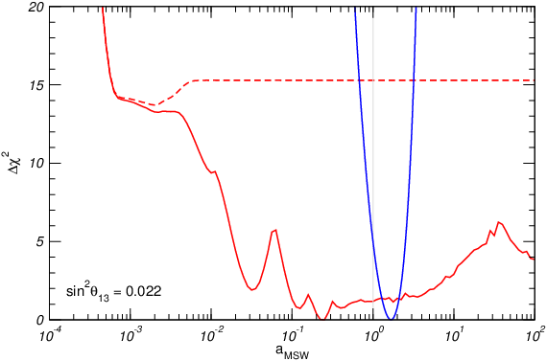
Scaling and potential
V = a_{MSW} V_{stand}
Δm²₂₁ = a_{MSW} Δm²₂₁
no Earth matter effects
app. 4σ
Solar neutrino
data only
l_{ν} > R_{SUN}
Adiabaticity
violation in
the Sun
Non-averaged oscillations in the Earth

Slide 16
Open issues
at about
3σ - level
Absence of upturn of the spectrum
Large D-N asymmetry
Difference of values of Δm²₂₁ extracted
from solar and KamLAND data
Can be related
Large value of matter potential extracted from global fit
KamLAND
New physics
another reactor anomaly?
in solar neutrinos?
Solar data alone have very good and consistent description at small Δm²₂₁
Non-standard
Neutrino
interaction
Very light
Sterile neutrinos
Reactor anomaly should affect KamLAND result
New sub-leading effects

Slide 17
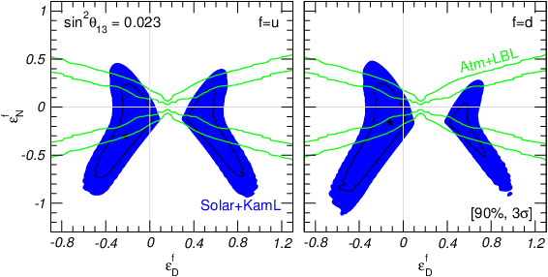
Non-standard interactions
Additional contribution
to the matrix of potentials
in the Hamiltonian
M C. Gonzalez-Garcia ,
M. Maltoni
arXiv 1307.3092
ε^{f}_{D} ε^{f}_{N}
ε^{f}_{N} ε^{f}_{D}
V_{NSI} = 2 G_{F} n_{f}
f = e, u, d
In the best fit points the D-N asymmetry is
4 - 5%
Allowed regions of parameters of NSI

Slide 18
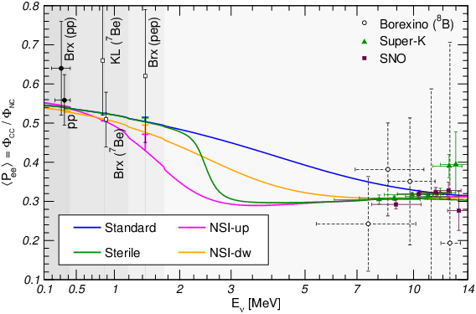
New physics effects
M. Maltoni, A.Y.S.
to appear
difference
Extra sterile neutrino with
Δm²₀₁ = 1.2 x 10⁻⁵ eV², and
sin² 2α = 0.005
Non-standard interactions with
ε^{u}_{D} = - 0.22, ε^{u}_{N} = - 0.30
ε^{d}_{D} = - 0.12, ε^{d}_{N} = - 0.16

Slide 19
meV physics
ν_{s}
ν_{e}
ν_{μ}
ν_{τ}
sterile neutrino
m₀ ~ 0.003 eV
ν₃
Adiabatic conversion for small mixing angle
Adiabaticity violation
sin²β
Δm²₃₁
Allows to explain absence of upturn and reconcile solar and KAMLAND
mass splitting but not large
DN asymmetry
mass
ν₂
Δm²₂₁
ν₀
ν₁
Δm²₀₁
sin²α
additional radiation
in the Universe if mixed in ν₃
For solar nu:
sin² 2α ~ 10⁻³
sin² 2β ~ 10⁻³ (NH)
no problem with LSS
bound on neutrino mass
For dark radiation
sin² 2β ~ 10⁻¹ (IH)

Slide 20
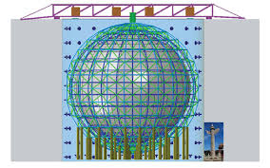
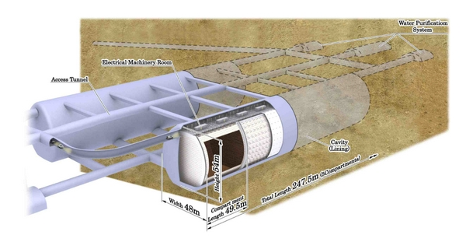
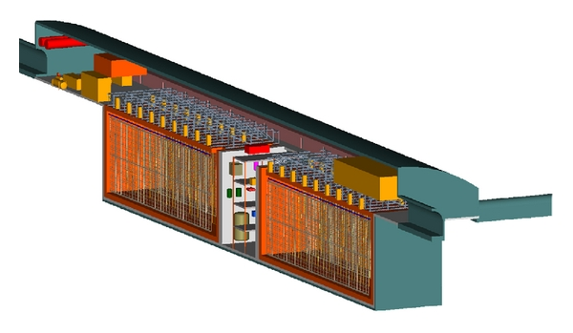
Perspectives

Slide 21
Goals
Clarification of
Absence of upturn of the spectrum
Large D-N asymmetry
Difference of values of Δm²₂₁ extracted
from solar and KamLAND data
Searches for new physics effects
Large value of matter potential extracted from global fit
Detection of CNO neutrinos to shed some light on the problem
of the SSM: controversy of helioseismology data and
abundance of heavy elements
High precision measurements of the pp- pep-
and Be- neutrino fluxes
Detailed study of the Earth matter effect

Slide 22
Experiments
SuperKamiokande
Not much to add?
870 tons
Double beta decay of Te
Simultaneously solar with E > 3 MeV, upturn
later pep- CNO- later
SNO+
JUNO
LS 20 kt,
too shallow, background?
HyperKamiokande
115 000 νe events/ year
Lower PMT coverage, E > 7 MeV
Shallower than SK 20 times larger background,
(4 – 5) σ D-N in 10 years
JinPing
MICA
DUNE

Slide 23
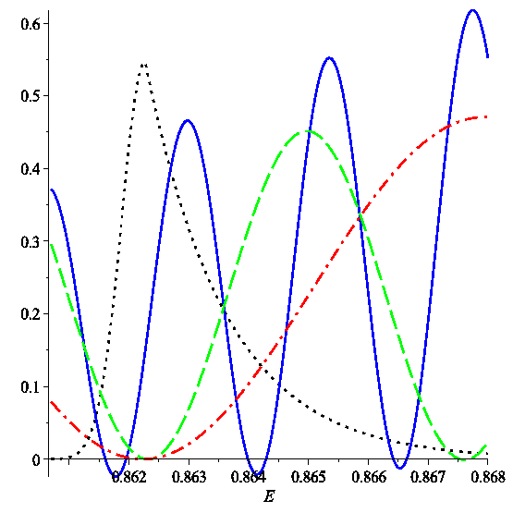
Oscillations of Be neutrinos in the Earth
N . Ioannisian, A.Y.S. ,
D. Wyler
Γ_{Be} = 1.6 kev
E = 862.27 kev
Γ_{Be} /E = 1.86 10⁻³
probability
Be7 line
coincidence
Γ_{Be} ~ ΔE_{T}
Oscillatory period in the energy scale
l_{ν}
2 R_{E} cos η
ΔE_{T} = E l_{ν} /L = E
Depending on nadir angle η level
of averaging changes
For different trajectories.
η = 1.4 (red); 1.0 (blue); 0.7 (blue)
BOREXINO:
A_{DN} = 0.001 +/- 0.012 (stat) +/- 0.007 (syst)

Slide 24
Main features
Oscillations of mass eigenstates – pure matter effect
2VE Δm₂₁²
ε = = 2.4 10⁻³ ( ρ/2.7g cm⁻³)
l_{m} = l_{ν} [ 1 + c₁₃² cos 2θ₁₂ ε + …] = 28.5 km
Variations
L
0
m
x → L
A_{e} = (P – P_{D})/P_{D} = - c₁₃² f(Δm₂₁², θ₁₂ , θ₁₃) ½ dx V(x) sin φ
f = 0.43
Constant density
A_{e} = - c₁₃² ε f sin² ½ Δ_{m} L
Δ_{m} = 2π / l_{m}

Slide 25
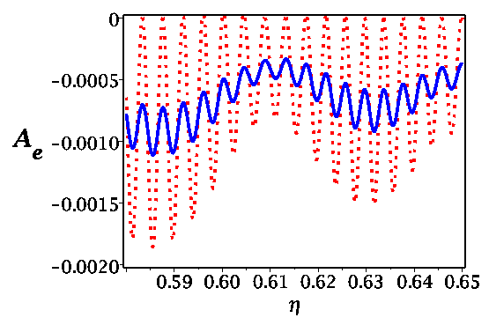
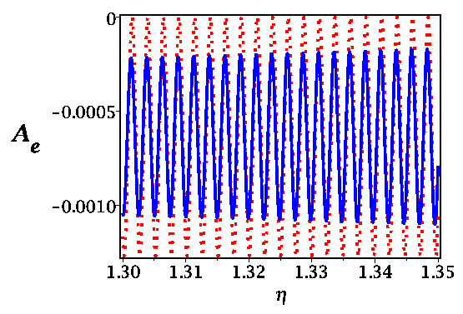
Variations of the Be flux
Nadir angle

Slide 26
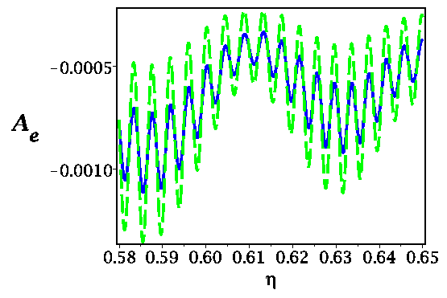
Measuring the width and temperature
Nadir angle
The relative change of the electron neutrino flux for the mantle
crossing trajectories as the function of for two different values of width of the 7Be line which correspond to two different temperatures in the center of the Sun:
T = 15.55 10⁶ degrees (solid line); T = 7.77 10⁶ degree (dashed line).

Slide 27
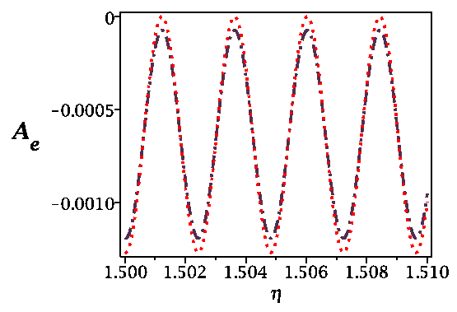
Finite size of the production region
Effect of averaging over the production region of 7Be neutrinos
in the Sun. The relative change of the electron neutrino flux for mantle crossing trajectories with = 1.50 - 1.51 without (dotted line) and with (dash-dotted line) averaging. For deeper trajectories
the effect of averaging is smaller.

Slide 28
Coherence in propagation
In the configuration space: separation of the wave packets due to
difference of group velocities
Δv_{gr} = Δm² /2E²
separation:
Δx_{sep}^{S} = Δv_{gr} L = Δm² L/2E²
σ_{x}
no overlap:
Δv_{gr} L > σ_{x}
ν₂
coherence length:
ν₁
L_{coh} = σ_{x} E²/Δm²
x
In the energy space: averaging over oscillations
Oscillatory period in the energy space
E^{T} = 4π E²/(Δm² L)
Averaging (loss of coherence) if energy resolution σ_{E} is
E^{T} < σ_{E}
→ leads to the same coherence length
If E^{T} > σ_{E} - restoration of coherence even if the wave packets separated

Slide 29
Spread of wave packets
Due to presence of waves with different
energies in the packet
Dispersion of the velocities with energy
m²
E³
σ_{spread} = σ_{E} L
x

Slide 30
Coherence of Be7 neutrinos
σ_{x} = 2π /Γ_{Be} = 6 10⁻⁸ cm
On the way from the Sun to the Earth:
m²
E³
for hierarchical
spectrum
spread:
σ_{spread} = σ_{E} L_{SUN} = 4 10⁻⁶ cm
separation
of WP
Δx_{sep}^{S} = Δv_{gr} L_{SUN} = Δm² L_{SUN} /2E² = 2 10⁻³ cm
Δx_{sep}^{S} >> σ_{spread}
separation of WP in the Earth
L_{E}
10⁴ km
Δx_{sep}^{E} = Δm² L/2E² = 5 10⁻⁸ cm
Δx_{sep}^{E} << σ_{spread}
No separation – no coherence loss, no averaging ?
In the energy space – no spread of the WP: coherence condition is not affected by the spread

Slide 31
Spread of wave packets
m²
E³
σ_{spread} = σ_{E} L
x
Loss of coherence between different parts of the WP
Although the shift is small the overlapping parts
of the WP will lose coherence
J. Kersten, AYS
WP becomes “classical”: describing that the highest energy neutrinos arrive first
No effect on coherence if considered in the p-space

Slide 32
Measurements
Establishing oscillations, matter effect
Quasi- periodic variations during night
Determination of the line width
Precision measurements of Δm₂₁²
Tomography of the Earth interior
- Small scale structures, at the surface (mountains, oceans, ..)
- Non-sphericity of the Earth
- Density jumps in the mantle,
- Shape of the core,,,
Searches for sterile neutrinos
especially for Δm₁₀² ~ 10⁻⁷ eV²
sin² 2θ_{s} ~ 10⁻²

Slide 33
Experiments?
Next generation of large (several tenth of ktons to a hundred ktons) scintillator detectors like JUNO will have sub-percent sensitivity to the Day-Night asymmetry.
Higher sensitivity can be achieved with 100 kton mass scale scintillator uploaded water detectors, WBLS. .
Water based liquid scintillator, J. R. Alonso, N. Barros, M. Bergevin, A. Bernstein, L. Bignell, E. Blucher, F. Calaprice and J. M. Conrad. et al.,
arXiv:1409.5864 [physics.ins-det].
For 100 kton fiducial mass and 5 years exposure such a detector
will collect 1.9 10³ bigger statistics than in BOREXINO
Correspondingly, the statistical error will be reduced down to 3 10⁻⁴ .
If systematic errors is well controlled, the 0.1% size Earth
matter effects on the 7Be neutrinos can be established at about 3 level.

Slide 34
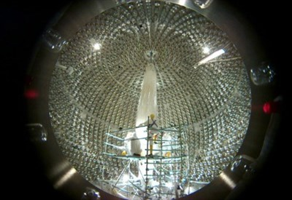
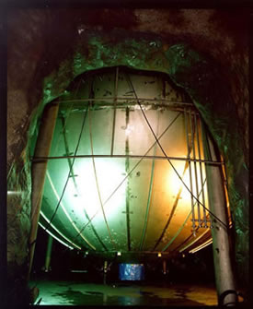
Conclusions

Slide 35
Solar neutrino physics is not over
Certain tension between data exists which must be understood/resolved
Still it can be statistical fluctuation or some overlooked systematics
or some new physics is behind
Solar neutrinos - strong potential to search for new physics: new neutrino states, new interactions, new dynamics, violation of fundamental symmetries
Experimental program is not very sound/ dedicated usually some addition/lateral to other issues: mass hierarchy, CP violation, supernova neutrinos
New level of accuracy, new effects become accessible,
new opportunities to search for physics beyond 3ν -paradigm and BSM

Slide 36
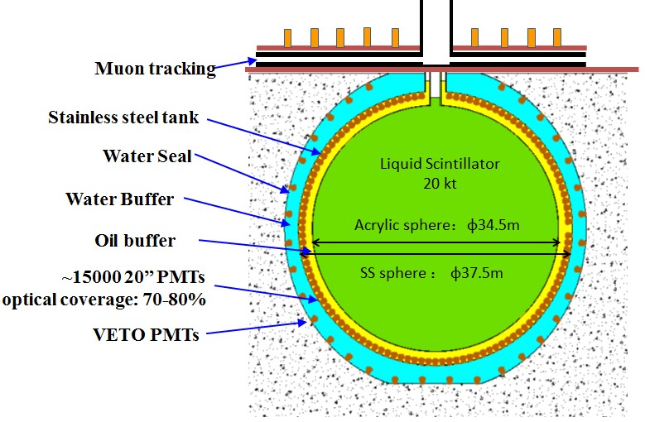
Also RENO-50
JUNO
Jiangmen Underground
Neutrino Observatory
d = 700 m, L = 53 km, P = 36 GW
20 kt LAB scintillator
n + p → d + γ
Key requirement:
energy resolution 3% at 1 MeV

Slide 37
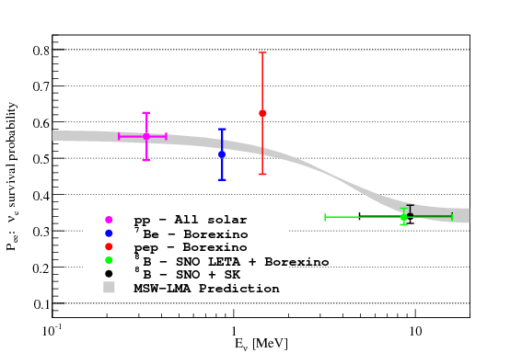
Finite size of the production region

Slide 38
Solar pp-neutrinos
Neutrinos from the primary
pp-reactions in the Sun BOREXINO Collaboration
(G. Bellini et al.) Nature 512 (2014) 7515, 383
Before direct pp-measurements
Higher accuracy
Upturn?
cos⁴ θ₁₃ (1 - ½ sin²2θ₁₂)

Slide 39
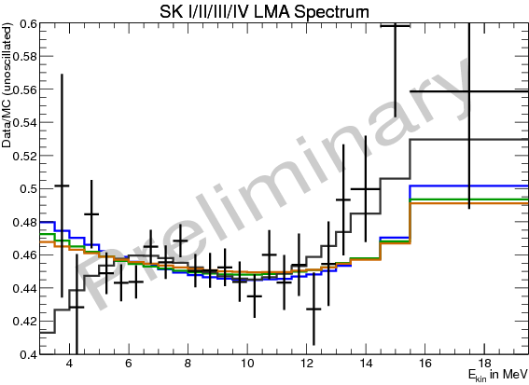
Finite size of the production region

Slide 40
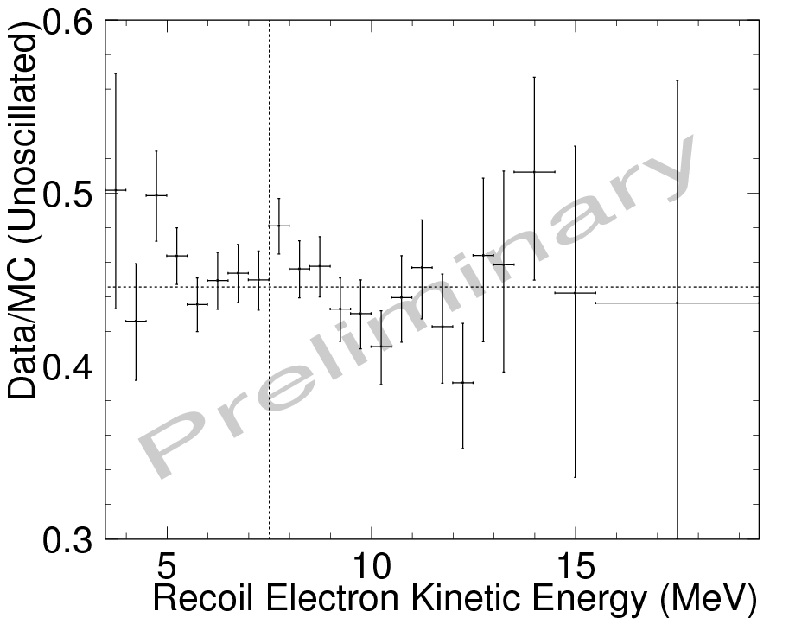
Finite size of the production region

Slide 41
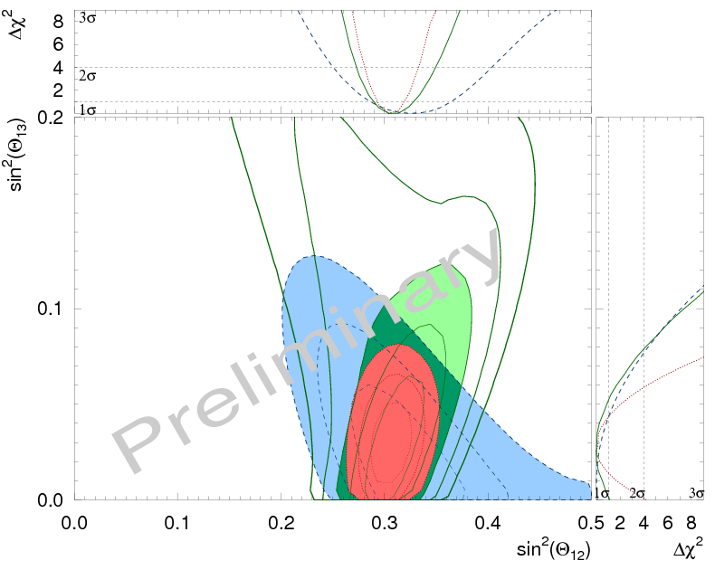
Finite size of the production region

Slide 42
Day-Night effect
First Indication of Terrestrial Matter Effects on Solar Neutrino Oscillation
Super-Kamiokande collaboration
(Renshaw, A. et al.)
Phys.Rev.Lett. 112 (2014) 091805 arXiv:1312.5176
fluctuations?

Slide 43
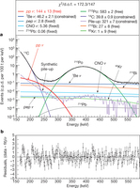
Finite size of the production region

Slide 44
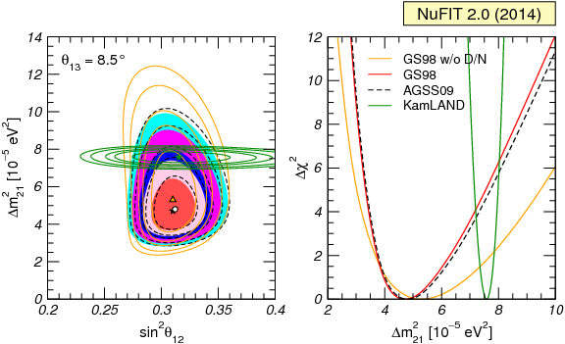
Consistency
Solar data vs KamLAND
About 2σ discrepancy
1σ, 90 %, 2σ, 99% and 3σ CL
(for 2 dof) allowed regions.
Full - GS98 model,
bf - blackstar;
Dashed - AGSS09 model
(bf - white dot),
Green - KamLAND ;
Orange - GS98 model,
without the D-N from SK .
Δχ2 dependence on Δm₂₁²
for the same four analysis after marginalizing over θ₁₂ .
fixed θ₁₃ = 8.5∘
Very light sterile neutrino?
P de Holanda, AYS
A. Suzuki: CPT violation?
K. Fujikawa, A. Tureanu,
1409.8023 [hep-ph]
Non-local interactions in Nu portal → CPT violation → nu-antinu mass splitting

Slide 45
Oscillations inside the Earth
θ_{ν}
zenith
angle
Θ = π − θ_{ν}
Θ
- nadir angle
Oscillations in
multilayer medium
core-crossing
trajectory
Θ = 33º
Applications:
flavor-to-flavor transitions
- accelerator
- atmospheric
- cosmic neutrinos
core
mass-to-flavor transitions
- solar neutrinos
- supernova neutrinos
mantle

Slide 46
Oscillation phase
φ = φ₂ - φ₁
φ_{i} = - E_{i} t + p_{i} x
p_{i} = E_{i}² – m_{i}²
Dispersion relation
φ = ΔEt - Δpx
These are averaged characteristics of WP
where
Δp = (dp/dE)ΔE + (dp/dm²)Δm² = 1/v_{g} ΔE + (1/2p) Δm²
group velocity
insert
Δm²
2E
φ = ΔE/v_{g} (v_{g}t - x) + x
standard
oscillation
phase
ΔE ~ Δm²/2E
< σ_{x}
σ_{x}Δm²/2E
Oscillation effect
over the size of WP
usually- small

Slide 47
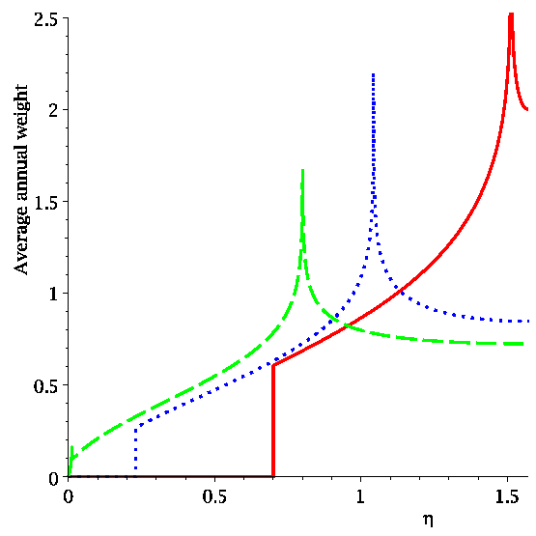
Exposure

Slide 48
Finite size of the production region

Slide 49
Results
Energy dependent deficit of signal
M. Maltoni, A.Y.S.
to appear
for two different values of Δm₂₁²
best fit value
from solar data
upturn
best global fit
1 – ½ sin ² 2θ₁₂
sin ²θ₁₂
Reconstructed exp. points for
SK, SNO and BOREXINO
at high energies
Vacuum
dominated
Transition region
resonance turn on
Matter dominated
region

